Slide 1

Exploring Majorana Nature of Massive Neutrinos
Shun Zhou
(IHEP, Beijing)
Current Status of Massive Neutrinos
Neutrinoless Double-Beta Decays
New Ideas to Probe Majorana Nature
The Symposium on Frontiers of Underground Physics
Chengdu, Oct. 29-Nov. 3, 2023

Slide 2
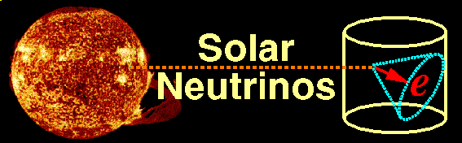
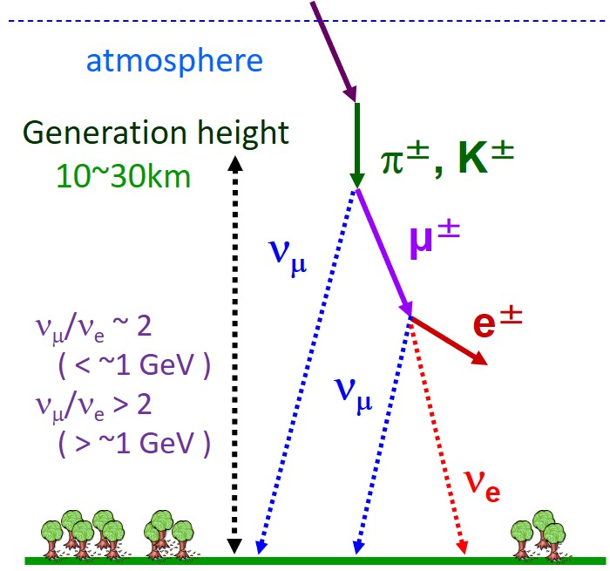
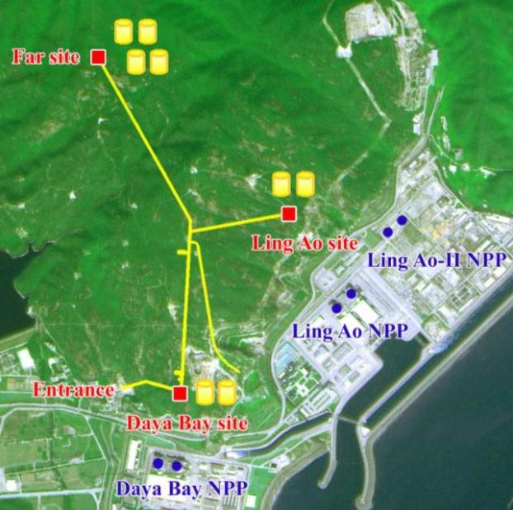
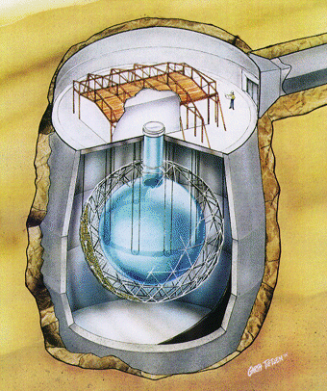
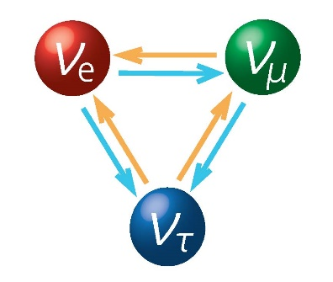
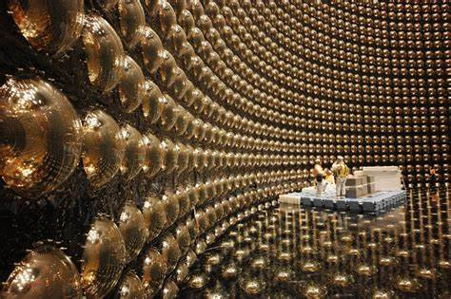
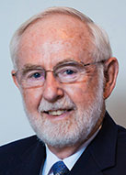
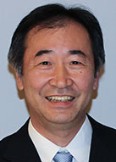
Massive Neutrinos：New Physics beyond the SM
Daya Bay
SNO
Neutrinos are massive !!!
New physics beyond the SM
Super-K
Nobel Prize in 2015

Slide 3
Current Status of Neutrino Oscillations
Basic neutrino parameters
Esteban et al., 2007.14792, NuFIT 5.2 (2022)
Future neutrino oscillation experiments will measure the octant of θ₂₃, the CP-violating phase δ (@DUNE/Hyper-K), and the neutrino mass ordering (@JUNO)
talks by K.B Luk, P. de Perio, Y.F. Li

Slide 4

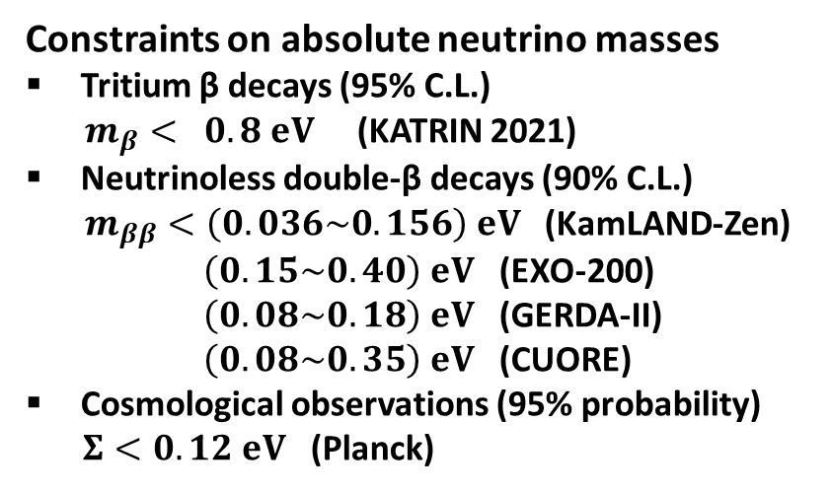


Current Status of Absolute Neutrino Masses
m₁ < m₂ < m₃ (NO) or m₃ < m₁ < m₂ (IO)
$m_{β}={\left(Σ_{i}{\left|U_{ei}\right|}^{2}m_{i}^{2}\right)}^{1/2}$ [eV]
Constraints on absolute neutrino masses
Tritium β decays (95% C.L.)
$m_{β}< 0.8 eV$ (KATRIN 2021)
Neutrinoless double-β decays (90% C.L.)
$m_{ββ}<\left(0.036\sim 0.156\right) eV$ (KamLAND-Zen)
$\left(0.15\sim 0.40\right) eV$ (EXO-200)
$\left(0.08\sim 0.18\right) eV$ (GERDA-II)
$\left(0.08\sim 0.35\right) eV$ (CUORE)
Cosmological observations (95% probability)
$Σ<0.12 eV$ (Planck)
Tritium β decays (KATRIN)
IO
Cosmological Bound
NO
Capozzi et al., 2003.08511
$m_{ββ}=\left|{Σ_{i}U}_{ei}^{2}m_{i}\right|$[eV]
Abazajian et al., 1907.04473
Neutrinoless double-β decays
IO
Cosmological Bound
NO
$Σ=m_{1}+m_{2}+m_{3}$ [eV]

Slide 5
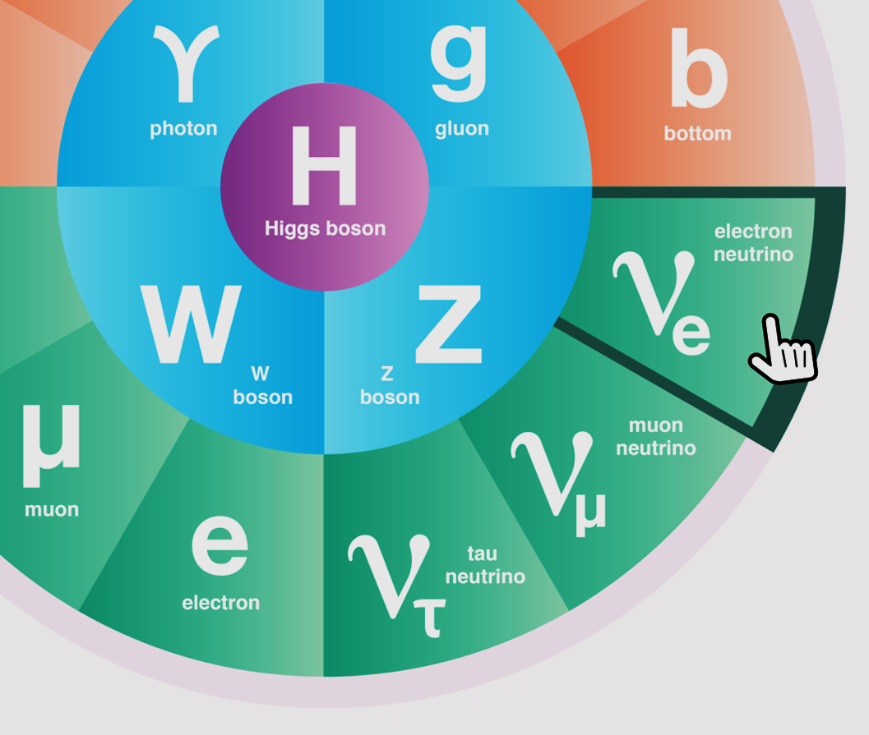
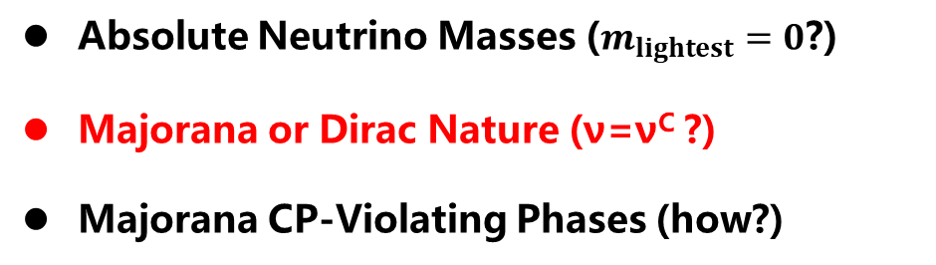
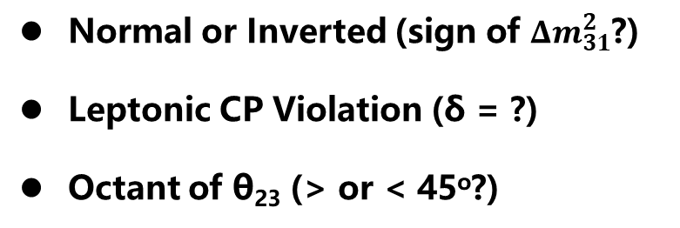
Open Questions in Neutrino Physics
Normal or Inverted (sign of ${Δm}_{31}^{2}$?)
Leptonic CP Violation (δ = ?)
Octant of θ₂₃ (> or < 45º?)
Absolute Neutrino Masses ($m_{lightest}=0$?)
Majorana or Dirac Nature (ν=ν^{C} ?)
Majorana CP-Violating Phases (how?)
ν Roadmap: mass ordering+0ν2β (Majorana)+LNV/LFV+Colliders+SMPT
Extra Neutrino Species
Exotic Neutrino Interactions
Various LNV & LFV Processes
Leptonic Unitarity Violation
Origin of Neutrino Masses
Flavor Structure (Symmetry?)
Quark-Lepton Connection
Relations to DM and/or BAU

Slide 6
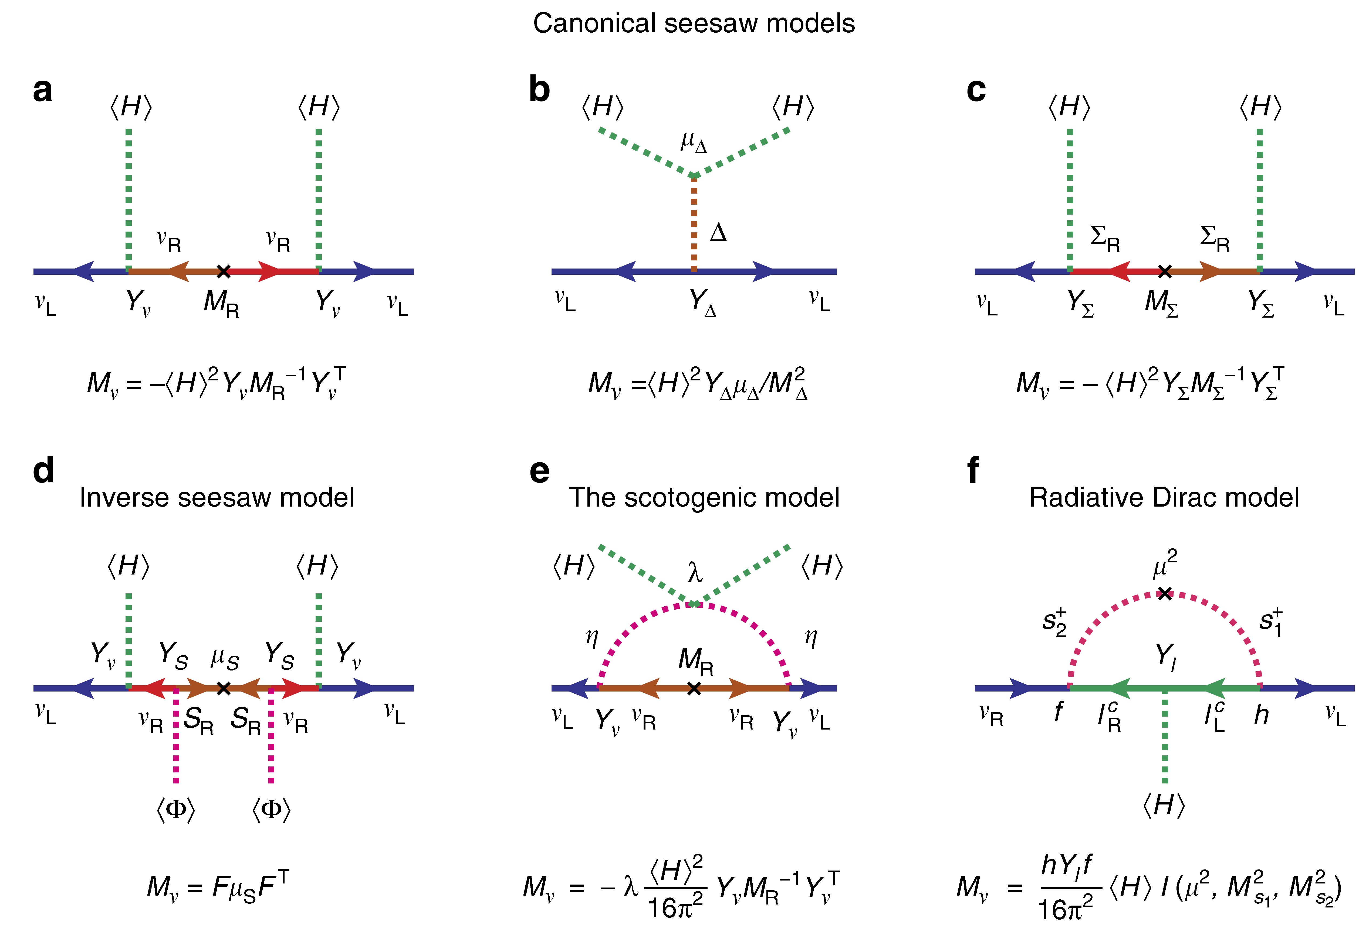
Origin of Neutrino Masses
Ohlsson, SZ, 14
Minkowski 77
Konetschny, Kummer, 77
Foot, Lew, He, Joshi, 89
Mohapatra, Valle, 87
E. Ma, 06
Kanemura et al, 11
Zee, 80, 86; Babu, 88

Slide 7
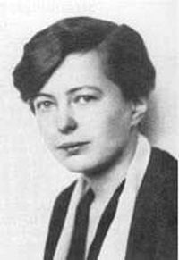
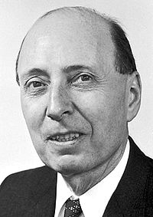
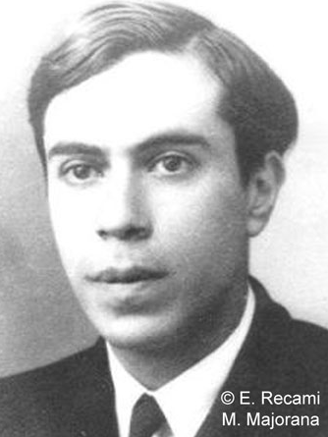
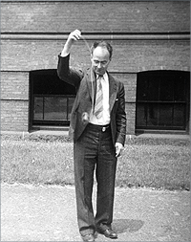
History of 0ν2β Decays
In 1935, Maria Goeppert-Mayer published the first calculation of 2ν2β decay rates based on the Fermi theory (proposed in 1934). It was acknowledged in her paper that Eugene Wigner suggested this problem.
Ettore Majorana
(ν=ν^{C}? 1937)
Wendell Furry
(1907 – 1984)

Slide 8
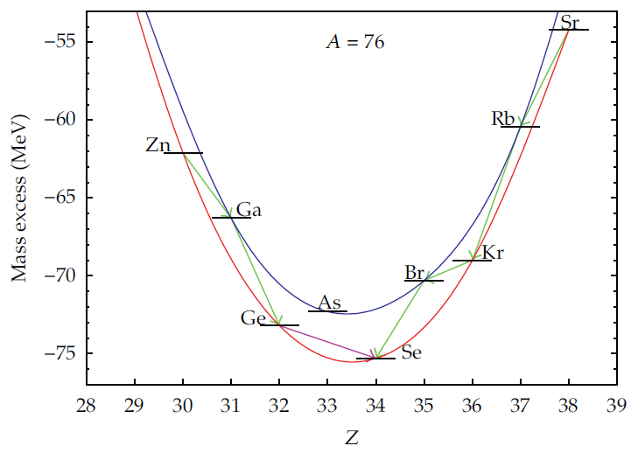
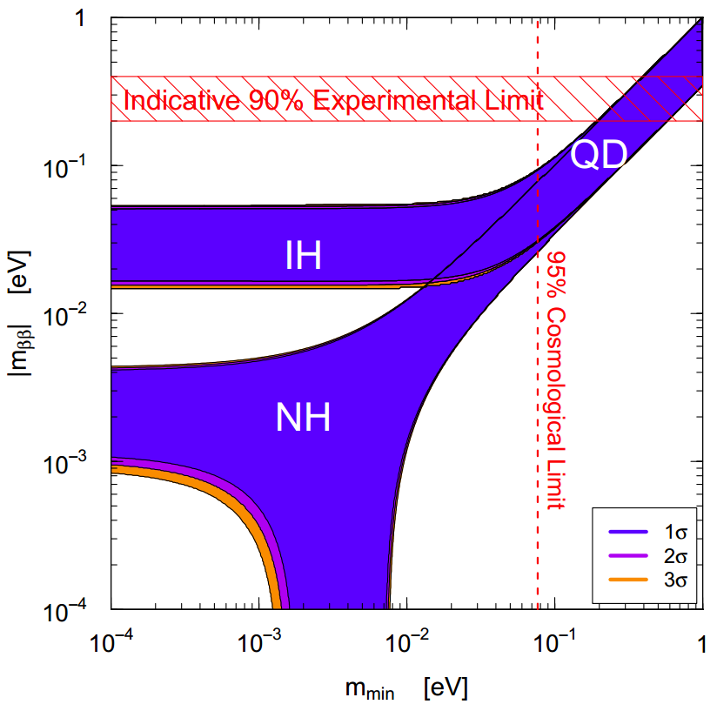
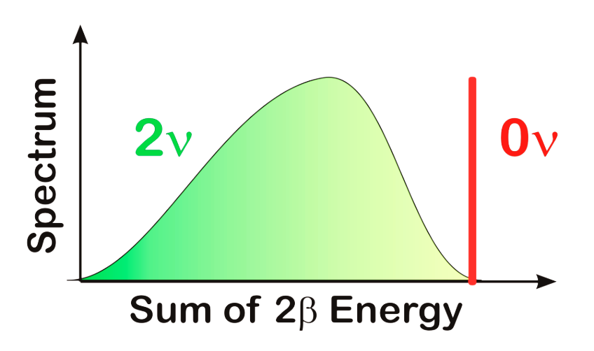
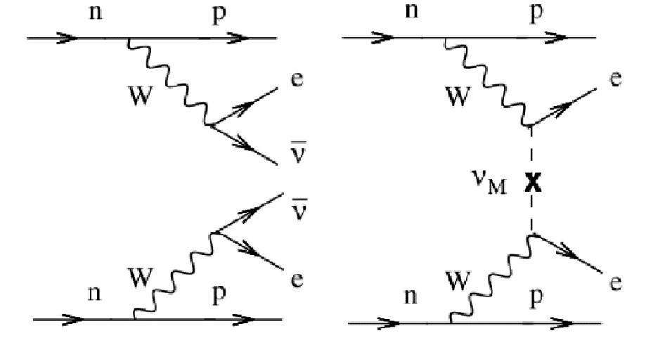
Basics of 0ν2β Decays
Nearly degenerate?
Vanishing
0ν2β mass?
Talk by C.L. Bai
Goeppert-Mayer, 35
Furry, 39
2ν2β
0ν2β

Slide 9
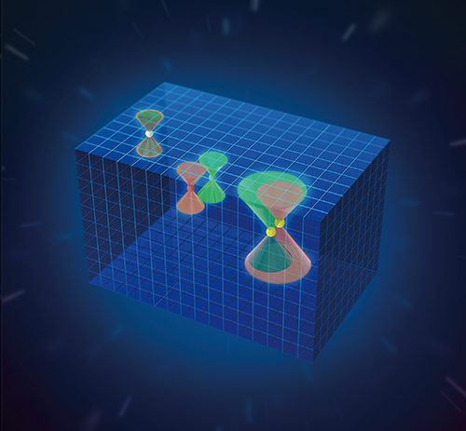
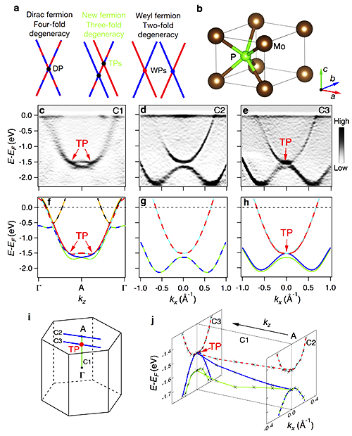
Importance of 0ν2β Decays
★ New feature of elementary particles: Majorana fermions (neutrinos)
Dirac Fermion
Weyl Fermion
New Fermion:
Three-fold
degeneracy
Majorana
zero mode
HOT!!! Weyl, Majorana, Dirac and new fermions in condensed matter physics,
but NOT really elementary particles
doi:10.1038/nature22390

Slide 10





Importance of 0ν2β Decays
★ Discovery of lepton number violation: baryon vs. lepton numbers
Dirac Neutrinos
Majorana Neutrinos
Generate Dirac ν masses in a similar way to that for quarks and charged leptons, after the spontaneous gauge symmetry breaking
Generate tiny Majorana ν masses via the so-called seesaw mechanism
$$≈174 GeV$$
$$O(0.1 eV)$$
$$O({10}^{−12})$$
$$O(0.1 eV)$$
$$O({10}^{14} GeV)$$
Need to introduce additional symmetries to the SM to forbid a Majorana mass for right-handed neutrino singlets
Need to explain a strong hierarchy for the Yukawa couplings of the SM fermions
Retain the SM symmetries
GUT or TeV energy scale?
Guide the theorists to build a model for tiny ν masses

Slide 11

Importance of 0ν2β Decays
★ Constrain ν masses and mixing parameters: Majorana CP phases?
Rodejohann, IJMPE, 2011; JPG, 2012; Bilenky, Giunti, MPLA, 2012; IJMPA, 2015
$$m_{ββ}=m_{1}{|U_{e1}^{}|}^{2}e^{iρ}+m_{2}{|U_{e2}^{}|}^{2}+m_{3}{|U_{e3}^{}|}^{2}e^{iσ}$$
$$m_{ββ}$$
ν mass ordering, lightest ν mass, Majorana CP phases
A unique way to constrain Majorana CP phases?
Xing, Zhao, EPJC, 2017

Slide 12
Schechter-Valle Theorem
Schechter-Valle Theorem (82): If the 0ν2β decay happens, there must exist an effective Majorana neutrino mass term.
Question: How large is such a mass term?
Assumptions: (1) no tree-level neutrino masses; (2) 0ν2β decays are mediated by heavy particles, i.e., short-range interactions:
Pas et al., PLB, 2001
Hadronic currents
leptonic currents

Slide 13

Schechter-Valle Theorem
Current experimental upper bounds on the 0ν2β decay width can be translated into upper limits on the coefficients ϵ_{i}’s
Nonzero quark and electron masses are crucial for us to draw the butterfly diagram, since we don’t know the chirality of (u, d, e)
Take one operator for example:
Upper bound
Duerr, Lindner, Merle, JHEP, 2011
Quantitatively, the 4-loop Majorana mass from the butterfly diagram is EXTREMELY small:
$$δm_{ν}≲O({10}^{−28} eV)$$
Duerr, Lindner, Merle, JHEP, 2011;
Liu, Zhang, SZ, PLB, 2016
Assume 0ν2β decays are governed by short-distance operators
The Schechter-Valle (Black Box) theorem is qualitatively correct, but the induced Majorana masses are too small to be relevant
for neutrino oscillations
Other mechanisms are needed to generate neutrino masses

Slide 14

Extended Schechter-Valle Theorem
Hirsch, Kovalenko, Schmidt (06): One-to-one correspondence relation between LNV processes and corresponding elements of the Majorana neutrino mass matrix
Conclusion:
current neutrino oscillation data indicate a finite 0ν2β rate
All possible mass matrices with
$${\left(M_{ν}\right)}_{ee}=0$$
The Majorana neutrino mass matrix A₁ is allowed by oscillation data, leading to a nonzero 0ν2β rate!

Slide 15
Other Lepton-Number-Violating Decays
Meson Decays:
Liu, Zhang, SZ, PLB, 2016

Slide 16
Effective Neutrino Mass for 0ν2β Decays
Xing, Zhao, Y.L. Zhou, 1504.05820; Ge, Lindner, 1608.01618;Xing, Zhao, 17; Penedo, Petcov, 18; Ge, Zhu, 20
1 meV frontier of 0ν2β decays
Jun Cao et al., 1908.08355
Talk by G.S. Li

Slide 17
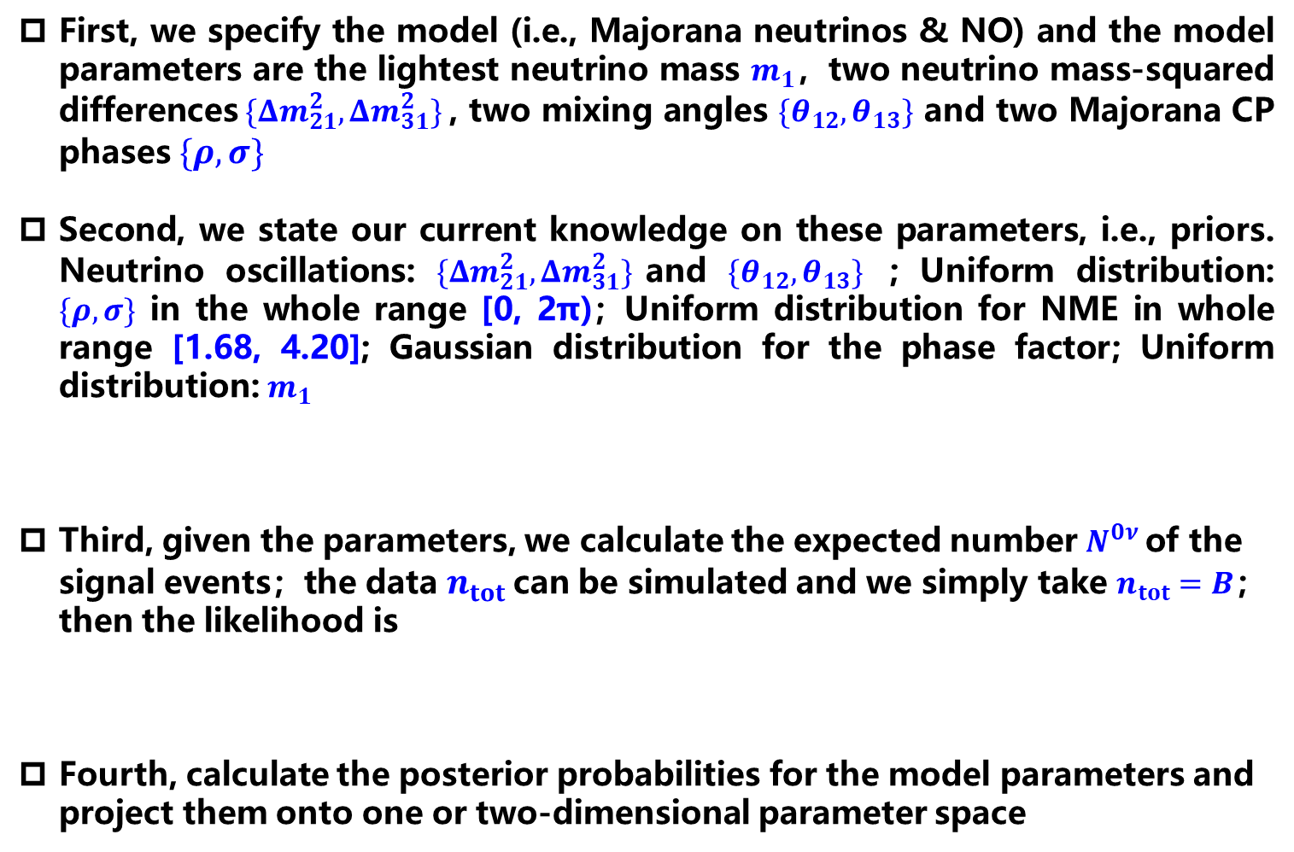
Bayesian Analysis: Masses & Majorana CP Phases
First, we specify the model (i.e., Majorana neutrinos & NO) and the model parameters are the lightest neutrino mass $m_{1}$，two neutrino mass-squared differences$\{Δm_{21}^{2},Δm_{31}^{2}\}$, two mixing angles ${\{θ}_{12},θ_{13}\}$ and two Majorana CP phases $\{ρ, σ\}$
Second, we state our current knowledge on these parameters, i.e., priors. Neutrino oscillations: $\{Δm_{21}^{2},Δm_{31}^{2}\}$and ${\{θ}_{12},θ_{13}\}$ ; Uniform distribution: $\{ρ, σ\}$ in the whole range [0, 2π)；Uniform distribution for NME in whole range [1.68, 4.20]; Gaussian distribution for the phase factor; Uniform distribution: $m_{1}$
Third, given the parameters, we calculate the expected number $N^{0ν}$of the signal events；the data $n_{tot}$ can be simulated and we simply take $n_{tot}=B$；then the likelihood is
Fourth, calculate the posterior probabilities for the model parameters and project them onto one or two-dimensional parameter space
Flat:
Log:

Slide 18
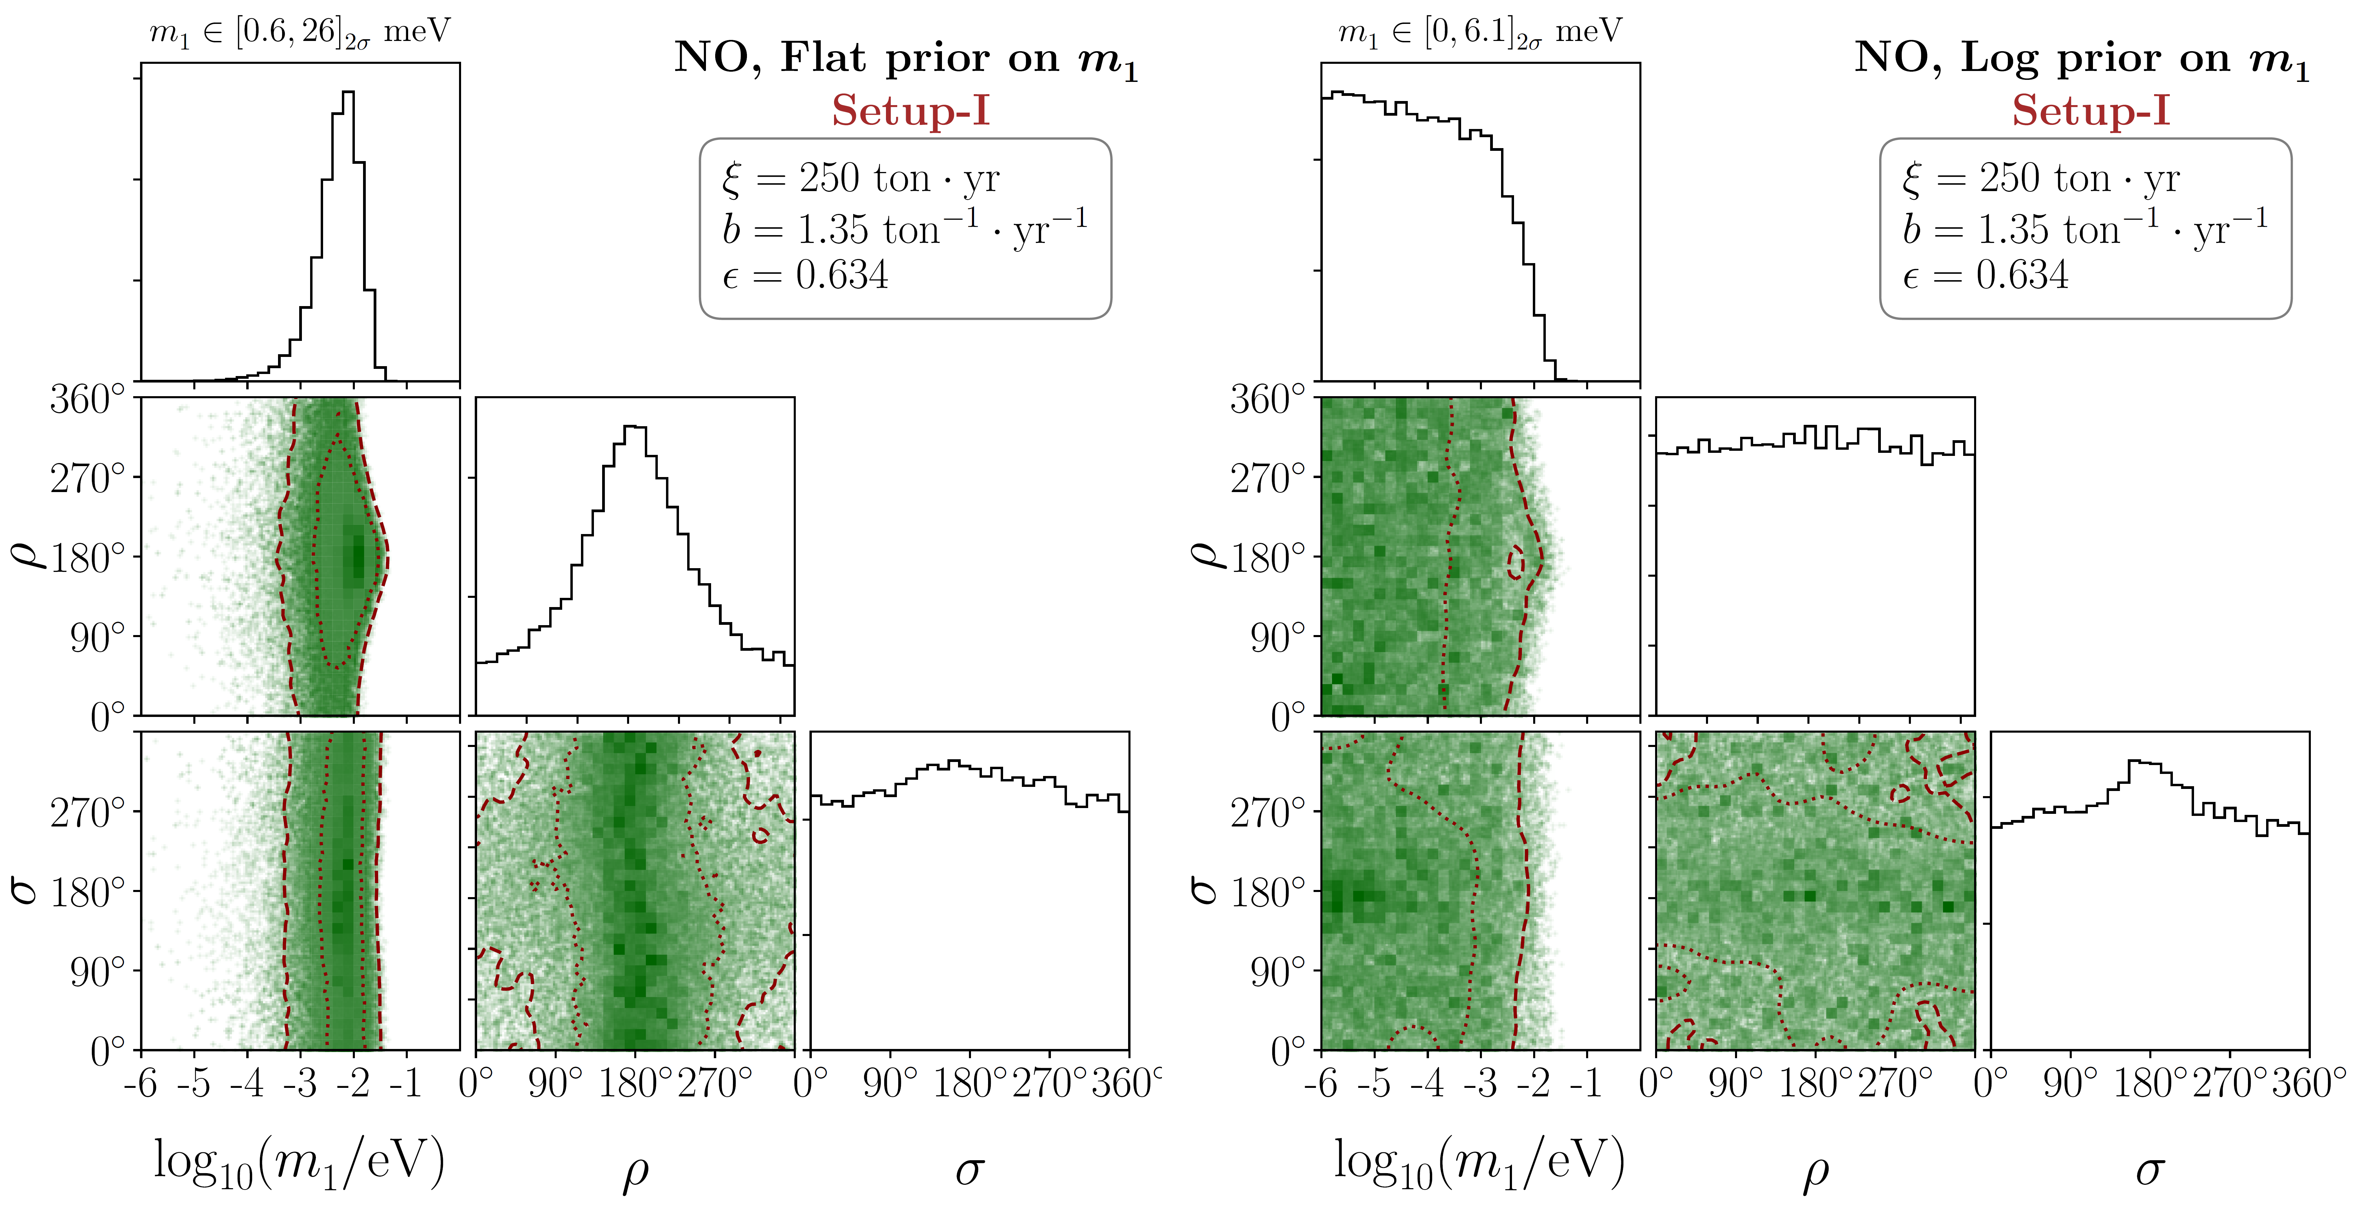
Bayesian Analysis: Masses & Majorana CP Phases
Final Results for Setup-I
Huang, SZ, 2010.16281

Slide 19
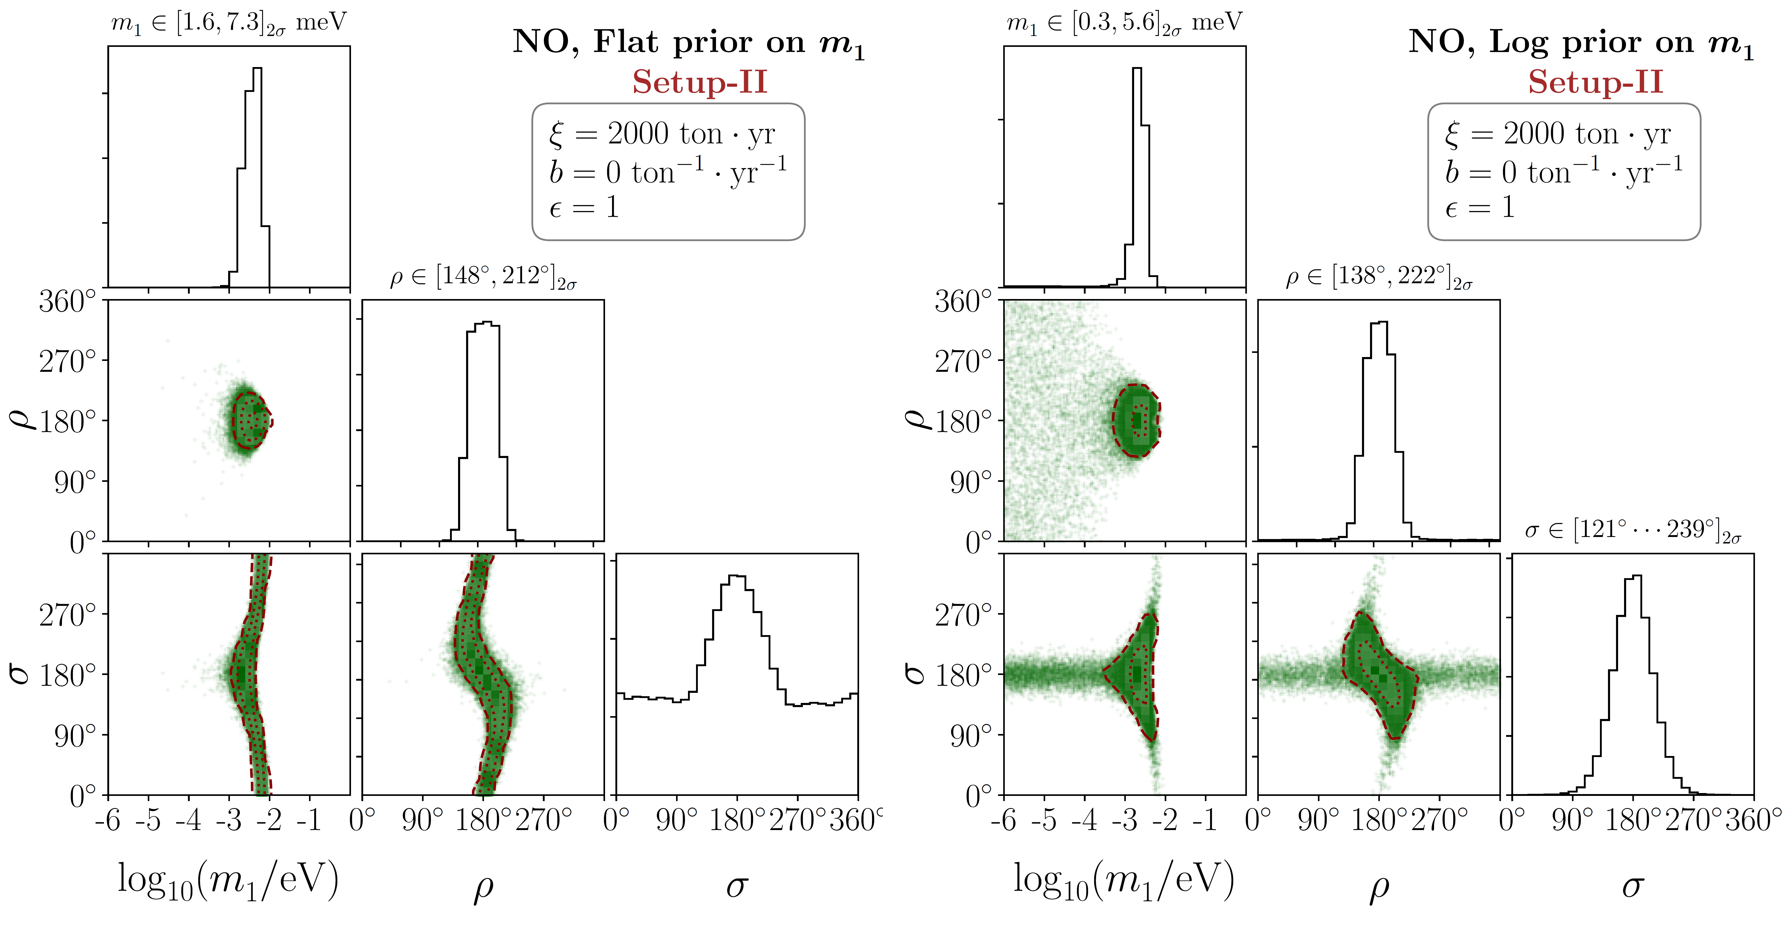
Bayesian Analysis: Masses & Majorana CP Phases
Final Results for Setup-II
Huang, SZ, 2010.16281

Slide 20
Bayesian Analysis: Comparison with Cosmology
Future sensitivity from cosmology
Background-free environment, average NME, and varying total exposure
Better sensitivity to lightest ν mass than future cosmological observations

Slide 21
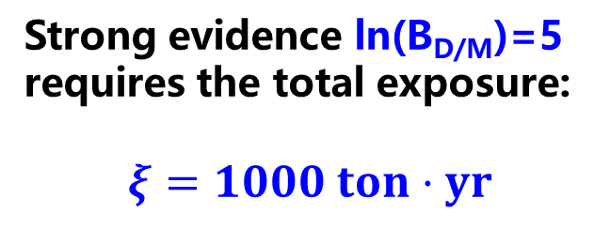
Bayesian Analysis: Majorana vs. Dirac Neutrinos
If no signals observed, is it possible to exclude Majorana neutrinos?
Setup I: JUNO Xe-LS
Log
NO
Flat
Inconclusive
Log
IO
Jeffreys scale
Flat
Very strong evidence
Setup II: NO case
Strong evidence ln(B_{D/M})=5 requires the total exposure:
$$ξ=1000 ton⋅yr$$

Slide 22
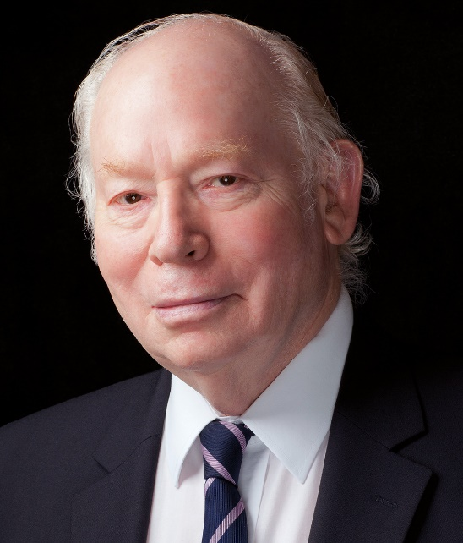
SM as Effective Field Theory
Weinberg, 79
Unique
dim-5 Weinberg operator
for Majorana neutrino masses
SM Effective Field Theory (SMEFT)

Slide 23
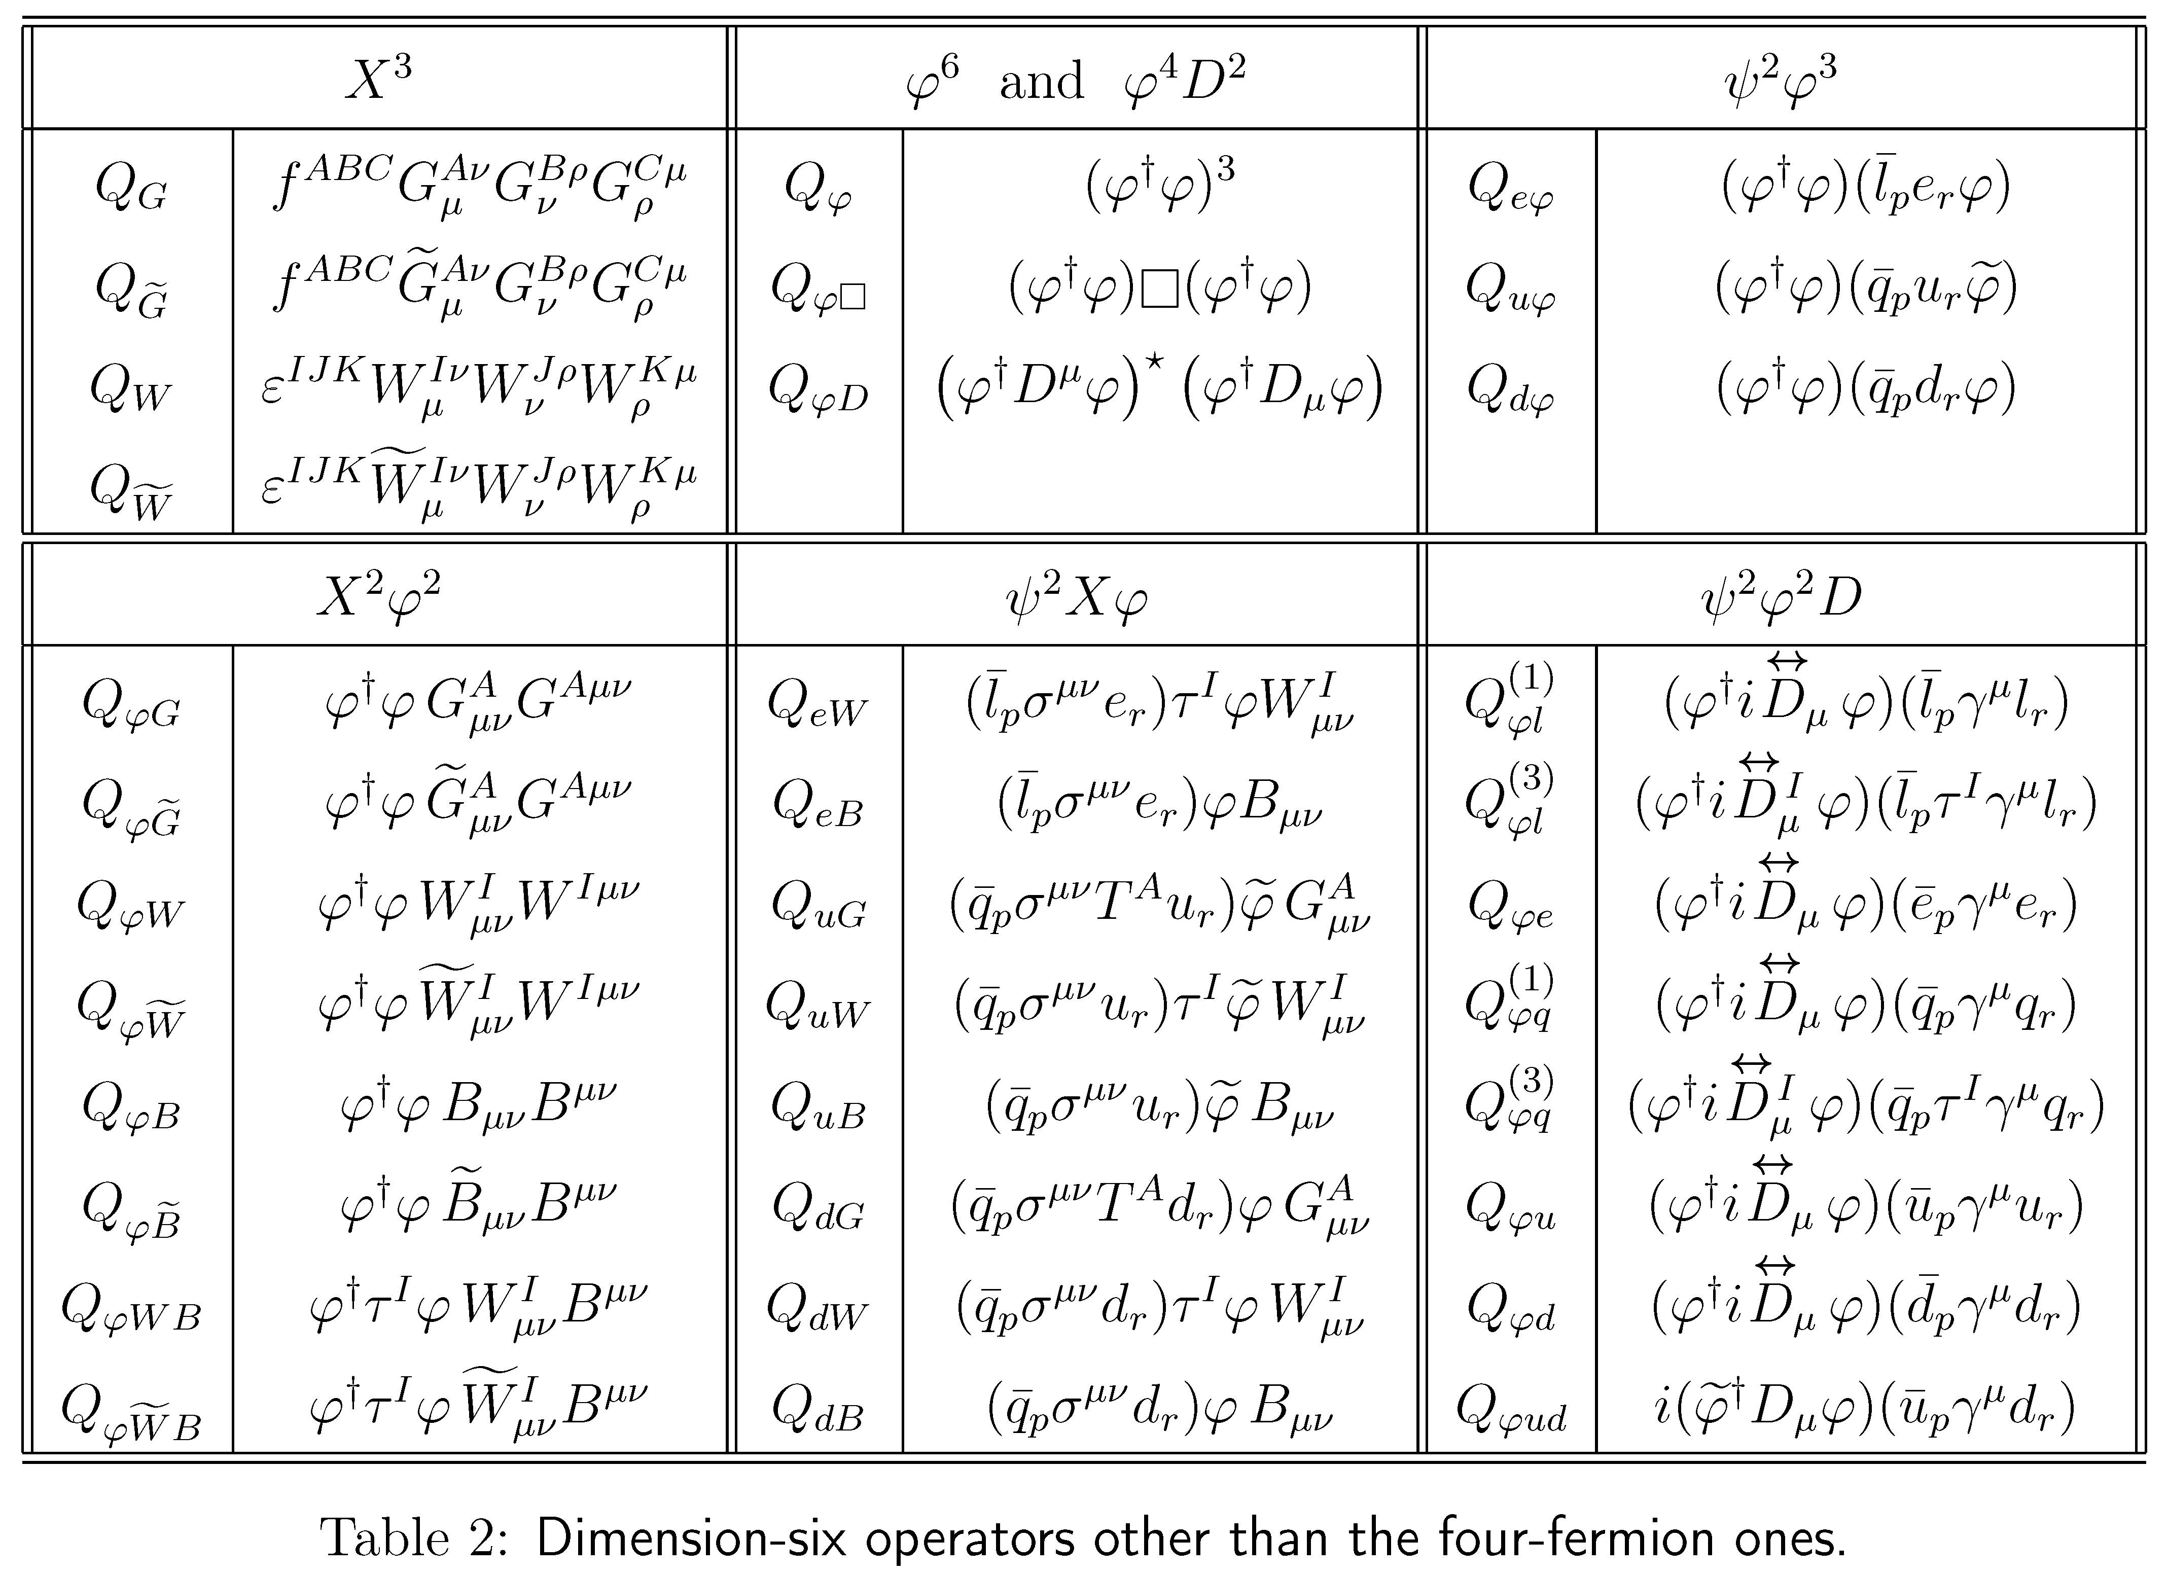
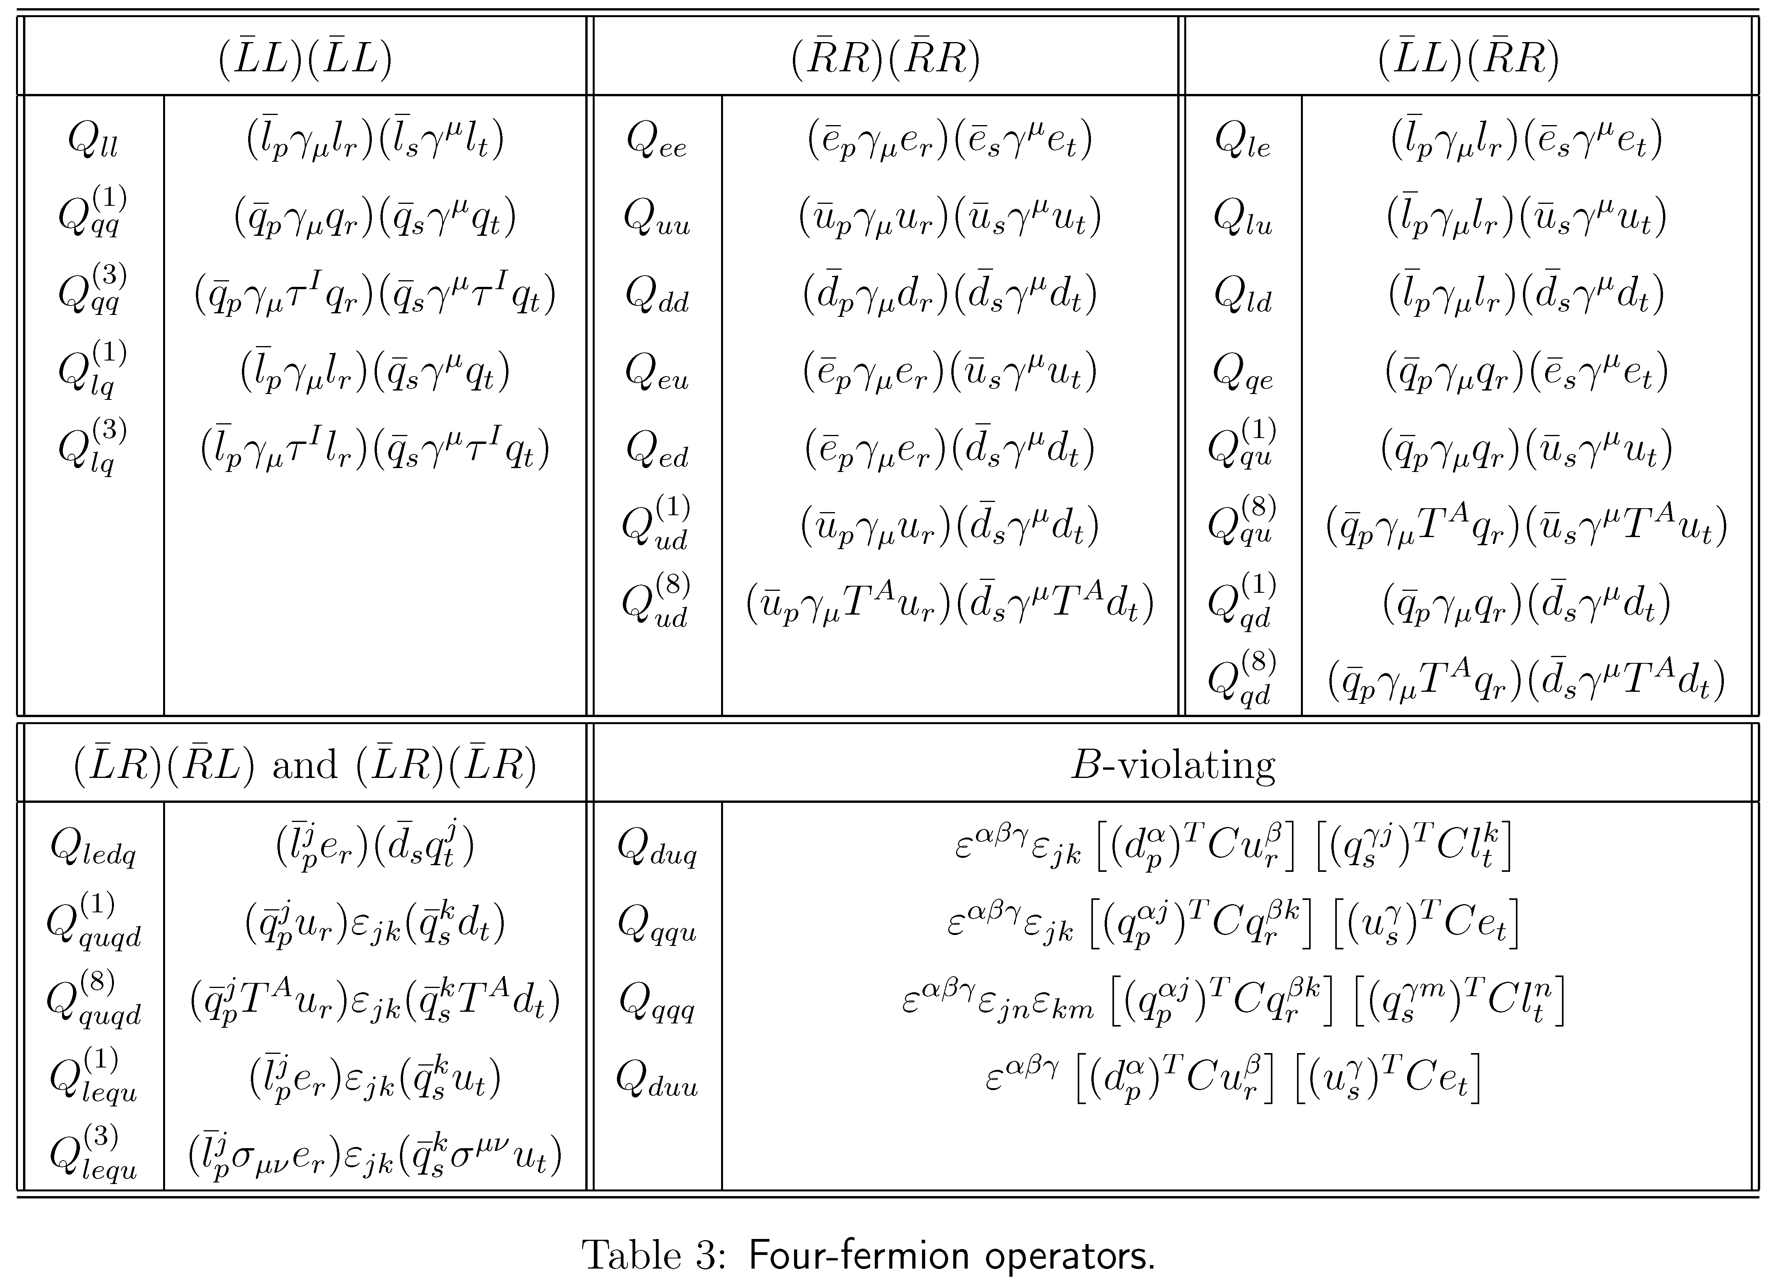
SM Effective Field Theory
Buchmüller & Wyler, 86
Dim-6 operators in the Warsaw basis
Brivio & Trott, Phys. Rept. 793 (2019) 1; Isidori, Wilsch, Wyler, 2303.16922
Grzadkowski, Iskrzynski, Misiak, Rosiek, 1008.4884
Too many free parameters?

Slide 24
Seesaw Effective Field Theory @ one-loop
# of dim-6 operators
Red
Blue
SEFT-I = 31
SEFT-II = 41
SEFT-III = 33
Zhang, S.Z., 2102.04954
Ohlsson & Penrow, 2201.00840
Threshold
Li, Zhang, S.Z., 2201.05082
Coy & Frigerio, 2110.09126
Zee model
Li, S.Z., 2309.14702
Liao, Ma, 2210.04270
Scotogenic/dim-7
Du, Li, Yu, 2201.04646

Slide 25
Effective Field Theory for 0ν2β Decays
νDoBe - A Python Tool for Neutrinoless Double Beta Decay
Scholer, de Vries, Gráf, 2304.05415
GitHub: https://github.com/OScholer/nudobe

Slide 26
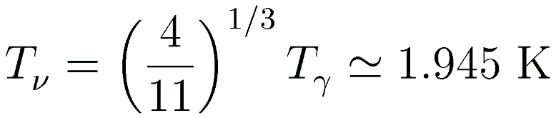
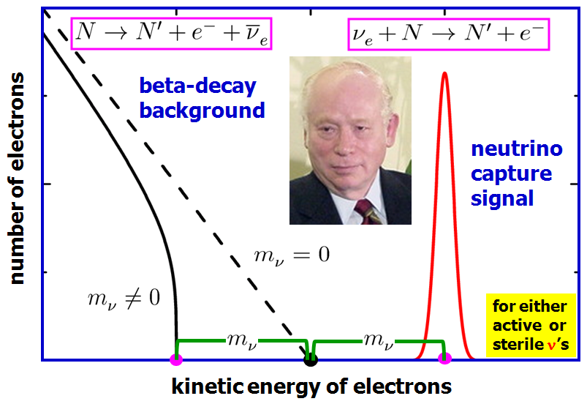
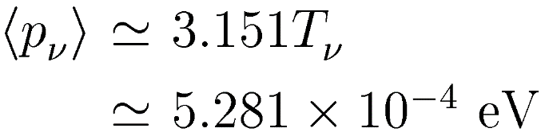
Another Possibility: Majorana vs. Dirac
When the temperature T ~ 1 MeV, neutrinos became decoupled from the thermal bath, and formed a ν background in the Universe. Today relic neutrinos are nonrelativistic, and their number density is 56 cm⁻³ per flavor, as predicted by the standard model of cosmology.
Temperature today
Relic neutrino capture on β-decaying nuclei
Mean momentum today
At least 2 ν’s cold today
NON-relativistic ν’s!
1962
(Irvine & Humphreys, 83)
no energy threshold on incident ν’s mono-energetic outgoing electrons

Slide 27
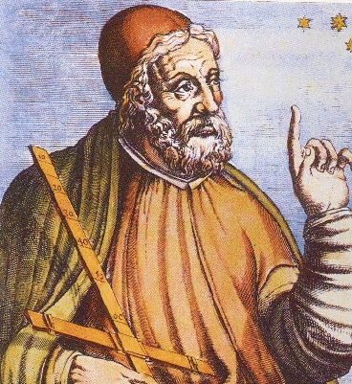
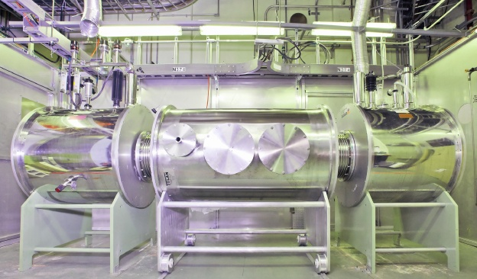
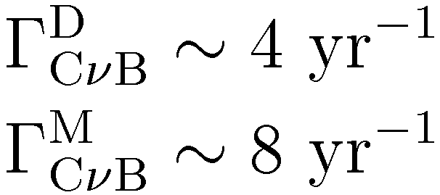

Another Possibility: Majorana vs. Dirac
Talk by J.C. Peng
³H → ³He + e⁻ + ${\overline{\text{ν}}}_{\text{e}}$
ν_{e} + ³H → ³He + e⁻
PTOLEMY
prototype
★ first experiment
★ 100 g of tritium
★ graphene target
★ planned energy resolution 0.15 eV
★ CνB capture rate
D = Dirac
M = Majorana
PTOLEMY Princeton Tritium Observatory for Light, Early-Universe, Massive-Neutrino Yield (Betts et al, arXiv:1307.4738)

Slide 28
Possible New Ideas?
★ Radiative Emission of Neutrino Pair (RENP): superradiant atoms/molecules
Yoshimura et al. (SPAN Group)
Zhang & S.Z., 16
Macro coherent emission of neutrino pairs (to compensate weak rates)
Irreducible EM backgrounds/ further effects needed (soliton-condensate)

Slide 29
Possible New Ideas?
★ Bremsstrahlung endpoint in coherent scattering on nuclei
Millar, Raffelt, Stodolsky, Vitagliano, 1810.06584
Intense low-energy neutrino sources (e.g., chromium)/ideal detectors are needed to probe neutrino masses

Slide 30
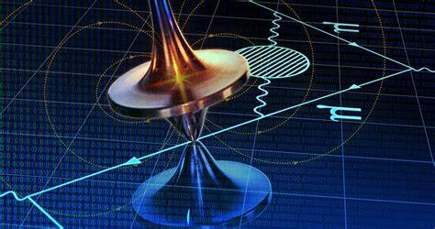
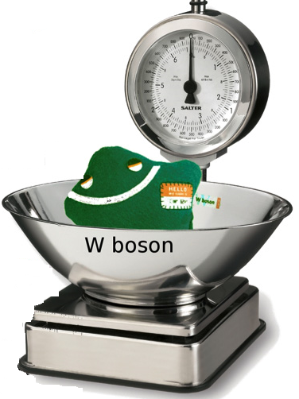
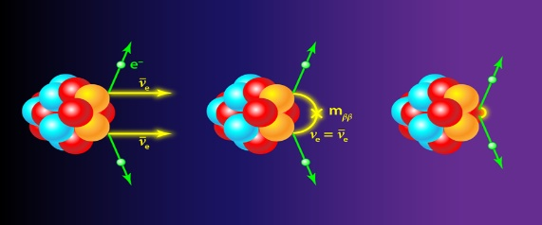
Summary
Neutrino masses and flavor mixing are well established, but their origin remains to be explored: seesaw models & flavor symmetry?
Neutrinoless double-beta decays play the central role in revealing the Majorana nature of massive neutrinos: Dirac or Majorana？
A self-consistent theoretical framework for low-energy tests of the canonical seesaw models is constructed (SEFT), ready for precision calculations (e.g., LFV/LNV at high-intensity/high-energy frontiers)
?
✓
?
?
Joint efforts from particle physics, nuclear physics,
astrophysics, cosmology
Thanks a lot for your attention!

