Slide 1
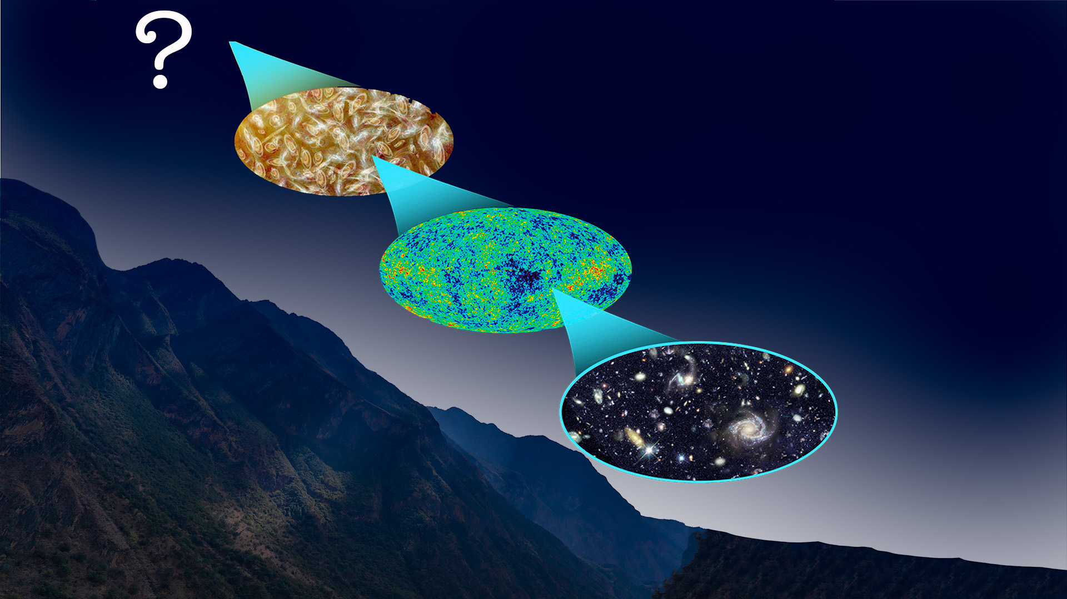
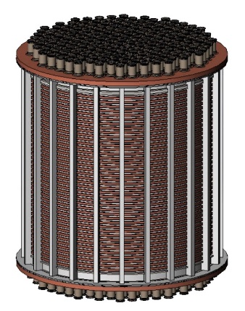
¹³⁴Xe 2𝜈𝛽𝛽/0𝜈𝛽𝛽 Search in PandaX-4T Experiment
Shaobo Wang (王少博)
2024-05-10
On behalf of PandaX collaboration
Shanghai Jiao Tong University, China

Slide 2
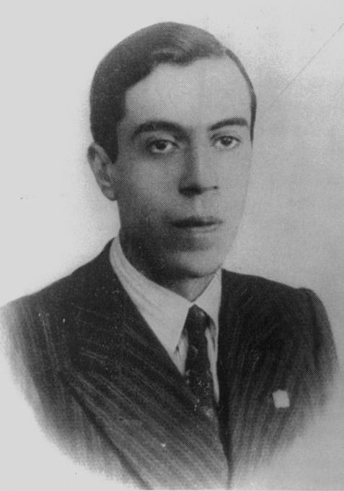
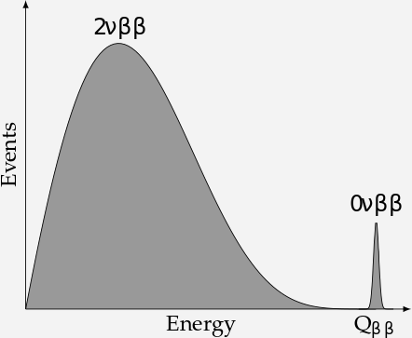
Neutrinos are Dirac or Majorana?
Double Beta Decay (2𝜈𝛽𝛽 )
Neutrinoless Double Beta Decay (0𝜈𝛽𝛽 )
Majorana neutrino may be an important link in connecting to matter-antimatter asymmetry in our universe
0𝜈𝛽𝛽 probes the nature of neutrinos: Majorana or Dirac; Lepton number violation; Measures effective Majorana mass

Slide 3
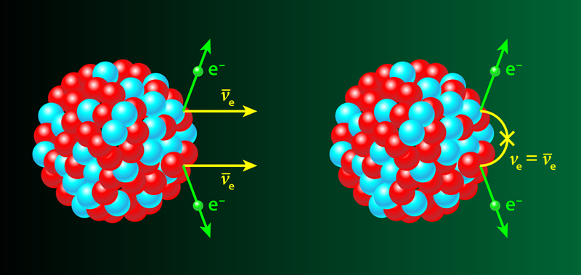
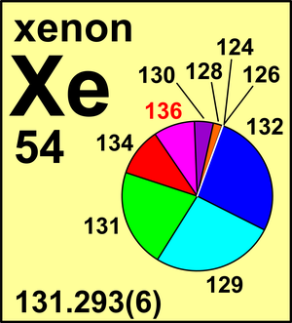
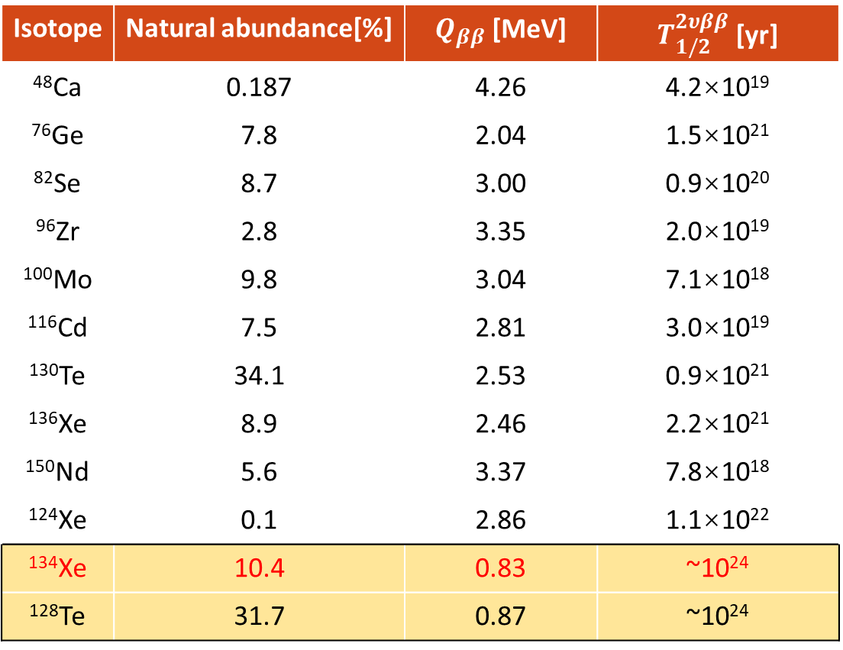

Double beta decay
0𝜈𝛽𝛽 : Golden channel for Majorana neutrino searches
2𝜈𝛽𝛽 candidate ¹³⁴Xe (10.4%): the next promising discoveries of 2𝜈𝛽𝛽
Isotope | Natural abundance[%] | $Q_{ββ}$ [MeV] | $T_{1/2}^{2υββ}$ [yr]
⁴⁸Ca | 0.187 | 4.26 | 4.2×10¹⁹
⁷⁶Ge | 7.8 | 2.04 | 1.5×10²¹
⁸²Se | 8.7 | 3.00 | 0.9×10²⁰
⁹⁶Zr | 2.8 | 3.35 | 2.0×10¹⁹
¹⁰⁰Mo | 9.8 | 3.04 | 7.1×10¹⁸
¹¹⁶Cd | 7.5 | 2.81 | 3.0×10¹⁹
¹³⁰Te | 34.1 | 2.53 | 0.9×10²¹
¹³⁶Xe | 8.9 | 2.46 | 2.2×10²¹
¹⁵⁰Nd | 5.6 | 3.37 | 7.8×10¹⁸
¹²⁴Xe | 0.1 | 2.86 | 1.1×10²²
¹³⁴Xe | 10.4 | 0.83 | ~10²⁴
¹²⁸Te | 31.7 | 0.87 | ~10²⁴
$$^{136}Xe→ ^{136}Ba+2e^{−}+?ν$$
the next promising discoveries of 2𝜈𝛽𝛽

Slide 4
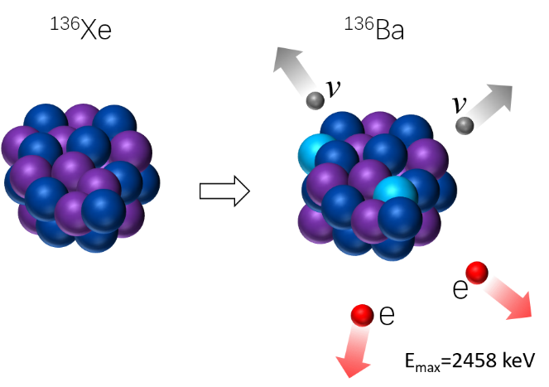

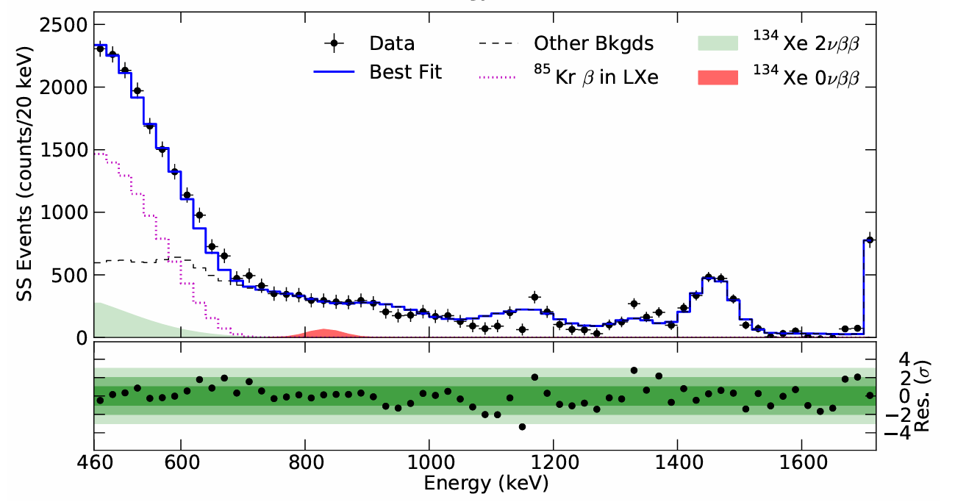

¹³⁴Xe 2𝜈𝛽𝛽 and 0𝜈𝛽𝛽
¹³⁴Xe
¹³⁴Ba
Double beta decay of ¹³⁴Xe into ¹³⁴Ba:
Q-value is 825.8±0.9 keV
Half-life from theoretical predictions: ~10²⁴ yr
Best experiment limits from EXO-200 with 29.6 kg∙𝑦𝑟 data of ¹³⁴Xe :
  $T_{1/2}^{2νββ}>8.7∙1020 yr$ at 90% CL
  $T_{1/2}^{0νββ}>1.1∙1023 yr$ at 90% CL
Isotopic composition in EXO-200 : 80.7% ¹³⁶ Xe and 19.1% ¹³⁴Xe
Energy spectrum: ROI between 460 keV and 740 keV for 2𝜈𝛽𝛽, energy resolution 𝜎/𝐸=3.56% @825.8 𝑘𝑒𝑉
E_{max}=825.8 keV
Phys.Rev.D 96 (2017) 9, 092001

Slide 5
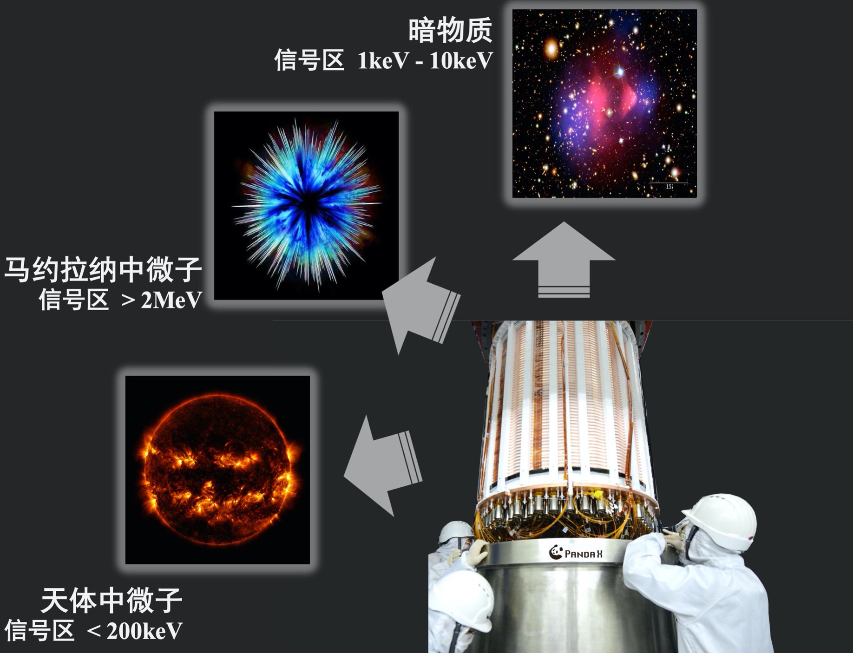
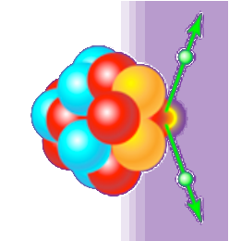
PandaX-4T experiment
Dark Matter
1 keV – 10 keV
Third generation of the PandaX experiments located at CJPL-II
Dual-phase Xe TPC: 1.2 m (D) ×1.2 m (H)
Sensitive volume: 3.7 ton LXe
Total volume: 5.6 ton LXe
3-inch PMTs: 169 top / 199 bottom
Water shielding: 10 m (D) ×13 m (H)
Data taking:
  Commissioning Run0 : ~95 days
  Physics Run1: ~164 days
Majorana neutrino
> 2 MeV
Astrophysics neutrino < 300 keV

Slide 6
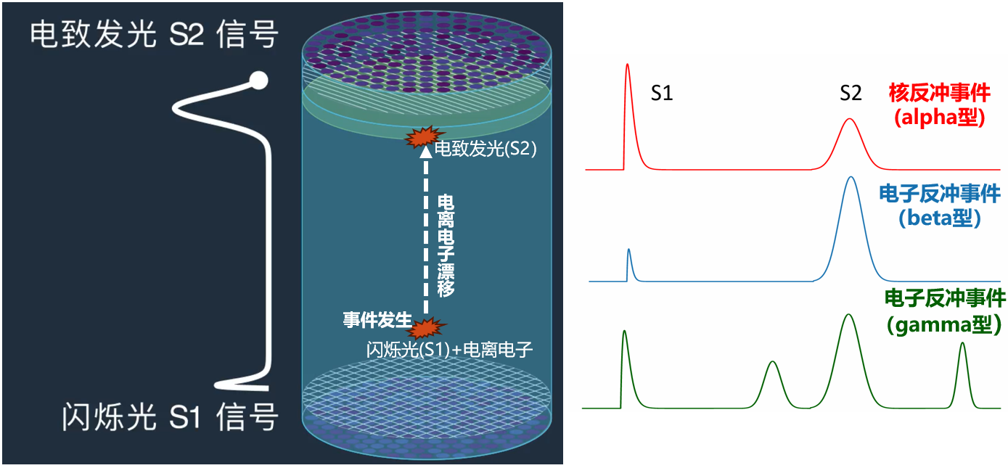
PandaX: Dual-phase xenon TPC
TPC: paired scintillation (S1) and ionization (S2) signals
  Precise energy measurement and low energy threshold
  3D position reconstruction
  Event discrimination: nuclear recoil, electron recoil (beta/gamma) signals

Slide 7
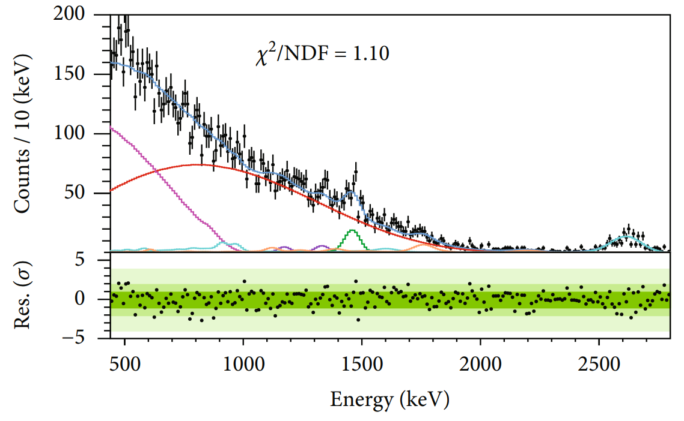
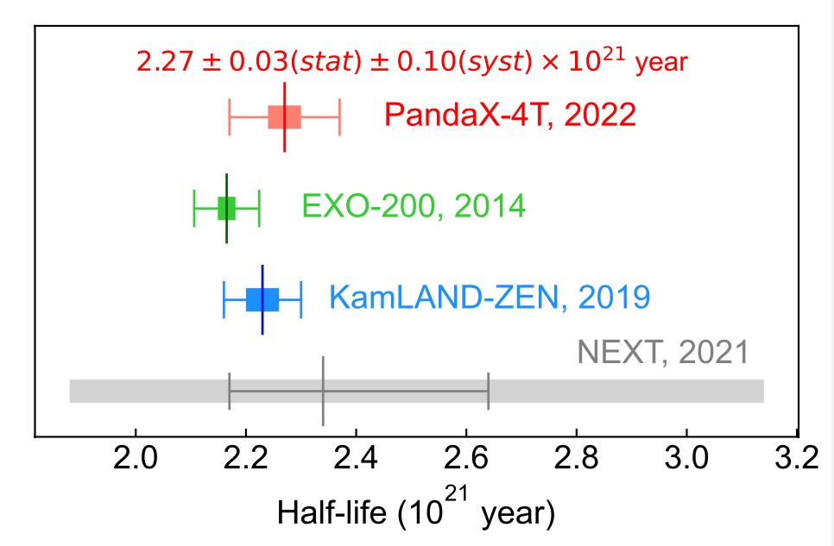
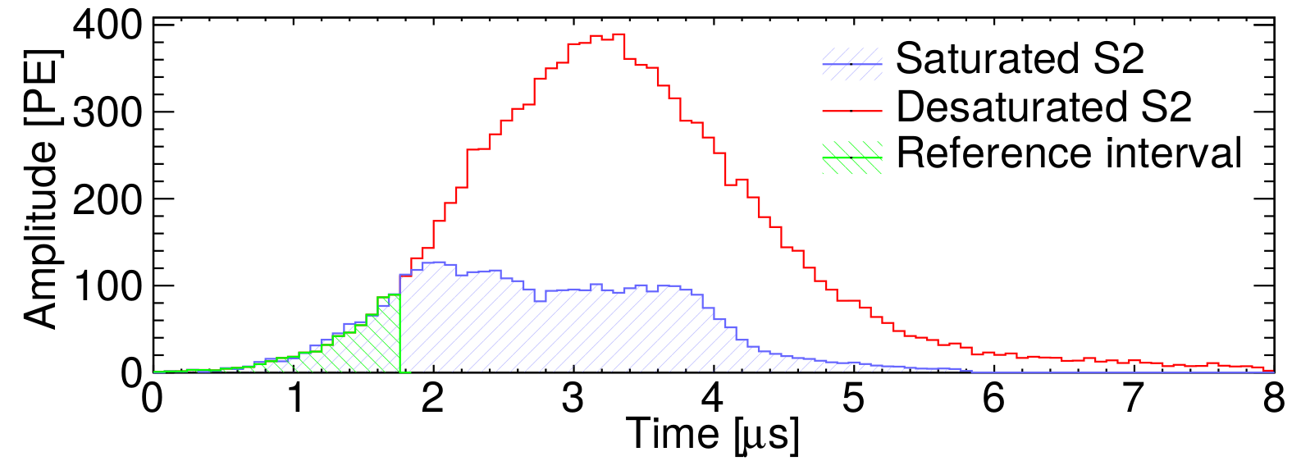
¹³⁶Xe 2𝜈𝛽𝛽 half-life measurement in PandaX-4T
PandaX-4T has extended the energy range from keV to MeV
¹³⁶Xe 2𝜈𝛽𝛽 half-life measured with 94.9 live-days of data :
2.27 ± 0.03(stat.) ± 0.10(syst.) × 10²¹ yr
First such measurement from a DM detector with natural xenon
Comparable precision with leading results
440 keV – 2800 keV range is the widest ROI
PandaX, Research 2022 (2022) 9798721

Slide 8
¹³⁴Xe 2𝜈𝛽𝛽 and 0𝜈𝛽𝛽 search in PandaX-4T
PandaX-4T: more ¹³⁴Xe; much less ¹³⁶Xe; wider energy range; self shielding effect; discovery possible
 | ¹³⁴Xe mass | ¹³⁶Xe abundance | Analysis threshold | Live Time
PandaX-4T | 68.7 kg | 8.9% | 200 keV | 94.9 days
EXO-200 | 18.1 kg | 81% | 470 keV | 600 days
470 keV
200 keV

Slide 9

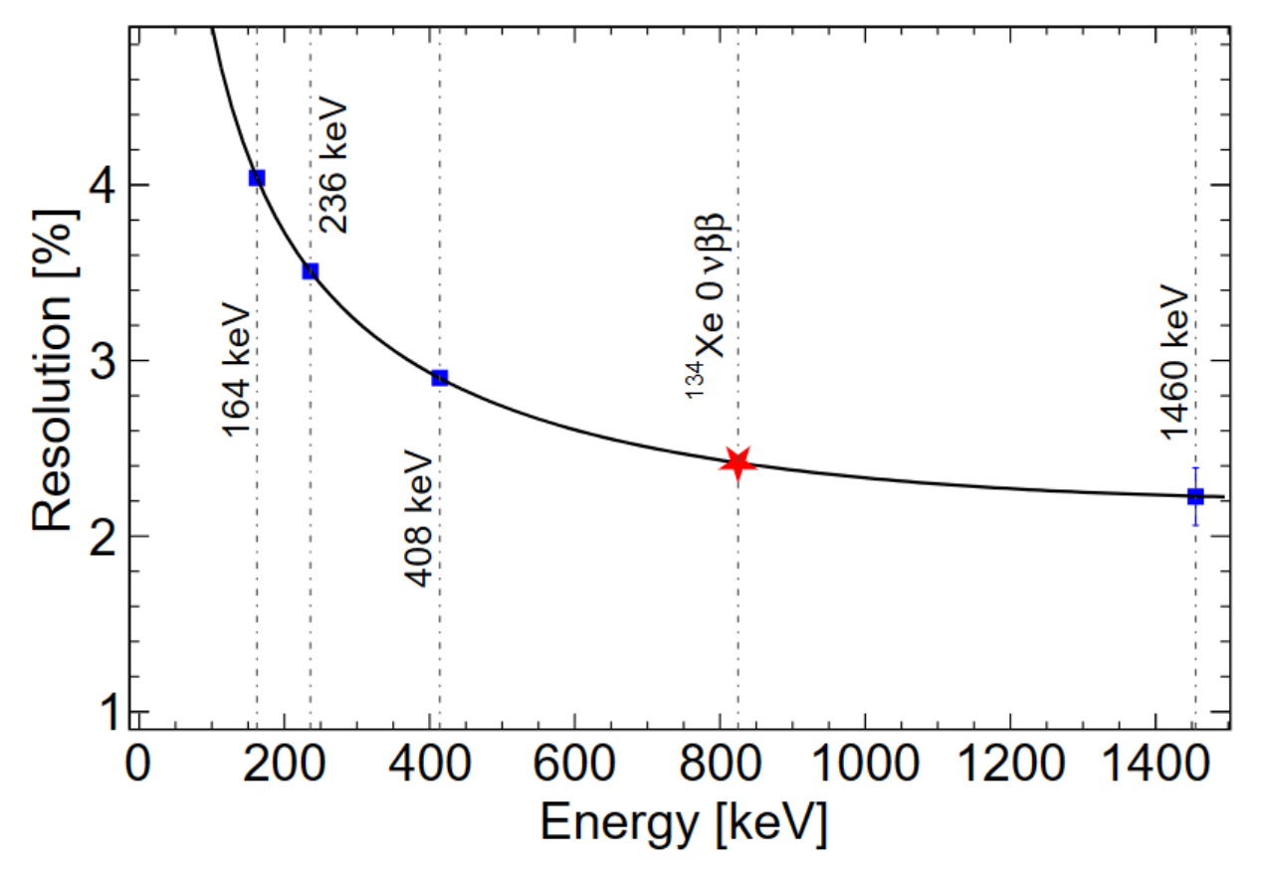

Extending detector response in [200, 1000] keV
Energy reconstruction:
Non-uniformity of detector response is corrected in three dimensions
Energy calibration from the gamma peaks: 164keV, 236keV, 408keV and 1460keV
Deviations of reconstructed peak positions less than 10keV
Relative energy resolution as a function of
energy: $\frac{a}{\sqrt{E}}+bE+C$
Energy resolution @ Q-value : σ/E=2.4% (3.56% in EXO-200 )
PDE: photon detection efficiency for S1
EEE: electron extraction efficiency
SEG_{B}: single-electron gain for S2_{B}

Slide 10
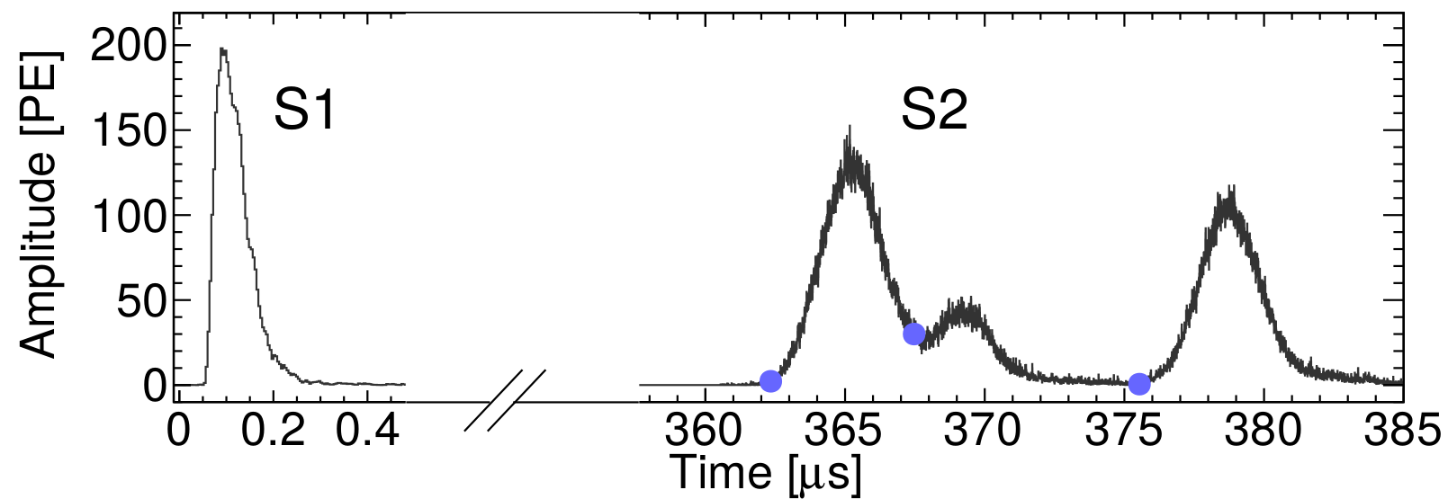
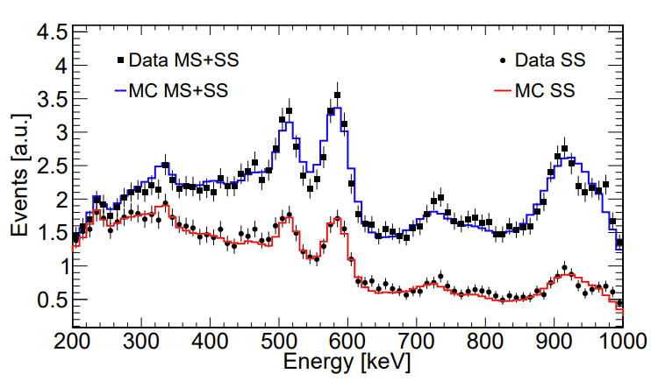
Events selection efficiencies
Data quality cut efficiencies: (99.94 ± 0.03)%
  S1, S2, S1/S2: remove non-electron recoil and alpha events
  Top and bottom S1 charge asymmetry vs. drift time
SS selection:
  MeV gammas events are mostly MS events, while signals are mostly SS events
  Identifying MS and SS with PMT waveforms
  Validated with ²³²Th calibration data agreement in the ROI is at 6.4%, taken as systematics

Slide 11
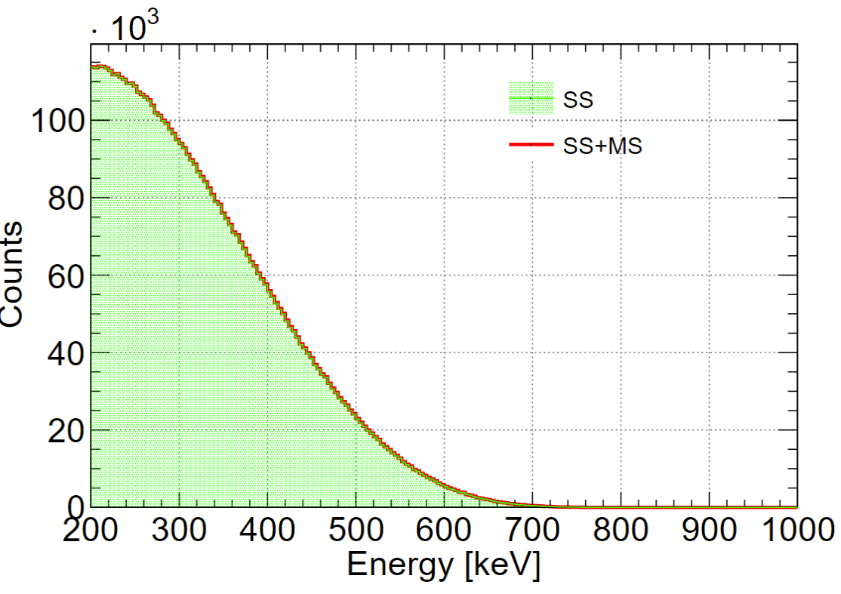
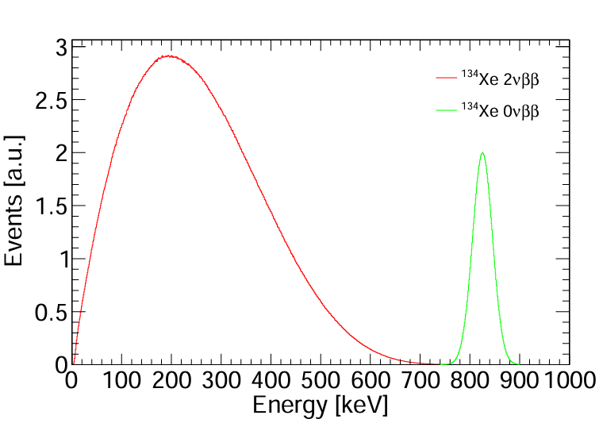
Signal efficiencies
¹³⁴Xe 2𝜈𝛽𝛽 and 0𝜈𝛽𝛽 events generated with the theoretical calculation
The signal events went through PandaX-4T simulation and data processing chain
ROI [200,1000]keV cut:
  2𝜈𝛽𝛽: 60.56%
  0𝜈𝛽𝛽: 99.98%
SS ratio in ROI:
  2𝜈𝛽𝛽: 99.89%
  0𝜈𝛽𝛽: 98.23%
Physical Review C 85, 034316 (2012)

Slide 12
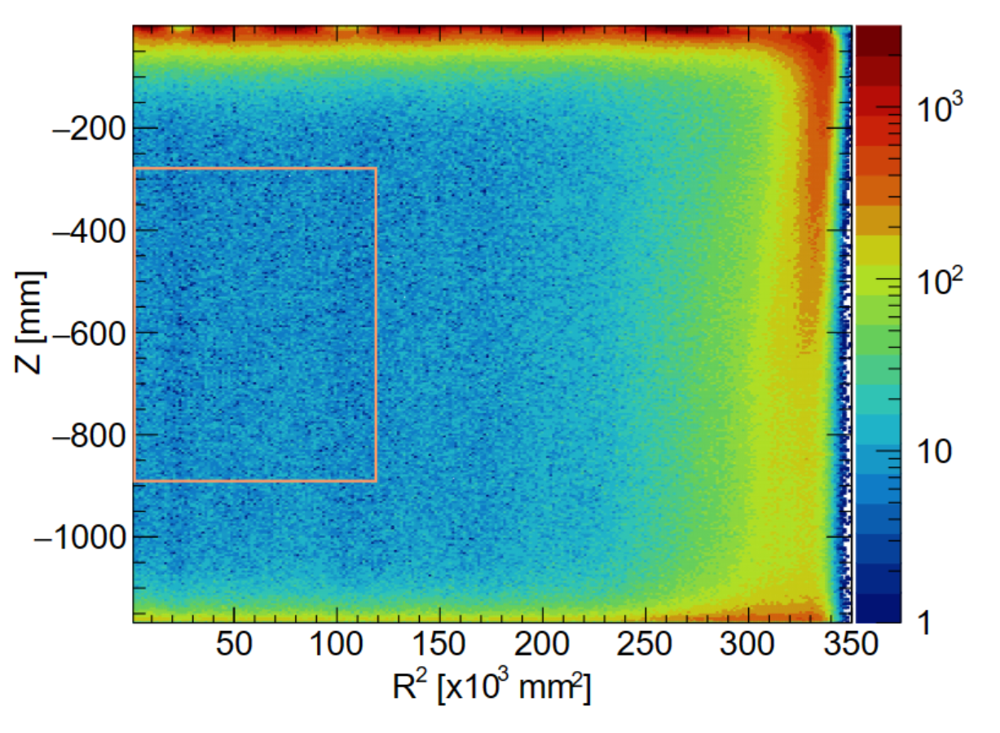
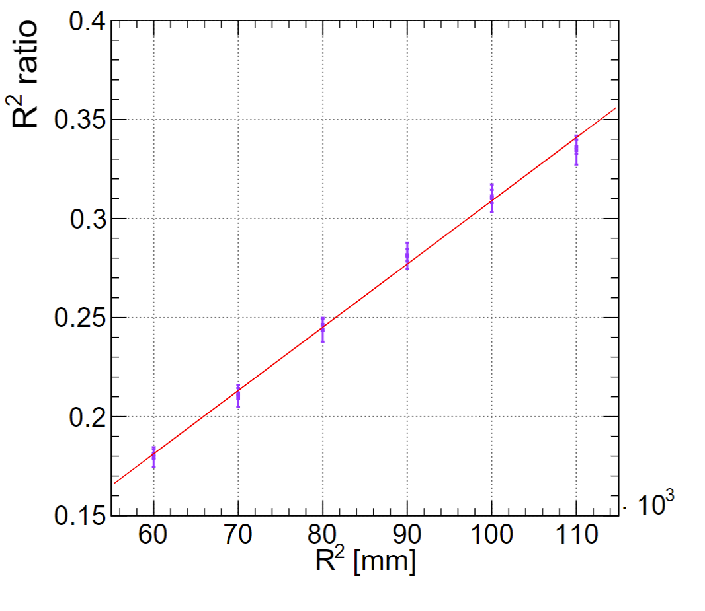
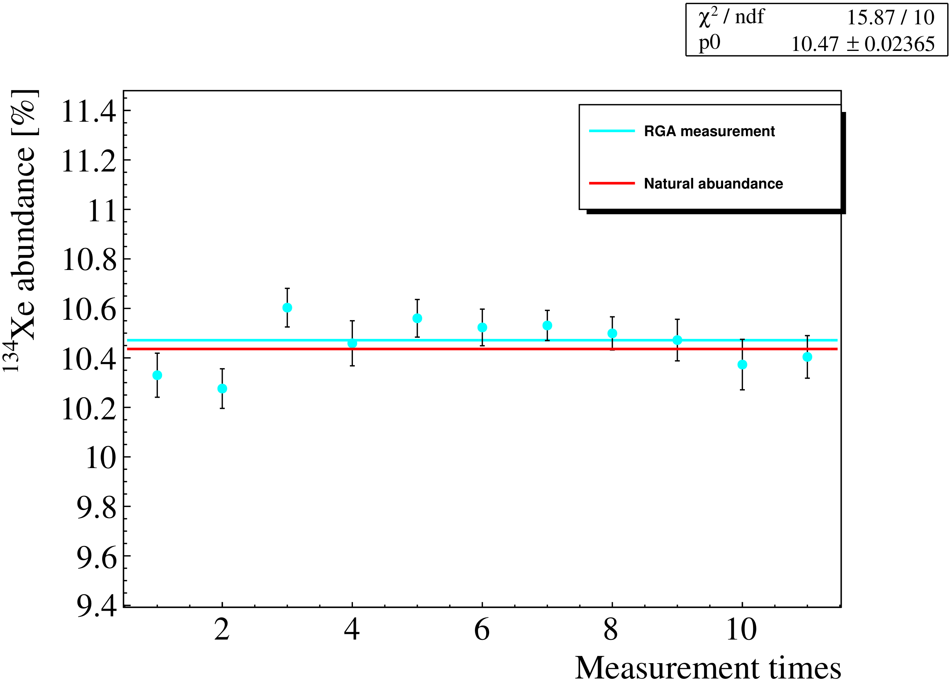
Fiducial Volume (FV) and exposure
The same data set and FV used in ¹³⁶Xe analysis
94.9 live-days of data from the initial data release
656 kg natural xenon within the selected FV
Measured ¹³⁴Xe abundance: 10.47%
Target mass uncertainty: FV selection (1.6%), abundance (0.2%), LXe density (0.03%)
Total isotopic exposure: 17.9 kg·yr

Slide 13
Background model
 | Component | Input Counts | Constraint
 | ⁶⁰Co | 130 | 13%
Materials | ⁴⁰K | 133 | 8%
 | ²³²Th | 950 | 5% | Measured in ¹³⁶Xe 2𝜈𝛽𝛽 analysis
 | ²³⁸U | 274 | 8% | Research 2022 (2022) 9798721
 | ¹³⁶Xe | 12372 | 5%
 | ²¹²Pb | 1012 | 29% | Measured by its daughter ²¹²Po alpha decay
 | ⁸⁵Kr | 296 | 52% | Determined by β−γ emission through the metastable state ^{85m}Rb
LXe | ¹³³Xe | 3423 | 10% | Estimated the β+γ shoulder of ¹³³Xe between 90 and 120 keV
 | ²¹⁴Pb | 19429 | Free | Determined by ²²²Rn
 | ¹²⁵Xe | - | Free | short-lived xenon isotopes induced by neutron calibration
 | Other Xe | - | Free | ¹²⁷Xe and ^{129m}Xe

Slide 14
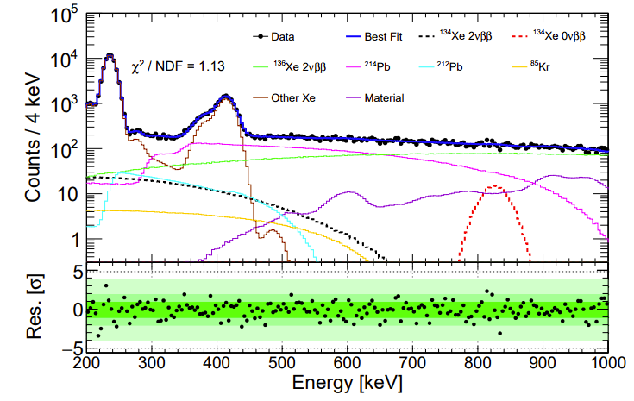
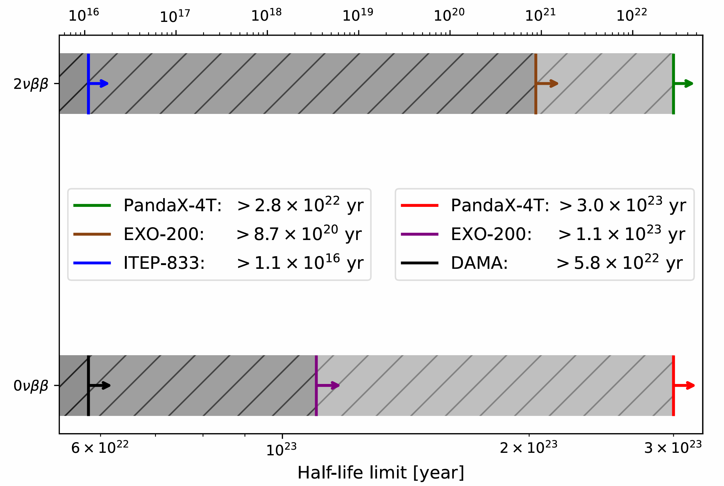
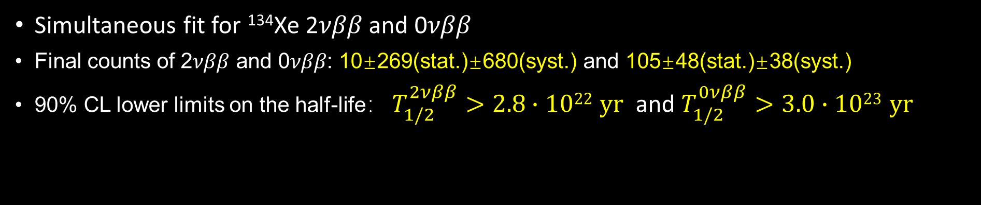
¹³⁴Xe half-life limits @ PandaX-4T
Simultaneous fit for ¹³⁴Xe 2𝜈𝛽𝛽 and 0𝜈𝛽𝛽
Final counts of 2𝜈𝛽𝛽 and 0𝜈𝛽𝛽: 10±269(stat.)±680(syst.) and 105±48(stat.)±38(syst.)
90% CL lower limits on the half-life： $T_{1/2}^{2νββ}>2.8∙1022 yr$ and $T_{1/2}^{0νββ}>3.0∙1023 yr$
PandaX, Phys.Rev.Lett. 132 (2024) 15, 152502

Slide 15
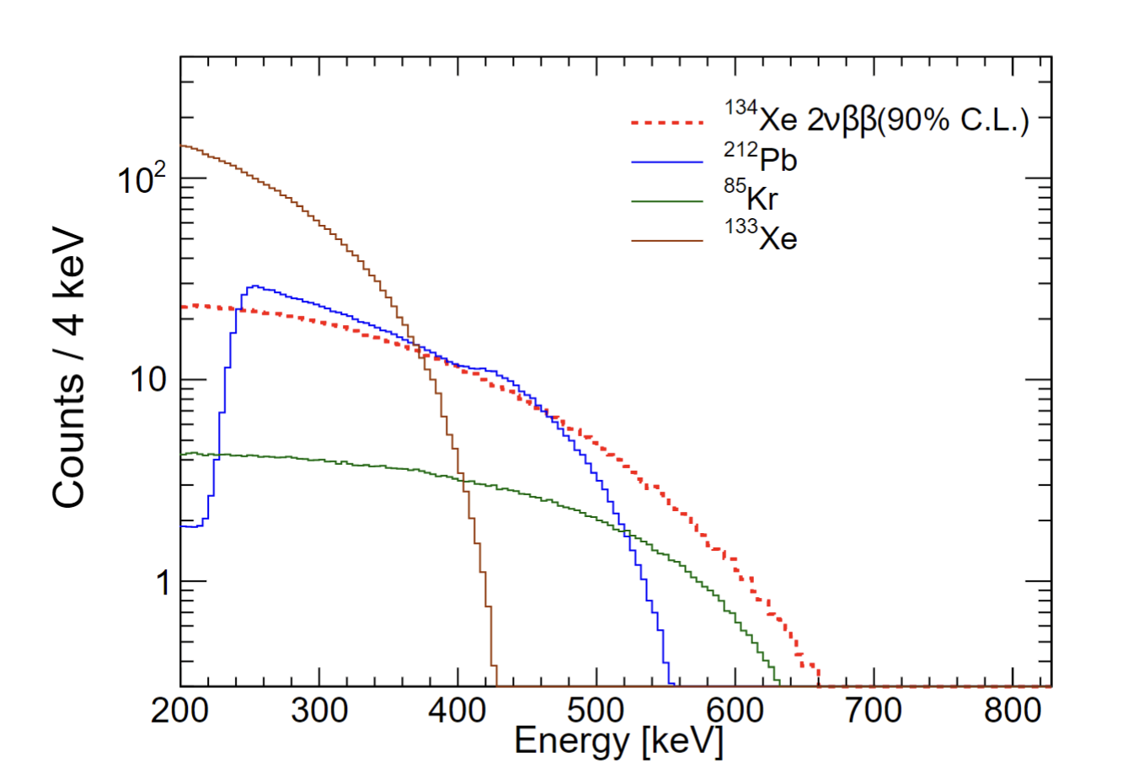
Systematic uncertainties
  Contributions from target mass, efficiency, energy reconstruction and background are included in the likelihood function as Gaussian constraint
  Contributions from bin size and energy scale of energy spectrum are evaluated independently
 | Sources | 2𝜈𝛽𝛽 [counts] | 0𝜈𝛽𝛽 [counts]
Statistical |  | 269 | 48
 | Target mass | - | -
 | Efficiency | 119 | 10
 | Energy resolution | - | -
Systematic | Background | 521 | 19
 | Bin size | 85 | 13
 | Energy scale | 410 | 28
 | Total | 680 | 38

Slide 16

Summary
PandaX-4T has extended the energy range from keV to MeV , the key advantages for ¹³⁴Xe 2𝜈𝛽𝛽 and 0𝜈𝛽𝛽 search: more ¹³⁴Xe; much less ¹³⁶Xe; wider energy range
Limits for ¹³⁴Xe 2𝜈𝛽𝛽 and 0𝜈𝛽𝛽 with 17.9 kg·yr exposure : $T_{1/2}^{2νββ}>2.8∙1022 yr$ and $T_{1/2}^{0νββ}>3.0∙1023 yr$ at 90% CL
The 2𝜈𝛽𝛽 (0𝜈𝛽𝛽 ) limit surpasses the previously reported best result by a factor of 32 (2.7), highlighting the potential of large monolithic natural xenon detectors
A discovery of ¹³⁴Xe 2𝜈𝛽𝛽 may be within reach with PandaX-4T and future large xenon TPCs
Thanks！

Slide 18
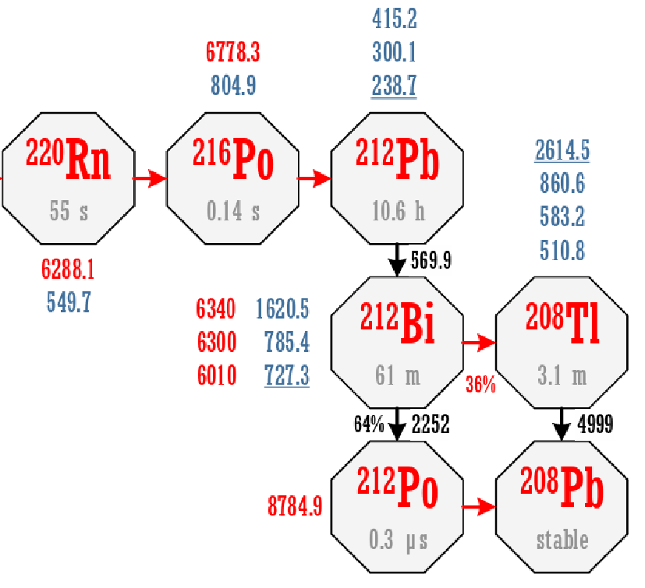
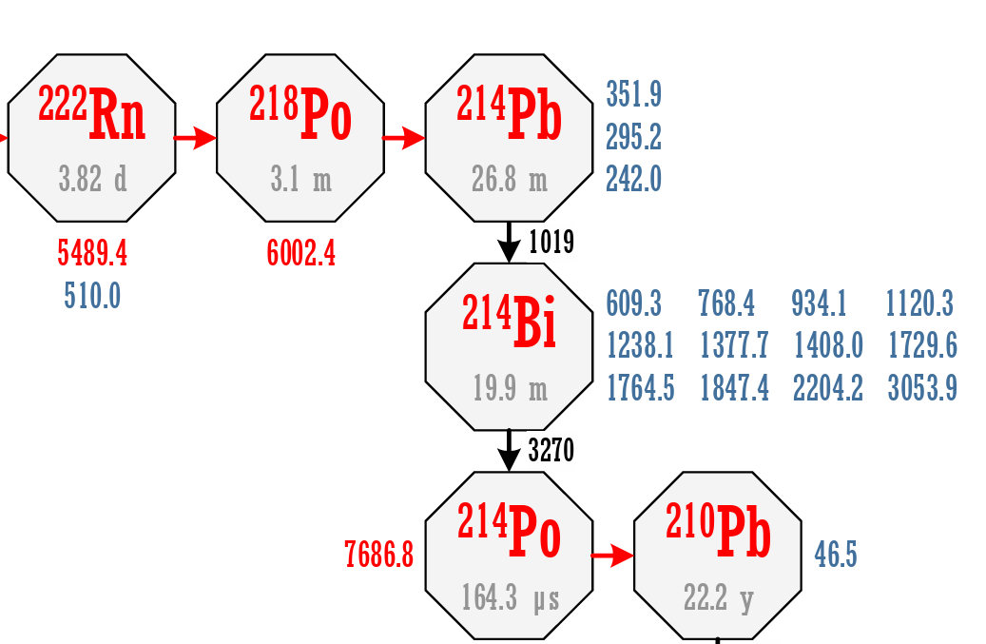

Slide 19
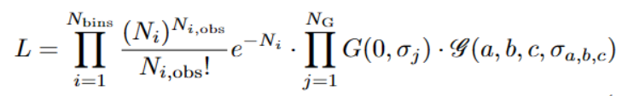

Simultaneous binned likelihood fit for ¹³⁴Xe 2𝜈𝛽𝛽 and 0𝜈𝛽𝛽
The systematic uncertainties from target mass, efficiency, energy resolution and background are included
The signals at the 90% CL upper limits
The background contributions of xenon isotopes except ¹³⁶Xe are grouped as one curve

