Slide 1
PandaX-4T Run0+Run1 WIMP Background Analysis and Signal Response Model
Yunyang Luo (University of Science and Technology of China)
On behalf of the PandaX Collaboration
COUSP 2024

Slide 2
Contents
01
Introduction of PandaX-4T
02
Signal Response Model
03
Background Analysis
04
Summary

Slide 3
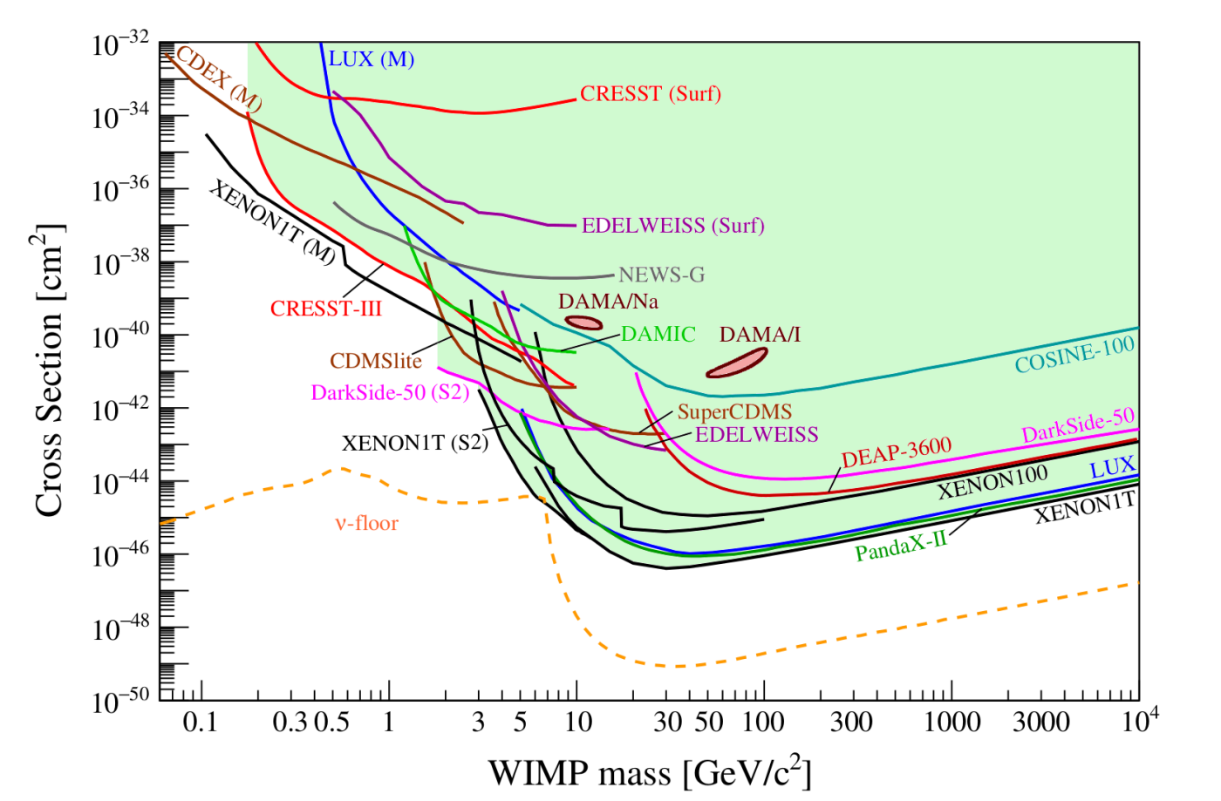
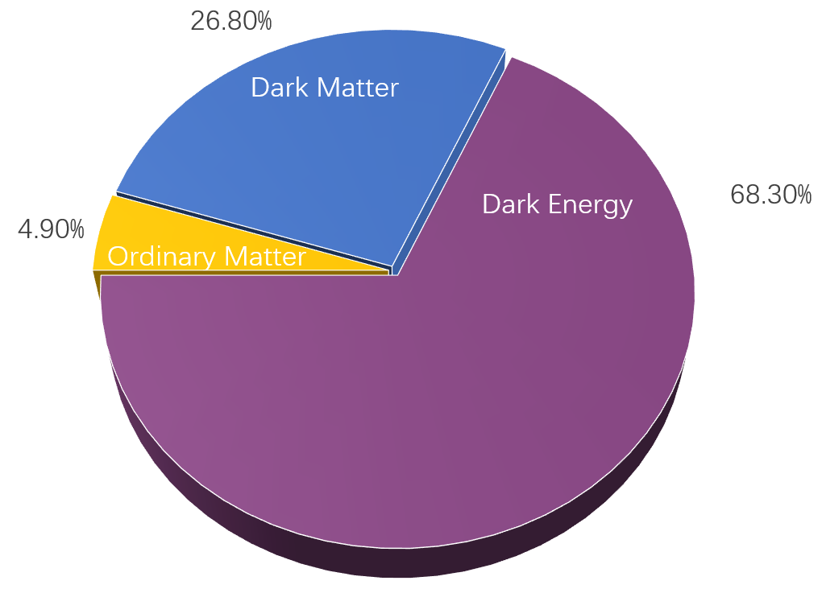
WIMP search
Dark Matter Candidates
10
10
WIMPs
Mass range: ~1GeV to ~1TeV
Experiments: PandaX-4T, XENONnT, LZ,
CRESST, DAMA, COSINE-100
10
10
10
Sub-GeV DM
Mass range: ~1keV to ~1GeV
Experiments: SENSEI, TESSERACT
10
10
1
10
Lower Eth
10
AXIONS
Mass range: ~10⁻⁶eV to ~10⁻³eV
Experiments: ADMX, MADMAX, QUAX
CAPP-8TB
10
10
10
Larger detector
10
Ultralight DM
Mass range: ~10⁻²²eV to ~10⁻⁶eV
Experiments: CASPEr, MAGIS-100
10
10
10
…
10
APPEC Committee Report
(arXiv:2104.07634)
10

Slide 4
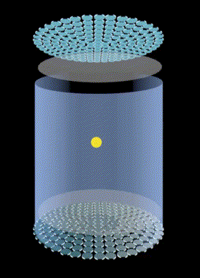
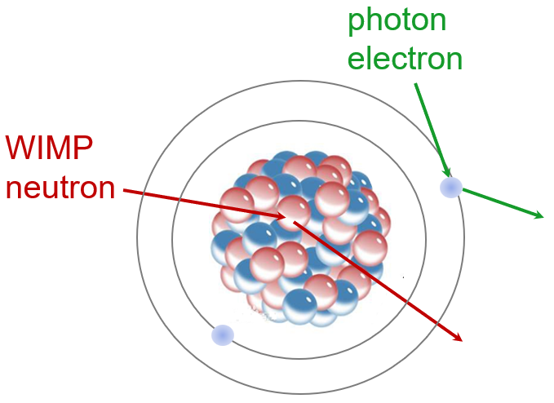
Dual-phase Xenon Time Projection Chamber(TPC)
Features:
Large monolithic target
3D pos. recon.
Good NR/ER discrimination
S2
z
x
e
S1
x,y

Slide 5
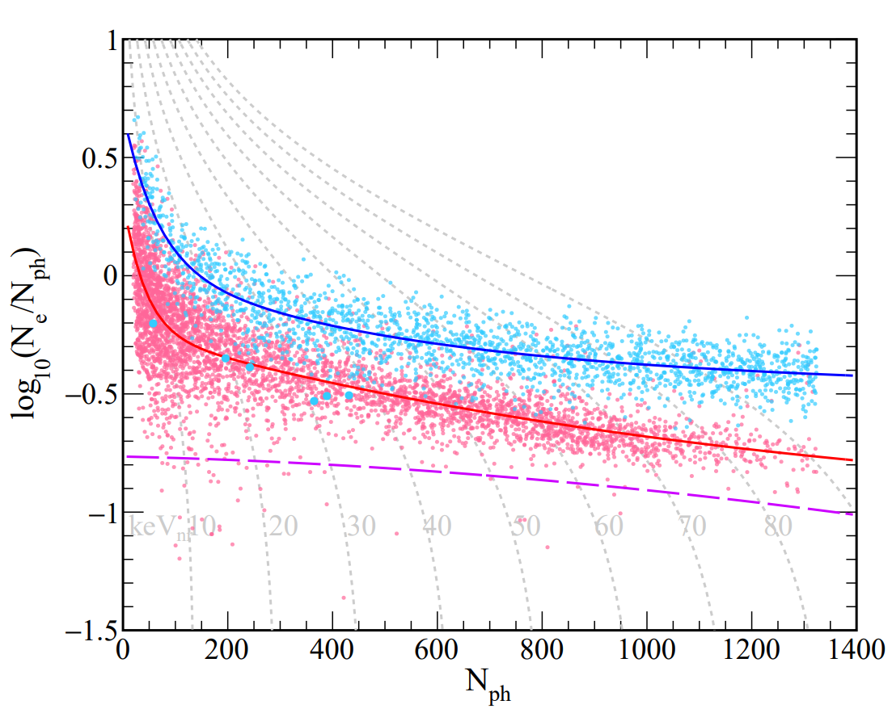
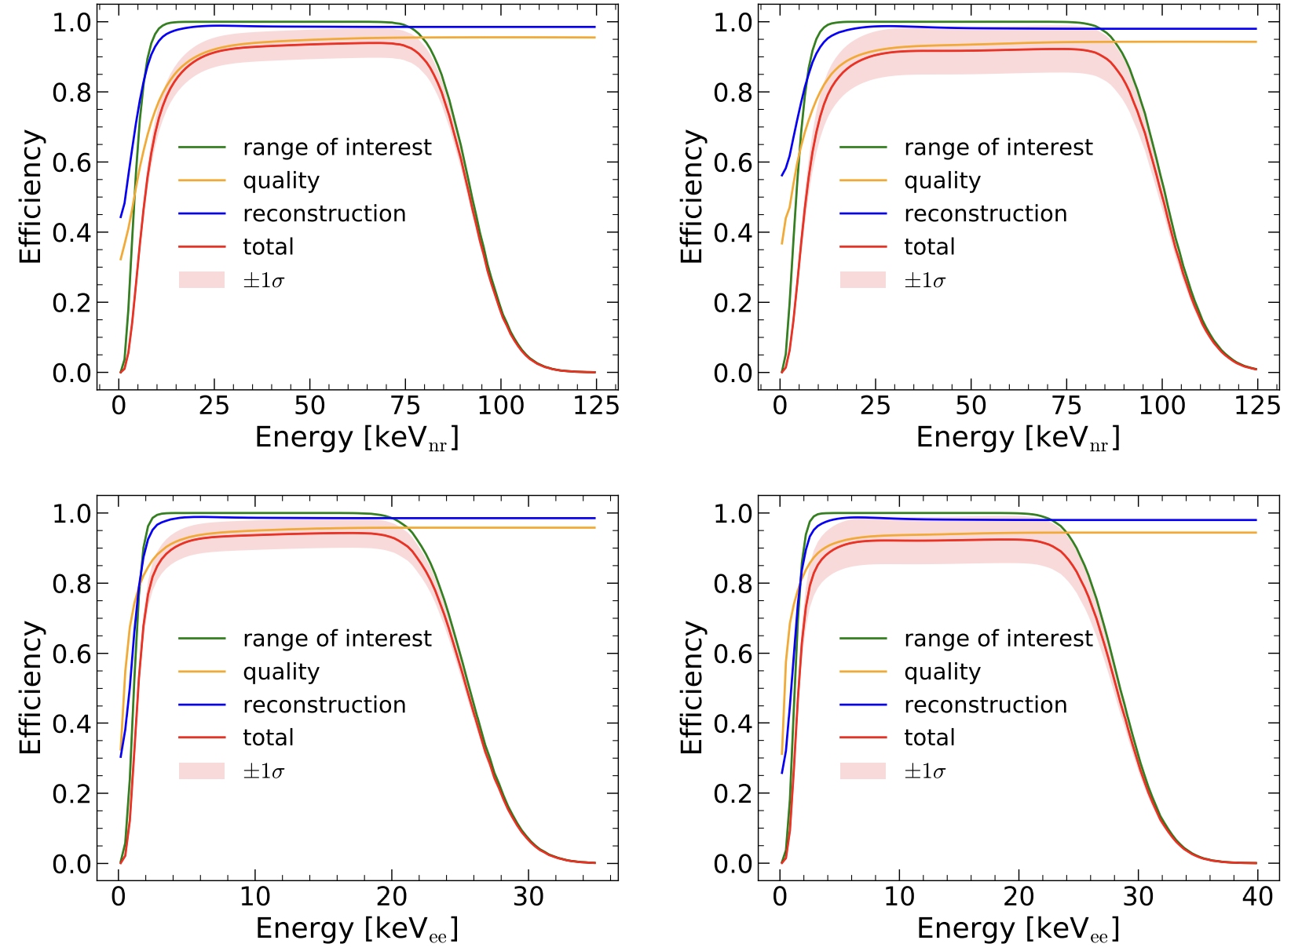
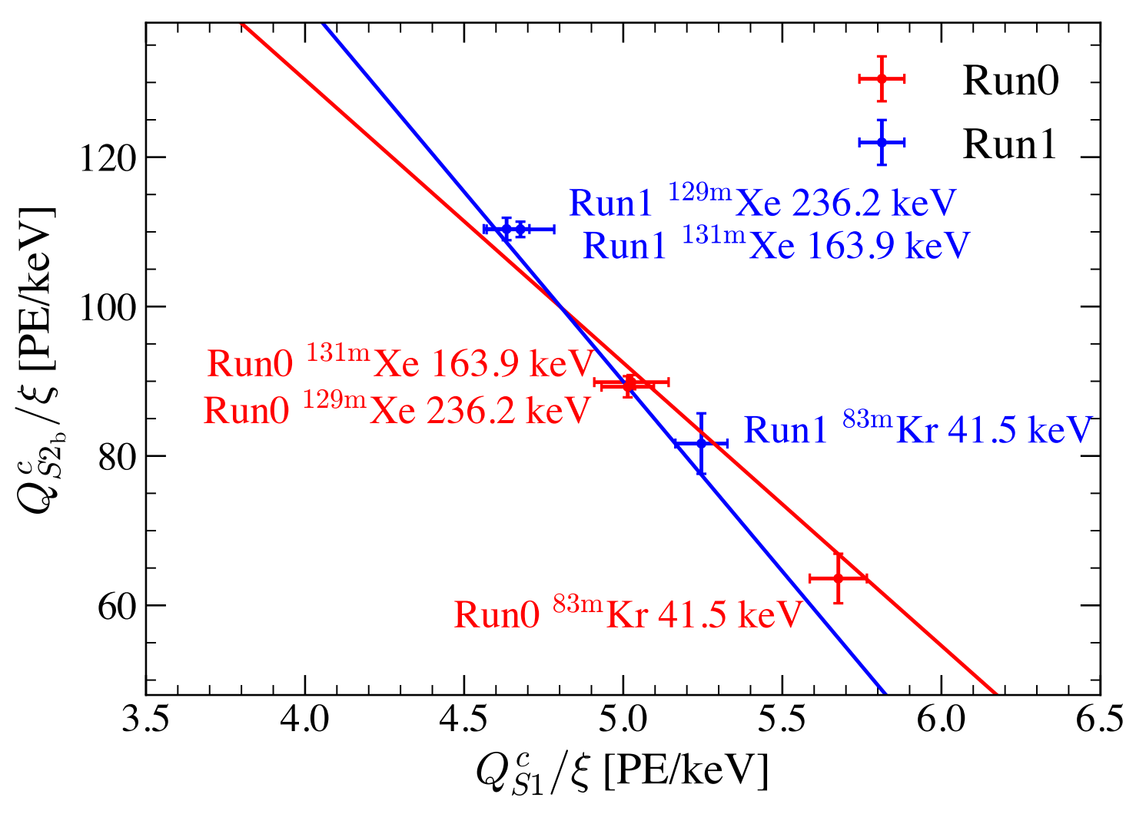
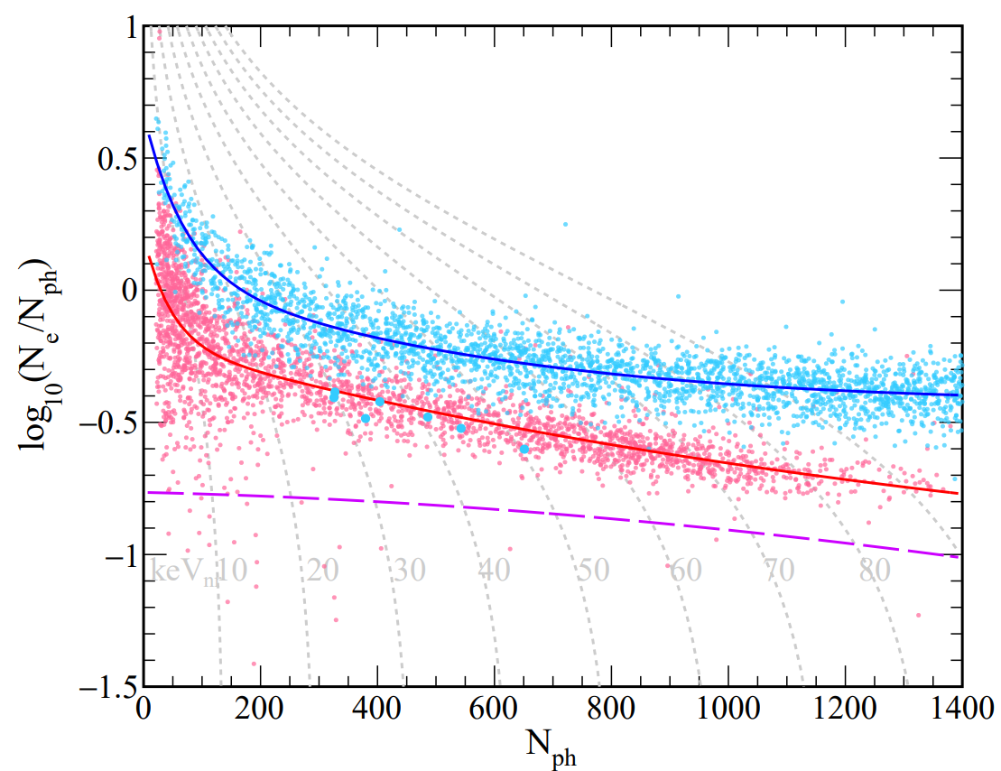
Joint analysis of run0+run1
run0
Rn
DD+AmBe
data process
energy reconstruction
low energy calibration
efficiency estimation
signal model
bkg analysis
Fit (g1, g2b):
Run0: (0.103±0.005, 3.9±0.4)
Run1: (0.093±0.004, 4.7±0.5)
$$E_{rec}=W(\frac{S1}{g1}+\frac{S2b}{g2b})$$
S1,S2?
Run0
0.545 tonne·year
+
Run0 NR
Run1 NR
Run1
0.995 tonne·year
run1
Rn
DD+AmBe
energy
Run0 ER
Run1 ER

Slide 6
Contents
01
Introduction of PandaX-4T
02
Signal Response Model
03
Background Analysis
04
Summary

Slide 7
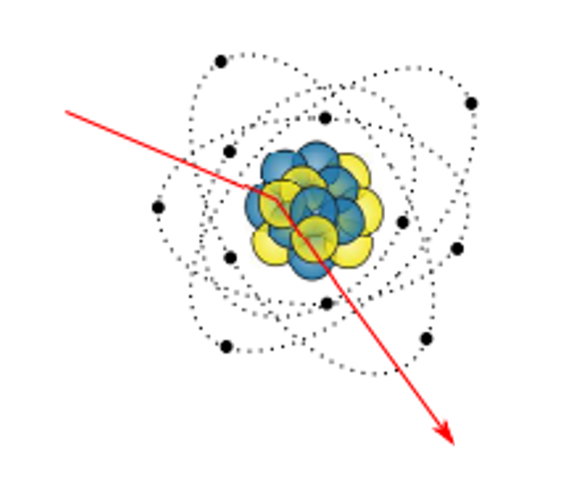
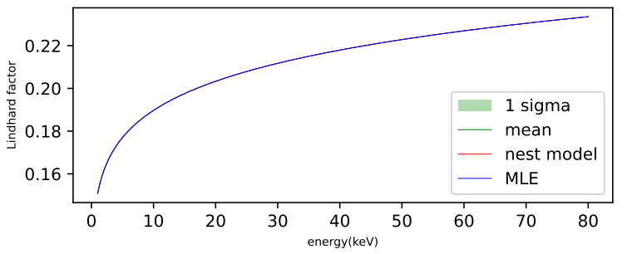
Modeling the response
Effects of Xenon
1.Energy quenching
2.Production of γ,e
(NEST model+tune)
$$Xe$$
Scintillation
Ionization
Heat→energy loss
Gas
ionization
excitation
$${Xe}^{+}+e^{−}$$
Quenching factor (Lindhard factor)
recombination
$${Xe}^{∗}$$
$$e^{−}$$
$γ$
$$e^{−}$$
γ
Liquid
$$S1$$
$$S2$$

Slide 8
Modeling the response
Effects of Xenon
1.Energy quenching
2.Production of γ,e
(NEST model+tune)
Gas
S2
S2
impurity
Effects of TPC
Electron loss
Gain by gas Xe
Detect efficiency
PMT double PE emission
Signal bias
Multi-scattering
…
electron drift
drift time (dt)
S1
Liquid
S1
$${N_{drift}\sim Binomial(N_{e},p}_{drift}), p_{drift}=e^{−dt/elife}$$
$${N_{extract}\sim Binomial(N_{drift},p}_{extract})$$

Slide 9
Modeling the response
Effects of Xenon
1.Energy quenching
2.Production of γ,e
(NEST model+tune)
Gas
S2
S2
impurity
Effects of TPC
Electron loss
Gain by gas Xe
Detect efficiency
PMT double PE emission
Signal bias
Multi-scattering
…
drift time
electron drift
S1
Liquid
S1
$$N_{hit}^{S2}\sim Guass(N_{ext} SEG,\sqrt{N_{ext}} ΔSEG)$$

Slide 10
Modeling the response
Effects of Xenon
1.Energy quenching
2.Production of γ,e
(NEST model+tune)
Gas
S2
Effects of TPC
Electron loss
Gain by gas Xe
Detect efficiency
PMT double PE emission
Signal bias
Multi-scattering
…
drift time
S1
Liquid
S1
$$N_{hit}^{S1}\sim Binomial(N_{ph},g_{1})$$

Slide 11
Modeling the response
Effects of Xenon
1.Energy quenching
2.Production of γ,e
(NEST model+tune)
Gas
S2
e
Effects of TPC
Electron loss
Gain by gas Xe
Detect efficiency
PMT double PE emission
Signal bias
Multi-scattering
…
γ
drift time
S1
Liquid
S1
$$N_{pe}\sim N_{hit}+Binomial(N_{hit},p_{dpe})$$
$${Signal}_{raw}\sim Guass(N_{pe},\sqrt{N_{pe}} {Res}_{PMT})$$

Slide 12
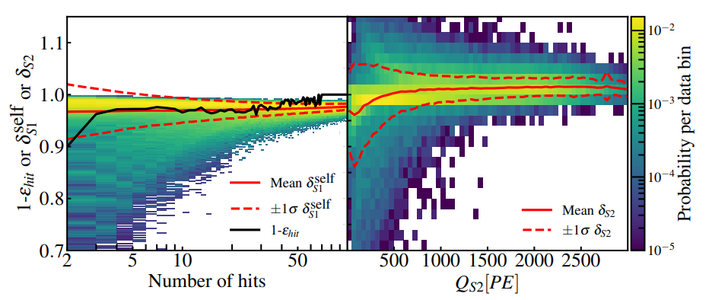
Modeling the response
cluster window
Effects of Xenon
1.Energy quenching
2.Production of γ,e
(NEST model+tune)
threshold
Effects of TPC
Electron loss
Gain by gas Xe
Detect efficiency
PMT double PE emission
Signal bias
Multi-scattering
…
loss
redundant
loss

Slide 13
Consider multi-scattering
n
$$S1→S1\left[0\right]+S1[1]$$
$$S2[0]$$
$$S2[1]$$
$$S1→S1\left[0\right]+S1[1]$$
$$S2→S2\left[0\right]+S2[1]$$
depends on:
Δz of energy depositions
Width of S2s
charge
x,y,z position
liquid level
….
More than one S2
S2s will merge

Slide 14
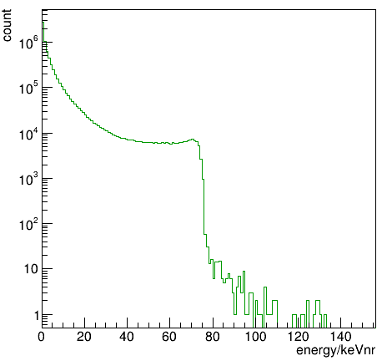
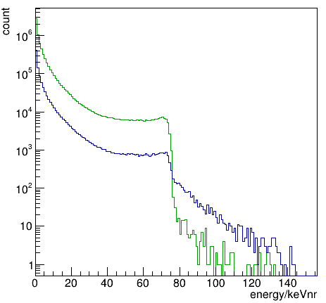
Consider multi-scattering
spectrum from Geant4
spectrum after cluster
cluster as one S2
S2s’ waveform
Geant4
Clustering in
waveform sim
Signal model
Fit calibration data

Slide 15
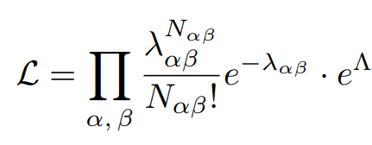
Tune the model
Fit run0+run1 DD+AmBe+Rn data. Tune γ,e yield.
Binned likelihood
$α$: indices of dataset
β: indices of 2D-distribution
Maximum likelihood fitting in GPUs trough MCMC
$$p_{accept}=min⁡(\frac{L\left(θ_{n+1}\right)}{L(θ_{n})},1)$$
accept: p
Penalty from energy calibration
Step 1
…
Step n
Step n+1
refuse: 1-p
Markov Chain
i: Kr83m, Xe129m, and Xe131m
Monte Carlo

Slide 16
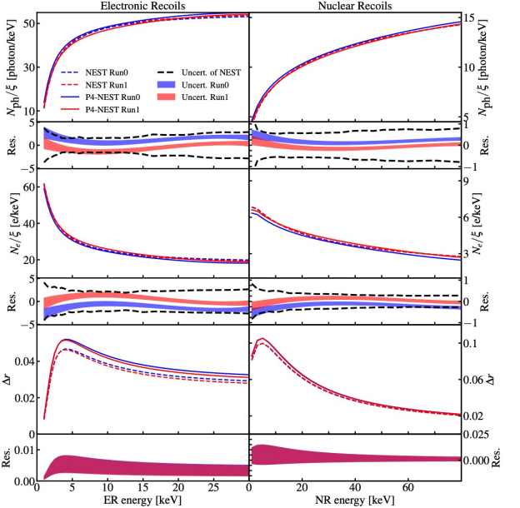
Fitting result
Fit run0+run1 DD+AmBe+Rn data. Tune γ,e yield.
For example, run1 DD:

Slide 17
Contents
01
Introduction of PandaX-4T
02
Signal Response Model
03
Background Analysis
04
Summary

Slide 18
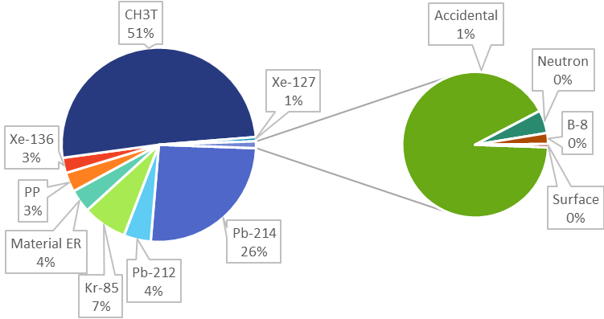
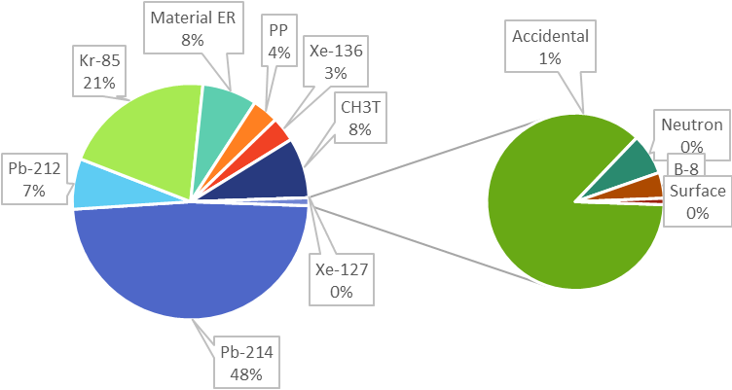
Backgrounds in WIMP analysis
FlatER
run0
run1
preliminary
preliminary

Slide 19
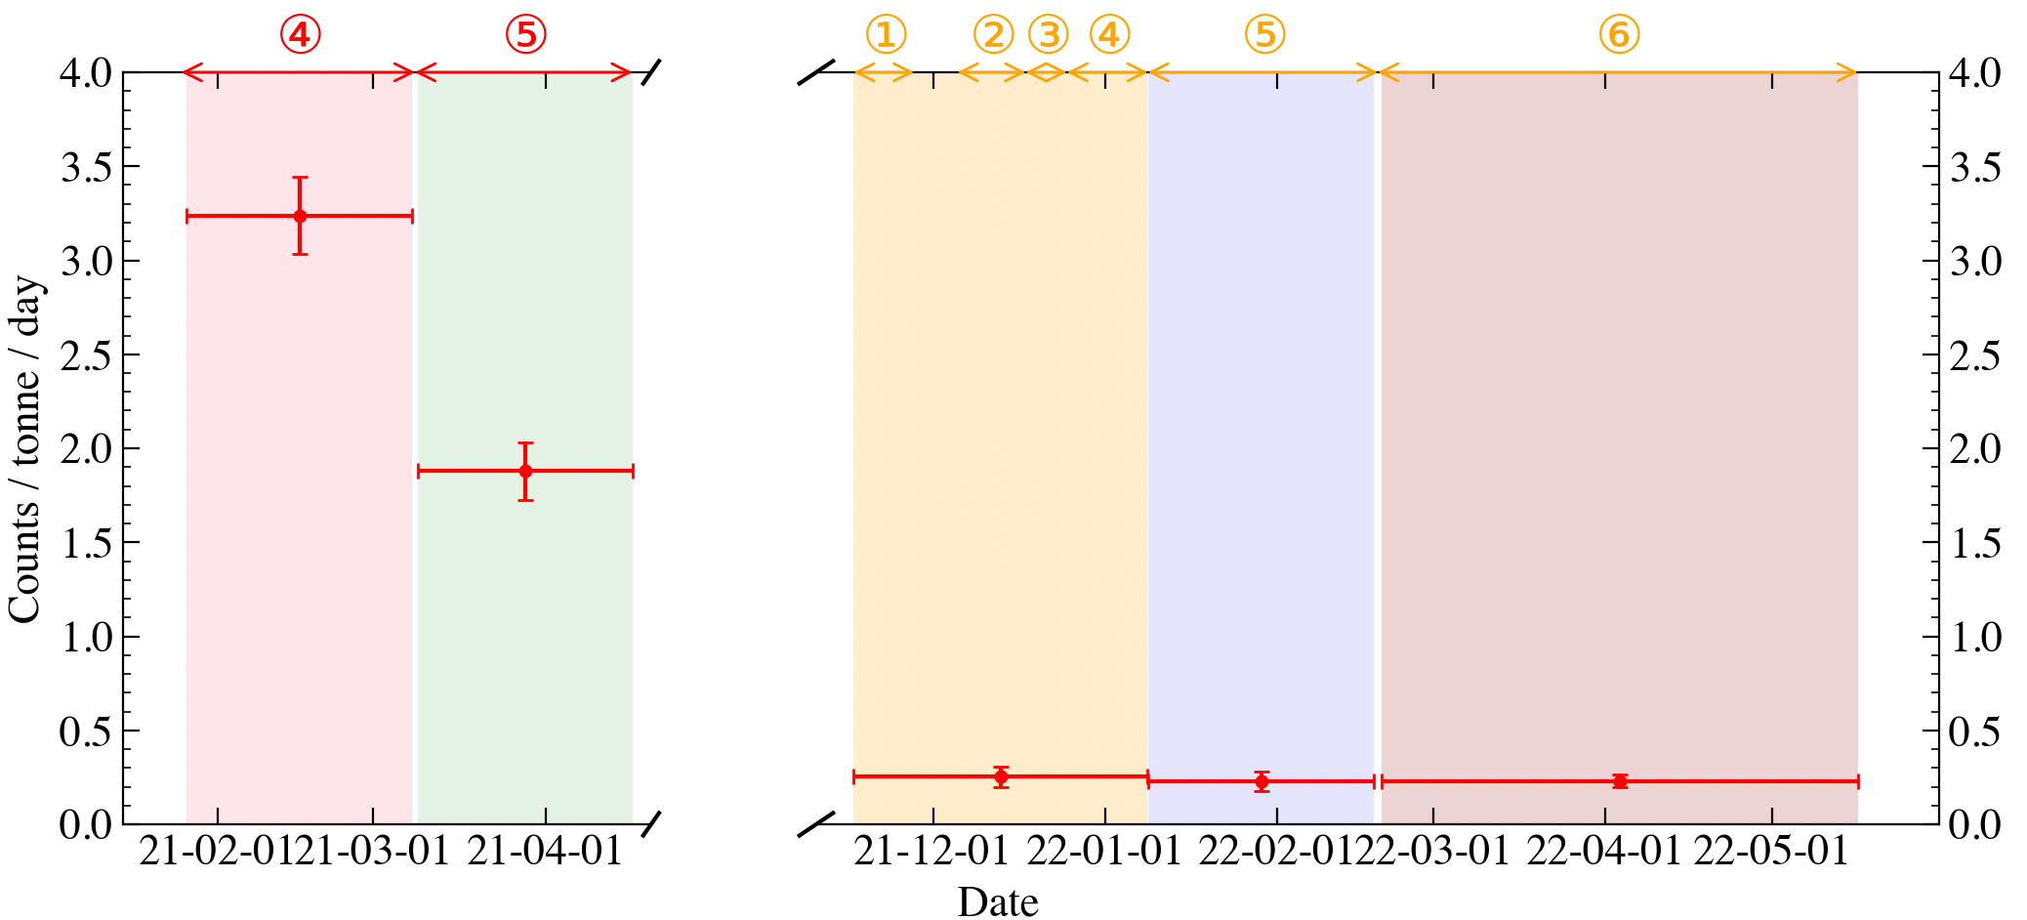
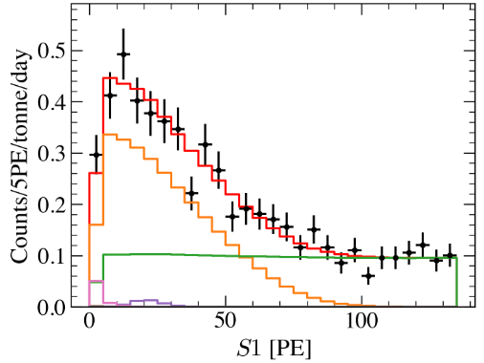
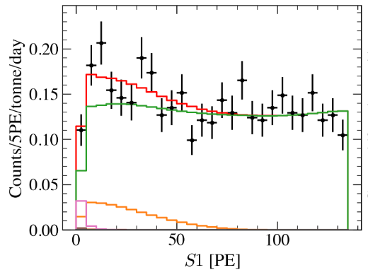
FlatER, Tritium
run0
preliminary
run1
Run0: Set ①-⑤ Run1: Set ①-⑥
preliminary
Dataset | Run0 Set4 | Run0 Set5 | Run1 Set1-4 | Run1 Set5 | Run1 Set6
Rate [/tonne/day] | 3.24±0.20 | 1.88±0.15 | 0.25±0.05 | 0.23±0.05 | 0.23±0.03

Slide 20
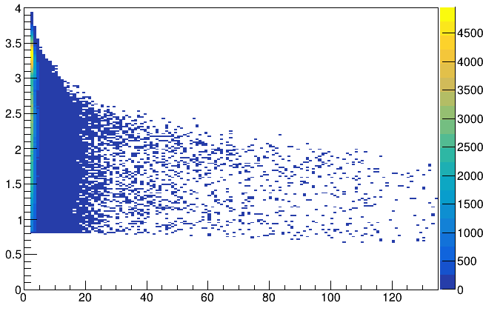
Accidental coincidence(AC)
Physical event
AC
Gas
S2
Gas
S2
S2
Isolated S1s
Isolated S2s
S1-S2 distribution in AC’s model
?S2
Random pair
electron drift
?S1
drift time
Log10(qS2BC/qS1C)
wrong pair
S1
event selection
AC S1-S2 distribution, and
$$rate=r_{is1}∗r_{is2}∗{dt}_{range}∗p_{accept}$$
Liquid
S1
Liquid
S1
qS1C

Slide 21
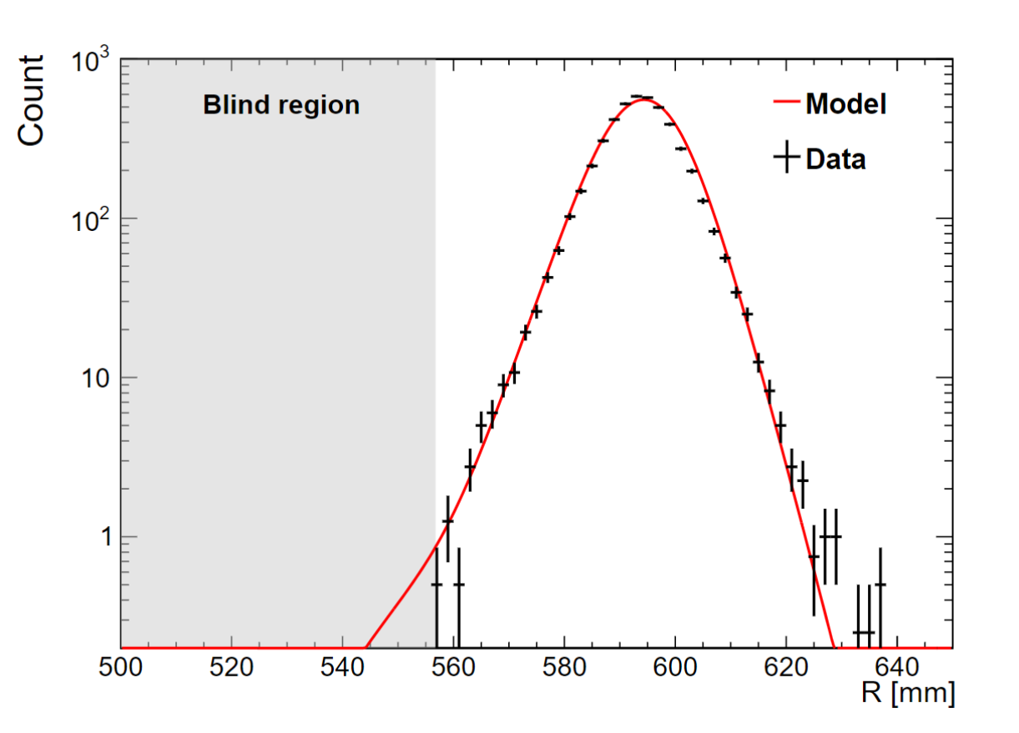
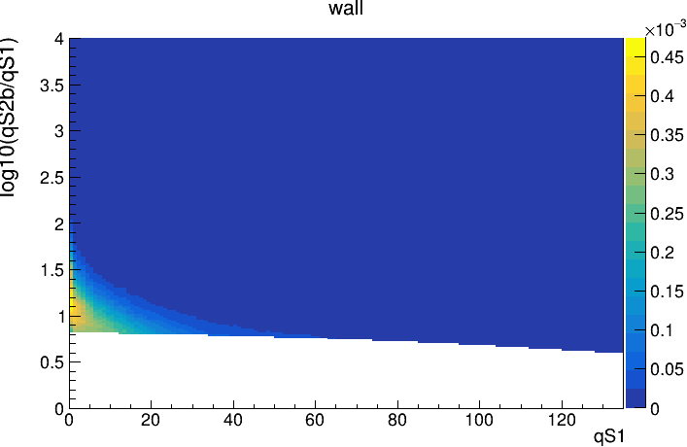
Surface
Wall model: the model of S2-S1-r near the wall
PTFE
Gas
S2
S2
S2 decreases
absorbed
$$e^{−}$$
expected count $N_{surface}=N_{out}∗r_{in/out}$
S1-S2 distribution
S1
S1
Liquid
Po210

Slide 22
Neutron
Combine 3 methods to estimate:
GEANT4 + signal model
high energy γ / neutron ratio
multi-scatter / single-scatter ratio
n
NR events
WIMP SS
n SS
…
Xe131
Xe132
capture
γ
n MS
$$N_{neutron}=N_{γ}∗r_{n/γ}$$
$$N_{neutron}=N_{MS}∗r_{SS/MS}$$

Slide 23
Contents
01
Introduction of PandaX-4T
02
Background Analysis
03
Signal Response Model
04
Summary

Slide 24
Summary
Signal response model
Improved the modeling of multi-scattering of neutron.
Bkg analysis
The Tritium bkg is significantly reduced in run1.
Next
Statistical inference of WIMPs.

Slide 25
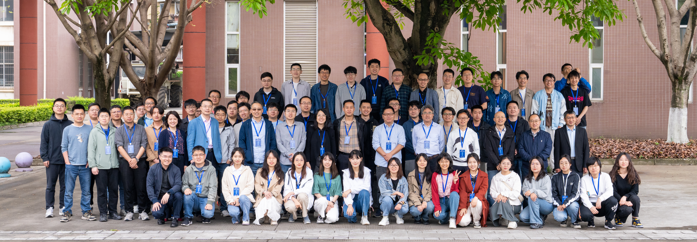
Thanks for your attention!

Slide 26
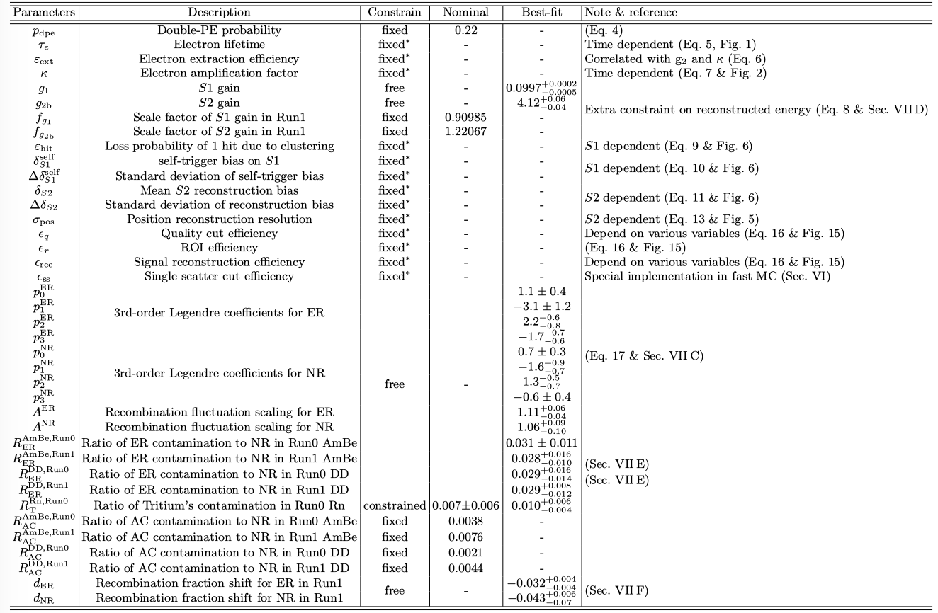
Back up: best fit of signal model

Slide 27
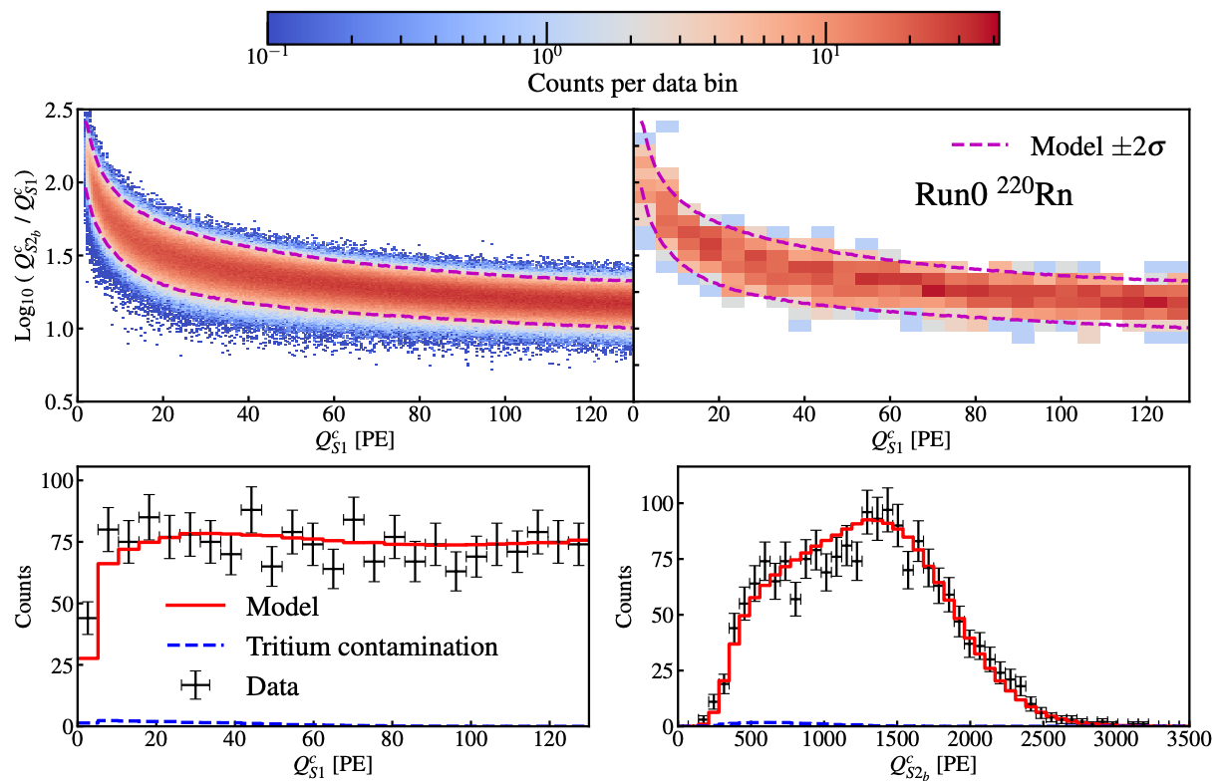
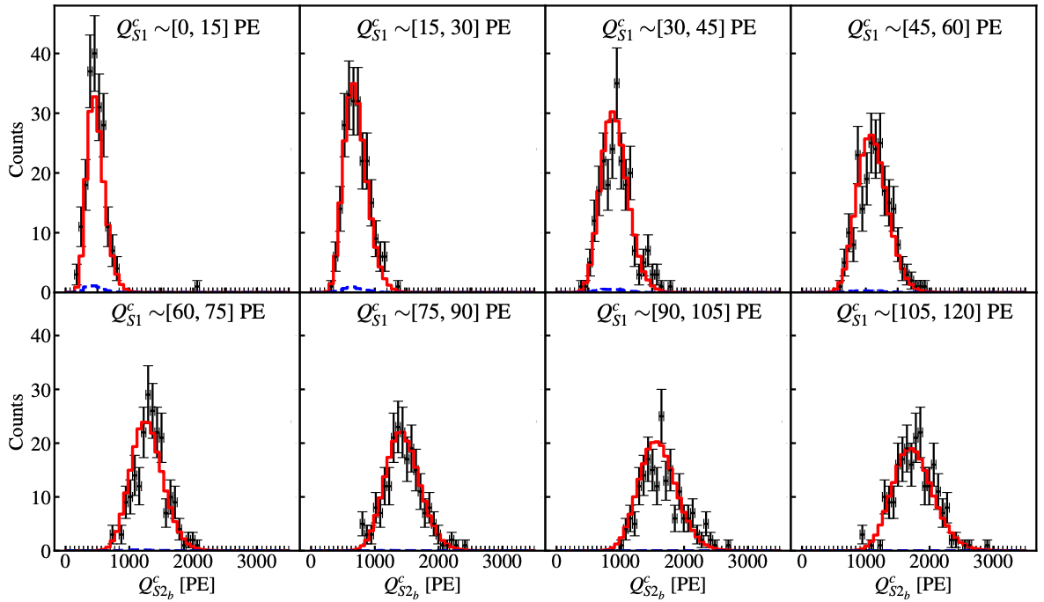
Back up: fit Run0 ²²⁰Rn

Slide 28
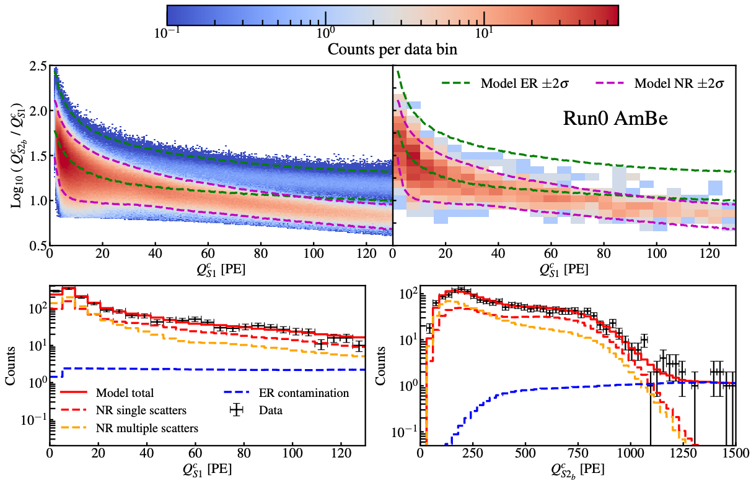
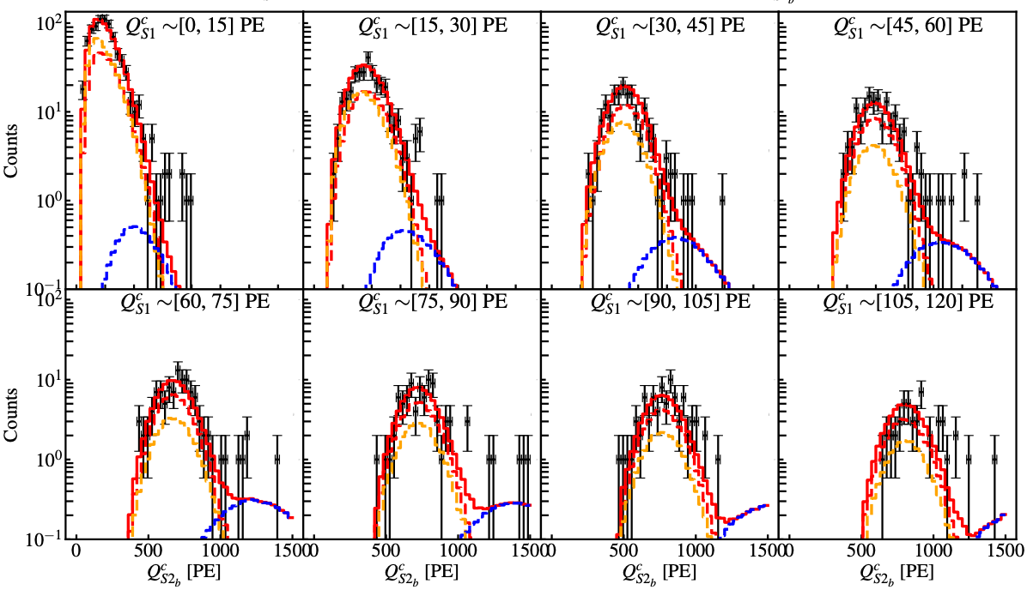
Back up: fit Run0 ²⁴¹AmBe

Slide 29
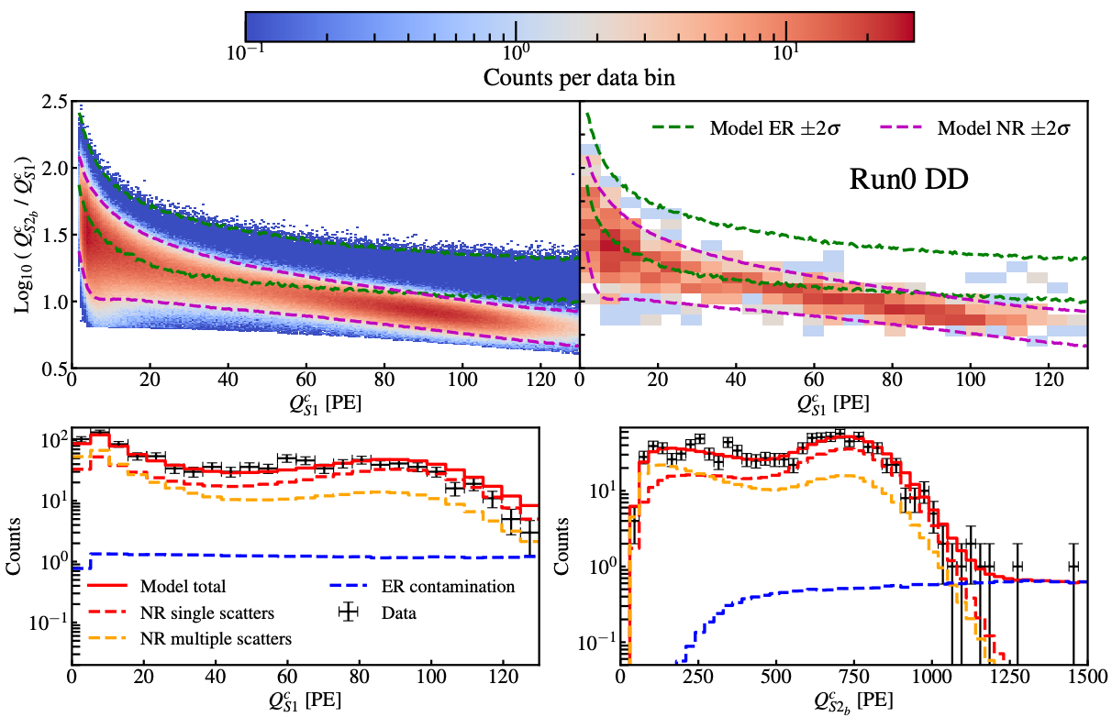
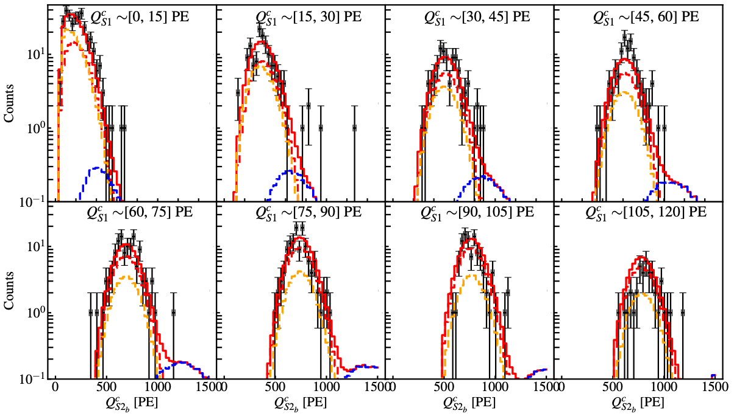
Back up: fit Run0 DD

Slide 30
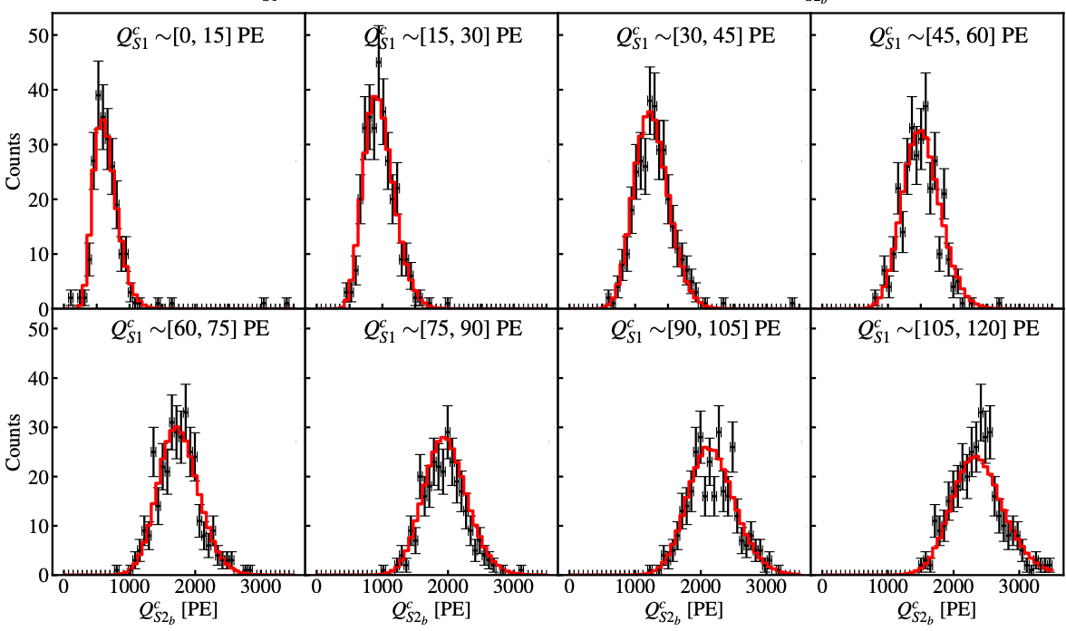
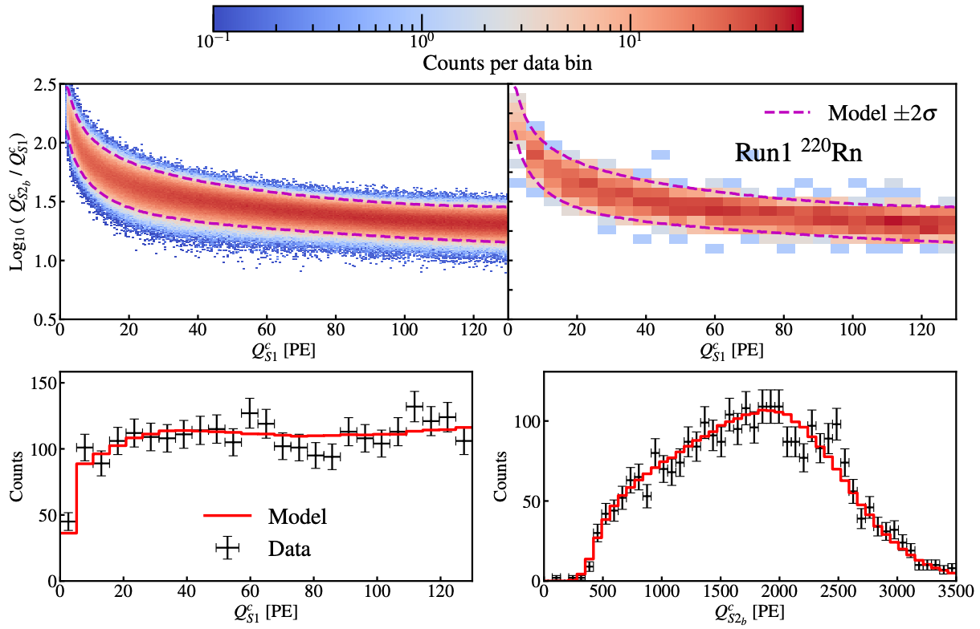
Back up: fit Run1 ²²⁰Rn

Slide 31
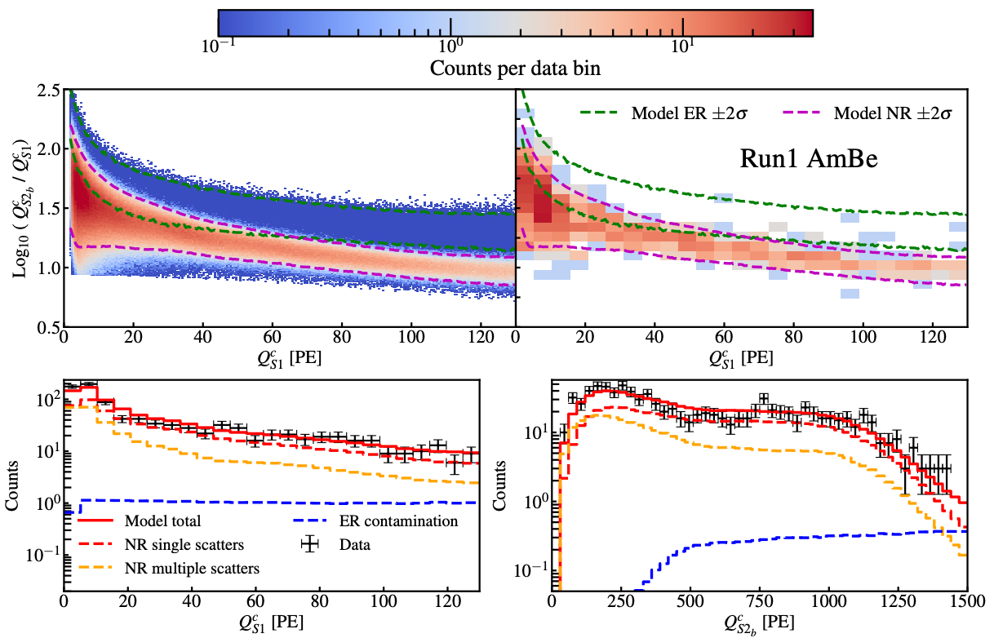
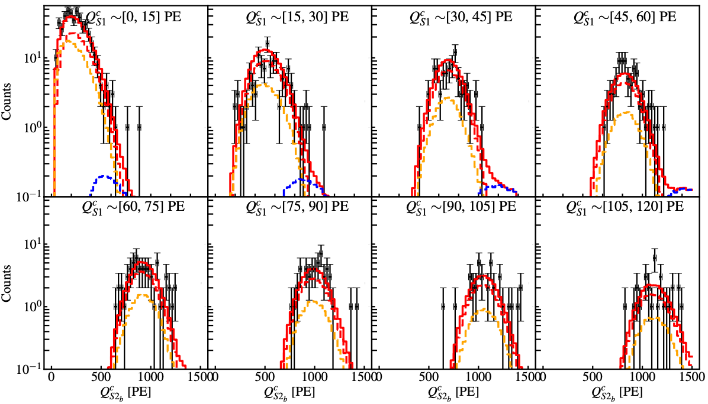
Back up: fit Run1 ²⁴¹AmBe

Slide 32
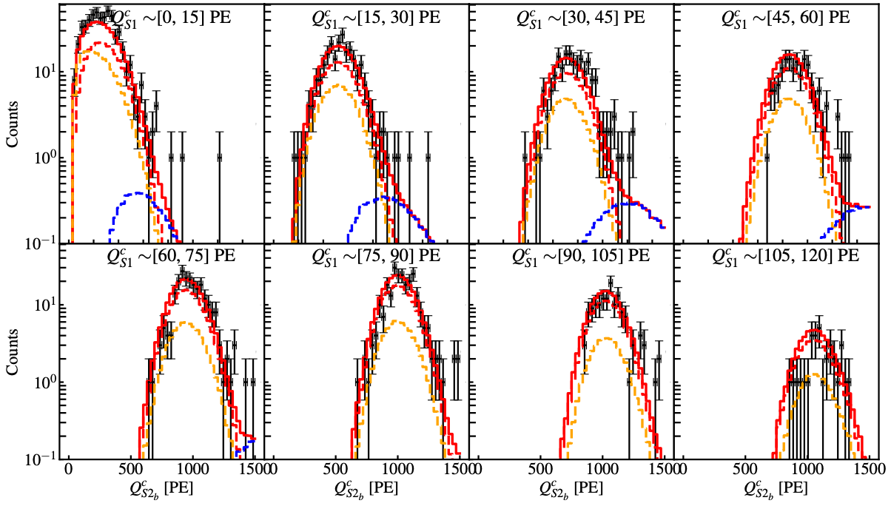
Back up: fit Run1 DD

