Slide 1


Ultra-high light yield scintillation crystals detector based on low-temperature CsI and SiPMs for CEνNS detection
孙希磊
IHEP
2024.05.08 西昌

Slide 2
Outline
Introduction
Successes and Challenges
Ultra-high light yield solutions
Prototype detector performance
Potential for CEvNS
Other Potential Applications
Summary

Slide 3
CEvNS
Theoretical prediction, about 50 years ago
Experimental confirmation, 2017
Akimovet al.,Science357, 1123–1126 (2017)

Slide 4
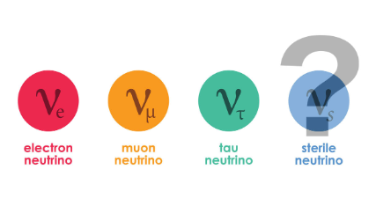
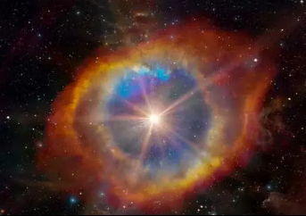
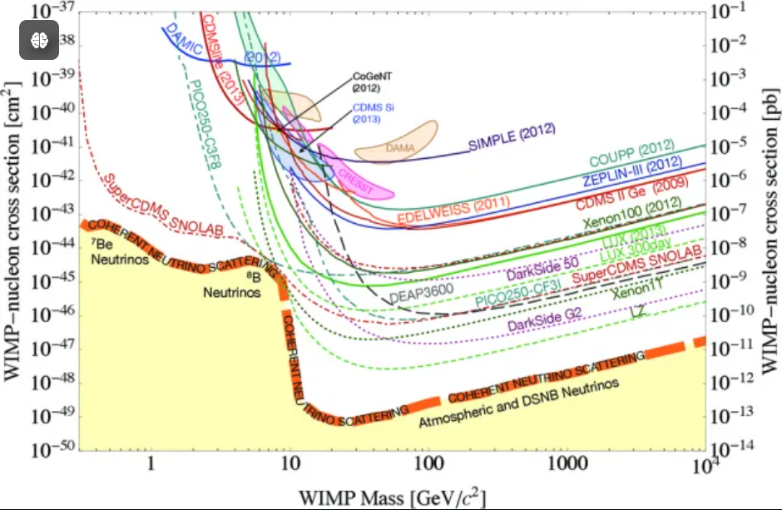
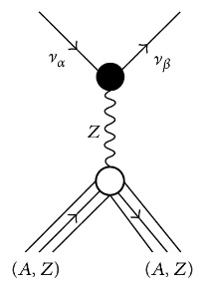
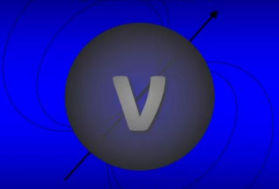
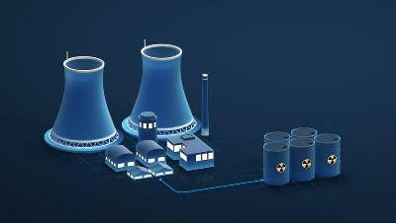
The CEvNS Physics
Rich physics, Eν <50 MeV
Sterile Neutrino Search
Supernova
SM precision tests (Weinberg-angle)
WIMPs direct detection
Neutrino Magnetic Moment
Constrain NSI parameters
Reactor monitoring

Slide 5

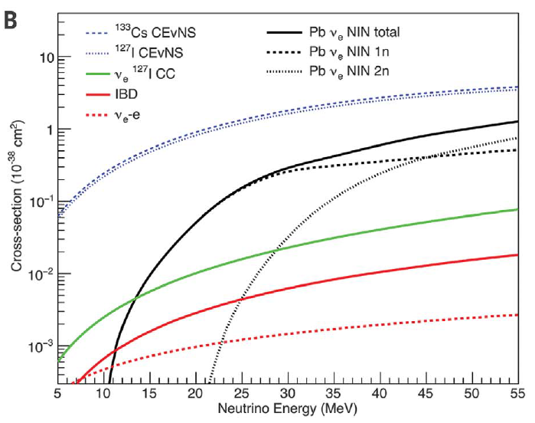
Signals of CEvNS
Nuclear recoil, ~ keVnr to 10’s of keVnr, like WIMPs
Cross section is large ~ 10⁻³⁸ cm², 2 orders larger than IBD
J. Link Science Perspectives
Akimov et al., Science 357, 1123–1126 (2017)

Slide 6
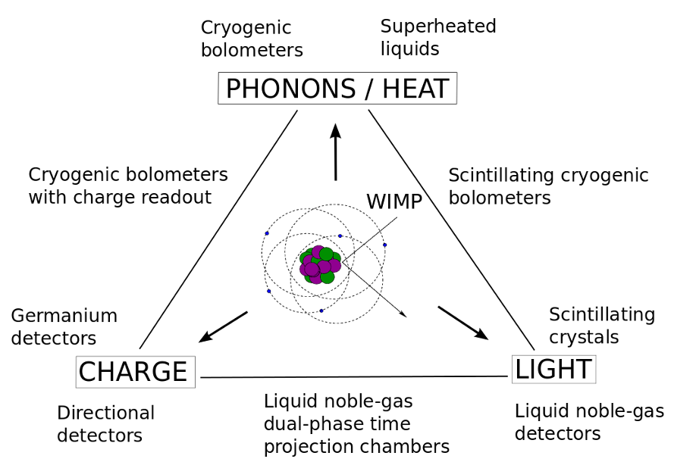
Detection technology of CEvNS
Photons, Phonons, Electrons
The same as WIMPs
ar5iv.labs.arxiv.org/html/1509.08767

Slide 7
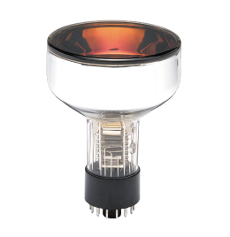
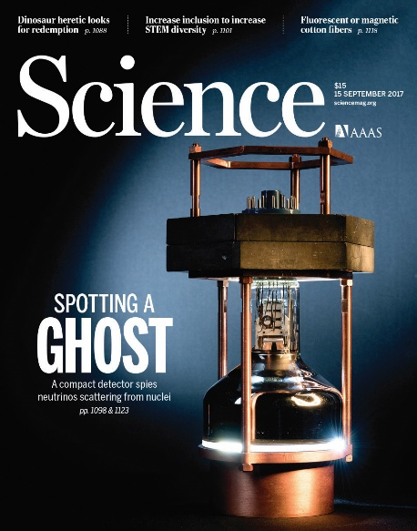
Successes and Challenges
First successful CEvNS detector, CsI(Na)+PMT at RT
Diameter 11 cm, length 34 cm, mass 14.57 kg
LY ~40000 photons/MeV, 420nm
QE ~33%, ~13.3 p.e./keVee
QF ~8.8%, ~1.17 p.e./keVnr
Jonghee Yoo’ report

Slide 8
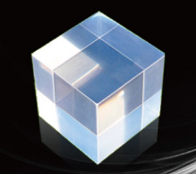
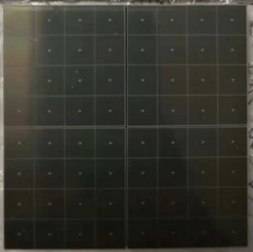

Ultra-high light yield solutions
Low temperature CsI+SiPM+TPB solution
CsI, LY >100000 photons/MeV, 2.5 times better than CsI(Na)
SiPM, PDE 50%-60%, 2 times better than PMT
Expected ~50-60 p.e./keVee
SiPM
TPB（WLS）
CsI
Low temperature

Slide 9
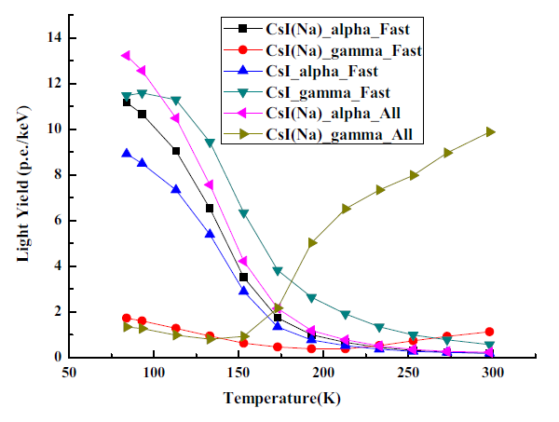
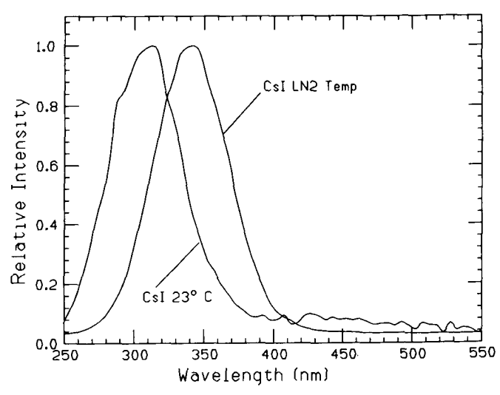
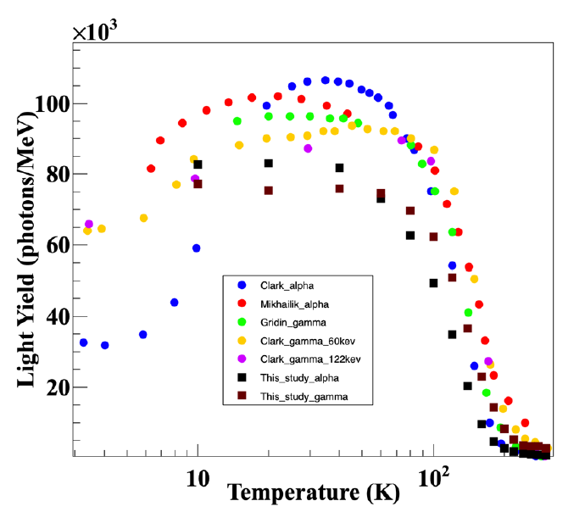
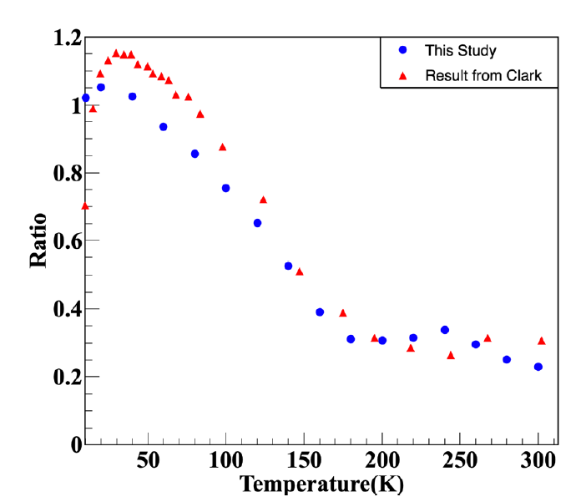
Pure CsI crystals
LY be significantly improved at LT
The brightest scintillator, 310-340 nm
QF>100% for alpha/gamma
QF for nuclear recoil/gamma 10%, 20%???
LY of CsI(Na), CsI(Tl) is reduced at LT
RDTM (2018) 2:15
IEEE TRANSACTIONS ON NUCLEAR SCIENCE, VOL. 37, NO. 2, APRIL 1990
New Physics: Sae Mulli,Vol. 71, No. 5, May 2021, pp. 469475

Slide 10
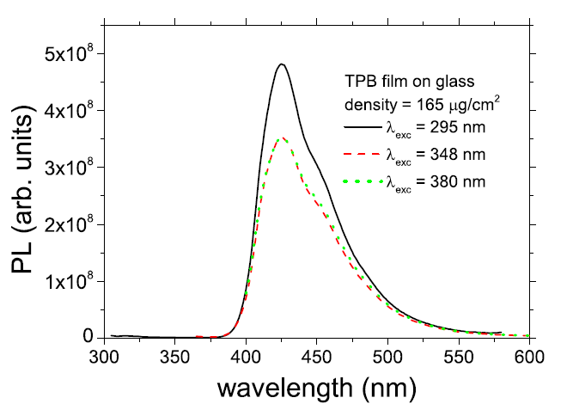
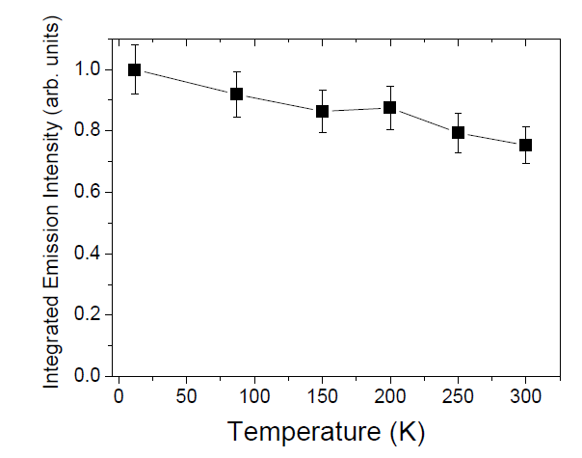
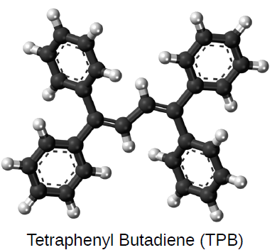
TPB wavelength shifter
Shift 340nm to 420 nm, match the SiPMs sensitive spectrum
Performance is enhanced at LT
Widely used in liquid argon detectors
R Francini et al 2013 JINST 8 P09006

Slide 11
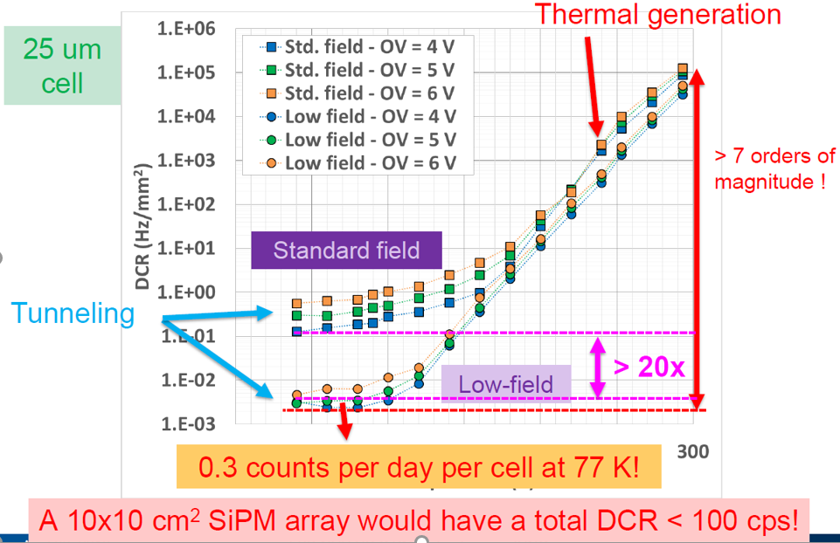
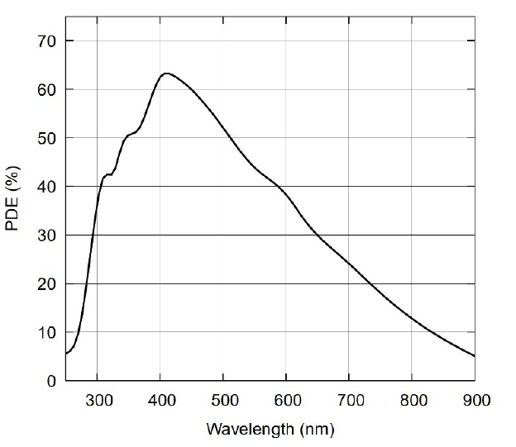
SiPMs Performance
PDE 50-60% at 420 nm
DCR reduced by 7 orders, < 0.01 CPS/mm² at 77K
Optical cross talk, acts as a photon amplifier
AFBR-S4N66P014M NUV-MT Silicon Photomultiplier
Alberto Gola FBK

Slide 12
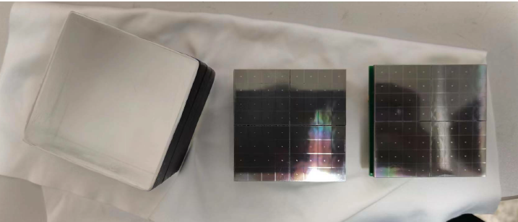
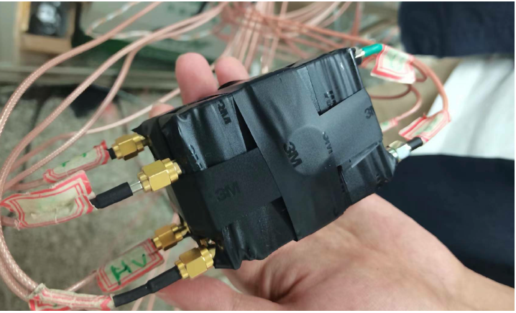
Prototype detector
CsI crystal 5x5x5 cm, 0.56kg, polished
Packaging with Teflon reflective film without TPB
SiPMs array, 5x5 cm, two end readout, with TPB
Cooling to 77 K with liquid nitrogen
Low temperature front-end amplifier circuit

Slide 13
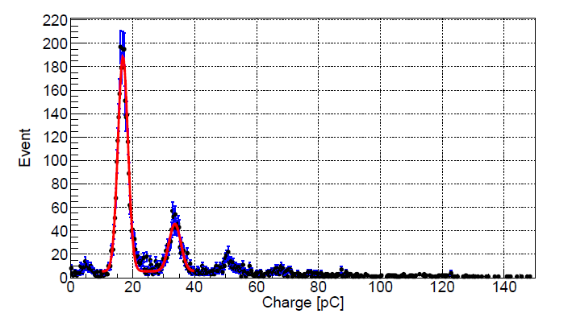
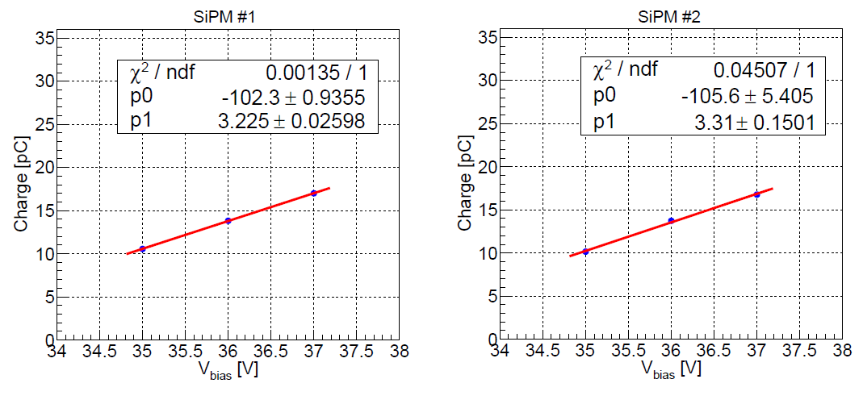
SiPMs array performance
SiPM and preamplifier run stably at low temperatures
Single photoelectron resolution is very good
Consistency of the two arrays is very good
DCR ~0.1 Hz/mm² @35V bisa
Eur. Phys. J. C (2024) 84:440

Slide 14
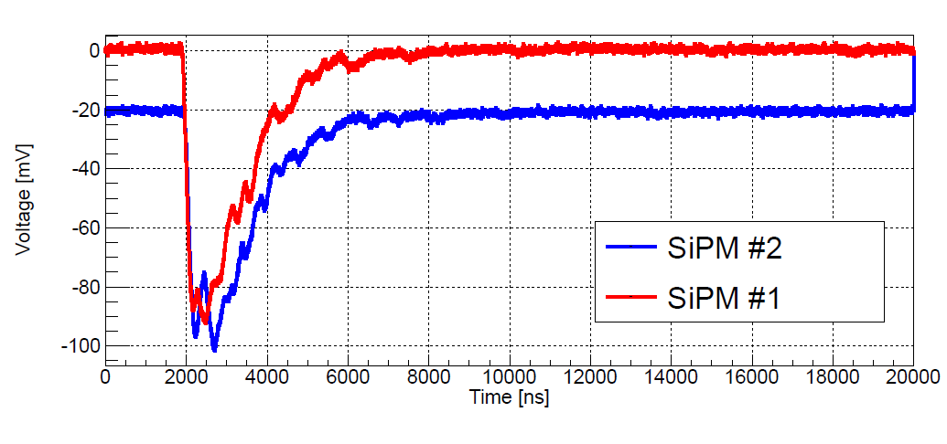
Waveform performance
Decay time ~1 µs, Pulse Width ~3 µs
Baseline width <5 mV
Eur. Phys. J. C (2024) 84:440

Slide 15
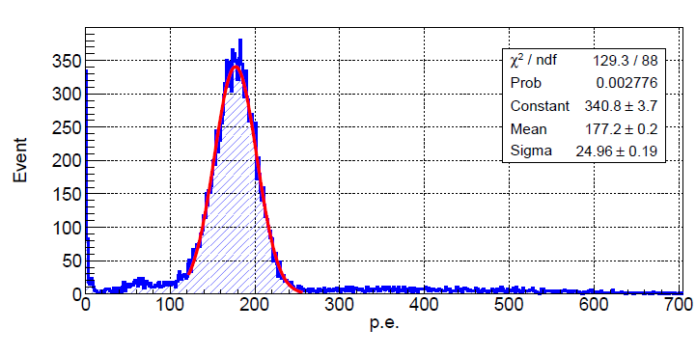
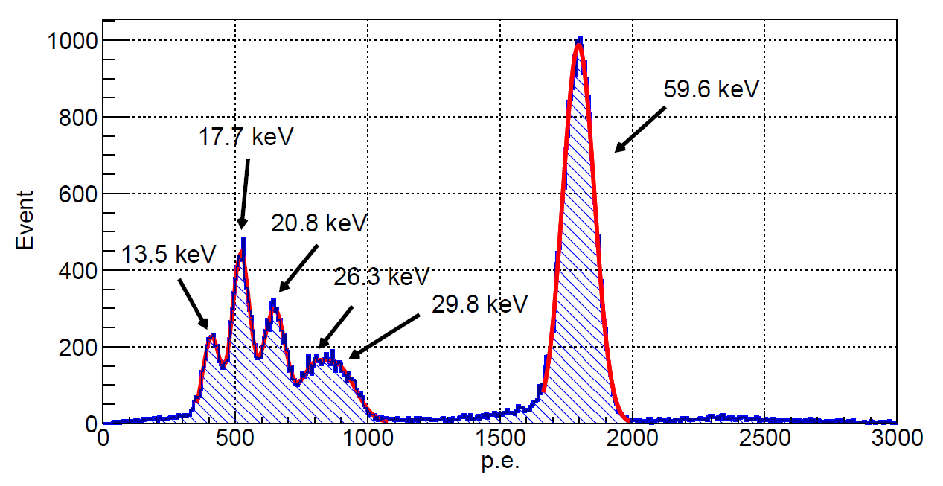
Energy spectrum
Test with ²⁴¹Am and ⁵⁵Fe
Excellent energy resolution, fine structures are clearly visible
Eur. Phys. J. C (2024) 84:440

Slide 16
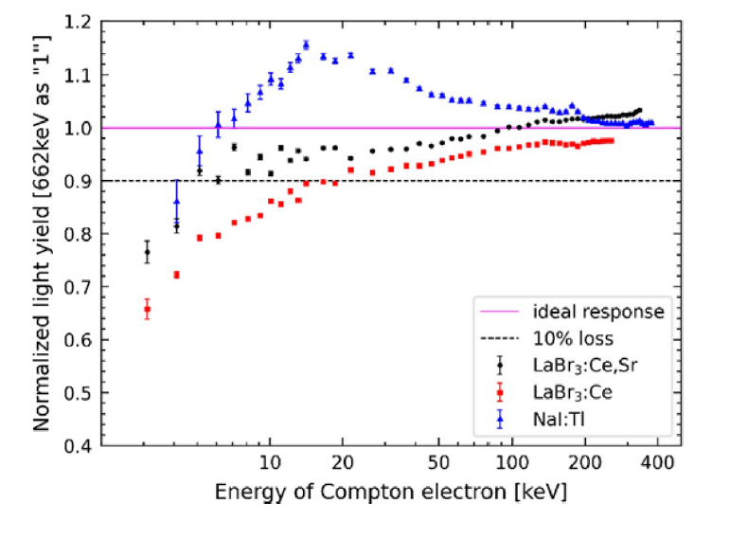
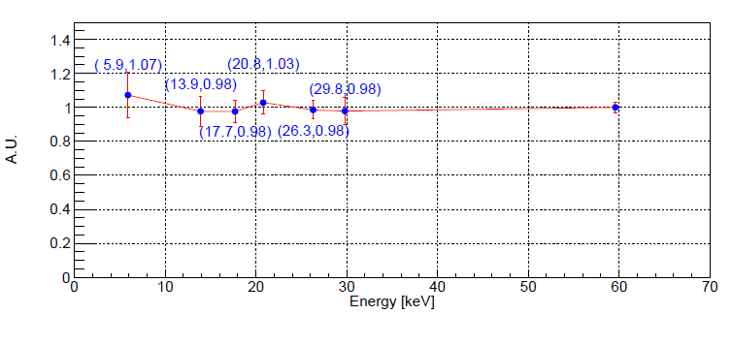
Luminescence linearity
Excellent luminescence linearity, no drop down below 10keV
Significantly better than LaBr₃, NaI:Tl
Nuclear Science and Techniques (2024) 35:23
Eur. Phys. J. C (2024) 84:440

Slide 17
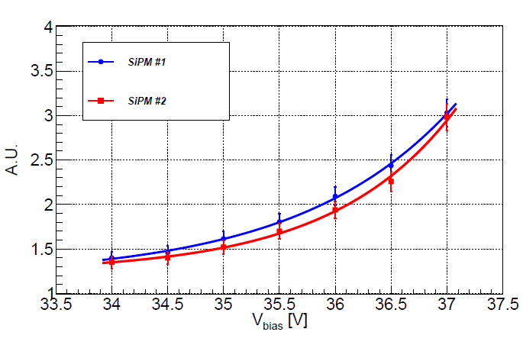
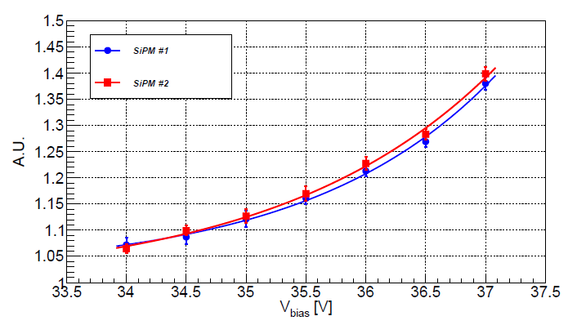
Influence of SiPMs Cross Talk and After Pulse
CT, AP significantly increasing the measured p.e. number
Internal CT, AP triples the number of p.e. at 37 V_{bias}
External CT 1.4 times the number of p.e. at 37 V_{bias}
Eur. Phys. J. C (2024) 84:440

Slide 18
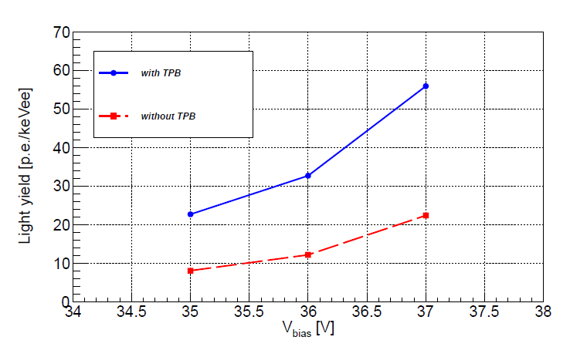
Influence of TPB
Photoelectrons number is doubled with TPB
Eur. Phys. J. C (2024) 84:440

Slide 19
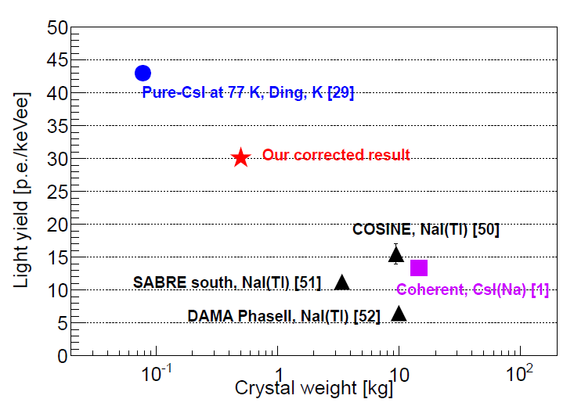
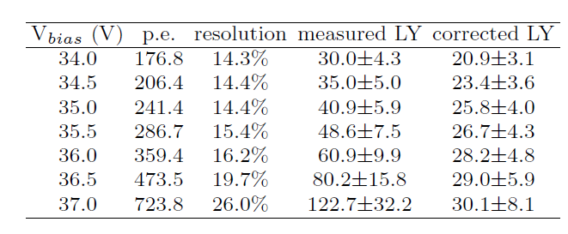
Light yield
The measured p.e. number increases significantly with increasing bias voltage, 30 to 122 p.e. /keVee
122.7 p.e./keVee, a world record
30.1 p.e./keVee, after CT subtract (50% PDE at LT?)
Eur. Phys. J. C (2024) 84:440

Slide 20
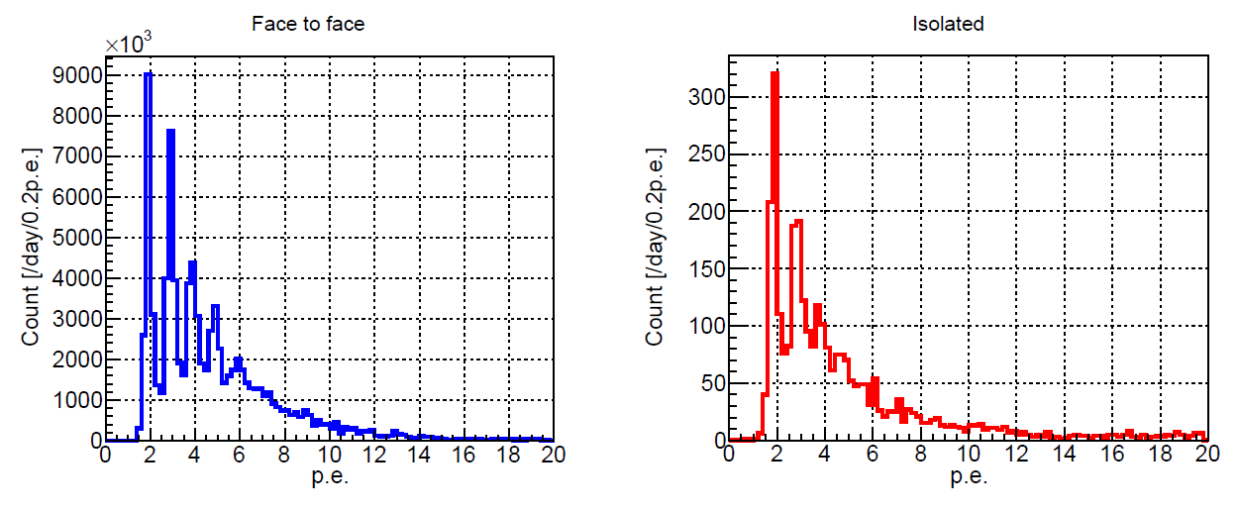
Issue of SiPMs eCT coincidence events
Events rate of eCT coincidence is very high
5 orders larger than accidental coincidence of DCR
Big issue for low threshold detectors
Need do further study, single-ended readout, correlation with iCT
Eur. Phys. J. C (2024) 84:440

Slide 21
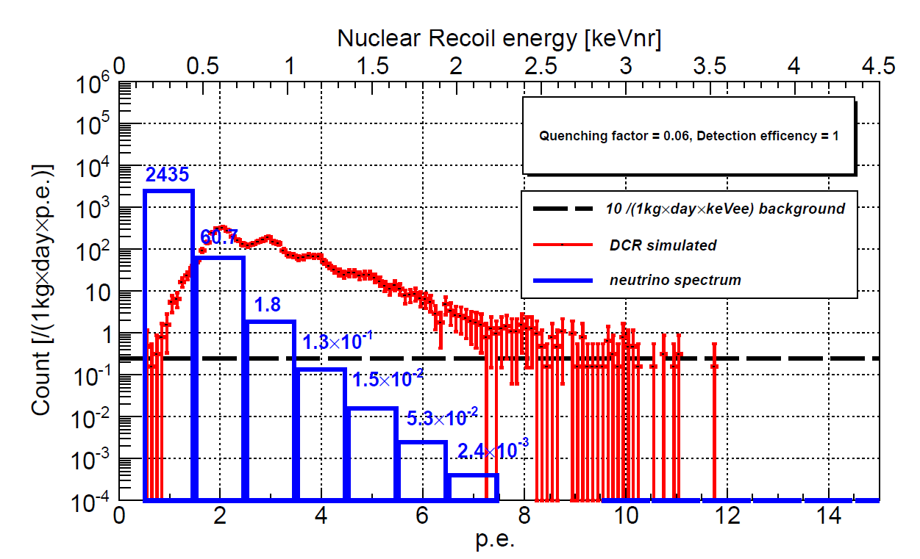
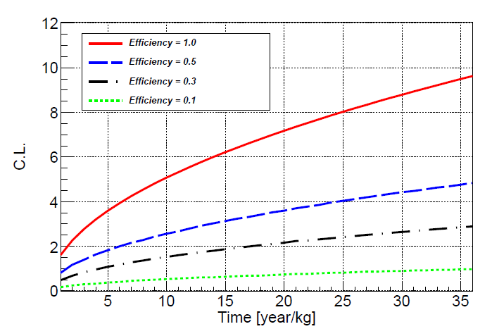
Potentials for the reactorCEvNS detection
35 m distance to 4.6 GW^{th} reactor
Threshold 2 p.e.
QF=0.06, DCR= 0.1 CPS/mm², DCR dominant background,
Eur. Phys. J. C (2024) 84:440

Slide 22
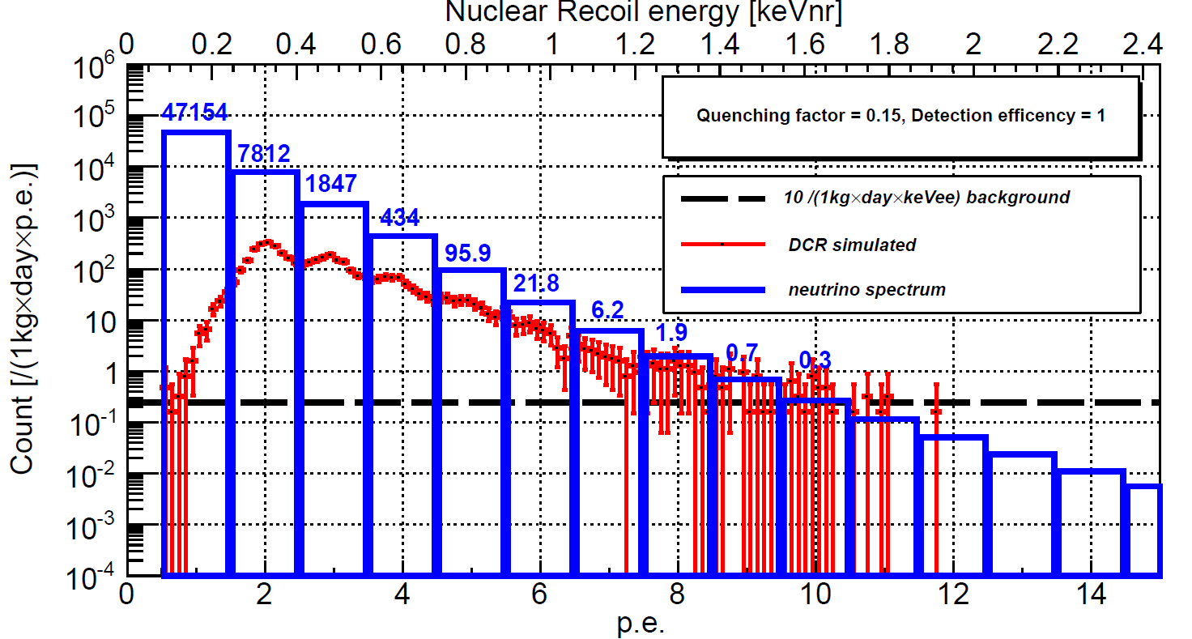
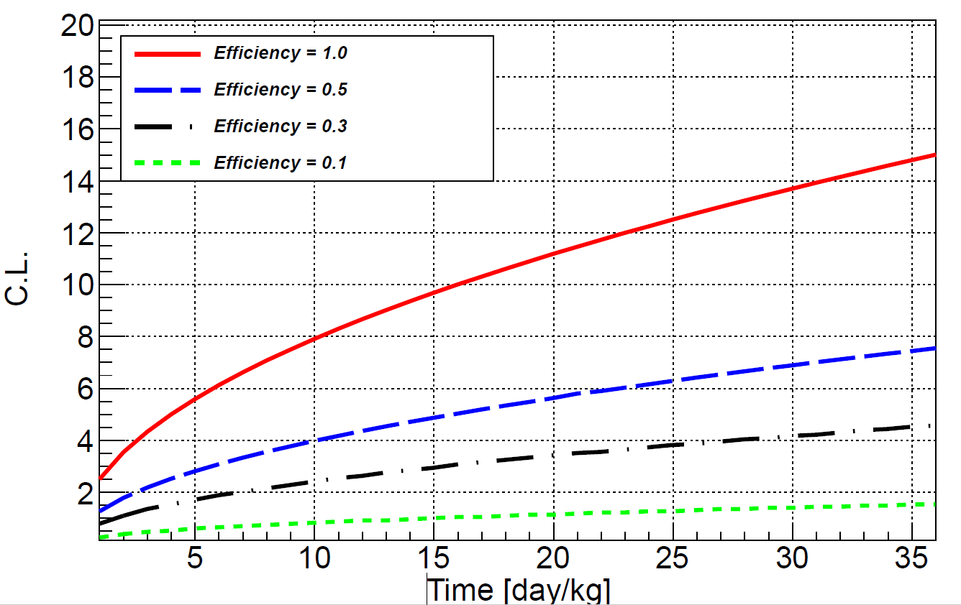
Potentials for the reactor CEvNS detection
35 m distance to a 4.6 GW^{th} reactor
Threshold 2 p.e
If QF ~15%?, DCR~0.01?, better sensitivity
Good chance for reactor CEvNS observation
With 10⁴ eCT coin
Preliminary
Preliminary

Slide 23
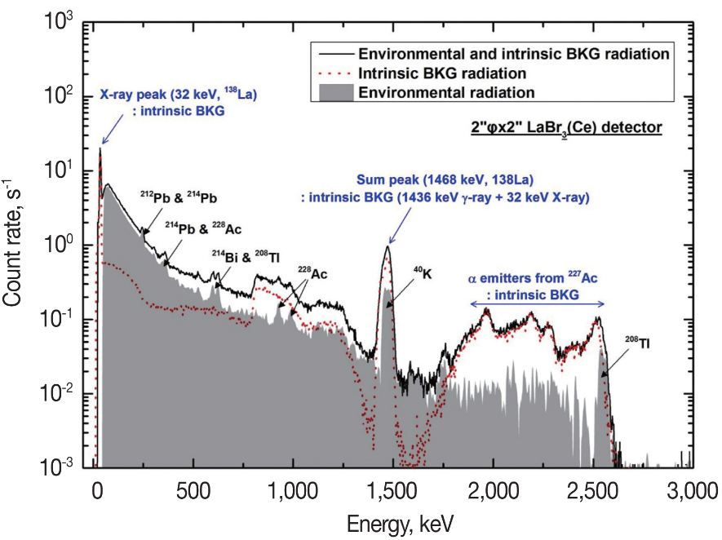
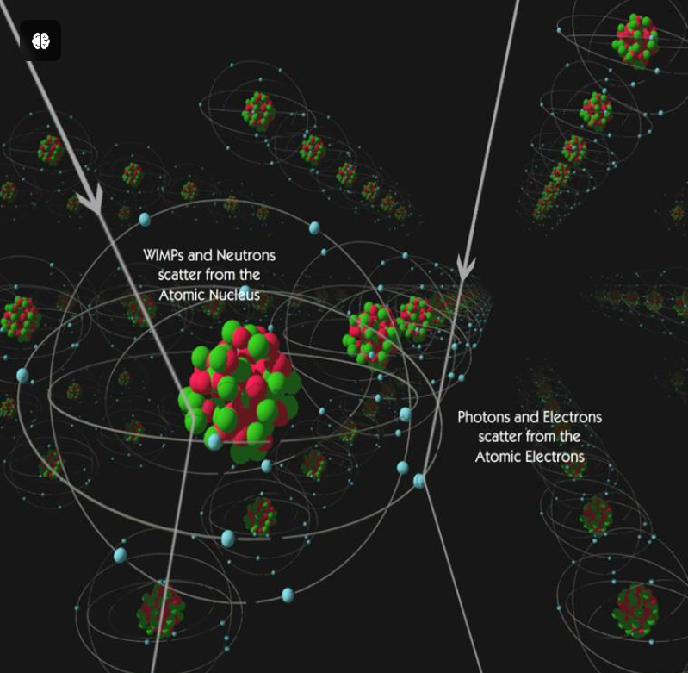
Other Potential Applications
Dark matter searches, better than RT NaI(Tl), CsI(Tl)
Gamma ray spectrometer, no intrinsic BKG like LaBr₃
Journal of Radiation Protection and Research 2018; 43(3): 85-96
UNIVERSITY OF CALIFORNIA, BERKELEY

Slide 24
Summary
Rich physics with CEvNS, very challenging
Ultra-high light yield solution is proposed
The prototype detector works well
eCT issue need further study
Application potential remains to be developed
Good chance for reactor CEvNS detection

Slide 25
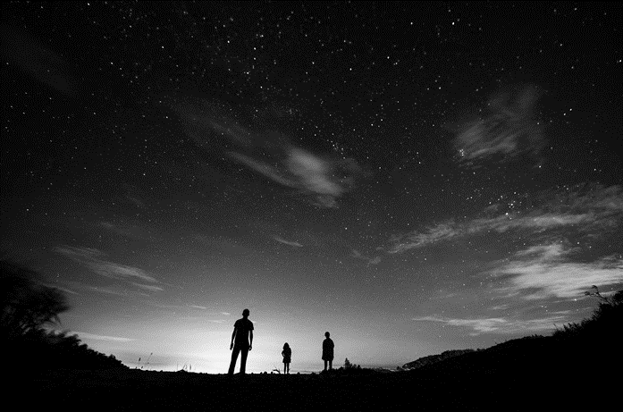
Thank you for your attention!

Slide 26
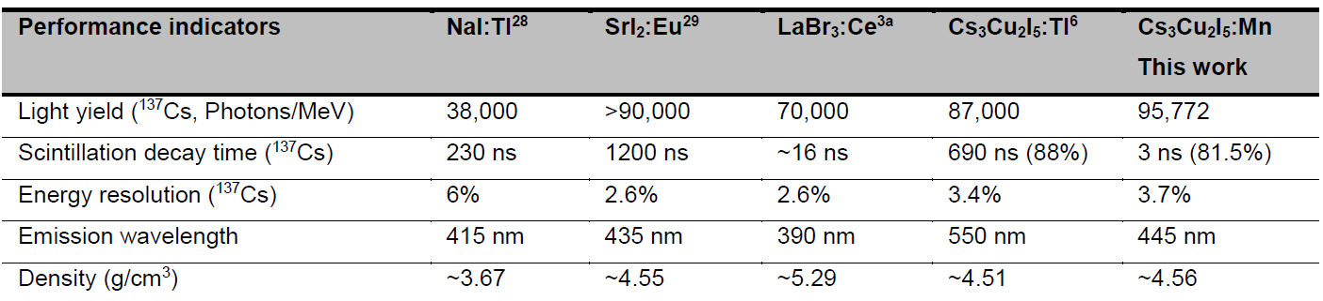
Summary
DOI: 10.1002/adma.202304938

Slide 27
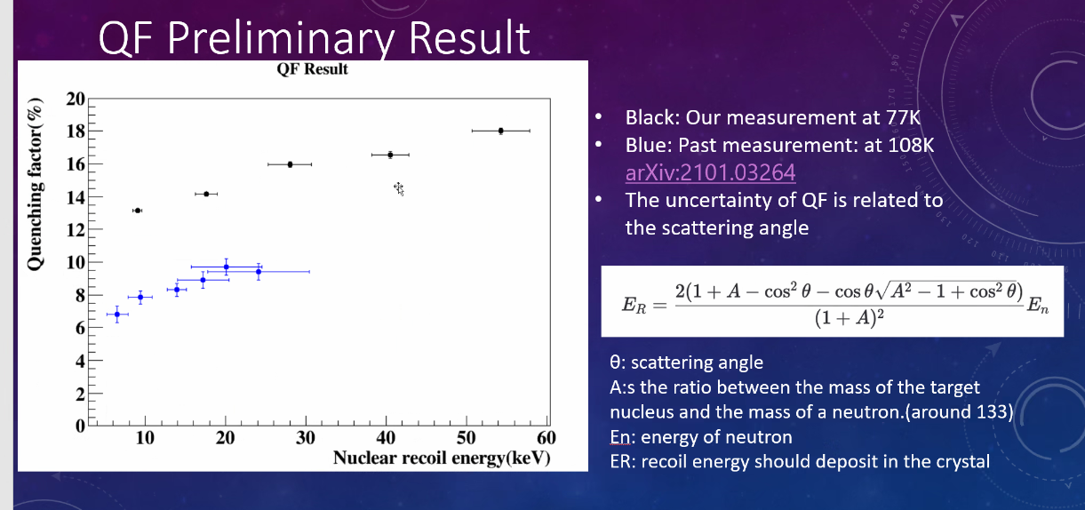
From Jing Liu

