Slide 1


Veto Development for the PandaX Experiment
Junting Huang for the PandaX Collaboration
Shanghai Jiao Tong University
COUSP Conference, Xichang, 2024

Slide 2
Outline
introduction
detector installation
Geant4 optical simulation
cold liquid scintillator R&D
Notes:
自从上次合作组会：
安装，高压，读出，触发，数据存储方式，270全部读出的读出板问题
模拟：几何，反符合效率
低温液闪：大装置，小装置，光纤
水基液闪：与mingfang的讨论

Slide 3
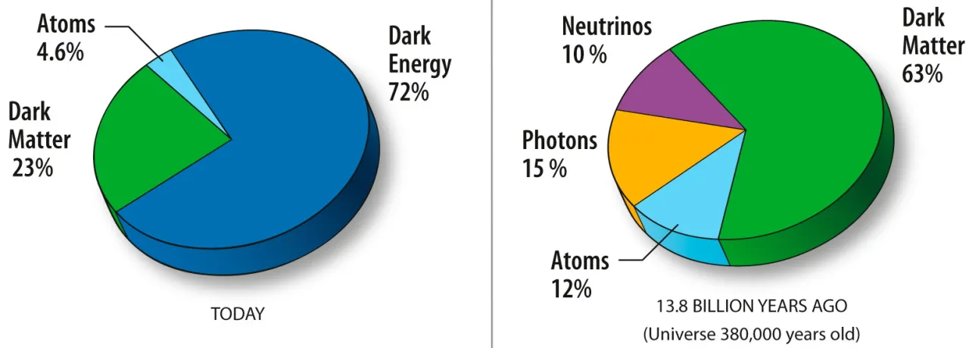
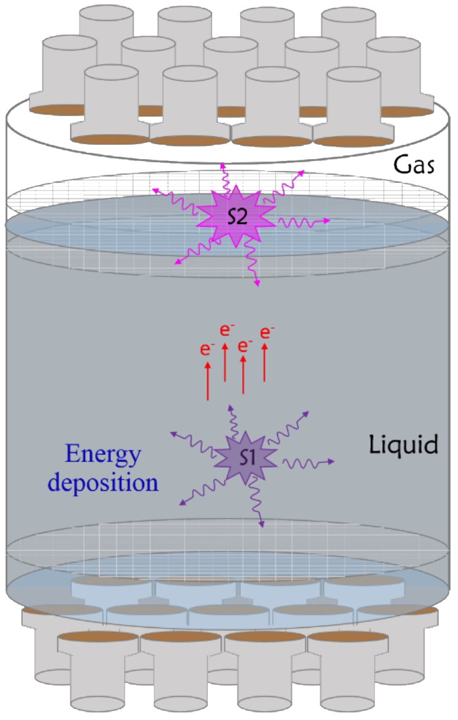
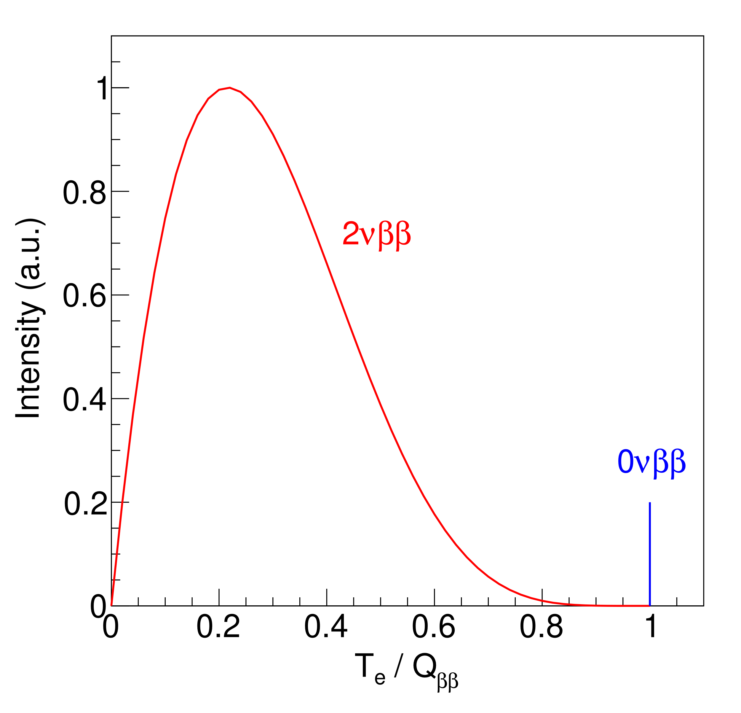
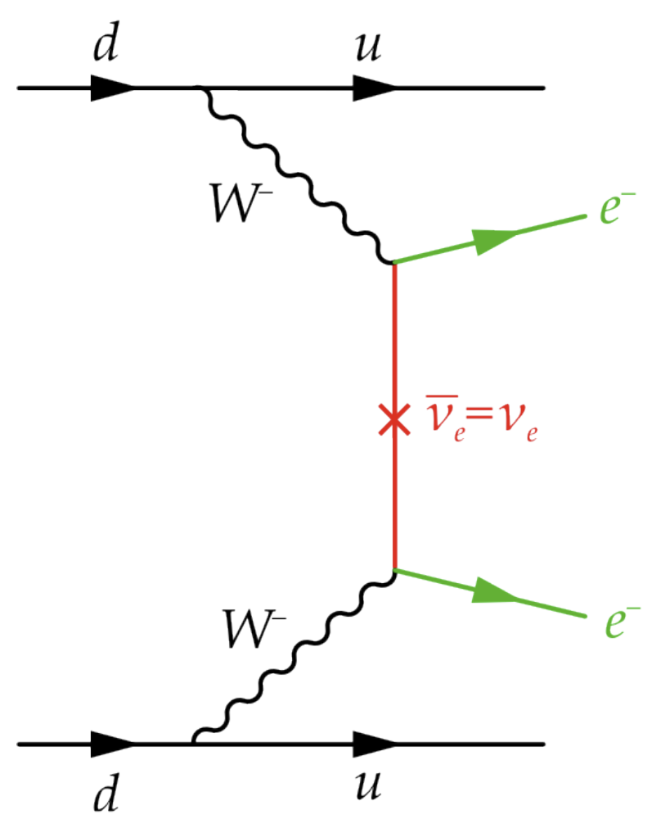
PandaX Experiment
nature of dark matter and neutrinos
liquid xenon (LXe) time projection chamber, multi-purpose
  search for weakly interacting massive particles（WIMPs）
  search for ¹³⁶Xe neutrinoless double-beta decay（0νββ）

Slide 4
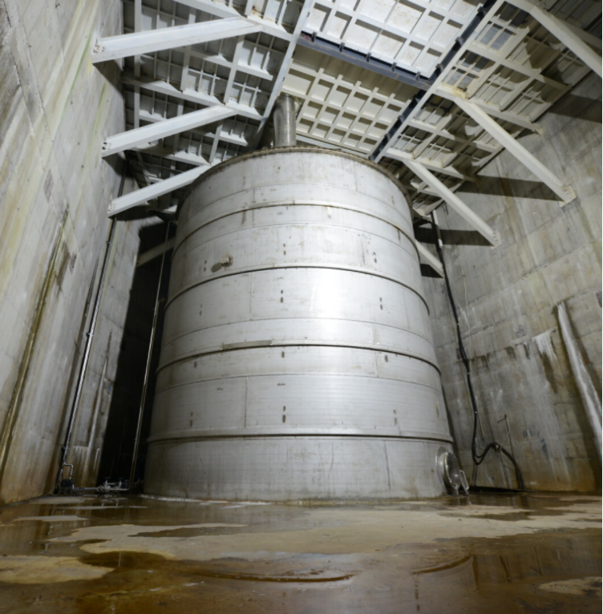
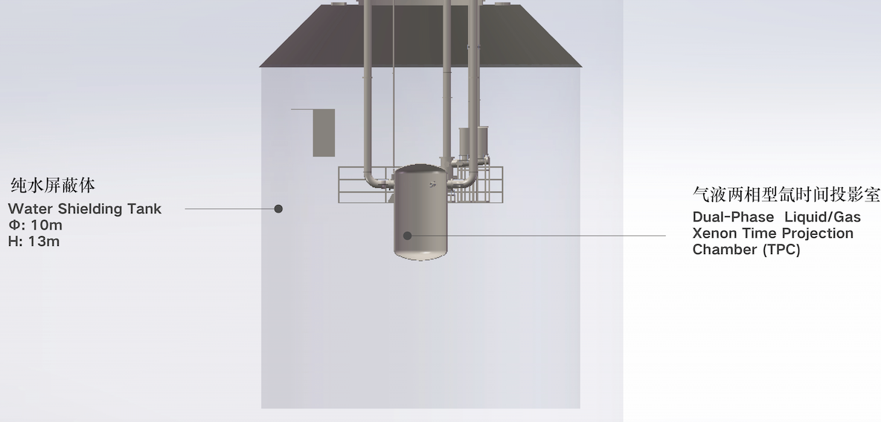
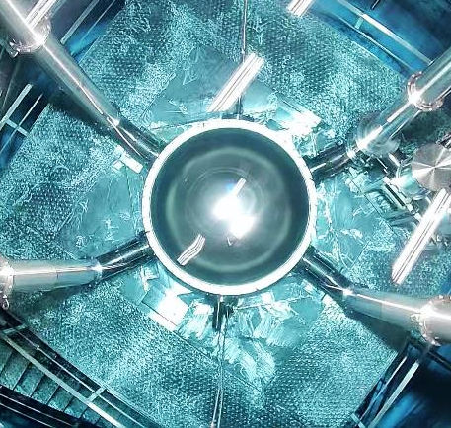
Water Shielding in PandaX
use 0.9 kton water in a stainless steel tank to shield environmental gammas and neutrons
liquid xenon detector is located at the center of the water shielding

Slide 5
Background: Gamma, Neutron, Cosmic Ray
muon
neutron
cryostat
liquid xenon
WIMP
gamma
atmospheric neutrinos
β
β
neutron

Slide 6
Upgrade Water Shielding into a Veto Detector
instrument the water shielding with PMTs to form an active veto for gammas, neutrons, and cosmic rays
water-based liquid scintillator, cold liquid scintillator
water shielding
liquid xenon detector
1. neutrons and gammas
cryostat
2. muons and atmospheric neutrinos
inner layer PMT
3. cold liquid scintillator veto R&D
outer layer PMT

Slide 7
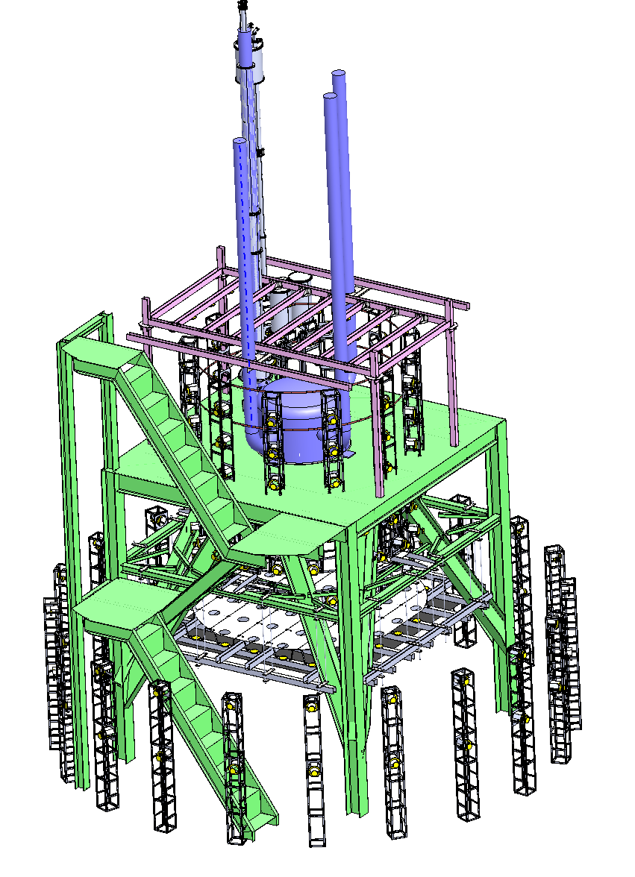
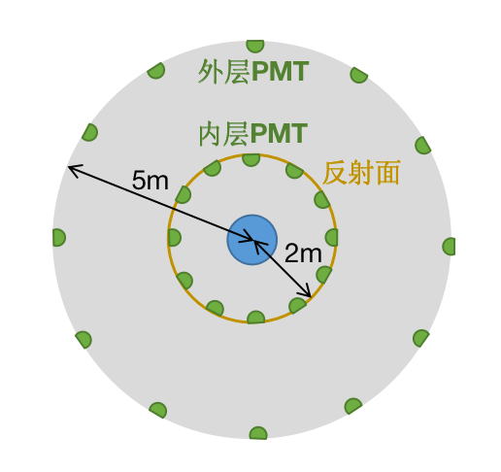
Upgrade the Water Shielding into a Veto
installed 270 8-inch PMTs in late 2023
inner layer: 2 m radius, about 1 m to the outer surface of the LXe cryostat
outer layer: 5 m radius

Slide 8
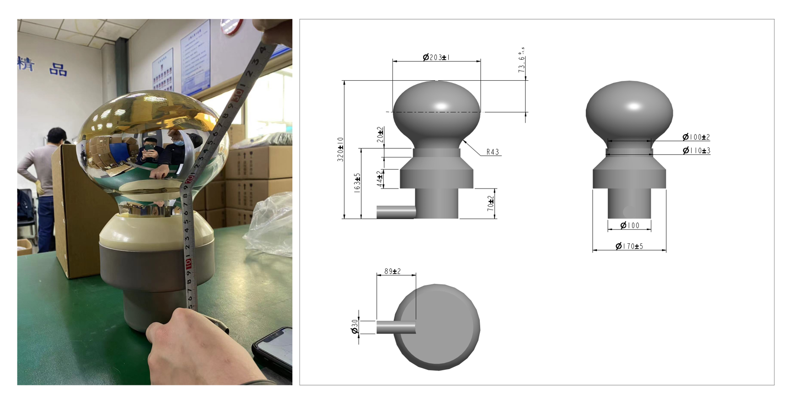
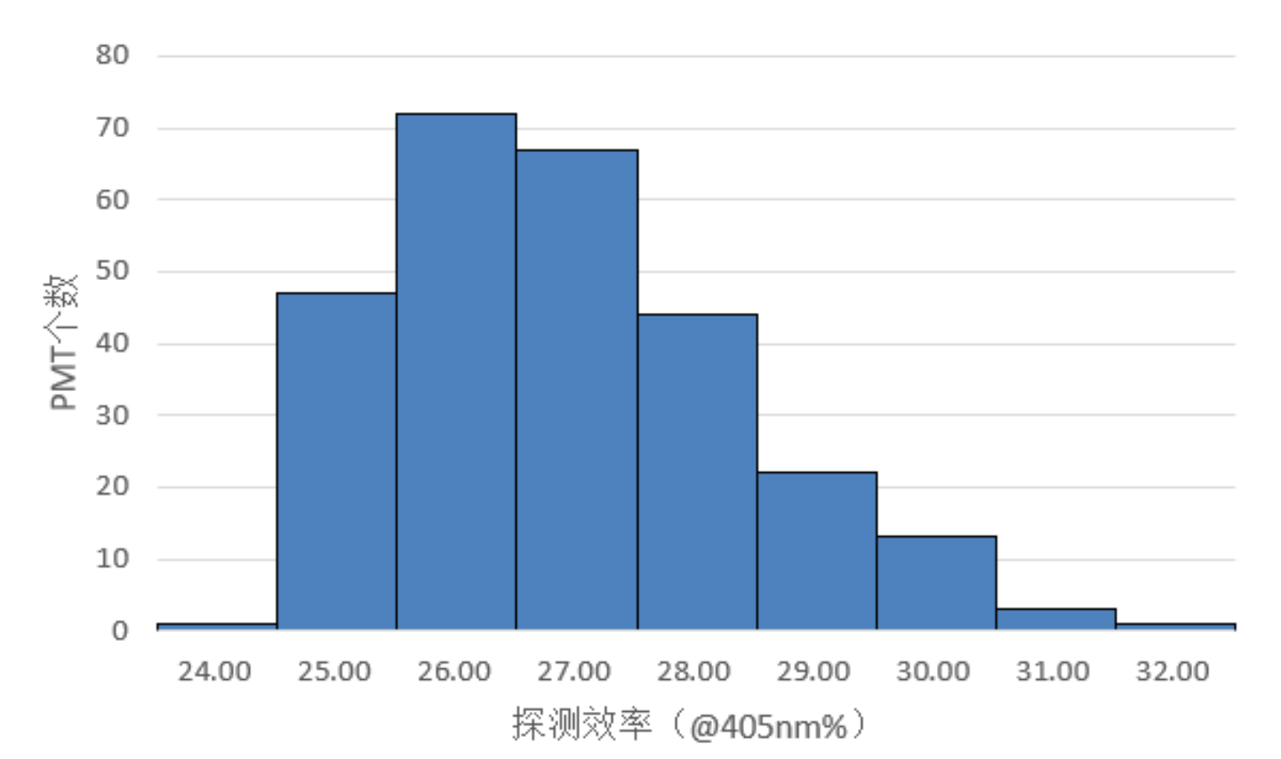
8-inch MCP PMTs from NNVT

Slide 9
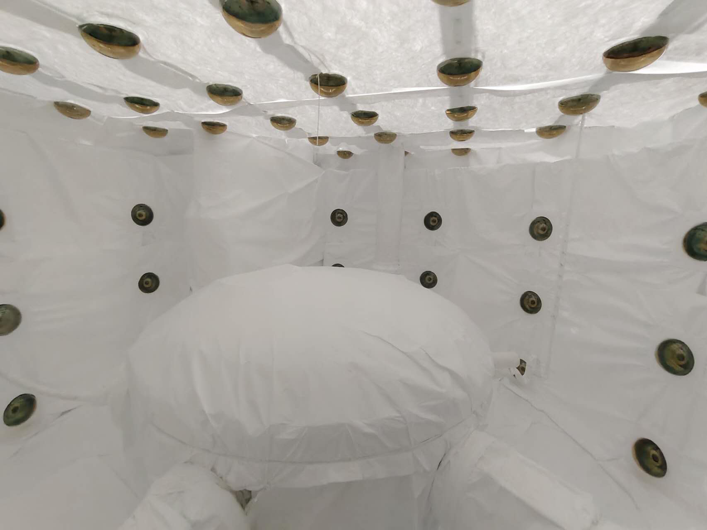
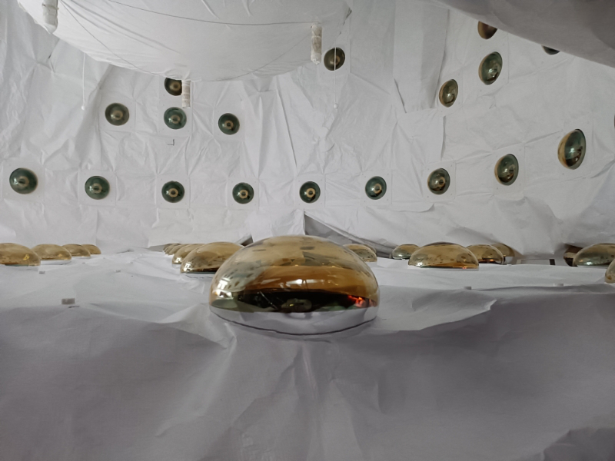
Neutron and Gamma Veto
inner layer: 165 PMTs, divided by the platform, optically decoupled
use Tyvek paper to increase light detection efficiency
above the platform
below the platform

Slide 10
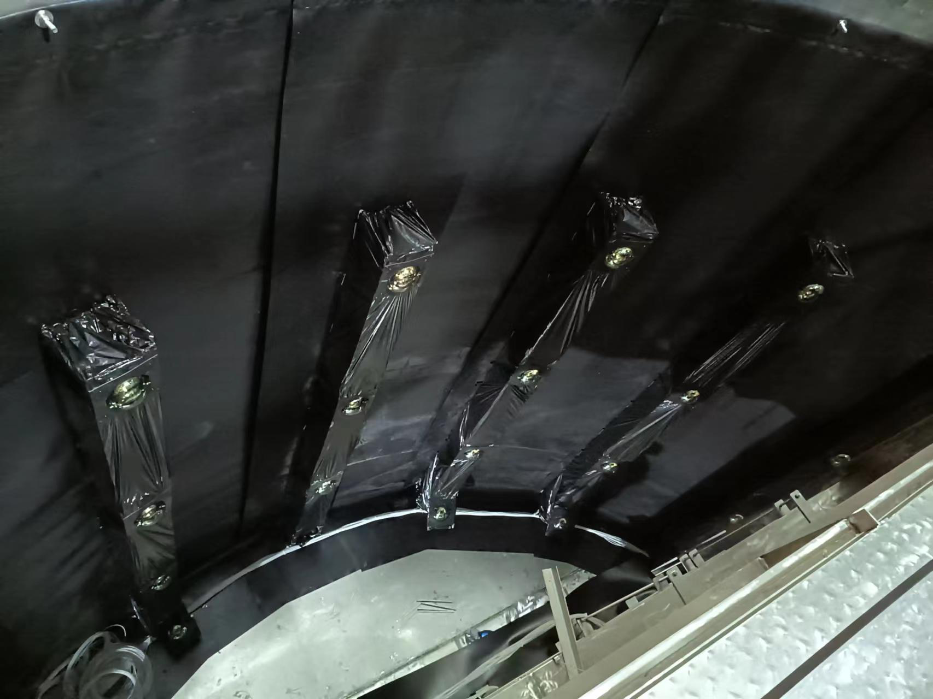
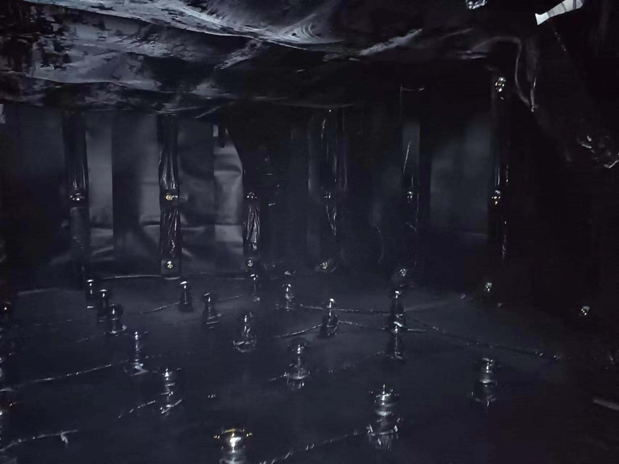
Cosmic Ray Veto
outer layer: 105 PMTs, side and bottom
use black PEs to reduce reflections for better timing measurement
side of the water tank
bottom of the water tank

Slide 11
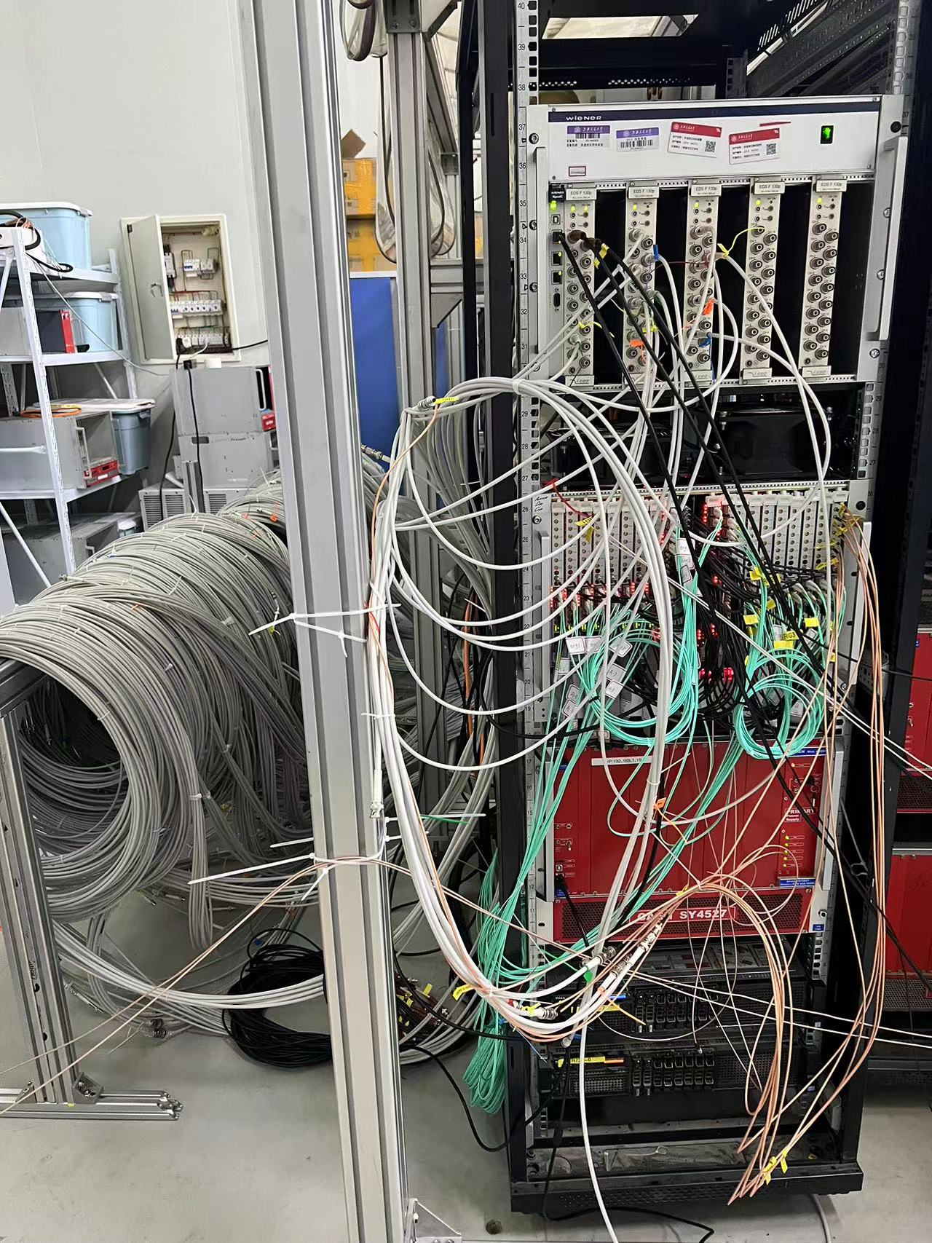
Readout
ADC boards: made in SJTU (Yong Yang), 500 MHz sampling rate, 16 boards (128 channels) available, the rest will put in production this year
trigger boards: made in SJTU (Yong Yang), sliding window, total charge in 40 ns, under testing
DAQ control: together with LXe detector to ensure synchronization
data saving: separate from LXe detector, working in progress

Slide 12
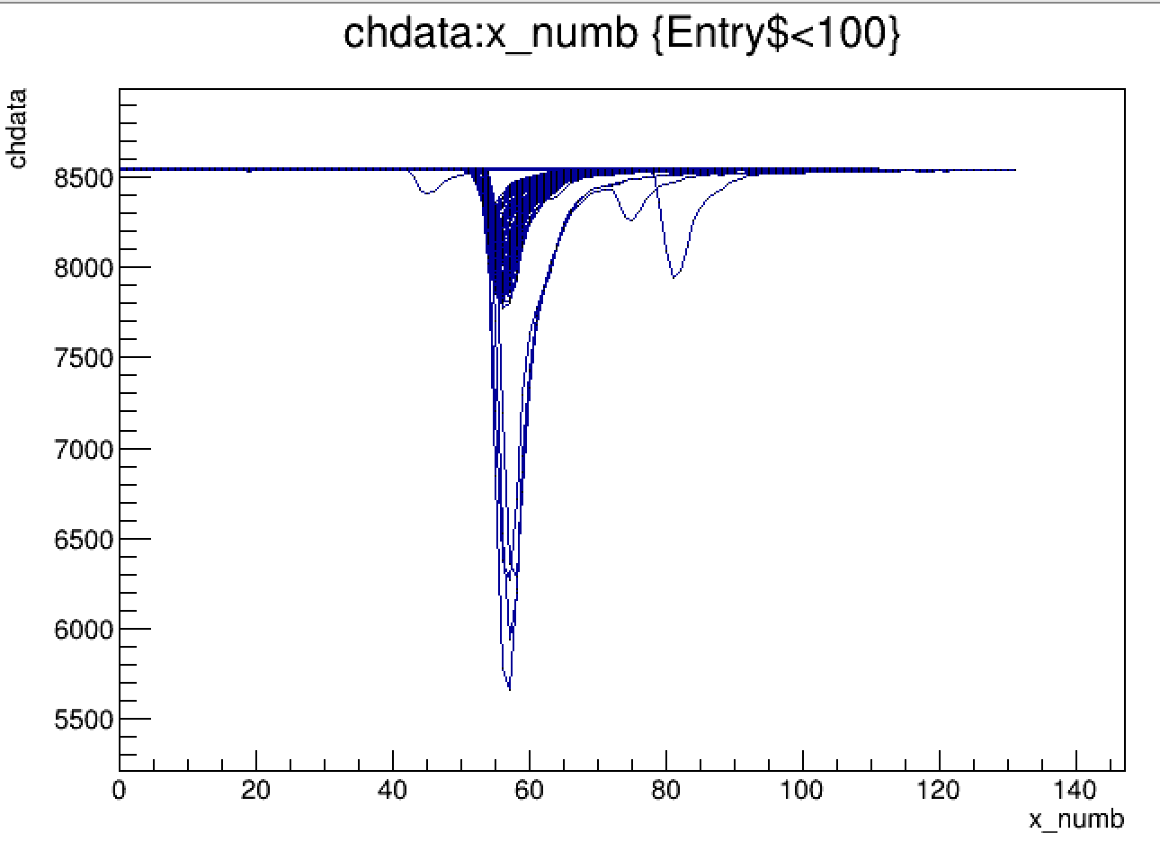
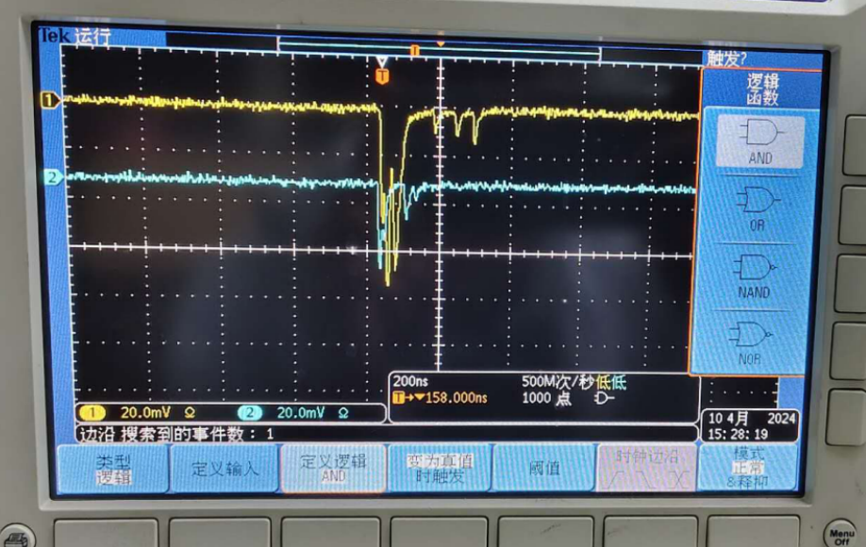
Waveforms
can see coincidences every 10-20 seconds with oscilloscope
self-triggering test: 30 ADC threshold, 8 channels, bandwidth is about 13 MB/s, single channel trigger rate 4-20 kHz

Slide 13
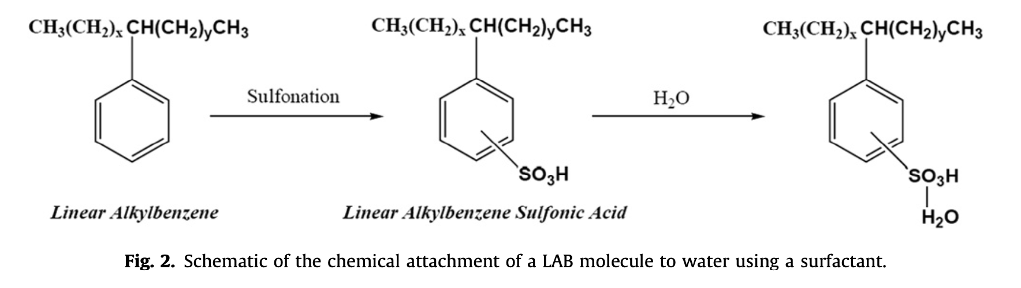
Upgrade with Water-Based Liquid Scintillator
currently, 0.9 kton water Cherenkov detector
hope to blend 5% water-based liquid scintillator (WbLS) to improve veto efficiency
possible source from BNL (Minfang Yeh)
an early formula for WbLS, NIM A 660 (2011) 51, M. Yeh et al.

Slide 14
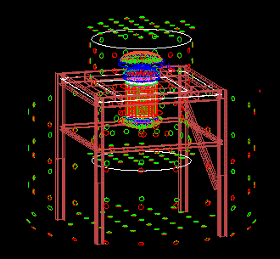
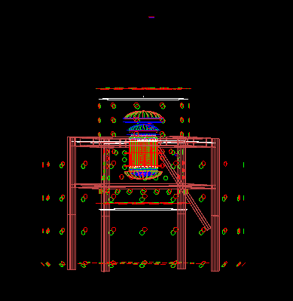
Optical Simulations in Geant4

Slide 15
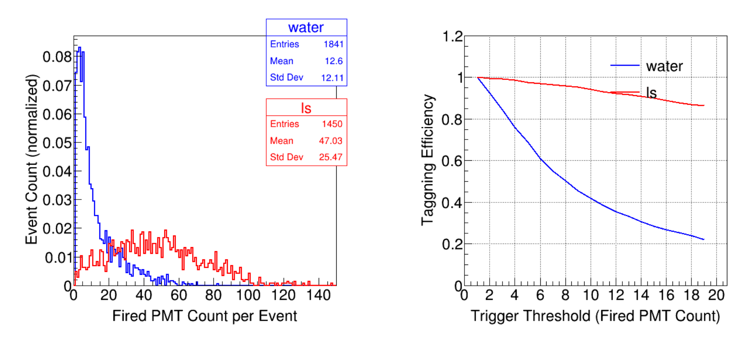
Neutron Veto Efficiency
neutrons from ²³⁸U fission in LXe container, > 1 keV in LXe
WbLS: 500 photons / MeV (about 5% blending)

Slide 16
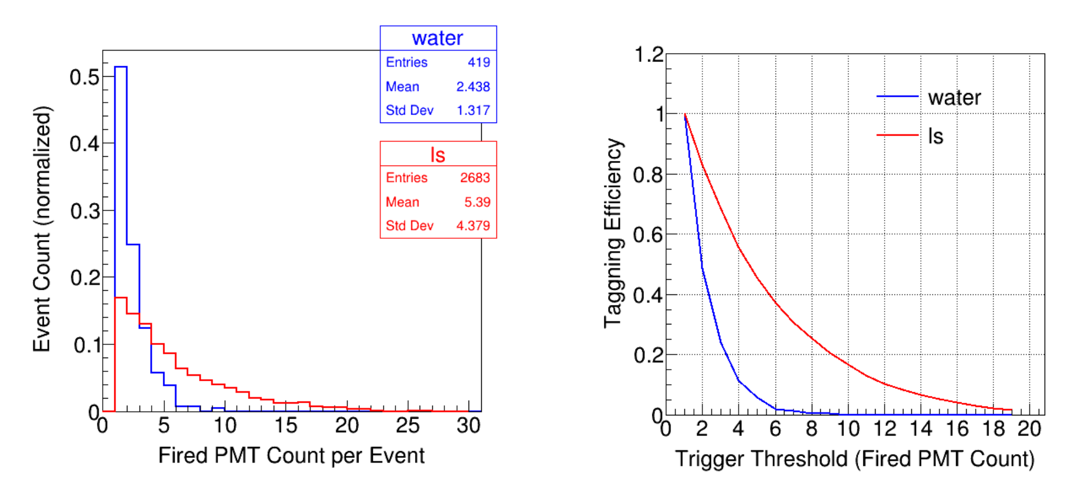
Gamma Veto Efficiency
simulated gammas from ²³⁸U decay in LXe container
the efficiency is much lower compared to that of neutron

Slide 17
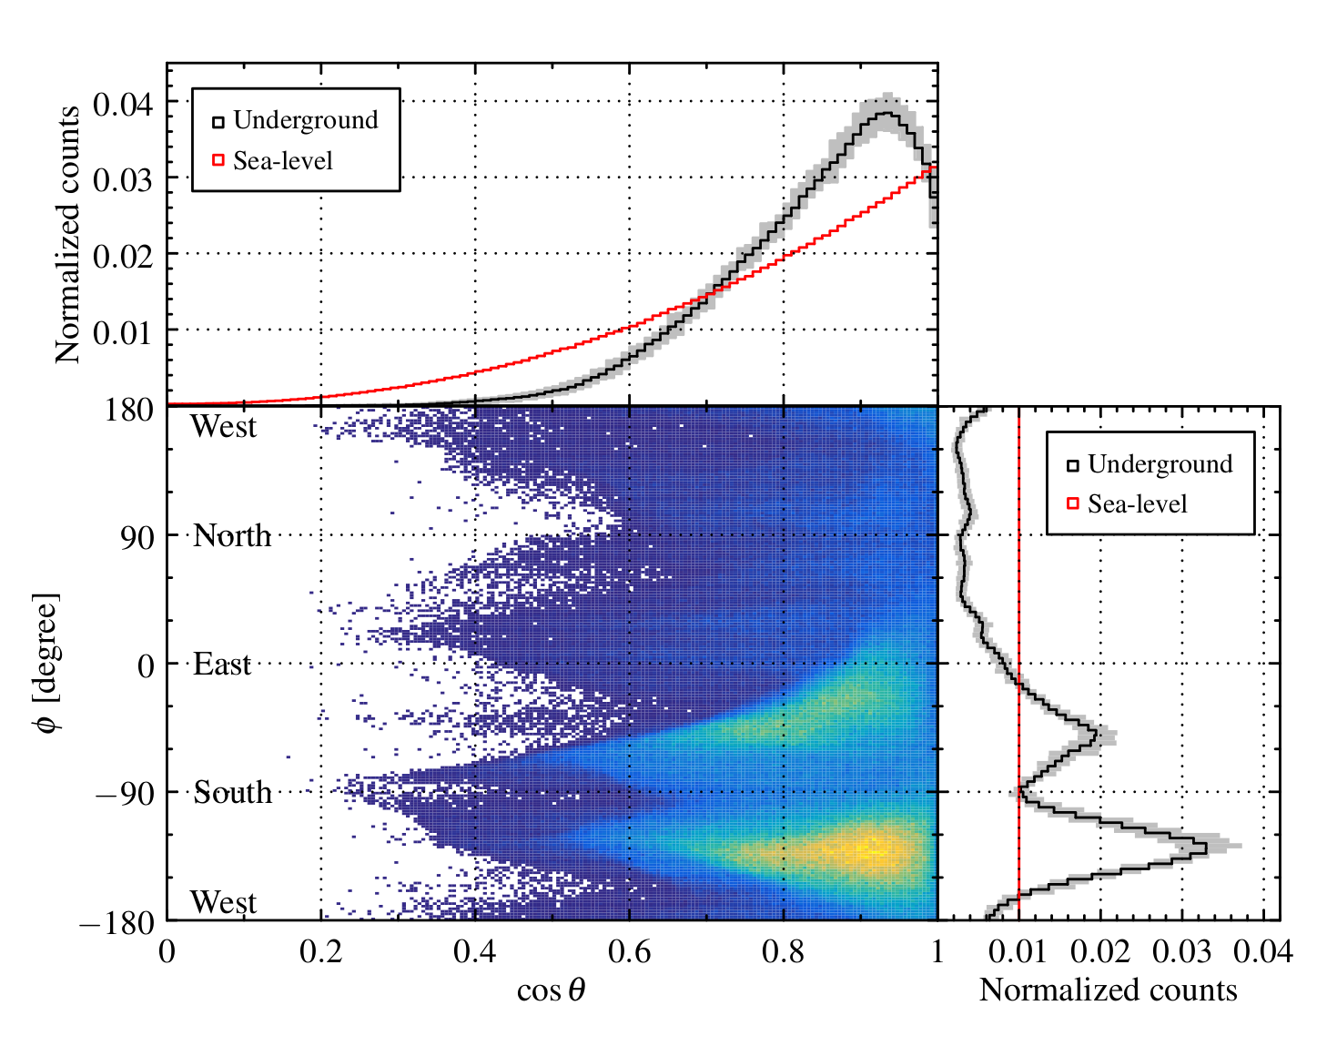
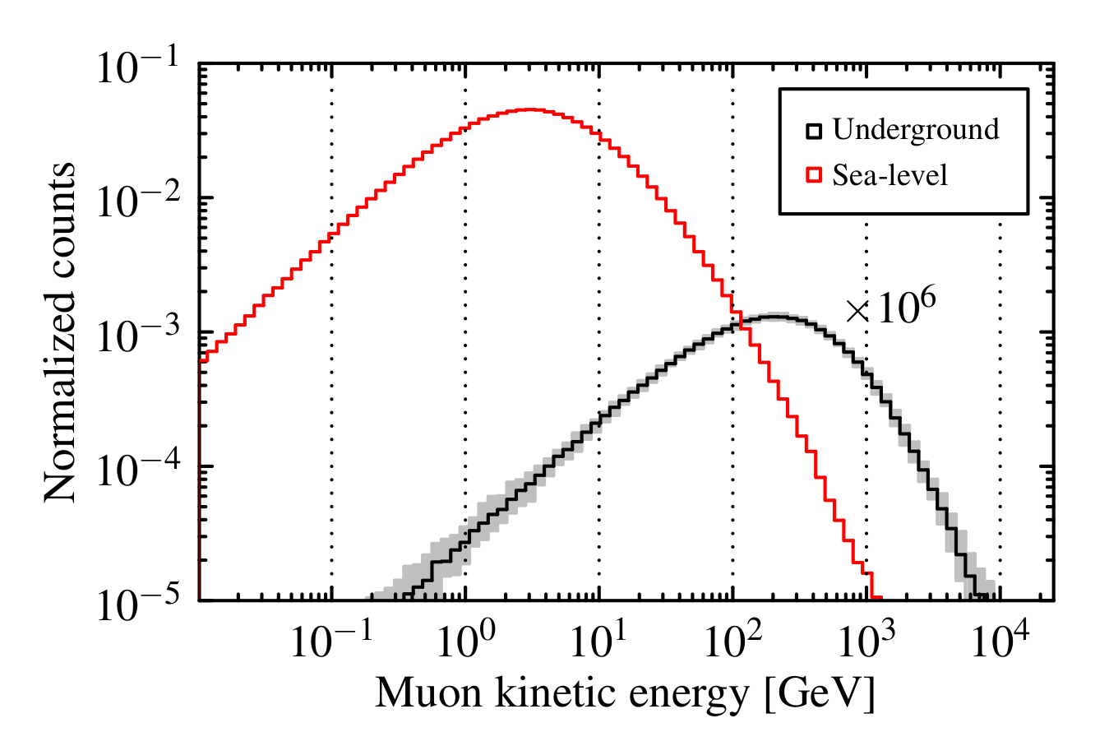
Muon Simulation
Ziyi Guo et al. arXiv:2007.15925
sampled the energy and theta distribution, assume flat phi distribution for an approximation

Slide 18
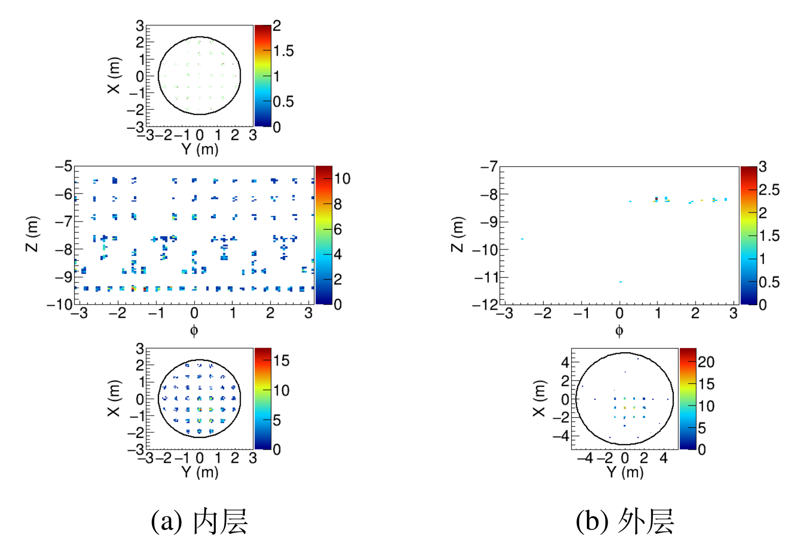
Event Display of a Muon Event
inner layer
outer layer

Slide 19
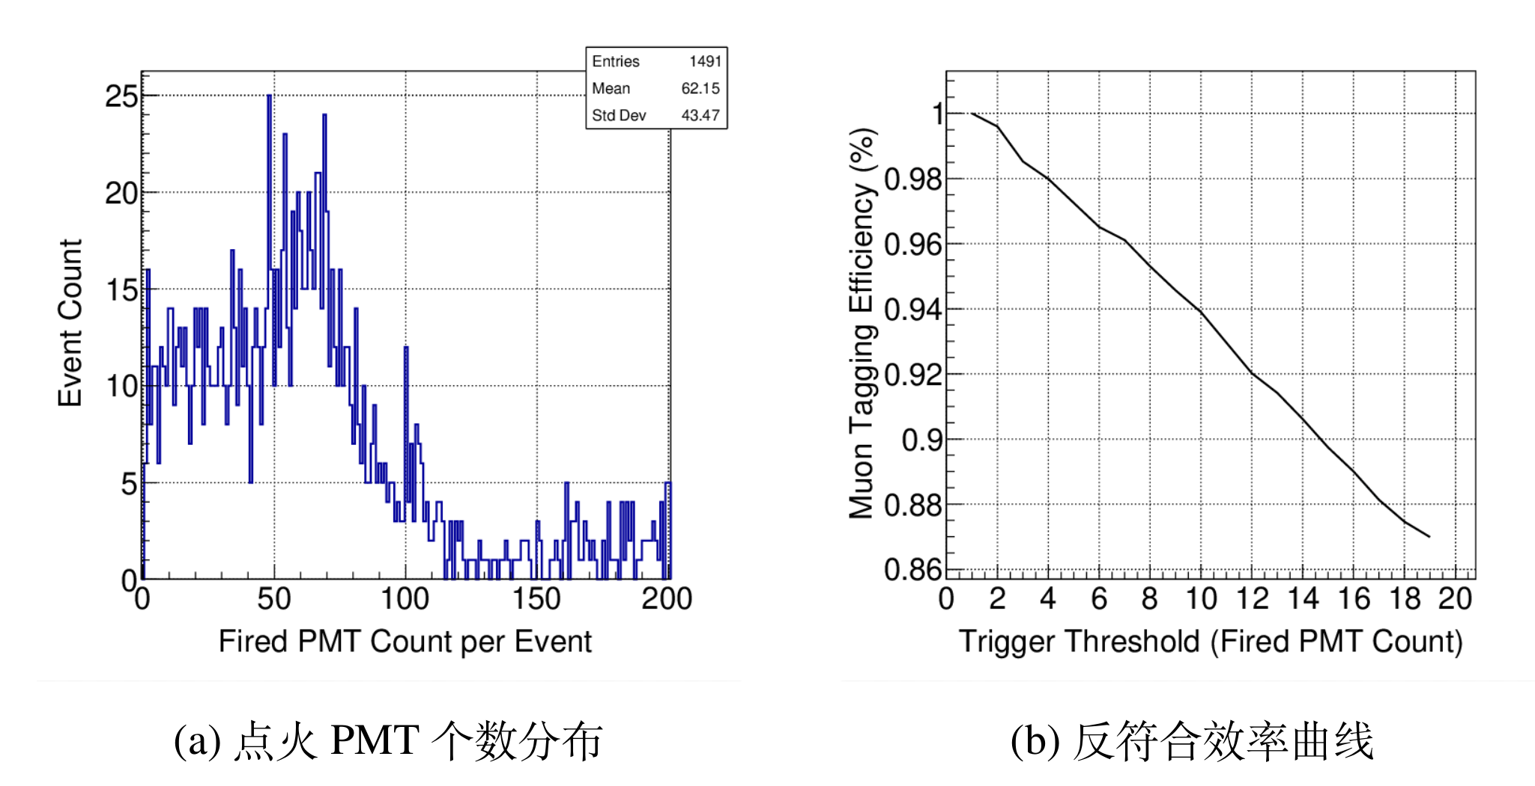
Muon Tagging Efficiency
require 100 MeV energy deposition in water
count number of fired PMTs (inner and outer layer)

Slide 20
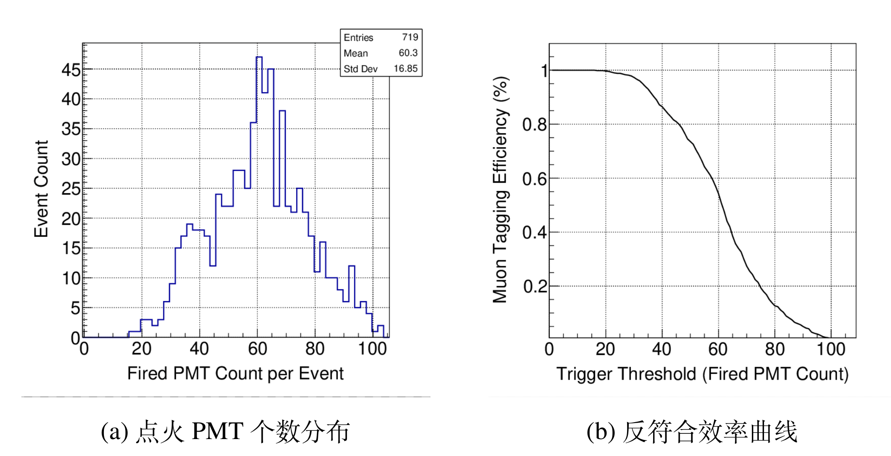
Muon Tagging Efficiency
require 5 fired PMTs in the inner layer
count number of fired PMTs in the outer layer

Slide 21
Cold Liquid Scintillator R&D

Slide 22
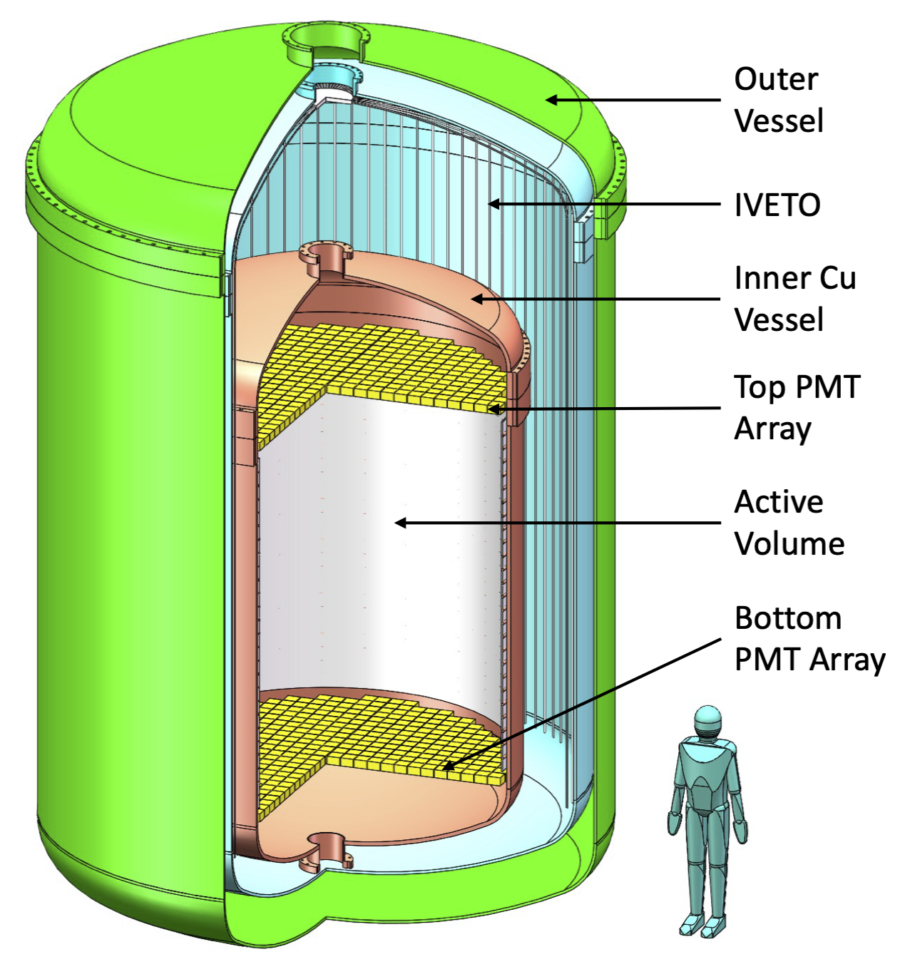
Cold Liquid Scintillator Veto
LAB-based liquid scintillator becomes semi-transparent and viscous at liquid xenon temperature (about -100 ℃)
  pressure balance: like refrigerant fluid (HFE-7000) used in EXO, make thinner liquid xenon container
  veto: use wavelength shifting fibers for light detection, as in LiquidO
TAO performed R&D under -50 ℃
high viscosity, small heat conductivity, need to consider thermal uniformity
Notes:
% https://arxiv.org/abs/1805.11142
% nEXO Pre-Conceptual Design Report
% Kharusi:2018eqi.pdf
% page 30: the LXe TPC located inside a vacuum insulated cryostat filled with HFE-7000 refrigerant fluid, doubling as the innermost γ-ray shield.
% page 33: As successfully done in EXO-200, the innermost shielding layer will consist of a bath of HFE-7000 2, at least 76 cm thick in all directions. The HFE-7000 results in very small temperature gradients across the TPC vessel, which is too thin to achieve this goal conductivity.
% https://iopscience.iop.org/article/10.1088/1748-0221/7/05/P05010/pdf
% The EXO-200 detector, part I: detector design and construction
% The inner cryostat contains an ultra-clean, dense (ρ = 1.8 g/cm2 at 170 K) fluid (HFE-7000 [20]), providing both shielding and thermal uniformity. The fluid also transfers the pressure load to the 25 mm thick inner cryostat copper vessel that is designed to tolerate absolute implosive (explosive) loads >100 kPa (>300 kPa).

Slide 23
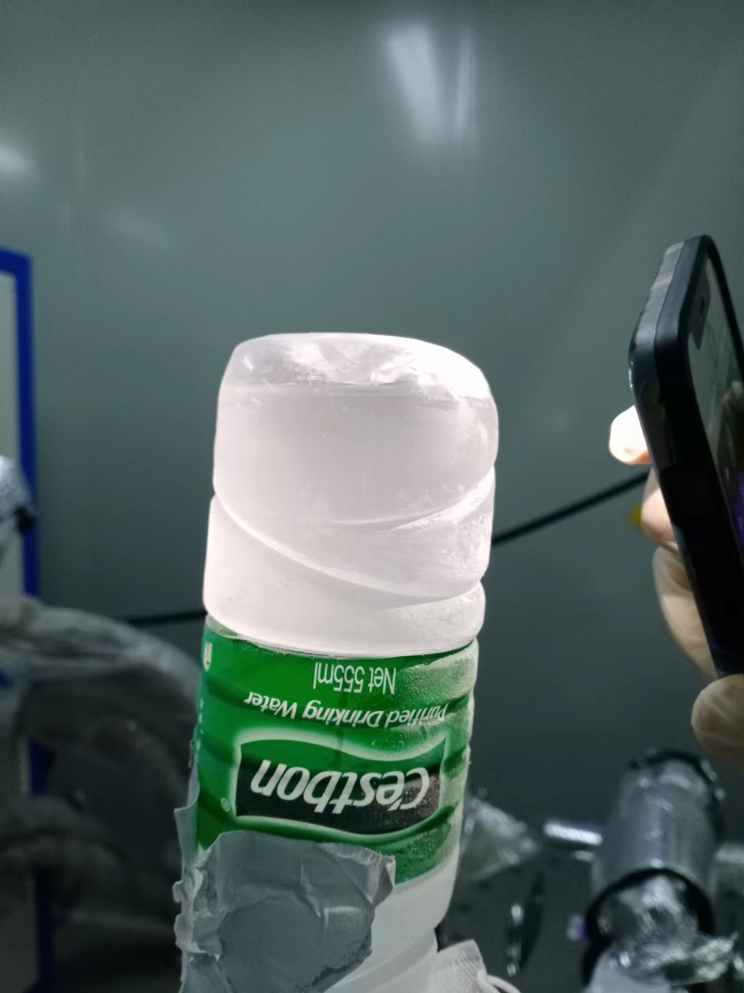
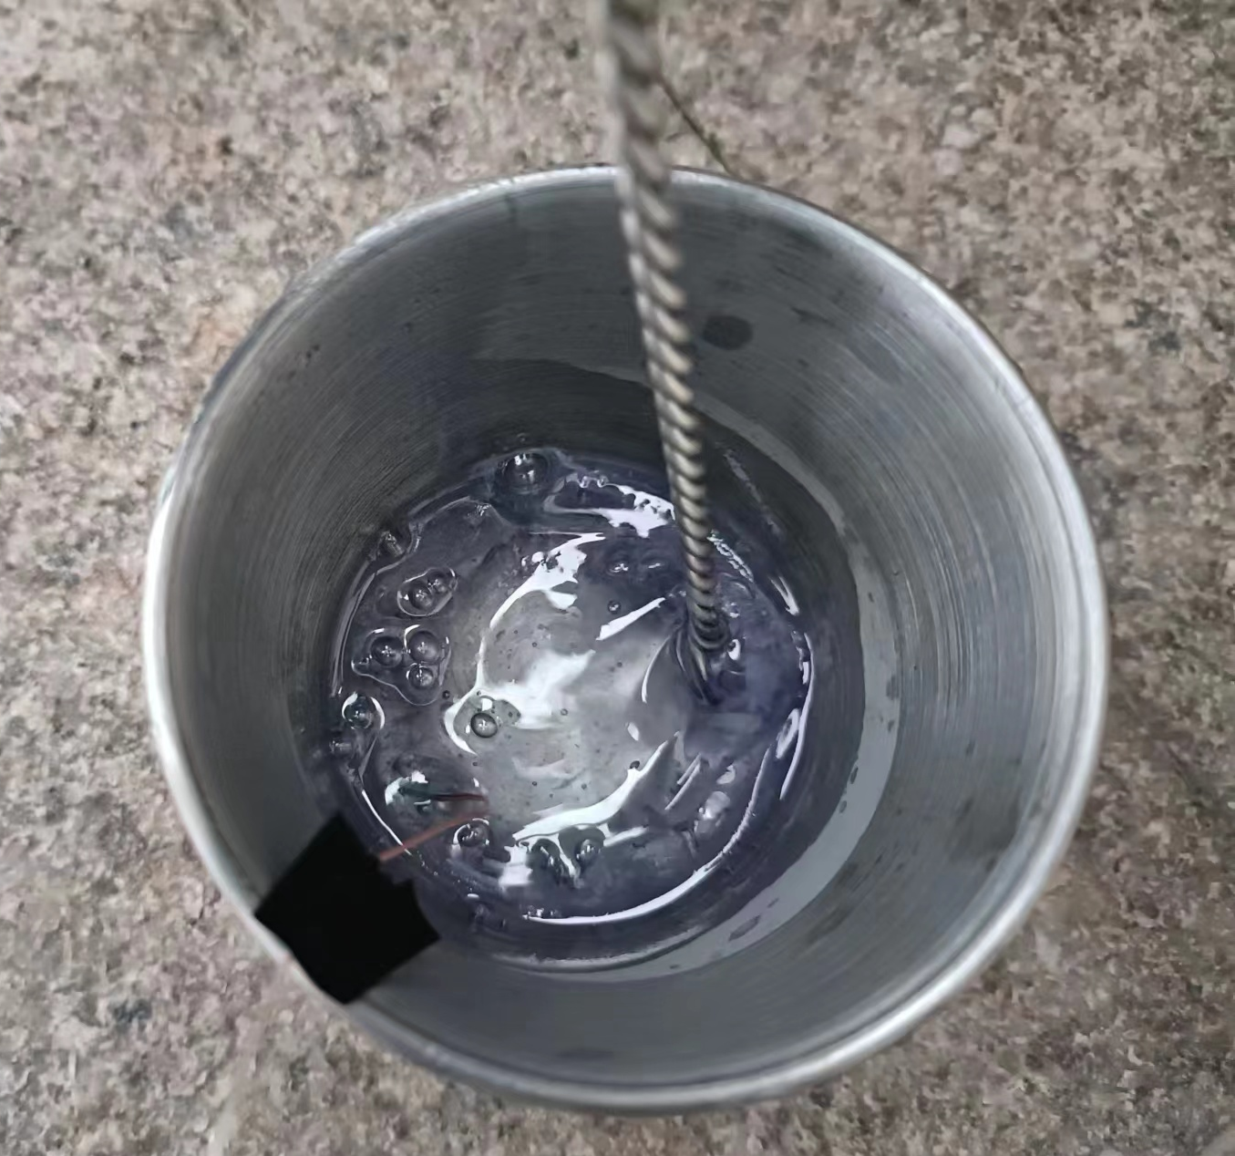
Visual Inspections

Slide 24
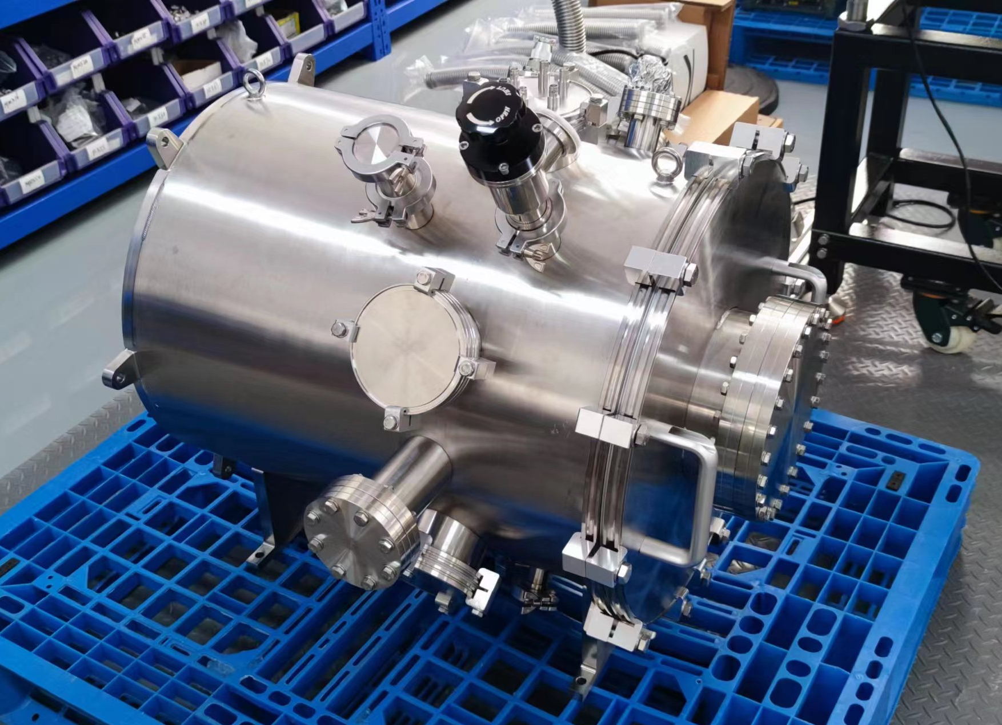
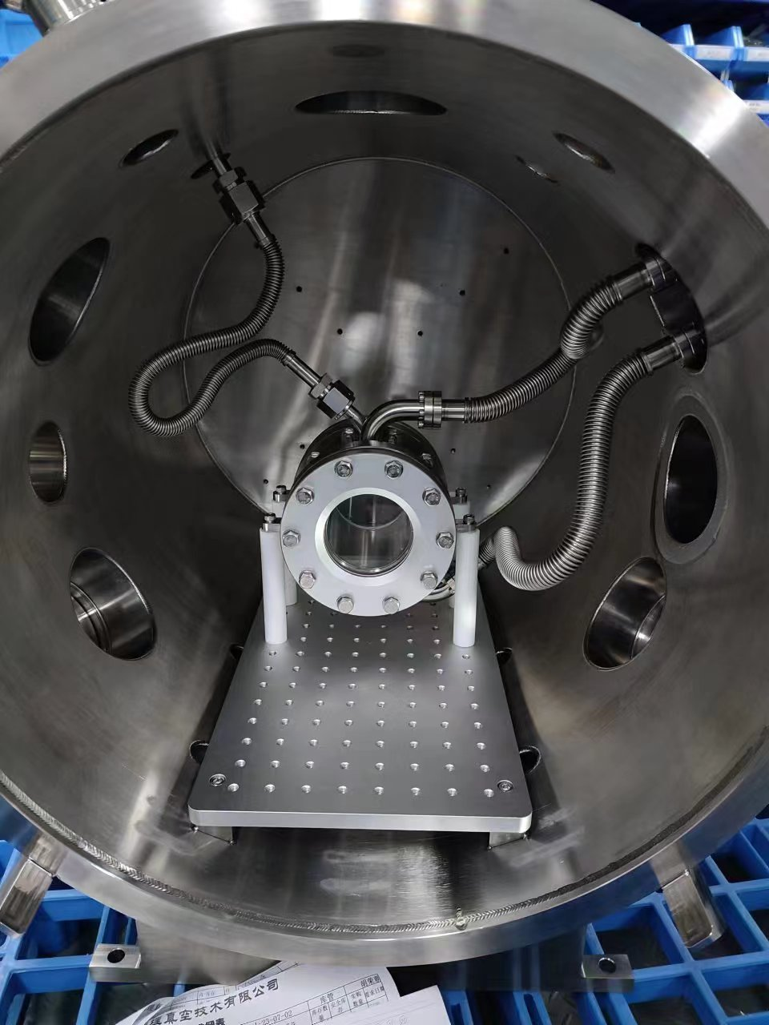
A Small Setup for Cold LS R&D
made a 10 cm scale setup, to be cooled to -100 ℃
study the light yield and transparency under about

Slide 25
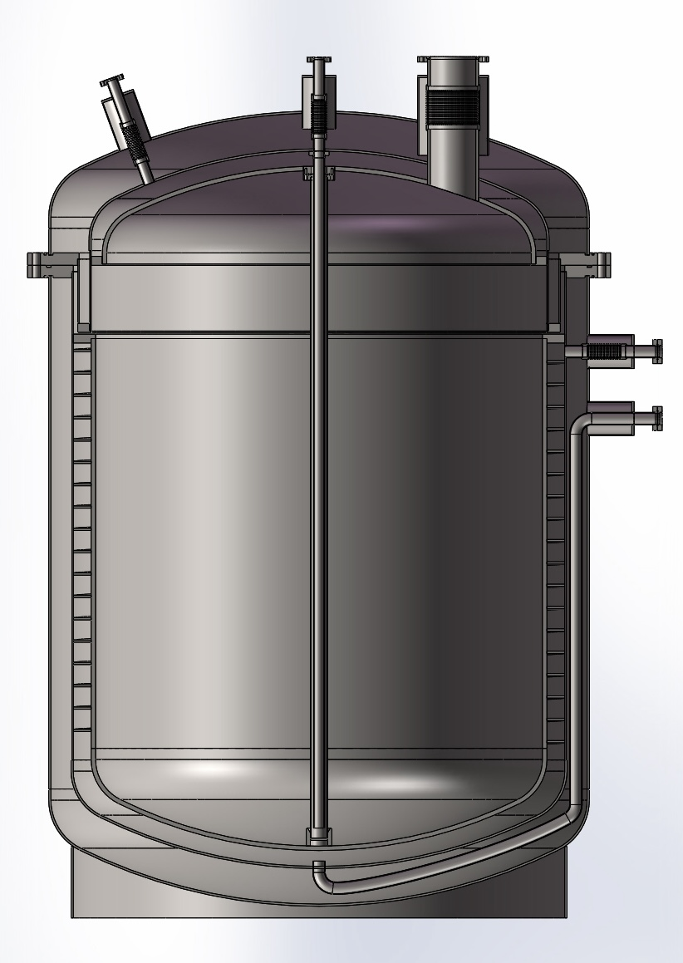
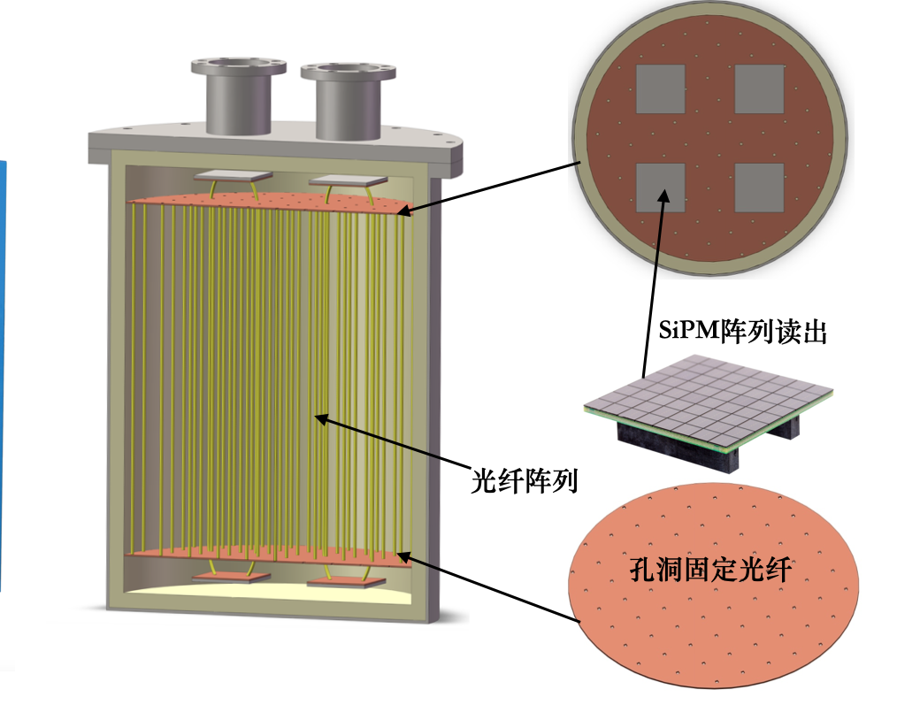
Meter-Scale Setup
a meter-scale cryostat is under design by Shanli (company)
ordered WLS fibers (1 mm in diameter, 1 km) and a refrigerator
2 cm spacing, 16 fibers per SiPM, require 120 SiPM

Slide 26
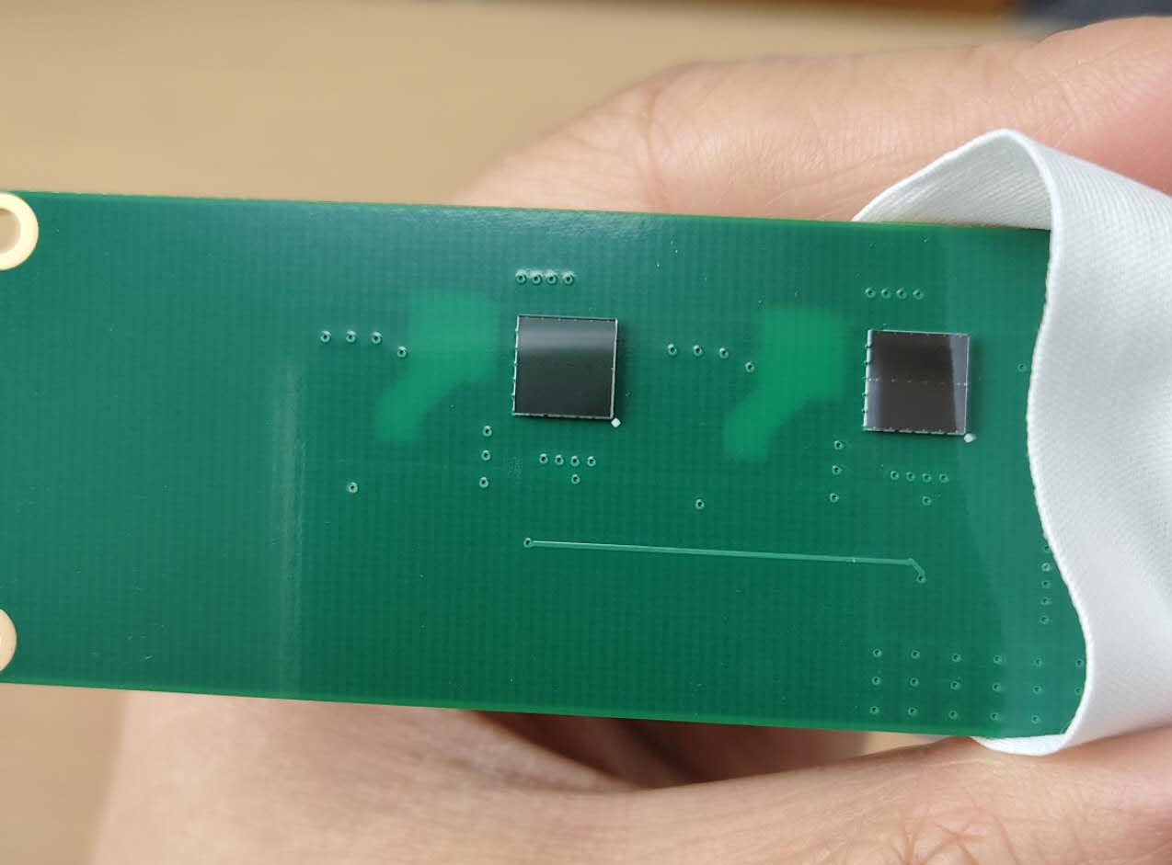
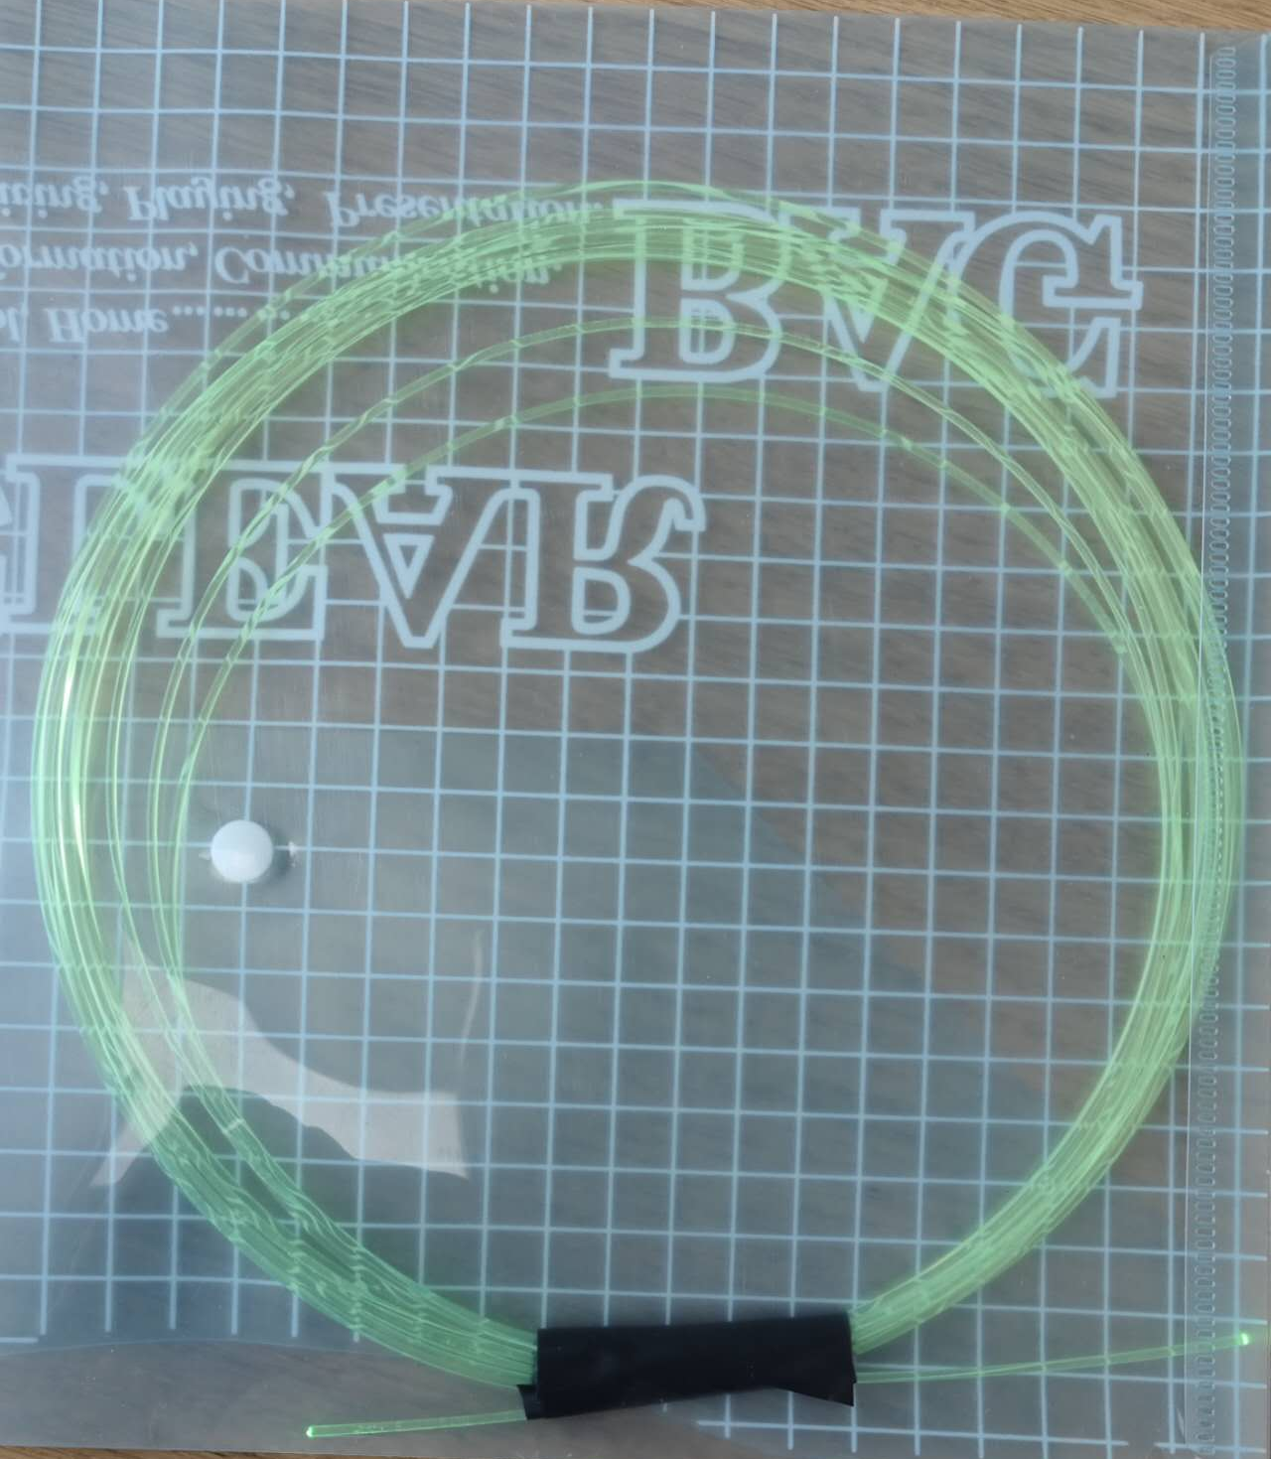
Fiber Readout R&D
4 SiPM (6 x 6 mm) and the readout boards
several meters of wavelength shifting fiber

Slide 27
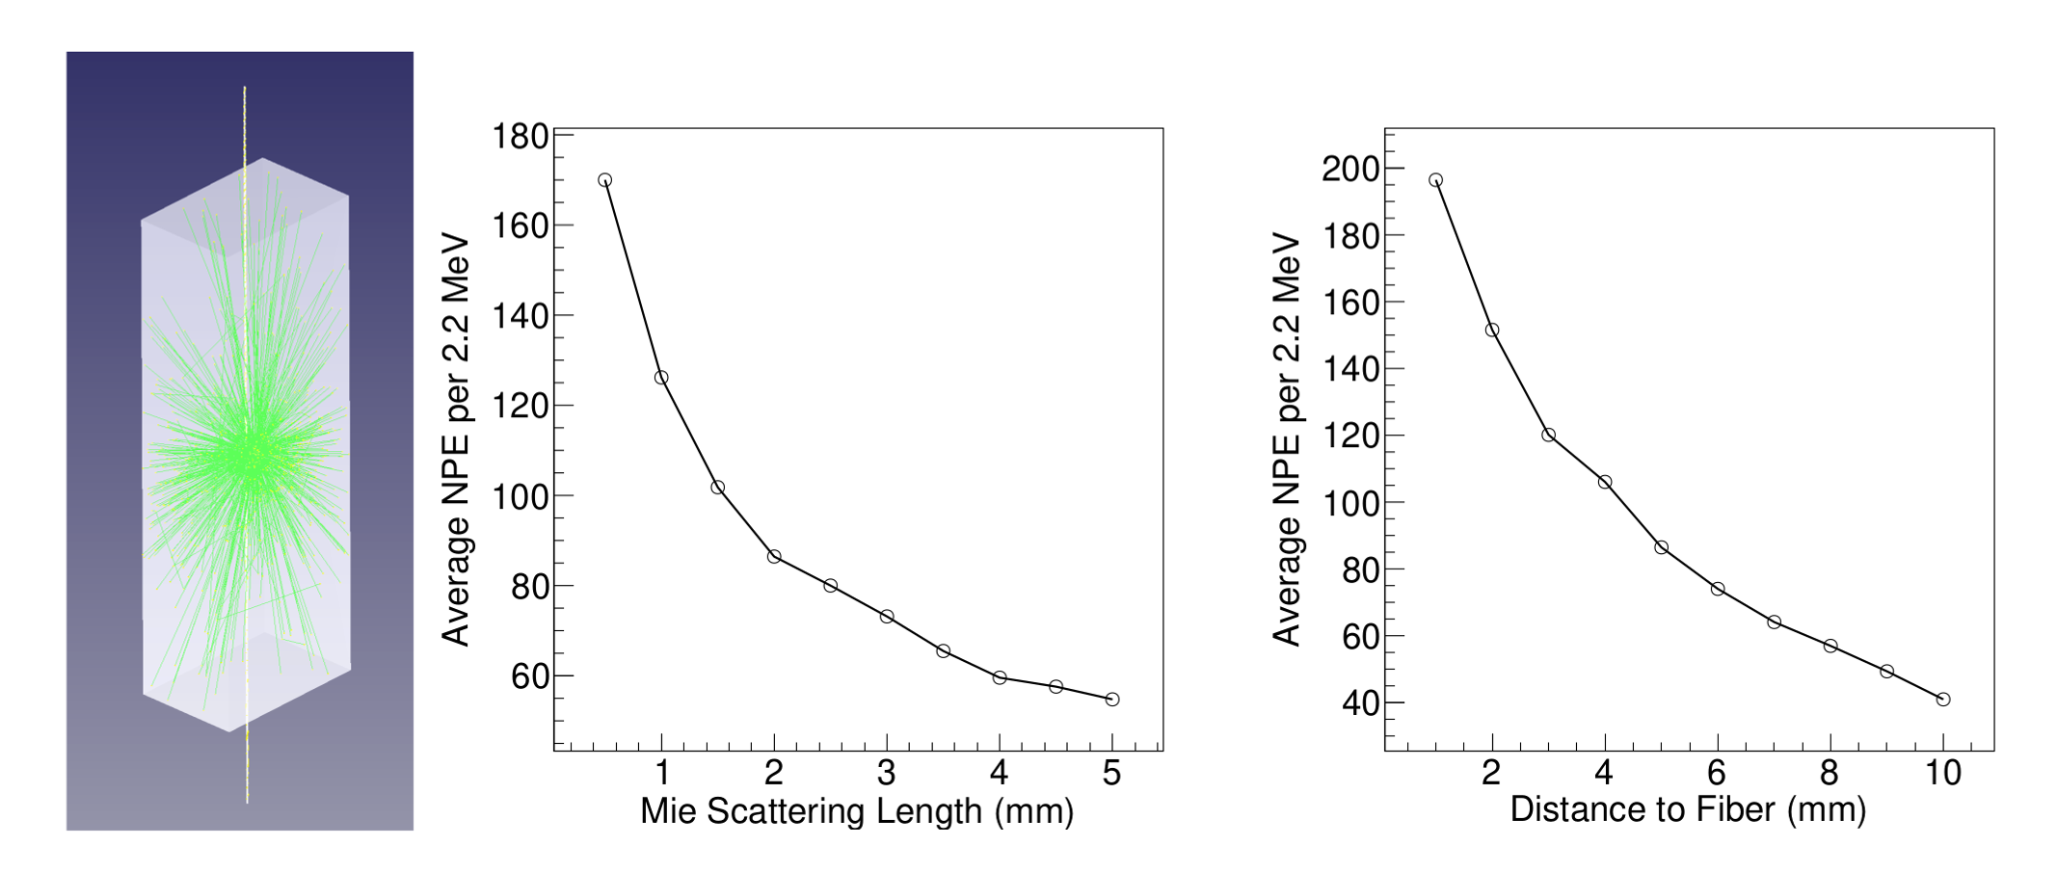
Optical Simulations
2.2 MeV electrons, distance to photosensor (APD) is 15 cm
light yield: 10000 photons / MeV
scanned Mie scattering length for different transparencies

Slide 28
Summary and Plan
instrumented the 0.9 kton water shielding with 270 PMTs, working on the readout, plan to start data taking this summer
estimated the veto efficiency with optical simulations
consider using water-based liquid scintillator: 5% blending (500 photons / MeV) can significantly improve veto efficiency
cold liquid scintillator R&D
  performed an optical simulation
  10 cm scale setup: do measurement once refrigerator is available
  meter scale setup: under design

Slide 29
Backup

Slide 30
Veto Efficiency with Water
neutron capture on hydrogen, emitting 2.2 MeV gamma
simulated neutrons and gammas from U238 in LXe container

Slide 31
Water-Based Liquid Scintillator
replace water with water-based liquid scintillator
200 photons per MeV (about 5% blending)

Slide 32
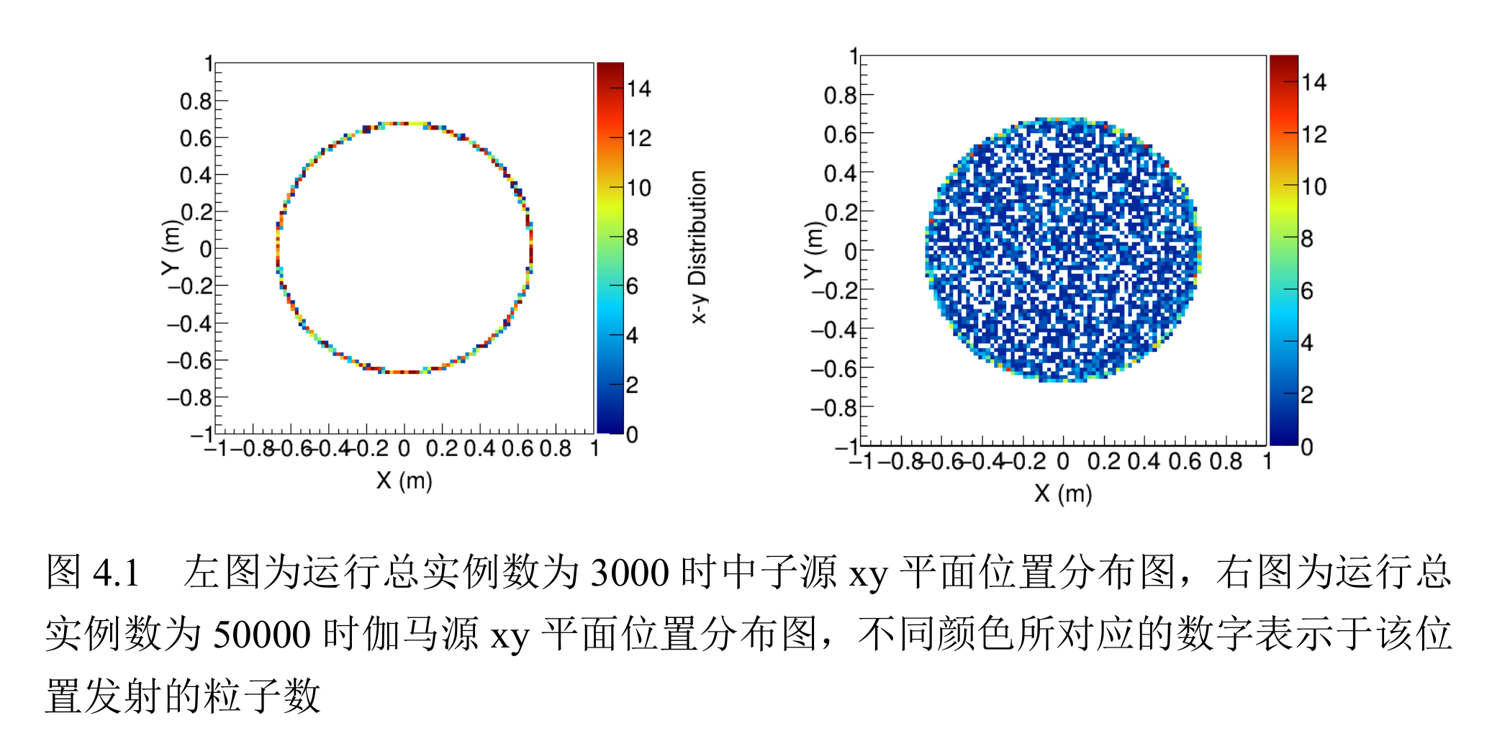
Neutron and Gamma Simulation

Slide 33
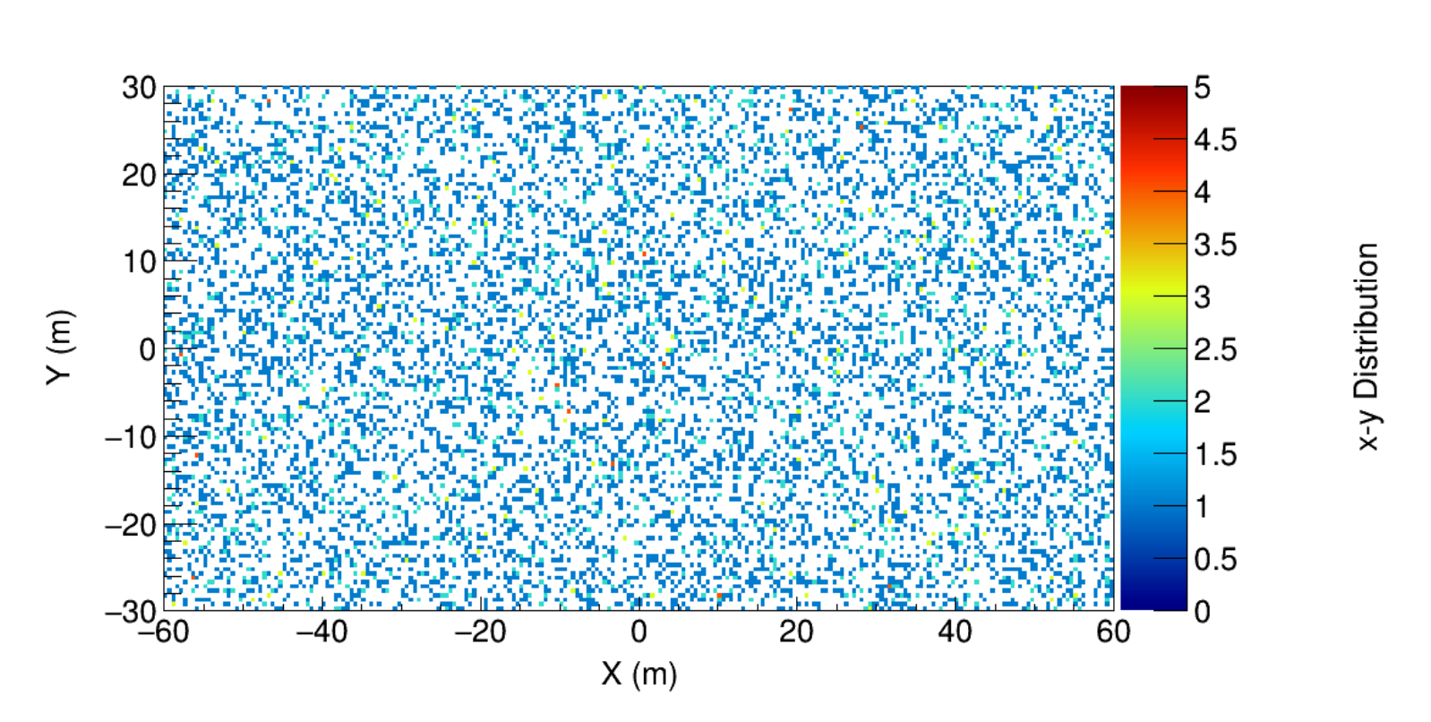
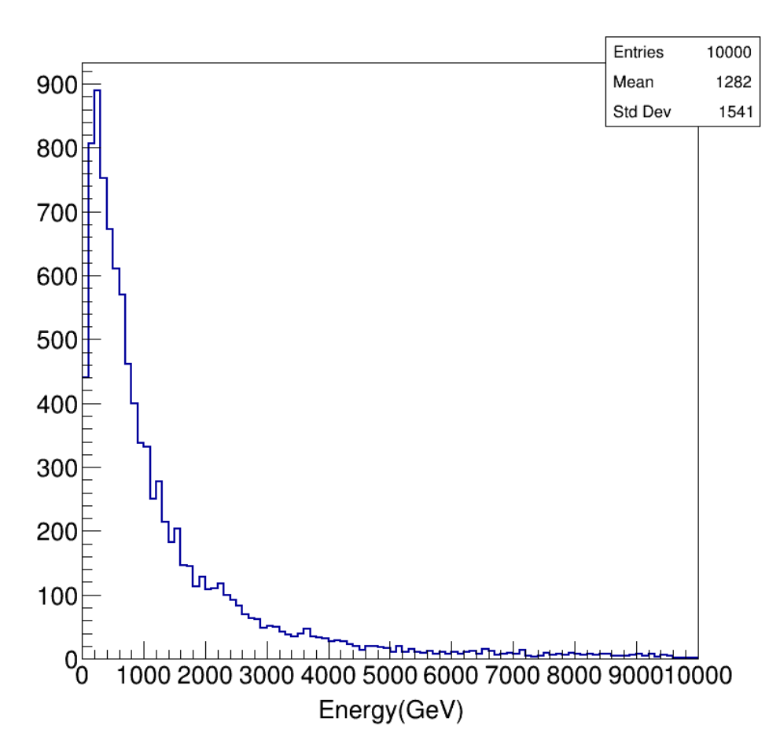
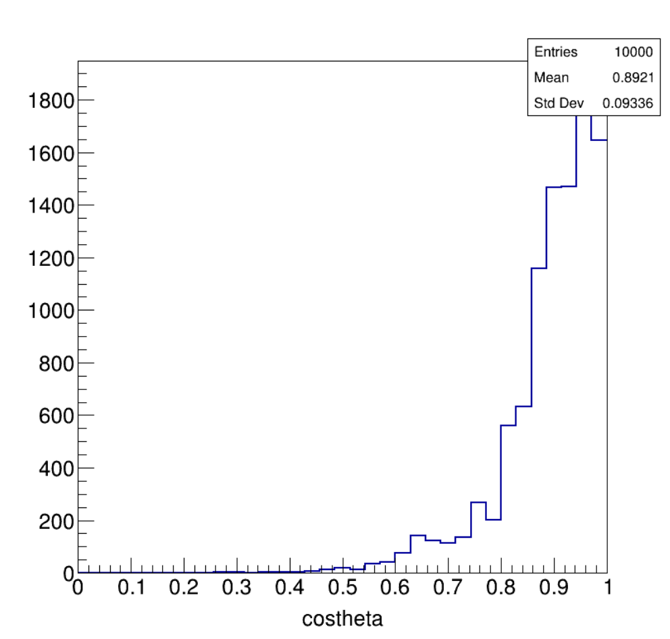
Muon Simulation

Slide 34
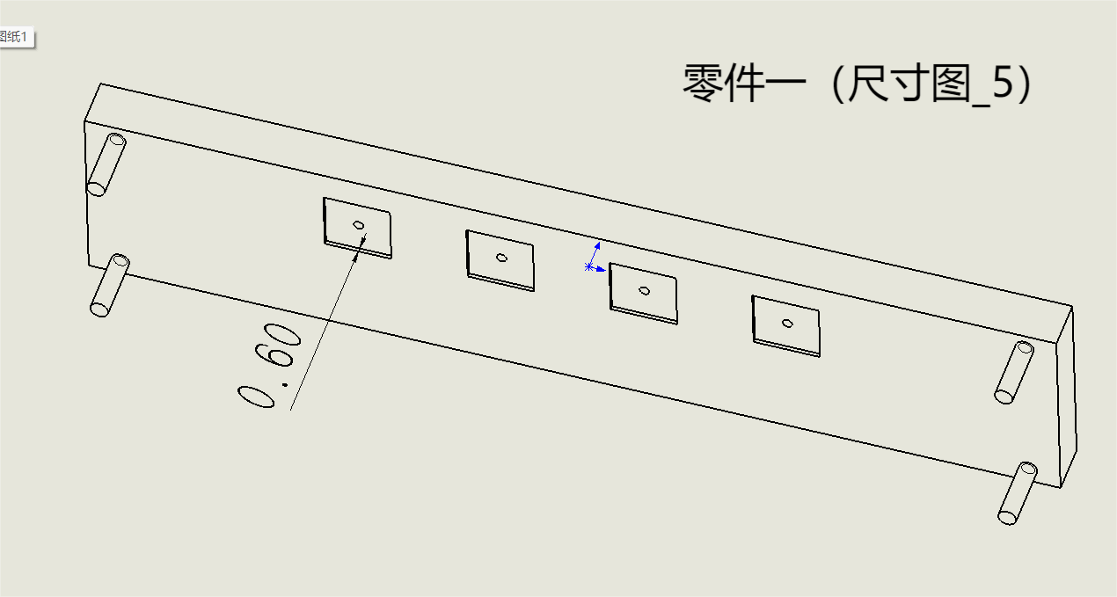
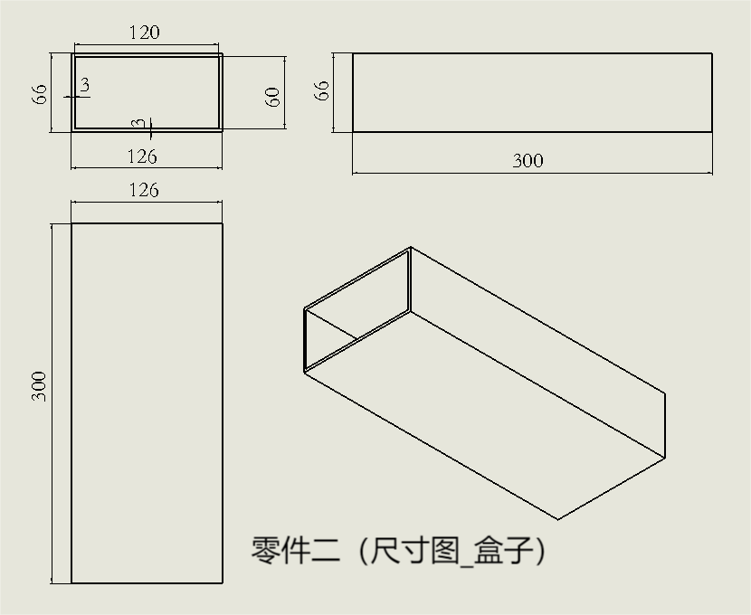
Fiber Readout R&D
a small setup: semi-transparent liquid scintillator + fiber
coupling between SiPM and fiber, liquid scintillator container
submitted the job to Yuan

Slide 35
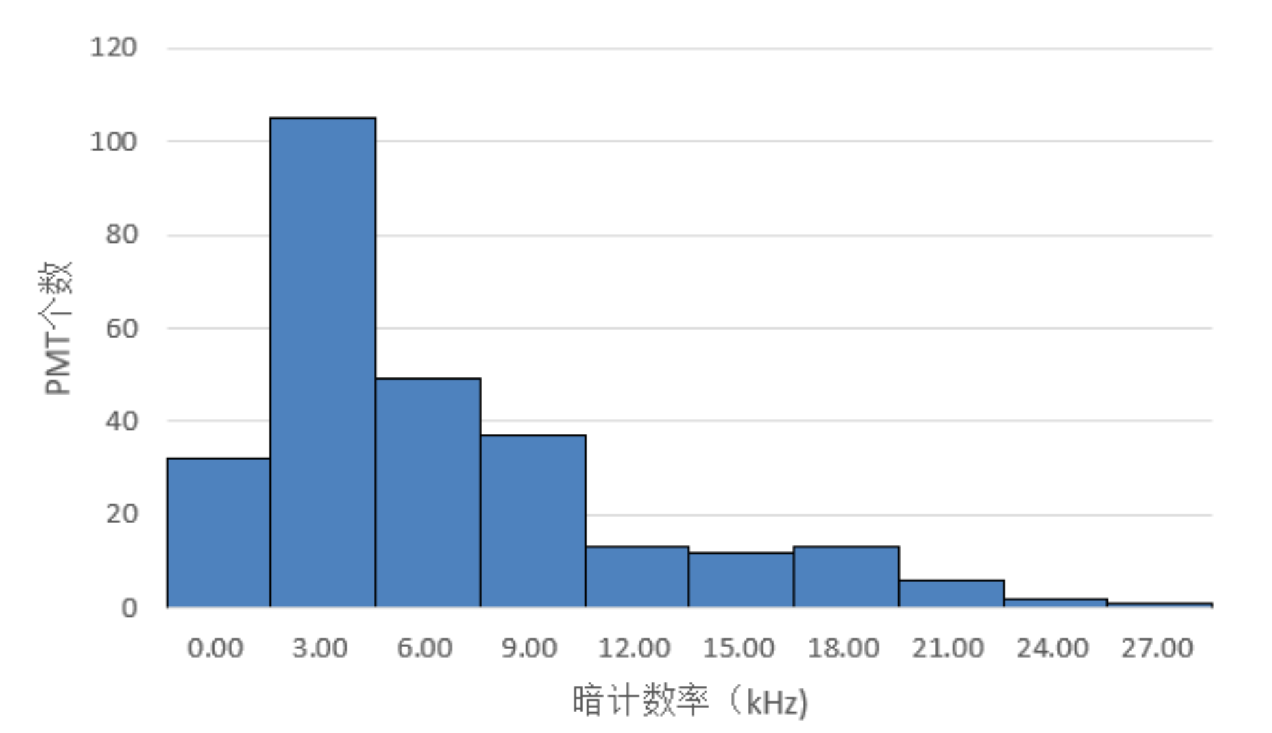

Slide 36
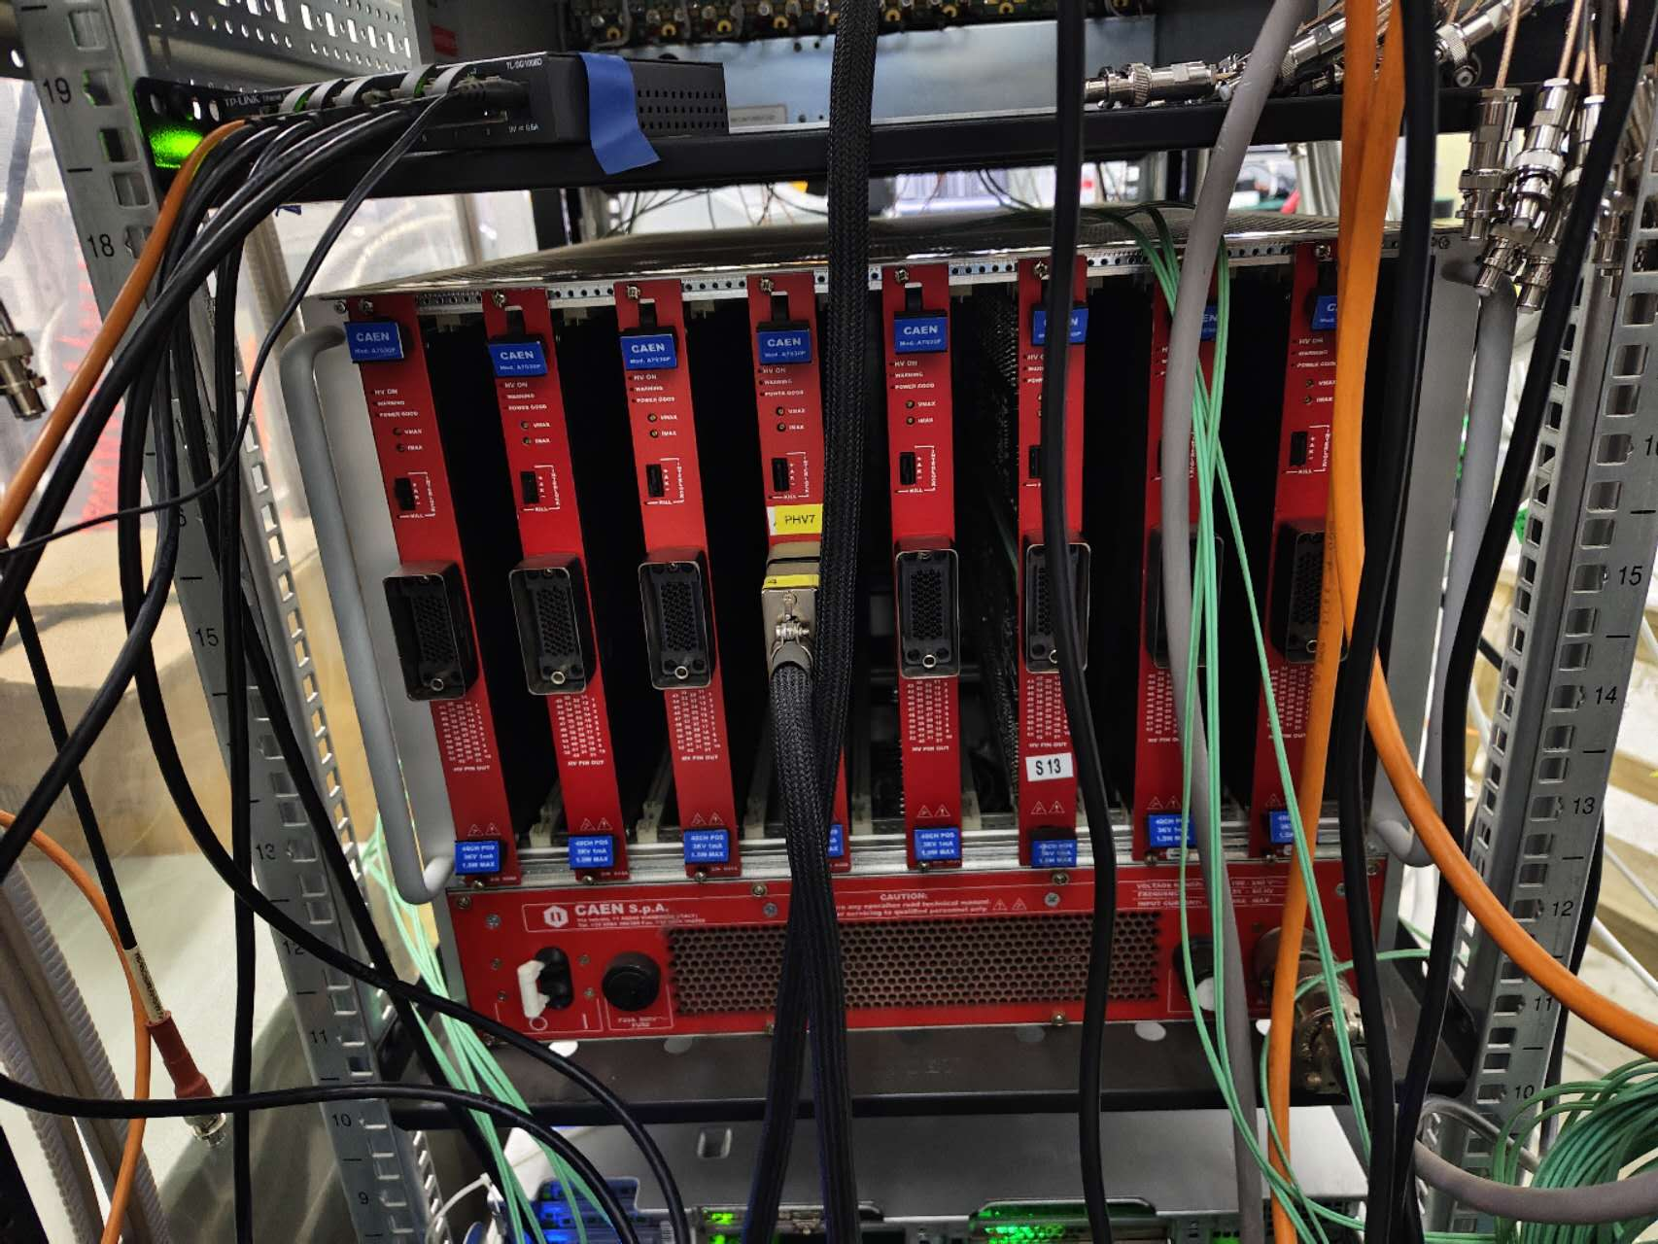
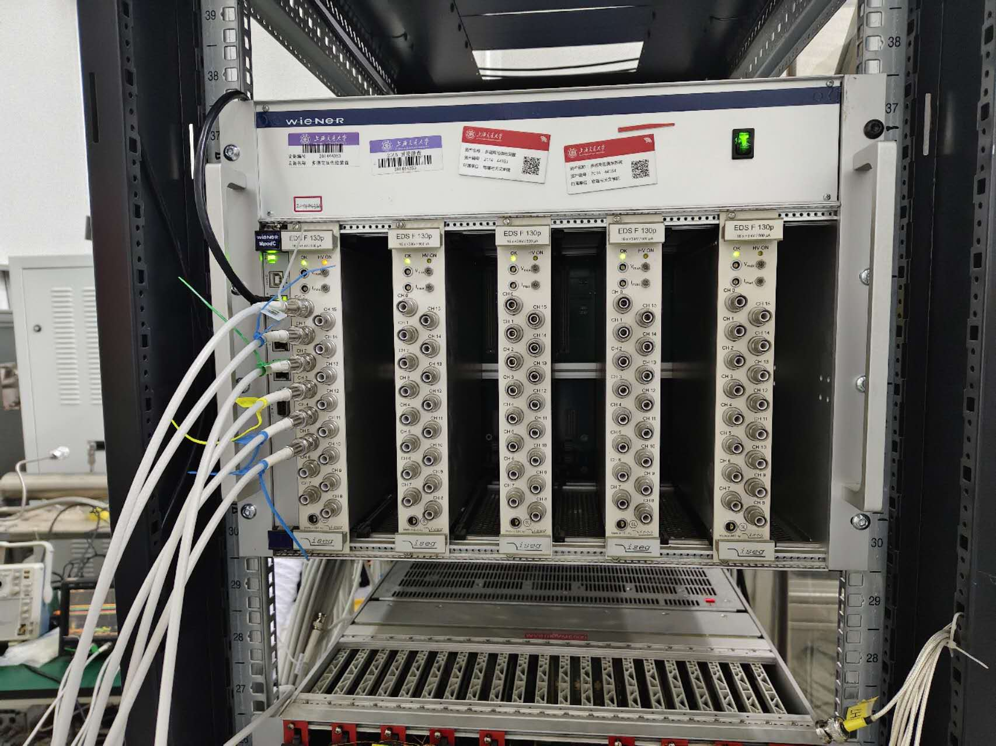
High voltage
positive, separate from signal
CAEN high voltage boards

