Slide 1


Spectral Features of Argon Light Emission for Next-Generation Rare Event Detectors
Roberto Santorelli
CIEMAT – Madrid
(on behalf of the CIEMAT-DM group)

Slide 2
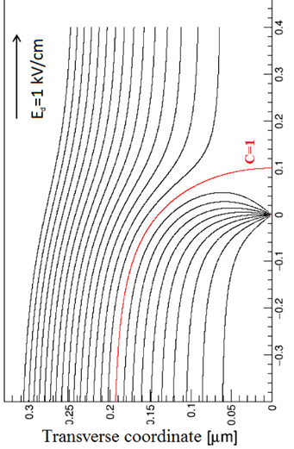
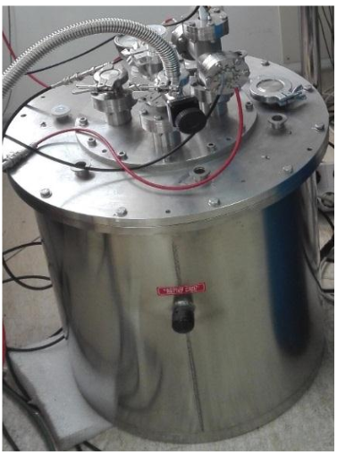



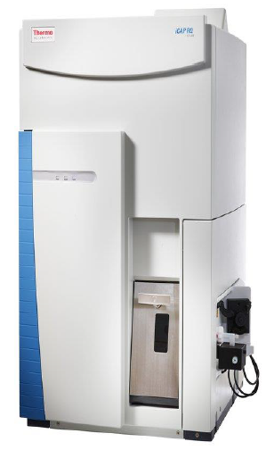
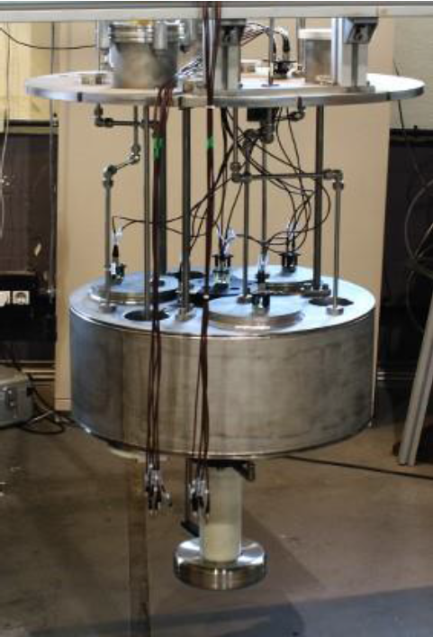
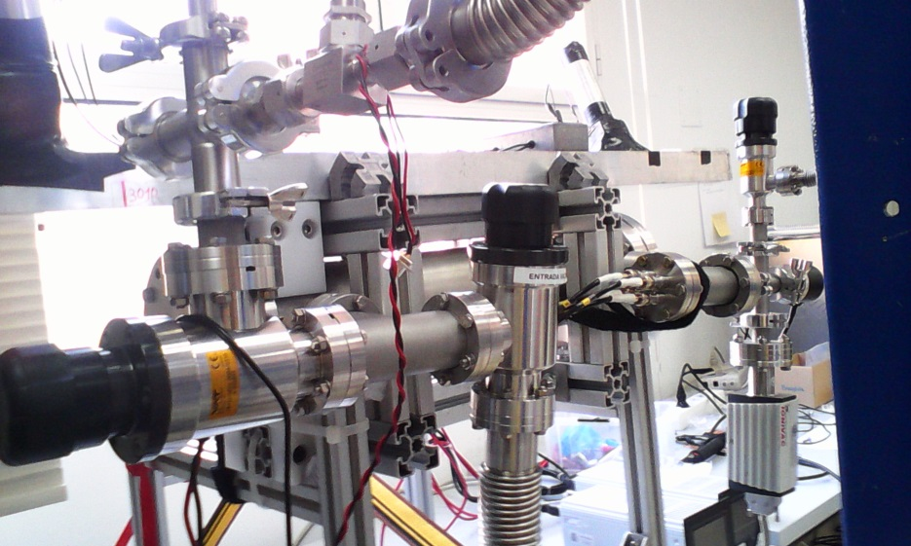
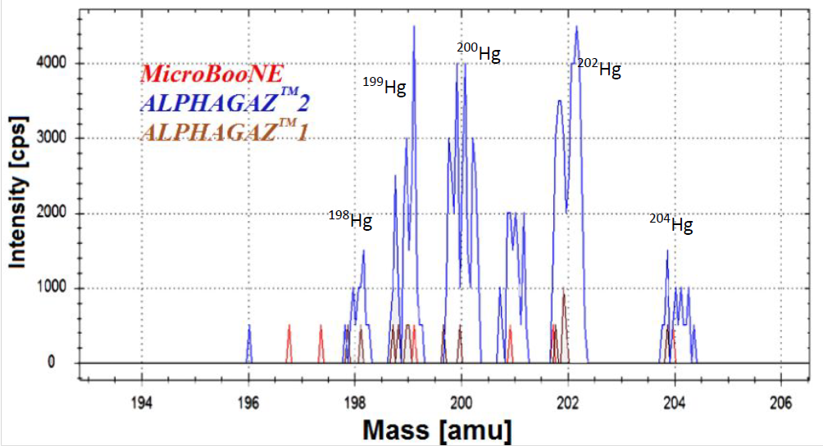
R&D program at CIEMAT
+ G. Vera Diaz (PhD student)

Slide 3
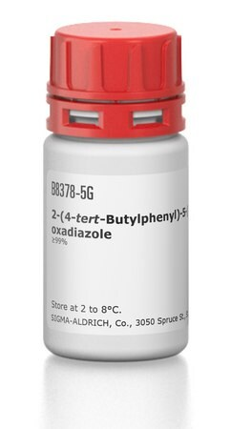
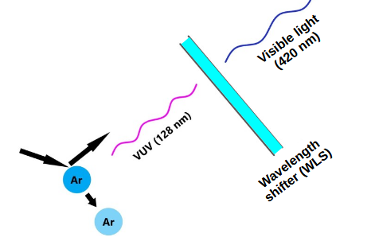
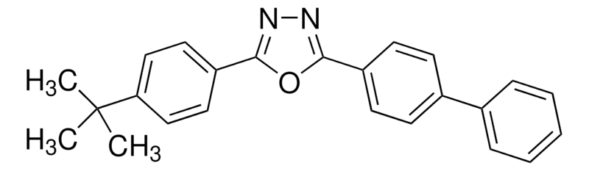
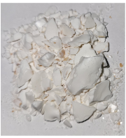
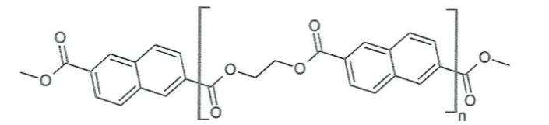
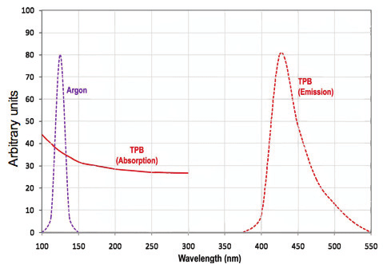
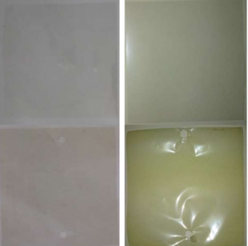
Wavelength shifting the VUV photons
Tetraphenyl butadiene (TPB) most popular solution:
– Fast emission, vey high conversion efficiency
– Emanation, degradation…etc
– Large vacuum chamber needed
PEN, or similar, polymeric materials. Relatively newer approach:
– Much easier
– Efficiency ≈0.5 (significantly lower than TPB)

Slide 4
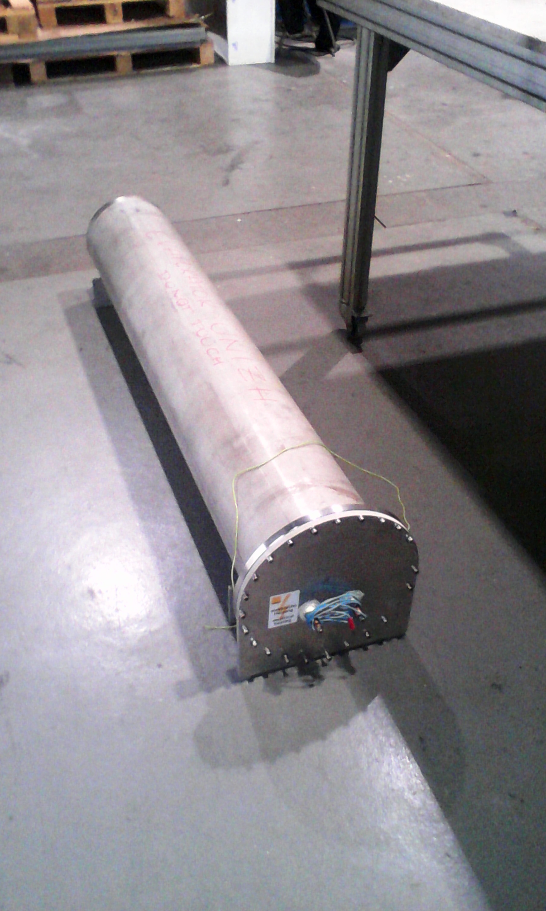
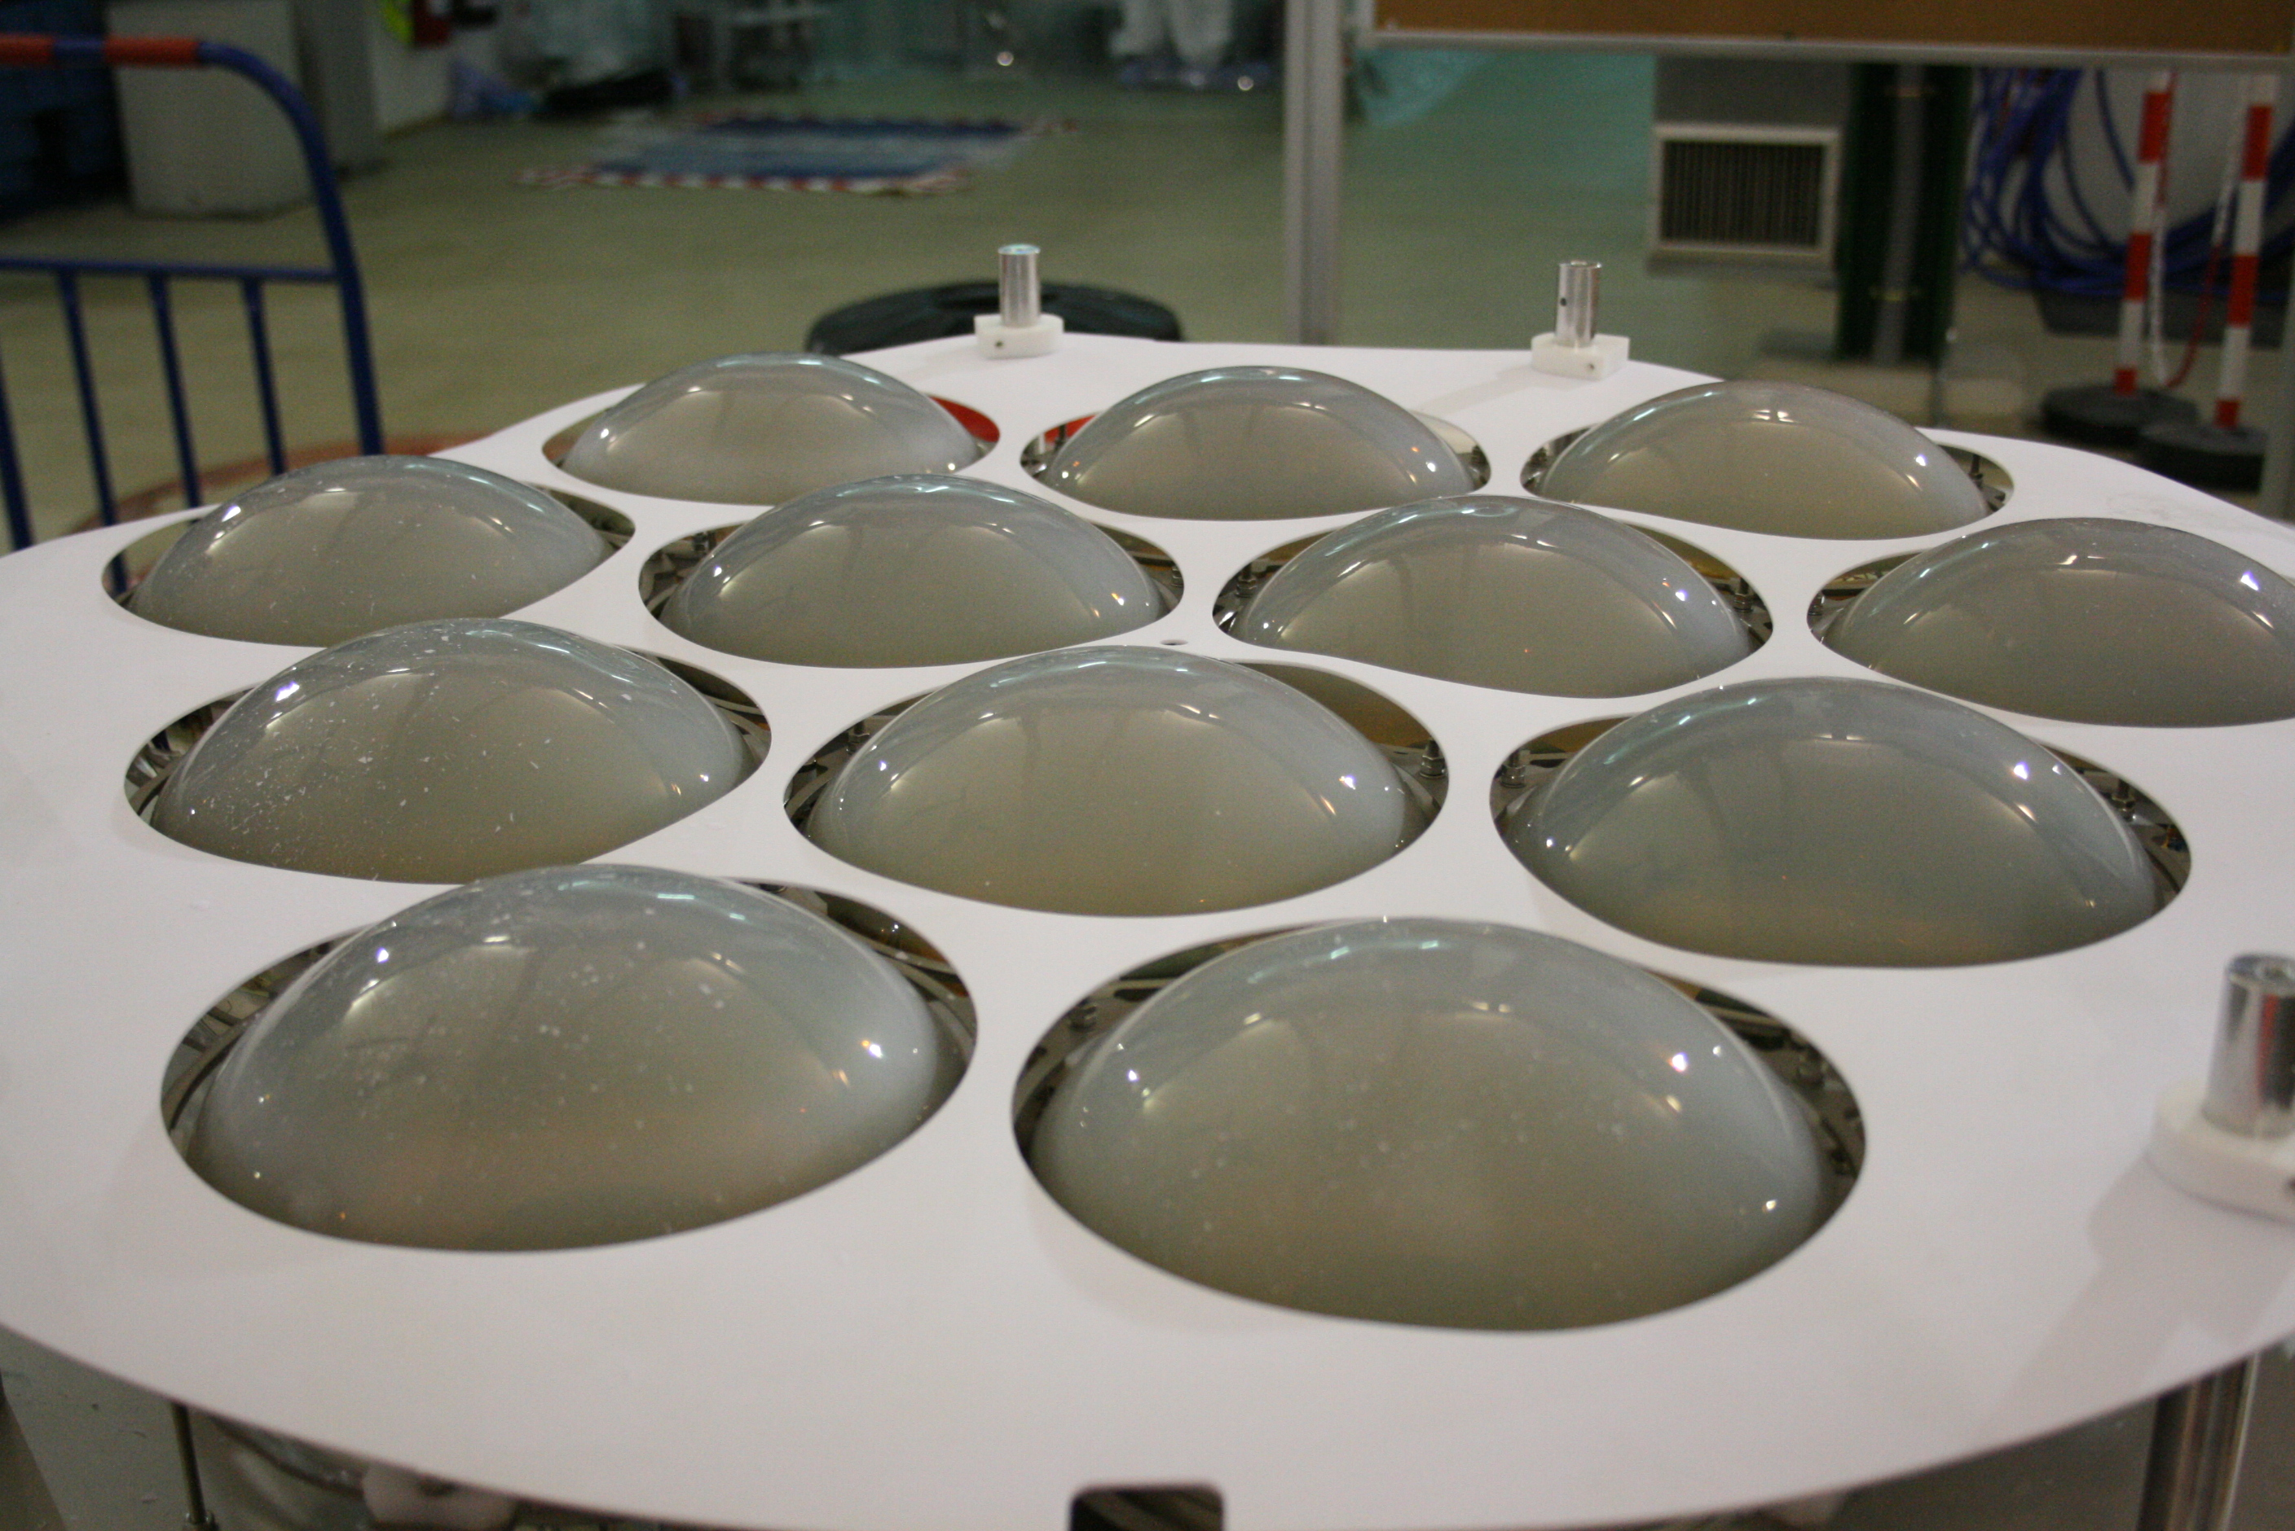
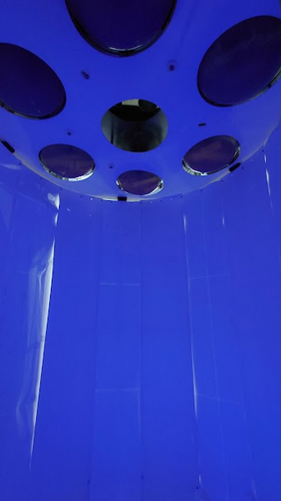
Wavelength shifting the VUV photons
Conventional dark matter (and neutrino) Ar detectors integrate the light signal over a wide spectral range!
Is it possible that we miss the potential information
provided by the scintillation wavelength?

Slide 5

Ar (and Xe) scintillation light
Ar
Excitation
e⁻ + Ar → Ar* + e⁻
Ar* + Ar → Ar^{v*}₂ Excimer formation
(bound diatomic molecules in the exc. state)
Ar^{v*}₂ + Ar → Ar₂* + Ar Relaxation
Ar₂* → Ar + Ar + hν Radiative de-exc.
and dissociation
Ionization
e⁻ + Ar → Ar⁺ + 2e⁻
Ar⁺ + Ar + Ar → Ar⁺₂ + Ar Molecular ion
Ar⁺₂ + e⁻ → Ar** + Ar Recombination
Ar** + Ar → Ar* + Ar + heat Excimer
The superscript v is used to distinguish the vibrational excited states from the purely electronic excitations
(Ar₂* with v=0)
hν
hν → second continuum at 128 nm (wavelength shifted to 420 nm)

Slide 6
This is not completely true:
We do see some light even without wavelength-shifting the photons to 420 nm
Where does this light come from?
What is the impact of this composite spectral emission?

Slide 7
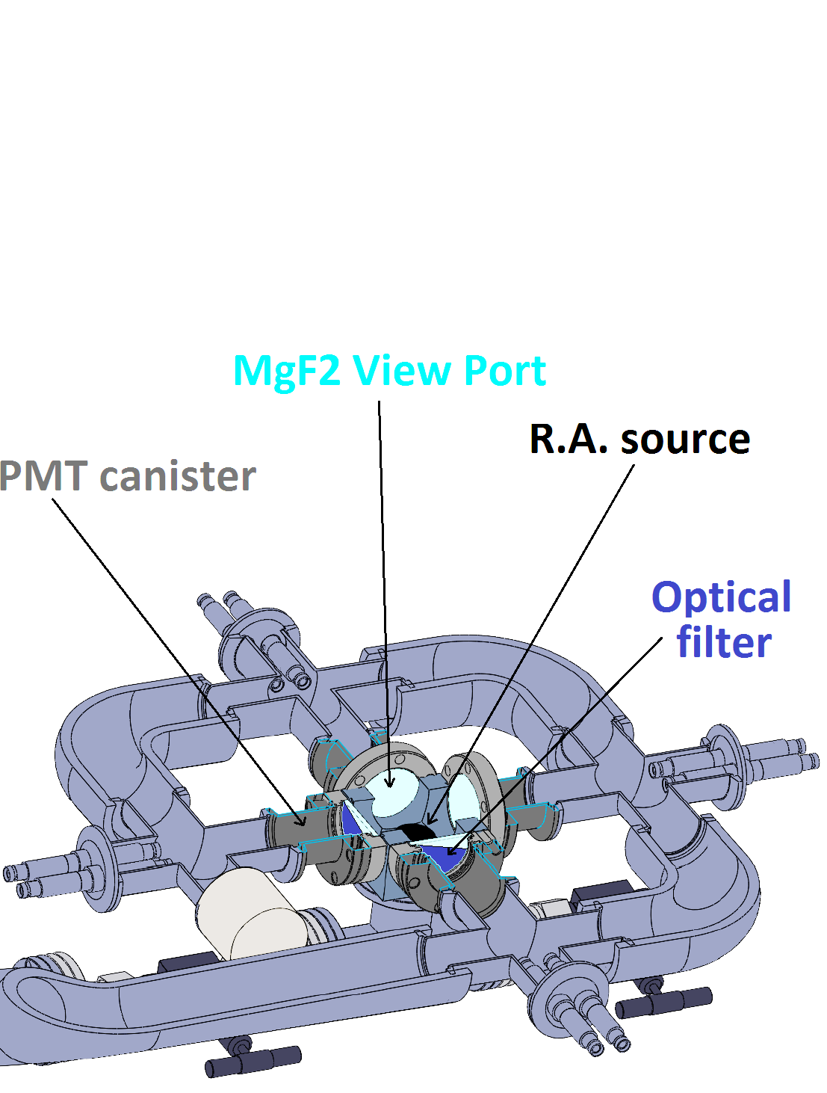

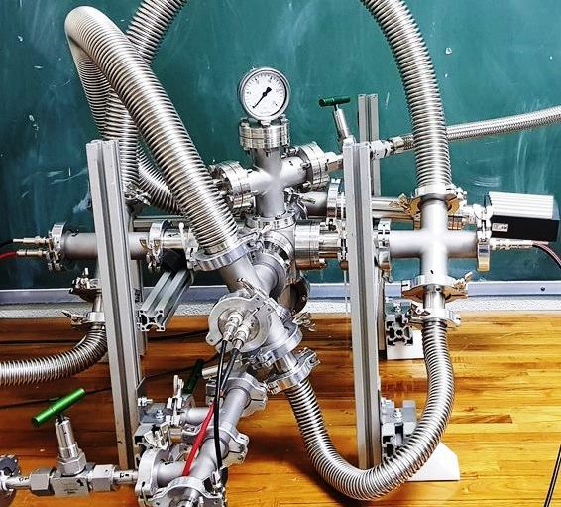
The Octopus detector
High pressure and low pressure regions decoupled.
Three wavelength regions defined with different PMT models and filters.

Slide 8
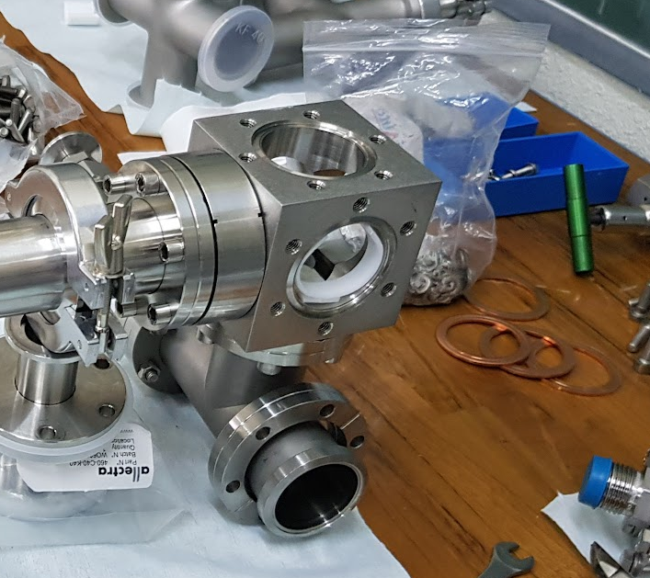

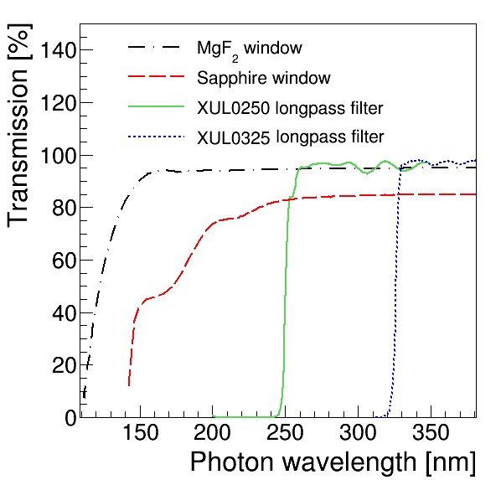
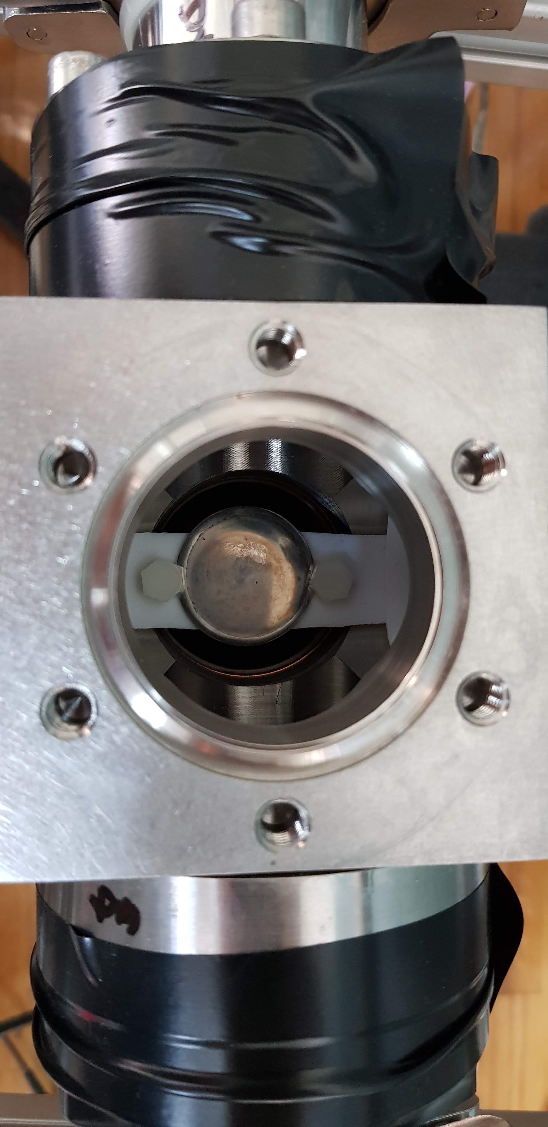
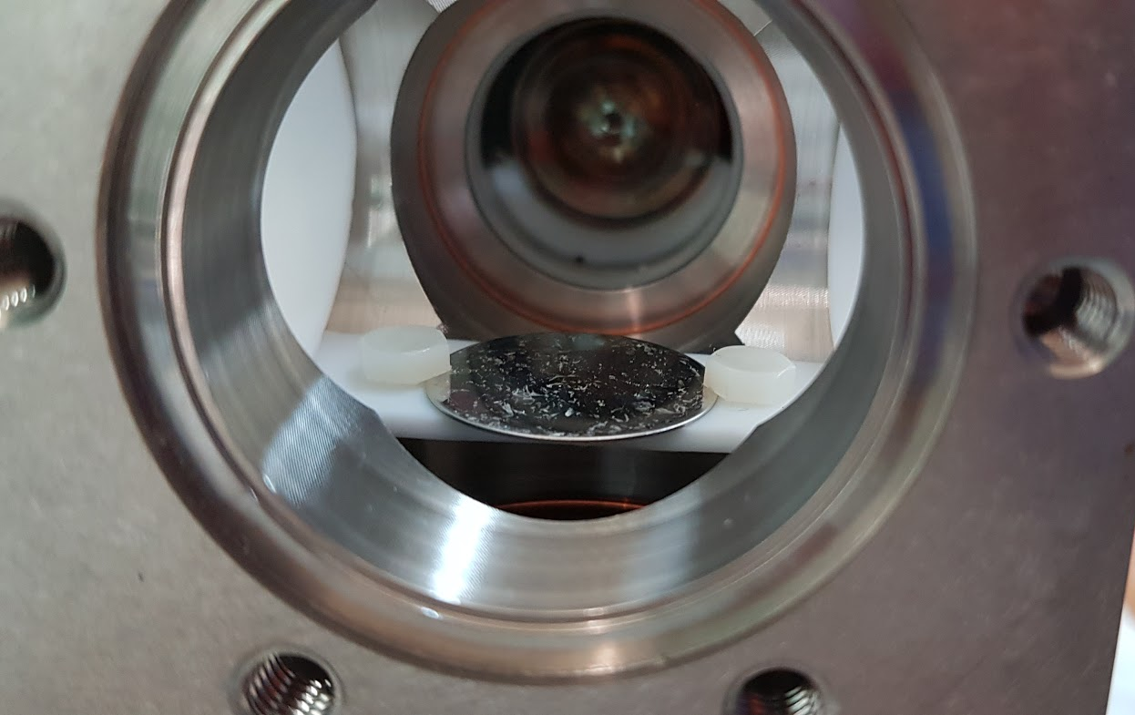
PMT | Model | Sensitivity Range [nm]
UV2 | R6835 | [115-160]
UV3 | R7378 | [160-visible]
TPB | R6095+TPB evaporated | [110-visible]

Slide 9
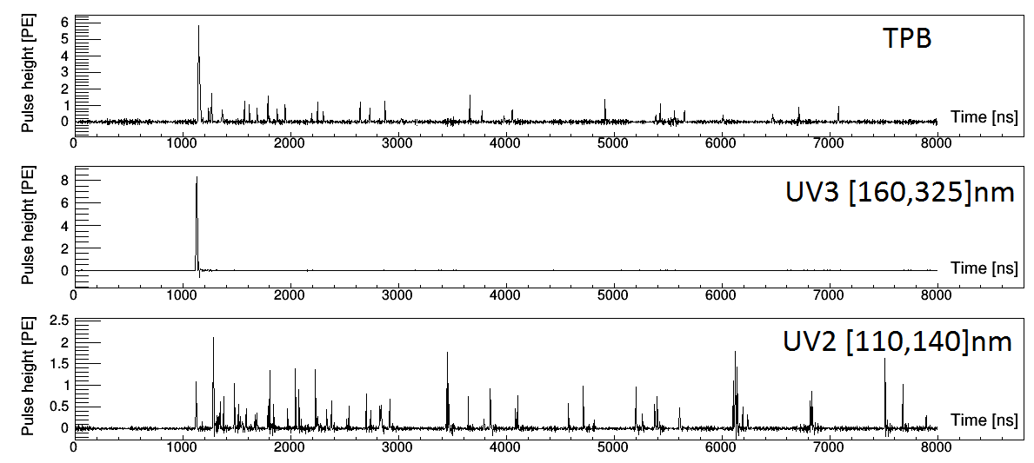
Ar scintillation at 1 bar (Am-241)
Eur. Phys. J. C 81, 622

Slide 10
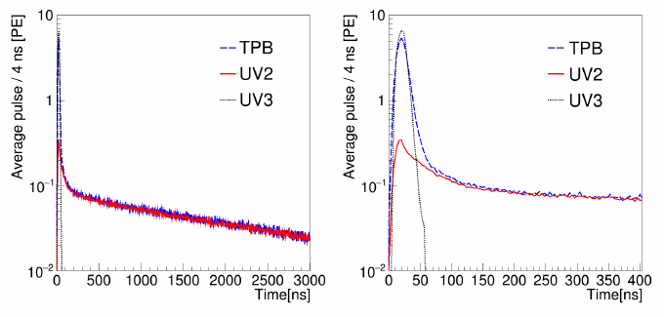
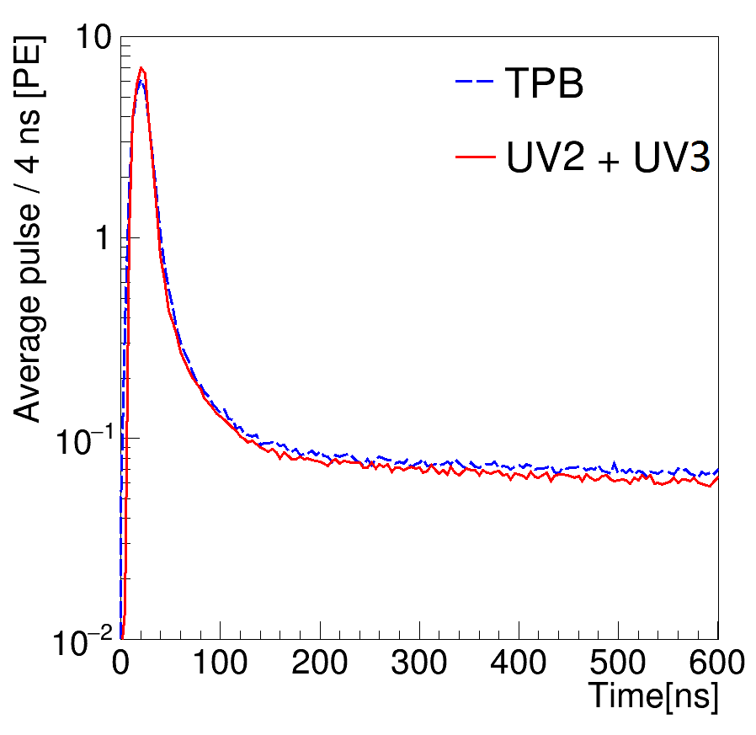
Ar scintillation at 1 bar (Am-241)
Average pulse over 3 x 10⁴ events using ²⁴¹Am source
The TPB pulse is the sum of the UV2 and UV3 signals

Slide 11
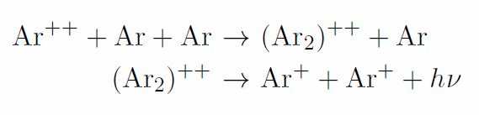
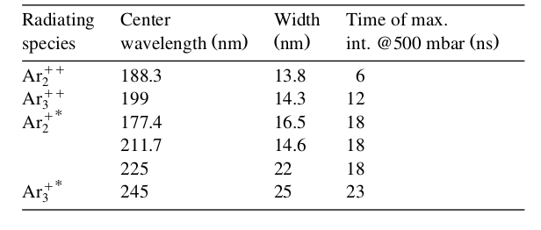

“Higher order” continuum
Mechanisms leading to scintillation mainly in the region 180-300 nm are grouped under the generic denomination of “3rd continuum” (despite it is very plausible that a number of different species contribute)
Two leading hypothesis for the precursors: doubly ionized (Ar⁺⁺) and excited (Ar^{+*}) ions
No quantitative predictions up to date from molecular physics:
Our data confirm that the “3rd continuum” is field independent.
[1] T.Heindl et al., “The scintillation of liquid argon”, Europhys.Lett. 91 62002s (2010).

Slide 12
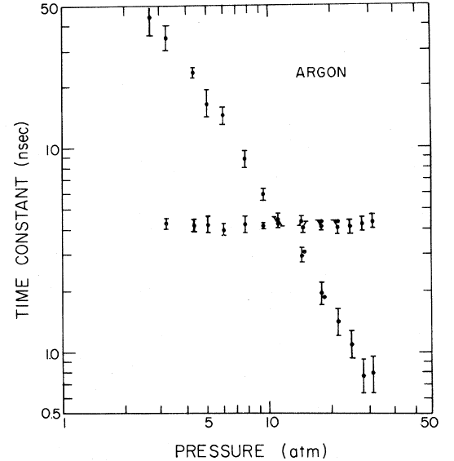
Fast component vs pressure and El. field
Phys. Rev. Lett. 33,
1365 (1974)
The UV3 signal is not affected by an external electric field
The third continuum dominates signal over the first 90 ns up to 5 bar (and continues to be an important contribution for higher pressures). Almost no dependence on P
The excimer formation time strongly depends on P

Slide 13
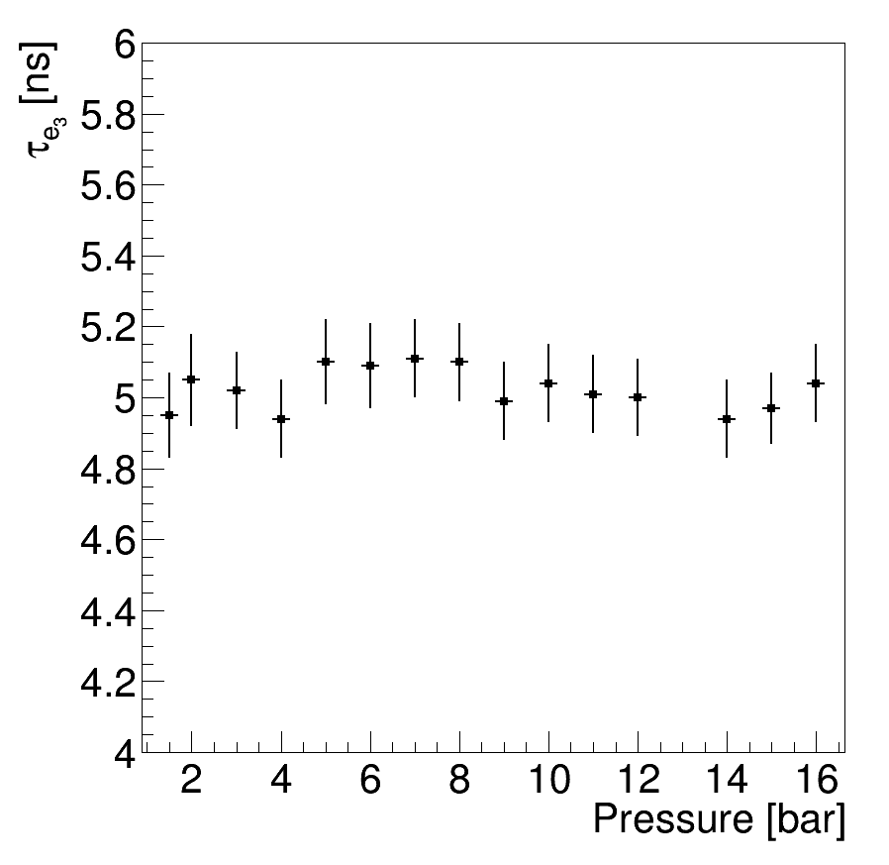
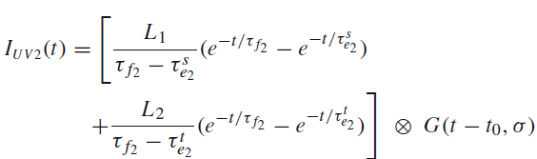

Emission constants

Slide 14
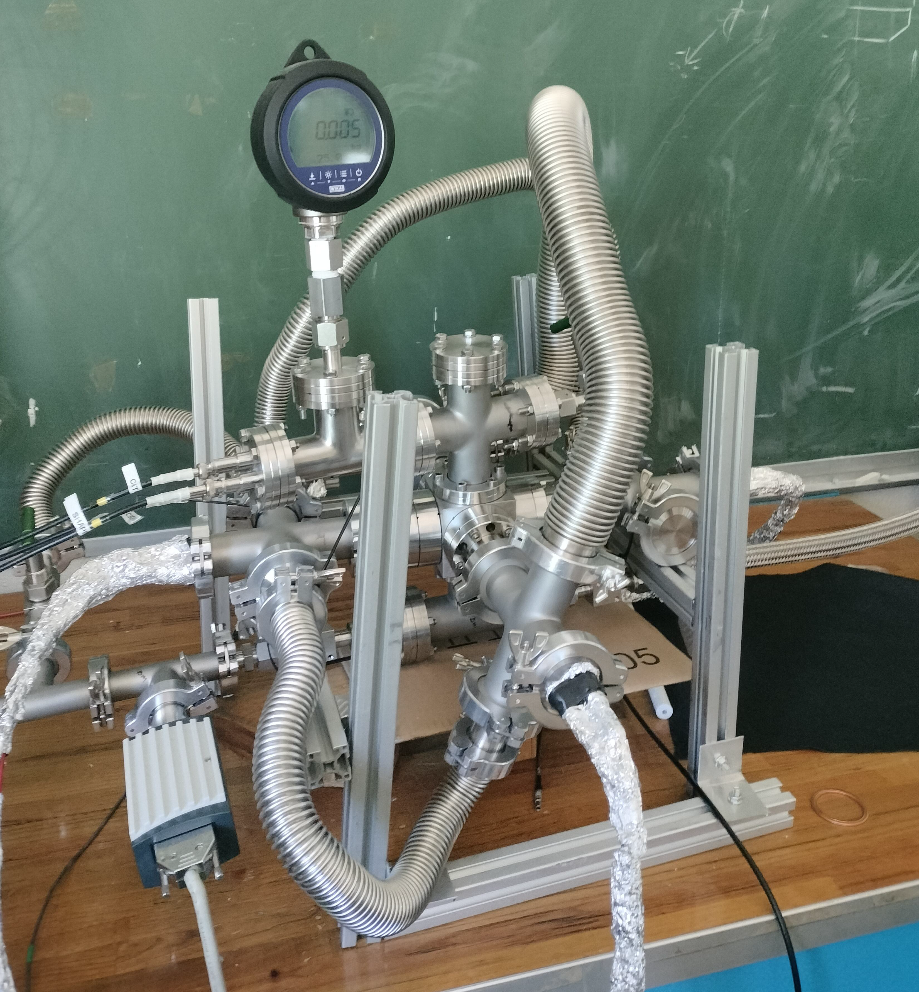
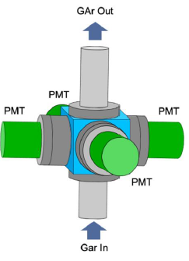
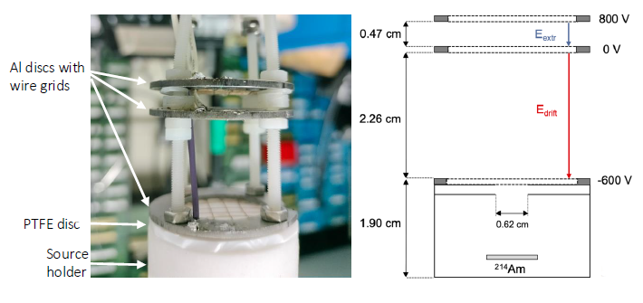
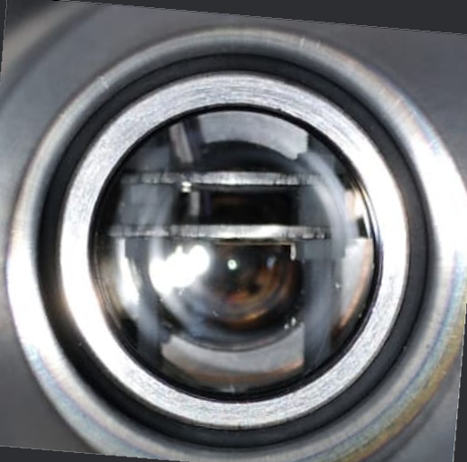
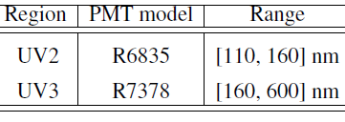
Electroluminescence studies
Small TPC designed to study the UV component (λ > 160 nm) of the EL light in Ar
P_{in}< 9e-5 mbar (before filling), P_{out}<5e−4 mbar (constant)
Alphagaz™-2 (6.0 purity), flux ∼1 slm, P_{in}=(1.08 ±0.02) bar
CAEN DT5730SB ADC 14-bit, 500 MS/s, 2 V
L_{drift}=2.26 cm, L_{EL}= 0.47 cm
E_{drift}= 266 V/cm, E_{EL}= 1.69 kV/cm
²⁴¹Am α source
(≈5.5 MeV, ≈ 90 Bq,
collimated)

Slide 15
Fields OFF (S1-pulse @1 bar)
τ_{PMT2} = 3.19 ± 0.15 μs
τ_{PMT1} = 3.11 ± 0.11 μs
“UV3” light (VUV photons with wavelength > 160 nm) detected with this upgraded setup
Features consistent with the previous results

Slide 16
Fields ON (El-pulse @ 1 bar)
EL light
We do see “UV3” light In the electroluminescence signal
UV3 photons emission fraction: (10.44 ± 0.23)%.

Slide 17
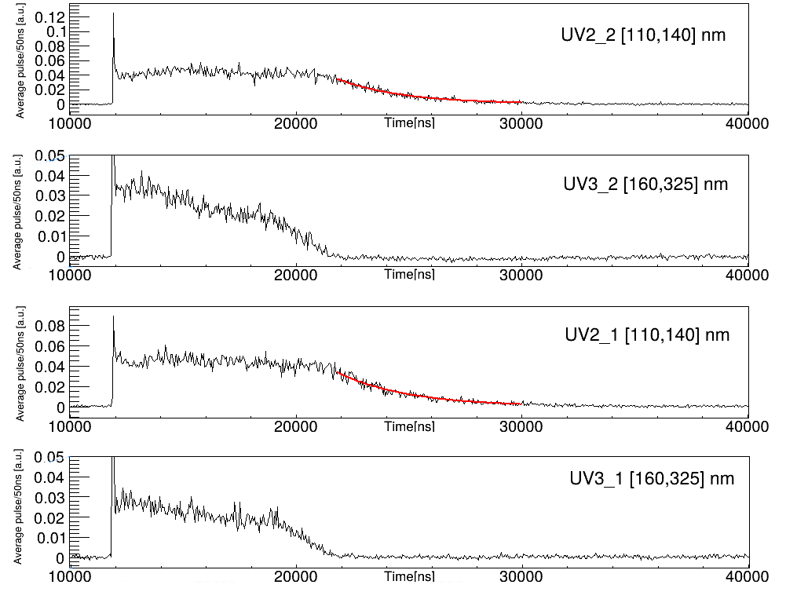
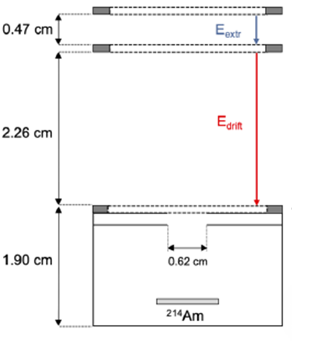


Fields ON EL-average pulse (1 bar)
[ns]
[ns]
[ns]
[ns]
$$t_{drift}^{Max}≅7.7 μs$$
$$t_{EL}^{Max}≅0.8 μs$$

Slide 18
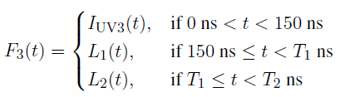

Fields ON EL-average pulse (1 bar)
PRELIMINARY
PRELIMINARY

Slide 19
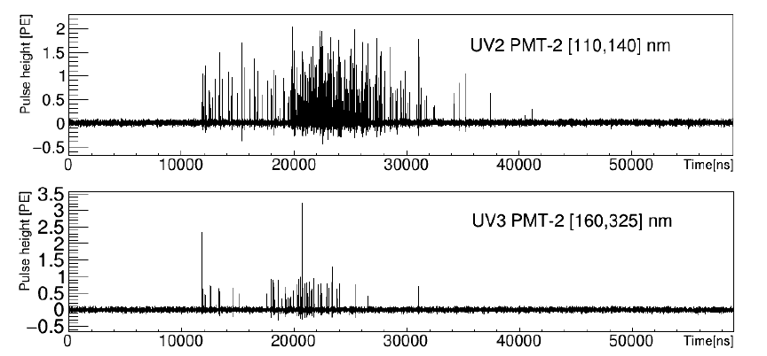
Event characterization

Slide 20
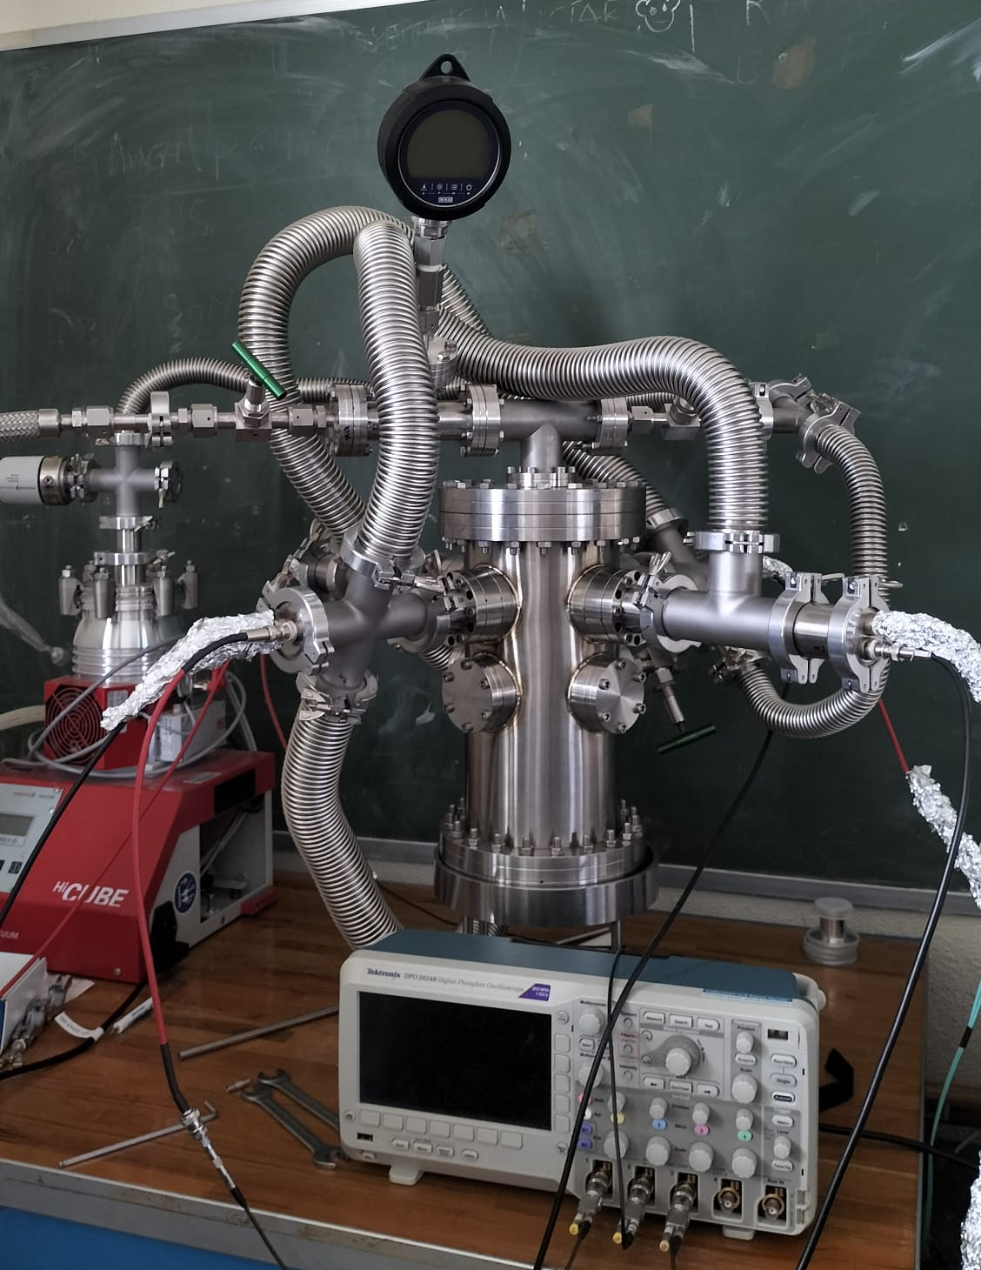
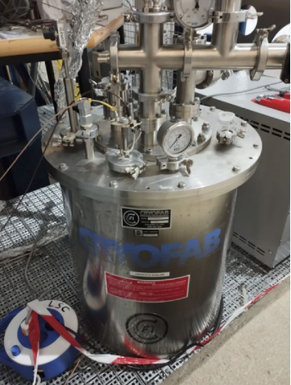
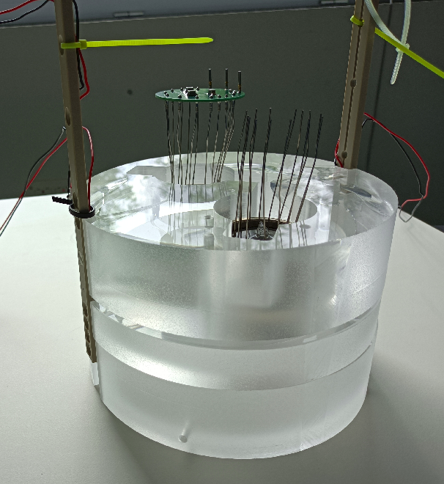
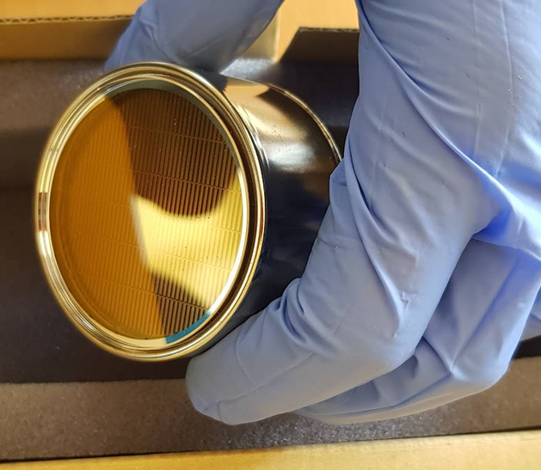
New detectors in preparation

Slide 21
Conclusions
Conventional Ar/Xe detectors are built with fast light detection devices coupled with photon wavelength-shifters that integrate the light signal over a wide spectral range
Potential information provided by the scintillation wavelength?
Fast emission in GAr detected, different from the standard second continuum and consistent with the third continuum
We have established that the argon second and third continuum can be distinguished experimentally by means of sensors with different spectral sensitivities
We have proved that this fast light emission is also present in the EL light
New studies on going (larger chambers, LAr studies)

Slide 22

谢谢大家！

Slide 23

BONUS SLIDES

