Slide 1
Determining the origin of cosmic rays from precise measurements of CR spectra and mass
Xiao-Jun Bi
Institute of High Energy Physics, CAS
The XIX International Conference on Topics in Astroparticle and Underground Physics (TAUP2025)
2025/8/25-30

Slide 2
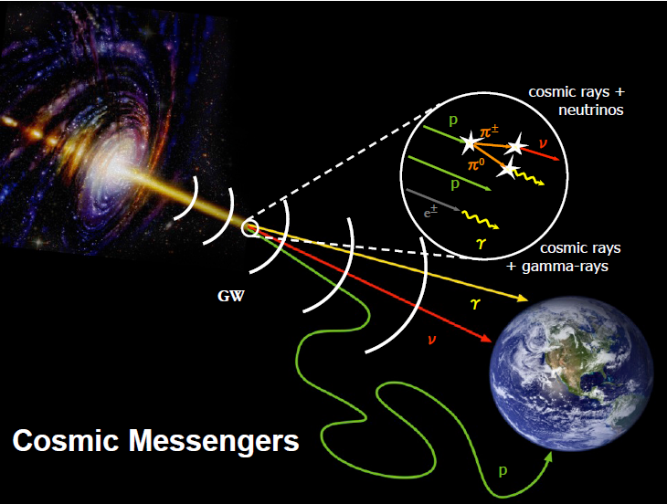
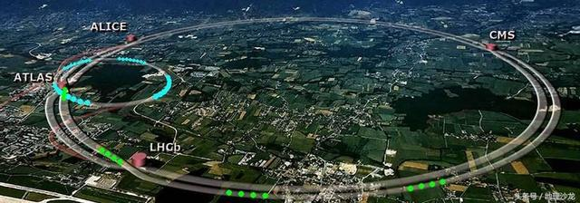
Key problem of HE CRs：origin and acceleration
Cosmic rays are HE charged particle from space
  P、He、C、O 、 … Fe
Highest energy is over 10²⁰eV
  10^7 times the energy of LHC
Magnetic field
Origin of HE CRs is unknown：
  《Science》125 key scientific questions
Earth
Mthods：gamma rays、neutrinos、
  Gamma ray astronomy is the active area in recent years
地球最大人造加速器，周长27公里
日内瓦：大型强子对撞机（LHC）
2
Implications of precise CR measurements for the origin of CRs

Slide 3

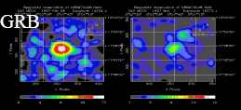
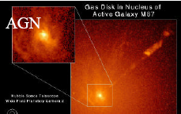
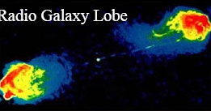
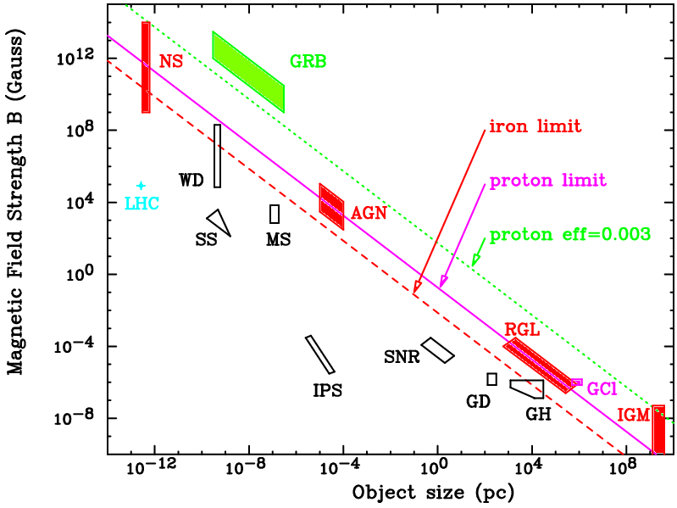
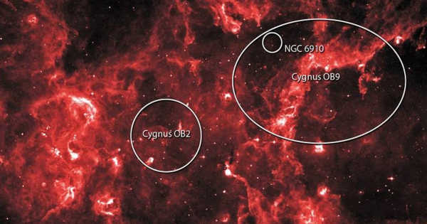

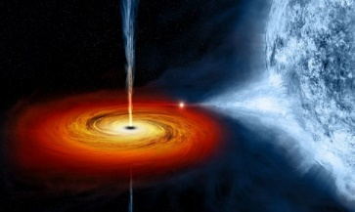

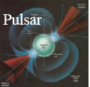
Possible CR sources
Extra-galactic
Galactic
M. Hillas Diagram (1984)
Young massive star cluster
Micro-quasar
Supernova remenant
Stars
Pulsar wind nebula
L
Hubble size
10 km 10⁴ km
1 a.u.
1 Mpc

Slide 4
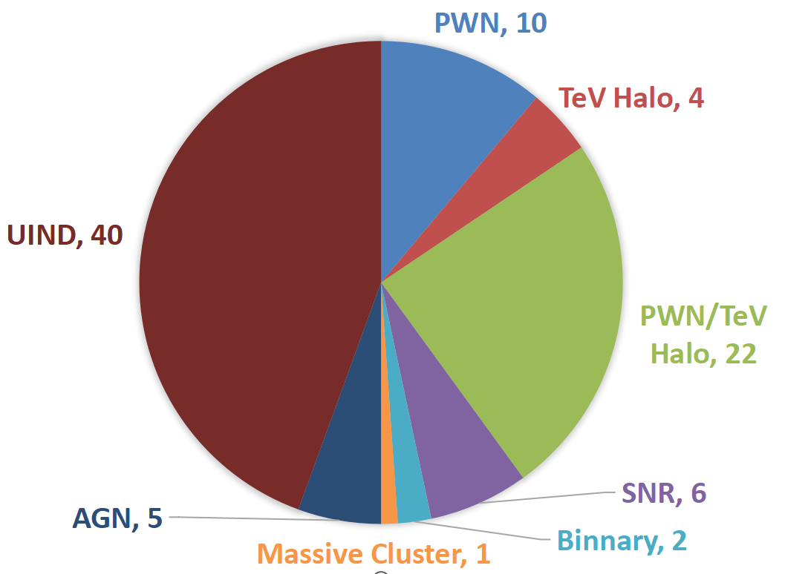
1st LHAASO catalog of gamma sources
The sources includes：young massive star clusters、supernova remenant、micr-quasars、pulsar wind nebula
90
Binary
LHAASO Collaboration:
Astrophys.J.Suppl. 271 (2024) 1, 25

Slide 5
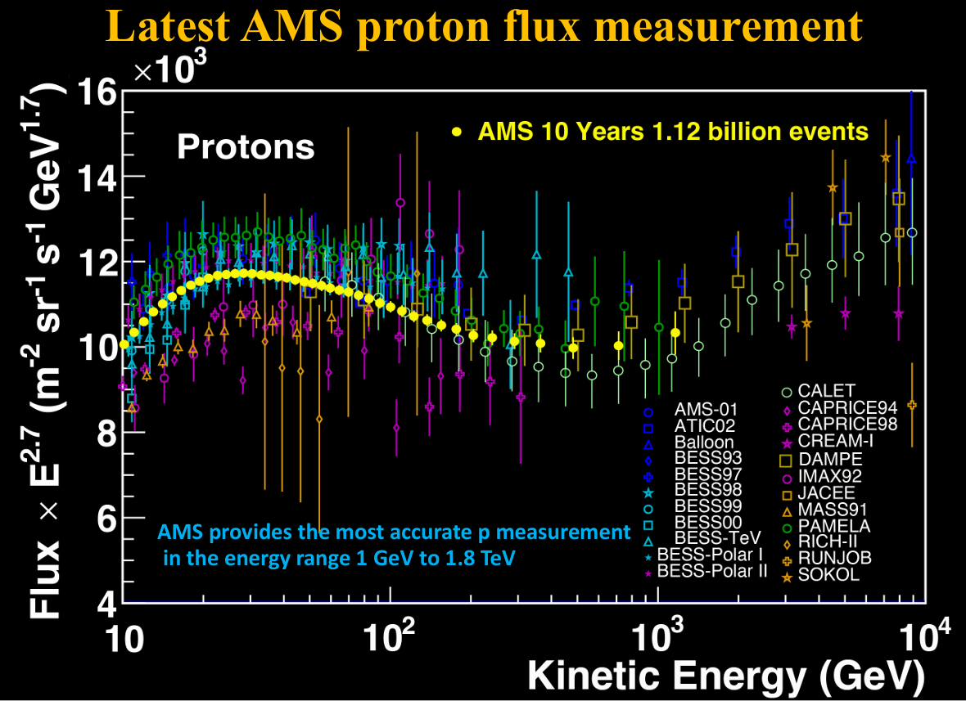
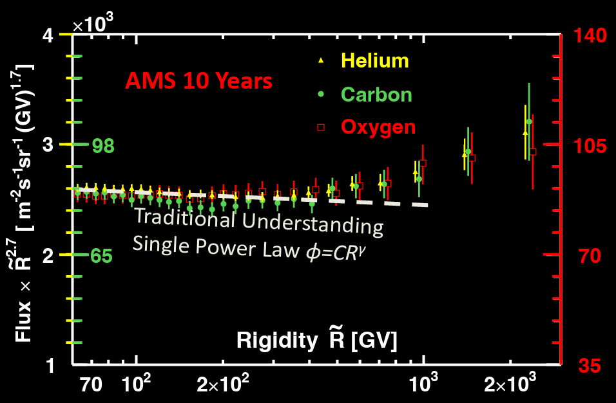
Cosmic ray precise measurements
AMS02 started a new era of precision cosmic rays – fine features in CRs were detected
Except the direct search of CR origins by γ-rays，precise measurement of CR spectra may provide indirect implications

Slide 6
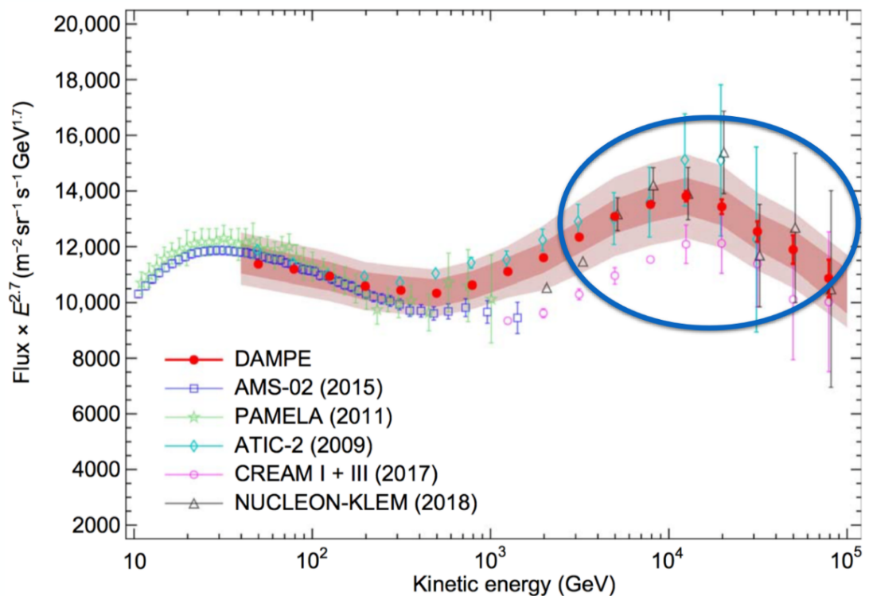
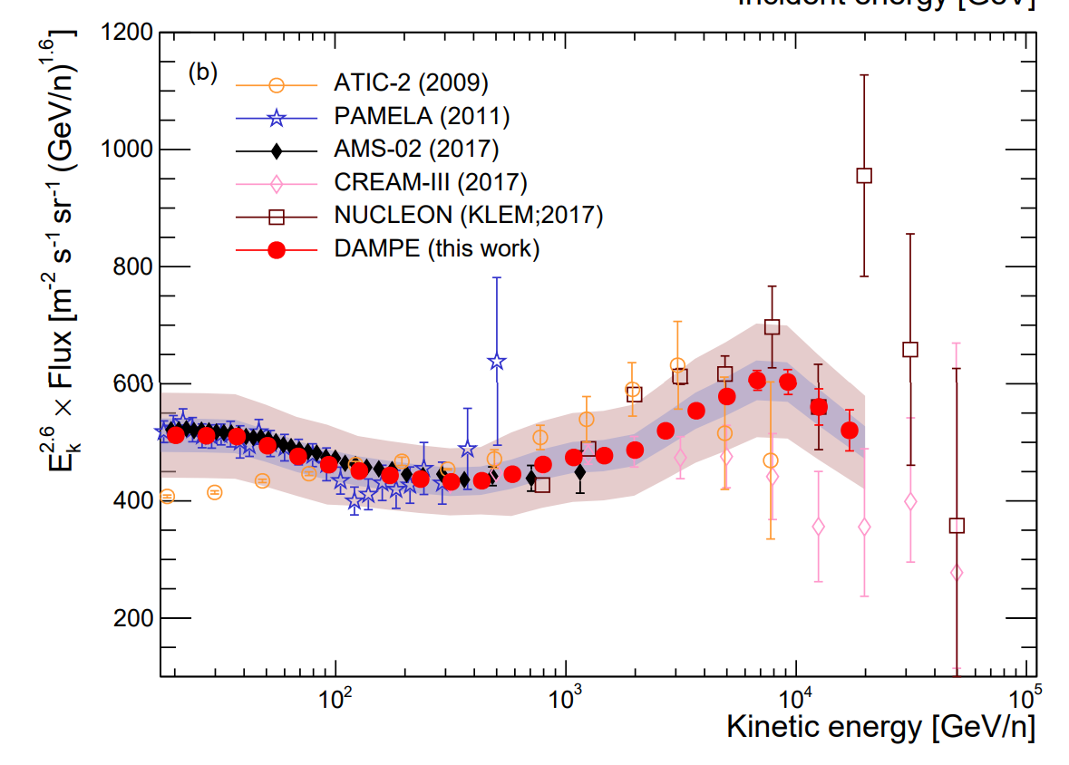
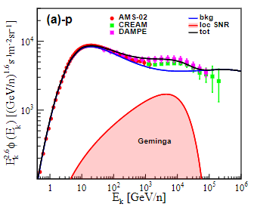
DAMPE discovery
---fine structure in CR spectra
P
Softening @ 14 TeV
P、He have Z-dependent softing，which means the structure may originate from a nearby source
He
Softening @ 34 TeV

Slide 7
prediction：coevolution of anisotropy and spectra (Guo et al，2019，JCAP)
Large anisotropy from the nearby source
spectra/anisotropy correlated closely；
Data strongly support the assumption.

Slide 8
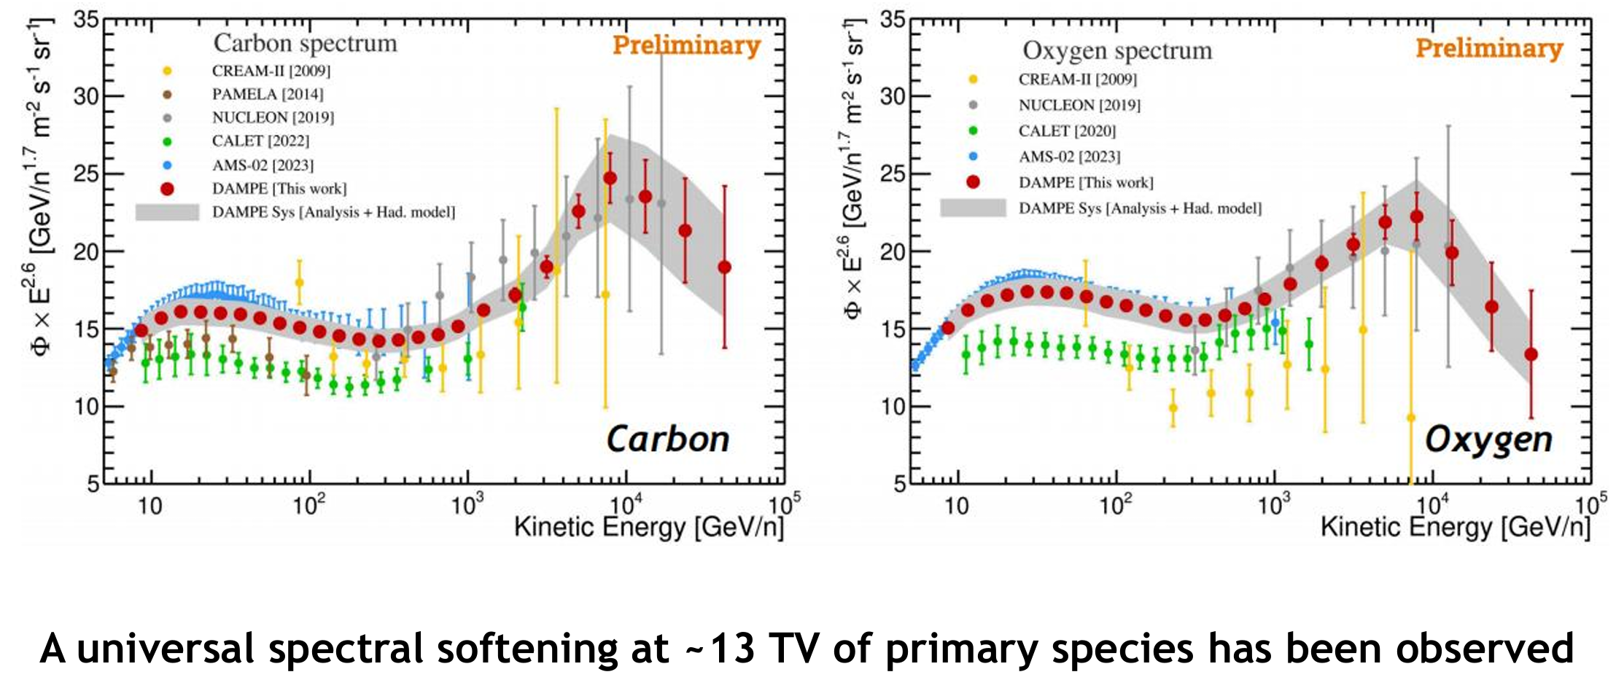
Most recent results of DAMPE

Slide 9
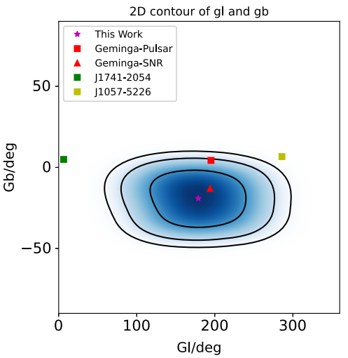
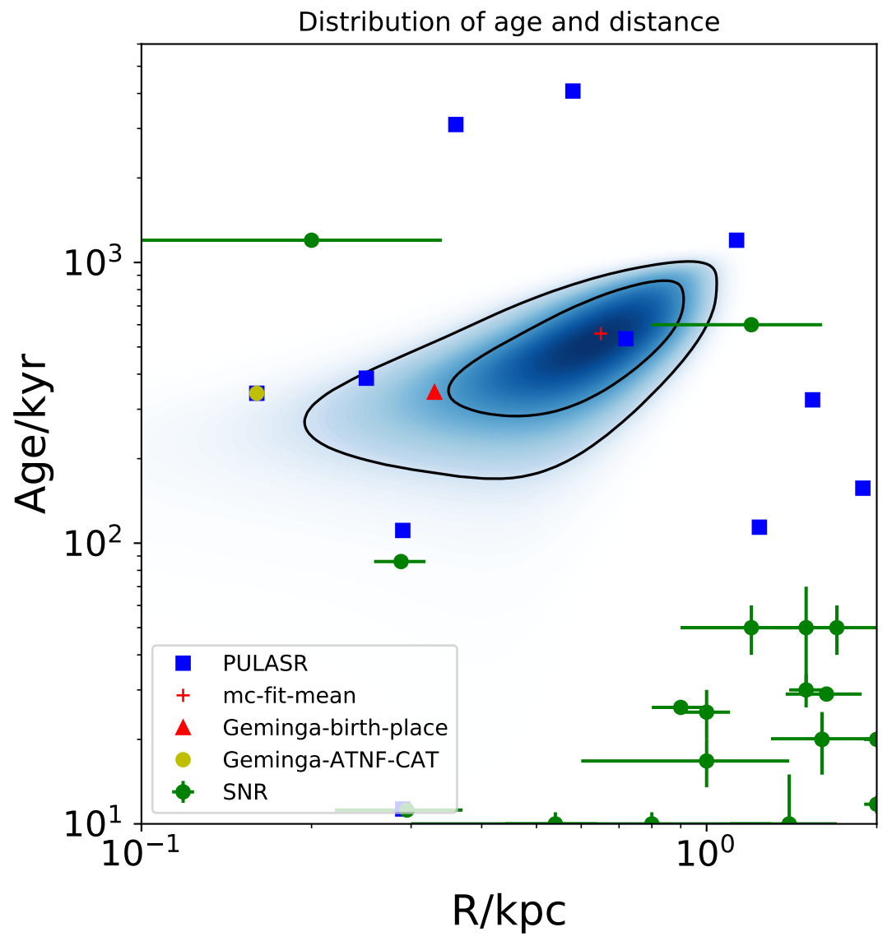
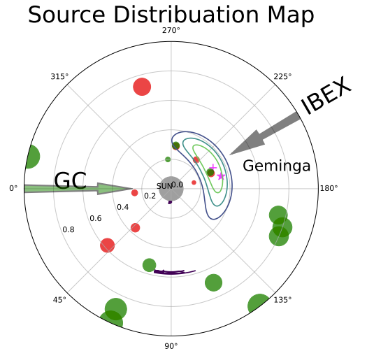
Which is the best nearby source (distance, direction)？
Geminga SNR is possibly the best nearby source contributing to the observation
Zhao et al. ，2022，ApJ, 2023, Universe

Slide 10
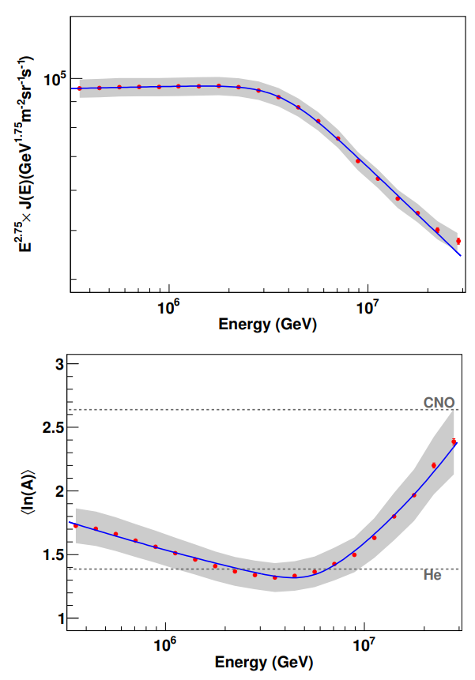
Precise measurement of CR spectrum and mass by LHAASO
The new measurement improves precision greatly
First time detect a decrease of <lnA> before knee, means the heavy component decreases
We decode the data to uncover the bkg CR model
Key: decrease of <lnA> may be from the cutoff of Fe from the local source

Slide 11
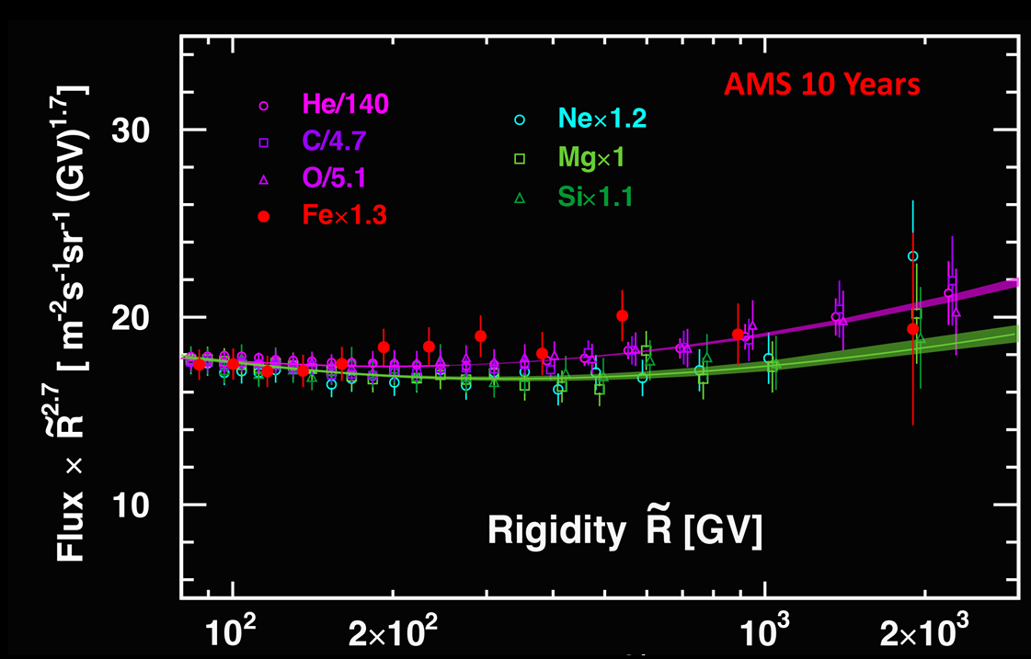
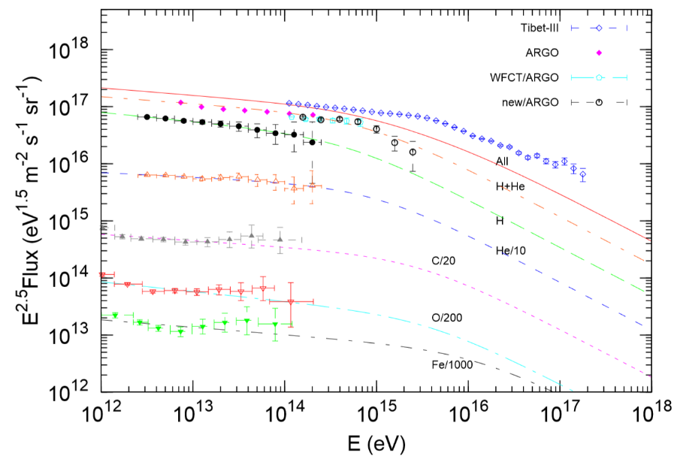
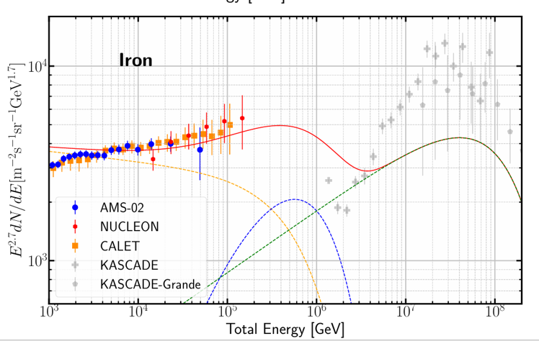
3 components of Galactic CRs
AMS02 spectra determine bkg; however, they are too soft to account for the knee
A ‘hard’ high energy component is needed to account for knee

Slide 12
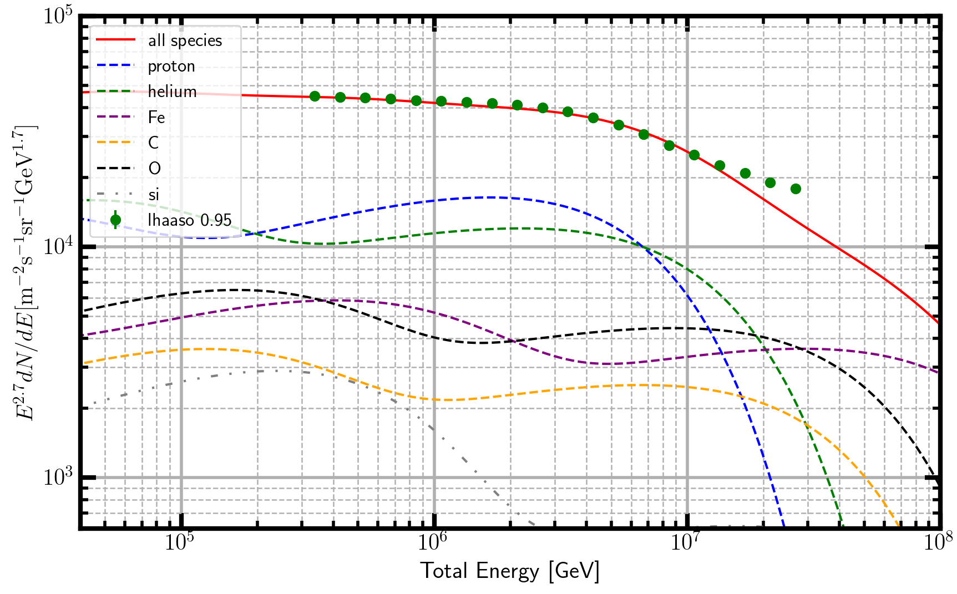
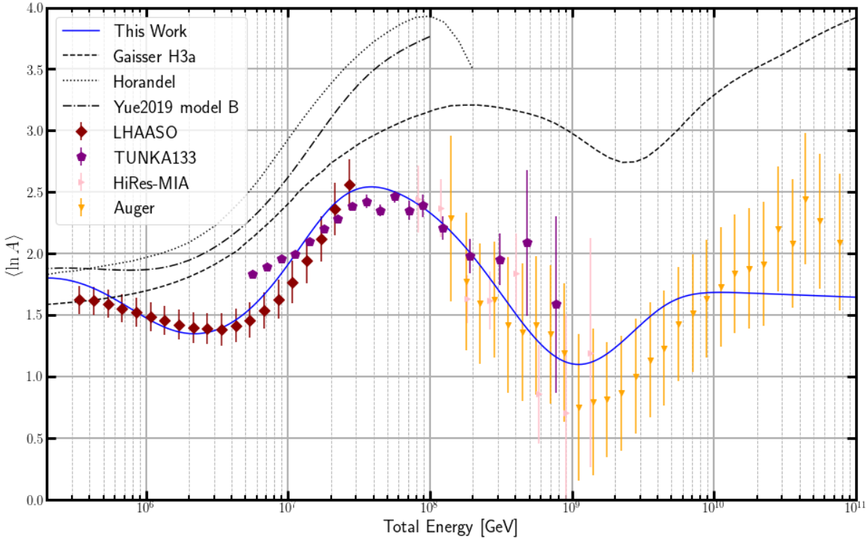
2 extra-galactic CR components
EG contribution needed
LHAASO highest energy data can not be explained by Galactic CR
Ankle and <lnA> show that at least 2 components: LE and HE
<lnA> decrease of EG component coms from the cutoff of Fe from the galactic ‘hard’ component

Slide 13
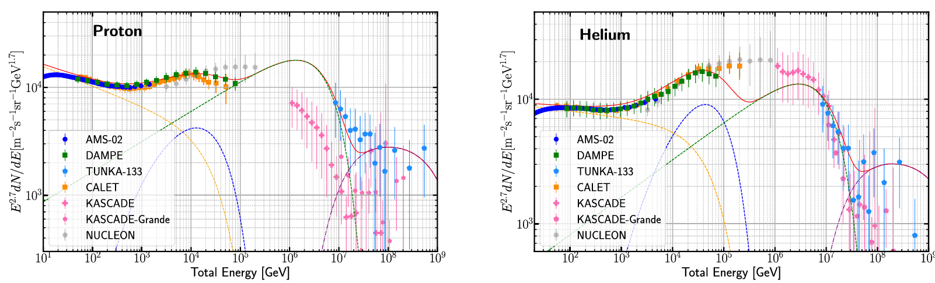
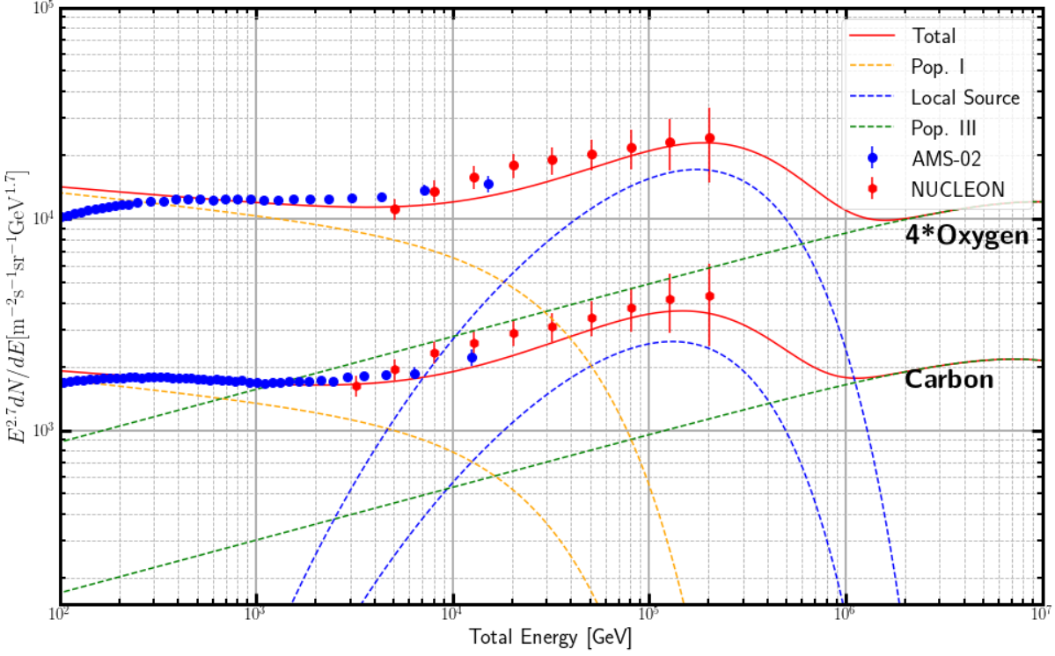
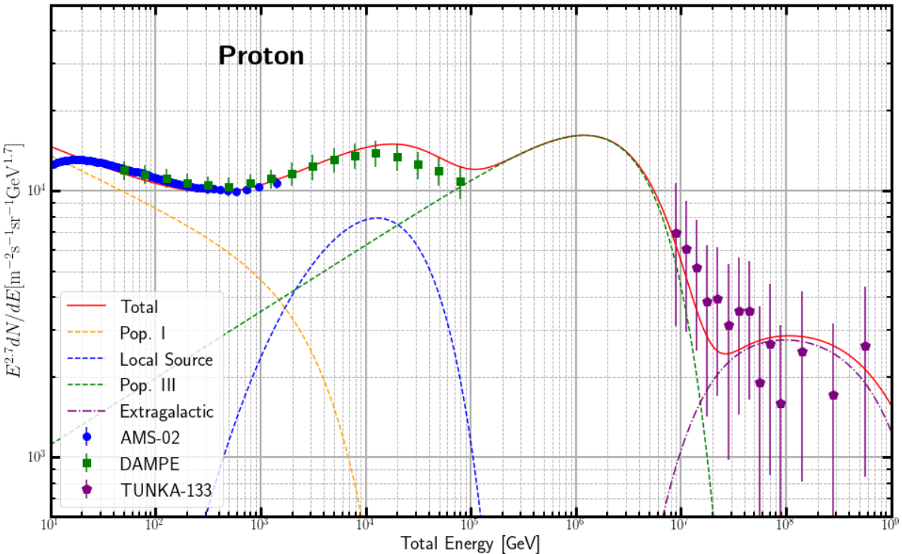
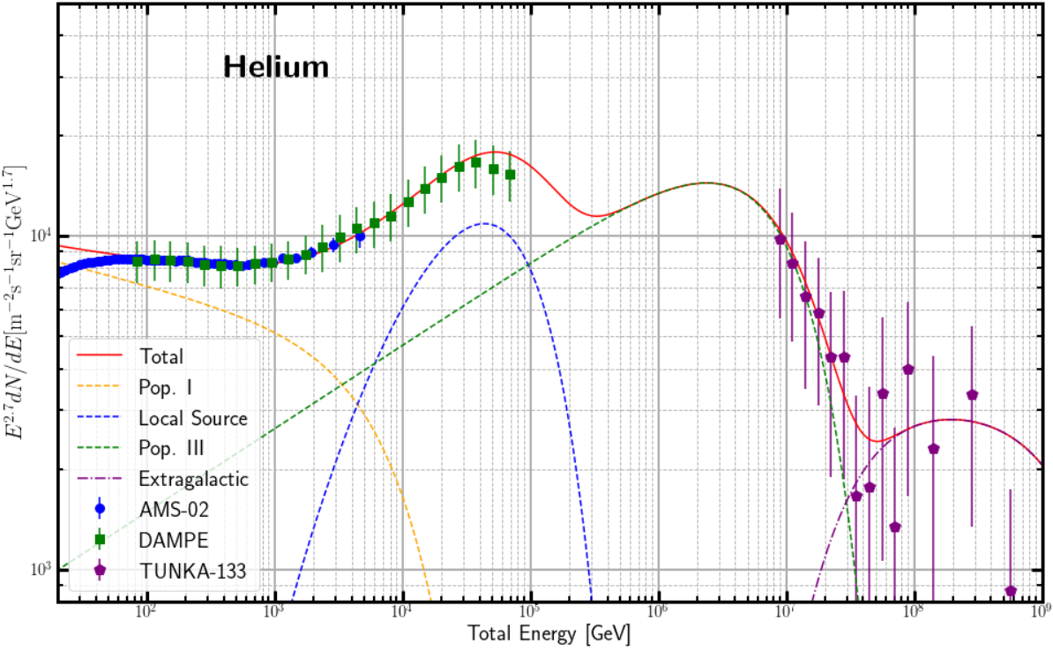
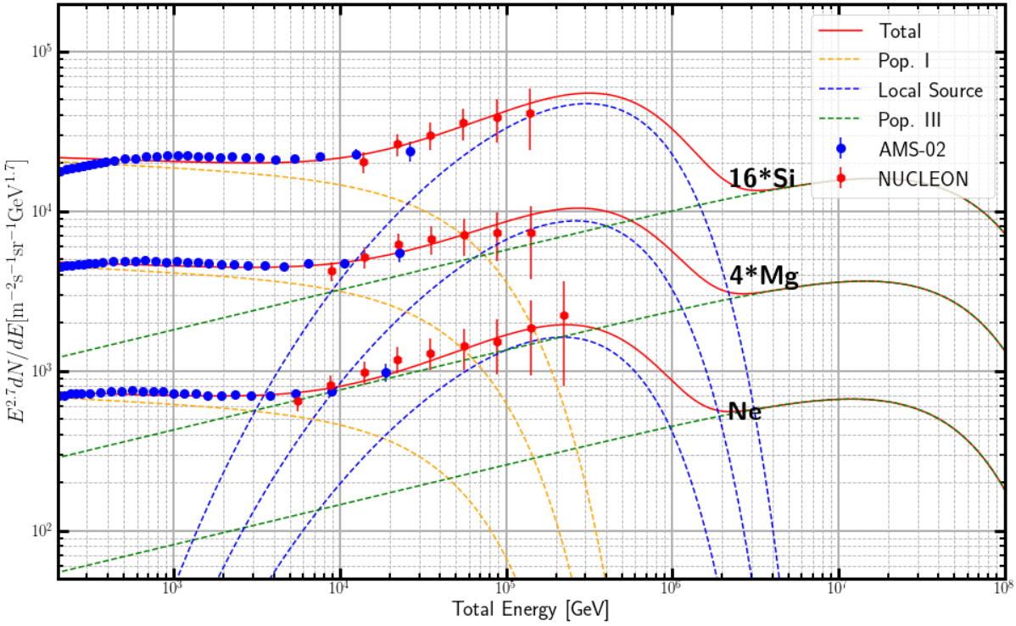
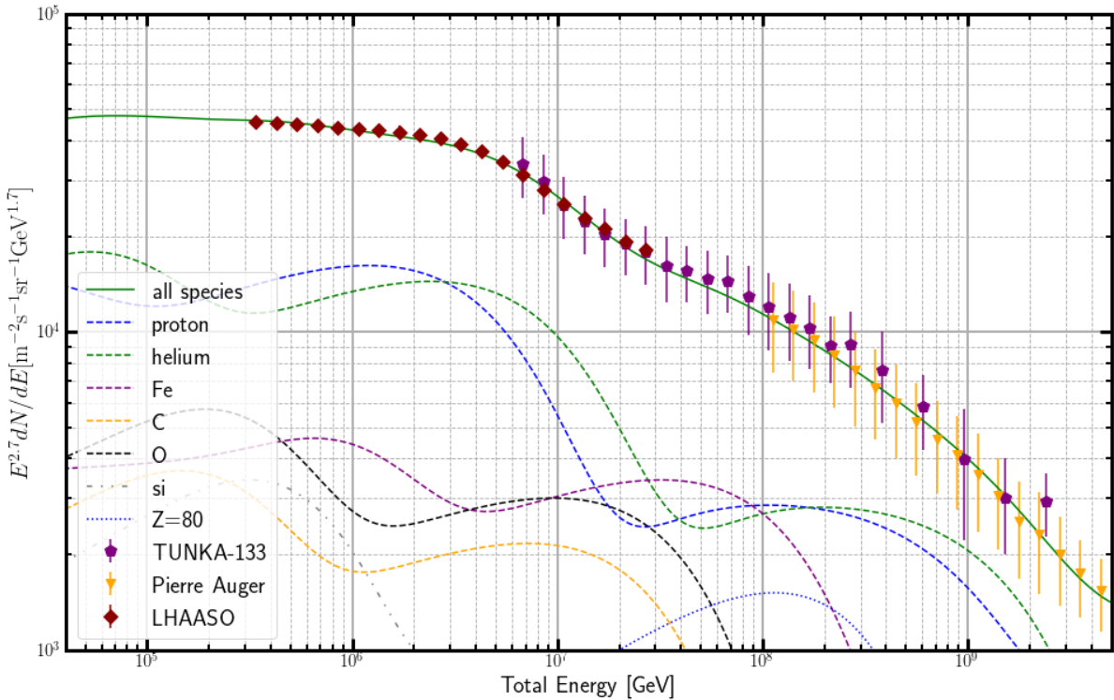
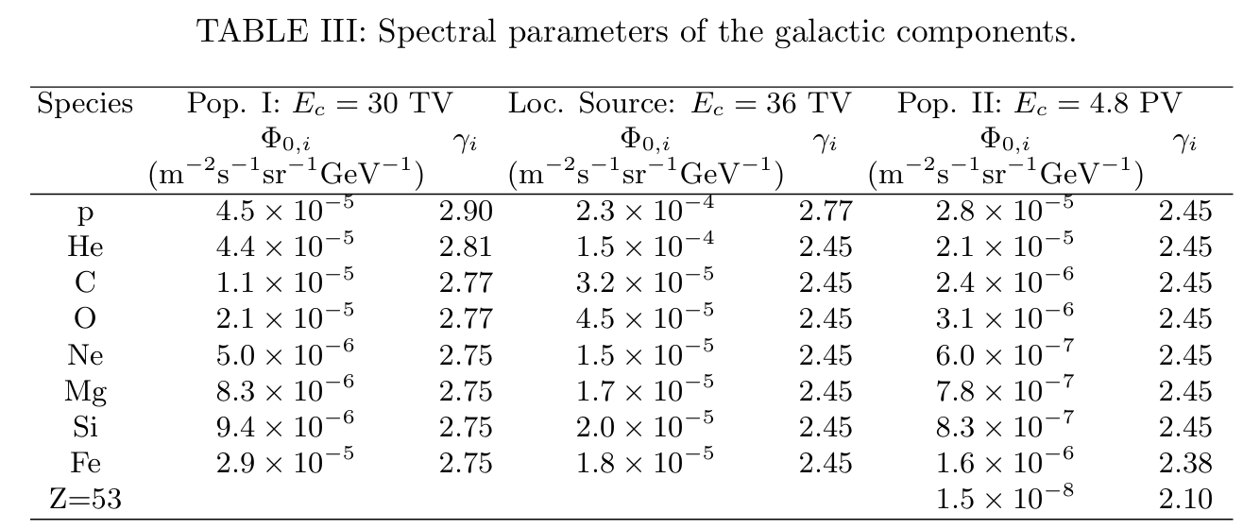
The model prediction
Small Extra-galactic

Slide 14
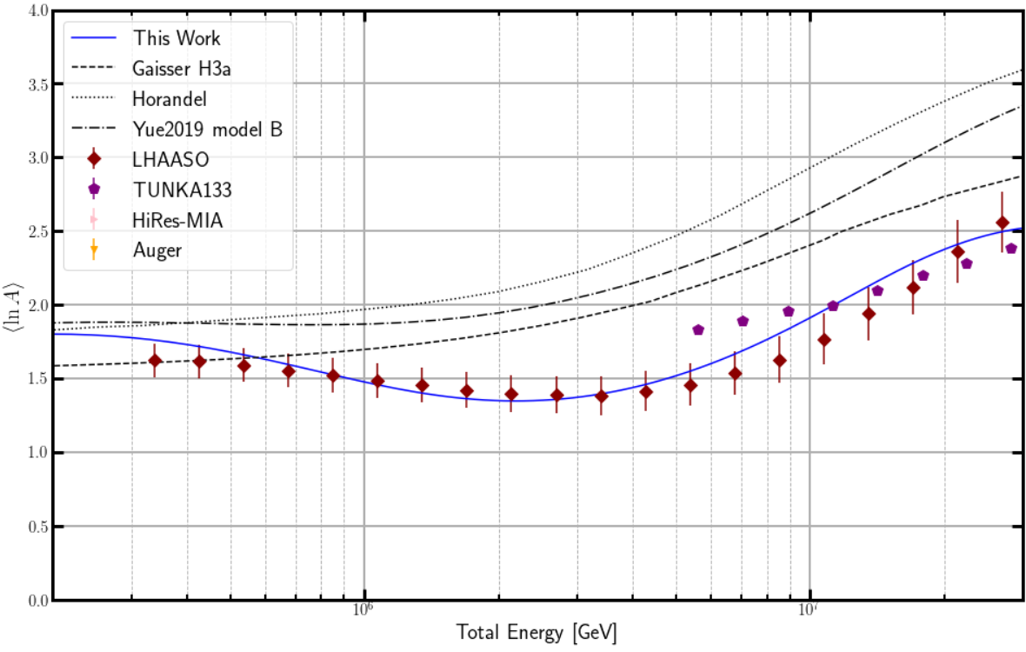
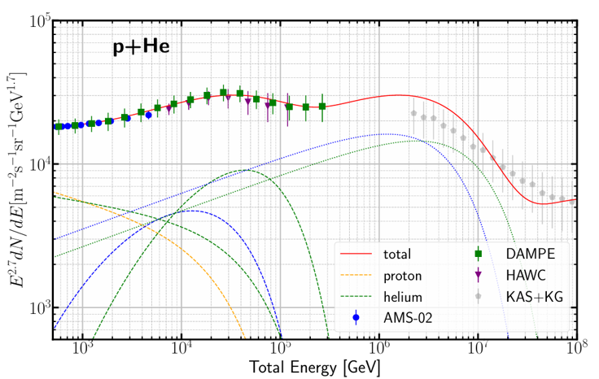
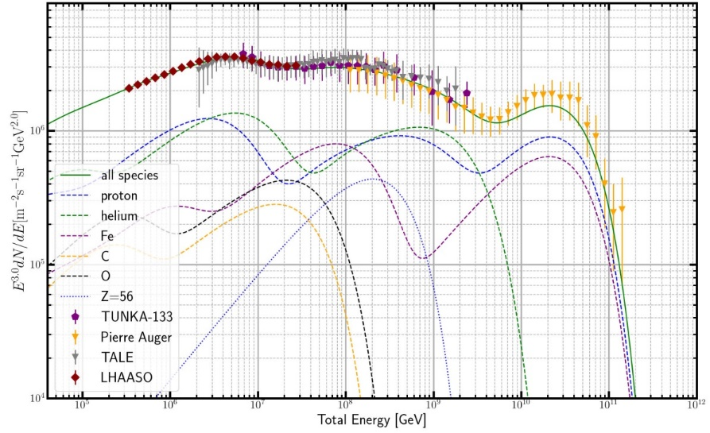
Local source cutoff energy is determined by DAMPE, while cutoff of Fe happens to account for the LHAASO <lnA> decrease; it is very intriguing
LHAASO定标-4.5%
Cutoff by local Fe
额外的河外轻成分？？
High bkg Fe cutoff
Cutoff energy of galactic CR is determined by LHAASO knee measurement, Fe cutoff happens to account for Auger <lnA> decrease

Slide 15
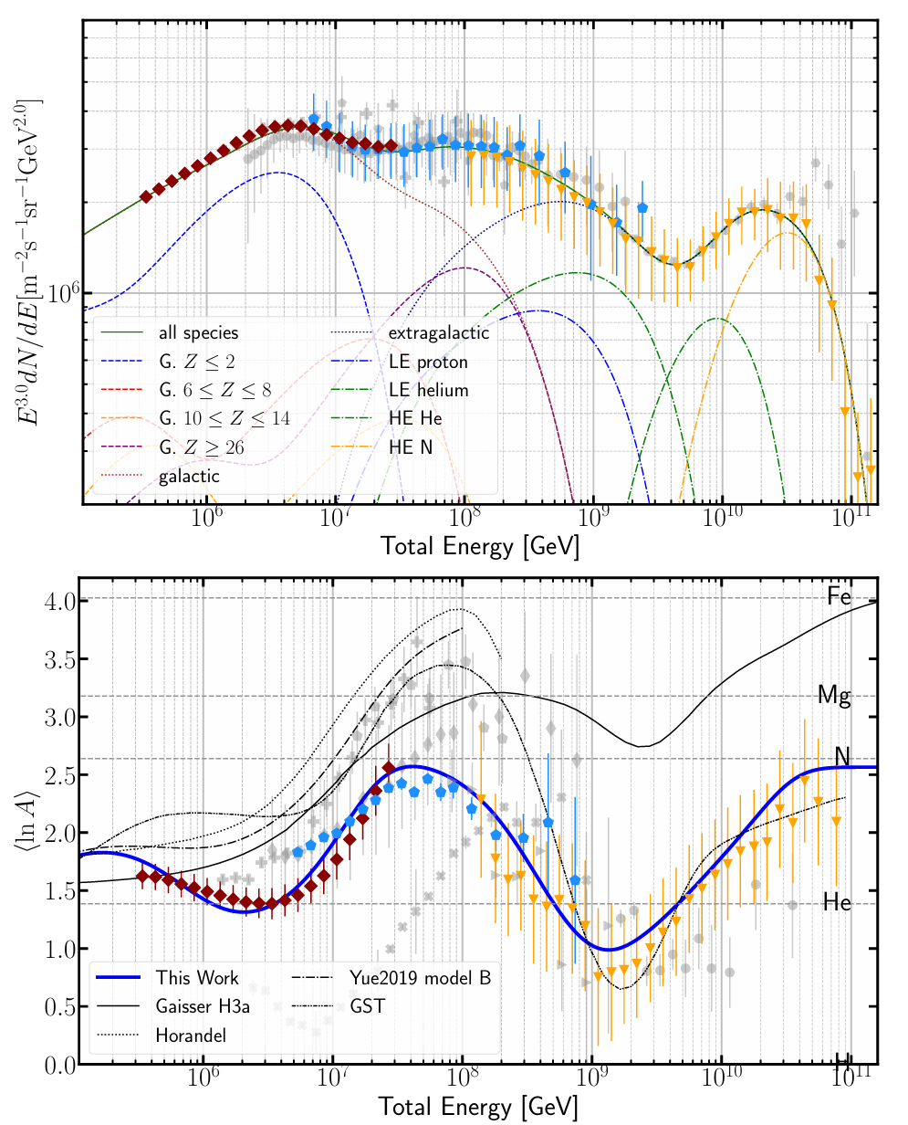
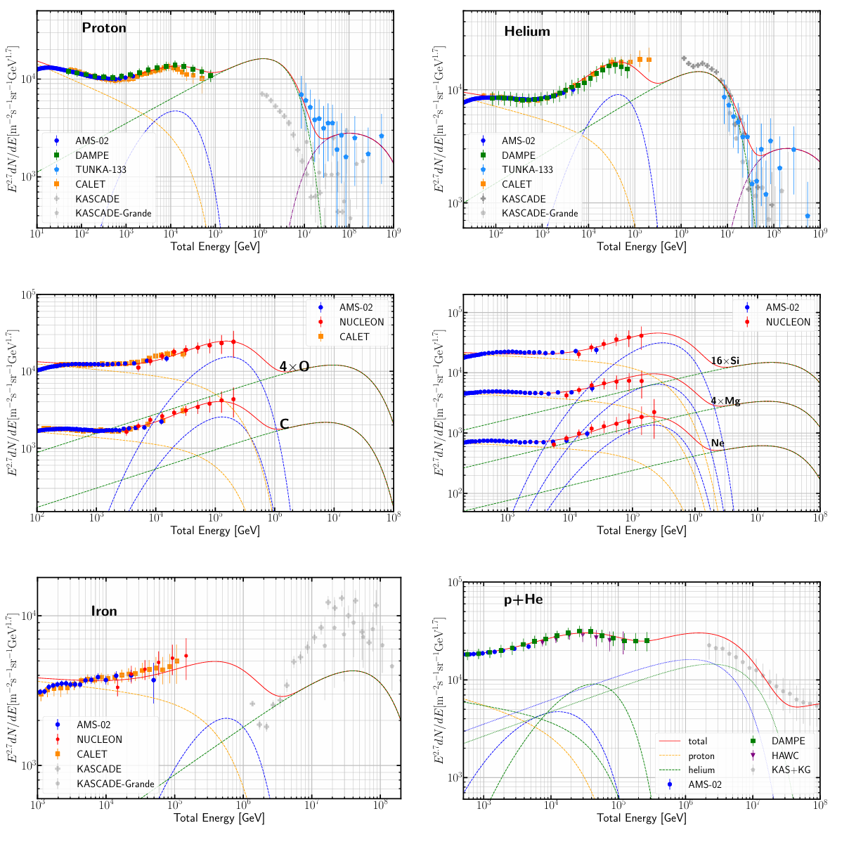
Lv, XJB et al., arXiv: 2403.11832
CR Origin：AMS02-DAMPE-HAWC-LHAASO-TUNKA-Auger energies are calibrated and rescaled to AMS02. very impressively that most rescale less than 5%.
knee
LE ank
SBG?
AGN?
2nd knee
ankle
Geminga?
PaVatrons，YMSC? MQ？PWN？
GZK
LE，SNR?
Cutoff of GA Fe
Old models
Cutoff of nearby Fe spec
rise by HE

Slide 16
Implications of CR origin
The observed CRs are contributed by at least 3 kinds of GA sources：LE may come from SNR，local source is probably Geminga，’hard’ HE component may come from binary/PWN/YMSC
/MQ; EG LE CR may come from SBG (by shock wave
acceleration) and AGN provide the HE
Model prediction：1, LHAASO observation of Fe softening at similar rigidity as p, He；2，p、He spectra measurement at the knee region

Slide 17
summary
The model explains CR data from AMS02、DAMPE、LHAASO、TUNKA、Aguer consistently. Features at the spectrum, including LE bump, knee, LE ankle, 2nd knee, ankle and GZK cutoff are all well reproduced in the model
Precise CR measurement implies origin of CRs which may has different kinds of sources contributing to different energy ranges

