Slide 1

LACT SiPM Camera
Mingjie Yang，Shoushan Zhang，Ming Wei，Huimin Yang，Jinfan Chang，Changge Zi，Yong zhang
Institute of High Energy Physics
TIANFU Cosmic Ray Research Center
2025.08.28
Notes:
Good afternoon，everyone! I am Mingjie Yang, from the Institute of high energy physics. Thanks to the organizing committee to give me a chance to stand here and share the work about the LACT camera.

Slide 2
Content
LACT project
Camera development plan
Key technologies
Current progress
Notes:
In this report, I will introduce the LACT project and the camera design plan. And then, I will share several key technologies inside the camera. At last, I will report the current progress and next plan about our first prototype.

Slide 3
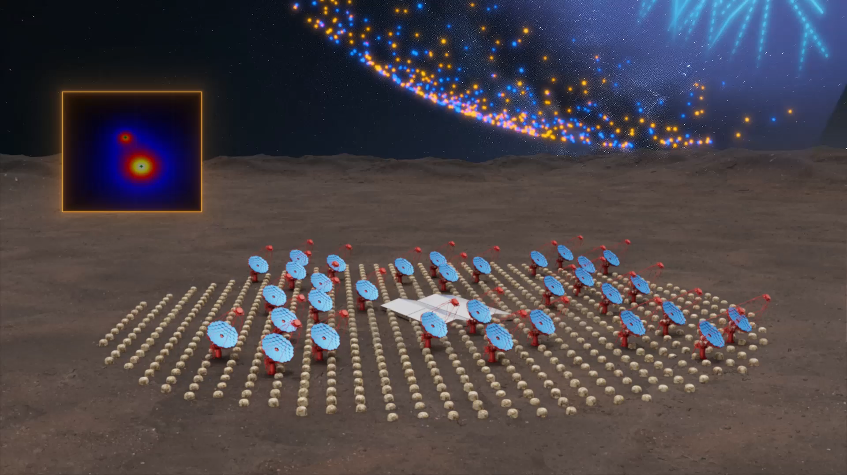
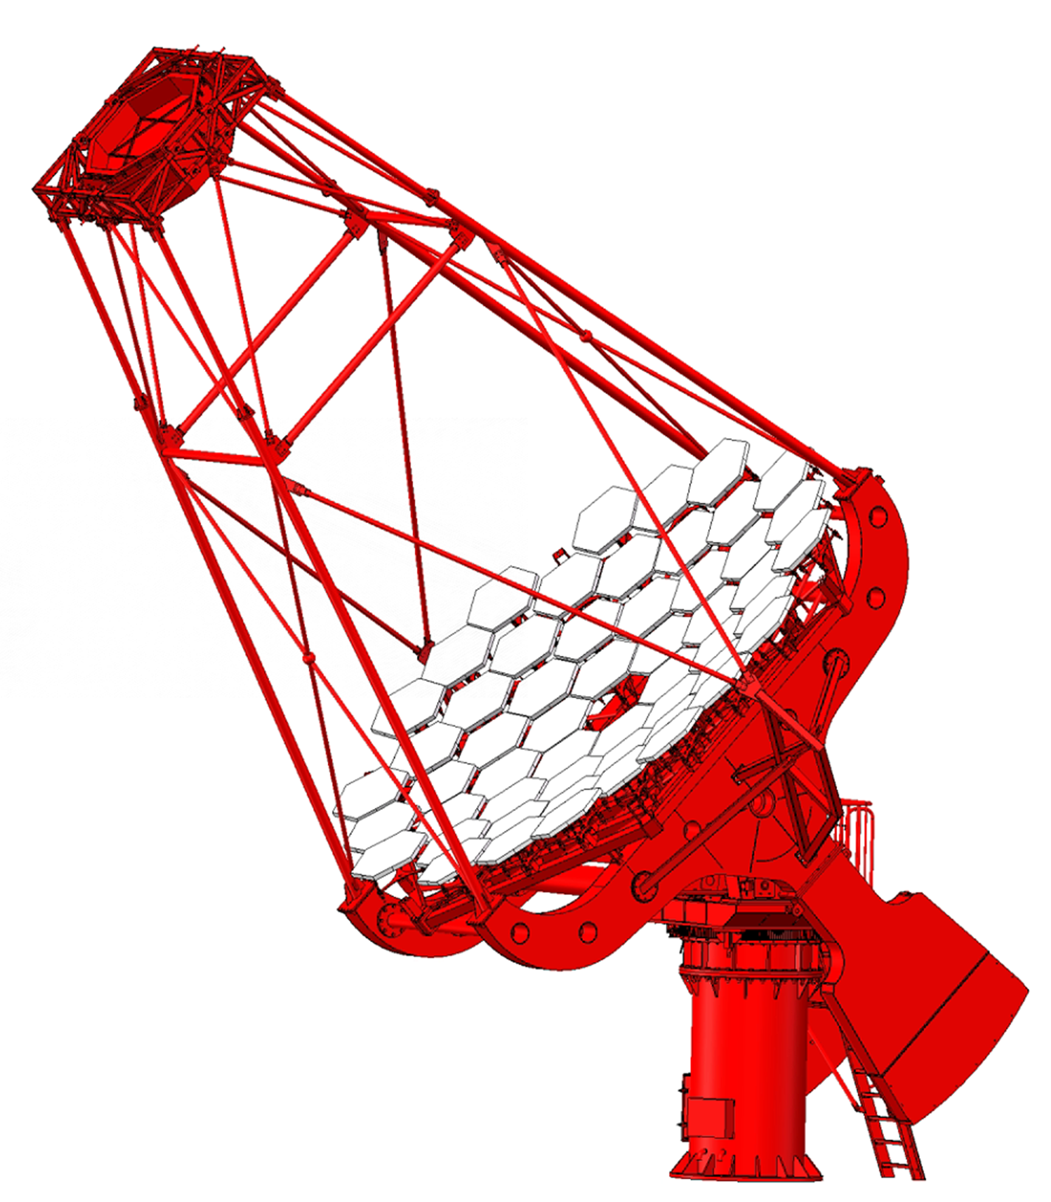
LACT Project
Telescopes: 32
Altitude: 4410 m
Site：Haizi Mountain（LHAASO site）
Energy Range: 1TeV – 1PeV
Field of view (FOV): ~8°
Angular resolution: ＜0.05° @ 10 TeV
Reflector diameter: ~6 m
Focal length: ~ 8 m
Camera
Observation with the LHAASO-MD Array
Mirror
Supporting and rotating system
Notes:
Up to now, the LHAASO experiment has found over 40 ultra-high-energy γ ray sources in the Milky Way Galaxy. However, the angular resolution of the LHAASO experiment is 0.3°。It is hard the take a clear picture for the ultra-high-energy γ ray source. The Cherenkov telescopes （MAGIC,HESS） have higher angular resolution, but their sensitivity is not enough at 100TeV.
We will build 32 large area imaging Cherenkov telescopes on the LHAASO site. Observation with the Moun-detector array of the LHAASO and based on the strong γ ray selectin ability, the LACT experiment can achieve enough sensitivity at 100 TeV. Base on the spatial imaging technology, the LACT experiment can realize the angular resolution of 0.05°。
The telescope of the LACT experiment is composed of the supporting and rotating system, the reflect-mirror dish with the diameter of 6 meter, and the SiPM camera.

Slide 4
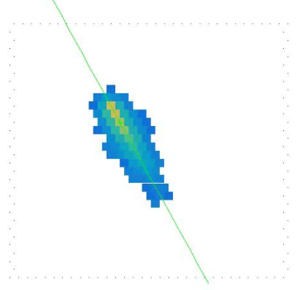
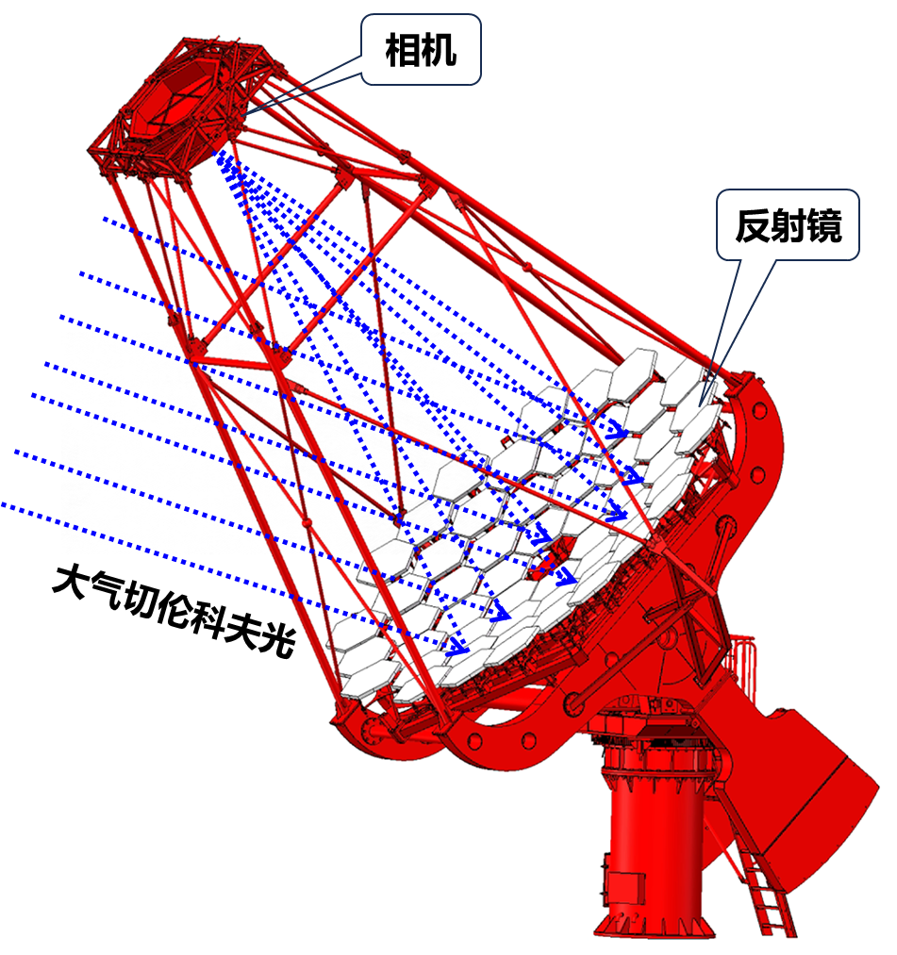
Camera
Camera
Mirror
Atmospheric Cherenkov light
Cherenkov light image
Camera pixels: 1616
Photosensor: SiPM
FOV of each pixel: ~0.19°
Notes:
The camera is located at the focal plane of the mirror. The focal length is about 8 meter, and the field of view angle is bout 8°。
When the atmospheric Cherenkov light is reflected and focused by the mirror to the camera’s surface. The camera will measure the intensity and shape by imaging.

Slide 5
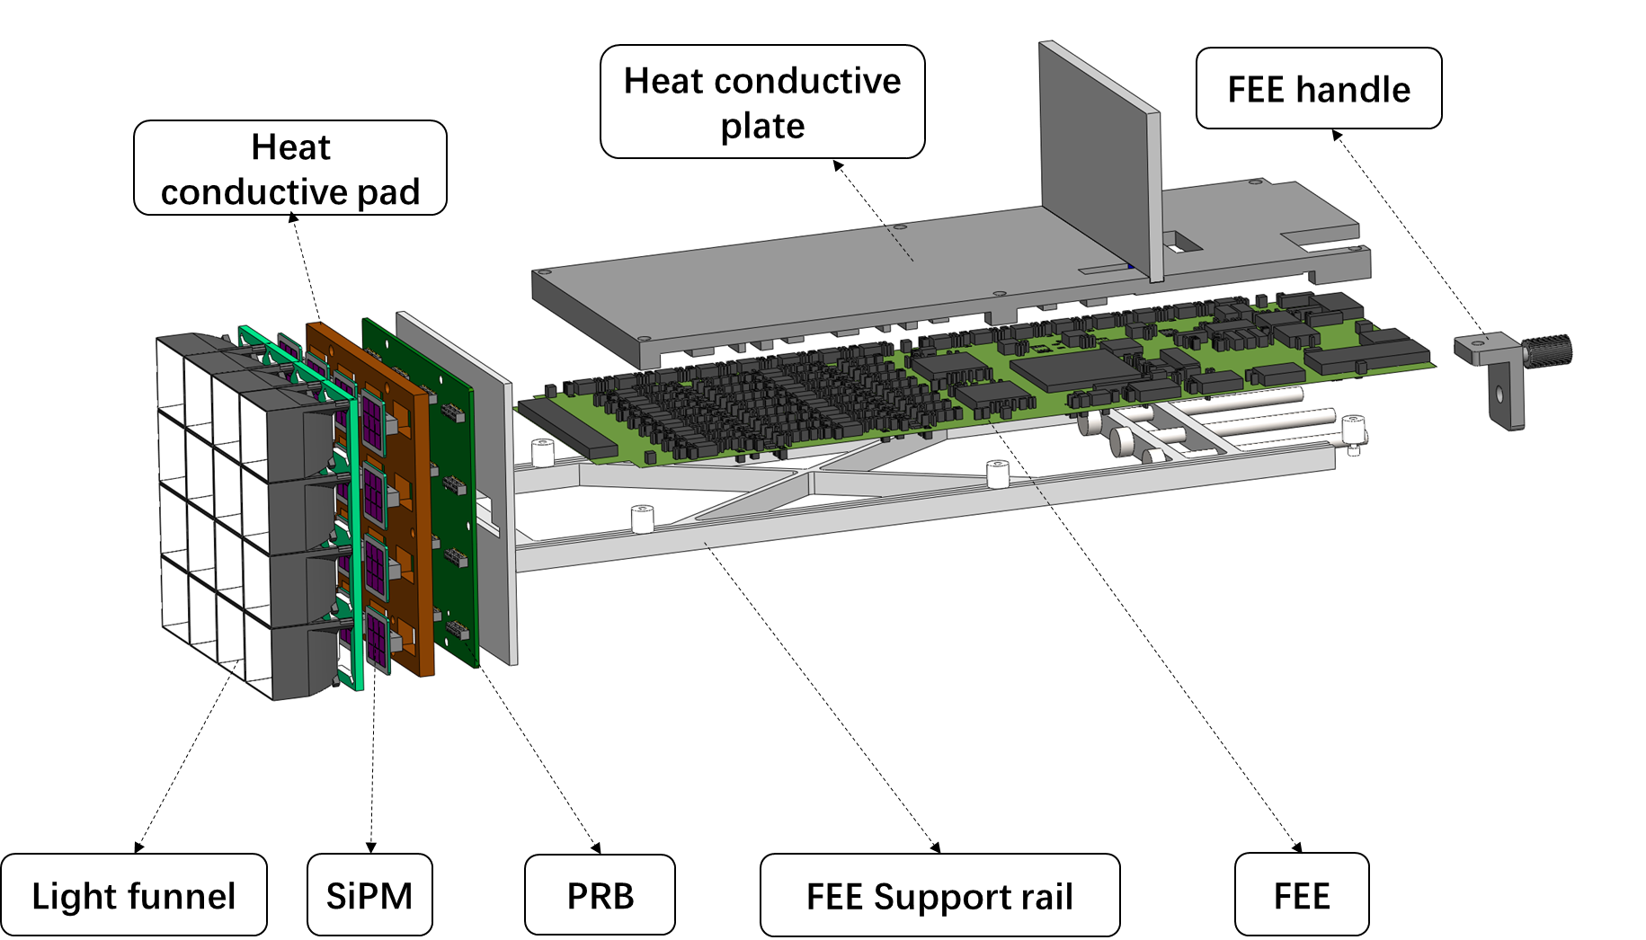
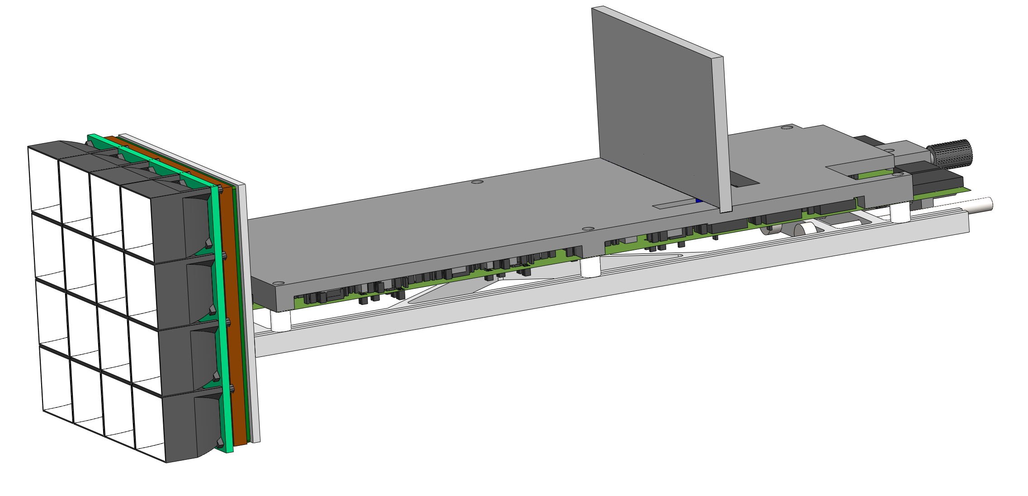
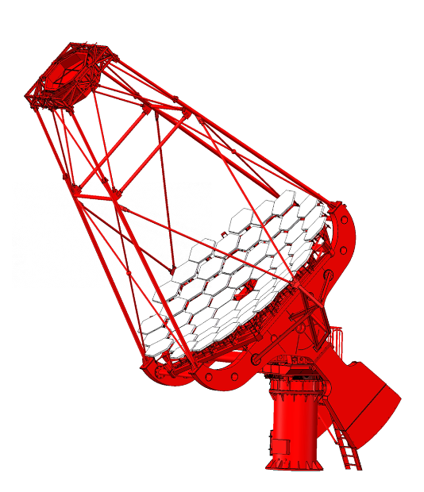
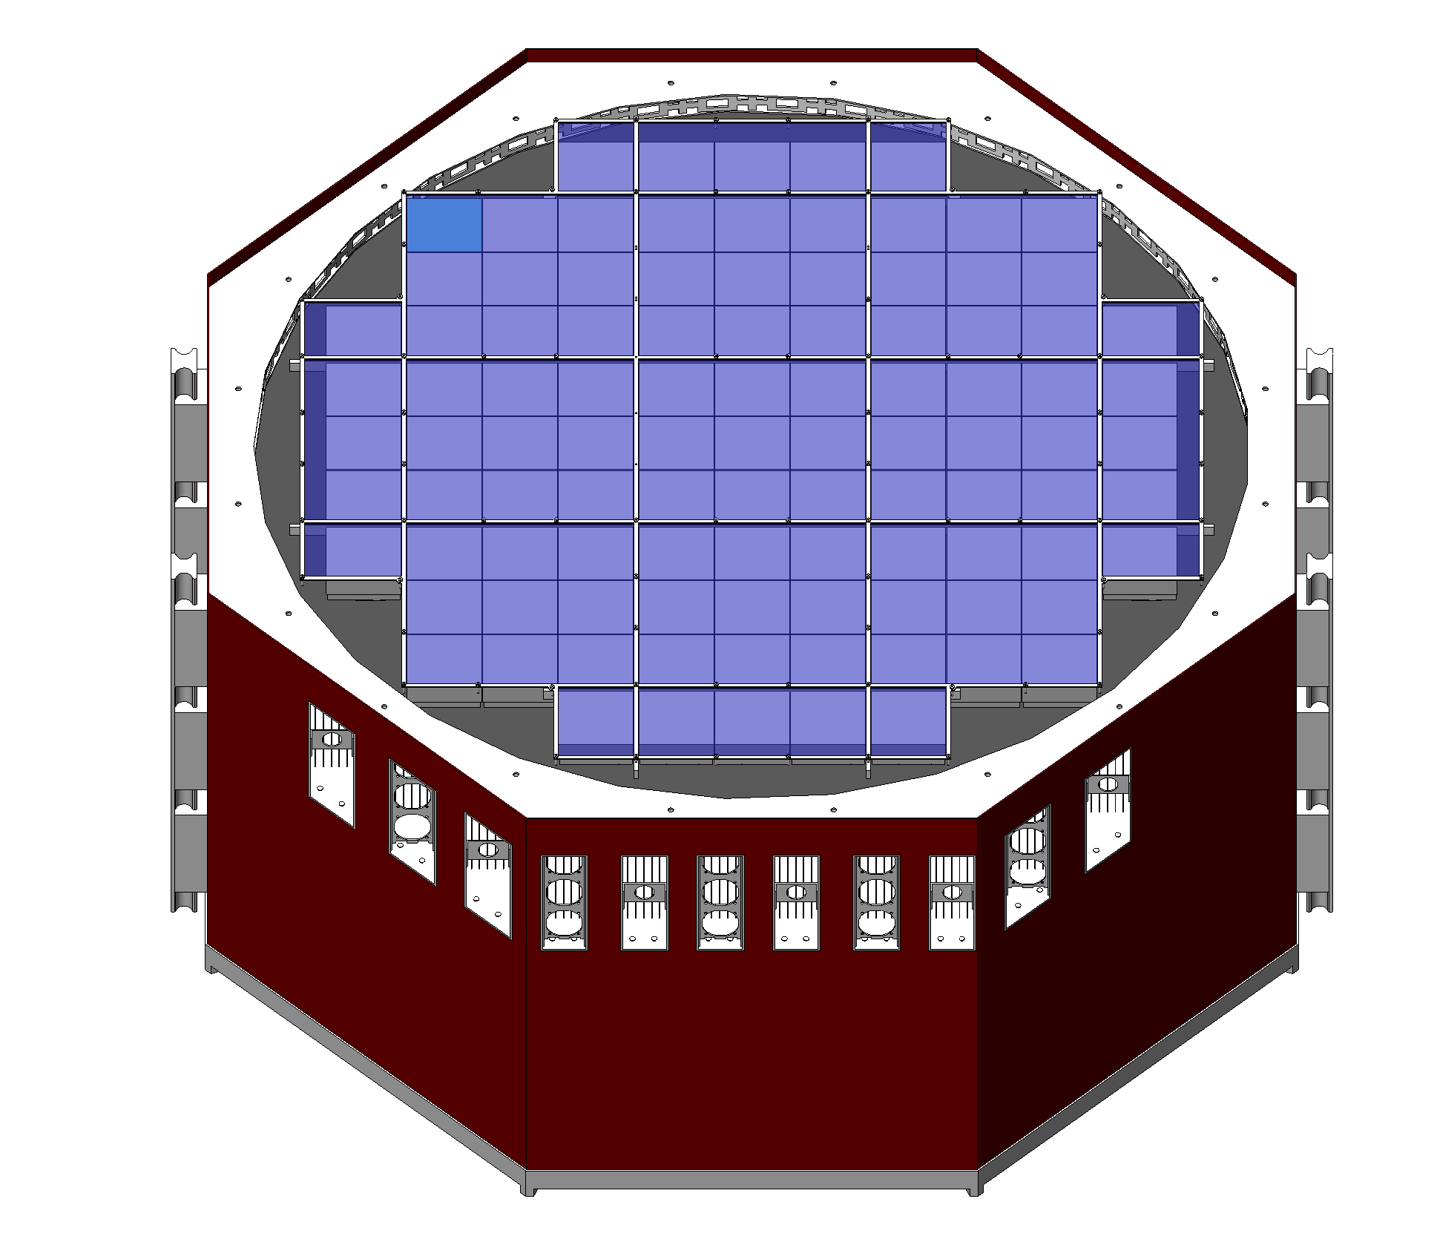
102.8mm
1.7 kg
1 sub-cluster=4×4 image pixels
380mm
Pixel size：25.4 mm
Full camera=101 sub-clusters
1616 image pixels
Dynamic range：5 ~ 8000 pe
Nonlinearity：＜5%
Resolution：＜5%@1000 pe
Bottom Pulse Width：~70 ns
Operation condition：-32 ~ +30 ℃
Photosensitive area：~1100 mm Octagon
Camera area：~1500mm Octagon
Weight：≤500 kg
Camera
Telescope
Filter Window
280-500 nm
Notes:
During the development, the whole camera is divided into 101 subclusters. Each sub-cluster has 16 pixels and they are arranged into a 4-4 array. The sub-cluster has a length of 380 mm and a weight of 1700 gram. It consisted with the light funnel array, the SiPM array, the heat conductive pad, the electronics board, the L-shaped heat conductive plate, and the support rail.
The light funnel can increase the light receiving area of SiPMs to 24.4 mm. It is made by the technology of coating film.
The PRB board is used to read out the SiPM’s signal and transmit is to FEE board through serval connectors.
We concentrate all the functional chips and circuits on the FEE board.
Additionally, several pieces of filter are mounted in a lattice. The filter window covers the whole photosensitive area of the camera. It only admit the photon with the wavelength between 280nm and 550nm.
This is the design specifications of the camera.

Slide 6
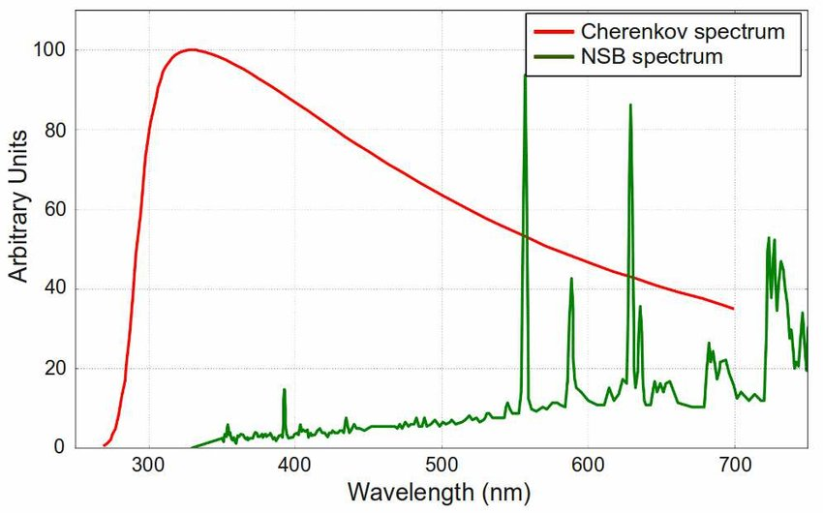
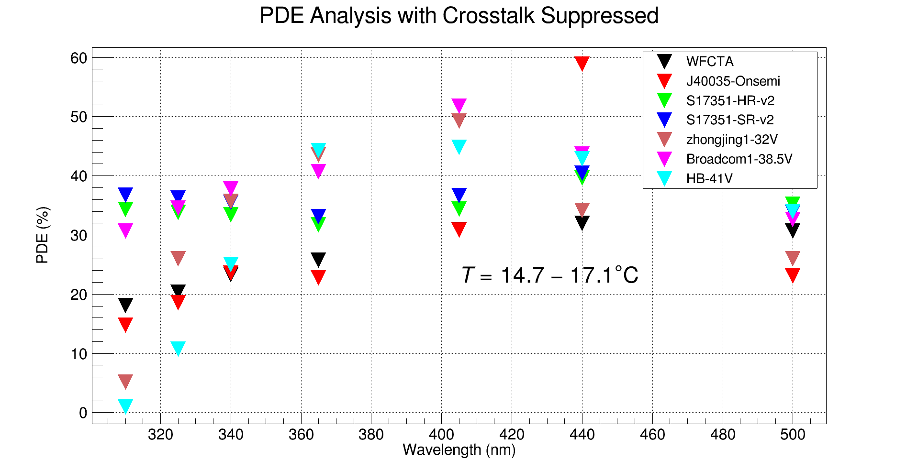
SiPM
Higher Photon Detective Efficiency （PDE, 280 ~ 500 nm）
Lower Dark Count Rate（DCR）
Smaller photosensitive area
Notes:
SiPM can work safely under the moon light. So, we use SiPM as the photosensor can increase the observation time for the Cherenkov telescope.
The Cherenkov light is weak to serval photons per square meter. So we need to select the SiPM with high photon detection efficiency, especially at the short wavelength.
We also require the SiPM has a low dark noise and let it work in a low temperature environment. SiPM with small size also has a low dark noise.

Slide 7
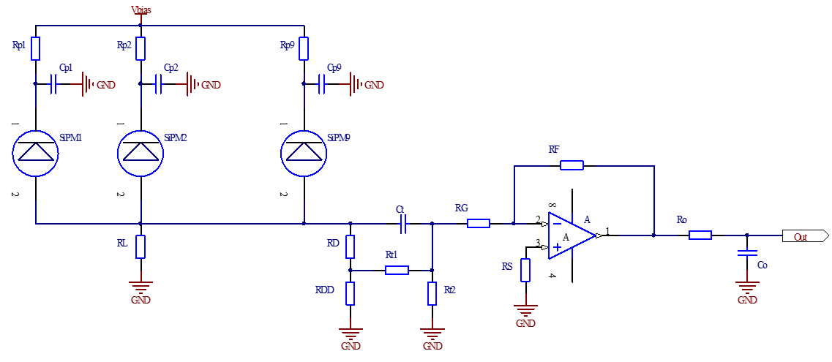
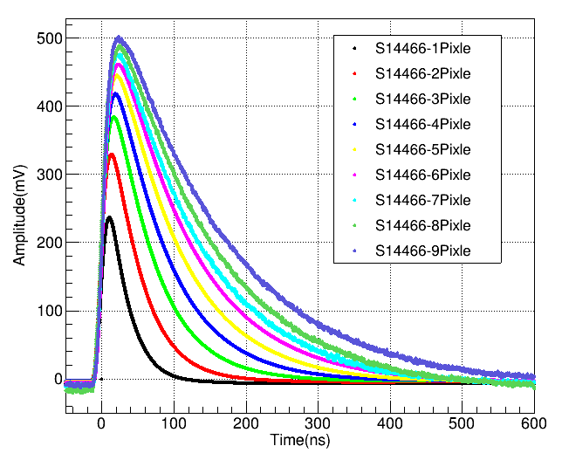
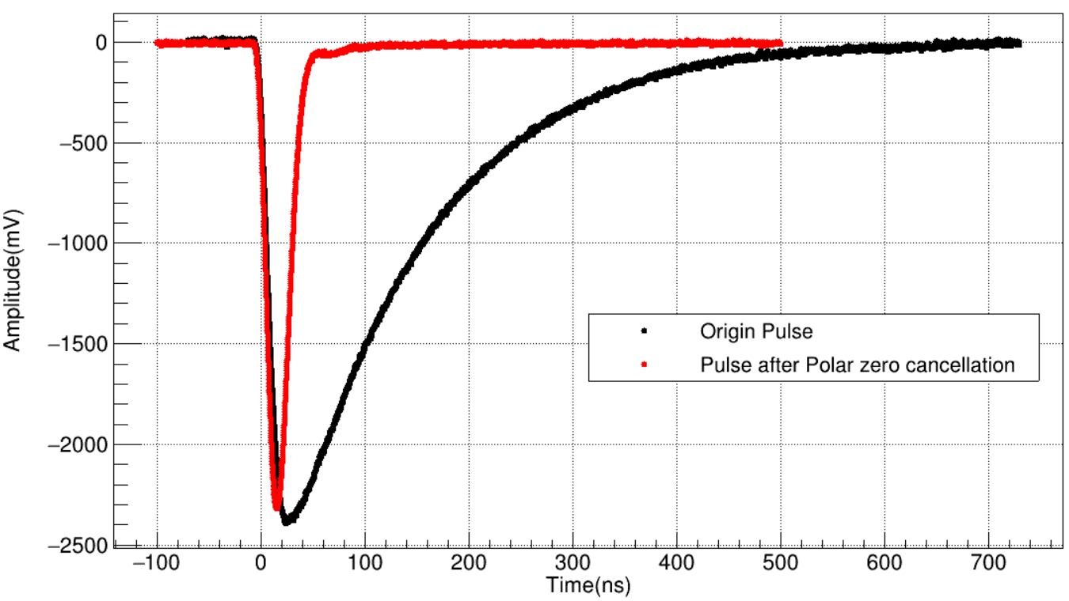
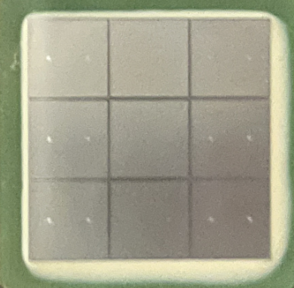
Narrow Pulse Readout
SiPM：61V；S14466，15mm×15mm
Polar-zero cancellation circuit（PZC）
OPA892，±5V ，6.5mA， 65mW
Rise Time: 20ns
Fall Time: ＜50ns
Amplitude normalized
Amplitude loss： 75%
Notes:
Because of the capacitance effect, larger size of SiPM means long discharging time. The area of SiPM we used in the LACT experiment will be over 100 square mm. This means the pulse form SiPM will be very wide.
The night sky background light distributes randomly in the time. The reduce the effect of night sky background light on the Cherenkov light measurement, it is necessary to make the pulse of SiPM short.
We employed the polar zero cancelation circuit to make the SiPM’s pulse short. Even we make the bottom pulse width from 300ns to 70ns, we loss 75% of the pulse amplitude.
Additionally, we use the new operational amplifier OPA892 as the amplifier. It has low power consumption and high bandwidth.

Slide 8
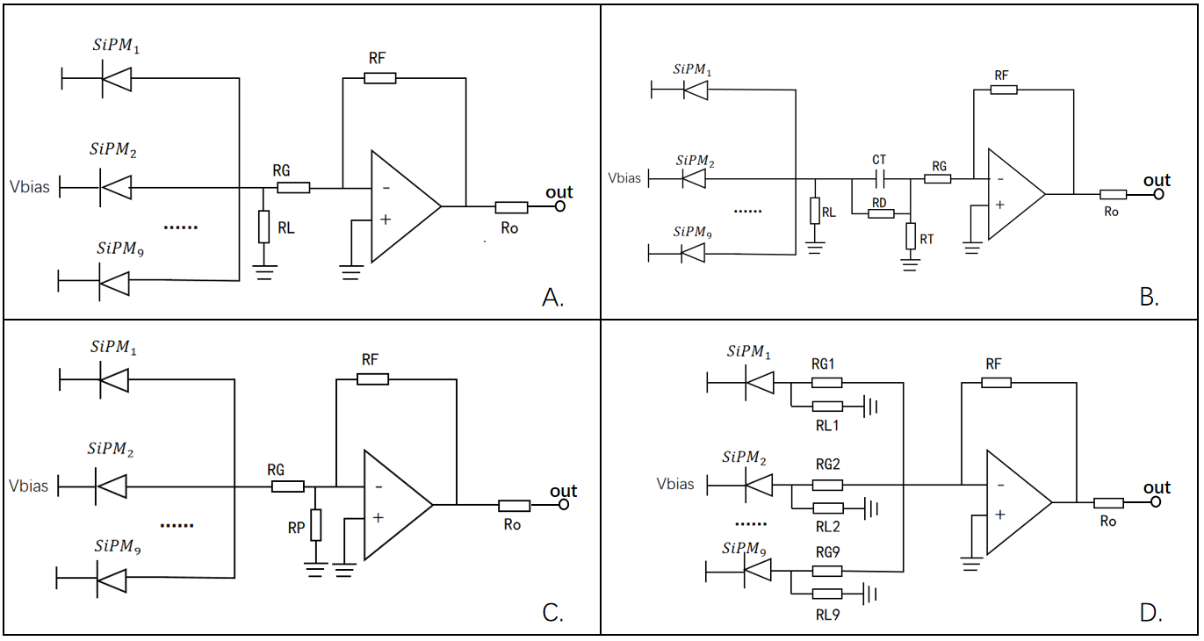
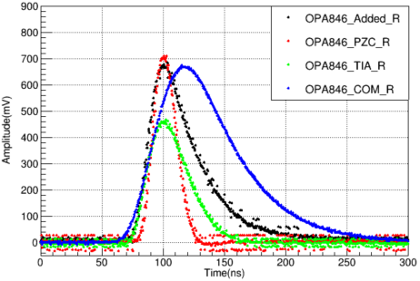
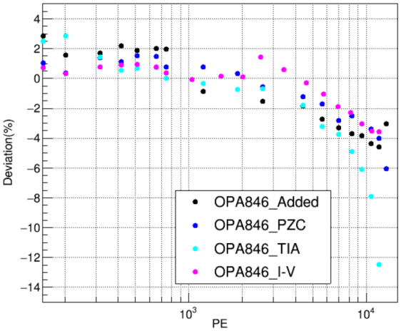
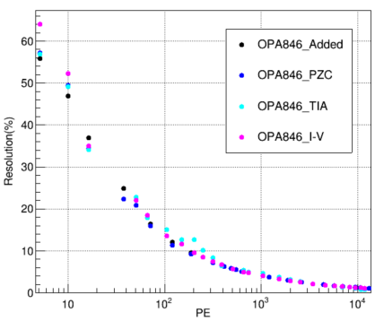
Narrow Pulse Readout
A. I-V converter circuit
B. Polar-zero cancellation circuit
C. Transconductance circuit
D. Addition Circuit
Notes:
In the early stage, we have studied and compared 4 kinds circuit to realize the narrow pulse readout for the large size SiPM. The polar-zero cancelation circuit achieves the shortest pulse and the best signal resolution, especially when the SiPM works under a back ground light.

Slide 9
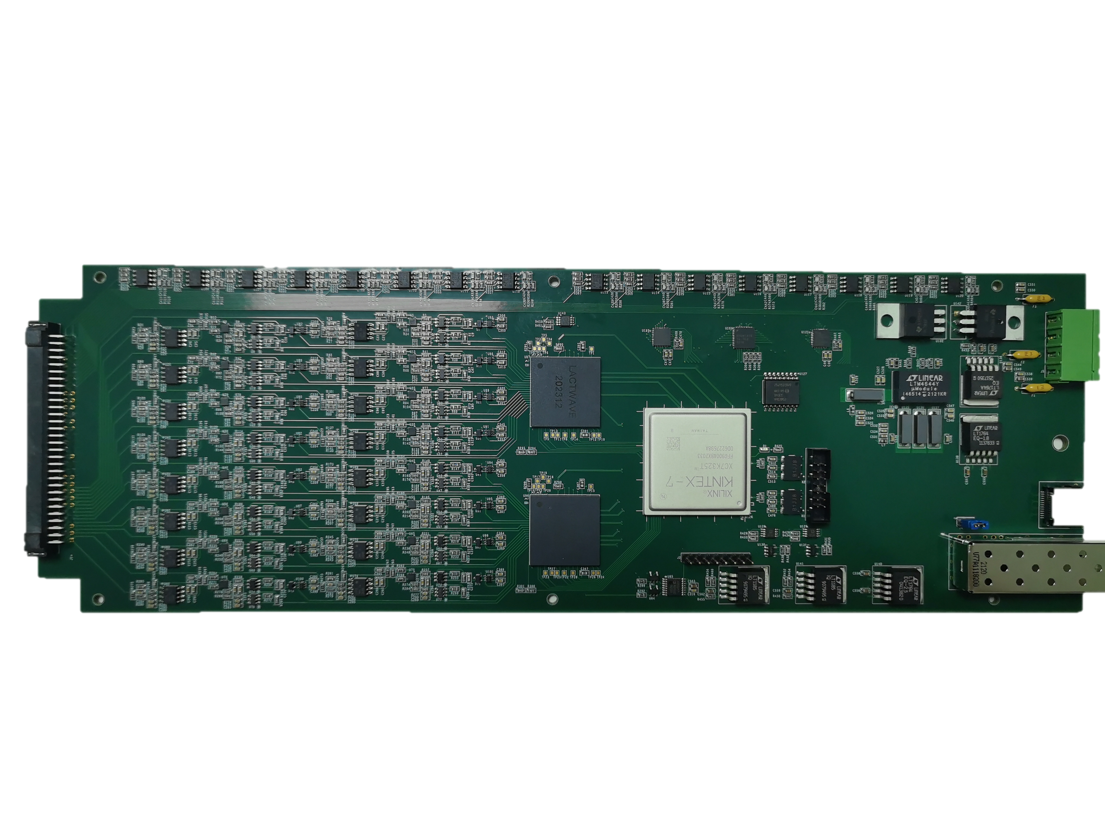
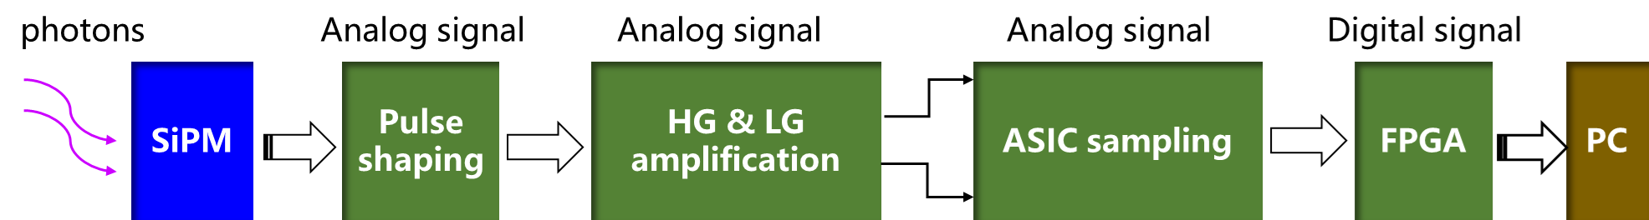
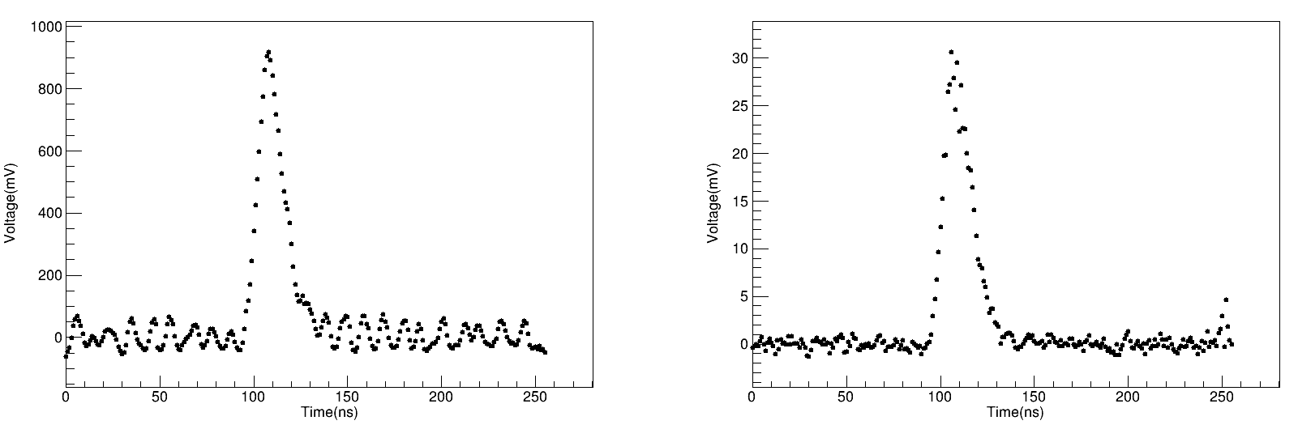
FEE Electronics
Self-developed ASIC Chip
  1GHz Sampling Rate
  256 sampling length
  0~1V input voltage range
  10 bit precision
  ~18mW/ch
  17channels + 1ADC
  lact-wave
High Gain
Low Gain
Notes:
The signal output from SiPM will be transmitted the FEE board through the high-speed connector. Narrow pulse shaping, high-gain and low-gain amplification, analog-digital convert and voltage-temperature compensation, all the process are finished on the FEE board.
The self-developed ASIC chip LACT-WAVE is used to realize the full-waveform sampling. It is developed by the Institute of High Energy Physics. It has a sampling rate of GHz and a range of 1000. Moreover, it is a low power consumption chip. Each chip has 17 channels of switch capacitance array and 1 ADC. The power consumption of the chip is about 500 mW.

Slide 10
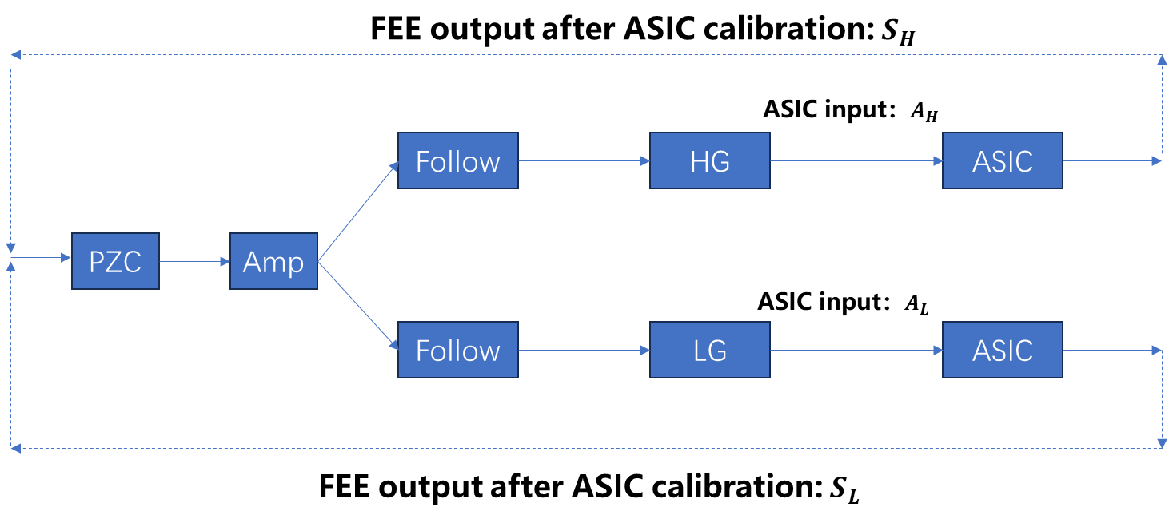
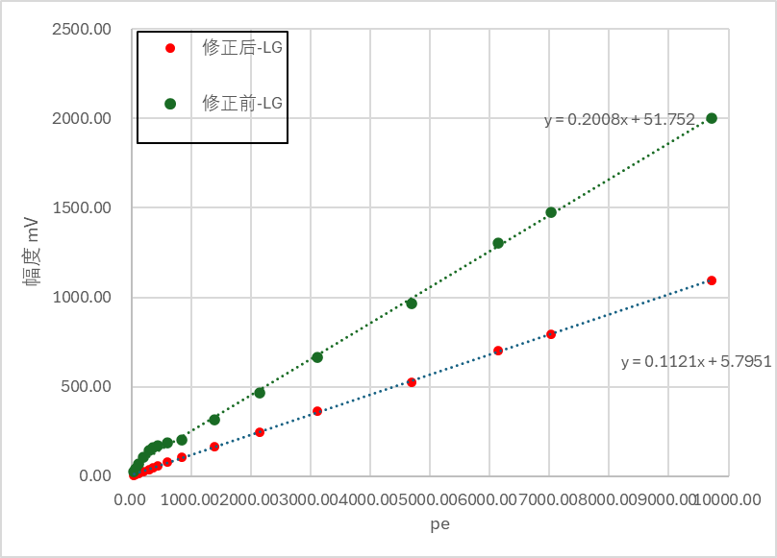
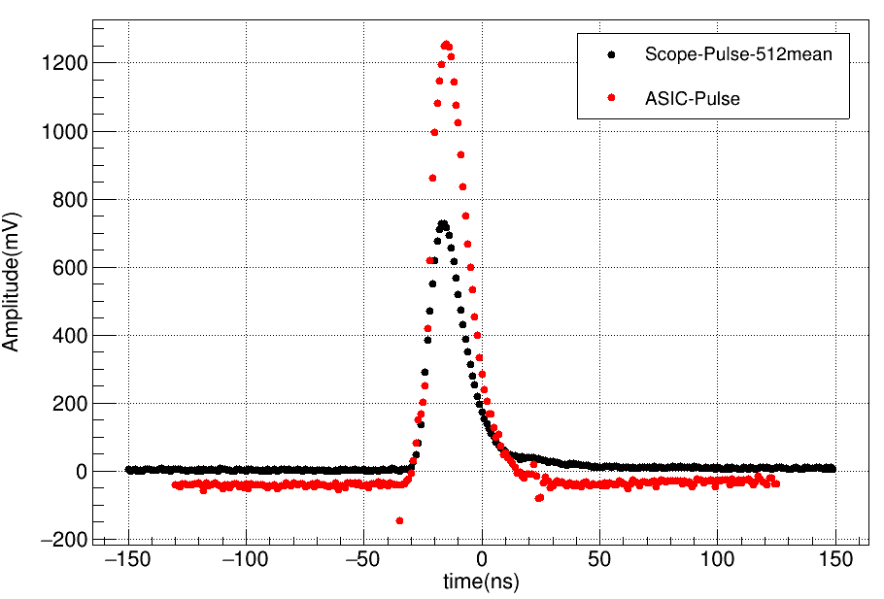
FEE Electronics：nonlinearity correction (preliminary)
After correction
Before correction
Amplitude
FEE (S)
Ocsilloscope (A)
pe
Notes:
The self-developed ASIC chip has an obvious non-linearity, when the input voltage is below 70 mV. The analog pulse between the High gain/low gain amplifier and the ASIC is sent to the oscilloscope through the coaxial line. We use the pulse amplitude to build the relationship between the FEE output and the oscilloscope. Different pulse amplitude gives different correction factor. When we have enough different pulse amplitude, the non-linearity will be corrected. As we test, the correction factor obtained in CH1 is also suitable to the other channels.

Slide 11
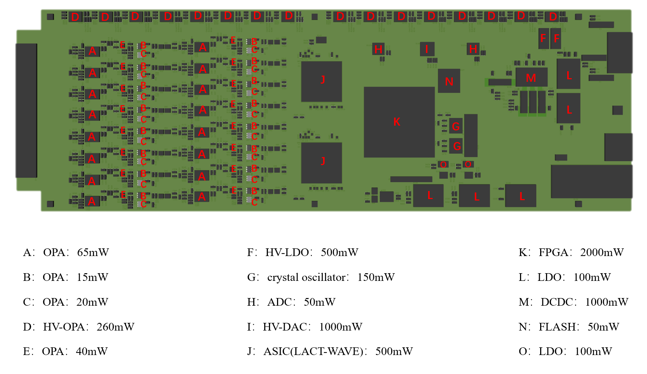
Cooling System
Power consumption
  Subcluster：~15W
  SiPM under the full Moon：~0.18W/CH
  Total camera：~1600W
Heat dissipation requirements
  High altitude(4410 m, 0.6 atm)
  Seal, light and portable, stable
  Self-Developed ASIC Temperature：≤55℃
Notes:
Even we chose the ASIC chip and operational amplifier with low power consumption. But chip used to set vias voltage to SiPM has a high-power consumption. The power consumption of the whole sub-cluster is about 15 W. The total power consumption of the camera is about 1600W.
Additionally, the power consumption of the SiPM under the full Moon is about 0.18W.
The cooling system should prevent electronics heating the SiPMs, and make all the components inside the camera cool.
The camera operates at an altitude over 4400m. The air density is only 60% of sea level.
During the LACT observation, the camera will move all sky with the rotating system. As a result, the long liquid tube is not a good choice.

Slide 12
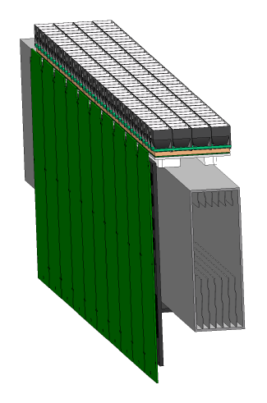
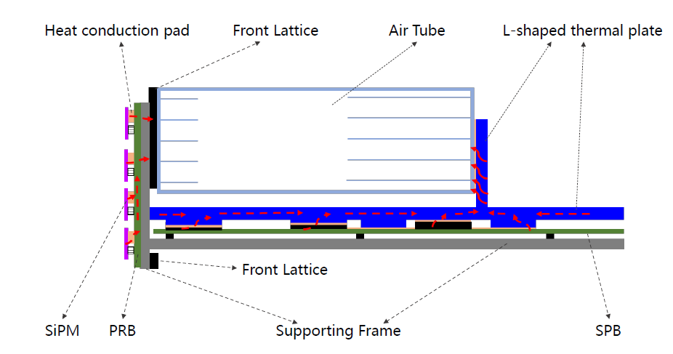
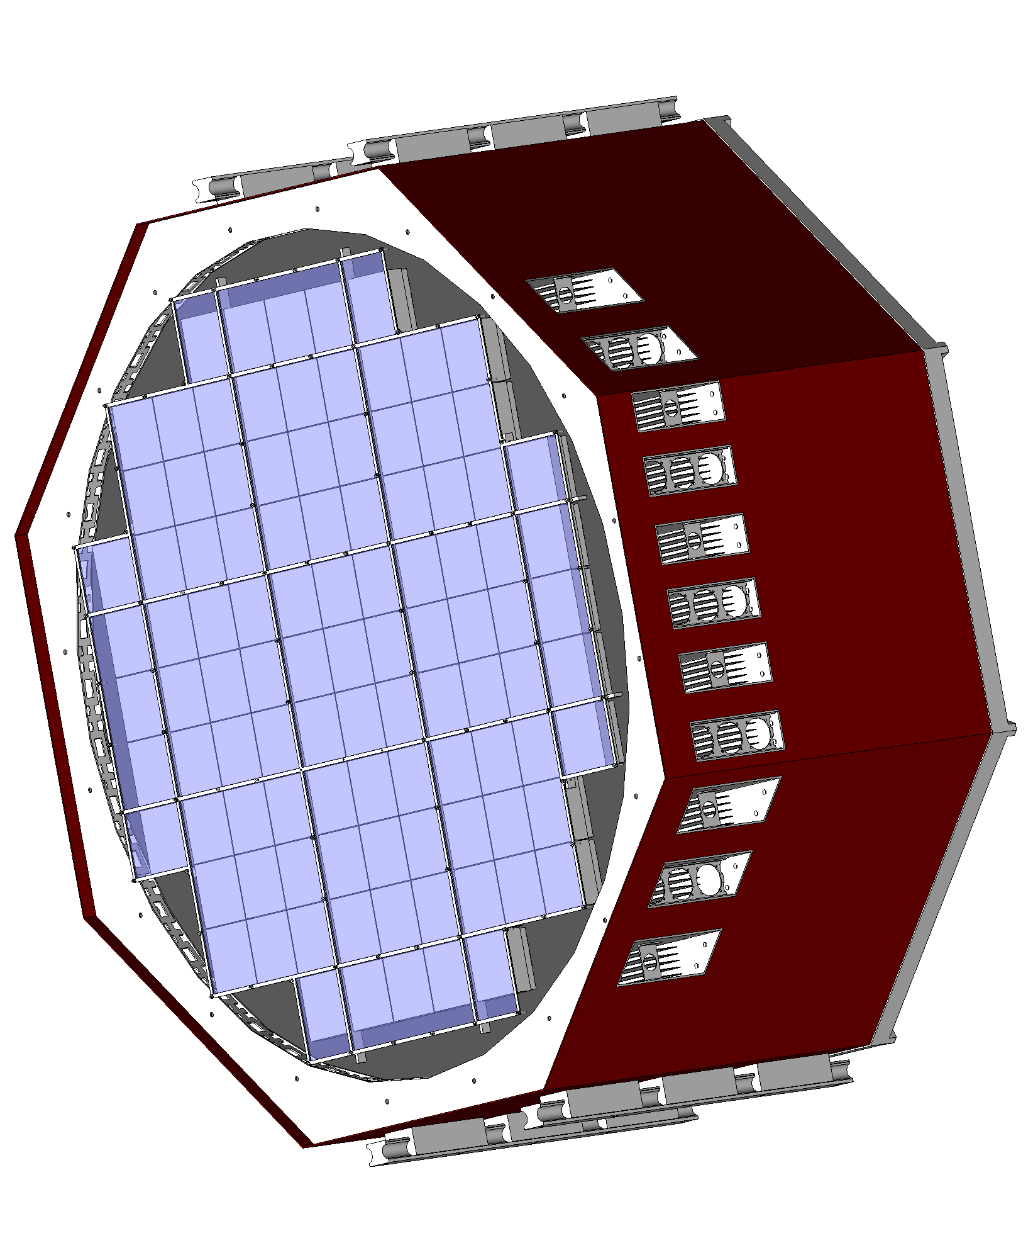
Cooling System
11 spatially independent air tubes run between the camera’s 11 rows of sub-clusters.
The air tubes are cooled by the 3 fans.
The front lattice and air tubes divided into SiPM area and electronics area.
Electronic chips → silicon pad → L-shaped thermal plate→ silicon pad → air tube
Electronics
SiPMs
Fan（IP55）：Prevent the accumulation of harmful dust; rinsing with water causes no harm.
Notes:
There are 11 spatially independent air tube mounted between the camera’s 11 rows of sub-clusters. These air tubes are welded on the camera’s container. Air tubes only permit the wind pass through its body, and prevent the air or dust from entering the internal space of the camera.
Air tubes are cooled by the fans. They divide the SiPM and electronics into two temperature area.
The heat of the electronics chips will be taken to the air tube by the L-shaped plate.
The SiPM will be cooled by the other side of the air tube, with the help of the heat pad.

Slide 13
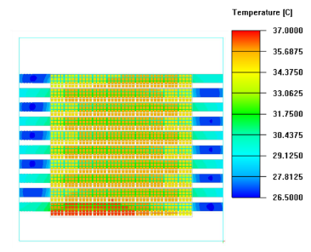
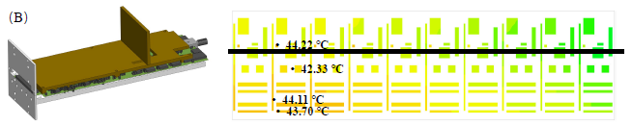
Cooling System (cooling simulation)
Icepak simulation
0.6 atm
25℃
1
Notes:
The simulation model is built based on the Icepak. The environment condition is set as the real condition of Haizi Mountain. We use this model the adjust the cooling system. When we let wind passing through the nearby tube has the opposite direction, the temperature difference on the camera’s surface is below 6℃。
The highest temperature of the electronics is about 44℃
Aluminum-Al
Copper-Cu

Slide 14
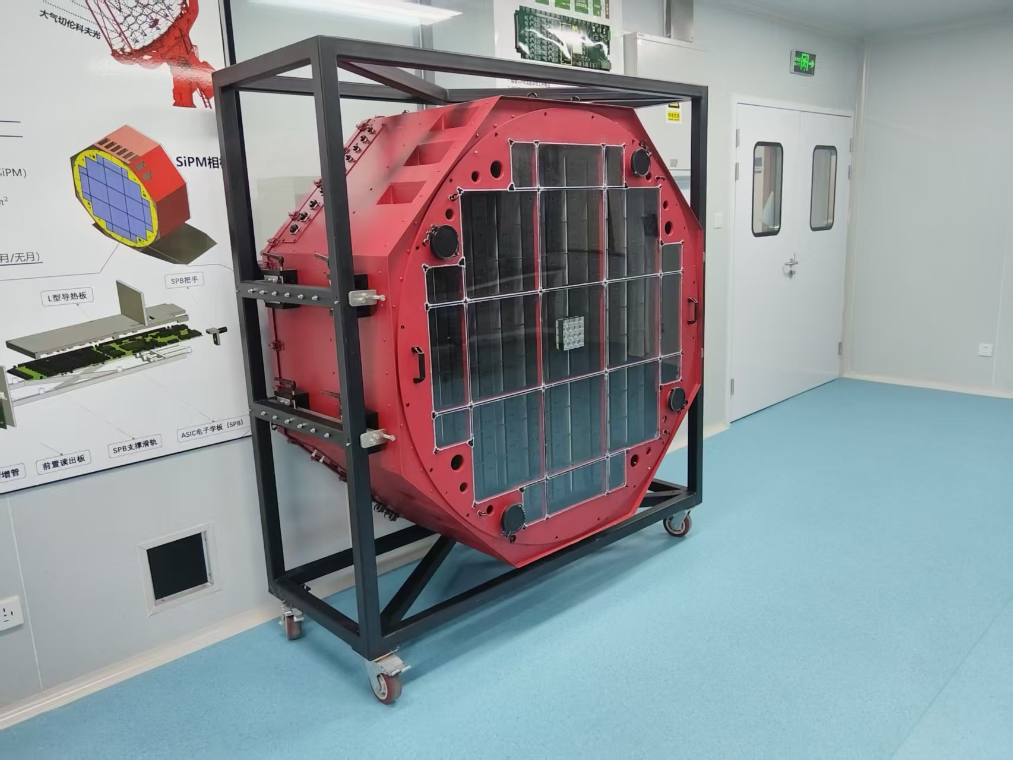
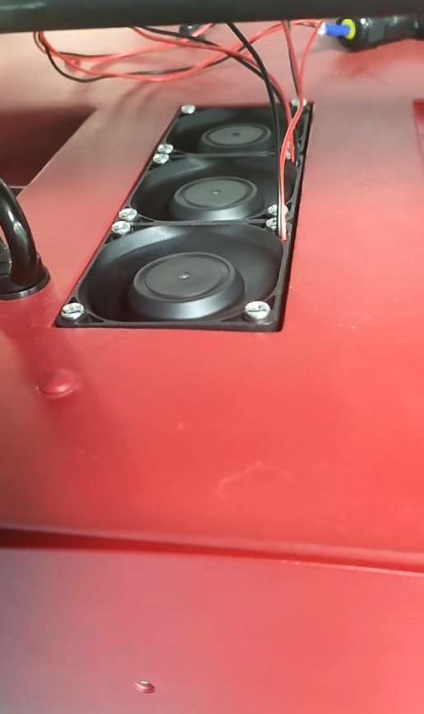
Cooling System (cooling performance test)
Condition | Operation Time(min) | ASIC Temp(℃) | Highest Temp(℃)
Start Operation | 0.5 | 25.47 | 27.12
Operation Without L-Shaped plate | 30 | 45.60 | 49.61
Operation With L-Shaped plate | 30 | 34.79 | 39.06
Fans
subcluster
Notes:
In the lab of Chengdu, we also installed a sub-cluster into the camera container. A black cloth is covered the surface of the whole camera. We make the sub-cluster powered normally, and open the fans. The temperature of the ASIC chip is below 35 ℃ and the highest temperature is bellow 40 ℃。 When we install more sub-clusters, we will power them step by step, to study the cooling performance.

Slide 15

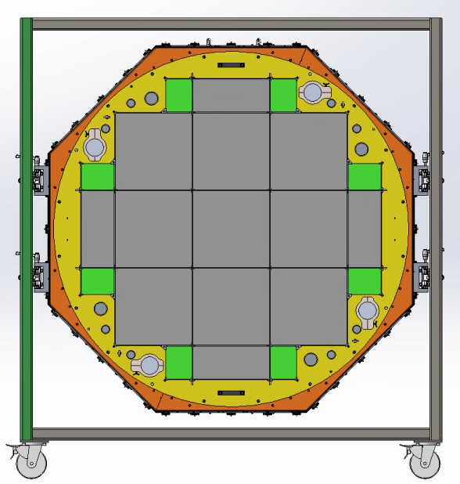
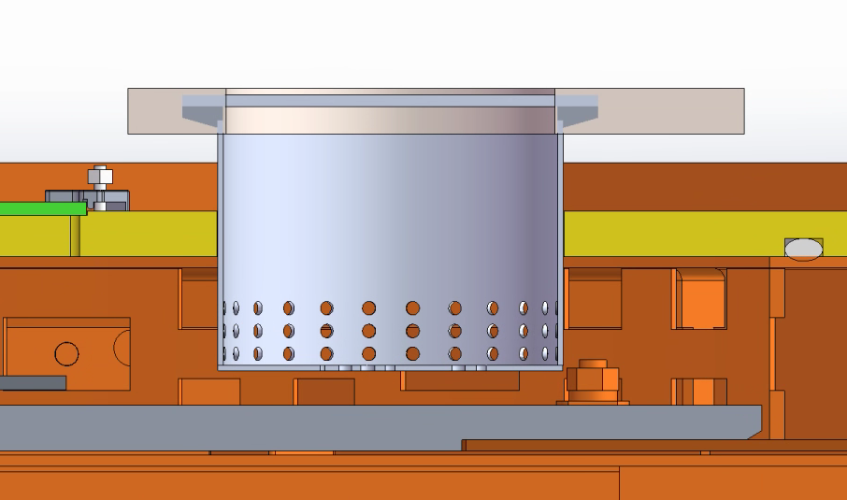
Drying Solution
Four tubes distribute in the filter window
Silica desiccant
Desiccant tube
Before absorbing
After absorbing
Humidity sensor
Humidity sensor
Desiccant tube
Φ73 mm × 50 mm
Desiccant tube
Notes:
There are four tubes with many small holes distributed at the corner of the camera’s surface. We will put the silica desiccant inside the tubes. When the desiccant absorbs water, it will change to pink. We can observe desiccant’s color and determine when it will be changed.

Slide 16
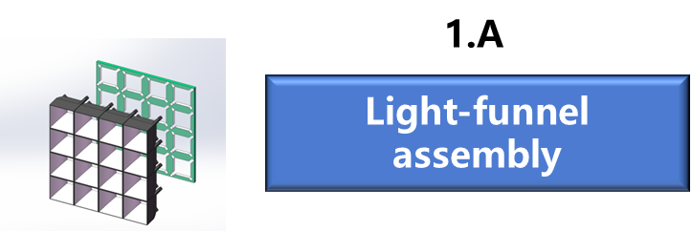
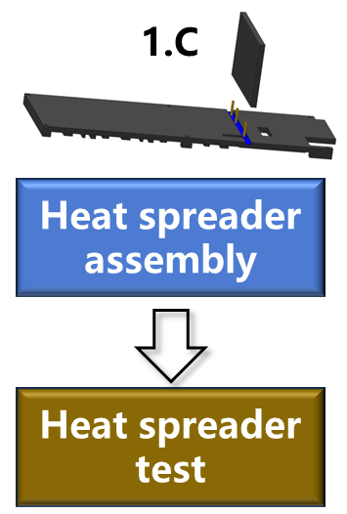
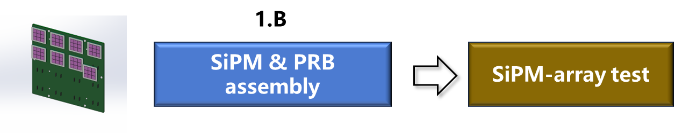
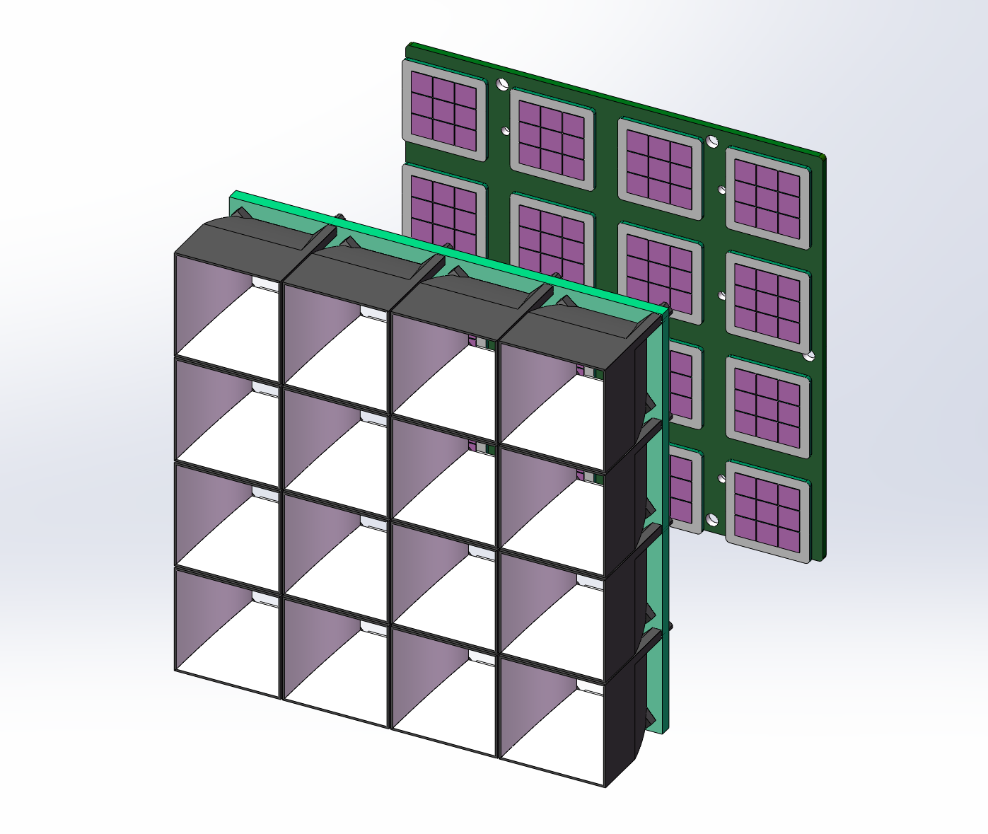
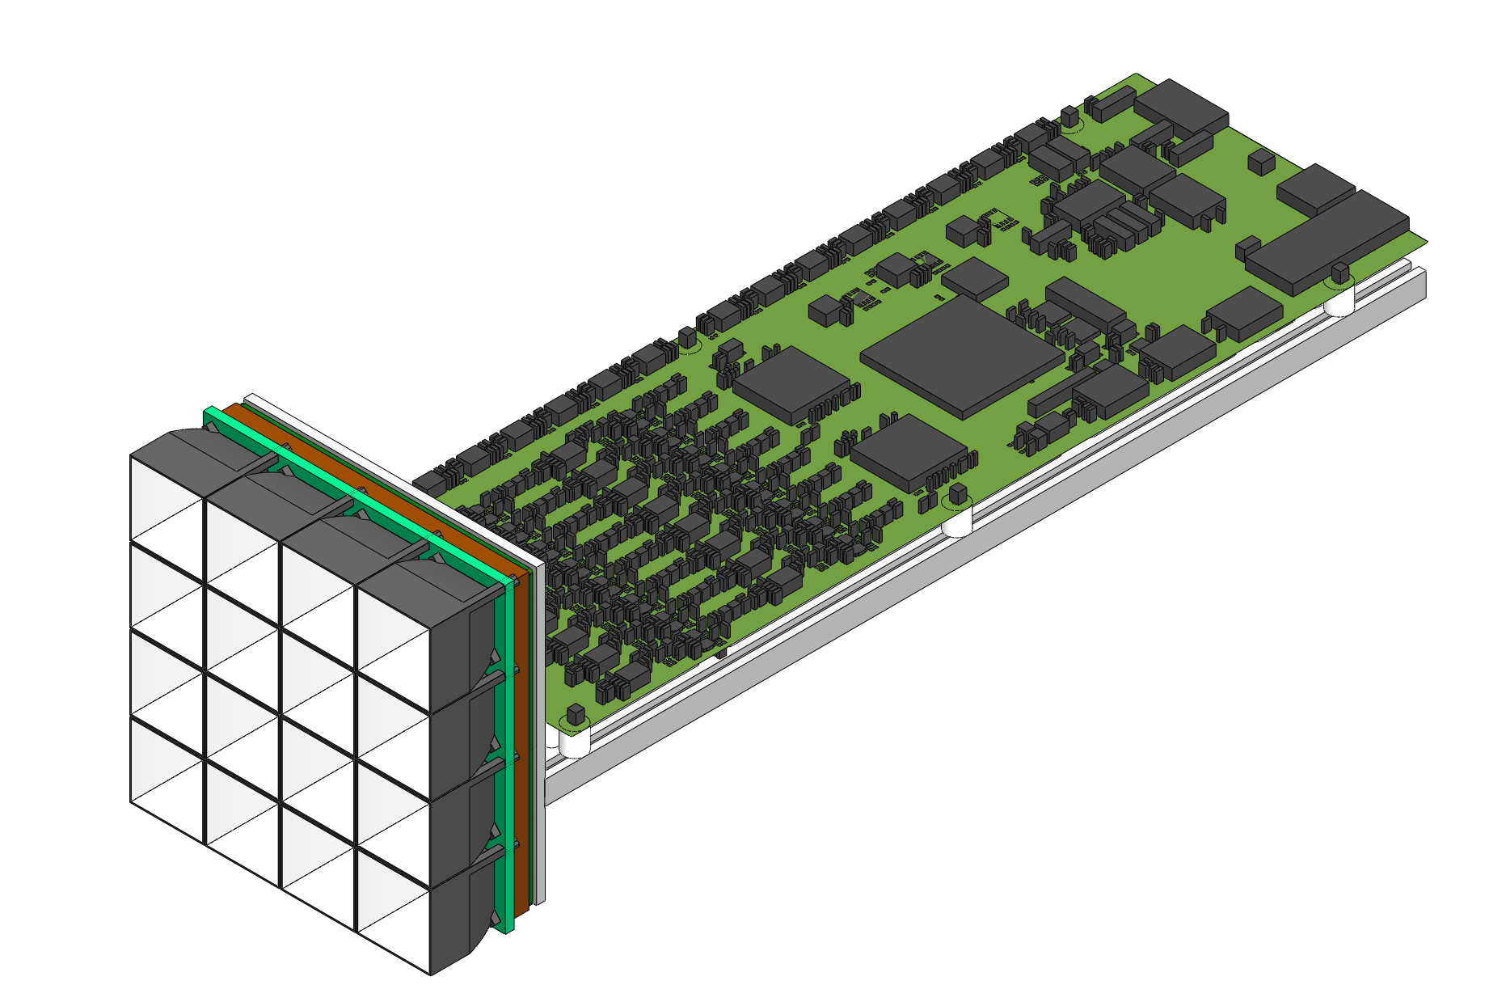
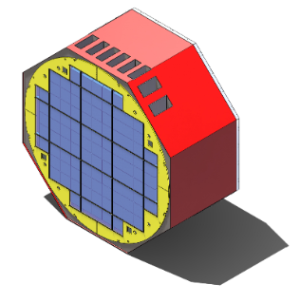
②
③
SiPMs & Light-funnel
Assembly with FEE Board
Test
Camera calibration & test
Camera assembly
Subcluster test
Assembly with heat spreader
⑦
⑥
⑤
④
Notes:
From the basic component to the camera, we need to finish these works.
We need assembly the light funnels to a 4-4 array through a supported board and glue. This process is finished with the help of a 3-D printed model.
We need install SiPMs on the PRB board. They are connected and fixed by the high-speed connector. And then, we should test the SiPM array and make sure each SiPM can work normally. The serial number of the SiPM is recorded.
And then, we will assembly the light funnel array with the SiPM array together through bolts.
The thermal resistance and the weight of L-shaped heat conductive plate are tested before it is assembled with the FEE board. There is several silicon heat pad between them.
And then, we can assembly a sub-cluster and test its performance to make sure each sub-cluster can work normally.
At last, we can install these sub-clusters into the camera.

Slide 17
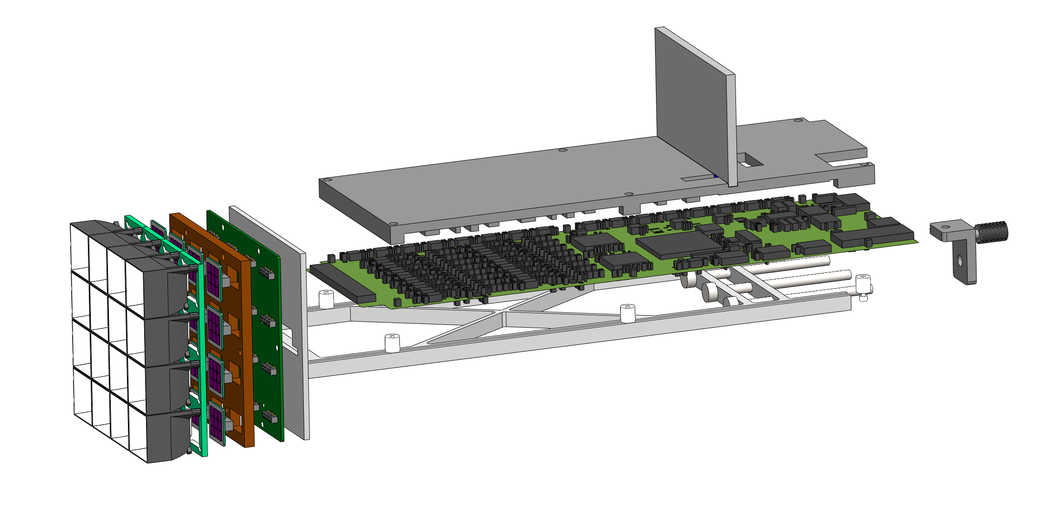
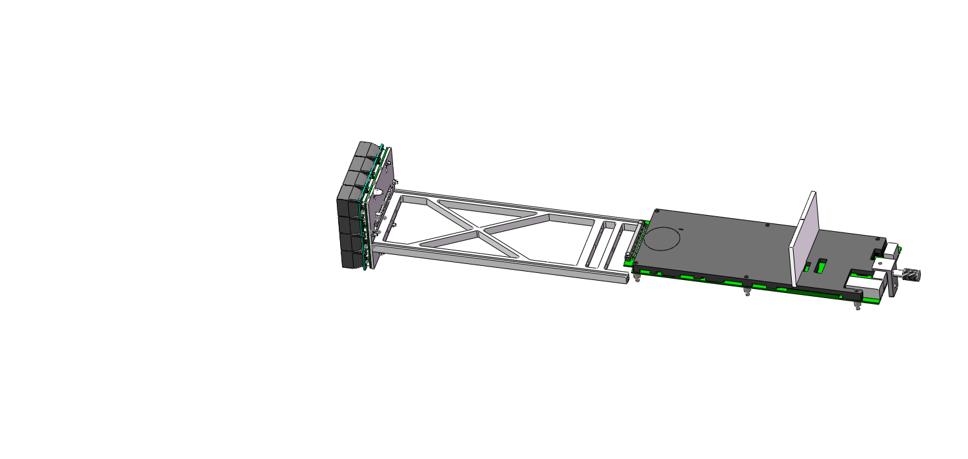
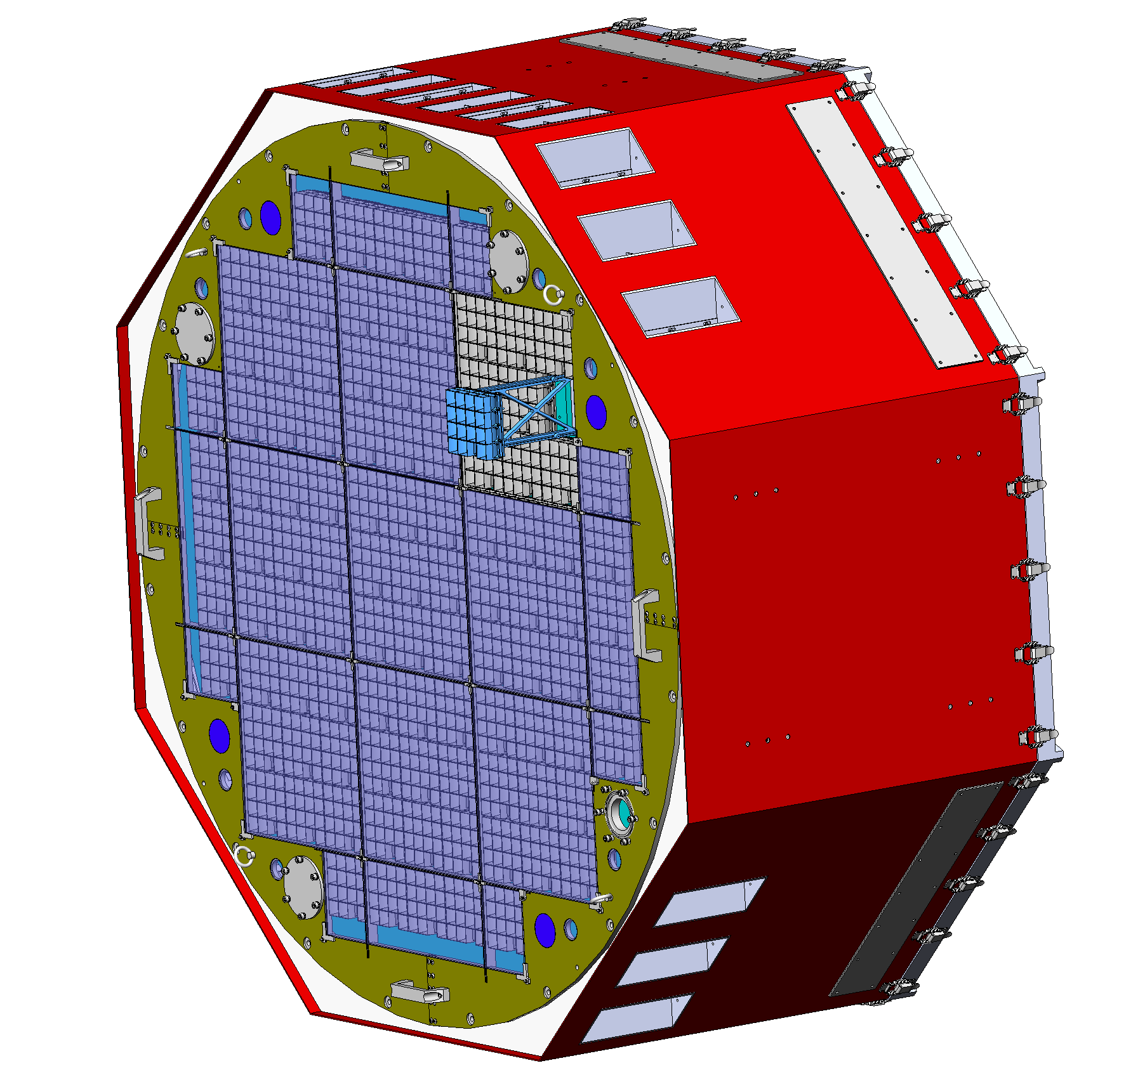
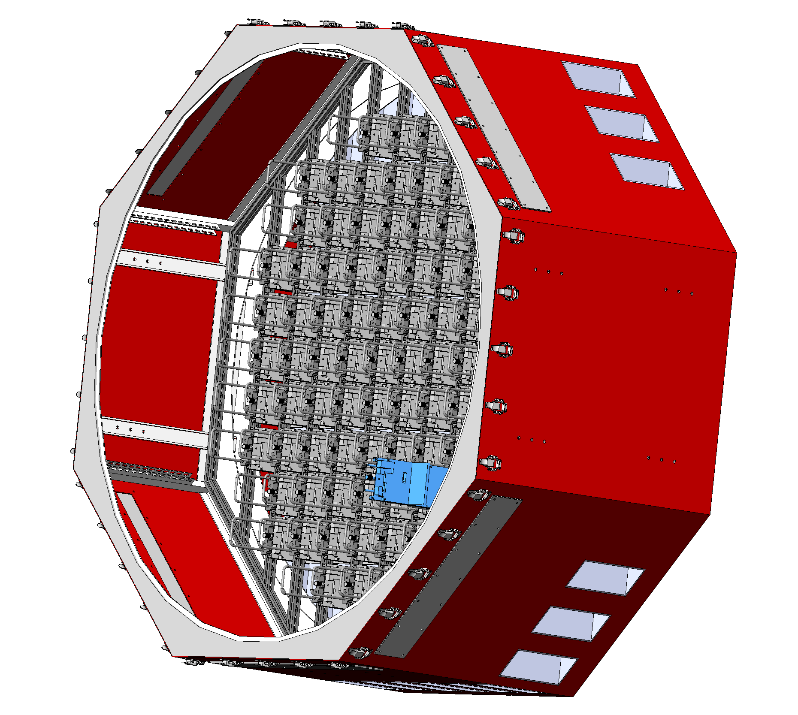
Installation
Divide sub-cluster into two parts: photosensitive and electronics part
Insert photosensitive part from the front lattice into the camera
Push the electronics part along the rail form the back lattice
Notes:
The sub-cluster will be divided into the photosensitive and electronics two parts, when it is needed to installed into the camera container.
The photosensitive part will be inserted form the front lattice and fixed to the back lattice through two bolts.
The electronics part is pushed into the camera along the rail and fixed to the back lattice through one bolt.
The type of the bolts is M5.

Slide 18
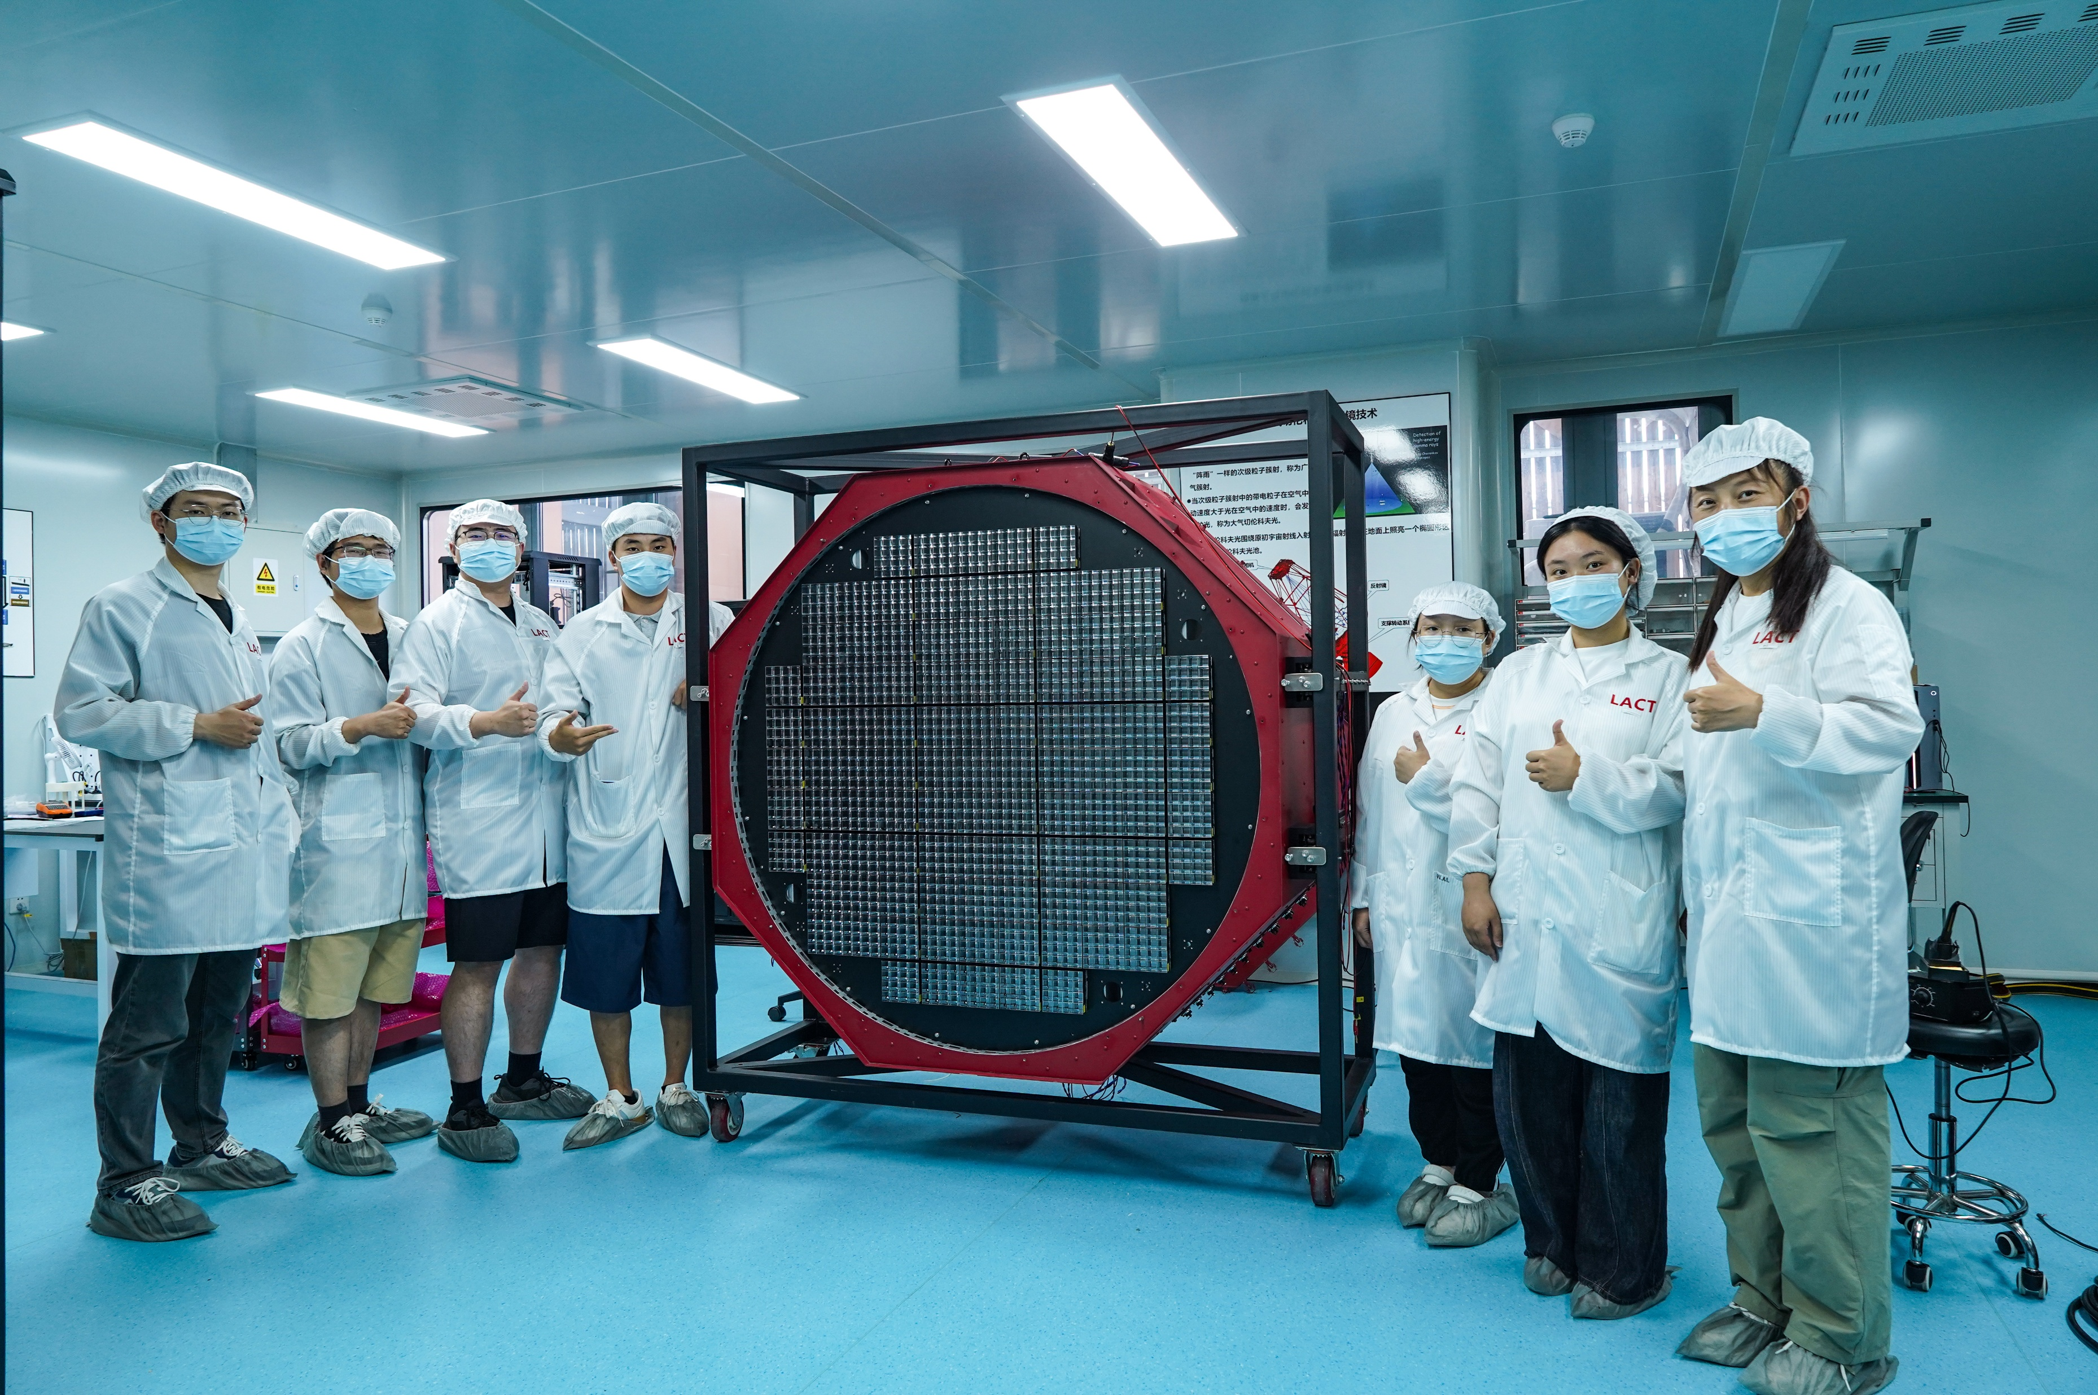
Current Progress
Chengdu University of Technology
Sichuan University
Yunnan University
Tibet University
IHEP
TIANFU Cosmic Ray Research Center
Notes:
In this week, we have installed all the sub-clusters into the camera. This work is finished together by the students and teachers from the Tibet university,……, and the Institute of high energy physics. Next week, we will test and study the performance of the whole camera in dark room.

Slide 19
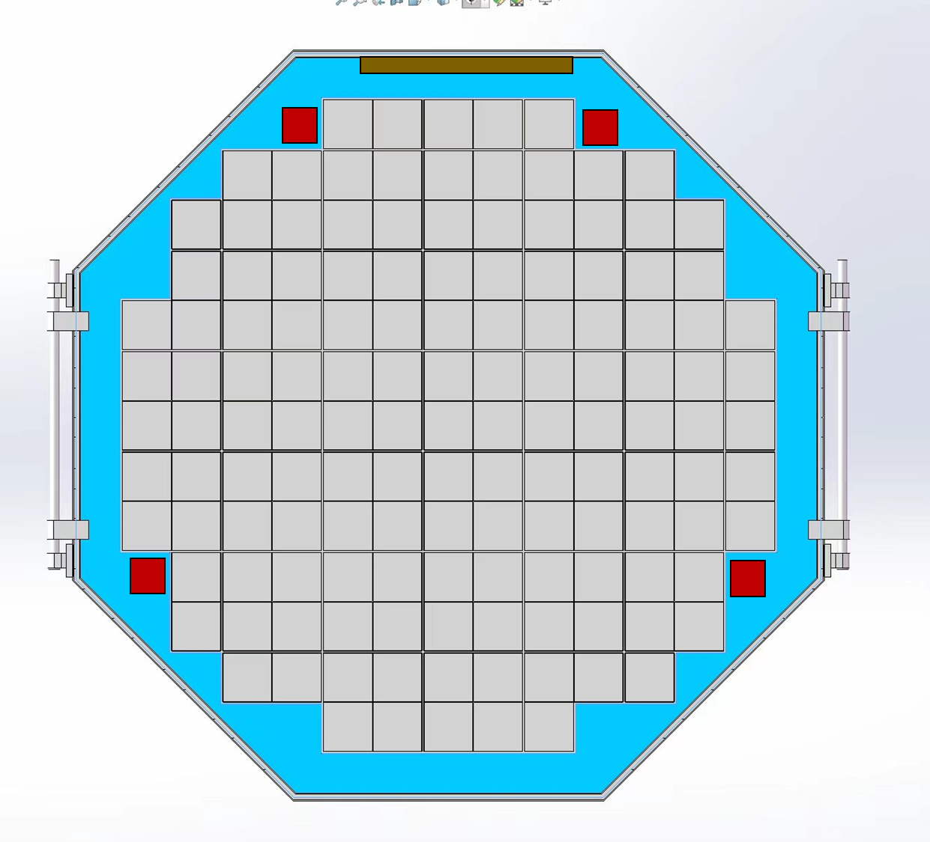
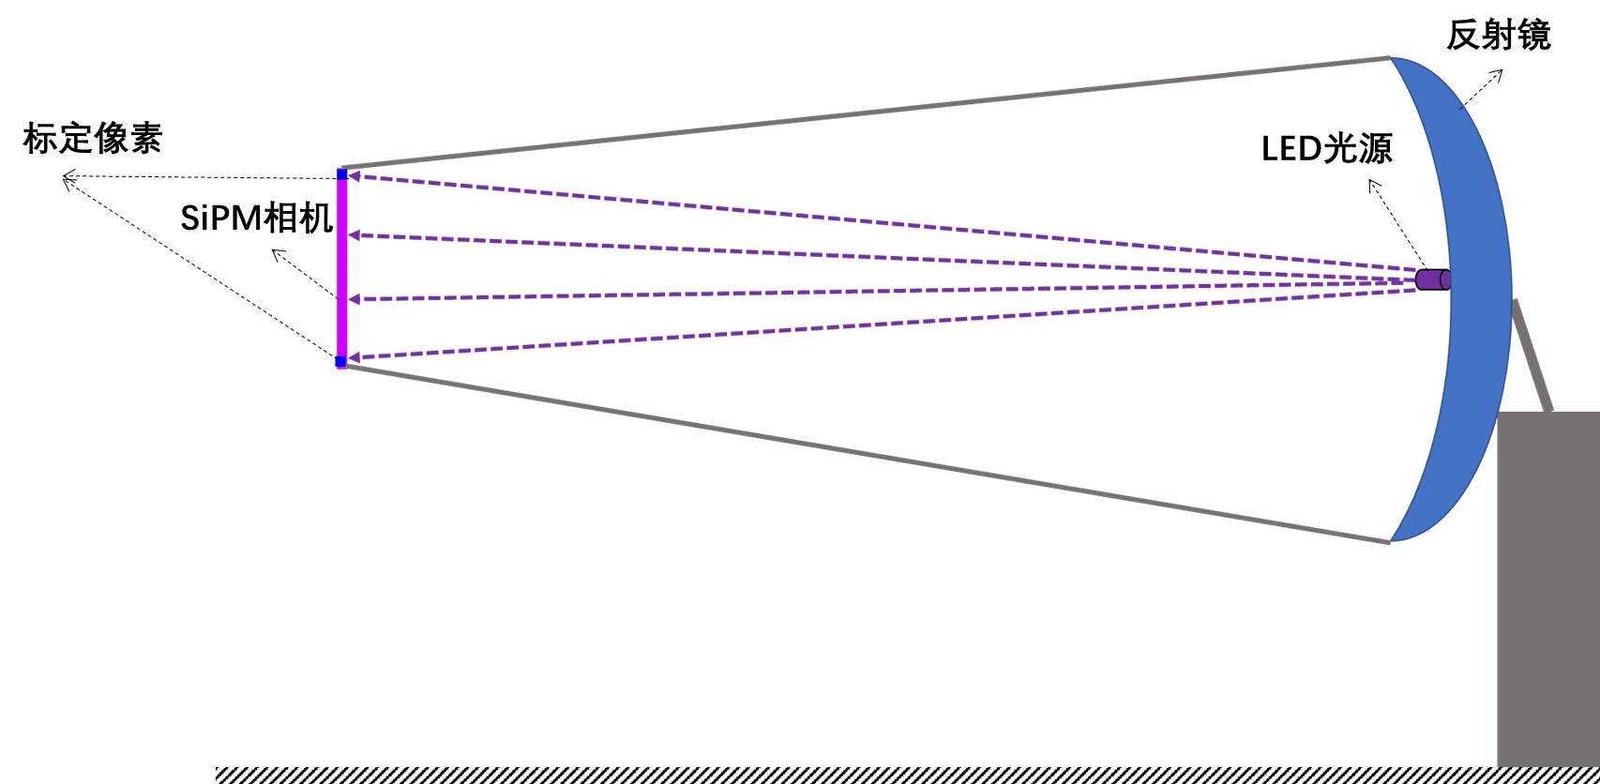
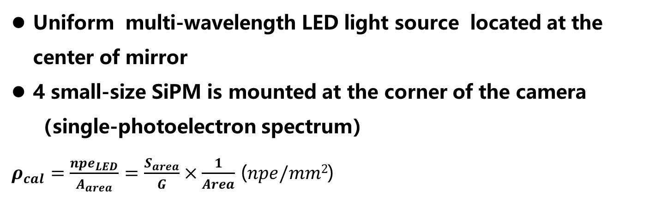
Calibration Plan
Uniform multi-wavelength LED light source located at the center of mirror
4 small-size SiPM is mounted at the corner of the camera（single-photoelectron spectrum）
$ρ_{cal}=\frac{{npe}_{LED}}{A_{area}}=\frac{S_{area}}{G}×\frac{1}{Area}$ ($npe/mm2$)
mirror
Small-size SiPM
LED light source
Notes:
At last, I want to share the calibration plan for the camera. We will install a large power LED light source at the center of the mirror. The LED light source will flash the camera. After using the flat-window LED, the LED light source presents a good uniformity at the view angle of 6°.
We also install 4 small size SiPMs to the surface of the camera. The small SiPM can detect the single electron spectrum, and used to calculated itself gain. And then, we can use the small size SiPM the calibrate the light intensity of the light source.

Slide 20
Thanks for your attention
yangmingjie@ihep.ac.cn

