Slide 1
2025/08/25
Radon-222 Screening Capability
and Research at SNOLAB
Dr Nasim Fatemighomi (she/her)
Staff Scientist
On behalf of SNOLAB Assay Group
TAUP 2025, Xichang, China

Slide 2
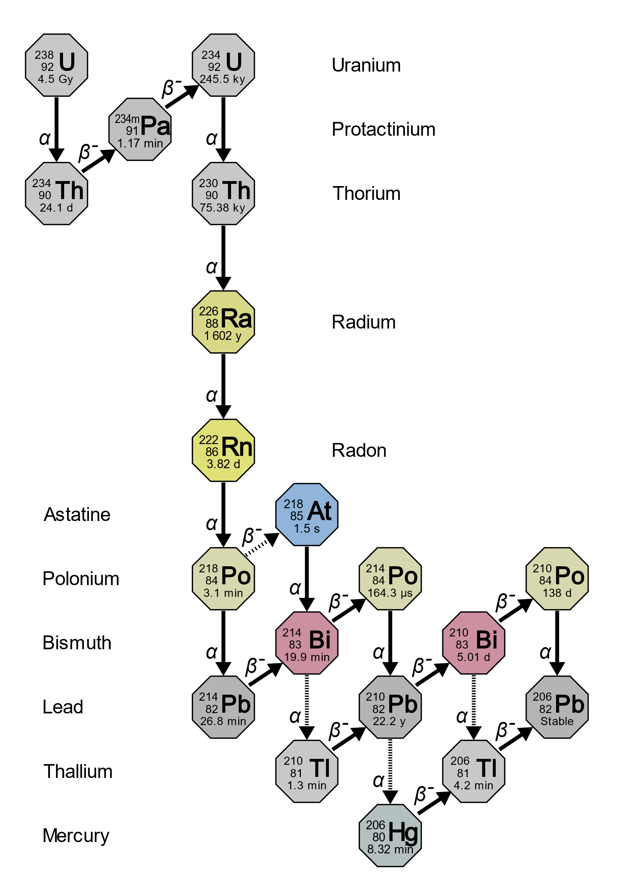

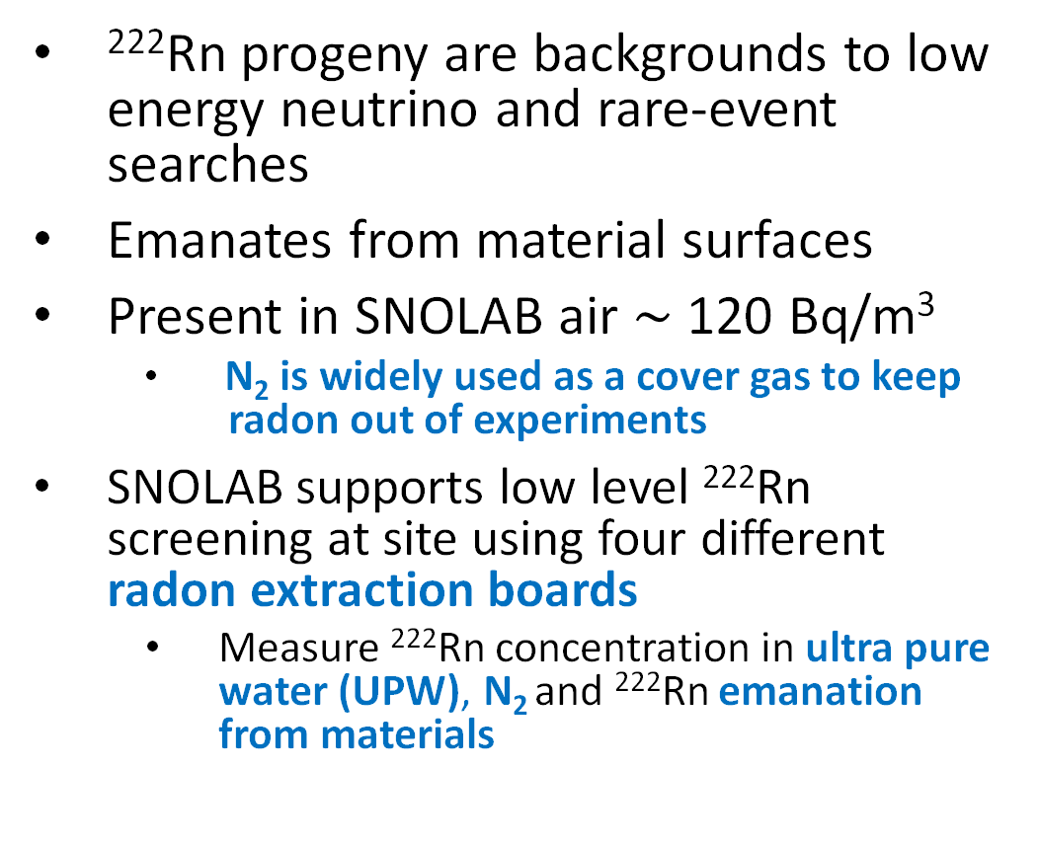
Introduction
²²²Rn progeny are backgrounds to low
energy neutrino and rare-event searches
Emanates from material surfaces
Present in SNOLAB air $\sim$ 120 Bq/m³
  N₂ is widely used as a cover gas to keep
  radon out of experiments
SNOLAB supports low level ²²²Rn screening at site using four different radon extraction boards
  Measure ²²²Rn concentration in ultra pure water (UPW), N₂ and ²²²Rn emanation from materials
From Wikipedia

Slide 3
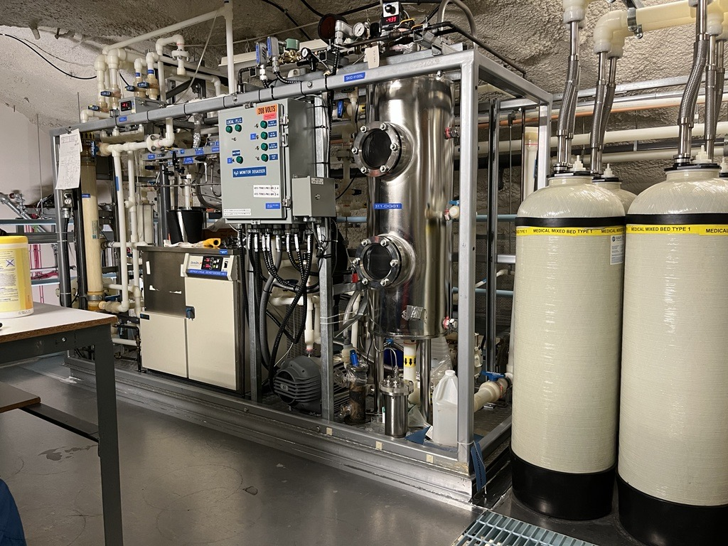
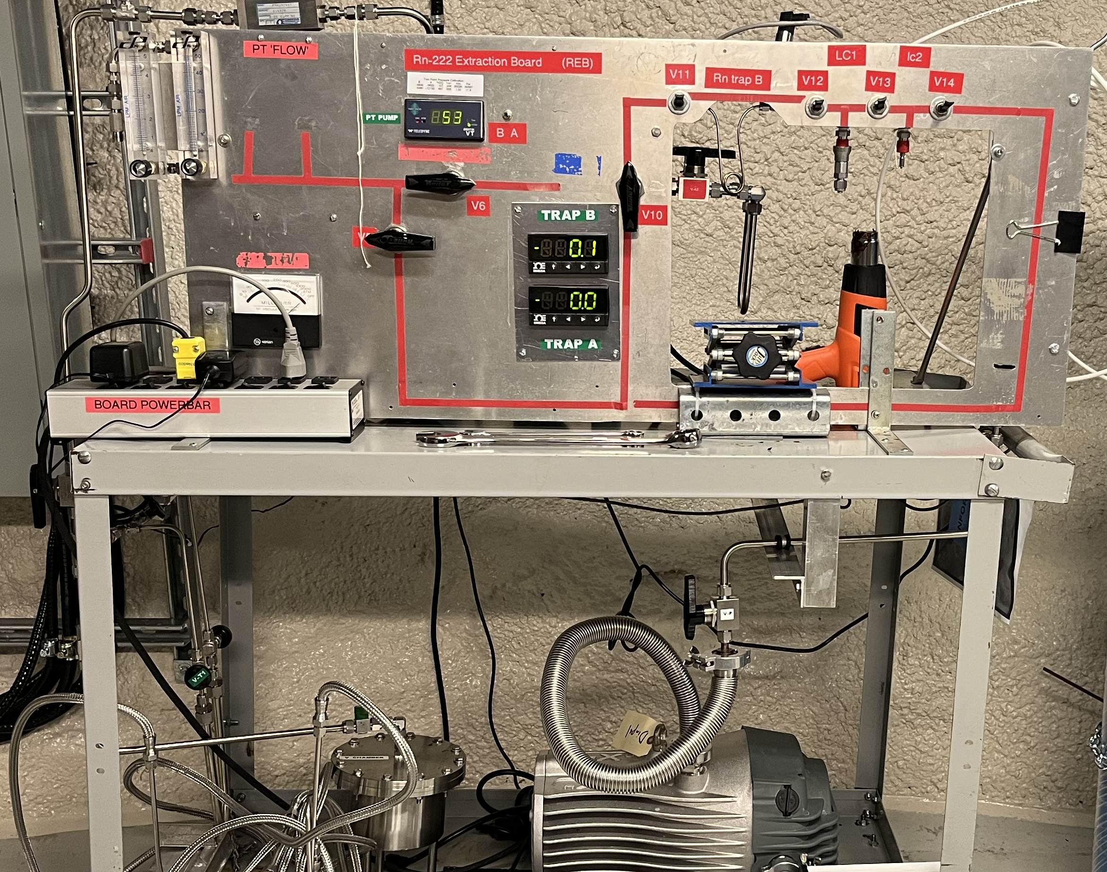
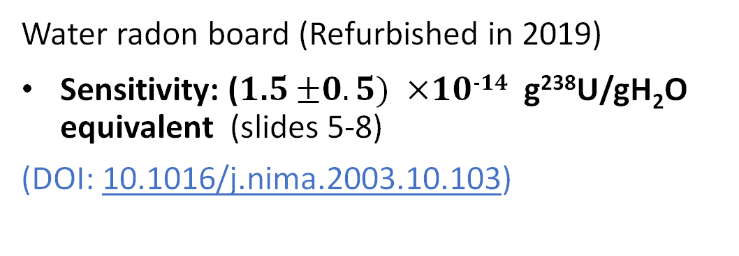
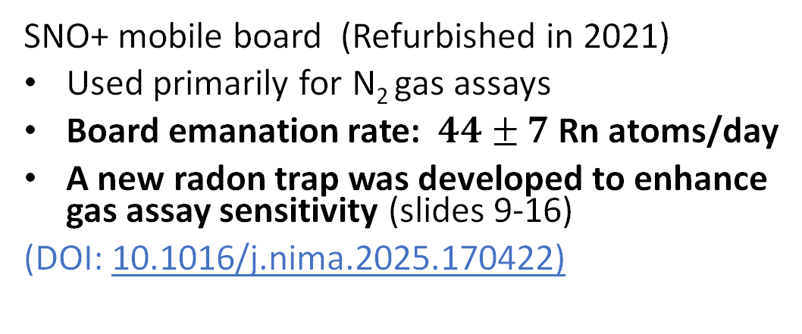
Underground Radon Assay Systems
Water radon board (Refurbished in 2019)
Sensitivity: (1.5 $±0.5) ×$10⁻¹⁴ g²³⁸U/gH₂O equivalent (slides 5-8)
(DOI: 10.1016/j.nima.2003.10.103)
SNO+ mobile board (Refurbished in 2021)
Used primarily for N₂ gas assays
Board emanation rate: 44 $±$ 7 Rn atoms/day
A new radon trap was developed to enhance gas assay sensitivity (slides 9-16)
(DOI: 10.1016/j.nima.2025.170422)

Slide 4
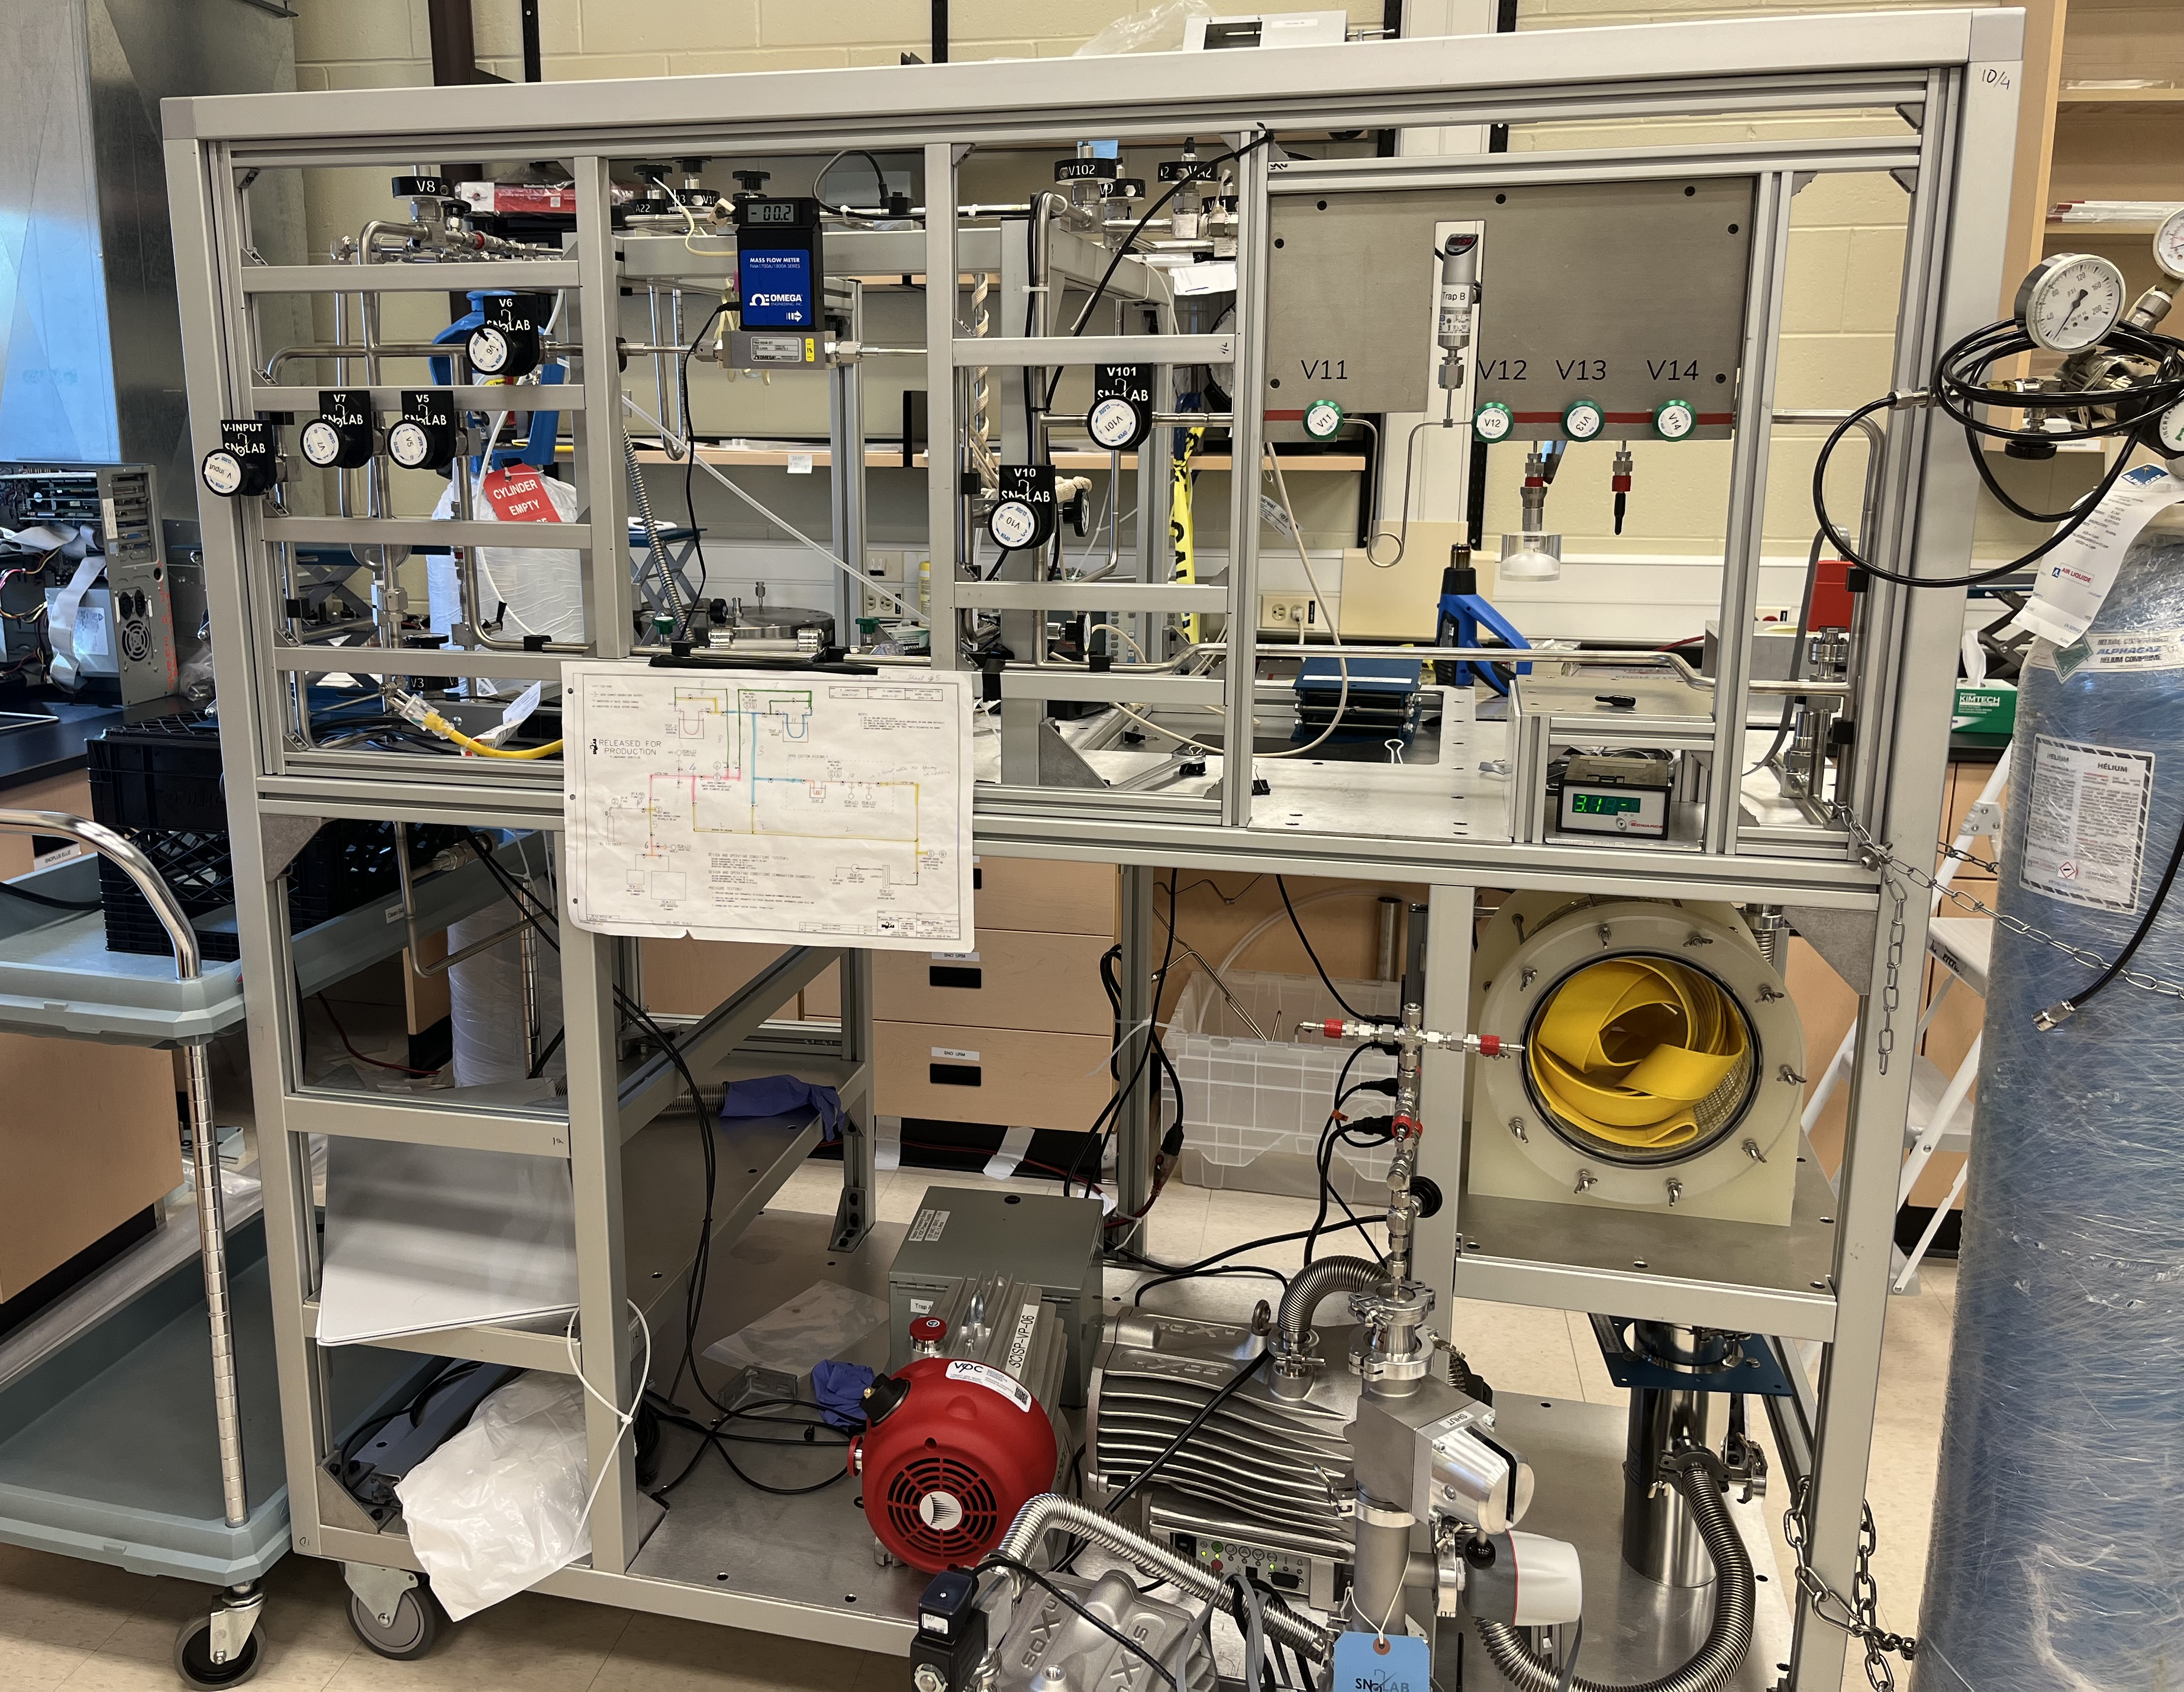
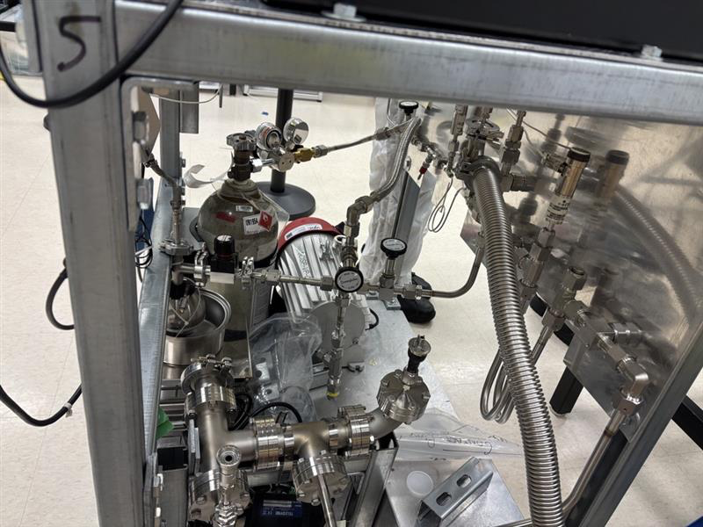
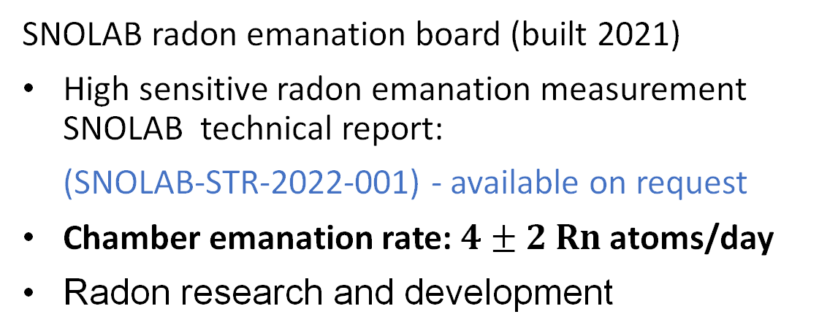
Surface Radon Emanation Systems
SNOLAB radon emanation board (built 2021)
High sensitive radon emanation measurement
SNOLAB technical report:
(SNOLAB-STR-2022-001) - available on request
Chamber emanation rate: 4$± 2$Rn atoms/day
Radon research and development
Radon Board
Emanation
Chamber
DEAP-3600 board (refurbished 2023)
The board emanation rate
< 6 Rn atoms/day@90% CL
Testing new radon detectors
Spherical proportional counter

Slide 5
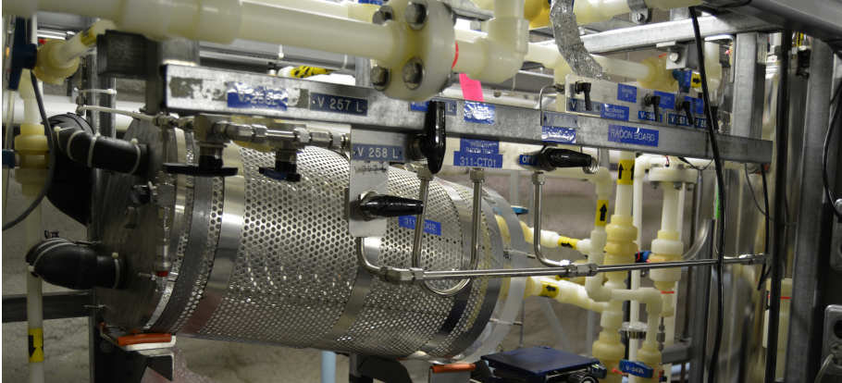
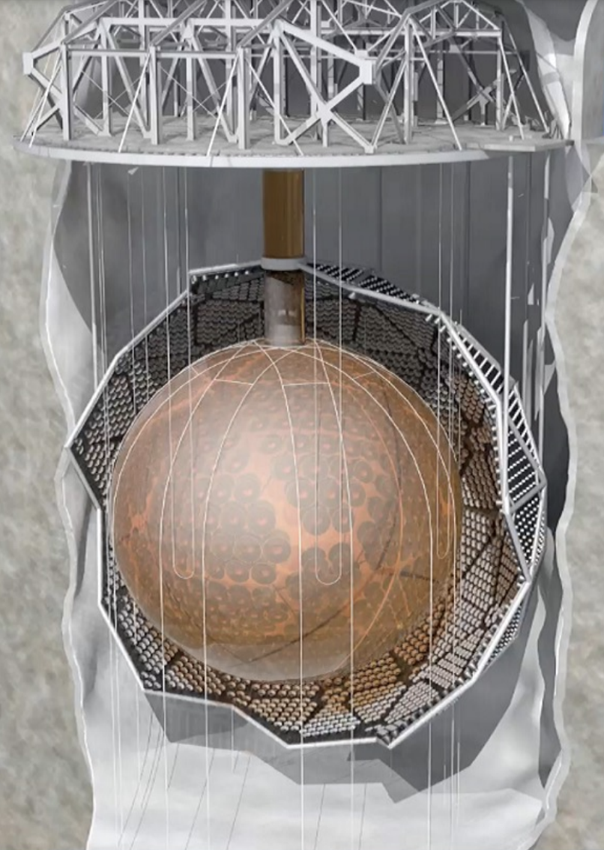
Water Radon Assay System
Designed and built by the SNO collaboration (DOI: 10.1016/j.nima.2003.10.103)
Operated by SNOLAB and SNO+ to monitor ²²²Rn level of SNO+ cavity UPW
and SNOLAB UPW plant
The SNO+ experiment
Degassser
Trap B
Water trap
Trap A
Water shielding
(7000 tonnes UPW)

Slide 6
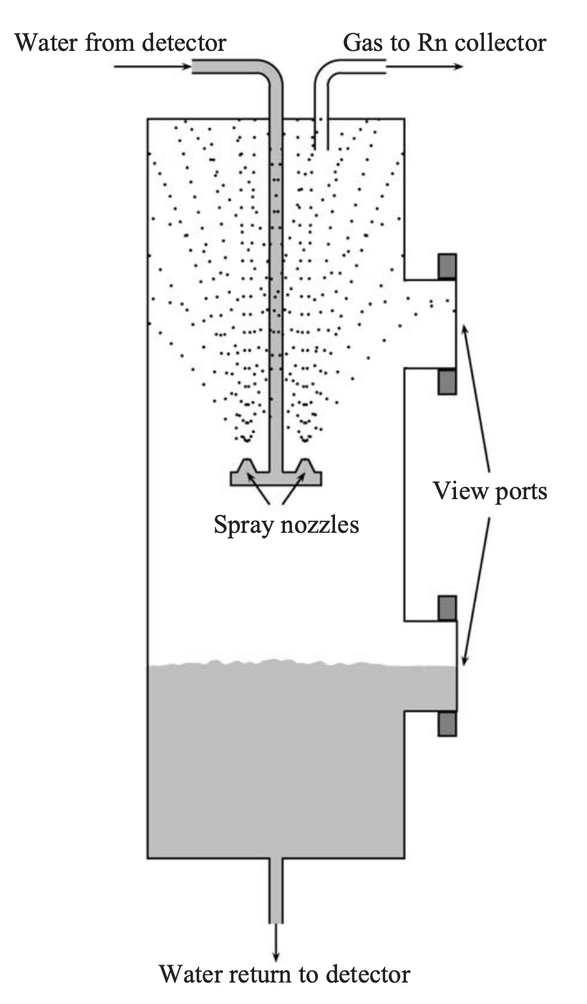
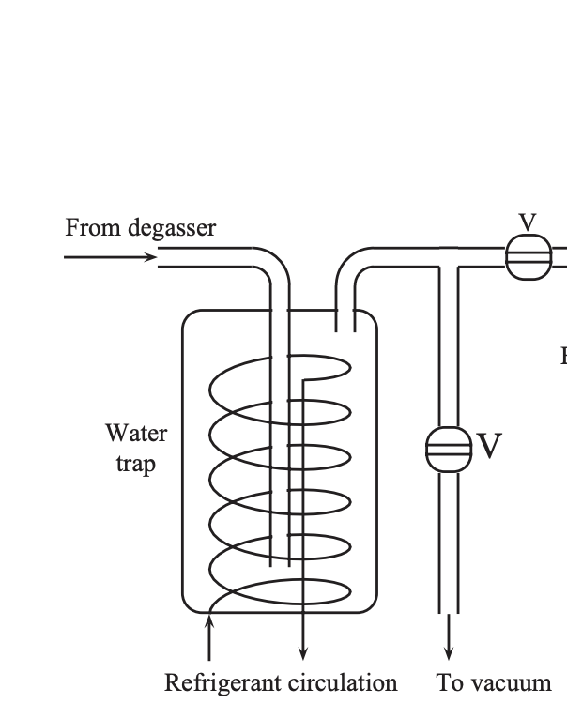
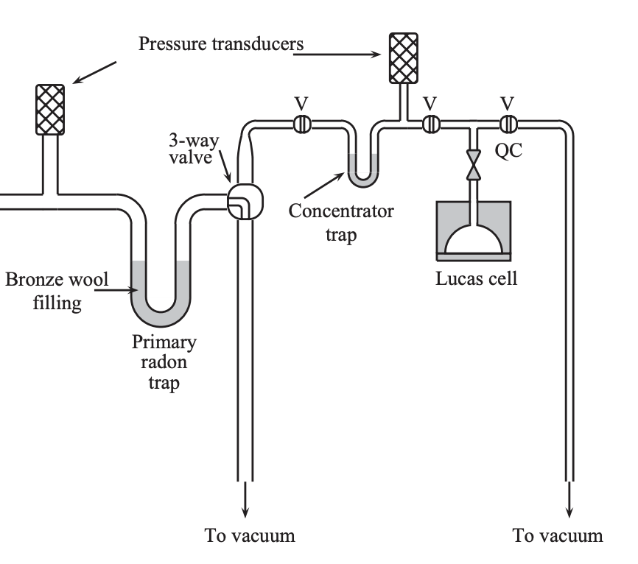
Water Radon Assay System
Degasser
Water trap (-60 C)
Radon extraction board
H₂O from SNO+ cavity/UPW plant
(19 SLPM)
Water return to cavity

Slide 7
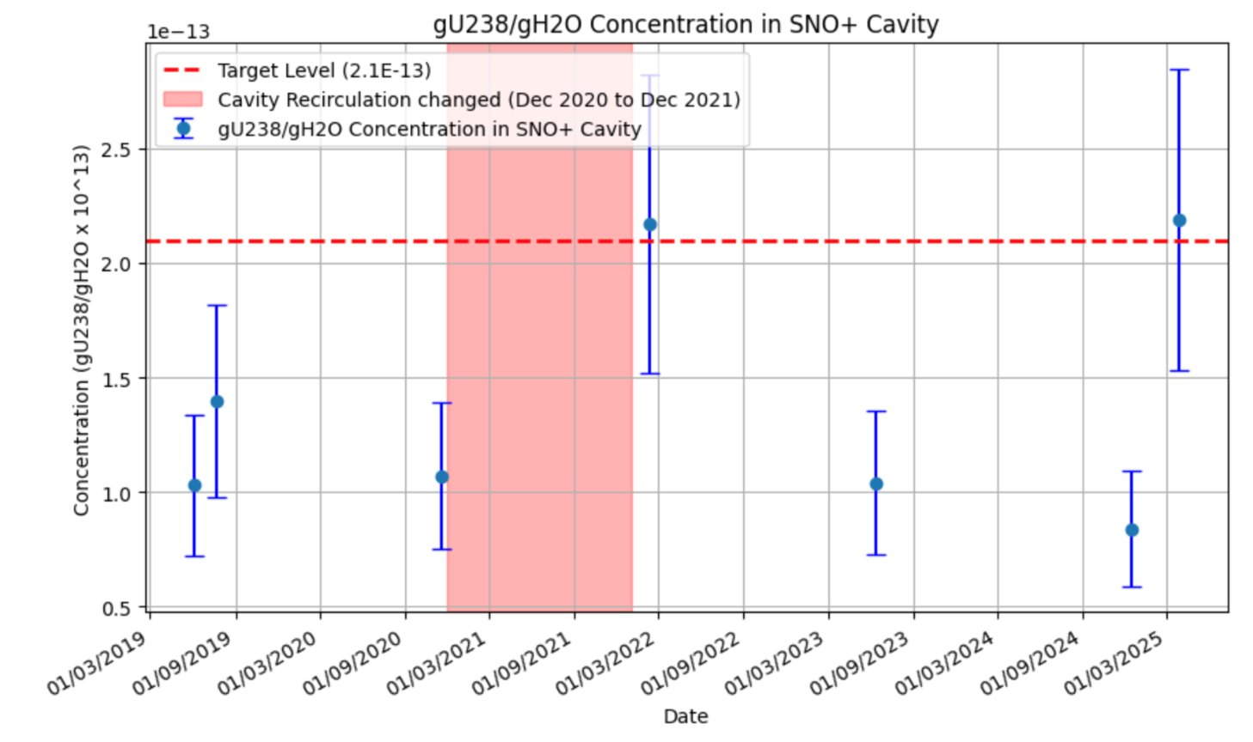
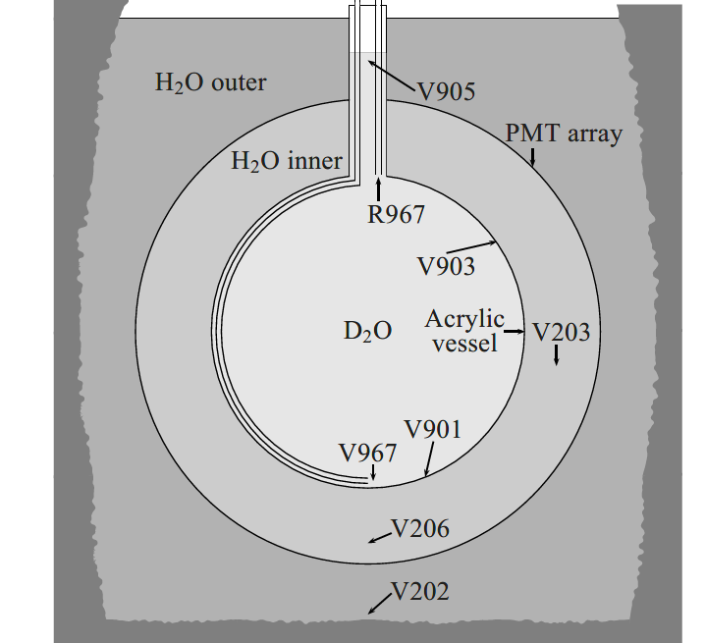
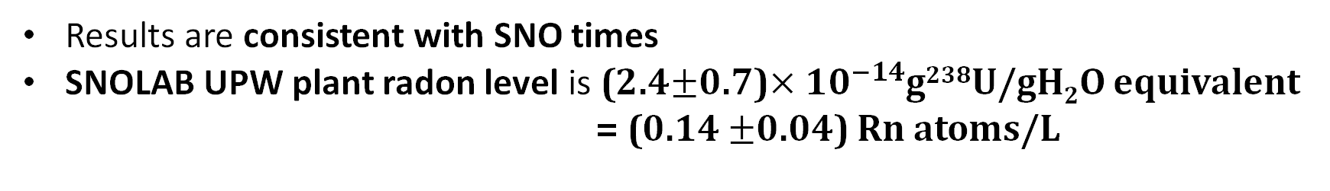
V203: Between Acrylic Vessel and PMTs
Results are consistent with SNO times
SNOLAB UPW plant radon level is (2.4$±$0.7)$×{10}^{−14}$g²³⁸U/gH₂O equivalent
= (0.14 $±$0.04) Rn atoms/L

Slide 8
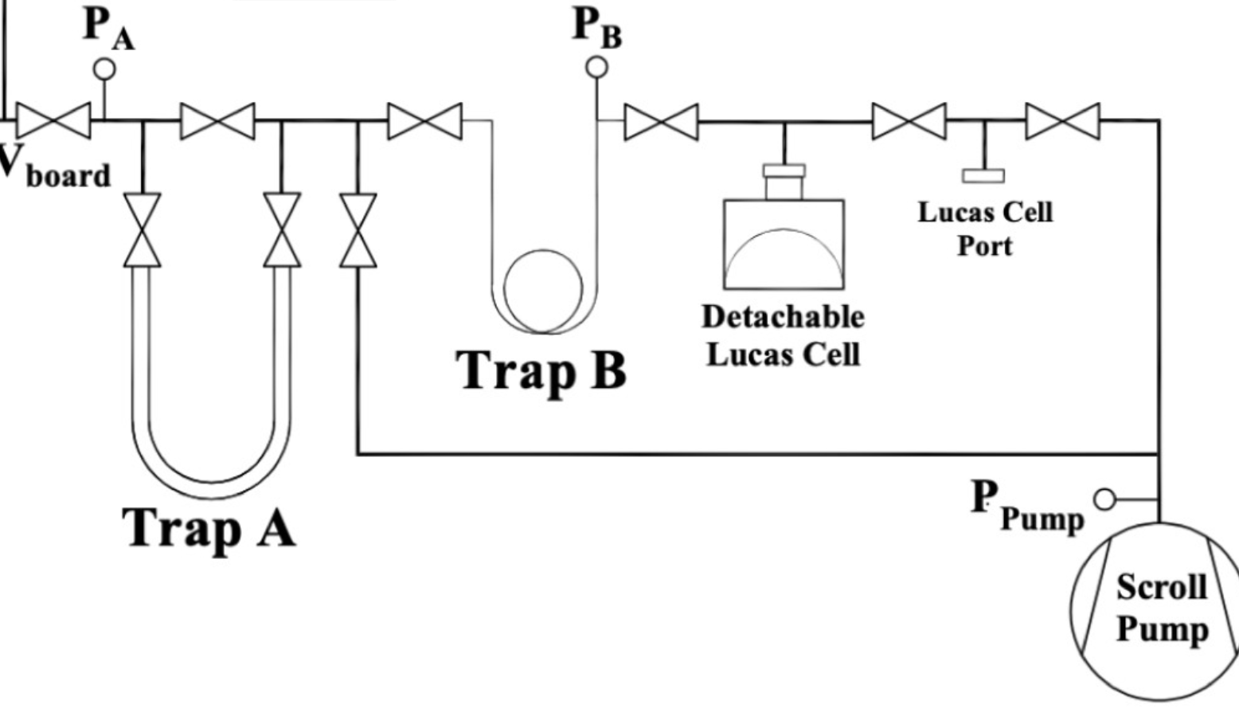
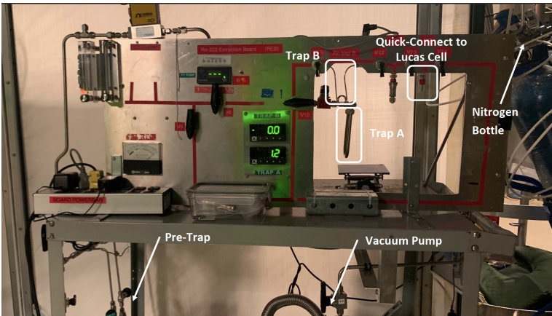
SNOLAB/SNO+ Gas Assay System
Modified low radon
emanation
vapor trap
Gas system
filled with N₂
Originally designed for vacuum radon emanation measurement
Has been adopted to perform N₂ gas assays (SNO+/SNOLAB gas systems and PICO-500)

Slide 9
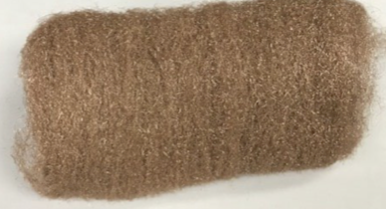
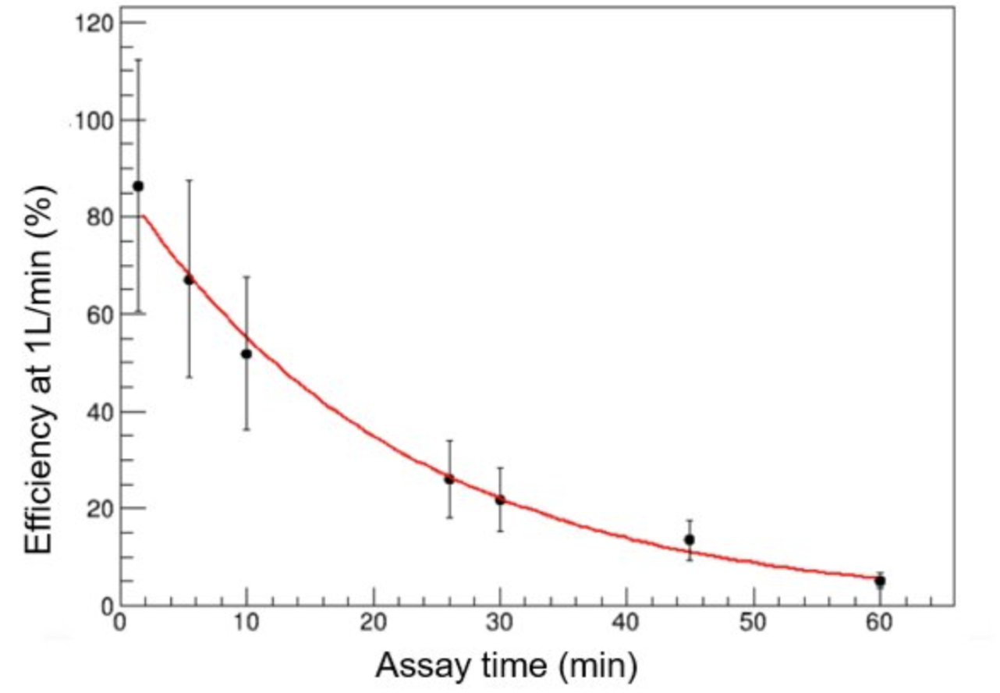
Primary Trap Limitation for Gas Assays
Radon traps use porous materials to enhance trapping
Bronze wool highly efficient under high vacuum
Gas assay efficiency decreases with longer duration or >1 SLPM flow
Limited extracted gas volume constrains sensitivity
Need for traps with more porous material
S.M.A. Hussain MSc thesis (2022)

Slide 10
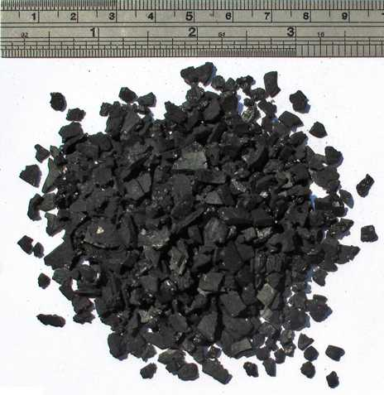
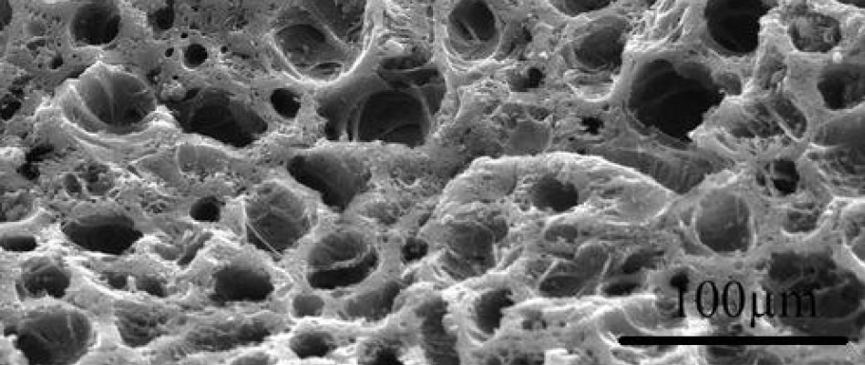
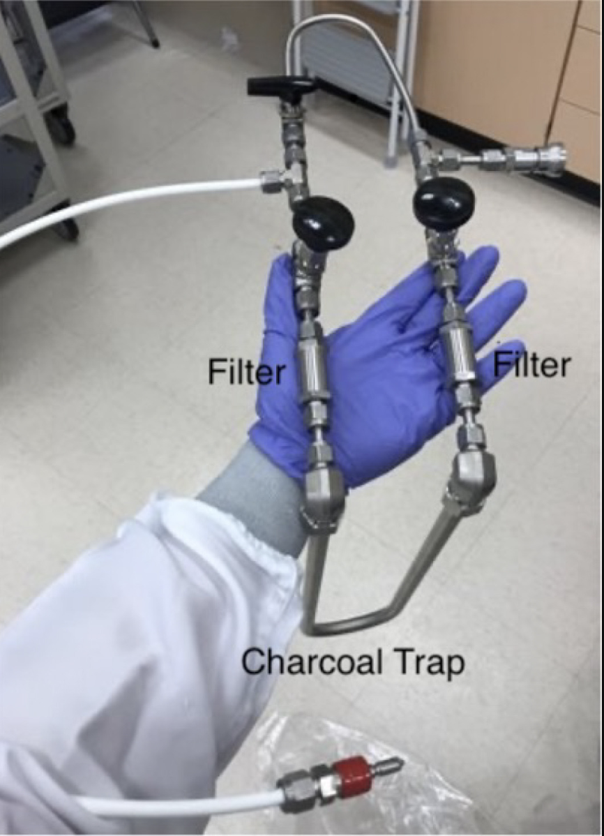
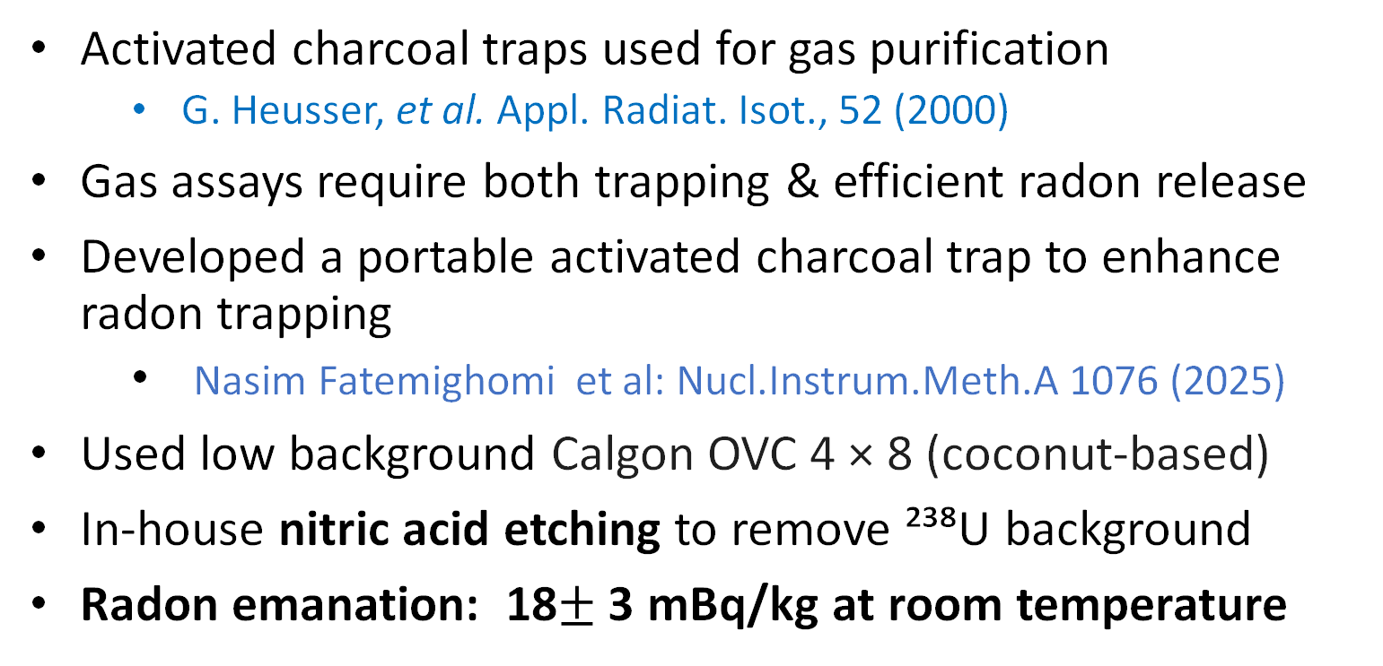
Activated Charcoal Trap
Activated charcoal traps used for gas purification
  G. Heusser, et al. Appl. Radiat. Isot., 52 (2000)
Gas assays require both trapping & efficient radon release
Developed a portable activated charcoal trap to enhance radon trapping
  Nasim Fatemighomi et al: Nucl.Instrum.Meth.A 1076 (2025)
Used low background Calgon OVC 4 × 8 (coconut-based)
In-house nitric acid etching to remove ²³⁸U background
Radon emanation: 18$±$3 mBq/kg at room temperature
100μm
22 g trap

Slide 11
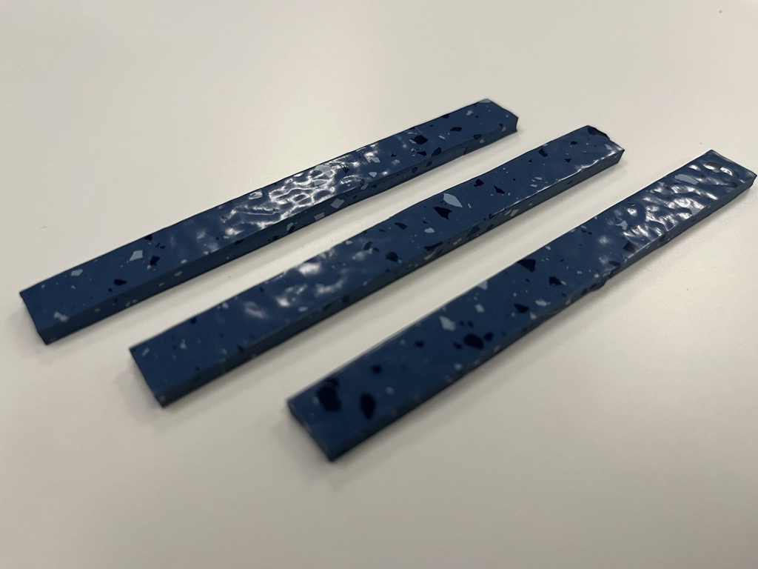
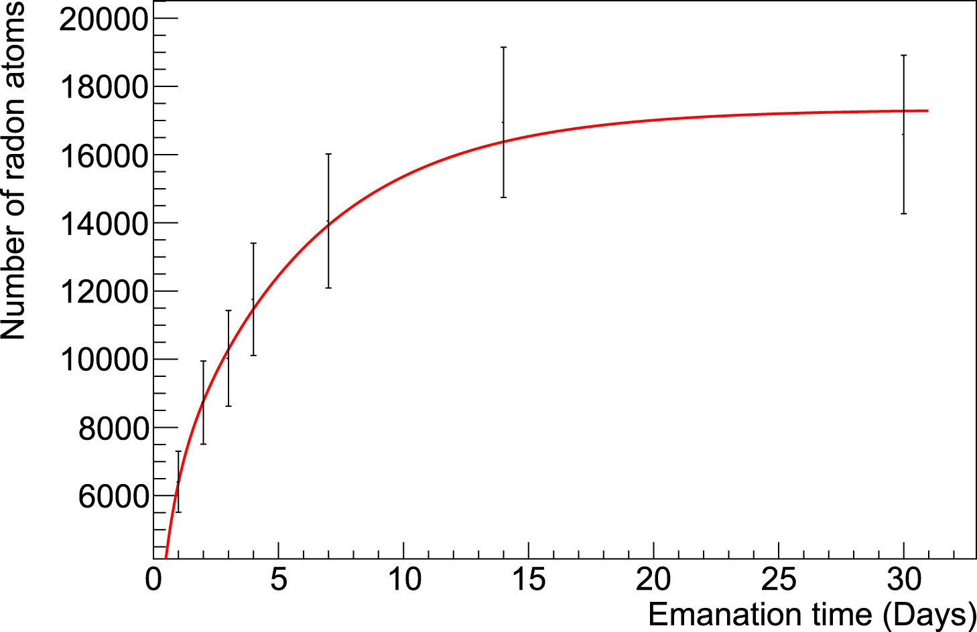
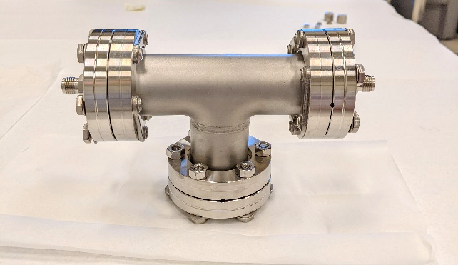
Radon Calibration Source for Trap testing
A calibrating source was made using Nora Xp 5319
rubber floor tile
10cm
Fit is based on²²⁶Ra-supported emanation
and ²²²Rn outgassing from porous rubber tiles
14 x 10 cm² floor tiles
Calibration Can

Slide 12
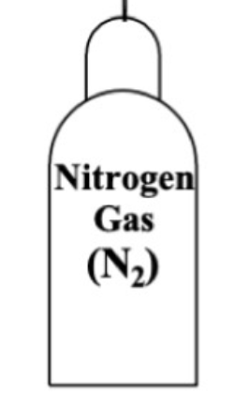
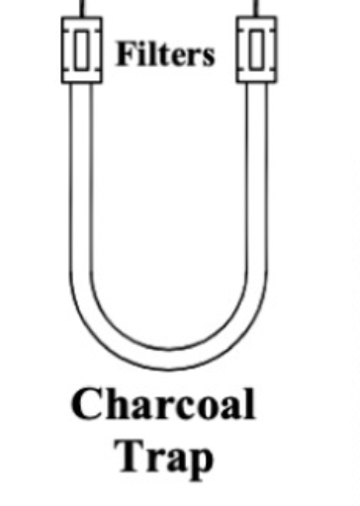
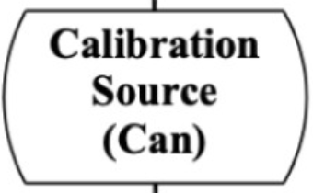
Trap Efficiency Test Set-up
N₂ flow through the source introduces radon atoms to trap
Charcoal cooled with LN₂–alcohol mix to trap radon
Radon released from charcoal trap by heating to 150 °C
Released radon were extracted using the radon board

Slide 13
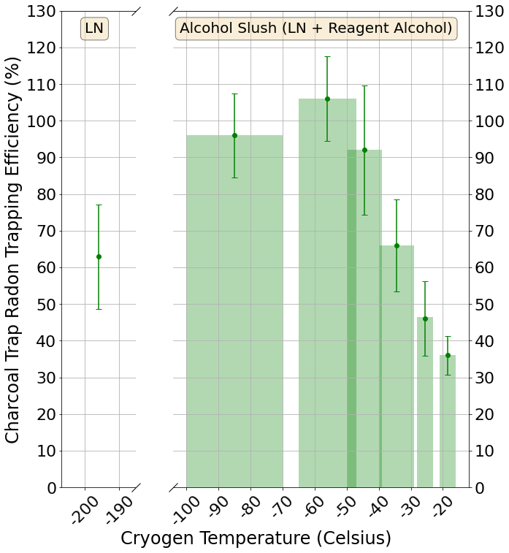
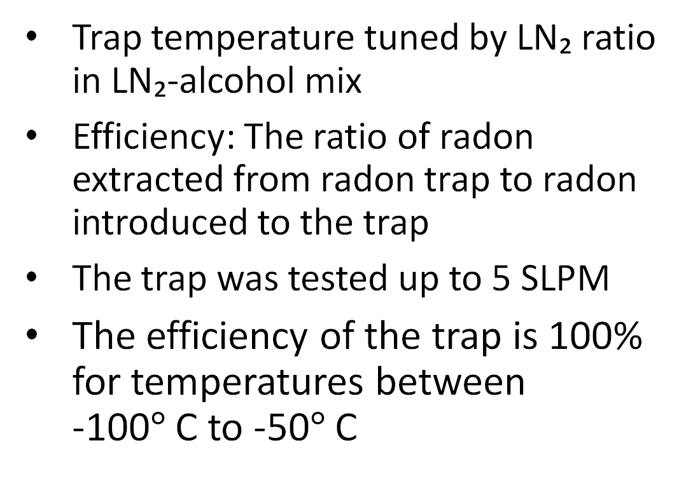
Efficiency versus Cooling Temperature
Trap temperature tuned by LN₂ ratio in LN₂-alcohol mix
Efficiency: The ratio of radon extracted from radon trap to radon introduced to the trap
The trap was tested up to 5 SLPM
The efficiency of the trap is 100% for temperatures between
-100$°$ C to -50$°$ C

Slide 14
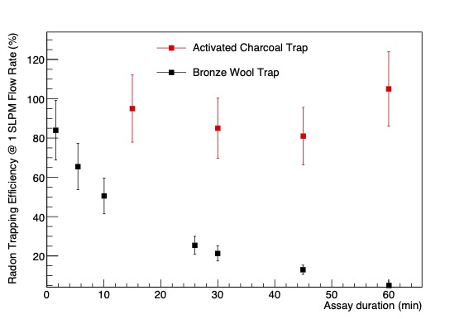
Charcoal versus Bronze Traps
Unlike bronze wool trap, charcoal trap is 100% efficient after one hour of assay duration
Bronze wool data shown in slide 9…

Slide 15
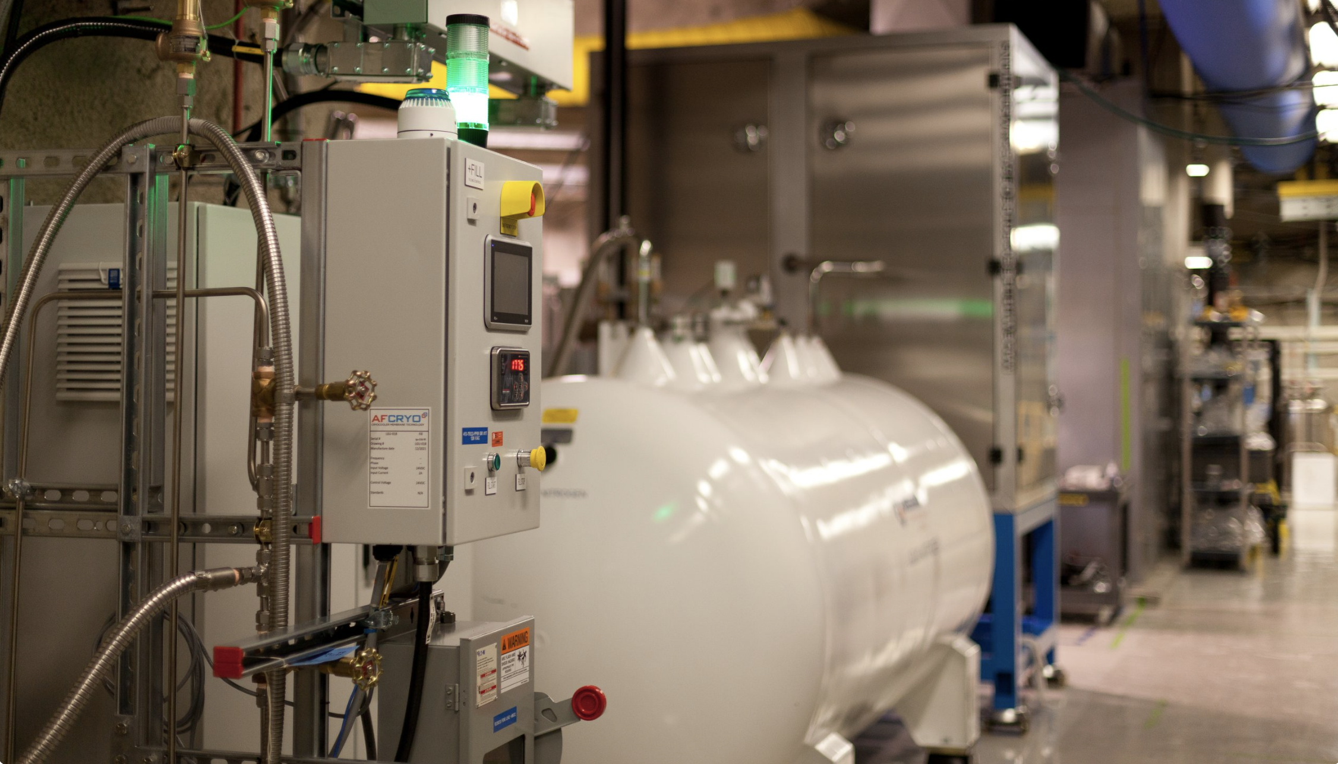
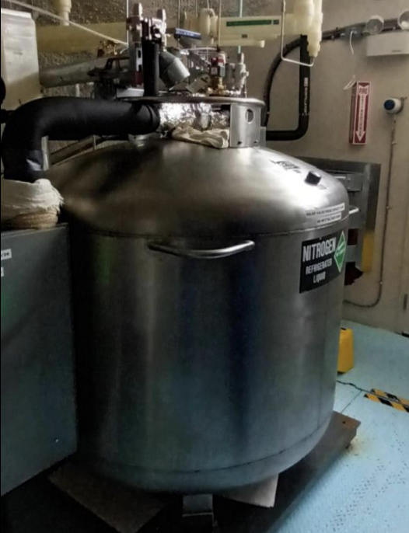
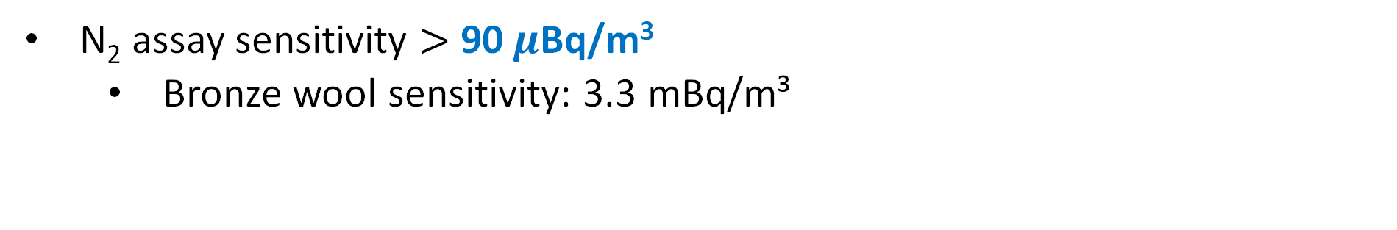
Charcoal Trap Sensitivity and Use
N₂ assay sensitivity $>$90$μ$Bq/m³
  Bronze wool sensitivity: 3.3 mBq/m³
Trap used to measure radon in N₂ systems, incl. SNOLAB LN₂ plant boil-off
SNOLAB LN₂ plant
SNOLAB International Dewar

Slide 16
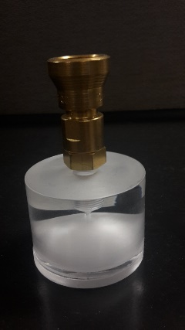
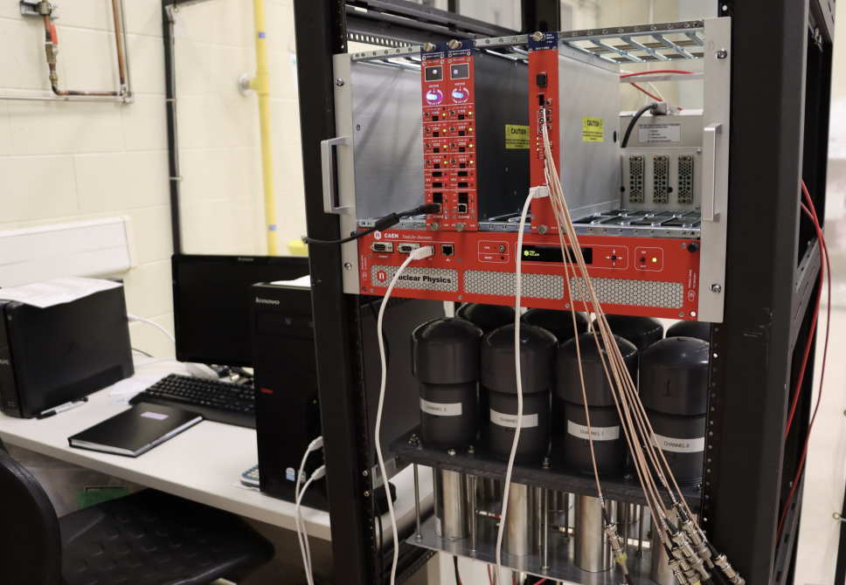
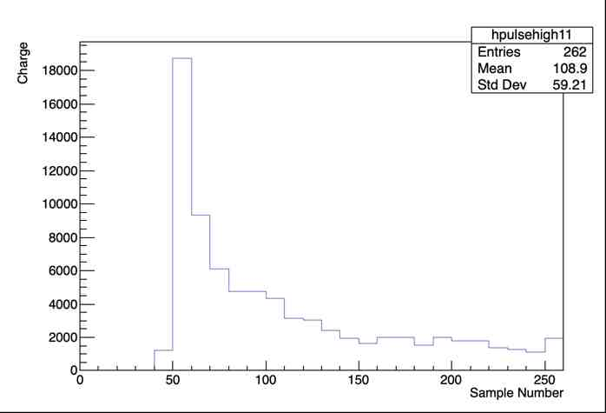
Radon Counting
Portable Lucas cells with ZnS(Ag) coating
ZnS(Ag) scintillates with α particles → ideal for radon detection
Eighteen Lucas cell channels available
2” diameter
2” diameter PMTs and CAEN electronics
4 μs window

Slide 17
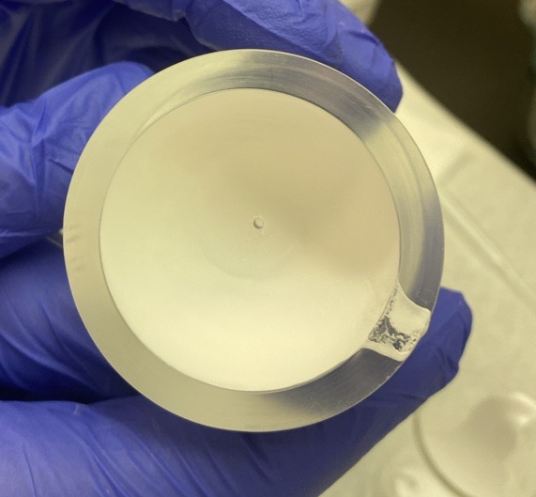
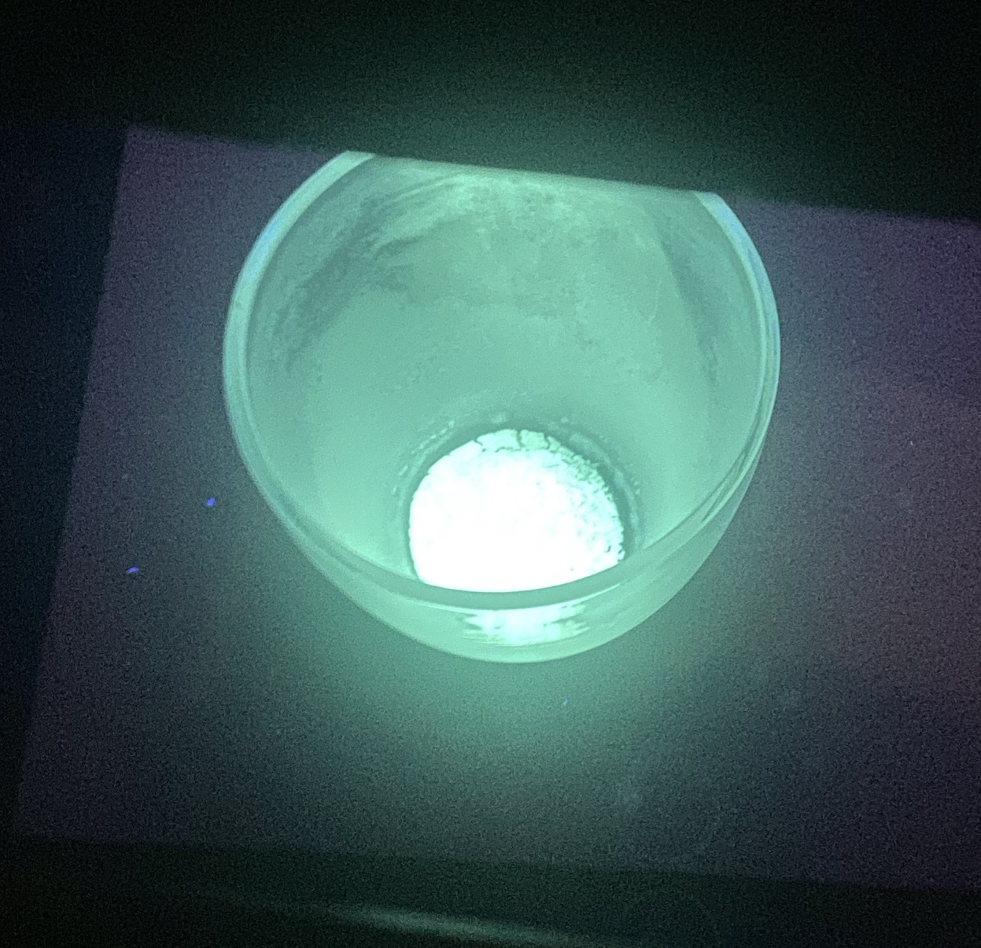
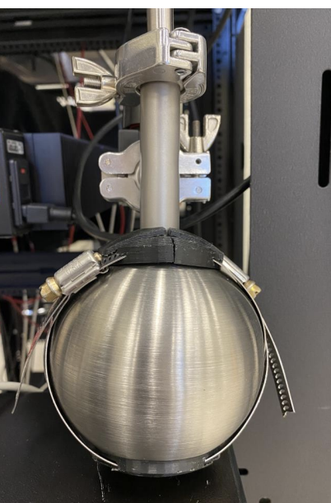
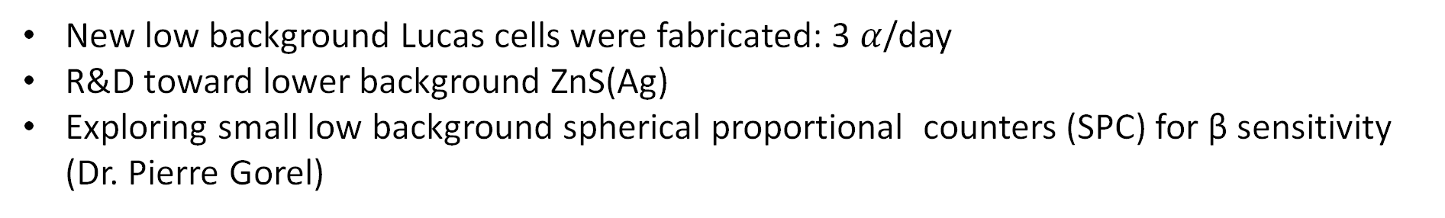
Enhancing Radon Counting
New low background Lucas cells were fabricated: 3 $α$/day
R&D toward lower background ZnS(Ag)
Exploring small low background spherical proportional counters (SPC) for β sensitivity (Dr. Pierre Gorel)
New Lucas cell
In-house ZnS(Ag)
SPC (a la NEWSG)

Slide 18
Summary and Future Work
At SNOLAB radon assay systems used to measure radon in UPW, solid samples, and N₂ gas
Developed a low-background radon trap to improve N₂ gas assay sensitivity
Continuing research on radon trapping methods
  R &D for radon measurement in noble gases
R &D toward making low background radon counting systems

Slide 19
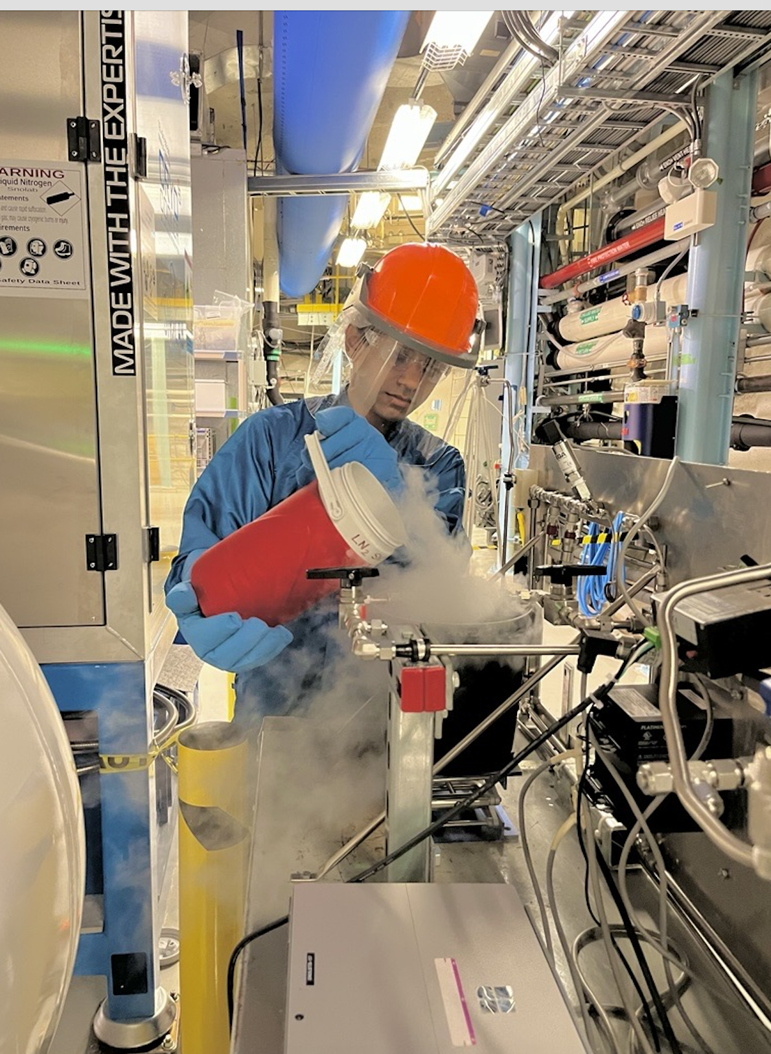
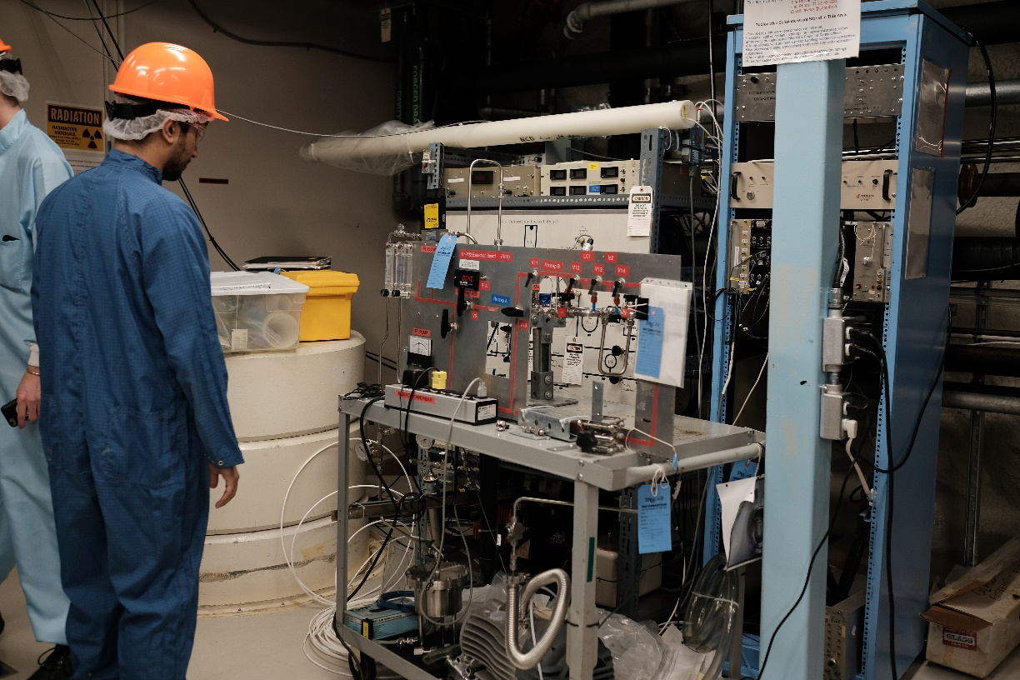
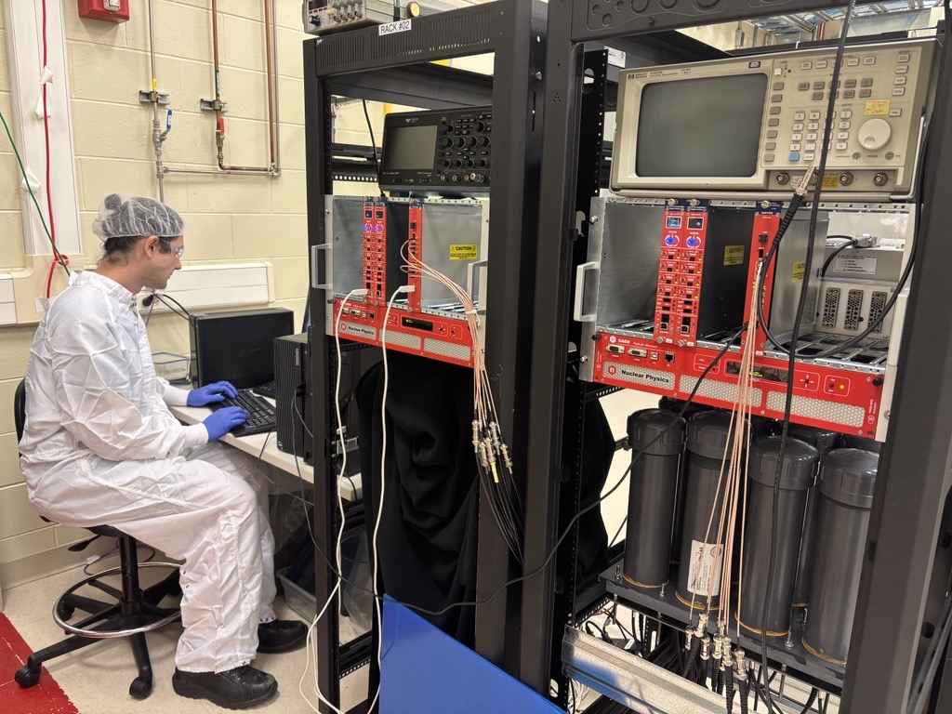
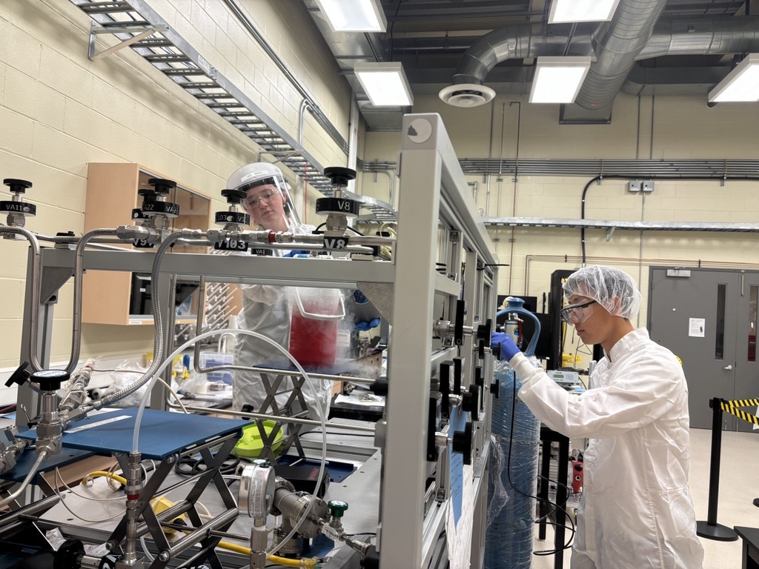
Acknowledgement
Research Students (SNOLAB/SNO+):
Yusuf Ahmed, Juliette Deloye, Peter Qin, Justin Suys, Keegan Paleshi, Adil Hussain, Jerry Lu and Ariana Pearson
Scientific Support Team:
Lina Anselmo, Steven Maguire, Sharayah Read and Deena Fabris

