Slide 1
Boosted Dark Matter Directionality in Large Liquid Scintillators
Samuel S.H. Tse¹, Qishan Liu^{1,3}, Kenny C.Y. Ng¹, Koun Choi², Yufeng Li³
¹The Chinese University of Hong Kong, Hong Kong, China
²Center for Underground Physics, IBS, Daejeon, Korea
³Institute of High Energy Physics, Beijing, China

Slide 2

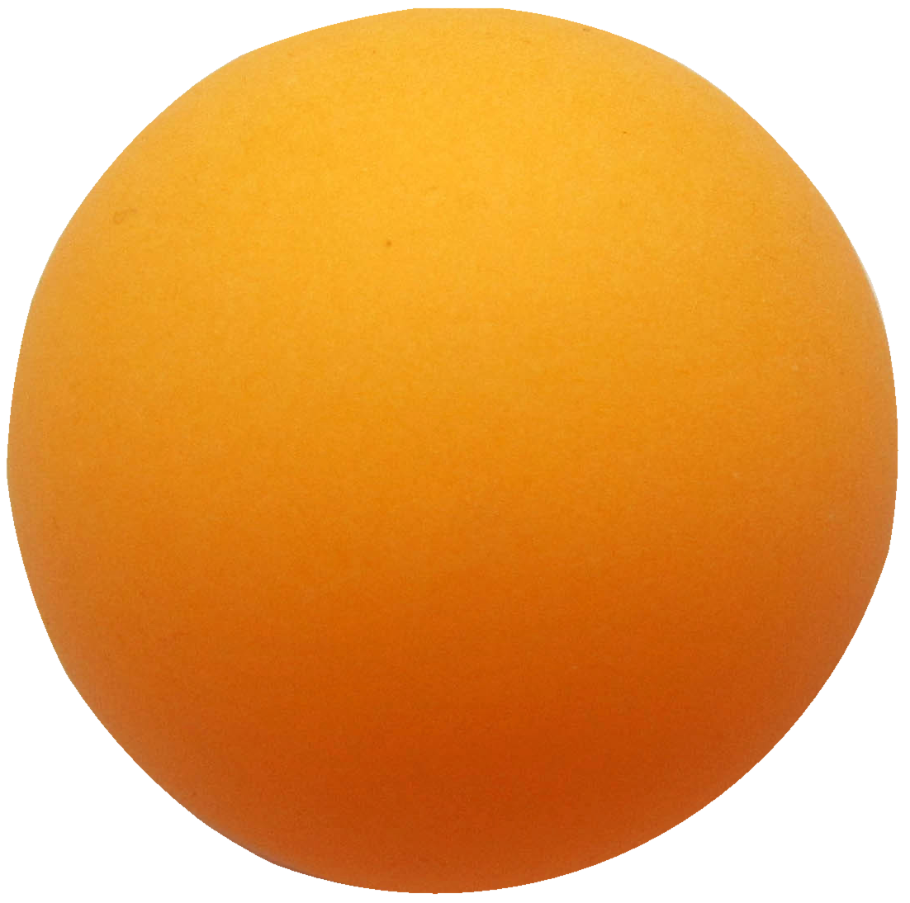
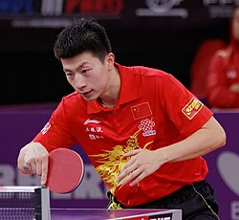
Boosted Dark Matter Directionality in Large Liquid Scintillators
No Successful DM detection has announced yet.
Hypothesis: The mass of DM particles in our galaxy halo are too light and too cold to trigger observable signals in current detectors.
DM particles that been boosted to relativistic speed by certain mechanism, could trigger our detectors, and possibly leave a directional signature.

Slide 3


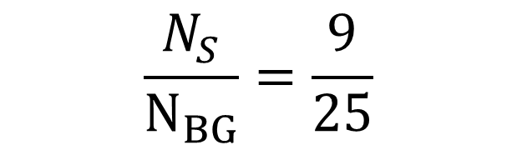
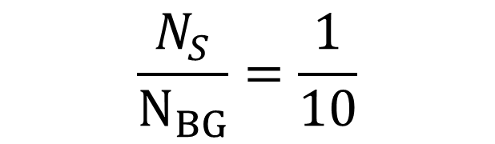

Boosted Dark Matter Directionality in Large Liquid Scintillators
$N_{BG}$= 100
$N_{S}$ =10
$$N_{BG}=75$$
$$N_{S}=1$$
$${ N}_{BG}=25$$
$$N_{S}=9$$
$$\frac{N_{S}}{N_{BG}}=\frac{1}{10}$$
$$\frac{N_{S}}{N_{BG}}=\frac{9}{25}$$

Slide 4

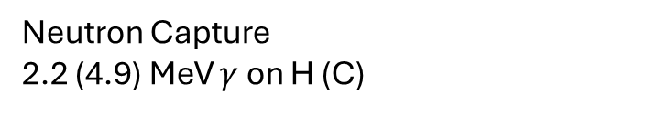


Boosted Dark Matter Directionality in Large Liquid Scintillators
Traditionally, charged particle directionality will be lost due to scintillation light.
We will use neutron interaction points to reconstruct directionality.
Lower energy threshold than Water Cherenkov detector.
Neutron Capture
2.2 (4.9) MeV $γ$ on H (C)
$$θ_{c}$$
lights from $C_{11}$ nucleus deexciation

Slide 5
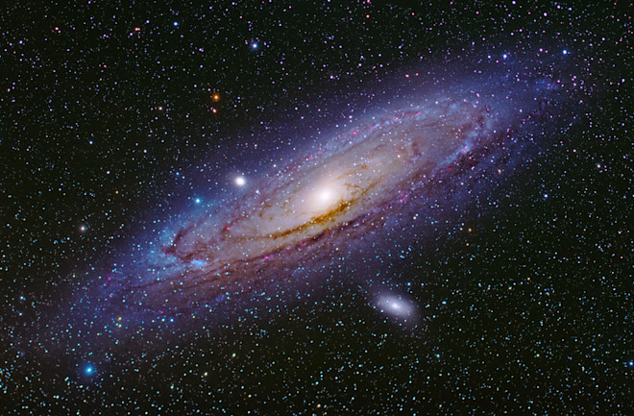
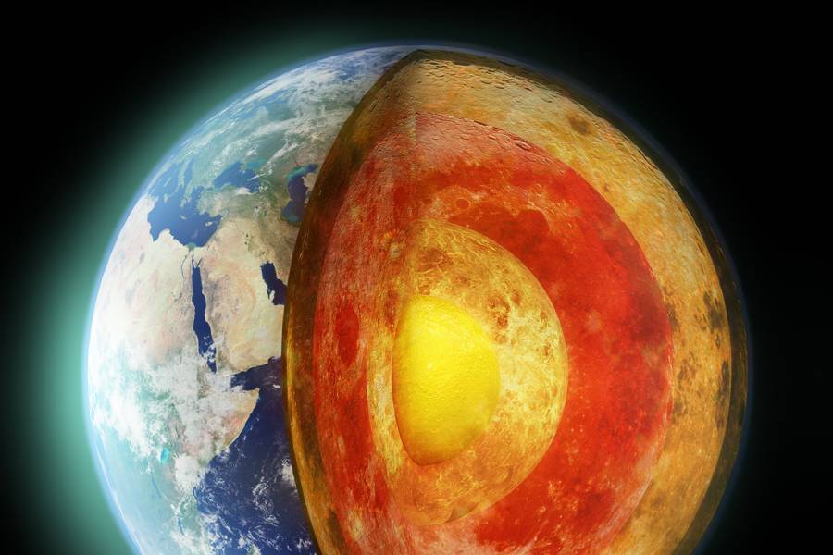
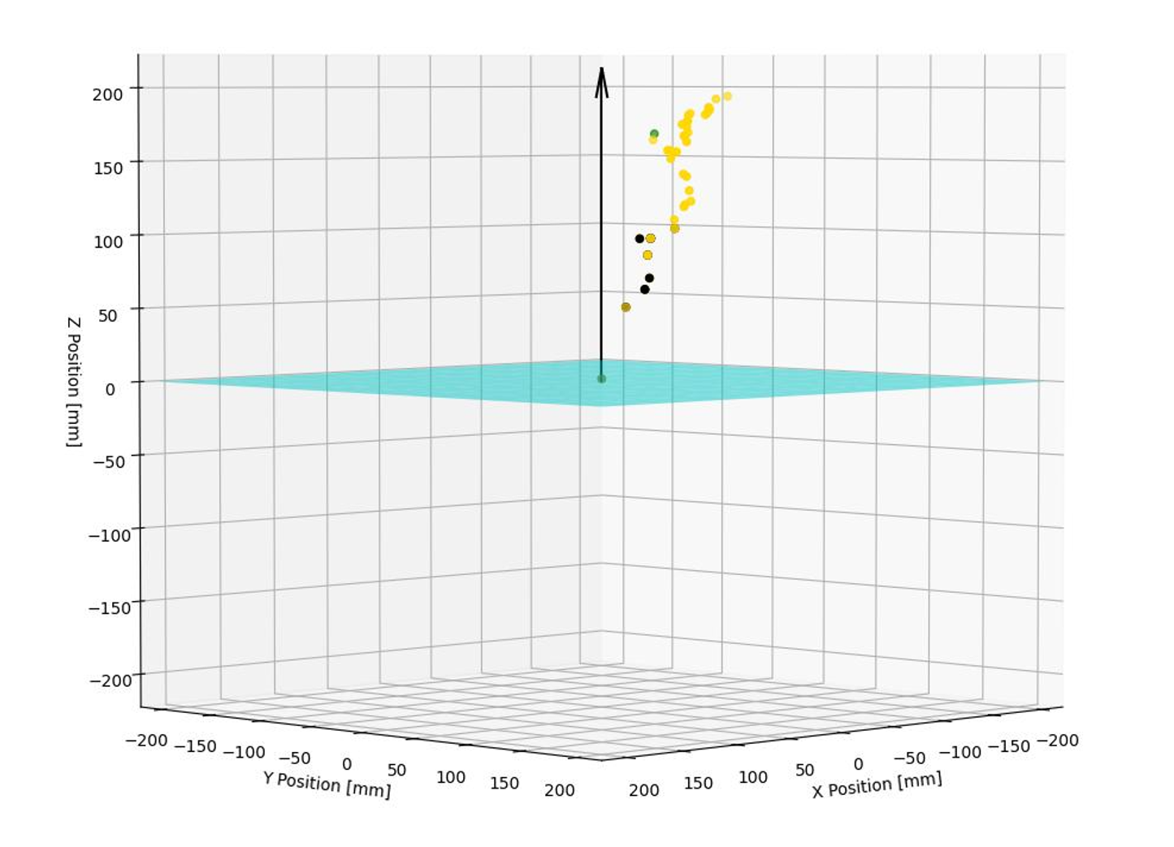
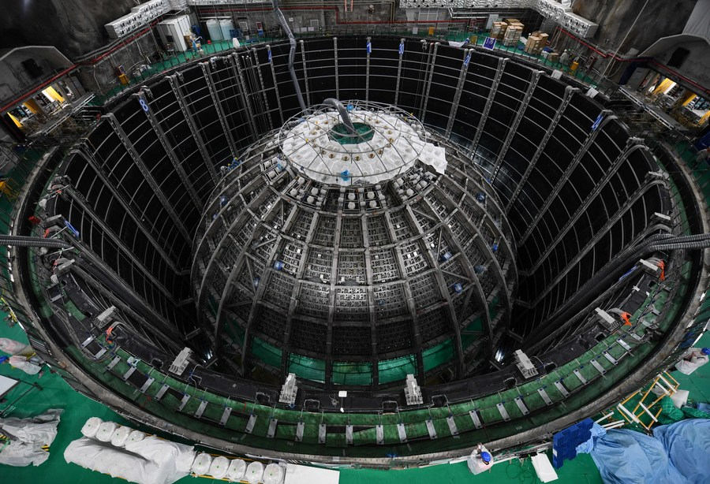
Outline:
1.
2.
BDM Flux From Milky Way
Earth Crust Stopping DM
3.
4.
DM Knocking
Neutrons
Neutrons Diffuse and Capture

Slide 6

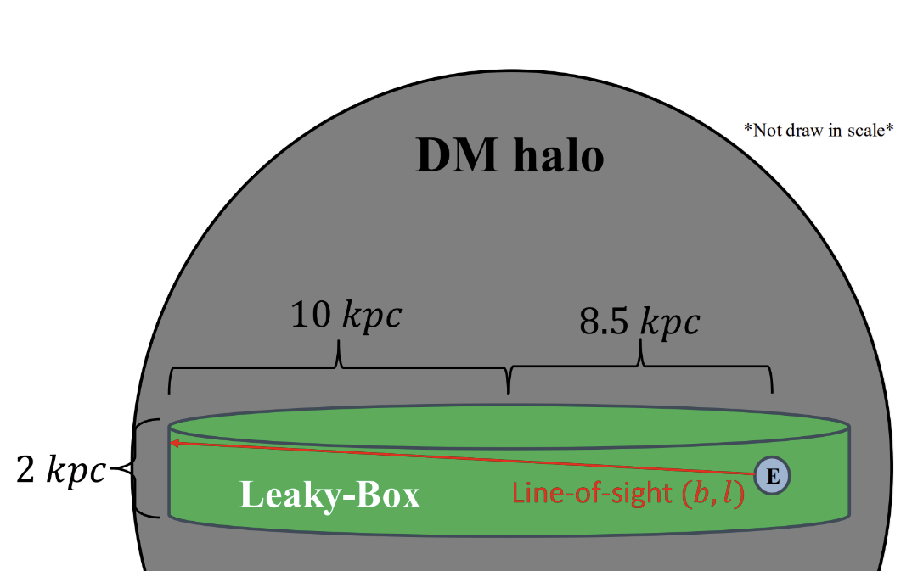

Boosted Dark Matter by Cosmic Rays
Detector’s nucleon $↔$ DM $↔$Cosmic ray
We Follow [Ema,2021] scheme to obtain BDM Flux.
DM density profile follows NFW profile.
Cylindrical Leaky-Box Model
Cosmic rays(p and He only ) are assumed to be isotropic and homogeneous.

Slide 7
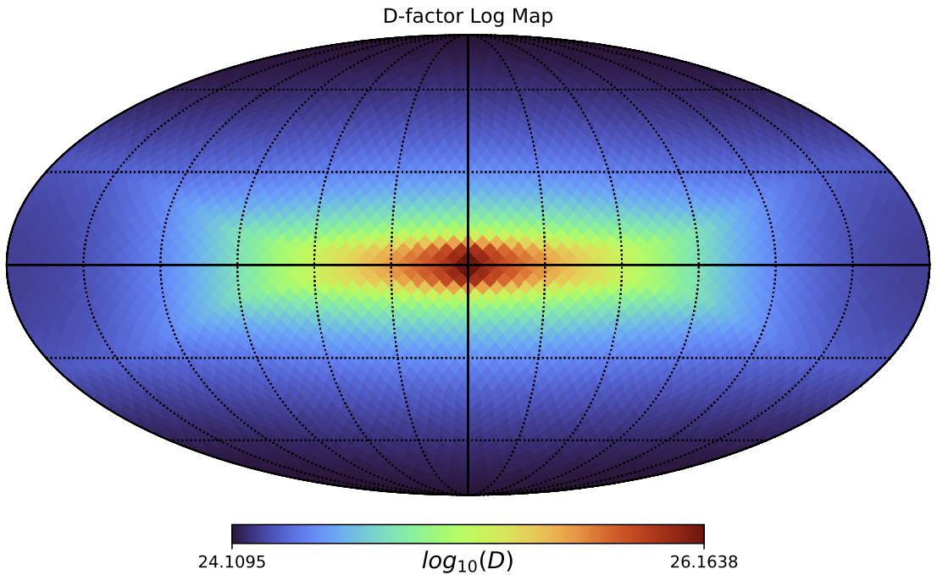

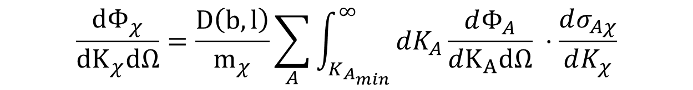

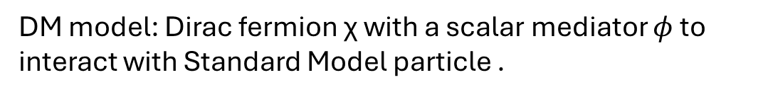
Boosted Dark Matter Flux
DM model: Dirac fermion χ with a scalar mediator $φ$ to interact with Standard Model particle .
LIS cosmic ray Flux
$$D\left(b,l\right)=\int_{l.o.s}{ρ_{χ}}⋅dl$$
$$\frac{dΦ_{χ}}{{dK}_{χ}dΩ}=\frac{D\left(b,l\right)}{m_{χ}}\sum_{A}{\int_{K_{A_{min}}}^{∞}{dK_{A}\frac{dΦ_{A}}{dK_{A}dΩ} ⋅\frac{dσ_{Aχ}}{dK_{χ}}}}$$
Found by NFW profile with Cylindrical Leaky Box (Galactic Disk Size)
DM-Nucleus Coherent Scattering
Preliminary
DM Flux Peaked at Galactic Center

Slide 8

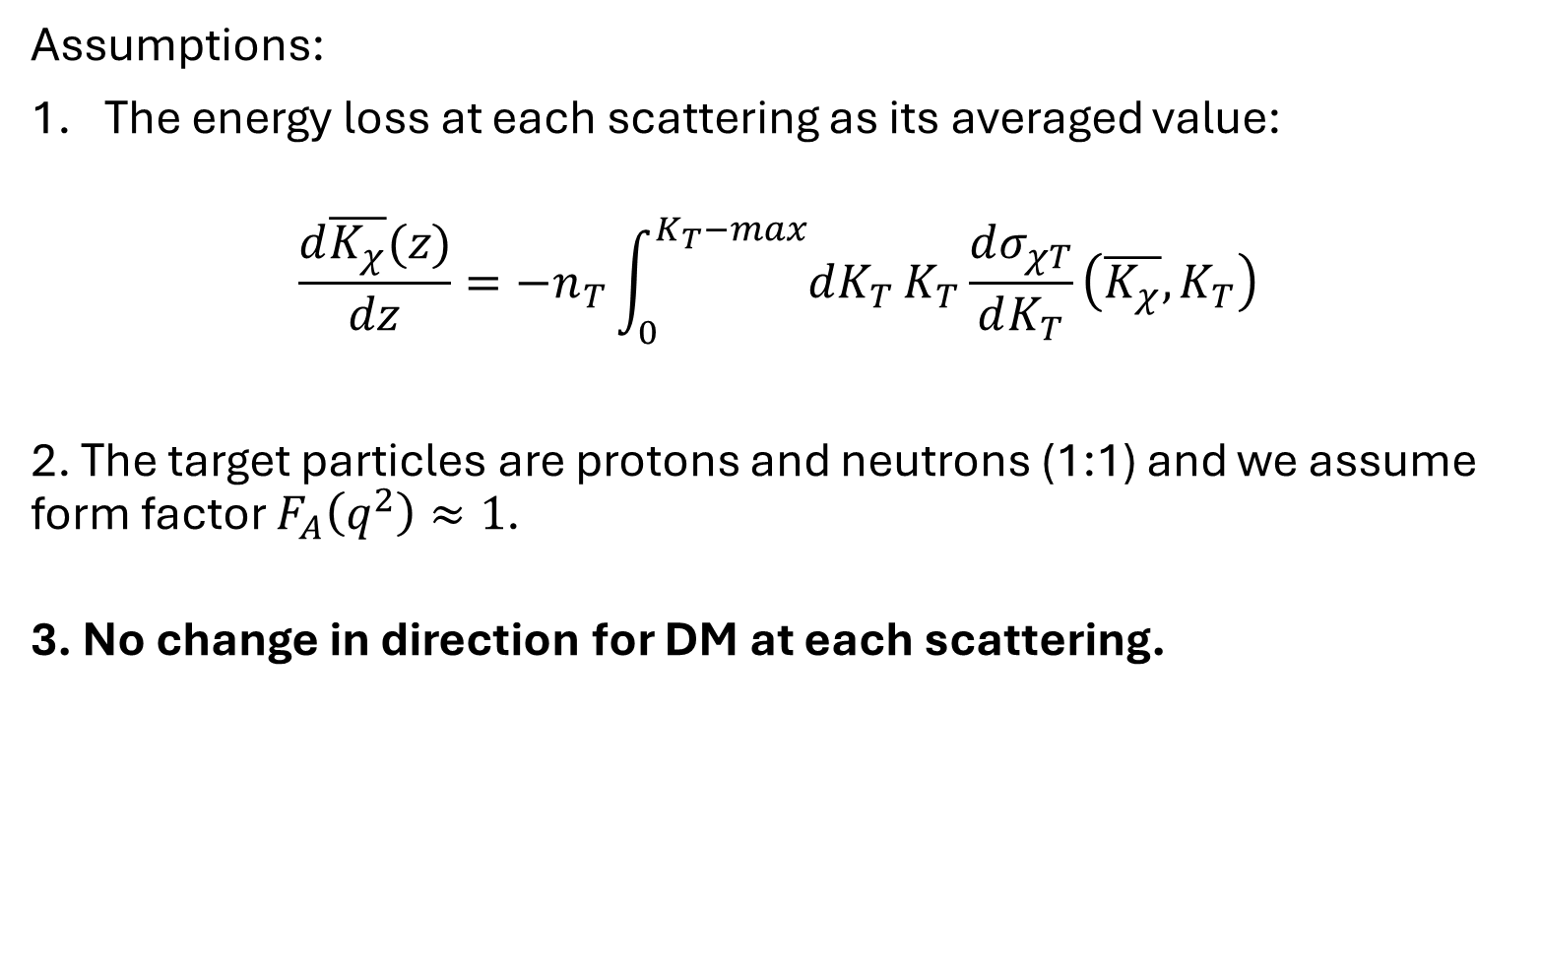


Earth Attenuation Effect (Ema,2021) & (Bringmann,2019)
Assumptions:
The energy loss at each scattering as its averaged value:
$$\frac{d\overline{K_{χ}}(z)}{dz}=−n_{T}\int_{0}^{K_{T}−max}{dK_{T}}K_{T}\frac{dσ_{χT}}{dK_{T}}\left(\overline{K_{χ}},K_{T}\right)$$
2. The target particles are protons and neutrons (1:1) and we assume form factor $F_{A}\left(q^{2}\right)≈1$.
3. No change in direction for DM at each scattering.
$$(b_{1},l_{1})$$
$$ω$$
$$(b_{2},l_{2})$$
This approximation serves as a conservative limit.
It overestimates the stopping power of Earth Crust than simulation. (Emken, 2018)

Slide 9
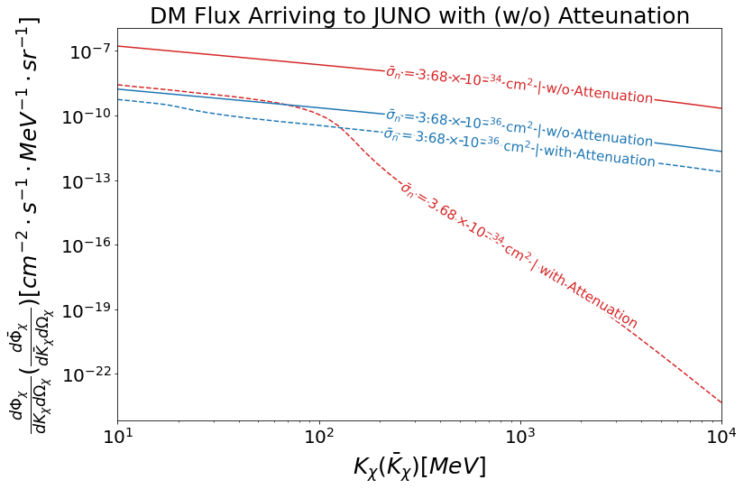

Preliminary
9
$$m_{χ}=1 MeV$$
$$m_{φ}=1 GeV$$

Slide 10
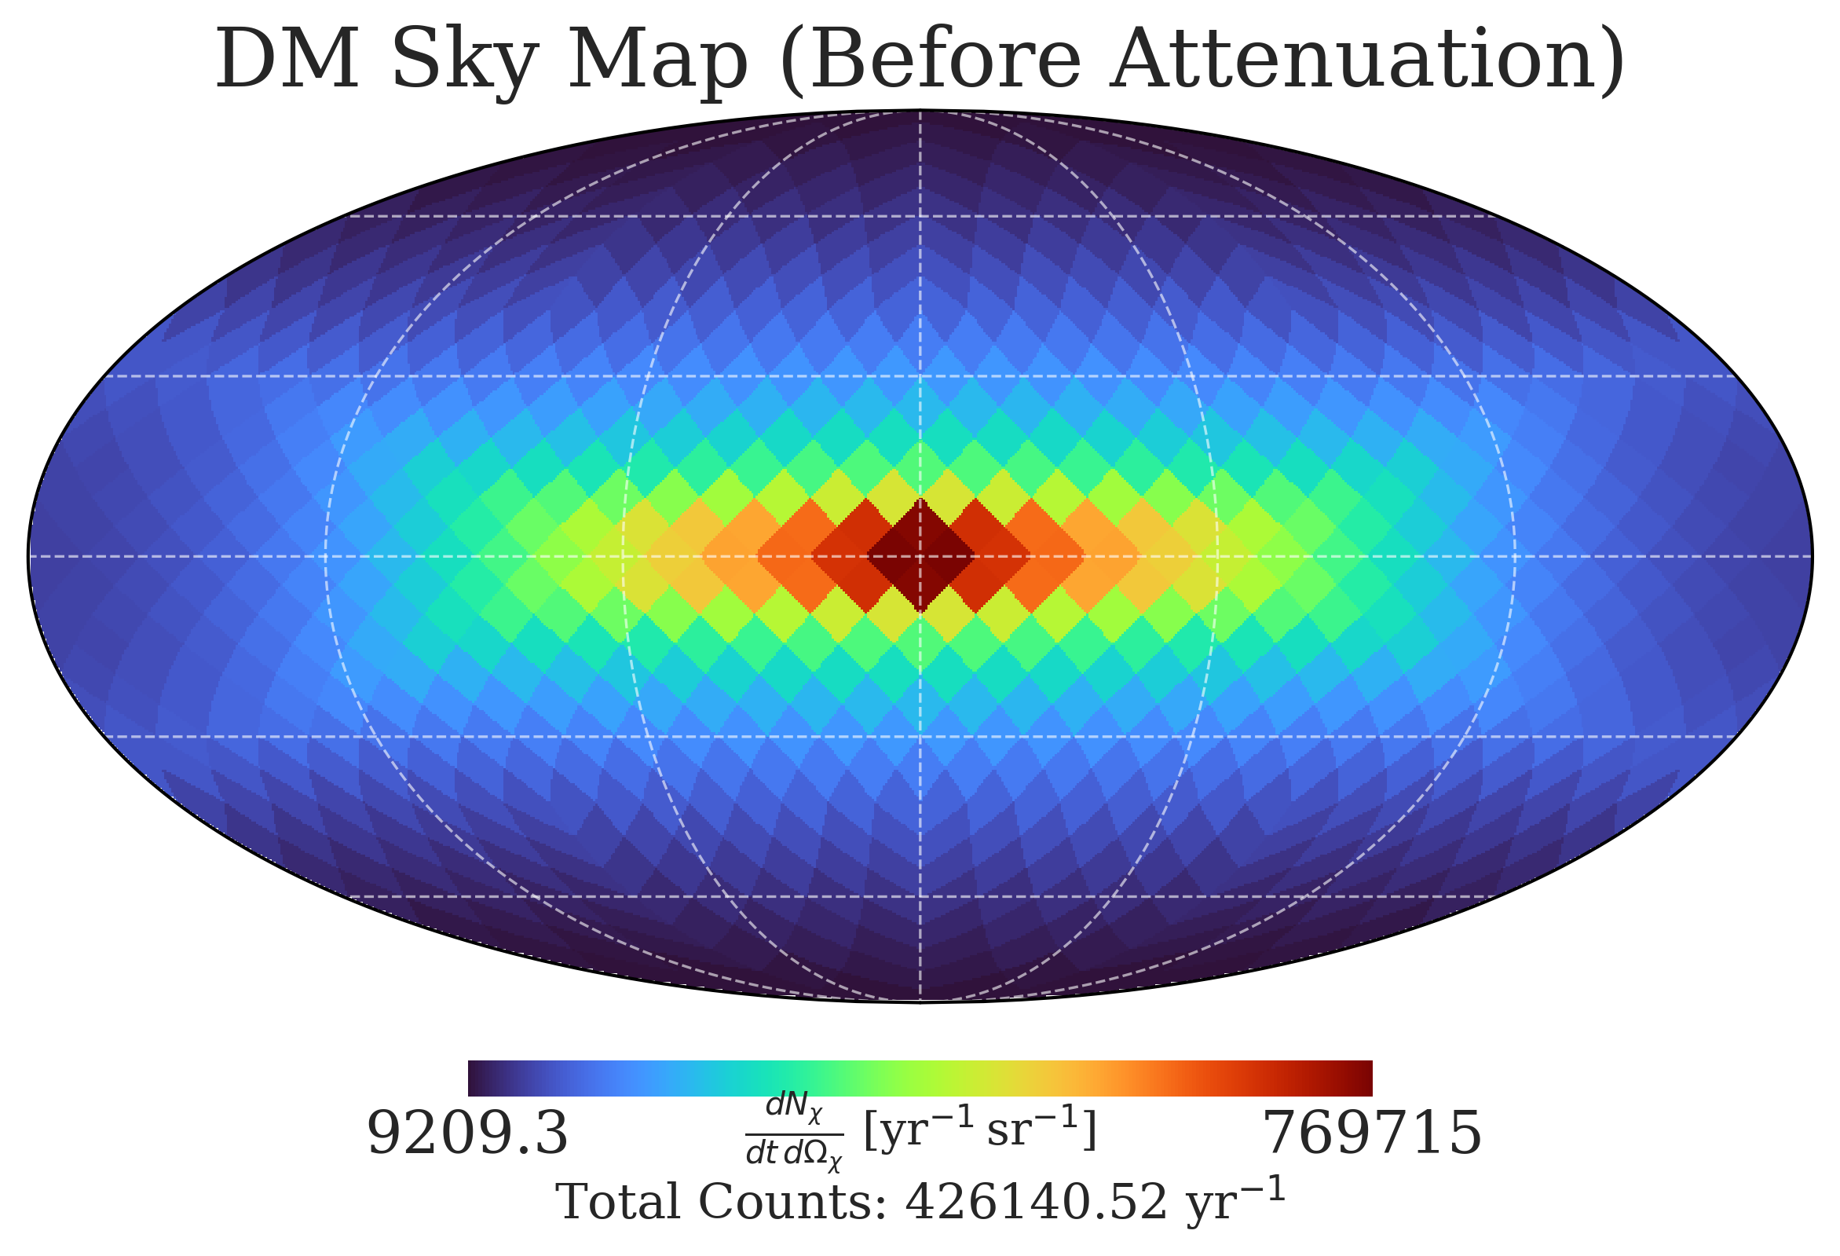
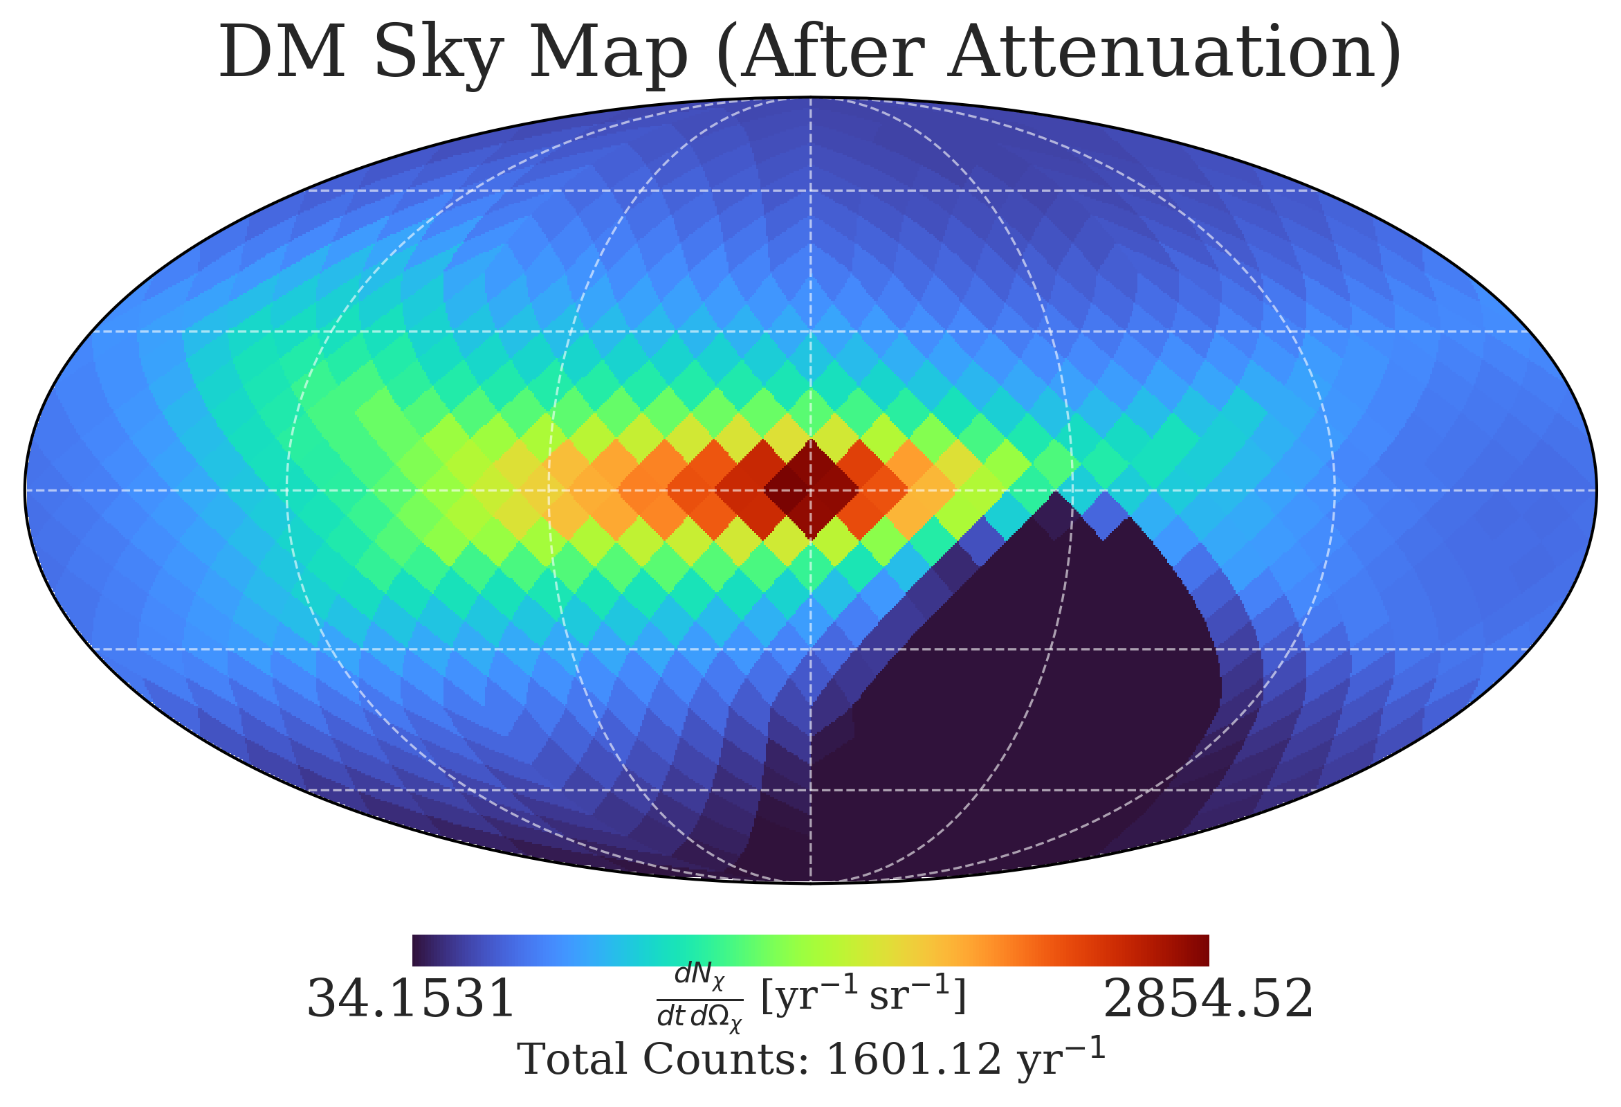
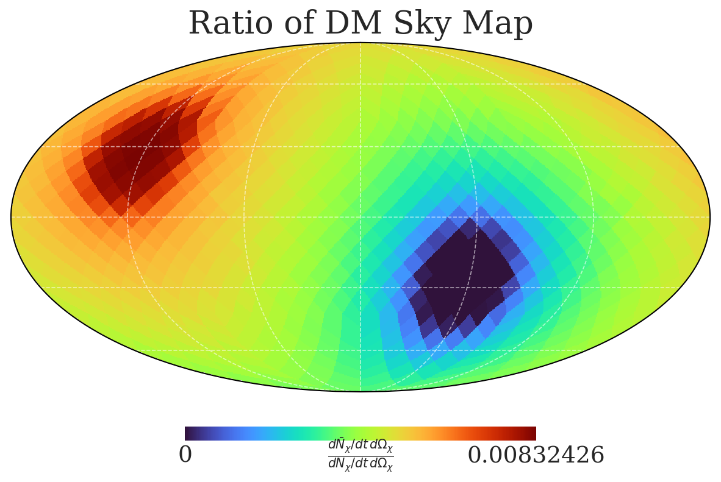

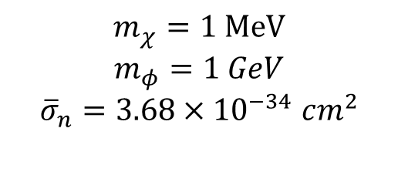
Preliminary
Preliminary
Preliminary
$$K_{χ}\left({\overline{K}}_{χ}\right)=[10 MeV \sim 10 GeV]$$
$$m_{χ}=1 MeV$$
$$m_{φ}=1 GeV$$
$${\overline{σ}}_{n}=3.68×{10}^{−34} cm^{2}$$

Slide 11


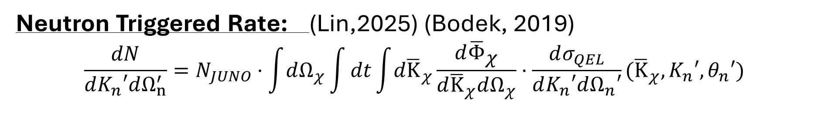


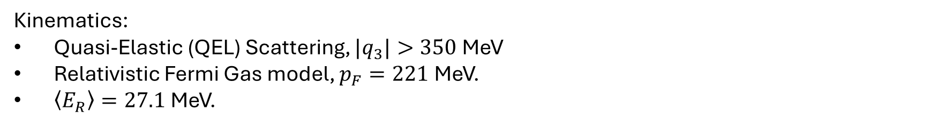
Neutron Triggered Rate: (Lin,2025) (Bodek, 2019)
$$\frac{dN}{dK_{n}′dΩ_{n}^{′}}=N_{JUNO}⋅\int{dΩ_{χ}}\int{dt\int{d{\overline{K}}_{χ}}\frac{d{\overline{Φ}}_{χ}}{d{\overline{K}}_{χ}dΩ_{χ}}}⋅\frac{dσ_{QEL}}{dK_{n}′dΩ_{n}′}({\overline{K}}_{χ},{K_{n}′,θ}_{n}′)$$
$$y$$
Carbon Nucleus
neutron
DM
$$θ_{n}′$$
$$z$$
$$x$$
Kinematics:
Quasi-Elastic (QEL) Scattering, ${|q}_{3}|>350$ MeV
Relativistic Fermi Gas model, $p_{F}=221$ MeV.
$\left\langle E_{R}\right\rangle =27.1$ MeV.
$$\left[\begin{matrix}{\overline{E}}_{χ} \\ 0 \\ \begin{aligned}0 \\ \overline{k}\end{aligned}\end{matrix}\right] + \left[\begin{matrix}E_{N} \\ p_{x} \\ \begin{aligned}py \\ pz\end{aligned}\end{matrix}\right] = \left[\begin{aligned}\begin{matrix}E_{χ}′ \\ k_{x} \\ k_{y}\end{matrix} \\ k_{z}\end{aligned}\right] + \left[\begin{matrix}\begin{aligned}E_{N}^{′} \\ 0\end{aligned} \\ p^{′}sinθ_{n}′ \\ p^{′}cosθ_{n}^{′}\end{matrix}\right] + \left[\begin{matrix}E_{R} \\ 0 \\ \begin{aligned}0 \\ 0\end{aligned}\end{matrix}\right]$$
Nuclear Effect:
Pauli Blocking
Final State Interaction
$$\frac{dσ_{QES}}{dK_{n}′dΩ_{n}′}=\frac{g_{χφ}^{2}g_{nφ}^{2}}{16π}\int{d{\overset{⃑}{p}}^{3}}P(\overset{⃑}{p})\frac{\left(4m_{χ}^{2}+Q^{2}\right)\left(1+\frac{{\tilde{Q}}^{2}}{4m_{n}^{2}}\right)}{{\left(m_{φ}^{2}+Q^{2}\right)}^{2}}F_{n}\left(Q^{2}\right)U(q^{3})((δ(E_{χ}+E_{n}−E_{χ}^{′}−E_{n}^{′}−E_{removal})$$

Slide 12
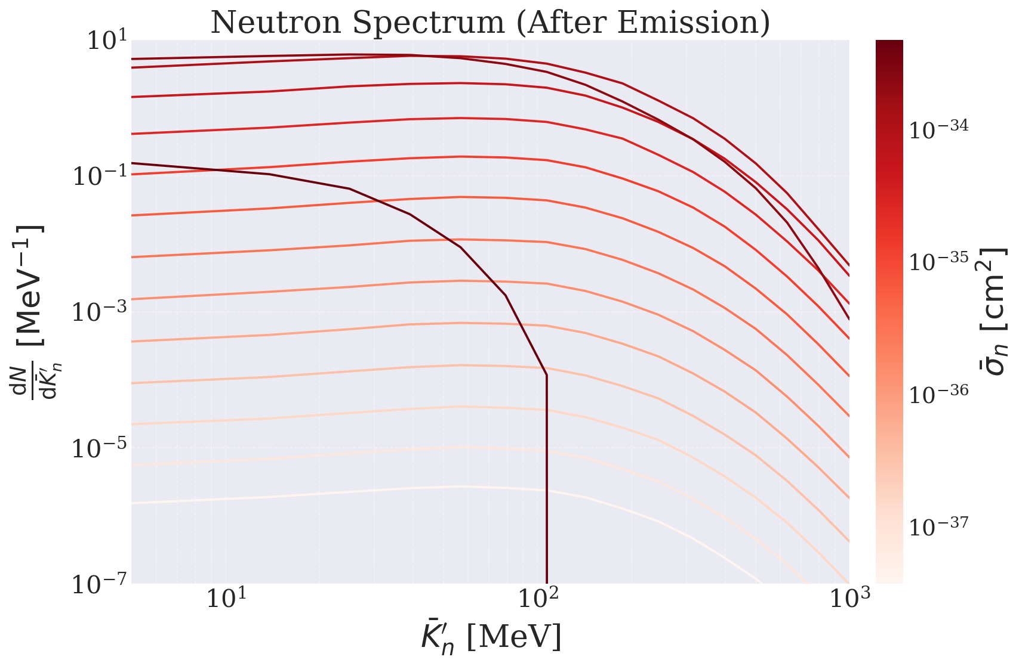

Preliminary
$$m_{χ}=1 MeV$$
$$m_{φ}=1 GeV$$

Slide 13
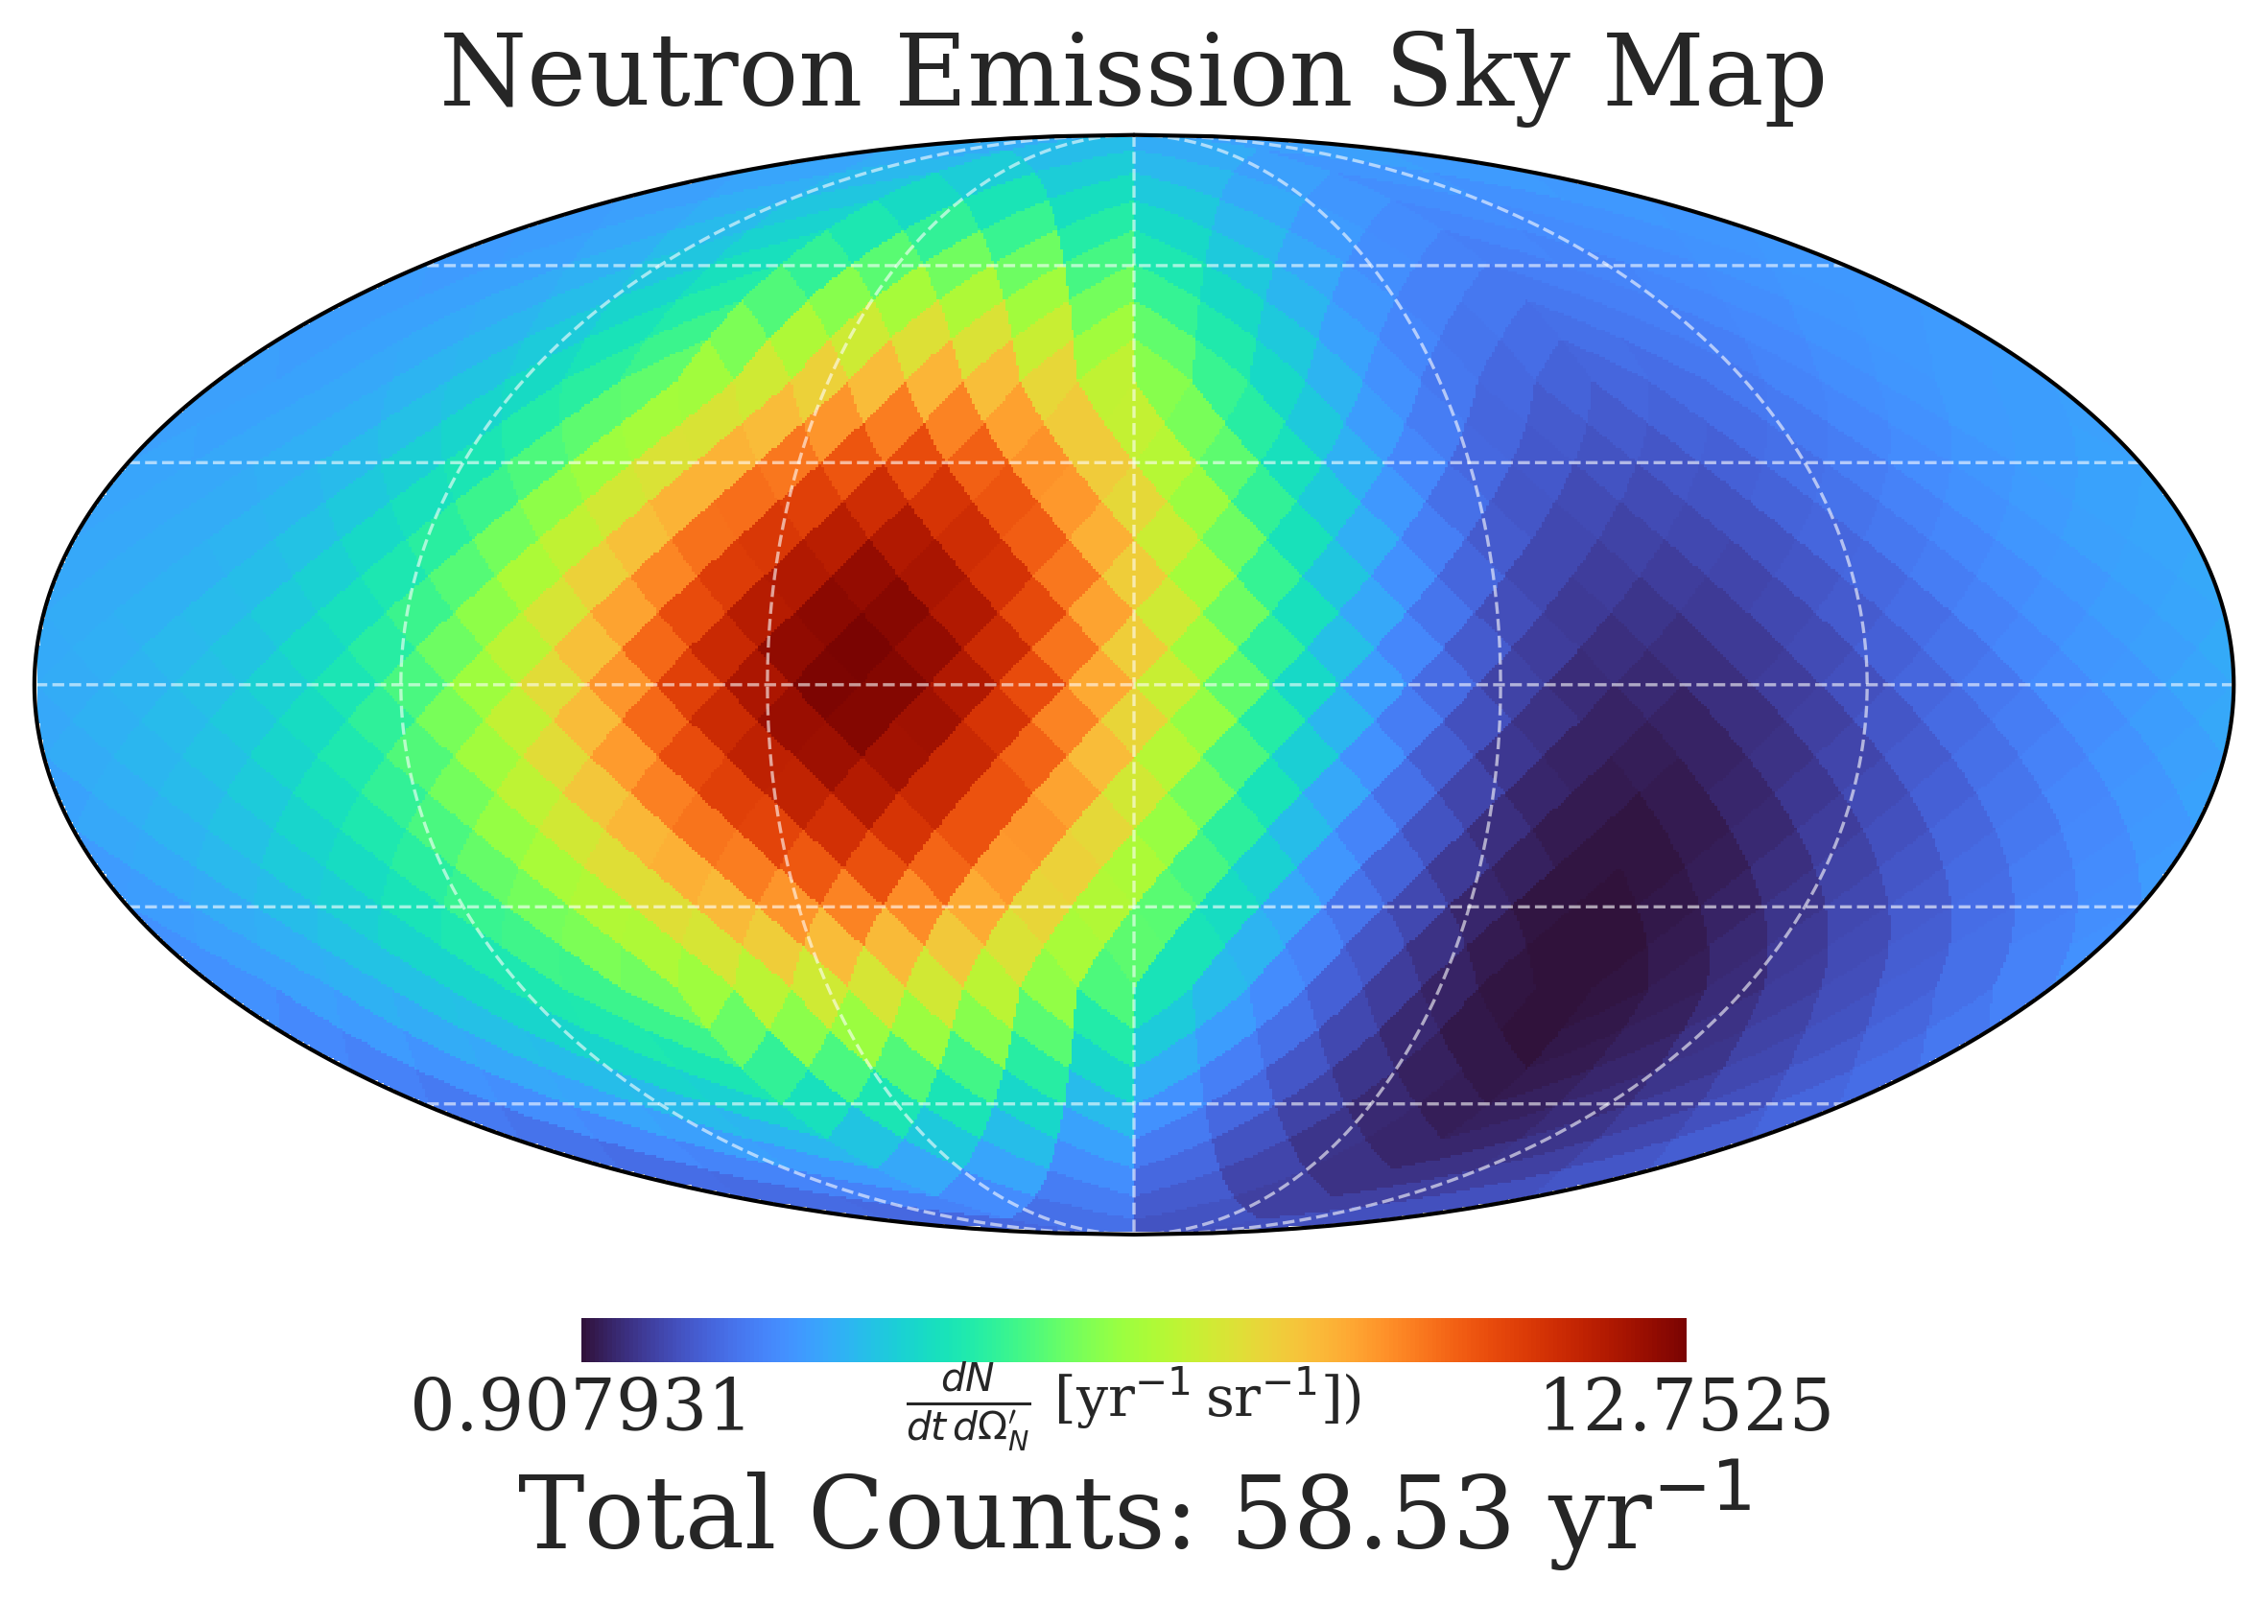


Preliminary
$${\overline{K}}_{N}^{′}=[\text{5} MeV, 1 GeV]$$
$$m_{χ}=1 MeV$$
$$m_{φ}=1 GeV$$
$${\overline{σ}}_{n}=3.68×{10}^{−34} cm^{2}$$

Slide 14
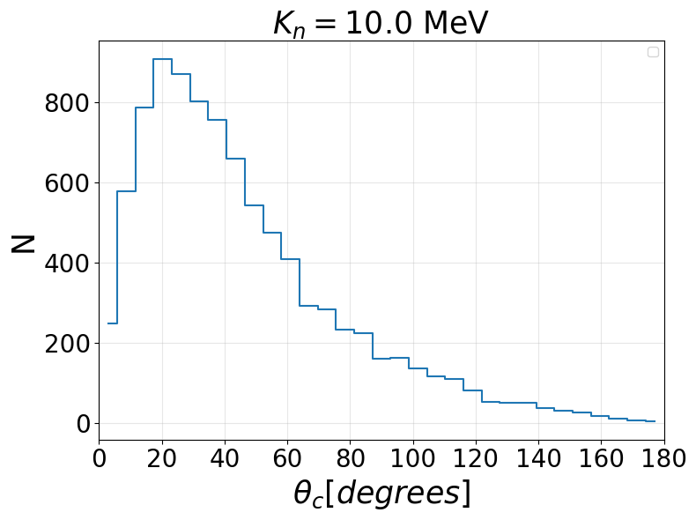
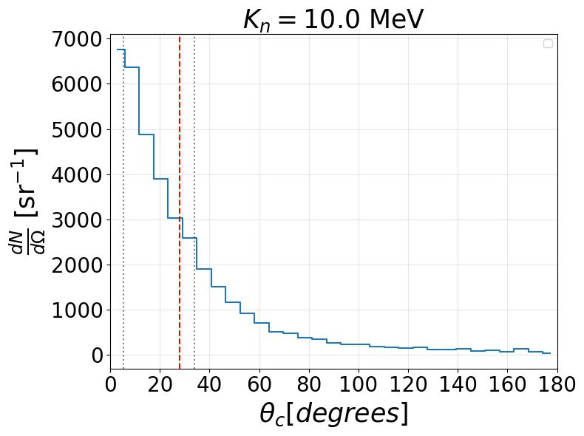
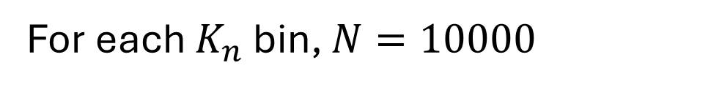
Simulated Capture Angle in Geant4 + Vertex Resolution
For each $K_{n}$ bin, $N=10000$
68.3%
Preliminary
Preliminary
(0,0,0)

Slide 15
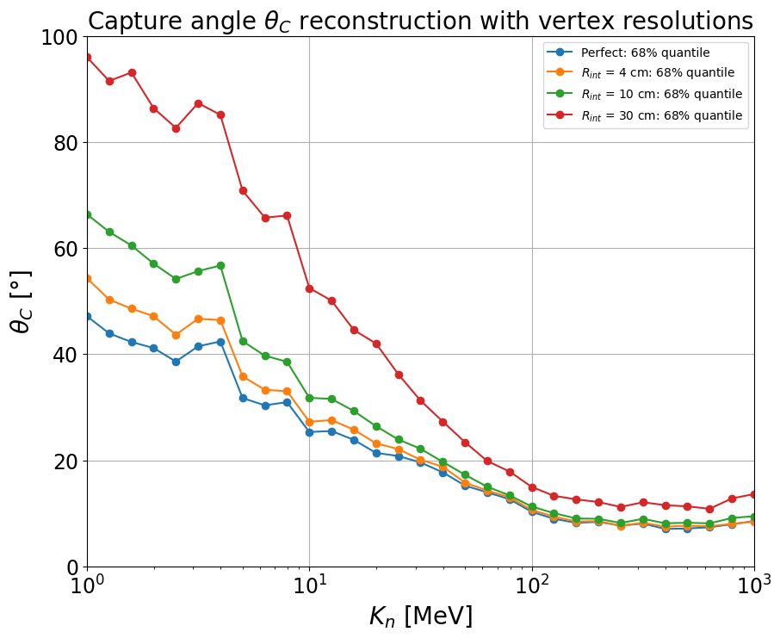
Reconstructed Capture (Deexcite) Position
Preliminary
Preliminary
Actual Capture (Deexcite) Position
‘The vertex reconstruction bias is kept within 4 cm level throughout the detector (JUNO) and resolution for events with around 1 MeV energy deposition is estimated to be approximately 9 cm.’ (Takenaka, 2025)

Slide 16
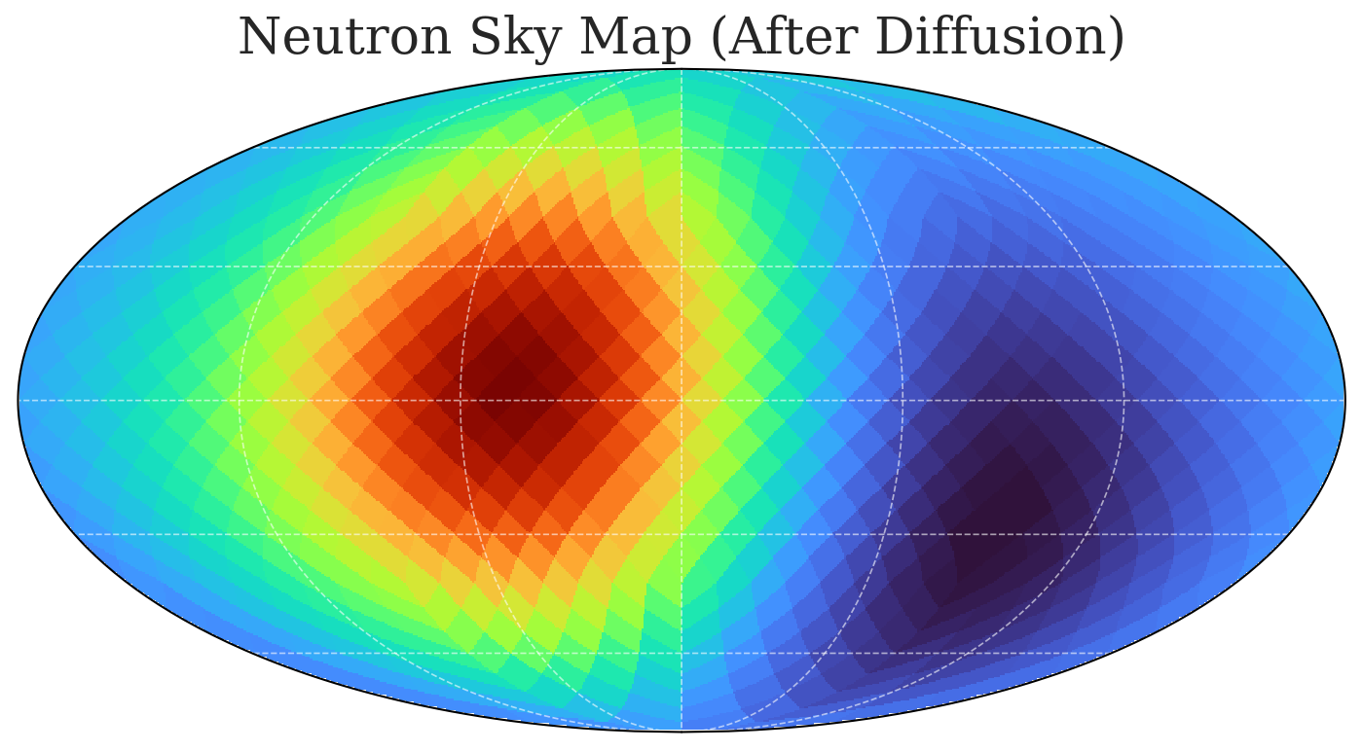
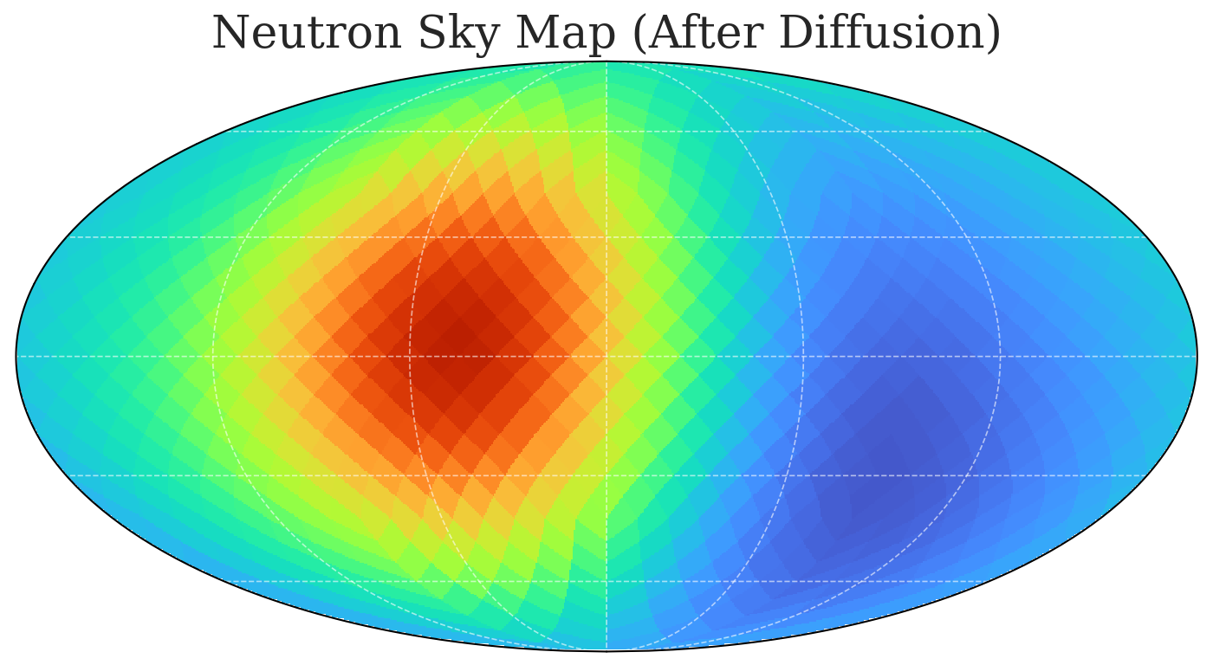

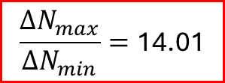
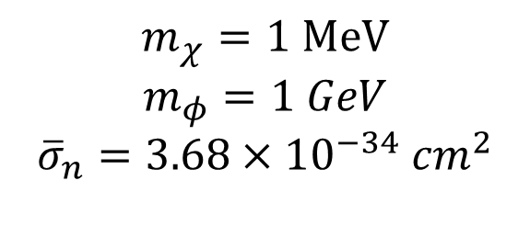

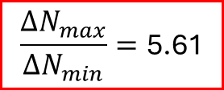
Before Diffusion
After Diffusion
Preliminary
Preliminary
Preliminary
$$\frac{{ΔN}_{max}}{ΔN_{min}}=\text{14}\text{.01}$$
$$\frac{{ΔN}_{max}}{ΔN_{min}}=\text{5.61}$$
$$m_{χ}=1 MeV$$
$$m_{φ}=1 GeV$$
$${\overline{σ}}_{n}=3.68×{10}^{−34} cm^{2}$$
$${\overline{K}}_{n}^{′}=\left[5 MeV,1 GeV\right]$$

Slide 17
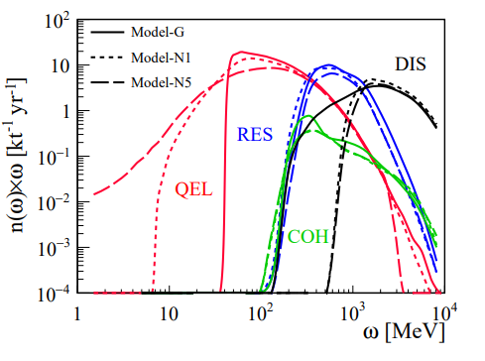
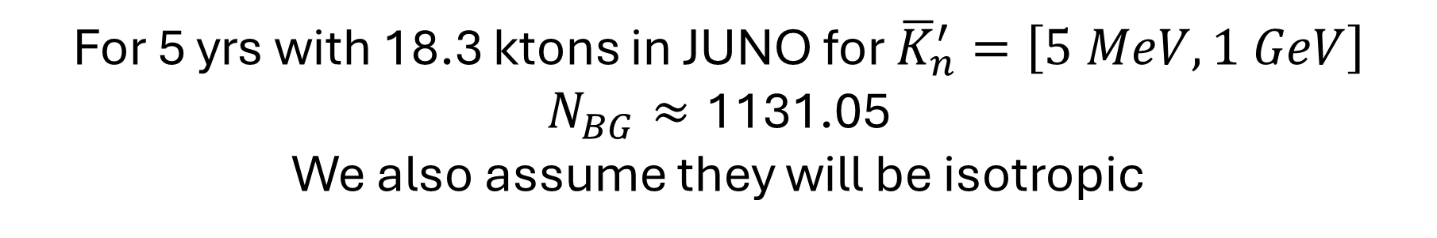
Background Estimation:
We only considered the Indistinguishable BG:
Atmospheric Neutrino-Neutron Neutral-Current QEL interaction.
Energy transfer for $ν−C^{12}$ NC interacion in LS
We choose Model-G, which is GENIE with RFGs
(Cheng,2021)
(Cheng,2021)
For 5 yrs with 18.3 ktons in JUNO for ${\overline{K}}_{n}^{′}=\left[5 MeV,1 GeV\right]$
$$N_{BG}≈\text{1131.05}$$
We also assume they will be isotropic

Slide 18
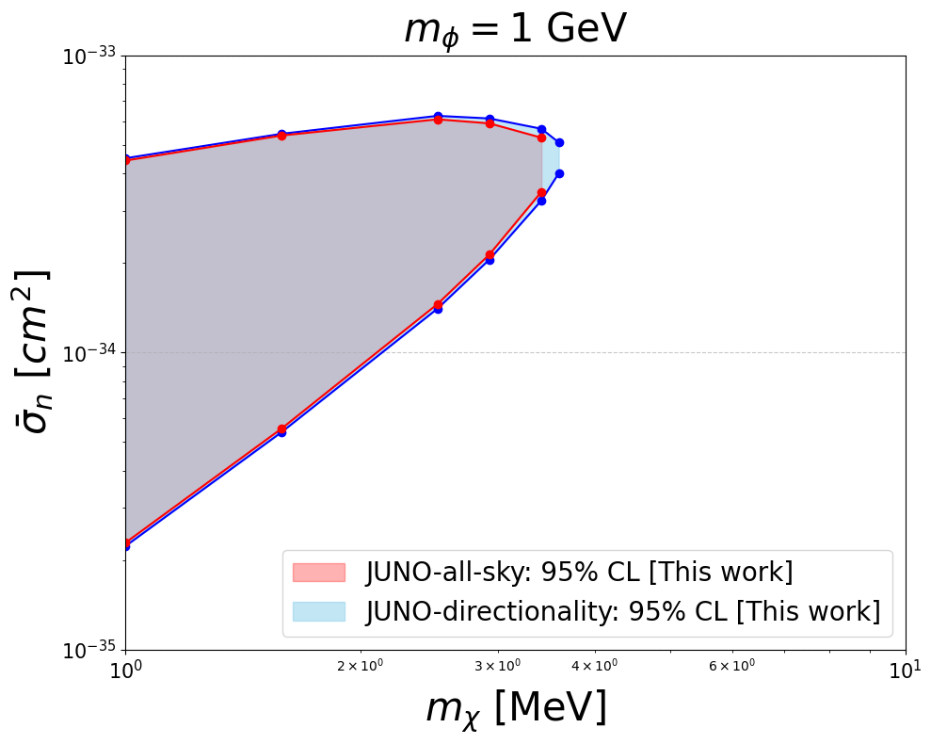
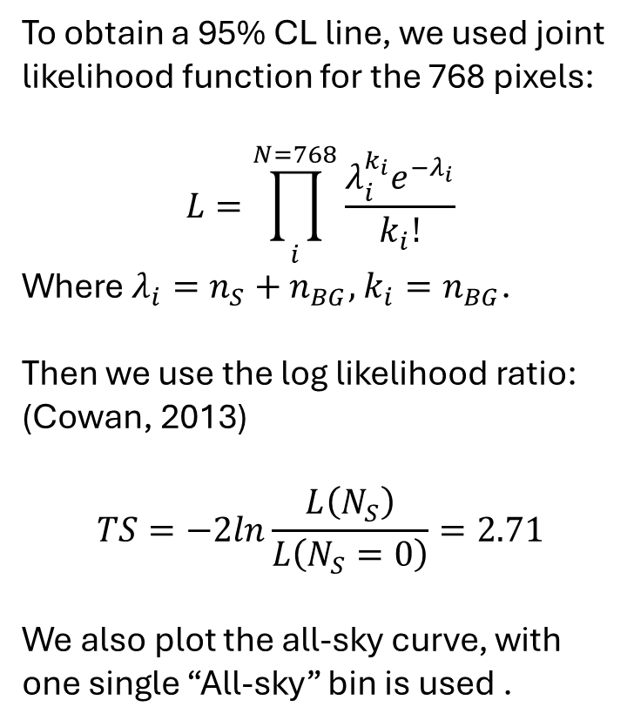
Likelihood and Constraint:
To obtain a 95% CL line, we used joint likelihood function for the 768 pixels:
$$L=\prod_{i}^{N=768}{\frac{λ_{i}^{k_{i}}e^{−λ_{i}}}{k_{i}!}}$$
Where $λ_{i}=n_{S}+n_{BG},$ $k_{i}=n_{BG}$.
Then we use the log likelihood ratio: (Cowan, 2013)
$$TS=−2ln\frac{L\left(N_{S}\right)}{L\left(N_{S}=0\right)}=2.71$$
We also plot the all-sky curve, with one single “All-sky” bin is used .
Preliminary

Slide 19
Conclusion:
Neutrons retain the directional signature of the BDM.
Leveraging this directionality provides a sightly better constraint than a single ‘All-Sky’ bin, with the enhancement becoming more significant at higher DM masses.
A further refinement of the energy bin range is expected to increase the signal-to-background ratio, thereby strengthening our constraints.

Slide 20
Thank you!

Slide 21
Backup Slides

Slide 22




Neutron Diffusion: Geant4
Physics list:
  G4HadronPhysicsFTFP_BERT_HP()
  G4HadronElasticPhysics()
  G4EmStandardPhysics()
Configuration:
  Linear alkylbenzene(LAB)
  2,5-diphenyloxazole (PPO)
  p-bis-(o-methylstyryl)-benzene (bis-MSB)
Neutron Capture
2.2 (4.9) MeV $γ$ on H (C)
$$θ_{c}$$
Chemicals | Chemicals Composition | Density (g/cm^3)
LAB | C=18, H=30 | 0.855985 (99.6%)
PPO | C=15, H=11, N=1, O=1 | 0.003 (0.3%)
Bis-MSB | C=24, H=22 | 0.000015
$$d=\sqrt{x^{2}+y^{2}+z^{2}}$$
$θ_{c}=\arccos\left(\frac{z}{d}\right)$
(0,0,0)

Slide 23
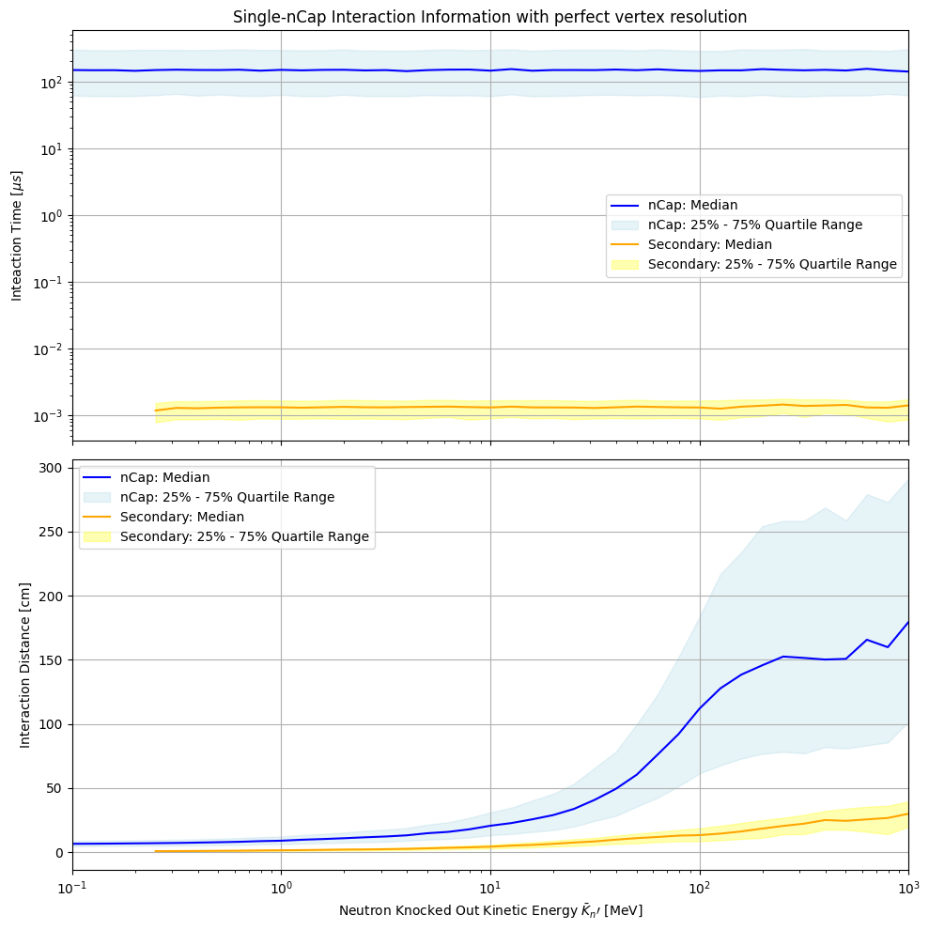


Preliminary
Neutron Capture
(~200 $μ$s)
(~10ns)
(Proton recoil, Inelastic scattering…..)
Preliminary
(0,0,0)
Set at time cut when doing analysis! (2ns)

Slide 24
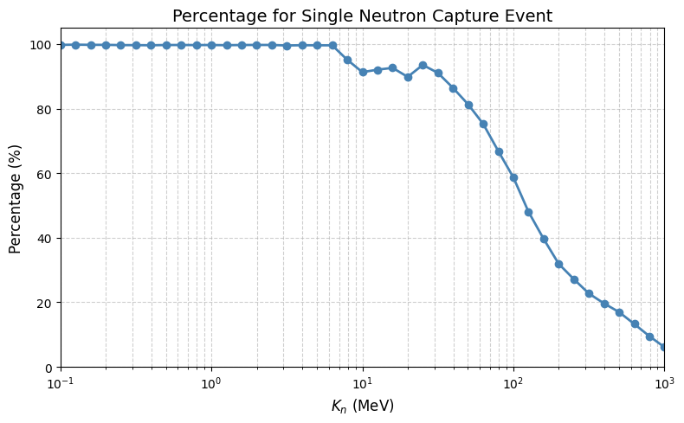


Filtering of Single Neutron Capture Event
Secondary neutrons
Preliminary
Inelastic
Scattering
Primary neutron

Slide 25
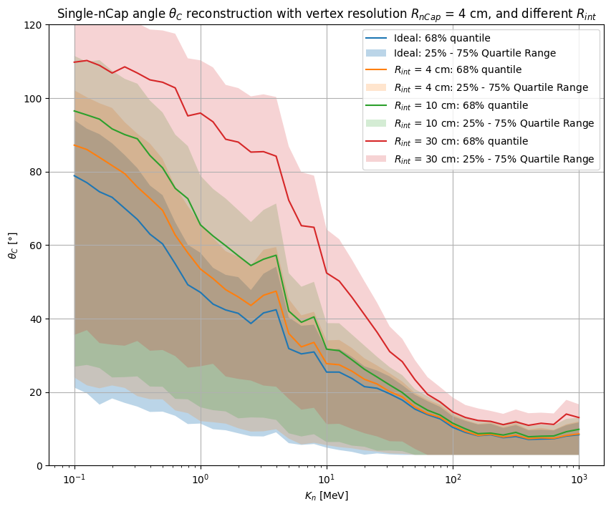
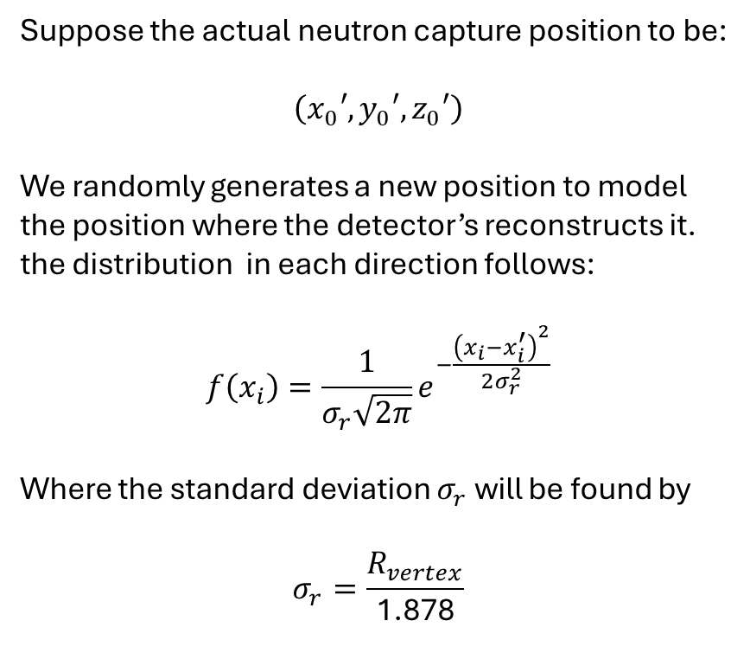
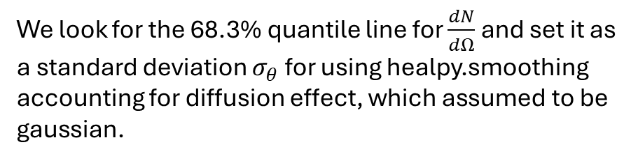
Simulated Capture Angle in Geant4 + Vertex Resolution
Suppose the actual neutron capture position to be:
$$\left(x_{0}′,y_{0}′,z_{0}′\right)$$
We randomly generates a new position to model the position where the detector’s reconstructs it. the distribution in each direction follows:
$$f\left(x_{i}\right)=\frac{1}{σ_{r}\sqrt{2π}}e^{−\frac{{\left(x_{i}−x_{i}^{′}\right)}^{2}}{2σ_{r}^{2}}}$$
Where the standard deviation $σ_{r}$ will be found by
$$σ_{r}=\frac{R_{vertex}}{\text{1.878}}$$
Preliminary
We look for the 68.3% quantile line for $\frac{dN}{dΩ}$ and set it as a standard deviation $σ_{θ}$ for using healpy.smoothing accounting for diffusion effect, which assumed to be gaussian.

Slide 26


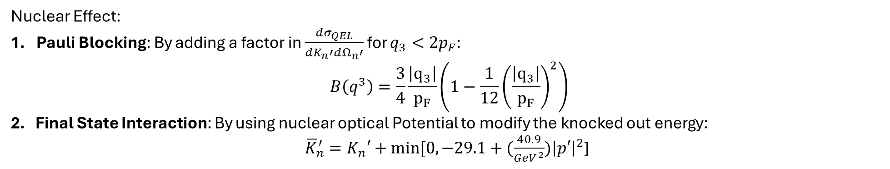

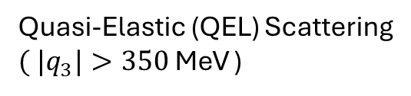

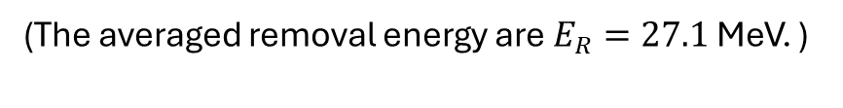
$$\frac{dN}{dK_{n}′dΩ_{n}^{′}}=N_{JUNO}⋅\int{dΩ_{χ}}\int{dt\int{dK_{χ}}\frac{dΦ_{χ}}{dK_{χ}dΩ_{χ}}}⋅\frac{dσ_{QEL}}{dK_{n}′dΩ_{n}′}(\overline{K_{χ}},{K_{n}′,θ}_{n}′)$$
$$y$$
Carbon Nucleus
Quasi-Elastic (QEL) Scattering
${( |q}_{3}|>350$ MeV )
neutron
DM
$$θ_{n}′$$
$$z$$
$$x$$
$$\left[\begin{matrix}{\overline{E}}_{χ} \\ 0 \\ \begin{aligned}0 \\ \overline{k}\end{aligned}\end{matrix}\right] + \left[\begin{matrix}E_{N} \\ p_{x} \\ \begin{aligned}py \\ pz\end{aligned}\end{matrix}\right] = \left[\begin{aligned}\begin{matrix}E_{χ}′ \\ k_{x} \\ k_{y}\end{matrix} \\ k_{z}\end{aligned}\right] + \left[\begin{matrix}\begin{aligned}E_{N}^{′} \\ 0\end{aligned} \\ p^{′}sinθ_{n}′ \\ p^{′}cosθ_{n}^{′}\end{matrix}\right] + \left[\begin{matrix}E_{R} \\ 0 \\ \begin{aligned}0 \\ 0\end{aligned}\end{matrix}\right]$$
(Relativistic Fermi Gas model, $p_{n}≤p_{F}=221$ MeV.)
(The averaged removal energy are $E_{R}=27.1$ MeV. )
Nuclear Effect:
Pauli Blocking: By adding a factor in $\frac{dσ_{QEL}}{dK_{n}′dΩ_{n}′}$ for $q_{3}<2p_{F}$:
$$B\left(q^{3}\right)=\frac{3}{4}\frac{\left|q_{3}\right|}{p_{F}}\left(1−\frac{1}{12}{\left(\frac{\left|q_{3}\right|}{p_{F}}\right)}^{2}\right)$$
2. Final State Interaction: By using nuclear optical Potential to modify the knocked out energy:
${\overline{K}}_{n}^{′}=K_{n}′+min[0,−29.1+(\frac{40.9}{GeV^{2}}){\left|p′\right|}^{2}$]
$$\frac{dσ_{QES}}{dK_{n}′dΩ_{n}′}=\frac{g_{χφ}^{2}g_{nφ}^{2}}{16π}\int{d{\overset{⃑}{p}}^{3}}P(\overset{⃑}{p})\frac{\left(4m_{χ}^{2}+Q^{2}\right)\left(1+\frac{{\tilde{Q}}^{2}}{4m_{n}^{2}}\right)}{{\left(m_{φ}^{2}+Q^{2}\right)}^{2}}F_{n}\left(Q^{2}\right)U(q^{3})((δ(E_{χ}+E_{n}−E_{χ}^{′}−E_{n}^{′}−E_{removal})$$

Slide 27
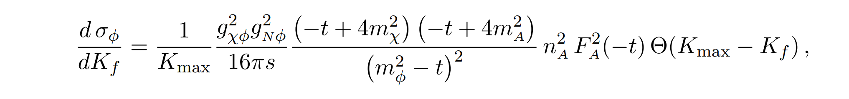
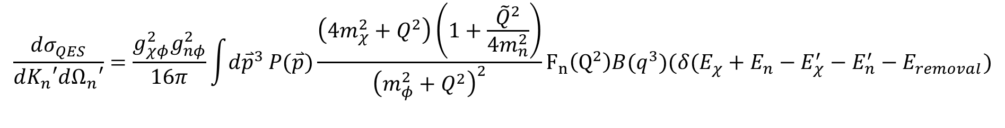
For CRBDM production and Earth attenuation:
For Neutron Knocked out Stage:
$$\frac{dσ_{QES}}{dK_{n}′dΩ_{n}′}=\frac{g_{χφ}^{2}g_{nφ}^{2}}{16π}\int{d{\overset{⃑}{p}}^{3}}P(\overset{⃑}{p})\frac{\left(4m_{χ}^{2}+Q^{2}\right)\left(1+\frac{{\tilde{Q}}^{2}}{4m_{n}^{2}}\right)}{{\left(m_{φ}^{2}+Q^{2}\right)}^{2}}F_{n}\left(Q^{2}\right)B(q^{3})(δ(E_{χ}+E_{n}−E_{χ}^{′}−E_{n}^{′}−E_{removal})$$

Slide 28
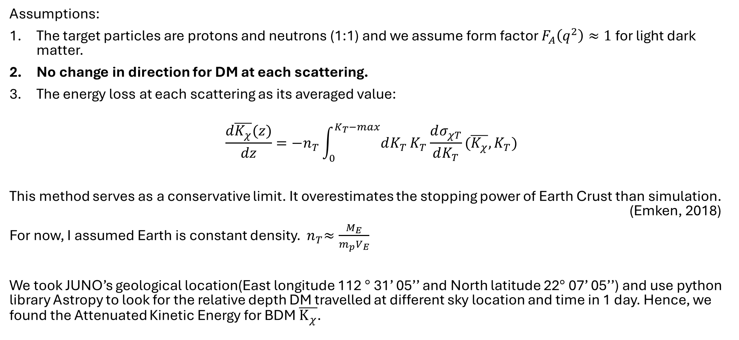
Earth Attenuation Effect (Ema,2021) & (Bringmann,2019)
Assumptions:
The target particles are protons and neutrons (1:1) and we assume form factor $F_{A}\left(q^{2}\right)≈1$ for light dark matter.
No change in direction for DM at each scattering.
The energy loss at each scattering as its averaged value:
$$\frac{d\overline{K_{χ}}(z)}{dz}=−n_{T}\int_{0}^{K_{T}−max}{dK_{T}}K_{T}\frac{dσ_{χT}}{dK_{T}}(\overline{K_{χ}},K_{T})$$
This method serves as a conservative limit. It overestimates the stopping power of Earth Crust than simulation. (Emken, 2018)
For now, I assumed Earth is constant density. ${ n}_{T}≈\frac{M_{E}}{{m_{p}V}_{E}}$
We took JUNO’s geological location(East longitude 112 $°$ 31’ 05’’ and North latitude 22$°$ 07’ 05’’) and use python library Astropy to look for the relative depth DM travelled at different sky location and time in 1 day. Hence, we found the Attenuated Kinetic Energy for BDM $\overline{K_{χ}}$.

