Slide 1
Development of Cryogenic ASICs for HPGe Detectors
for Dark Matter and Neutrino experiments
Canwen Liu, Xiangke Ye, Zhi Deng
2025-08-26
XICHANG, SICHUAN, CHINA
Notes:
Hello everyone, I am Canwen Liu from Tsinghua University.
My talk is Development on CMOS ASIC for high-purity germanium Detectors

Slide 2
CONTENTS
01
Introduction
02
Development of Cryogenic CMOS ASICs for HPGe Detectors
03
Summary
Notes:
My report consists of three parts
First is the introduction of the reason we use cryogenic readout electronics
Then I will introduce the Development of Cryogenic CMOS ASICs for HPGe Detector
Finally is the summary

Slide 3
01
Introduction

Slide 4
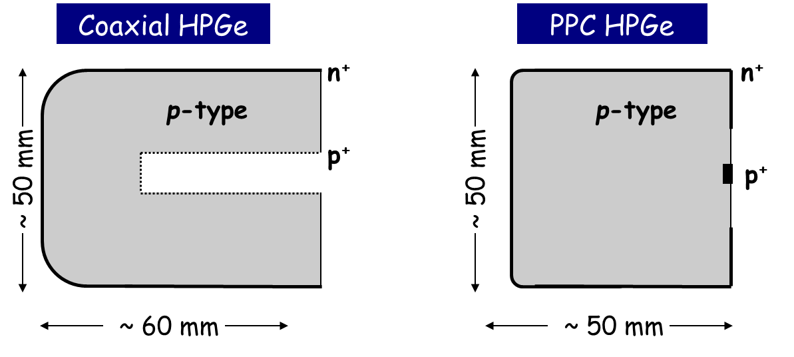
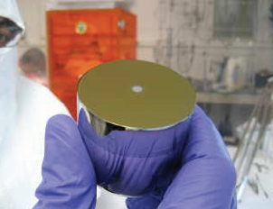
HPGe detectors for dark matter and 0νββ
PC-HPGe detector
low capacitance ~ 1 pF
low energy threshold~ 300 eV
high energy resolution
low radioactive background
pulse shaping
P.N. Luke, et. al. TNS 1989
used in many low-background experiments
Neutrinoless double-beta decay（0νββ）：GERDA， Majorana
GERDA: half-life time of 0νββ 8.0×10²⁵ y with the lowest background.
Direct Dark Matter Detection：CoGeNT，CDEX
CDEX: 160eV energy threshold in 2018，the most sensitive result in 4~5 GeV.
Notes:
Compared to the coaxial germanium detector, the point contact HPGe has a small electrode, so it has the advantage of Low input capacitor (~1 pF ), Low energy threshold (~300 eV ),
High energy resolution, Pulse shape analysis ability.
HPGe detector has been used for low-background physics experiment, including Neutrino-less Double Beta Decay(0υββ) and Dark Matter.
GERDA, Majorana, CoGeNT, CDEX Collaboration. CDEX is the china dark mater experiment, leading by Tsinghua University, located in China Jinping Underground Lab
In order to bring a phased 0υββ experiment with discovery potential at a half-life approaching 10^28 (ten to the power of 28) years.
Legend collaboration has been formed to pursue a ton-scale 76Ge experiment

Slide 5
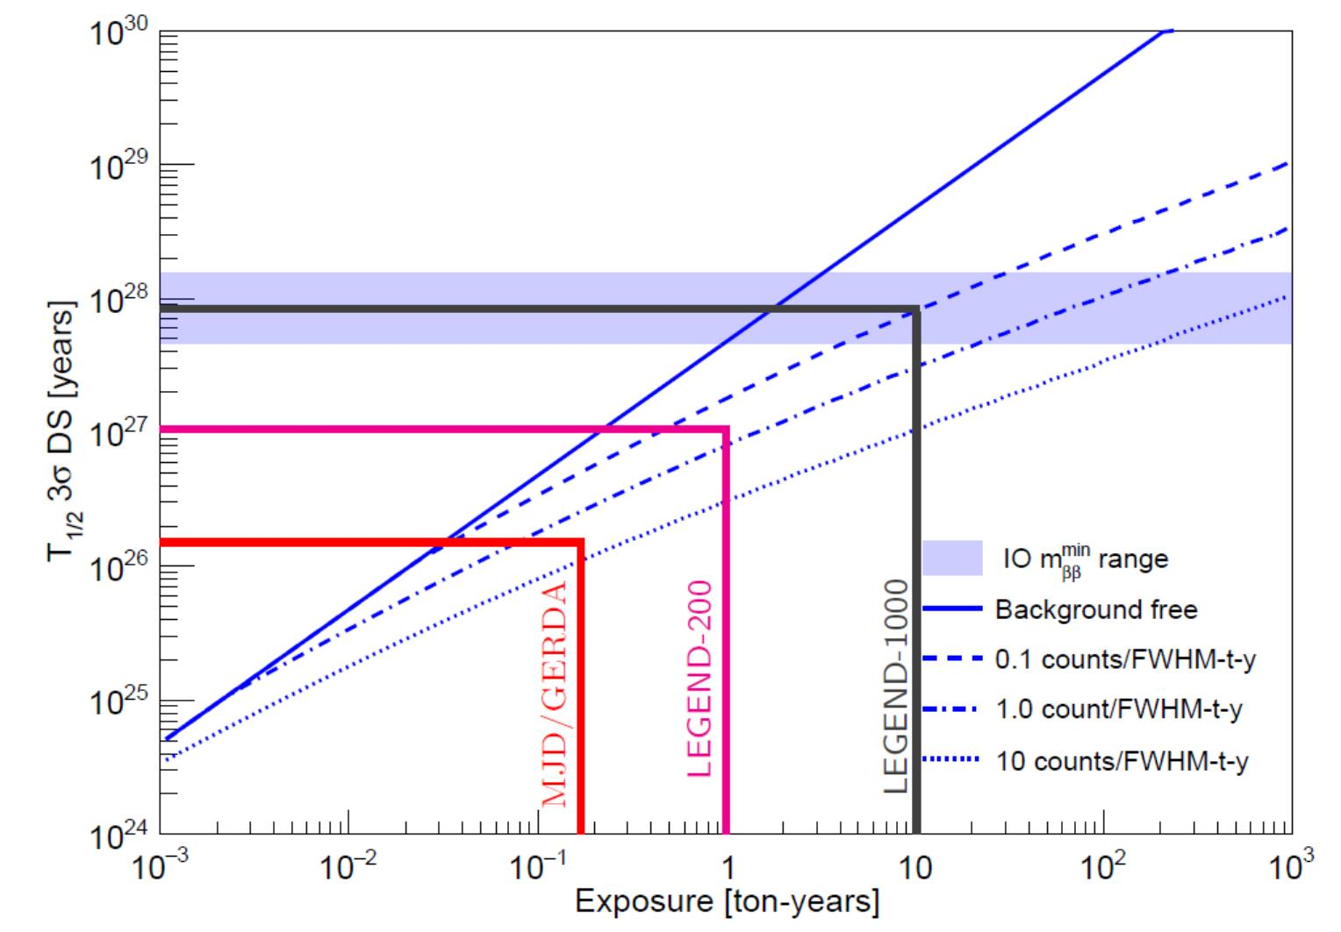
HPGe detectors for dark matter and 0νββ
Ton-scale HPGe detector arrays for higher sensitivity
LEGEND-1000
  Large detector mass
  Low background
~10m
LEGEND-1000
0νββ half-life versus exposure curve
LEGEND,TAUP 2017
Notes:
In those experiments, we choose Ton-scale HPGe detector arrays for higher sensitivity.
Like legend one thousand, the mass of the germanium detector is about 1000 kg.
The system should work in a low background environment

Slide 6
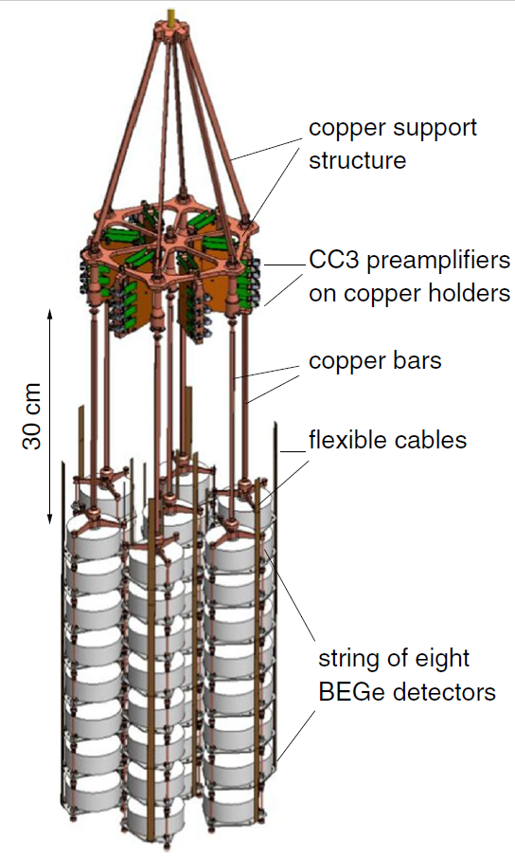
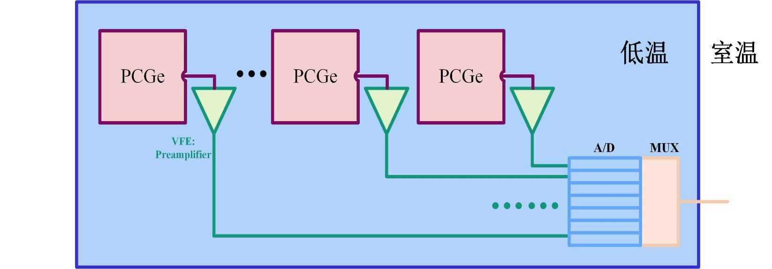
HPGe detectors for dark matter and 0νββ
Cryogenic front-end electronics solution
Low temperature
Room temperature
detector arrays
Advantages：
less cables and connectors
Signal Integrity
Challenges：
low-temperature CMOS device model
electronic interference
low background, low power consumption and low noise requirements
Notes:
So here is the Cryogenic readout electronics solution
In this way, it can decrease the system complexity and radioactivity background, Improved signal integrity
On the other hand, we need an reliable cryogenic CMOS device model for ASIC design, Interference between the high-speed digitizer and the low noise preamplifier, and it should be low background, low power consumption and low noise

Slide 7
02
Development of Cryogenic CMOS ASICs for HPGe Detectors

Slide 8
Low temperature CMOS preamplifier
Sources of electronic noise: detector leakage current and capacitance, input stage transistors
$$C_{f}$$
$$VD$$
$$\overline{v_{n}^{2}}$$
$$shaper$$
$$\overline{i_{n}^{2}}$$
$$C_{in}$$
Notes:
The main sources of electronic noise are input stage transistor and detector leakage currents. Therefore, the calculation formula of ENC is:

Slide 9
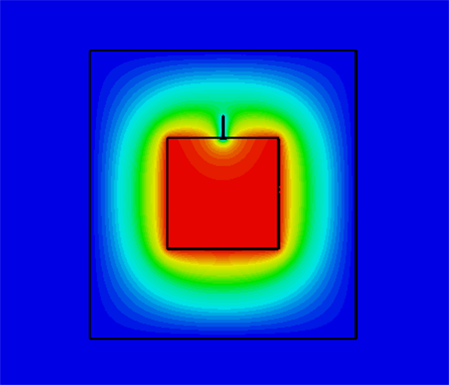
Low temperature CMOS preamplifier
HPGe detector
  Simulation setting
    0.5 kg
    50 mm diameter and height
    3 mm electrode diameter
  C_{d} ≈ 1.1 pF，C_{in} ≈ 2 pF
Optimal peak time
  Detector leakage current~1 pA
  A noise is equal to B noise
  Optimal peak time ~10 μs
ENC/ele
（7μs，5.05 ele）
peak time/μs
Notes:
The electrode capacitance of the point electrode high purity germanium detector was simulated. When the detector mass is 0.5 kg, the shape is a cylinder, the diameter and height are both 50 mm, the point contact diameter is 3 mm, the electrode capacitance is 1.14 pF.
Considering the parasitic capacitance generated by the bonding wires and PCB board routing, Cin is taken as 2 pF in the noise optimization analysis.

Slide 10
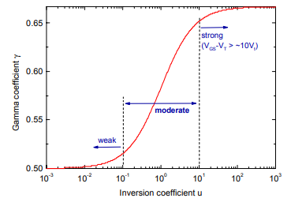
Low temperature CMOS preamplifier
Input stage transistors
  Gate capacitance C_{g} = C_{gs} + C_{gd} + C_{gb}
  C_{gs} is related to the working status of MOSFET
De Geronimo G, O'Connor P. MOSFET Optimization in Deep Submicron Technology for Charge Amplifiers. IEEE TNS,2005,52(6):3223.
Notes:
The gate capacitance Cg of the input MOS transistor is an important parameter in the ENC optimization process. The gate capacitance Cg should include the capacitance Cgs between the gate and the source and the capacitance Cgd between the gate and the drain. The capacitance Cgb between the gate and the substrate cannot be ignored.
The input-stage MOS transistor generally operates in the weak inversion region or the transition region, so the capacitance Cgs between the gate and the source is expressed as

Slide 11
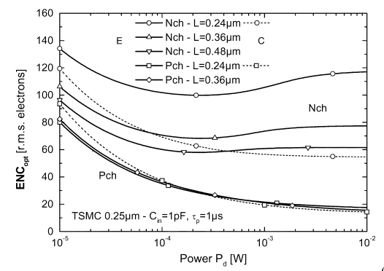
Low temperature CMOS preamplifier
Input stage transistors
  The greater the channel current I_{d}, the lower the PMOS transistor thermal noise;
  The greater the channel current I_{d} the greater the PMOS transistor 1/f noise;
  The channel current design value is 1 mA (transition region)
c
a
c 噪声
a 噪声
ENC/ele
Channel current/mA
Notes:
Another important parameter in the ENC optimization process is the channel current of the input MOS transistor.
The greater the channel current Id, the lower the PMOS transistor thermal noise, and the greater the PMOS transistor flicker noise;
We choose the channel current as 1 mA

Slide 12
Low temperature CMOS preamplifier
Input MOSFET size optimization
1.5 mm
2.5 e⁻
total
c
ENC/ele
Channel width/mm
Notes:
When the channel current is 1 mA, flicker noise becomes the most important noise component. The ENC contributed by flicker noise is:

Slide 13
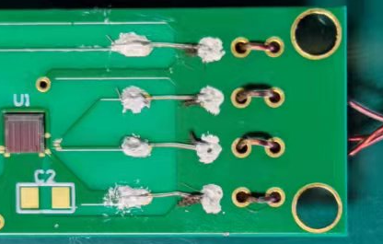
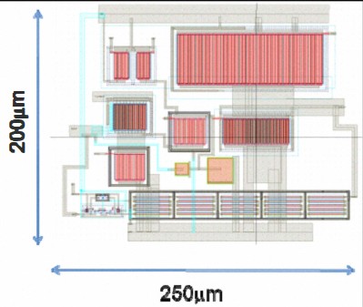
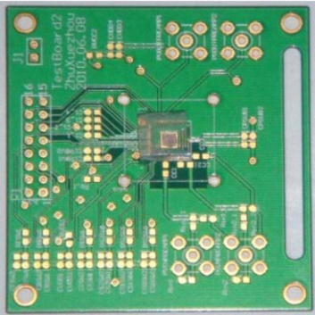
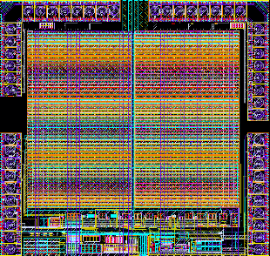
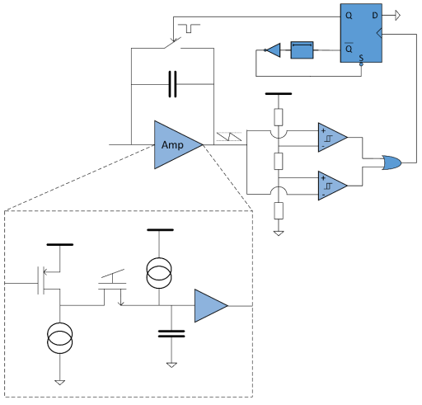
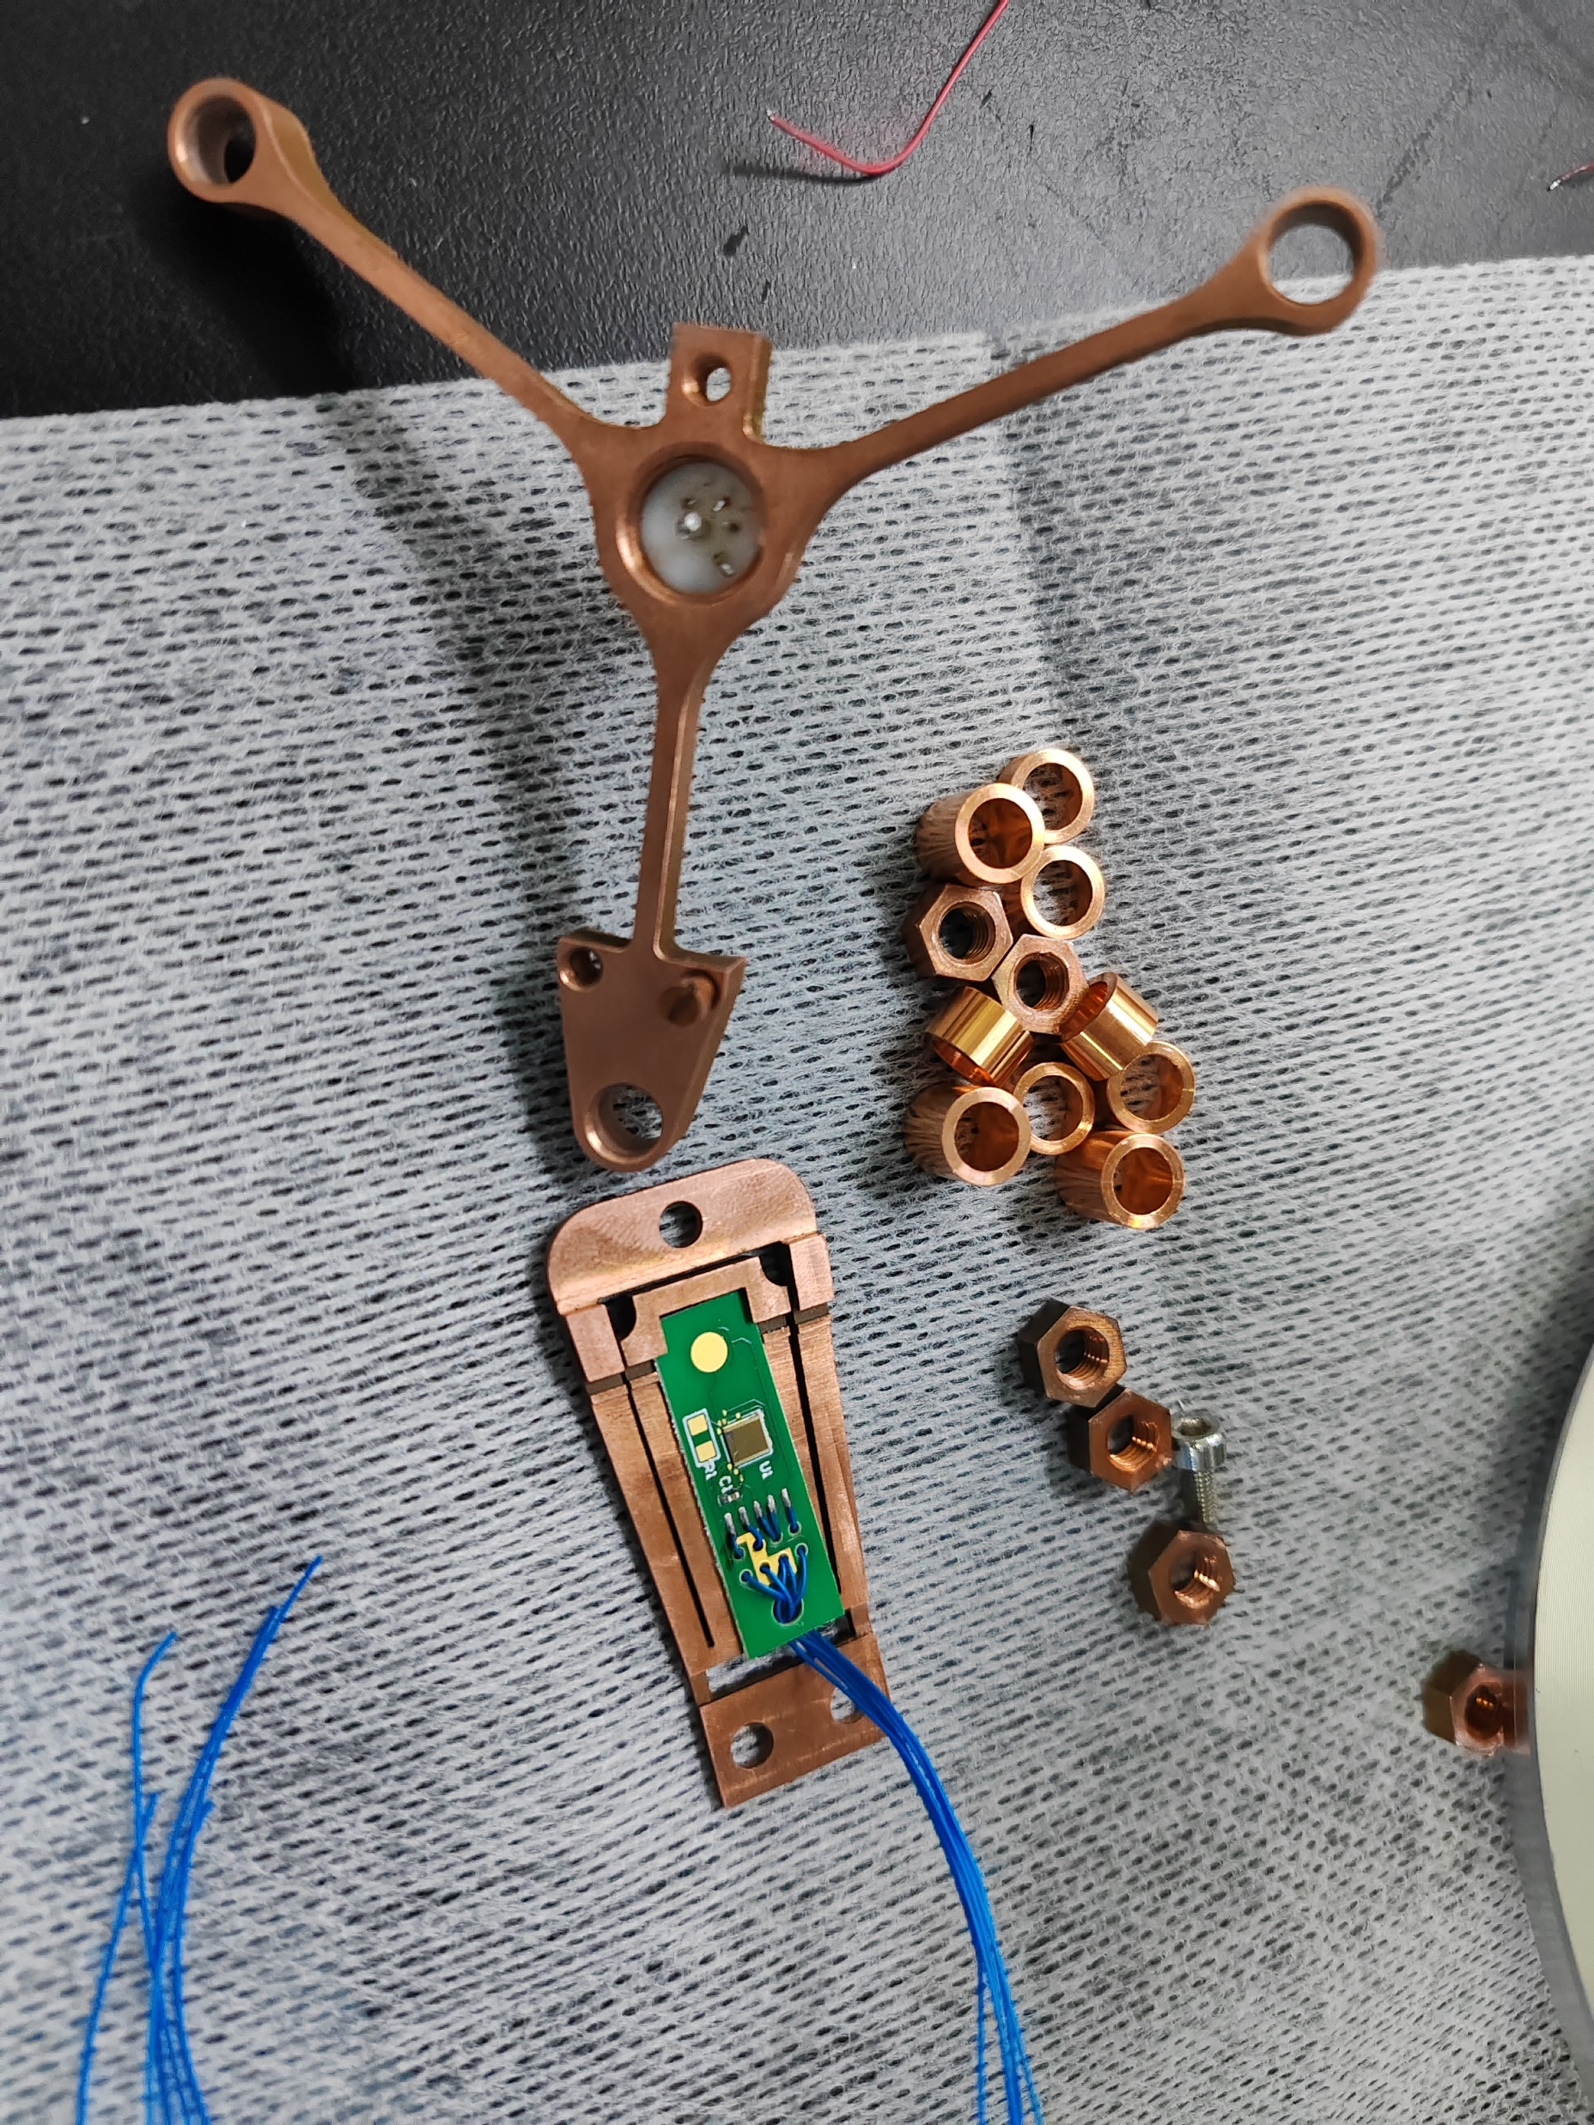
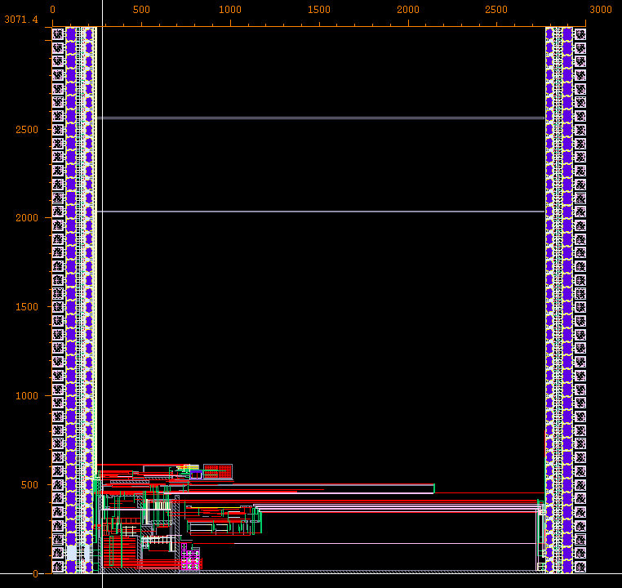
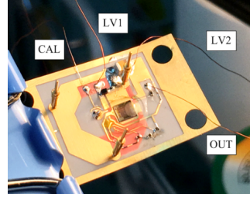
Low temperature CMOS preamplifier
The development process of CMOS preamplifier
L3GeRO (Low temperature, Low noise and Low background Germanium detector ReadOut)
process | GF 350nm
ENC | 6.5 e⁻ @ 213K 12μs
energy resolution | 3.9 keV @ 662 keV
process | XFAB 350nm
ENC | 8.9 e⁻ @ 77K 12μs
energy resolution | 600 eV @ 122 keV
L3GeRO-2011
L3GeRO-2021
2011
2018
2021
2023
2024-2025
L3GeRO-2018
L3GeRO-2023
process | GF 350nm
ENC | 9.7 e⁻ @ 77K 12μs
energy resolution | 640 eV @ 122 keV
process | GF 180nm
ENC | 3.0 e⁻ @ 77K 12μs
energy resolution | -
Notes:
Since 2011, several versions of CMOS preamplifiers for HPGe detectors have been designed and tested. We mainly focus on its noise performance.
The latest version of the preamplifier was implemented in GF 0.18 μm (micrometer) CMOS process in 2023.

Slide 14
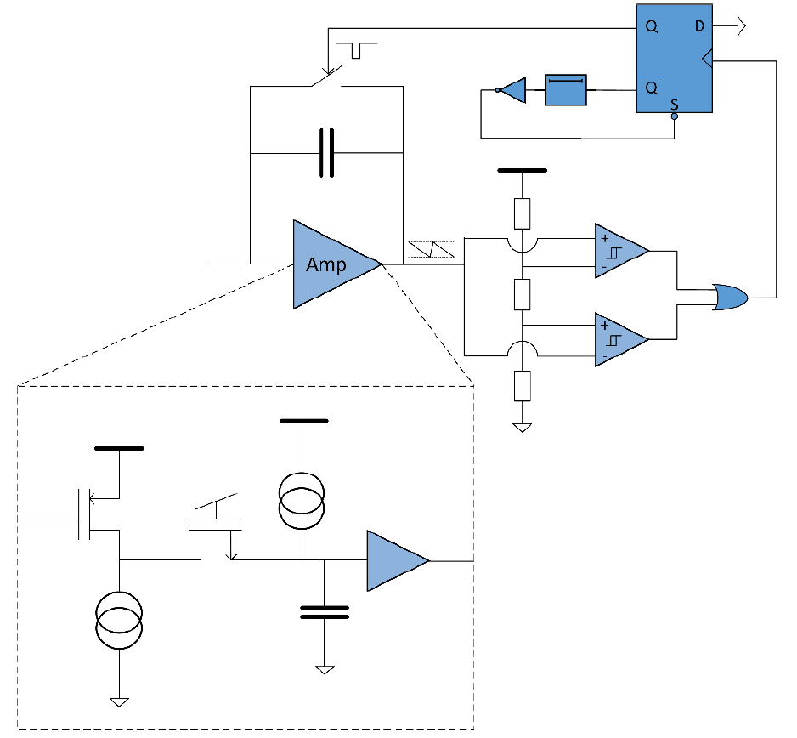
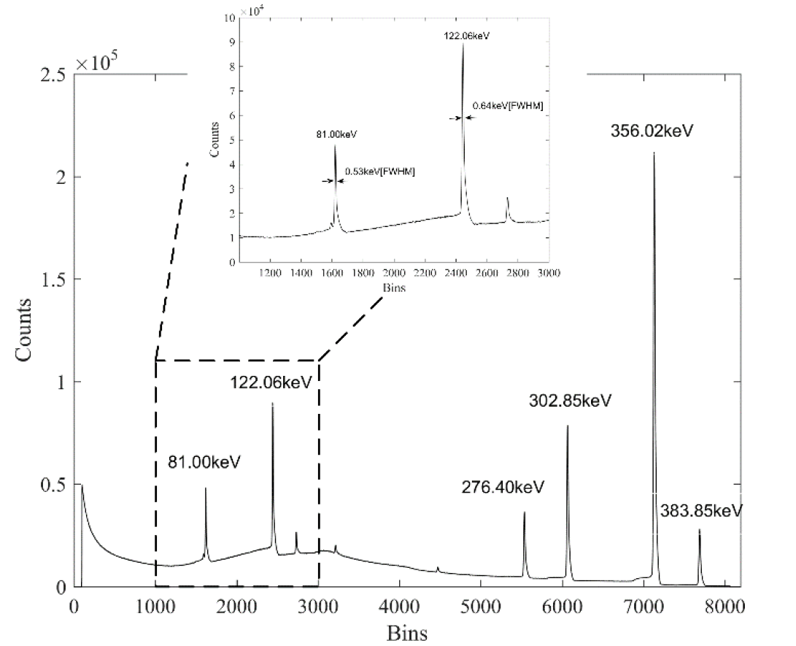
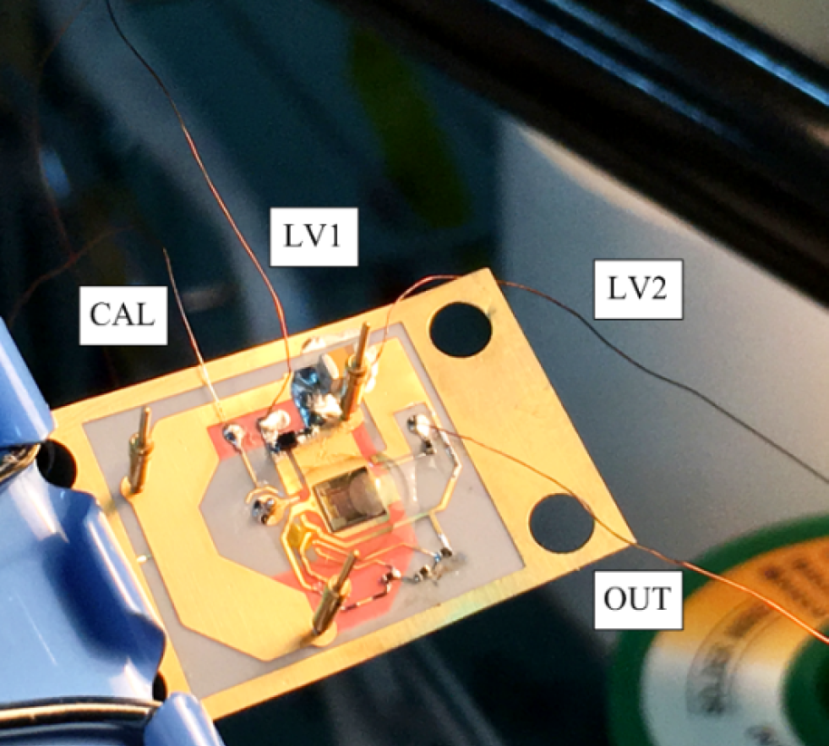
Low temperature CMOS preamplifier
L3GeRO-2018
  0.35 um CMOS process
  pulse reset
  ENC：13.3 e @ 2pF, 77K
Z. Deng, et. al. JINST P08019 2018
Notes:
The 2018 version of the preamplifier chip is made of 0.35 micrometer CMOS process. In order to reduce noise, pulse reset is selected as the reset method. When the DC level exceeds the threshold set in the chip, the switch is turned on to complete the reset. The ENC is 13.3 electrons when the input capacitance is 2pF.

Slide 15
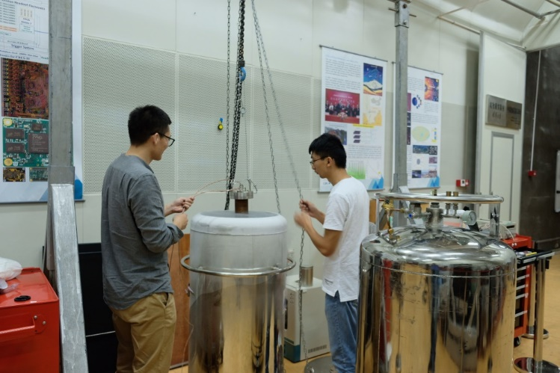
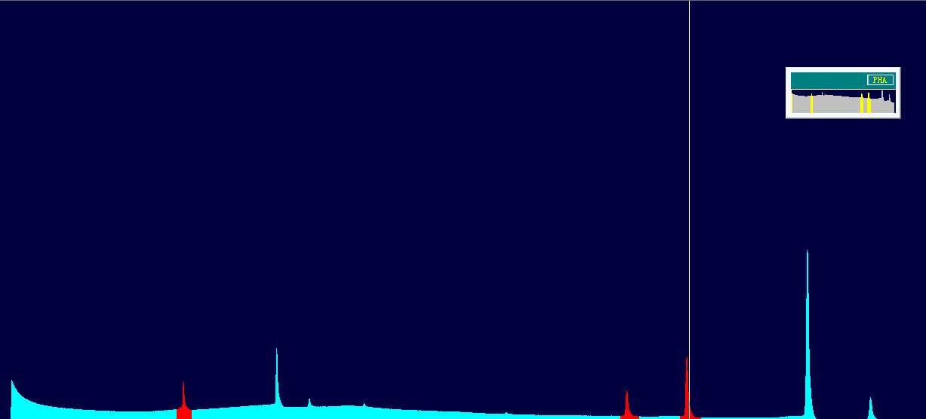
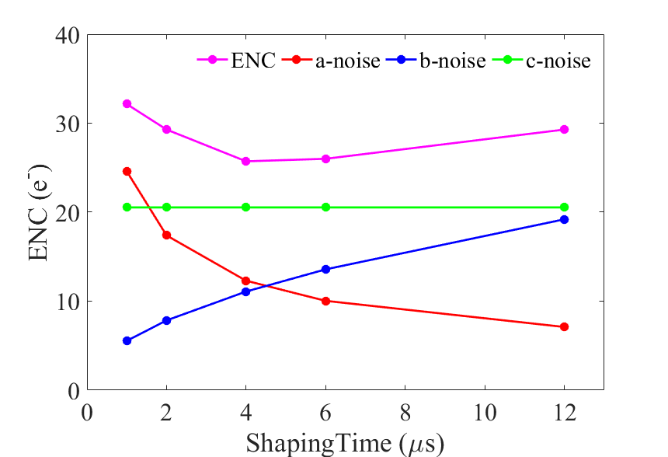
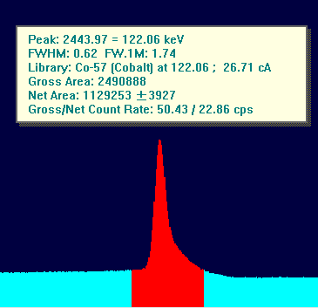
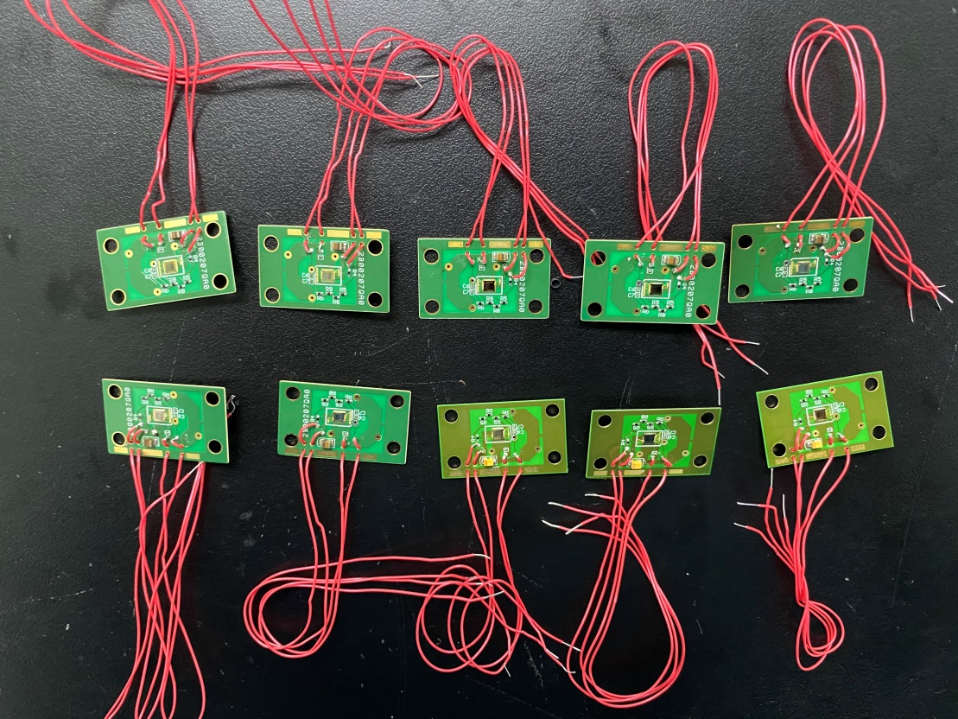
Low temperature CMOS preamplifier
L3GeRO-2018 in CDEX
ENC=182eV FWHM
FWHM=620eV@122keV
Notes:
The preamplifier and detector are installed in a vacuum chamber and cooled in liquid nitrogen. The four wires are welded to the vacuum chamber flange and then connected to the data acquisition system in room temperature environment through coaxial cables. The energy resolution is 620eV @ 122keV.

Slide 16
Low temperature CMOS preamplifier
Problems and requirements in the CDEX
  Electronic noise
  Input charge over 250 fC
  Complex external configuration circuitry
  Background from coaxial wires and HV wires
  Driving capability
  Reset logic with higher stability

Slide 17
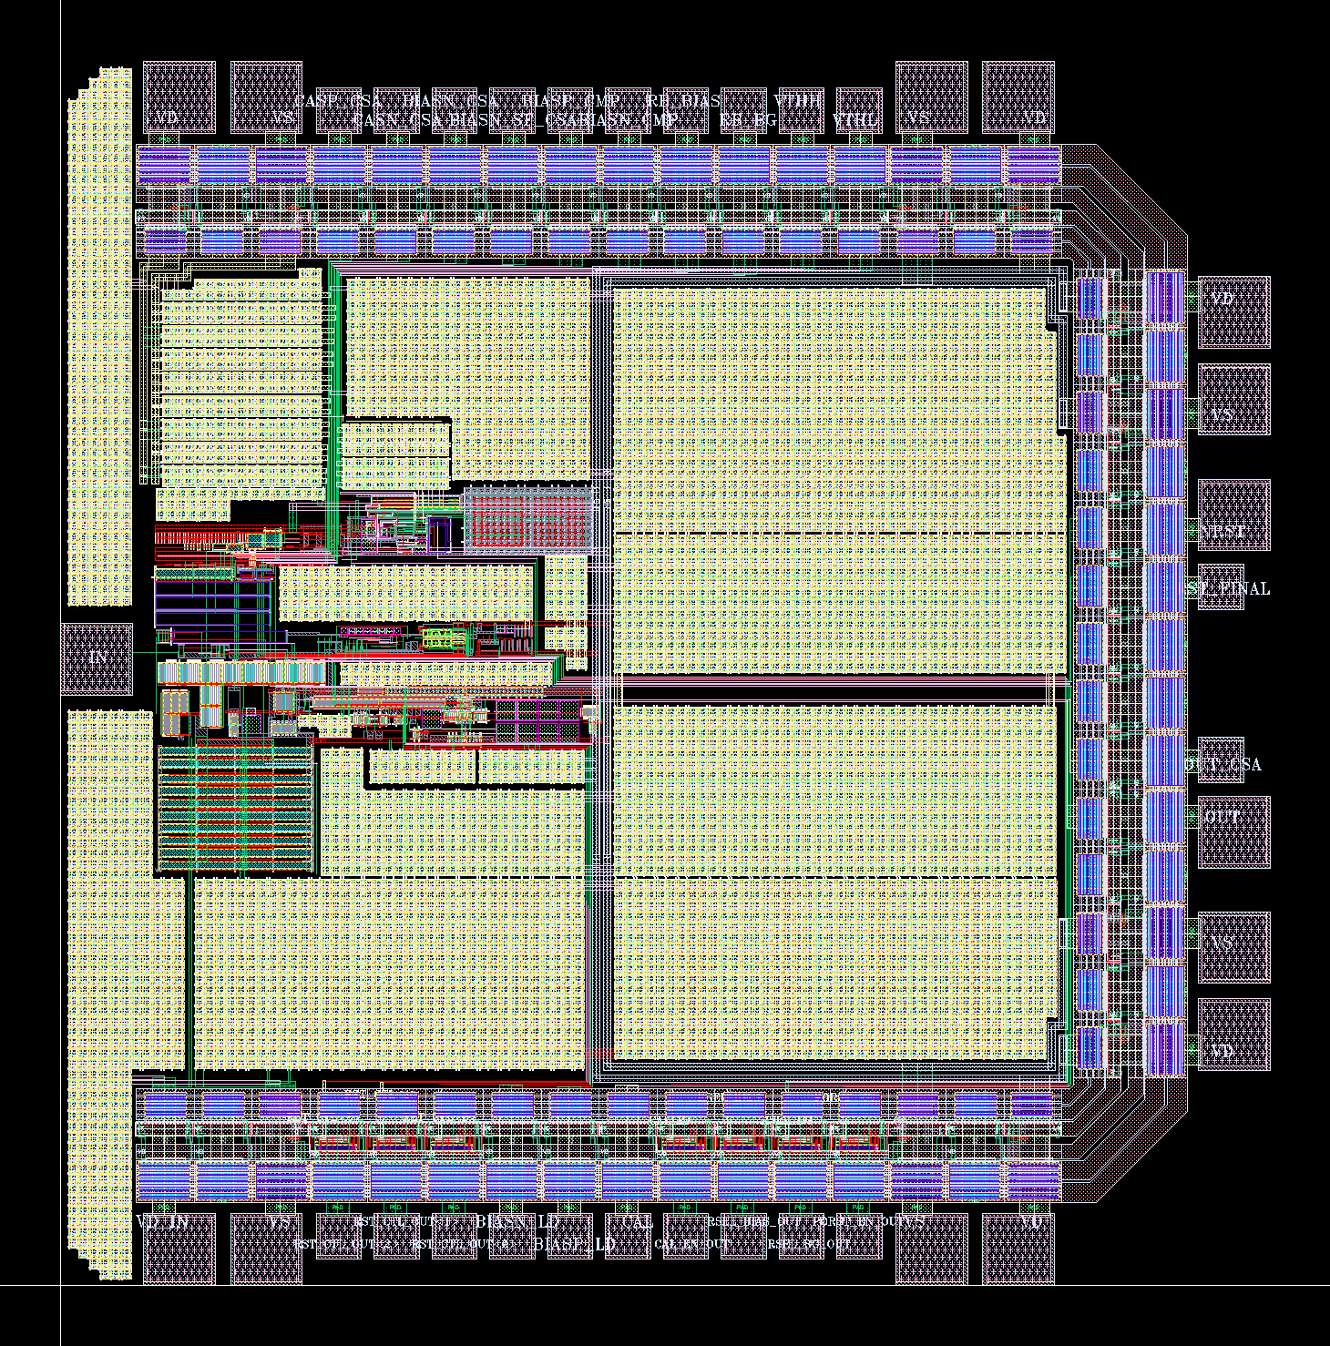
Low temperature CMOS preamplifier
L3GeRO-2025
  Without external configuration circuitry
  Updated reset logic
  Line Driver to improve PSRR
  Simulation ENC：<3 e @ 2pF, 77K
Notes:
The latest version of preamplifier ASIC does not require additional configuration circuitry.
The chip updates the threshold reset logic and adds a Line Driver .
At the same time, the arrangement of IO-PAD is optimized for the signal routing on PCB board.
The chip has been submited and preliminary test results are expected by the end of the year

Slide 18
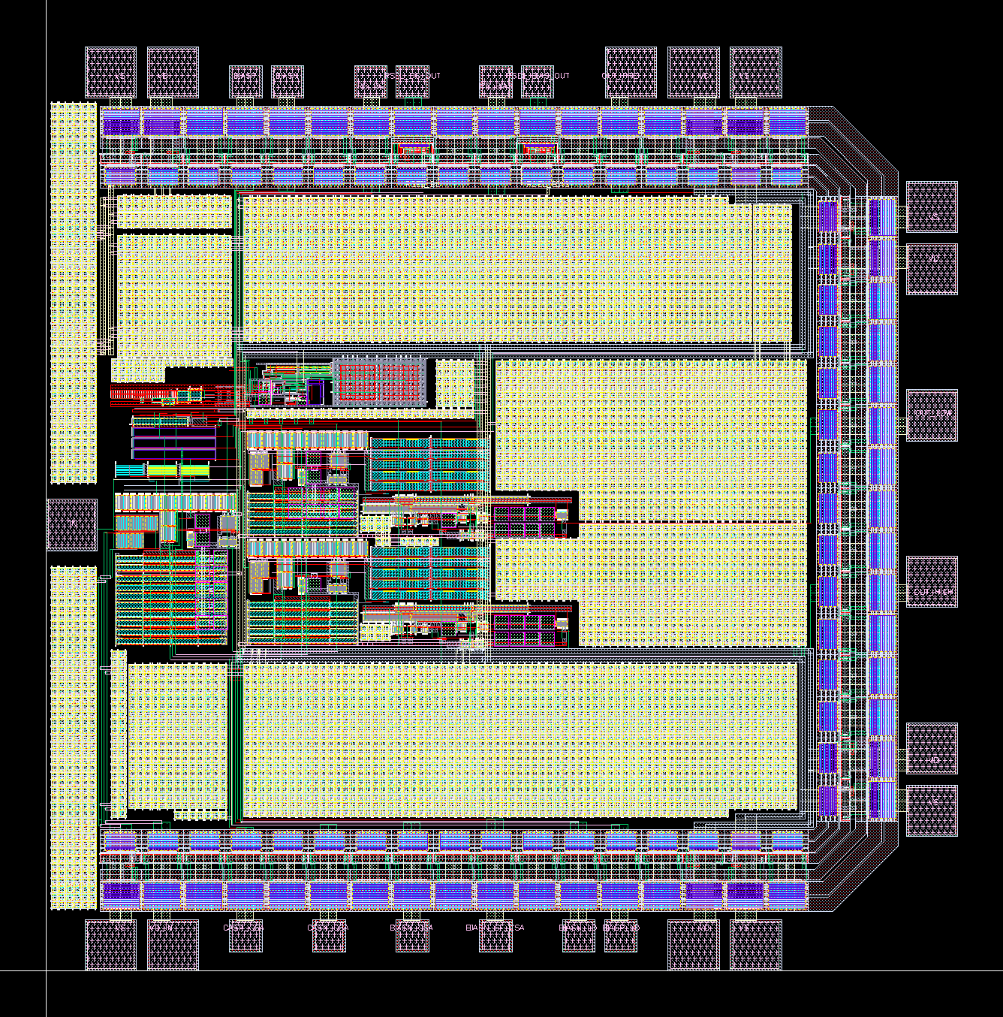
Low temperature CMOS preamplifier
L3GeRO-2025W(Wide-dynamic)
  Two-stage CSA with line driver
  Resistive-feedback
  Input charge over 250 fC
Notes:
There is also a dynamic range preamplifier chip that is submitted.
This chip contains a two-stage charge amplification circuit, and the second stage of charge amplification is divided into two gain levels with two line drivers
This chip achieves an input charge of more than 250fC

Slide 19
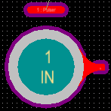
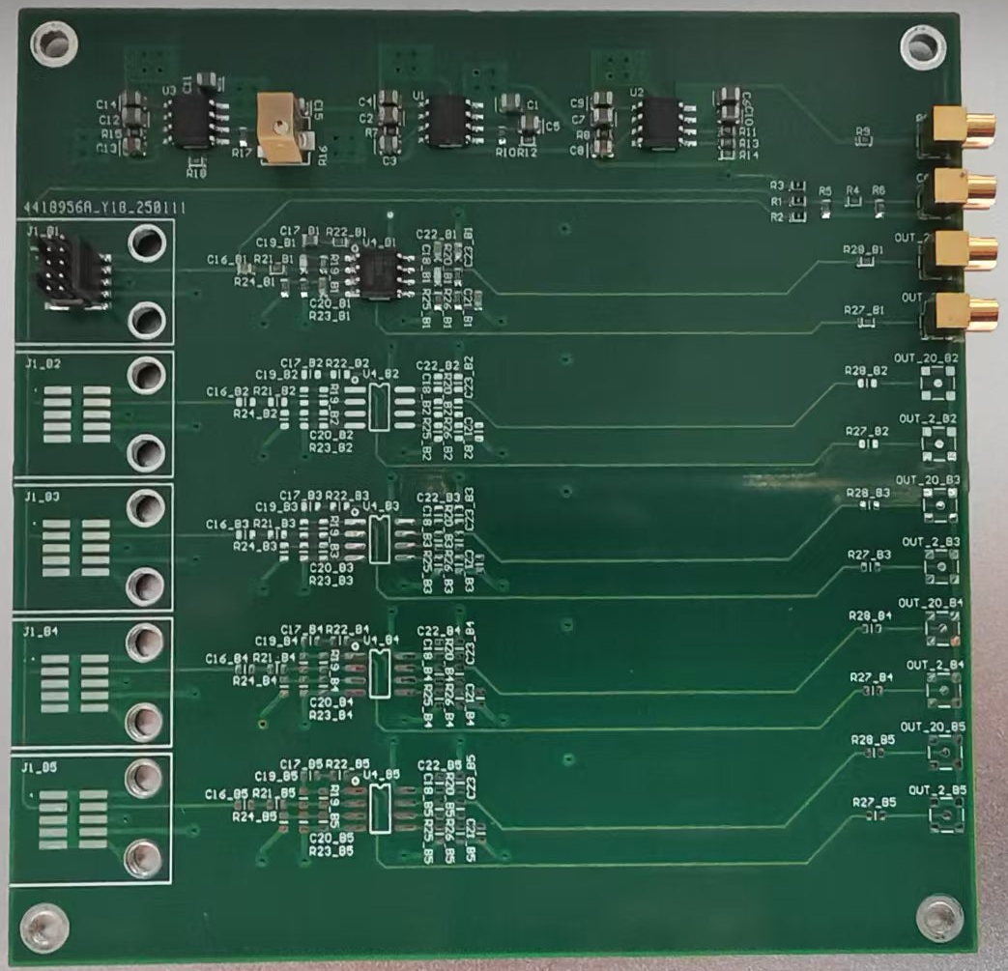
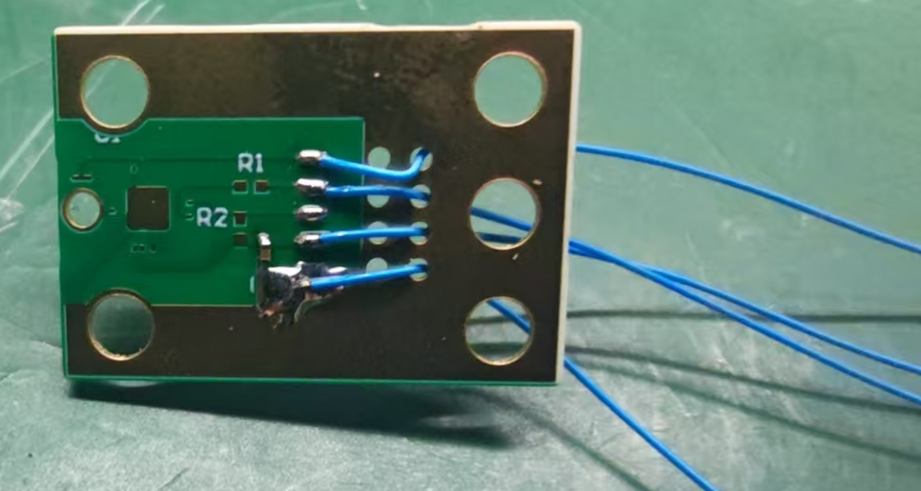
Low temperature CMOS preamplifier
L3GeRO-2024 in CDEX
  HPGe detector + VFE + BN
  HPGe and VFE in a vacuum chamber
  Vacuum chamber in liquid nitrogen
  Coaxial cables between VFE and BN
HV
HPGe
CAL
Δ
V
NRST
Ccal
VD
MMCX
PreAmp
OUT
VS
VFE
In vacuum chamber
In liquid nitrogen
Coaxial Cables
Notes:
The following will introduce the application and testing of the latest version of the preamplifier chip in CDEX.
The CDEX readout circuit mainly includes VFE board, BN board and data acquisition system.
the right figure shows the connection relationship between detector, VFE board and BN board.
The detector and VFE plate are placed in a vacuum chamber and then immersed in liquid nitrogen.
A low-background coaxial cable connection is used between the VFE and BN plates.

Slide 20
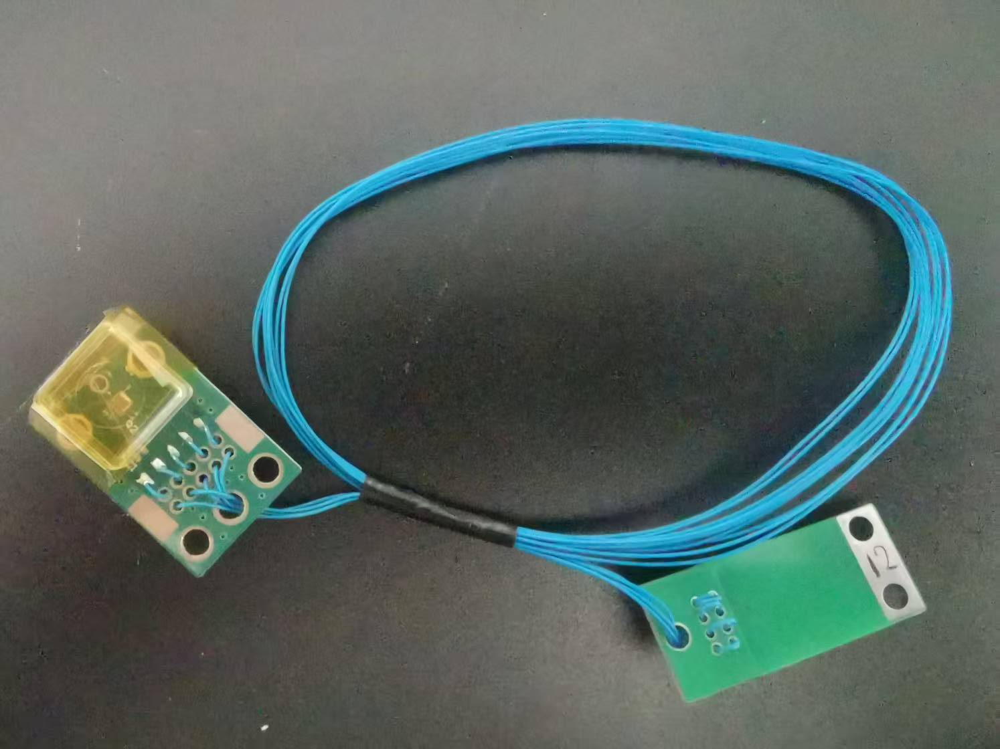
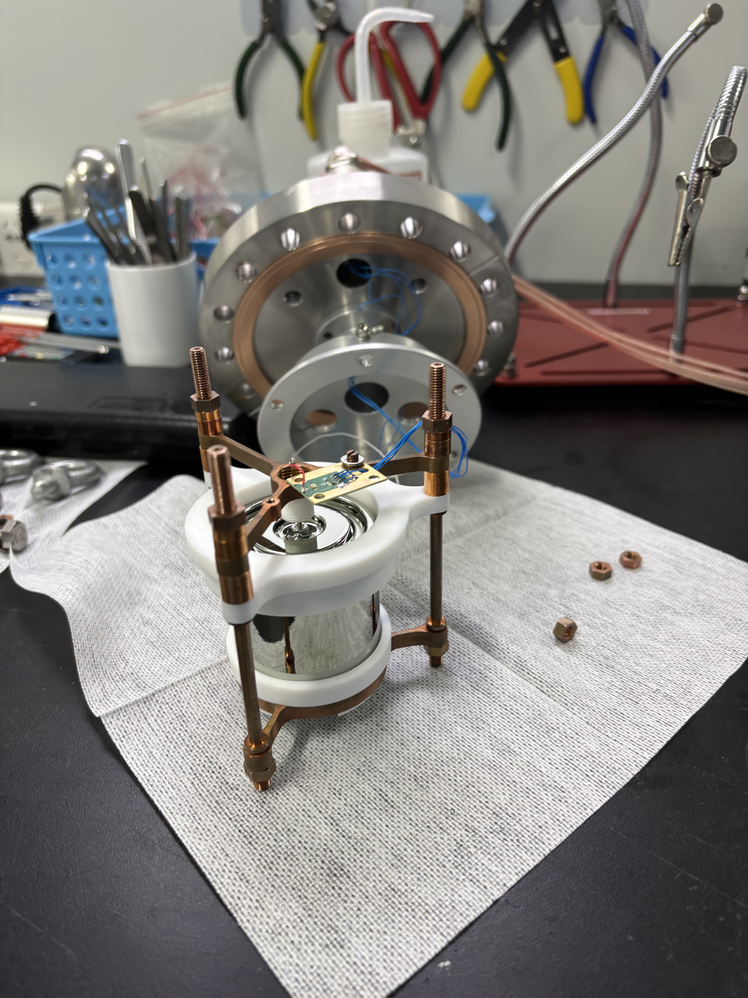
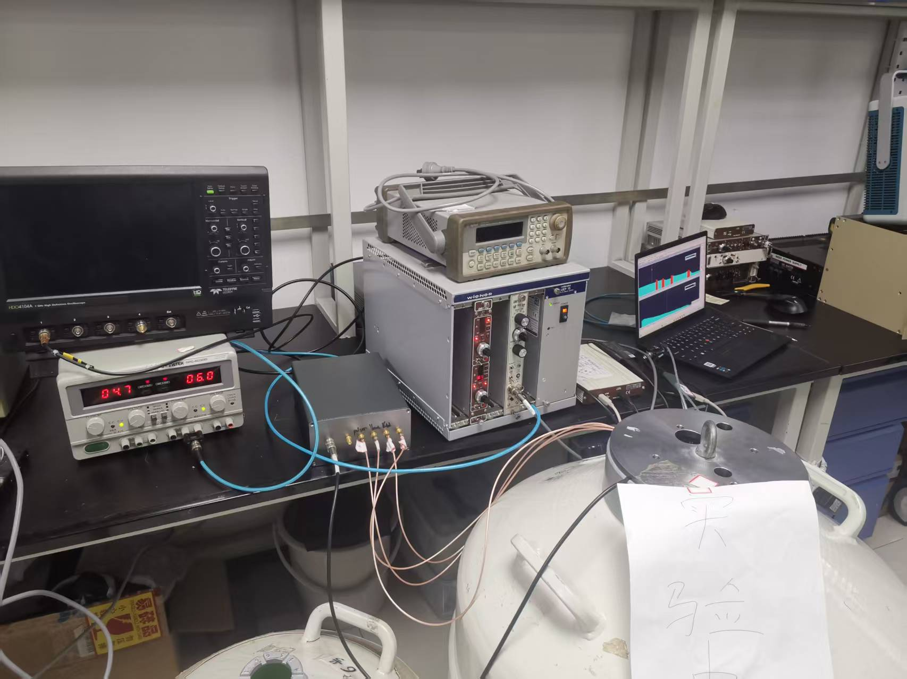
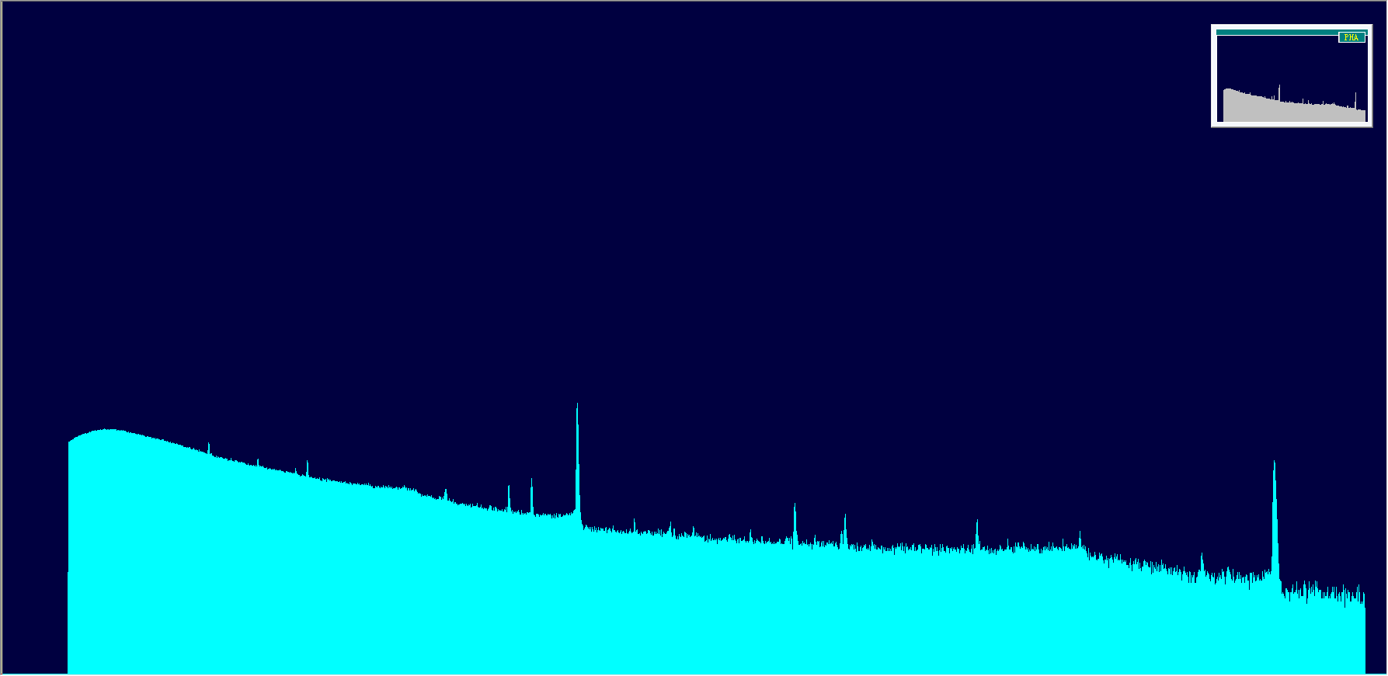
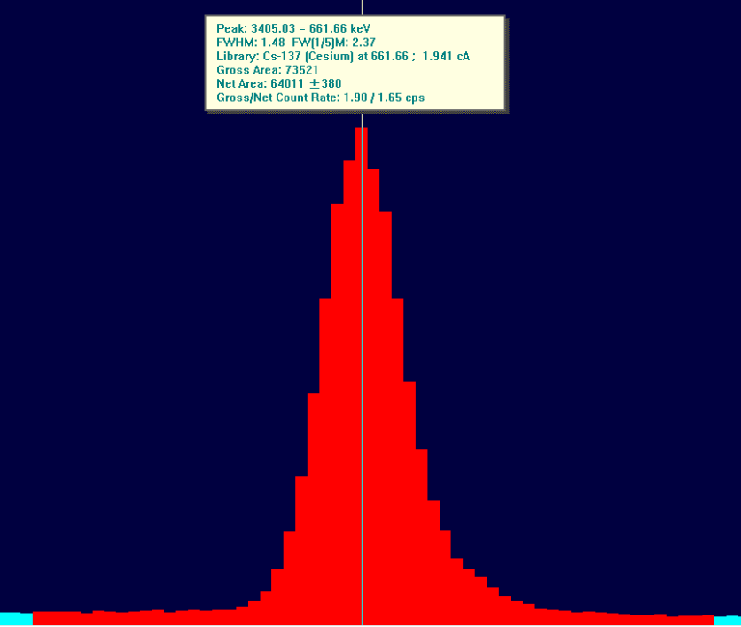
Low temperature CMOS preamplifier
L3GeRO-2024 in CDEX
  HPGe and VFE in a vacuum chamber
  Vacuum chamber in liquid nitrogen
  FWHM=1.5 keV @ 662 keV(Cs-137)
Notes:
The 2024 version of the chip was tested with the high-purity germanium detector, and this is the VFE board, the detector and the test system
The detector and front end plate are placed in a vacuum tank that is immersed in liquid nitrogen
The measured full width at half maximum of six hundred and sixty-two keV is one point five keV

Slide 21
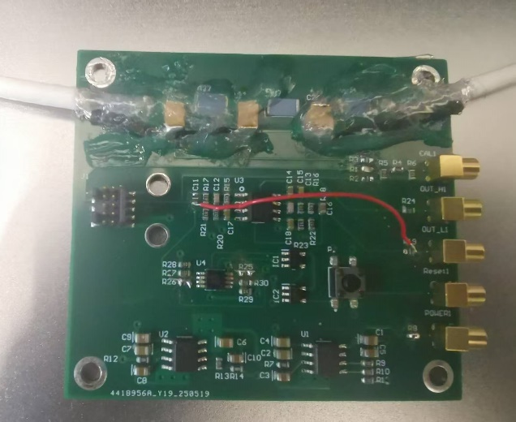
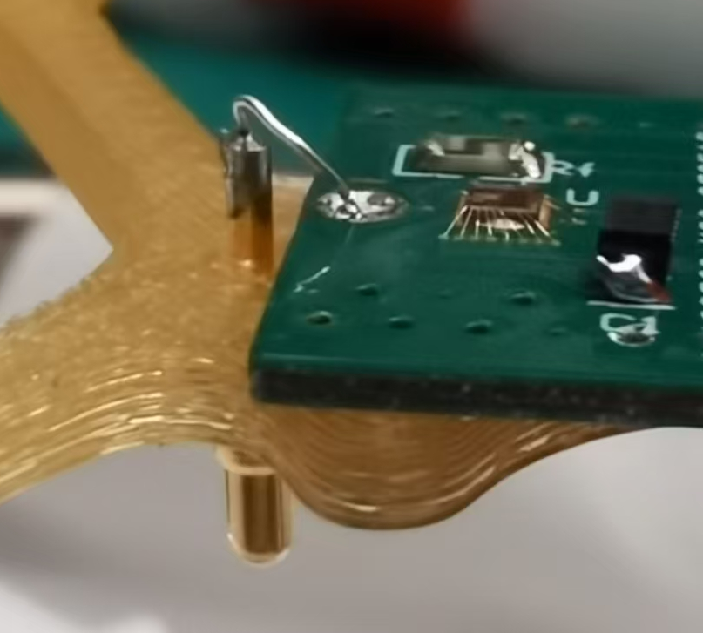
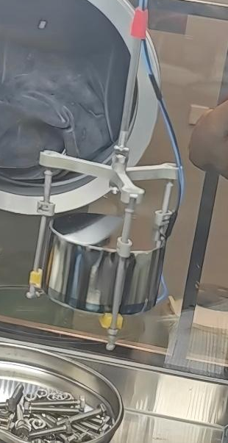
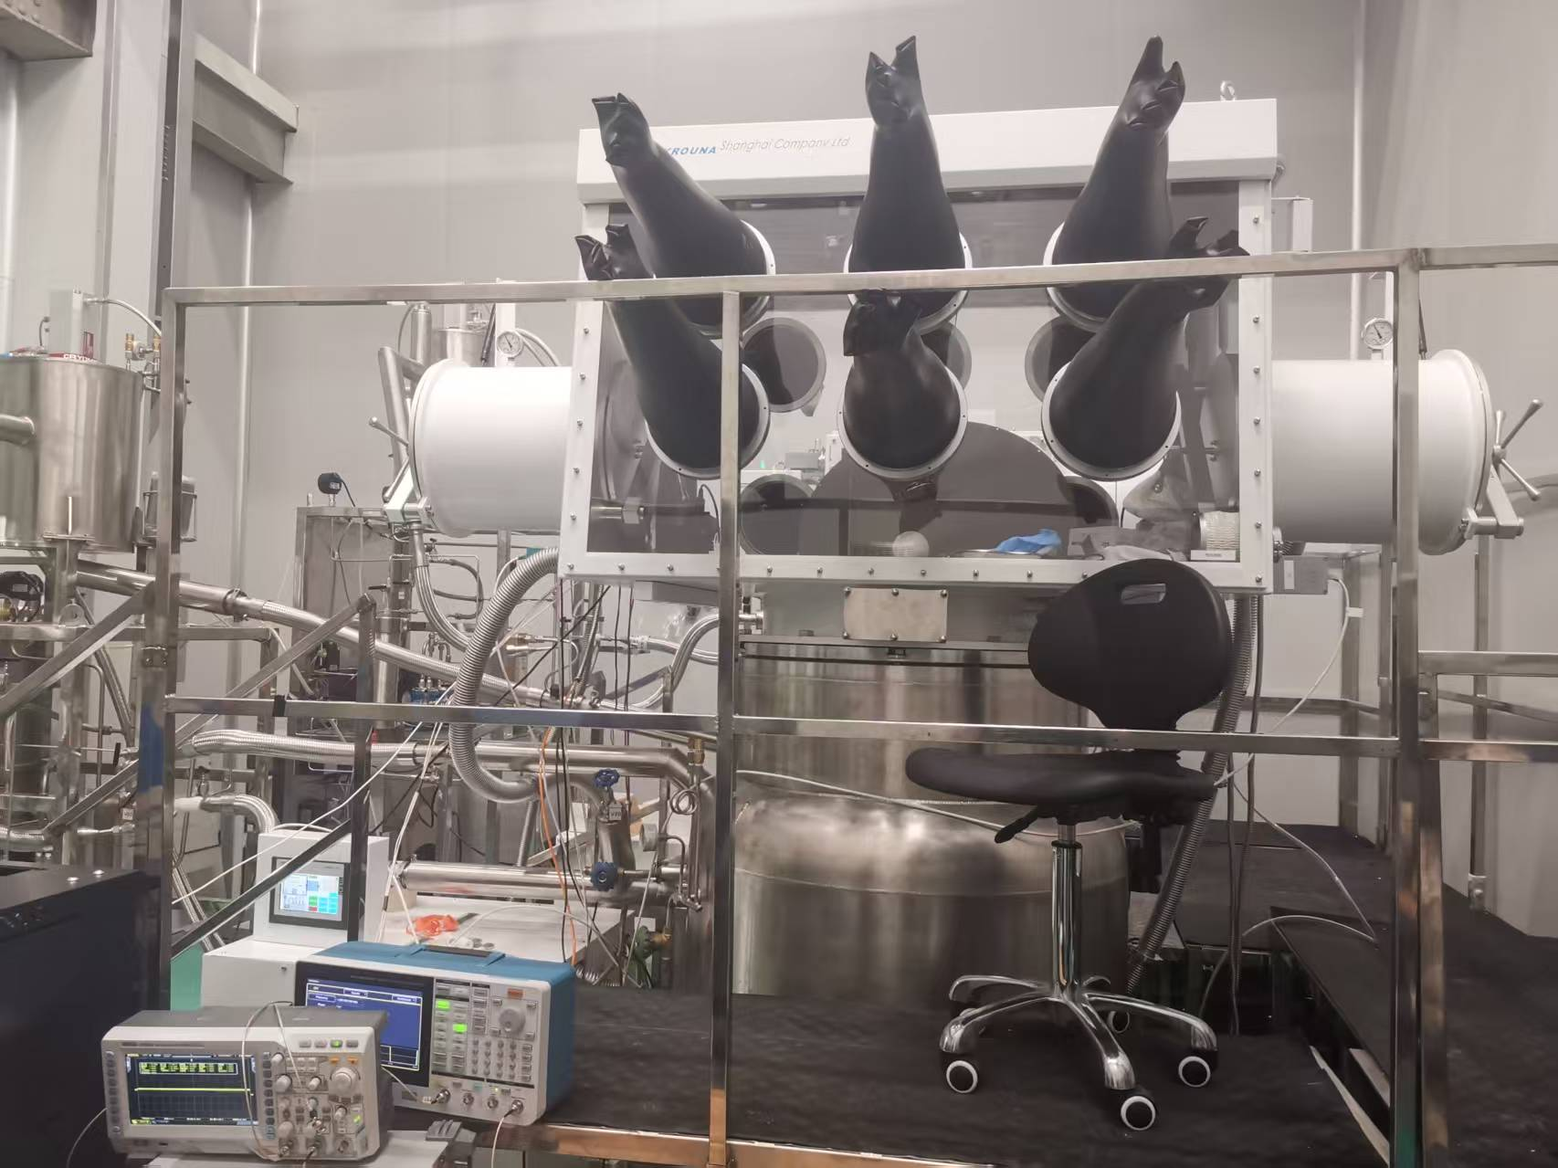
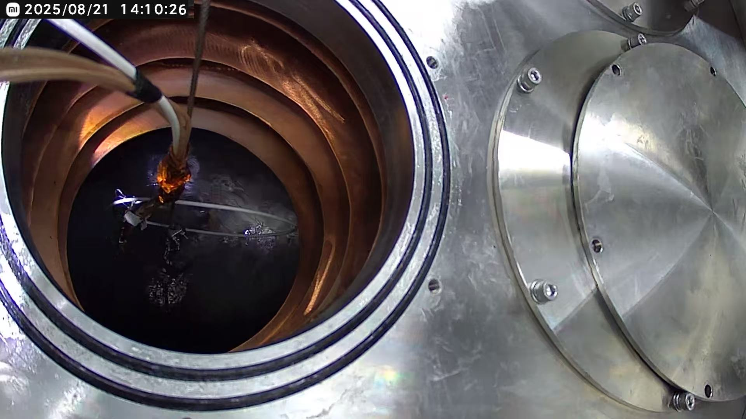
Low temperature CMOS preamplifier
L3GeRO-2024 in CDEX
  HPGe detector + VFE + BN
  HPGe and VFE directly in liquid nitrogen
  Joint testing is ongoing
Notes:
To better match the CDEX readout, a bare detector test is performed
the detector and VFE board are directly immersed in liquid nitrogen
The test is ongoing

Slide 22
03
Summary

Slide 23
Summary
We have developed several cryogenic readout ASICs for the readout of high-purity germanium detector arrays.
The performance of cryogenic readout ASICs have been verified.
The joint testing with high-purity germanium detector and L3GeRO-2024 is underway.
Two L3GeRO(Low temperature, Low noise and Low background Germanium detector ReadOut) ASICs have been submitted.
Notes:
This the summary

Slide 24
THANKS

Slide 25
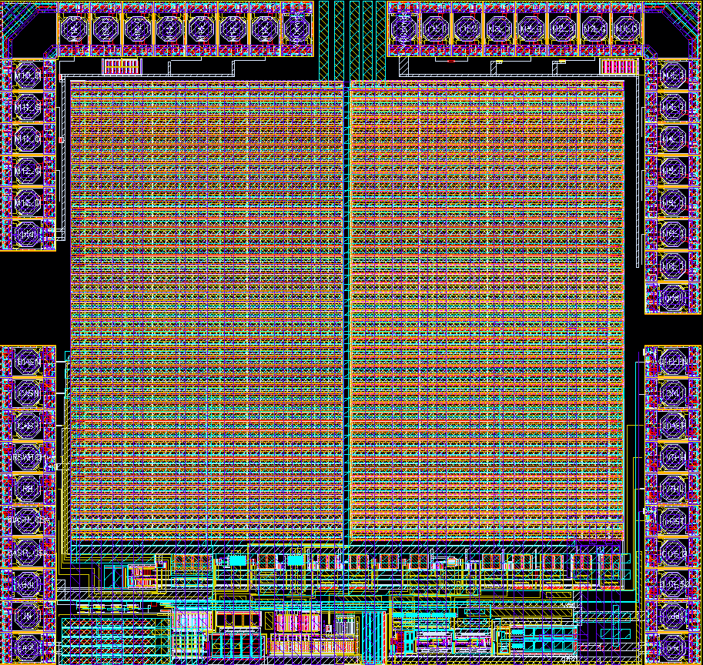
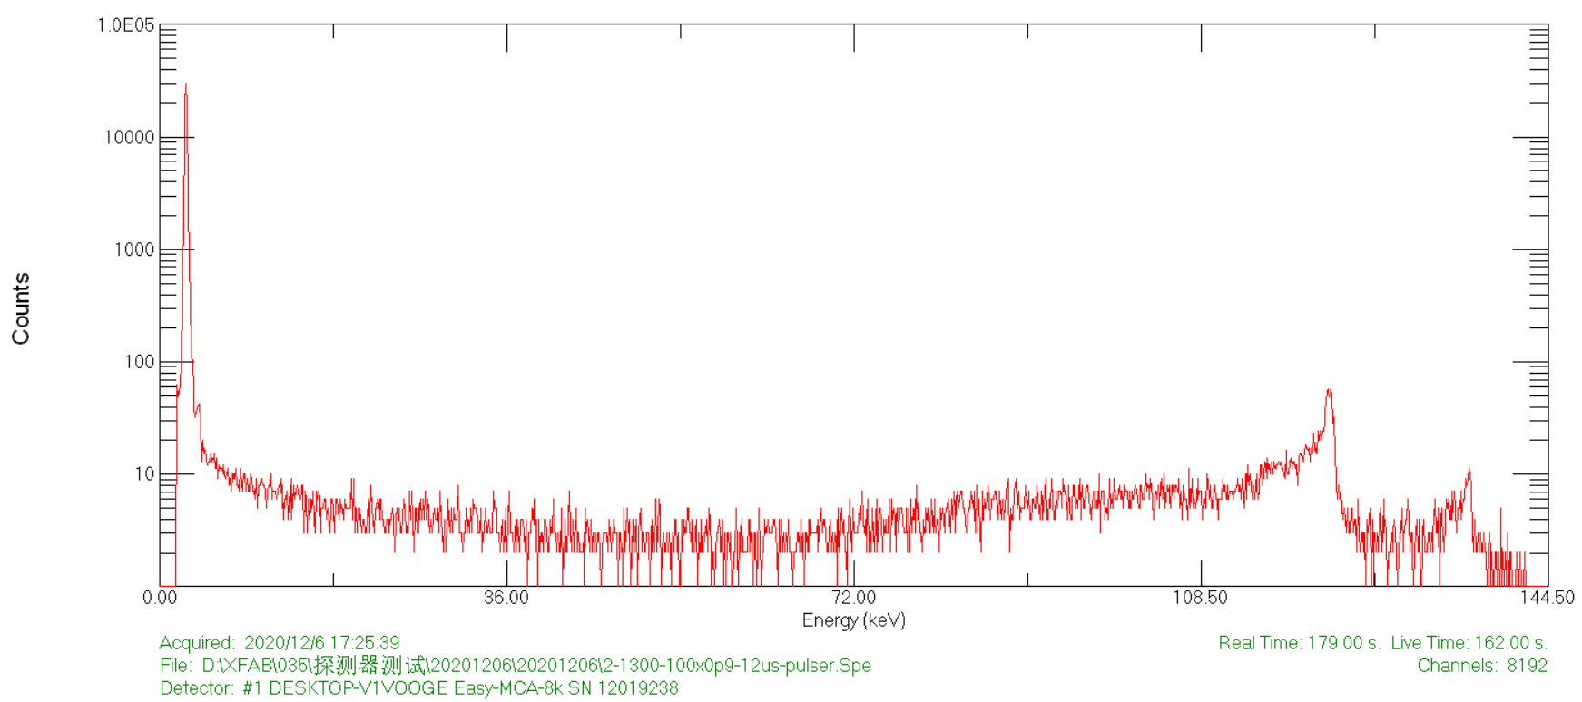
Low temperature CMOS preamplifier
2.7 mm
L3GeRO-2021
  XFAB 350nm
  ENC=15.5 e
  600eV@122keV
2.6 mm
pulser
@0.5kg HPGe
ENC/e
Shaping time/us
Notes:
The 2021 version of the preamplifier measured ENC=8.9e at 77K temperature and 12us shaping time. With a 0.5kg high-purity germanium detector, the results of the test was ENC=15.5e, and the energy resolution was 600eV @ 122keV

Slide 26
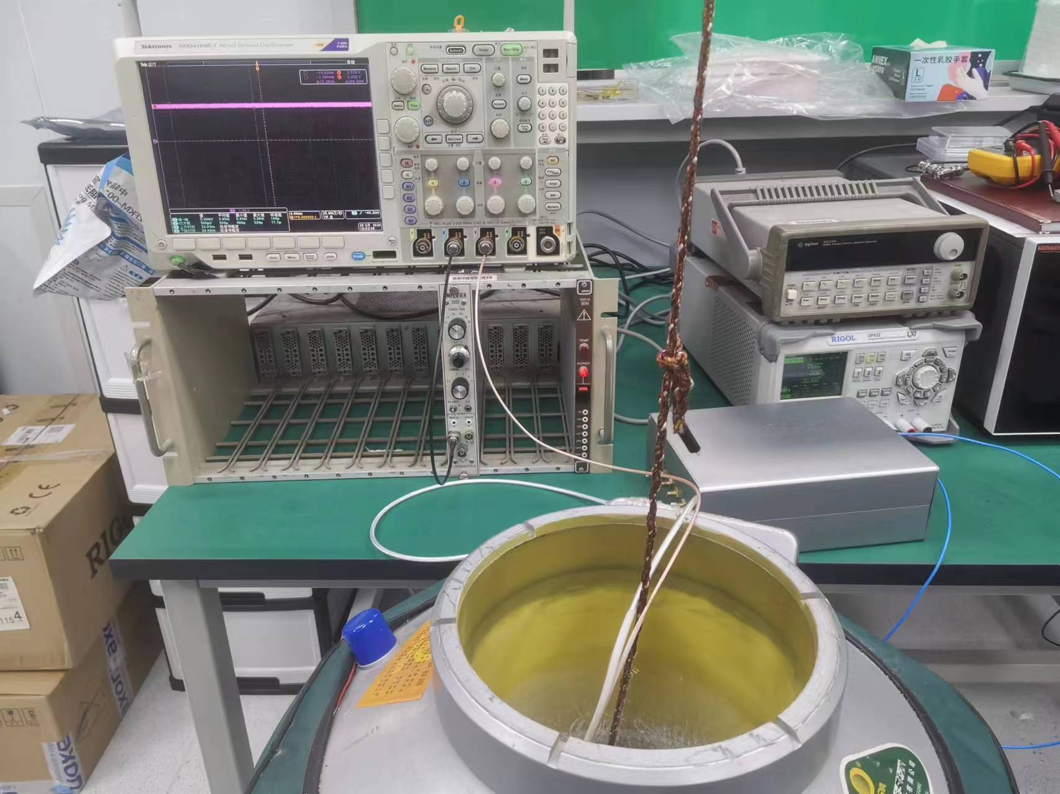
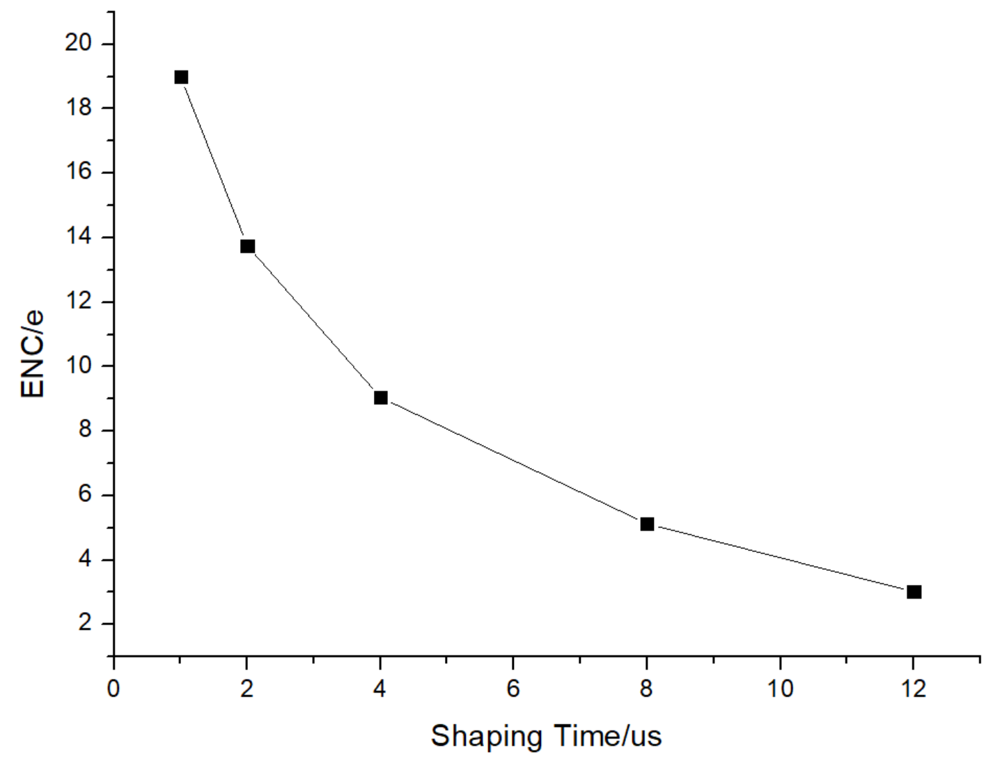
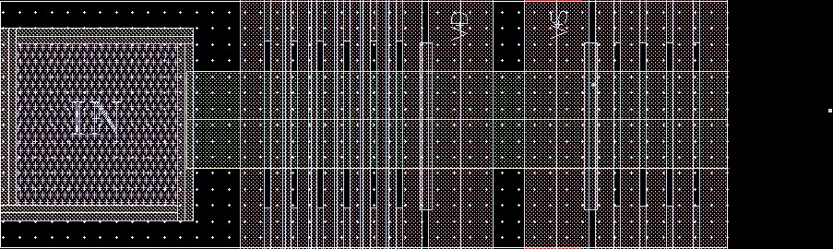
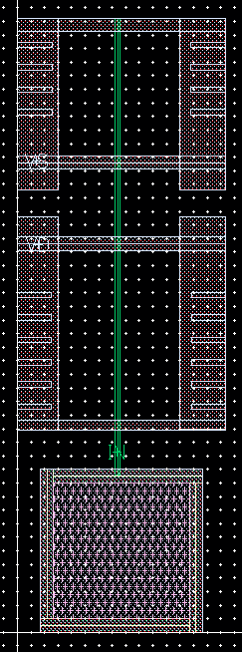
Low temperature CMOS preamplifier
L3GeRO-2023
  Reduce the input PAD routing width and decrease parasitic capacitance
  power-on-reset module
  Line Driver to improve PSRR
  ENC = 3.0 e @ 0 pF, 77K
Notes:
Compared with the previous version, the latest version of the preamplifier has a reduced input PAD routing width in design, thereby reducing parasitic capacitance; the previous version of the preamplifier was relatively unstable in working condition, and sometimes required manual reset outside the chip. The new version of the preamplifier has added a power-on-reset module, which will reset once if the DC level is too high after the chip is powered on; a line driver has been added to improve PSRR. At 77K temperature and 0 input capacitance, the measured ENC is 3.0e.

Slide 27
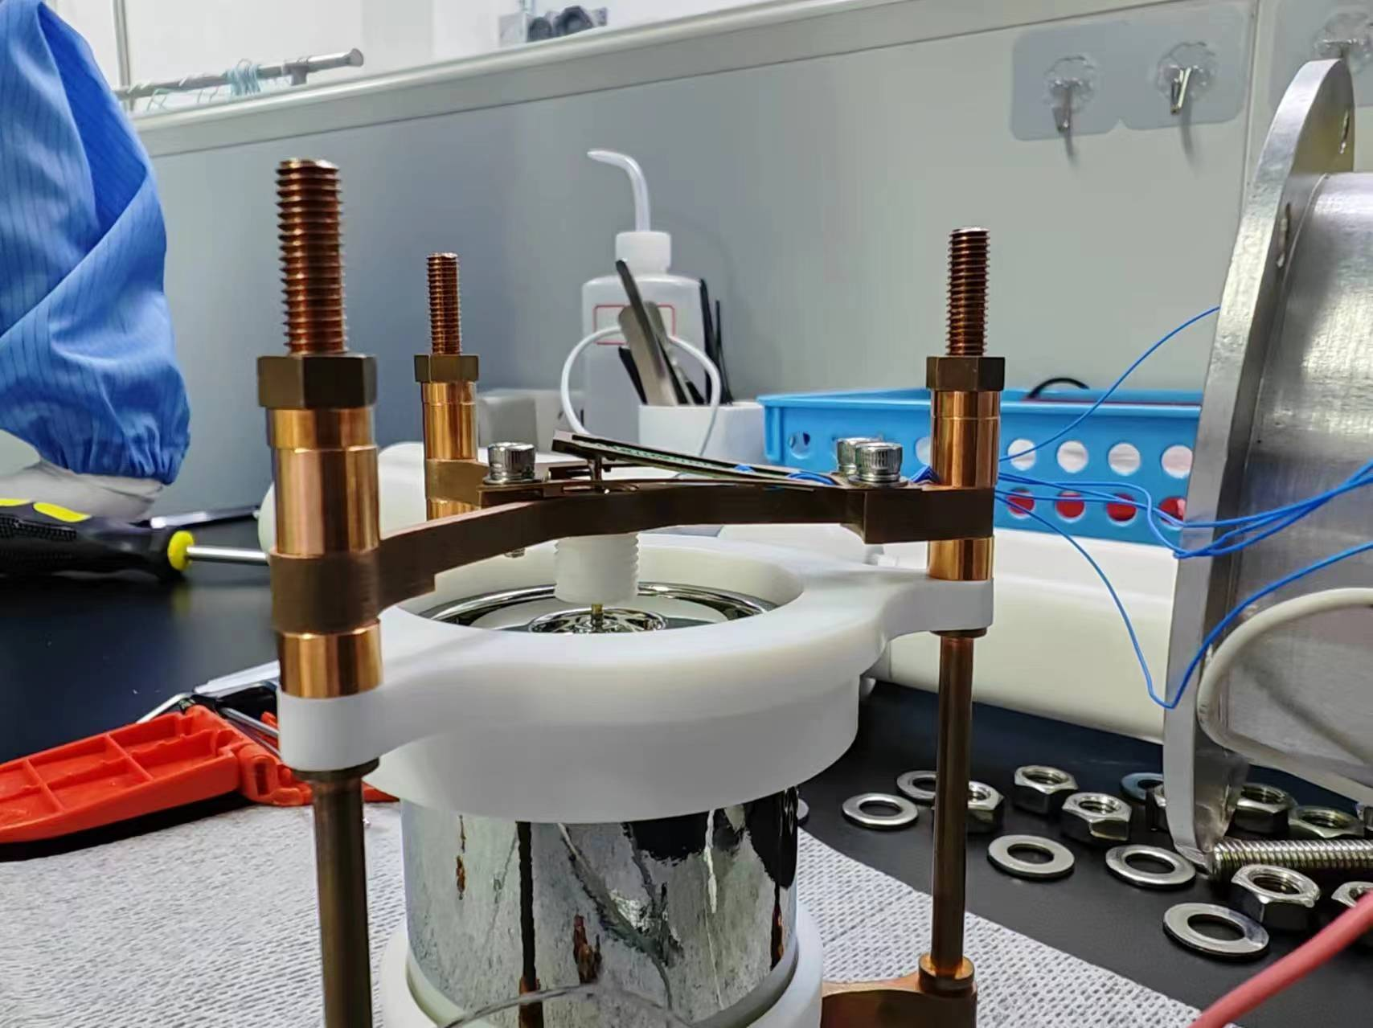
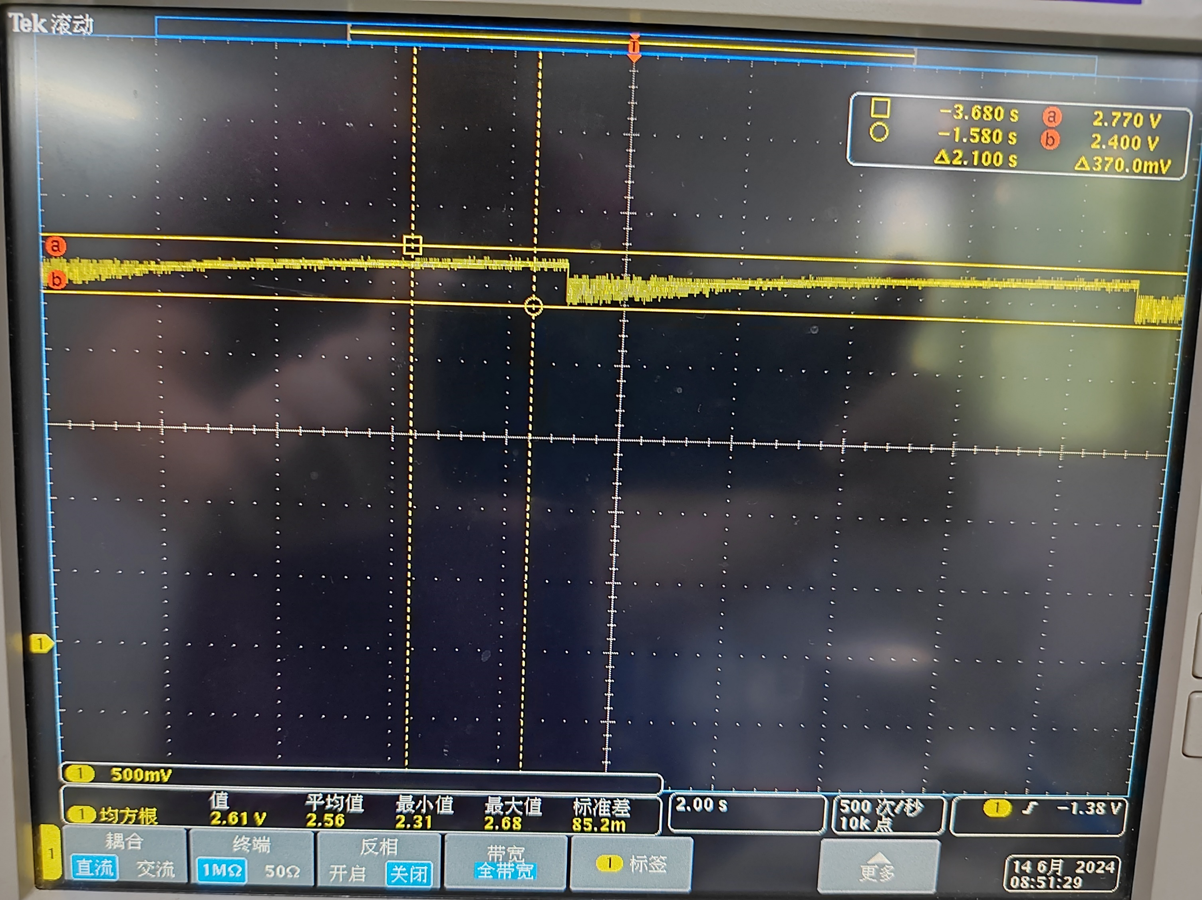
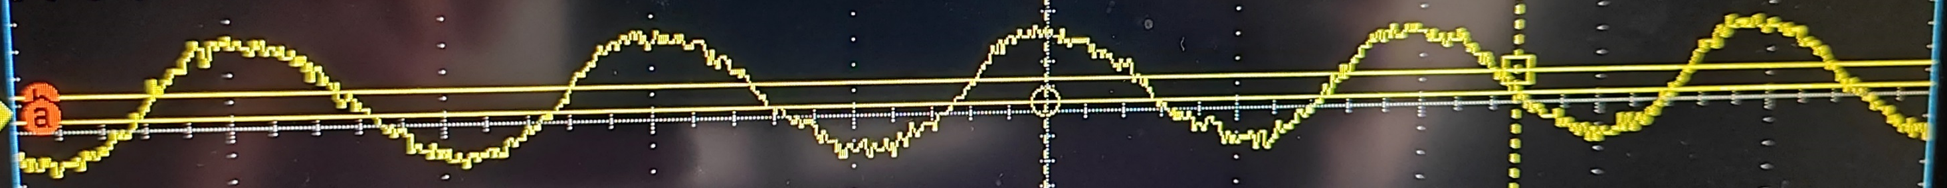
Low temperature CMOS preamplifier
Detector testing
  Oscillations @ 77K
  Caused by power-on-reset
Notes:
我们对该芯片进行了连接探测器的测试，该芯片在77K低温下输出基线会出现振荡现象
这是因为芯片内部power-on-reset模块工作异常，整个芯片处于复位状态，表现出来就是输出基线出现振荡

Slide 28
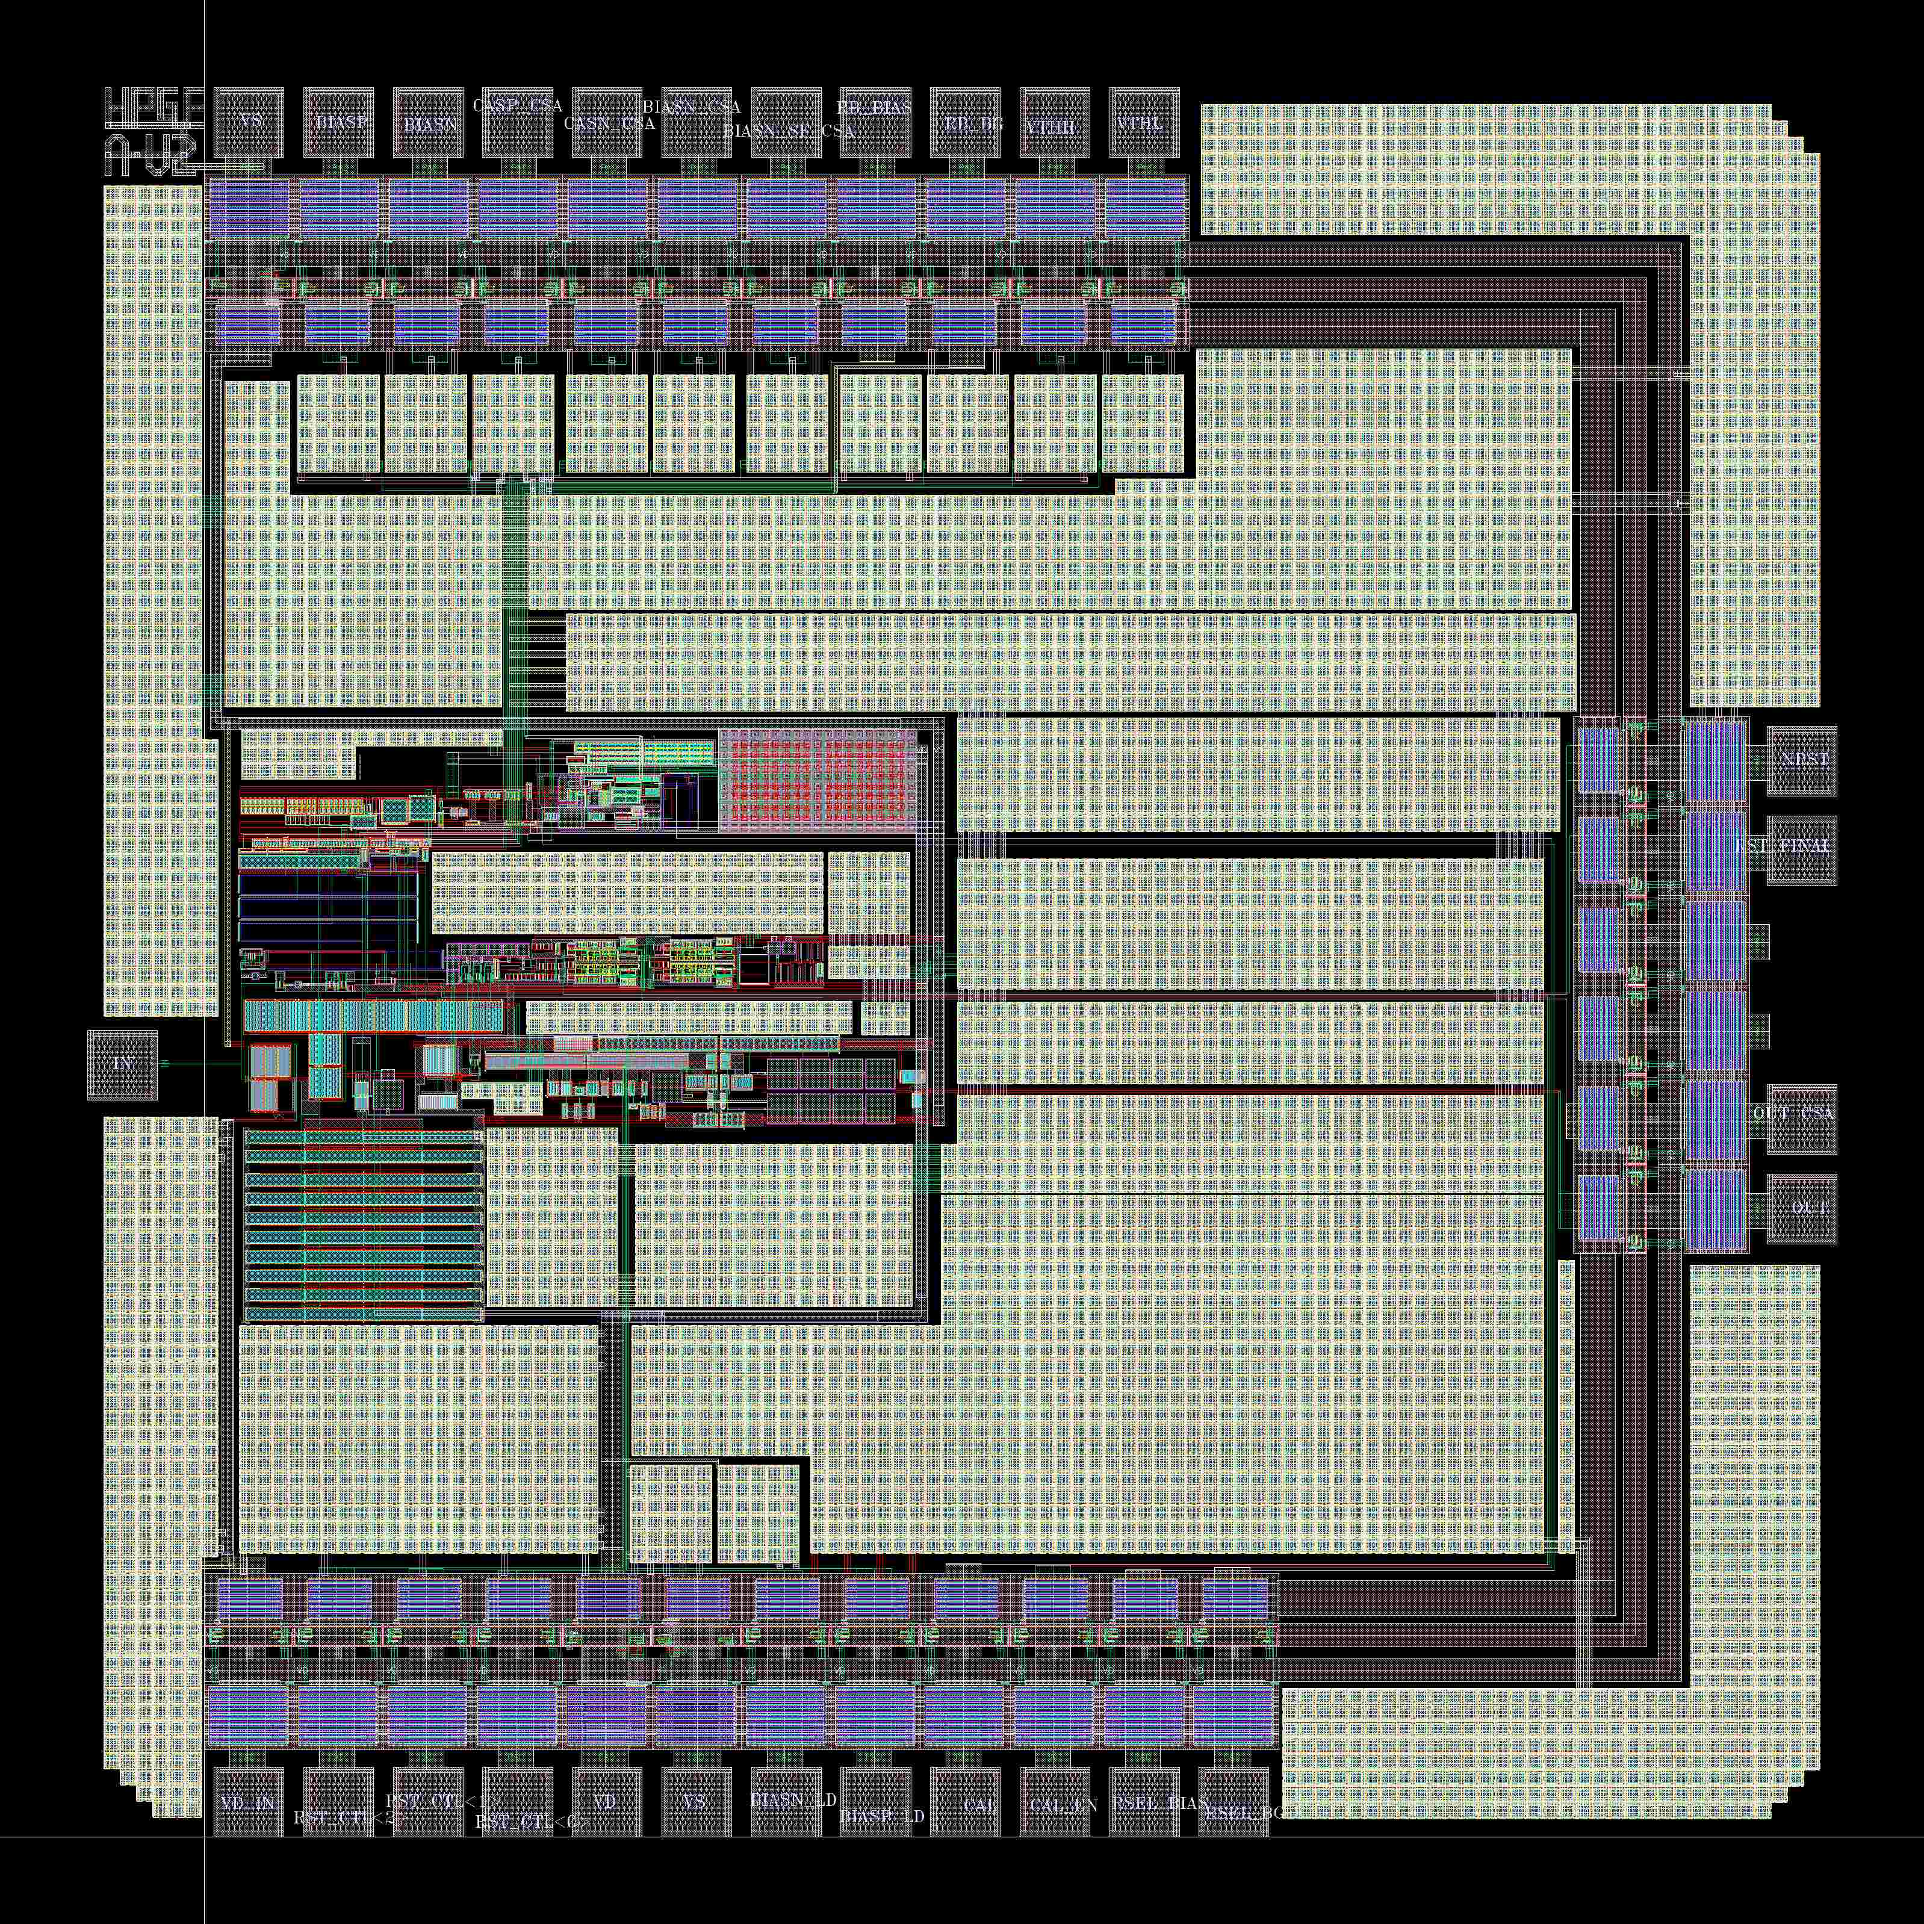
Low temperature CMOS preamplifier
L3GeRO-2024
  Updated power-on-reset module
  Updated permutation order of ID-PAD
  Smaller chip area
Notes:
2024版本前放芯片在2023版本芯片基础上进行优化设计，修改了power-on-reset模块在77K下异常的问题
同时，调整了芯片版图IO-PAD的布局，避免输入PAD周围出现其他信号，减小输入端电容
另外，芯片尺寸上有一定的减小

