Slide 1
Wave Effects of Gravitational waves
Jian-hua He
The XIX International Conference on Topics in Astroparticle and Underground Physics
(TAU2025)
25/08/2025
Notes:
Good day, everyone. It’s a pleasure to be here, and I’d like to extend my sincere thanks to Lijing for the kind invitation. Today, I will talk about an interesting topic: the wave effects of gravitational waves (GWs), a key aspect of their behavior. This talk will focus on the challenges and breakthroughs in understanding how GWs pass through and are influenced by black holes.

Slide 2
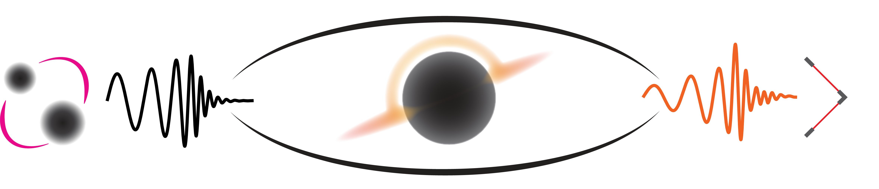
Outlines
Challenges in studying GWs passing through a black hole
Perturbed 3+1 Einstein’s equations in a Schwarzschild black hole
Simulating gravitational waves passing through a black hole
The detectability of stellar-mass black hole lensing with advanced LIGO
Notes:
Here are the outlines of my talk. First, I will discuss the challenges in studying gravitational waves (GWs) as they pass through a black hole. Initially, I thought this would be straightforward given the extensive research in general relativity over the years. However, I soon find that it is a highly complex and demanding field.
Secondly, I will discuss the perturbed 3+1 formulation of Einstein’s equations within a Schwarzschild black hole. Although the 3+1 decomposition is not typically used in black hole perturbation theory, I will explain why it is necessary in our case, as we have no other viable options.
In the third part of my talk, I will present our simulation results, highlighting some intriguing patterns in the lensed waveform.
Finally, I will talk about whether these unique features can be identified by aLIGO using Bayesian analysis.

Slide 3
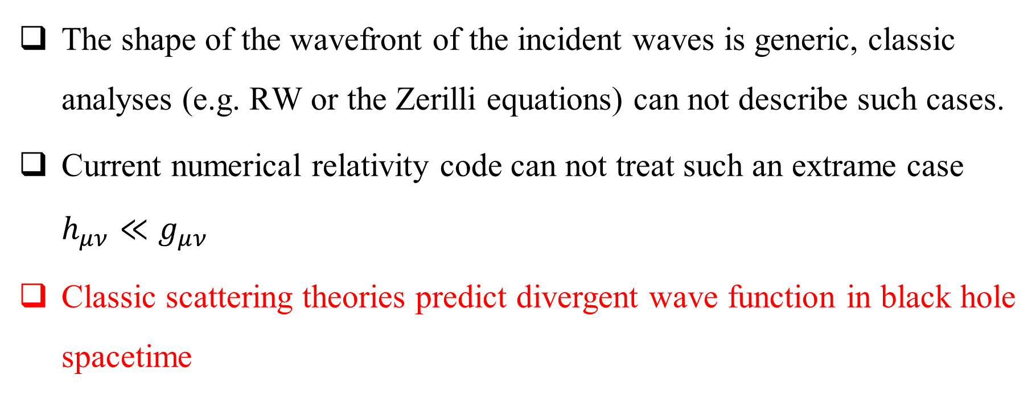
Challenges in studying GWs passing through a black hole
The shape of the wavefront of the incident waves is generic, classic analyses (e.g. RW or the Zerilli equations) can not describe such cases.
Current numerical relativity code can not treat such an extrame case $h_{μν}≪g_{μν}$
Classic scattering theories predict divergent wave function in black hole spacetime
Notes:
There are several approaches to studying how gravitational waves propagate in black hole spacetimes. One of the earliest methods is through black hole perturbation theory, specifically using the Regge-Wheeler (RW) or Zerilli equations. These equations rely on spherical harmonic decomposition, but unfortunately, this technique is limited and cannot be applied to more general, non-symmetric cases. You might wonder if numerical relativity could be a solution. The short answer is no. The reason is that the perturbations we’re dealing with are incredibly small compared to the background metric, and numerical relativity isn’t well-suited to handle such extreme cases. What’s more relevant is scattering theory, which describes how waves interact with objects. However, even this has its challenges, as classical scattering theories pred
ict divergent wave functions in the context of black hole spacetimes. I’ll come to these issues in more detail

Slide 4
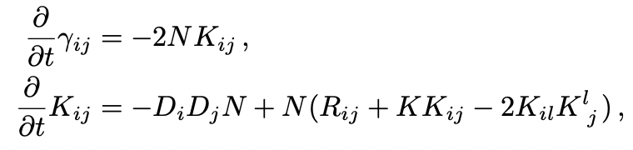
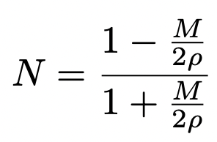
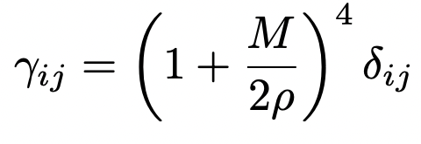
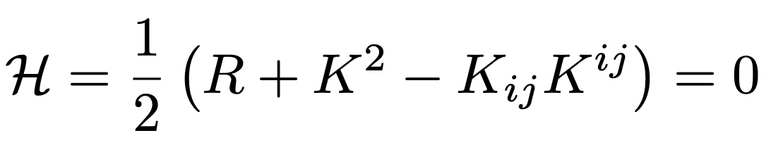
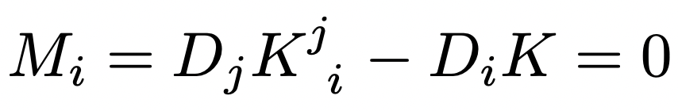
3+1 Decomposition
3+1 Einstein’s equations for a Schwarzschild black hole
The lapse function and metric in isotropic coordinate are given by
The Hamiltonian and momentum constraints
Notes:
To address the well-posedness problem, we need to utilize numerical relativity techniques. One of the core issues in numerical relativity is solving the well-posedness of hyperbolic equation systems. Since numerical relativity is based on the 3+1 formalism, we need to calculate the black hole perturbation equations in this framework. First, we consider the black hole background equations, where the 3+1 formalism consists of both dynamical equations and constraint equations. For a black hole in a vacuum, the constraint equations are zero.

Slide 5
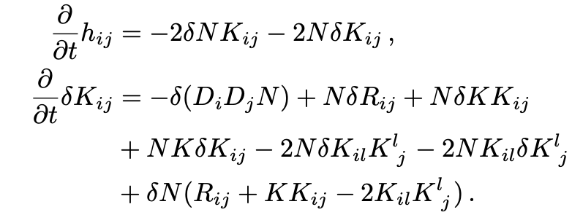
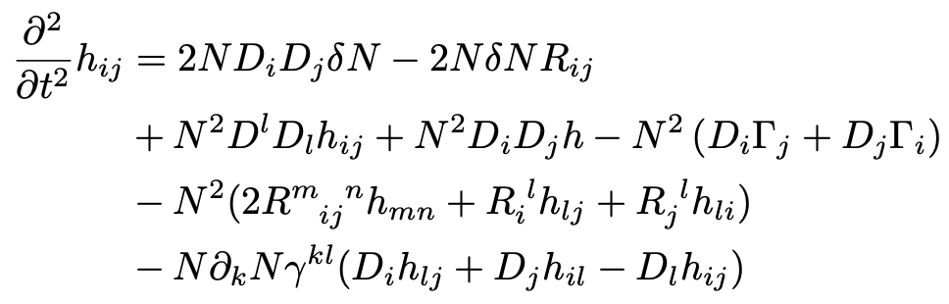

3+1 Decomposition
Perturbed 3+1 Einstein’s equations for a Schwarzschild black hole
Second-order wave equations
Not well posed!
Where,
Notes:
Building on the foundation of the background equation, we proceed directly to calculate the linear perturbation equations. By employing the second perturbation equation, we eliminate the extrinsic curvature perturbation term from the first equation, leading to the derivation of the wave equation for gravitational waves. However, careful attention is required, as the resulting equation still includes mixed spatial second-derivative terms of h, indicating that it has not yet reached a well-posed form.

Slide 6
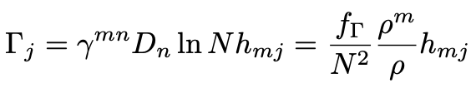
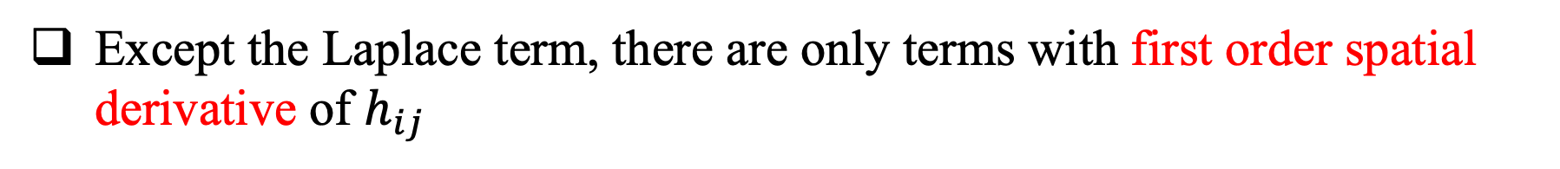
Well-posed equations
Momentum constraint!
Symmetric hyperbolic equations
Well posed!
Except the Laplace term, there are only terms with first order spatial derivative of $h_{ij}$
Notes:
One approach to addressing this problem is by utilizing the momentum constraint. In this case, Γ\GammaΓ is no longer the derivative of hhh, but rather becomes proportional to hhh. Aside from the Laplacian term, the equation contains only first-order spatial derivatives of hhh. The wave equation is symmetric hyperbolic, which is well-posed.

Slide 7
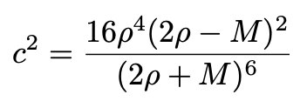
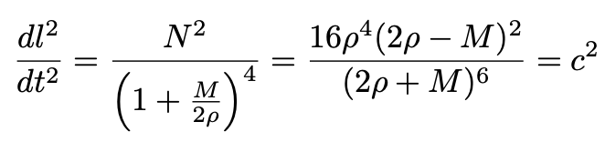
Isotropic wave speed
Isotropic speed of GWs
Speed of light!
Notes:
It is important to highlight a distinctive feature of this wave equation. The term ccc in the equation represents the wave speed. From a metric perspective, ccc corresponds to the speed of light as observed from spatial infinity. However, unlike standard relativity literature, where ccc is typically set to 1, here ccc varies with spatial position. In our case, ccc approaches 1 at regions far from the black hole but reduces to zero at the event horizon.

Slide 8
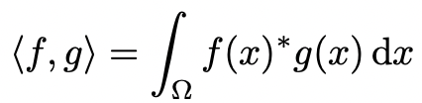
Finite element method
Weak formulation(variational formulation)
where
Notes:
The finite element method is based on the weak formulation of wave equations, also known as the variational formulation. The concept is straightforward: we convolve the original equation with a test function. If the resulting equation holds for any test function, we can conclude that the original equation is valid.

Slide 9
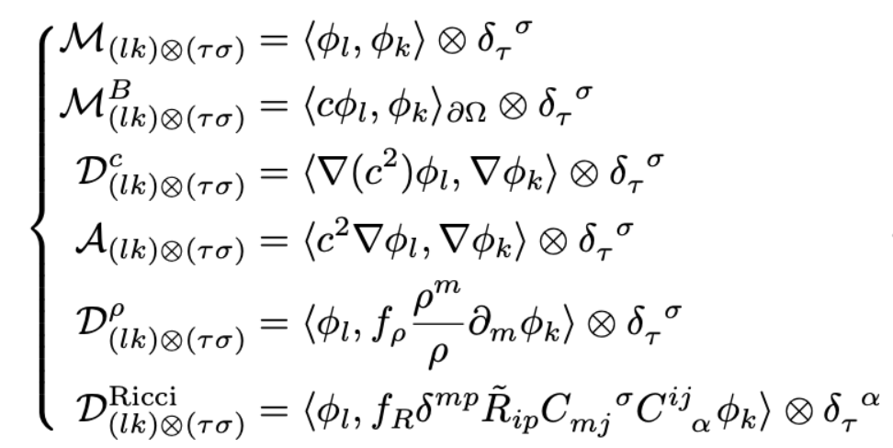
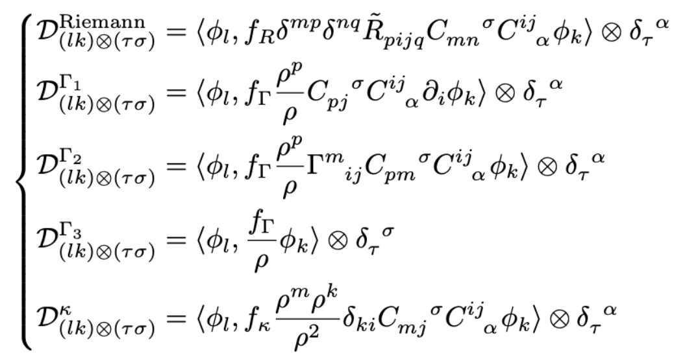
Finite element method
Matrix functions
Matrix elements
Notes:
The continuous wave equations are converted into a large system of linear equations. These are equation in matrices format.

Slide 10

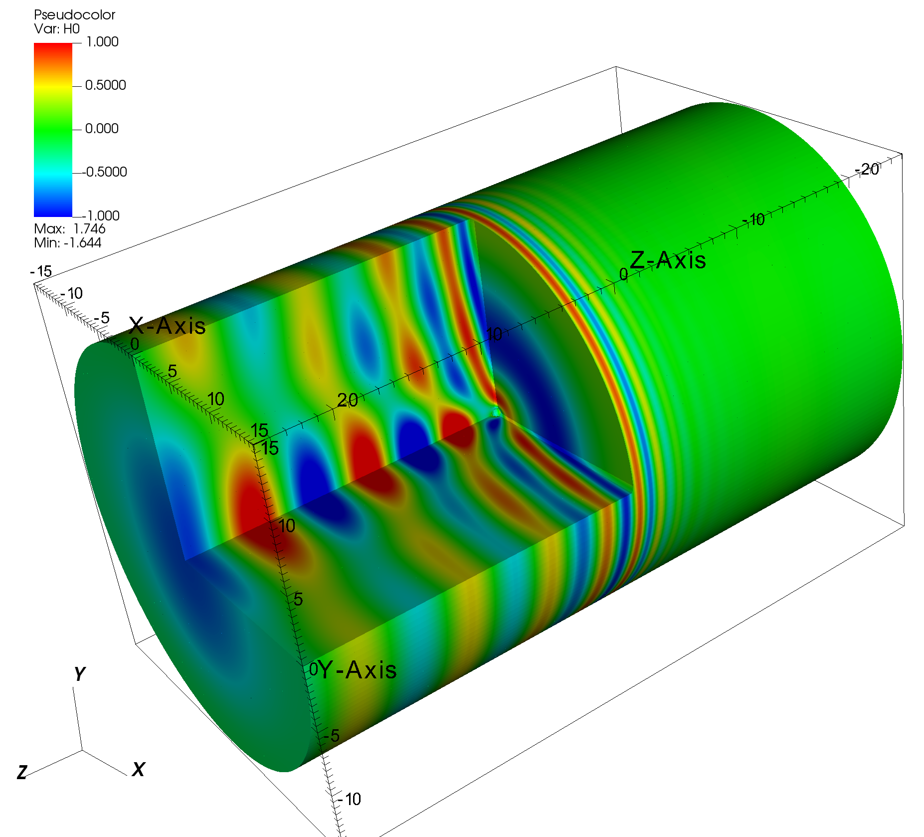
Finite element method
Simulation domain
Notes:
One advantage of the finite element method is its flexibility in adopting different shapes for the simulation domain, depending on the problem. Since the problem we are studying exhibits axial symmetry, we use a cylindrical domain in our simulations.

Slide 11
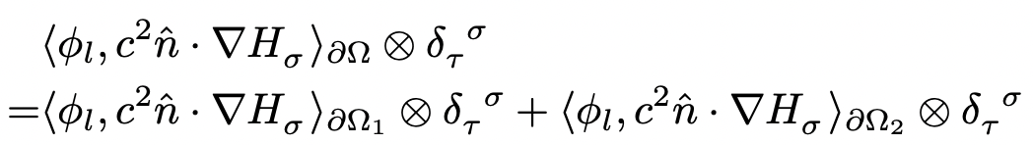
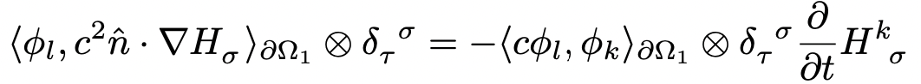
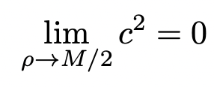
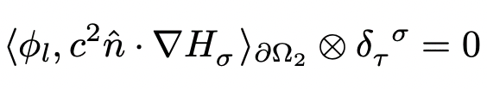
Finite element method
Boundary conditions
Absorbing boundary conditions
Boundary conditions at horizon of the black hole
Notes:
Next, we will discuss how to handle boundary conditions. In the finite element method, boundary conditions are primarily related to the Laplace term. For the outer boundary of the cylinder, we applied absorbing boundary conditions. As for the boundary of the black hole, the situation is more specific: since the wave speed in our wave equation drops to zero at the event horizon, the boundary condition for the black hole is automatically satisfied. This is an important feature of our equation.

Slide 12
Numeircal Results
Notes:
This is a comparative display between the numerical simulation results and the theoretical calculations of null geodesics. In this illustration, the red and blue lines mark the wave's front and rear, respectively, while the colored area represents the shape of the wave packet in the simulation. It is worth noting that this wave packet adopts a sinusoidal waveform and contains only one complete cycle

Slide 13
Numeircal Results
Notes:
When a wave passes through a black hole, its wavefront is significantly distorted due to the strong gravitational influence of the black hole. In particular, interference occurs in the overlapping regions.

Slide 14
Numeircal Results
Notes:
Beyond the interference phenomenon, another remarkable feature is the oscillation that emerges just after the wave tail, situated between the blue lines. These blue lines represent the trajectory of the light cone as projected in three-dimensional space. When we observe the red oscillation signals within this region, it indicates that the oscillations occur inside the light cone. The penetration of waves into the light cone during propagation is a distinct characteristic of curved space.

Slide 15
Numeircal Results
Power-law tail
Notes:
When we observe a one-dimensional signal, we notice that a tail appears behind the wave. This tail is caused by the wave entering inside the light cone. This phenomenon is known as back-scattering.

Slide 16
Numeircal Results
Continous waves
Notes:
The input wave mentioned above is a finite wave packet. When we replace the input wave source with a continuous wave of longer duration, we can observe a stable interference pattern appearing on the far side of the black hole.

Slide 17
Reallistic waveform
Notes:
The input source mentioned earlier is not a real gravitational wave source waveform. In the simulations that follow, we will use an actual gravitational wave source template for analysis. During the inspiral phase, characterized by longer wavelengths, the black hole has a minimal effect on the input wave. However, as the wave enters the ring-down phase—where its wavelength becomes comparable to the radius of the black hole‘s event horizon—the wave effects become much more pronounced. After interacting with the black hole, a distinct wave beam forms along the optical axis and continues to propagate forward.

Slide 18
Reallistic waveform
Notes:
The image displayed in front shows the waveform in three-dimensional space. However, what we are more concerned with is the time-domain waveform observed by an observer at a fixed position. In this illustration, the observer is positioned along the optical axis behind the black hole. In the diagram, the orange line represents the waveform affected by the black hole’s lensing effect, while the black line indicates the original input waveform. For comparison purposes, we have normalized the amplitude of the waveforms. It can be clearly observed that the black hole not only significantly alters the amplitude of the waveform but also causes its stretching.

Slide 19
Black hole lensing signals
Fitting factor between lensed waveform and GR templates
SEOBNRv4PHM
Spin-precesstion
Higher order multipoles
aLIGO O3 Hanford PSD
MCMC search
Notes:
In the previous content, we observed that black holes have a significant influence on incoming gravitational waves. Our next focus is whether the distinct characteristics of black holes can be detected in real-world observations. A crucial challenge in achieving this is determining whether these features overlap, or exhibit degeneracy, with the known templates from general relativity. To quantify this degeneracy, we introduce a key parameter: the fitting factor. This factor measures the similarity between two templates, where a value of 1 indicates a perfect match, and 0 means they are entirely different.
In our study, we used the effective one-body template as the reference for general relativity, incorporating the effects of precession and higher-order modes. To compute the fitting factor, we utilized the real power spectral density (PSD) data from aLiGO O3. We then performed a Markov chain Monte Carlo (MCMC) search across the full parameter space of the standard template library.
Our results reveal that when the lensing black hole’s mass is less than 100 times that of the Sun, the deviation between the features of the lensing black hole and the general relativity template is at least 5%

Slide 20
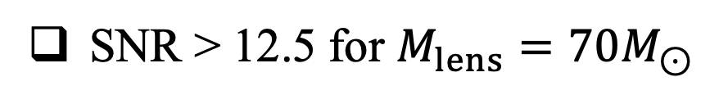
Detectability of black hole lensing
Bayes factor
SNR > 12.5 for $M_{lens}=70M_{⊙}$
Attainable for aLIGO sensitivity
Notes:
The detectability of a signal is influenced not only by the differences between templates but also by the signal-to-noise ratio (SNR), a critical factor that’s easy to grasp. When the SNR is fixed, larger differences between templates make it easier to distinguish the signal. Likewise, when the template differences are constant, a higher SNR makes signal identification easier. To quantitatively assess signal detectability, we introduce the Bayesian factor, a mathematical tool that integrates both of these key factors. The black line represents the critical value of the Bayesian factor under aLIGO's sensitivity conditions. When the signal-to-noise ratio (SNR) exceeds 12.5, we can effectively distinguish the lensing effect signal produced by a black hole with a mass of 70 times that of the Sun. It is worth noting that this SNR value is well within the sensitivity range of aLIGO

Slide 21
Summary
Due to the long range nature of gravity, wave functions in classical scattering theory are divergent along the axis of a black hole
Based on the perturbed 3+1 Einstein’s equations, we have developed a code that does not have coordinate singularities and does not need boundary conditions at the horizon of the black hole.
GWs passing through a stellar-mass black hole can leave detecable features in advanced LIGO.

