Slide 1
Quantum entanglement for gravitational-wave detectors
Yohei Nishino
University of Tokyo

Slide 2
Quantum entanglement for gravitational-wave detectors
teleportation
Yohei Nishino
University of Tokyo

Slide 3
Outline
Introduction of gravitational-wave detection
Teleportation-based Frequency-dependent squeezing

Slide 4
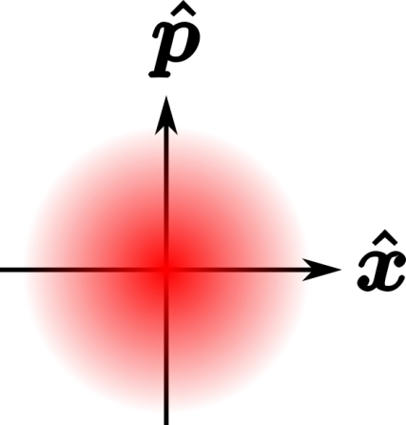
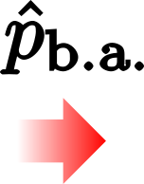
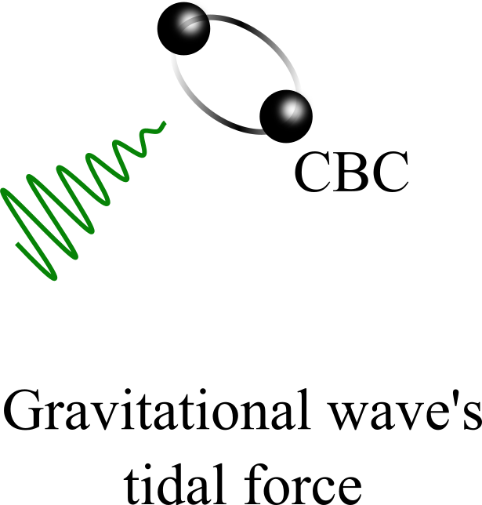
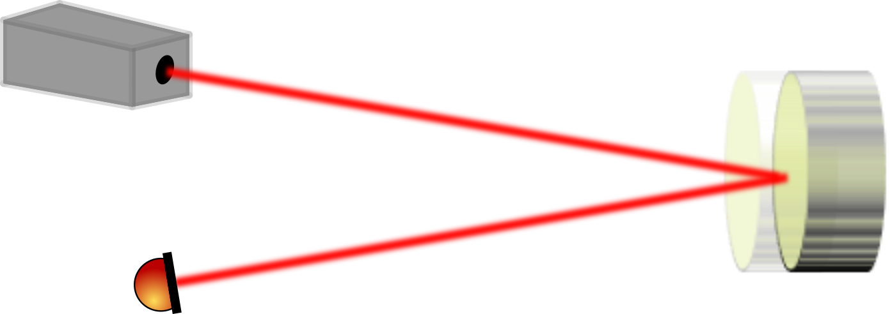

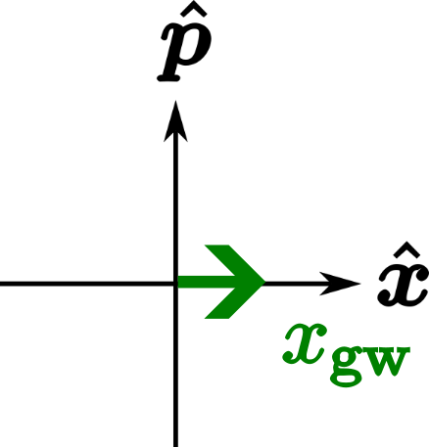
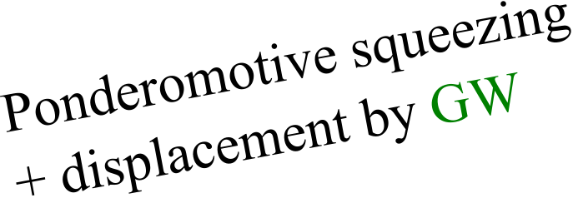
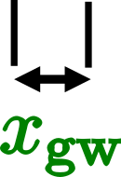


Gravitational-wave detector: measurement of tiny displacement
+
+

Slide 5
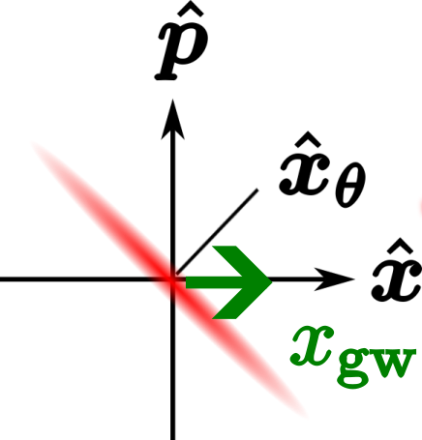
Gravitational-wave detector: measurement of tiny displacement
+
+

Slide 6

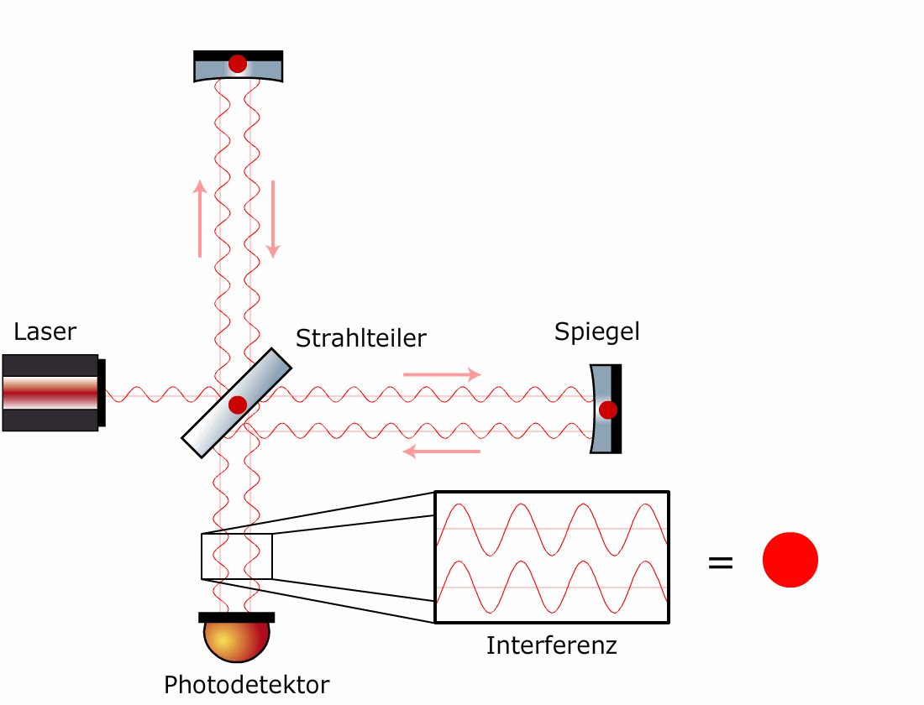


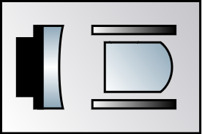


Michelson interferometer
Beam Splitter
Source laser
Mirror
Phase
Squeezer
Amp
Interference
Photo detector
Squeezed vacuum
Crédit : Harald Lück

Slide 7
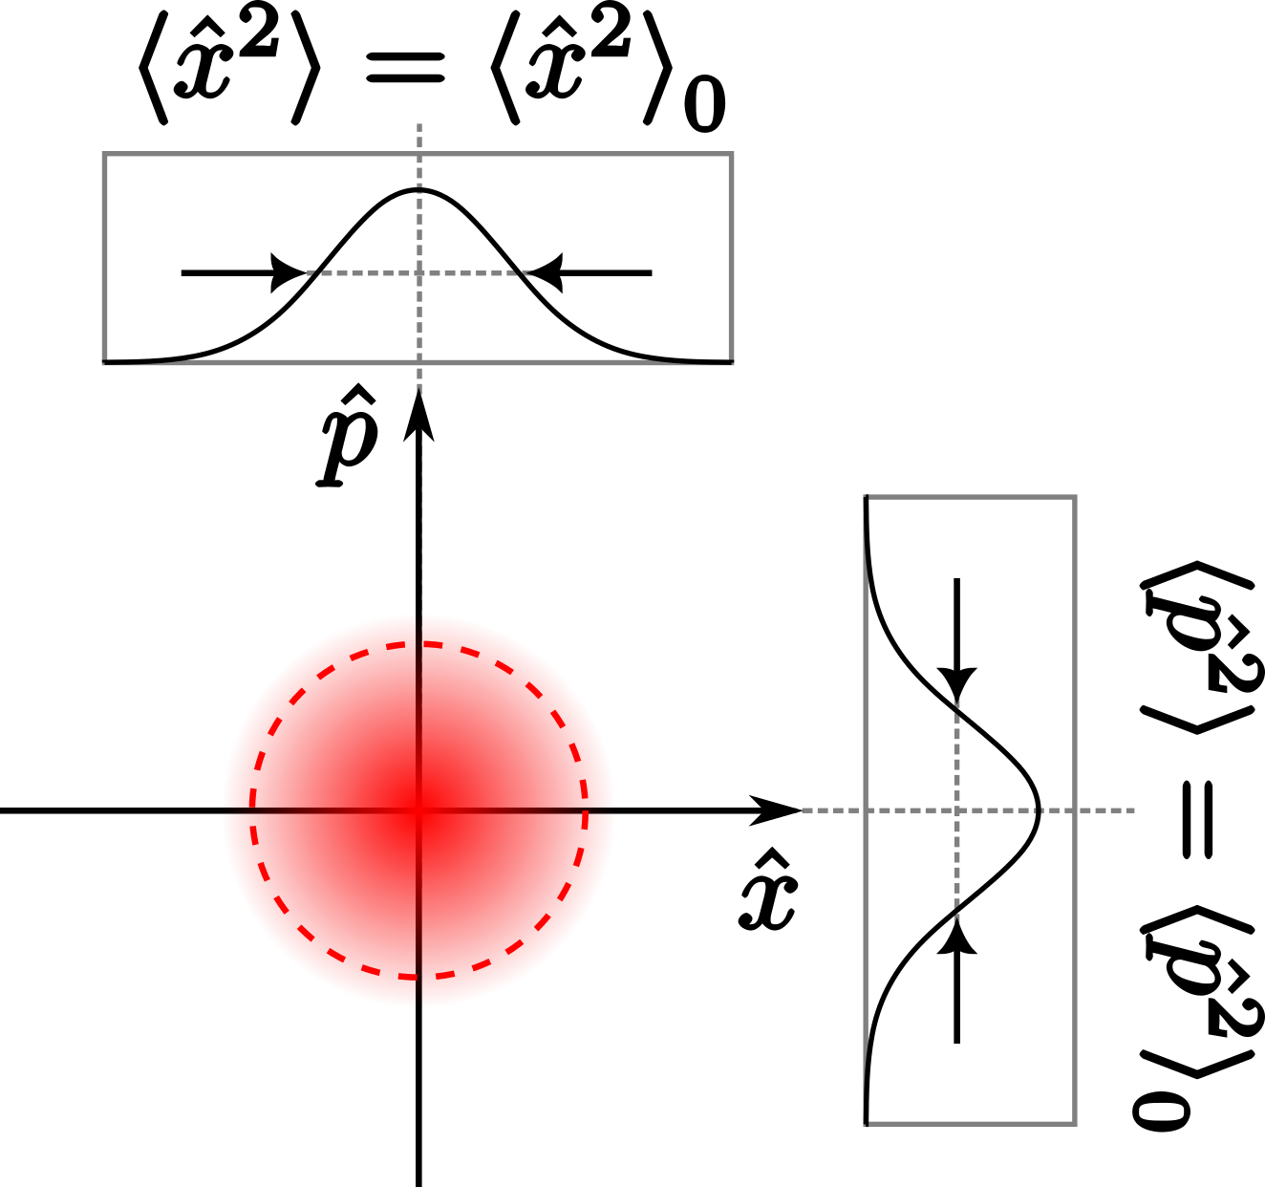
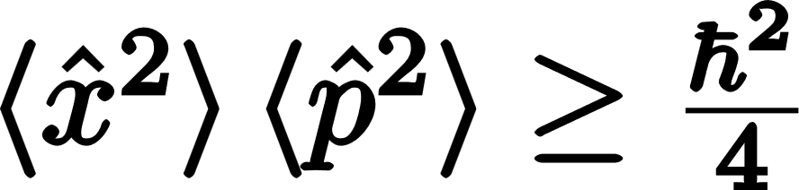
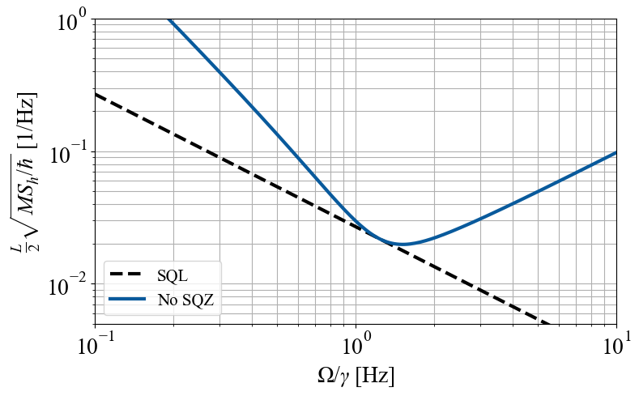
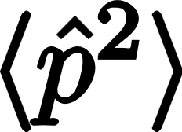
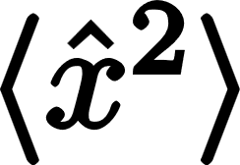

Uncertainty principle
Heisenberg’s uncertainty principle
$$h_{SQL}∝\frac{1}{\sqrt{m}L }$$
SQL

Slide 8
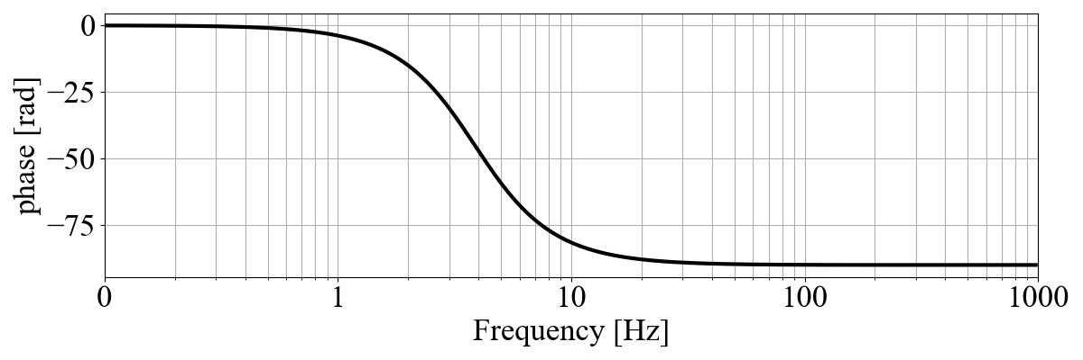
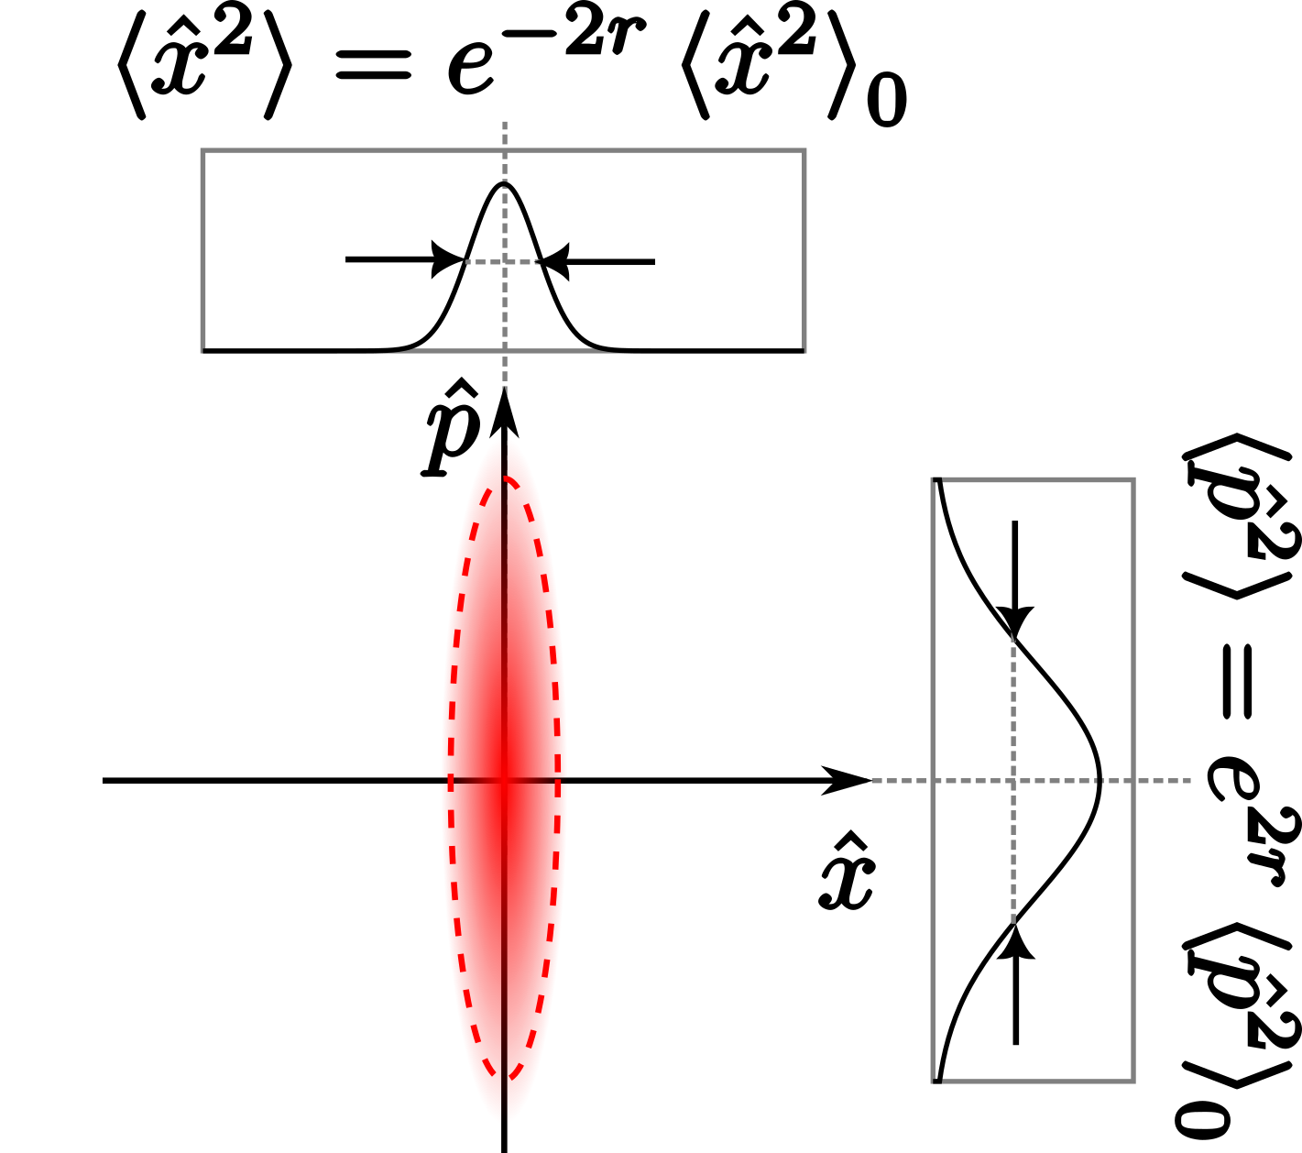
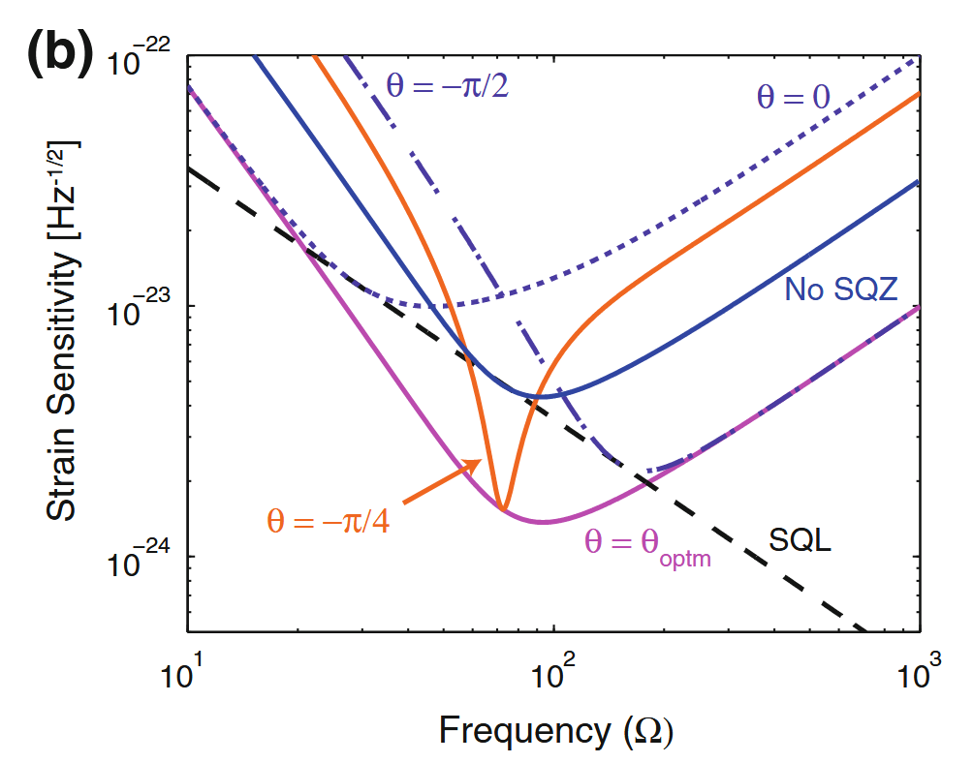
Squeezing
Frequency-dependent quadrature rotation
S. Chua’s PhD thesis

Slide 9


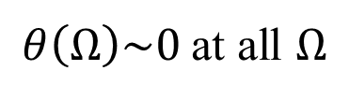
Frequency-dependent squeezing (FDS)
Frequency-dependent quadrature rotation
Filter cavity
Beating SQL wideband!
Phase
$$θ(Ω)$$
$θ\left(Ω\right)\sim 0$ at all $Ω$
Amp
S. Chua’s PhD thesis

Slide 10
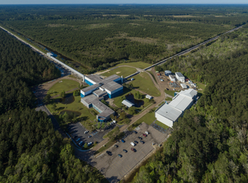
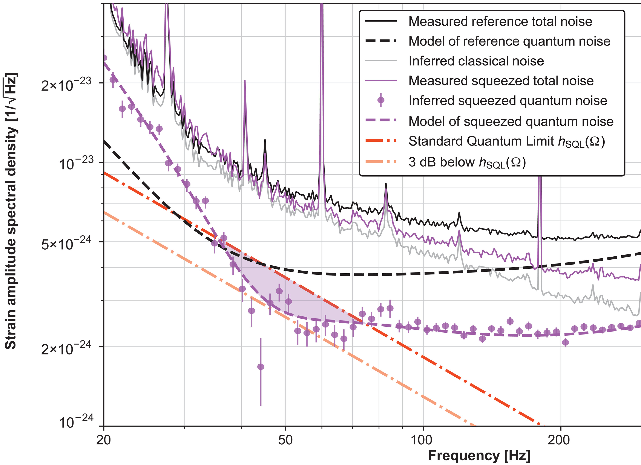
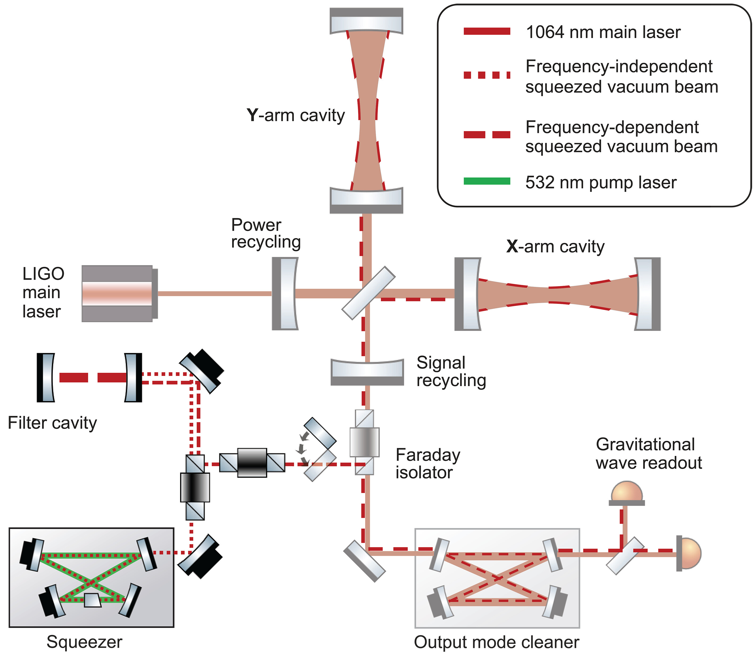
FDS demonstrated in LIGO
Science,19 Sep 2024, Vol 385, Issue 6715, pp. 1318-132
LIGO Livingstone ©Caltech/MIT/LIGO Lab

Slide 11
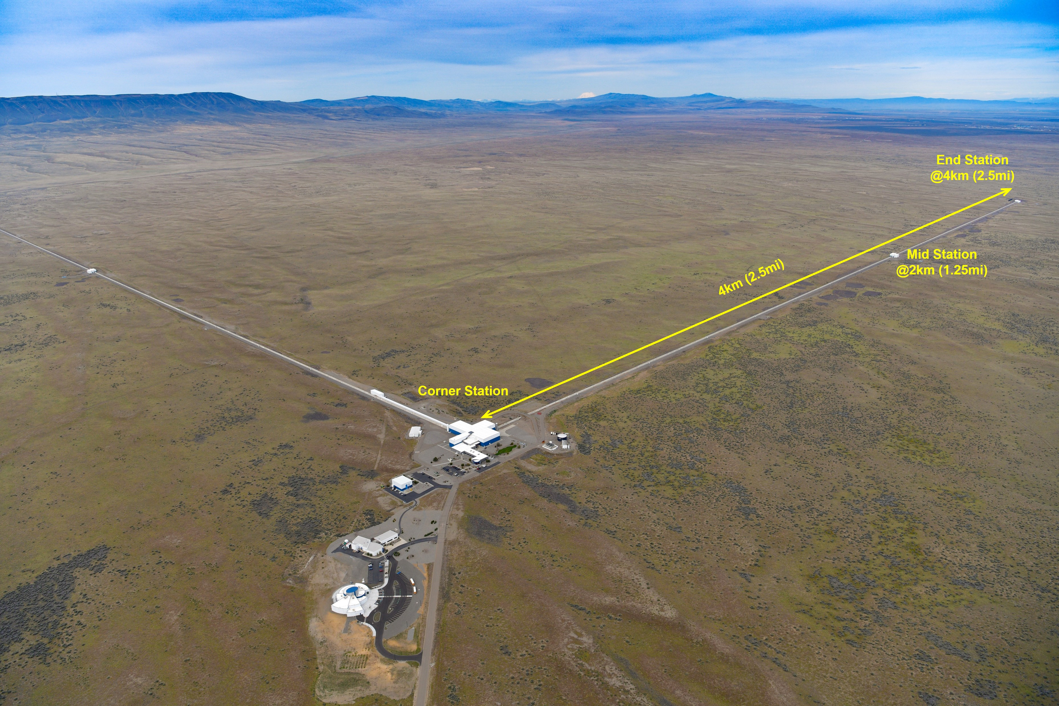
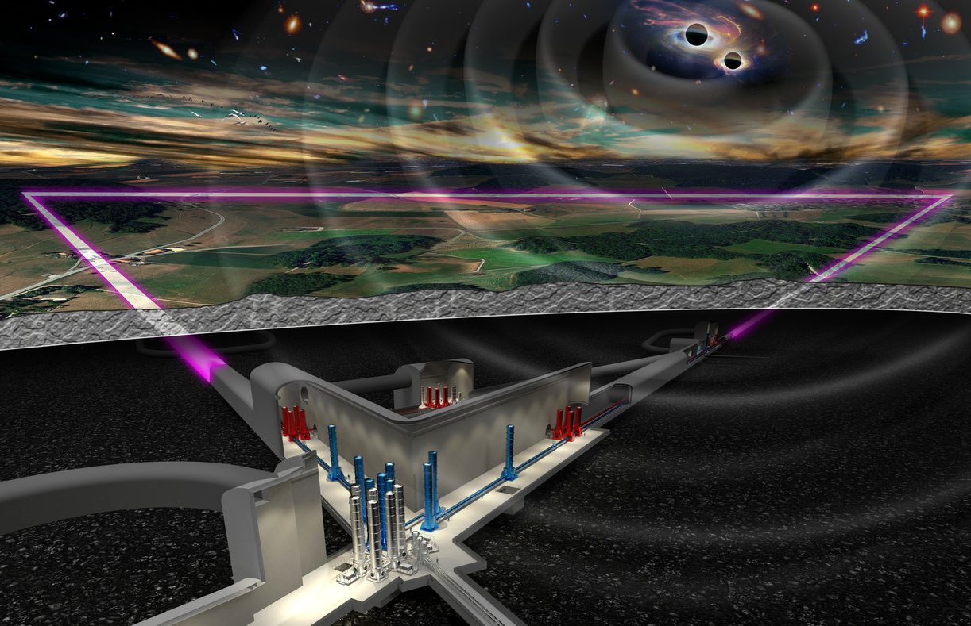
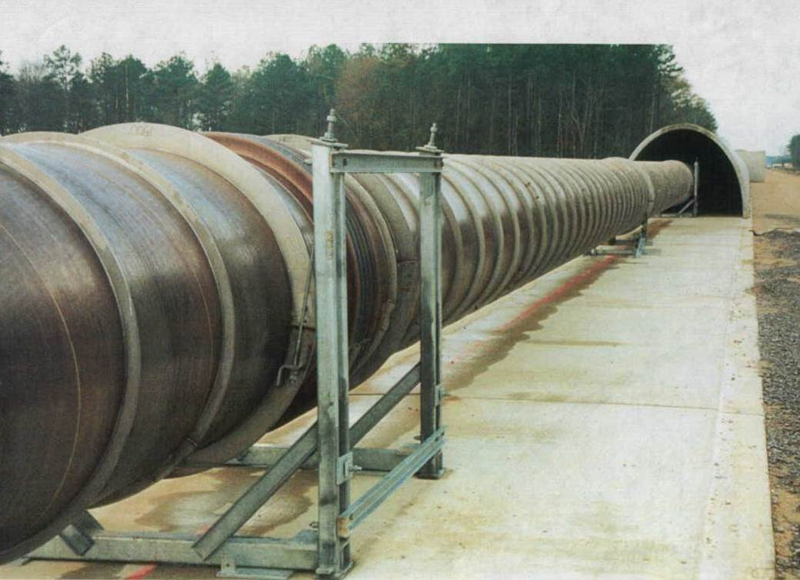
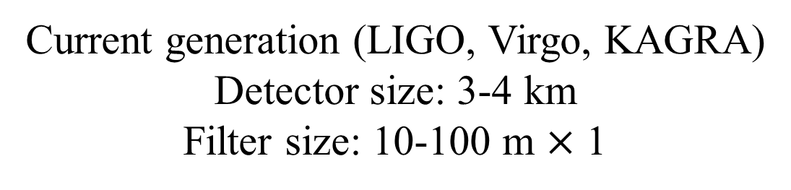
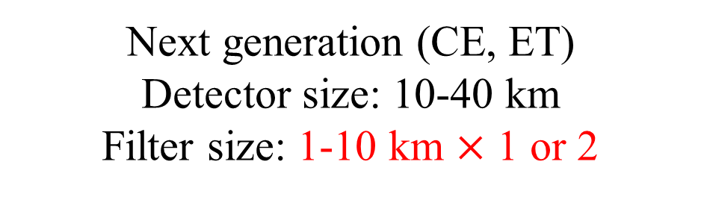
Filters cost a lot…
Current generation (LIGO, Virgo, KAGRA)
Detector size: 3-4 km
Filter size: 10-100 m $×$ 1
Next generation (CE, ET)
Detector size: 10-40 km
Filter size: 1-10 km $×$ 1 or 2
Vacuum tube
LIGO Hanford ©Caltech/MIT/LIGO Lab
©NIKEF

Slide 12
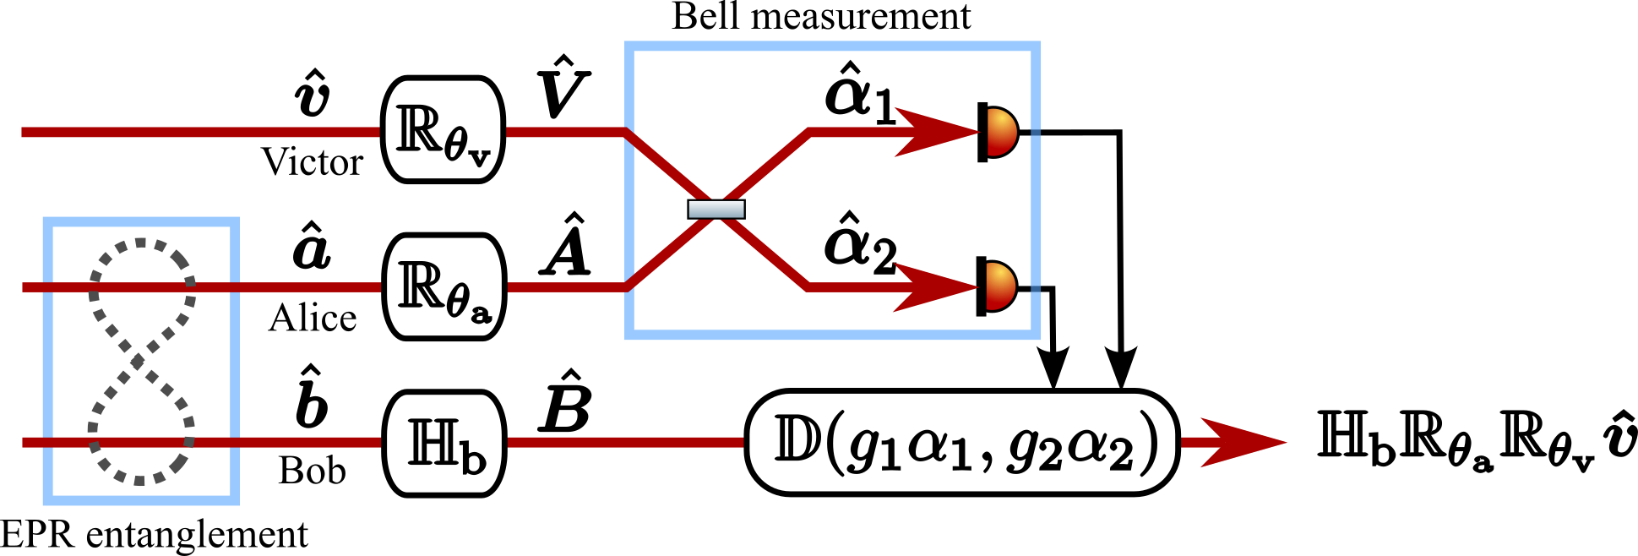
Proposal of “teleportation squeezing”
Nishino, Y., et al. PRA (2024)
Filtering!☺

Slide 13


Proposal of “teleportation squeezing”
Nishino, Y., et al. PRA (2024)
Conventional Scheme
Three cavities
Squeezed state
Filtered squeezed state
Filter
(1 km)
Filter
(1 km)
Detector (10 km)
Teleportation-based scheme
Single cavity (10 km)
Bell measurement
Filter
Beam splitter
$$g_{1}$$
Filter
$$g_{2}$$
Teleported squeezed state
Beam splitter
Detector
Disp.
EPR entanglement

Slide 14
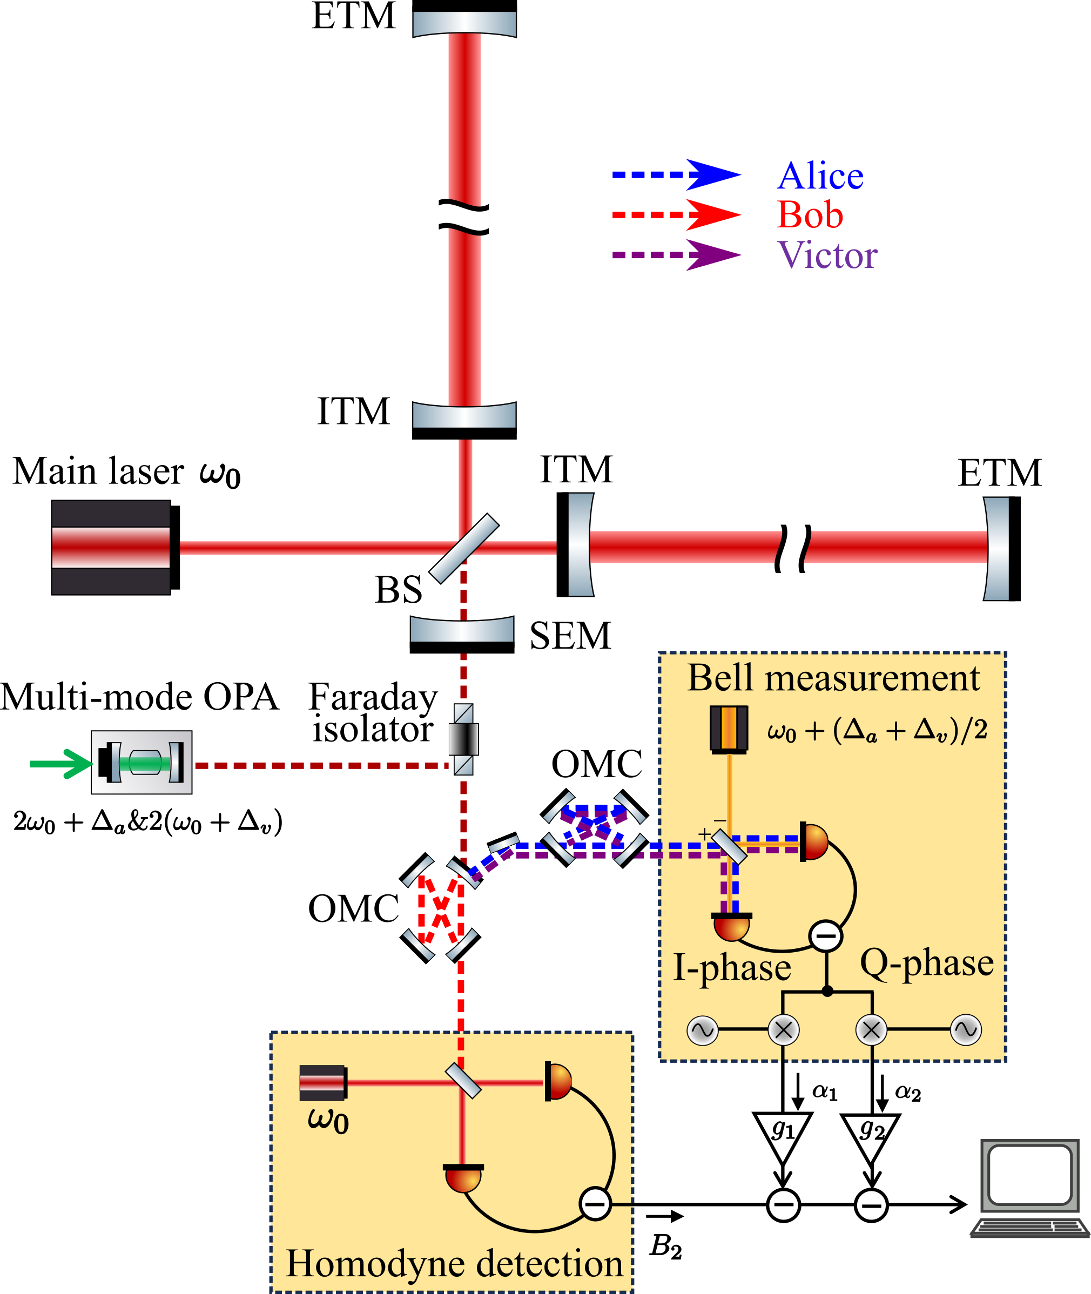
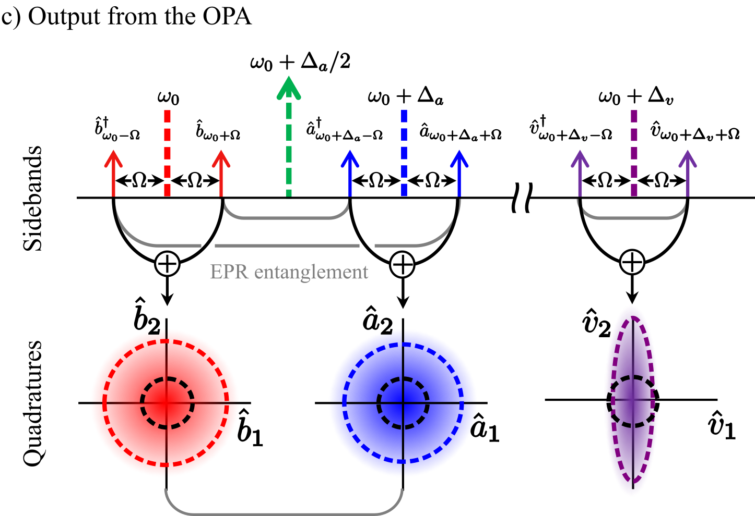
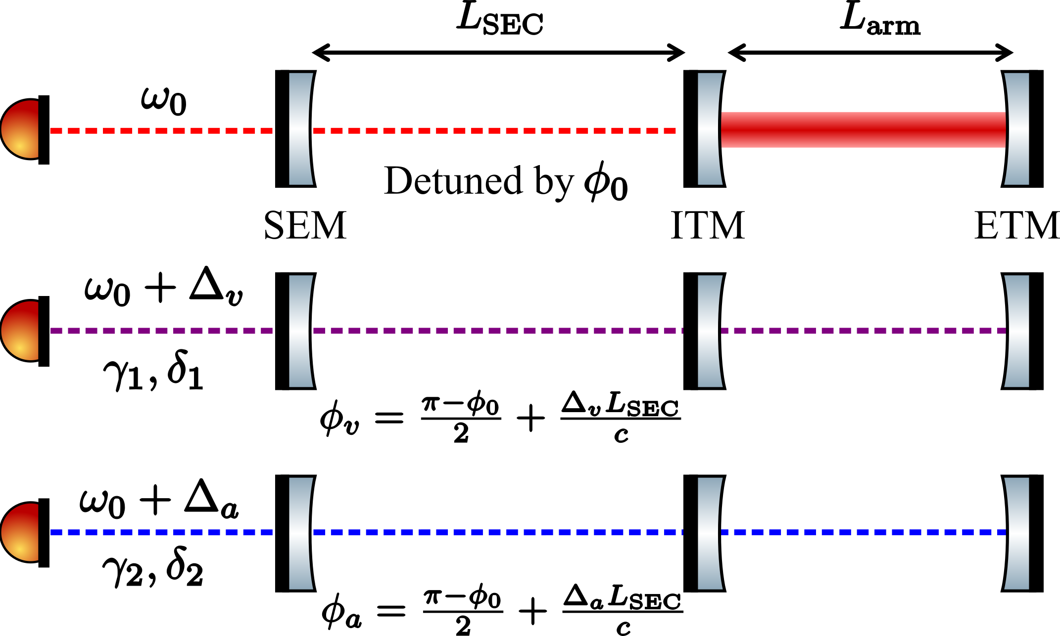
Proposal of “teleportation squeezing”
Nishino, Y., et al. PRA (2024)
Interferometer response for each field

Slide 15
Proposal of “teleportation squeezing”
Nishino, Y., et al. PRA (2024)
Interferometer response for each field

Slide 16
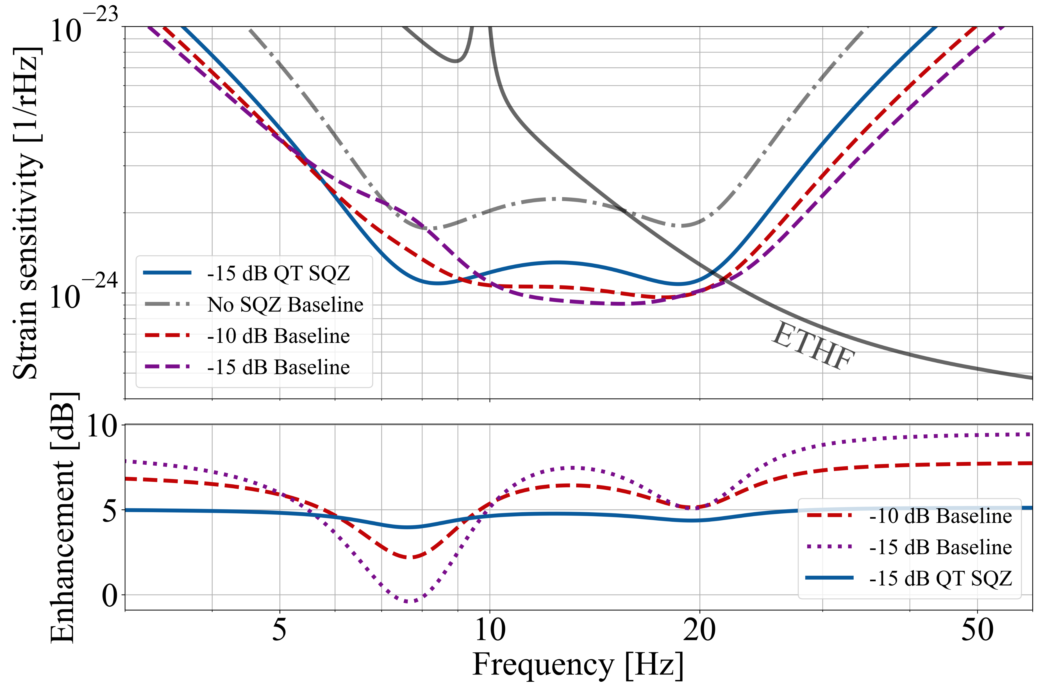
Proposal of “teleportation squeezing”
Nishino, Y., et al. PRA (2024)
Ma, Y., et al., Nature Phys 13, 776–780 (2017).
High filter performance
No need of filter cavities
Low-loss and highly stable filter
Tunable parameter
N-filter cavities
Loss

Slide 17
Summary
Quantum teleportation (QT) can help us to solve technical issues and improve detectors’ sensitivity, for example…
Squeezing angle rotations by filter cavities can be prepared through QT, reducing the infrastructure-induced costs for future detectors

Slide 18
Back up slides

Slide 19
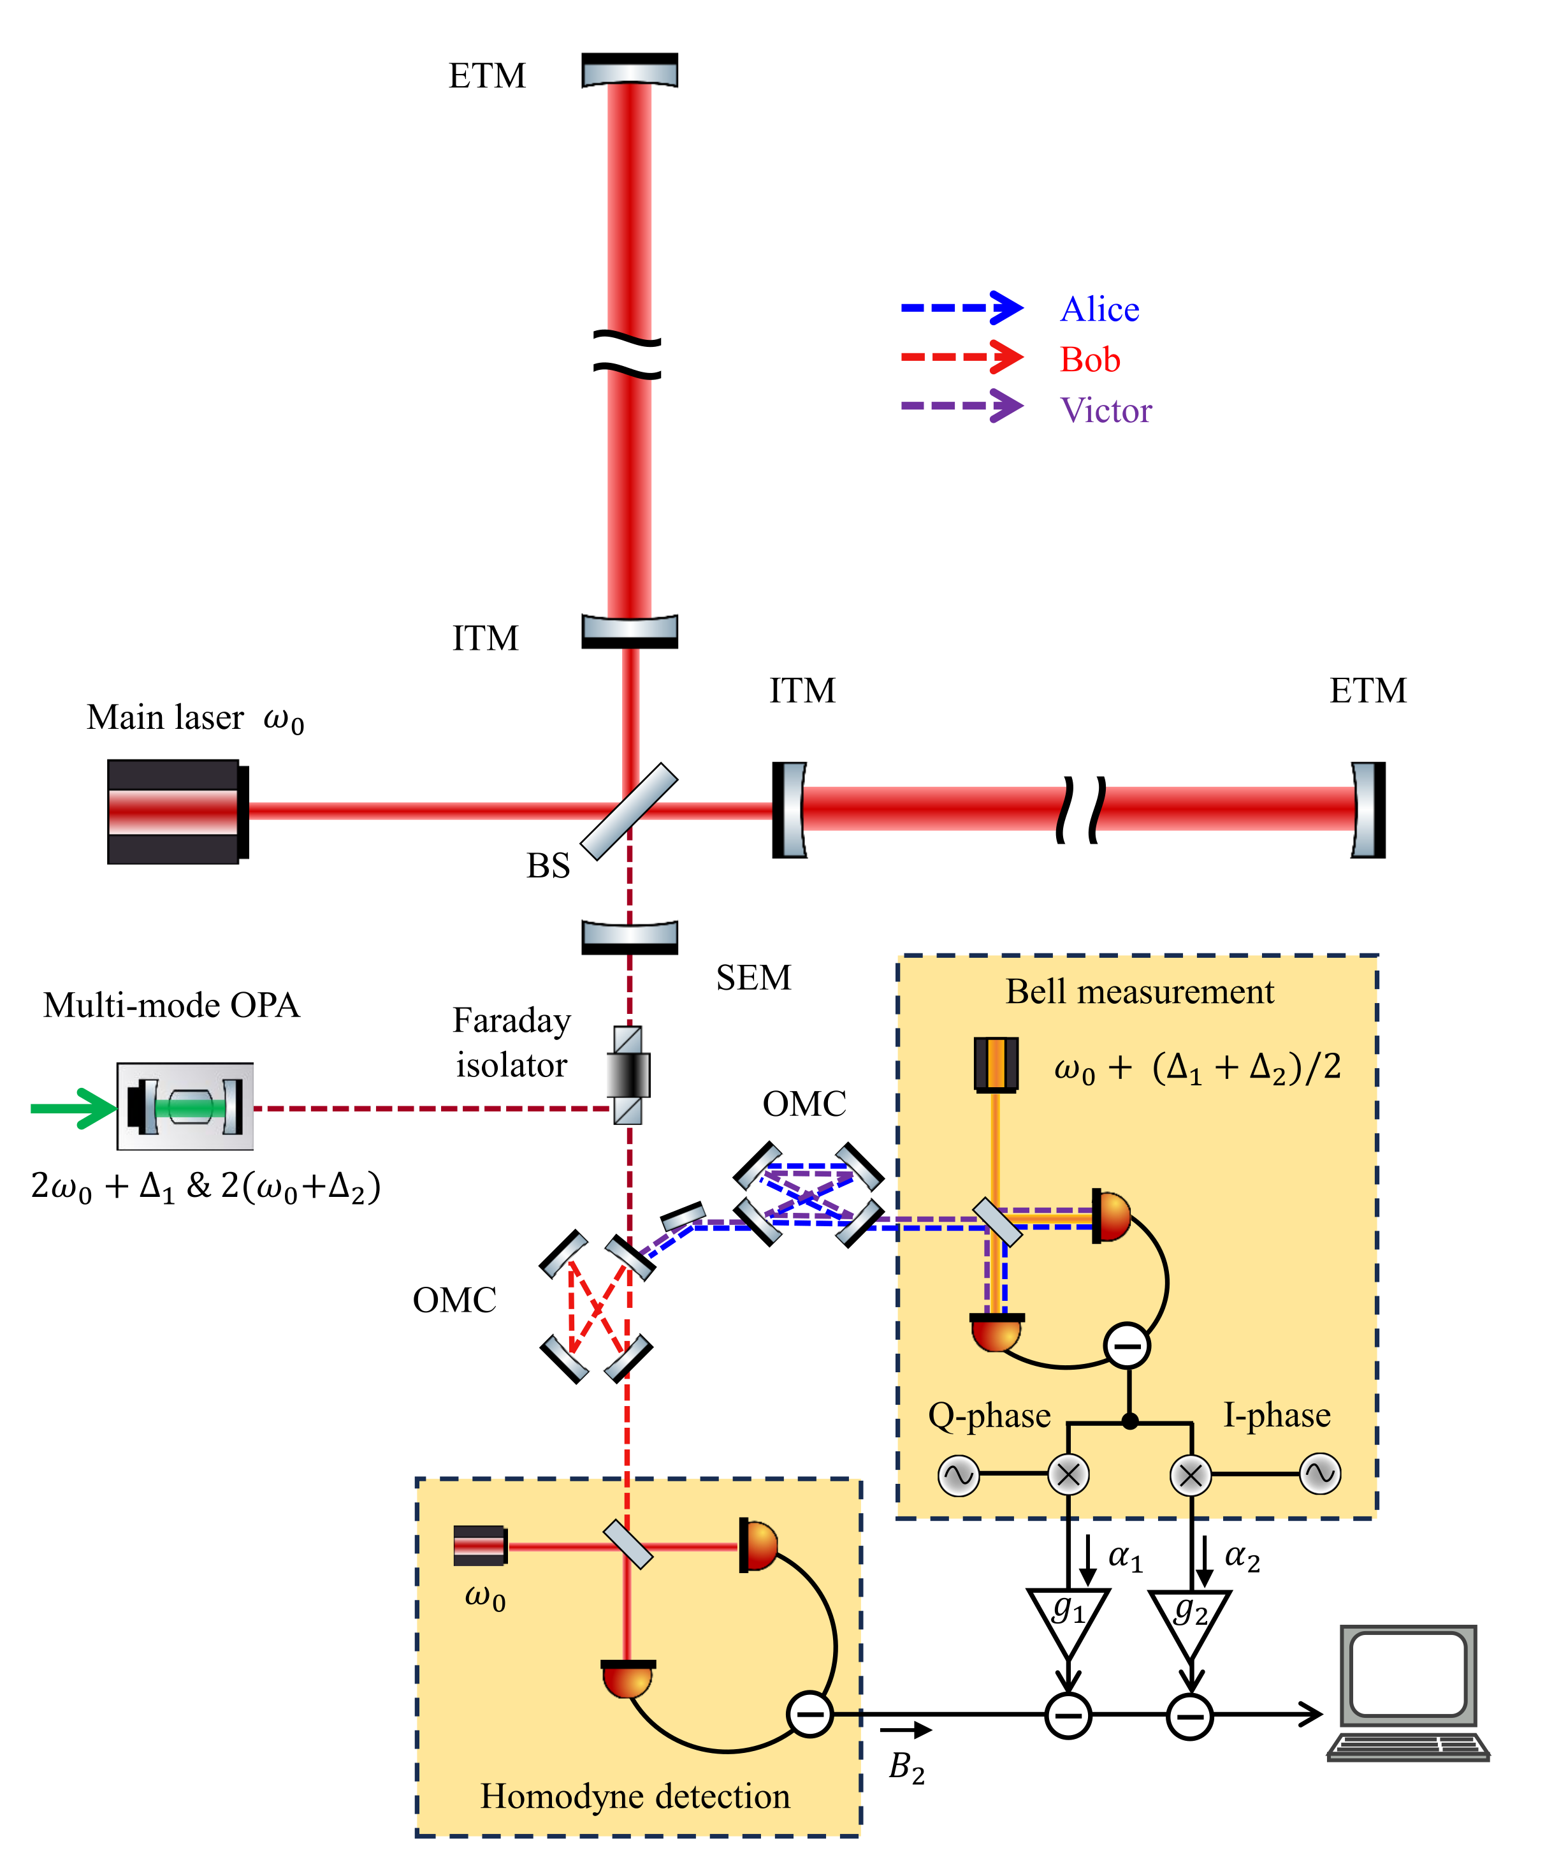
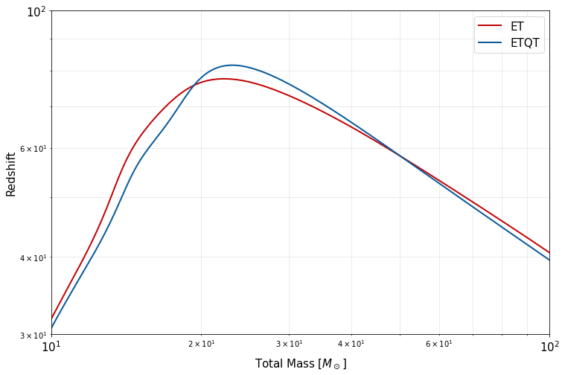

Quantum teleportation for GW detectors
Y. Nishino, S. Danilishin, Y. Enomoto, T. Zhang, Phys. Rev. A 110, 022601
80
Redshift (z)
20
30
60
Total solar mass $M_{⊙}$
Advantages II
Less noise contribution in terms of loss per unit length due to 10 km arm and low-loss mirrors.
Length stability is much better than conventional FCs

