Slide 1
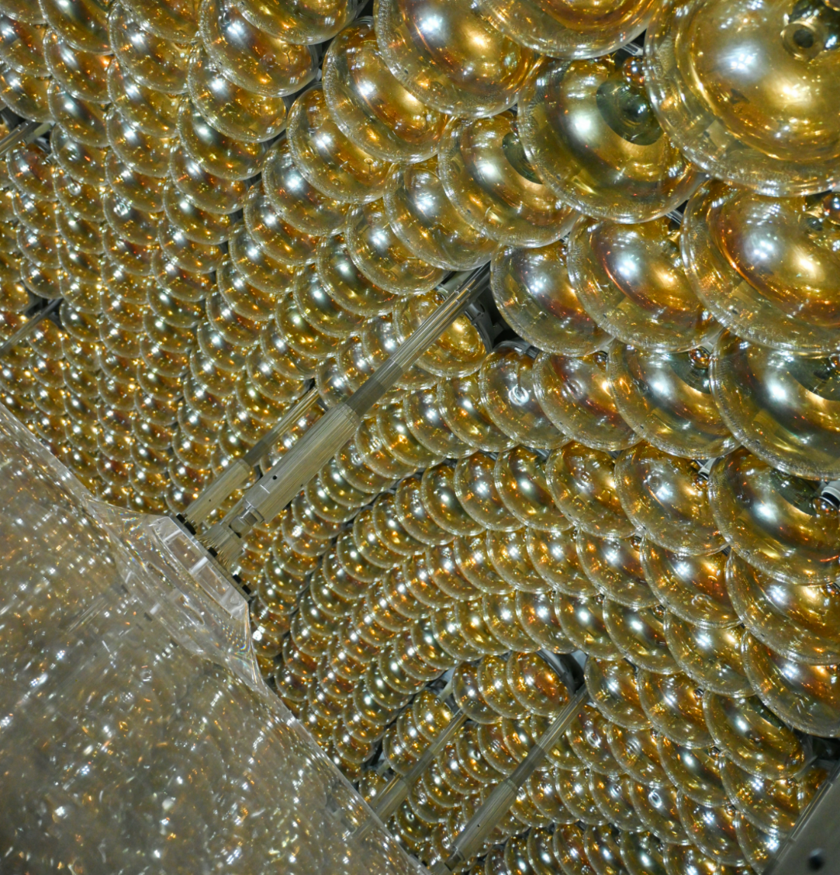


Commissioning of the JUNO Detector
Iwan Morton-Blake
On behalf of the JUNO collaboration
Tsung-Dao Lee Institute,
Shanghai Jiao Tong University
TAUP 2025 in Xichang, China

Slide 2
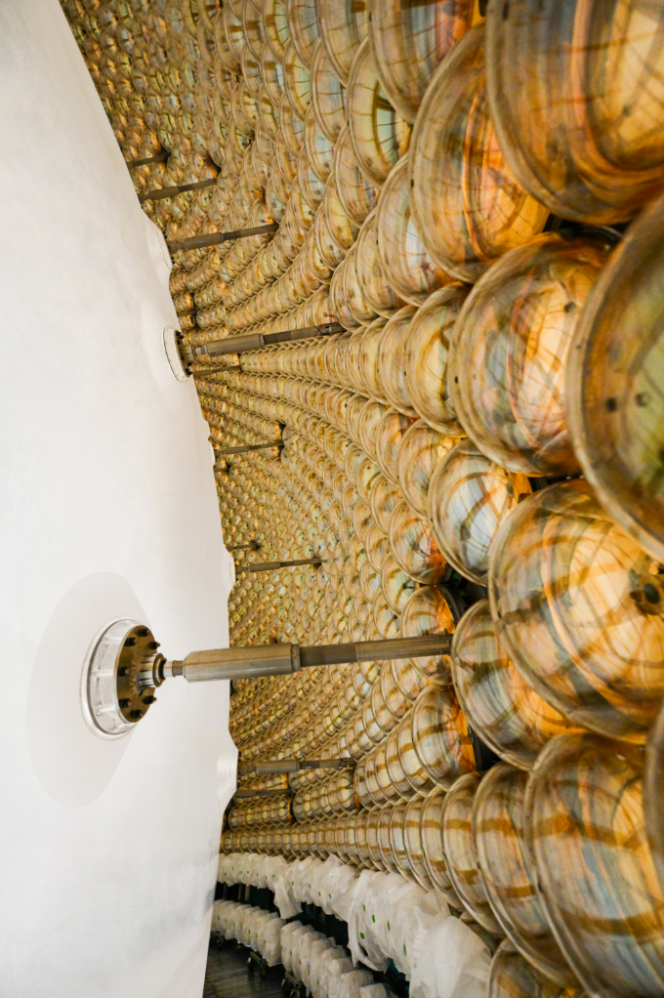
CONTENTS
01 ___
02
03
The JUNO Experiment
Detector Commissioning
Ahead
ichang | Iwan Morton-Blake

Slide 3
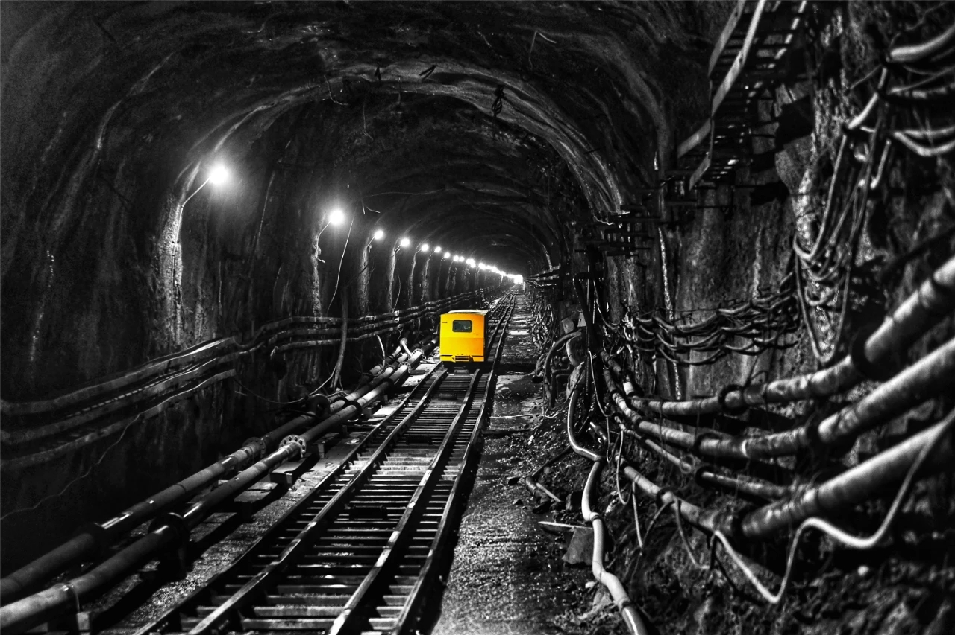
The JUNO Detector

Slide 4
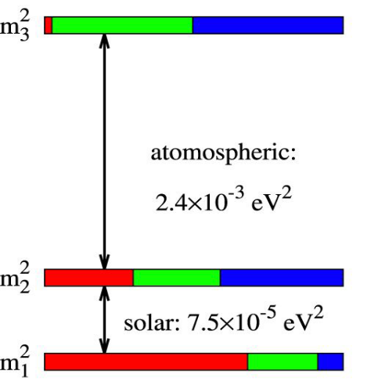
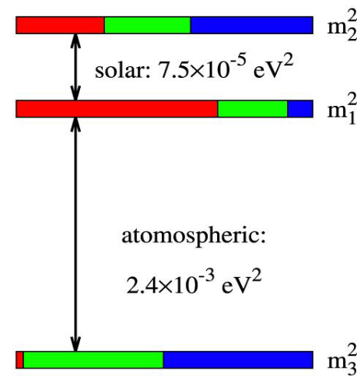

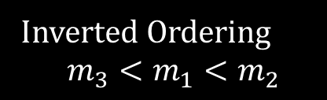
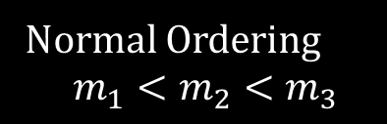
JUNO Physics Goals
Determine Neutrino Mass Ordering (NMO)
Precisely determine oscillation parameters $Δm_{31}^{2},Δm_{21}^{2}$and $sin2θ_{12}$
atmospheric:
atmospheric:
Normal Ordering
$$m_{1}<m_{2}<m_{3}$$
Inverted Ordering
$$m_{3}<m_{1}<m_{2}$$

Slide 5
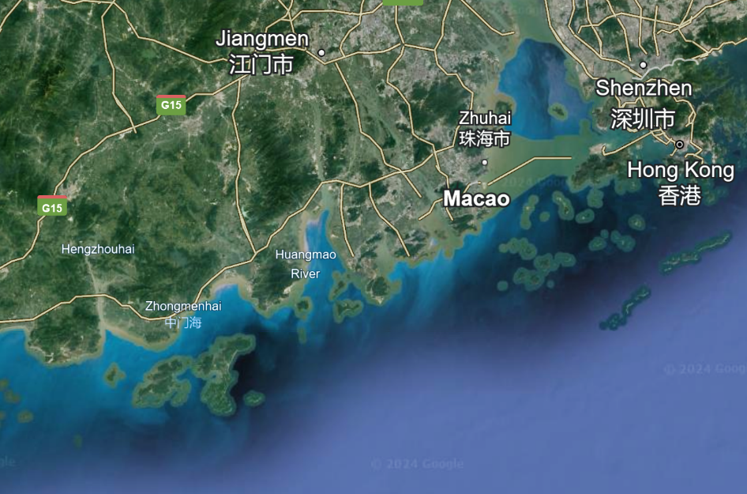
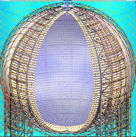
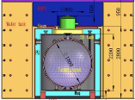

JUNO : Reactor Neutrinos
JUNO
JUNO TAO
JUNO’s nearest nuclear reactors
53km
53km
Screenshot Google Earth 2024
“Status and Prospect of JUNO-TAO” – Ruhui Li

Slide 6


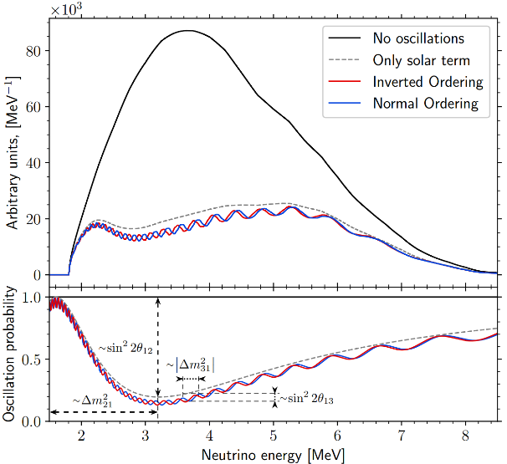
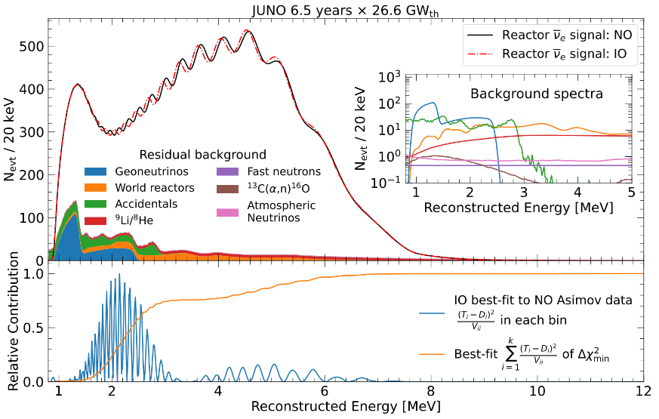
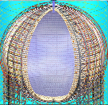



JUNO : Reactor Neutrinos
“Potential to Identify the Neutrino Mass Ordering with Reactor Antineutrinos in JUNO,” Chinese Phys. C 49, (2025)
“Sub-percent precision measurement of neutrino oscillation parameters with JUNO,” Chin. Phys. C 46 (2022)
Reactor ${\overline{ν}}_{e}$ Energy Spectrum
Expected Reconstructed Energy Spectrum
Detector Response
$$P_{{\overline{ν}}_{e}→{\overline{ν}}_{e}}=1−\sin^{2}{2θ_{13}}(\cos^{2}{θ_{12}\sin^{2}{Δ_{31}+\sin^{2}{θ_{12}\sin^{2}{Δ_{32})}}}}−\cos^{4}{θ_{13}\sin^{2}{2θ_{12}\sin^{2}{Δ_{21}}}}$$
No $δ_{CP}, θ_{23}$ dependency
$$Δ_{ij}=\frac{Δm_{ij}^{2}L}{4E}$$

Slide 7

JUNO : Reactor Neutrinos
“Potential to Identify the Neutrino Mass Ordering with Reactor Antineutrinos in JUNO,” Chinese Phys. C 49, (2025)
“Sub-percent precision measurement of neutrino oscillation parameters with JUNO,” Chin. Phys. C 46 (2022)
Reactor ${\overline{ν}}_{e}$ Energy Spectrum
Expected Reconstructed Energy Spectrum
Detector Response
JUNO Goals:
Separate NO vs IO
Precisely measure $Δm_{31}^{2},Δm_{21}^{2}\text{and} sin2θ_{12}$

Slide 8
JUNO : Reactor Neutrinos
“Potential to Identify the Neutrino Mass Ordering with Reactor Antineutrinos in JUNO,” Chinese Phys. C 49, (2025)
“Sub-percent precision measurement of neutrino oscillation parameters with JUNO,” Chin. Phys. C 46 (2022)
Reactor ${\overline{ν}}_{e}$ Energy Spectrum
Expected Reconstructed Energy Spectrum
Detector Response
Excellent Energy Resolution
Needed to resolve fine oscillation structure
JUNO Goals:
Separate NO vs IO
Precisely measure $Δm_{31}^{2},Δm_{21}^{2}\text{and} sin2θ_{12}$

Slide 9
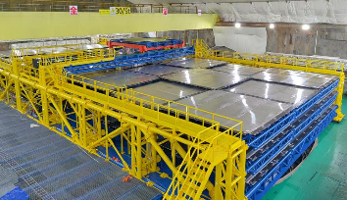
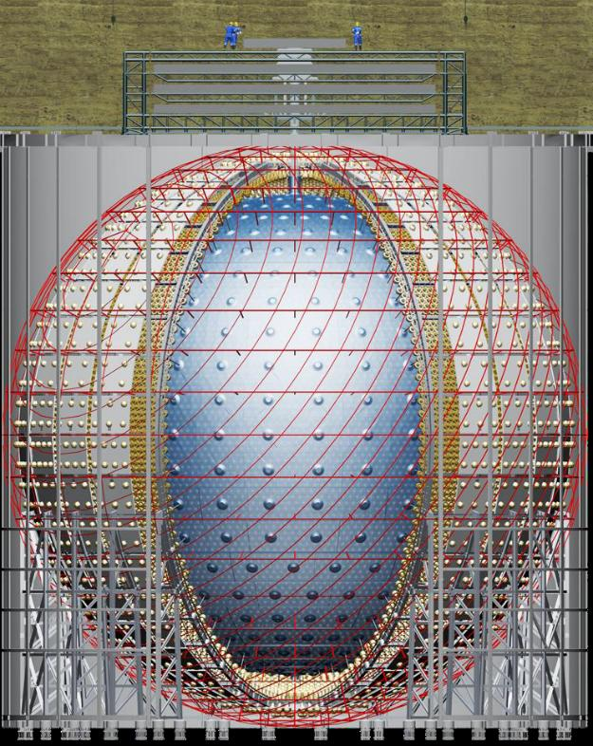
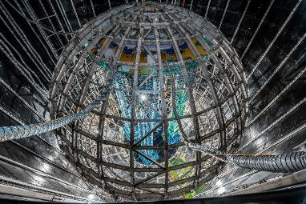
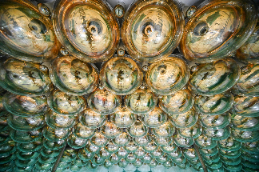
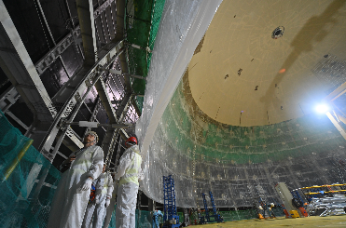
The JUNO Detector
μ
~650m
overburden
Top Tracker
Plastic scintillator layers
Outer Cherenkov Detector
35 kilotons ultrapure water
>2500 20” PMTs
PMTs
17,596 20” + 25,600 3”
17.7m
Acrylic Vessel
17.7 m in radius
20 kilotons of liquid scintillator
LAB + 2.5 g/L PPO + 3 mg/L bis-MSB
“Characterization of the JUNO Liquid Scintillator with Proton and Carbon Beams” – Ulrike Fahrendholz

Slide 10

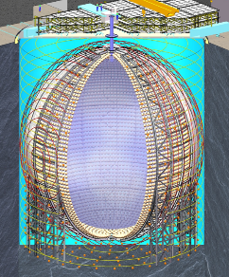
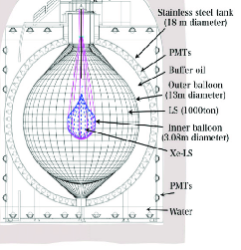
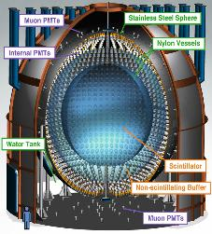
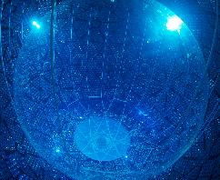
JUNO : Detector Comparison
“Prediction of Energy Resolution in the JUNO Experiment”, Chinese Phys. C 49, No. 1 (2025)
JUNO:
Energy Resolution
< 3% @ 1MeV
 | KamLAND [1] | Borexino [2] | SNO+ [3] | JUNO
Target Mass [kilotons] | 1.0 | 0.3 | 0.78 | 20
Number of PMTs | 1900 | 2200 | 10,000 | 17,596 + 25,600
PMT Coverage | ~34% | ~30% | ~50% | 78%
Light Collection [photoelectrons/MeV] | ~250 | ~450 | ~520 | >1600

Slide 11


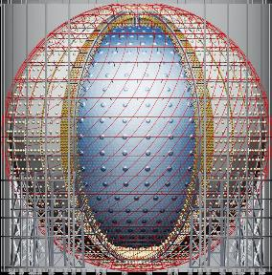
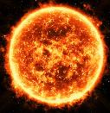
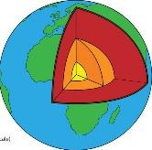
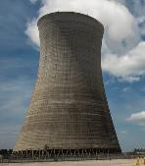
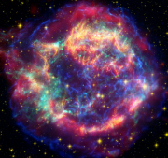

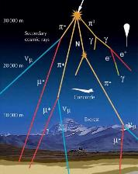
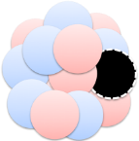
Neutrino Sources
“Physics potential of detecting solar neutrinos at JUNO” – Marco Beretta
Solar
10¹⁰
Geoneutrinos
Reactor
Flux [cm⁻² s⁻¹ sr⁻¹ MeV⁻¹]
1
Supernova
10⁻¹⁰
Atmospheric
10⁻²⁰
JUNO
Sensitivity
O(10keV) – O(10GeV)
+Exotic Searches
“R&D program for neutrinoless double beta decay search at JUNO” - Gaosong Li
keV GeV PeV

Slide 12
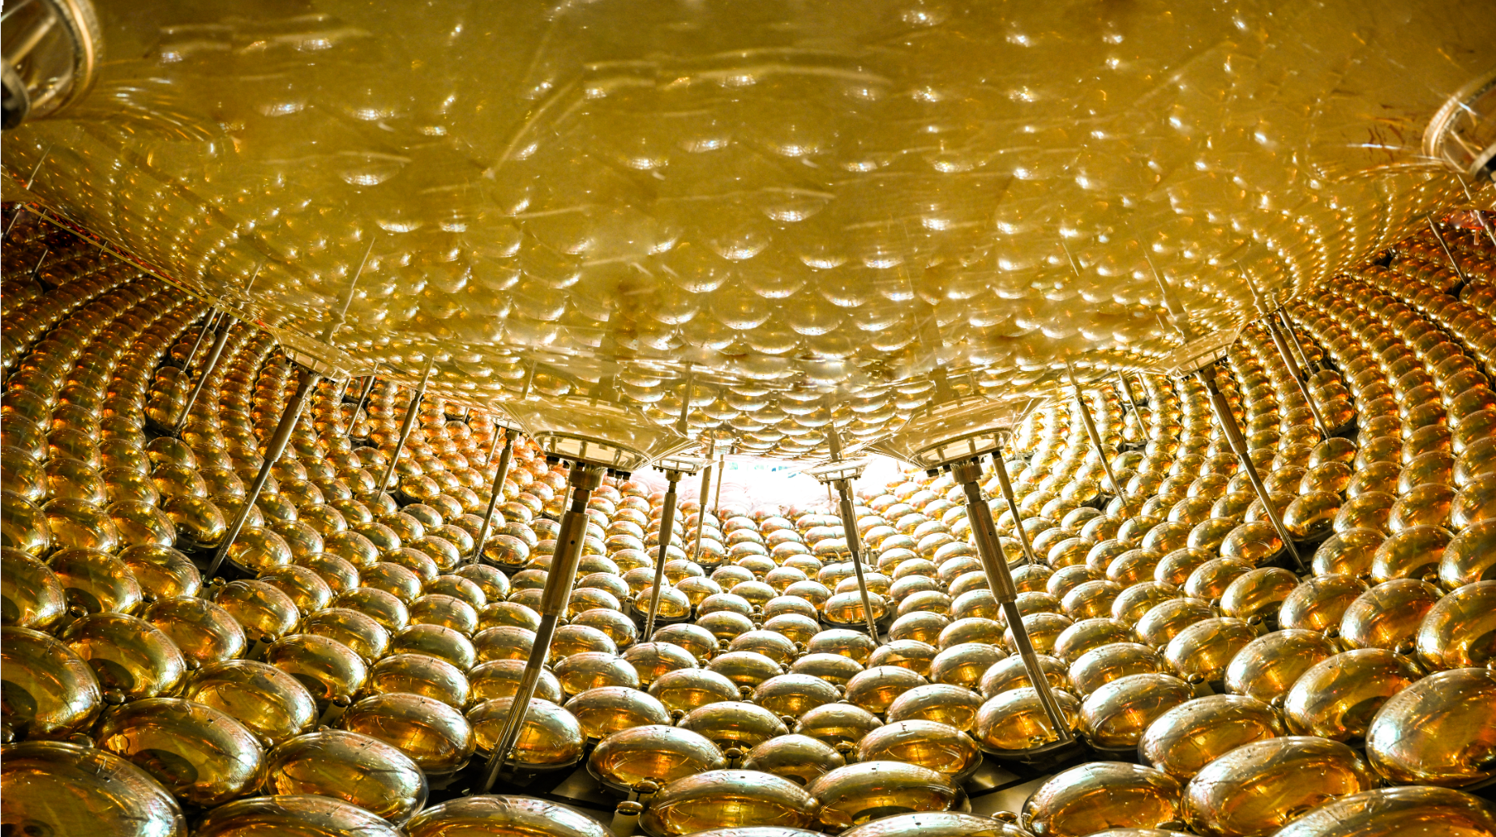
Detector Commissioning

Slide 13
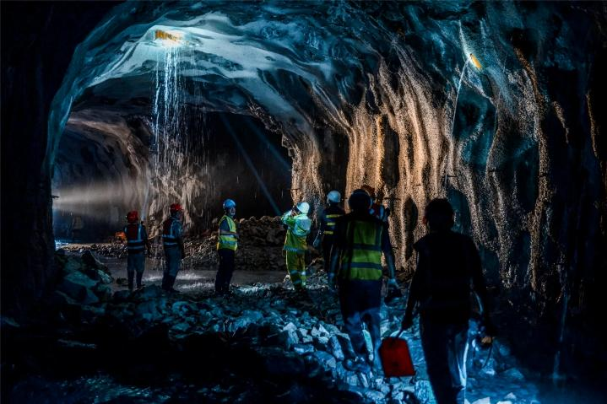
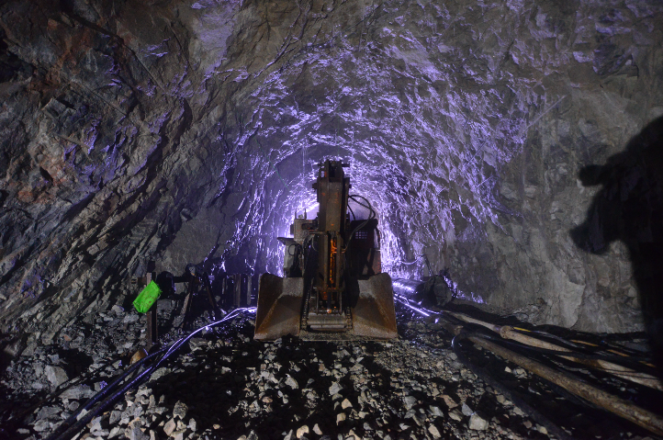
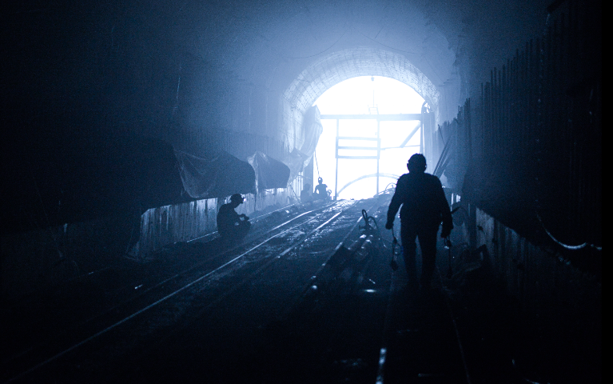
Commissioning
→ Project begins
→ Ground breaking
2013
Jan
2015

Slide 14
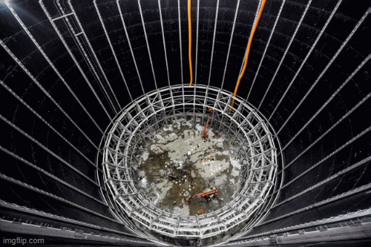
Commissioning
→ Project begins
→ Ground breaking
→ Detector installation
→ Installation complete
2013
Jan
2015
2022
2024
Evolution of detector installation (animated gif)

Slide 15
Commissioning
→ Project begins
→ Ground breaking
→ Detector installation
→ Installation complete
2013
Jan
2015
2022
2024
Checking the acrylic surface prior to filling

Slide 16
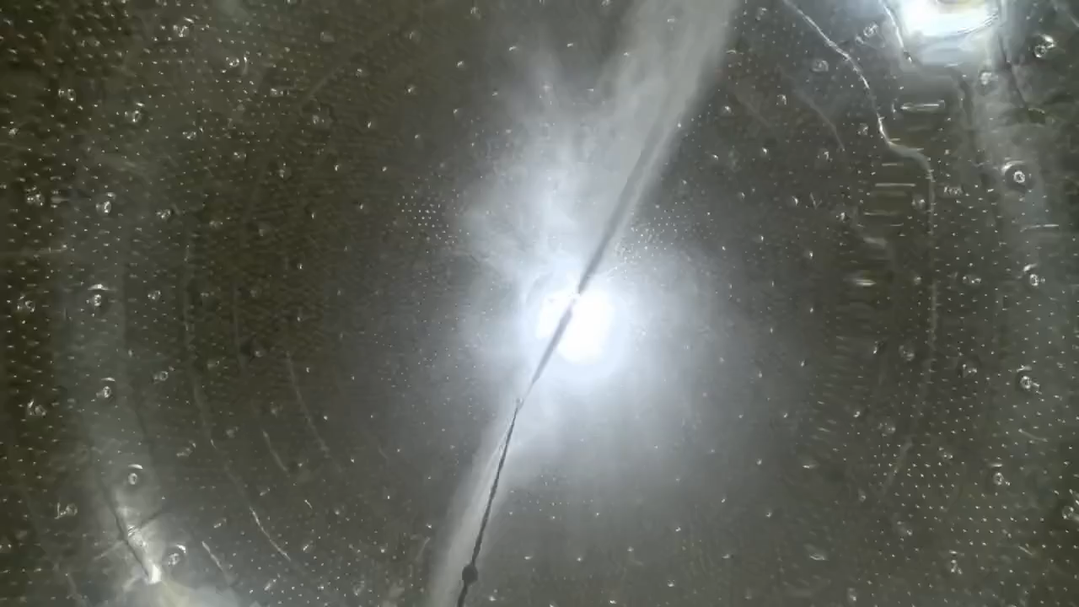
Commissioning
→ Project begins
→ Ground breaking
→ Detector installation
→ Installation complete
2013
Jan
2015
2022
2024
Cleaning the inner surface of the acrylic vessel (x2.5 speed)

Slide 17
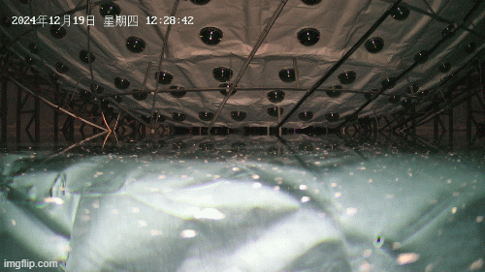
Commissioning
→ Project begins
→ Ground breaking
→ Detector installation
→ Installation complete
→ Water fill starts
2013
Jan
2015
2022
2024
Dec 18
2024
Filling of water pool (animated gif)

Slide 18
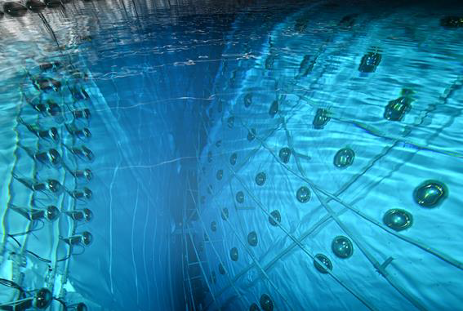
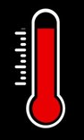
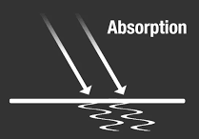

Commissioning
→ Project begins
→ Ground breaking
→ Detector installation
→ Installation complete
→ Water fill starts
→ Water filling complete
2013
Jan
2015
2022
2024
Dec 18
2024
Water pool, muon veto region
Temperature control: 21 ± 1℃.
Water attenuation length: ~60m
U/Th concentration < 0.4 x 10⁻¹⁵ g/g_{water}
Muon detection in WP (through CD) ~99.9%
Feb 1
2025

Slide 19
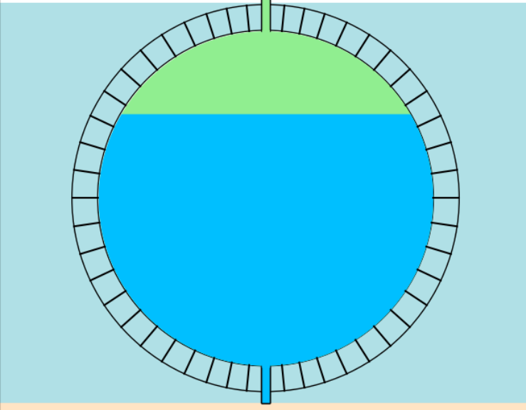
Commissioning
~7 days of Pure Water Phase
First tests of full detector chain
→ Project begins
→ Ground breaking
→ Detector installation
→ Installation complete
→ Water fill starts
→ Water filling complete
2013
Jan
2015
JUNO needs high light collection in liquid scintillator
Test: Can see a low energy threshold in water?
E.g. neutron capture on Hydrogen (2.2 MeV γ)?
2022
2024
Dec 18
2024
Liquid Scintillator : 1 MeV e⁻ → ~1700 p.e.
Water : 2.2 MeV γ → ~15-30 p.e.
Difficult to detect!
O(10kHz) dark noise each PMT in early data
Feb 1
2025
Used JUNO’s dedicated low-energy Multi-Messenger trigger [4]

Slide 20
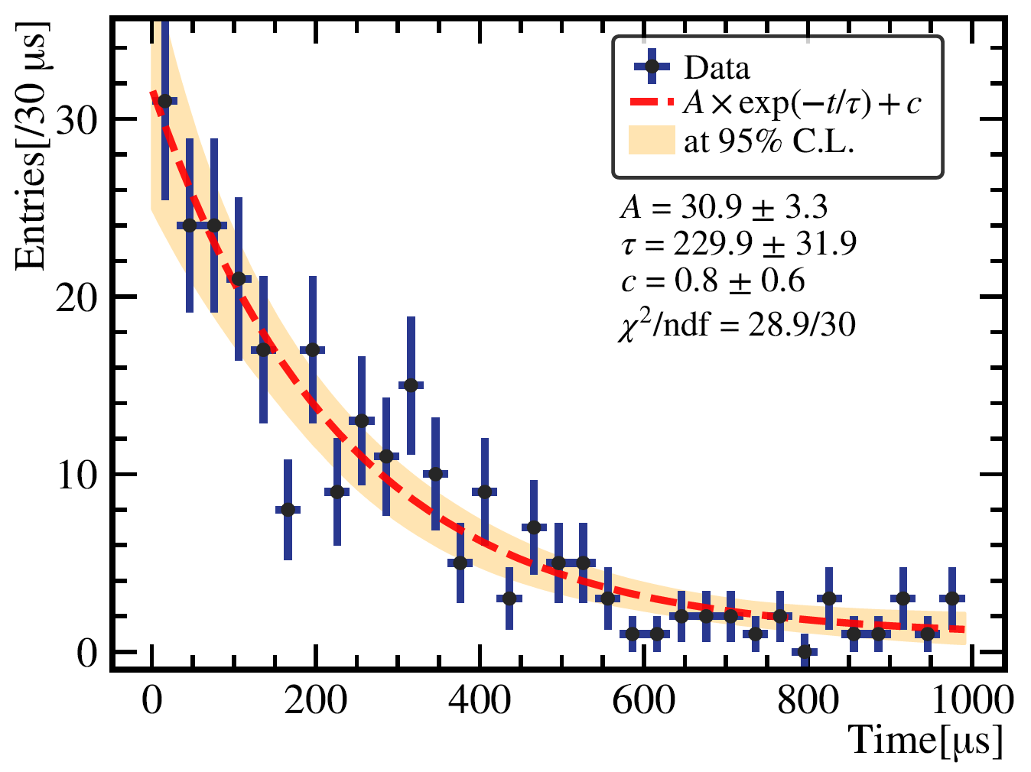
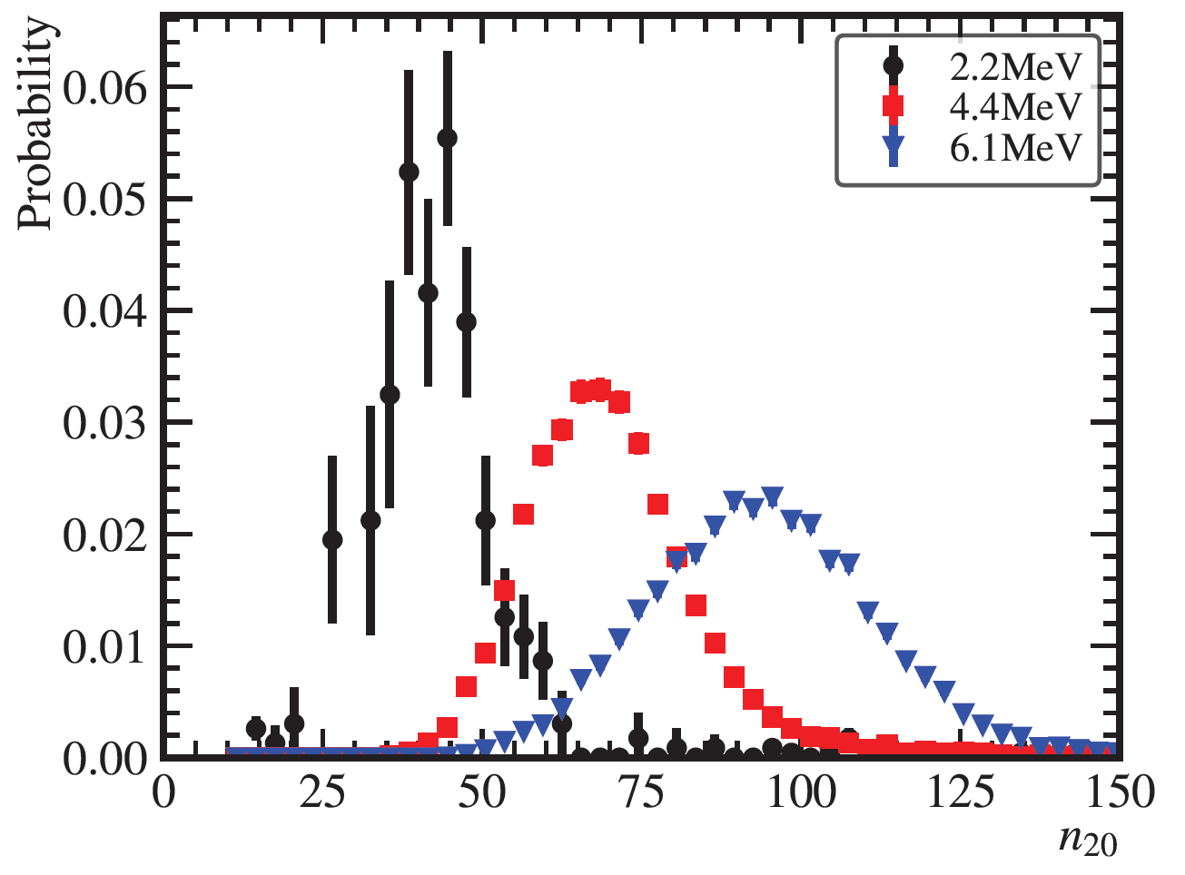
Commissioning
~7 days of Pure Water Phase
Vertex/direction reconstruction for gammas in water
Deploy AmBe/AmC : γ + neutron
→ Project begins
→ Ground breaking
→ Detector installation
→ Installation complete
→ Water fill starts
→ Water filling complete
2013
Jan
2015
Time between gamma and neutron
Energy of gammas + neutrons
2022
2024
JUNO Preliminary
Dec 18
2024
JUNO Preliminary
Feb 1
2025
Characteristic neutron capture time
Clear peaks in number of hits
First measurement of neutrons in JUNO’s short pure water phase

Slide 21
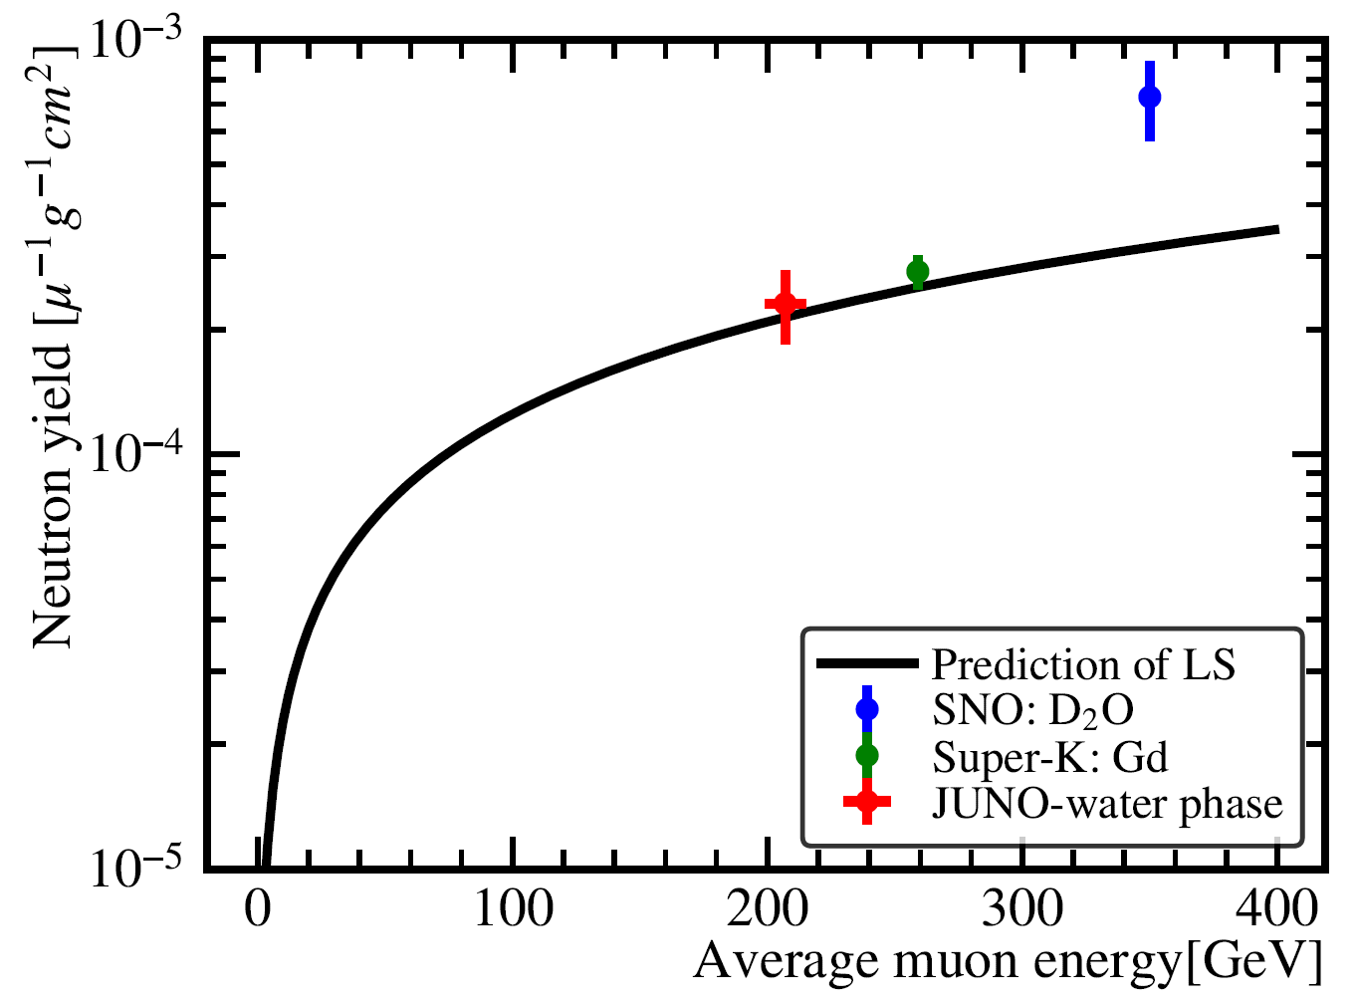
Commissioning
~7 days of Pure Water Phase
Muons produce spallation neutrons
Reconstruct muon direction in water
→ Project begins
→ Ground breaking
→ Detector installation
→ Installation complete
→ Water fill starts
→ Water filling complete
2013
$$μ$$
Jan
2015
Neutron distance from muons
Spallation neutron yield in pure water
2022
2024
JUNO Preliminary
Dec 18
2024
JUNO Preliminary
Feb 1
2025
Spallation neutron yield from muons measured in pure water

Slide 22
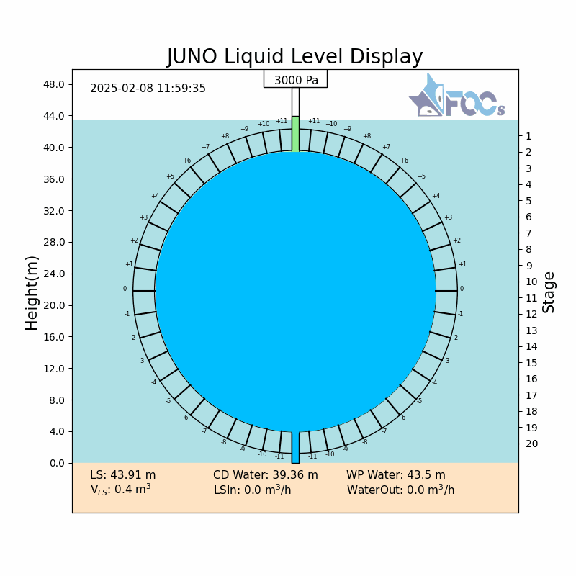
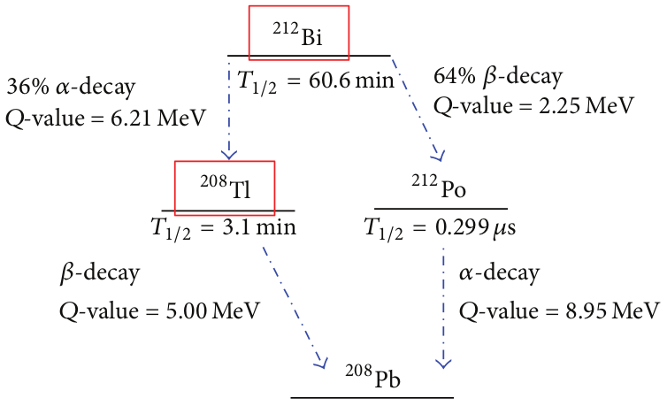
Commissioning
(animated gif)
In partially filled LS detector
Radioactivity monitoring
→ Project begins
→ Ground breaking
→ Detector installation
→ Installation complete
→ Water fill starts
→ Water filling complete
→ LS / Water exchange
2013
Jan
2015
²³⁸U:
2022
2024
In-situ BiPo 214 and BiPo212 in the liquid scintillator:
²³⁸U/²³²Th < 10⁻¹⁶g/g_{LS}
Dec 18
2024
Feb 1
2025
²³²Th:
Feb 8
2025
Backgrounds are in good shape!

Slide 23
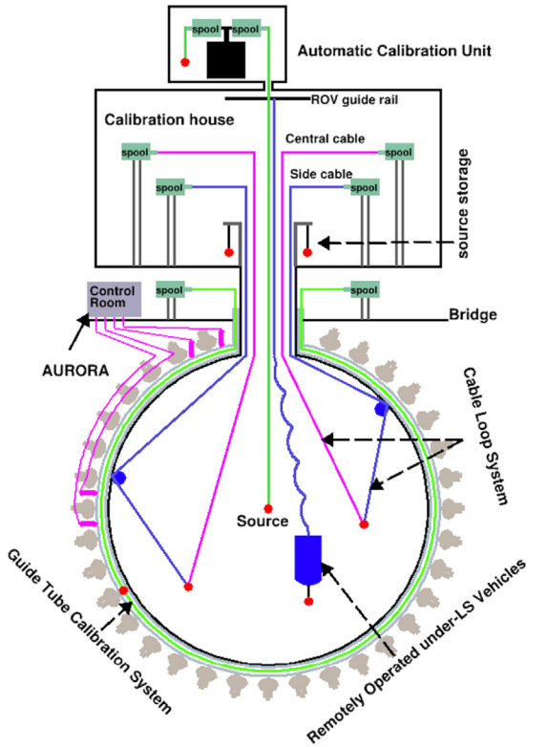
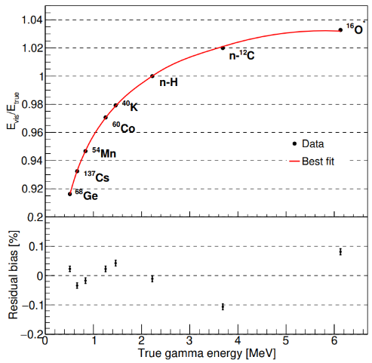
Commissioning
“Calibration strategy of the JUNO experiment”, JHEP 004, (2021)
In partially filled LS detector
Radioactivity monitoring
Calibration device deployments
→ Project begins
→ Ground breaking
→ Detector installation
→ Installation complete
→ Water fill starts
→ Water filling complete
→ LS / Water exchange
2013
Jan
2015
2022
2024
Dec 18
2024
Have deployed calibration sources (+laser) over a wide energy range
Also calibrate using natural radioactivity (e.g. BiPo214)
Feb 1
2025
Feb 8
2025
“Development of the calibration sources for the JUNO experiment” – Akira Takenaka

Slide 24
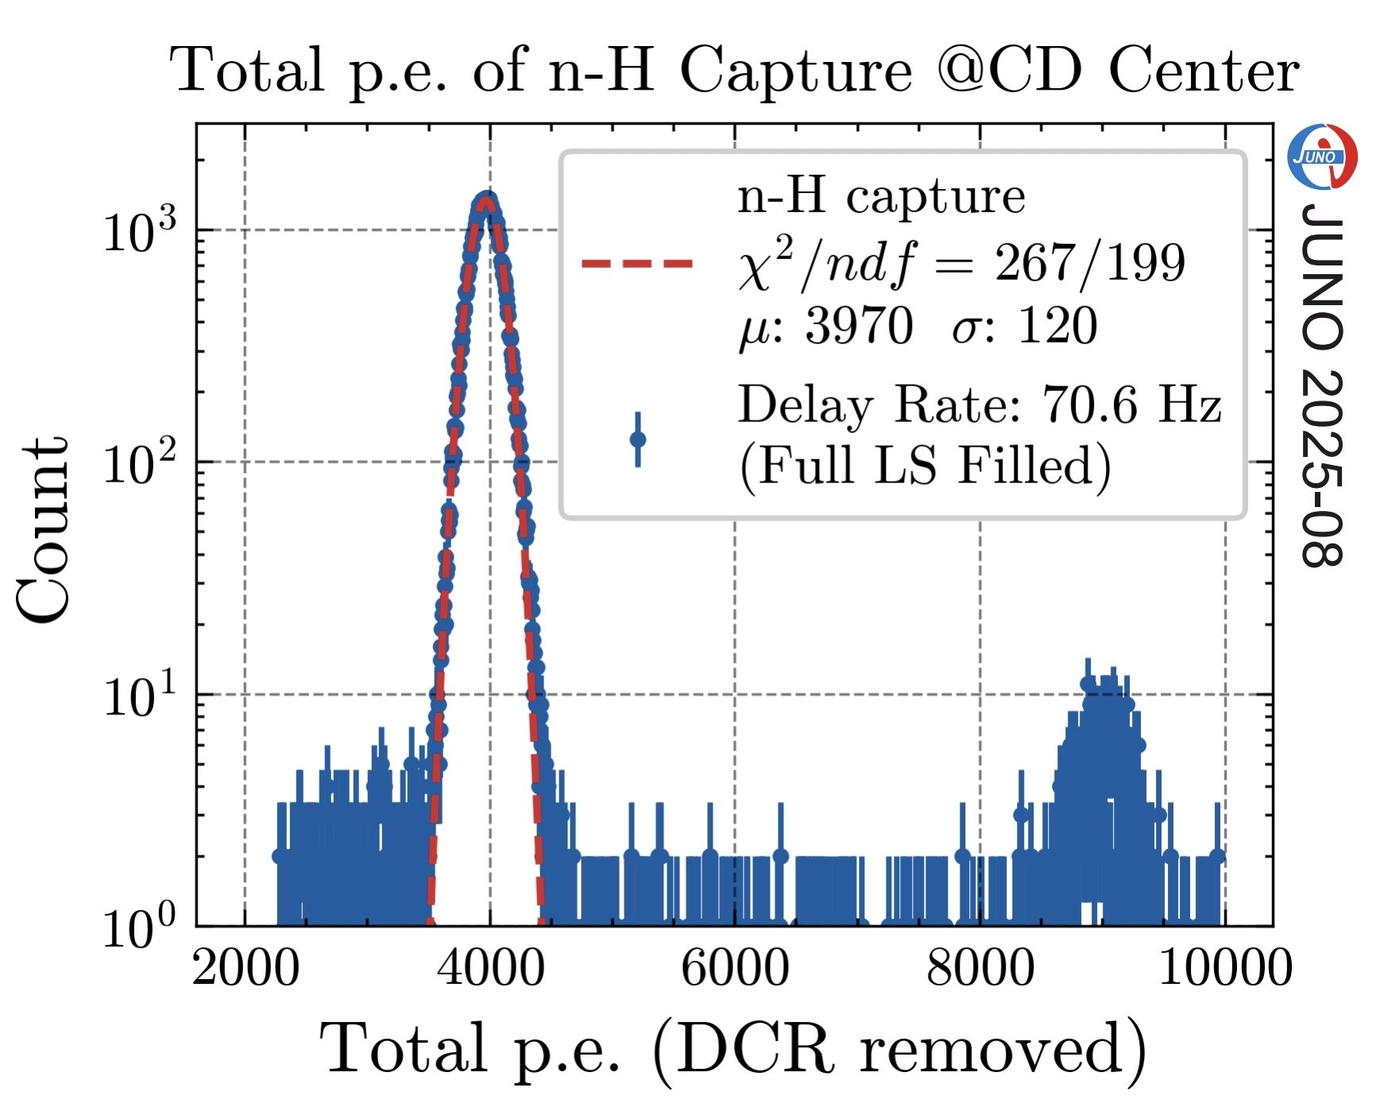
Commissioning
In partially filled LS detector
Radioactivity monitoring
Calibration device deployments
LS / Detector performance
→ Project begins
→ Ground breaking
→ Detector installation
→ Installation complete
→ Water fill starts
→ Water filling complete
→ LS / Water exchange
2013
Jan
2015
JUNO Preliminary
PMT loss during installation 0.1%
PMT gain stability < 1%
Attenuation length > 20m
Light yield 1786 p.e./MeV for n-H capture at the detector centre
→ better than expectation
2022
2024
Preliminary light yield using neutron capture
Dec 18
2024
“First performance results from the JUNO experiment commissioning phase” – Alberto Garfagnini
Feb 1
2025
Feb 8
2025
Detector performing within/beyond expectations!

Slide 25
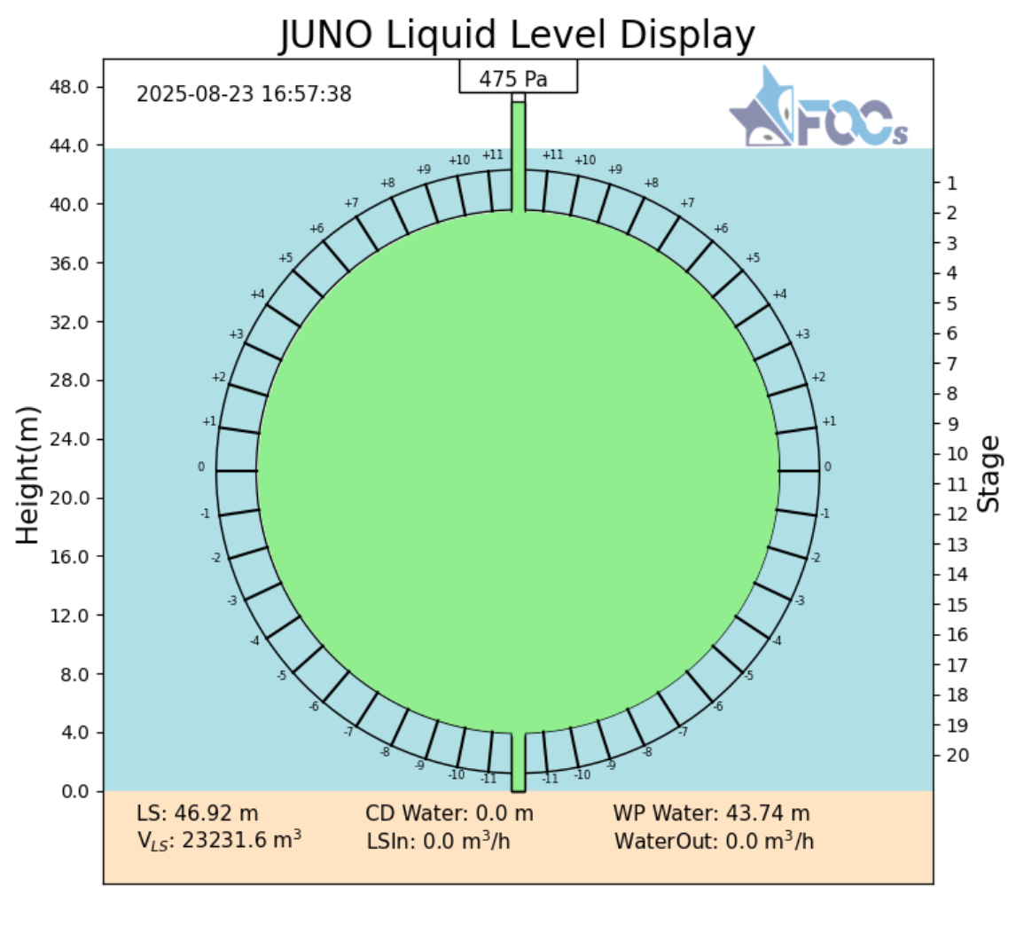
Ahead
→ Project begins
→ Ground breaking
→ Detector installation
→ Installation complete
→ Water fill starts
→ Water filling complete
→ LS / Water exchange
2013
Jan
2015
Aug 22 2025
JUNO is fully filled with LS
Ready for fully filled data-taking
Physics begins
2022
2024
Dec 18
2024
Feb 1
2025
Feb 8
2025

Slide 26








Conclusion
JUNO: 20 kT liquid scintillator detector – now fully filled and is performing well
Diverse physics program : O(10keV) – O(10GeV)
Forecast world-leading measurements of neutrino mass ordering and oscillation parameter $Δm_{31}^{2}$, $Δm_{21}^{2}\text{and} sin2θ_{12}$
Expect early results within the first year of data-taking

Slide 27
TAUP 2025 Contributions
Talks:
66. Simulation of the background from 13C(alpha,n)O reaction in the JUNO scintillator – Maxim Gromov
75. Characterization of the JUNO Liquid Scintillator with Proton and Carbon Beams – Ulrike Fahrendholz
108. Physics potential of detecting solar neutrinos at JUNO – Marco Beretta
142. Development of the calibration sources for the JUNO experiment – Akira Takenaka
162. R&D program for neutrinoless double beta decay search at JUNO - Gaosong Li
165. Status and Prospect of JUNO-TAO – Ruhui Li
526. First performance results from the JUNO experiment commissioning phase – Alberto Garfagnini
Posters
74. JUNO as 2 MeV Water Cherenkov Detector – Dian Li
112. Core-Collapse Supernova monitor study during the JUNO filling phase – Yixuan Jiang
161. Calibration of 20-inch Photomultiplier Tubes in JUNO – Yaoguang Wang
413. Calibration system of the JUNO experiment – Rui Li
497. The accelerated Reactor fitter and Oscillation analysis for JUNO – Jingqin Xue

Slide 28
References
[1] G. Alimonti et al., The Borexino detector at the Laboratori Nazionali del Gran Sasso, Nucl. Instrum. Methods Phys. Res., Sect. A 600, 568 (2009).
[2] A. Gando et al., Measurement of the double-β decay halflife of 136Xe with the KamLAND-Zen experiment, Phys. Rev. C 85, 045504 (2012).
[3] S. Andringa et al., Current status and future prospects of the SNO+ experiment, Adv. High Energy Phys. 2016, 6194250 (2016).
[4] I. Morton-Blake “Extending JUNO’s Astrophysical Reach with a Low-Energy Multi-Messenger Trigger System.” PoS(ICRC2023) (2023)
[5] A. Takenaka et al., Neutron source-based event reconstruction algorithm in large liquid scintillator detectors, arXiv:2504.19236
[6] SNO+ Collaboration, Initial measurement of reactor antineutrino oscillation at SNO+, Eur. Phys. J. C 85, 17 (2025)

Slide 29
Backup

Slide 30


Commissioning
→ Project begins
→ Ground breaking
→ Detector installation
→ Installation complete
2013
Boost atmospheric neutrino reconstruction with additional PMTs placed in the water pool
Jan
2015
2022
2024

Slide 31









LS Purification
OSIRIS: separate 18 ton LS detector
→ Rapid monitoring of Radon in LS during filling
5000 m³ LAB tank
1) Al₂O₃
2) Distillation
Mixing PPO and bis-MSB
SS pipes to underground
JUNO detector
CD FOC system
4) Gas stripping for Rn and O₂ removal
3) Water extraction to remove radioactive impurities

Slide 32

NMO with reactor neutrinos
“Potential to Identify the Neutrino Mass Ordering with Reactor Antineutrinos in JUNO,” arXiv:2405.18008 (2024)
Expected reconstructed energy spectrum NO vs IO
Expected uncertainties in predicted spectrum
(assuming 3σ NMO sensitivity livetime)
High-statistics reactor ${\overline{ν}}_{e}$measurement:
→ Important systematics from energy resolution, backgrounds and reactor spectrum

Slide 33



NMO with reactor neutrinos
“Potential to Identify the Neutrino Mass Ordering with Reactor Antineutrinos in JUNO,” arXiv:2405.18008 (2024)
Expected NMO sensitivity vs livetime
Expected NMO sensitivity vs livetime
Parameter | PDG 2024 | JUNO 100 days | JUNO 6 years
$$Δm_{31}^{2}$$ | 1.2% | 0.8% | 0.2%
$$Δm_{21}^{2}$$ | 2.4% | 1.0% | 0.3%
$$\sin^{2}{θ_{12}}$$ | 4.0% | 1.9% | 0.5%
$$\sin^{2}{θ_{13}}$$ | 3.2% | 47.9 | 12.1%
3σ expected in 6.5 yrs using reactor neutrinos alone
World-leading measurements of $Δm_{21}^{2},Δm_{31}^{2}$and $θ_{12}$ in ~100 days

Slide 34






Core-Collapse Supernova Neutrinos
“Real-time monitoring for the next core-collapse supernova in JUNO”, Journal of Cosmology and Astroparticle Physics (2024)
2 Independent Trigger Systems:
Global Trigger E_{thr}~200 keV
Multi-Messenger Trigger E_{thr}~20 keV
$${ν_{x}+\overline{ν}}_{x}$$
MM Trigger
~20keV
Expected Flux vs Visible Energy
Expected Event Rate (@10kpc)
SN @ 10kpc
Process | Num. Events (E_{thr} = 0.2MeV)
IBD | ${\overline{ν}}_{e}+p→e^{+}+n$ | ~5000
pES | $ν+p→ν+p$ (${ ν}_{e,μ,τ}$) | ~2000
eES | $ν+e→ν+e$ (${ ν}_{e,μ,τ}$) | ~400
CC | $ν_{e}+^{12}C→e^{−\left(+\right)}+^{12}N(^{12}B)$ | ~200
NC | $ν+^{12}C→ν+^{12}C^{∗}$ (${ ν}_{e,μ,τ}$) $→γ(15.11MeV)$ | ~300
( )
( )
( )
( )
Boost pES statistics
Aim for CE$ν$NS | $ν+^{12}C→ν+^{12}C$

