Slide 1




Veto Development for PandaX Experiment
Junting Huang for the PandaX Collaboration
Shanghai Jiao Tong University
2025/8/28
TAUP 2025, Xichang, China

Slide 2
Outline
veto system for PandaX-4T (MVETO)
veto upgrade for PandaX-20T (OVETO)
cold liquid scintillator veto R&D for PandaX-xT (IVETO)
numbers and plots reported in this talk are preliminary
Outer Veto (OVETO)
0.9 kton water tank
4 kton water pit
LXe TPC
Middle Veto (MVETO)
Cryostat
8-inch PMT
Inner Veto (IVETO)
3-inch PMT

Slide 3
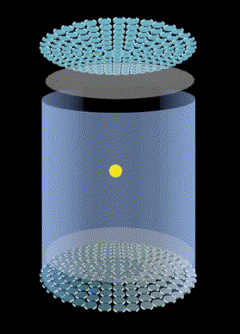
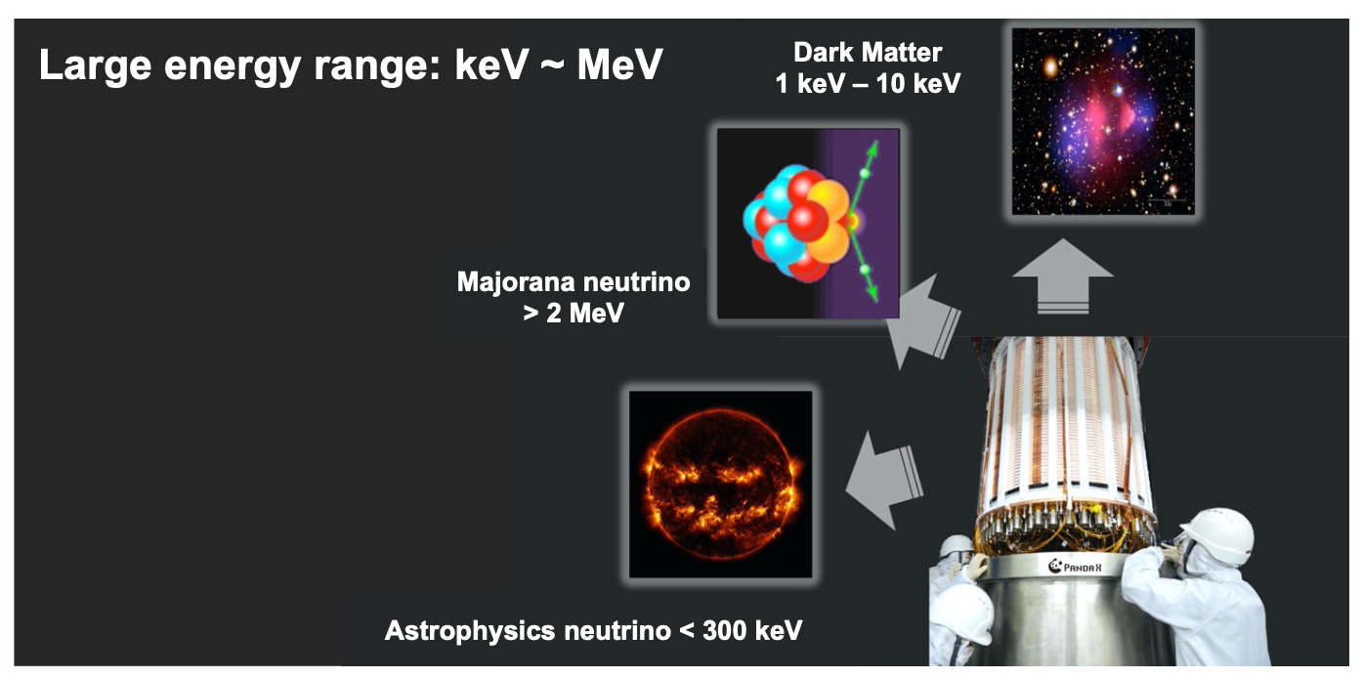
PandaX Experiment
PandaX (Particle and Astrophysical Xenon Experiment)
  dual phase liquid xenon TPC, located at B2 Hall of CJPL
  currently running PandaX-4T, to be upgraded to PandaX-20T in 2026-2027
backgrounds: neutrons, gammas, cosmic muons, Rn, Kr, etc.

Slide 4
Veto for PandaX-4T

Slide 5
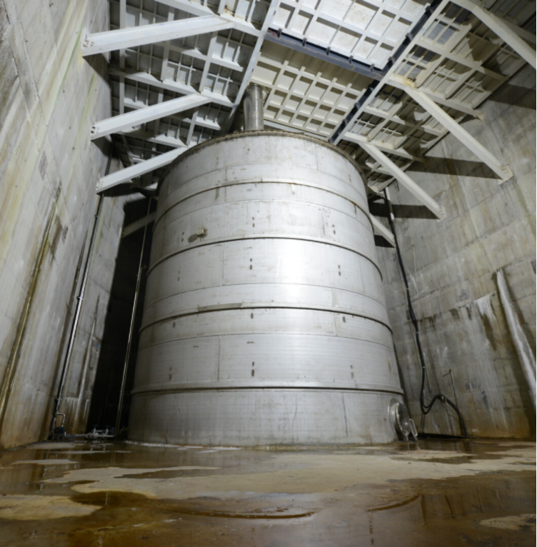
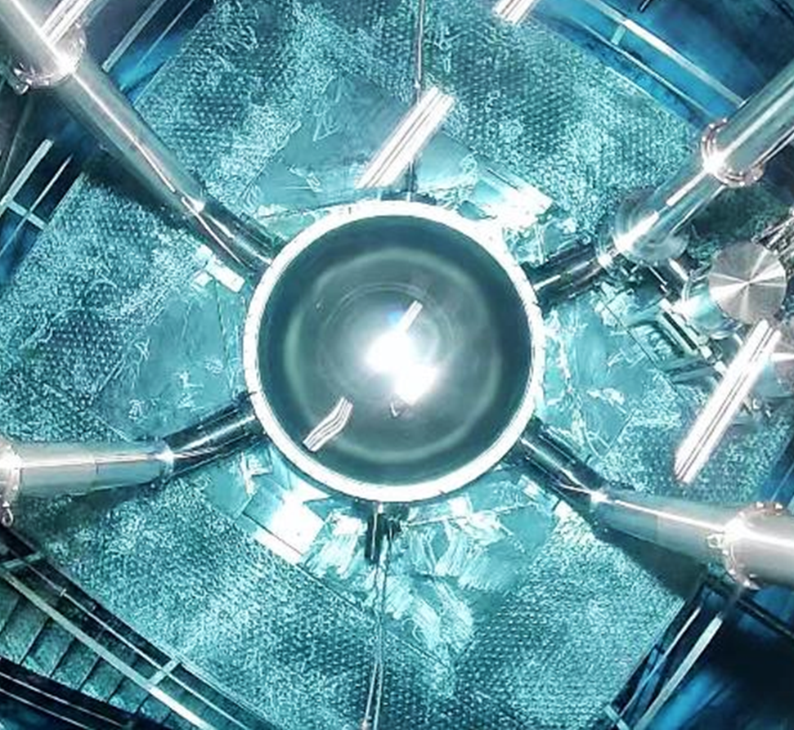
0.9 kton Water Shielding for PandaX-4T

Slide 6
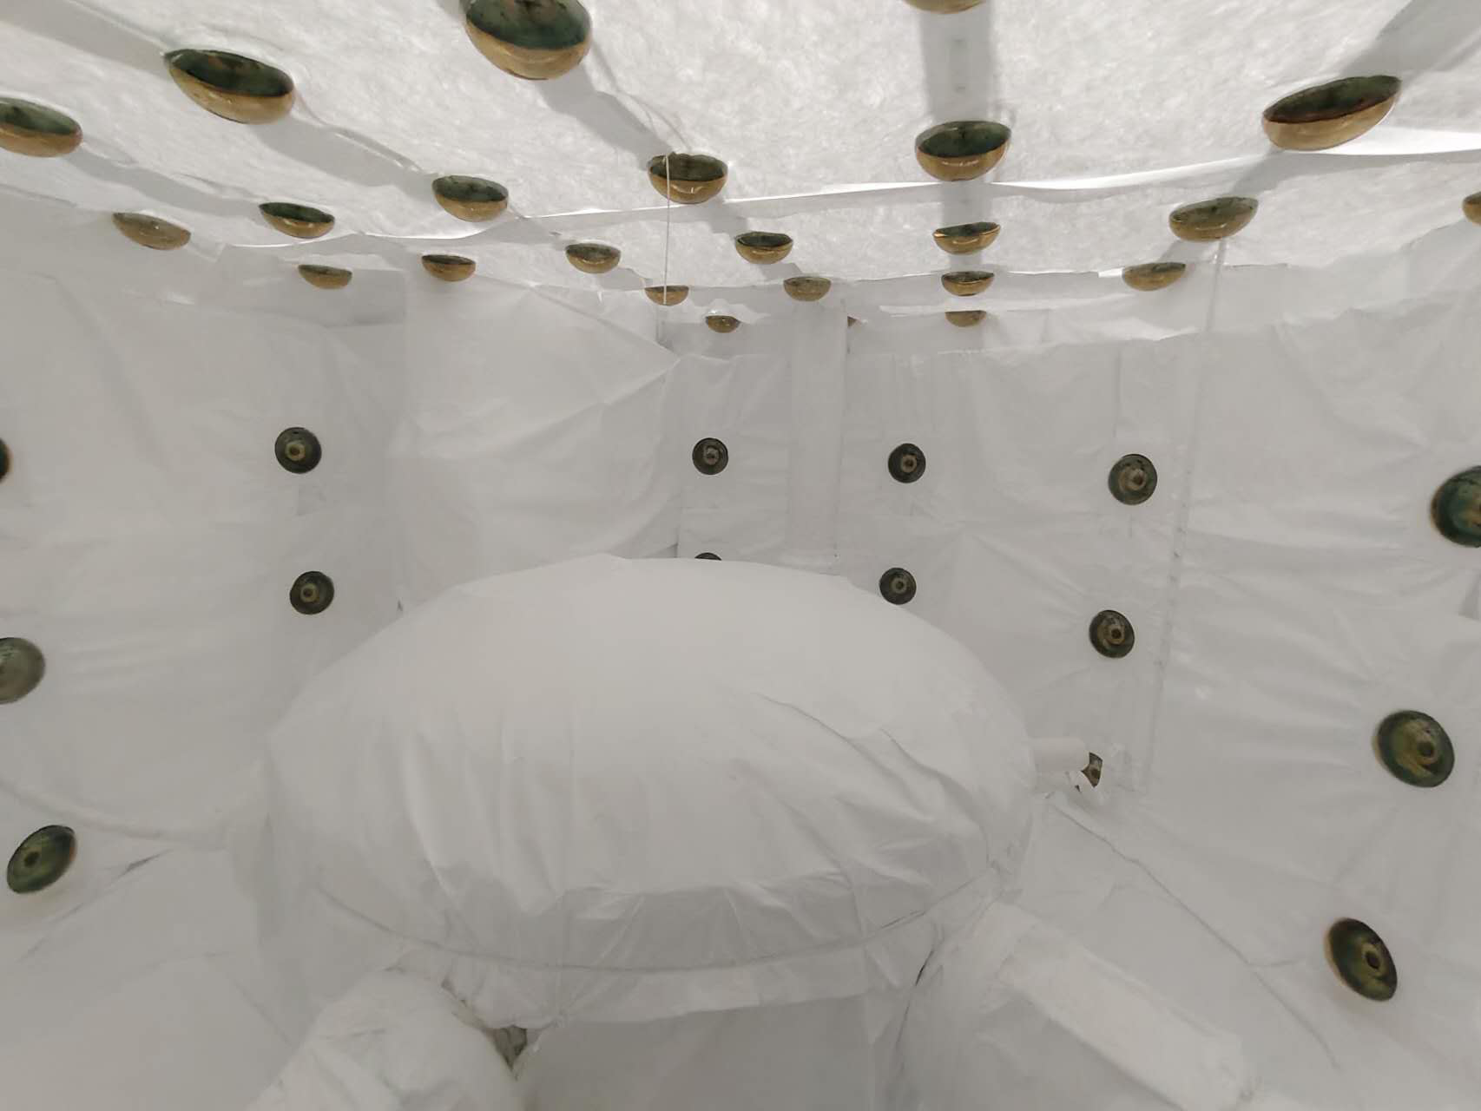
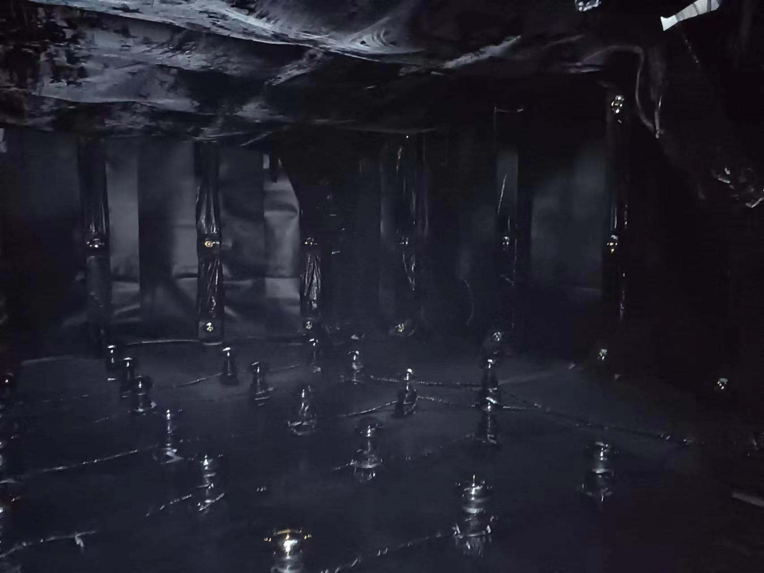
PMT Instrumentation
two layers of 8-inch MCP PMTs in 0.9 kton water shielding
  inner layer: 165 PMTs, divided by the steel platform
  outer layer: 105 PMTs, side and bottom
installation finished in January 2024, data taking since July 2024

Slide 7
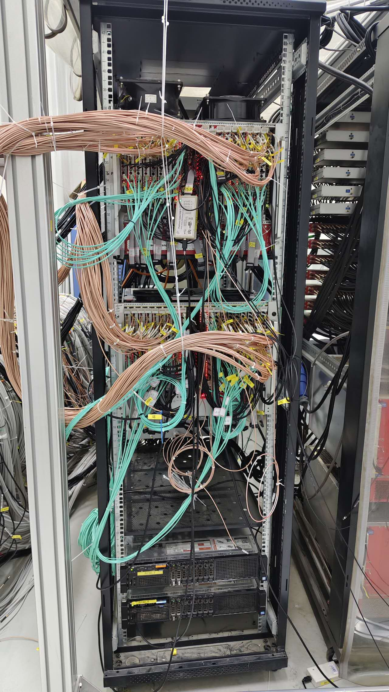
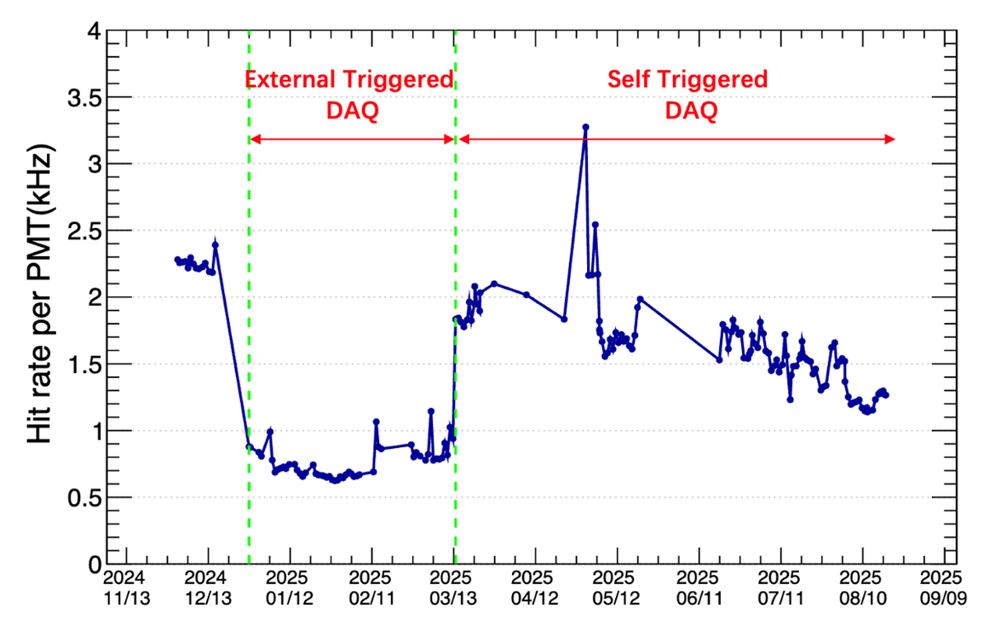
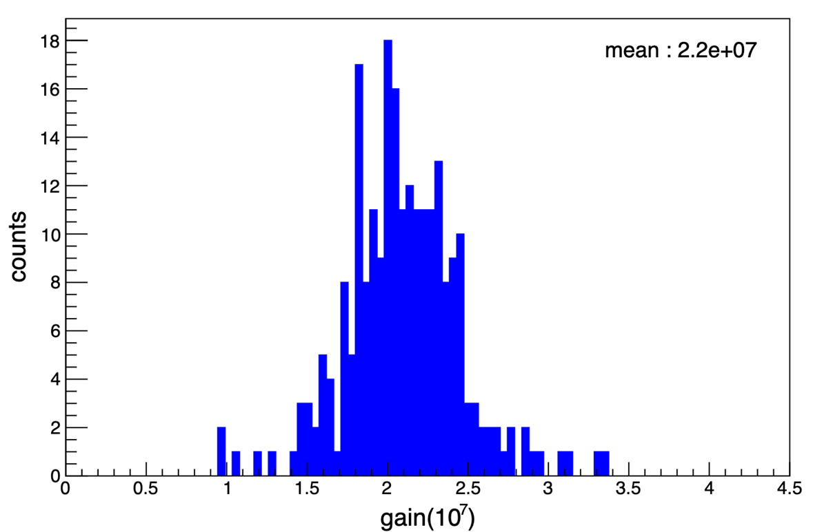
Readout and PMT Calibration
14-bit, 500 MHz readout board, self-trigger
on average 1-1.5 kHz dark count rate per PMT
average PMT gain is 2.2e7

Slide 8
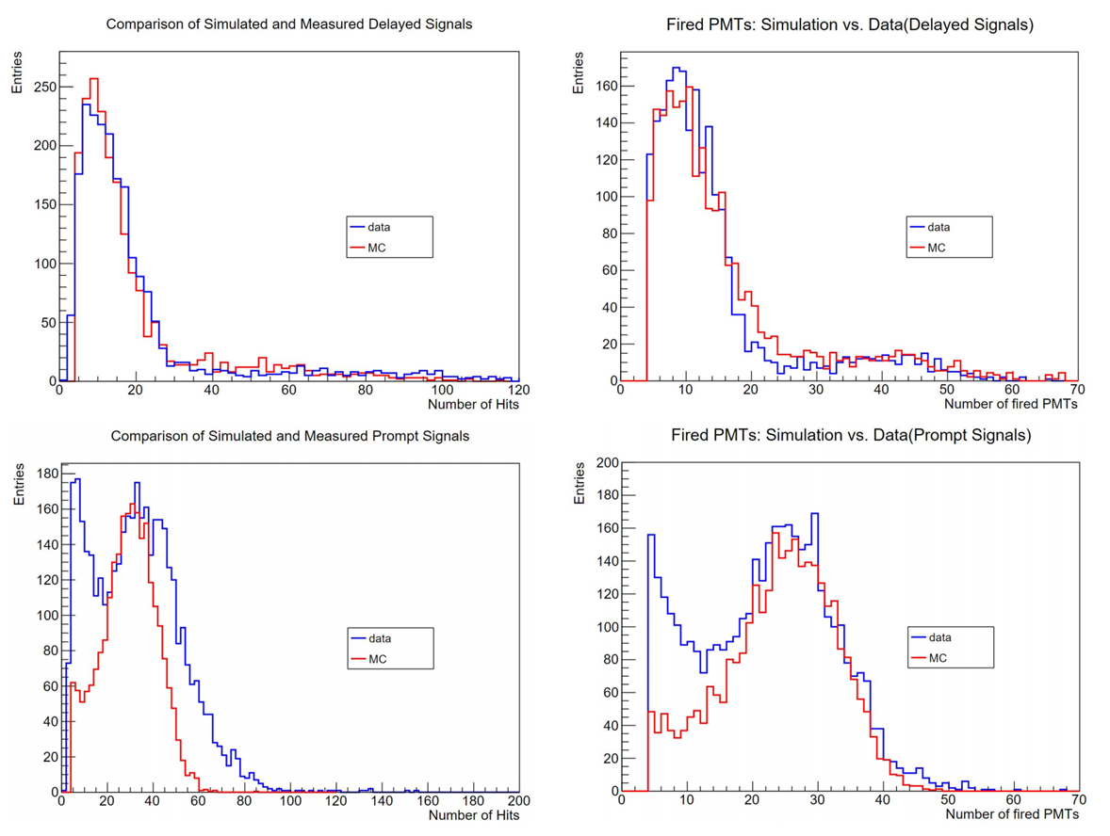
Neutron Veto Calibration
AmBe source placed at different positions of cryostat
prompt: 4.4 MeV gamma in water + neutron scattering in LXe
delayed: 2.2 MeV gamma from neutron capture in water

Slide 9
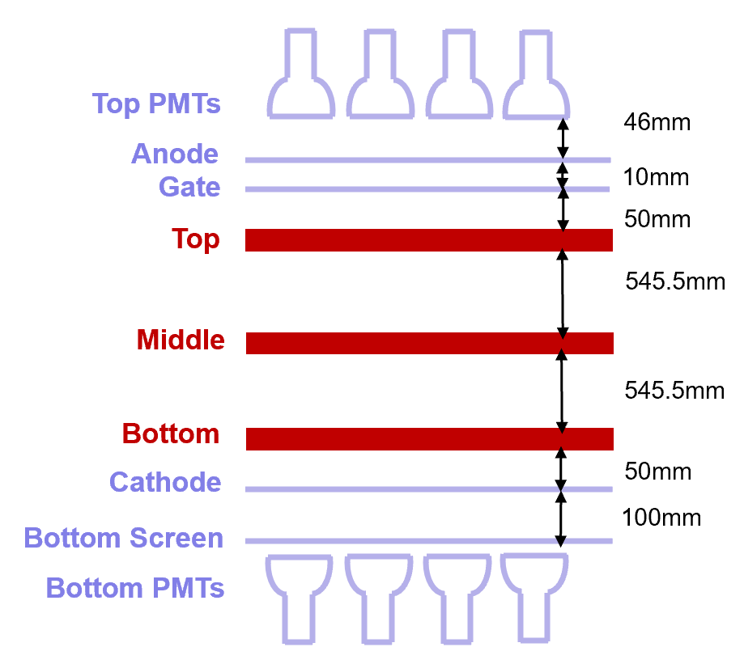
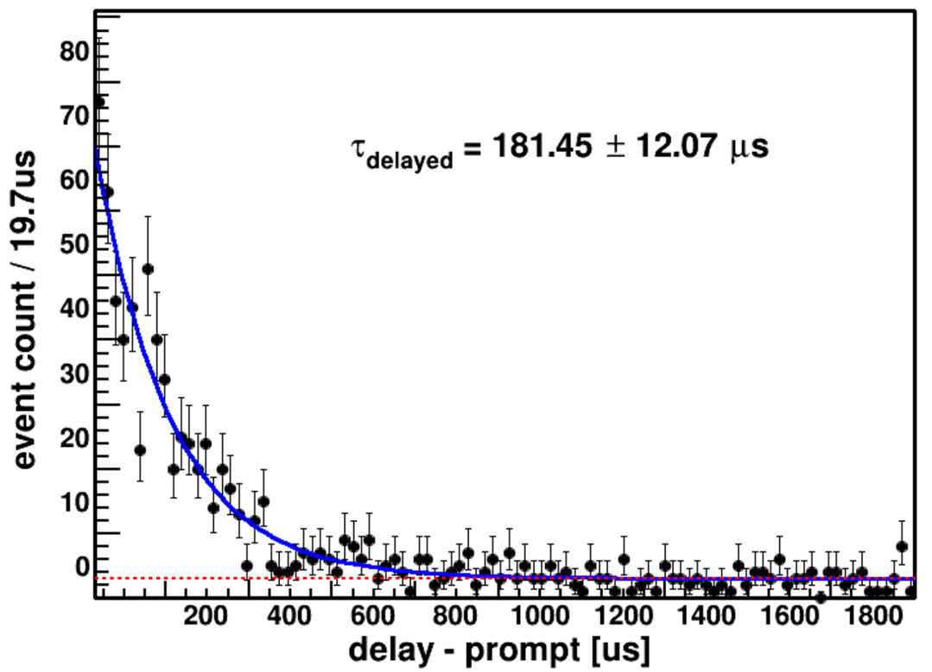
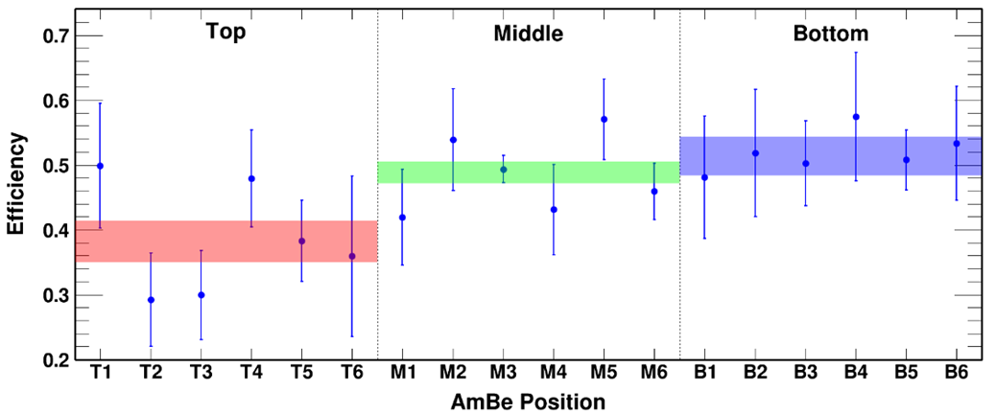
Neutron Veto Efficiency
preliminary average neutron veto efficiency
  about 52.2% within an 800 μs window
  about 49.5% within a 500 μs window
veto efficiencies depend on source positions
preliminary
preliminary

Slide 10
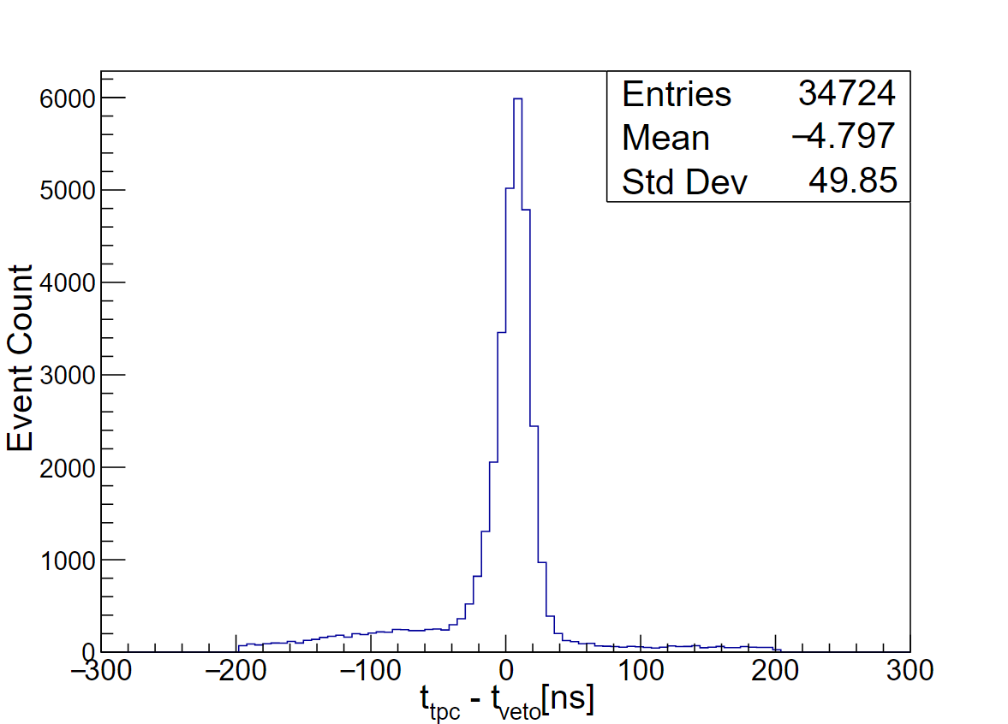
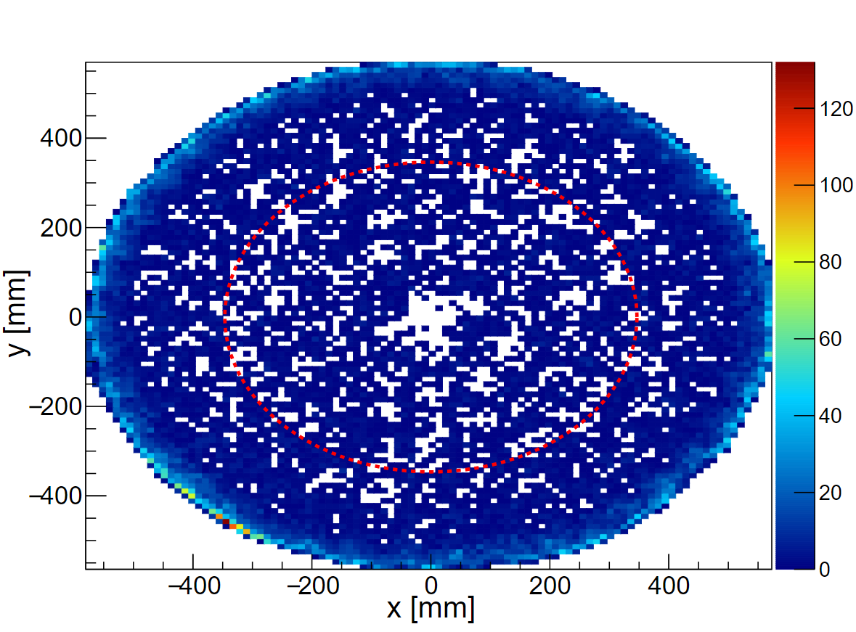

Gamma Veto
steel platform contributes significantly to $0νββ$ background*
about 11 coincident single-site events / day in $0νββ$ fiducial volume
*Sci.Bull. 70 (2025) 1779-1785
Notes:
after single/multi-site cut

Slide 11
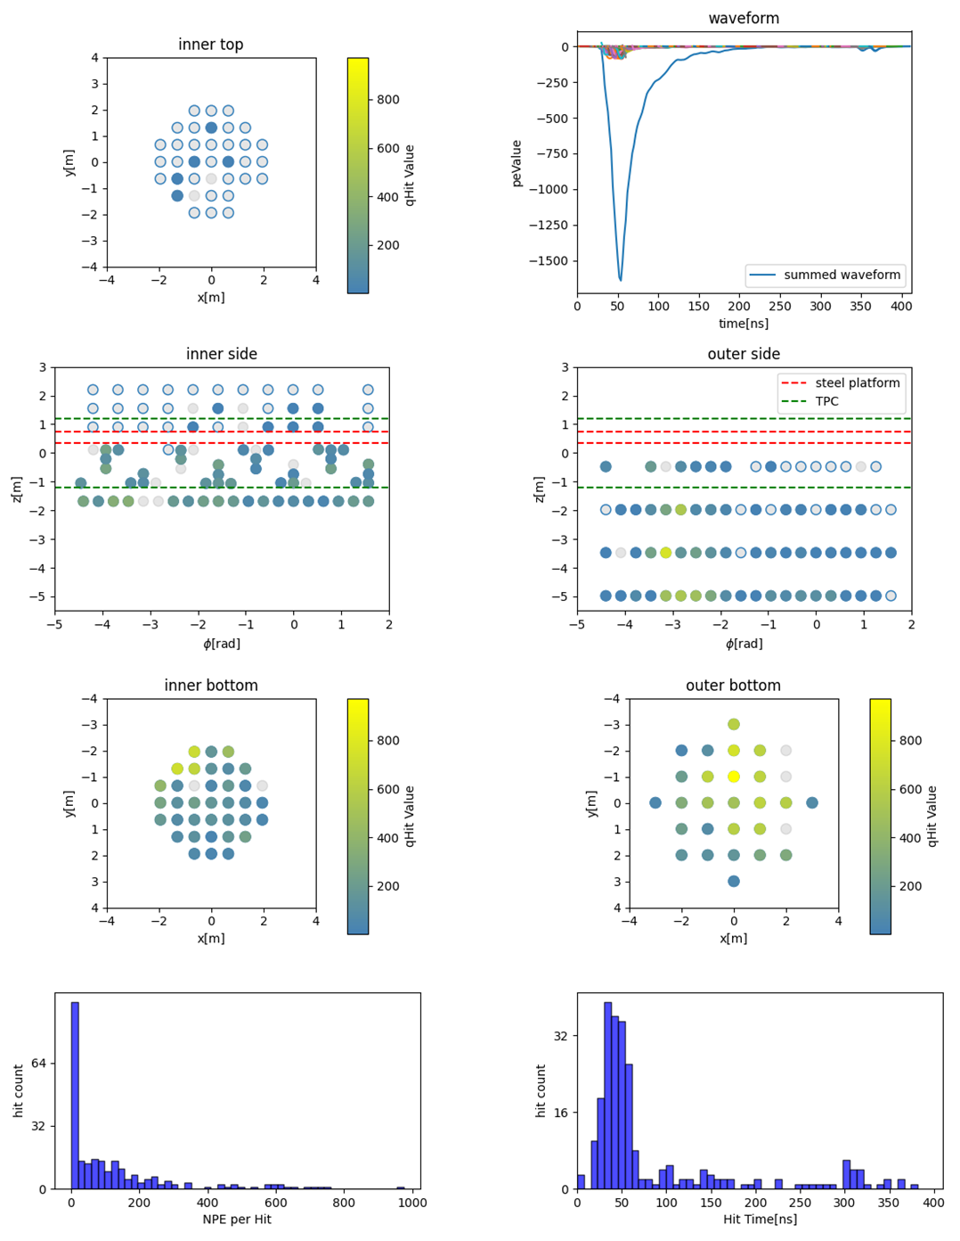
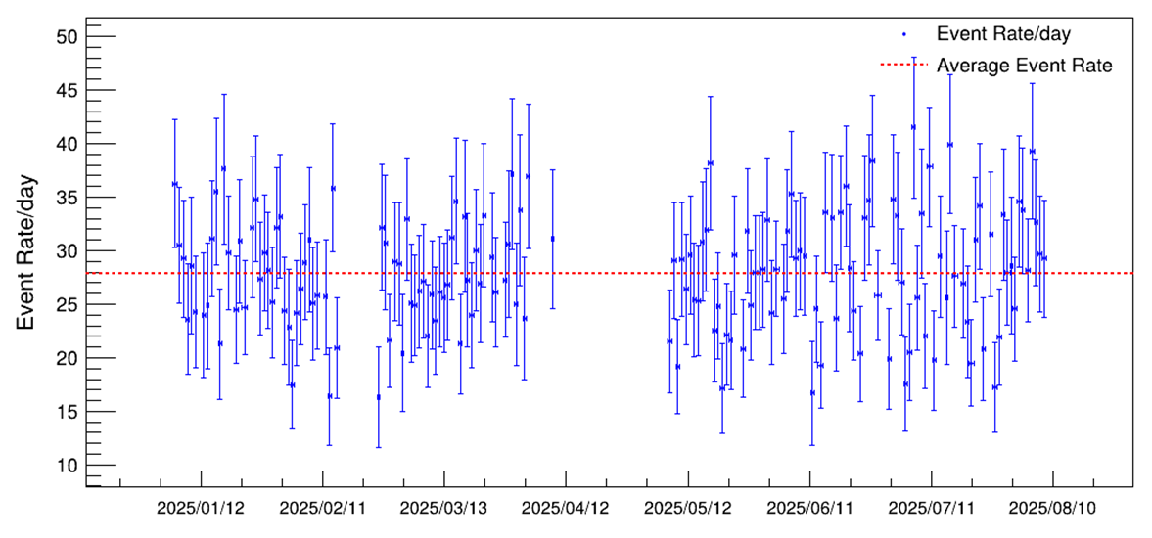
Cosmic Ray Veto
cosmic muon rate is very low at the CJPL (2400 m rock)
require at least 12 fired PMTs on the PMT outer layer
about 28 muons / day

Slide 12
4 kton Veto for PandaX-20T

Slide 13
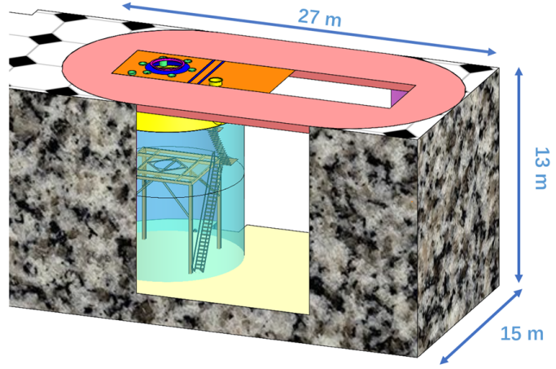
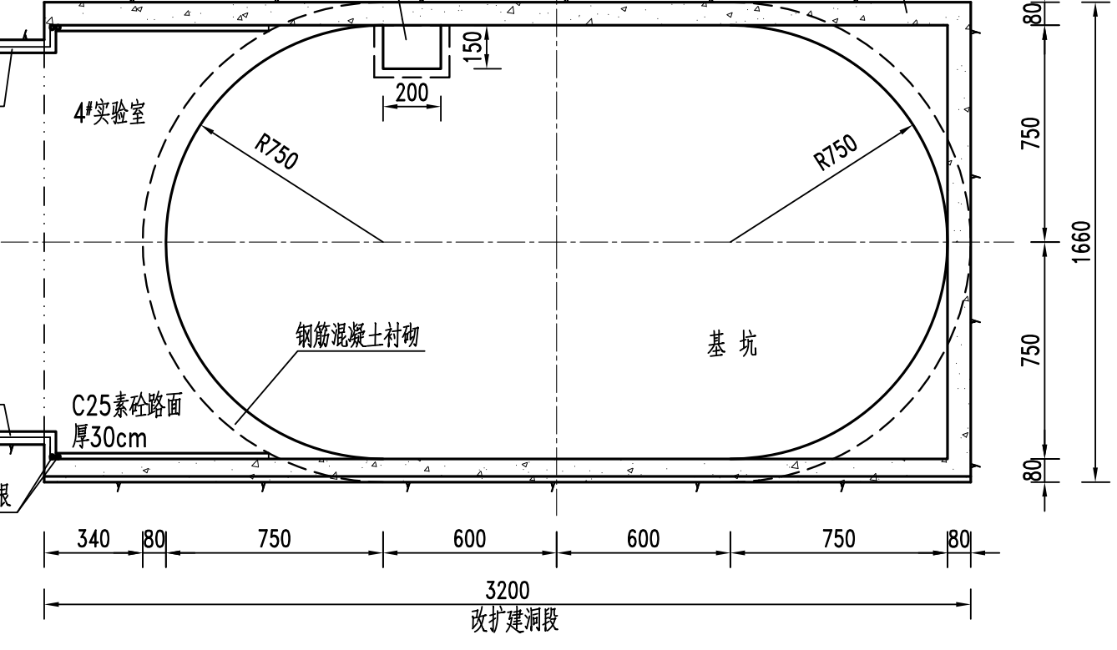
Motivation
PandaX-20T construction will start in 2026, replacing PandaX-4T
instrument 4 kton water pit with PMTs, tag muons
measure atmospheric neutrino flux in situ
  reduced flux at low latitude, 2-3 times smaller w.r.t. SNOLAB, LNGS, etc.*
  main background for WIMP mass greater than tens of GeV
5 m
* Phys.Rev.D 105 (2022) 4, 043001
Notes:
cosmic ray interaction at the upper atmosphere
average energy is about 340 GeV

Slide 14
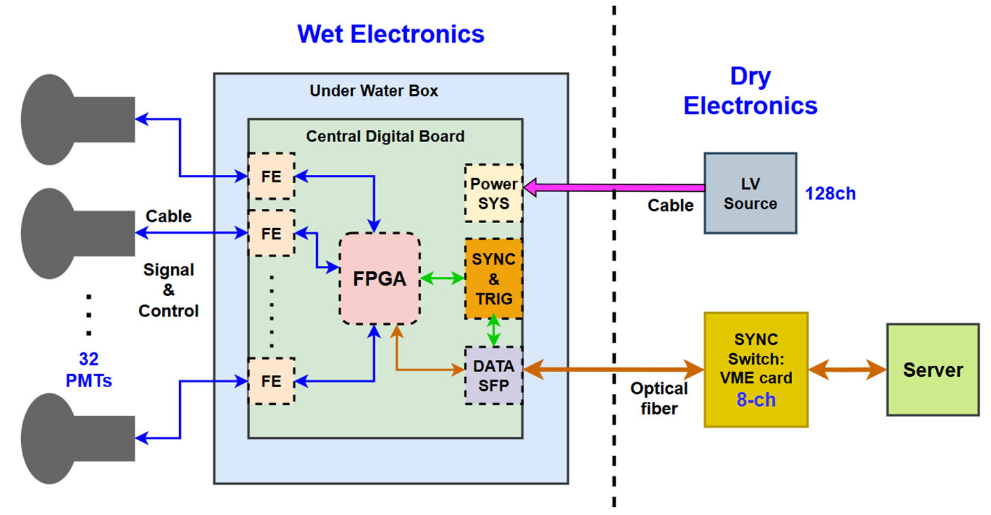
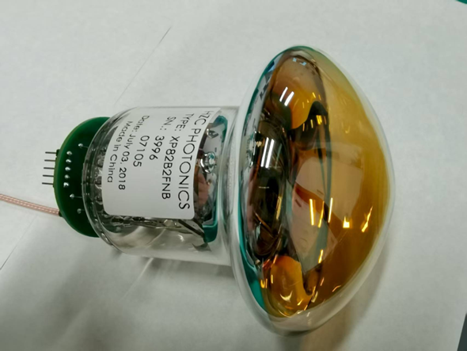
Photon Detection and Readout System
3-inch PMTs: donated by UCL, originally used for CHIPS
readout electronics: time over threshold, under development
HZC 3-inch PMT (XP82B2FNB) donated by UCL
Notes:
4000 m3 water pool, a few thousands 3-inch PMTs

Slide 15
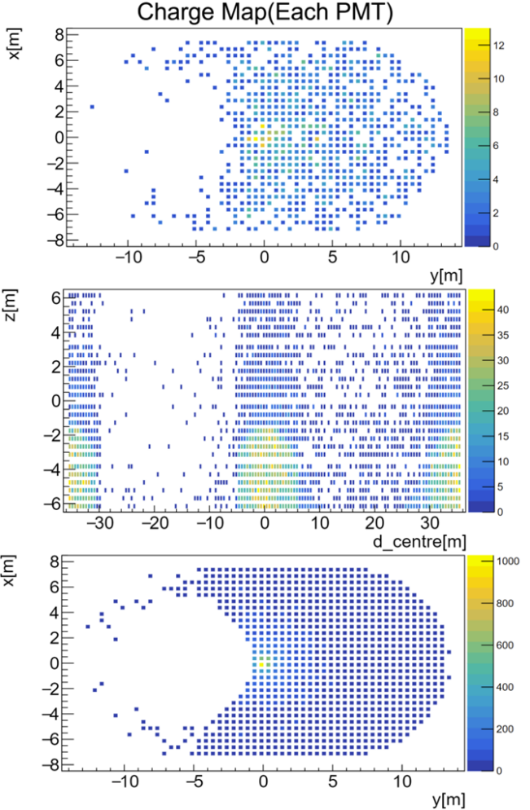
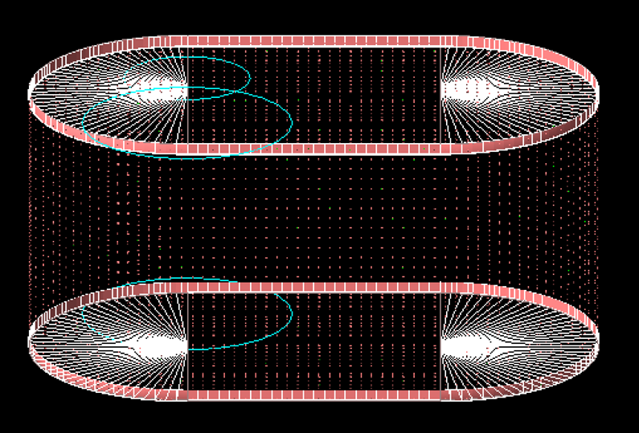
Detector Simulation
simulation: GENIE + WCSim
studying the reconstruction precision to optimize the PMT layout

Slide 16
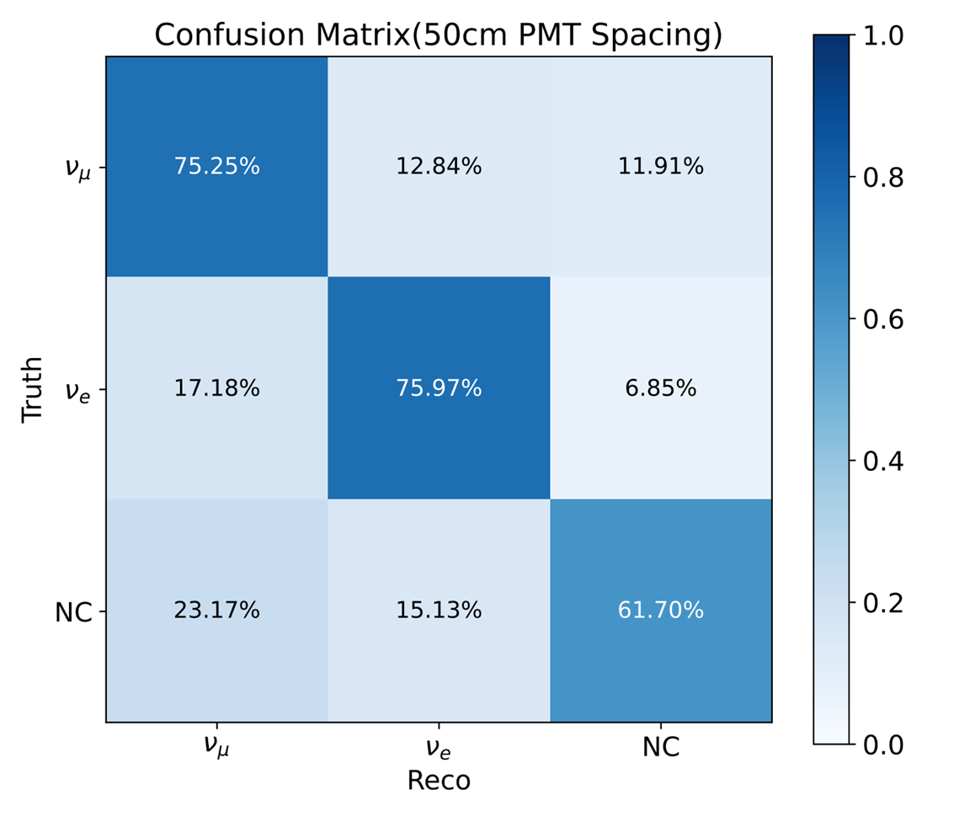
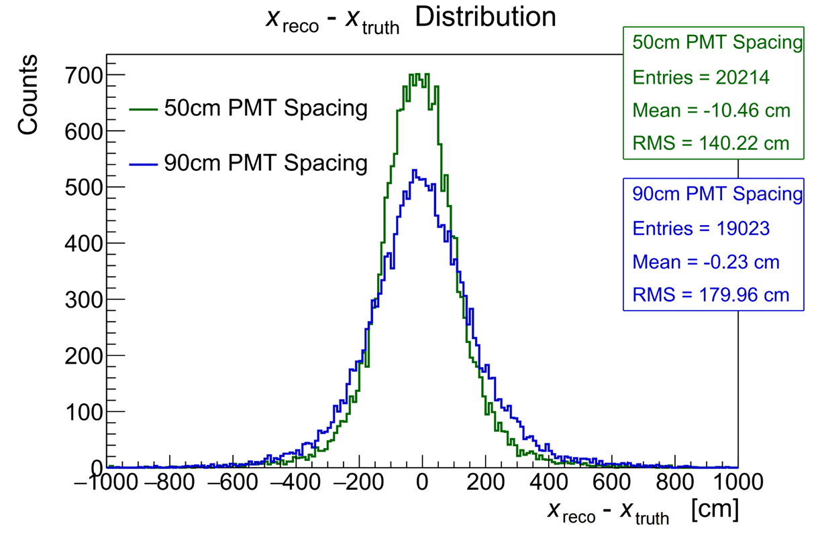

Preliminary Reconstruction
GraphNet: event reconstruction and particle identification
preliminary results with 50 cm PMT spacing
  position resolution about 1.4 m
  75% precision for ${ν_{e}}/{ν_{μ}}$ identification

Slide 17
Cold Liquid Scintillator Veto R&D for PandaX-xT

Slide 18
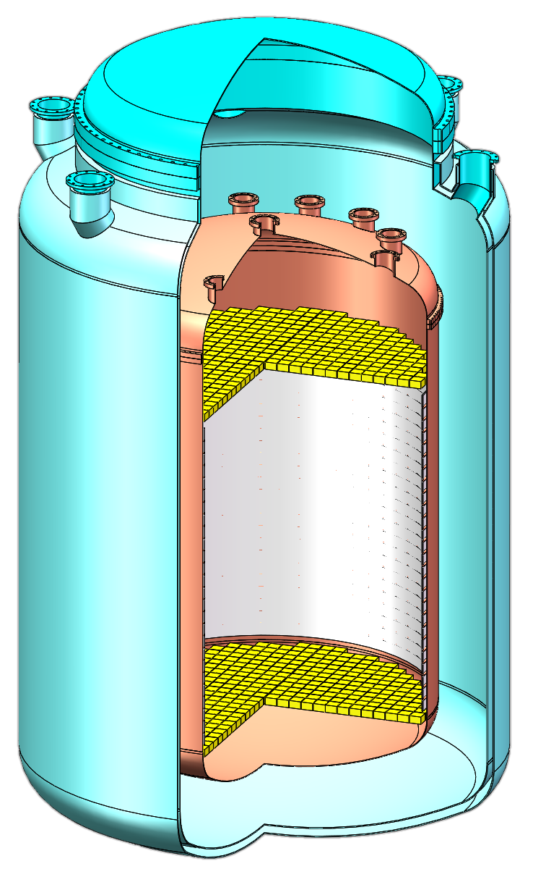
Motivation
PandaX-xT, a next generation multi-ten-ton experiment
aim to reduce detector materials as much as possible
use liquid scintillator (LS) to pressure-balance the LXe container
close to LXe, expect good eff.
shield cryostat radioactivity
under R&D, borrowing ideas from EXO, TAO, LiquidO, etc.
outer vessel
IVETO: 30 ton cold liquid scintillator
inner vessel

Slide 19
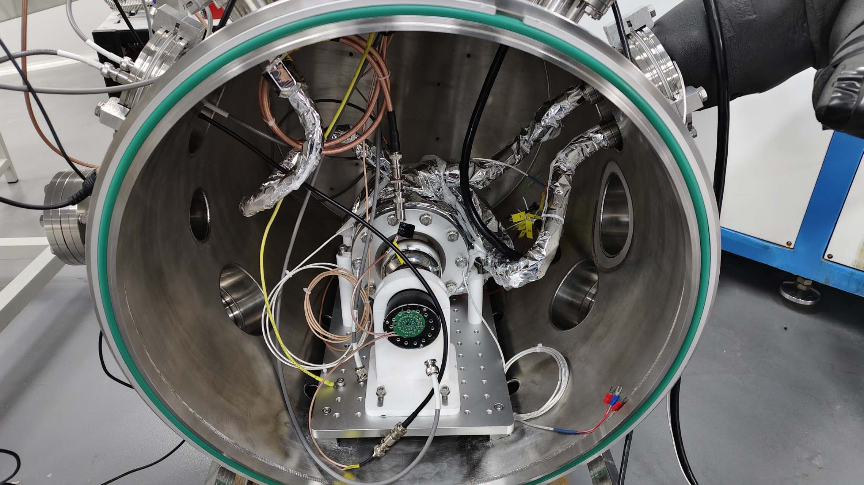
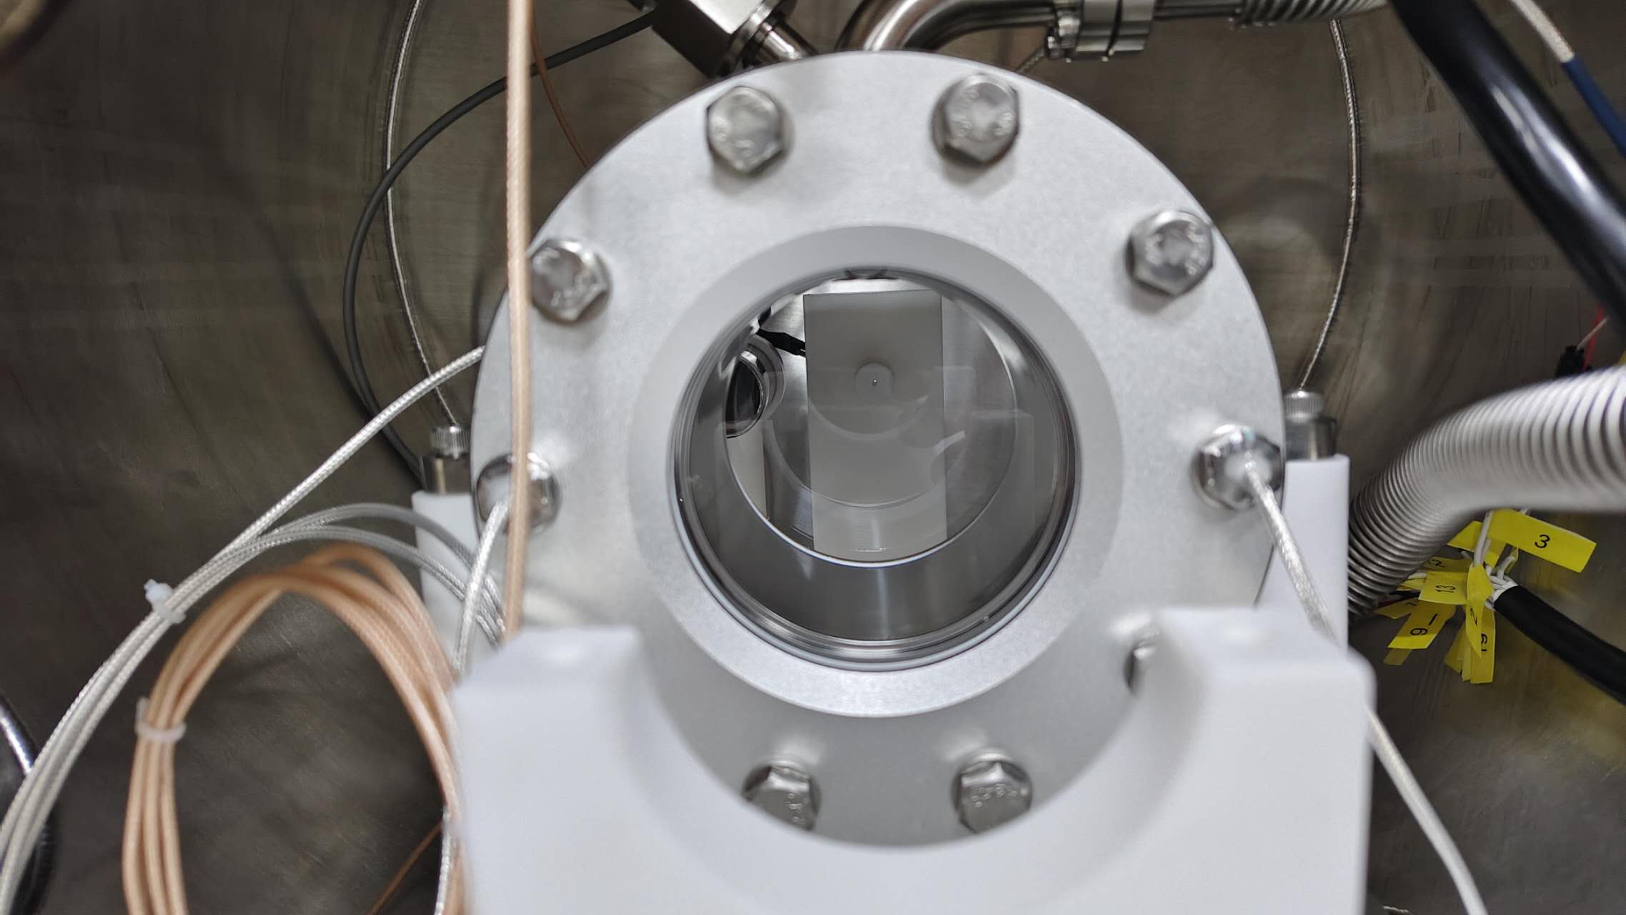
1-Liter Setup
JUNO liquid scintillator (LAB + PPO + bis-MSB)
3-inch + 1-inch PMTs for light detection
measure relative transparency and light yield at different temperatures down to -100 ℃

Slide 20
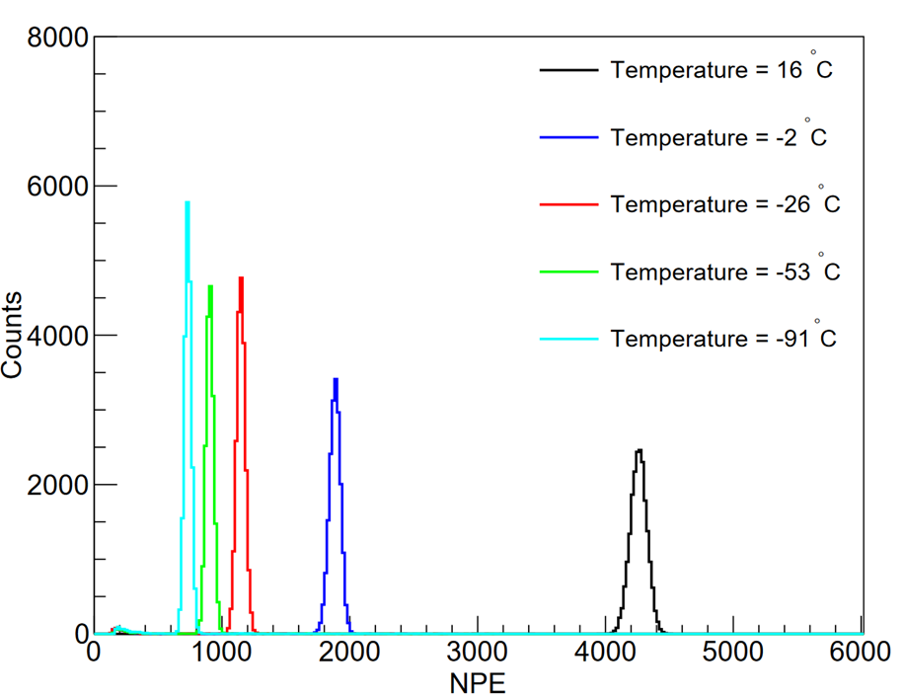
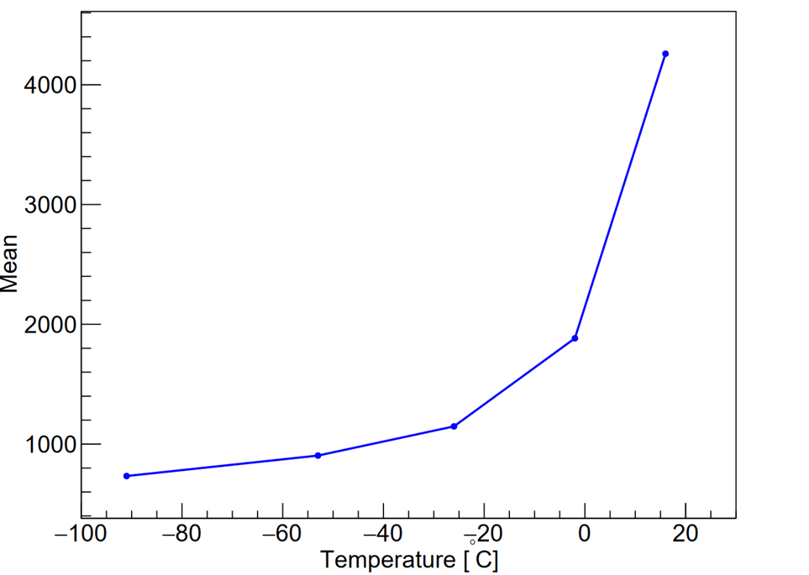
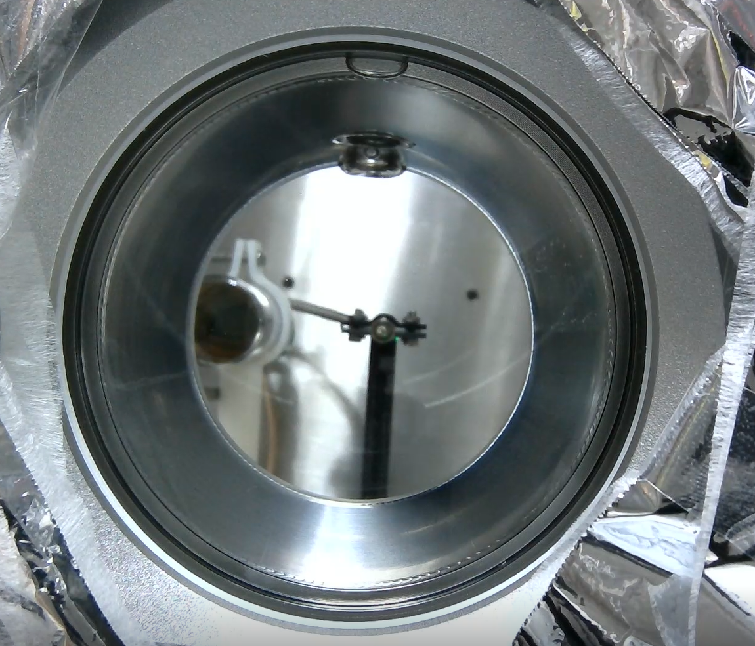
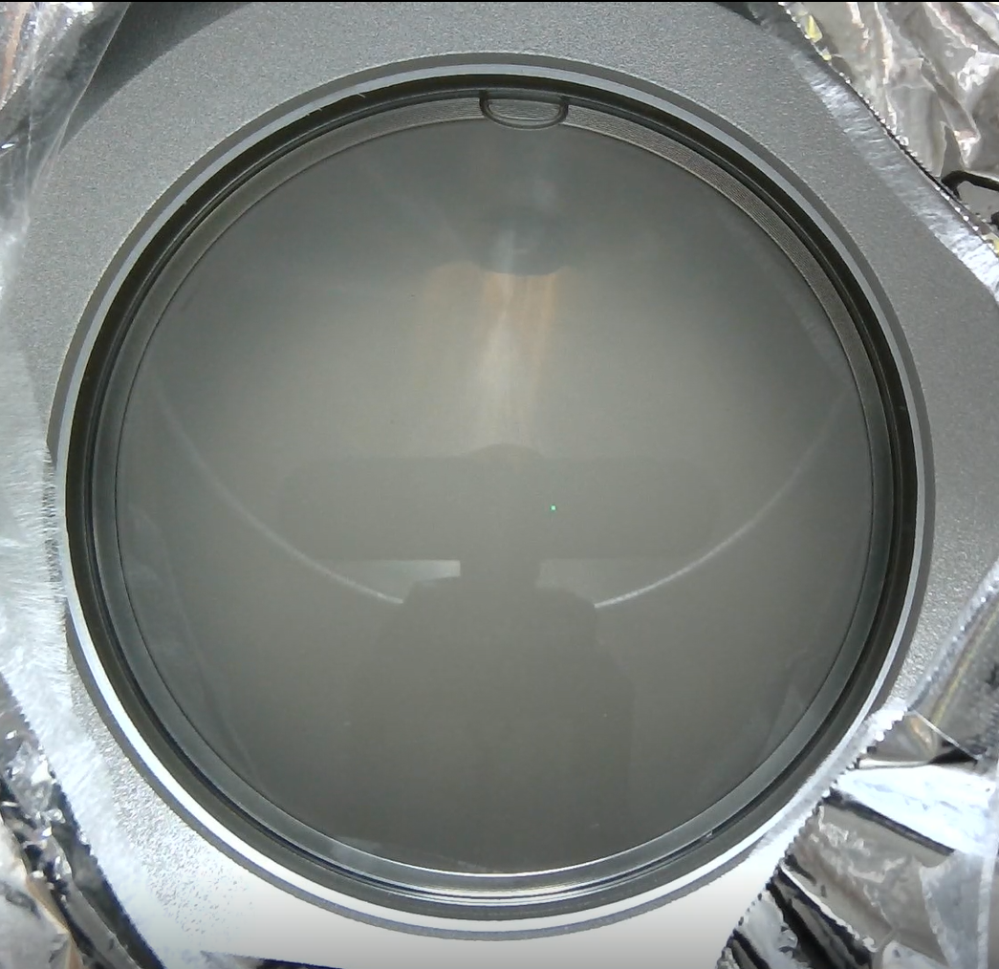
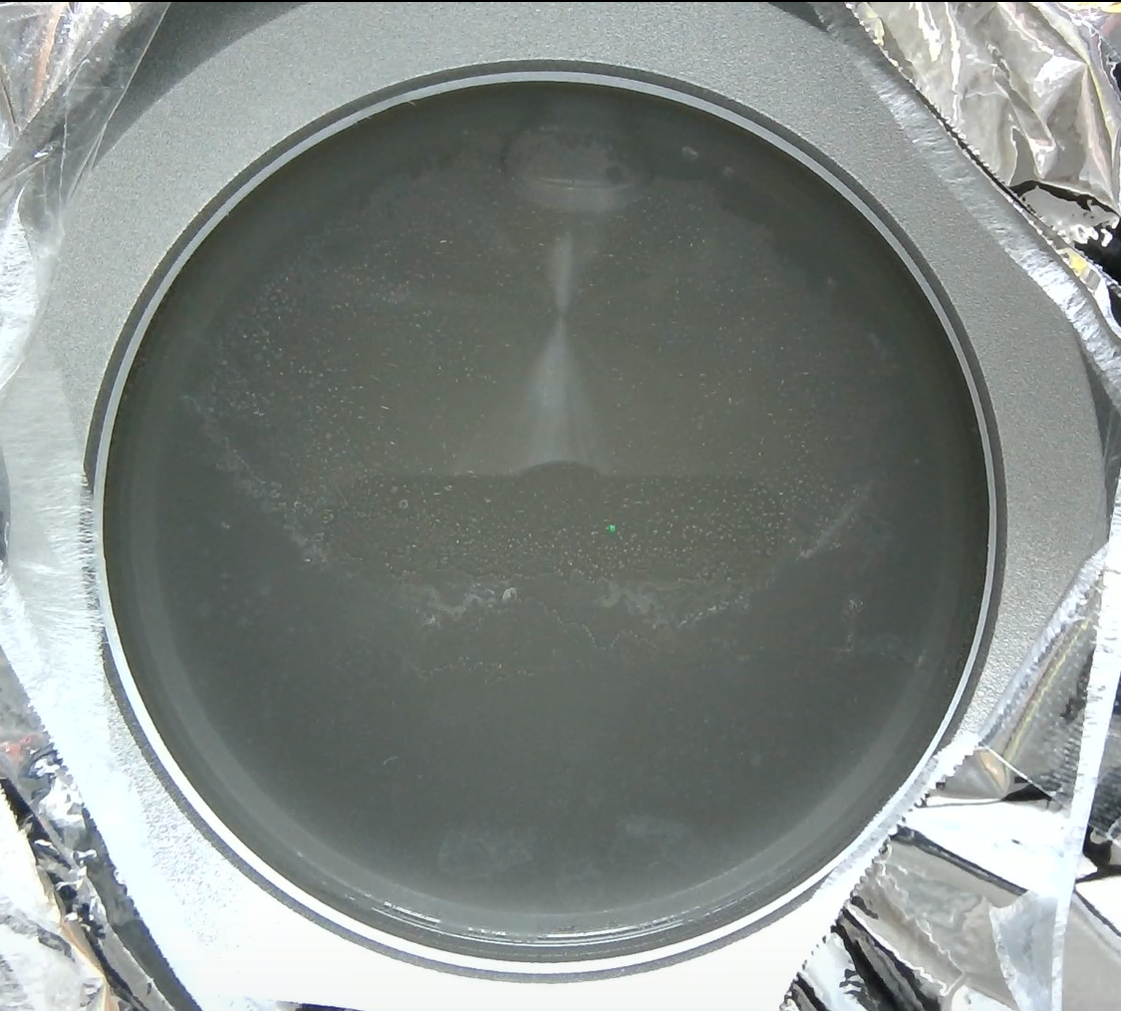
Transparency
due to water content in LS, transparency decreases as the temperature drops
near 0 ℃, liquid becomes cloudy
at -91 ℃, transparency drops to about 20% of that in room temperature (430 nm LED)
16°C
-2°C
-91°C

Slide 21
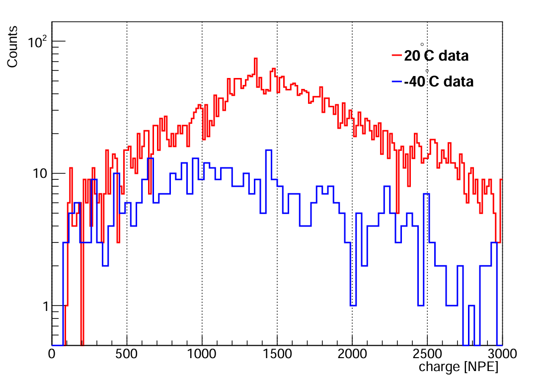
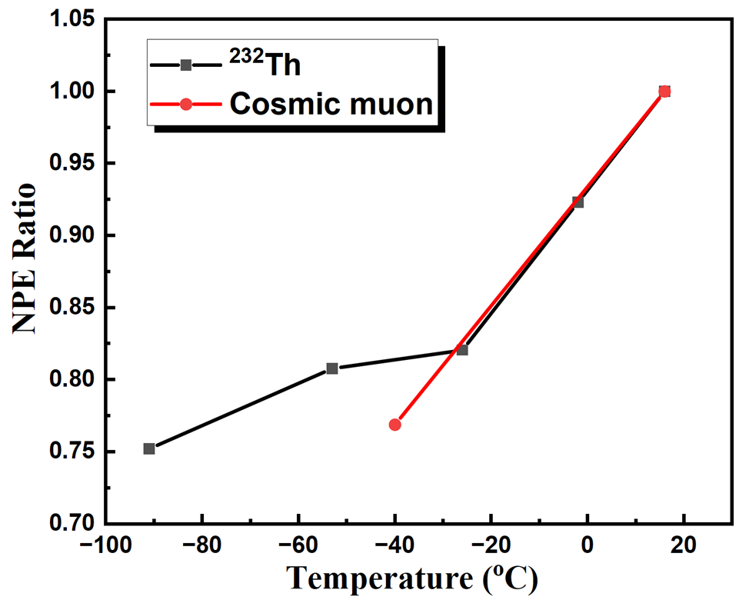
Light Yield
cosmic rays, ²³²Th gamma source
light yield decreases with temperature due to drop in scintillation light production and transparency
cosmic muons

Slide 22
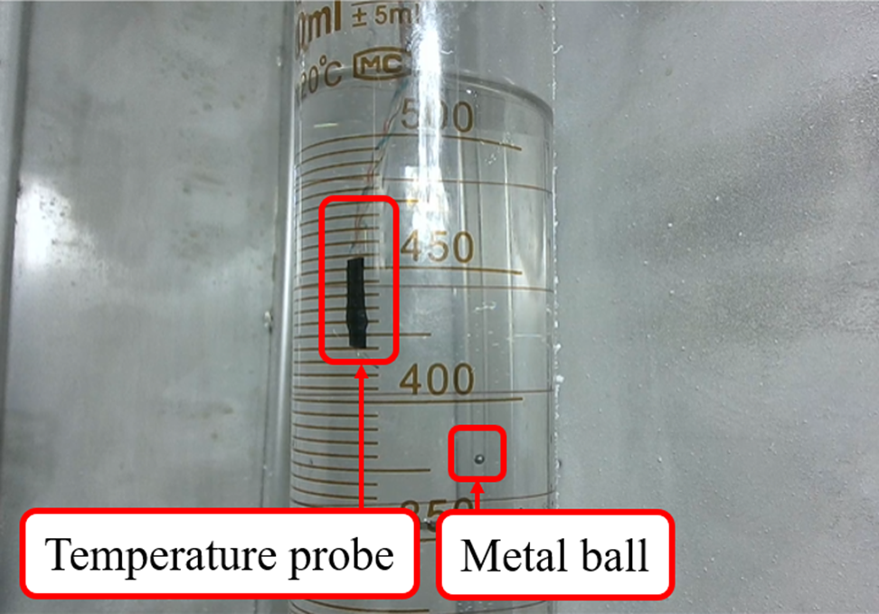
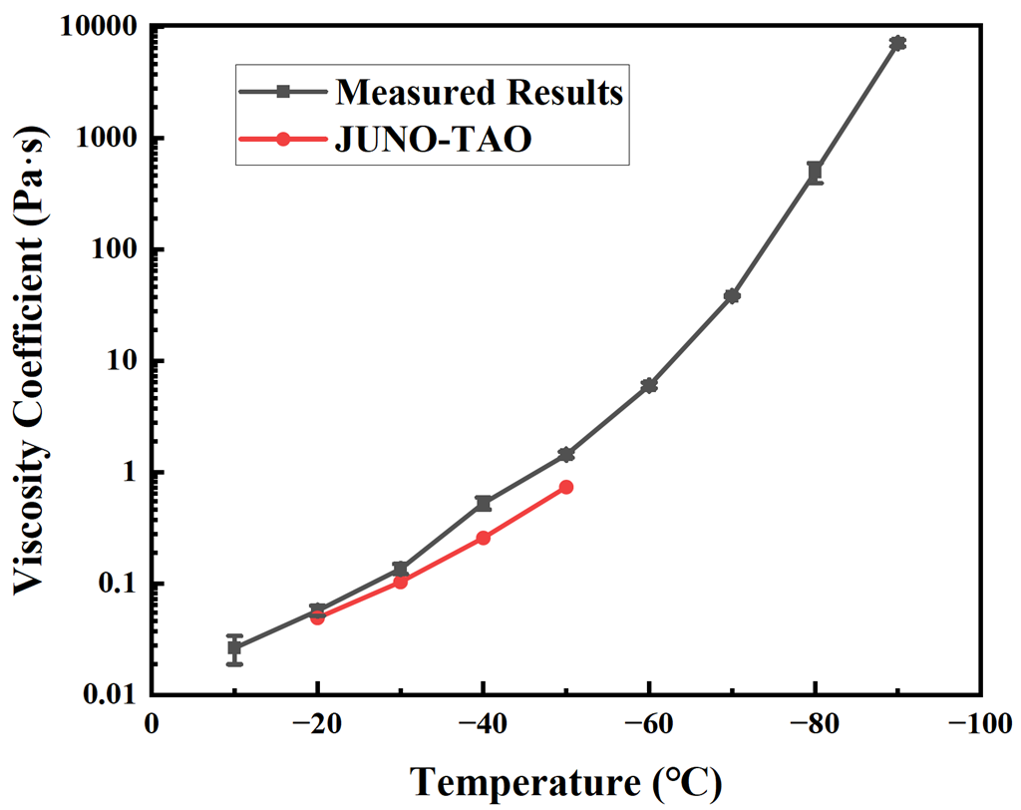
Viscosity Measurement
measure viscosity at low temperatures with the falling-ball method
remove water content with argon gas for better visibility of the ball
*
* Z.Q. Xie et al, Nucl. Instrum. Meth. A,165459 (2021)

Slide 23
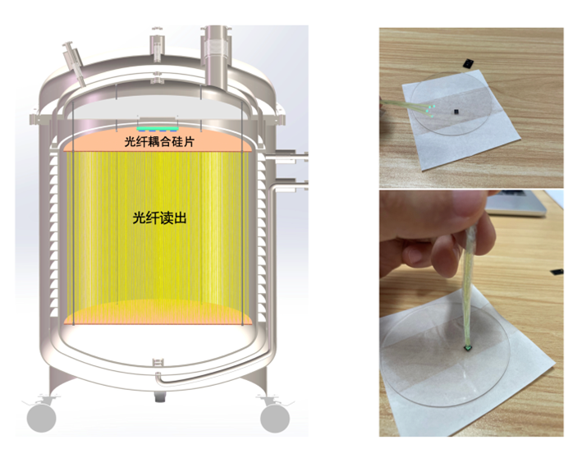
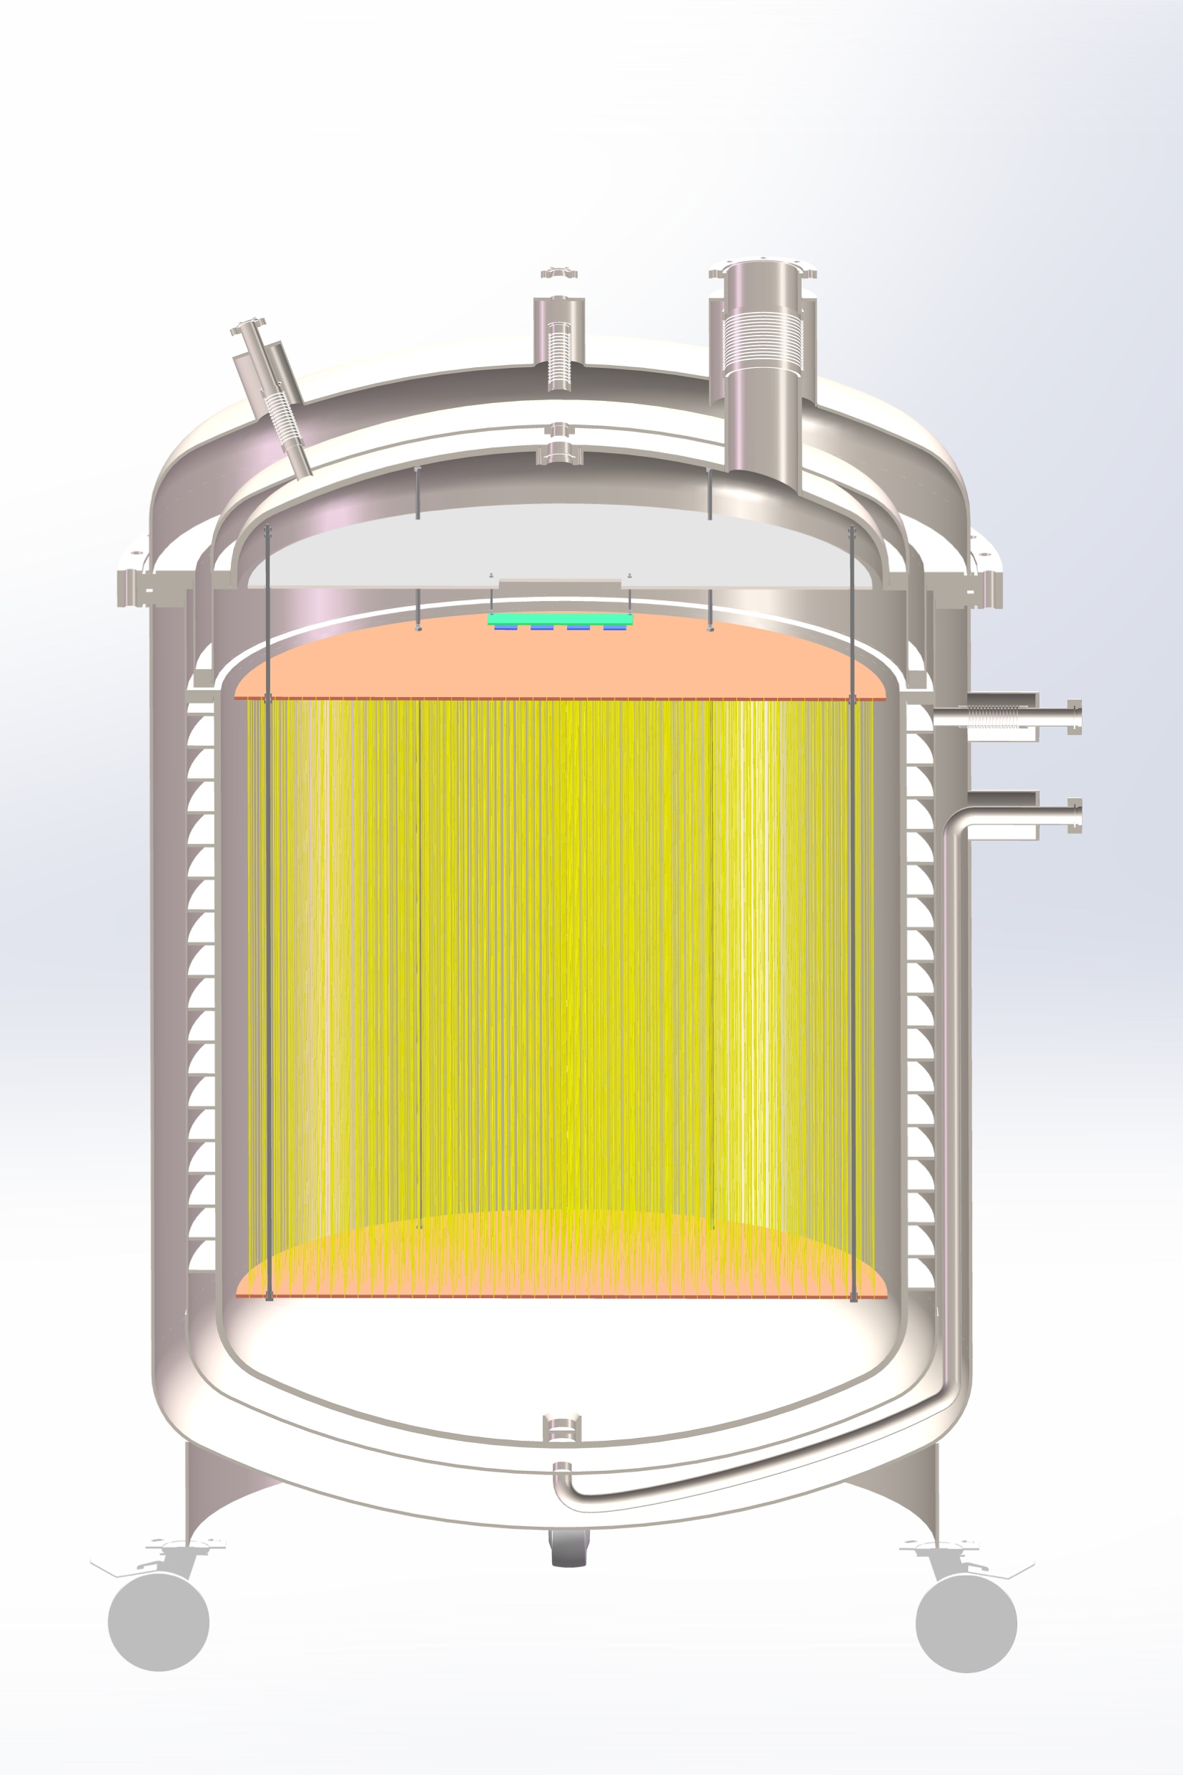
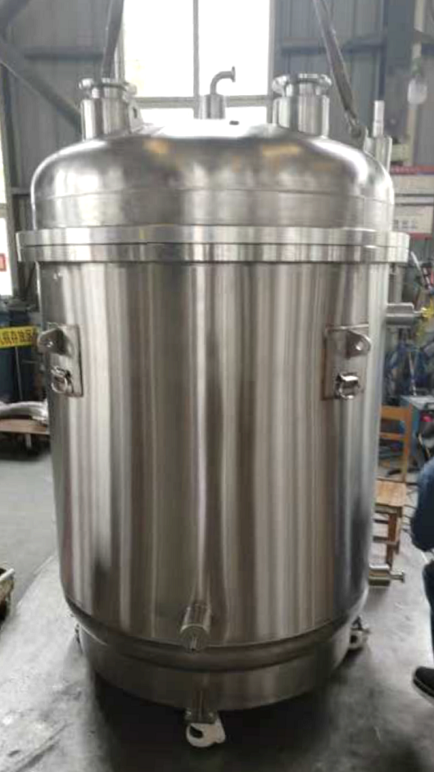
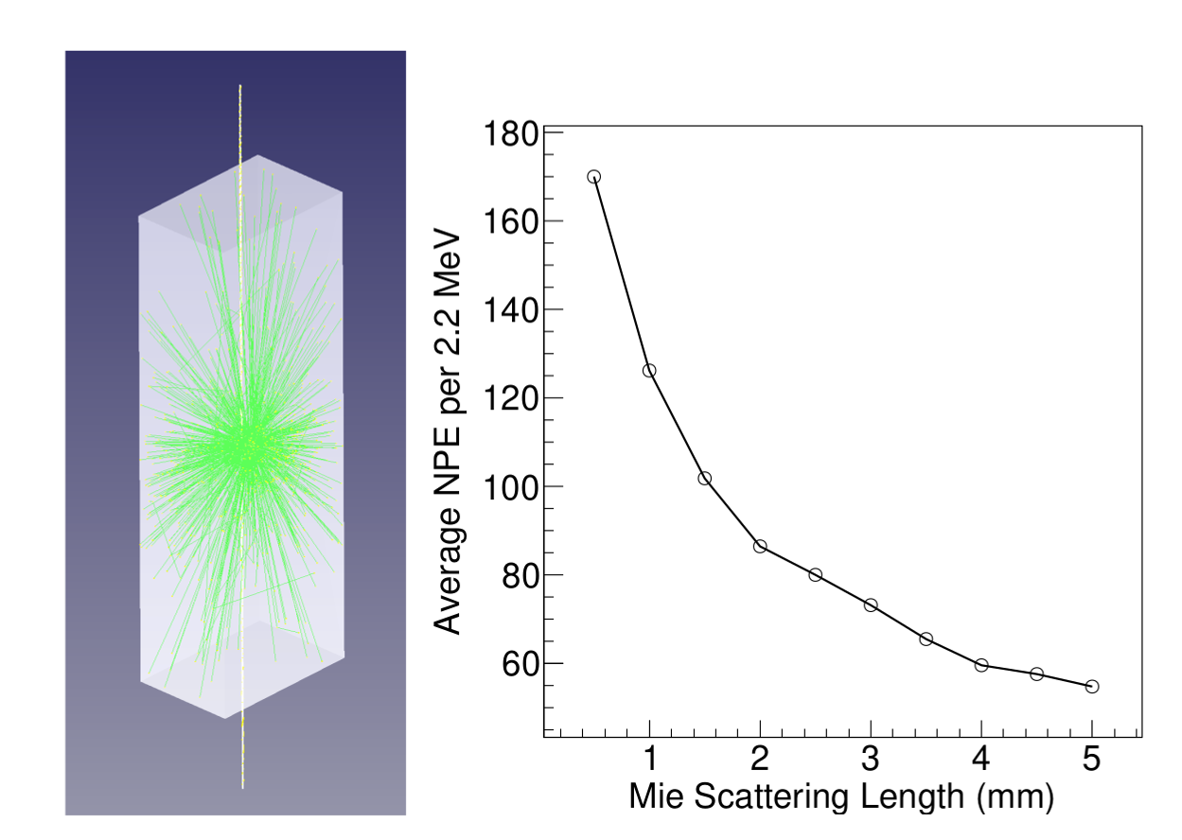
1 m³ Prototype
opaqueness helps light collection with fibers (LiquidO concept*)
1 m³ prototype under construction, considering fiber + SiPM readout
about 1 m³
* Commun.Phys. 4 (2021) 273

Slide 24
Summary and Plan
0.9 kton water Cherenkov veto for PandaX-4T
  tagging neutrons, gammas, and cosmic rays
  52.2% neutron tagging efficiency
4 kton water Cherenkov veto for PandaX-20T
  muons, atmospheric neutrinos
  3-inch PMT array, time over threshold, electronics are being developed
  detector design is ongoing
cold liquid scintillator veto for PandaX-xT
  preliminary measurement on transparency, light yield, and viscosity
  1 m³ prototype being constructed
for more details, please see posters
  332: Xuanye Fu, Yule Huang, Peiyuan Li, Zhiyuan Li, Dongqi Yang
  343: Manna Deng, Yujie Ge,Yule Huang, Peiyuan Li, Xiyuan Shao, Jianqin Xu
  344: Yuxin Tian

Slide 25
Backup

Slide 26
