Slide 1




TAUP 2025, Xichang, August 27, 2025
Multiband Gravitational Wave and Multimessenger Astronomy with Galactic compact binaries
Yan Wang (王炎)
Huazhong University of Science and Technology
ywang12@hust.edu.cn
in collaboration with
Wen-Fan Feng (冯文凡, HUST), Hong-Ming Jin (靳鸿鸣, HUST), Yao Fu (付瑶, HUST), Tan Liu (刘谈, HIAS), Jiewen Chen (陈洁文, NTSC),
Yong Shao (邵勇, NJU), Bo Ma (马波, SYSU), and
Soumya Mohanty (UTRGV)

Slide 2
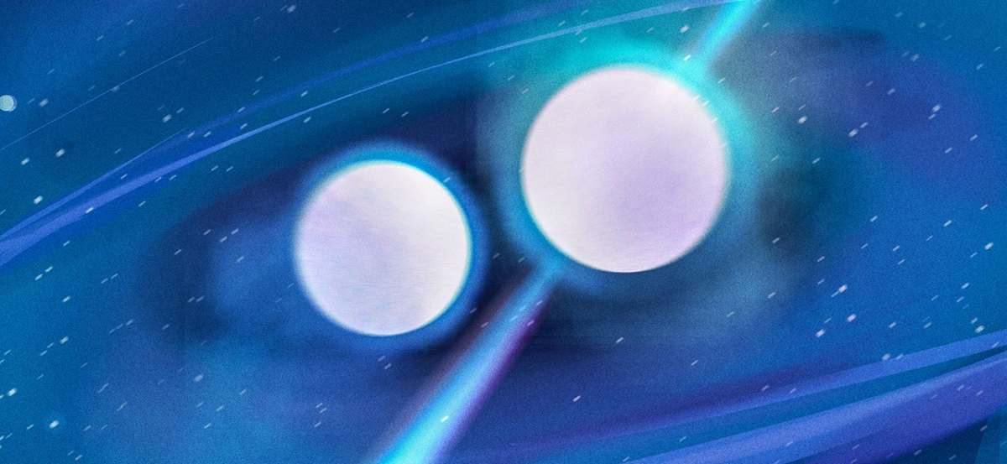
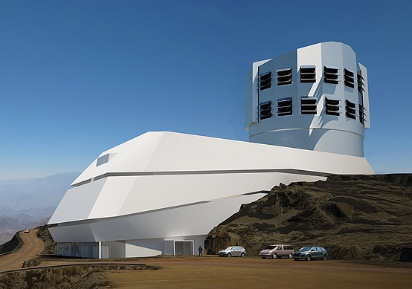
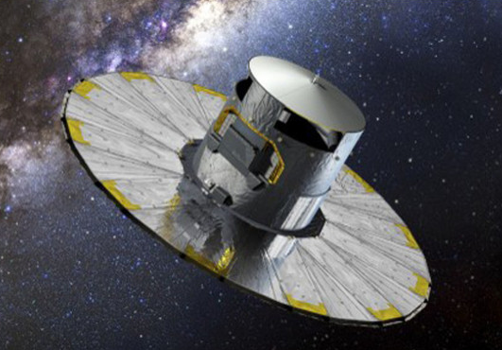
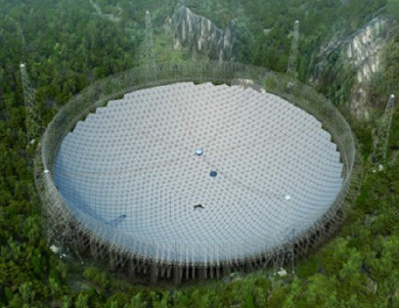
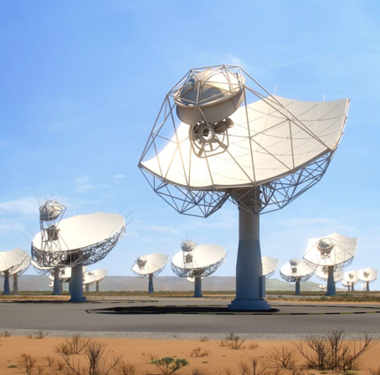
Multimessanger astronomy of Galactic compact binaries
Binary star evolution
+
Galactic structure
Binary population & distribution
VRO
GAIA
GW detectable
EM detectable
PE accuracy
by GW
PE accuracy
by EM
FAST
SKA
Multimessanger
astronomy
Notes:
For multimessanger astronomy of the galactic compact batteries, our approach is to combine the binary star evolution and Galaxy structure to syntheses binary population and their distribution in our Galaxy and then based on anticipated performance of gw() and em detectors(), we study the perspectives of their multi-messenger astronomy.

Slide 3
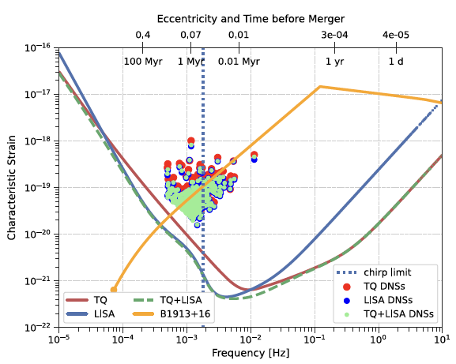
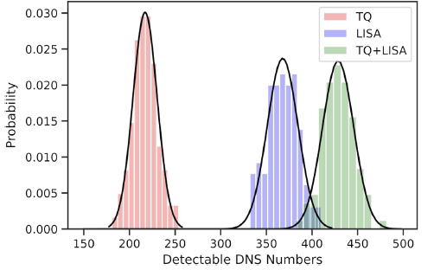
Numbers of DNS detectable by GW
20 DNSs discovered by radio (PSR J1946+20, Pb = 1.88 hr);
Doppler smearing makes searching for shorter period DNS challenging;
LIGO inferrs DNS merger rate ~210/Myr for our Galaxy;
Expect ∼2100 DNSs with Pb < 1 hr (Andrews et al., ApJL, 2021).
Feng et al. PRD 2023a (arXiv: 2305.05202)
Notes:
The first thing is the double neutron stars in our Galaxy. Some studies shows that there could be more than 2000 DNS with orbit period less than one hour, these are potentially detectable by space GW detectors. And our simulation results, based on the sensitivity curves of LISA and TQ, show that > 300 sources can be detectable by LISA/TJ, and this number is > 200 for TQ. Their combination can increase the LISA alone case by about ~20%.

Slide 4
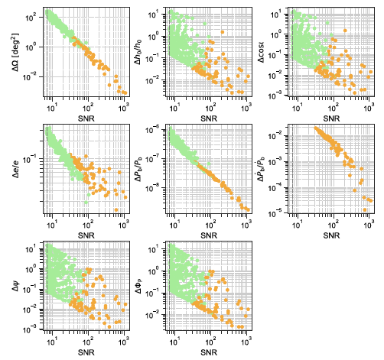
Parameter estimation accuracy by GW
Feng et al. PRD 2023a (arXiv: 2305.05202)
Notes:
Based on Fisher information analysis, our results show that for TQ+LISA, a source with total SNR around 100, the sky localization ΔΩ ≲ 1 deg2, the relative error of orbital eccentricity Δe/e ≲ 0.1, the relative error of the orbital period derivative ΔPb/Pb ≲ 0.004. These information (sky loc and orbit elements) will be crucial for radio telescopes to conduct follow up observation of the possible radio pulsars in these systems.

Slide 5
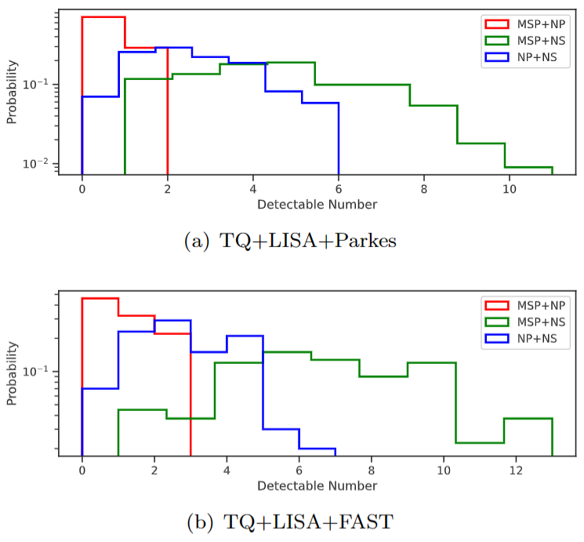

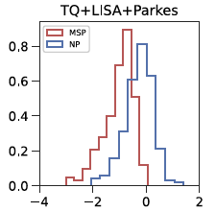
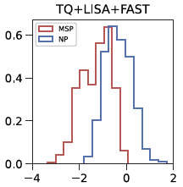
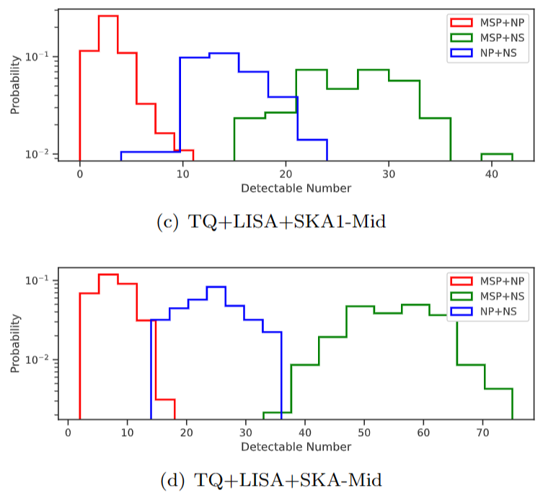
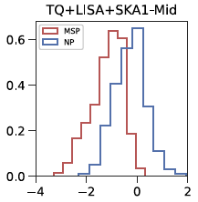
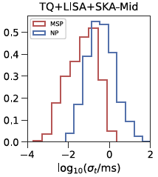
DNS jointly detectable by GW & Radio
Feng et al. PRD 2023a (arXiv: 2305.05202)
Notes:
For the radio band counterpart, we simulate the radio pulse emission from the possible pulsars in these DNSs according to pulsar beam geometry and the empirical distributions of spin period and luminosity. This is the histograms of the numbers of the pulsar binaries jointly detectable by TQ+LISA and the radio telescopes (Parkes, FAST, SKA1-Mid, and SKA-Mid). Say, we can detect several dozens of MSP+NS with SKA-mid. Some of them can be time with a timing precision better than 1 us by SKA.

Slide 6
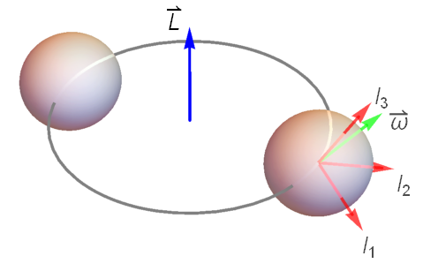
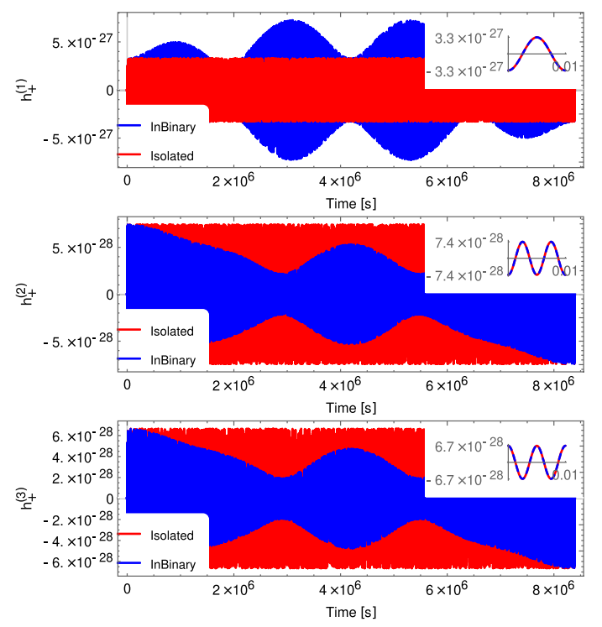
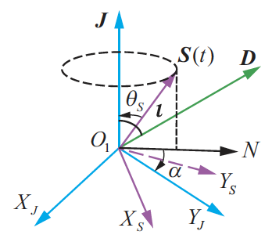
Spin-orbit coupling effects on GW
Feng et al. PRD 2023b (arXiv: 2307.01055)
Notes:
In our double neutron star simulation, we found sources that could have orbit period less than ten minutes. And in the such ultra compact batteries, we need to consider the spin-orbit coupling in the calculation of the gravitational waveform, especially for the high frequency continuous GWs (CWs) from the spinning of a NS that can be detected by the current and the next generation ground-based GW detectors such as CE and ET.
In such a system, the spin axis S of the NS will precess around the total angular momentum J of the system in a typical period of a few months.
The spin-orbit coupling makes the CW waveform more complicated, particularly, the frequency will be split into several harmonics of the spin precession frequency around the original spin frequency.

Slide 7
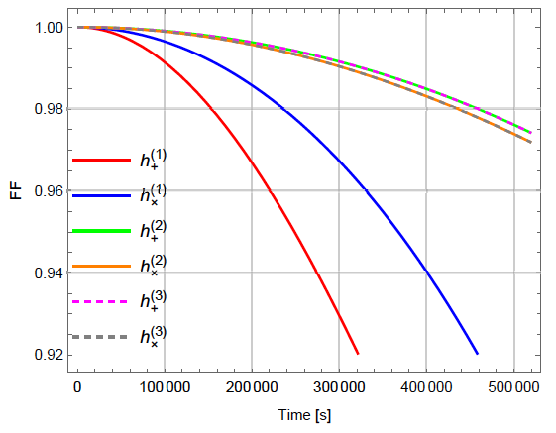
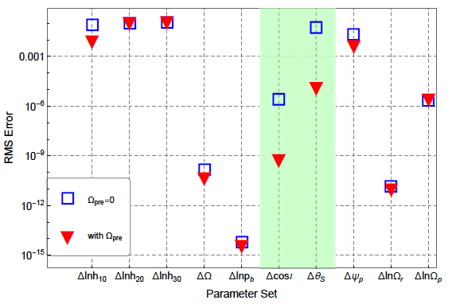
Waveform mismatch and PE accuracy
Feng et al. PRD 2023b (arXiv: 2307.01055)
Notes:
In short, this waveform turns out to be very important for the future third-generation ground-based detectors, since if we don't consider the spin-orbit effects, then the fitting factors (FF) between the true waveform and the template waveform will be decreased dramatically after several days. On the other hand, considering this effects will improve the parameter estimation accuracy than the no spin-orbit coupling cases. Especially, for the inclination angle iota and spin misalignment angle thetaS (between S and J) will be dramatically improved by about three order of magnitude.

Slide 8
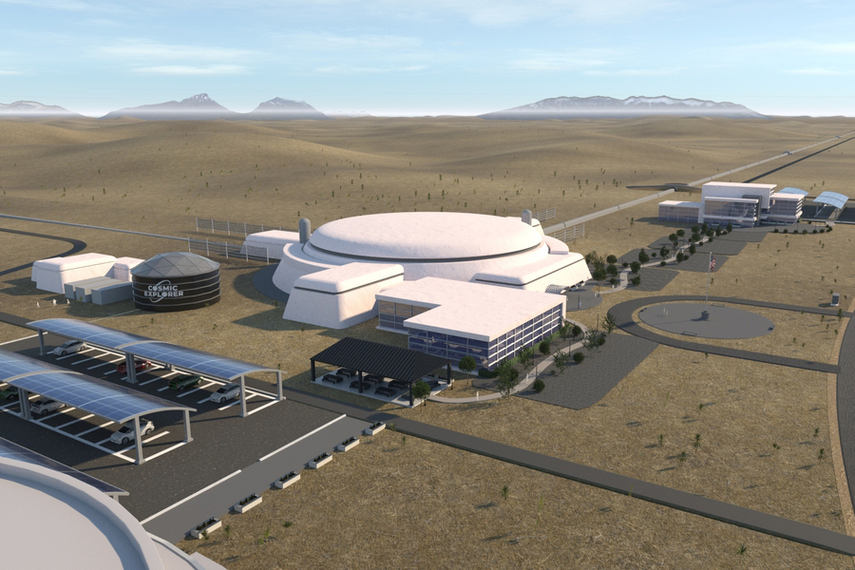
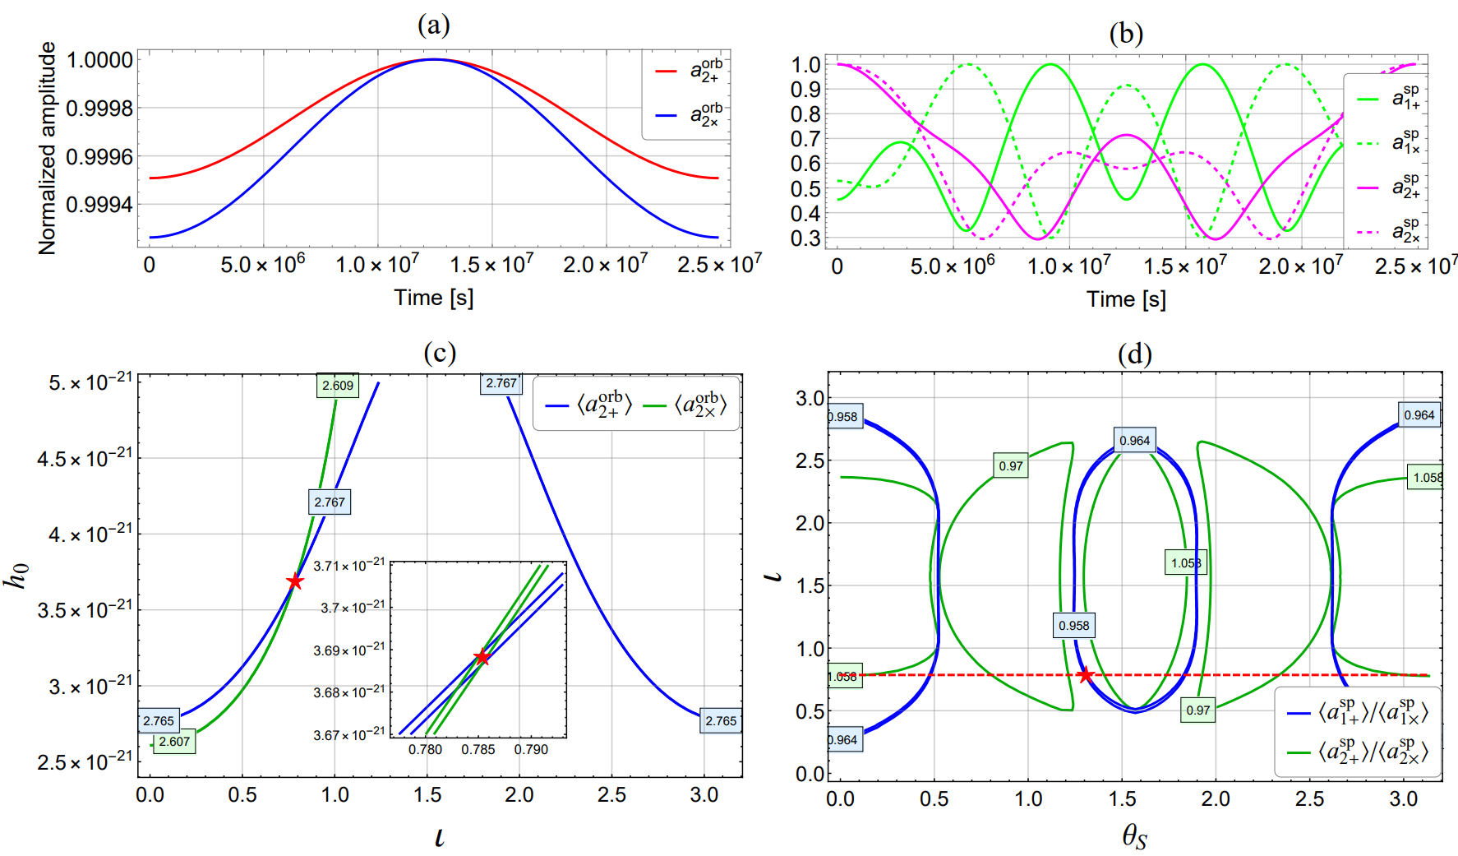
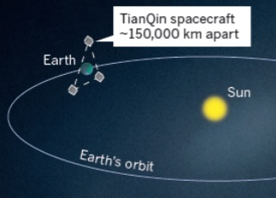
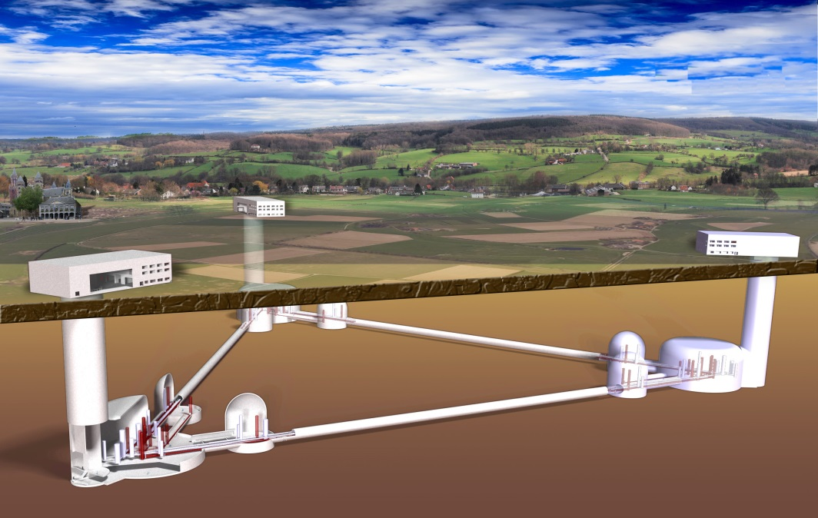
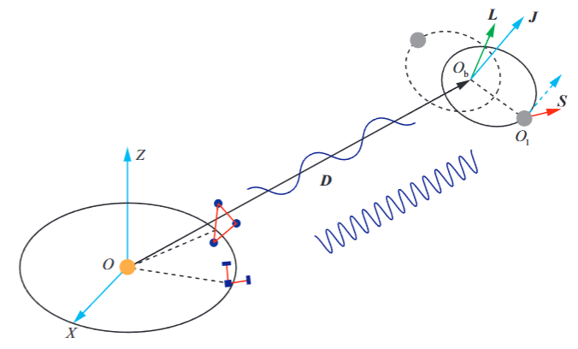
Dual-line GWs from DNS
Space detector
(TianQin/LISA)
Ground detector
(CE/ET)
Reconstruct the evolope of high and low frequency GW amplitudes
spin-orbit misalignmentangle ~1%
NS moment of inertial ~5%
Feng et al. PRD 2024 (arXiv: 2401.11241);
Feng et al. PRD 2025 (arXiv: 2410.09540)
Notes:
In addition to the high frequency CWs from spinning NS, the orbital motion between the two NSs will generate low frequency GWs that can be detected by the space-based detectors. It is a so-called dual line system.
Based on our preliminary investigation, if we can reconstruct the envelop of the high frequency and low frequency GW amplitudes from data. We can constrain the mis-alignment angle to a precision of about 1% or even better, and constrain NS moment of inertial to a few percent which is hard to be archived by EM/radio observations. This provides us an unique opportunity to study the geometry of the binary system and NS physics.

Slide 9
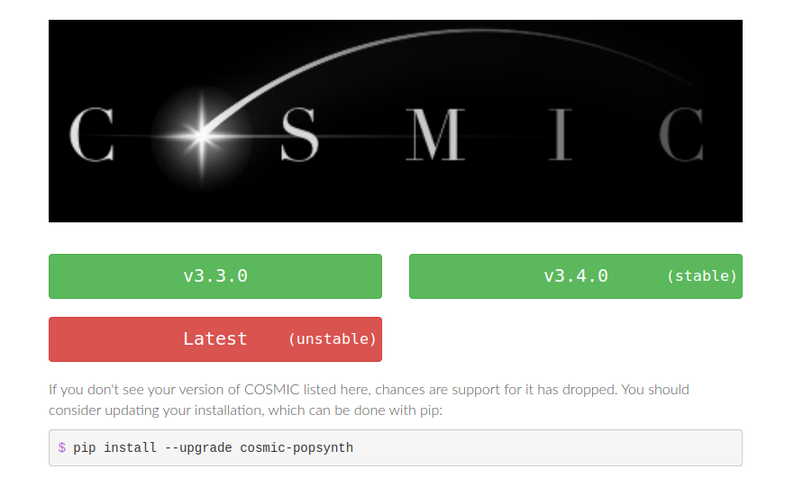
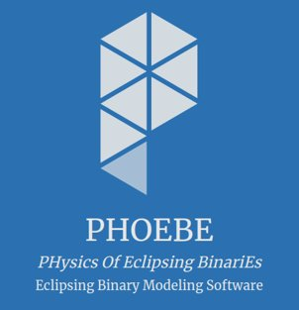
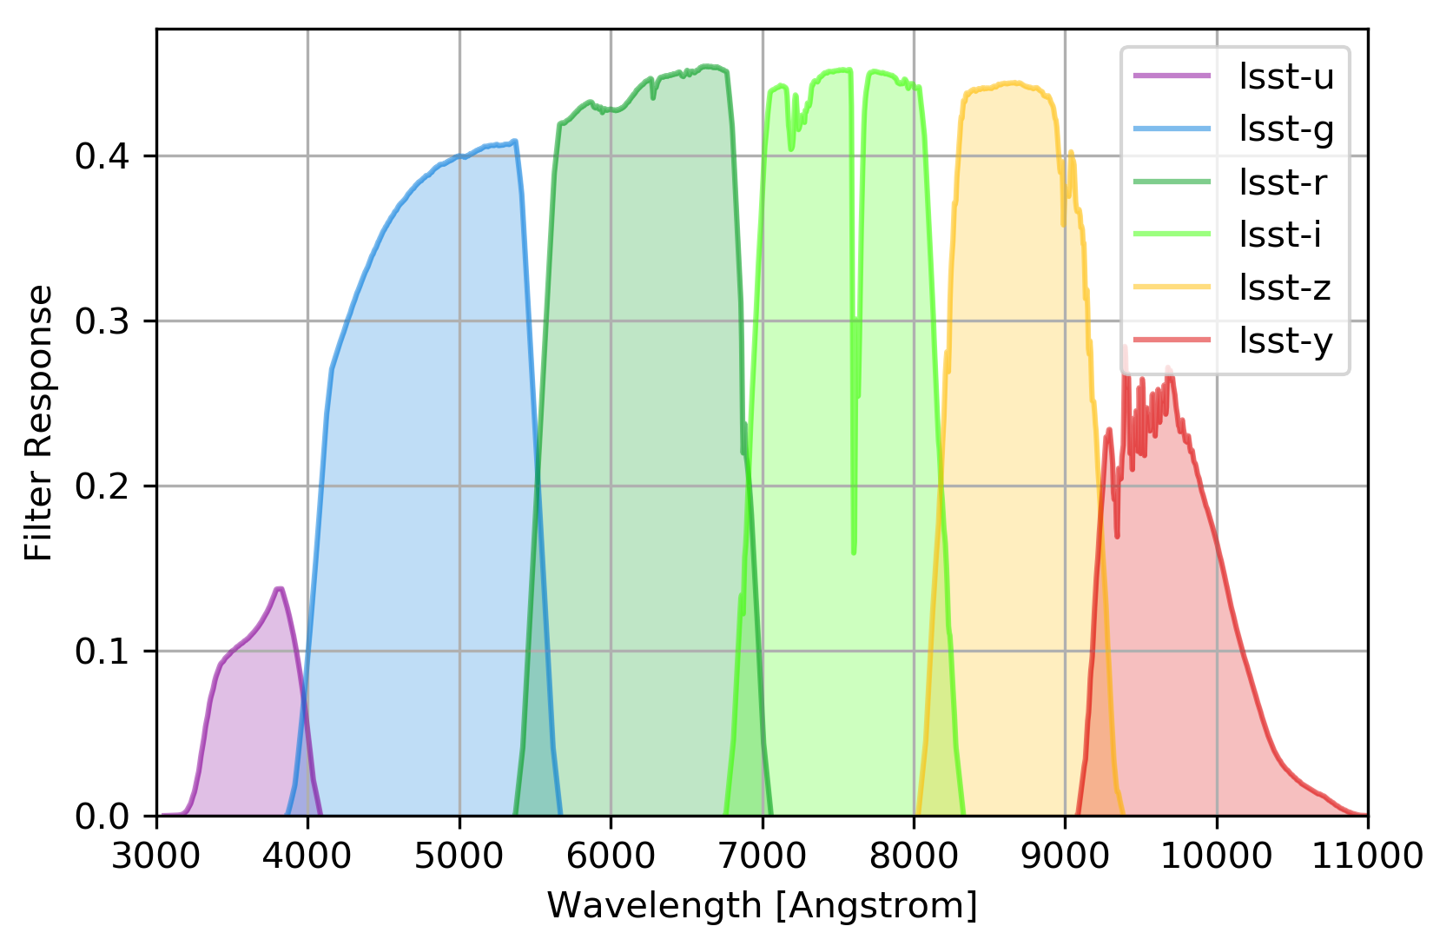
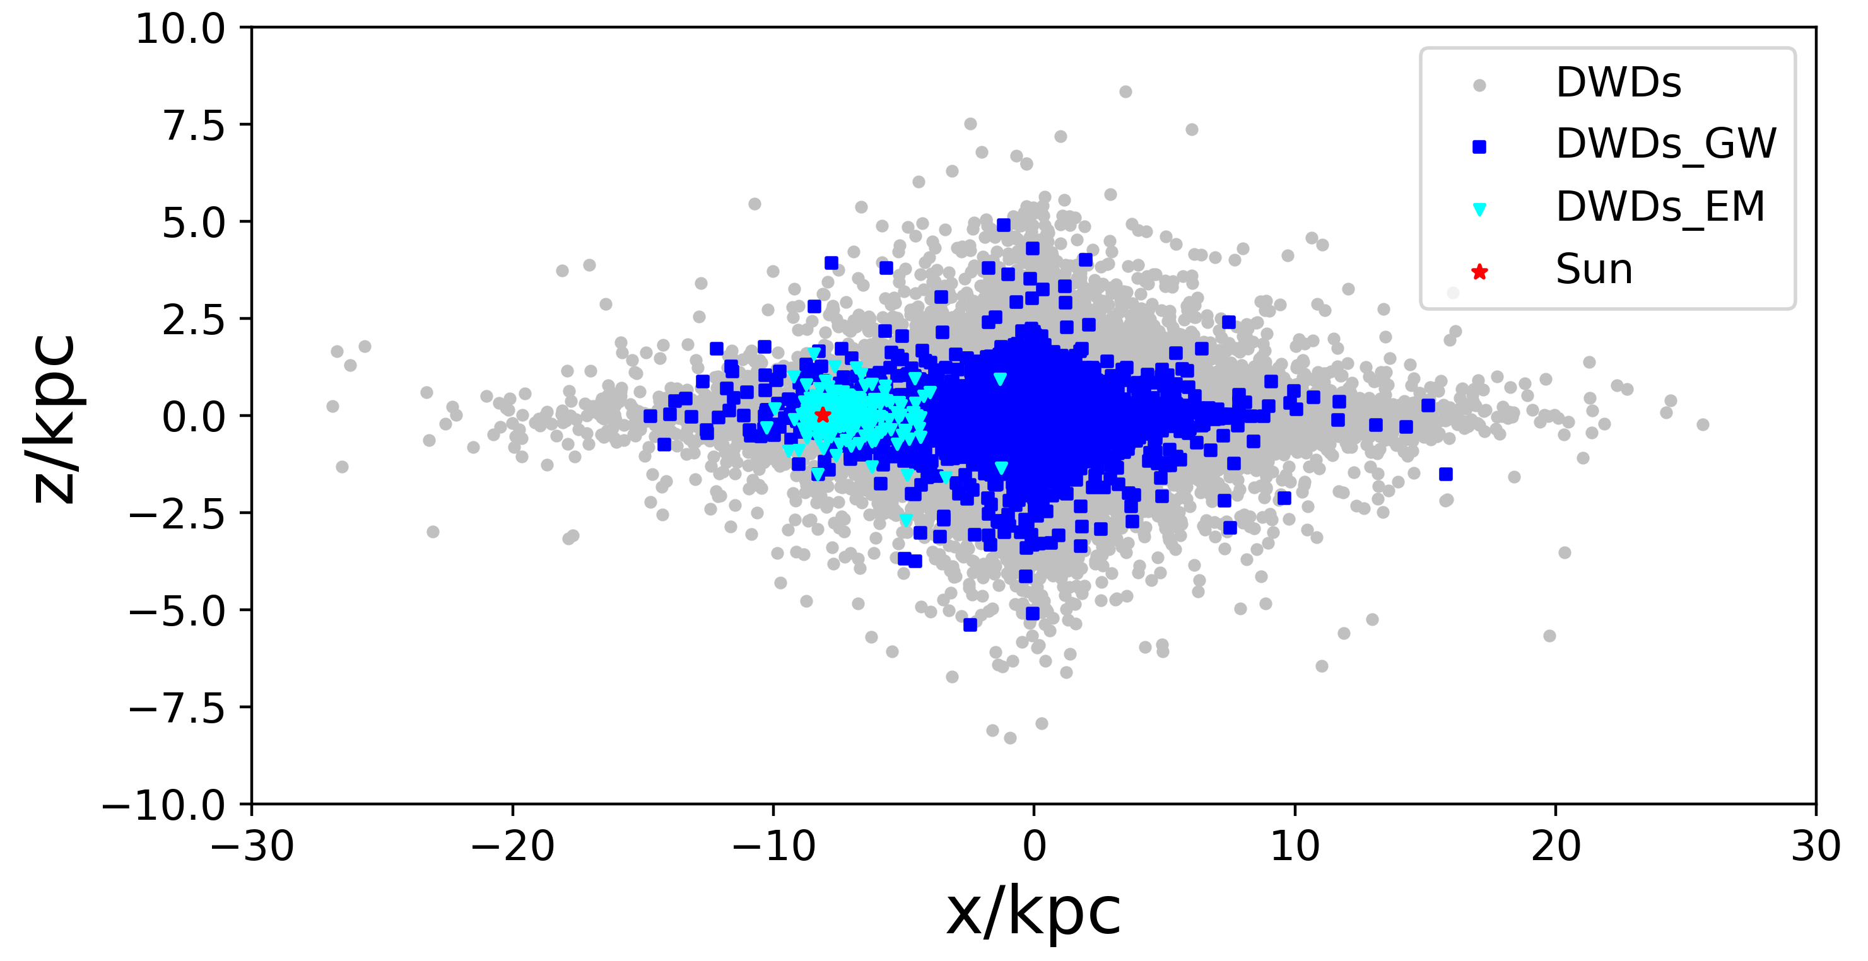
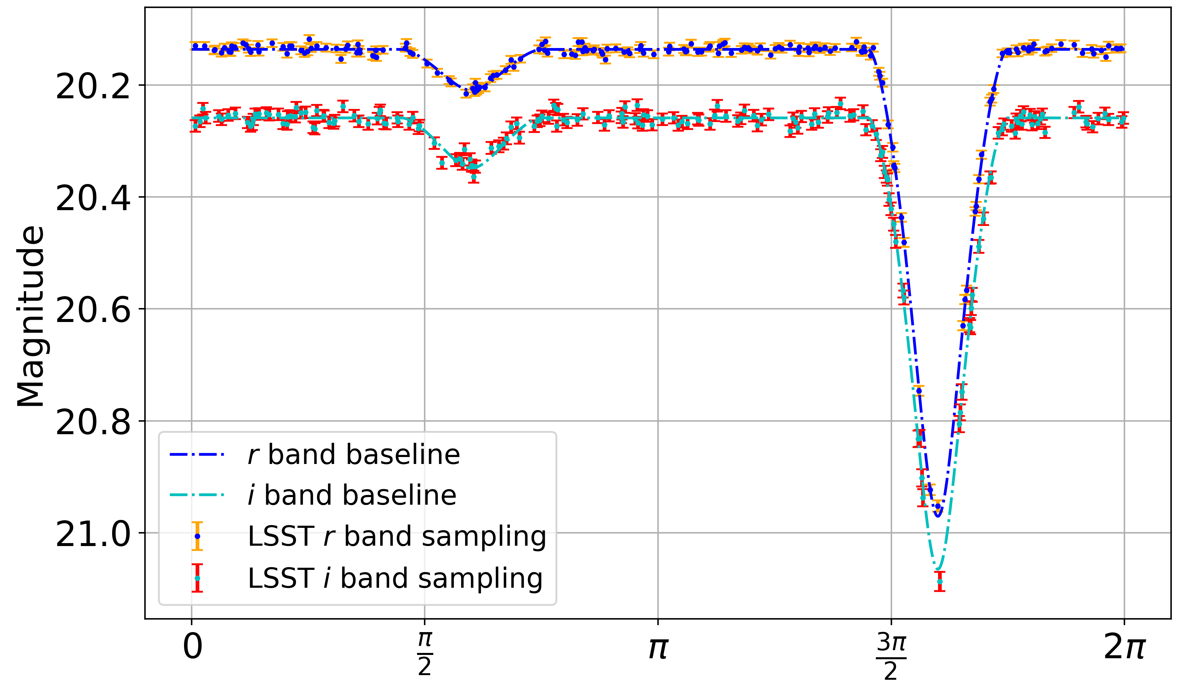
DWD population synthesis & light curve
DWD in bulge: 1.04e8
DWD in thick disk: 1.686e8
DWD in thin disk: 5.05e8
Jin et al. MNRAS 2025 (arXiv: 2406.16474)
Notes:
The the second galactic compact binary is the double white dwarfs. They are the most popular ones in our galaxy. For this, we conducted some systematic simulations of the DWD population in the disk and bulge of our galaxy based on a BSE package cosmic.
Meanwhile giving the physical parameters of the DWDs such as the radius, surface temperature of these DWDs, we can simulate light curves of them in the optical telescopes such as Gaia and LSST (Vera Robin Obs.) using a software called phoebe. Here, we also consider the filter response of these telescopes as well as the number of visits of certain sky area during their all sky survey.

Slide 10
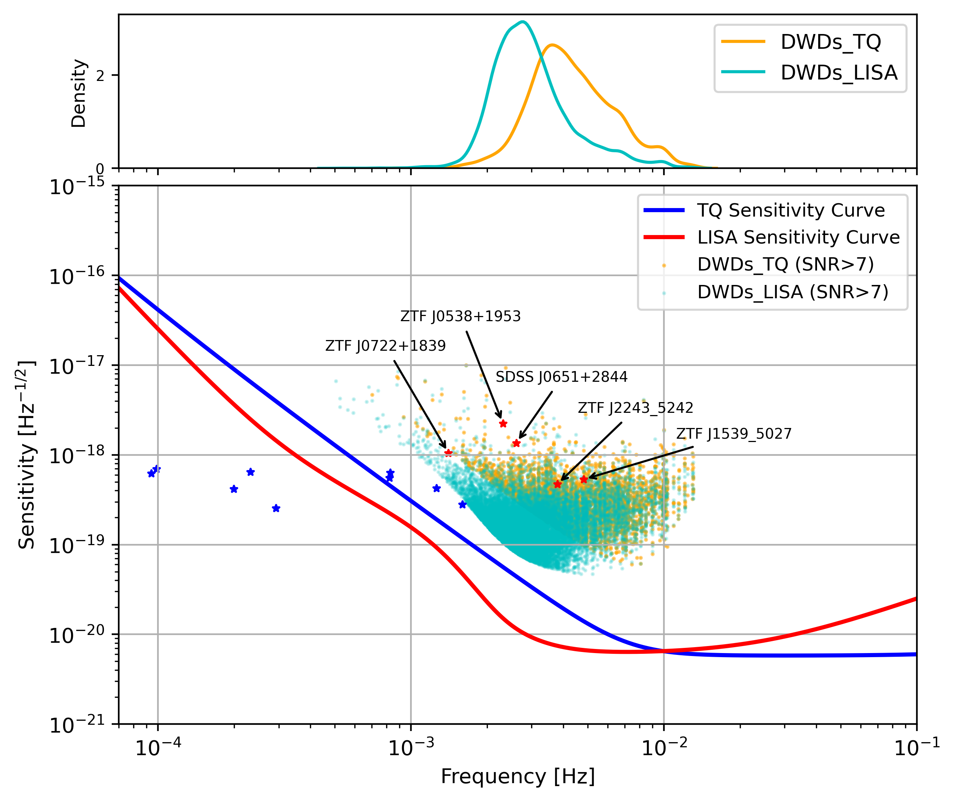
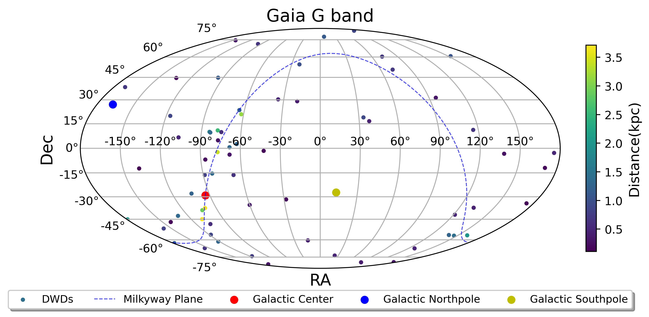
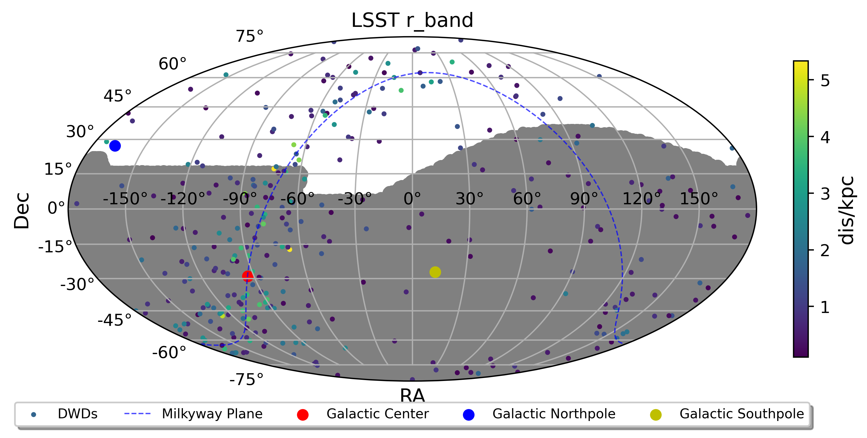
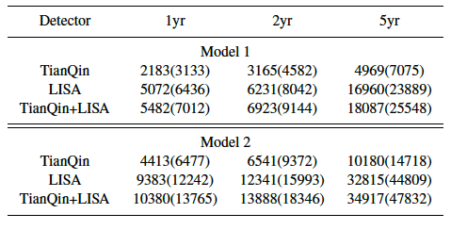
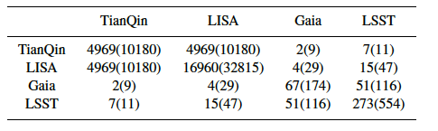
GW and EM observations of DWDs
Jin et al. MNRAS 2025 (arXiv: 2406.16474)
Notes:
Based on LISA and TianQin's sensitivity curves, we found the number of the DWDs that can be detected, with SNR>7, by TQ, Lisa and their joint observation for populations from two distinct star formation histories. We consider a duty cycle of 50% for Tianjin and 75% for Lisa. These numbers from M2 are more consistent with previous study for these two detectors. In the plot on the right hand side, we show the sky distribution of the eclipsing double white dwarfs that can be detected by Gaia and LSST. The shaded area represents the visible sky area by LSST. We can see from this table that around several hundred eclipsing DWDs can be observed by LSST. Among them, dozens can be jointly detected by Tianjin or Lisa.

Slide 11
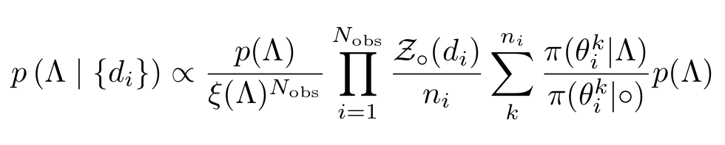
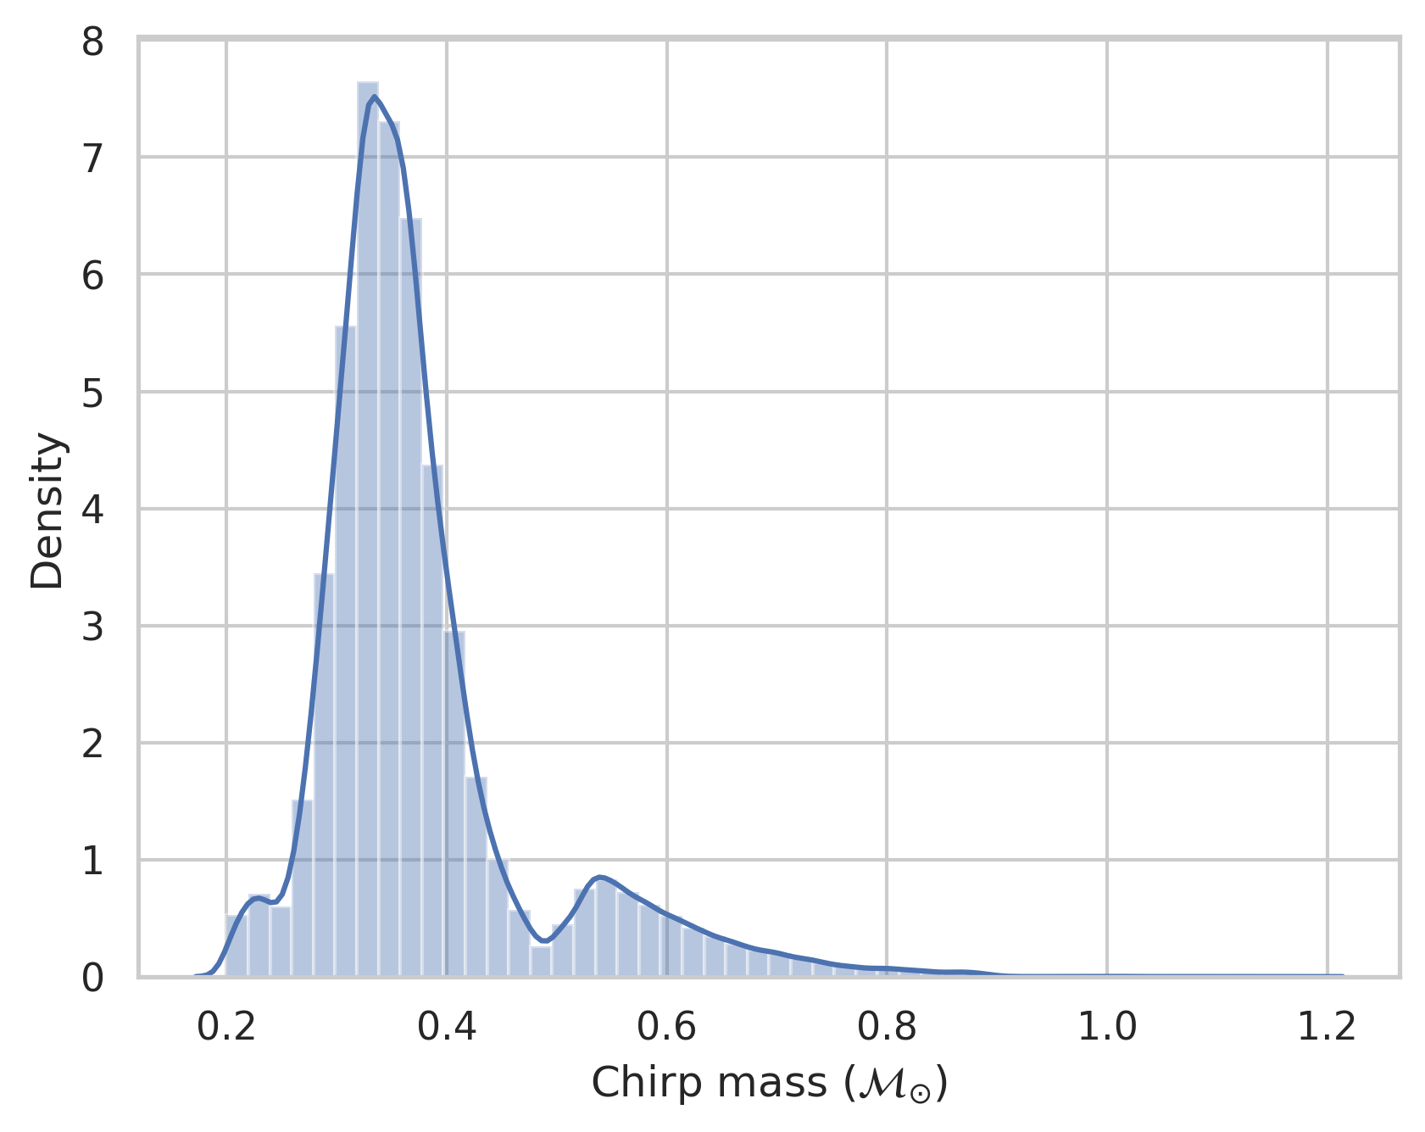

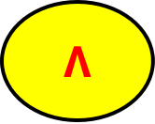

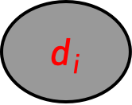
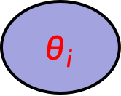
Hierarchical Bayesian for DWDs
$$Λ$$
Hyper-parameters
$$θ_{i}$$
Parameters
$$d_{i}$$
Observations
$$N_{obs}$$
Models : Powerlaw + Gaussian
Notes:
Besides the estimated parameters of the individual DWDs in our Galaxy, we want to know the overall property of the population, which are characterized by several hyper parameters. The values of the hyper para. can be inferred from HB method. Based on our DWD simulation, we found that our chip mass can be described by a power law plus peak (Gaussian distribution) model. There are four hyper parameters.

Slide 12
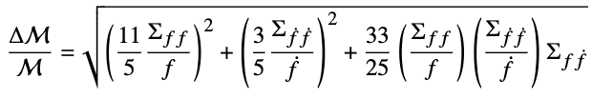
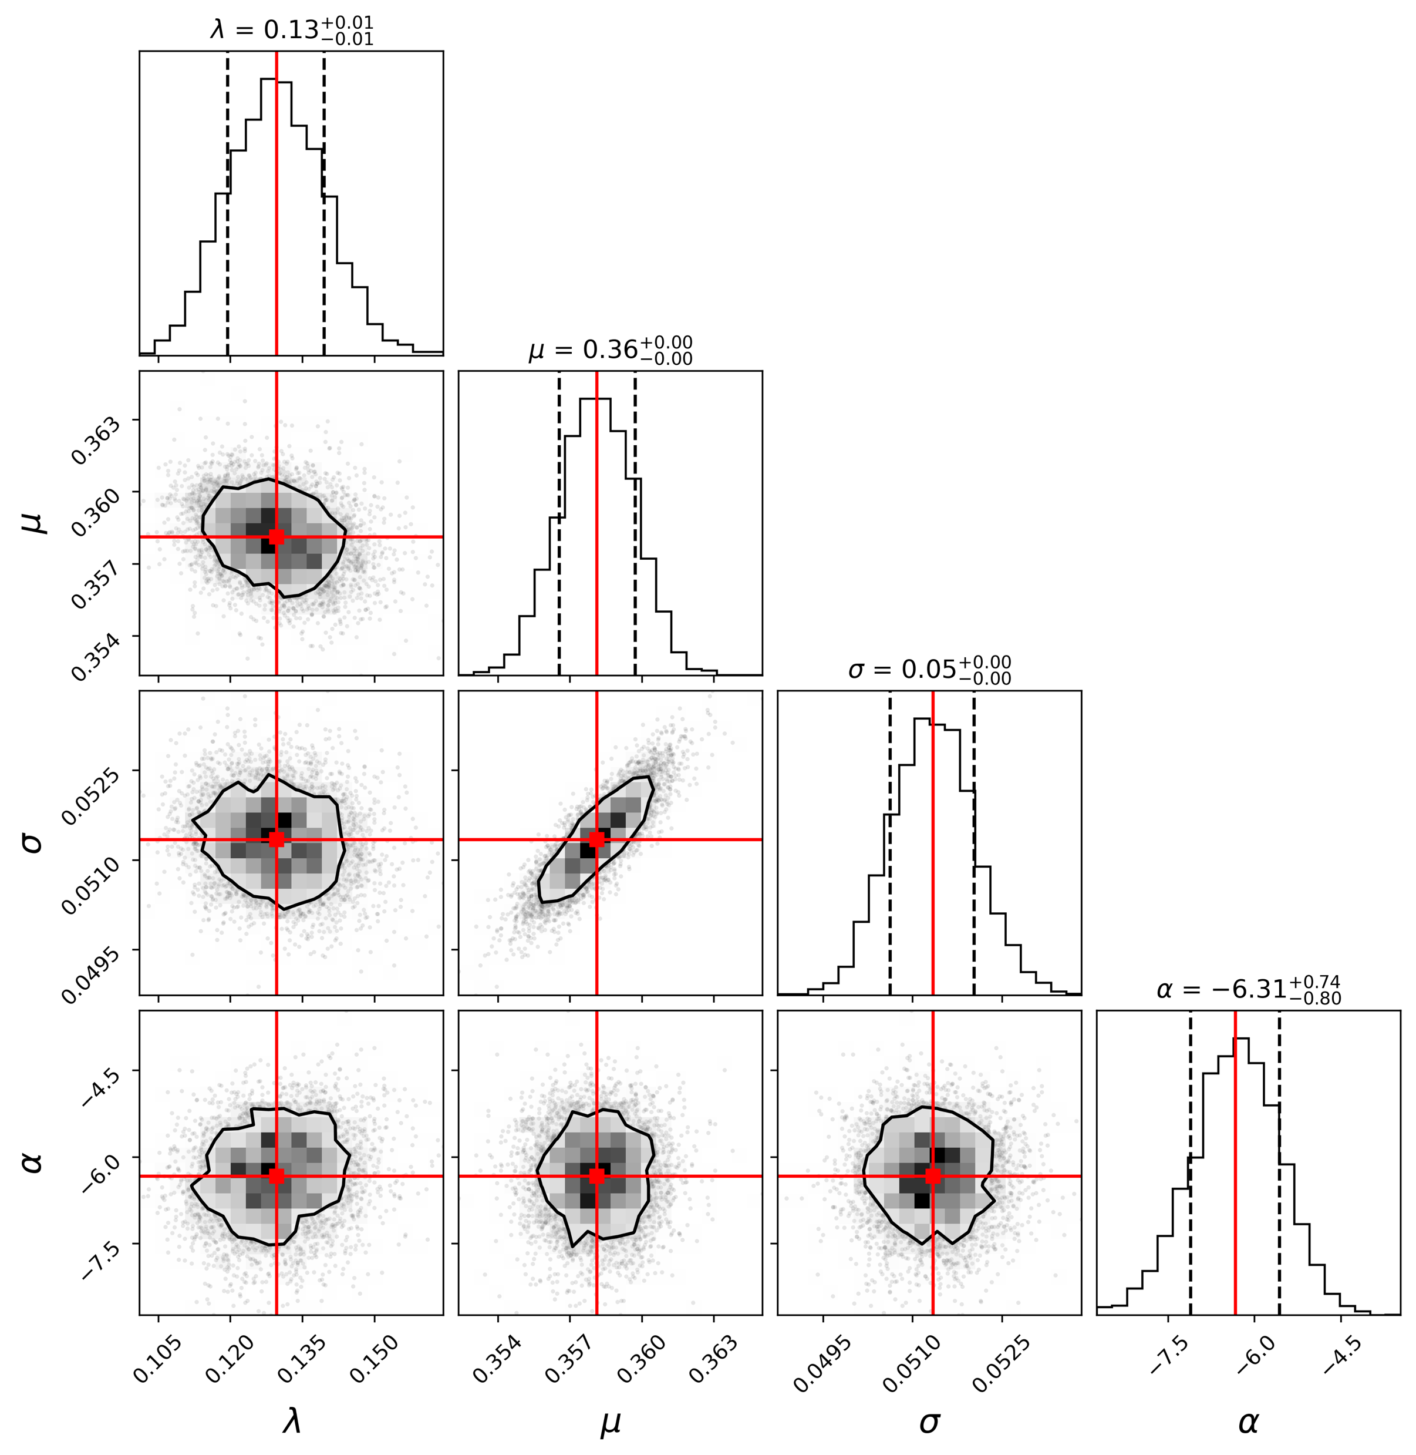
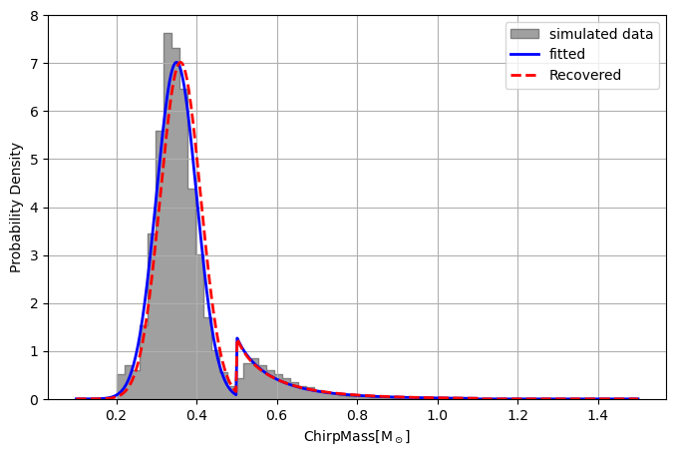

Posterior of hyper-parameter
True values：$ω=0.12，μ=0.35，σ=0.05，α=−5.95$
$$\frac{Δℳ}{ℳ}<10\%：$$
$$ω=0.13，μ=0.36，$$
$$σ=0.05，α=−6.31$$
TQ+LISA
Jin et al. 2025 in prep.

Slide 13
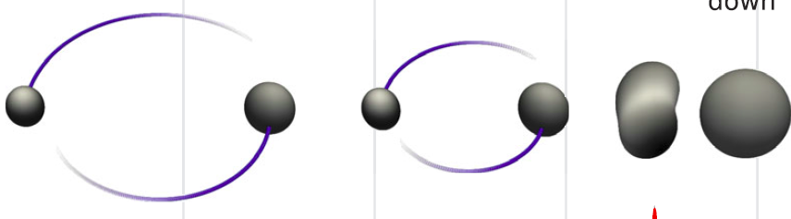
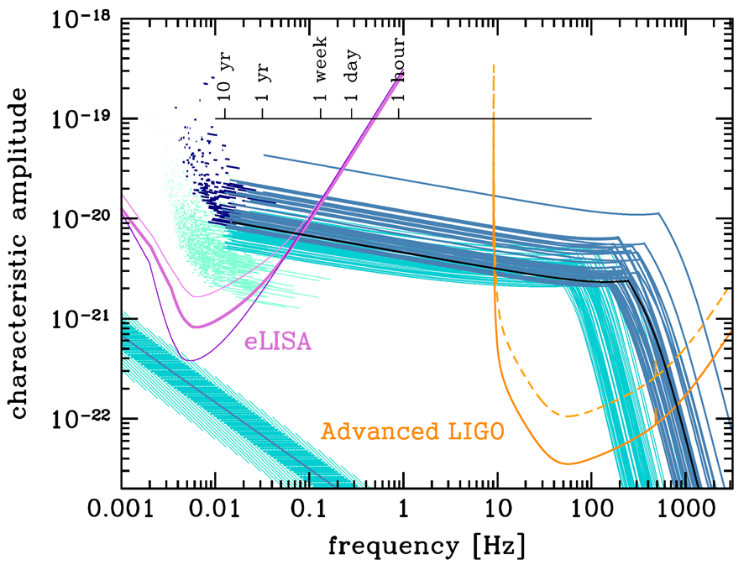
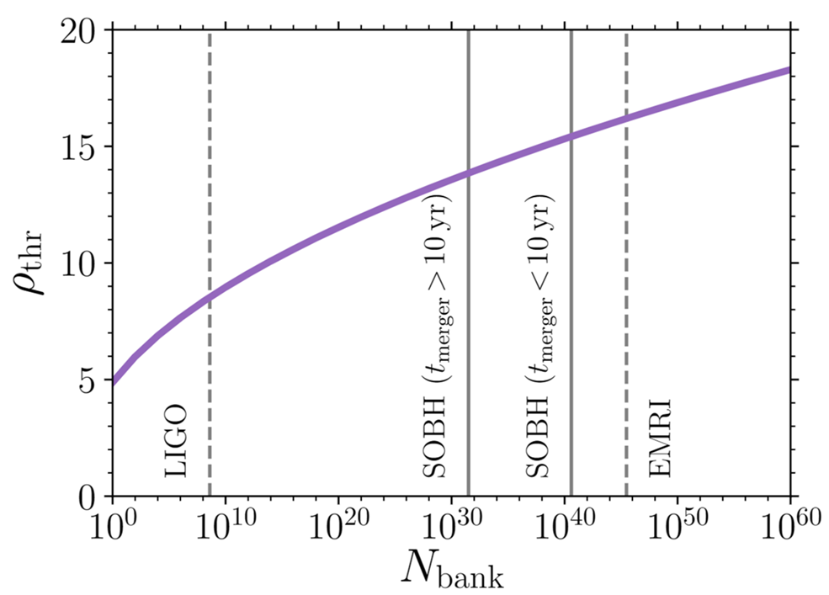
Stellar-mass binary black holes
Sesana, PRL, 2016
Moore et al, MNRAS, 2019
Notes:
OK. Now, I want to switch the topic to the data analyses for the stellar-mass binary black holes. Previous study shows that years before they merge in the high frequency band, it can be detectable/show up in the space-based detectors. So, they are another kind of multi-wavelength GW sources. However, further study shows that detecting these binaries in the low frequency band is extremely challenging. Namely, it requires a higher threshold for the SNR as well as huge number of templates in matched filtering, up to 10+40.

Slide 14
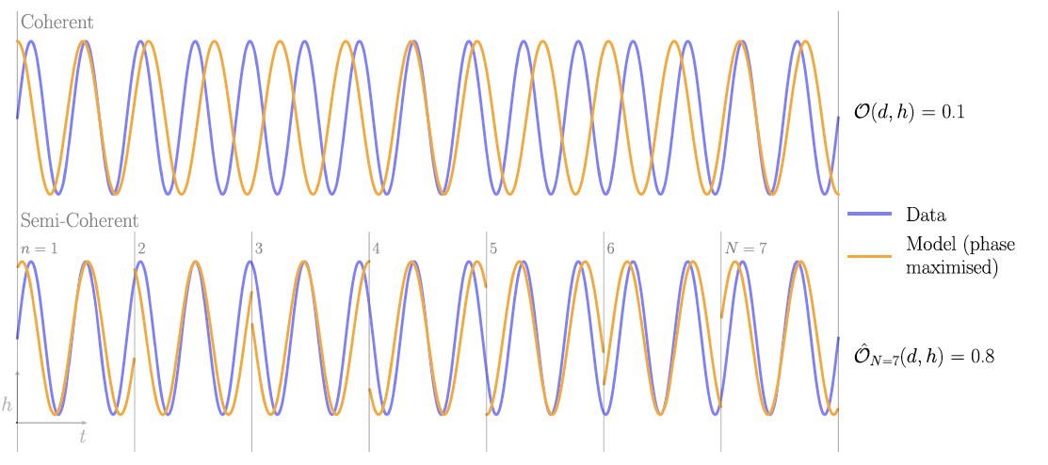
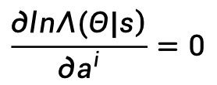
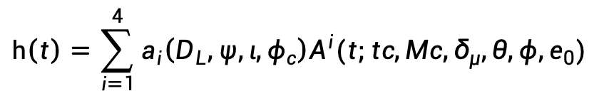

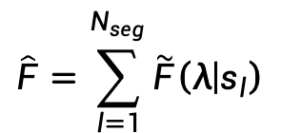



Semi-coherence & F-statistic (int. & ext. parameters)
Bandopadhyay & Moore, PRD (2023)
$$h\left(t\right)=\sum_{i=1}^{4}{a_{i}\left(D_{L},ψ,ι,φ_{c}\right)A^{i}(t;tc,Mc,δ_{μ},θ,φ,e_{0})}$$
$$\frac{\left.∂lnΛ(Θ|s\right)}{∂a^{i}}=0$$
semi-coherent
$$\hat{F}=\sum_{l=1}^{N_{seg}}{\tilde{F}\left(λ | s_{l}\right)}$$
$$\tilde{F}\left(λ | s\right)=\frac{1}{2}NM^{−1}N^{T}$$
$$\left.N^{i}=(s|A^{i}\right)$$
$$\left.M^{ij}=(A^{i}|A^{j}\right)$$
$$λ=(tc,Mc,δ_{μ},θ,φ,e_{0})$$
Fu, Wang & Mohanty, PRD (2025)
Notes:
inspired by previous work in the CW searches by ground based detectors, we have conceived a method that builds upon the ideas, such as semi-coherence and F-statistic.
The semi-coherency means that we will try to ensure the phase coherent between the signal and templates within each small data segment, instead of the whole data. This way is actually sub-optimal, however, every coin has two sides, the advance/plus side of doing this is to make the data not overly sensitive to the template parameters. Here is an illustration for the semi-coherence in the time domain, in contrast, what we actually implemented in the following is in the frequency domain.
For the binary inspiral, we adopted the 2.5 PN eccentric waveform that contains up to ten unknown parameters.
In addition, we adopted F-stat. to further reduced dimension of the searching space, in which, four out of the ten parameters are set to be extrinsic and the rest including ... are intrinsic. The intrinsic parameter space will be searched over using the Particle swarm optimization (PSO).

Slide 15



PE accuracy
$$Θ_{I}=(tc,Mc,δ_{μ},θ,φ,e_{0})$$
Fu, Wang & Mohanty, PRD (2025)
Notes:
Okay, here we define the semi-coherent F statistic. It is simply a summation of fully coherent F stat from N segments.
The hyper-parameter, N_seg, cannot be either too large or small. We did some experiments and set it to be 16 for the following testing cases with 2.5 yr LISA data. This is proven to be successful.

Slide 16





PE accuracy
$$x\left(t\right)=F\left(t\right)h(t+d\left(t\right))$$
 | 2.5 yrs obs.
CPU (28 cores) | >1000 days
GPU (8 cards) | 2.5 days
FFT
SPA
$$\tilde{x}\left(f\right)=FT[Fh_{d}](f)$$
$$T(f)\tilde{h}(f)$$
Marsat & Baker, arXiv:1806.10734
Fu, Wang & Mohanty, PRD (2025)
Notes:
However, a direct implementation of this semi-coherent F-stat. in the full parameter space is still not working for a blind search due to multiple local maxima of the likelihood function in parameter space of the data contains noise. To mitigate this, we separate spaces for some of the sensitive parameters, namely the time to coalescence tc and chirp mass Mc (labeled in vertical axes of each stack) into smaller subspaces to be searched independently using PSO. The size of the subspaces narrows down and the number of subspace reduces according to this flowchart for the hierarchical stages starting from left.
This hierarchical stages involve a large number of PSO runs over independent subspaces, with each run requiring a large number of iterations. To mitigate the computational costs involved, we use an efficient calculation of the frequency domain first generation TDI response to plane GWs and implement GPU acceleration of parallelizable steps.
For our algorithm, if implemented in a cluster with 28 CPU cores, it will take more than 1000 days to finish for a 2.5 yr long LISA observation data. However, when implemented in a GPU cluster with 8 cards, it only takes 2.5 days.

Slide 17



Parameter estimation (SNR=11):
tc~100 s & Mc~0.01%
Fu, Wang & Mohanty, PRD (2025)
Notes:
for a testing example with an SNR of about 11, the left panels show the estimated values for tc (top) and Mc (bottom) from each subspaces of 3 stages. The red circle marks the true parameter value in horizontal and associated F-stat in vertical. The right panel shows the true values, estimated values, and full search ranges for the intrinsic parameters. Tc~100 s, Mc~0.01%.

Slide 18


Parameter estimation (SNR=11):
\theta & \phi (~0.2 deg2)
Fu, Wang & Mohanty, PRD (2025)
Notes:
Similarly, this shows the estimation of the ecliptic longitude and latitude, the sky localization uncertainty is less than 1 deg2, which may be sufficiently good for the other detectors (GW/EM) to point at the source direction before its final merger.

Slide 19


Parameter estimation (SNR=11):
\delta & e0~1%
Fu, Wang & Mohanty, PRD (2025)
Notes:
Finally, the symmetric mass ratio and the eccentricity of the binary. One can see that eta cannot be estimated precisely, this is mainly because, at the early inspiral, the BBH waveform does not show strong PN effect to be used to constrain this parameter.
We also tested our method on other data sets with different parameters, all of them, with SNR between 11 and 14, seem consistent with the example shown here. You can find more details from our published PRD paper.

Slide 20

Thank you !
ywang12@hust.edu.cn

