Slide 1
Equilibrated Stochastic Gravitational Wave Background Model and its role in the formation of large-scale structure in the universe
Manjia Liang, Institute of Mechanics,CAS
Based on 2410.10722 and subsequent version
Notes:
“Good afternoon everyone. My name is Manjia Liang, and today I will talk about the connection between general relativity, statistical mechanics, and the stochastic gravitational-wave background. In particular, I will introduce our model of an equilibrated SGWB and explain how it influences the formation of cosmic large-scale structures. The key idea is to use tools from statistical mechanics to treat gravity itself as a fluctuating background, and to test this idea against observational data.”

Slide 2

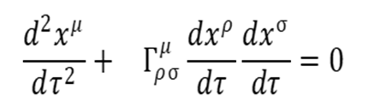

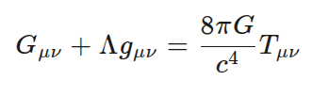
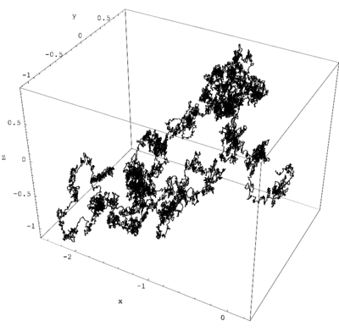
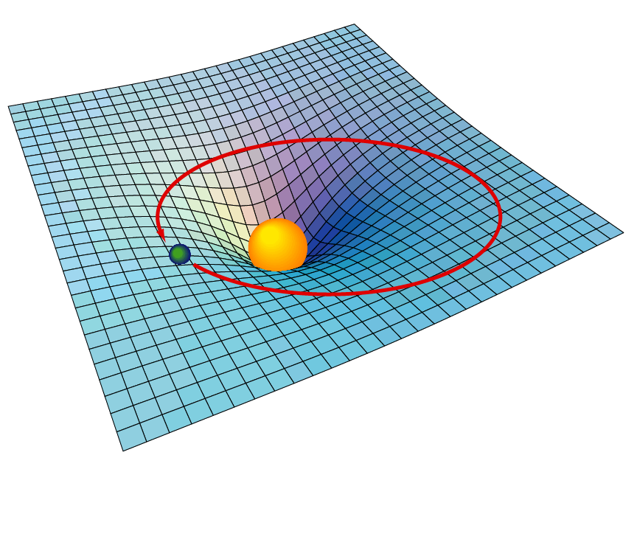
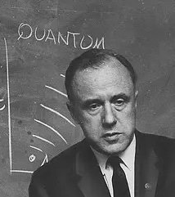
Overview – General Relativity and Statistical Mechanics
Statistical mechanics: deals with the average behavior of a vast number of particles.
General relativity: describes gravity and the structure of spacetime.
“A theory is the more impressive the greater the simplicity of its premises, the more different kinds of things it relates, and the more extended its area of applicability”– Albert Einstein
“Matter tells spacetime how to curve, and spacetime tells matter how to move”– J. A. Wheeler
Notes:
“As Wheeler once said, matter tells spacetime how to curve, and spacetime tells matter how to move. General relativity describes the structure of spacetime, while statistical mechanics deals with the average behavior of huge numbers of particles. These two frameworks are among the most powerful in physics, but combining them is far from trivial. Following Einstein’s spirit, we aim to unify them under simple principles that can apply to many different systems.”

Slide 3

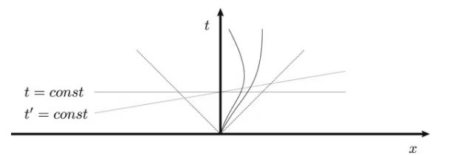
Overview – General Relativity and Statistical Mechanics
Statistical-mechanics puzzles in curved spacetime
How to define “energy”
Difficulties in constructing the partition function
General relativity lacks a global law of energy conservation because time-translation symmetry is absent.
Without global energy conservation, the traditional notions of temperature and entropy lose their meaning.
Irreversible processes and the arrow of time
Non-equilibrium statistical theory lacks a unified framework within general relativity
The equations of general relativity are time-symmetric (no “arrow”).
The entropy-increase principle in statistical mechanics introduces “macroscopic irreversibility.
”
Deriving fluctuation–dissipation structures from the GR equations remains a fundamental challenge.
A generally covariant theory of non-equilibrium statistical mechanics is still missing; existing generalizations of diffusion equations and similar tools in curved spacetime frequently violate causality in strong gravitational fields.
Notes:
When we attempt to apply statistical mechanics in curved spacetime, several puzzles appear. First, how do we even define energy, when general relativity lacks a global conservation law? Without global energy, standard notions of temperature and entropy lose their meaning. Second, while general relativity equation is time-symmetric, statistical mechanics relies on entropy increase to define an arrow of time. Deriving a fluctuation–dissipation structure directly from Einstein’s equations is still an unsolved challenge. Finally, we still do not have a generally covariant theory of non-equilibrium statistical mechanics—most current generalizations break down in strong gravity.”

Slide 4

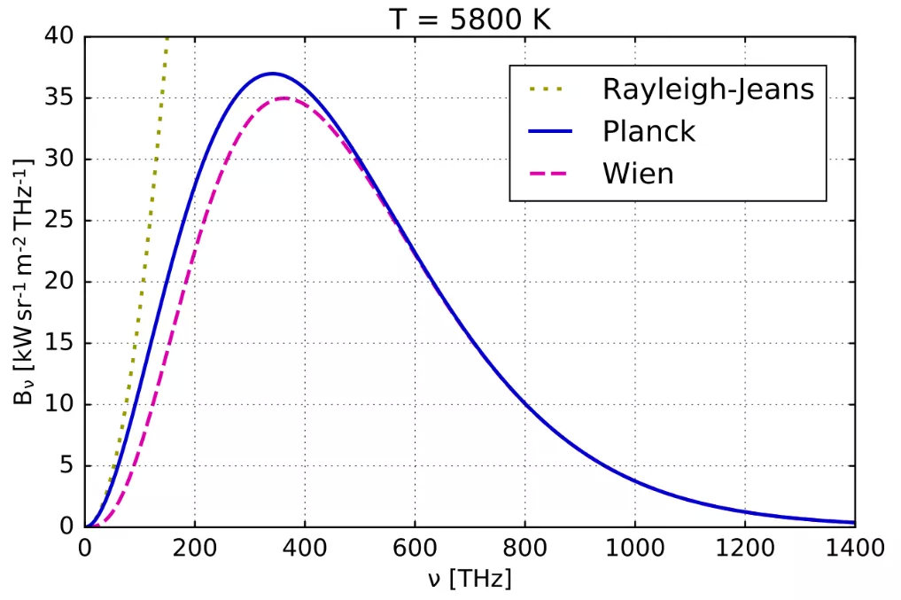
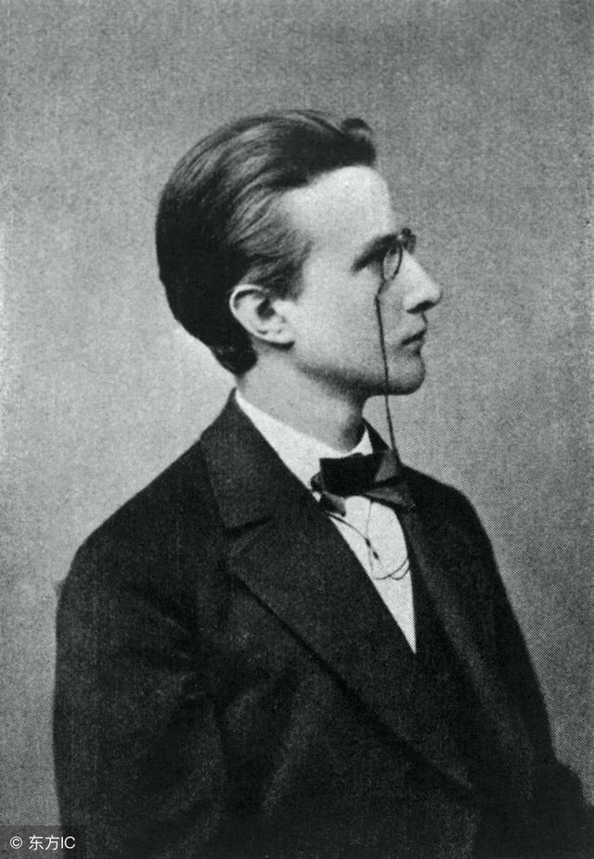
Overview – General Relativity and Statistical Mechanics
The profound influence of statistical mechanics on the foundations of quantum mechanics
Boltzmann’s entropy formula
Black-body radiation: the failure of classical statistical theory → Wien’s law, the ultraviolet catastrophe of the Rayleigh–Jeans formula
Acceptance of the unknowability of microscopic states
These developments laid the conceptual groundwork for later quantum statistics and the probabilistic interpretation of the wave function.
Statistical mechanics not only inherited the task of dealing with quantum systems; it in turn inspired and propelled the construction of quantum mechanics’ basic structure. Statistical physics provided quantum mechanics with conceptual, mathematical, and philosophical support alike.
Notes:
“Statistical mechanics has not only inherited the task of treating quantum systems, it also laid the foundations of quantum mechanics itself. The ultraviolet catastrophe of black-body radiation forced Planck to introduce quantized energy levels. Boltzmann’s entropy formula encouraged us to accept the unknowability of microscopic states. Together, these ideas inspired the probabilistic interpretation of the wave function. So statistical mechanics provided quantum mechanics with conceptual, mathematical, and even philosophical support.”

Slide 5
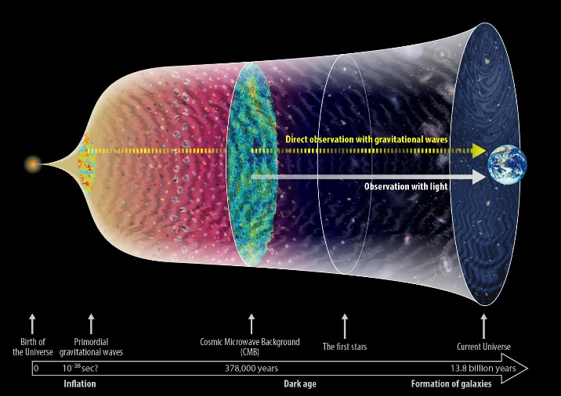

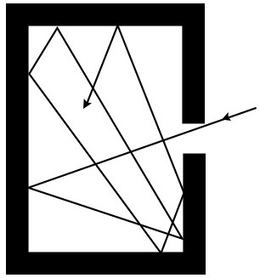
Overview – General Relativity and Statistical Mechanics
Random electromagnetic wave fields
stochastic gravitational-wave background
Treating gravity itself as a stochastic statistical background
Traditionally, theorists have focused on how physical processes in the early universe generate a stochastic gravitational-wave background—i.e., they study the SGWB from a cosmological perspective.
From a statistical-mechanics viewpoint, however, far less attention has been paid to questions such as: How does the stochastic gravitational-wave background couple to matter? What impact does it have on cosmic evolution? How do we investigate the classical statistical quantities intrinsic to the SGWB? Establishing a fluctuation–dissipation theorem for the SGWB is a crucial first step toward addressing these issues from a statistical perspective.
cosmos
Gravitational wave blackbody？
Notes:
Traditionally, theorists study the stochastic gravitational-wave background mainly from a cosmological generation perspective. But from a statistical viewpoint, we can ask new questions. How does this background couple to matter? What impact does it have on cosmic evolution? Can we describe the SGWB using statistical quantities, just like we do with random electromagnetic fields? Establishing a fluctuation–dissipation theorem for the SGWB is our first step toward answering these questions. This way, we can think of the SGWB as a kind of gravitational blackbody spectrum.”

Slide 6
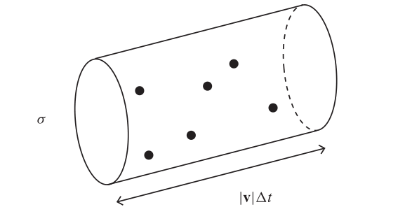
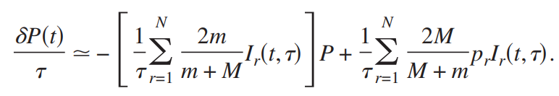


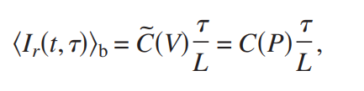

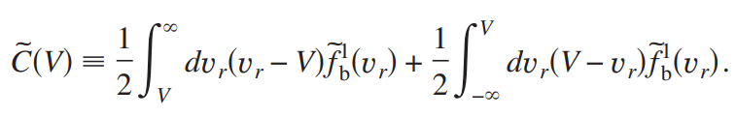
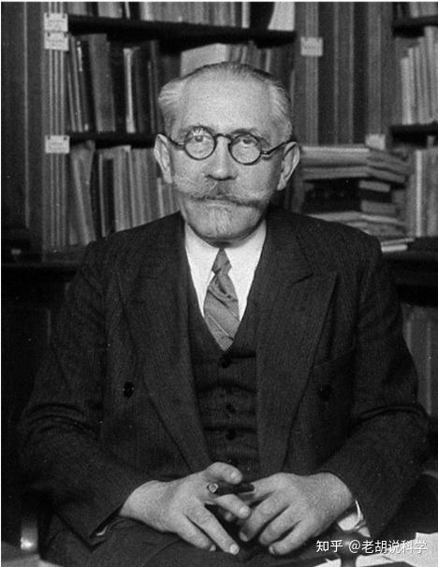
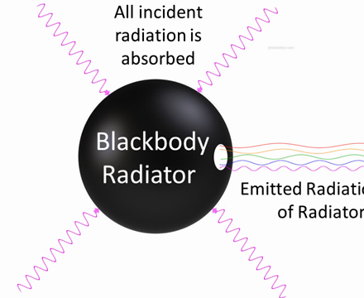
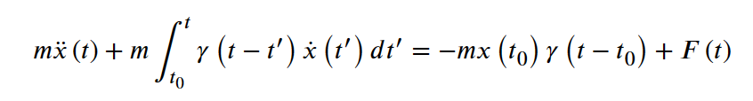
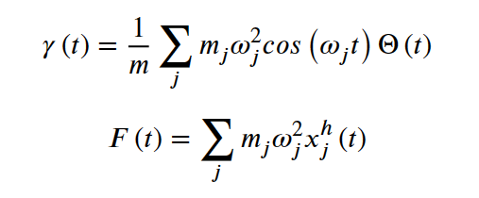

The Fluctuation–Dissipation Theorem for the SGWB
Langevin kinematic model: the bridge between fluctuation and dissipation
Molecular collision model
Radiation model
,
Notes:
To connect fluctuation and dissipation, we use the familiar language of Langevin dynamics. Just as a Brownian particle exchanges energy with its environment, matter in a gravitational field can also lose energy through dissipation while simultaneously gaining energy through fluctuations. In this analogy, the SGWB acts as the random background force. The Langevin model therefore becomes our bridge: it lets us quantify how stochastic gravitational fluctuations and dissipation balance each other.”

Slide 7






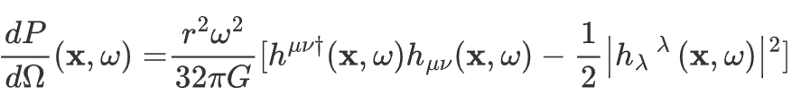


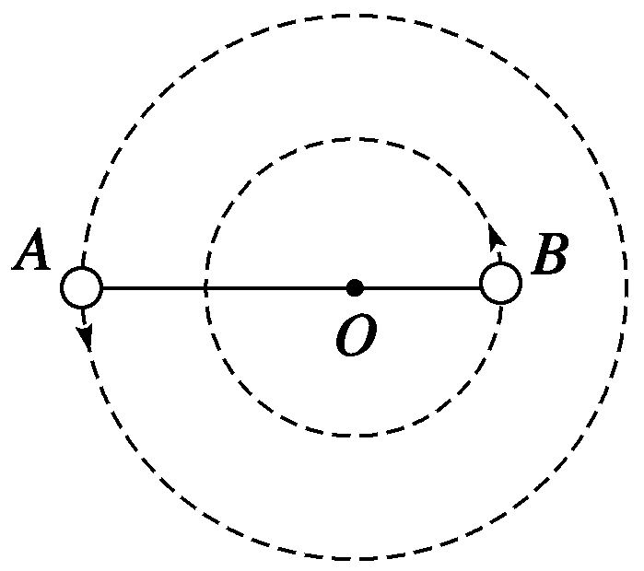
The Fluctuation–Dissipation Theorem for the SGWB
Fluctuation and dissipation in a gravitational field
Fluctuation: the background performs work on the Brownian particle
Dissipation: the Brownian particle loses energy to the background
Gravitational energy dissipation arising from self-gravity
Notes:
Following cosmological convention, we adopt the rest frame of the SGWB as our reference frame to study this non-equilibrium statistical process. Within the Langevin model, the fluctuating force originates from the stochastic connection perturbations produced by random gravitational waves; this contribution is captured by the geodesic equation. Dissipation, on the other hand, arises from the loss of gravitational energy due to the system’s self-gravity. This part can be extracted succinctly from the linearized Einstein field equations, yielding a dissipative energy proportional to the square of the acceleration.

Slide 8




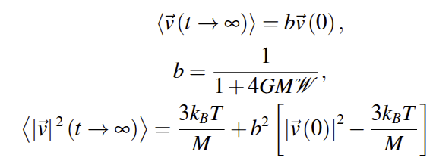
The Fluctuation–Dissipation Theorem for the SGWB
Fluctuation–dissipation theorem: temperature and equilibrium spectrum of the SGWB
Requiring that matter undergoing stochastic motion in the SGWB ultimately reaches equilibrium—dissipated energy equals fluctuation energy—one may find that
the final kinetic energy of the stochastically moving test particle as an effective temperature.
The fluctuation–dissipation relation then reads:
Final state of motion of the test mass
Notes:
“From this model we derive a fluctuation–dissipation relation for the SGWB. The key idea is equilibrium: when matter undergoing random motion in the SGWB reaches equilibrium, the dissipated energy is exactly balanced by the fluctuation energy supplied by the background. In that state, the kinetic energy of the test particle defines an effective temperature of the SGWB. This gives us not only a spectrum, but also a statistical interpretation of the background itself. Moreover, in such an equilibrium SGWB spectrum, a complete Langevin model allows us to derive the time evolution of matter’s stochastic motion—manifesting as ballistic diffusion.

Slide 9
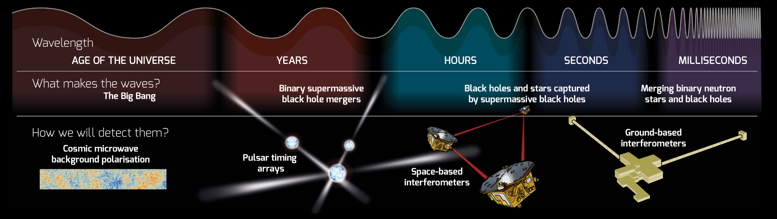
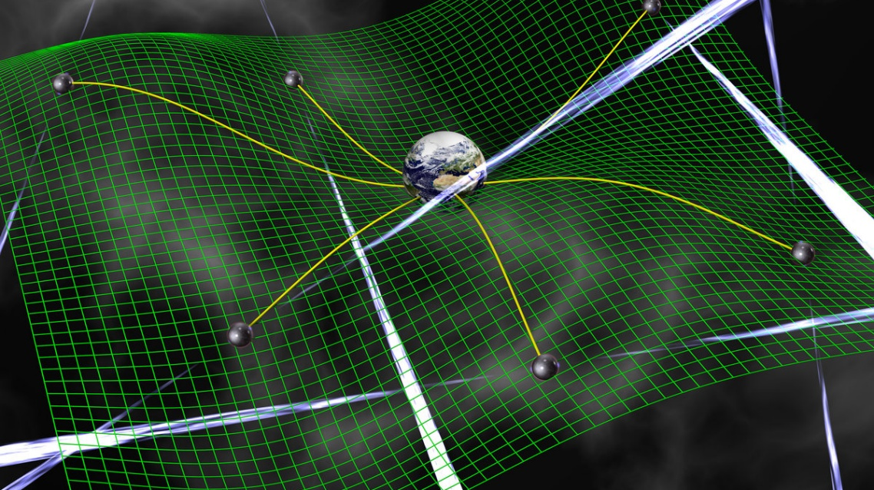
Support for our theory from PTA
North American pulsar-timing array: 15 years of data on 68 Galactic millisecond pulsars, the farthest lying 6,500 light-years away.；
EPTA: 25 years of observations on 25 Galactic millisecond pulsars.；
FAS: 1,000 pre-selected pulsars discovered, 56 Galactic millisecond pulsars used for precision analysis, the most distant at 28,000 light-years.。
Notes:
Our theory needs observational support, and pulsar timing arrays provide exactly that. The North American PTA has 15 years of data from 68 millisecond pulsars, some thousands of light-years away. The European PTA has 25 years of data, and the FAST array in China already contributes dozens of pulsars with very high precision.

Slide 10
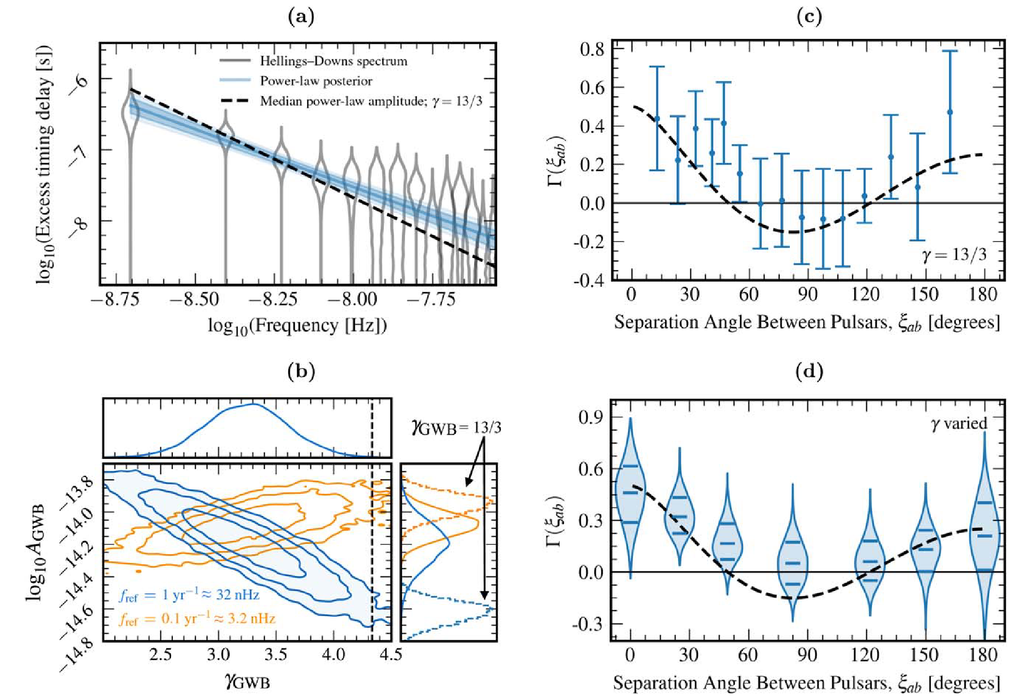
Support for our theory from PTA
Notes:
By monitoring the long-term variations in pulse arrival times between pulsars and Earth, PTA experiments extract gravitational-wave signals through the cross-correlation of timing residuals from pulsars located in different sky positions—the well-known Hellings–Downs (HD) correlation.

Slide 11
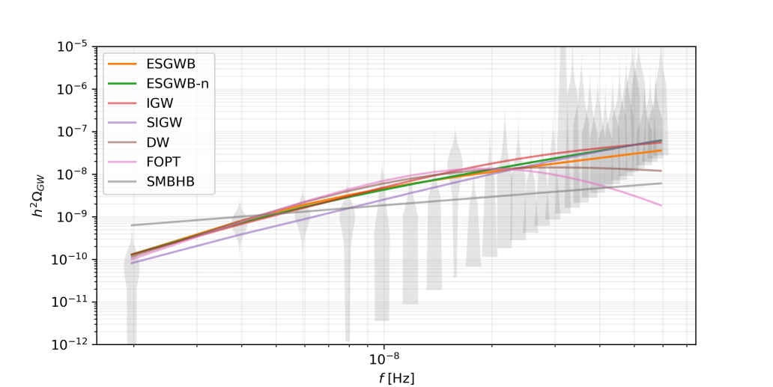
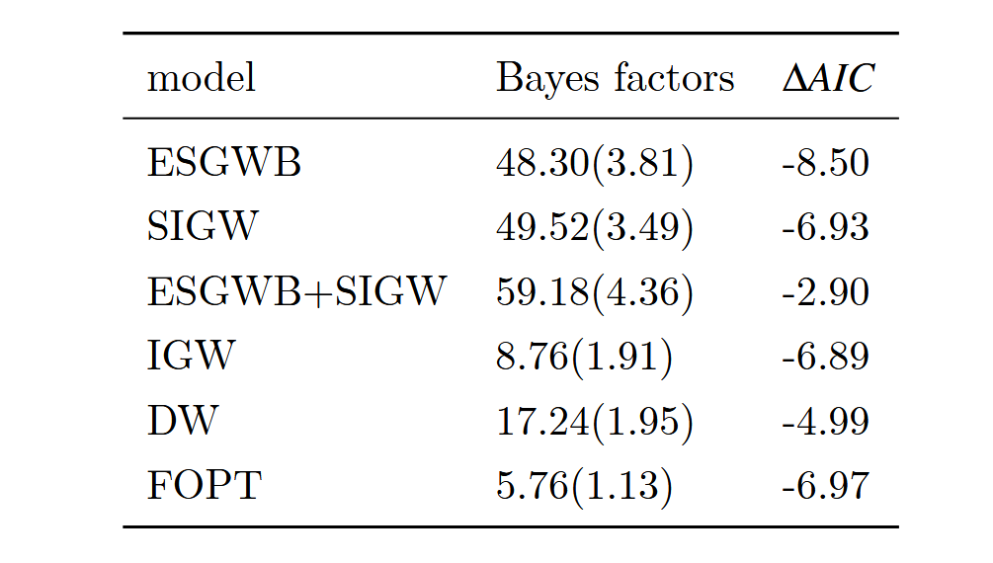
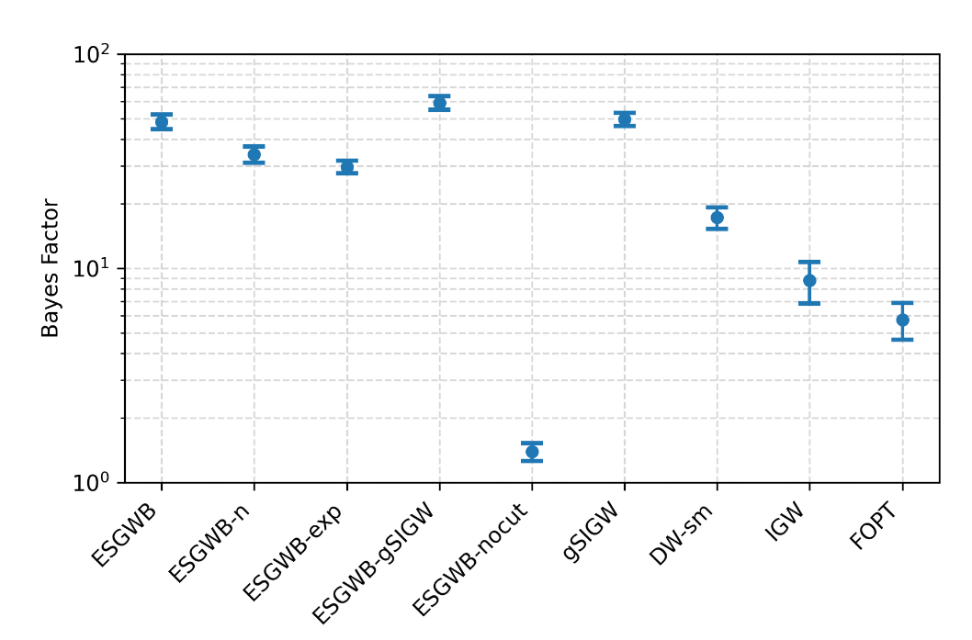
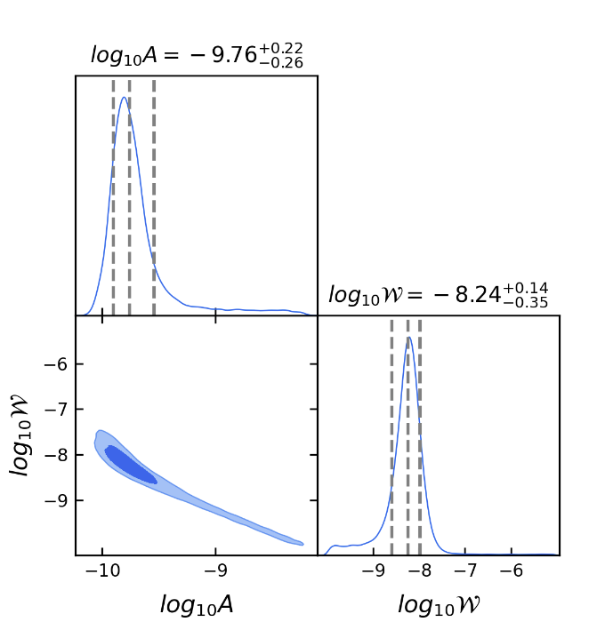
Support for our theory from PTA
The current observational data from NG15 strongly support our conclusion.
Notes:
When we fit our model to PTA data, we obtain optimal parameter estimates for the two parameters of the ESGWB model and compute its Bayes factor. The resulting Bayes factor of 48 strongly indicates that PTA observations provide robust support for our theory.

Slide 12
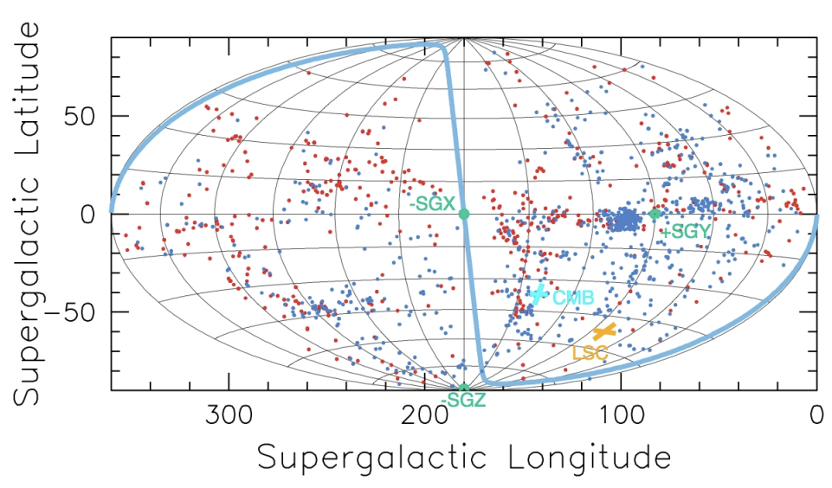
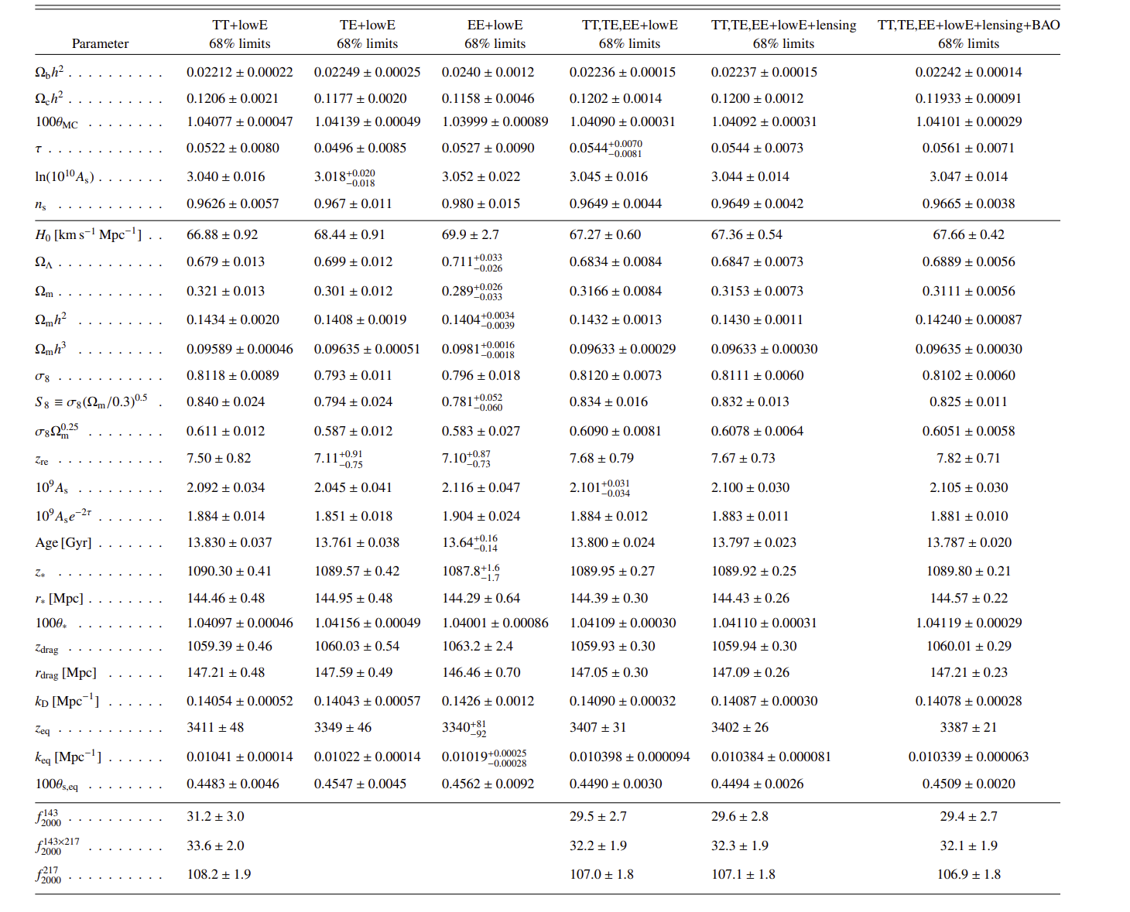
Support from redshift surveys and velocity-field measurements
Planck’s data
Velocity-field measurements and Planck-survey observations both show that, on scales larger than ≈ 8 Mpc, the bulk peculiar velocities of astronomical systems are relatively smooth, with 8 Mpc marking the typical boundary between the linear and non-linear regimes of the present-day Universe.
Notes:
Independent support also comes from redshift surveys and velocity-field measurements. Observations show that, on scales larger than about 8 megaparsecs, peculiar velocities of galaxies are relatively smooth. This 8-Mpc scale marks the boundary between linear and non-linear structure in the present Universe. Our model reproduces this boundary naturally, without assuming any specific form of the primordial density perturbations. That agreement is a strong indication that the SGWB plays a role in shaping cosmic structure.”

Slide 13

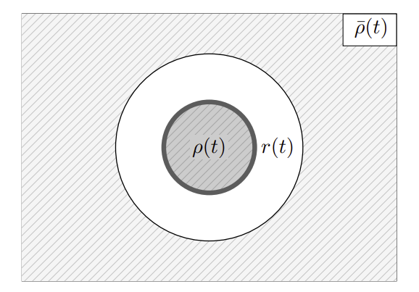

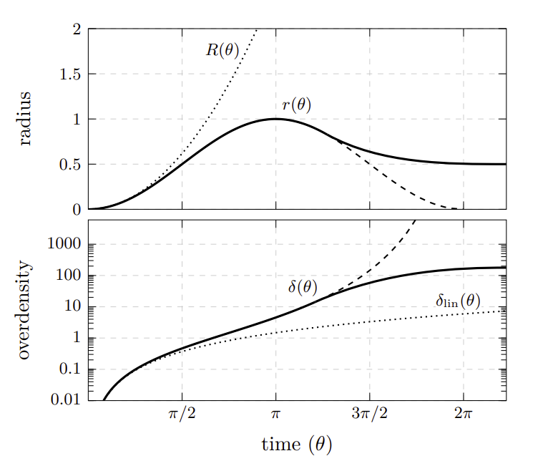




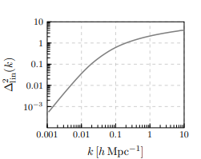


Support from redshift surveys and velocity-field measurements
Linear vs. non-linear regimes of the Universe
Master equation for linear density perturbations
Spherical collapse model: initial density perturbations grow under gravity and eventually collapse
When the linear density perturbation exceeds 1, linear theory is deemed to break down.
Notes:
In cosmology, the ratio of the matter-density perturbation to the mean density, so-called the contrast, is taken as the criterion for whether the system can still be treated within linear theory. The famous spherical-collapse model describes how these density perturbations evolve, cluster, and eventually form non-linear structures. Fundamentally, the formation of such structures arises because initial density perturbations keep accreting under their own gravity, causing the contrast to grow until it exceeds unity. In the standard cosmological model, the 8 Mpc dividing line is inherited from assumptions about the primordial density perturbations.

Slide 14


Support from redshift surveys and velocity-field measurements
Non-Markovian nature and the mass demarcation point of SGWB-induced stochastic motion
Non-Markovian factor b
Motion of matter coupled to the SGWB under the pull of massive attractors
The SGWB attenuates gravity’s pull on matter, thereby damping the growth of density perturbations and suppressing the formation of the non-linear regime. This effect operates only for astrophysical systems with mass M≳1e44kg, in close agreement with the observed boundary between today’s linear and non-linear regions.
Notes:
In our theory the explanation is far simpler. The key lies in ballistic diffusion: the motion itself possesses an intrinsic length-scale boundary, governed by the non-Markovian factor. The motion of matter coupled to the SGWB is non-Markovian. This means the system retains memory of its past evolution.
Then, the SGWB damps the growth of density perturbations, but only for very massive systems. This damping weakens gravitational clustering, naturally suppressing the formation of non-linear structures.
Remarkably, this matches the observed boundary between the linear and non-linear regimes of today’s Universe. So the ESGWB not only modifies cosmic dynamics, but also helps explain why we see structure forming the way it does.

Slide 15
summry
The intersection of gravitation and statistical mechanics harbors a wealth of physics.
By analyzing the interaction between matter and the SGWB under the assumption of equilibrium, we have derived an equilibrium spectrum for the SGWB—now a compelling candidate for the actual background.
Processing the NG15 data, we find that PTA observations lend strong support to our theoretical predictions.
In the standard ΛCDM cosmology, the predicted boundary between the non-linear and linear regimes has long been regarded as a cornerstone of the model. Yet our theory reproduces this boundary just as well—without any reliance on assumptions about the primordial density-perturbation spectrum.
Notes:
To summarize: the intersection of gravitation and statistical mechanics contains rich physics. By analyzing the interaction between matter and the SGWB, and requiring equilibrium, we derive a natural fluctuation–dissipation relation. This leads to an equilibrium spectrum for the background itself. Pulsar timing array observations support our predictions, and large-scale structure surveys confirm the expected mass and scale boundaries. Together, this suggests that the equilibrated SGWB is a compelling candidate for the actual gravitational background that shapes our Universe. Thank you for listening.”

Slide 16
Thank you for listening!

