Slide 1

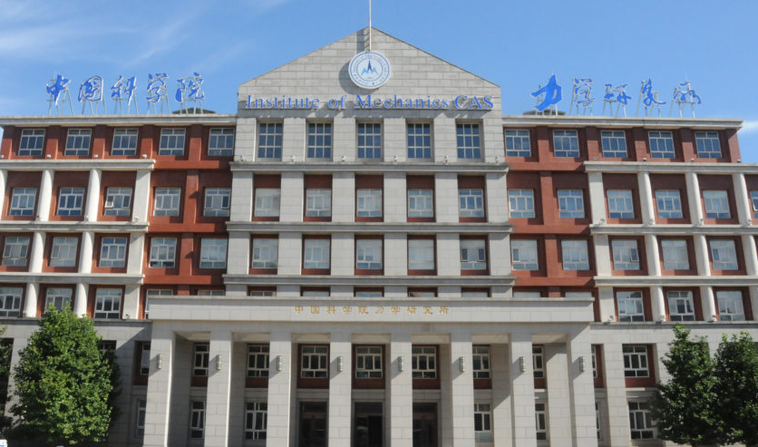
Accelerating Stochastic Gravitational Wave Backgrounds Parameter Estimation in Pulsar Timing Arrays with Flow Matching
Bo Liang

Slide 2
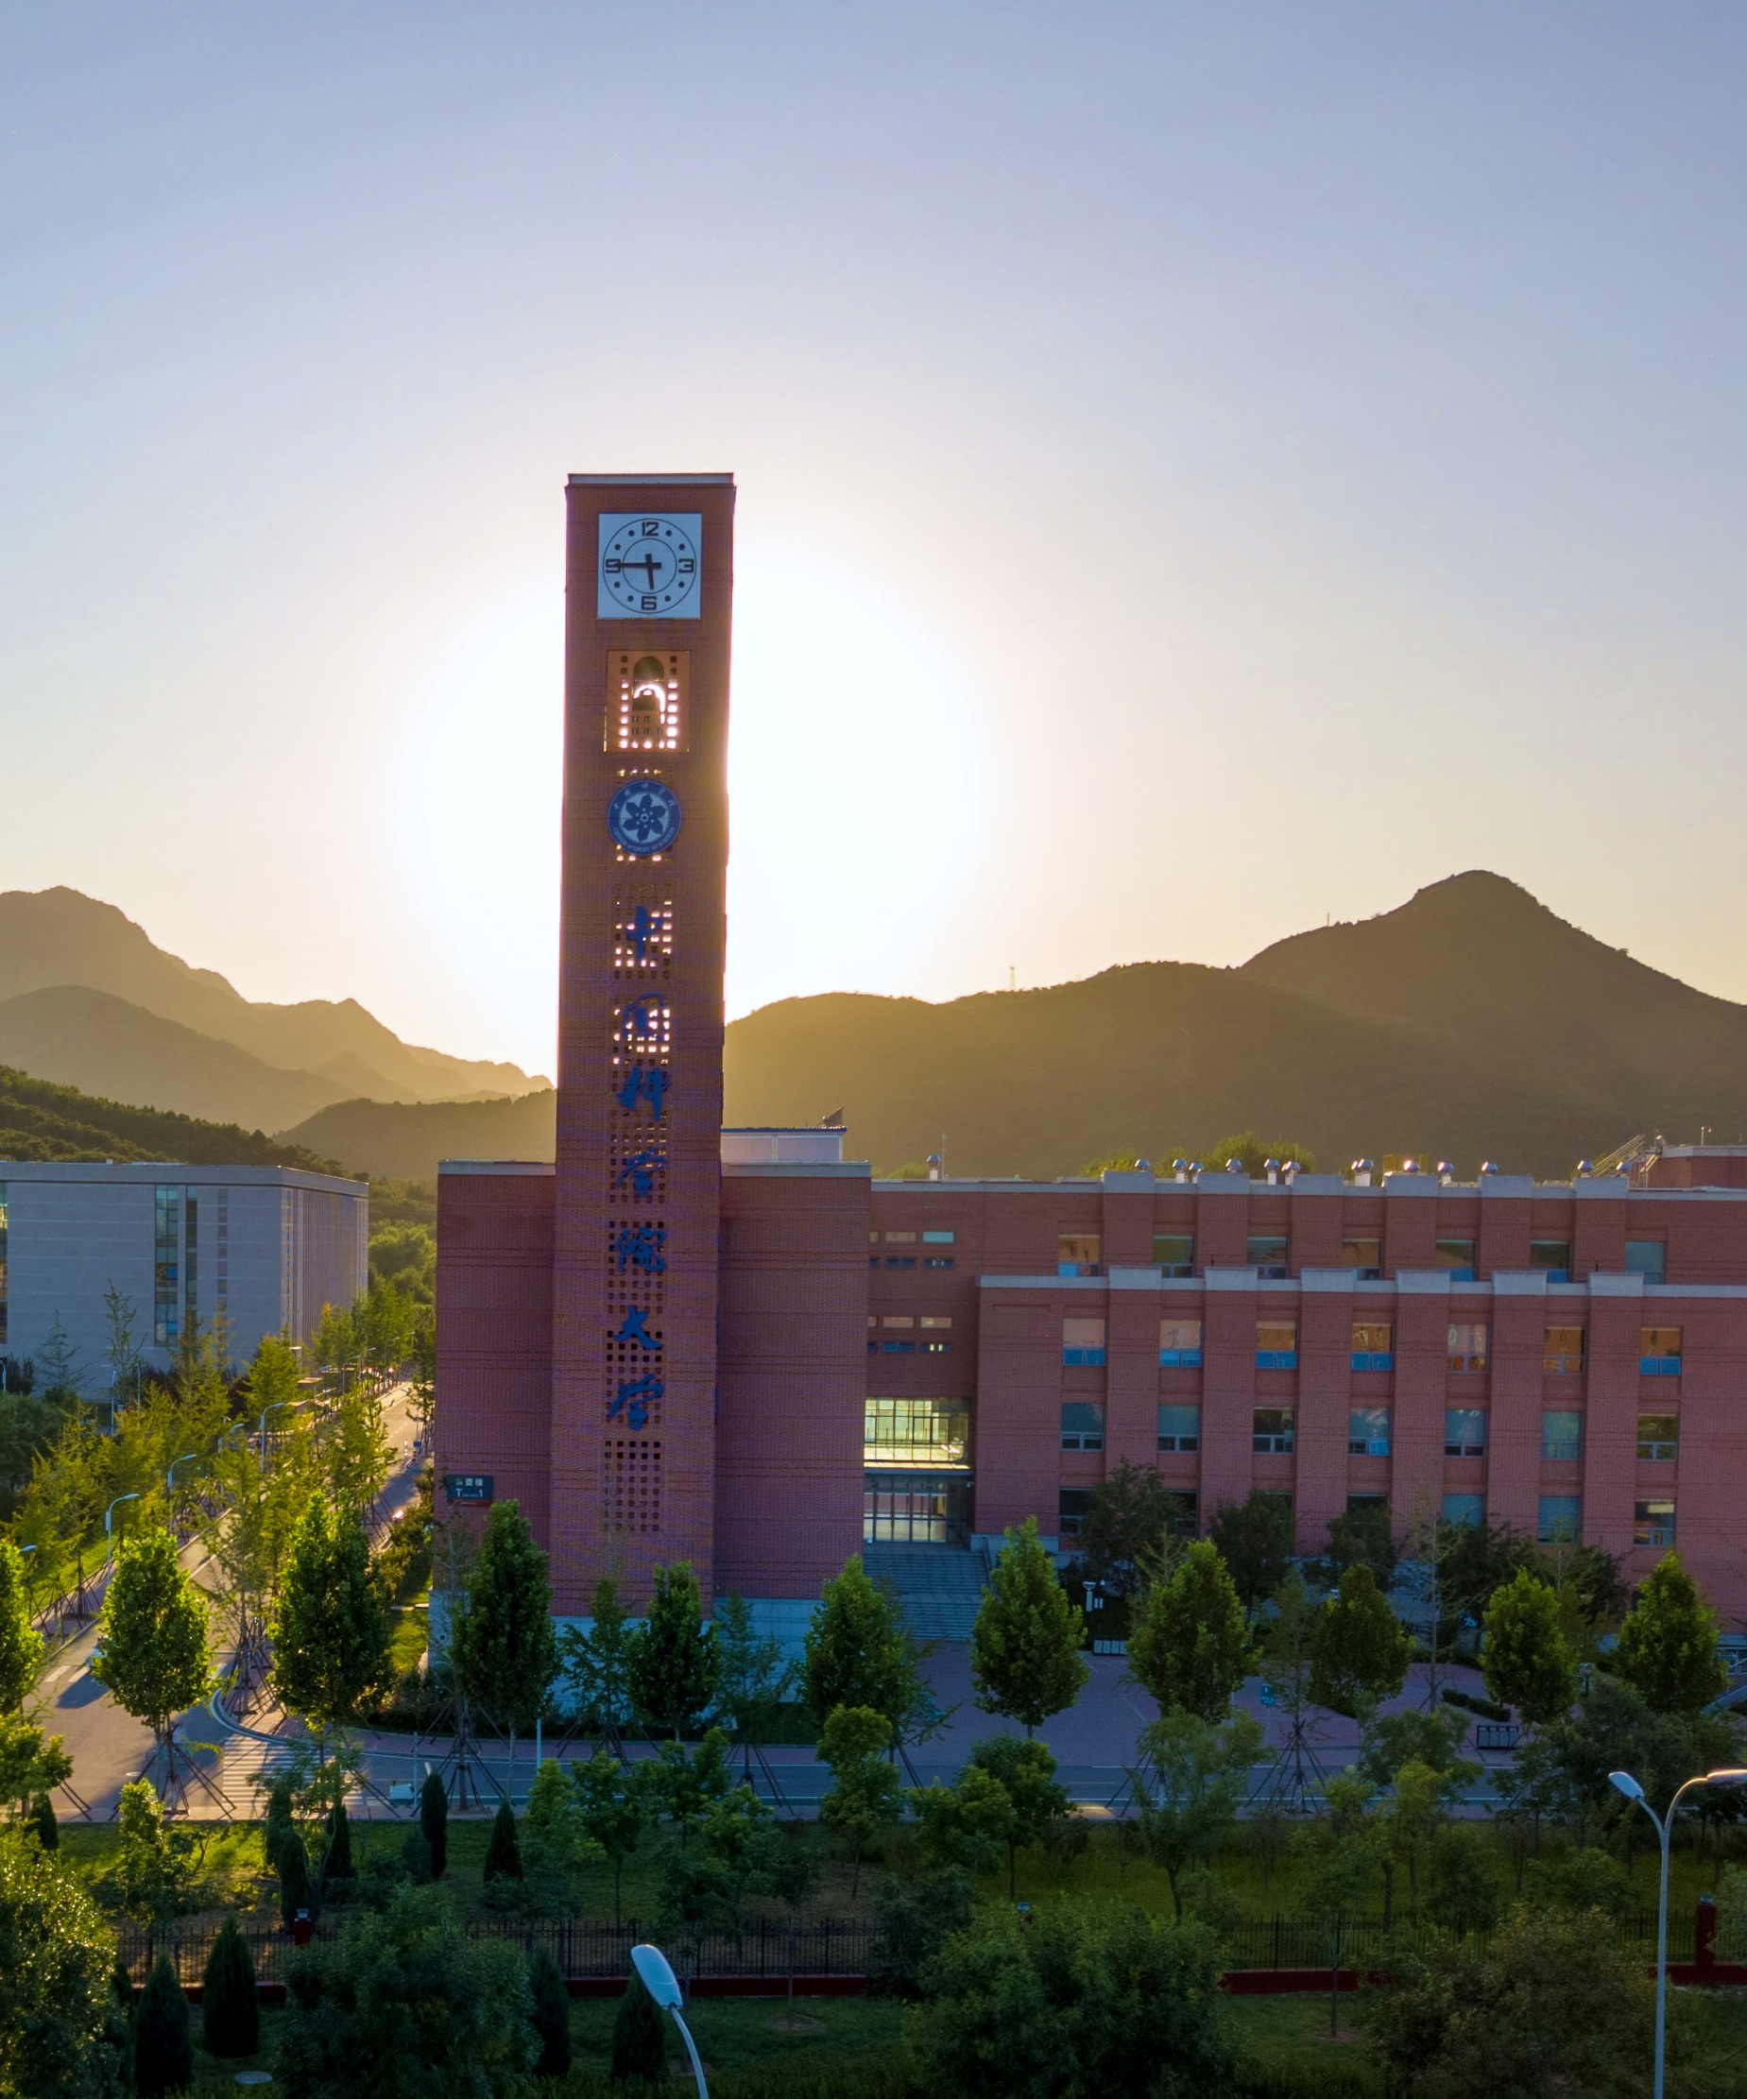

1
Summary of Gravitational Wave Data Processing
2
Current Research States
3
Conclusions
目录
Contents

Slide 3

01
Summary of Gravitational Wave Data Processing

Slide 4
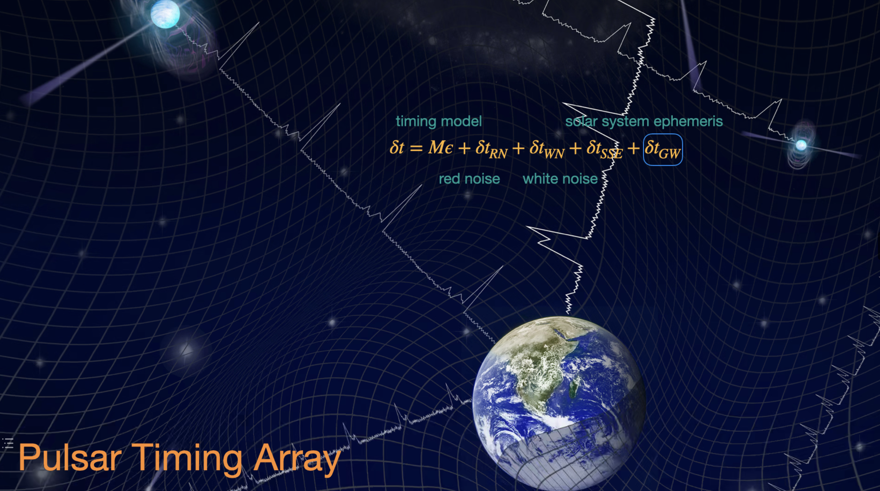
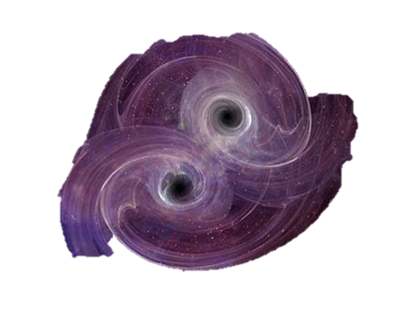
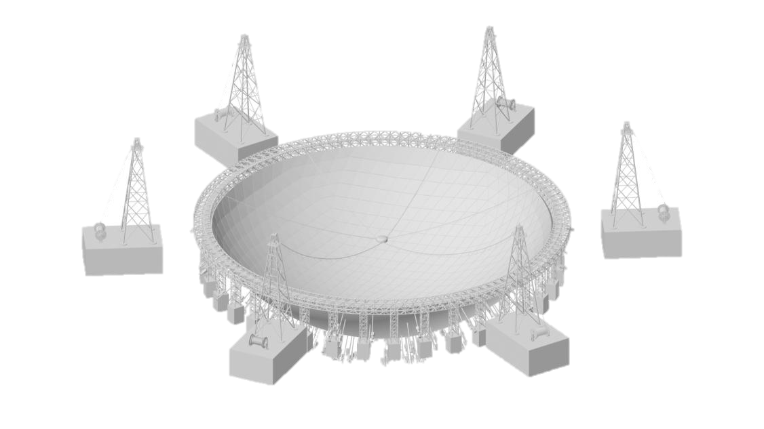
Millisecond Pulsar
PTAs are detectors for nano-Hz Gravitational Waves.
SMBHB
Timing residuals:
Pulse measurements Time of Arrivals (TOAs)
Earth
Credit: NANOGrav
Image Credit: NANOGrav/T Klein
Notes:
脉冲星计时阵列是我们观测纳赫兹引力波的重要手段，而超大质量双黑洞是纳赫兹引力波最有可能的波源，它们辐射的引力波会在PTA中产生一种特殊的空间关联，称为Hellings-Downs关联曲线。一直以来，我们都将HD曲线作为我们确证探测到引力波背景的关键证据。
毫秒脉冲星就像具有稳定周期的太空灯塔，当它扫过地球的时候，我们就在射电波段探测到一个脉冲。我们可以把脉冲到达的时间（Time of Arrival, TOA）准确地记录下来。而所有这些脉冲就能够成为一个十分精确的时钟，不断的记录着时空间隔的微小变化。
我们预期脉冲到达时间之间的间隔是恒定不变的，但实际上这些间隔会有极其细微的变化。导致这些变化有很多因素，已知的就有地球的运动，太阳系天体导致的引力红移，星际介质的变化等等。我们把这些因素包括到我们的计时模型中，去拟合观测得到的脉冲到达时间，模型预言和实际观测之间的差别称为计时残差（Timing Residuals）。引力波是时空本身的涟漪，可以改变脉冲星和地球之间的距离，自然会使得脉冲到达时间发生变化，从而体现在计时残差中。
当然由于宇宙中还有很多我们不清楚的机制，它们也会作为噪声存在于这个计时残差里面，比如脉冲星本身的物理，甚至是射电望远镜自己的噪声。但我们都可以把它们包括在计时残差里面。

Slide 5
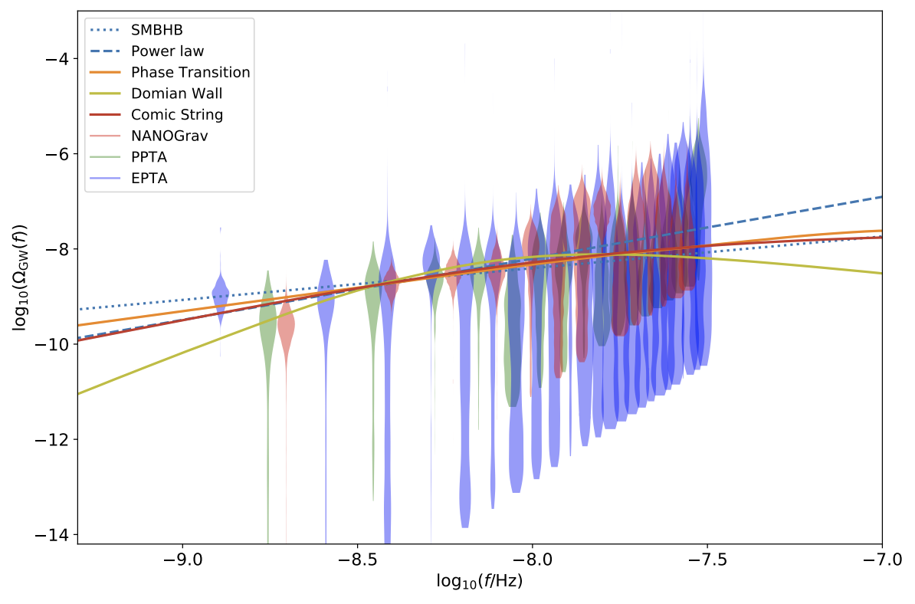
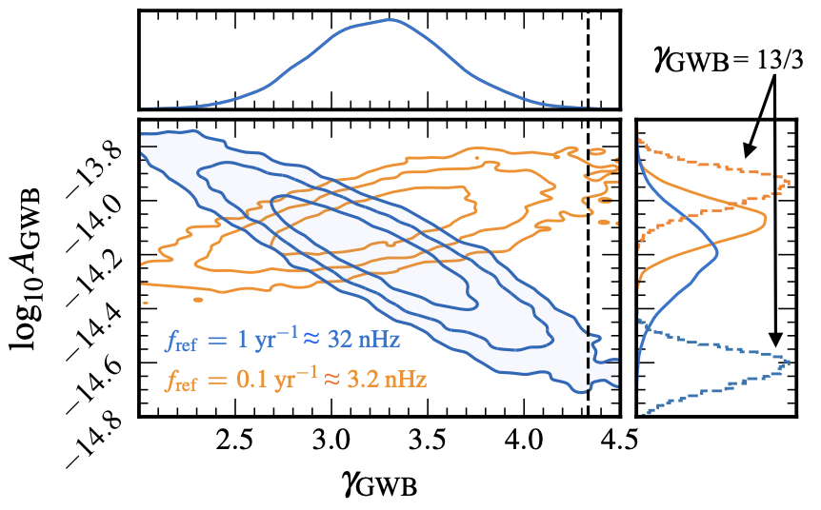
1.1 Explanations for the stochastic signal discovered in PTAs
Astrophysical explanation
  Supermassive black hole binaries (Most promising!)
Cosmic explanations
  Phase transition
  Domain wall and so on …
Credit: Wu, Chen, and Huang, SCPMA (2024) (arXiv:2307.03141)
NANOGrav Collaboration. Astrophys.J.Lett. 951 (2023)

Slide 6
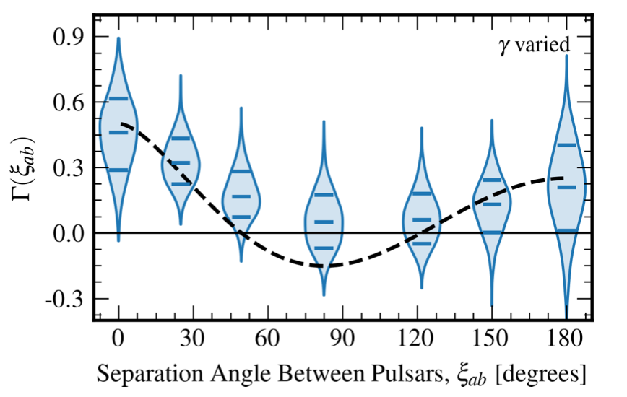
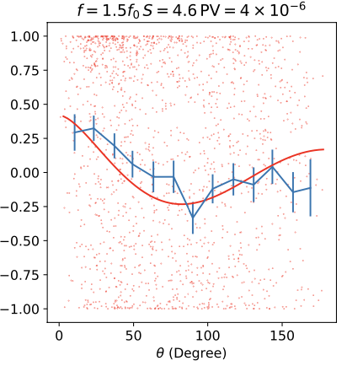
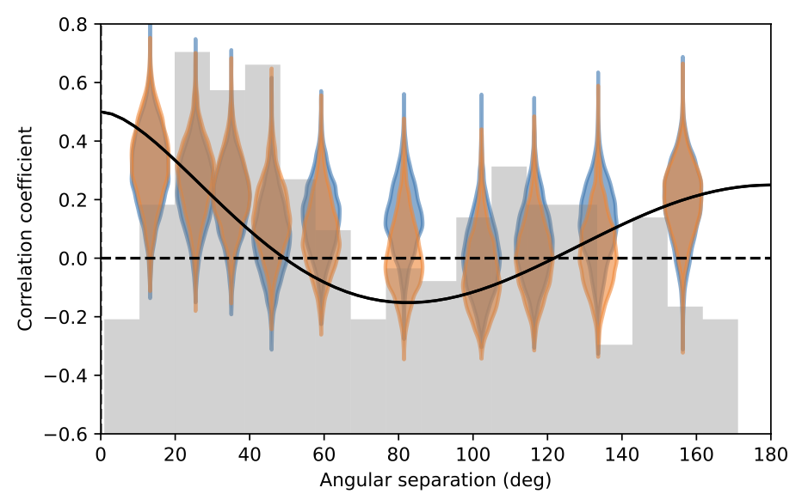
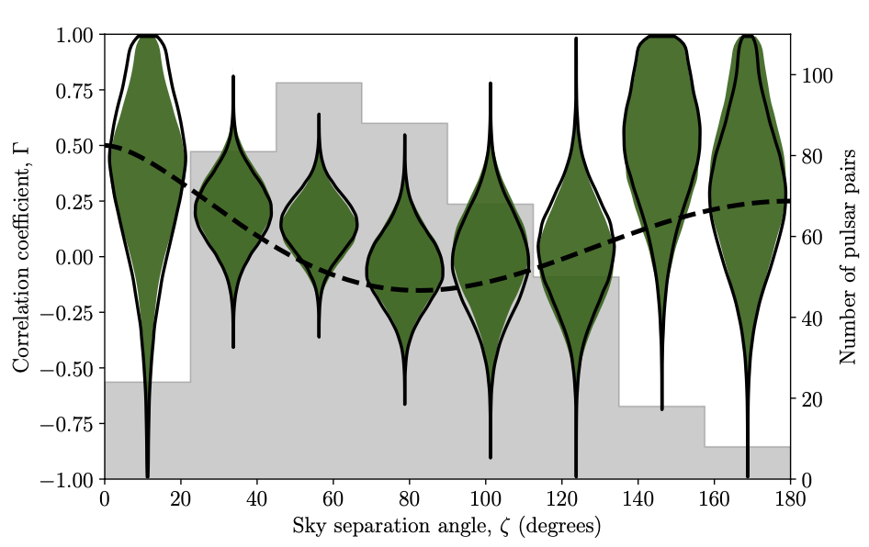
1.1 Recent Progress of Pulsar Timing Arrays
NANOGrav 15yr
CPTA DR1
EPTA DR2
PPTA DR3

Slide 7
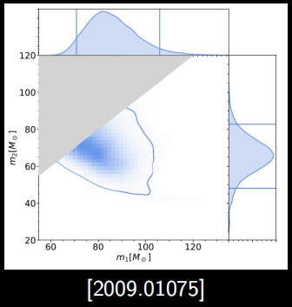
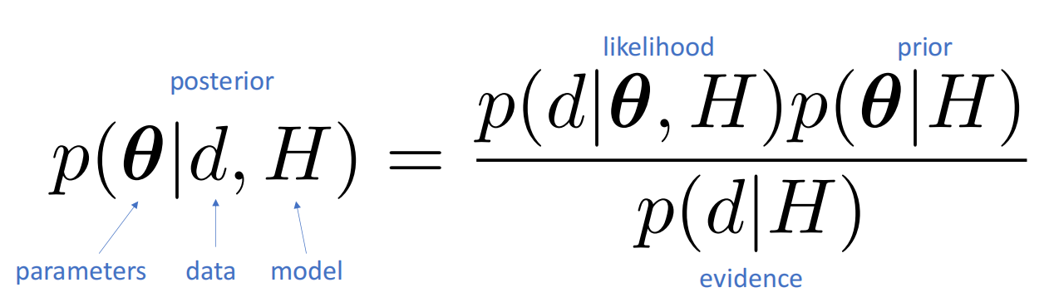
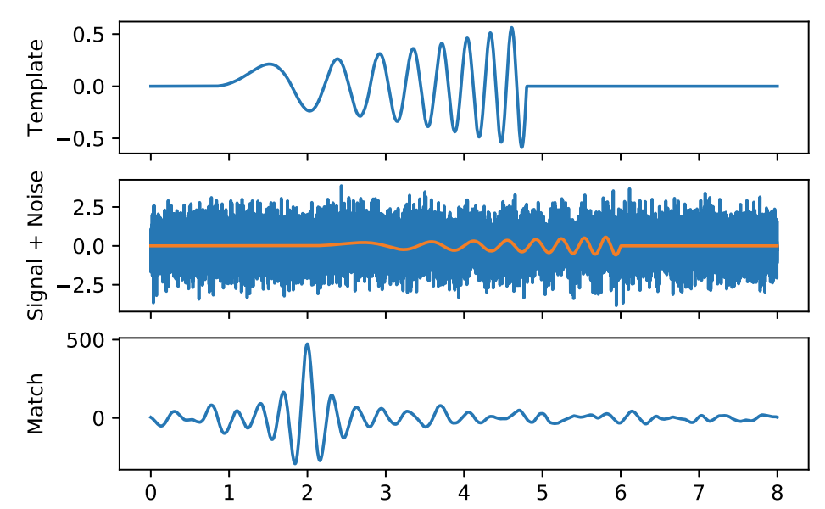

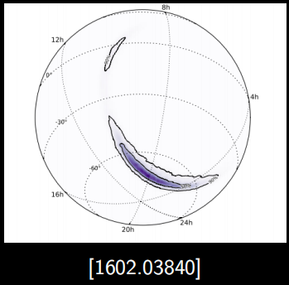
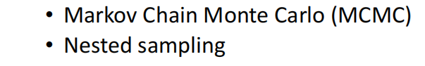
1.2 Realizing Scientific Goals - Traditional Methods
Scientific goals must be achieved through scientific data processing. (traditional methods)
astronomy
cosmology
particle physics
……
Scientific goals
observational data
likelihood function
random sampling
parameter estimation
How to provide comprehensive and unbiased estimates.

Slide 8
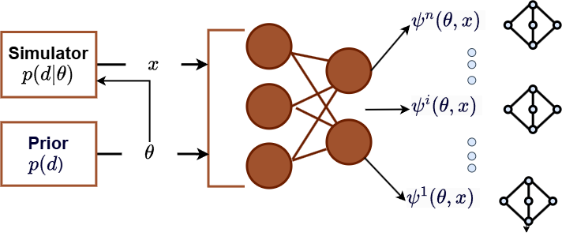
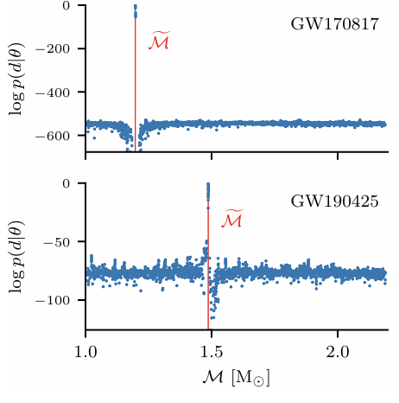
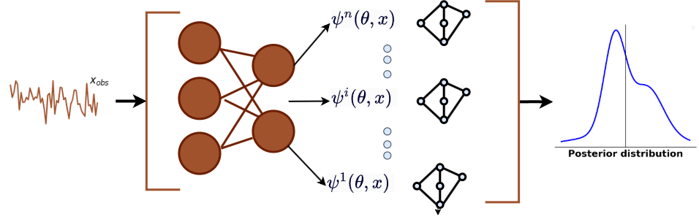
1.2 Realizing Scientific Goals - AI Methods
Scientific goals must be achieved through scientific data processing. (AI methods)
Traditional methods cannot handle it.
Is the AI-based approach really feasible?
Train
[Liang et. al. arXiv.2507.11192 ]
Prior
Simulator
Inference

Slide 9
1.2 Realizing Scientific Goals - Challenges and difficulties
PTA parameter estimation
Key difficulties and challenges still exist
Set up a specific generative model for the PTA field based on prior knowledge in the PTA field.
Although MCMC is time-consuming, it can accurately provide the posterior distribution of gravitational wave events.
Difficulties and Challenges
Solution
The estimation of target wave source parameters based on traditional methods is time-consuming.
The number of parameters for red noise and white noise is enormous.
There are numerous pulsars and a huge amount of data.
Calculating HD correlation exacerbates the time and difficulty of data analysis

Slide 10
02
Current Research States

Slide 11
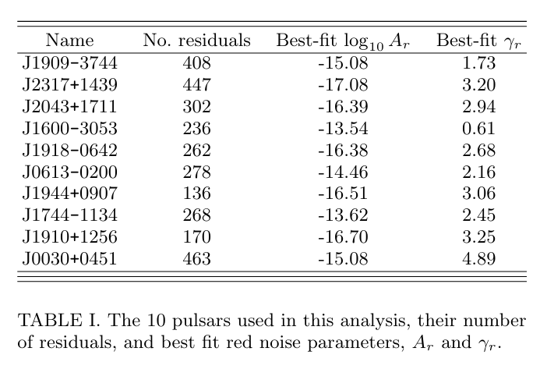
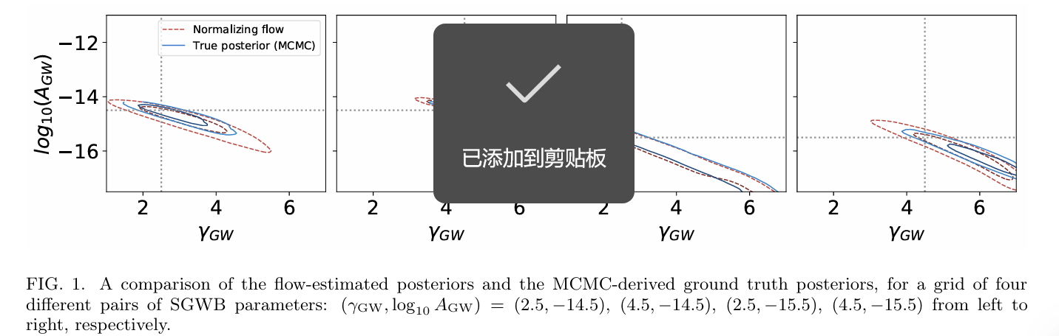
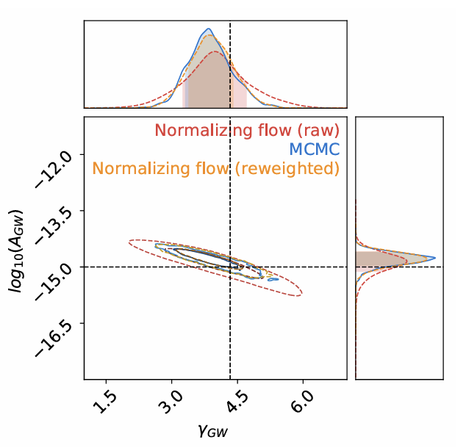
2.1 Progress in PTA Data Analysis - AI Method
Pulsars selection
Result (Shih et al. PhysRevLett.133.011402)
Model
NPE + importance sample
Fortunately, generating simulated data is fast, so modern simulation-based inference techniques can be brought to bear on the problem.

Slide 12
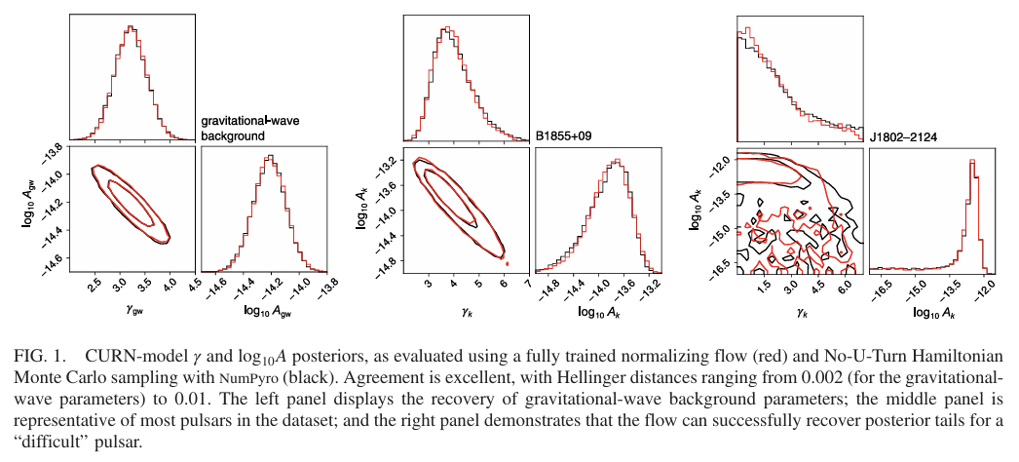
2.1 PTA数据分析相关进展-AI方法
Model
Result ( Vallisneri et al.PhysRevLett.135,071401)
variational inference and normalizing flows（or called FlowMC）.
The core idea is to accelerate MCMC inference through machine learning.
This makes it extremely fast on modern graphical processing units, where it can analyze the NANOGrav 15-yr dataset in few tens of minutes, depending on the probabilistic model, as opposed to hours or days with the analysis codes used until now.
We introduce an alternative procedure that relies instead on stochastic gradient-descent Bayesian variational inference, whereby we obtain the weights of a neural-network approximation of the pos terior by minimizing the Kullback–Leibler divergence of the approximation from the exact posterior.

Slide 13
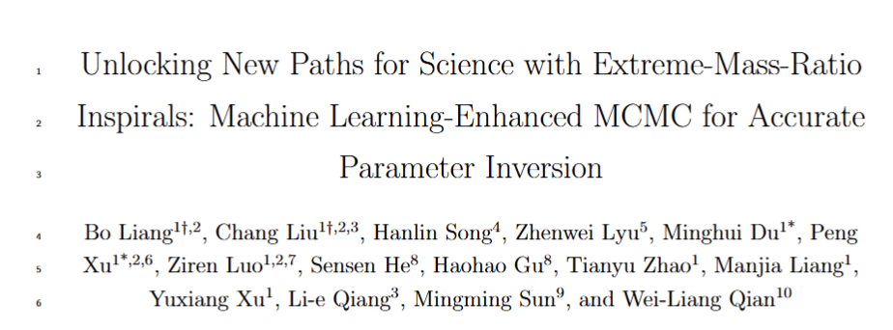
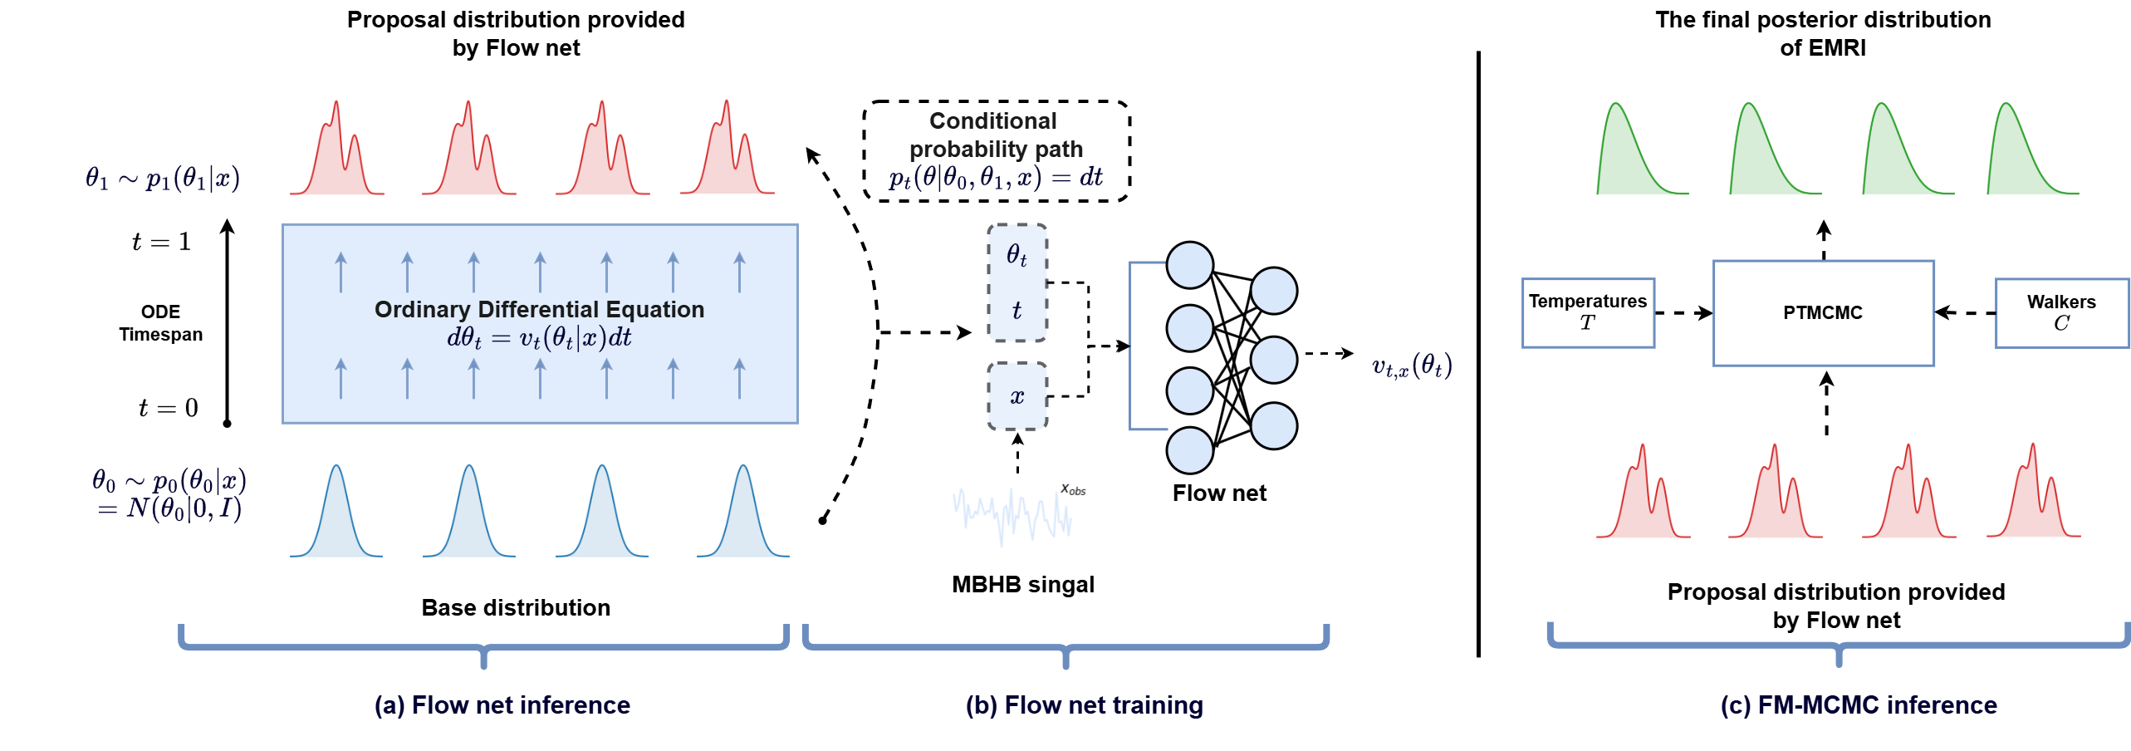
2.1 PTA数据分析相关进展-AI方法
FM-MCMC for EMRI. （Just an example. Flowmc overall framework diagram. 2508.00348）

Slide 14
03
Conclusions

Slide 15
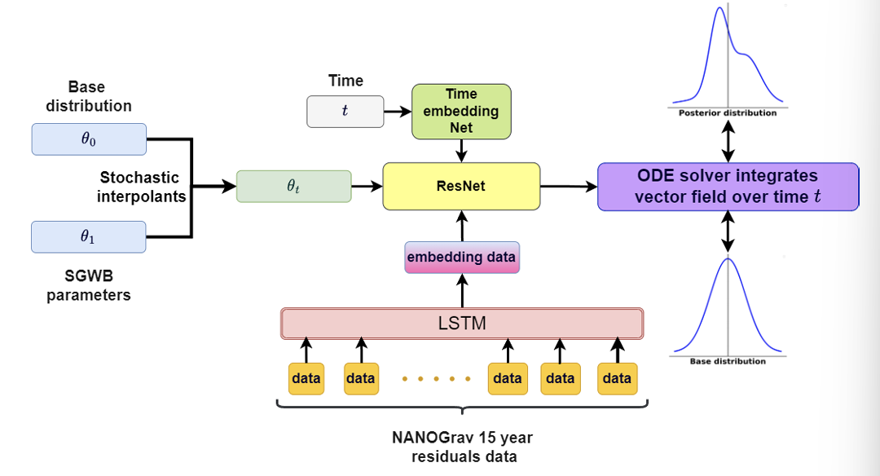
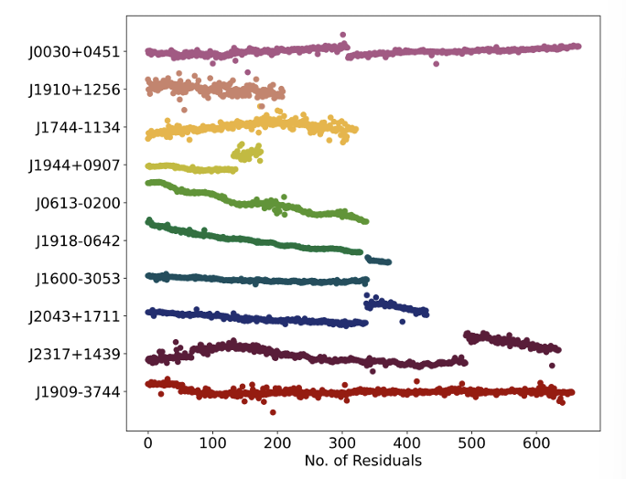
3 Conclusions
Pulsars selection
Model. (Flow matching + LSTM)
We selected real residual data from ten pulsars in NG15 for analysis.
These pulsars provided the strongest evidence for a SGWB in NG12.5, providing a solid data foun dation for our research.
This process involves utilizing the invertible property of CNFs to solve a mapping obtained from a neural ordinary differential equation (ODE), thereby achieving a transition from a simple distribution to a complex one.

Slide 16
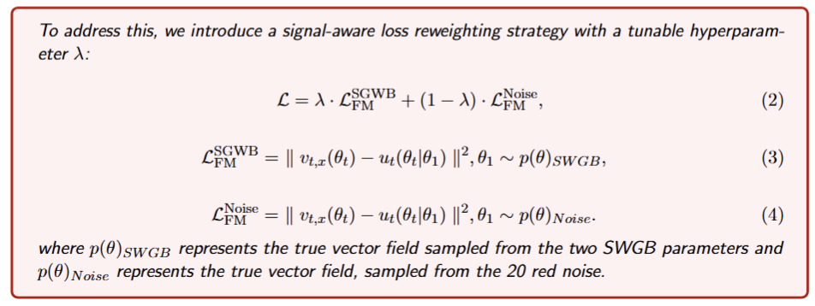
3 Conclusions
Theoretical Method
In PTA research, a key challenge lies in effectively addressing the high-dimensional noise parameters, which can span tens of dimensions, compared to the two-dimensional SGWB parameters associated with the HD correlation. The dominance of noise parameter dimensions often limits the focus on SGWB signals, leading to high computational costs and convergence difficulties in MCMC analysis.

Slide 17
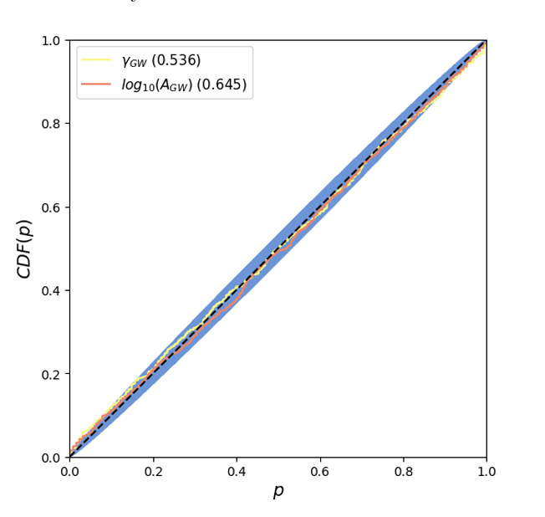
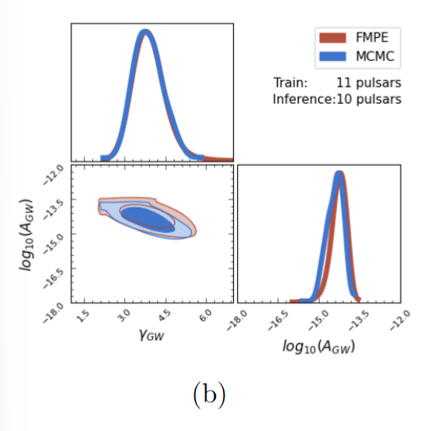
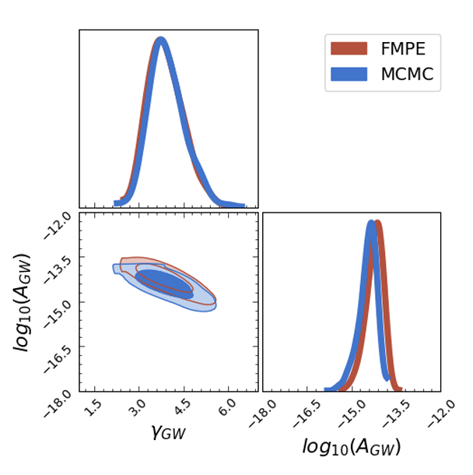
3 Conclusions
Result
In estimating the parameters of the power-law spectrum SGWB associated with HD, CNFs show a significant speed advantage.
The method can complete parameter esti mation in tens of seconds (indicated in blue), which matches the results provided by Enterprise (indicated in orange) and is several orders of magnitude faster than existing methods.
In the P-P plot of 800 injections, the p-values for each parameter are indicated in the legend, and the average p-value across all parameters is calculated to be 0.591.

Slide 18

Thanks！

