Slide 1
Study of Li₂MoO₄ and Na₂Mo₂O₇ crystals for ¹⁰⁰Mo neutrinoless double beta decay search with cryogenic bolometers
Deyong Duan
State Key Laboratory of Particle Detection and Electronics (SKLPDE)
University of Science and Technology of China (USTC)
The XIX International Conference on Topics
in Astroparticle and Underground Physics
August 27, Xichang

Slide 2
Outline
Motivation
LMO&NMO Low Temperature Properties
  Light yield
  Heat capacity
LMO Bolometer Test
USTC Lab Status
Summary

Slide 3
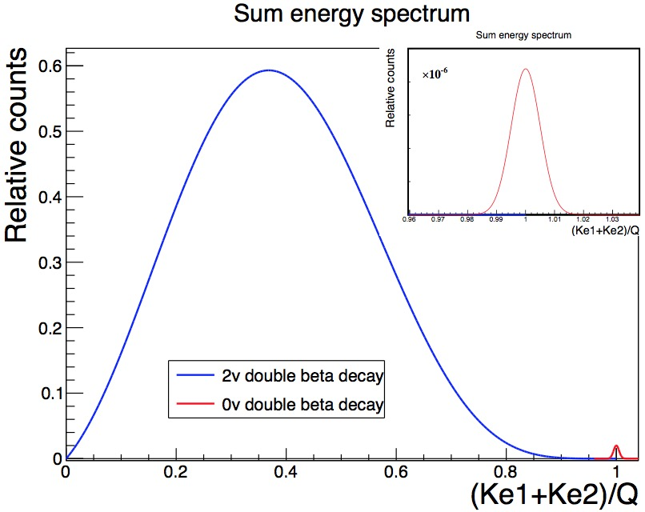
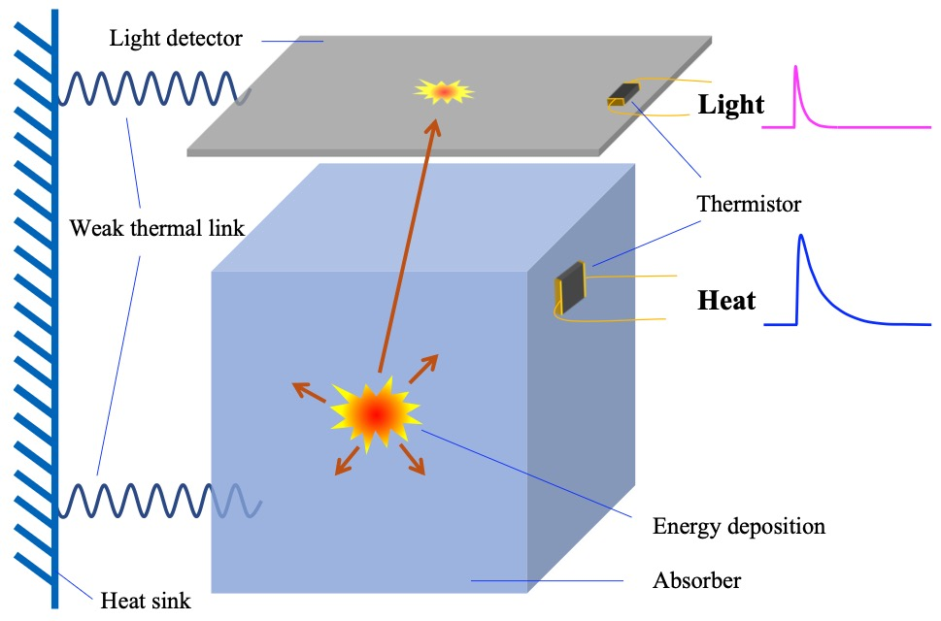
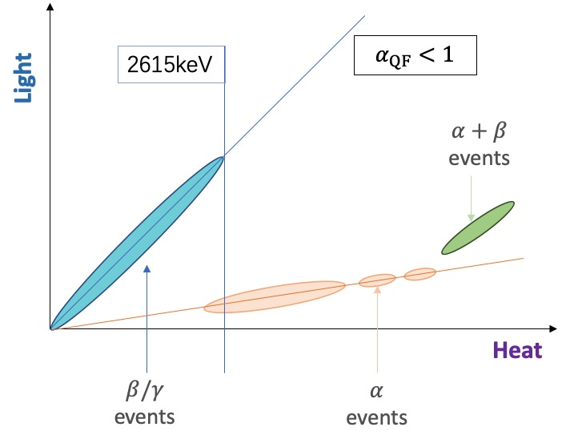
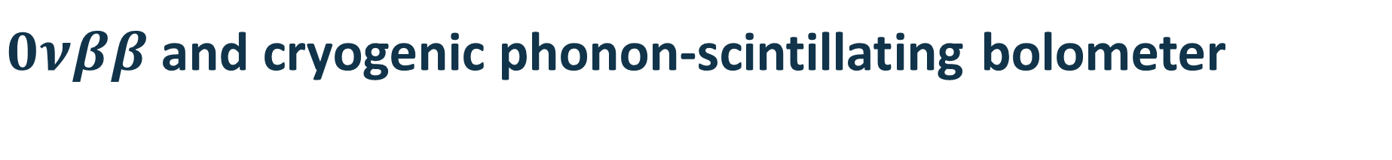

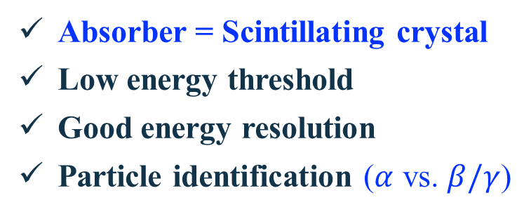
$0νββ$ and cryogenic phonon-scintillating bolometer
Physics goal: neutrinoless double beat decay ($0νββ$)
Lepton number violation
Majorana or Dirac particles
Neutrino mass
Asymmetry of (anti-)matter…
$$\left(A,Z\right)→\left(A,Z+2\right)+2e^{−}$$
Light-heat dual-bolometer
Absorber = Scintillating crystal
Low energy threshold
Good energy resolution
Particle identification ($α$ vs. $β/γ$)
3

Slide 4
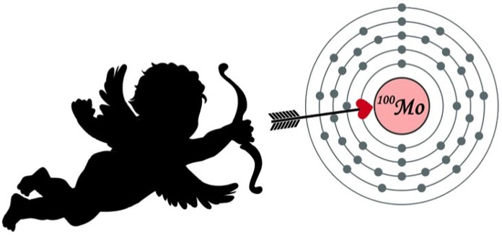
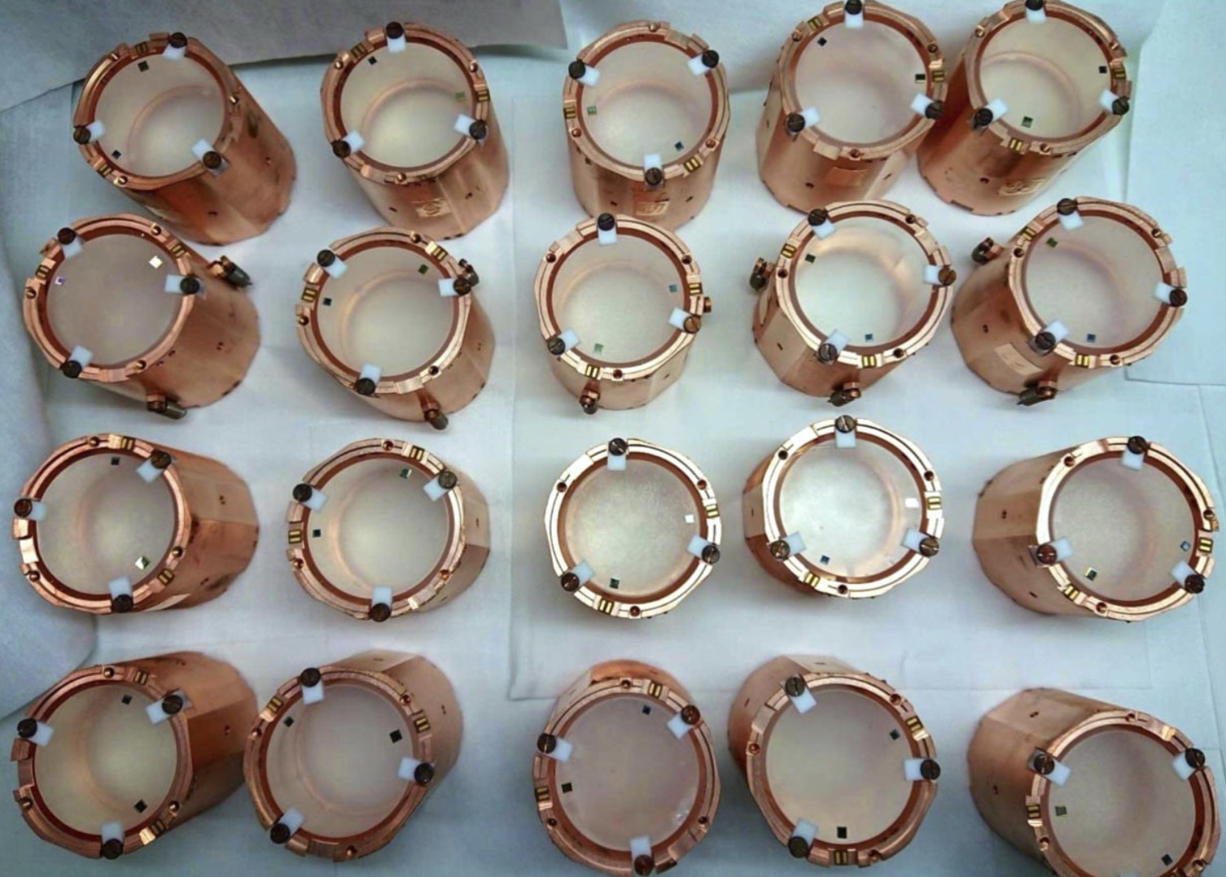
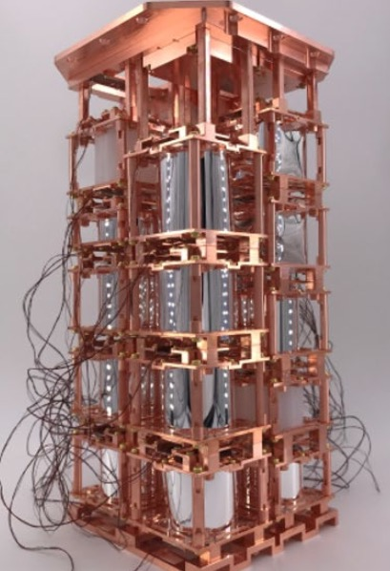
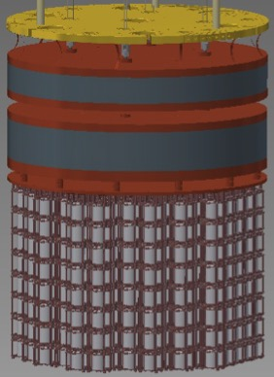

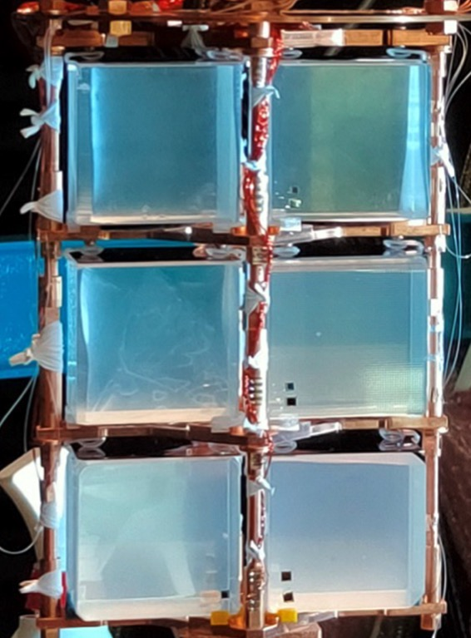
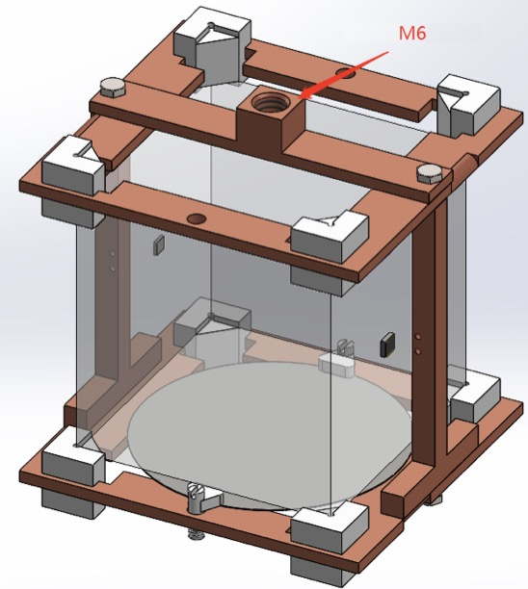
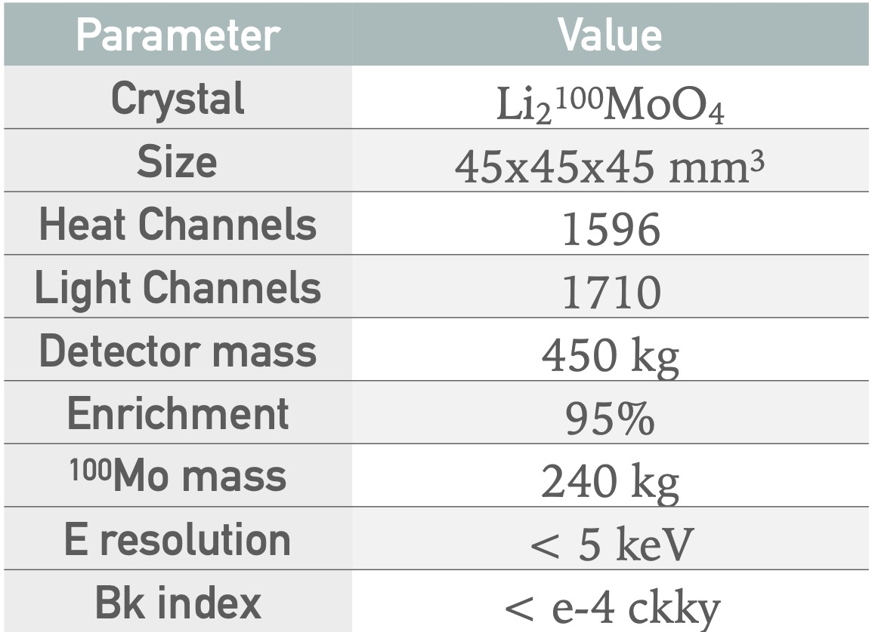
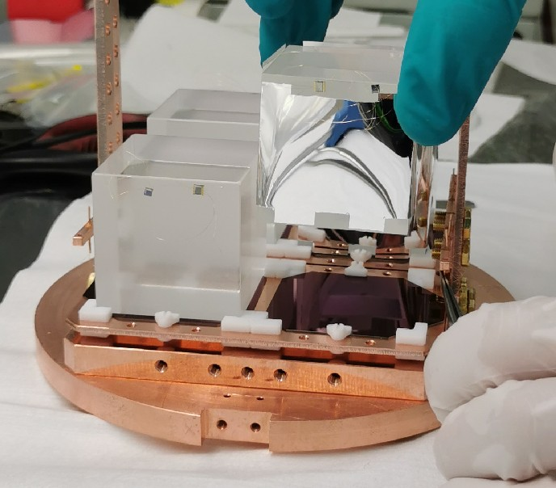
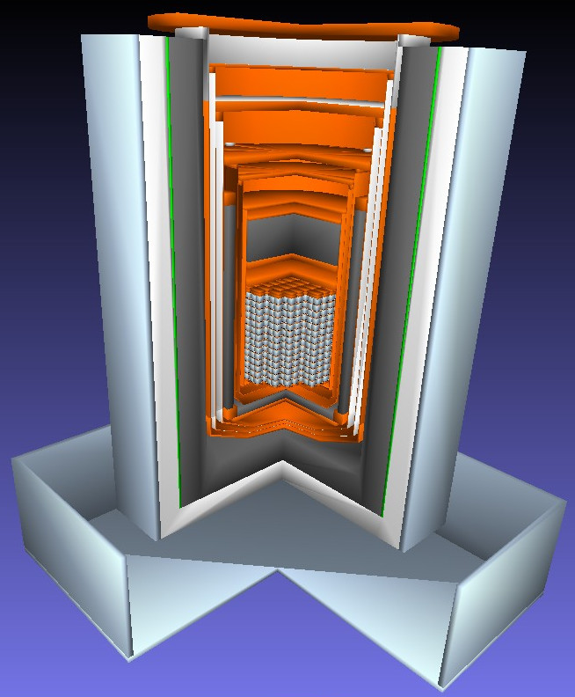
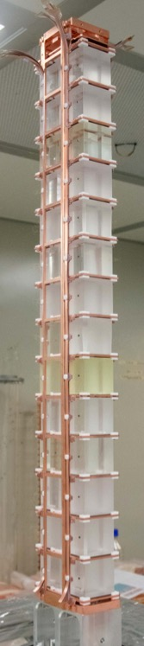

Why molybdate crystals
CUPID-Mo
AMoRE-I
CaMoO₄
AMoRE-II
Li₂MoO₄
Li₂MoO₄
Li₂MoO₄
@Modane
@Canfranc
@Y2L
ZnMoO₄ PbMoO₄
CdMoO₄ Na₂Mo₂O₇
High Q value (3034 keV) &
natural isotope abundance
Li₂MoO₄ @CJPL
Li₂MoO₄ @LNGS

Slide 5
LMO&NMO Low Temperature Properties
01

Slide 6
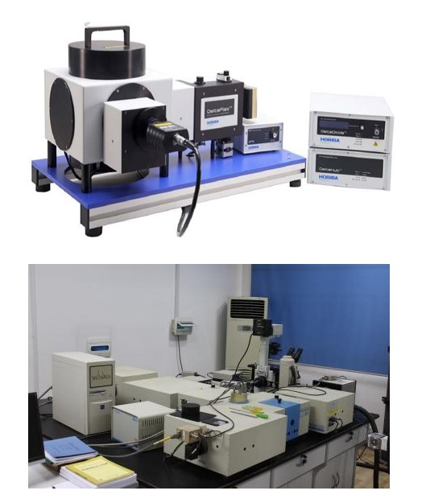
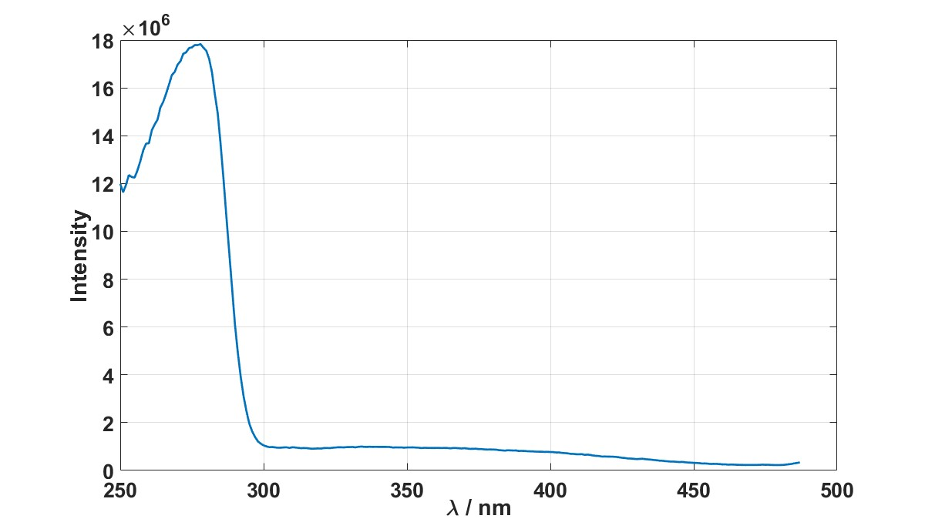
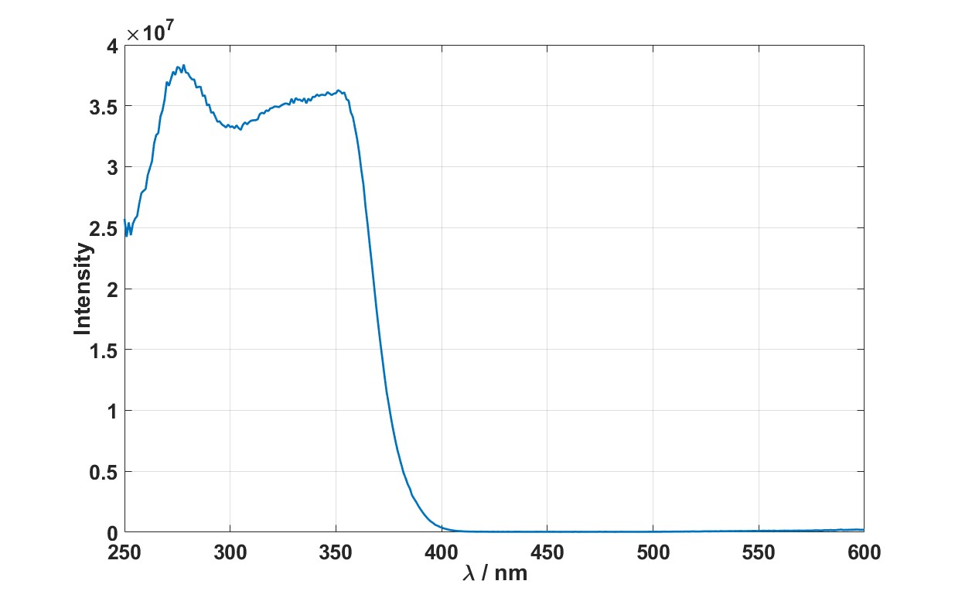
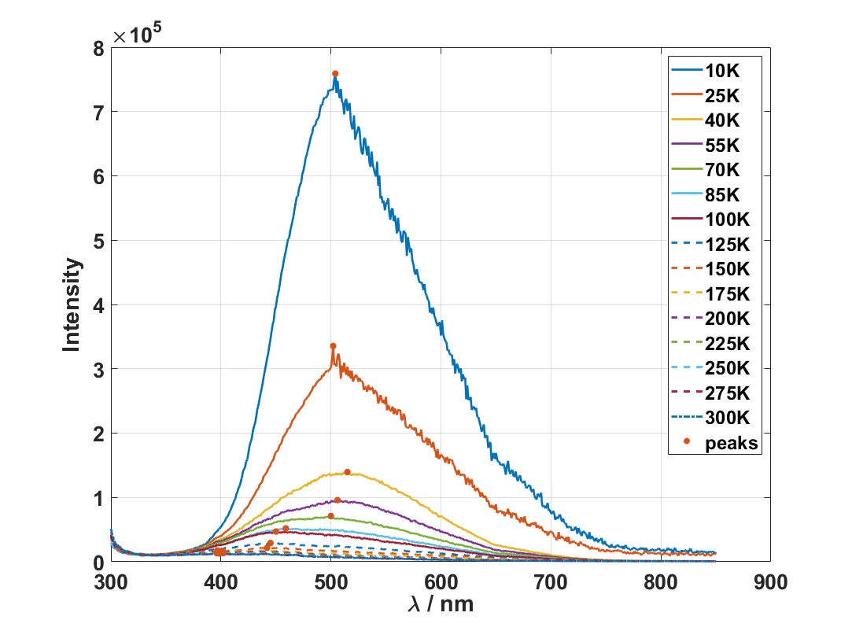
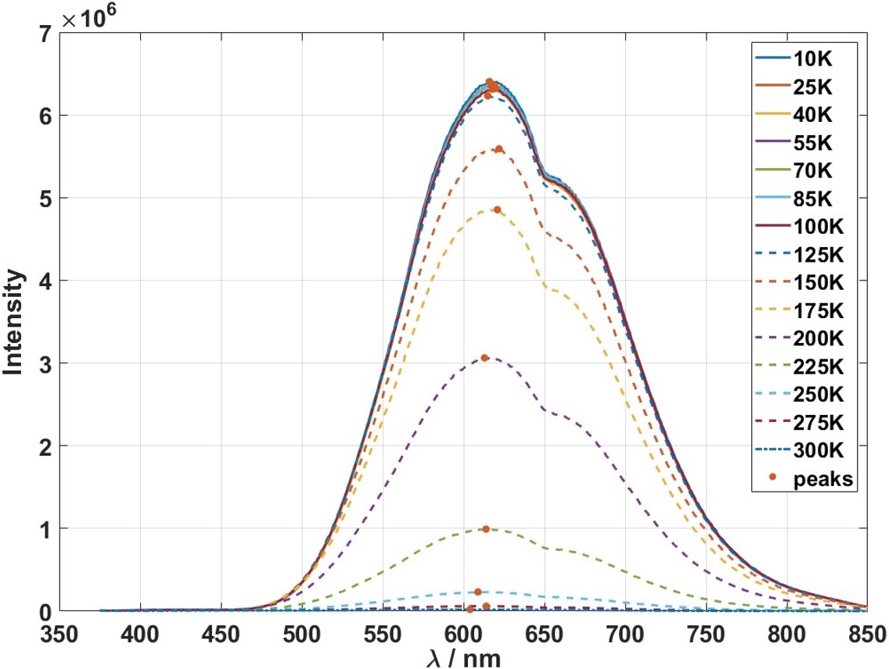


Scintillation light properties
LMO test with laser 280 nm, peak at 510 nm, lower temperature, higher light yield
NMO test with laser 355 nm, peak at 620 nm, lower temperature, higher light yield
Low temperature test platforms with laser (10-300 K), laser 250-1700 nm
LMO-280 nm
NMO-355 nm
Intensity
Intensity
Intensity
$λ$ /nm
$λ$ /nm
Spectrofluorometer
Excitation spectrum @10 K and emission spectrum

Slide 7
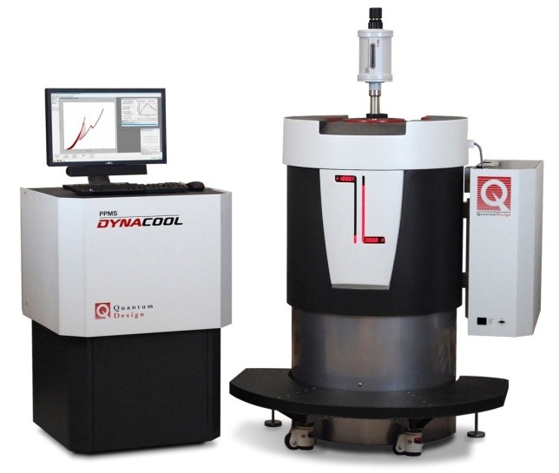
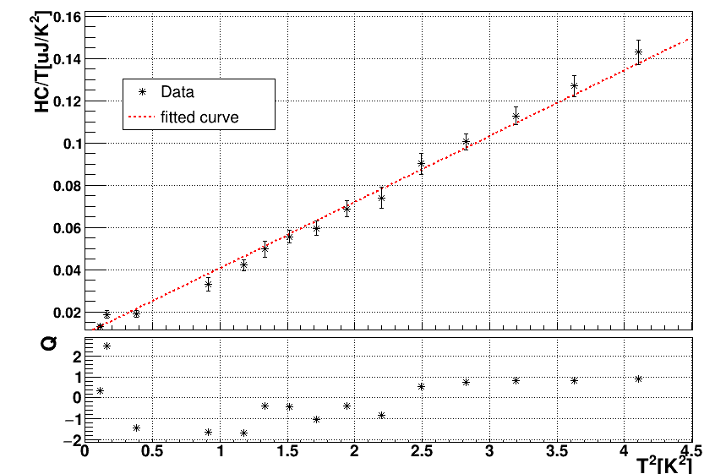
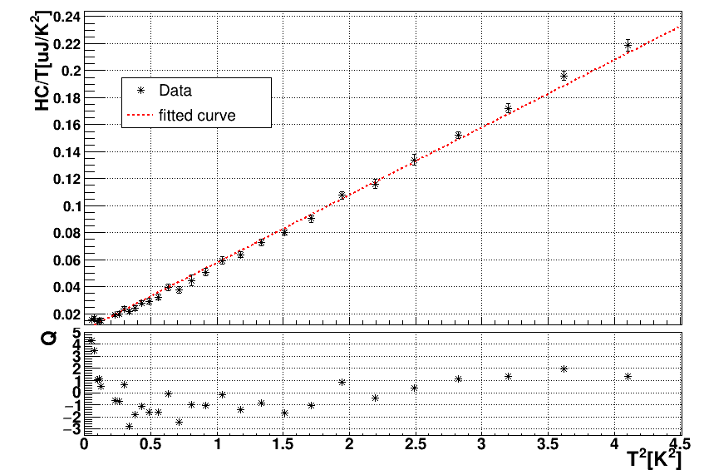
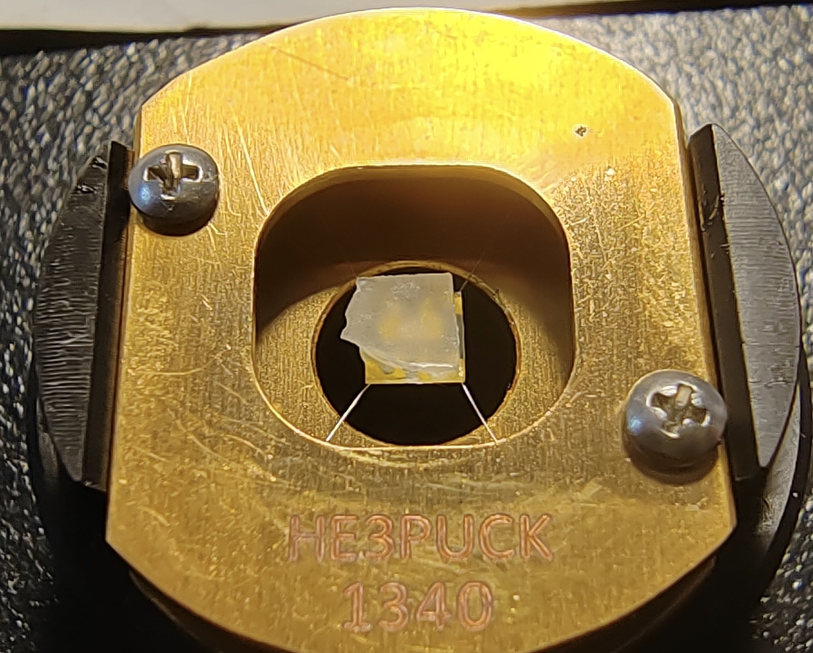
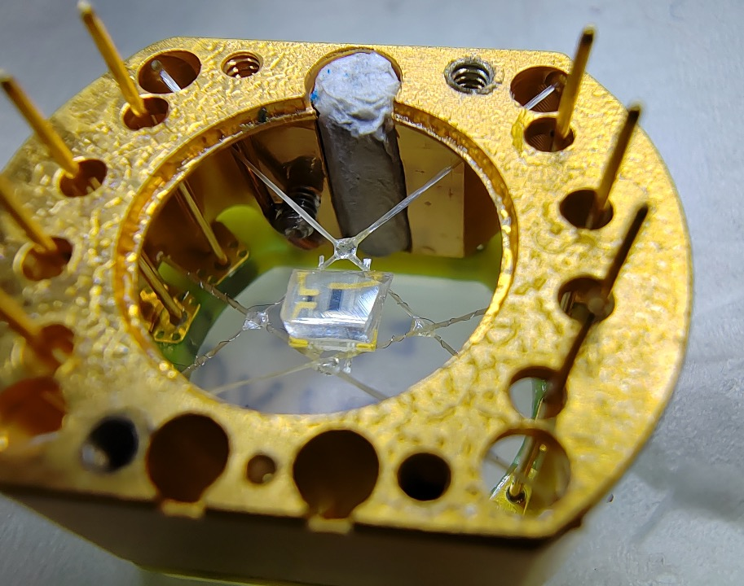

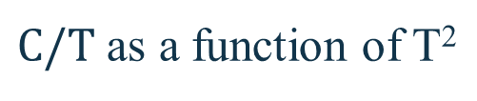
Heat capacity measurement
PPMS (Physical Property Measurement System, Quantum Design), 50 mK - 400 K
Heat capacity measurements of LMO and NMO from 200 mK - 2 K with PPMS, the results are consistent with the Debye model, $θ_{D}(LMO)=330±3 K$, $θ_{D}(NMO)=351±2 K$
$$C_{v}\left(T\right)=βn\frac{m}{M}{\left(\frac{T}{θ_{D}}\right)}^{3}$$
14.3 mg LMO
32.3 mg NMO
Test platforms
$C/T$ as a function of T²
Thanks SICCAS for the crystals

Slide 8
LMO Bolometer Test
02
We constructed serval LMO bolometers and tested they performance

Slide 9
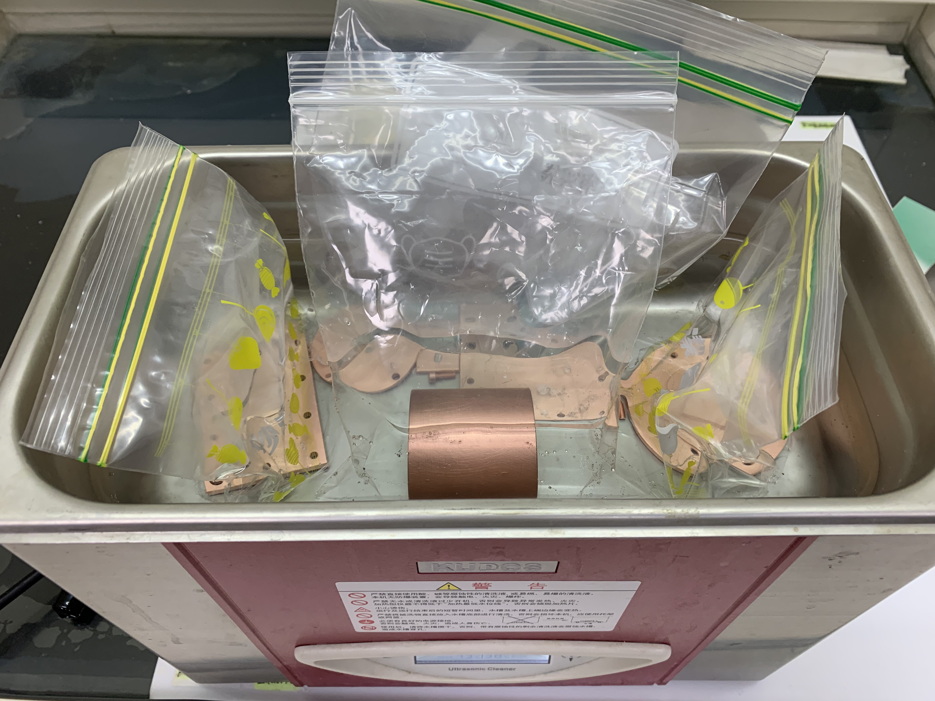
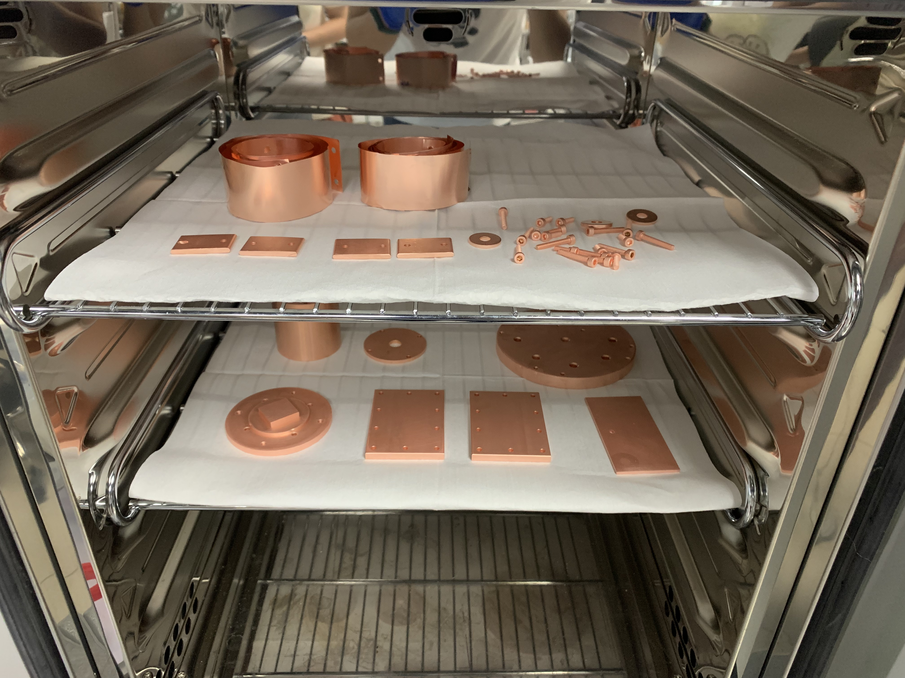
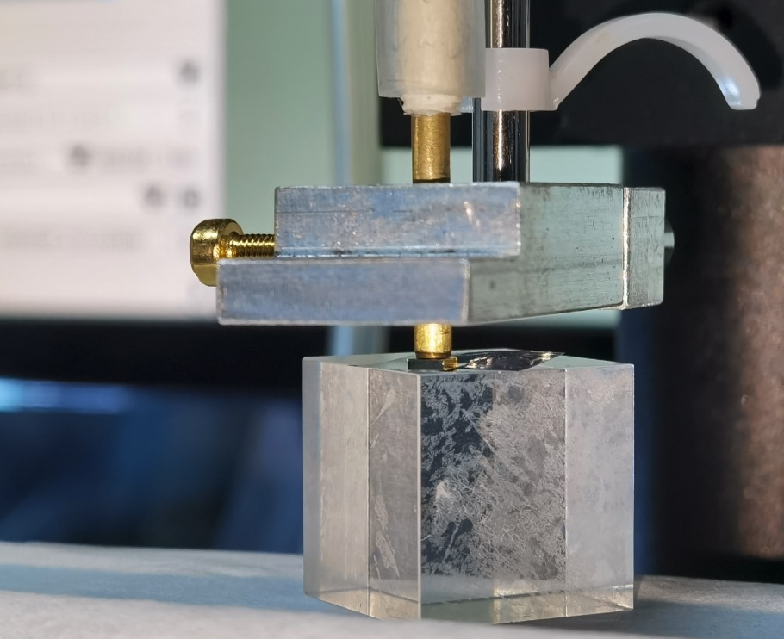
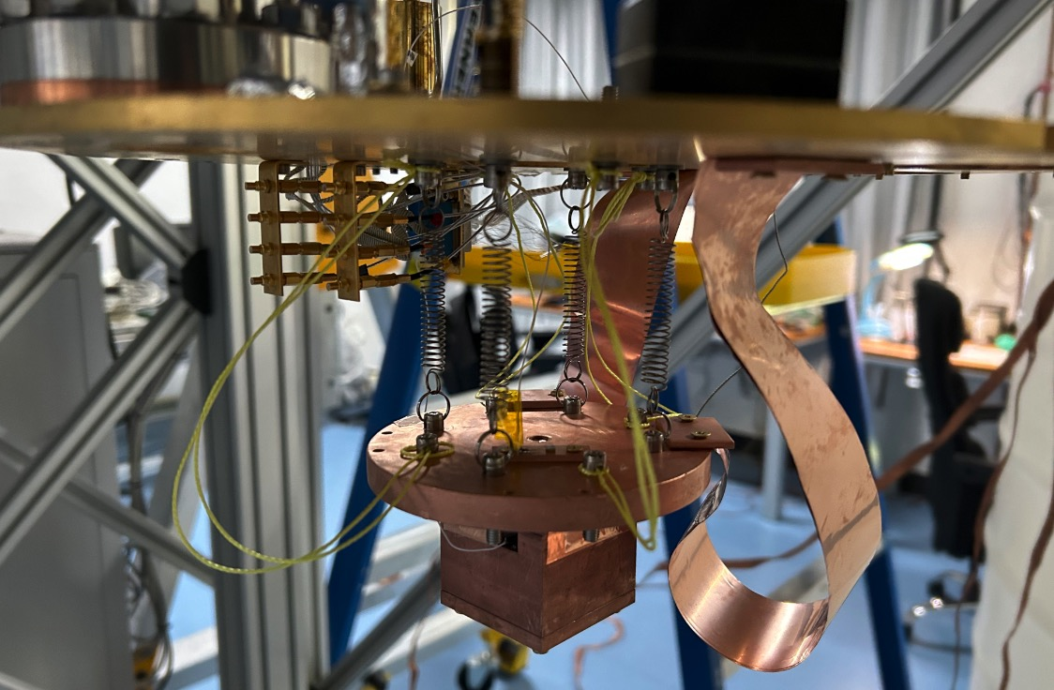
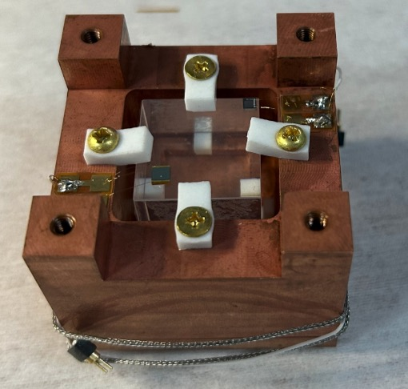
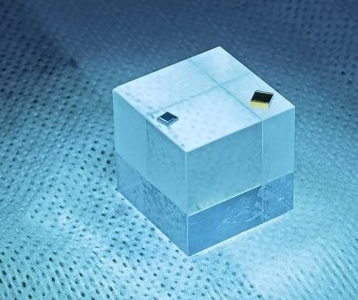
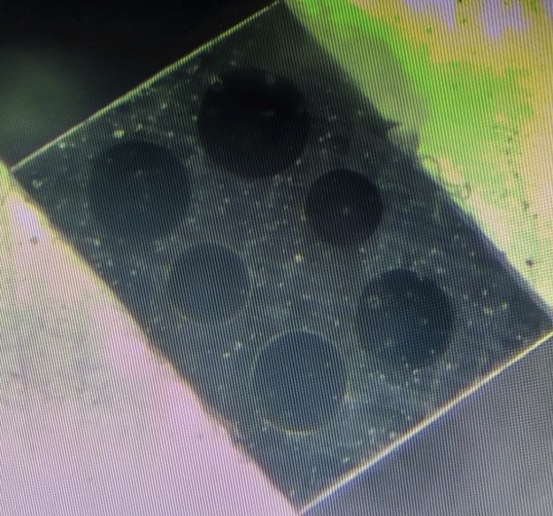
$2×2×2 cm^{3}$ LMO Bolometer
Cleaning
LMO bolometer design
Copper frame cleaning
Gluing
Drying
NTD/Heater gluing
Bolometer assembly
Spring Plate
NTD & Heater
Electrical connection
Fixed on the cryostat
Electrical connect

Slide 10
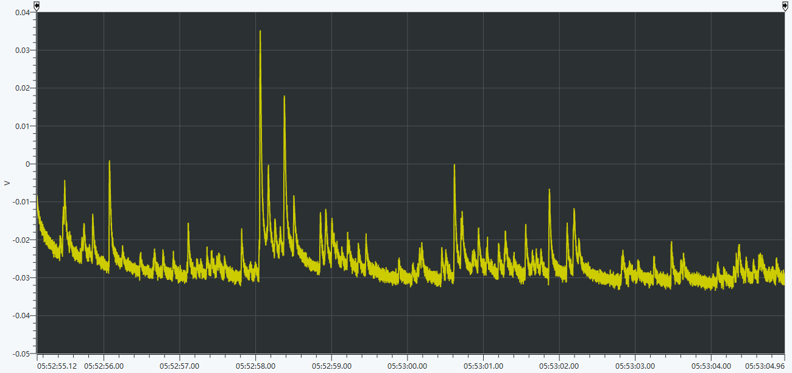
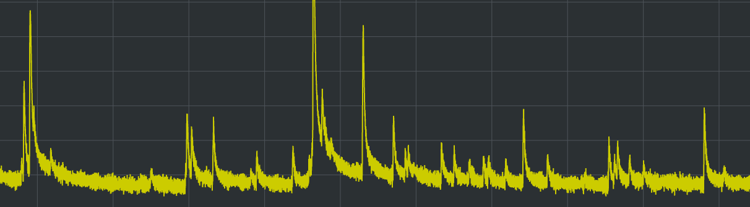
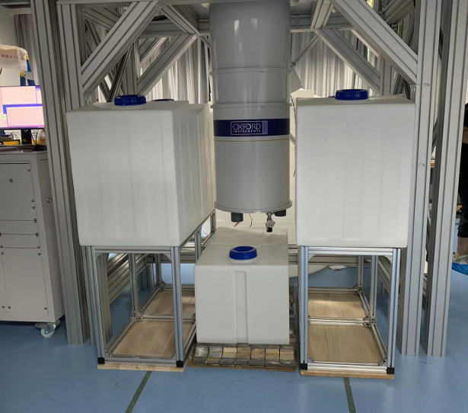
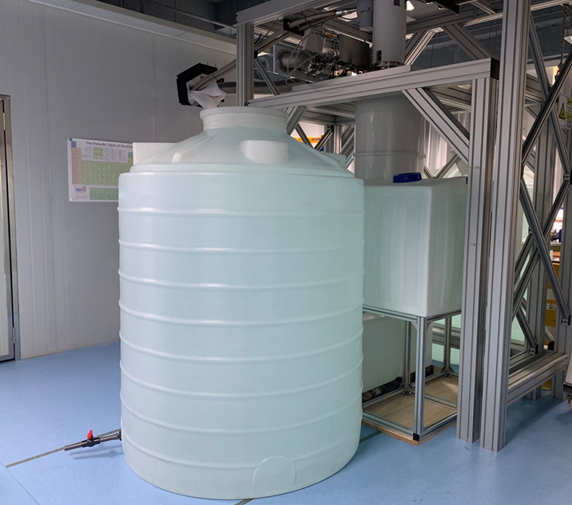
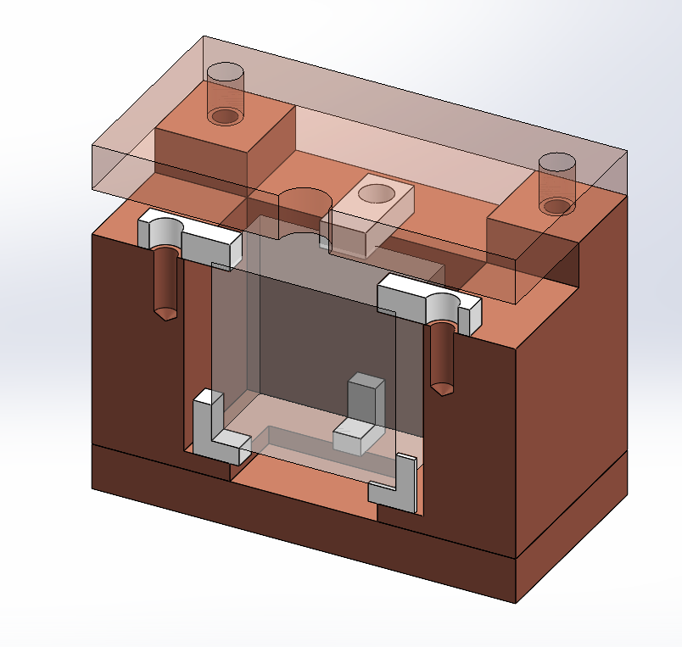
Running state
No shield
Water shielding reduced the pile-up events
LMO Temperature
  Down to 20 mK
10 sec
Water Shield
Water shield
PTFE
Water shield
Crystal
Copper

Slide 11
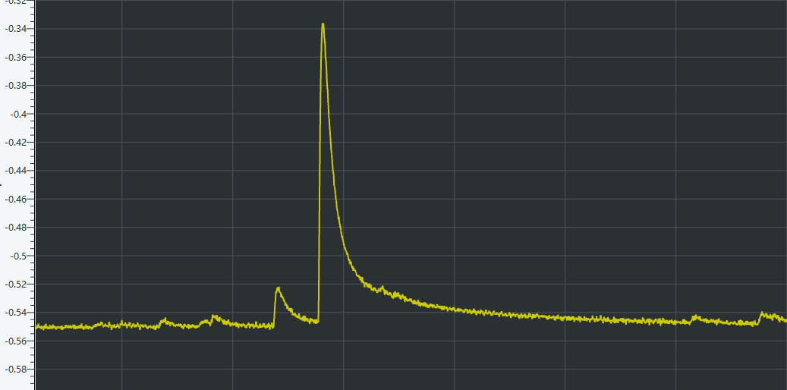
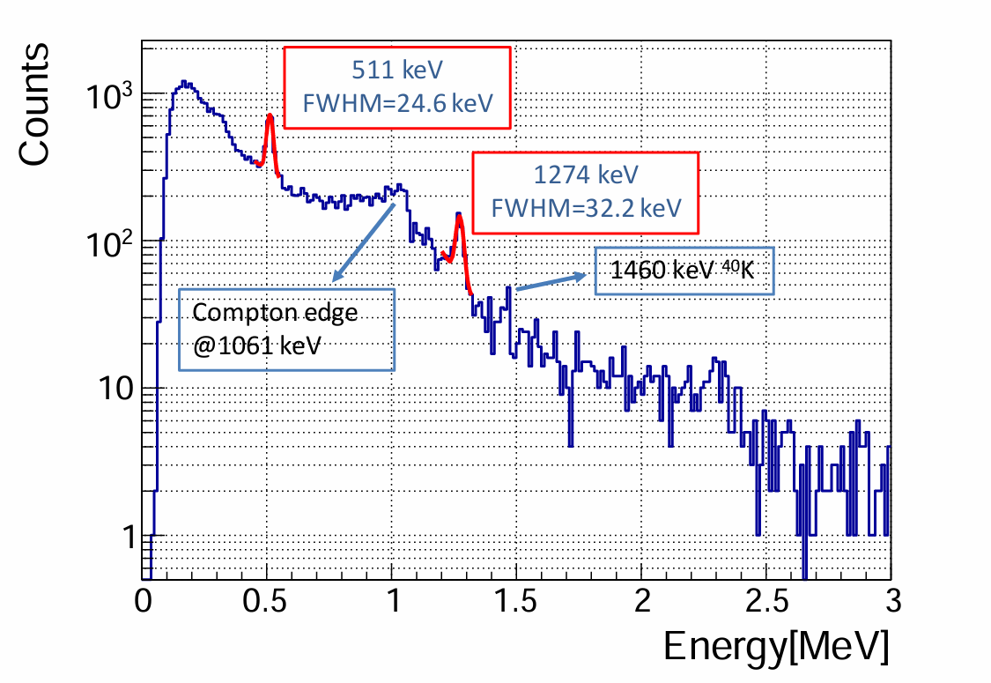
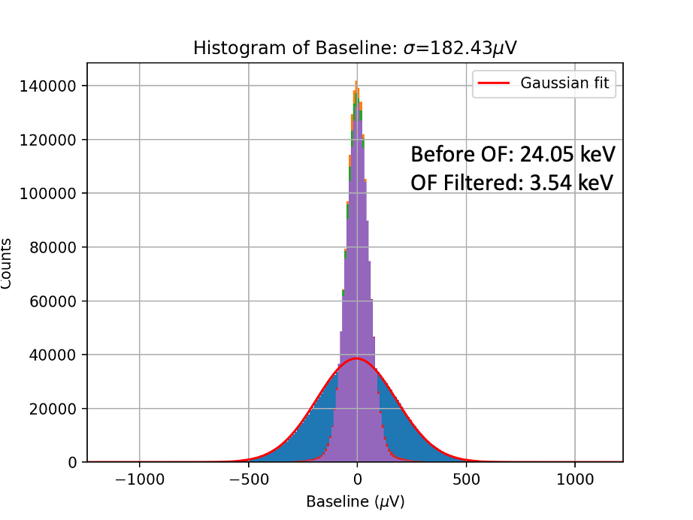

Data Processing
Pulse shape
1.5 s
Decay time ~ 16 ms
Calibrated by ²²Na $γ\text{−}\text{source}$
  FWHM = 21.5 keV@511 keV
  Baseline resolution ~ 3.54 keV

Slide 12
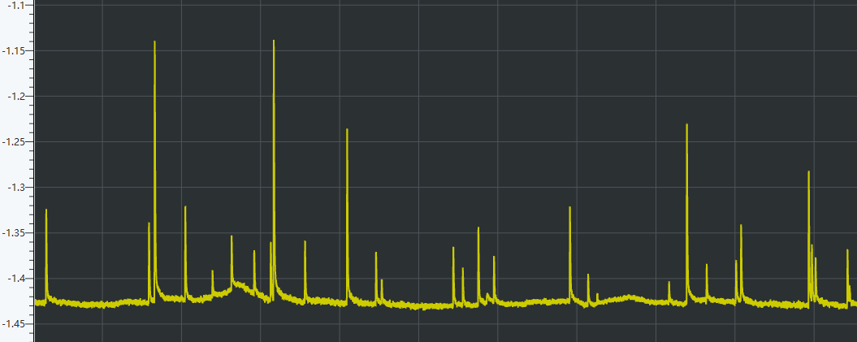
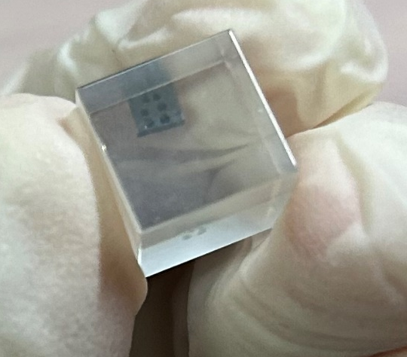
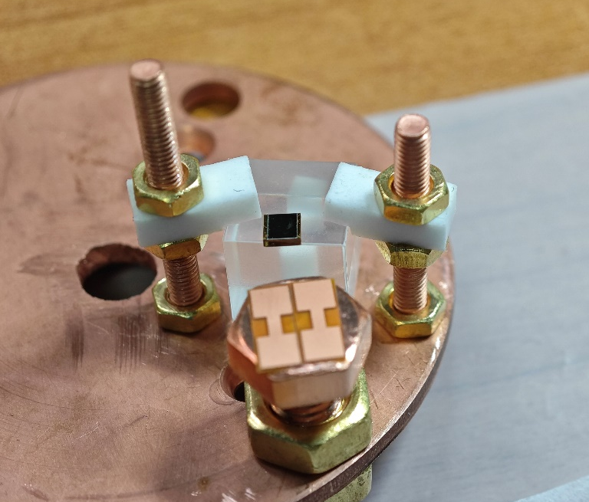
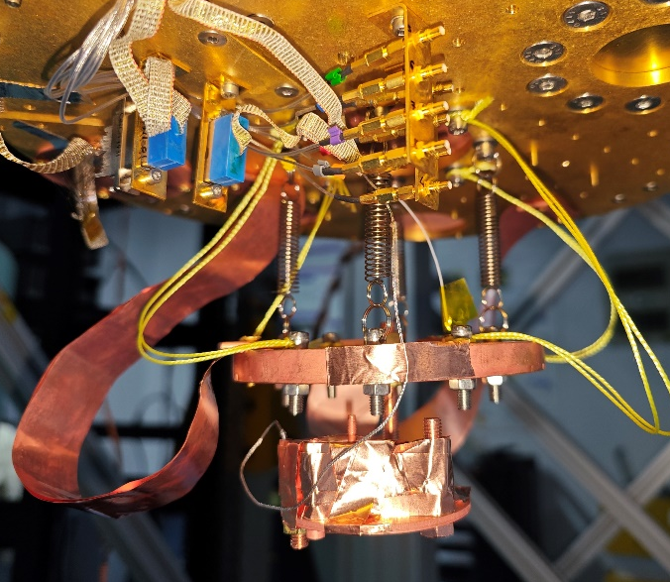

$1×1×1 cm^{3}$ LMO Bolometer
30 s
Pile-up reduced
For still high pile-up rate
  Use the $1×1×1 cm^{3}$LMO
  Reduce size to reduce pile-up
Temperature is about 20 mK
LMO
Glue points
Assemble

Slide 13
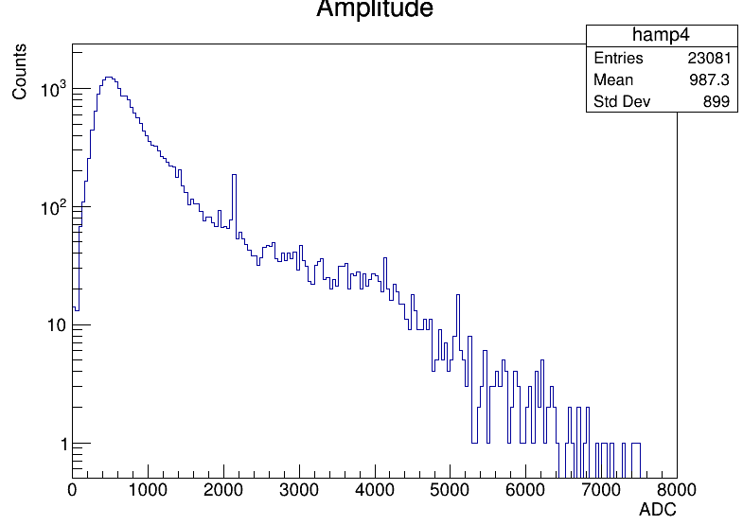
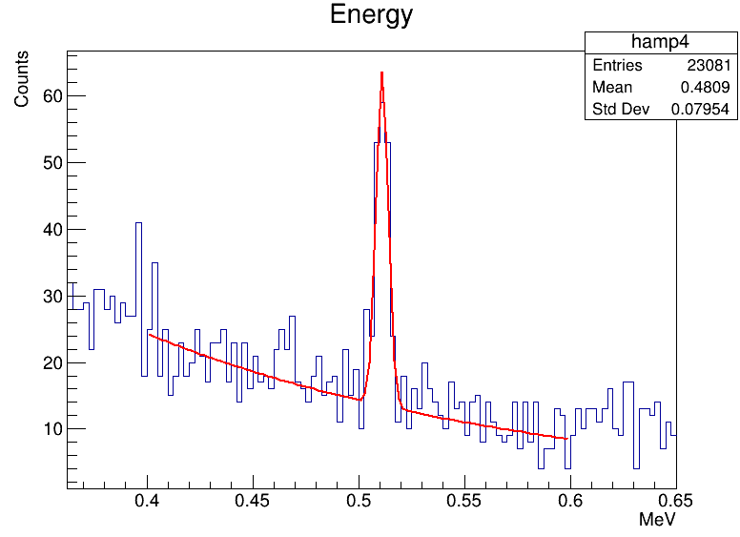
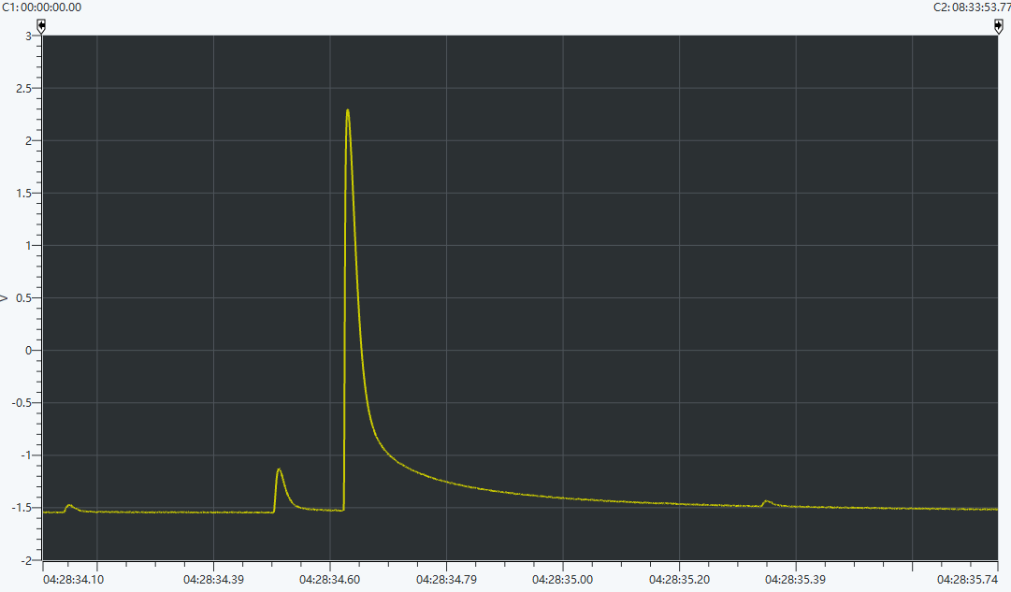

Data Processing
0.511 keV
Decay time ~ 13 ms
  Pile-up rate is lower
FWHM= 7 keV@511 keV
preliminary
1.27 MeV
$$E=511 keV$$
$$σ \sim 3 keV$$
Pulse shape
1.5 s
preliminary

Slide 14
USTC Lab Status
03

Slide 15


USTC Ground Lab Status
Oxford Triton 500@USTC, 2021
Running with water shielding, reduce pile-up
Notes:
effective

Slide 16




Ground Lab Gamma Flux
CZT(CdZnTe) detector $+$ unfolding method $→$ high $γ$ flux backgrounds
Long decay time (hundreds ms)$→$ pile-up events $→$ shielding
arxiv.org/abs/2401.12034

Slide 17



Radioactive Shielding
Two orders of magnitude. Material: Pb (Pb-210<100 Bq/kg), Cu
Three design options: 10 cm Pb, 10 cm Pb +2 cm Cu, 15 cm Cu
Height: 120 cm = 140 cm
Thickness: 15 cm Cu = 10 cm Pb
G4 simulation

Slide 18


Shield Construction
15 cm thick Cu will be used as shield, about 5 tons
The construction of the copper shield was finished
Foundation construction
Shield design

Slide 19
Summary
LMO and NMO are both attractive crystals, especially for 𝟎𝝂𝜷𝜷 search
Scintillation properties and Heat capacity of LMO/NMO crystals have been investigated experimentally at low temperature
R&D work on scintillating crystals’ low temperature characteristics, bolometer design and mK running, radioactive shielding, NTD-Ge and LD fabrication for CJPL.
Thanks!
NTD-Ge and LD fabrication
Post ID: #55 #381

Slide 20
Backups
04

Slide 21


Stream data processing software
Collect triggerless stream data, python-based visualization software
Exploit a matched filter, the Gatti-Manfredi optimum filter, to maximize the Signal Noise Ratio (SNR) and to get the information about the pulse-shape parameters

