Slide 1



New 1-ton neutrino detector at CJPL-I: equipment upgrades and performance
Haozhe Sun
19th International Conference on Topics in Astroparticle and Underground Physics
On Behalf of JNE
Aug, 27, 2025
Notes:
Good after-noon everyone. I’m Haozhe, and it’s my pleasure to have the opportunity to introduce the status of the 1-ton detector in CJPL-I on behalf of JNE here.

Slide 2

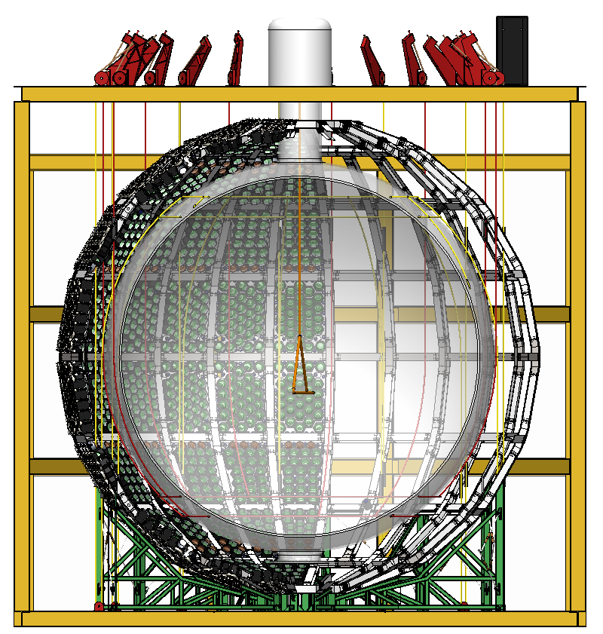
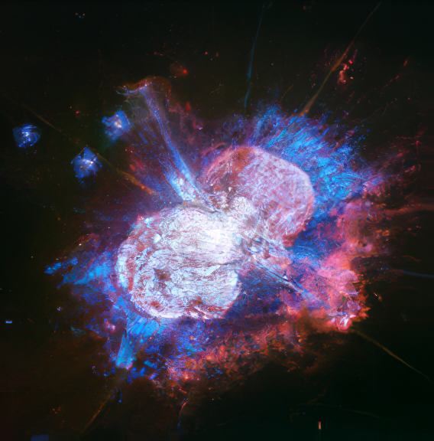
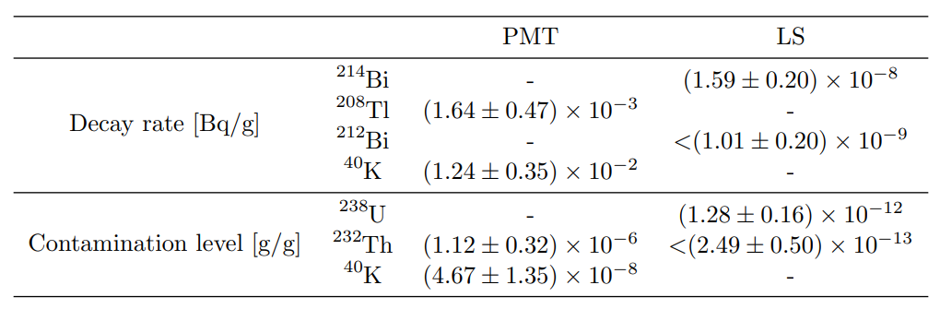
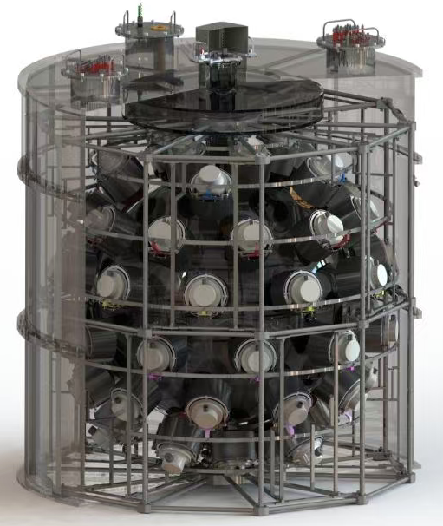
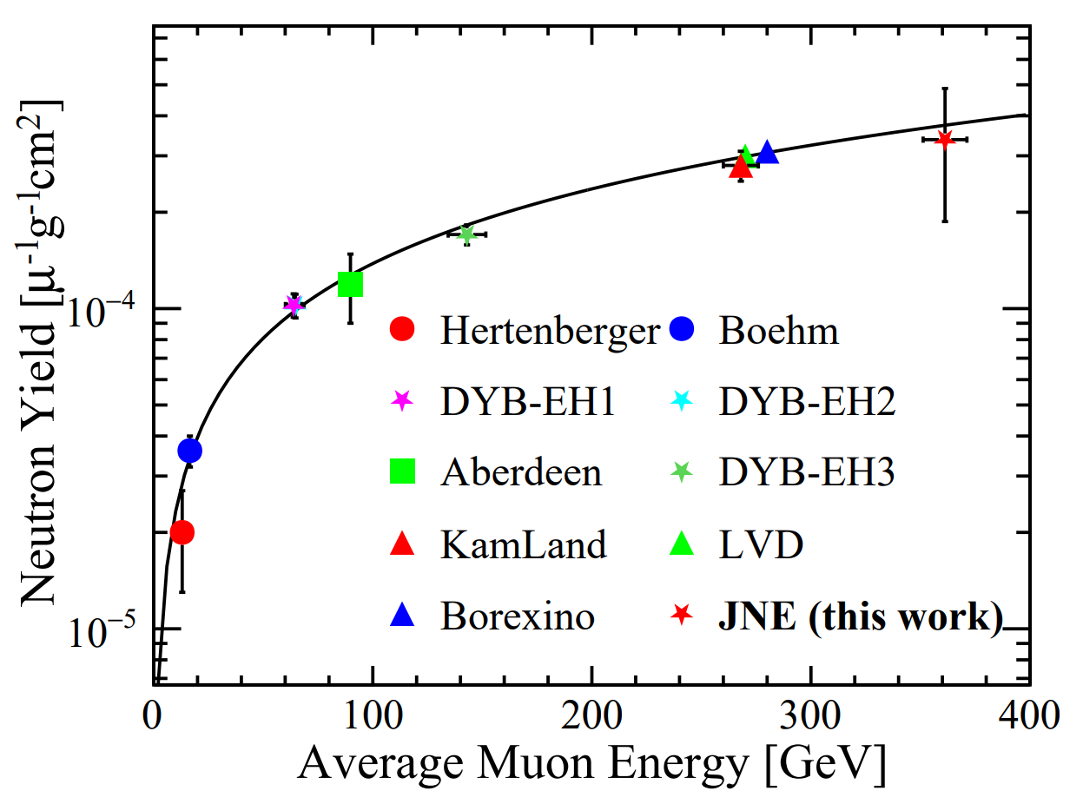










Motivation
Solar $ν$
Supernova $ν$
The 1-ton detector is a prototype for the future 500t detector.
  Testing MCP-PMTs and self-developed electronics system
  Testing reconstruction algorithm
The 1-ton detector has capability for some physics study.
  Background measurement
  Muon flux and muon induced neutron yield measurement
500 cubic meter
$$e^{−}$$
$${\overline{ν}}_{e}$$
$${\overline{ν}}_{e}$$
Geo-$ν$
0$νββ$
$$ν_{e}$$
$${\overline{ν}}_{e}$$
$$e^{−}$$
Prototype
DOI:10.1016/j.nima.2023.168400
DOI:10.1103/PhysRevD.110.112017
Notes:
The 1-ton detector is a prototype of the future 500-ton detector in CJPL-II, which aims to detect the signal from solar neutrino, geo-neutrino, supernova neutrino and neutrino-less double beta decay. The 1-ton detector can play the role of testing the new liquid scintillators, MCP-PMTs, self-developed electronics system, and testing the reconstruction algorithm. In addition, the 1-ton detector also processes its capability to conduct some physics research, such as the muon flux and muon induced neutron yield measurement, and the environment background measurement.

Slide 3
Outline
Experimental Site
Detector Structure
  Target
  MCP-PMT
  Electronics System
Calibration and Reconstruction
  Time and Energy Calibration
  Event-by-event Direction Reconstruction
Prospect
Notes:
Here’s the outline of my talk today. At first, I will briefly introduce the experimental site, CJPL. After that, the detector structure and the details of every component will be shown, including the target, the MCP-PMTs and the self-developed electronics system. Following that, some results of the calibration and reconstruction will be listed. And in the end, we will see what we can do next to explore the potential capability further.

Slide 4
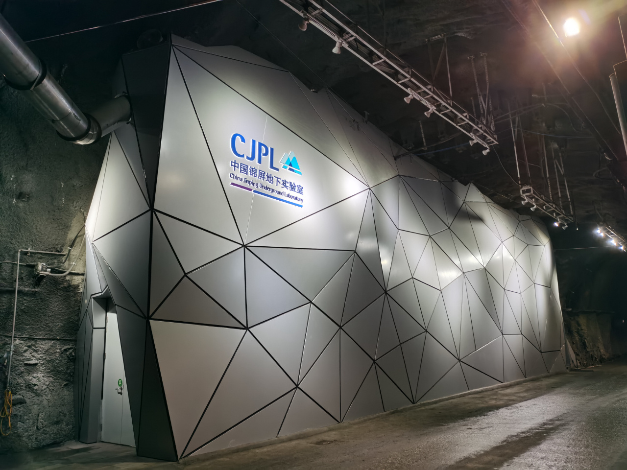
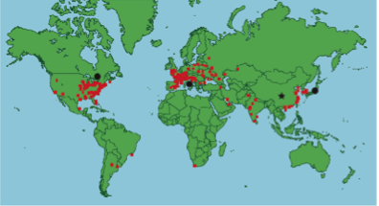
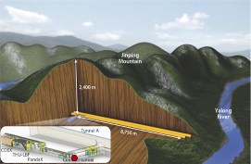
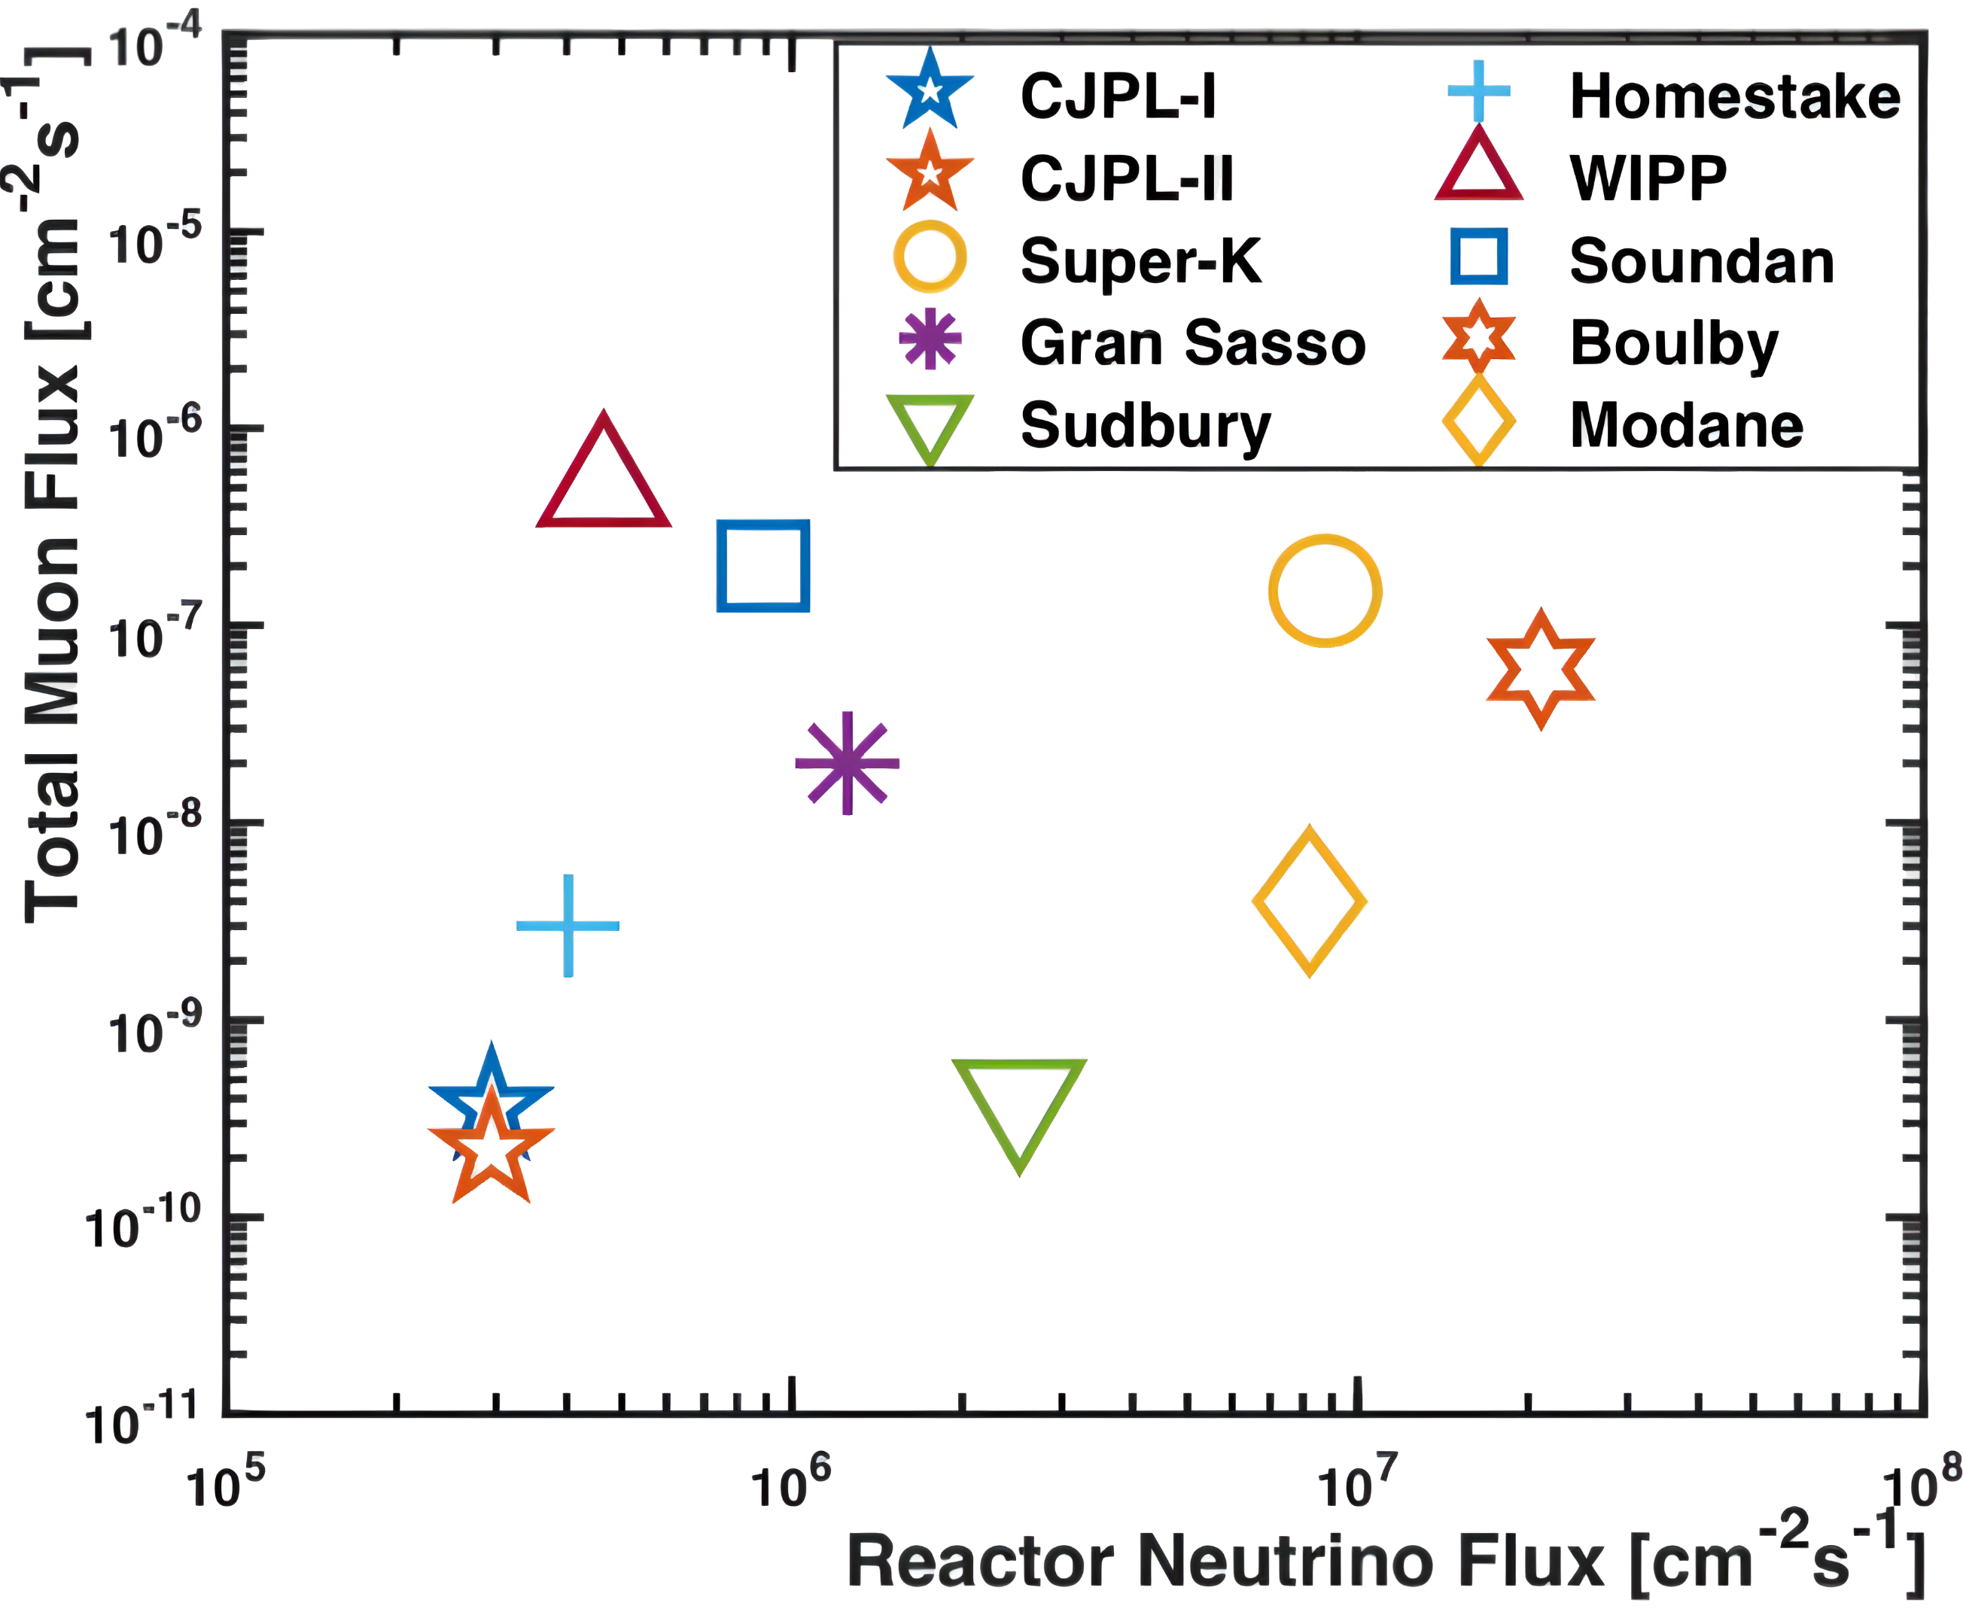
Experimental Site
The China Jinping Underground Laboratory (CJPL) is located in Sichuan province, China.
  Low reactor neutrino rate and low muon rate
  Granite, low natural radioactivity background
  Suitable for neutrino experiment
Lowest muon and reactor neutrino flux
DOI:10.1088/1674-1137/41/2/023002
Notes:
Here’s the basic information of CJPL: located in Sichuan Province, far from reactor plants, and with a 2400-meter rock overburden, the experimental has low reactor neutrino rate and low muon rate, suitable for neutrino research.

Slide 5
Outline
Experimental Site
Detector Structure
  Target
  MCP-PMT
  Electronics System
Calibration and Reconstruction
  Time and Energy Calibration
  Event-by-event Direction Reconstruction
Prospect
Notes:
Next is the structure of detector.

Slide 6
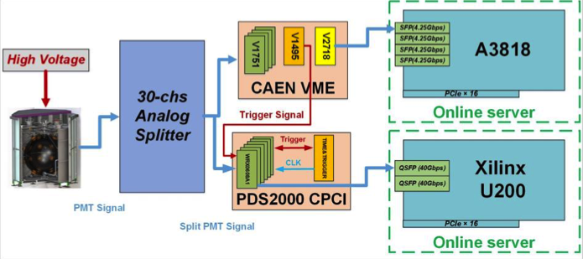
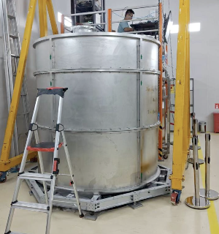
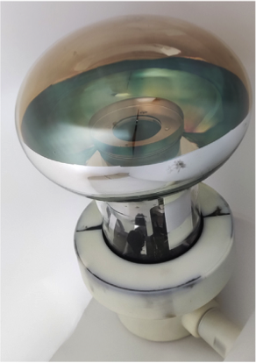
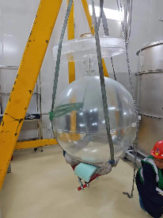
Detector Structure
Outer
Electronics
Water and steal shielding
MCP-PMTs
Acrylic sphere
Target: water / LS / LiCl
Inner
Notes:
The structure is shown on the left. From inner to outer, there are the target, the acrylic sphere, the MCP-PMTs, water and steal shielding, and the electronics system outside.

Slide 7
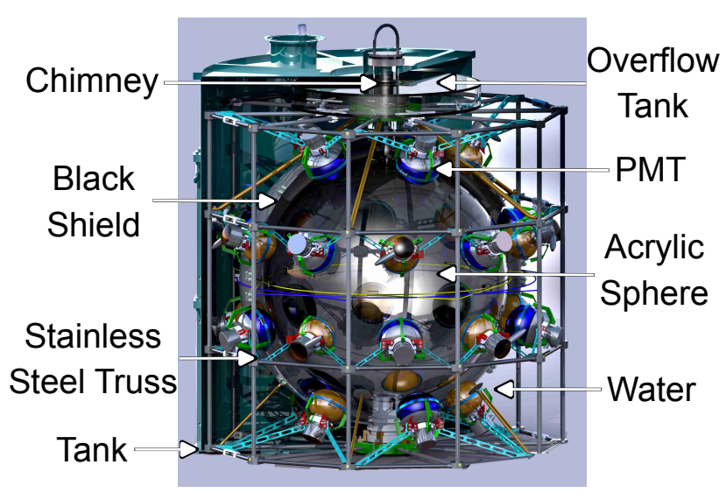
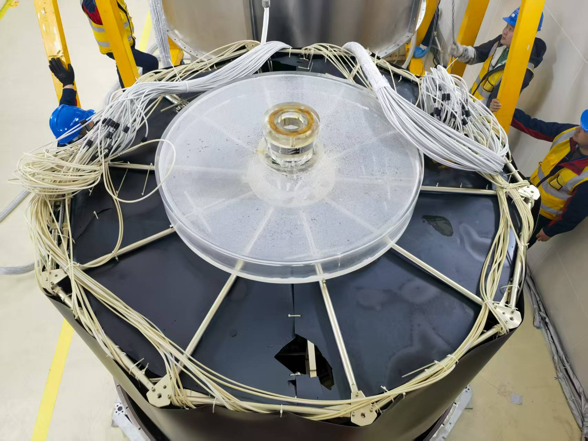
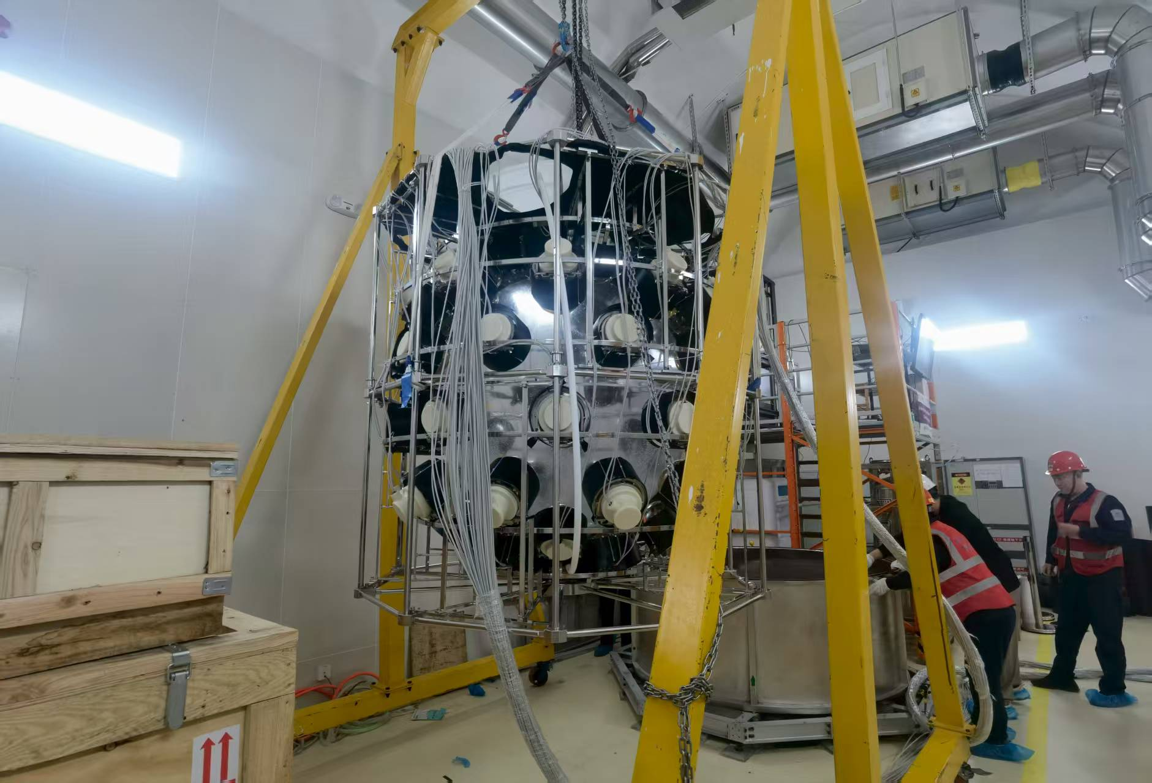
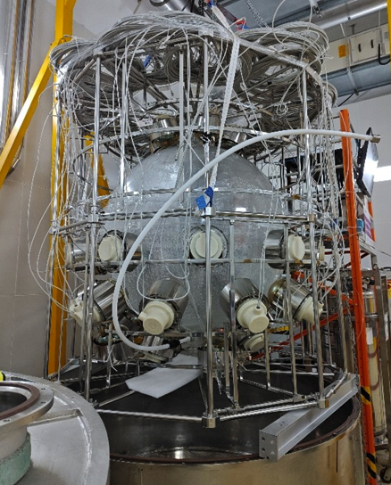
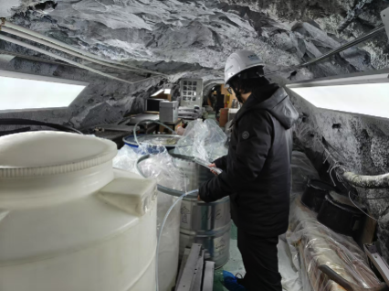
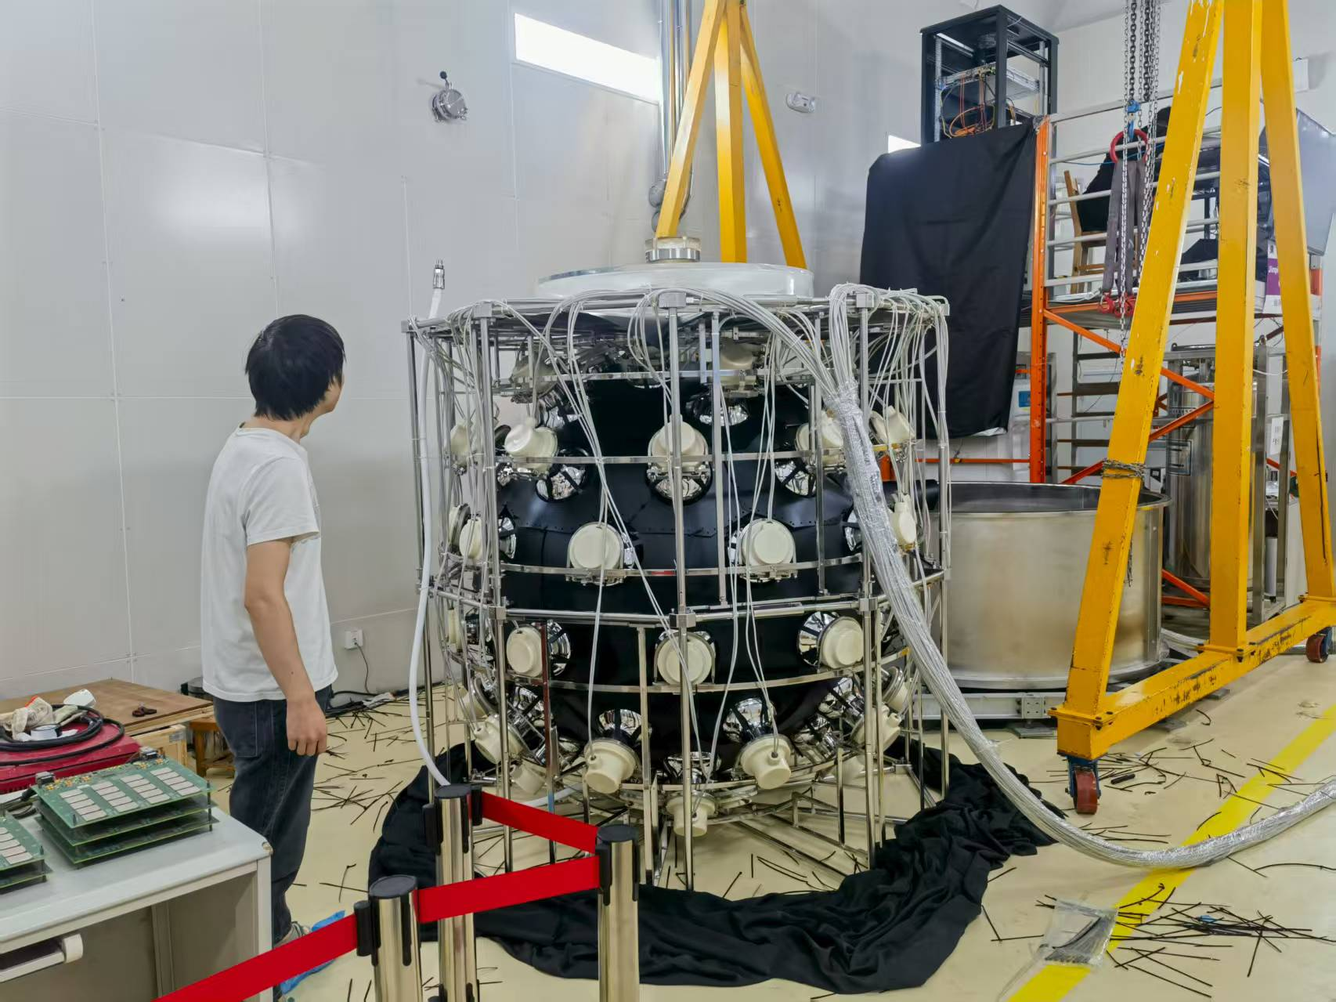
Equipment Upgrade
Filled with pure water
Installed light shielding cylinder
30PMTs
Changed PMTs
New liquid scintillator
New Electronics system
……
2017 - 2024.6
2024.9
2025.5
Future
Old 1-ton detector
Dry run
Water
LS
Dry run
Water
2024.6
2025.1
2025.6
2025.8
Replaced with 60 MCP-PMTs
Removed lead shielding
Filled with liquid scintillator
Calibrated the detector
Installed light shielding sphere
Notes:
The 1-ton prototype was constructed in 2017, and got upgrade in June, 2024. Since then, the detector has run for more than one year, and has undergone dry run phase, purified water phase and liquid scintillator phase. And we have applied several equipment upgrades during the stage: we replaced the Hamamatsu PMTs with the MCP-PMTs, installed light shielding cylinder and light shielding sphere. In the future, we will continue to make upgrades to further enhance the detector’s performance.

Slide 8
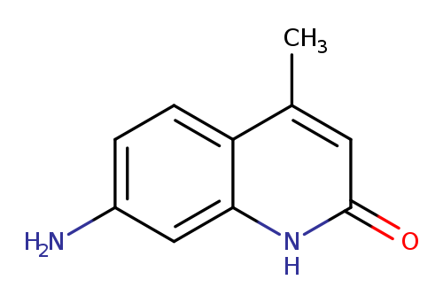
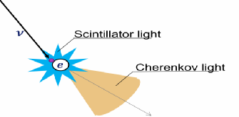
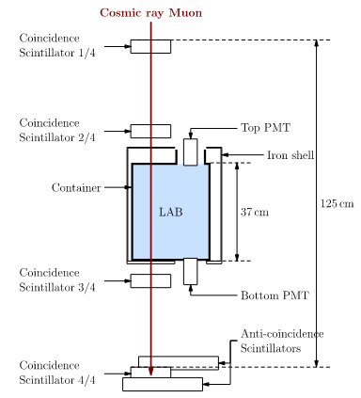
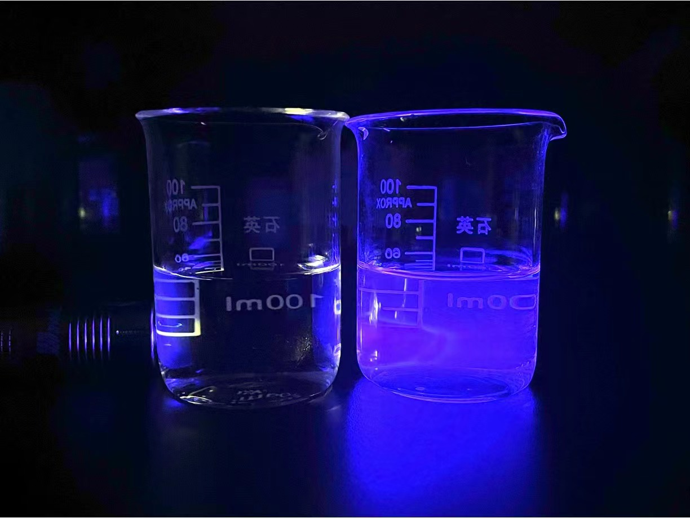
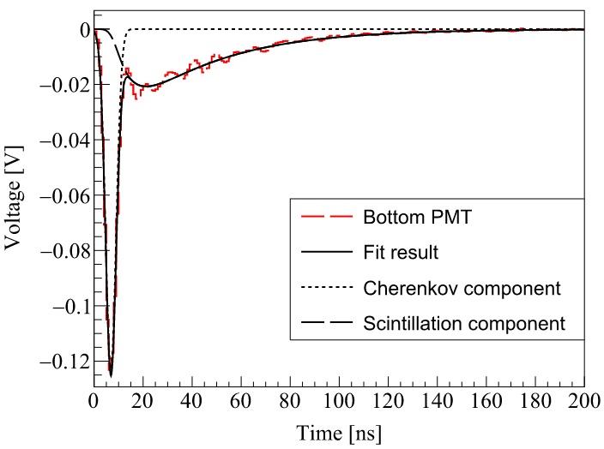
Target (Slow LS & LiCl aqueous solution)
The properties of Slow LS and LiCl aqueous solution has been studied
  Slow LS: separating scintillation and Cerenkov light
  LiCl aqueous solution: detecting solar neutrino spectrum & separating CS light
Flour: Carbostyril-124
no flour
1ppm flour
Large cross section
High natural abundance
High transparency
20L detector structure and bottom PMT waveform
LiCl aqueous solution sample
DOI:10.1016/j.nima.2016.05.132
DOI:10.1088/1748-0221/18/07/P07039
Notes:
We have investigated some of the candidate materials for the detector target, including slow liquid scintillator and lithium chloride aqueous solution. We can separate the scintillation and Cerenkov light due to the scintillation rise time. With the direction and energy reconstruction, the detector can have a better performance in the searching for neutrino-less double beta decay and potassium-40 geo-neutrinos. The figures show the test platform and the discrimination of the scintillation and Cerenkov light in a waveform. Another candidate material is lithium chloride. The lithium chloride aqueous solution offers advantages for measuring solar neutrino spectrum, which can be used to test the solar model. We enable the solution to fluoresces by adding the fluorescent molecules Carbostyril-124 in it. The detection medium we developed has a sufficient transparency and light yield.

Slide 9
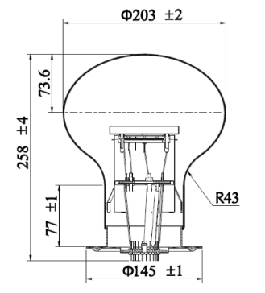
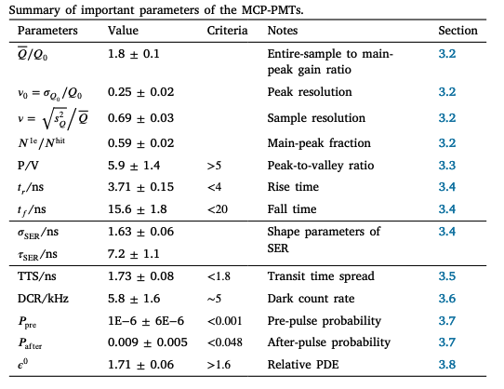
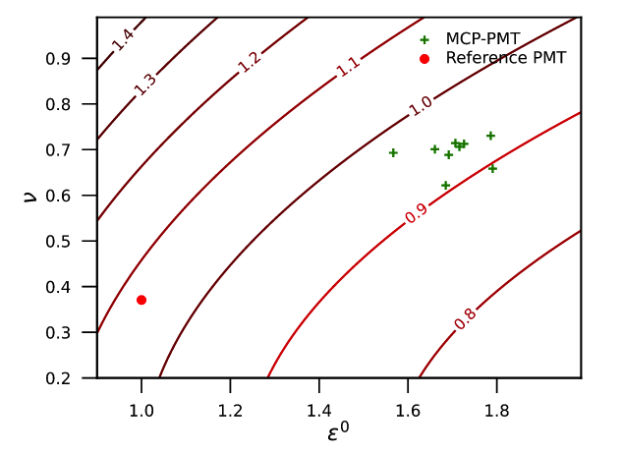
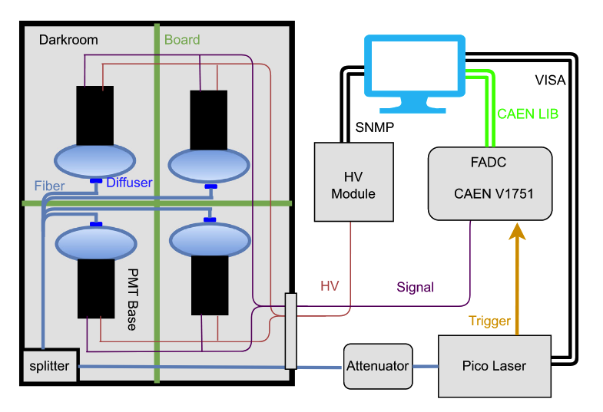
MCP-PMT Performance Measurement
Jointly developed by NNVT and Tsinghua
Parameters of MCP-PMTs have been measured with a testing system.
  High QE, low TTS, low DR and low background
  Better photon detection efficiency boost
DOI:10.1016/j.nima.2023.168506
Notes:
In order to improve the photon detection efficiency, the North Night Vision Science & Technology Research Institute (NNVT) and Tsinghua University collaborated developing our MCP-PMTs. The structure of the PMT is shown. With a testing platform, the important parameters of the PMT were measured, and the result shows the MCP-PMTs have high quantum efficiency, low TTS, low dark noise rate and low background. What’s most important is that the MCP-PMT has a better photon detection efficiency boost. As a result, we decided using MCP-PMTs in our future detector.

Slide 10
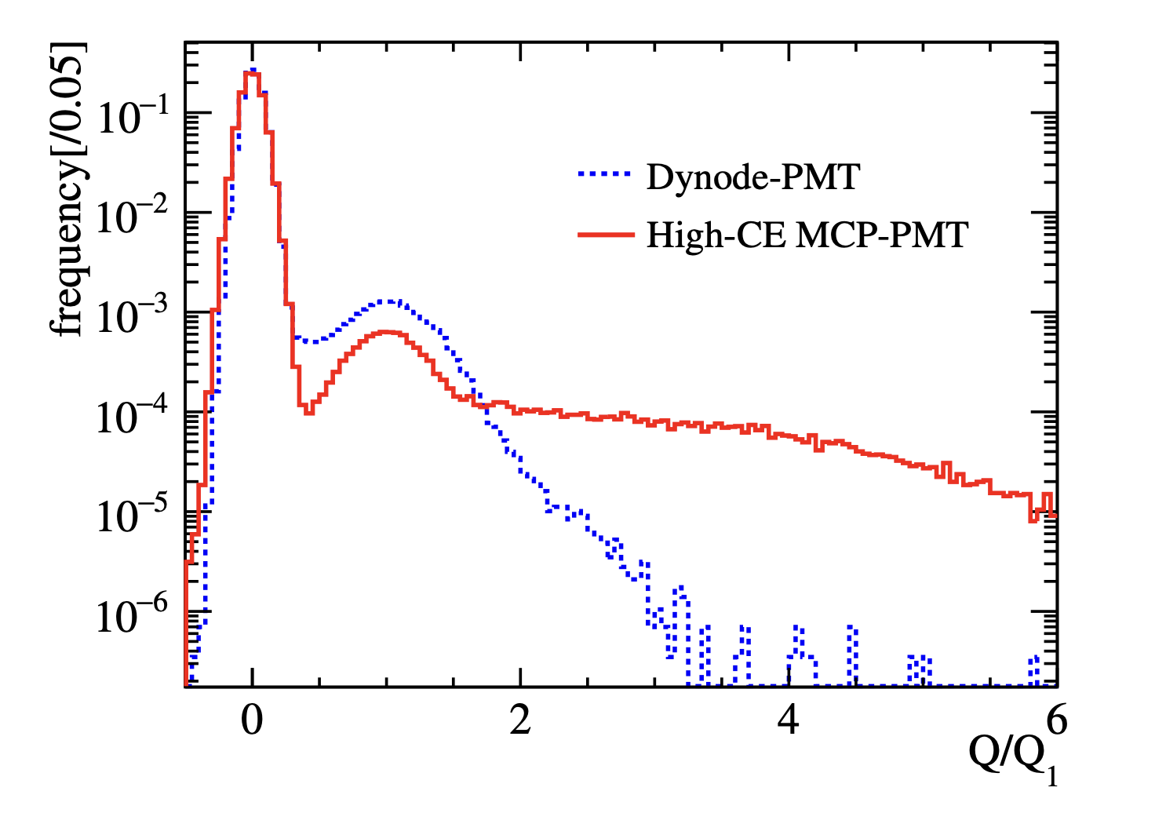
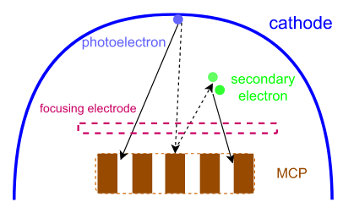
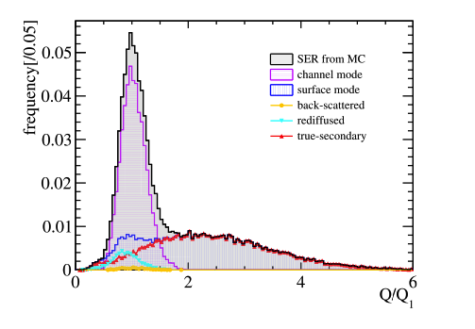
Single Electron Charge Spectra of MCP-PMT
The long tail structure in single electron charge spectra has been studied.
  The long tail structure is caused by secondary electrons emission.
  Using a Gamma-Tweedie mixture distribution to fit the single electron charge spectra.
Long tail structure,
caused by secondary electrons emission
Poisson: different modes
Gamma: single mode
Poisson-Gamma compound → Tweedie
DOI:10.1016/j.nima.2024.169626
Notes:
In addition to the performance measurement, the long tail structure of the single electron charge spectra has been studied. The long tail structure in spectra is caused by the secondary electrons emission, and we can use a Gamma-Tweedie mixture distribution to fit the single electron charge spectra. In detail, We use the Poisson distribution to describe different modes, the Gamma distribution to describe a specific mode, and the joint Poisson-Gamma distribution forms the Tweedie distribution.

Slide 11
MCP-PMTs’ Dark Noise Evolution
We measured the dark noise rate of the MCP-PMTs
  The dark noise rate is 1.1kHz (2025.3)
  The rate decreases over time, dropping to 1/3 within 8 month.
  We plan to study the reason of the decrease.
dry run phase
water phase
LS phase
Notes:
The dark noise rate of MCP-PMTs were also measured. We found a decrease over time, dropping to about 1/3 within 8 months, the dark noise rate we measured in March this year is about 1.1kHz. So far we have no idea about the decrease, and it’s our next task to understand this.

Slide 12
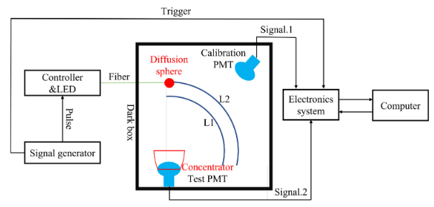
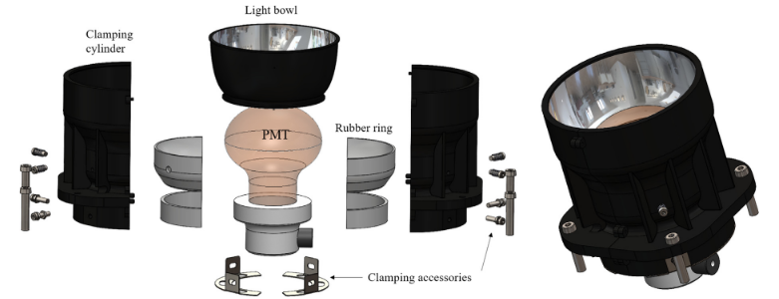
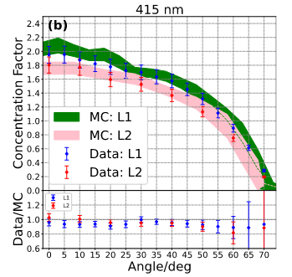
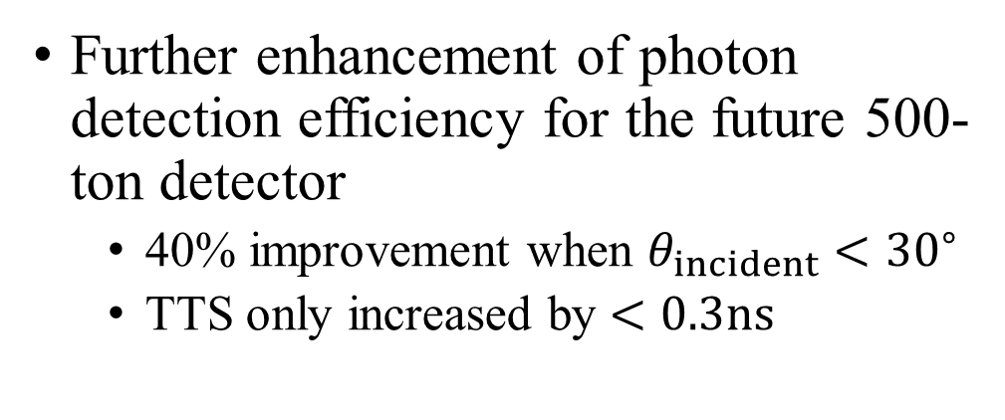
MCP-PMT + Light Concentrator
Further enhancement of photon detection efficiency for the future 500-ton detector
  40% improvement when $θ_{incident}<{30}^{∘}$
  TTS only increased by $<0.3ns$
DOI:10.1016/j.nima.2025.170755
For more details, see Shuai’s poster #219
Notes:
To further enhance the photon detection efficiency, a light concentrator was developed. The constructure is shown here. And the test result shows that the concentrator can improve the photon efficiency by about 40%, with TTS increasing by less than 0.3 nanosecond. And for more details, Shuai has a poster about it tonight.

Slide 13
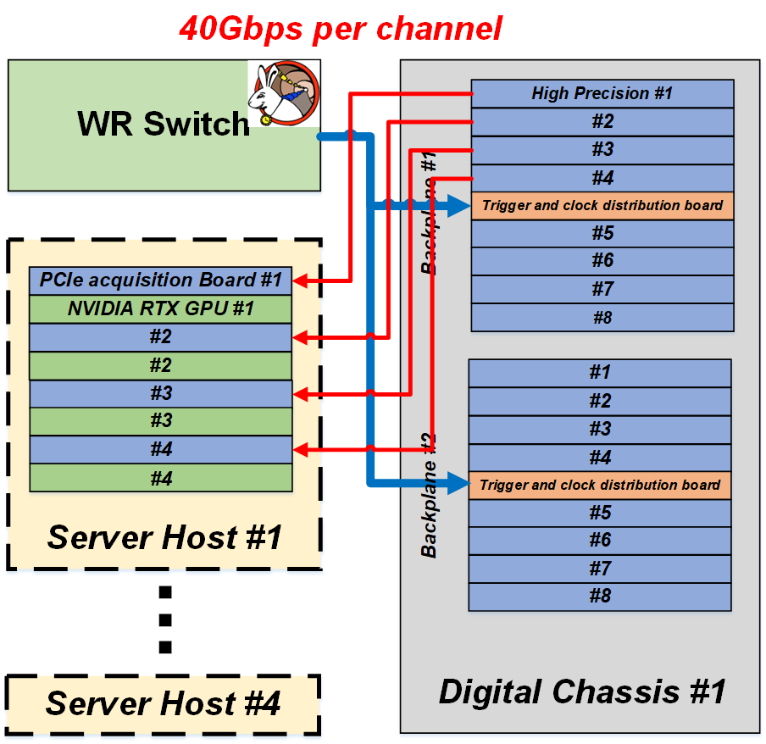
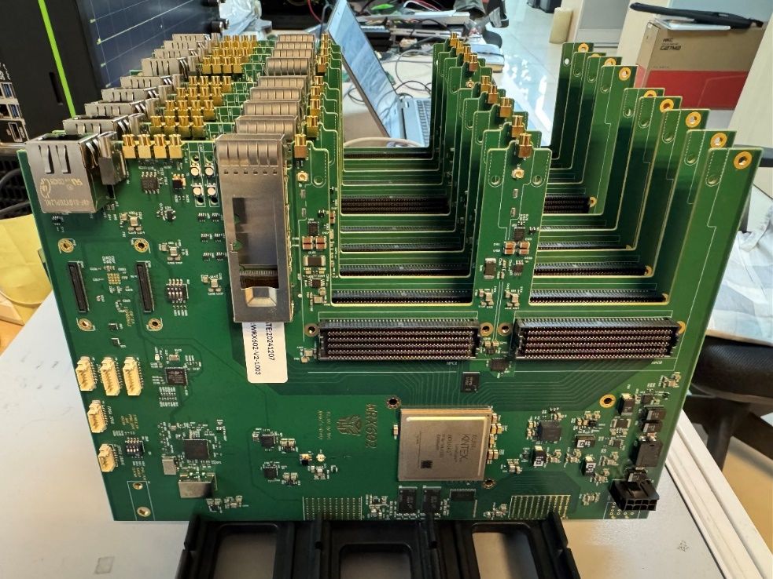
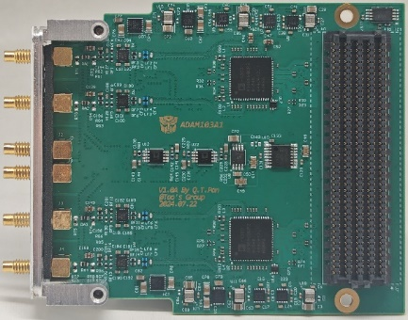
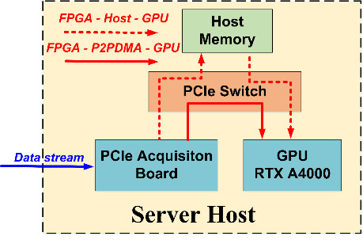
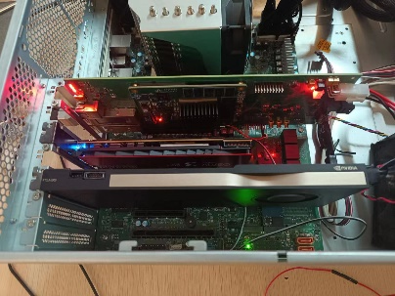
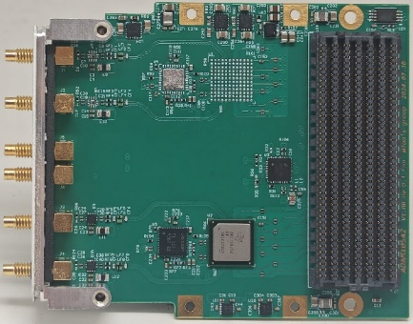
Electronics System
To meet the experimental requirements, a new self-developed electronic system has been designed.
  350 mW/ch, 12-bit, 1 GSps
  Readout board, Bandwidth 300 MHz, 40Gbps
  Higher accuracy FADCs are being developed and tested
ADAM103A1
JNE triggerless readout system
WRX602
ADAM105A2
DOI:10.1016/j.nima.2025.170211
Notes:
To meet the experimental requirements, a new self-developed electronic system has been designed. The self-developed electronics system has a high sampling rate, high resolution, high-speed data handing, and can operate stably in a low power. Some of the detail parameters are listed here.

Slide 14
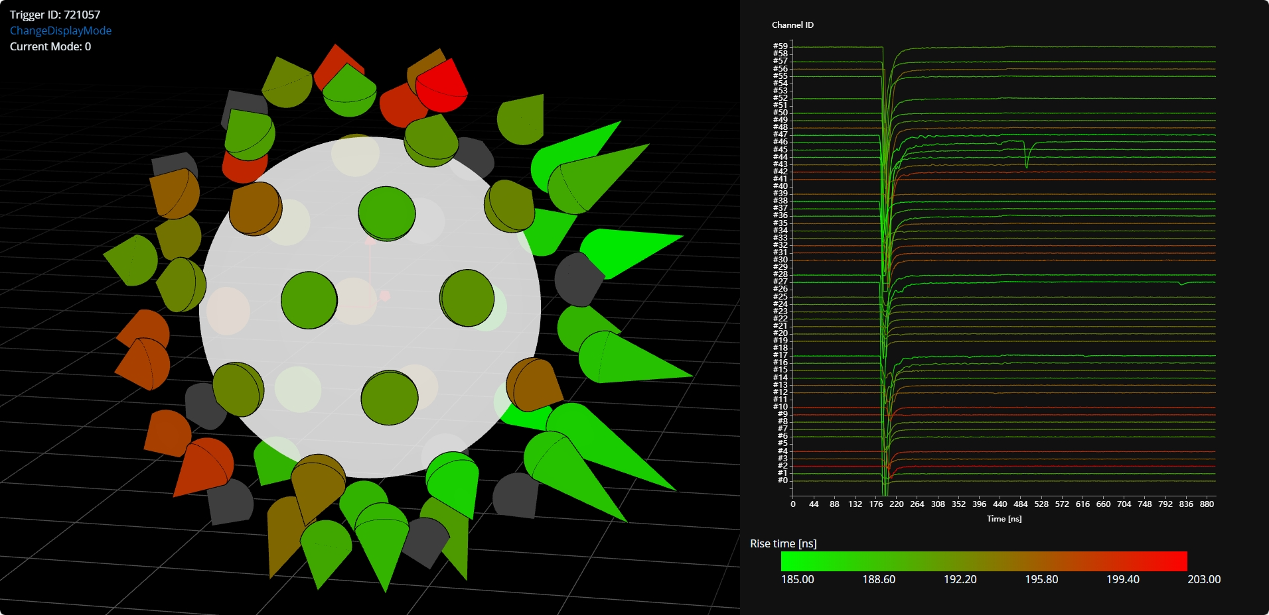
Event Display
An event display program based on JavaScript.
  Real-time event visualization
  Real-time detector status monitoring
Notes:
We also have an event display program, which can help us with real-time event visualization and detector status monitoring.

Slide 15
Outline
Experimental Site
Detector Structure
  Target
  MCP-PMT
  Electronics System
Calibration and Reconstruction
  Time and Energy Calibration
  Event-by-event Direction Reconstruction
Prospect
Notes:
And next is some result of the calibration and reconstruction.

Slide 16
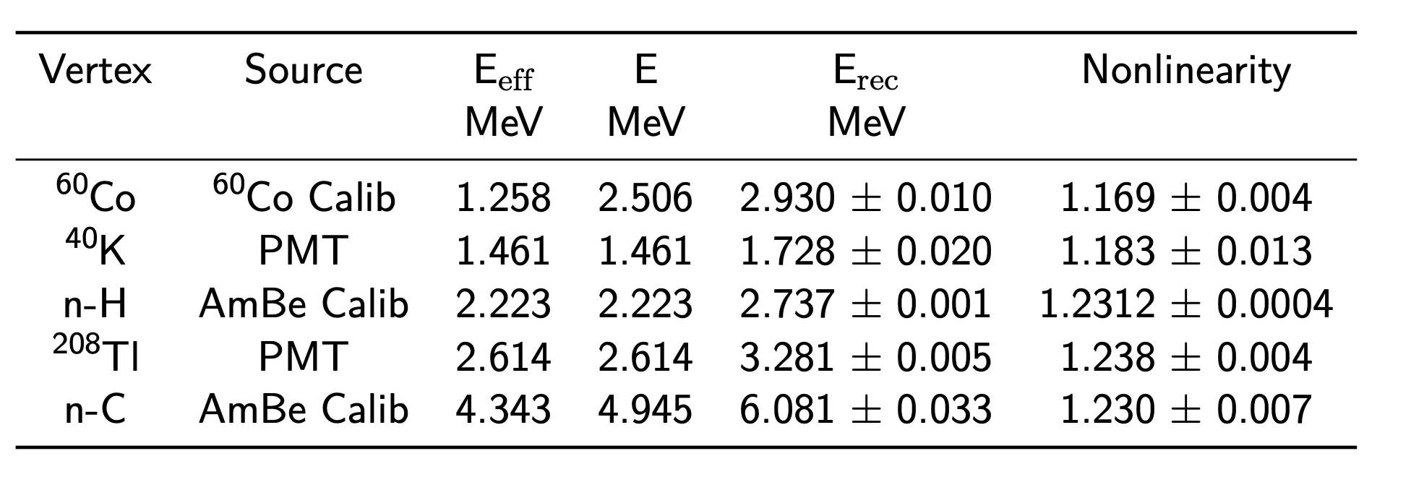
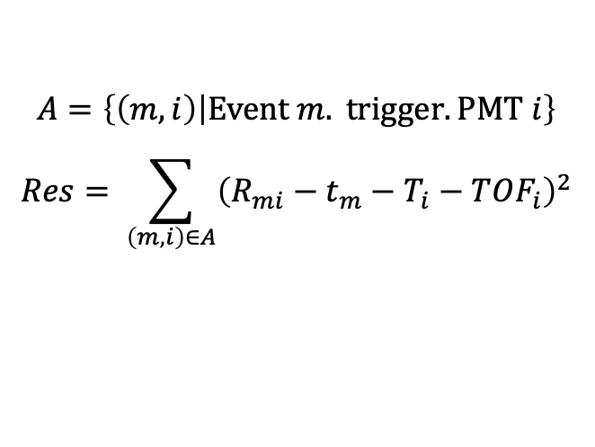
Time and Energy Calibration
Time Calibration:
  Defined residual, and minimize the residual through iteration.
Energy Calibration:
  Hang radioactivity source in the center of the detector.
$$A=\left\{\left(m,i\right) | Event m. trigger. PMT i\right\}$$
$$Res= \sum_{\left(m,i\right)∈A}{{\left(R_{mi}−t_{m}−T_{i}−TOF_{i}\right)}^{2}}$$
time deviation
Acrylic sphere
rise time
reconstruction time
Source (Am-Be/Co-60)
Need to be studied
Time calibration
Energy Calibration
DOI:10.1016/j.nima.2023.168400
Notes:
We calibrate the time using an iteration method: we define a time residual at first, and then we reconstruct the events, minimize the residual to obtain a time deviation, and then use this value to perform the event reconstruction again. By iterating this process continuously, we can determine the final time deviation. As for energy calibration, we lowered a radioactive source in the center of the detector, including a Cobalt-60 source and an Americium-Beryllium source, and reconstruct the energy. The nonlinearity was found, it’s a preliminary result, and so far, we have no idea about it.

Slide 17
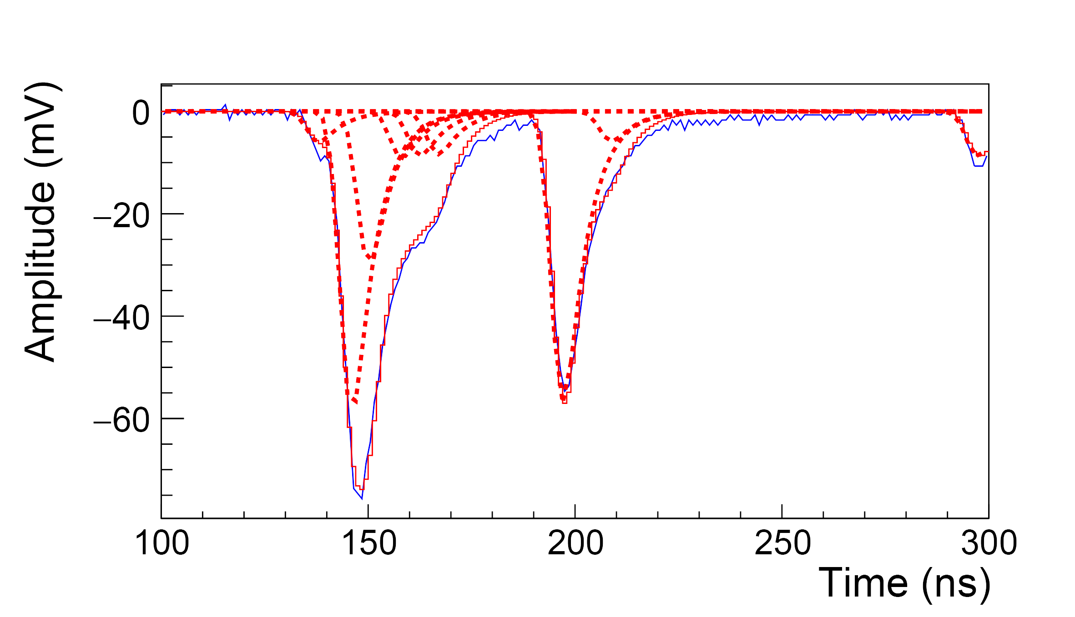
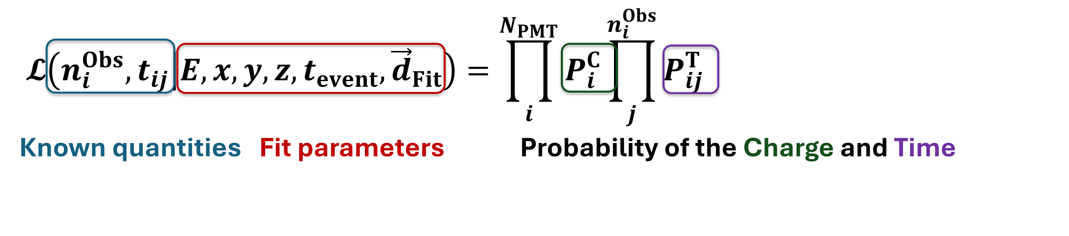
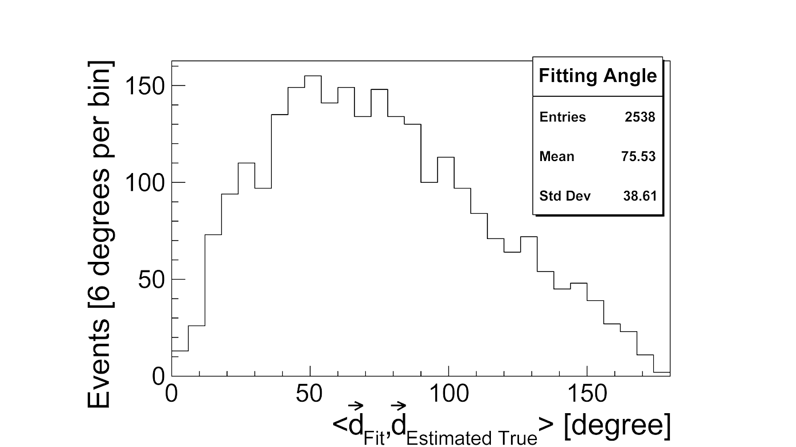
Event-by-event Direction Reconstruction
From waveform analysis to event reconstruction.
  Obtain PE number and each PE time from waveform
  Scintillation and Cerenkov light are reconstructed separately, for direction and energy reconstruction.
QiscinT Algorithm
Preliminary result
DOI: 10.1088/1748-0221/18/02/P02004
For more details, see Yutao’s poster #471
Notes:
And for slow liquid scintillator, we have an event-by-event direction reconstruction algorithm, the QiscinT algorithm. We obtain the PE number and each PE time at first, and reconstructed the Cerenkov and scintillation light separately, for direction and energy reconstruction. Here shows a preliminary result of the angle resolution. For more details, Yutao has a nice poster tonight.

Slide 18
Outline
Experimental Site
Detector Structure
  Target
  MCP-PMT
  Electronics System
Calibration and Reconstruction
  Time and Energy Calibration
  Event-by-event Direction Reconstruction
Prospect
Notes:
And at last, is the prospect. What we will do next.

Slide 19
Prospect
Studying performance of new technology
  Stability of MCP-PMTs
  Sampling rate of self-developed electronics system
  ……
Testing new liquid scintillators
  Slow LS
  LiCl aqueous solution
  ……
Studying experiment hall’s background
  Muon flux measurement using different targets
  Environment background
  ……
Notes:
The 1-ton detector is the prototype for 500t detector, so it will keep on helping with studying the performance of new technology, such as the stability of MCP-PMTs, the performance of the self-developed electronics system. Besides, it can help to test the new liquid scintillators as a big platform. And we will keep on studying the experimental hall’s background, including the muon flux measurement using different targets, the environment neutron flux and so on.

Slide 20
Thanks for Attention!
Notes:
That’s all for my talk today, thank you for your attention!

