Slide 1
Calculation and comparison of sensitivities in 0νββ experiments based on key parameters
Xiao, Yu
CDEX, THU
2025/8/27
yuxiao23@mails.tsinghua.edu.cn
Notes:
Good afternoon, everyone. I am Yu Xiao, a second grade phd student from CDEX group of Tsinghua University. Today I am going to introduce my work, which is Calculation and comparison of sensitivities in 0νββ experiments based on key parameters

Slide 2



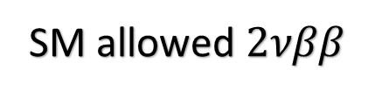









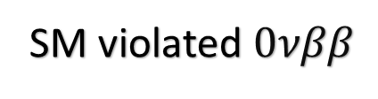





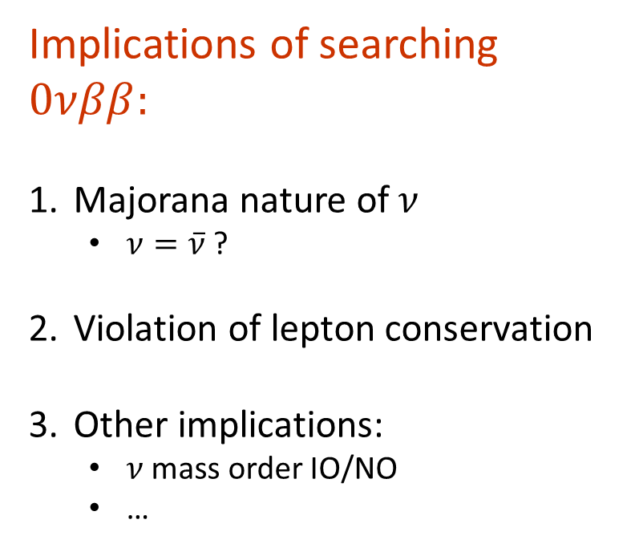



1. Introduction: Implication
SM allowed $2νββ$
Implications of searching $0νββ:$
Majorana nature of $ν$
  $ν=\overline{ν}$ ?
Violation of lepton conservation
Other implications:
  $ν$mass order IO/NO
  …
$$p$$
$$e$$
$$n$$
$$W^{−}$$
$${\overline{ν}}_{e}$$
$${\overline{ν}}_{e}$$
$$n$$
$$W^{−}$$
$$e$$
$$p$$
$$Δ$$
$$β$$
SM violated $0νββ$
$$ββ$$
$$Q_{ββ}$$
$$e$$
$$p$$
$$Z$$
$$n$$
$$W^{−}$$
$${\overline{ν}}_{e}$$
╳
$${\overline{ν}}_{e}$$
$$n$$
$$W^{−}$$
$$p$$
$$e$$
Notes:
0vbb, has been an essential path to physics beyond SM, where two neutrons simultaneously transform into two protons and two electrons without releasing neutrino, in contrast to the two neutrinos emitted in 2vbb which is allowed by SM. It is expected to support the Majorana nature of neutrino, the violation of lepton number conservation, as well as determining v mass order.

Slide 3
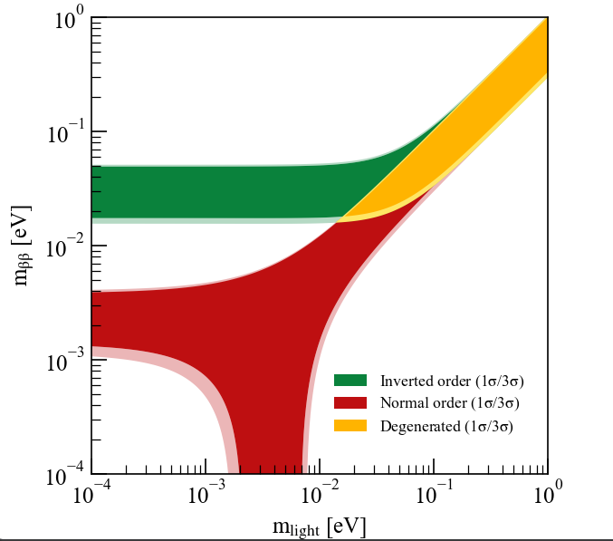
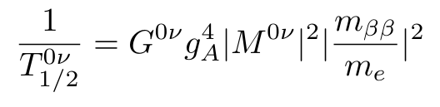
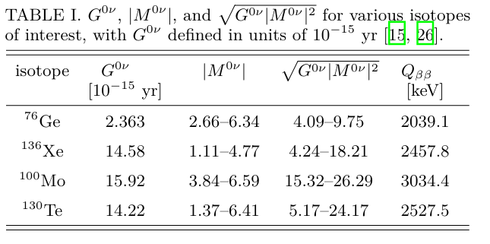

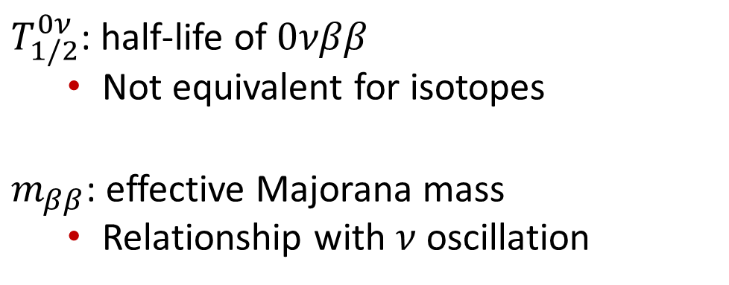
2. Introduction: Mechanism
Light Majorana Neutrino Mass Mechanism
Space phase factor
Axial vector coupling,
1.27 assumed
IO band: (14-51) meV
NO band: (0.78-4.3) meV
Nuclear Matrix Element
$T_{1/2}^{0ν}$: half-life of $0νββ$
  Not equivalent for isotopes
$m_{ββ}$: effective Majorana mass
  Relationship with $ν$ oscillation
Lack of Shell Model, the low estimation
Notes:
Given Majorana Neutrino Mass Mechanism of $0νββ$, there is a negative relation between halflife and Mbb. The potential parameter space for neutrino can be depicted in the diagram of Mbb and the lightest v mass eigenvalue for both IO and NO.
This Table shows the difference of nuclear parameters for four major isotopes in the double beta deacy experiment. There is uncertainty in NME due to different calculation methods.

Slide 4
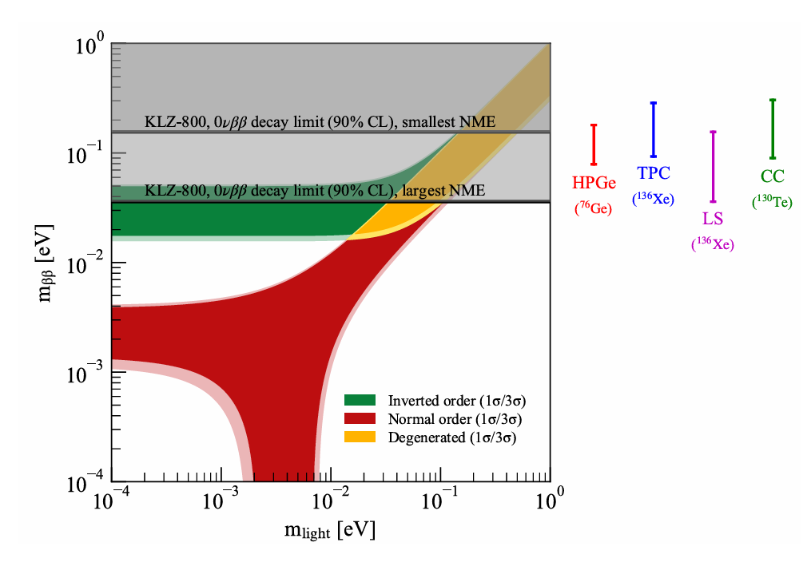
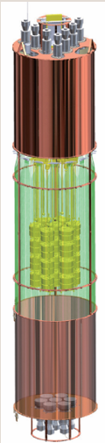
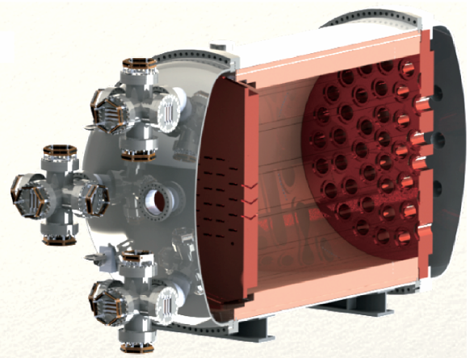
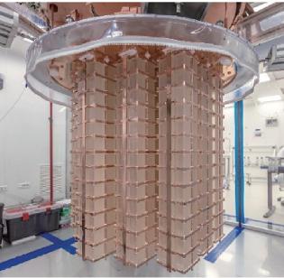
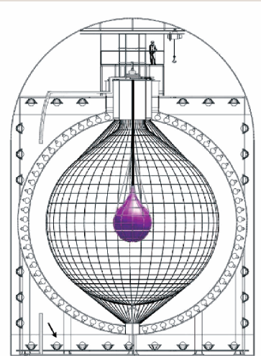
3. Introduction: Technologies
Technology | Isotope | Collaboration | signal
High purity Germanium Detector (HPGe) | ⁷⁶Ge | GERDA, MJD LEGEND, CDEX | drifting
Time Projection Chamber (TPC) | ¹³⁶Xe | nEXO, XLZD, PandaX, NEXT | Drifting, scintillation
Liquid Scintillator (LS) | ¹³⁶Xe ¹³⁰Te | KamLAND-Zen SNO+, JUNO | scintillation
Cryogenic Calorimeter (CC) | ¹³⁰Te ¹⁰⁰Mo | CUORE, CUPID | phonon
KLZ-800
Not finished experiment in bold form
NEXT
GERDA
CUORE
Notes:
As is shown in the Table, four major techniques High purity germanium detector, Time Projection Chamber, Liquid Scintillator and Cryogenic Calorimeter are adopted by collaborations all over the world. 10 typical experiments in bold form with competitiveness will be compared with each other to evaluate their prospect. The best result achieved for the four typical technologies so far are demonstrated in the right figure. We have started to exclude the IO region. The next generation experiment is expected to fully exclude IO region

Slide 5

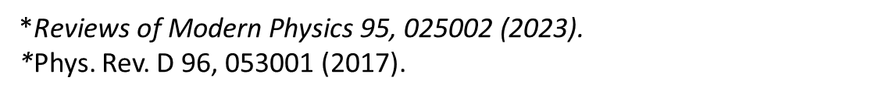
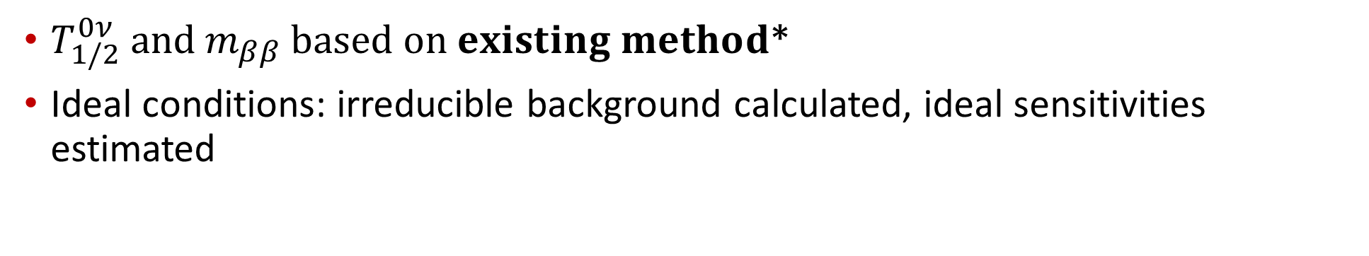
4. Introduction: Research Aim
Status
Meaningful to estimate sensitivities
New $experiments emerge$: XLZD, PandaX …
Upper limit sensitivity when ideal condition ?
Ideal condition means only irreducible background exist
Aim
$T_{1/2}^{0ν} and m_{ββ} based on existing method$*
Ideal conditions: irreducible background calculated, ideal sensitivities estimated
*$\text{Reviews} \text{of} \text{Modern} \text{Physics}\text{ 95, 025002 (2023).}$
*Phys. Rev. D 96, 053001 (2017).
Notes:
Since the variety of 0vbb experiments, it’s meaningful to compare sensitivities and prospects of different experiments. Based on the existing method which has been achieved, we can implement the current literature in two ways. The addition of them in the comparison is important.
Two aims are set in the work to achieve the goals.

Slide 6
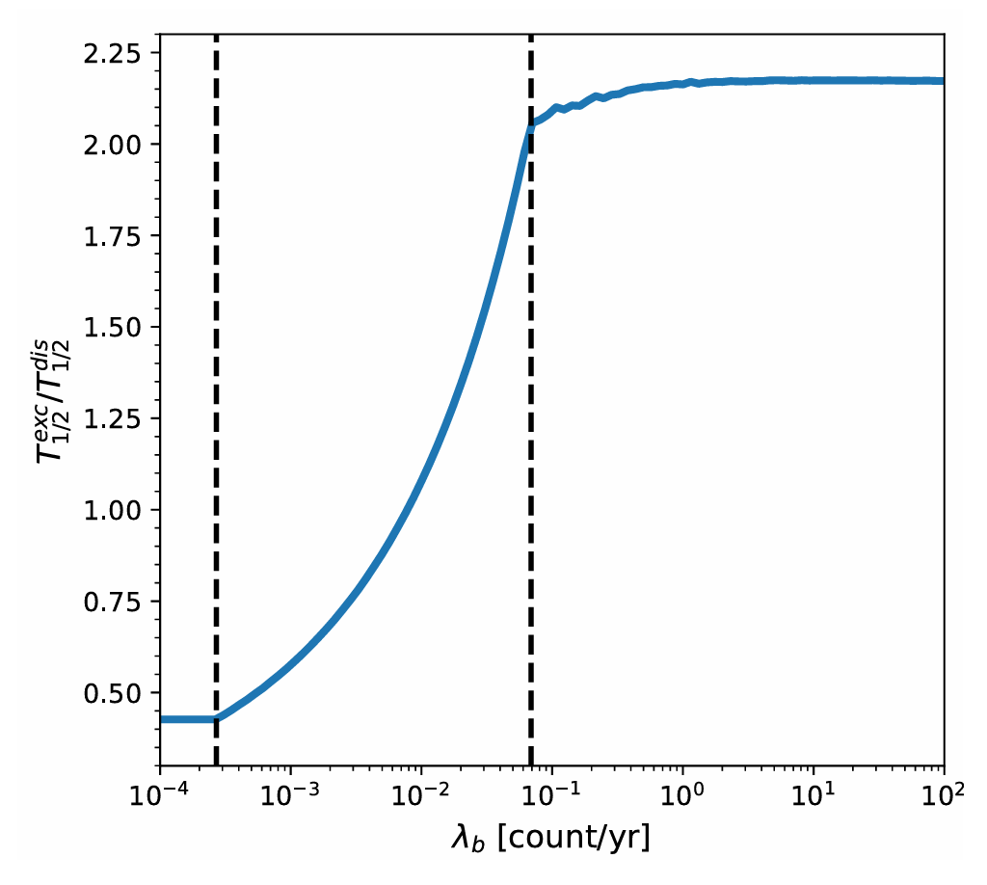
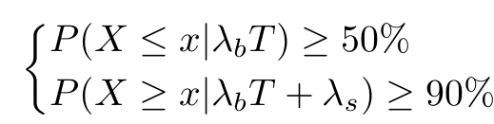
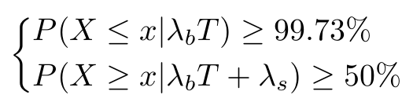
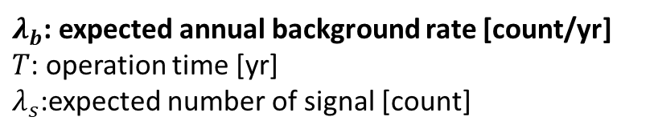
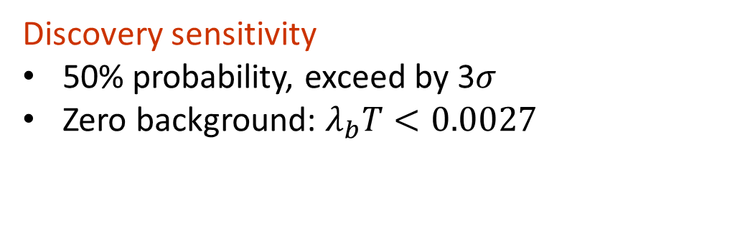
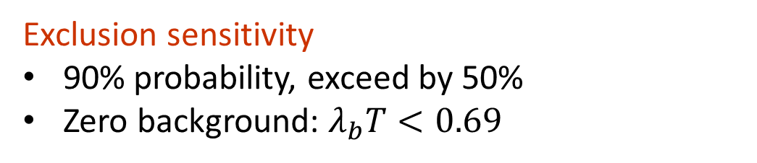
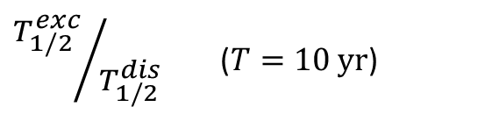
5. Definition: Sensitivity Rule
${T_{1/2}^{exc}}/{T_{1/2}^{dis}}$ ($T=10 yr$)
Exclusion sensitivity
90% probability, exceed by 50%
Zero background: $λ_{b}T<0.69$
Discovery sensitivity
50% probability, exceed by 3$σ$
Zero background: $λ_{b}T<0.0027$
$λ_{b}$: expected annual background rate [count/yr]
$T$: operation time [yr]
$λ_{s}$:expected number of signal [count]
Notes:
First, we set the sensitivity rule. Two rules of sensitivity, exclusion sensitivity and discovery sensitivity are adopted, exclusion sensitivity refers to the expected number of signal events, λs, when an experiment has a 90% probability of excessing background at a 50% level, and the discovery sensitivity refers to λs for which an experiment has a 50% probability of detecting a excess of background at the significance of 3sigma.
The relation between ratio of exclusion and discovery sensitivity and lambda_b is shown in the figure where there is advantage for discovery when background is low and become favorable for exclusion when background is large.

Slide 7
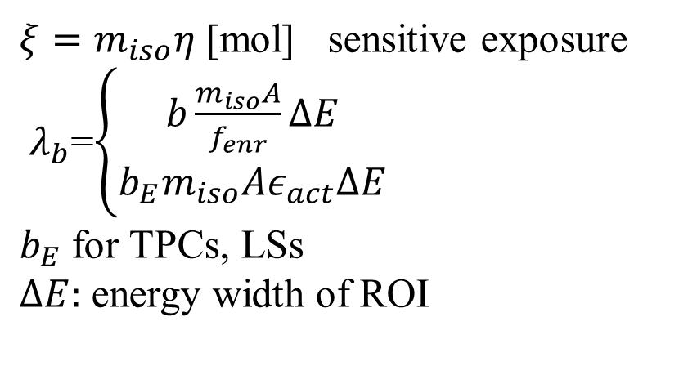
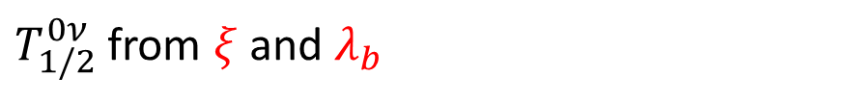
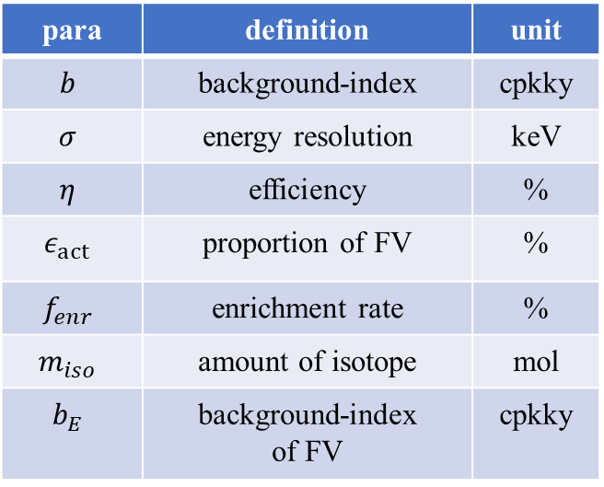
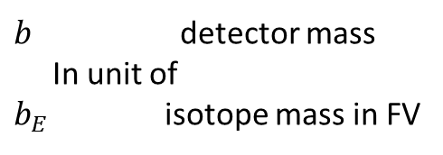


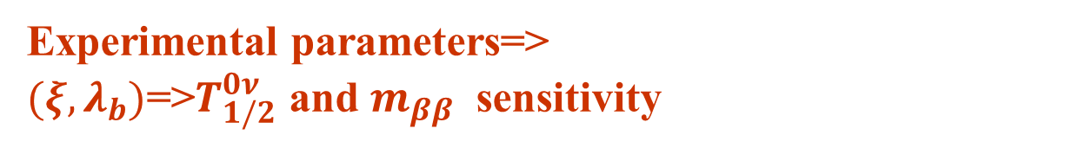

6. Definition: Parameters and Formulas
para | definition | unit
$$b$$ | background-index | cpkky
$$σ$$ | energy resolution | keV
$$η$$ | efficiency | %
$$ε_{act}$$ | proportion of FV | %
$$f_{enr}$$ | enrichment rate | %
$$m_{iso}$$ | amount of isotope | mol
$$b_{E}$$ | background-index of FV | cpkky
$T_{1/2}^{0ν}$ from $ξ$ and $λ_{b}$
$$T_{1/2}^{0ν}=F\left(ξ,λ_{b}\right)=\frac{ln2N_{A}ξT}{λ_{s}(λ_{b}T)}$$
Formula for $m_{ββ}$
$ξ=m_{iso}η$ [mol] sensitive exposure
$λ_{b}$=$\left\{\begin{aligned}b\frac{m_{iso}A}{f_{enr}}ΔE \\ b_{E}m_{iso}Aε_{act}ΔE\end{aligned}\right.$
$b_{E}$ for TPCs, LSs
$ΔE:$ energy width of ROI
Experimental parameters=>
$(ξ,λ_{b})$=>$T_{1/2}^{0ν}$ and $m_{ββ}$ sensitivity
$b$ detector mass
In unit of
$b_{E}$ isotope mass in FV
$$\text{Reviews} \text{of} \text{Modern} \text{Physics}\text{ 95, 025002 (2023).}$$
Notes:
Given rule of sensitivity there has been a very effective way to deduce the sensitivity by two parameters, the sensitive exposure \Xi and annual background rate \lambda_b. We can summarize all factors that influence the sensitivity in these two parameters. Such as the amont of target isotope, eta,the efficiency, \, background level b, and energy resolution sigma
It is worth mentioning that there are two expressions for \lambda_b. Respectively corresponding to two definitions of background index. b represent the background level per unit of detector mass, while bE represents background level per unit of target isotope in fiducial volume. For HPGes and CCs, b is chosen, while for TPCs and LSs, bE is chosen.
Therefore a path to sensitivity is constructed, first experimental parameters are collected from literature, second Xi and lambda_b is calculated, finally sensitivity based on a certain rule is estimated.

Slide 8
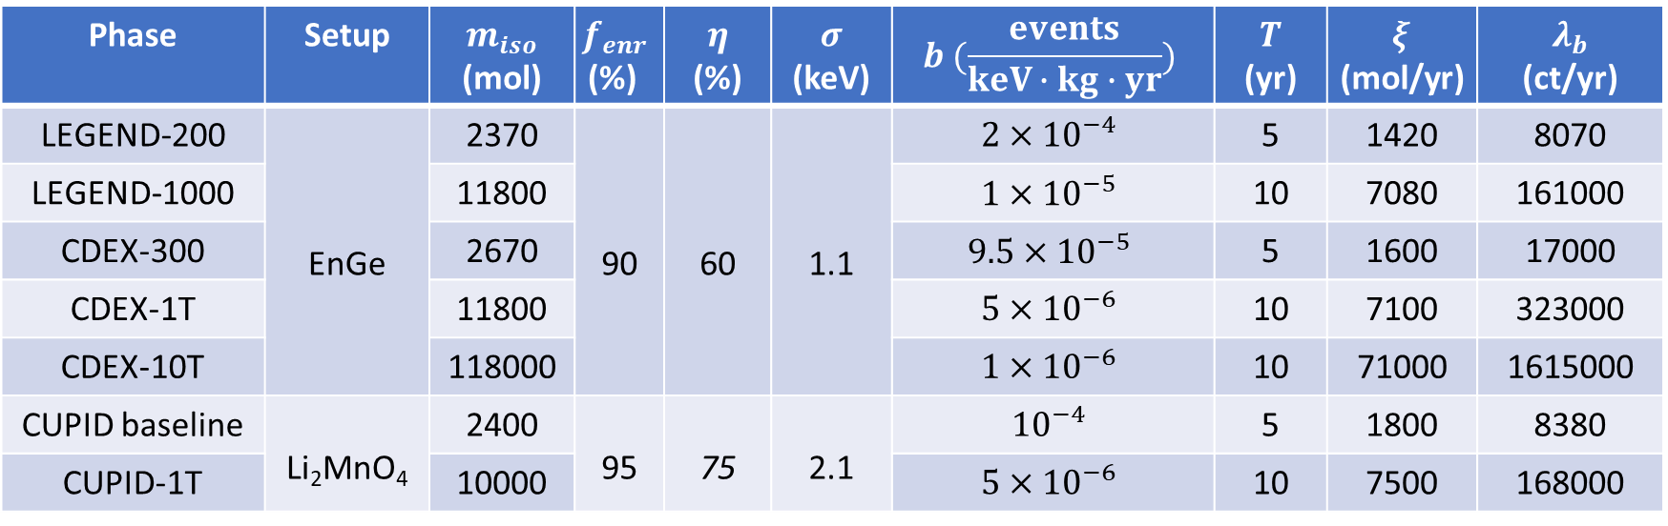
7. Parameters-HPGes and CCs
Phase | Setup | $m_{iso}$ (mol) | $$f_{enr}$$ (%) | $$η$$ (%) | $$σ$$ (keV) | $$b (\frac{events}{keV∙kg∙yr})$$ | $$T$$ (yr) | $$ξ$$ (mol/yr) | $$λ_{b}$$ (ct/yr)
LEGEND-200 | EnGe | 2370 | 90 | 60 | 1.1 | $$2×{10}^{−4}$$ | 5 | 1420 | 8070
LEGEND-1000 |  | 11800 |  |  |  | $$1×{10}^{−5}$$ | 10 | 7080 | 161000
CDEX-300 |  | 2670 |  |  |  | $$9.5×{10}^{−5}$$ | 5 | 1600 | 17000
CDEX-1T |  | 11800 |  |  |  | $$5×{10}^{−6}$$ | 10 | 7100 | 323000
CDEX-10T |  | 118000 |  |  |  | $$1×{10}^{−6}$$ | 10 | 71000 | 1615000
CUPID baseline | Li₂MnO₄ | 2400 | 95 | 75 | 2.1 | $${10}^{−4}$$ | 5 | 1800 | 8380
CUPID-1T |  | 10000 |  |  |  | $$5×{10}^{−6}$$ | 10 | 7500 | 168000
EnGe: Enriched Ge
Notes:
This is he experimental parameters needed to for HPGe and CC. For early phase of an experiment, 5 yr operation time is applied and for later phase, 10 yr operation time is applied

Slide 9
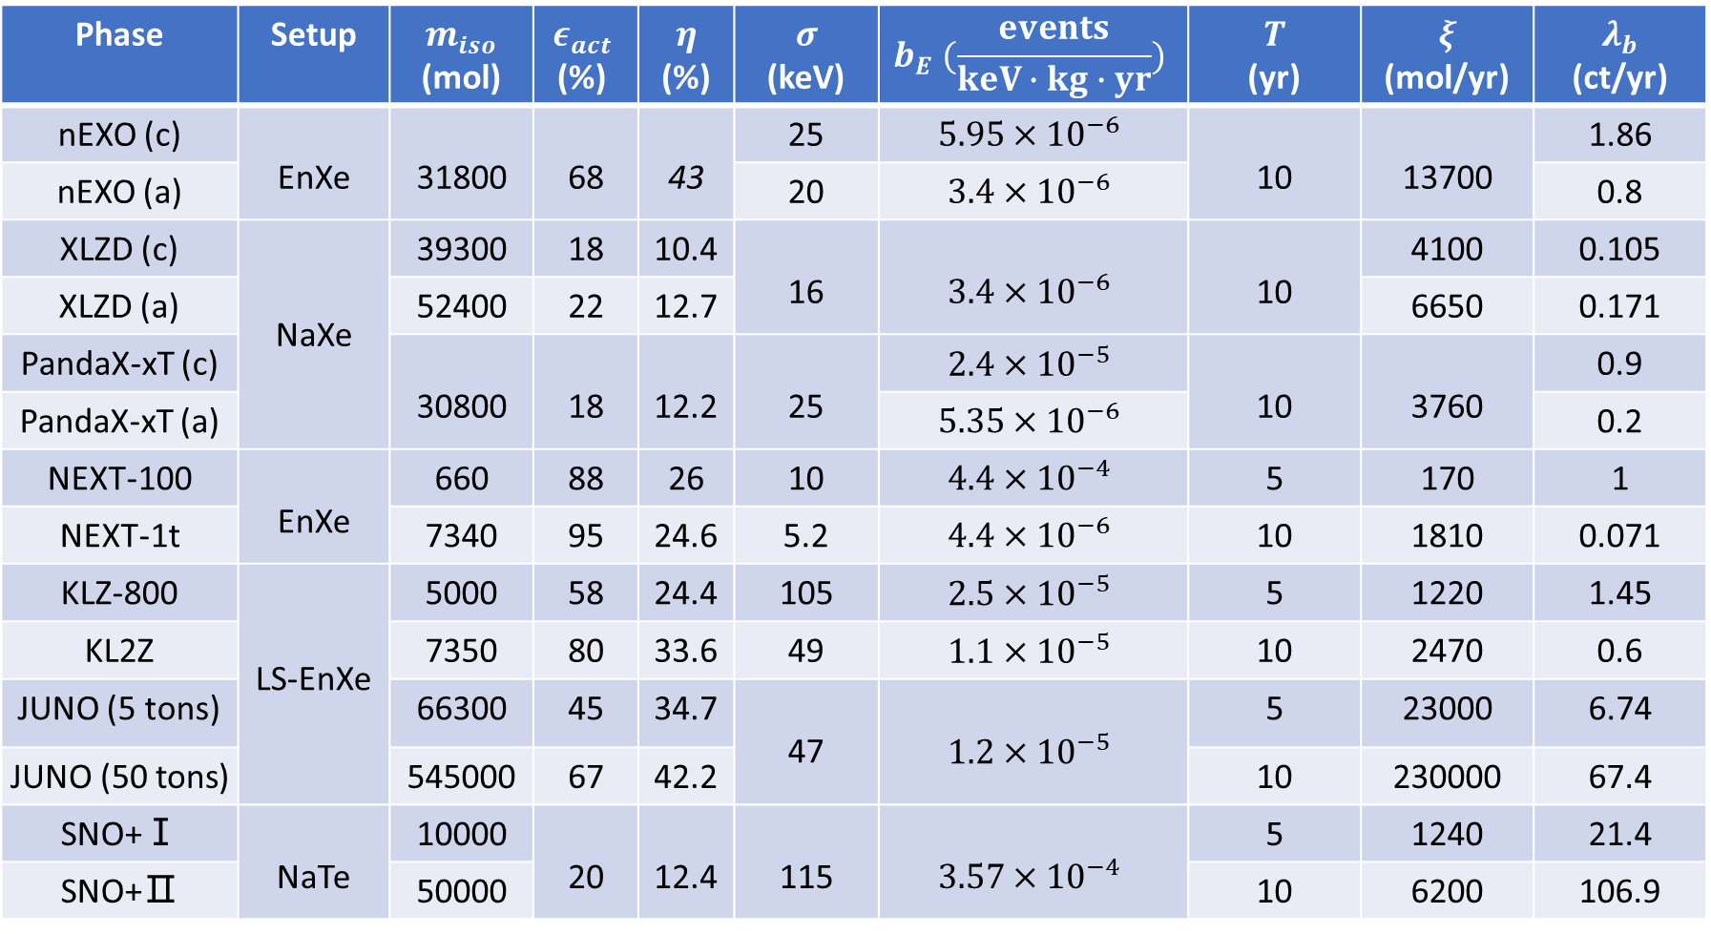
8. Parameters-TPCs and LSs
(c): conservative En(Na)Xe: enriched(natural) Xe
(a): aggressive NaTe: natural Te
Phase | Setup | $m_{iso}$ (mol) | $$ε_{act}$$ (%) | $$η$$ (%) | $$σ$$ (keV) | $$b_{E} (\frac{events}{keV∙kg∙yr})$$ | $$T$$ (yr) | $$ξ$$ (mol/yr) | $$λ_{b}$$ (ct/yr)
nEXO (c) | EnXe | 31800 | 68 | 43 | 25 | $$5.95×{10}^{−6}$$ | 10 | 13700 | 1.86
nEXO (a) |  |  |  |  | 20 | $$3.4×{10}^{−6}$$ |  |  | 0.8
XLZD (c) | NaXe | 39300 | 18 | 10.4 | 16 | $$3.4×{10}^{−6}$$ | 10 | 4100 | 0.105
XLZD (a) |  | 52400 | 22 | 12.7 |  |  |  | 6650 | 0.171
PandaX-xT (c) |  | 30800 | 18 | 12.2 | 25 | $$2.4×{10}^{−5}$$ | 10 | 3760 | 0.9
PandaX-xT (a) |  |  |  |  |  | $$5.35×{10}^{−6}$$ |  |  | 0.2
NEXT-100 | EnXe | 660 | 88 | 26 | 10 | $$4.4×{10}^{−4}$$ | 5 | 170 | 1
NEXT-1t |  | 7340 | 95 | 24.6 | 5.2 | $$4.4×{10}^{−6}$$ | 10 | 1810 | 0.071
KLZ-800 | LS-EnXe | 5000 | 58 | 24.4 | 105 | $$2.5×{10}^{−5}$$ | 5 | 1220 | 1.45
KL2Z |  | 7350 | 80 | 33.6 | 49 | $$1.1×{10}^{−5}$$ | 10 | 2470 | 0.6
JUNO (5 tons) |  | 66300 | 45 | 34.7 | 47 | $$1.2×{10}^{−5}$$ | 5 | 23000 | 6.74
JUNO (50 tons) |  | 545000 | 67 | 42.2 |  |  | 10 | 230000 | 67.4
SNO+Ⅰ | NaTe | 10000 | 20 | 12.4 | 115 | $$3.57×{10}^{−4}$$ | 5 | 1240 | 21.4
SNO+Ⅱ |  | 50000 |  |  |  |  | 10 | 6200 | 106.9
Notes:
This is the table demonstrating the experimental parameters of TPCs and LSs.

Slide 10
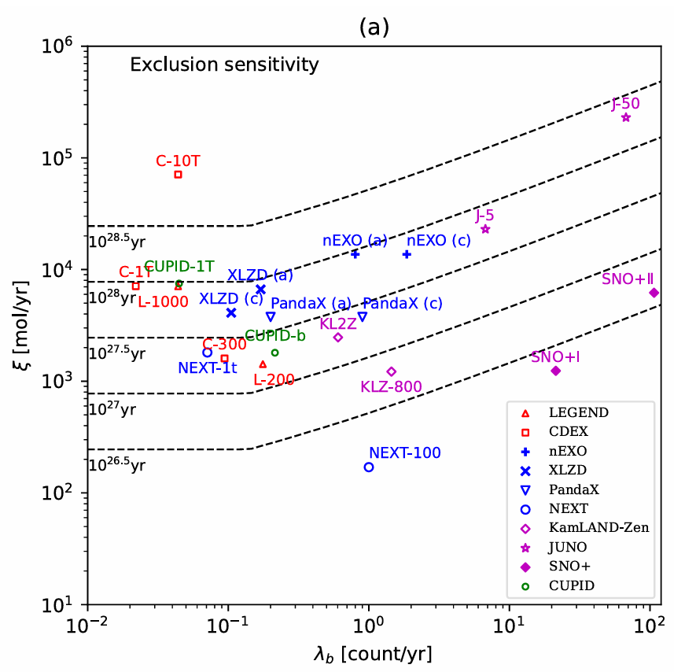
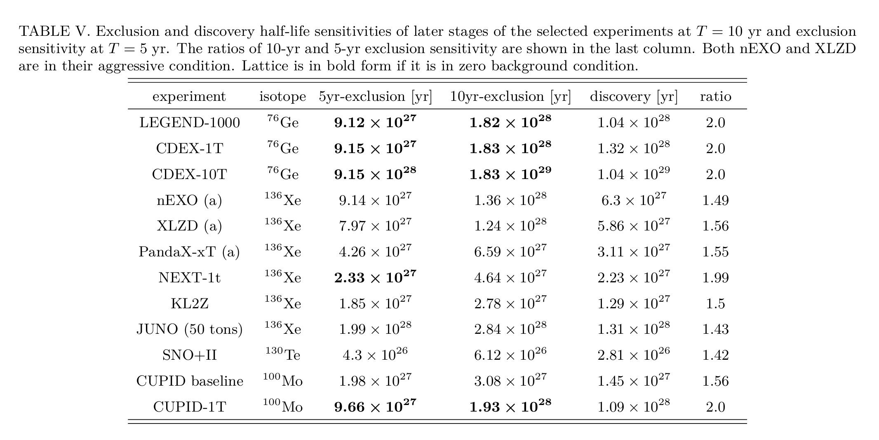
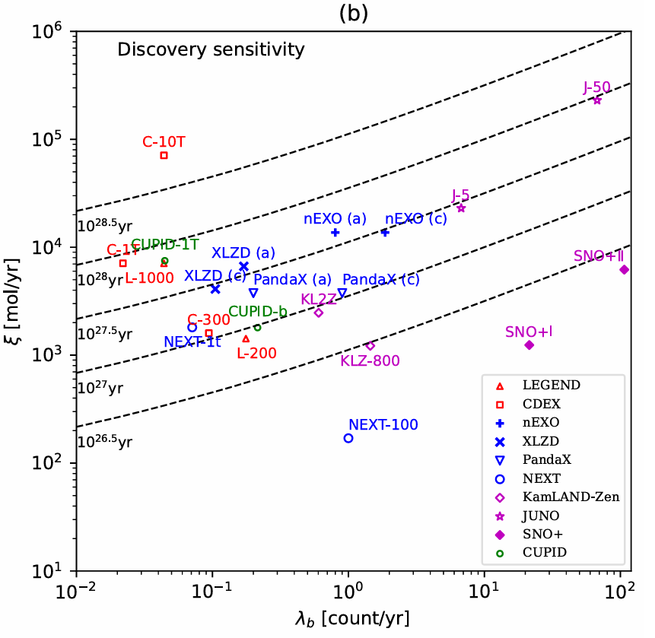
9. Halflife sensitivity
Notes:
After \xi and \lambda_b is calculated, the location of each experiment in \xi-\lambda_b diagram is depicted, the sensitivity level is intuitively demonstrated.
This table shows the specific halflife sensitivity. The number is in bold form if it reaches zero background condition.

Slide 11
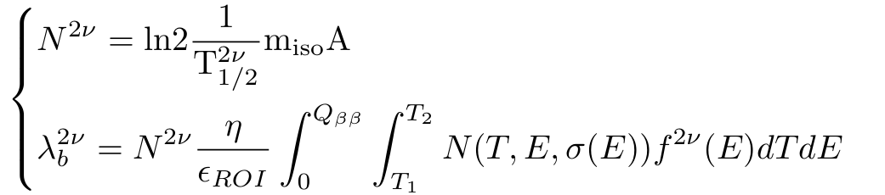
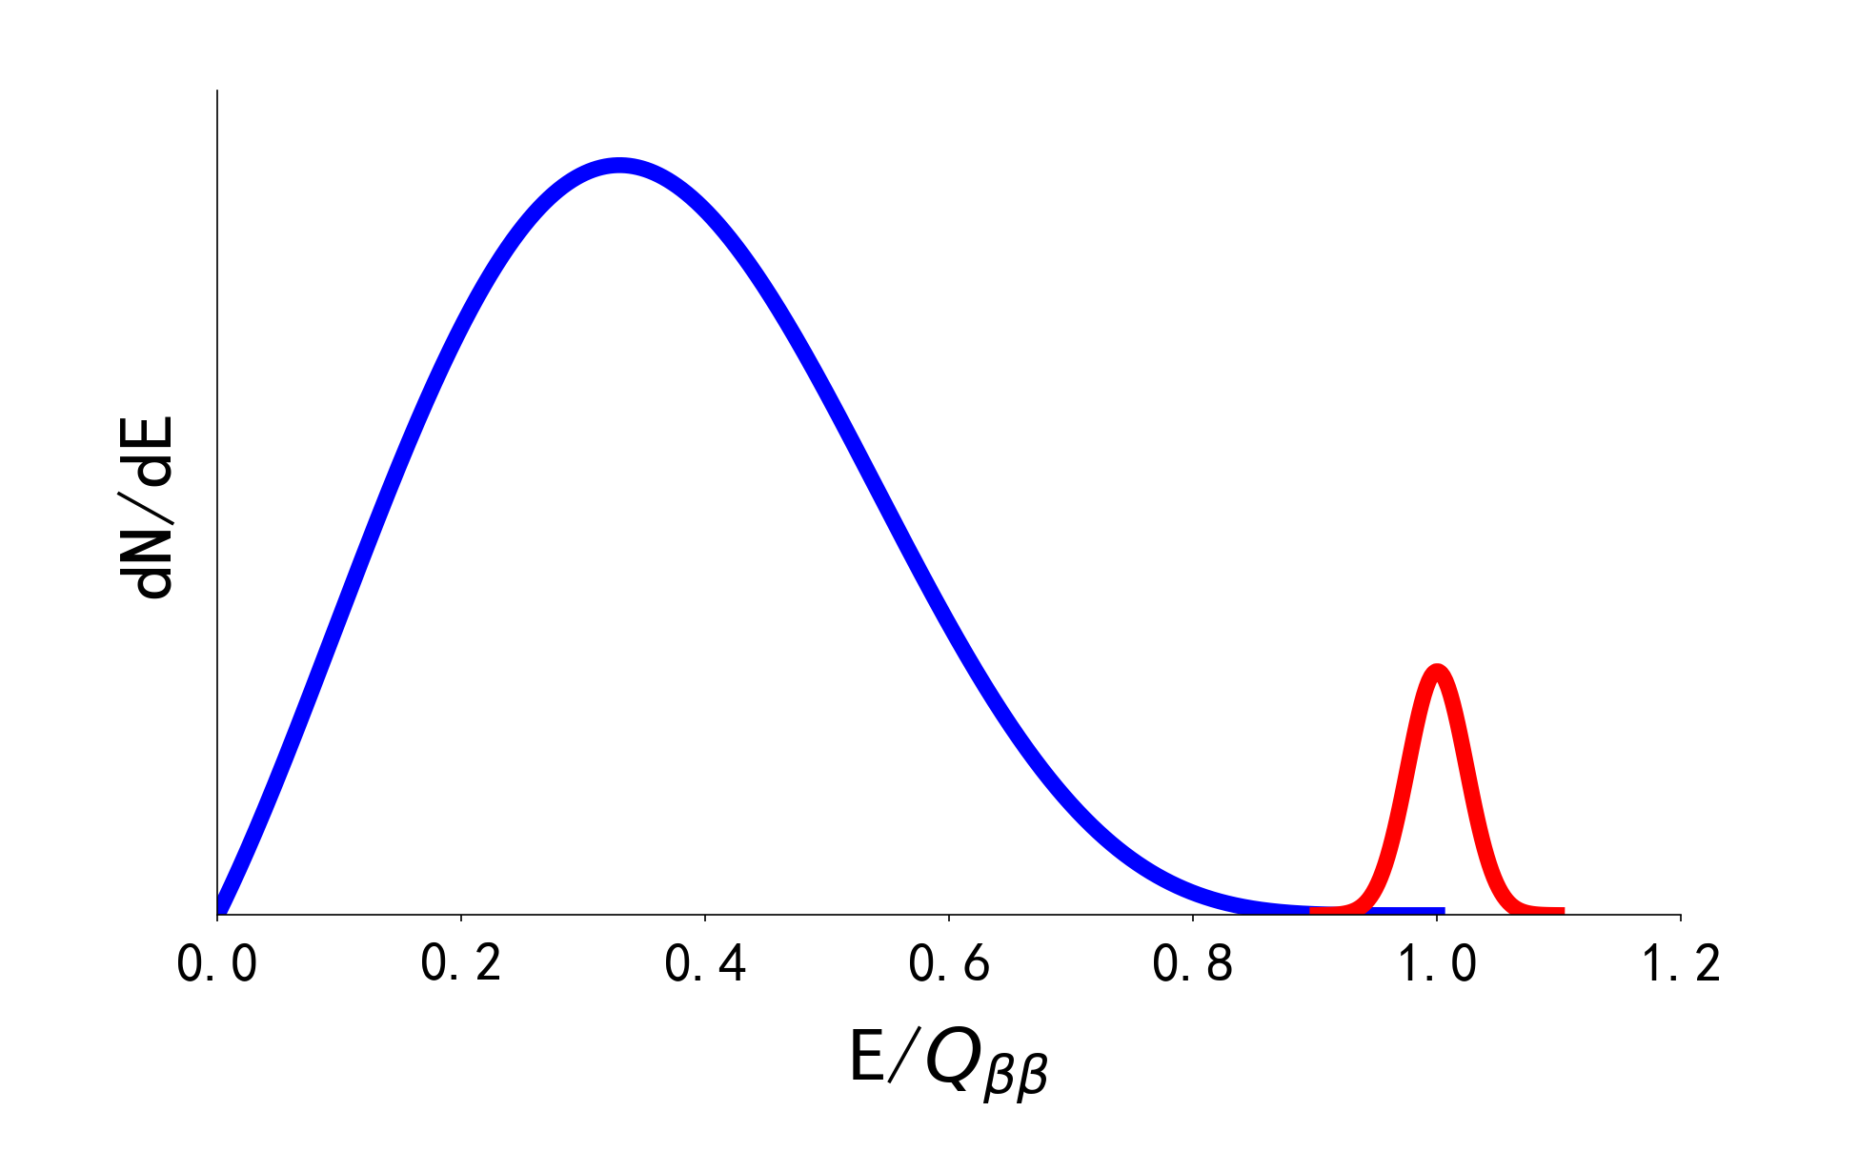
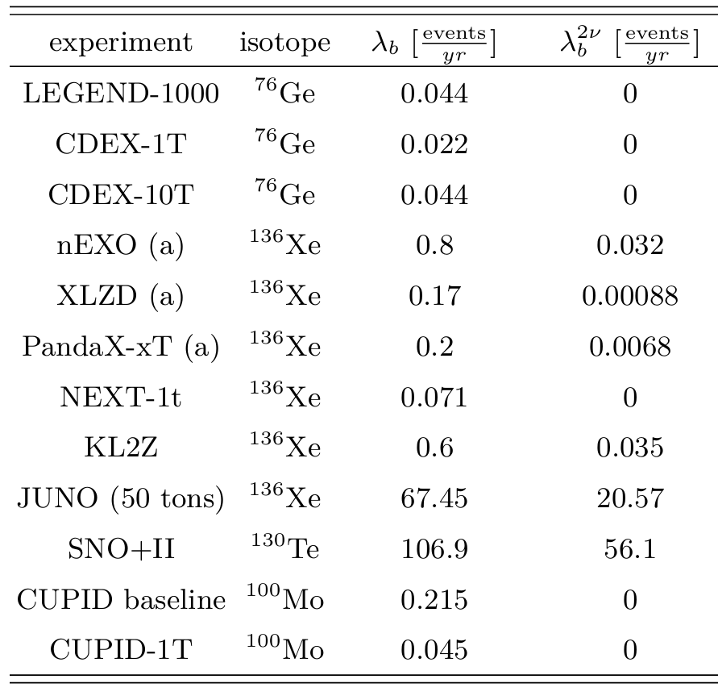




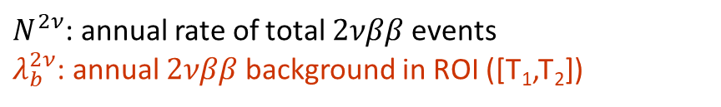
10. Ideal Condition: $2νββ$
Normal distribution at T
Energy distribution of $2νββ$
$$2νββ$$
$$0νββ$$
$N^{2ν}$: annual rate of total $2νββ$ events
$λ_{b}^{2ν}$: annual $2νββ$ background in ROI ([T₁,T₂])
HPGe
Same topology with $0νββ$
Significant for large ROI (LSs)
Negligible for small ROI (HPGes and CCs)
TPC
LS
CC
Notes:
At the previous sections, I introduce how the sensitivity for each selected experiment is estimated. To further evaluate the potential of each experiment, the ideal condition when only irreducible background remains is discussed. The first source of irreducible background is 2vbb event, which shares the same topology with 0vbb. Given the up-mentioned parameters, 2vbb distribution as well as ROI[T1,T2], the background contributed by 2vbb can be calculated from these equations.
Annual 2vbb background can be shown in the table, where 2vbb background in HPGe and calorimeter can be neglected due to good energy resolution,. On the other hand, 2v background in LS experiments have already contributed to a large proportion of total background because of relatively bad resolution.

Slide 12
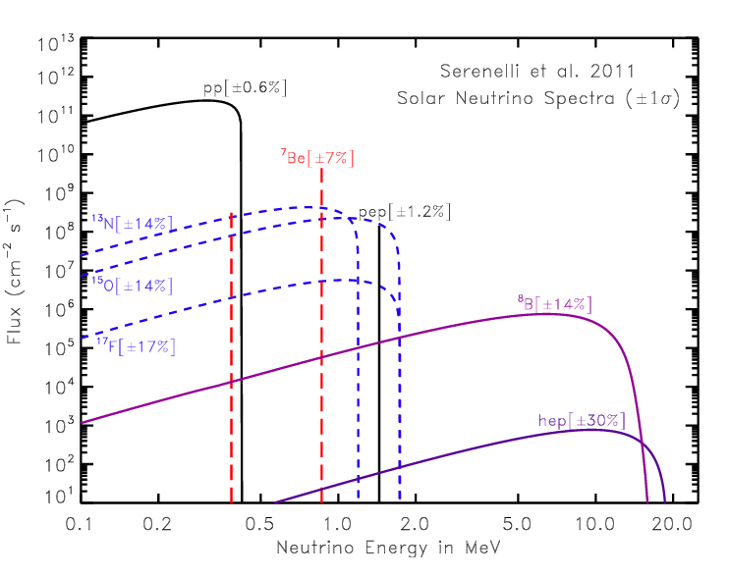
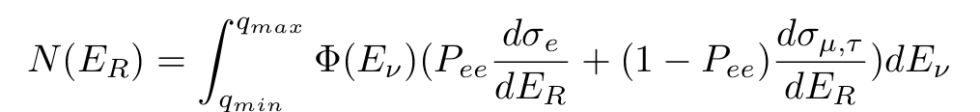

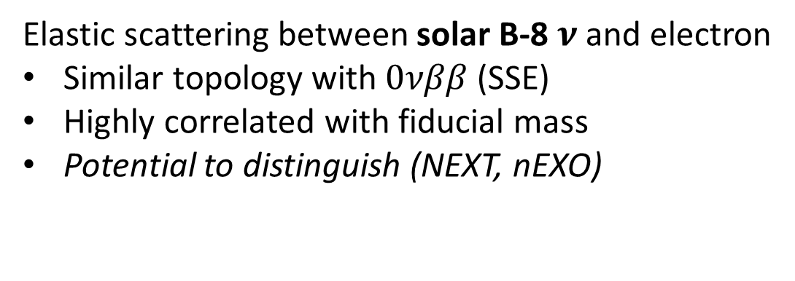





11. Ideal Condition: ES-$ν$ (1)
$$ν$$
$$e$$
Elastic scattering between solar B-8 $ν$ and electron
Similar topology with $0νββ$ (SSE)
Highly correlated with fiducial mass
Potential to distinguish (NEXT, nEXO)
$E_{R}$ recoiled
$Q_{ββ}$ related
Number of recoiled electron $[{keV}^{−1}{yr}^{−1}{target e}^{−}]$:
Spectrum of B-8 $ν$ flux
Survival rate of $ν_{e}$
Notes:
Another source of irreducible background is elastic scattering between electron and B-8 solar-v. As is shown in the figure about the solar neutrino, B-8 v is the major channel that contribute to energy region of 0vbb, hep v is another source, but it is negligible. There are some TPC experiments, such as NEXT, where ES events can be distinguished by Ba tagging techniques in development. For those experiments, both circumstances with and without ES background are considered.
To calculate the ES background, We can get the number of recoiled electron at certain energy ER by intergrating the product of v flux and differential cross section by v energy. v oscillation is considered in the equation since cross section is different for electron v and non-electron v.

Slide 13
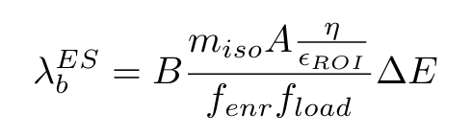
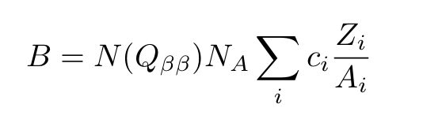
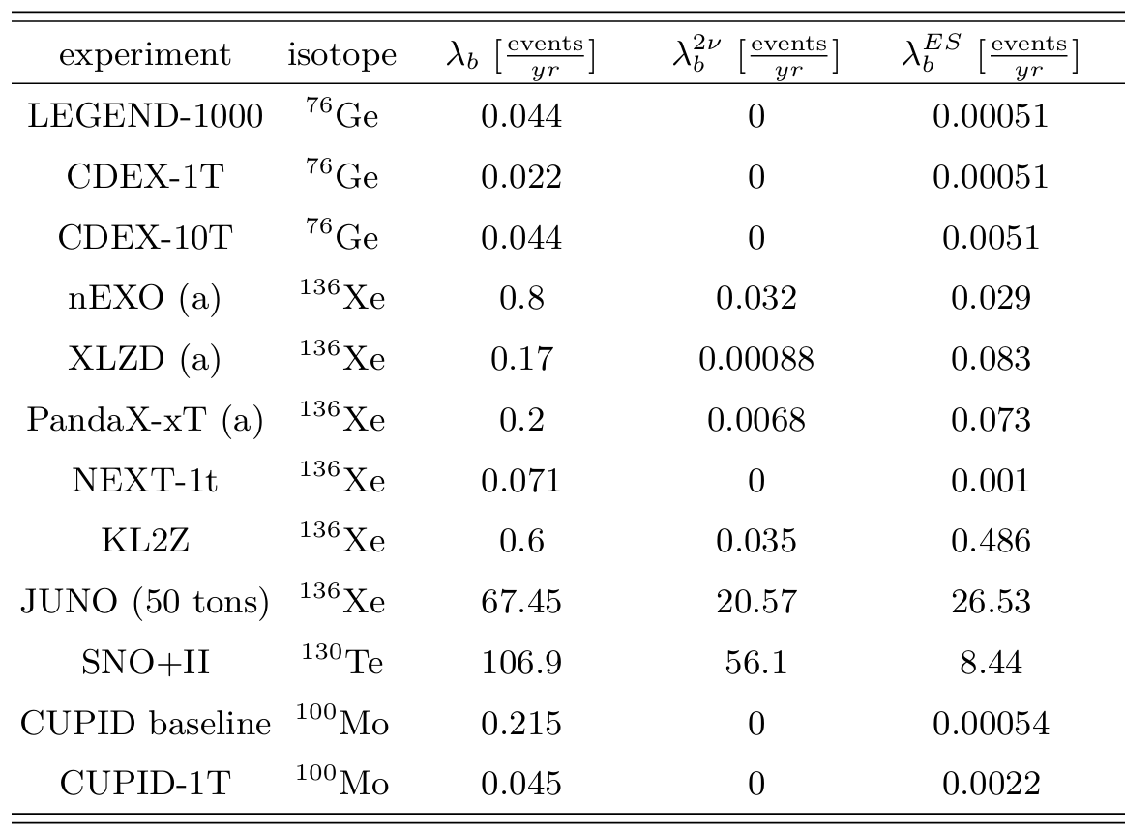
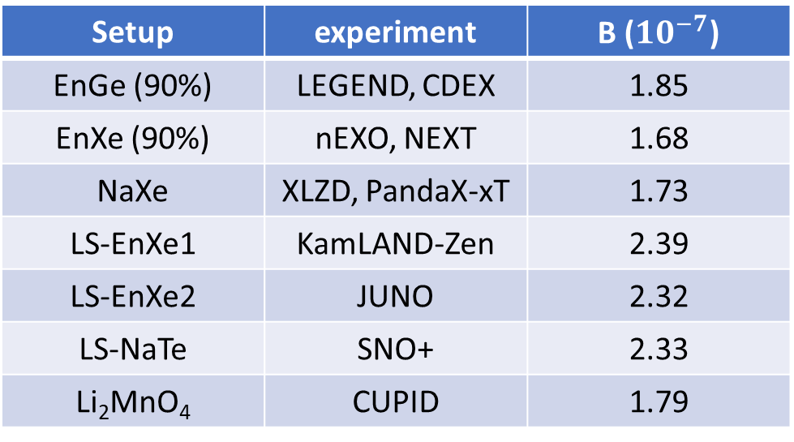
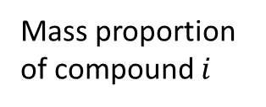
12. Ideal Condition: ES-$ν$ (2)
Annual ES background rate:
ES background level $[{keV}^{−1}{yr}^{−1}detector {kg}^{−1}]$:
Fiducial mass
Low for HPGes and CCs
Significant for large scale LS experiments
Mass proportion of compound $i$
e number/detector kg
Setup | experiment | B (${10}^{−7}$)
EnGe (90%) | LEGEND, CDEX | 1.85
EnXe (90%) | nEXO, NEXT | 1.68
NaXe | XLZD, PandaX-xT | 1.73
LS-EnXe1 | KamLAND-Zen | 2.39
LS-EnXe2 | JUNO | 2.32
LS-NaTe | SNO+ | 2.33
Li₂MnO₄ | CUPID | 1.79
HPGe
TPC
LS
CC
Notes:
After N(ER) is acquired, background level of ES background at Qbb can be calculated according to the components of detector in the fiducial volume. The background level for each experiment is summarized in the table, we can see that the background level for each experiment is similar, which agrees with the literature.
Then the annual ES background can be calculated from background level and experimental parameters by multiplying background level with the total fiducial mass.
The ES background is highly correlated with the fiducial mass, which is low for HPGes and CCs, and significant for large scale LS experiments.

Slide 14
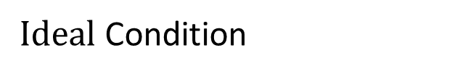
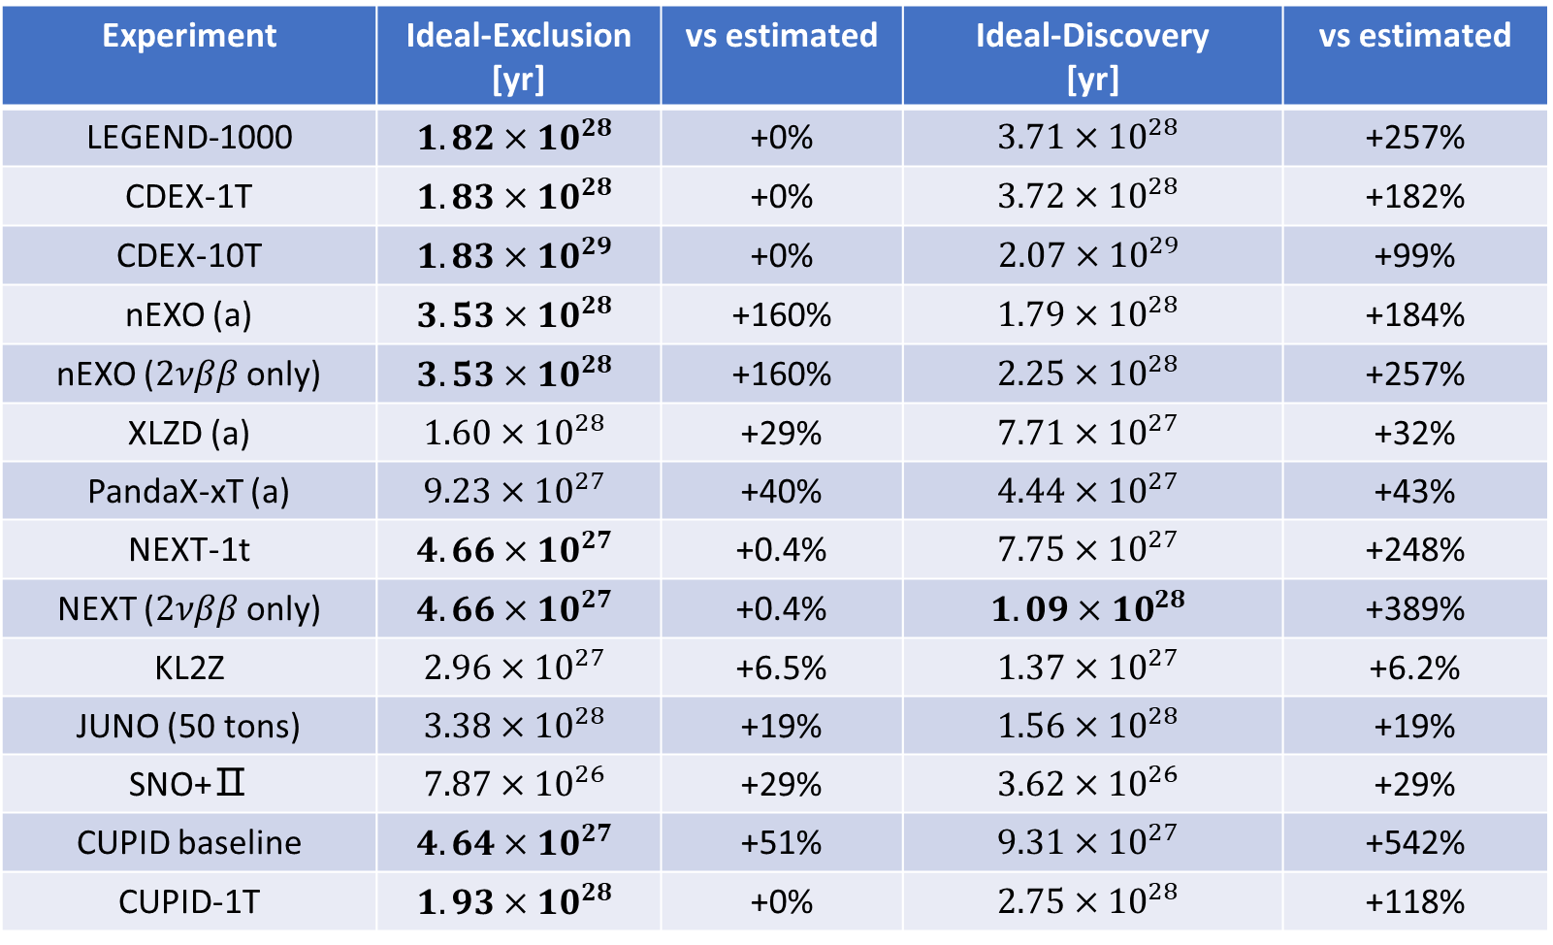
13. Ideal Condition: sensitivity
$Ideal$ Condition
$λ_{b}^{i}=λ_{b}^{2ν}+λ_{b}^{ES}$ vs $λ_{b}$
Experiment | Ideal-Exclusion [yr] | vs estimated | Ideal-Discovery [yr] | vs estimated
LEGEND-1000 | $$1.82×{10}^{28}$$ | +0% | $$3.71×{10}^{28}$$ | +257%
CDEX-1T | $$1.83×{10}^{28}$$ | +0% | $$3.72×{10}^{28}$$ | +182%
CDEX-10T | $$1.83×{10}^{29}$$ | +0% | $$2.07×{10}^{29}$$ | +99%
nEXO (a) | $$3.53×{10}^{28}$$ | +160% | $$1.79×{10}^{28}$$ | +184%
nEXO ($2νββ$ only) | $$3.53×{10}^{28}$$ | +160% | $$2.25×{10}^{28}$$ | +257%
XLZD (a) | $$1.60×{10}^{28}$$ | +29% | $$7.71×{10}^{27}$$ | +32%
PandaX-xT (a) | $$9.23×{10}^{27}$$ | +40% | $$4.44×{10}^{27}$$ | +43%
NEXT-1t | $$4.66×{10}^{27}$$ | +0.4% | $$7.75×{10}^{27}$$ | +248%
NEXT ($2νββ$ only) | $$4.66×{10}^{27}$$ | +0.4% | $$1.09×{10}^{28}$$ | +389%
KL2Z | $$2.96×{10}^{27}$$ | +6.5% | $$1.37×{10}^{27}$$ | +6.2%
JUNO (50 tons) | $$3.38×{10}^{28}$$ | +19% | $$1.56×{10}^{28}$$ | +19%
SNO+Ⅱ | $$7.87×{10}^{26}$$ | +29% | $$3.62×{10}^{26}$$ | +29%
CUPID baseline | $$4.64×{10}^{27}$$ | +51% | $$9.31×{10}^{27}$$ | +542%
CUPID-1T | $$1.93×{10}^{28}$$ | +0% | $$2.75×{10}^{28}$$ | +118%
HPGe
TPC
LS
($T=10 yr$)
CC
Notes:
The ideal sensitivity when there is only irreducible background is calculated. Compared to the estimated sensitivity, We can find that more experiments realize zero background condition. And There is larger increase in discovery sensitivity.

Slide 15
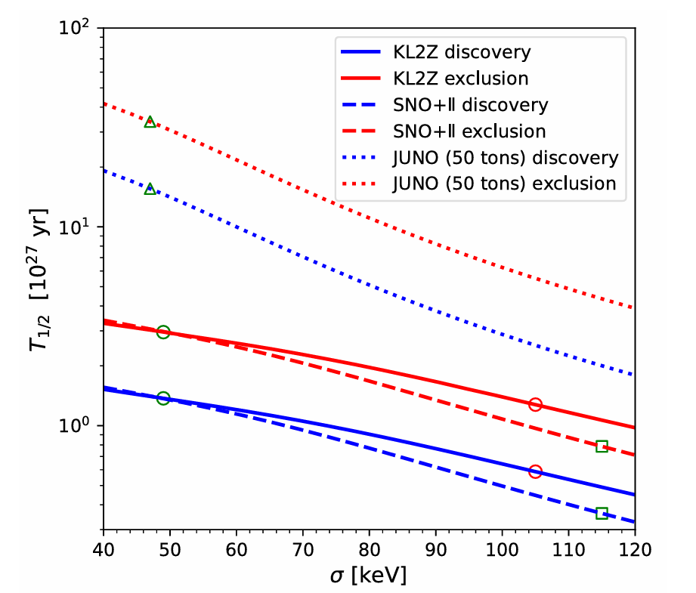
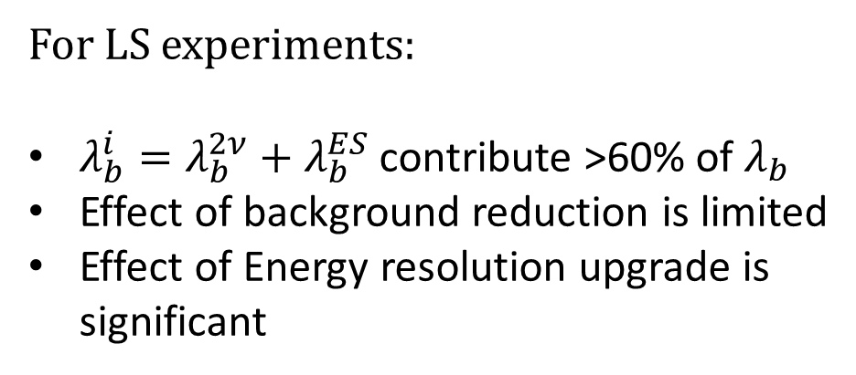

14. Ideal Condition: Energy Resolution
Ideal sensitivity-$σ$
For LS experiments:
$λ_{b}^{i}=λ_{b}^{2ν}+λ_{b}^{ES}$ contribute >60% of $λ_{b}$
Effect of background reduction is limited
Effect of Energy resolution upgrade is significant
Notes:
Since we have known that for LS experiments, effect of background reduction is limited for its large irreducible background. The more effective way to raise sensitivity is to upgrade their relatively bad energy resolution. When sigma decreases, two sources of irreducible background both desease sharply. As is seen in the figure, ideal sensitivity has quick rise with the upgrade of energy resolution.

Slide 16
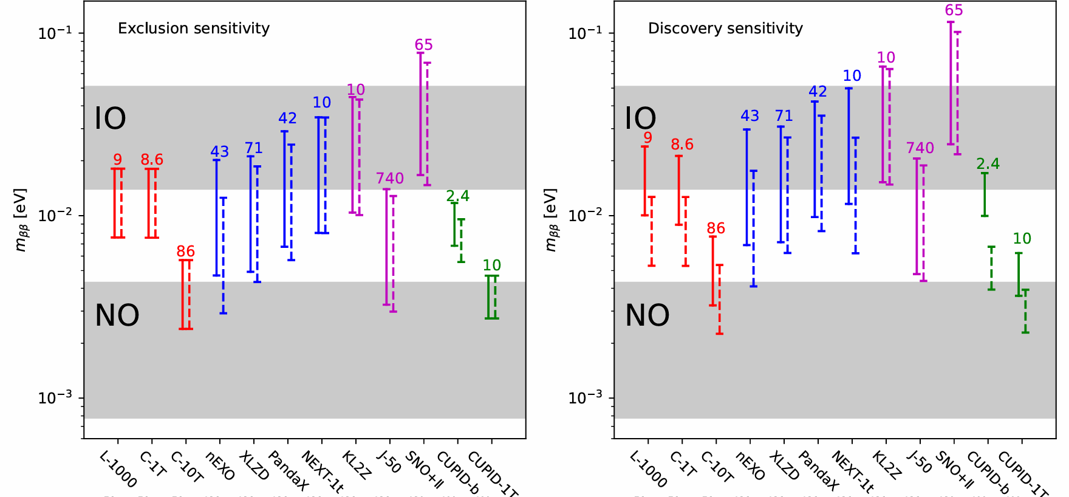
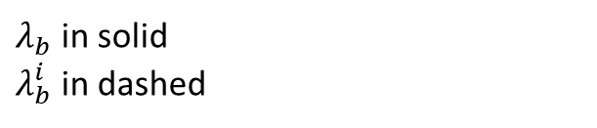


15. $m_{ββ}$ sensitivity
$m_{ββ}$ sensitivity
Favorable for ¹⁰⁰Mo
Ideal condition:
Limited improvement for LSs
Large improvement for HPGes and CCs
Large improvement for discovery
Exposure in unit of $ton∙yr$
$λ_{b}$ in solid
$λ_{b}^{i}$ in dashed
Notes:
Based on the previous analysis, Mbb sensitivity for each experiment can be calculated.
This figure shows the expected sensitivity in solid lines as well as ideal sensitivity in dashed lines for later phases of experiments. The exposure of each experiment is also shown in the figure in the unit of ton*yr. We can see that compared to exclusion sensitivity, there is more increase of sensitivity in ideal condition for discovery sensitivity, showing better effect of background reduction. We also find that CUPID lead in sensitivity, which can start to discover NO region at exposure of only 10 ton yr and halflife sensitivity of 10^28 yr, this is mostly because of Mo's favorable nuclear parameter. CDEX and JUNO also has an edge in discovery sensitivity respectively due to low background of HPGe and large exposure of LS.

Slide 17

16. $Summary$
Contributions
Limitations
Collect experimental parameters
Calculate $T_{1/2}^{0ν}$ and $m_{ββ}$ for typical experiments
Analysis of ideal condition (only $2νββ$ and ES of solar B-8 $ν$)
  Effective for discovery
  Effective for HPGes and CCs
  Resolution upgrade for LSs
Not cover all experiments and techniques
  SuperNEMO, AMoRE …
Not latest experimental parameters collected
Ideal condition only gives a rough upper limit
Notes:
In conclusion, this work made several achievements. First, we collect experimental parameters of typical experiments from the current literature, providing latest general information. Second, $T_{1/2}^{0ν}$ and $m_{ββ}$ sensitivities of experiments are calculated and compared based on existing method. The nuclear parameter advantage of ¹⁰⁰Mo is demonstrated and discovery sensitivity proves to be favorable metric for low background experiment such as HPGe. Finally, ideal condition when there is only $2νββ$ and ES of solar B-8 $ν$ background is analyzed. Background contribution from irreducible background is calculated. Limited improvement of LSs and great improvement from HPGe and CC is observed.
Also there are limitations, a limited number of only 10 experiments are discussed. Some experimental parameters cannot be found or indicated from current literature, causing uncertainty in sensitivity estimation. And ideal condition only gives a rough upper limit from theoretical physic, which is difficult to realize.

Slide 18
Thank you!

