Slide 1
High-Energy Gamma-Ray Astronomy:
Breakthroughs and Future Prospects from Space- and Ground-Based Observations
Songzhan Chen (chensz@ihep.ac.cn)
Institute of High Energy Physics (IHEP), CAS
Tianfu Cosmic Ray Research Center
2025-08-28@TAUP2025

Slide 2
Outline
1. Why do we study γ-ray astronomy?
2. How to observe γ-rays?
3. Recently breakthroughs in γ-ray astronomy
4. Future prospects for γ-ray observations
5. Summary

Slide 3
1. Why do we study γ-ray astronomy?

Slide 4
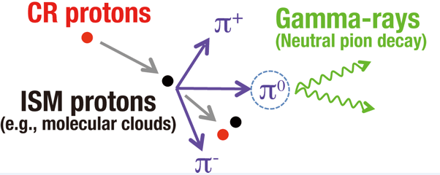
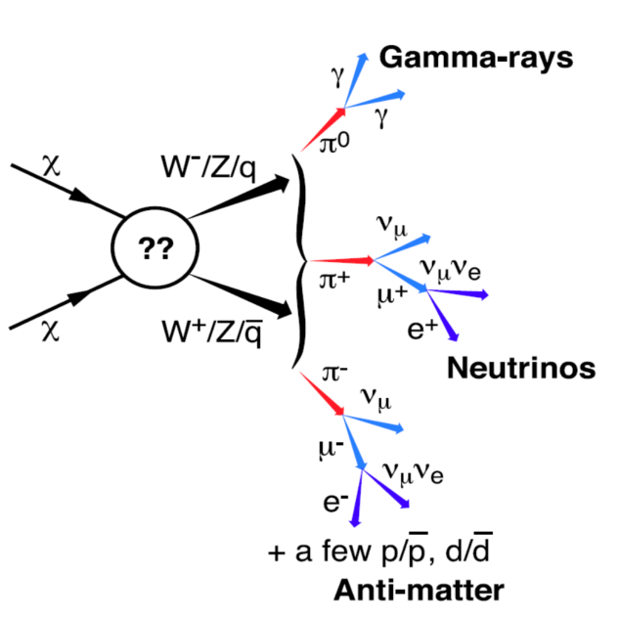
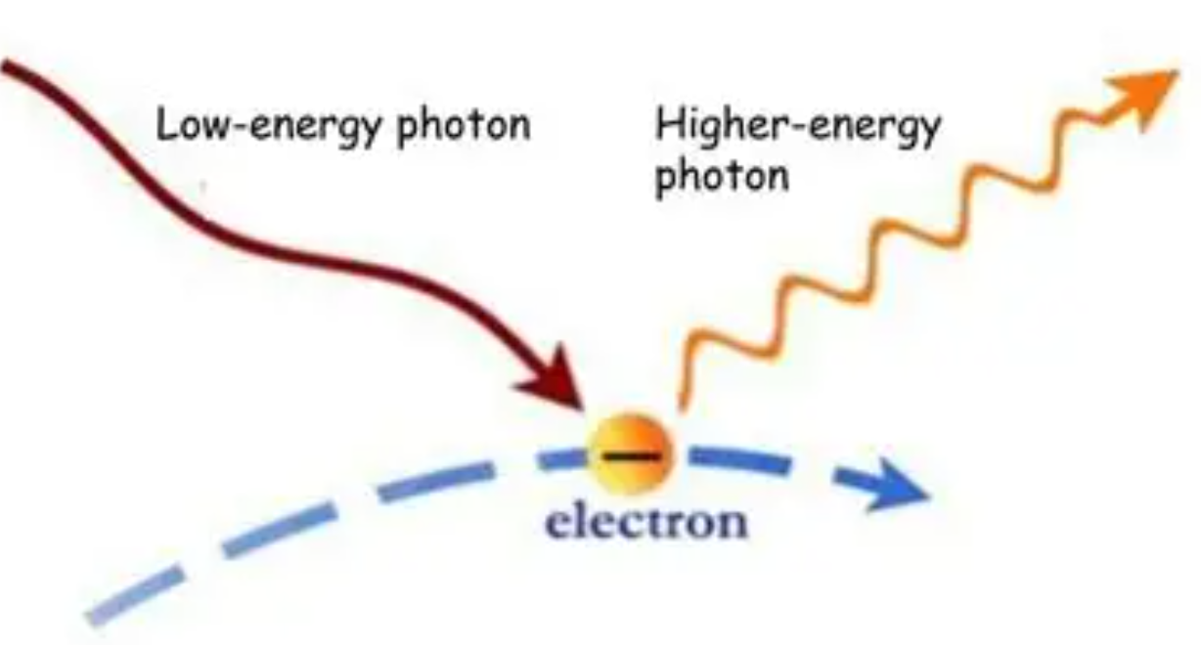

Mechanism of γ-ray production
Emission of High Energy electron
Emission of High Energy Proton
Possible dark matter decay or annihilation
Inverse Compton
$→π$⁰ $→γ+γ$
$→$ $π+$ $→μ+νμ→e+⊽μνeνμ$
$→$ $π−$ $→μ−⊽μ→e−νμ⊽e⊽μ$
Multi-wavelength
Multi-messenger
Indirect method
γ-ray is an important window to explore the universe!

Slide 5
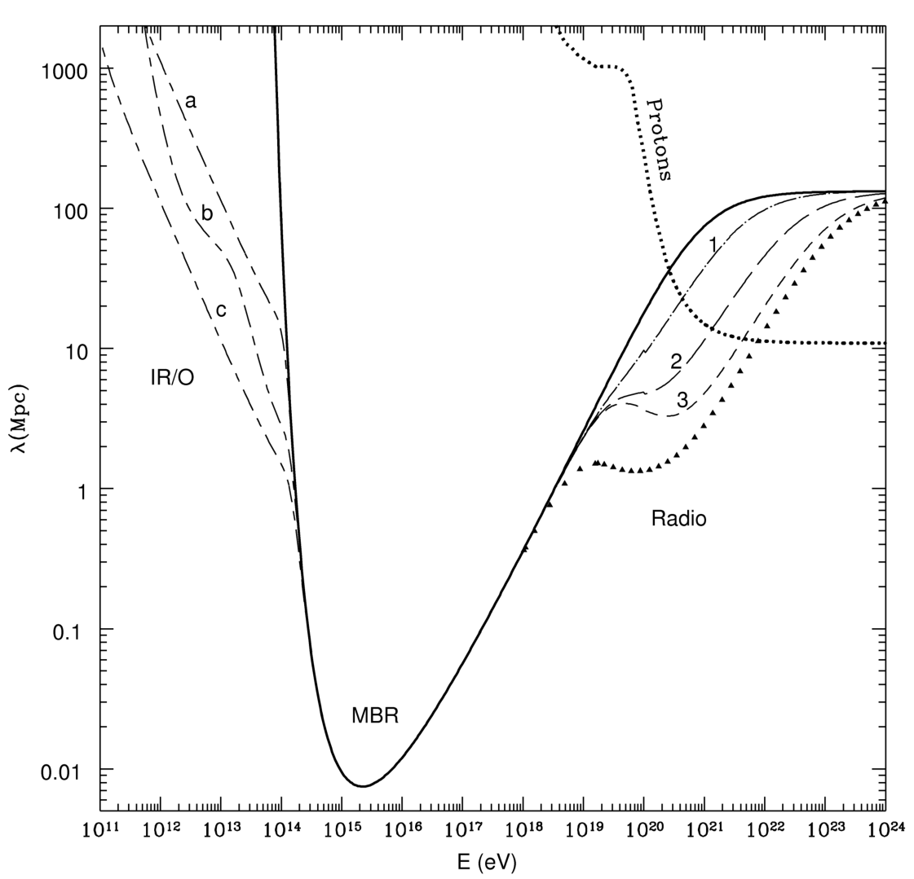
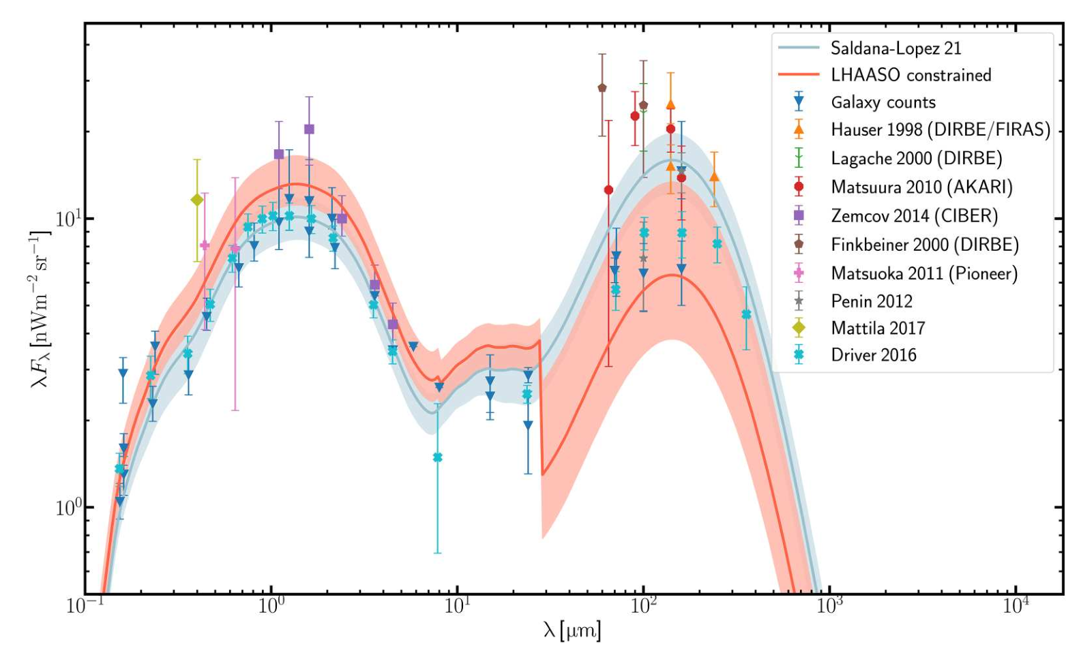
γ-ray propagation mechanism
γ_{high} + γ_{low}→e⁺+e⁻
γ-ray Horizon
EBL(extra-galactic background light)
Coppi and Aharonian 1997
LHAASO coll. 2023
VHE γ-ray can be used to explore the evolution of Universe!

Slide 6


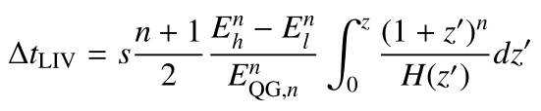
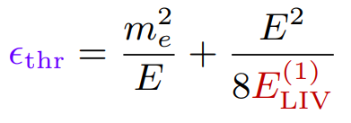

Possible factors affect on γ-rays propagation
1. Lorentz Invariance Violation(LIV)
Superluminal Scenario
  UHE Photon Splitting
  UHE Single-Photon Decay
  HE Photons Arrive Before LE
Subluminal Scenario
  HE Photons Arrive After LE
  Reduced EBL Absorption (Increased Threshold Energy)
2. Axion–γ-ray conversion
γ-ray can be used to explore new physics frontier!

Slide 7
2. How to observe γ-rays?

Slide 8
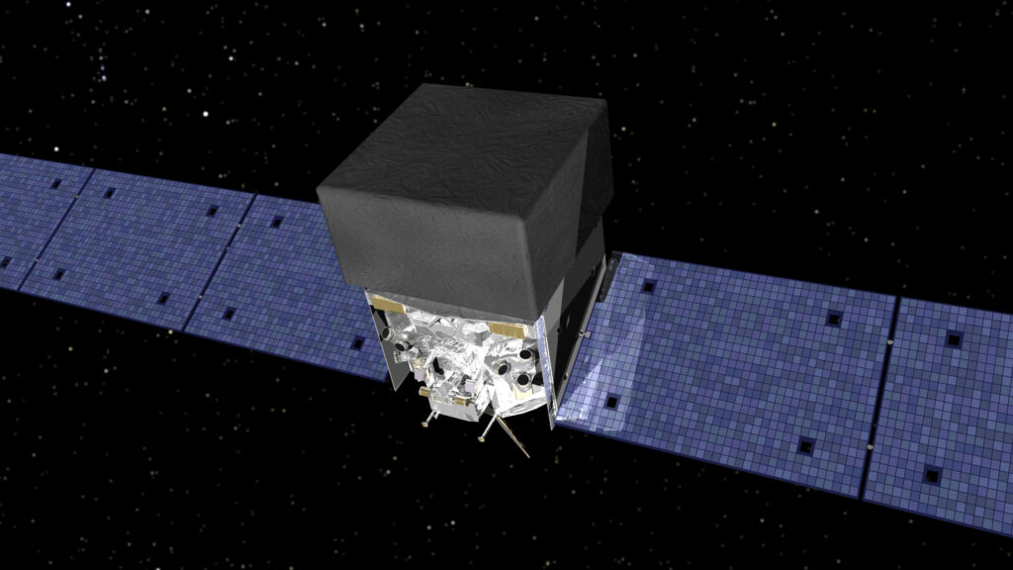
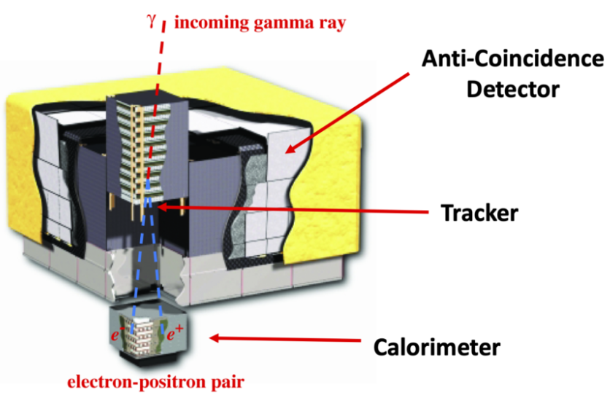
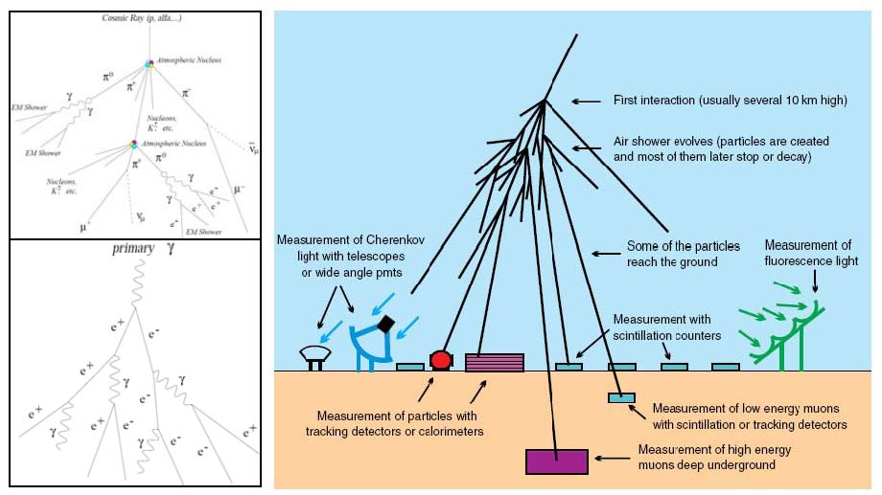
How to observe γ-rays?
Direct measurement above the atmosphere
Indirect measurement via EAS at ground

Slide 9
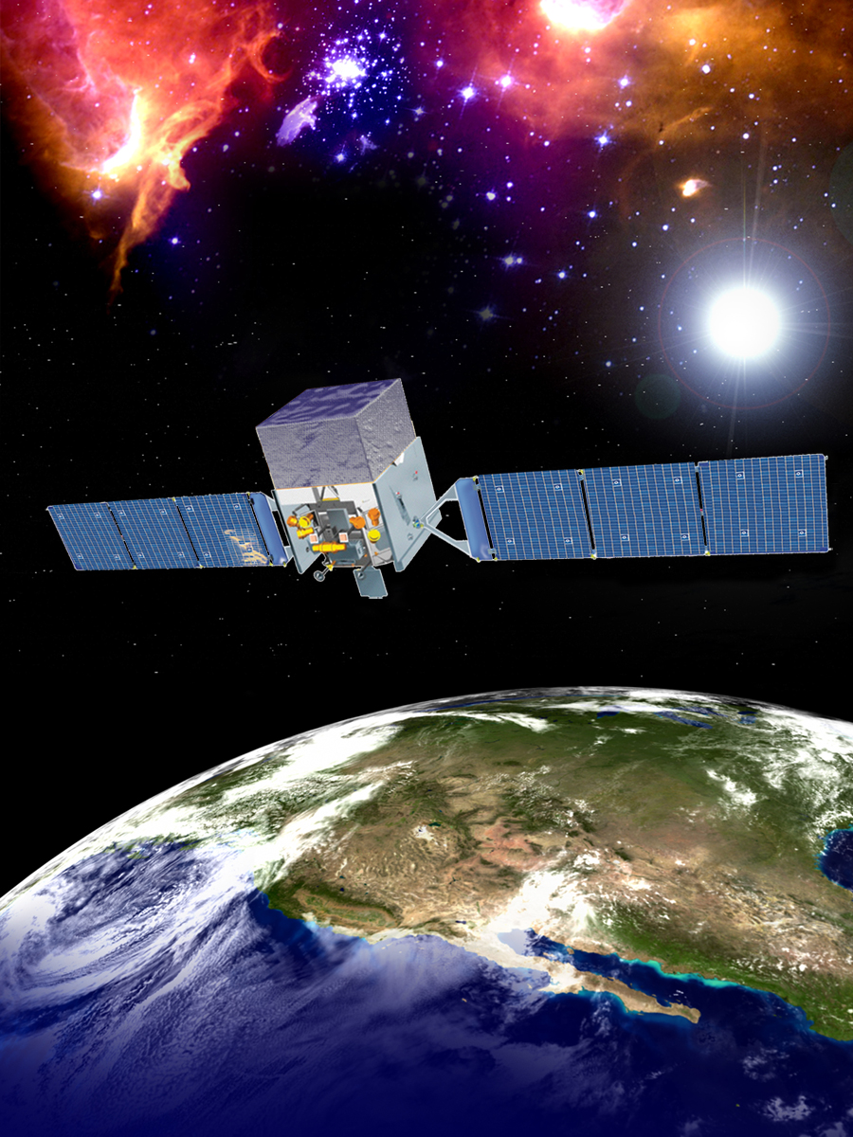
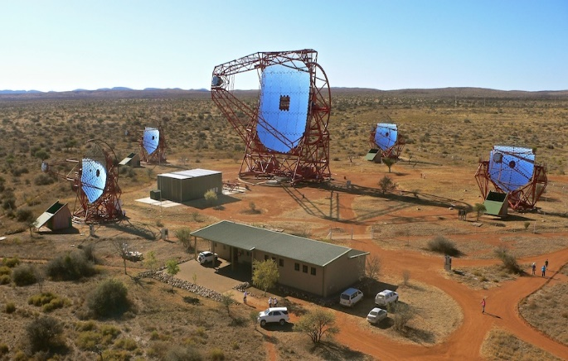

Current major HE γ-ray detectors
Space-based
AGILE (2007-2024)
Fermi (2008-Now)
Ground-based: IACT
H.E.S.S. (2003-Now)
VERITAS (2007-Now) MAGIC (2009-Now)
Ground-based: EAS array
ASγ+MD (2014-2017?)
HAWC (2015-Now)
LHAASO (2021-Now)
VHE：>0.1 TeV
UHE：>0.1 PeV
Large FOV
100% duty cycle
0.1º ~ 1º resolution
HE: >0.1 GeV
Large FOV
80% duty cycle
0.1º ~ 5º resolution
VHE:>0.1 TeV
3º~5º FOV
15% duty cycle
0.06º~ 0.17º resolution

Slide 10
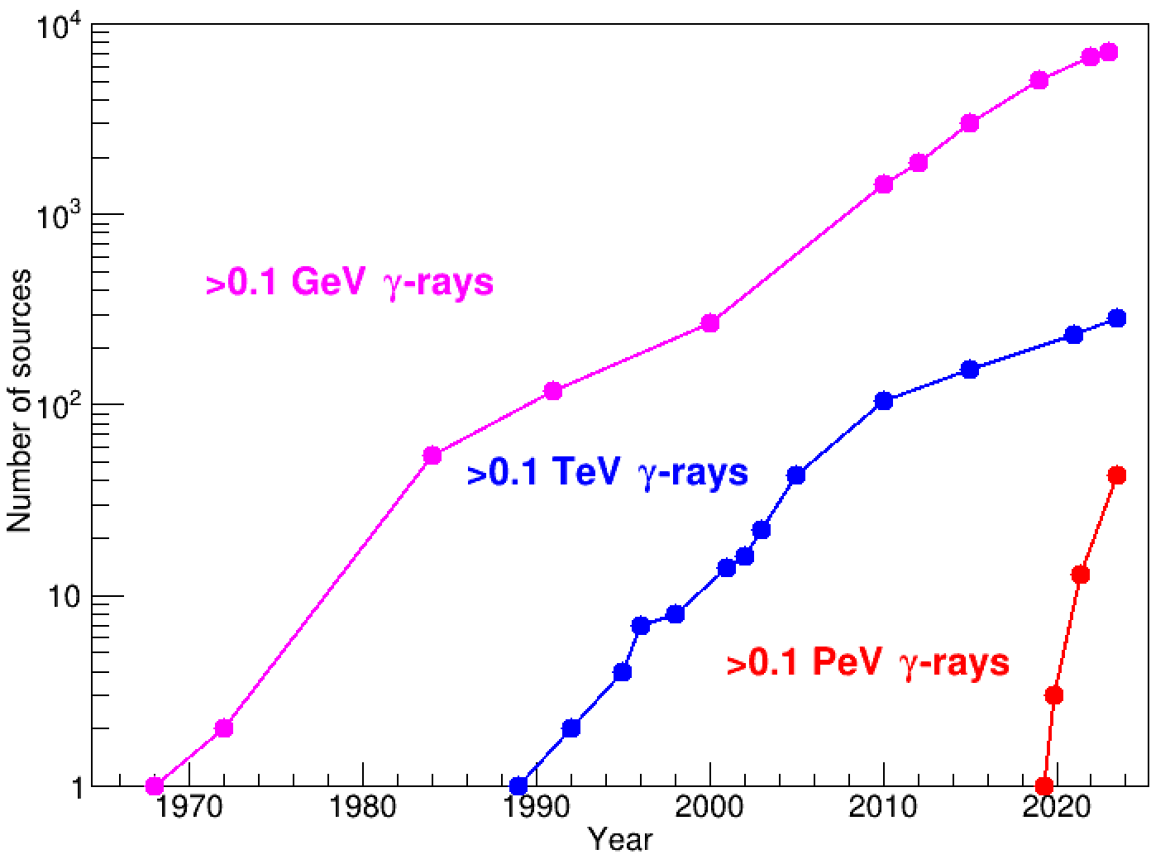
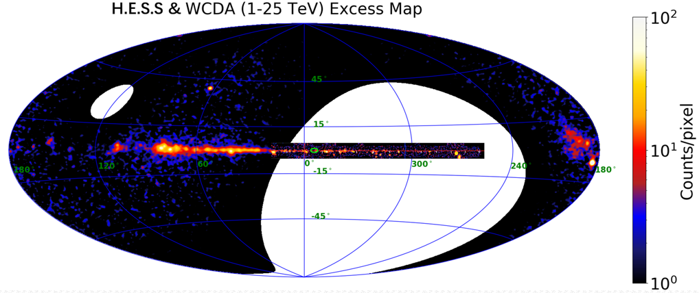
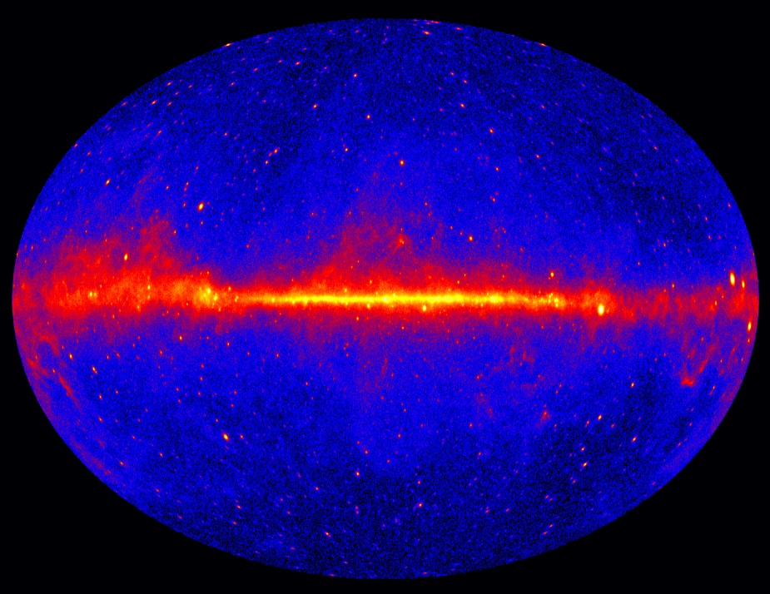
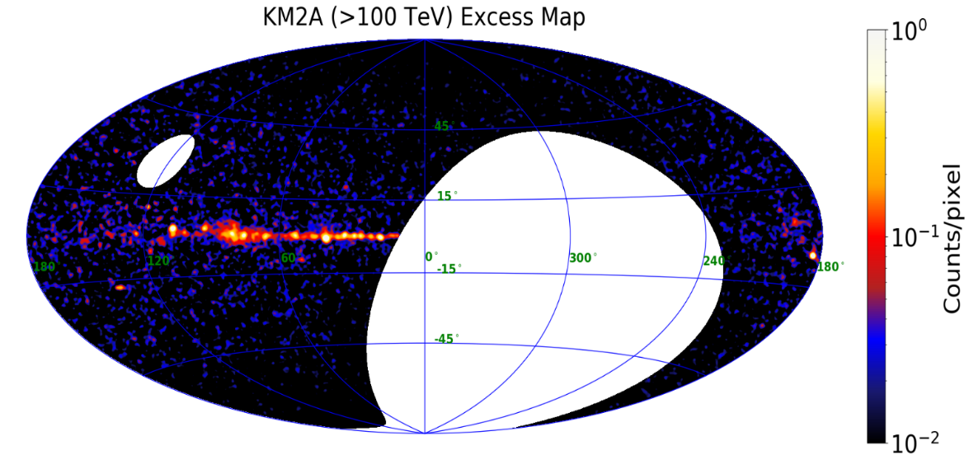
Fruitful Gamma-ray Astronomy
7195
H.E.S.S. & LHAASO VHE γ-ray sky
~300
43
Fermi-LAT HE γ-ray sky
LHAASO UHE γ-ray sky

Slide 11
3. Recently breakthroughs in γ-ray astronomy

Slide 12
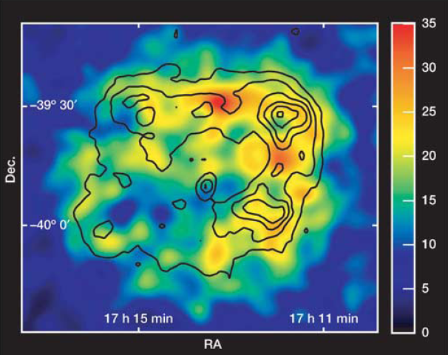
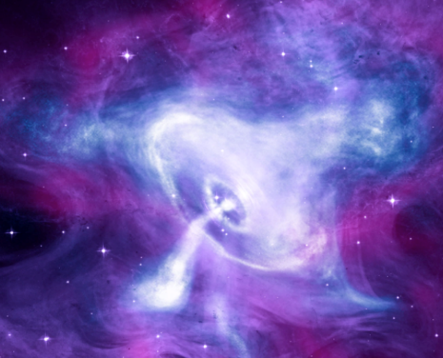
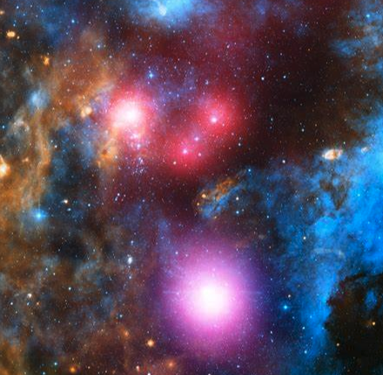
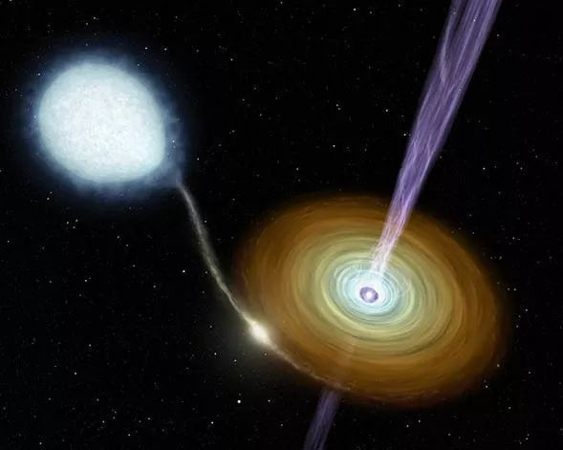
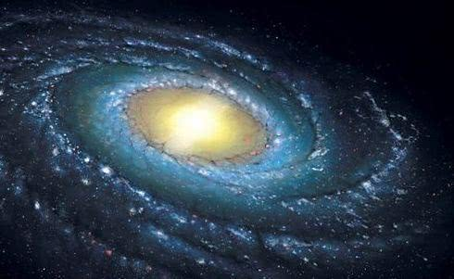
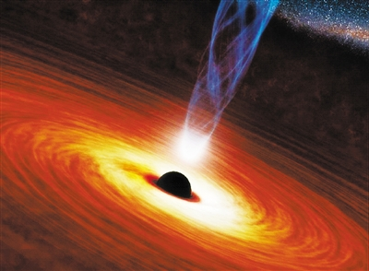
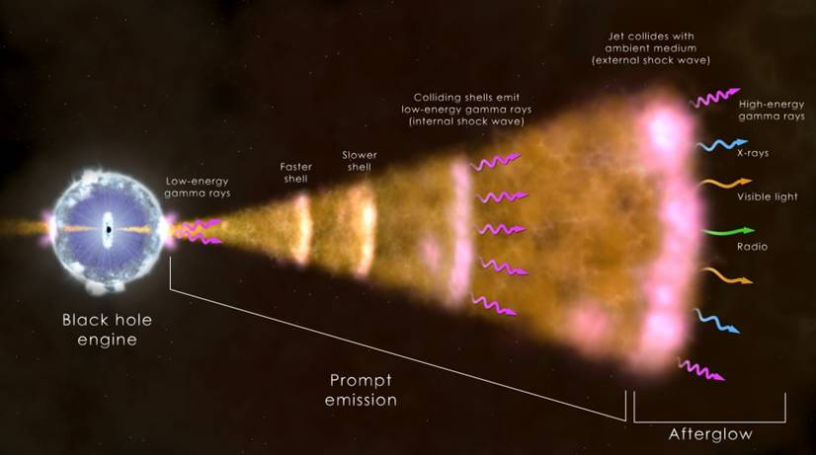
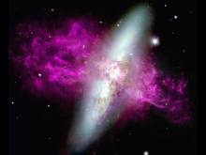
Known Gamma-ray sources
SNR
Pulsar and PWN
Young star cluster
Binary star
Galactic center
Galaxy
AGN
GRB
Starburst galaxy
Extra-galaxy

Slide 13
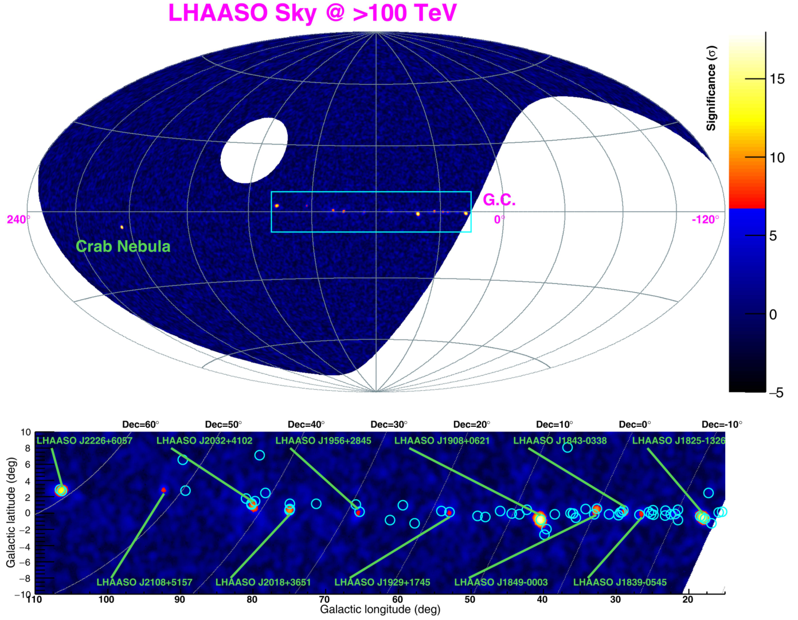
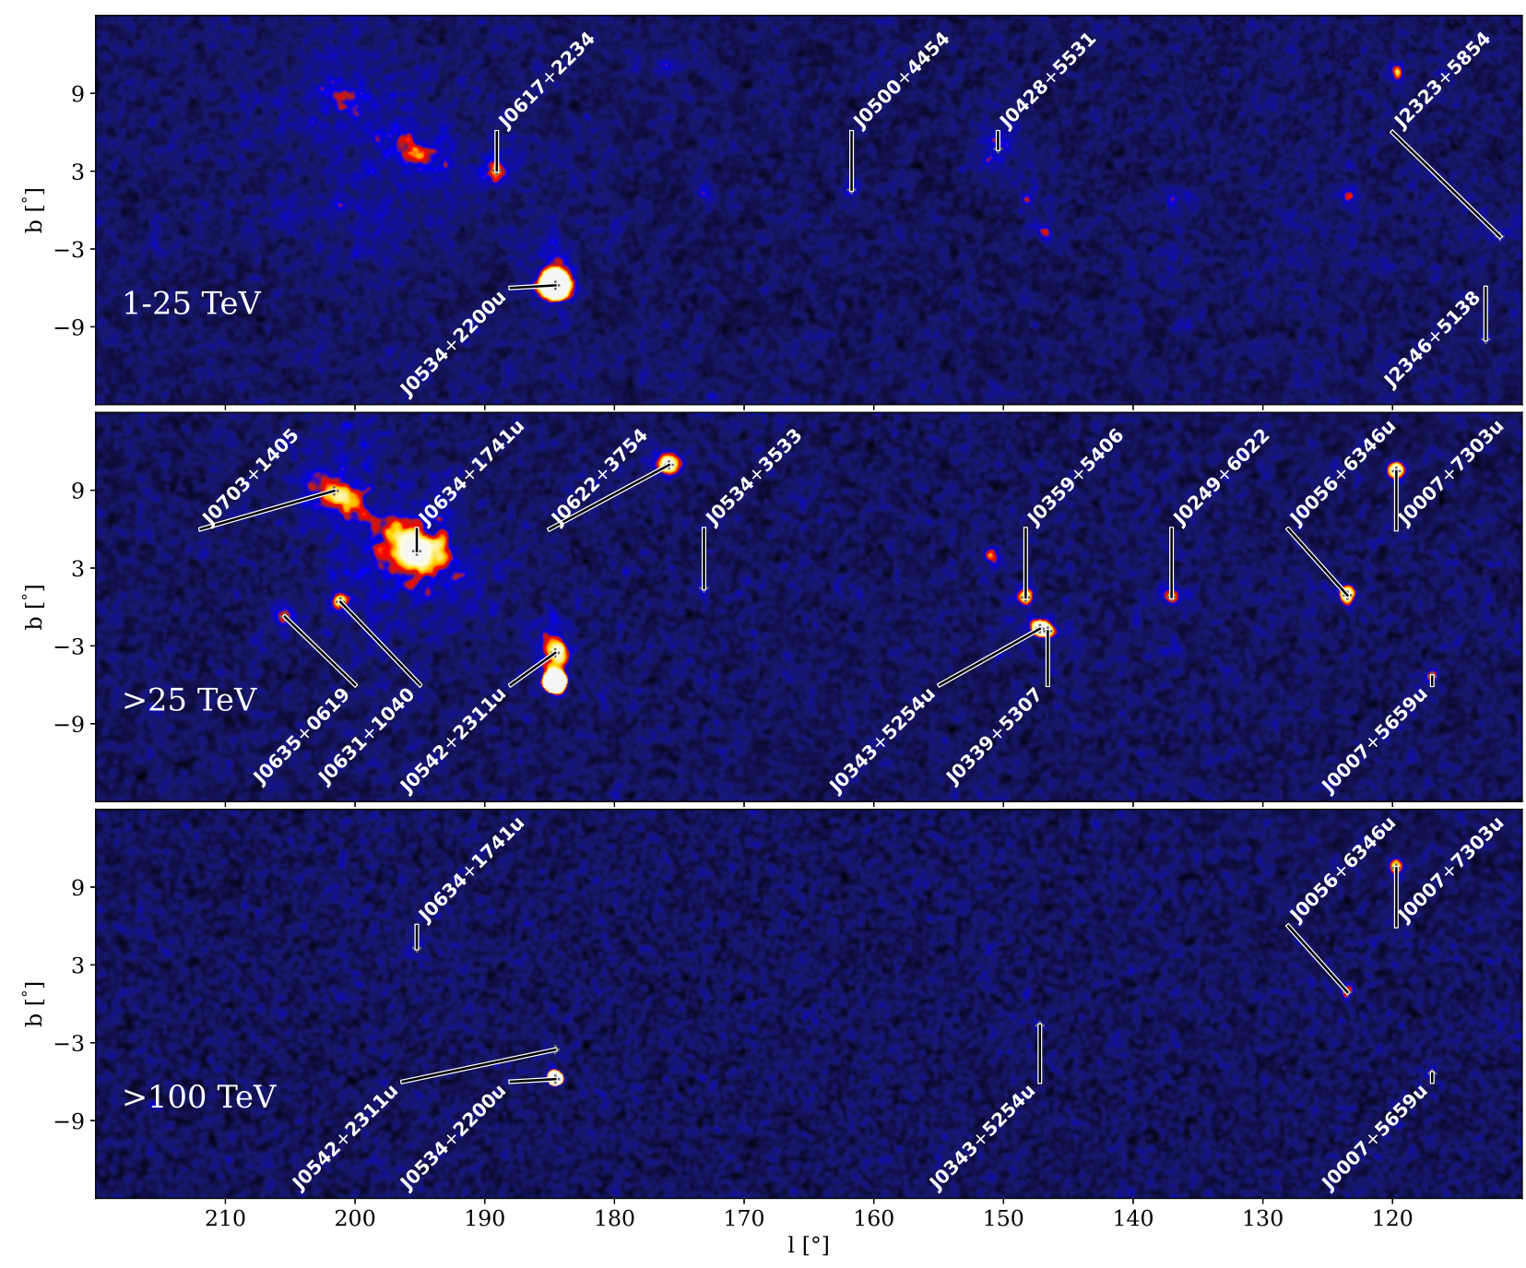
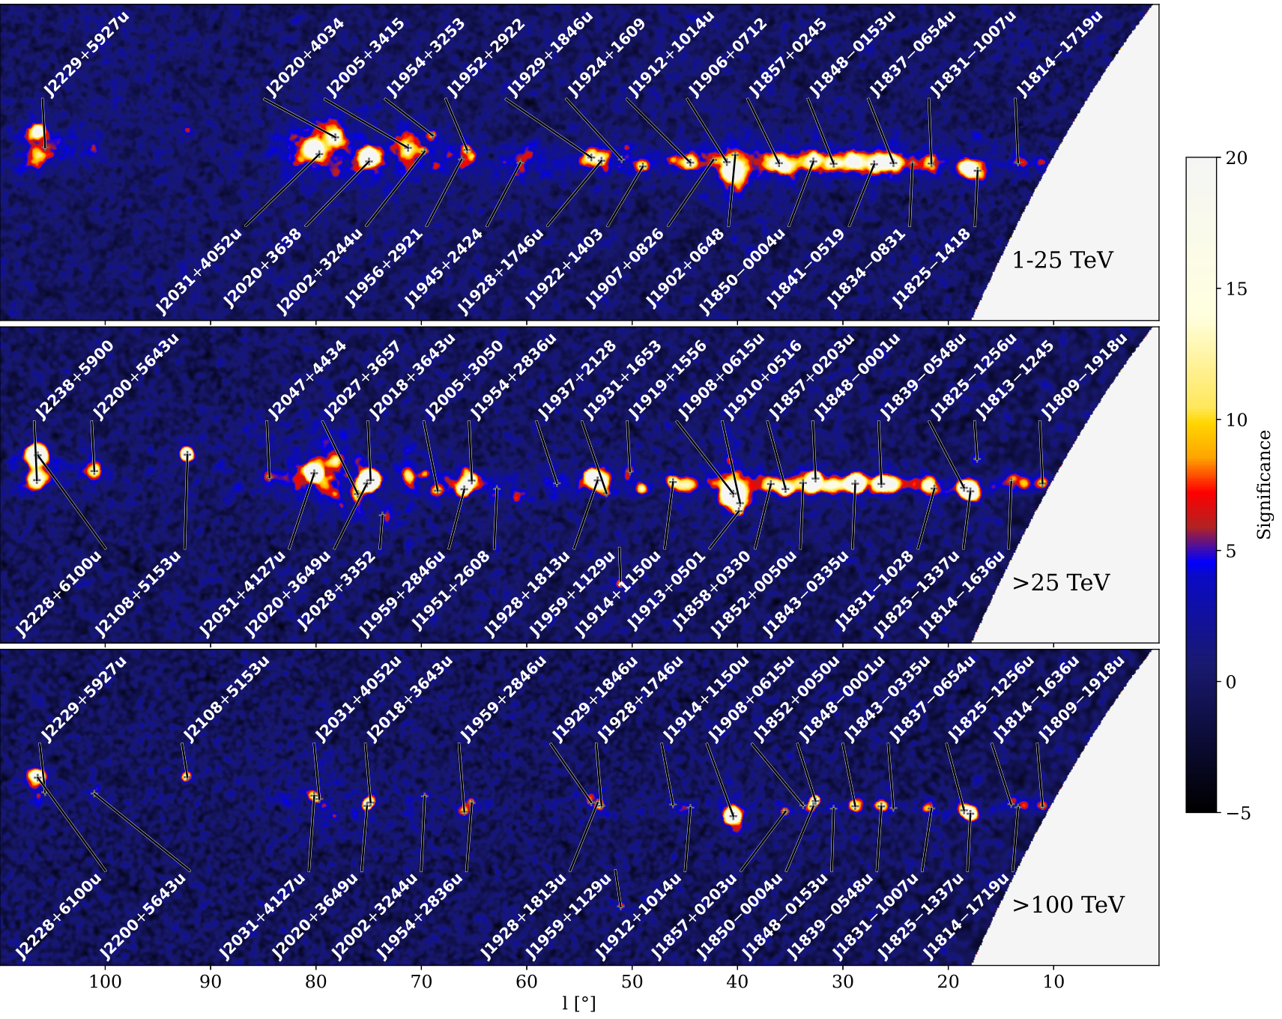
3.1 Unexpected UHE γ-ray sky
The biggest surprise bright by LHAASO:
Milky Way is full of UHE sources!
12 UHE sources
90 VHE sources + 43 UHE sources
LHAASO coll. 2021
LHAASO coll. 2024

Slide 14
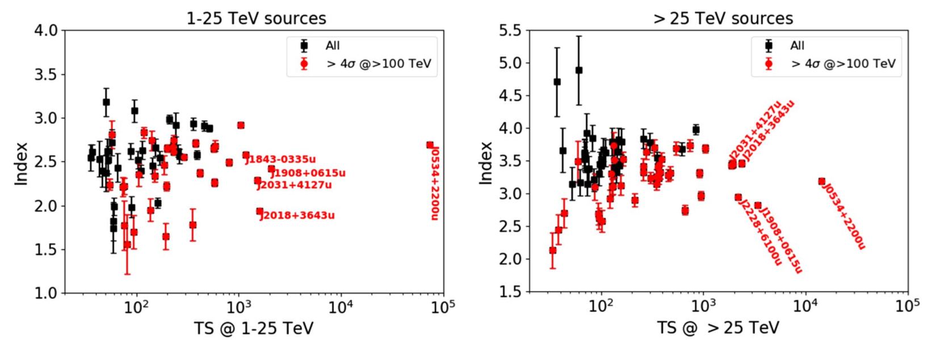
PeVatrons
Most of VHE sources will be detected with UHE emission in the future
These sources can accelerate particles to PeV
Milky Way is full of PeVatrons!
LHAASO coll. 2024

Slide 15
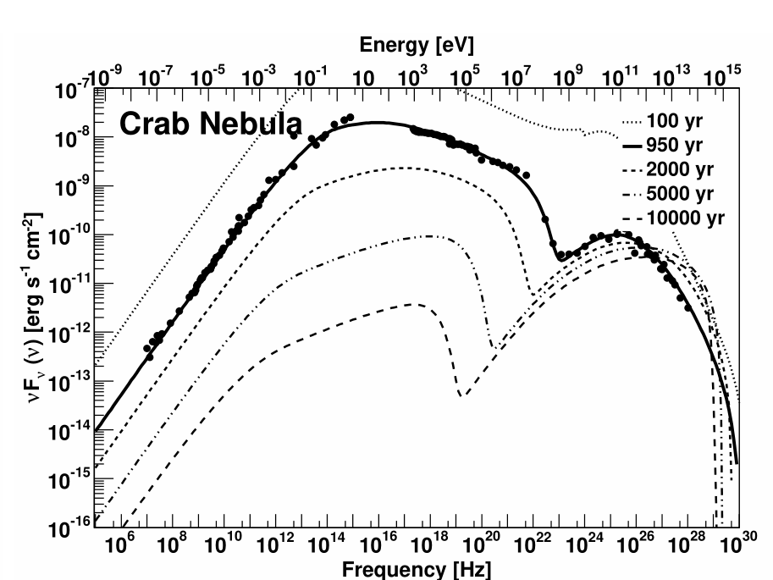
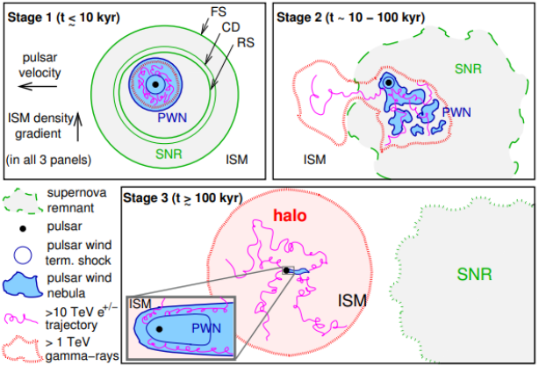
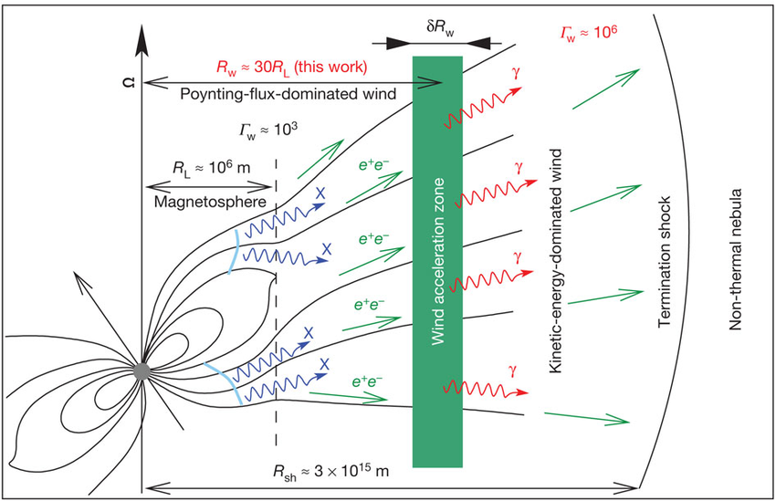
3.2 Pulsar wind nebula (PWN)
PWN account for the largest proportion of VHE γ-ray sources within the Milky Way!
Inverse Compton
Synchrotron
Aharonian+2012
Torres et al.2014
Giacinti et al.2020

Slide 16
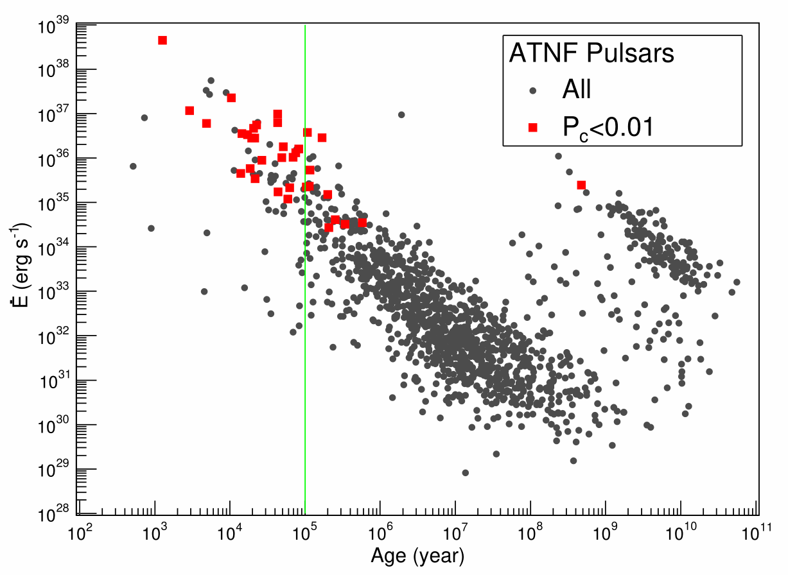
PWN are effective VHE and UHE emitters
35/90 1LHAASO would be PWN (associations with pulsar chance coincide probability <1%)
Most(>50%) of energetical pulsars with FOV of LHAASO are detected with VHE emission.
22/35 PWNs are detected with UHE
LHAASO coll. 2024

Slide 17
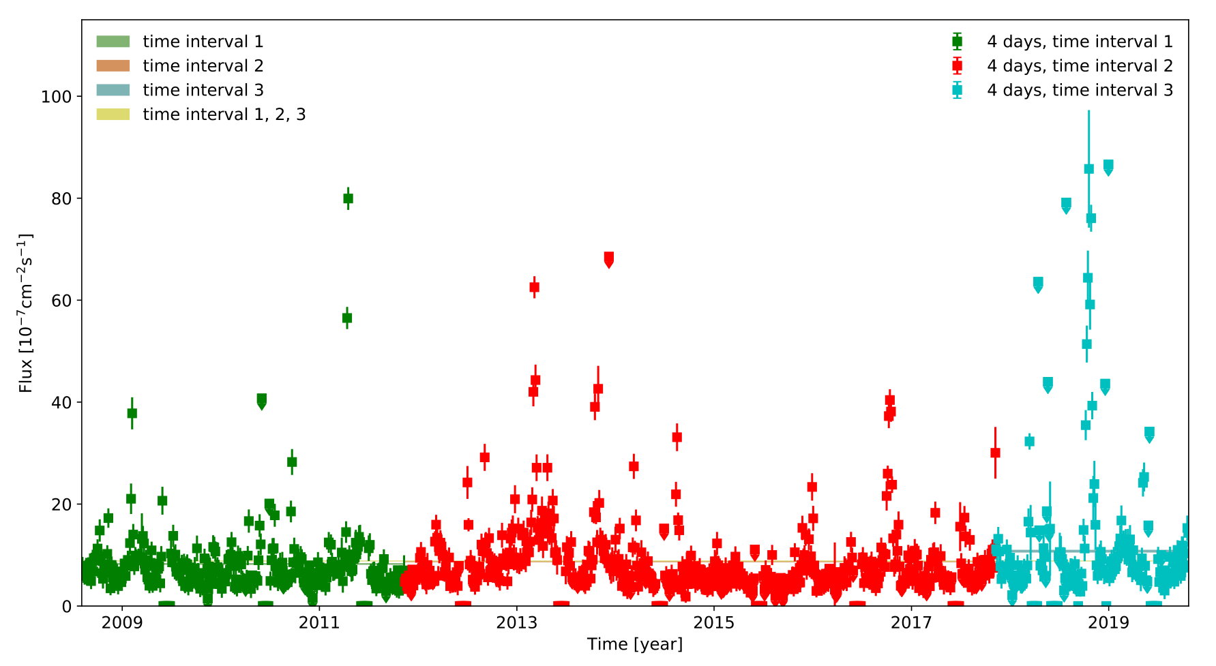
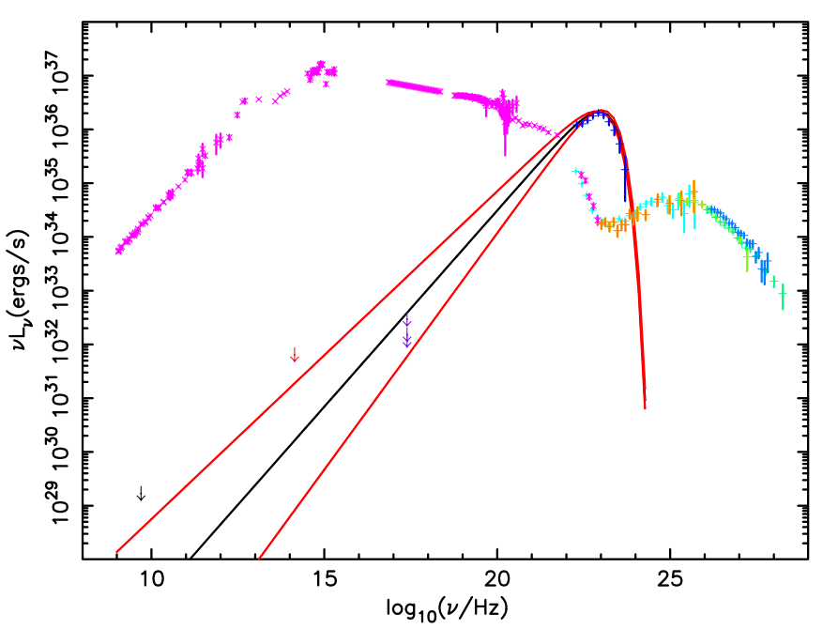
Two big surprises from Crab nebula
Crab Nebula is a standard candle in γ-ray astronomy originated the supernova in 1054
PeV emission is not related with GeV flares (see JY Zhang poster)
Surprise 1: GeV flares
Surprise 2: PeV emission
Huang et al. 2021
Highest γ-ray energy 1.1 PeV→1.4PeV
Extreme electron accelerator
Acceleration rate exceeding 15% of the theoretical limit.
Weisskopf et al. 2013
LHAASO coll. 2021

Slide 18
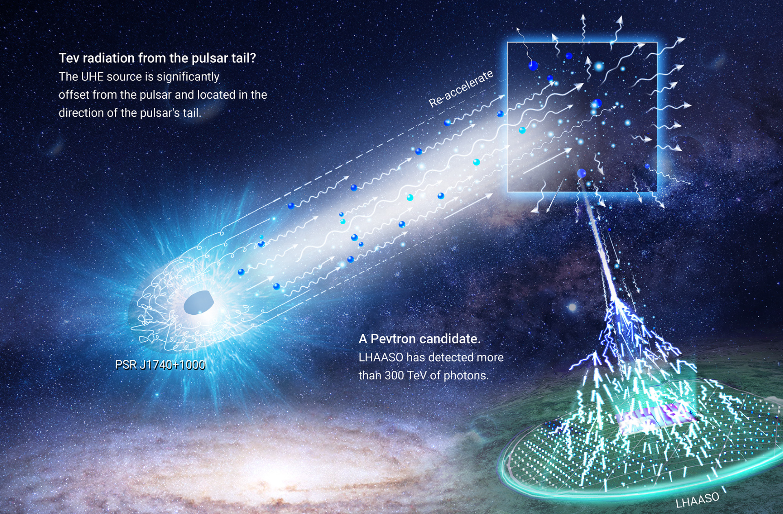
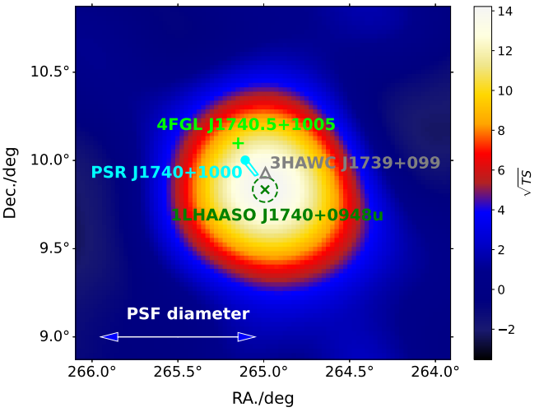
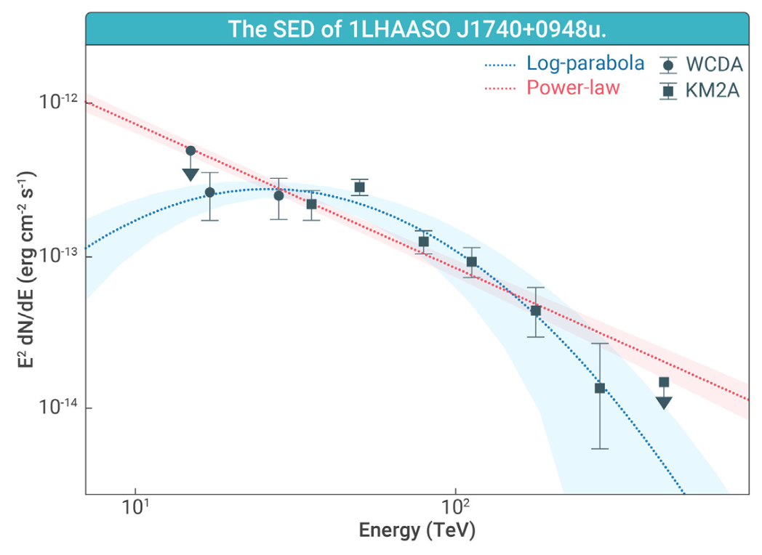
New accelerate place in PWN?
LHAASO discovery UHE emission from the tail region of a bow-shock PWN
New clues:
  Possible particle acceleration in pulsar tails.
  No TeV halo is detected. The formation of TeV halos may be related to the surrounding medium environment
Pulsar：PSR J1740+1000
Age：110 ky
Distance ：1.4 kpc
LHAASO coll. 2025

Slide 19
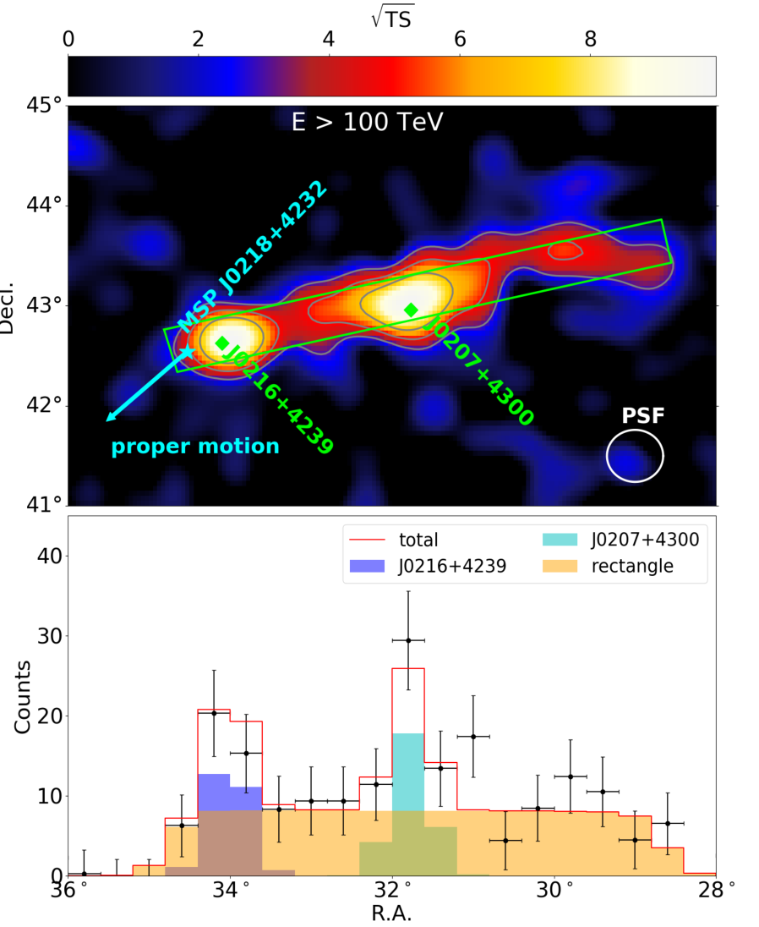
New type UHE source
First detection of a peanut-shaped HE γ-ray source.
May be caused by anisotropic diffusion of UHE particles
An energetical millisecond pulsar located at the head. Maybe the first evidence for MSP nebular systems with VHE and UHE γ-ray radiation
LHAASO coll. 2025 (submitted)
See Zhe Li’s talk

Slide 20
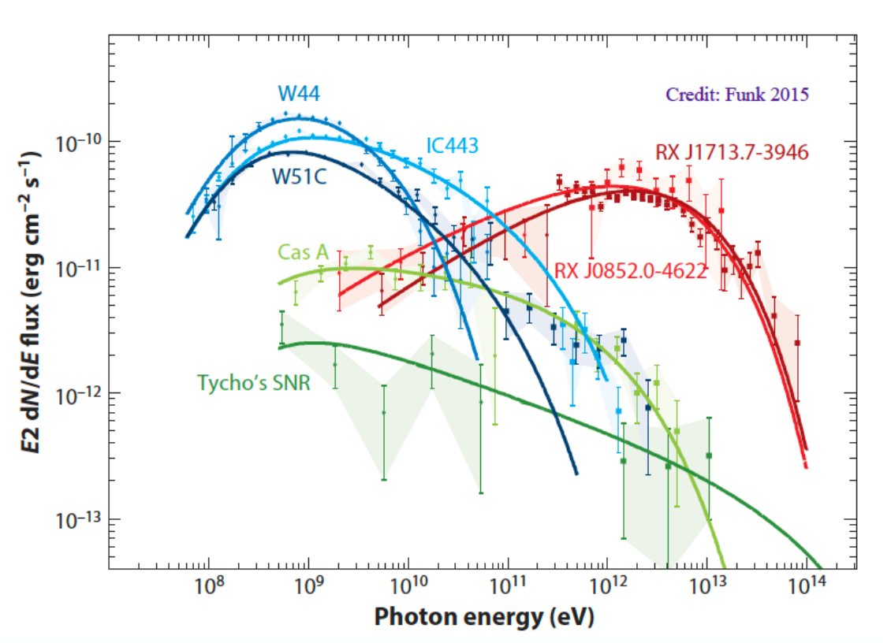
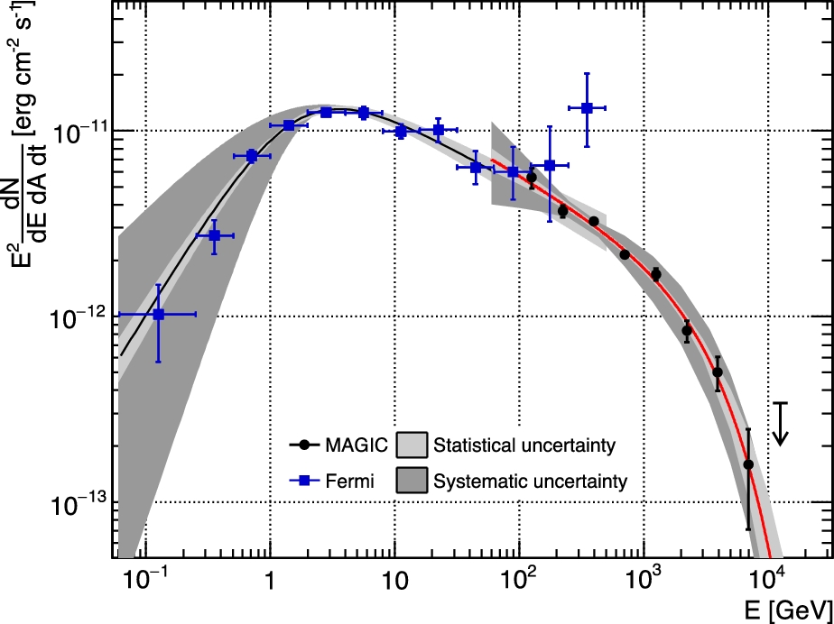
3.3 Supernova remnant (SNR)
SNRs are very important CR accelerators!
What is the maximum energy that SNR can accelerate?
Theoretical maximum particle acceleration energy
~Zx10TeV, ~Zx100TeV (Lagage & Cesarsky 1983)
~Zx1000TeV (Berezhko 1996)
~Zx1000TeV only for young SNR+ dense circumstellar pre-SN wind (Bell et al. 2013)
Cas A (330 yr)
Only up to 10 TeV?
MAGIC coll. 2017

Slide 21
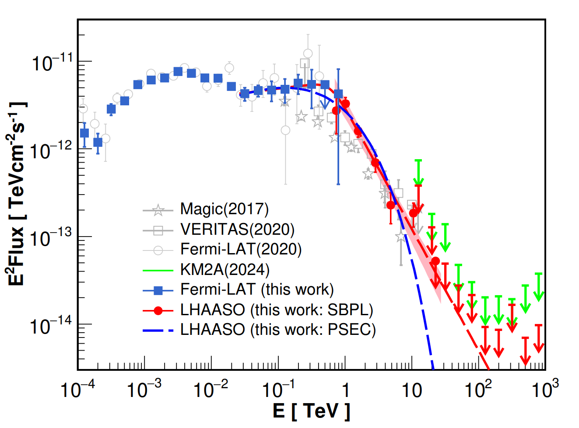
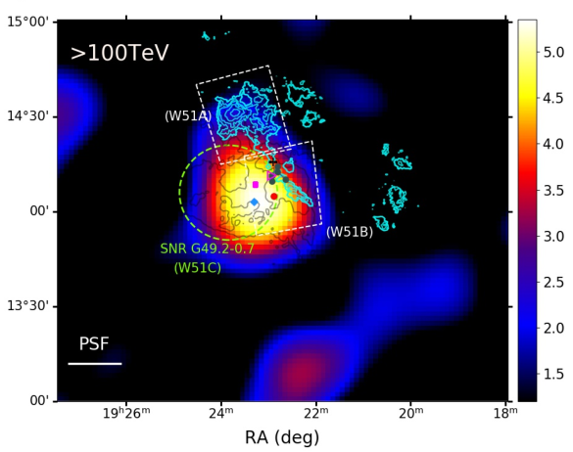
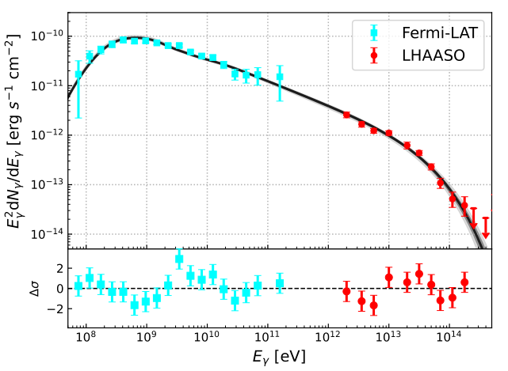

New story from LHAASO about SNR
LHAASO reveal the particles approaching PeV (0.4PeV) from SNR W51C
LHAASO reveal the emission of several SNRs have two components
W51C:~30k yr
Cas A (330 yr)
¹²CO
LHAASO coll. 2024
LHAASO coll. 2025

Slide 22
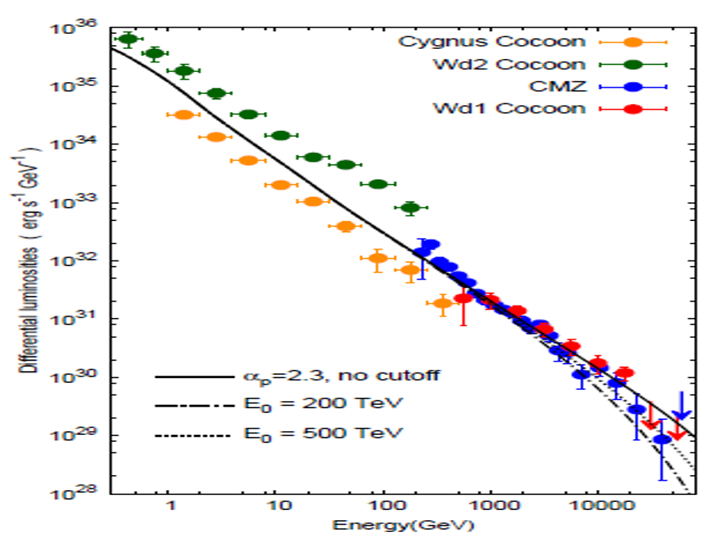
3.4 Young massive star cluster(YMSC)
YMSC cluster have the potential to supply the required power for cosmic ray with a rate of 10⁴¹ erg/s.
Aharonian et al. 2018

Slide 23
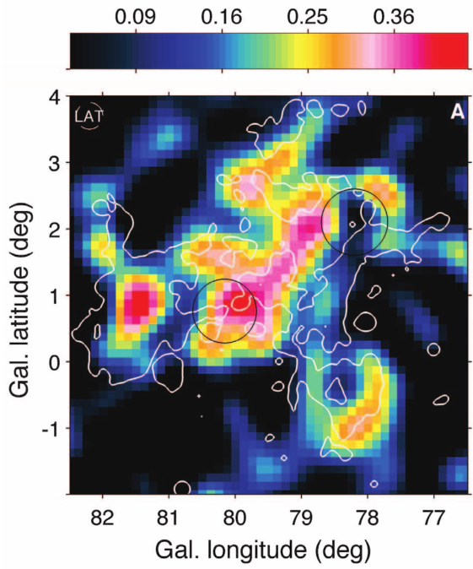
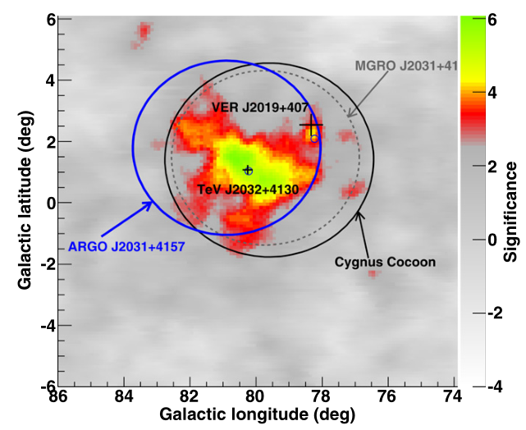
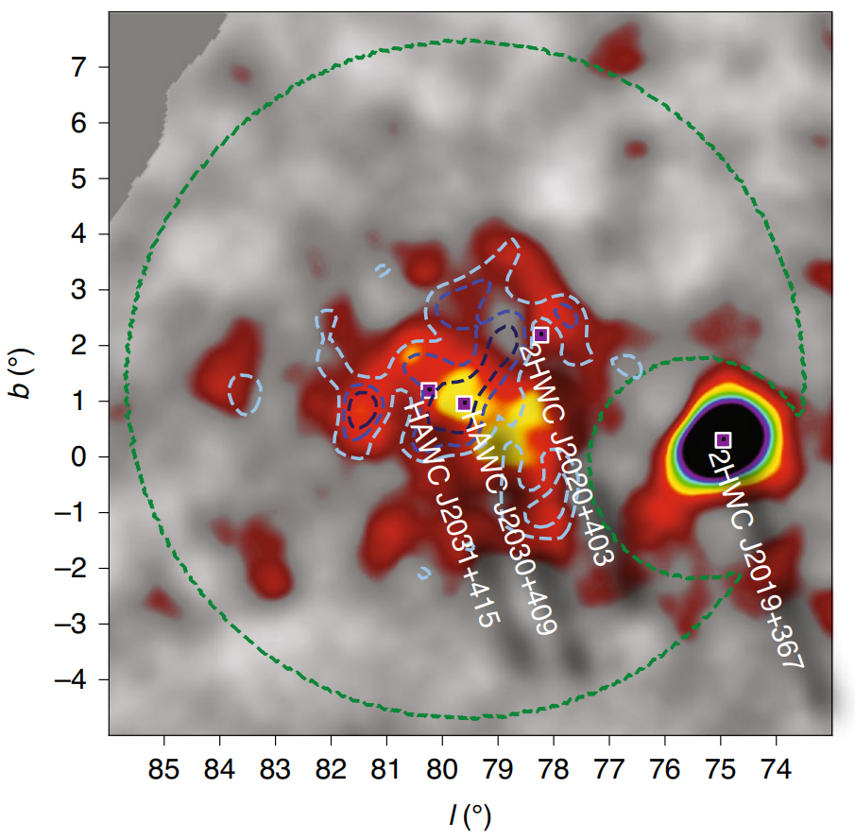
Cygnus Cocoon
A freshly accelerated cosmic rays source revealed in GeV-TeV
with extension radius ~2º.
YMSC OB2 is the most possible underline source
Fermi-LAT: 10~100 GeV
ARGO-YBJ: 0.2-10 TeV
HAWC: 1-100 TeV
Fermi-LAT coll. 2011
ARGO-YBJ coll. 2014
HAWC coll. 2021

Slide 24
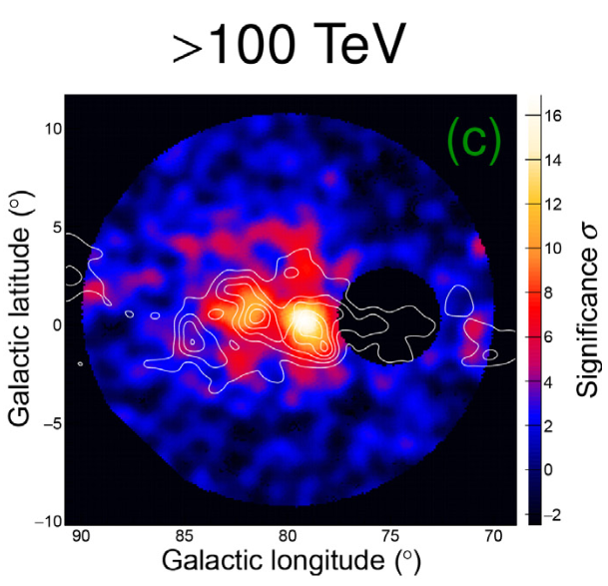
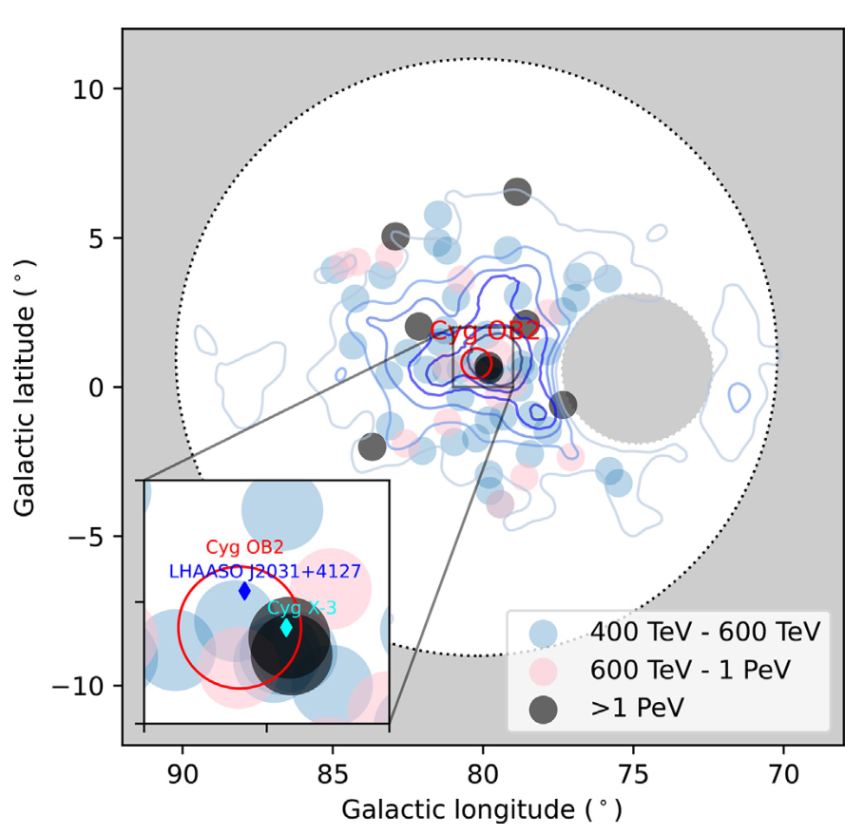

LHAASO identify a super PeVatron
Large UHE γ-ray bubble with a radius of 6º （~150pc）
  Larger than the Cygnus Cocoon(2º)
  SED is connected with Fermi-LAT for core region
Associated with Molecular Clouds
8 photons >1 PeV
10 PeV cosmic ray super PeVatron
LHAASO: 1-2500 TeV
E_{max}=2.5 PeV
LHAASO coll. 2024
New story will come soon!

Slide 25


3.5 γ-ray Binary
More than half of the stars in the Milky Way are located in binary star systems. HE γ-ray binaries typically consist of a normal star and a compact star.
Compact star: white dwarf (WD), neutron star (NS), or black hole (BH).
Guillaume et al. 2013

Slide 26


Nova as HE and VHE source
Nova with HE γ-ray emission is important discovery by Fermi-LAT at GeV
RS Ophiuchi (RS Oph) is a recurrent nova system (WD/red giant binary) undergoing an outburst approximately every 15-20 years.
The outburst in 2021 is detected up 1 TeV. The maximum energy is consistent with theoretical expectation.
H.E.S.S. Coll. 2022

Slide 27


Micro-quasar as VHE source: SS 433
SS 433 (~4.6 kpc)
Attractive features
Black hole
Accretion disk
Relativistic jet
~20 TeV
1-30TeV
HAWC coll. 2018
HESS coll. 2024

Slide 28


Micro-quasar as UHE source: SS 433
The UHE emission seems shift to the center region comparing to VHE emission
LHAASO coll. 2024

Slide 29




Micro-quasar as UHE source: V4641 Sgr
~6.2 kpc
Hard spectrum up to 1 PeV, a super-PeVatron?
Jet-like morphology?
a=-2.2±0.2
a=-2.67±0.27
HAWC coll. 2024
LHAASO coll. 2024

Slide 30

Other micro-quasars
UHE gamma-ray detection demonstrates that accreting BH-jet system are extremely efficient accelerators.
LHAASO coll. 2024

Slide 31


3.6 Galactic Diffuse Emission
An important probe for revealing the density, acceleration, and propagation characteristics of cosmic rays at different locations within the Milky Way.

Slide 32



Galactic Plane diffuse γ-ray measurement
GP diffuse γ-ray have observed with much wide energy range from 100MeV to1 PeV
LHAASO coll. 2025
Fermi-LAT coll. 2012

Slide 33

How to explain the GP diffuse emission?
The measurement is consistent with expectation of Galactic cosmic ray sea or new contribution is need?
Grasso et al. 2025 ICRC

Slide 34




3.7 GRB
Thousands GRBs at MeV
Hundreds GRBs at HE
Handful GRBs at VHE
GRB 090926A
Prompt
Afterglow
credit NASA
Fermi-LAT coll. et al. 2011

Slide 35


Complete measurement of GRB VHE emission
The bright of all time GRB 221009A
TeV emission is afterglow!
First time detect onset of the TeV afterglow!
The most strict limit on the prompt TeV emission: R=F_{TeV}/F_{MeV} < 2 ⨉ 10⁻⁵
Maximum photon energy up to 13TeV
MeV
TeV
LHAASO coll. 2023

Slide 36







The BOAT GRB 221009A
Precise LC provides a unique opportunity to study the early afterglow physics！
Peak time : The bulk Lorentz factor of ~500.
Slow decay: Electron SED index -2.1
Slow rise: Favor ISM environment？
Fast decay: A jet break at the earliest time! Jet half opening angle of 0.8º.
Unusual Fast rise: energy injection ?
LHAASO coll. 2023

Slide 37



3.8 Strong constraints on dark matter
The strongest constraints on heavy dark matter decay lifetime
Strong constraints on the axion–γ-ray coupling constant
The strongest constraints on dark matter annihilation cross section
Galactic Halo UHE γ-ray
NGC 1275 VHE γ-ray
Dwarf galaxies UHE γ-ray
LHAASO coll. 2022
MAGIC coll. 2024
LHAASO coll. 2024

Slide 38




3.9 Strong constraints on LIV
Using decay of PeV γ-ray
Using the EBL absorption on 10 TeV γ-ray （EBL）
Using the time lag of different energy γ-ray
LHAASO coll. 2022
LHAASO coll. 2023
LHAASO coll. 2024

Slide 39
4. Future prospects for γ-ray observations

Slide 40

Ground-based γ-ray detectors
Future detectors
IACTs:
  ASTRI
  LACT
  CTA-North
  CTA-South
EAS arrays:
  ALPACA
  SWGO
Credit: H.N. He@ICRC2025

Slide 41



Next generation IACT: CTA
The sensitivity of CTA will be improved by a factor 10 comparing to current IACTs
CTA-North (~0.25 km²) ：4xLST(23m), 9xMST(12m)
CTA-South (~3 km²) ：14xMST(12m)，37x SST(4m)
CTA -North
CTA -South

Slide 42



LHAASO upgrade plan: LACT
A prototype in LHAASO
LACT: 32x6m telescopes
LACT + KM2A muon detectors
→ Better gamma-ray selection
Construction: 2025.1 – 2028.12

Slide 43



EAS array: SWGO (Southern Wide-field Gamma-ray Observatory)

Slide 44

Sensitivity
IACT sensitivity will improve by a factor of 10
EAS array will fulfill the south sky region
SWGO

Slide 45
5. Summary

Slide 46
Summary
Due to the great success of space- and ground-based experiments, HE γ-ray astronomy has achieved fruitful results over the past 20 years.
It has deepened our understanding of various non-thermal astronomical phenomena. It also throws light on the new physics frontier.
The capabilities of the IACTs and EAS arrays will be further enhanced in the future!
Thank you!

