Slide 1
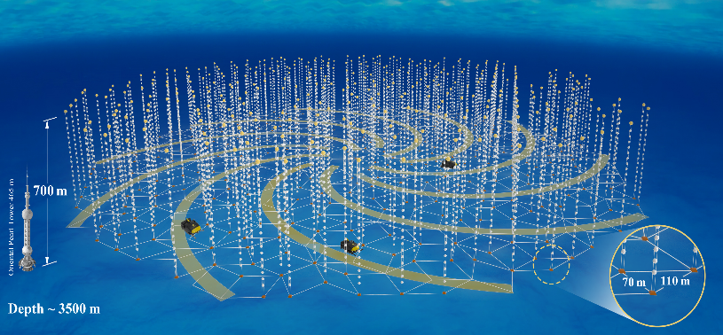
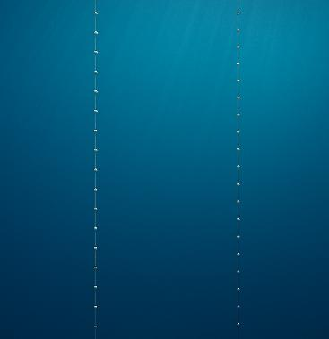
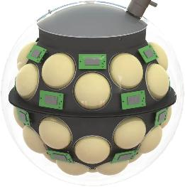


Status and Prospects of the TRIDENT Neutrino Telescope
...(and its design)
Iwan Morton-Blake
On behalf of the TRIDENT collaboration
Tsung-Dao Lee Institute,
Shanghai Jiao Tong University
TAUP 2025 in Xichang, China

Slide 2

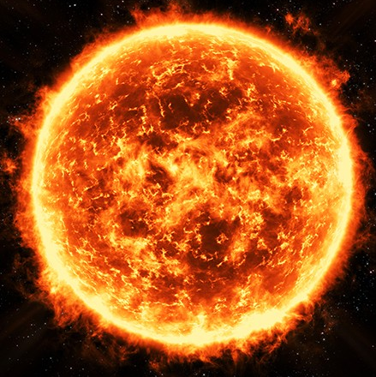
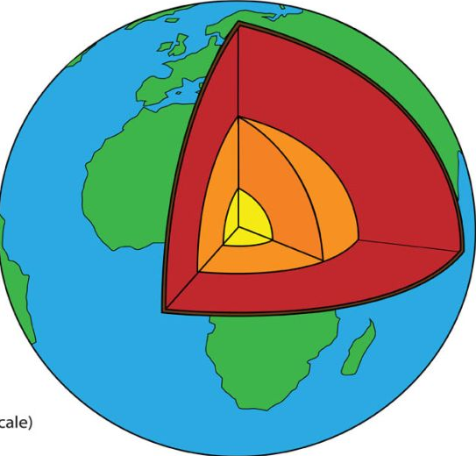
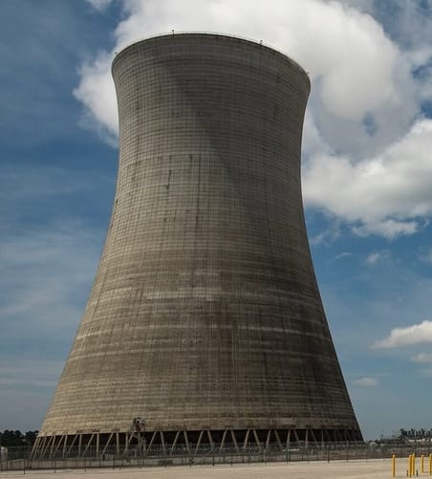
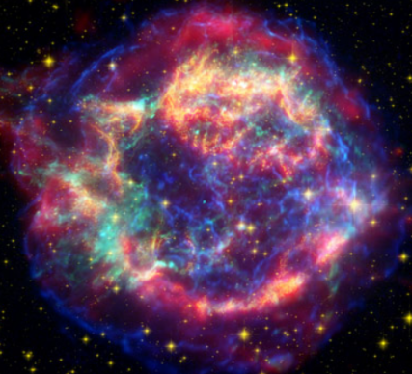
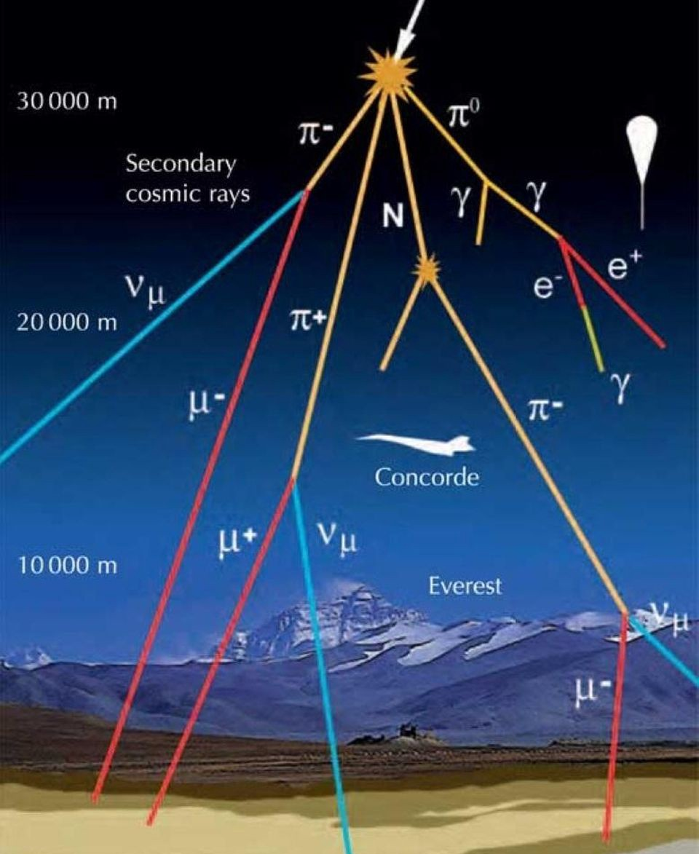
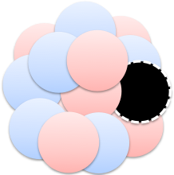
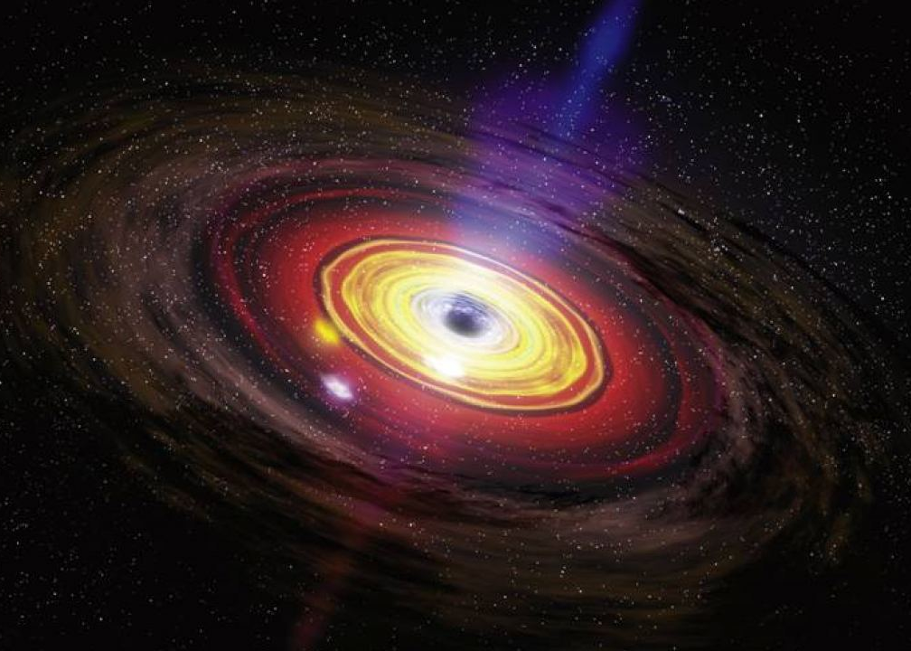
Neutrino Sources
~70 years experience in neutrino measurement!
Solar
Detectors have been steadily growing to reach the desired precision/fluxes
Geoneutrinos
10¹⁰
Reactor
1
Searches for astrophysical sources are no exception to the rule
Flux [cm⁻² s⁻¹ sr⁻¹ MeV⁻¹]
Supernova
10⁻¹⁰
Atmospheric
10⁻²⁰
This Talk
Exotic Searches
Active galactic nucleus, cosmological sources
keV GeV PeV

Slide 3
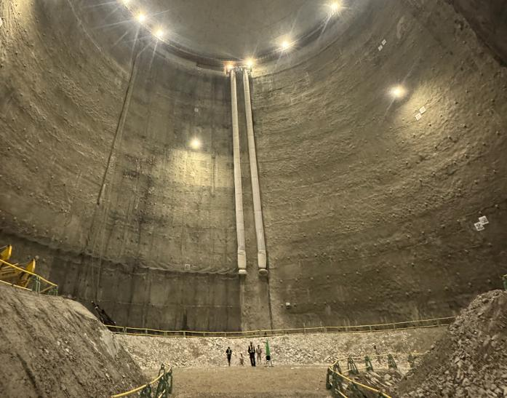
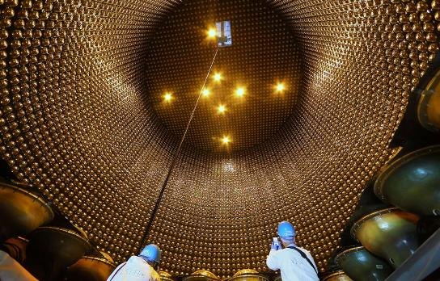
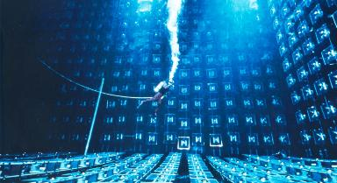
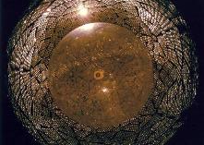

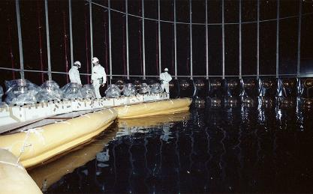
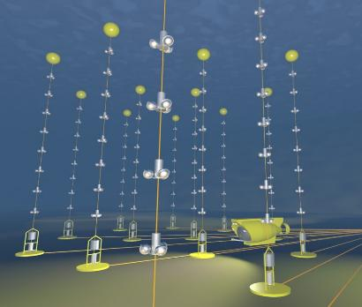
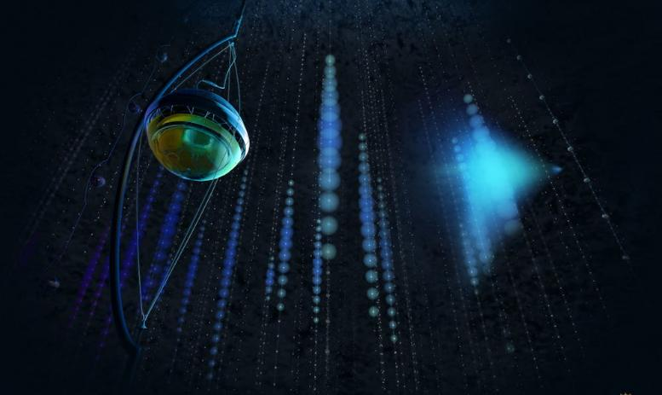
23 kilotons
190
kilotons
3 kilotons
…
200
kgs
1 kiloton
1 kiloton
They grow up so fast 🥲
0.1 km³
1 km³

Slide 4
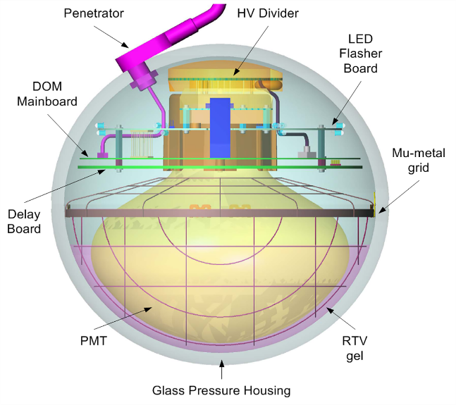
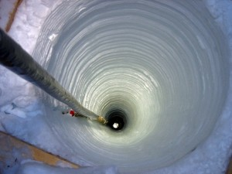
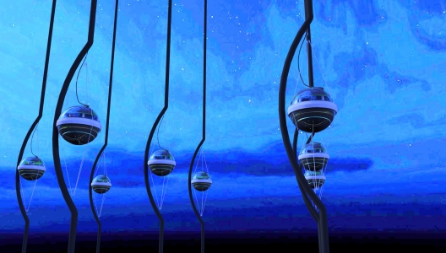
IceCube
Single Downward 10” PMT
Hot Water Drilling
~1km³ footprint
IceCube Collaboration, R. Abbasi et al., Nucl. Instrum. Meth. A700 (2013) 188–220
Cofield, C. IceCube catches high-energy neutrino oscillations. Nature (2012).

Slide 5
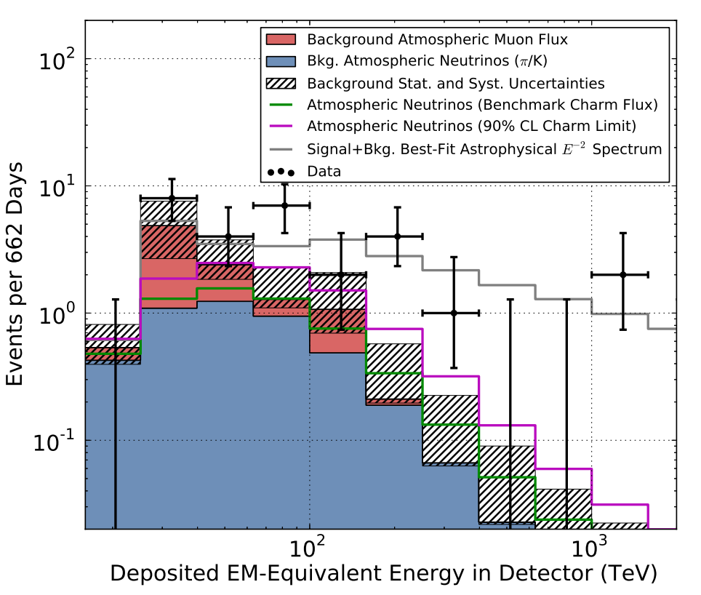
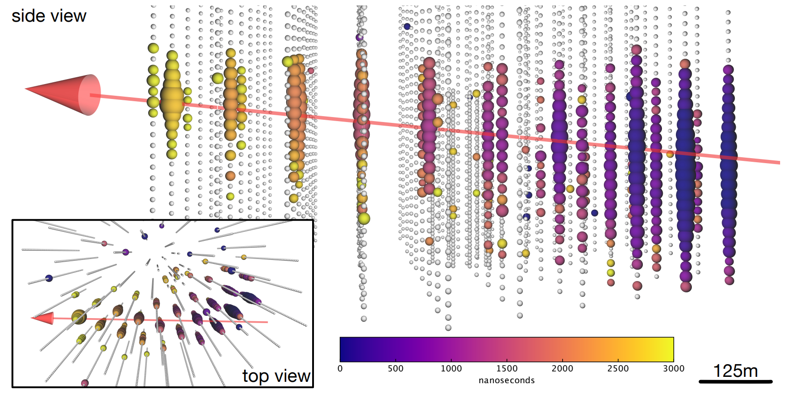
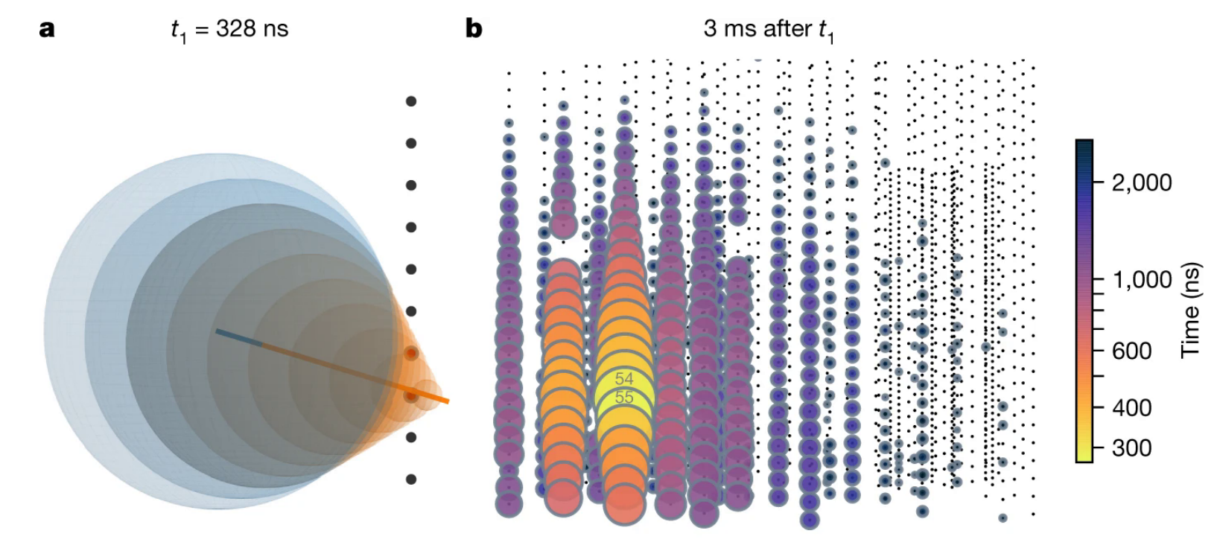
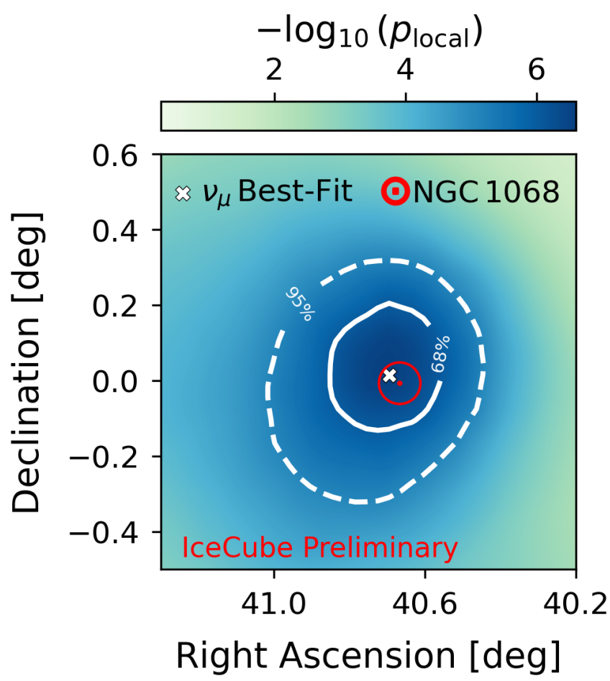
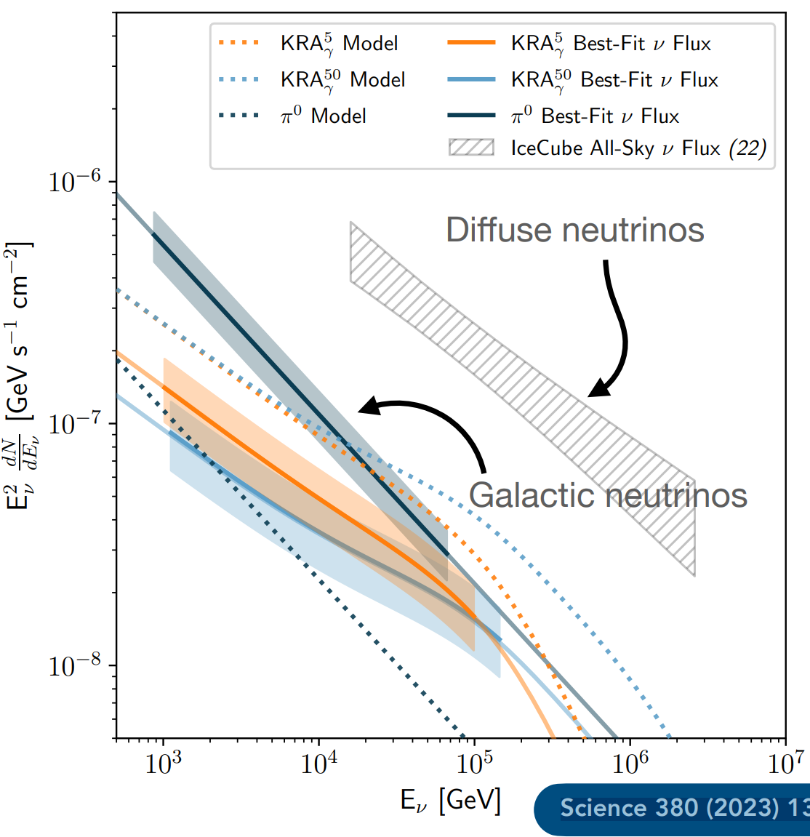
IceCube
Science. 342 6161 (2013)
(Some) highlights from the last 12 years
Detect extraterrestrial high-energy diffuse neutrino flux
Evidence for neutrino emission from a flaring blazar
Glashow resonance event at 2.3σ
Neutrino emission from active galaxy NGC 1068 reaches 4σ
Galactic plane >TeV neutrinos observed at a 4.5σ
Science. 361 6398 (2018)
Nature 591 220-224 (2021)
Science 378 538-543 (2022)
Science 380 1338 (2023)

Slide 6


TRIDENT → ~10km³
Experimental goals:
Rapidly discover neutrino sources
Sensitivity to all flavors

Slide 7
TRIDENT → ~10km³
Detector Design:
Experimental goals:
Rapidly discover neutrino sources
Sensitivity to all flavors
Bigger is better?
Want to optimize for both goals simultaneously

Slide 8

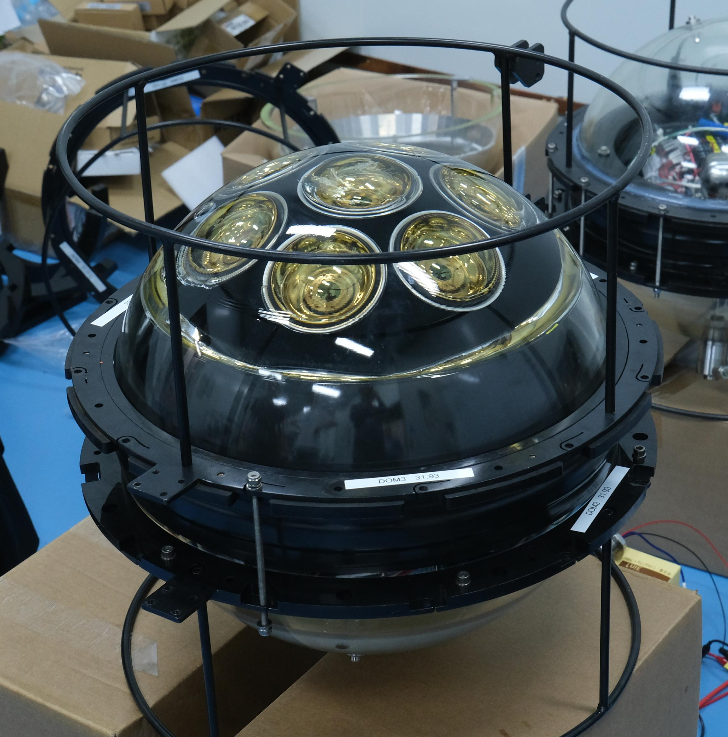
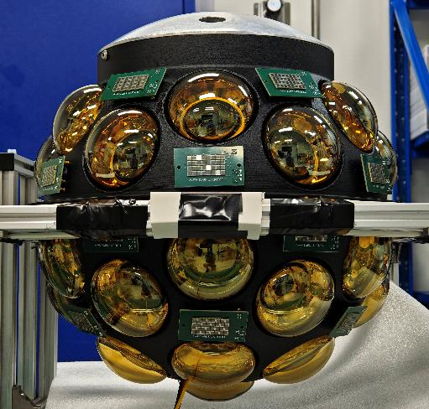
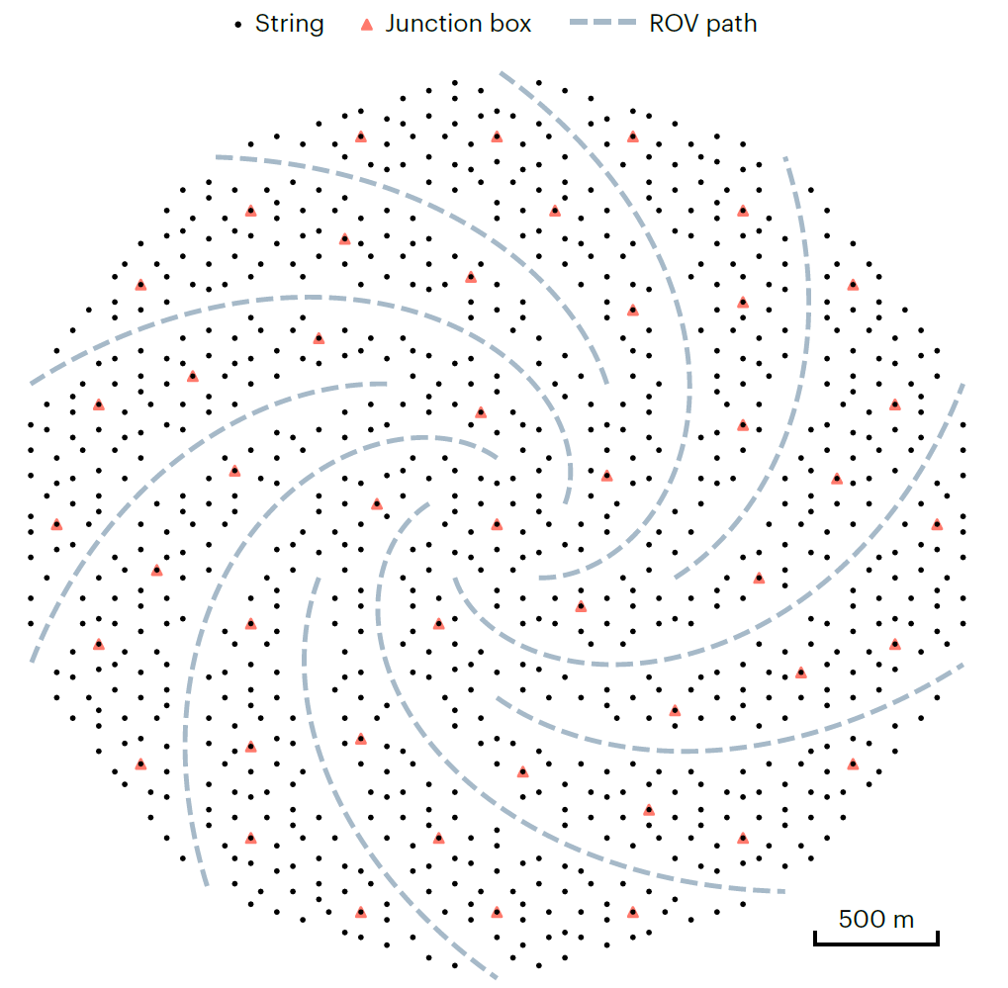
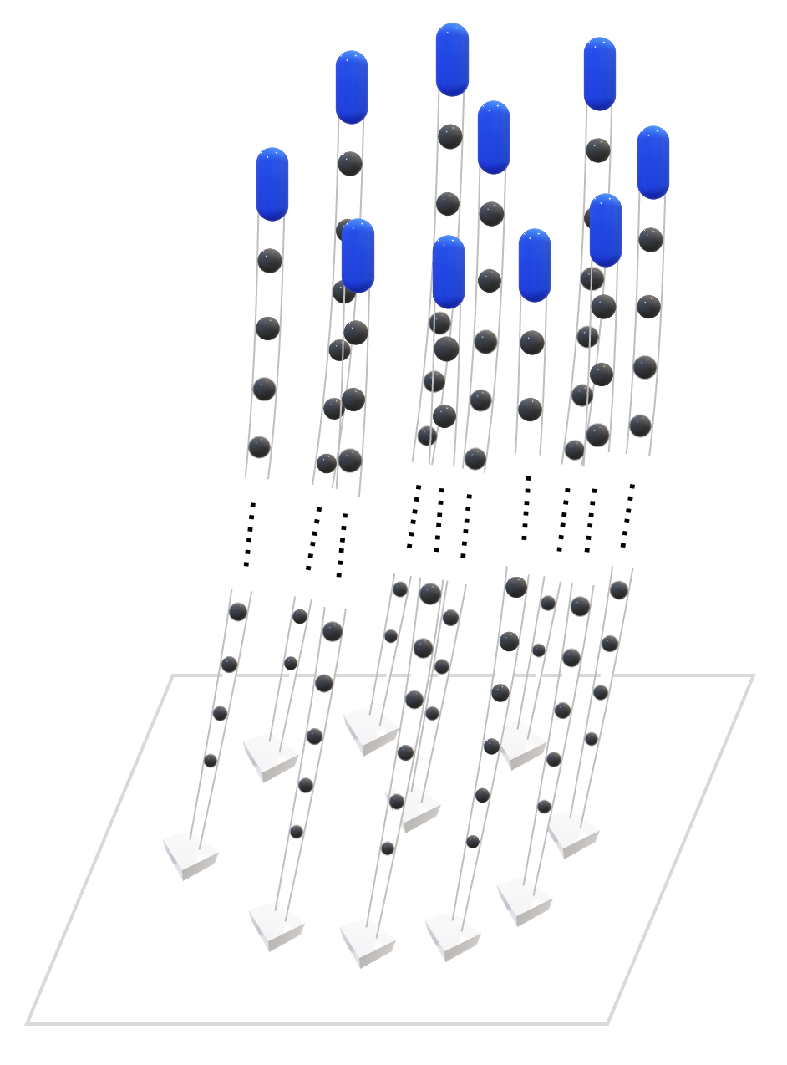
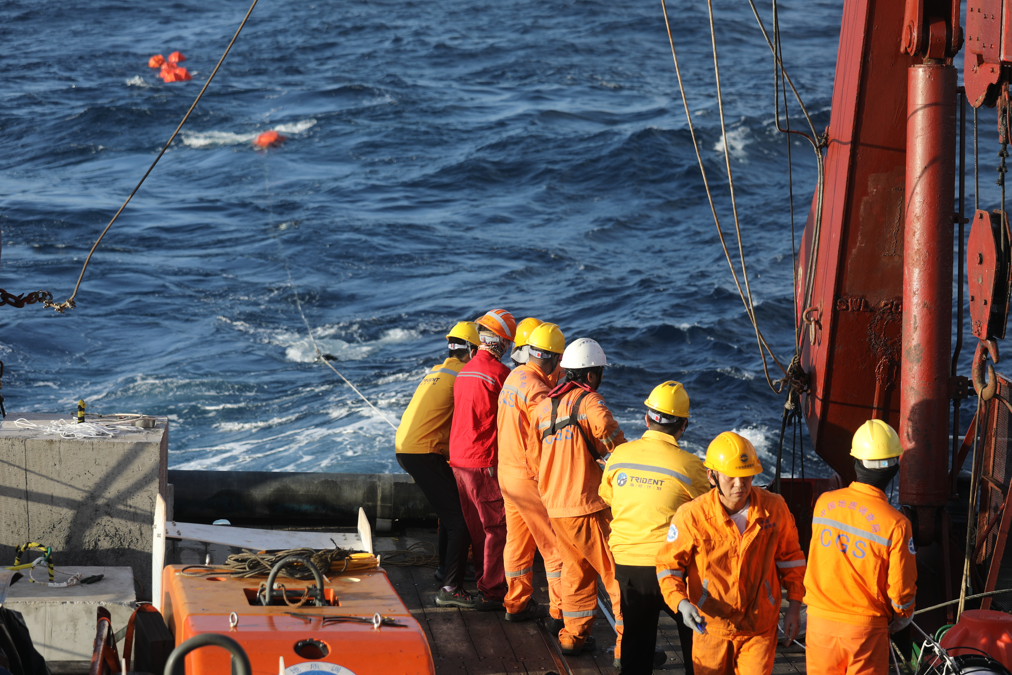
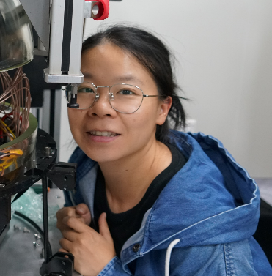
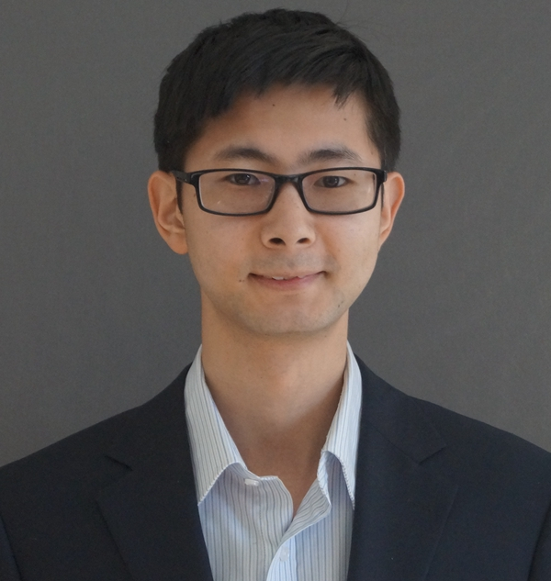
TRIDENT Timeline
Present day
First String Deployment: Phase -1
Expeditions to Sea
TRIDENT
R&D
for Technology + Deployment
Full TRIDENT Array
“Prototype Testing for TRIDENT: In-Situ Performance of Multi-PMT Optical Modules” – Fuyudi Zhang
“TRIDENT: Advancing Future Deep-sea Neutrino Observatory” – Xin Xiang
This talk

Slide 9
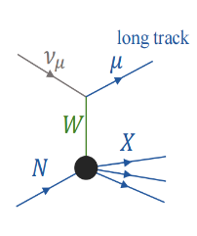
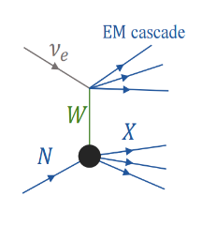
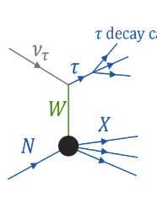
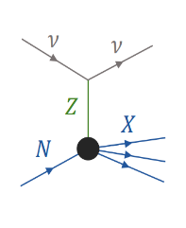
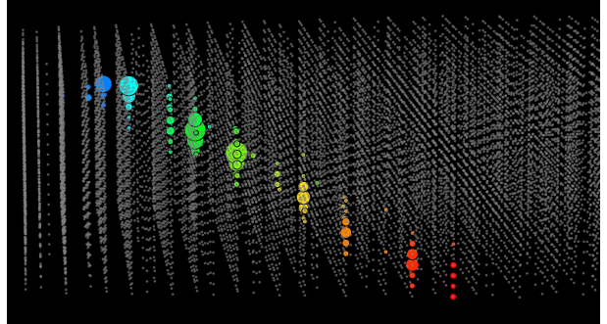
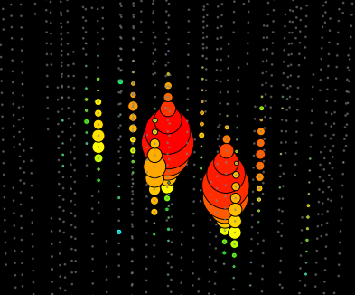
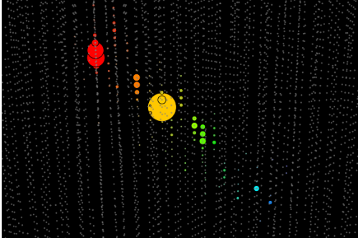
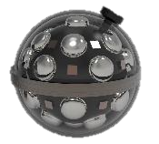




Event interaction types
Charged-Current
Neutral-Current
$τ$ decay
Muon tracks
Cascades
(τ decay can also produce muons)
$$ν_{μ}$$
$$ν_{e}$$
$$ν_{τ}$$

Slide 10
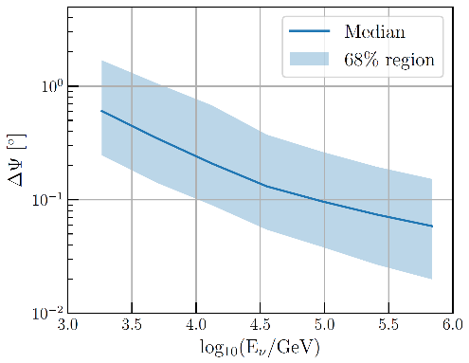
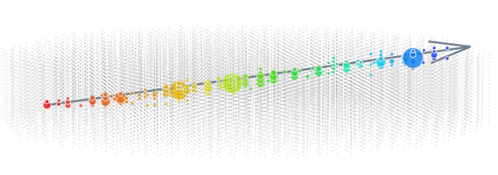
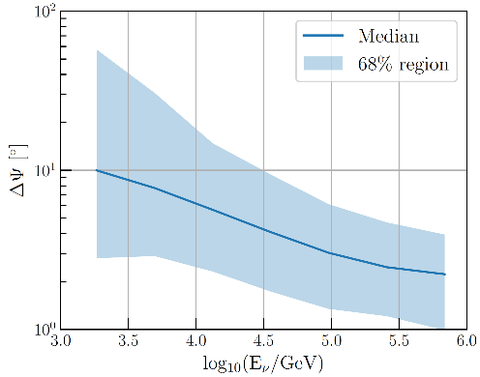
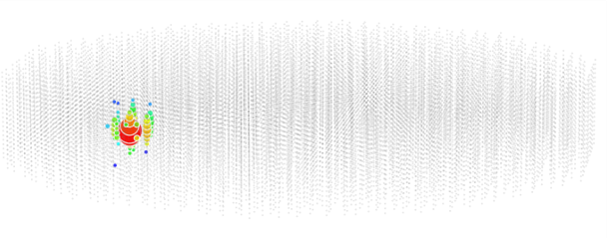


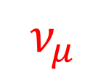
All-Flavour Detection
Track angular resolution
Simulated Track-like event in TRIDENT
~0.1°
$$ν_{μ}$$
$$μ$$
TRIDENT Simulation
Cascade angular resolution
Simulated Cascade-like event in TRIDENT
TRIDENT Simulation
$$ν_{e}$$
~2°

Slide 11
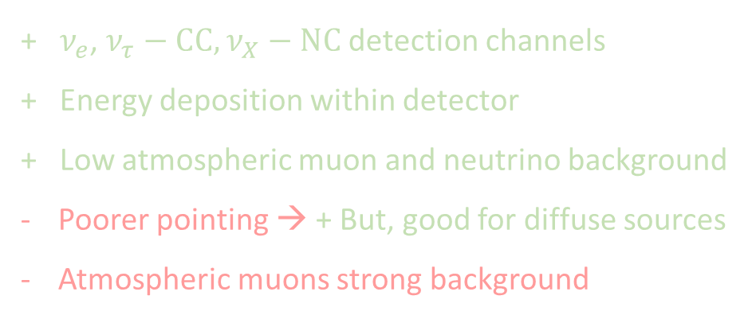
All-rounder detector
+ Excellent for pointing → point source discovery
+ Detection volume > Detector volume
Partial energy deposition within detector
Atmospheric muons : strong down-going background
+ $ν_{e}$, $ν_{τ}−CC,$ $ν_{X}−NC$detection channels
+ Energy deposition within detector
+ Low atmospheric muon and neutrino background
Poorer pointing → + But, good for diffuse sources
Atmospheric muons strong background
Difficult to optimize for all types events of all energies!

Slide 12
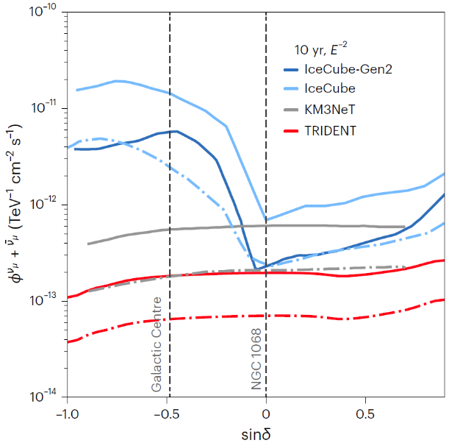
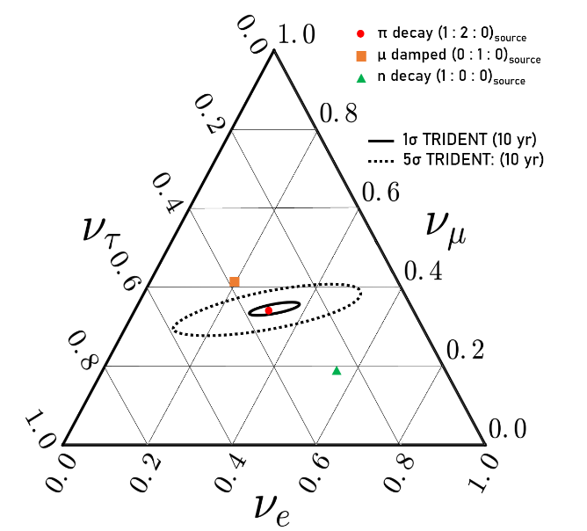
Experimental goals:
Rapidly discover neutrino sources
Sensitivity to all flavors
“Real-time Optical Calibration Strategy and Astrophysical Tau Neutrino Identification in Water-based Next-generation Neutrino Telescopes” W. Tian, PhD Thesis
TRIDENT neutrino flavour ratio sensitivity
with tracks, cascades and double-pulse tau identification
Point source sensitivity/Discovery potential vs declination,
with tracks
Nature Astronomy 7, 1497–1505 (2023)
Combine both goals into a single figure of merit?
(Publication in preparation)

Slide 13
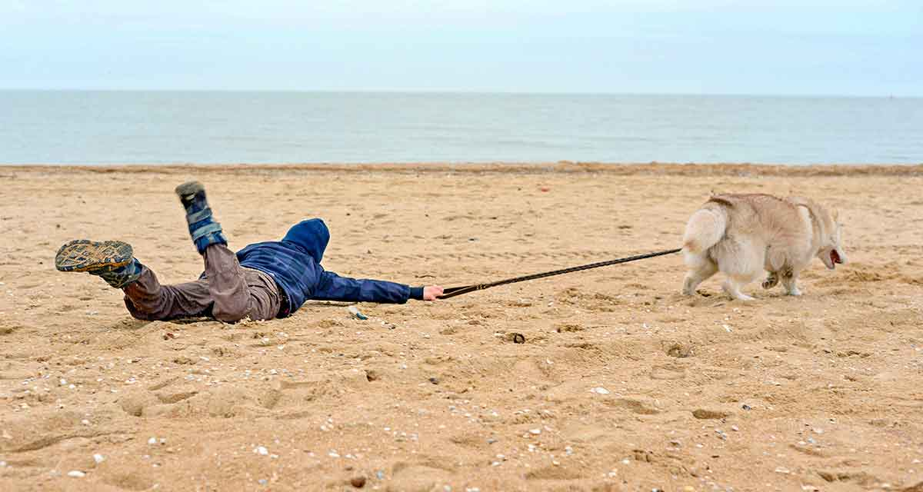
An experiment’s design must be lead by physics
limited by engineering and cost
Cost + Engineering
Physics

Slide 14
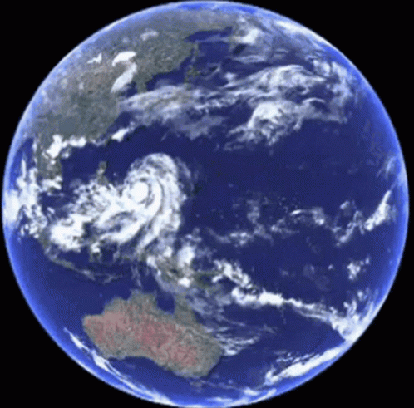



Neutrino Telescope Design
Location
2) Optical Modules
3) String Layout / Volume

Slide 15



Detector Design – Location
TRIDENT sensitive viewing region:
Hong Kong
540km
Low seacurrents, bioactivity
Low atmospheric muon rate
Sanya
480km
TRIDENT
180km
YongXing Island
“MuonSLab: A plastic scintillator based detector for muon measurement in the deep ocean”
South China Sea
Near the equator
3.5 km deep
Large, flat plane
1:25 scale string models in SJTU Ship-towing tank

Slide 16

Detector Design – hDOM
“A Cost Effective Optimization of the hybrid-DOM Design for TRIDENT”
JINST 19 (2024) 06, P06011
JINST 19 (2024) 05, P05040
Hybrid Digital Optical Module
Hybrid: PMTs + SiPMs
PMTs
Fine timing resolution (TTS FWHM ~1.8 ns)
High quantum efficiency >30% at 400nm
Balance design with:
Reduction of backgrounds:
e.g. ⁴⁰K & PMT Dark noise
Cost & Power consumption
Additional low energy physics
SiPMs
→ Fine timing resolution
Fills spaces between the PMTs, extra sensitivity
SiPM arrays aids in calibration

Slide 17




Detector Design – hDOM
“A Cost Effective Optimization of the hybrid-DOM Design for TRIDENT”
Check / compare performances for various designs:
e.g. neutrino detection efficiency + angular resolution
3-inch PMT hDOM design
31 3” PMTs
24 SiPMs
(4x8 array)
4-inch PMT hDOM design
19 4” PMTs
5 SiPMs
(8x8 array)
Efficient light collection is important (as expected)

Slide 18




Detector Design - Geometry
Nature Astronomy 7, p1497–1505 (2023)
KM3NeT
Baikal GVD
P-ONE
Nature Astronomy volume 4, p913–915 (2020)
Lake Louise Winter Institute 2025,
Agustín Sánchez Losa
5th International Symposium on Cosmic Rays and Astrophysics, Zhan-Arys Dzhilkibaev

Slide 19



Detector Geometry : String Spacing
Given N number of strings, how should they be arranged?
Can quickly expand detector volume
Must balance volume with detection efficiency
Deployment difficulties, strings may tangle if too close!
(looking down on detector)
Increasing string spacing

Slide 20



Detector Geometry : String Height
Given N number of strings, how should they be arranged?
Improve horizontal event detection cross-section
Deployment/maintenance issues if too tall!
(looking side-on)
Increasing string height

Slide 21



Detector Geometry : Clustering
Given N number of strings, how should they be arranged?
Deployment/maintenance benefits
Low energy threshold
Miss events in cluster-cluster gaps
More edge events
(looking top-down)
Equal volume,
More severe clustering

Slide 22








1) Source neutrino flux
Energy + Direction
TRIDENTSim
2) Forced Interaction near the detector
Event weighting → Earth propagation, cross sections, oscillation
3) Deep Inelastic Scattering (CORSIKA8[1,2])
Neutral and Charged Current interactions
Particle production
4) Lepton, hadron propagation (CORSIKA8/Geant4[3])
5) Cherenkov photon generation + propagation (Geant4/Optix[4])
Scattering, absorption, dispersion
6) Detector response
Photoelectron generation, ⁴⁰K + dark noise mixing
Signal photons +
noise + radioactivity
7) Electronics response, Triggering, data cleaning
time

Slide 23










Comparing Geometries
Calculate neutrino source discovery potential for each design
Include TRIDENT-site measured optical conditions, atmospheric backgrounds, hDOM backgrounds
Compare versus “Reference” geometry:
Average string spacing ~ 100m
String height ~ 600m
“Reference” geometry
“A multi-cubic-kilometre neutrino telescope in the western Pacific Ocean”
Nature Astronomy (2023)

Slide 24





Track Performance vs Detector Size
Track-like events
Relative signal event rate
Rel. pointing resolution
Better
TRIDENT Simulation
TRIDENT Simulation
Dense 3km³ → Sparse 16km³
Big sparse detector : More (fewer) high (low) energy tracks Worse direction resolution
Small dense detector : Fewer (~equal) high (low) energy tracks Better direction resolution

Slide 25



Cascade Performance vs Detector Size
Cascade-like events
Relative Signal Event Rate
Rel. Pointing Resolution
Better
TRIDENT Simulation
TRIDENT Simulation
Dense 3km³ → Sparse 16km³
Big sparse detector : More (fewer) high (low) energy cascades Worse direction resolution
Small dense detector : Fewer (~equal) high (low) energy cascades Better direction resolution

Slide 26




Source Discovery Potential
Assuming the “standard” geometry takes 5 years to discover a given source
How much slower/faster can each geometry discover same source?
$$E^{−2}$$
“hard” source
$$φ\left(E_{ν}\right)∝$$
$$E^{−3}$$
“soft” source
Bigger detector is not necessarily better
Worse at low energies tracks and cascades:
Worse at high energies tracks and cascades:
Dense detector favours low energy events
TRIDENT Simulation

Slide 27

Source Discovery Potential – String Clustering
Clusters of strings shows poorer performance for all channels, except for low energy cascades.
However, physics must be weighed against deployment & maintenance cost, safety
TRIDENT Simulation

Slide 28

Source Discovery Potential – Optical properties
While geometry choice is significant,
water optical properties are essential!
→ e.g. attenuation length can have larger impact than geometry choices
Photon detection efficiency should lead the design of a detector.
i.e. ongoing/future measurements at site and in TRIDENT Phase-1 will influence the final design choice
TRIDENT Simulation

Slide 29
Conclusion
TRIDENT is an upcoming neutrino telescope expected to reach next-generation size and performance
Phase-1 of the experiment expected to start next year
TRIDENT’s design is optimised directly via its physics goals:
→ Rapid source discovery and all-flavour detection
Bigger does not necessarily mean better:
→ Event rate must be balanced with reconstruction quality.
Optical properties play a significant role and should lead design

Slide 30




Team efforts
When they’re not building telescopes,
they’re contributing to the work shown here!
+ …
Dr. Fan Hu
Dr. Wei Tian
Fuyudi Zhang
Qichao Chang
Weilun Huang

Slide 31
Backup

Slide 32







Optimisation: Many degrees of freedom
Understanding our Galactic Centre
Source discovery
Rapid discovery of multiple neutrino sources
Understand energy spectra
Flavor ratio
Probe acceleration mechanisms
Oscillation over astro. baselines
Tests of BSM physicss
Low energy neutrinos
Core-collapse neutrino sensitivity
TRIDENT work in progress
Dark matter searches
Astrophysical neutrino detection
Geophysics:
Modelling of Earth’s matter density

Slide 33








Looking Ahead
P-ONE
Baikal GVD
KM3NeT
HUNT
NEON
TRIDENT
IceCube Gen 2
What are our individual and collective physics goals in each experiment?
Fast discovery of potential sources?
Once discovered, how do we deepen our understanding of sources?
What exactly is each detector’s target energy range?

Slide 34






TRIDENTSim
~Kilometers of ice/water + air above
Cosmic rays
Cosmic neutrinos
Atmospheric μ + ν
$$ν_{μ}:CC$$
$$ν_{e}:CC$$
$$μ$$
Cascade ~O(m) long
Muon track ~O(km) long
High-energy neutrinos can be absorbed in the Earth
Carry out all-sky search for potential sources
φ
δ

Slide 35




TRIDENT Sensitivity + Discovery Potential
$$δ$$
90% confidence-level median sensitivity (dashed-dot lines)
5σ discovery potential (solid lines)
$\sin\left(δ\right) →$ declination
(source position in the sky)

