Slide 1


Bayesian model selection for
Bare or Dressed Primordial Black Holes with lensed Gravitational Waves
Affiliation: Beijing Normal University
Authors: Xin-yi Lin, Zhengxiang Li, Jian-dong Zhang
DOI: https://doi.org/10.1103/5y6q-8f89
Arxiv: 2504.14980

Slide 2
OUTLINE
1. INTRODUCTION
2. LENSING EFFECT OF BARE AND DRESSED PBHS
3. MODEL SELECTION
4. RESULT
5. CONCLUSIONS

Slide 3
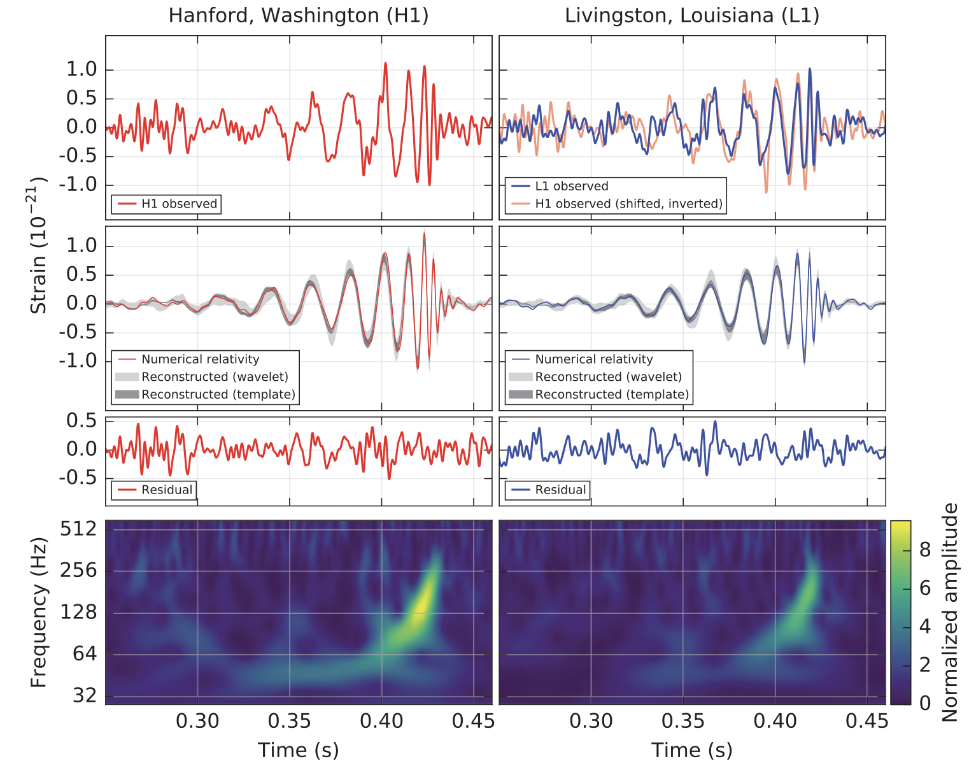
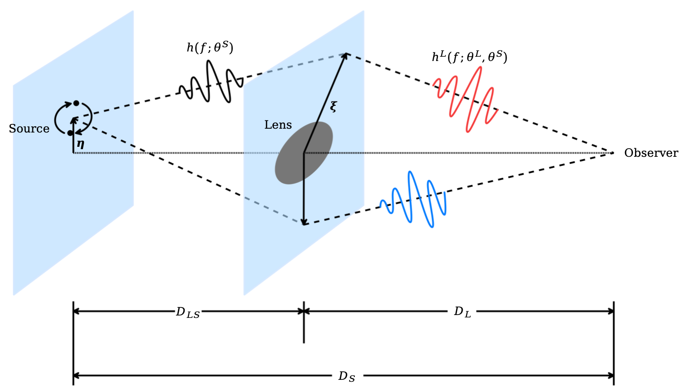

INTRODUCTION
The LVK Collaboration detect $𝒪\left(100\right)$ GW signals in O1～O3 observing runs.
When a GW signal propagates through a celestial body, lensing effect appears.
On September 14, 2015, Advanced LIGO and Virgo observed the first gravitational wave (GW) signal, GW150914^{[1]}.
[1] B. P. Abbott et al. Phys. Rev. Lett. 116, 061102
Notes:
On September 14, 2015, Advanced LIGO and Virgo observed the first GW signal.
Untial now, the LIGO, Virgo, and KAGRA Collaboration detect about 100 GW signals durling O1, O2 and O3 observing runs.
Similar to electromagnetic signals, when a GW signal propagates through a celestial body, it experiences amplification, deflection, and time delay due to the gravitational field.

Slide 4
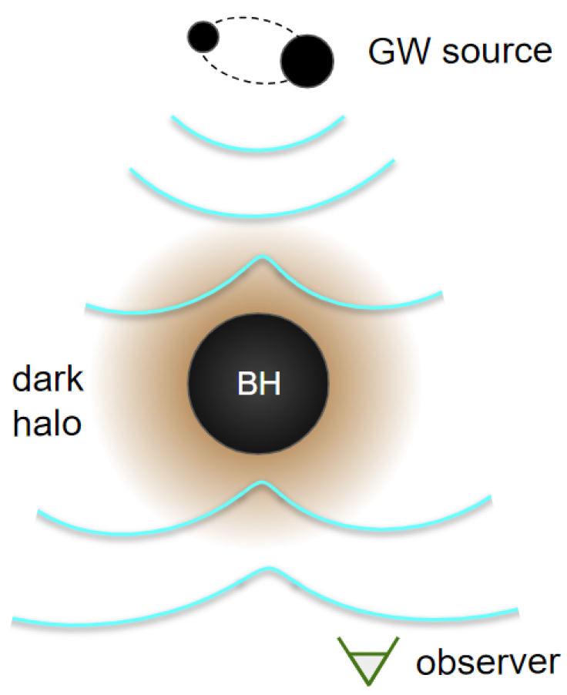
INTRODUCTION
The PBHs act as a strong gravitational seed, causing a halo of dark matter (DM) particles to form around each PBH^{[1]}.
If particle DM and PBHs coexist, dressed PBHs will be formed.
Lensed GWs provide a method to discriminate dPBHs^{[2]}.
[1] A. Julian et al. Phys. Rev. D 100, 023506
[2] H. G. Choi et al. Phys. Rev. Lett. 133, 101002
Illustration of the diffractive lensing of chirping GWs from binary mergers by dPBHs at cosmological distances^{[2]}
Notes:
Though there is no conclusive evidence to confirm the existence of lensed GW signals, the third-generation observatories are expected to observe the lensing effect.
The PBHs act as a strong gravitational seed ...
If particle dark matter and primordial black holes (PBHs) coexist, PBHs will be surrounded by particle DM, forming celestial objects known as dressed PBHs (dPBHs).
Lensed GWs provide a method to discriminate the dPBH from a bare one.

Slide 5
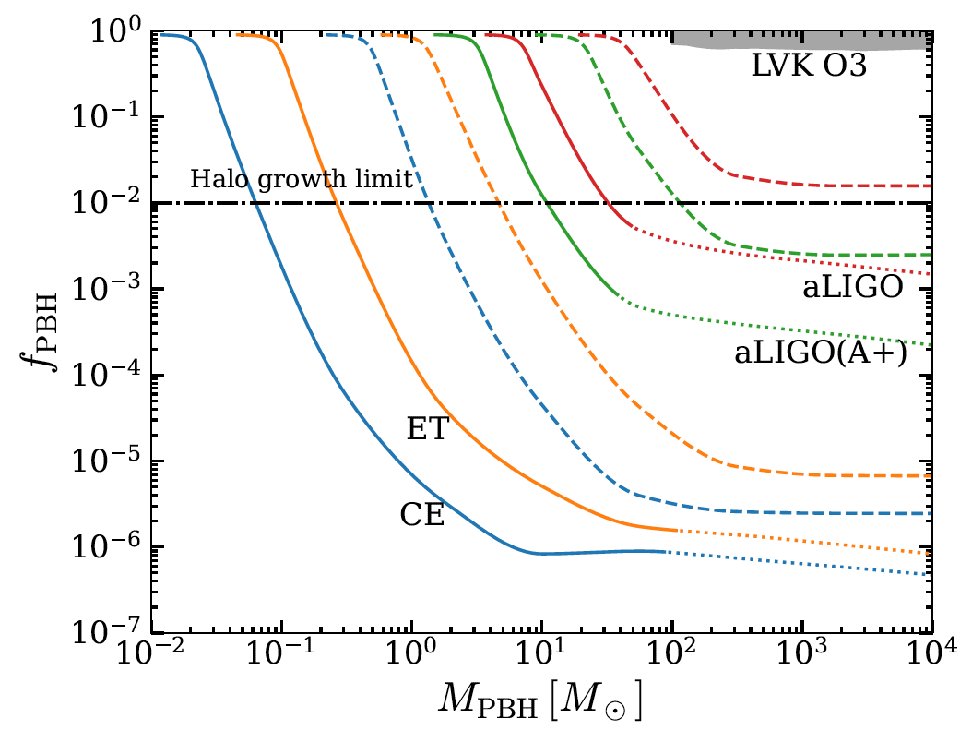
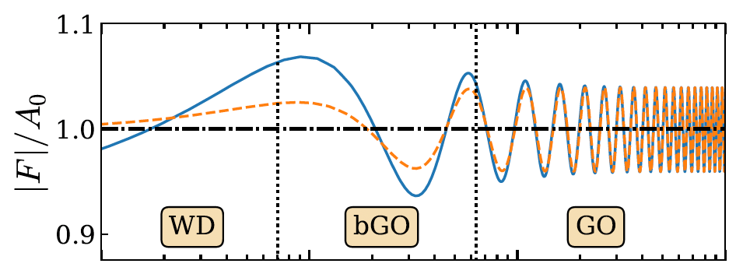
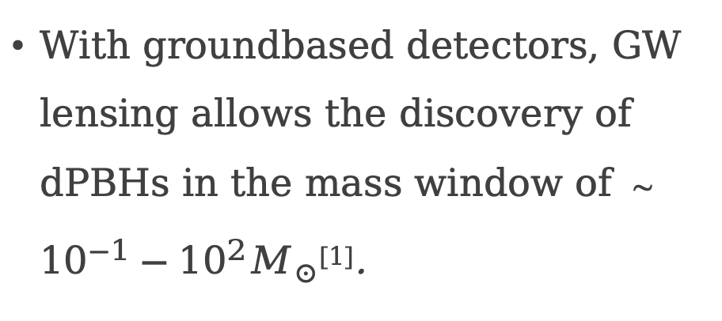
INTRODUCTION
Groundbased detectors are able to discriminate dPBHs from bare PBHs^{[1]}.
With groundbased detectors, GW lensing allows the discovery of dPBHs in the mass window of ～ ${{10}^{−1}−10}^{2}M_{⊙}$^{[1]}.
Frequency dependence of the magnification and phase shift^{[1]}
[1] H. G. Choi et al. Phys. Rev. Lett. 133, 101002
Projected sensitivity on $f_{PBH}$ at 90% confidence level^{[1]}
Notes:
According to this work, we konw that GW lensing allows ... with groundbased detectors.
In addition, groundbased detectors can discriminate dPBHs from bare PBHs due to the distinctive mass profiles.

Slide 6
OUTLINE
1. INTRODUCTION
2. LENSING EFFECT OF BARE AND DRESSED PBHS
3. MODEL SELECTION
4. RESULT
5. CONCLUSIONS

Slide 7

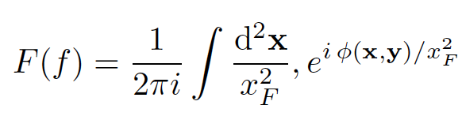
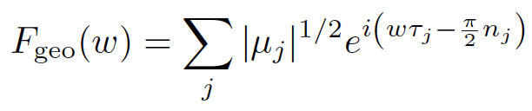
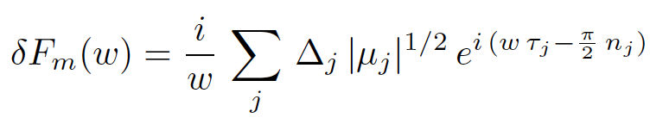
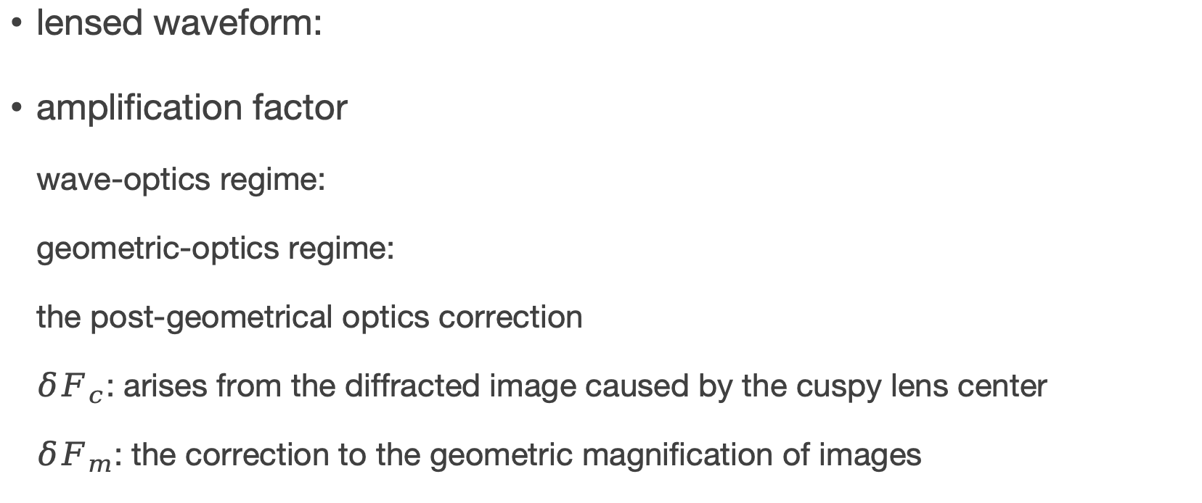
LENSING EFFECT OF BARE AND DRESSED PBHS
lensed waveform:
amplification factor
wave-optics regime:
geometric-optics regime:
the post-geometrical optics correction
$δF_{c}$: arises from the diffracted image caused by the cuspy lens center
$δF_{m}$: the correction to the geometric magnification of images

Slide 8

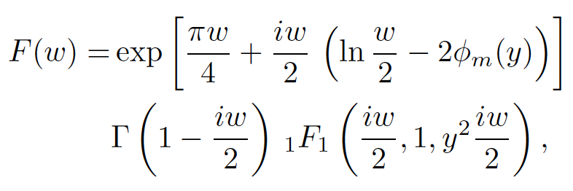

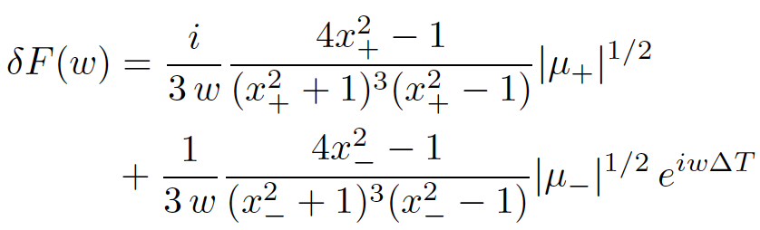
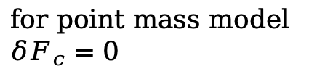
LENSING EFFECT OF BARE AND DRESSED PBHS
PBHs
dimensionless lensing potential:
wave-optics regime:
geometric-optics regime:
the post-geometrical optics correction
for point mass model $δF_{c}=0$

Slide 9
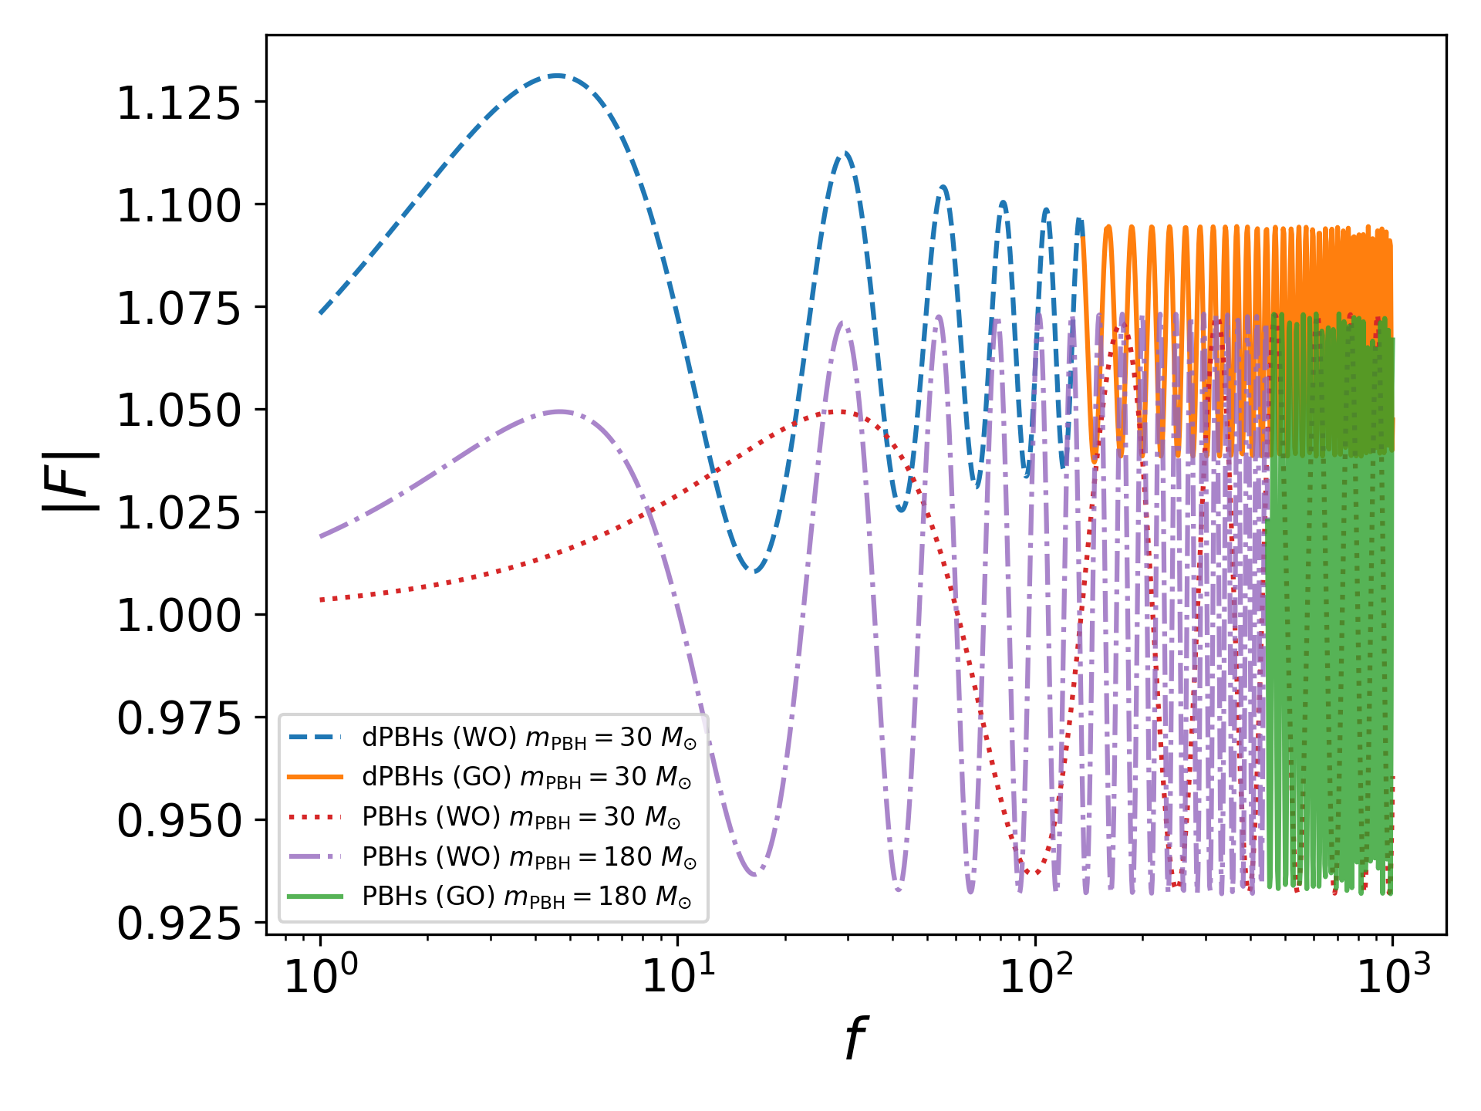
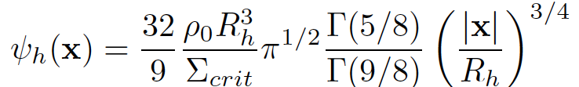
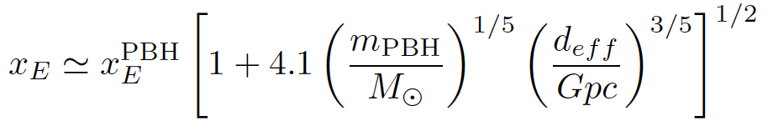
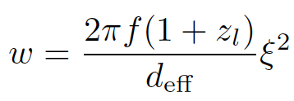
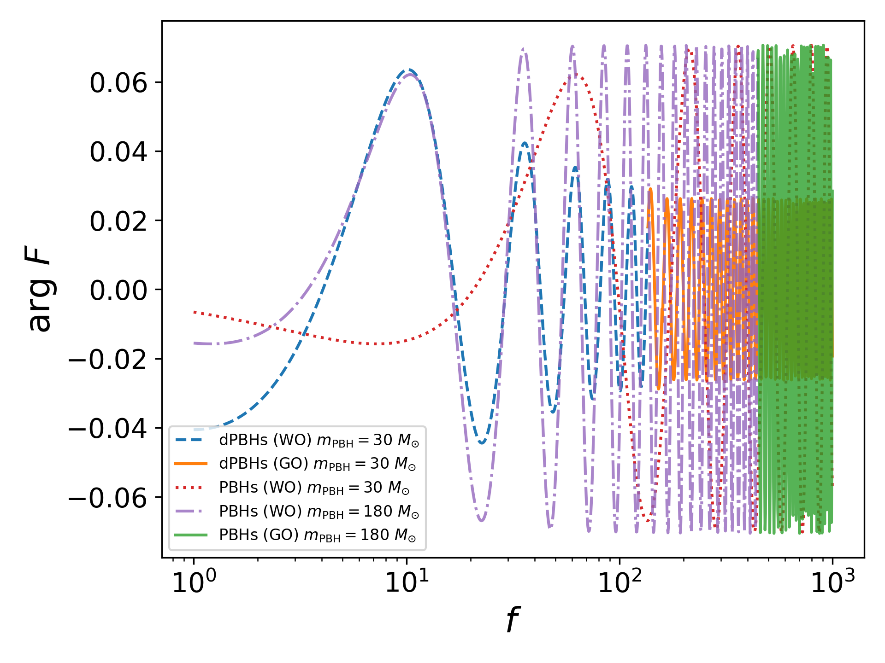
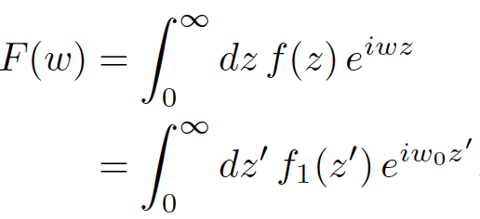

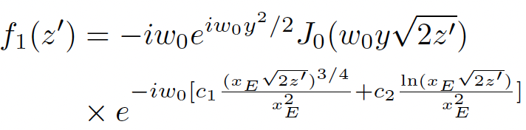

LENSING EFFECT OF BARE AND DRESSED PBHS
dPBHs
lensing potential:
Einstein radius:
asymptotic expansion method(n=5):

Slide 10
OUTLINE
1. INTRODUCTION
2. LENSING EFFECT OF BARE AND DRESSED PBHS
3. MODEL SELECTION
4. RESULT
5. CONCLUSIONS

Slide 11
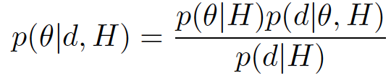
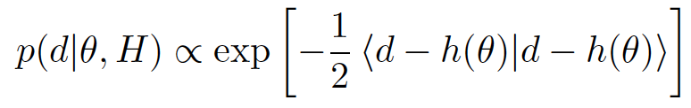
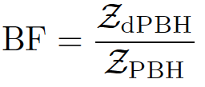
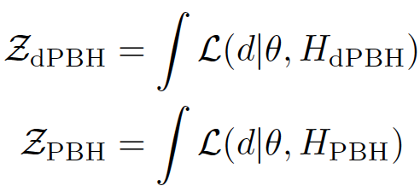

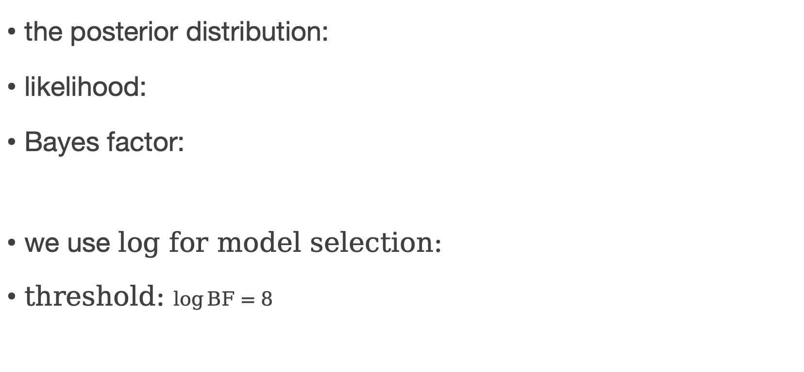
MODEL SELECTION
the posterior distribution:
likelihood:
Bayes factor:
we use $log$ for model selection:
threshold: $\log{BF}=8$

Slide 12
OUTLINE
1. INTRODUCTION
2. LENSING EFFECT OF BARE AND DRESSED PBHS
3. MODEL SELECTION
4. RESULT
5. CONCLUSIONS

Slide 13
RESULT
waveform model: IMRPhenomD
incorporating inspiral, merger, ringdown
detectors: ET and CE
data: affected by the dPBH lens

Slide 14
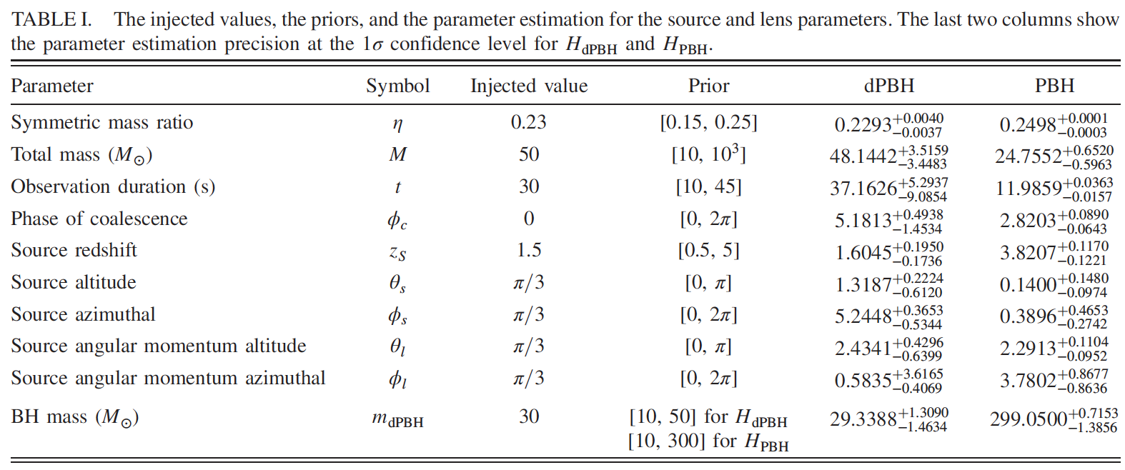
RESULT

Slide 15
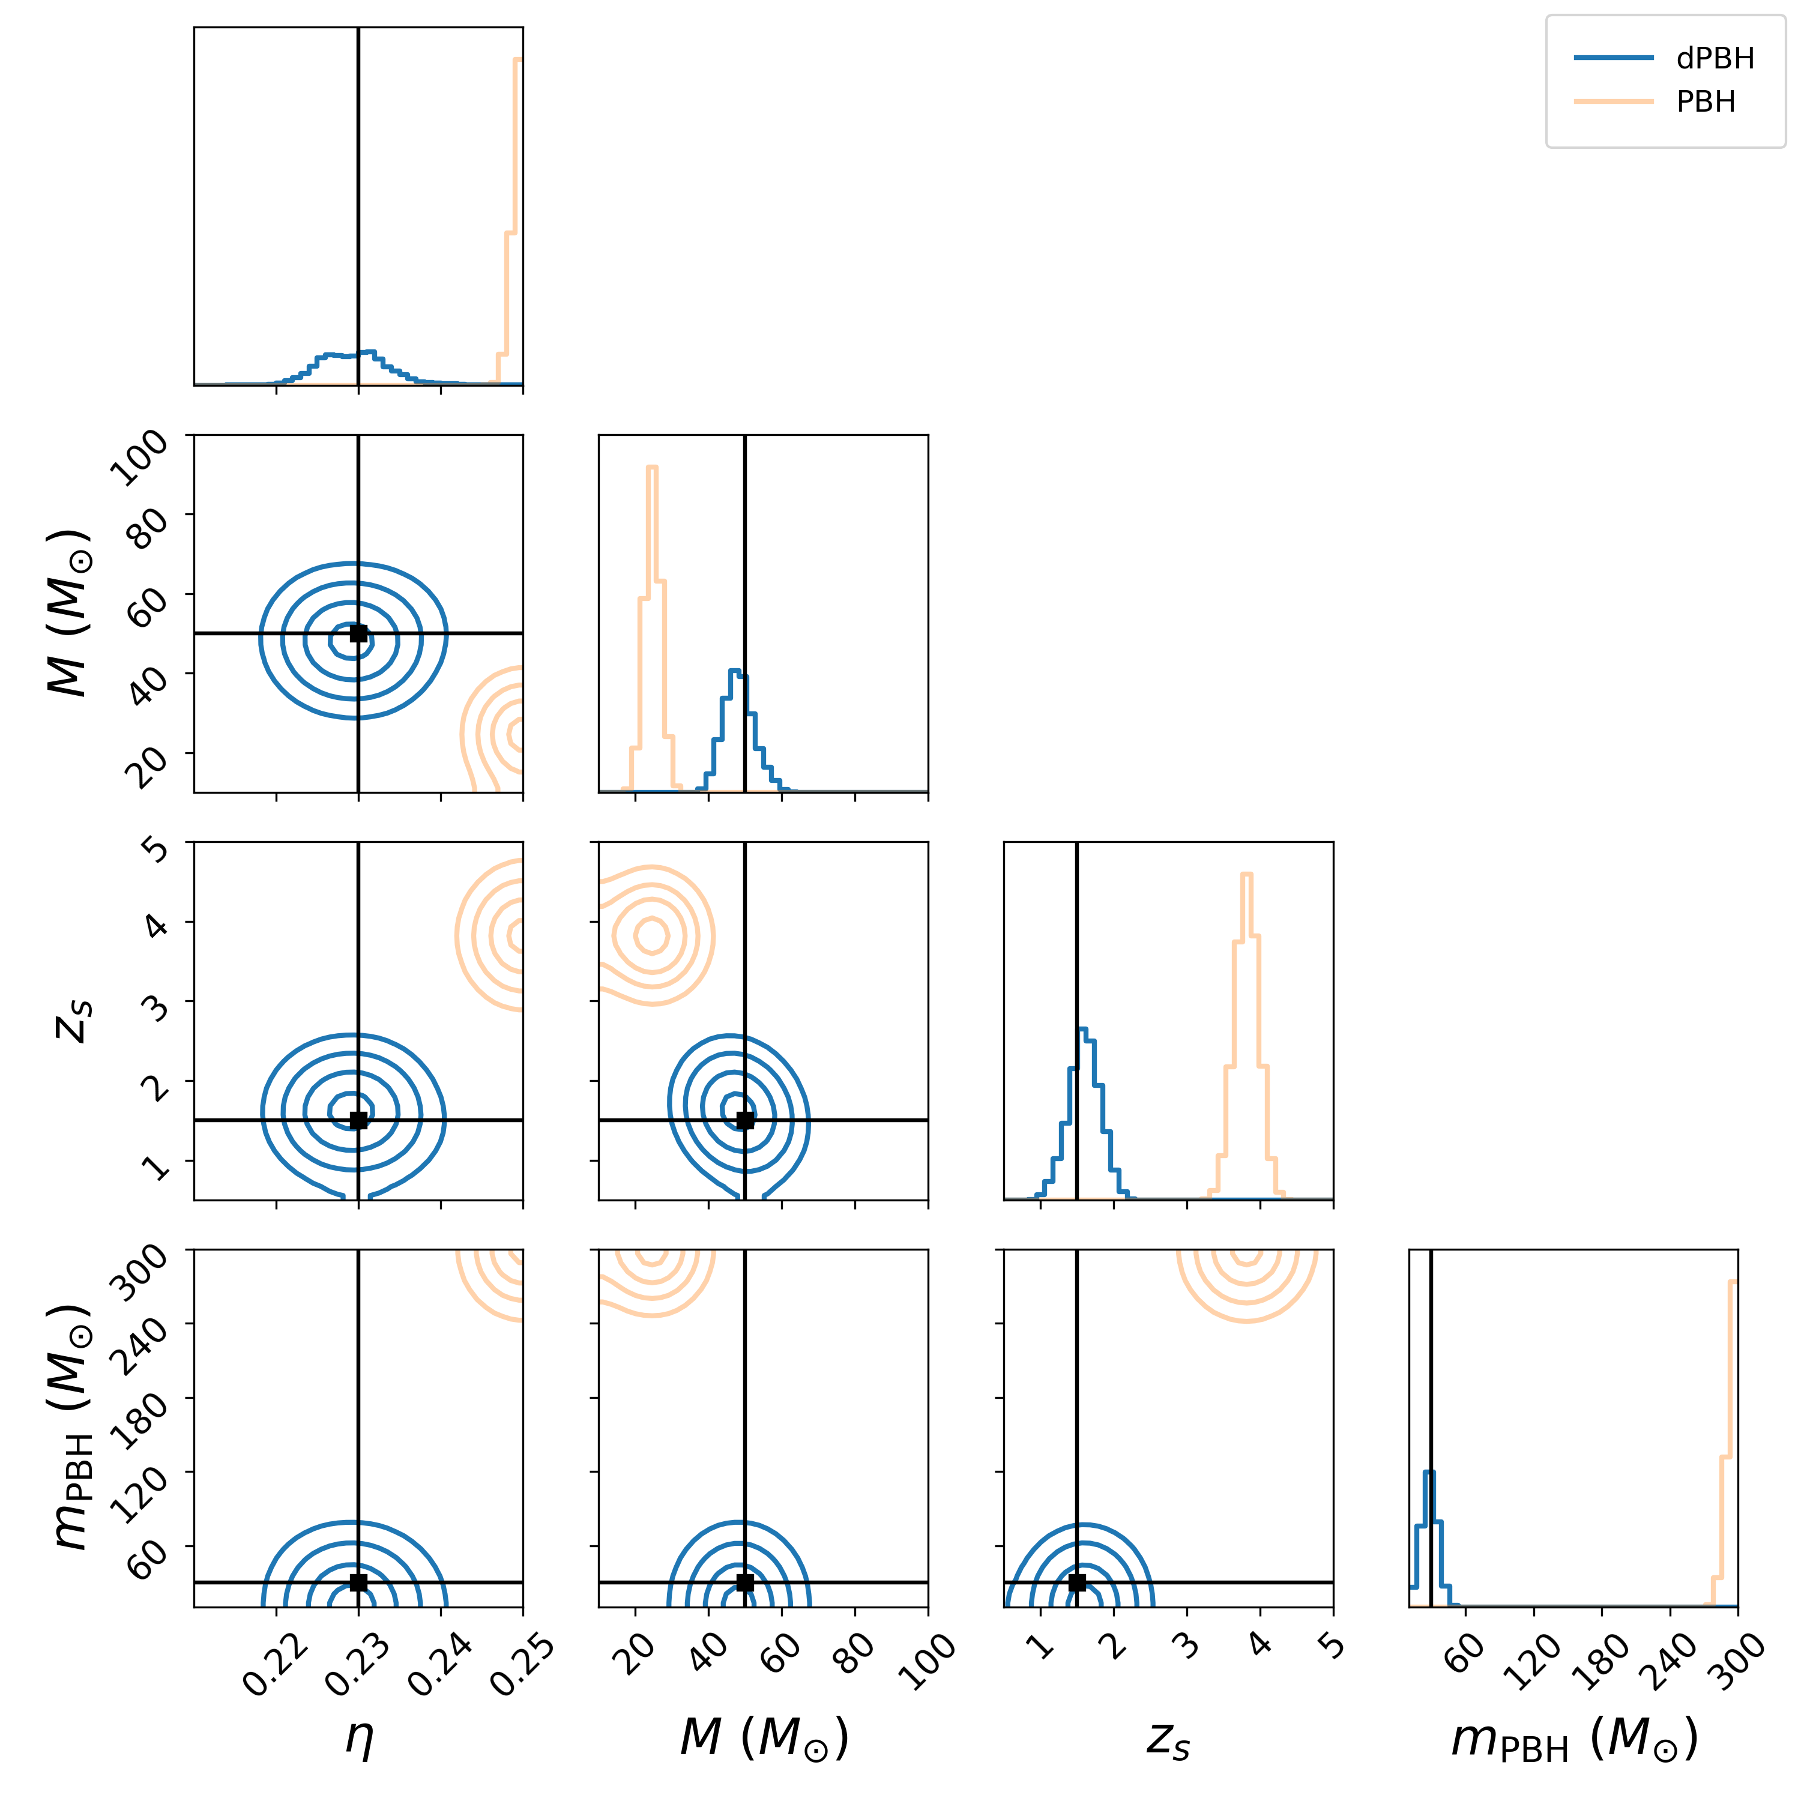
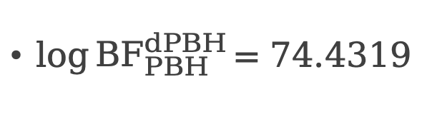
RESULT
$\log{{BF}_{PBH}^{dPBH}}{=74.4319}$

Slide 16
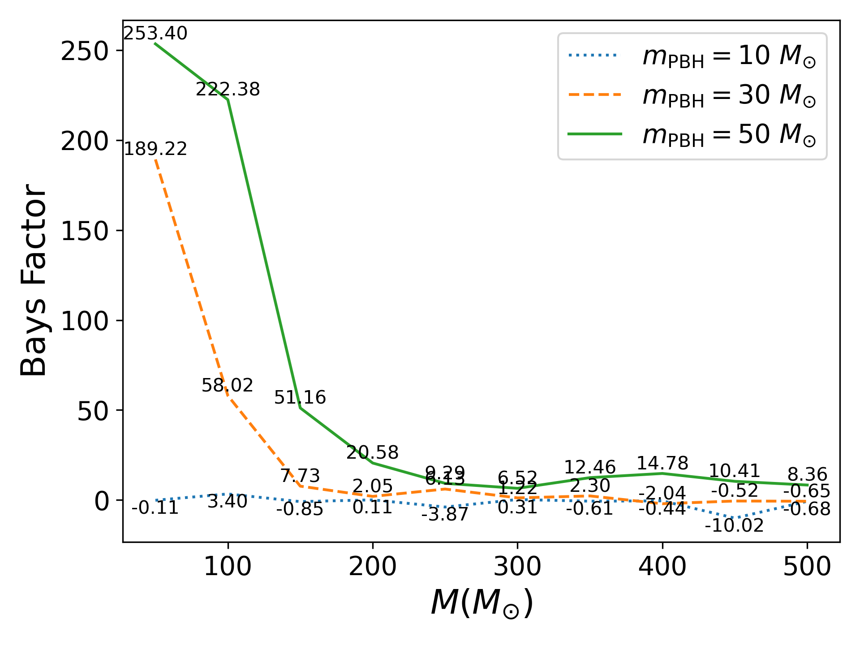
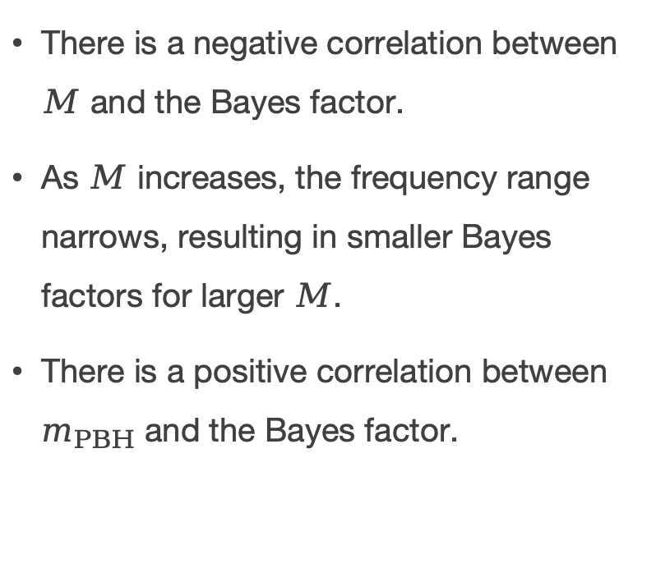
RESULT
There is a negative correlation between $M$ and the Bayes factor.
As $M$ increases, the frequency range narrows, resulting in smaller Bayes factors for larger $M$.
There is a positive correlation between $m_{PBH}$ and the Bayes factor.

Slide 17
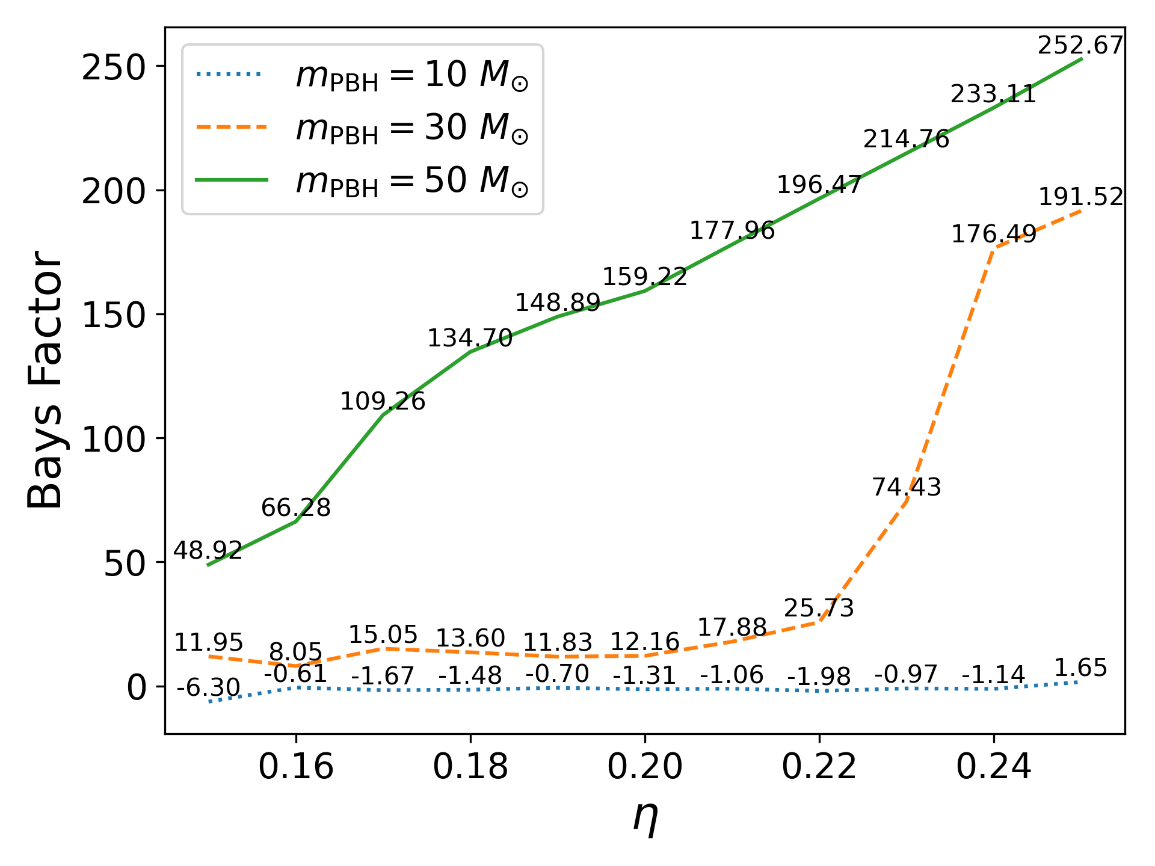
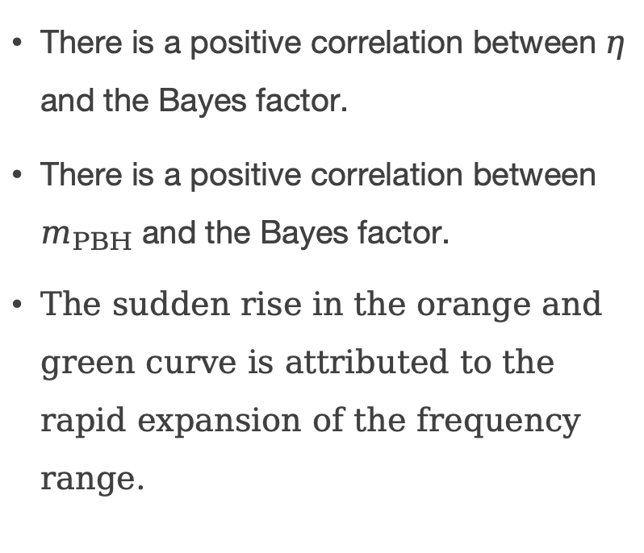
RESULT
There is a positive correlation between $η$ and the Bayes factor.
There is a positive correlation between $m_{PBH}$ and the Bayes factor.
The sudden rise in the orange and green curve is attributed to the rapid expansion of the frequency range.

Slide 18
OUTLINE
1. INTRODUCTION
2. LENSING EFFECT OF BARE AND DRESSED PBHS
3. MODEL SELECTION
4. RESULT
5. CONCLUSIONS

Slide 19
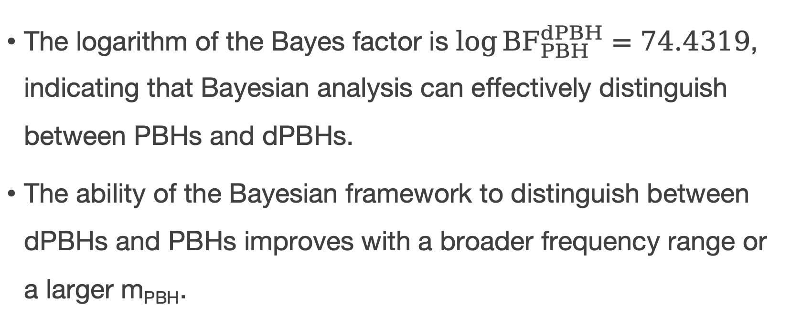
CONCLUSIONS
The logarithm of the Bayes factor is $\log{{BF}_{PBH}^{dPBH}}=74.4319$, indicating that Bayesian analysis can effectively distinguish between PBHs and dPBHs.
The ability of the Bayesian framework to distinguish between dPBHs and PBHs improves with a broader frequency range or a larger m_{PBH}.

Slide 20
Thank you!

