Slide 1



Interpreting the Earth’s geoneutrino flux
William F. McDonough
Geology, University of Maryland, College Park, MD, USA
and
WPI: Advanced Institute for Marine Ecosystem Change,
Research Center of Neutrino Sciences, and Earth Sciences, Tohoku University, Sendai, JAPAN

Slide 2
Outline
Surface heat flux: 46 ± 3 TW
Primordial vs radiogenic – proportions?
Continents vs mantle sources
Measuring the Earth’s geoneutrino flux

Slide 3
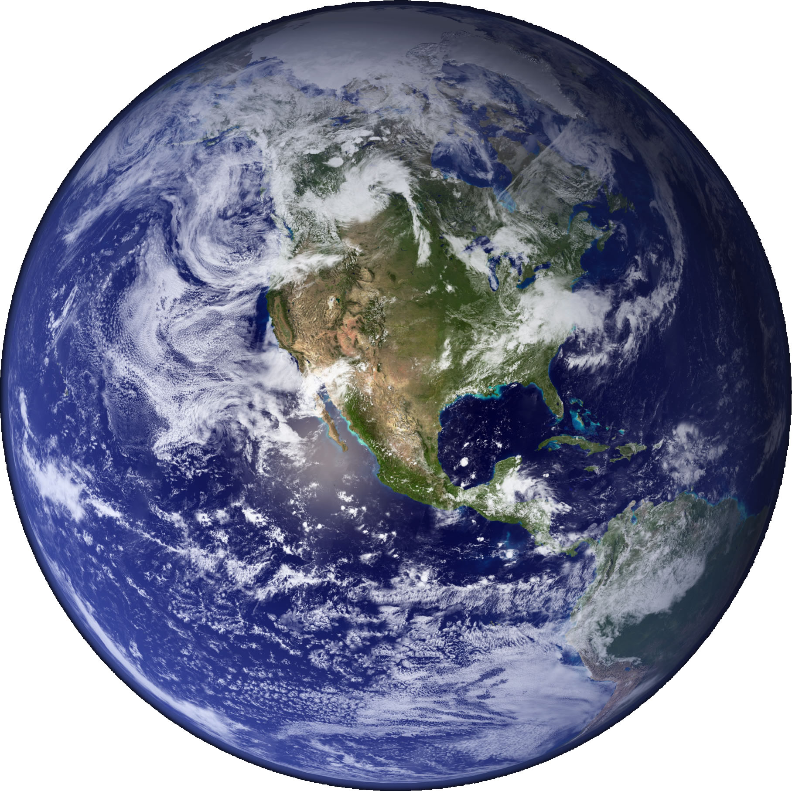
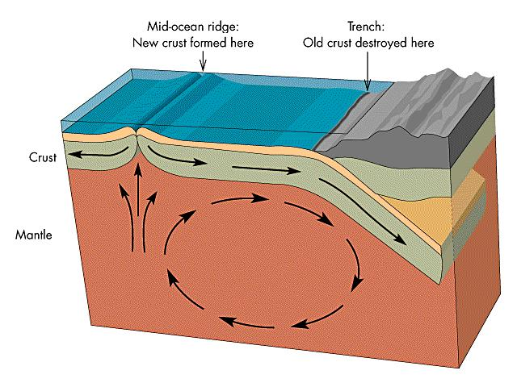
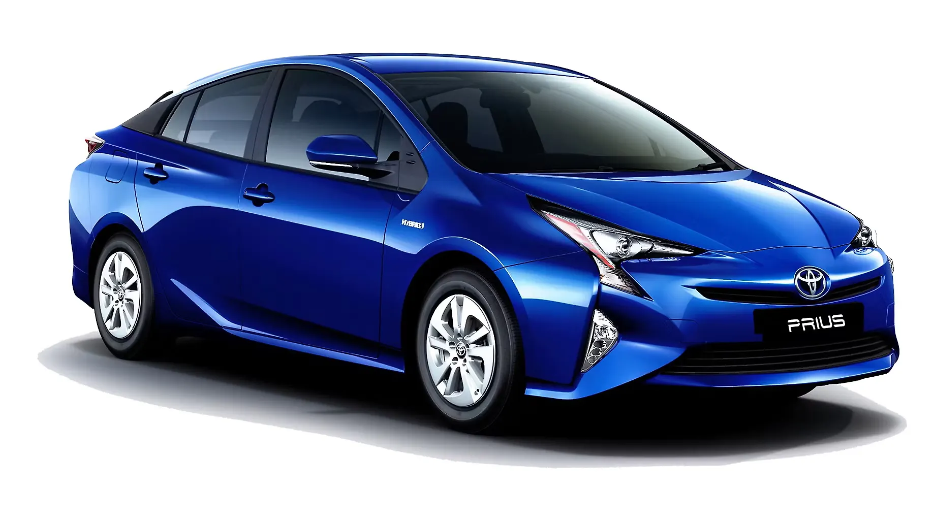
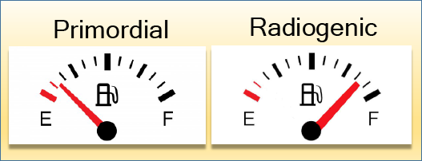
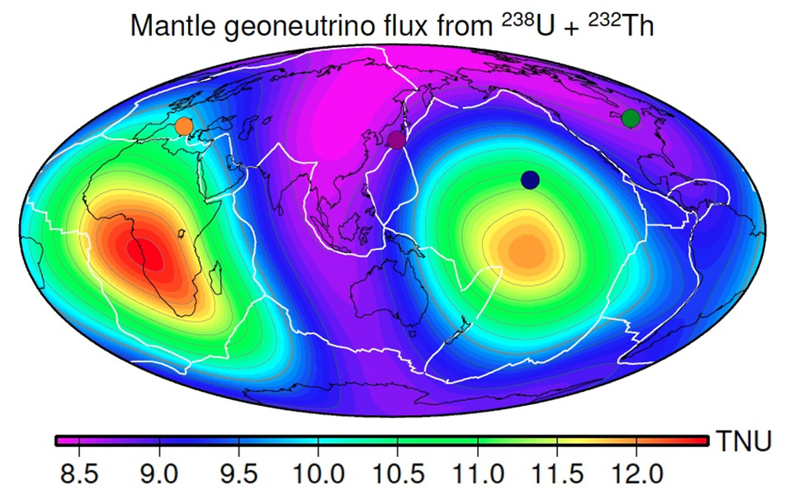


Surface heat flux
40,000+ observations: oceans & continents
Heat flux ~44 TW, known since 1950s
Surface variation: 20 to 140 TW
Poorly known areas: e.g., Siberia
Surface heat flux: 46 ± 3 TW
46±3 TW
Hybrid vehicles
What are the relative proportions?

Slide 4
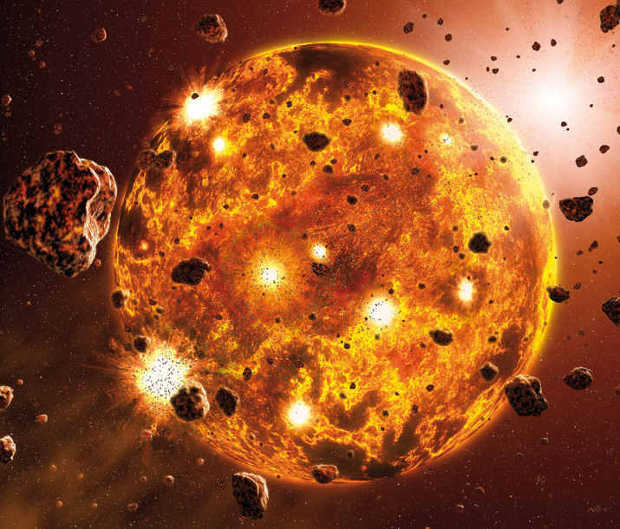
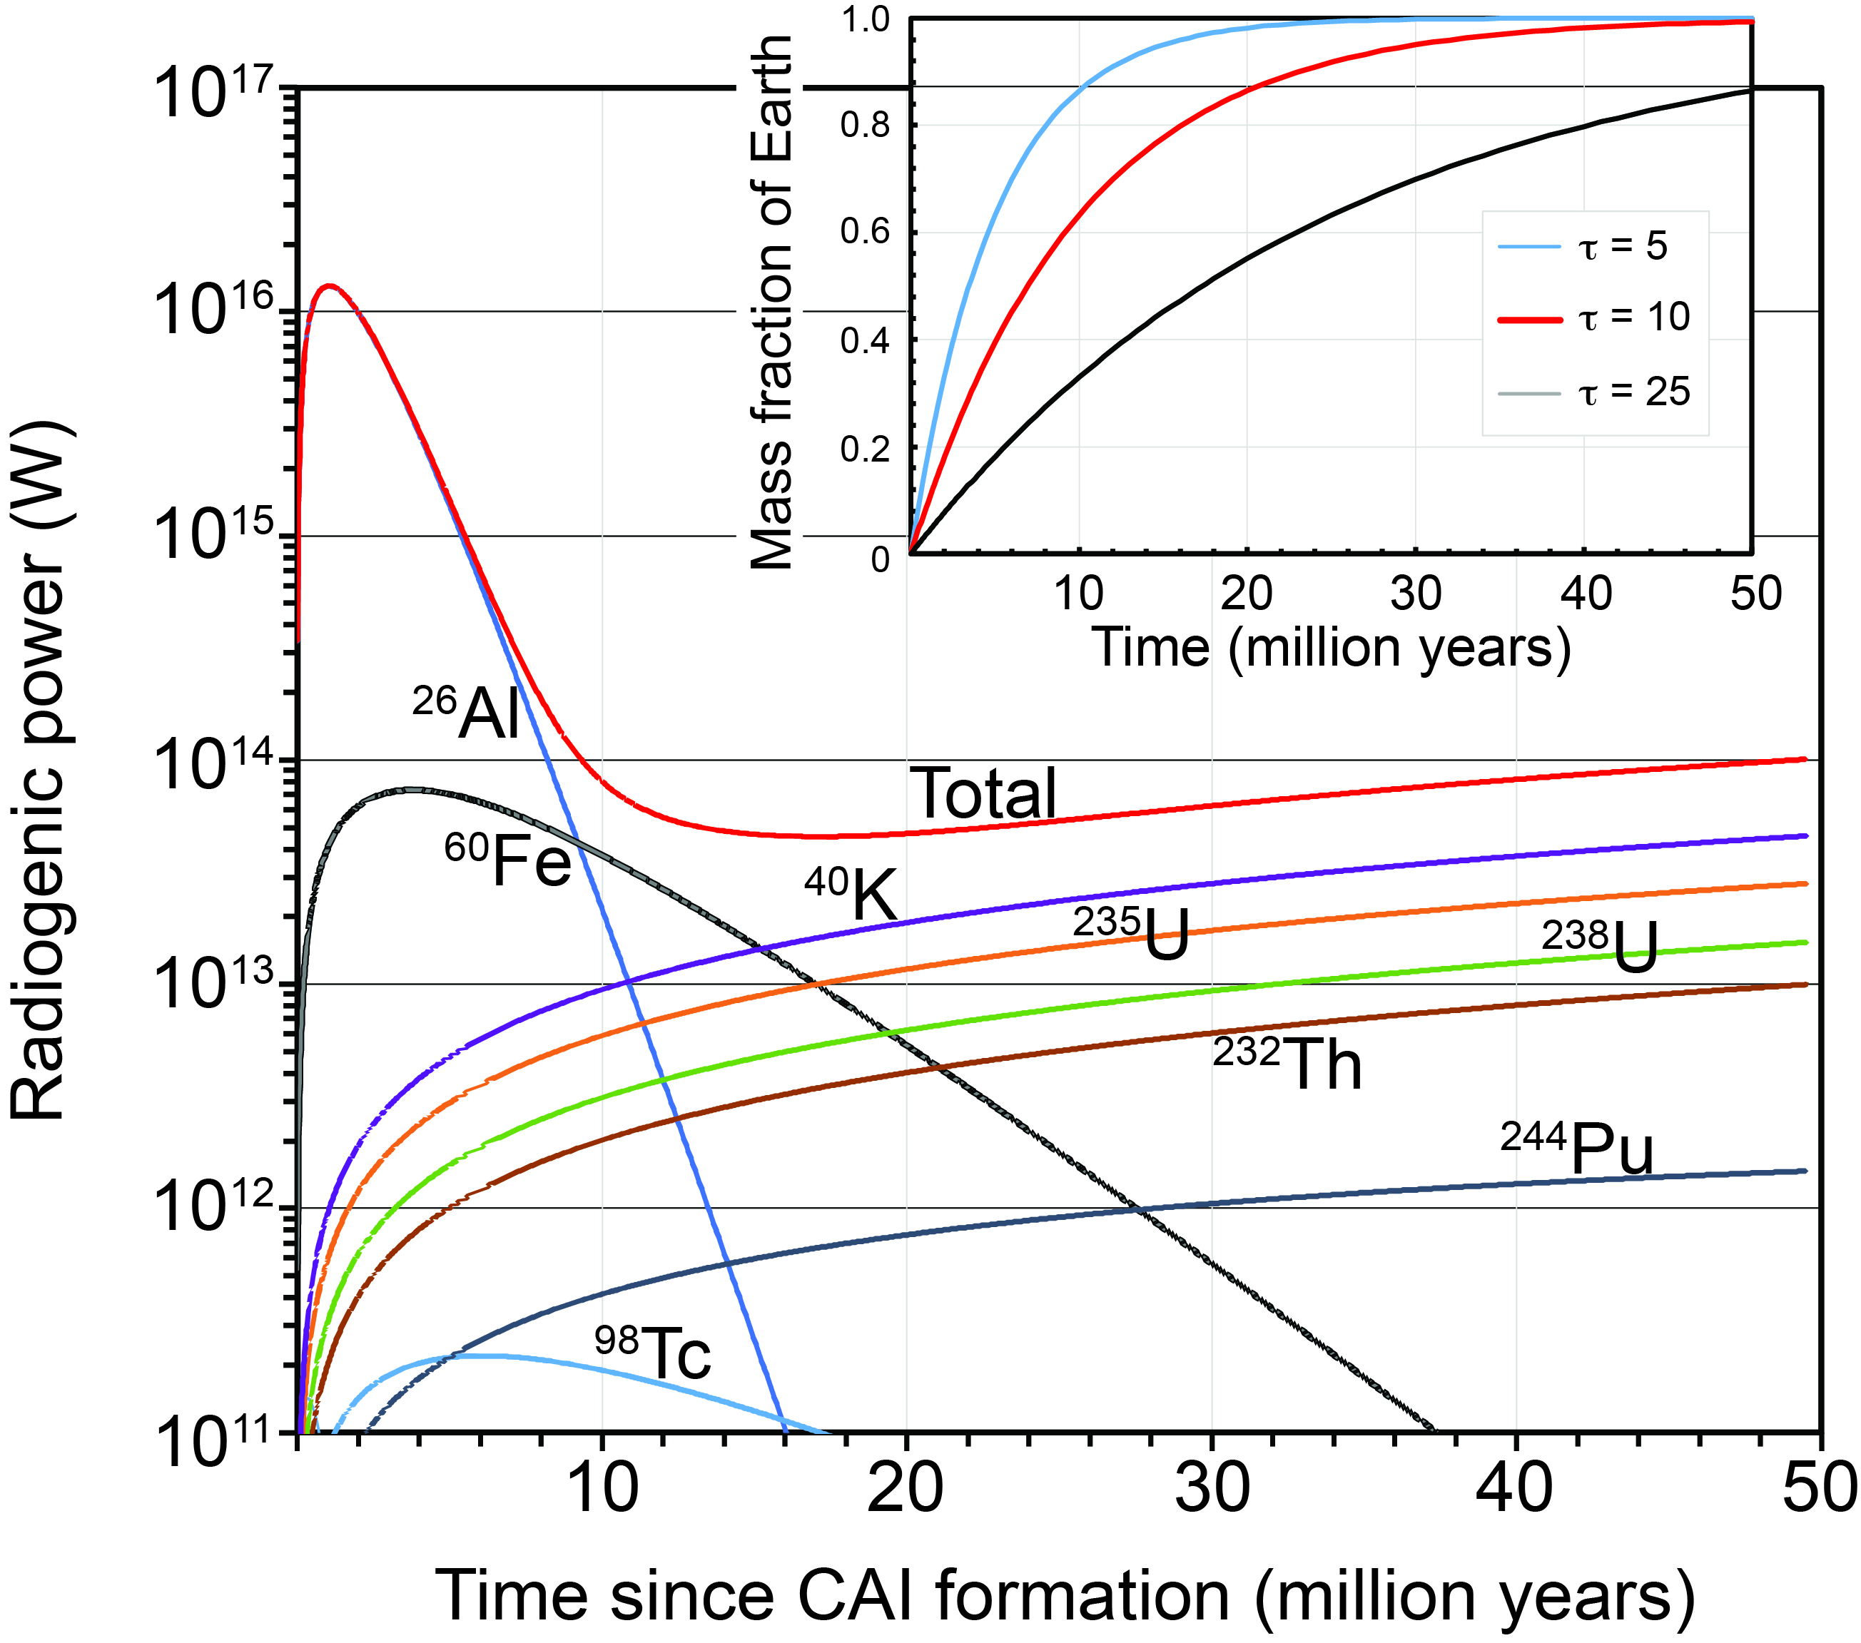
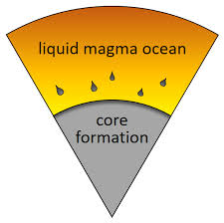
Primordial energy
Earth’s mass 6 x 10²⁴ kg
Accretion velocity 10⁴ m s⁻¹
Primordial impact energy 10³² J
Core formation (2 x 10²⁴ kg) ~10³⁰ J
Dissipation rate: unknown
10³² J
Accretion time scale
10³⁰ J

Slide 5
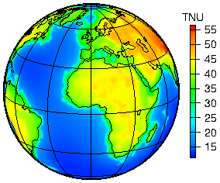
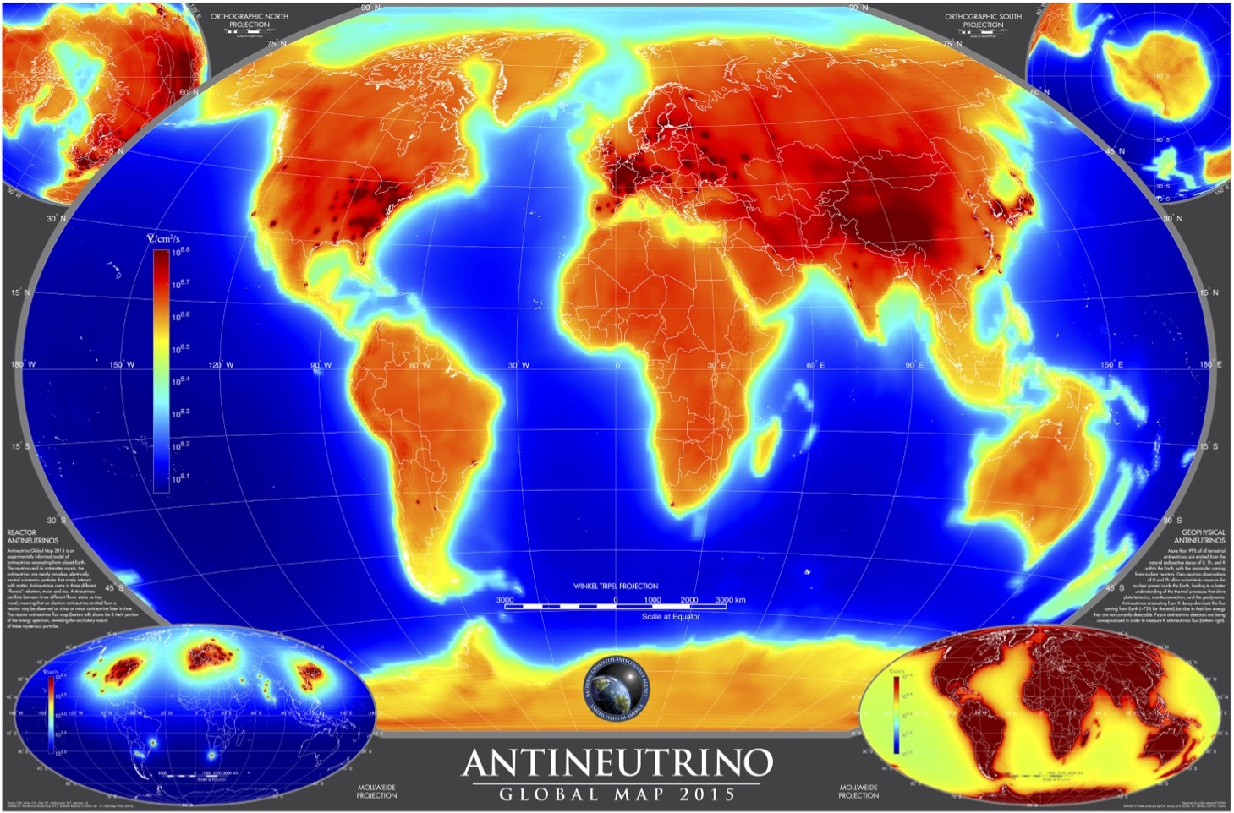
Radiogenic energy: 20 ± 10 TW
K(20%), Th(40%), & U(40%), 99.5% of radiogenic heat
Extinct nuclides (²⁶Al & ⁶⁰Fe) were important
IBD allows Th & U anti-neutrino detection (1.8 MeV threshold)
K anti-neutrino detection: highly desired (1.3 MeV)
Directionality: applications – geoscience & nuclear security
Spread of geo estimates
Predicted Global
geoneutrino flux

Slide 6
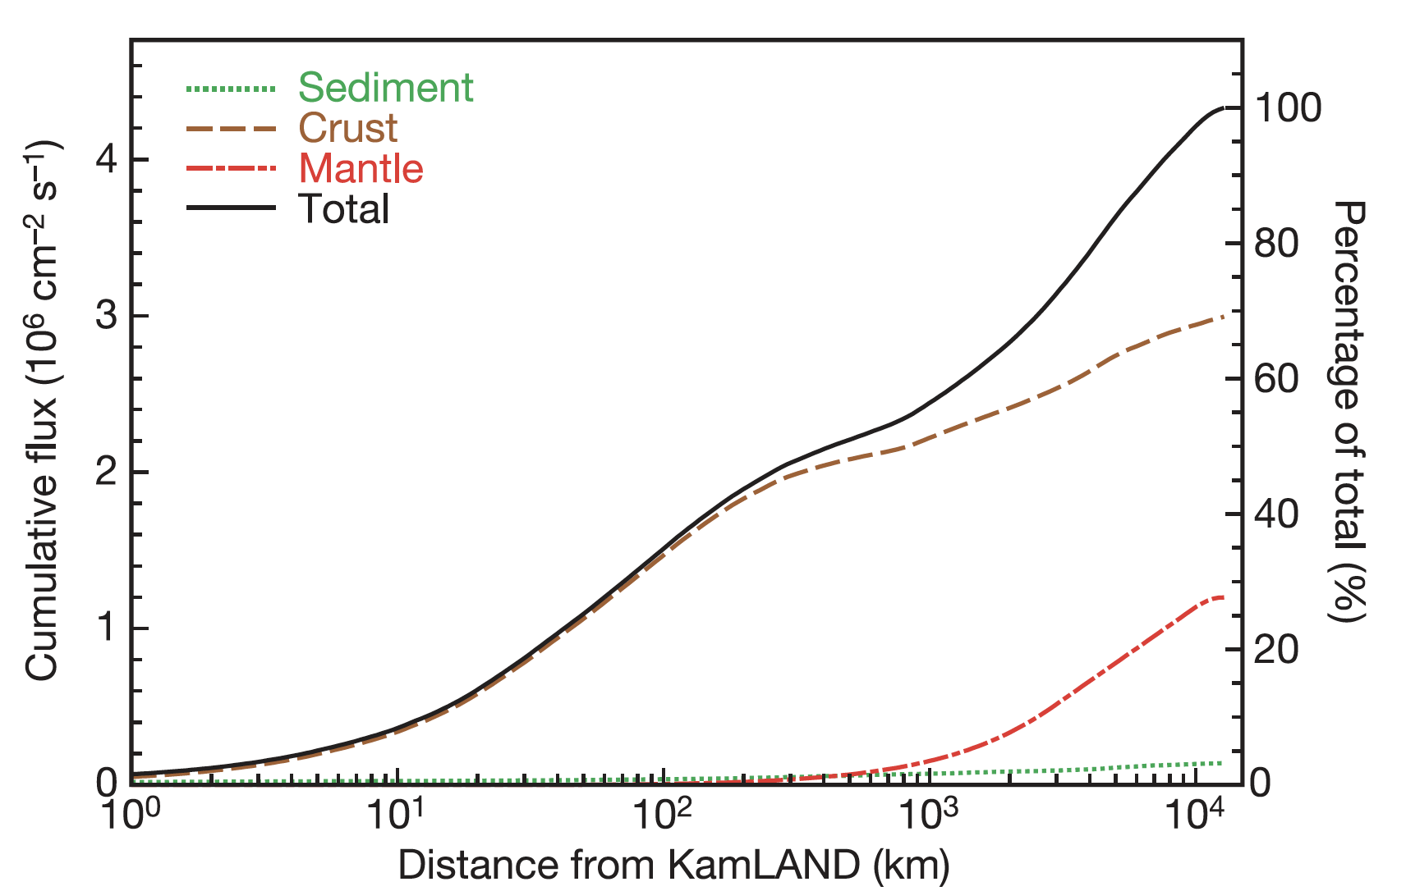
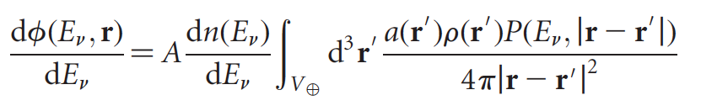
Role of Geology
50%
signal
Geoneutrino flux U & Th abundances and 1/r²
Equation for flux
Closest 250 km contribute ~50% of the signal
Accurate geological survey is fundamental
∝
Earth structure (ρ and L) and
chemical composition (a)
Activity and number of produced geoneutrinos
Volume of source unit
Abundance and density of the source unit
Survival probability function
Distance between source unit and detector

Slide 7
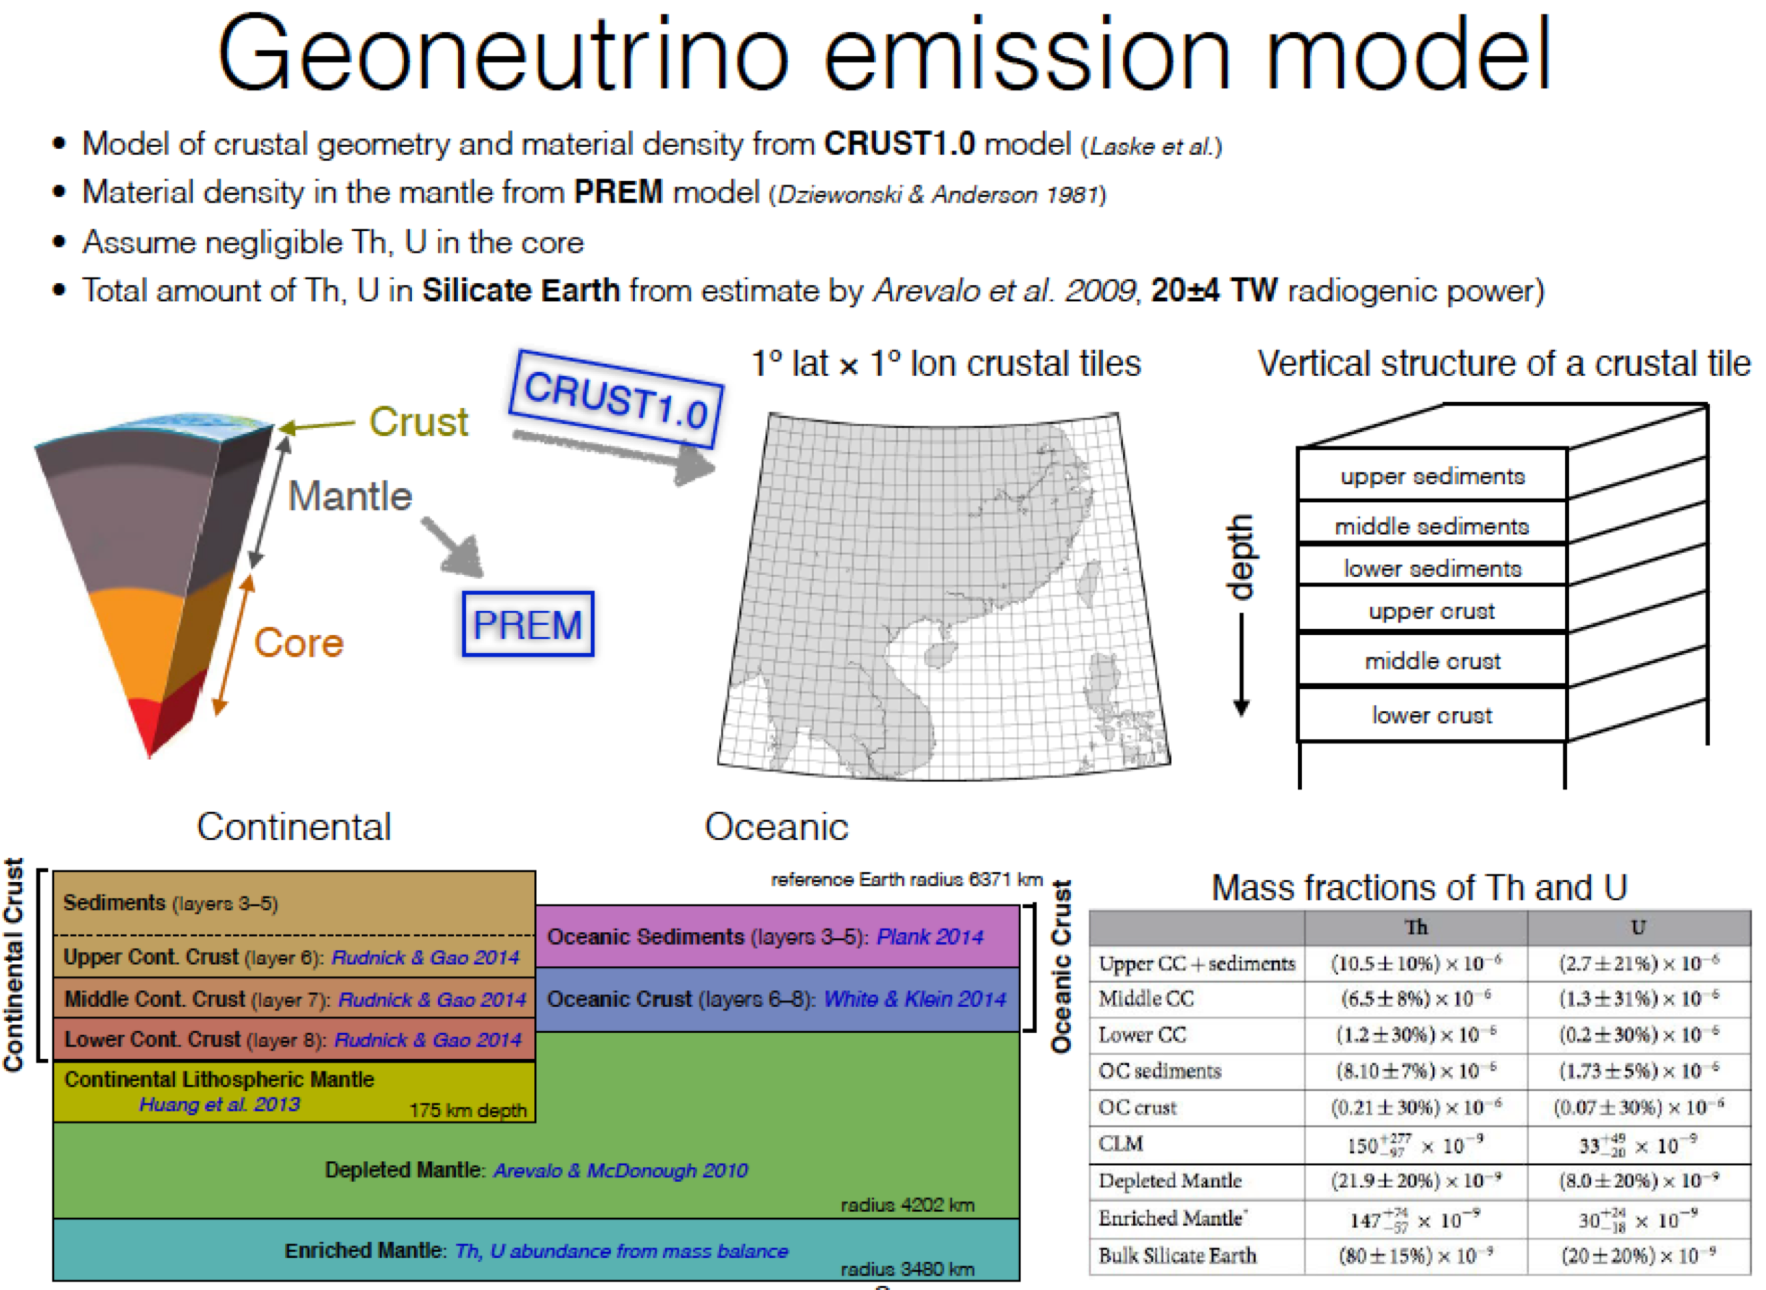


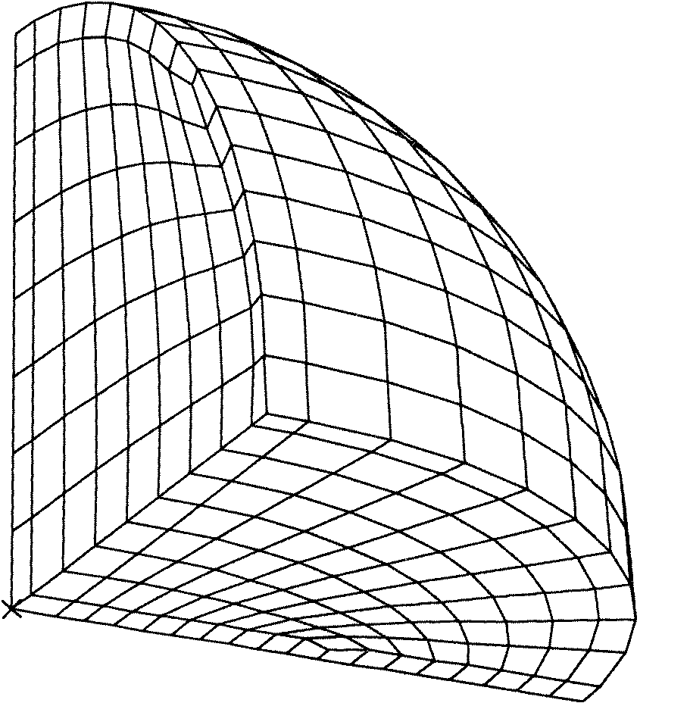
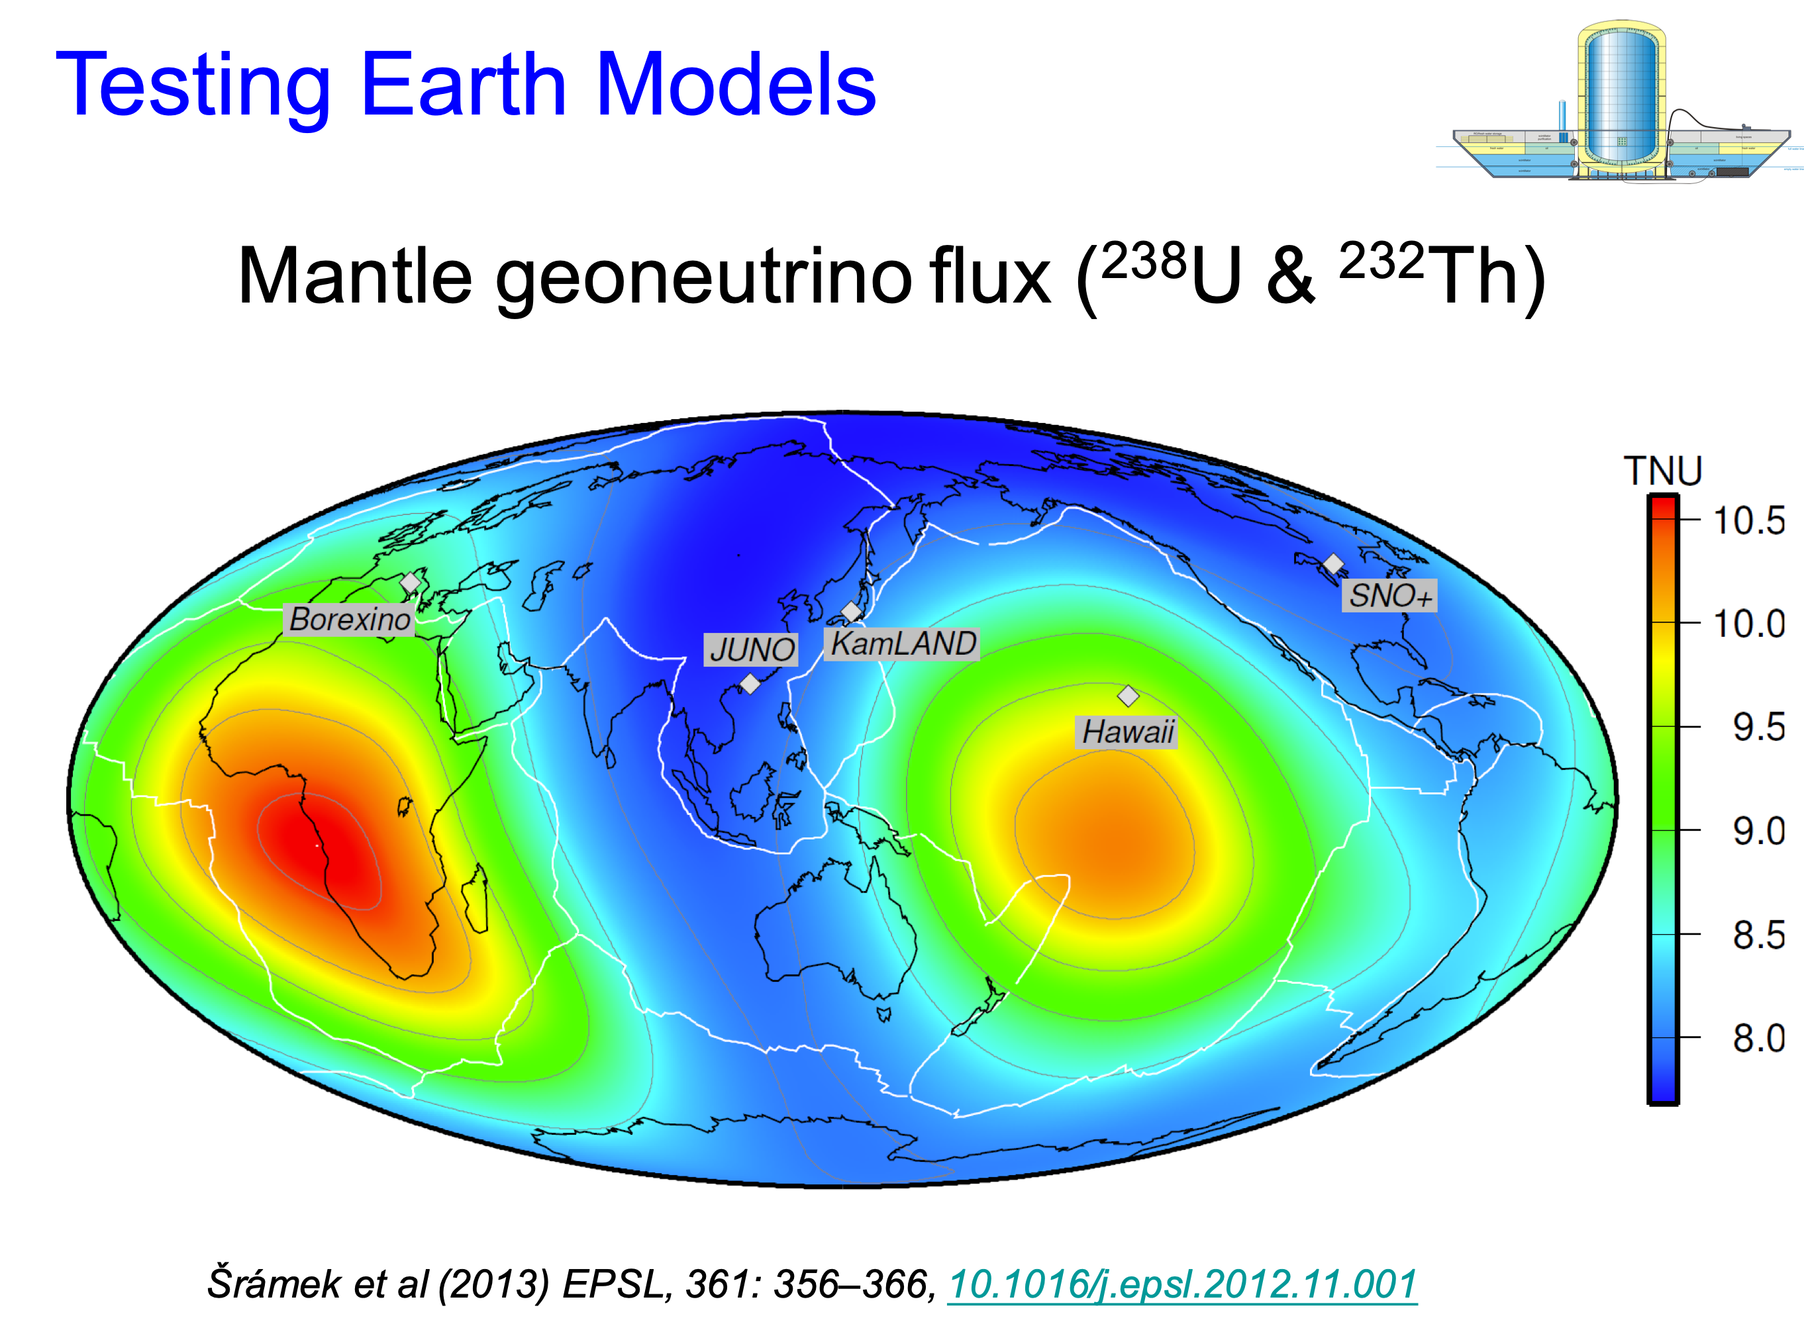
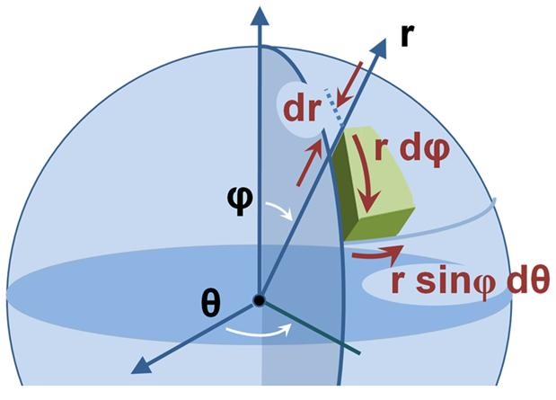
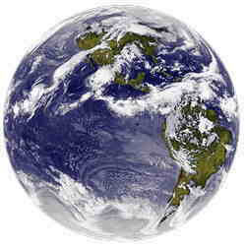
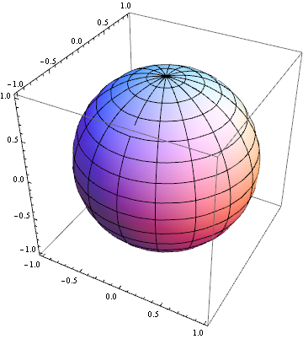
U & Th in continental crust (CC) vs mantle
Concentration of U & Th increase upwards in Earth
Earth’s Th/U_{molar} = 3.9, CC = 4.0, Mantle = 3.8
U in upper crust 3 ppm; U in oceanic mantle ~ 3 ppb
Earth’s total geo-nu flux = 5 x 10²⁵ ν (and ν) s⁻¹
Radiogenic power: CC = 7 ± 1 TW, Mantle ~13 ± 8 TW
_
assigning chemical and physical states to Earth voxels

Slide 8
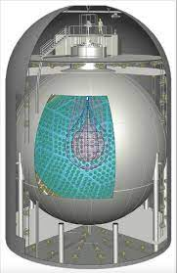
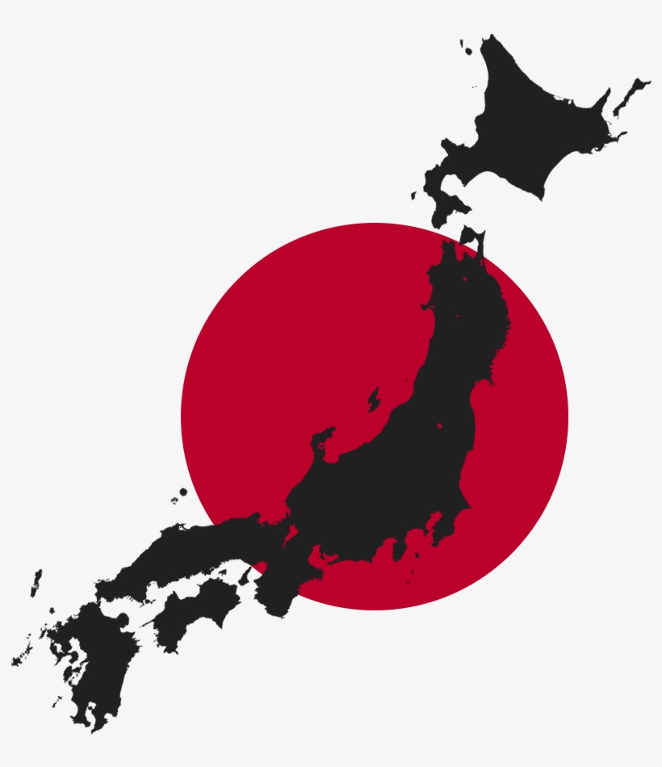
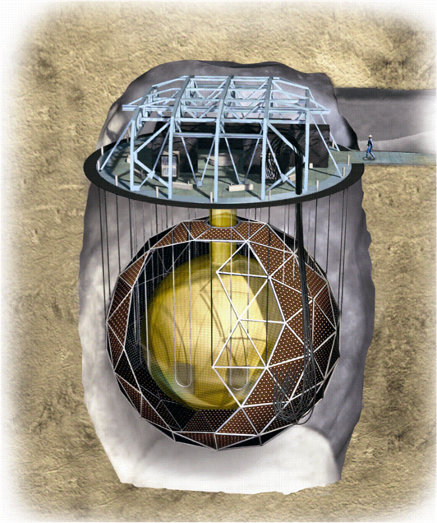
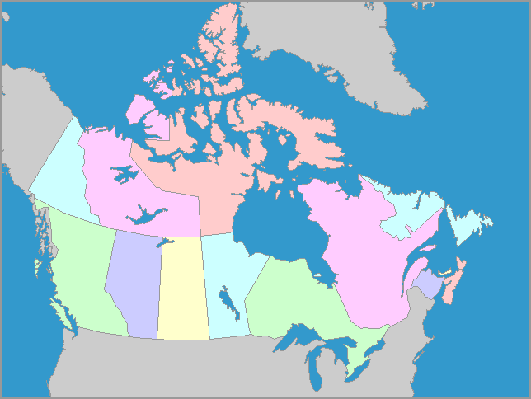
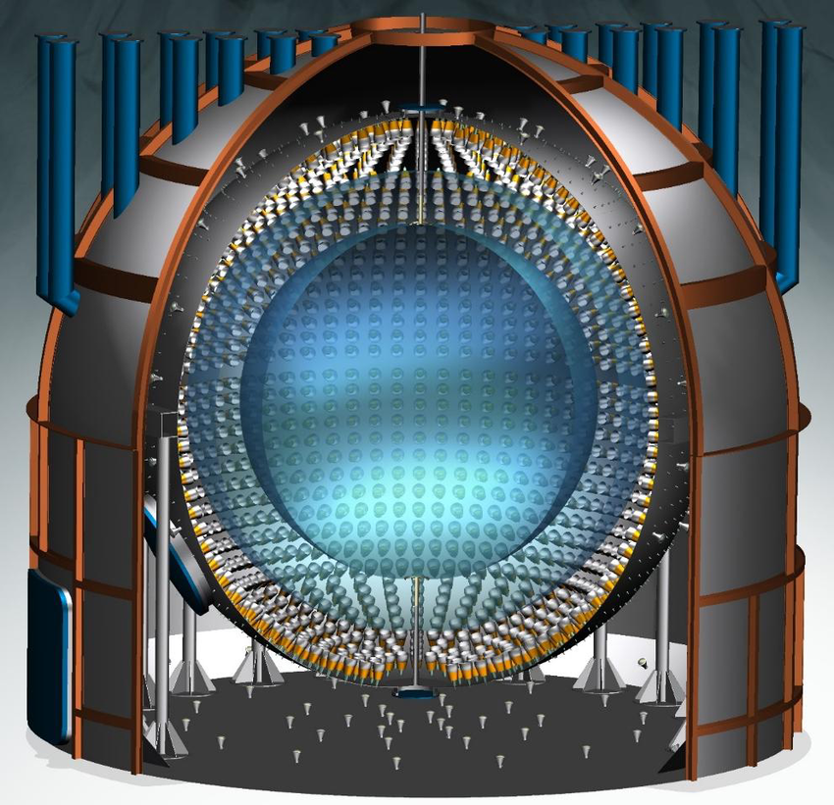
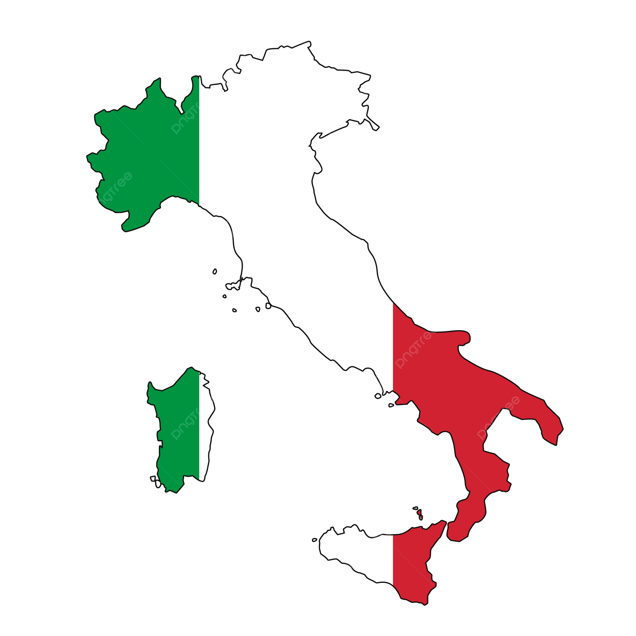
Current and past experiments
1st detection 2005, Nature
KamLAND (Japan): 2002-2024
Borexino (Italy): 2009-2021
SNO+ (Canada): 2022-present
+8.9
KamLAND 1kt
15.4 TW
-7.9
+13.6
Physics results
31.3 TW
-12.7
Th & U heat only
+47
47 TW
-43
SNO+ 1 kt
Ontario, Canada
Borexino 0.3 kt

Slide 9
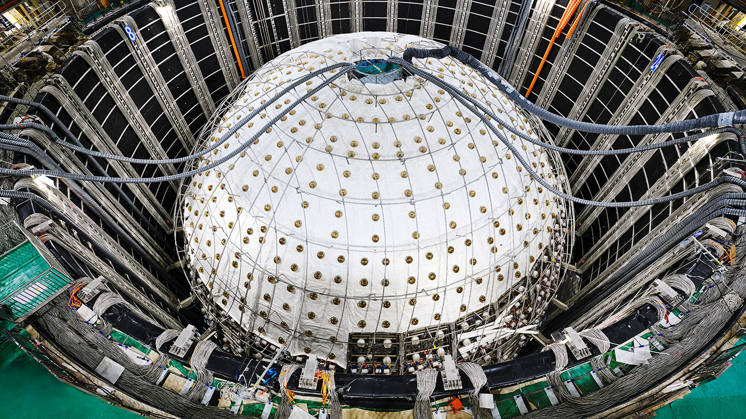
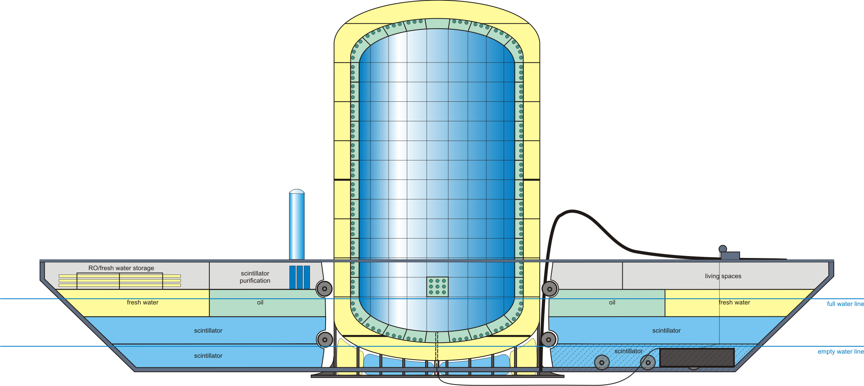
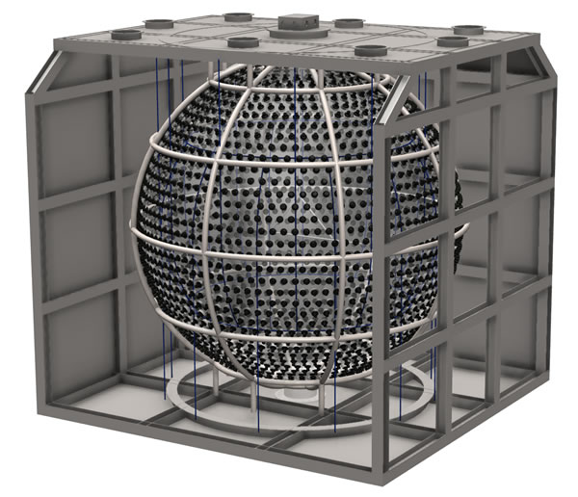
Future experiments
JUNO – 20 kt!
JUNO (China)
KamLAND2 (Japan)
Jinping (China)
*OBD (Japan-US)
JNE:
Jinping Neutrino Experiment
Key for geoneutrino studies
Ocean Bottom Detector
mobile: Th & U map of Pacific mantle
KamLAND2
Minor development for geonu studies
* See also Xu et al (Wednesday, 2:20 PM)
Towards imaging Earth’s large-scale structures by directional geoneutrino detection with Ocean Bottom Detector
Novel applications when combined with KL & JUNO

Slide 10
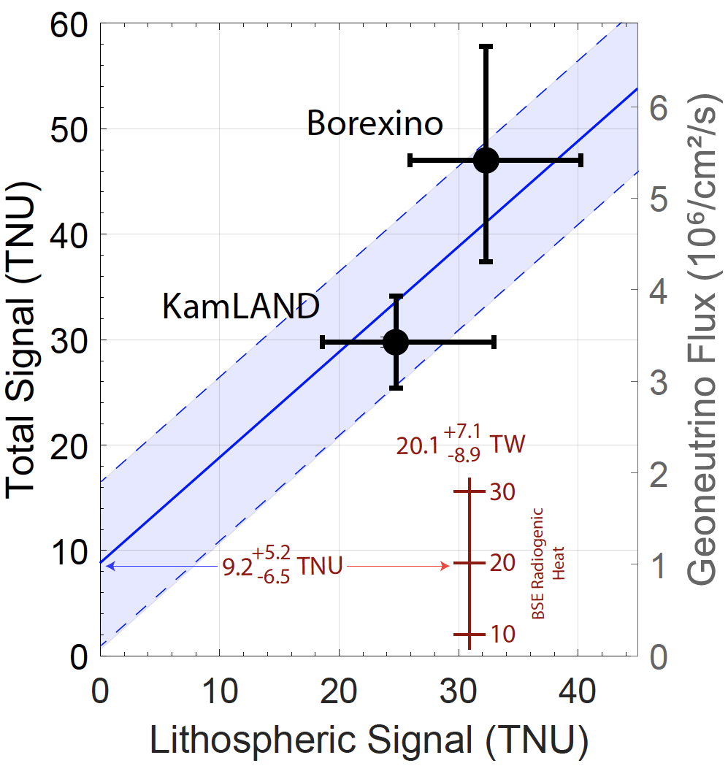
Current Status
Slope ≡ 1.0
Results from KamLAND and Borexino
Crustal composition surrounding Borexino
Insights from SNO+
Estimates of JUNO’s crustal composition
Bulk Earth 20 ± 8 TW
Physics
measurement
3 component system:
intercept is mantle contribution
Current day mantle ~13 TW
Geological prediction

Slide 11
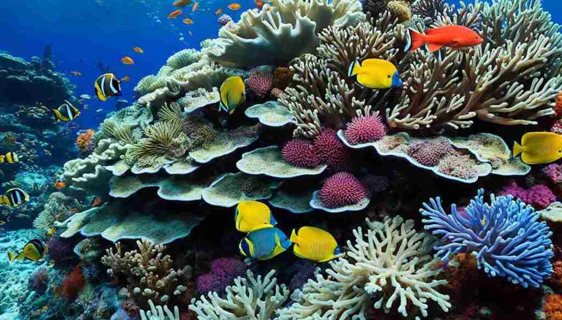
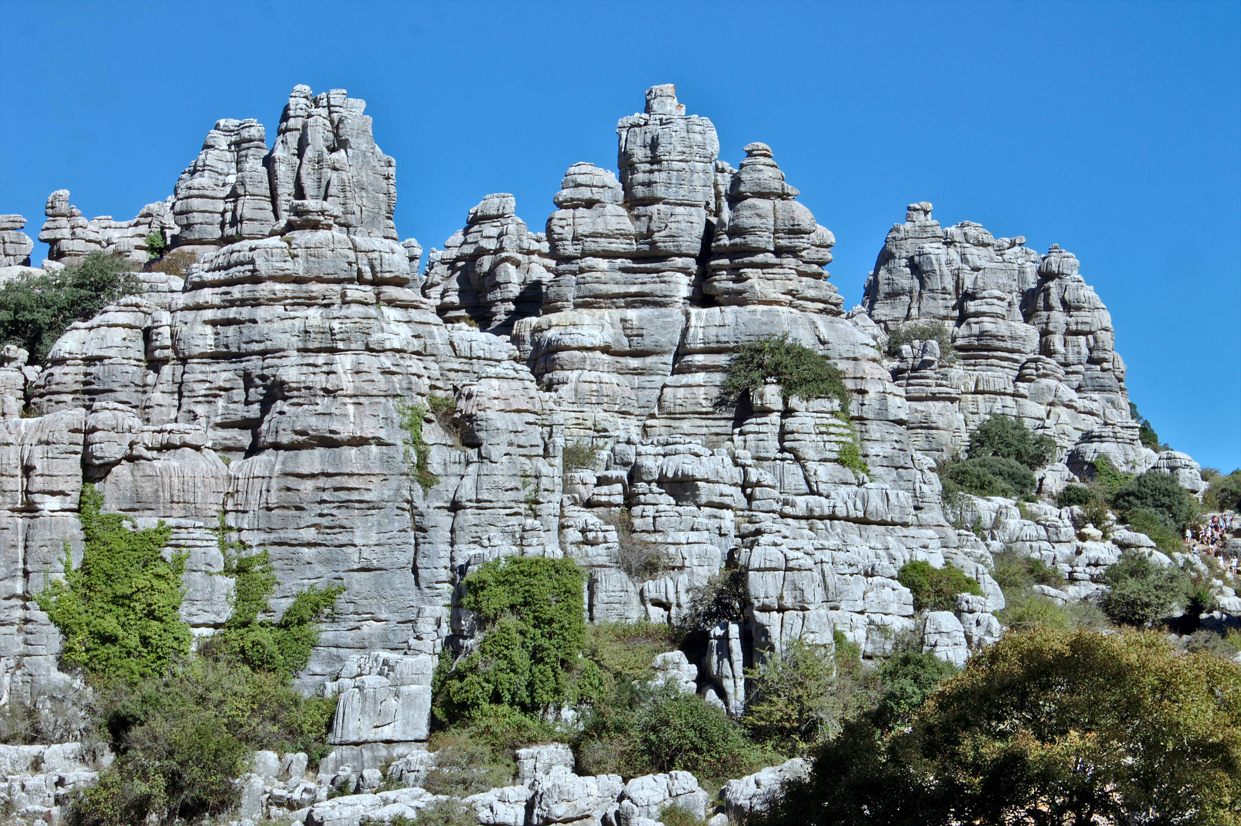
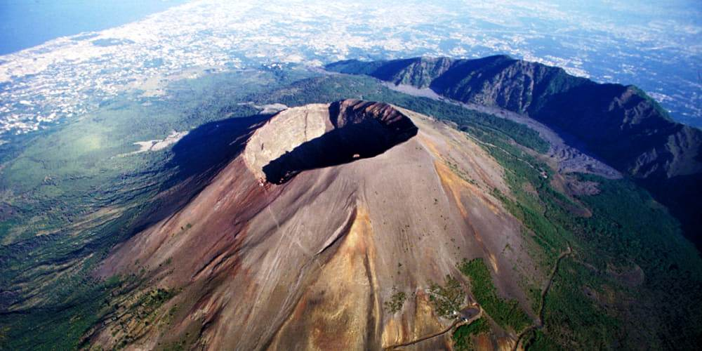
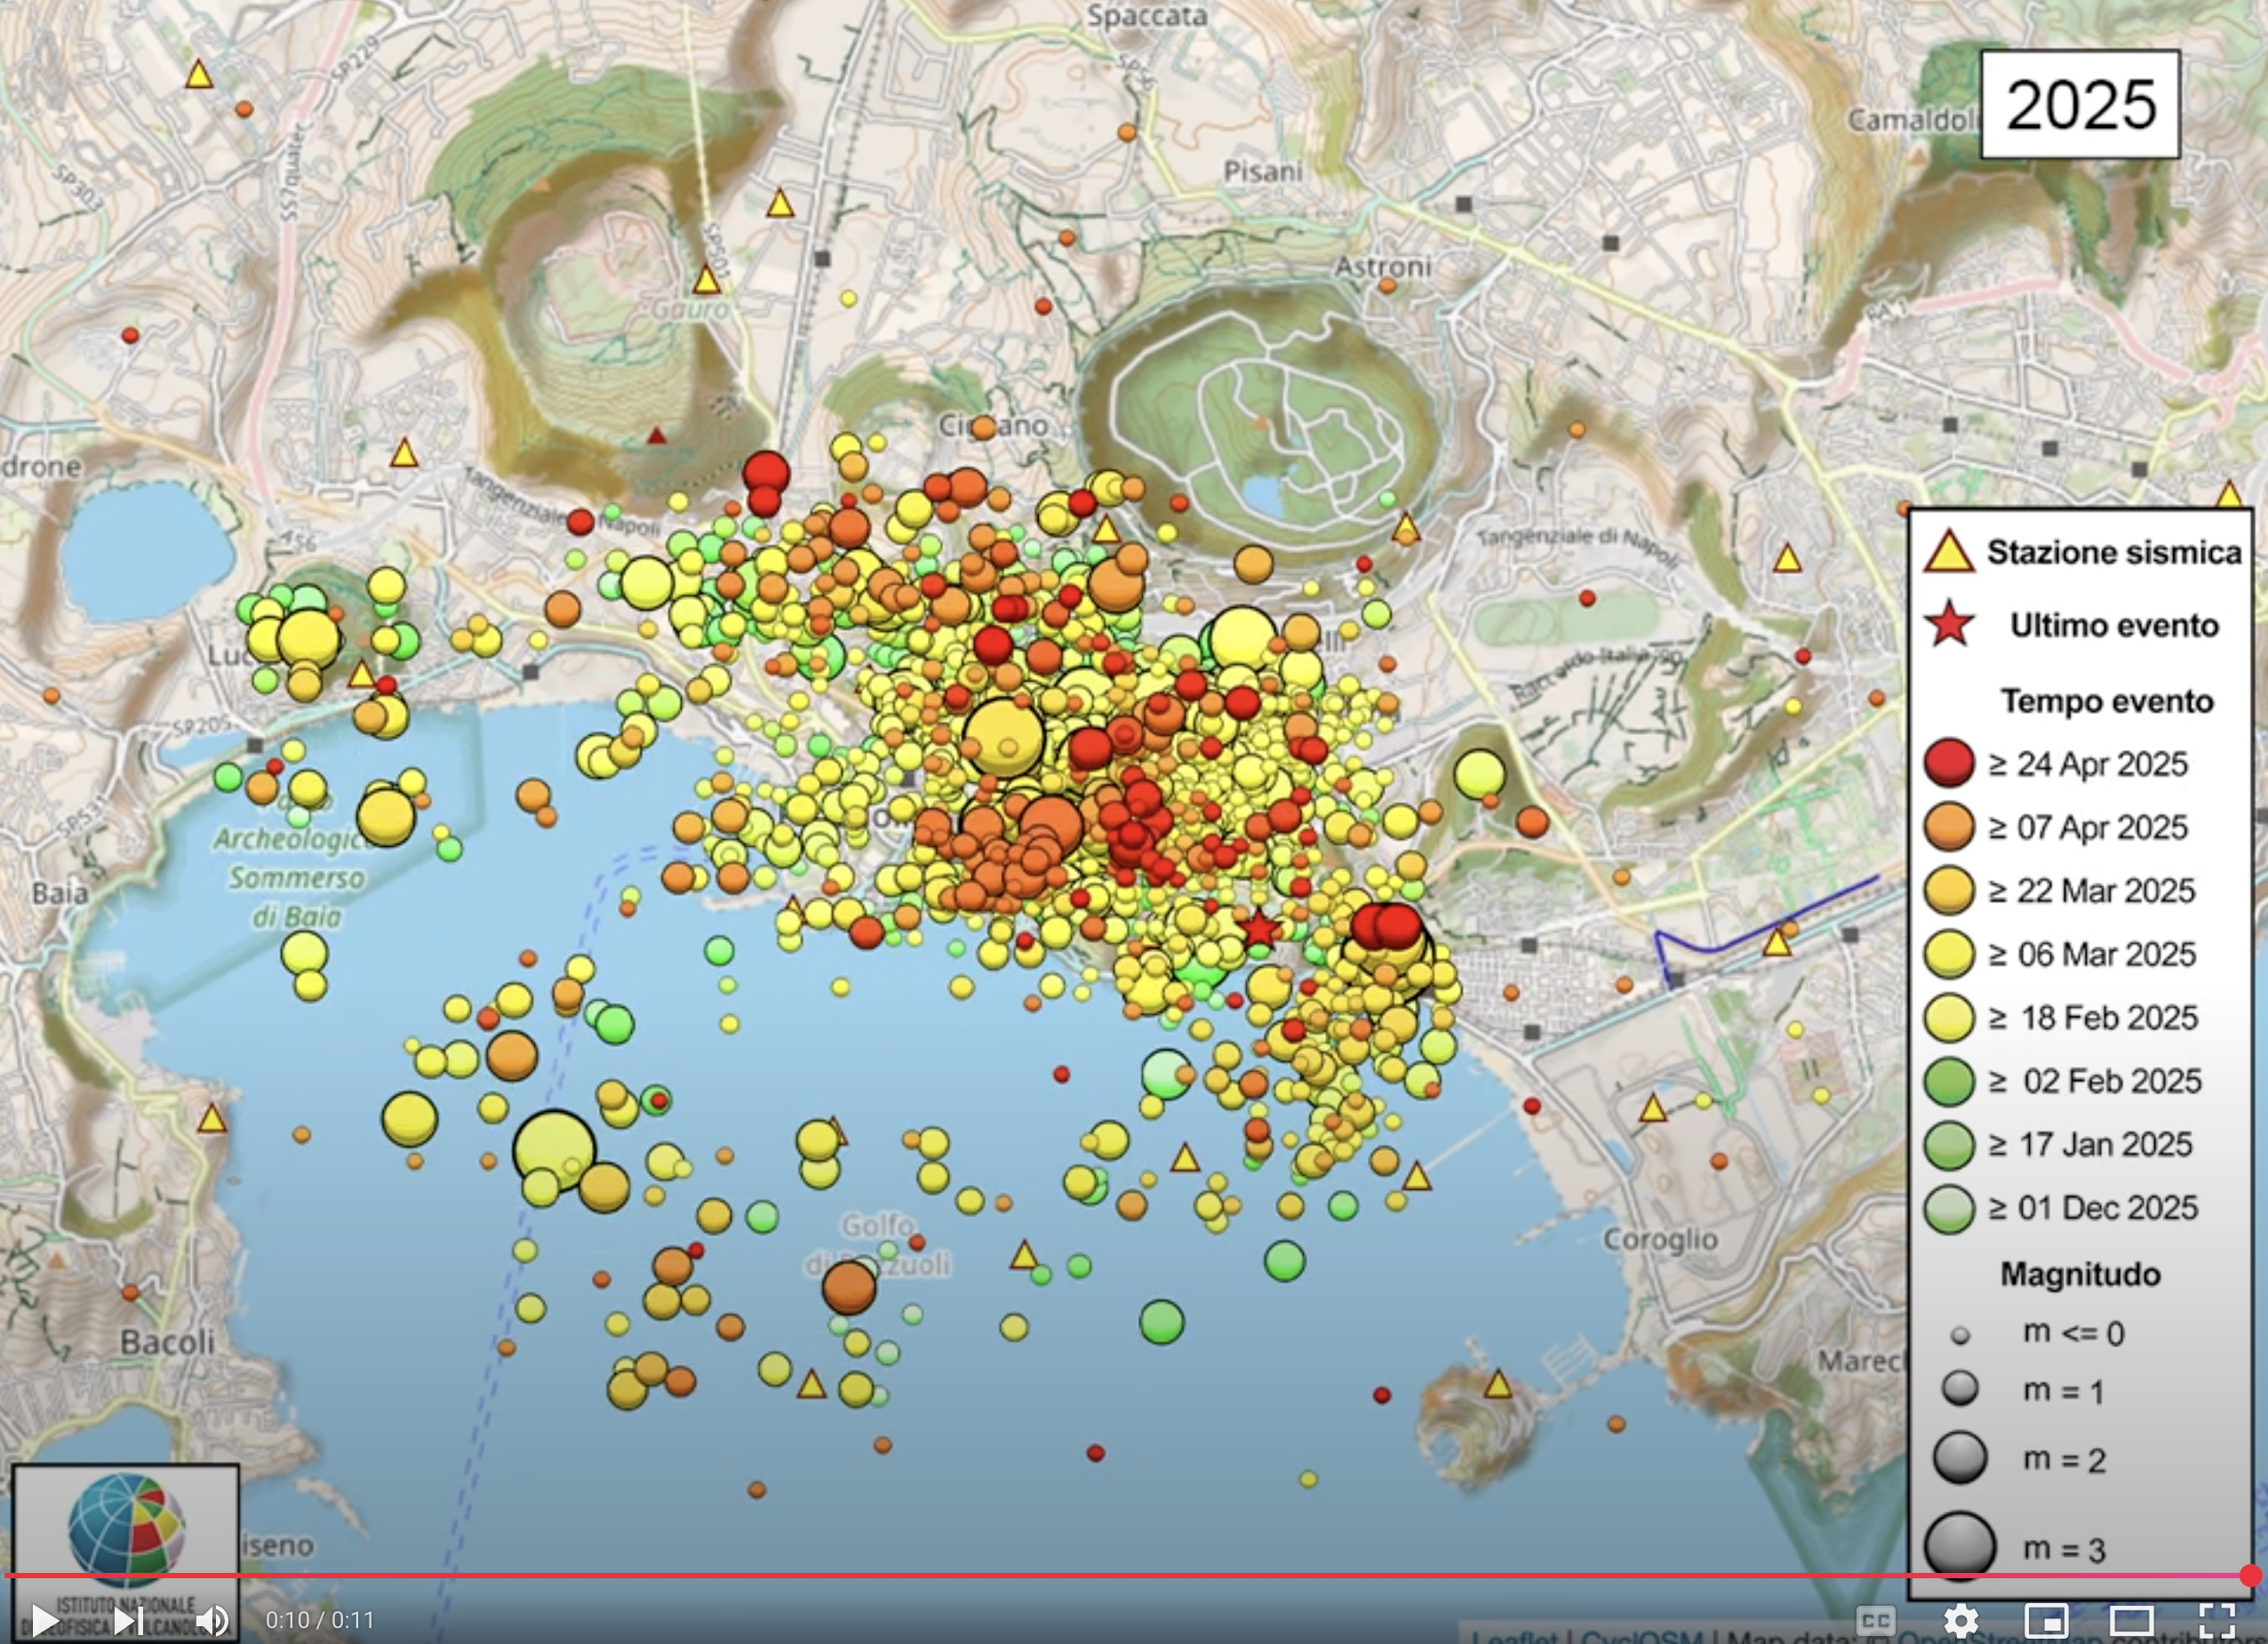
Lessons from Borexino
Coltorti et al (2011, GCA) initial geological survey
Their conclusion: low Th & U crust surrounding BX
Agostini et al (2020, PRD): Earth 38 TW of radiogenic power!
Sammon & McDonough (2022, EPSL): new geological survey
Their conclusion: Earth has ~20 TW of radiogenic power
BX upper crust prediction
(no igneous rocks)
Coral reef 13 km Limestone rocks
Italian igneous rocks have ~10 times K, Th & U than average upper crustal rocks
Headline News
58
Italian Volcano on Steroids
52
Naples
130 km
115 km
190 km
Vesuvis
Supervolcano
shows signs of waking up
https://spark.liceodesio.edu.it/mod/wiki/prettyview.php?pageid=111

Slide 12
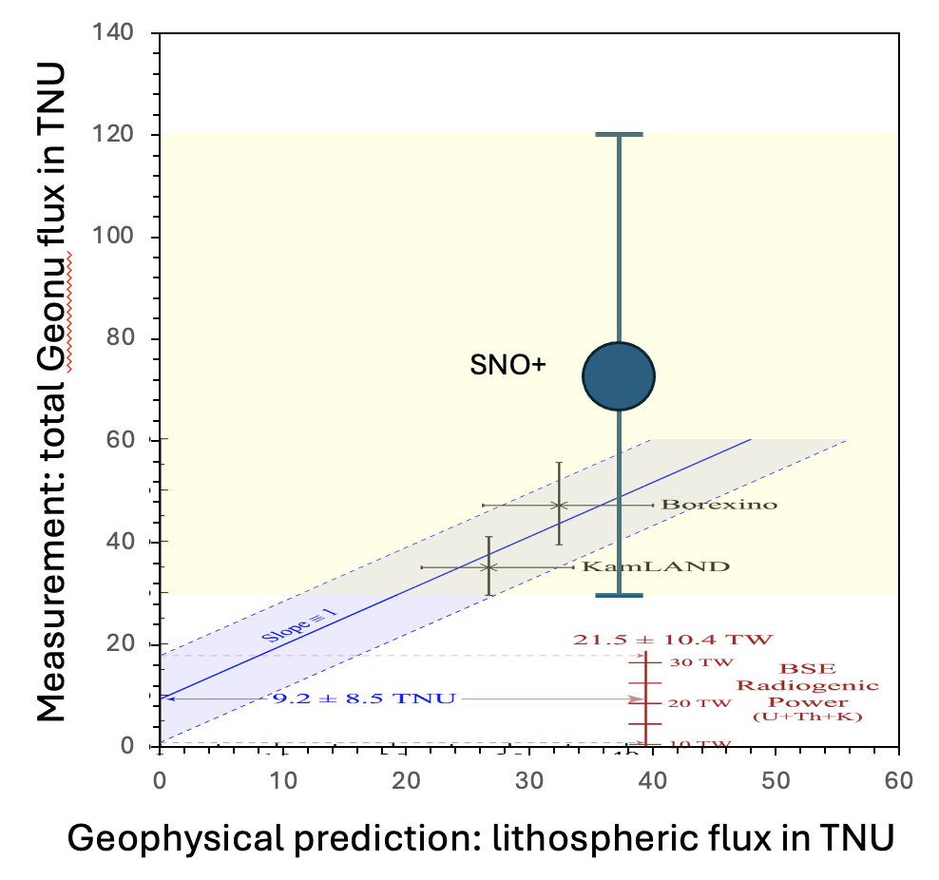
Insights from SNO+
Huang et al (2014, G³) initial estimate:
Strati et al (2017, G³) updated estimate:
Data release (2025, PRL): measurement
+6
40 TNU
-4
+8
37 TNU
-5
+47
73 TNU
-43
SNO+ measurement: 47 TW from Th & U
or 59 TW from K, Th, & U
More radiogenic power than Earth’s surface flux??

Slide 13
JUNO’s crustal composition
Gao et al (2020, PEPI) updated estimate:
Strati et al (2015, PEPS) initial estimate:
Data collection begun
Conflicting geological predictions??
important experiment for geoscience

Slide 14
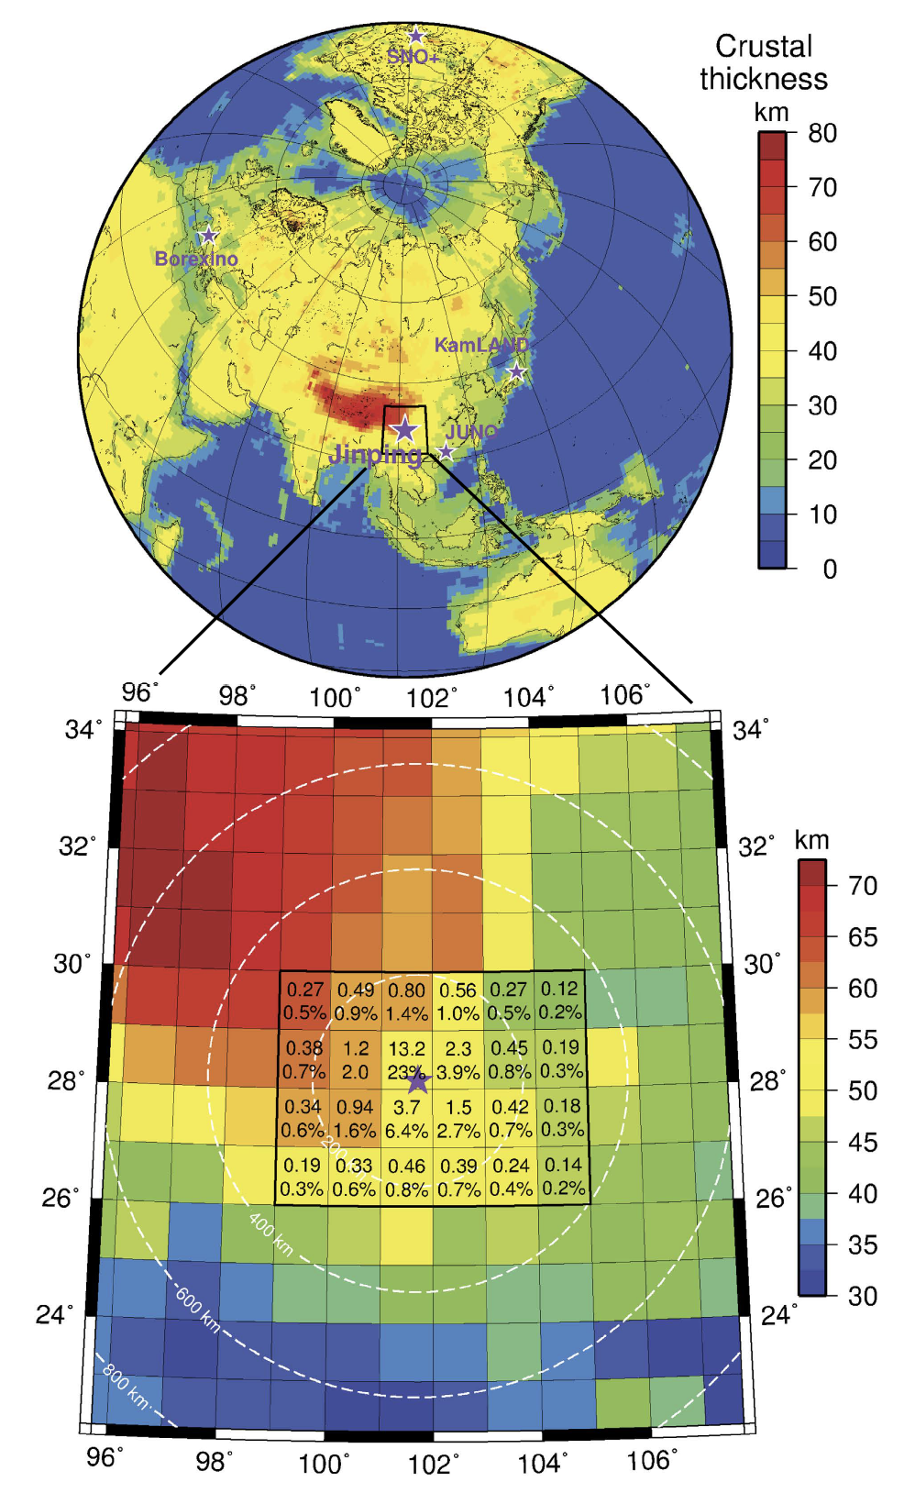
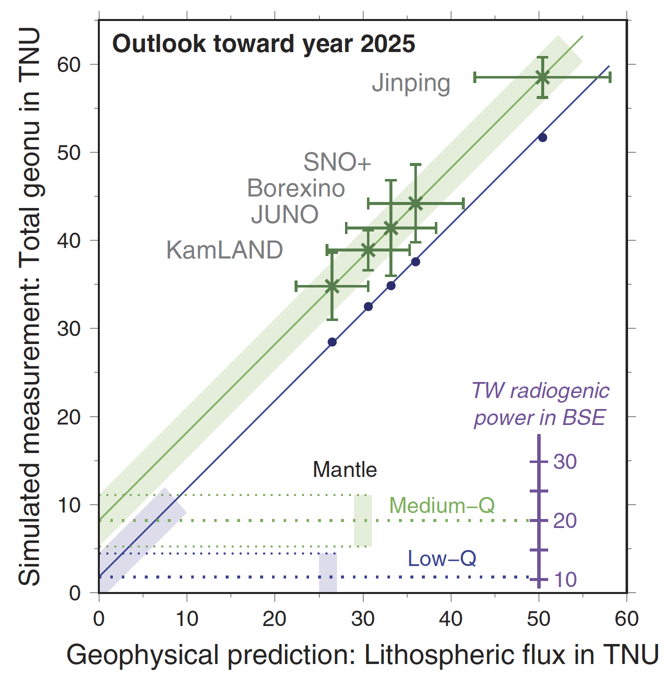
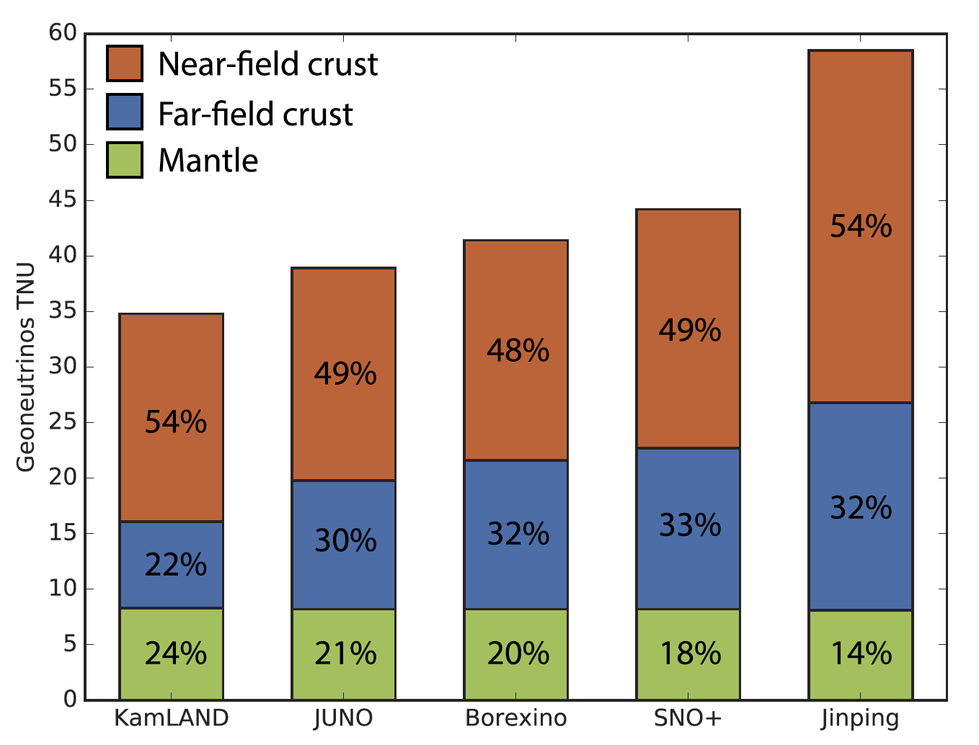
Jinping’s crustal composition
Sramek et al (2016, Nature Sci Reports) initial estimate:
Wan et al (2017, PRD) updated estimate:
Greatest overburden, lowest muon flux
Important novel applications

Slide 15
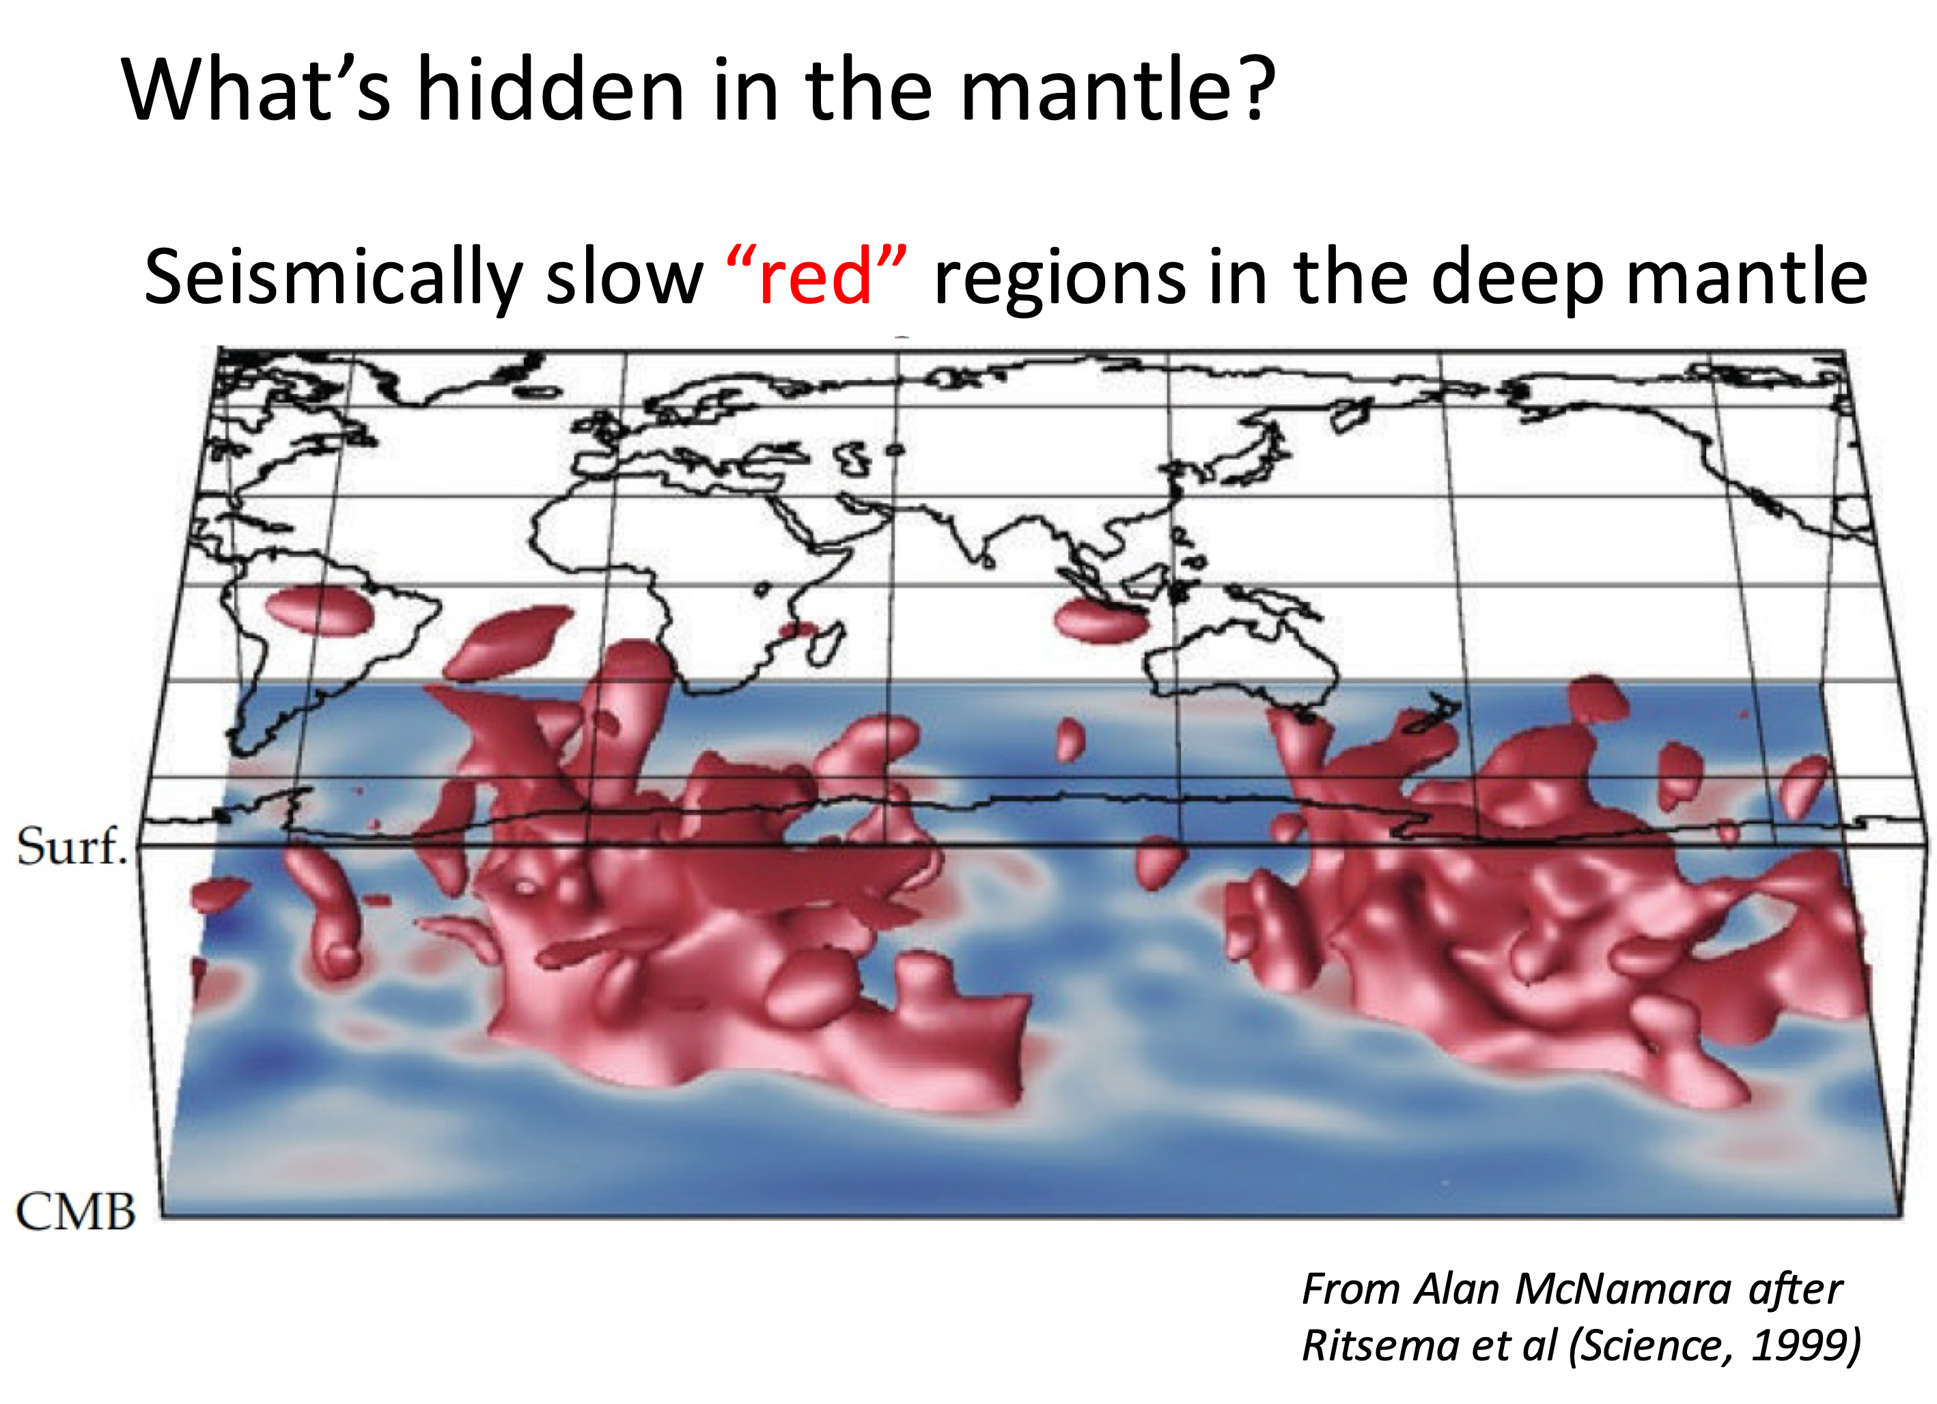
Ocean Bottom Detector
What’s hidden in the mantle?
Sramek et al (2013, EPSL) geology concept paper
Determining the mantle flux
* Chemical mapping of the Earth’s interior
* See also Xu et al (Wednesday, 2:20 PM)

Slide 16
Summary
Current data prefer a
  20 ± 8 TW radiogenic Earth
Radiogenic power in mantle: ~13 TW
Need to reduce uncertainties
Future is bright

