Slide 1
Fundamental Limit of Gravitational Wave Detection
at Ultra-high frequency
Xinyao Guo
Tsinghua University
2025.8
arXiv. 2501.18146
Notes:
Hello everyone, I'm Xinyao Guo, currently a PhD student of Tsinghua University. My report is about the fundamental limit of GW detection at ultra-high frequency.

Slide 2
01
Background
02
Unified Quantum Limit
CONTENTS
03
Numerical Benchmark
04
Summary
Notes:
Here's an outline of my report, firstly I'll quickly go through the background of ultra-high frequency gravitational waves, then I'll introduce an unified quantum limit that holds for a wide range of detectors, and give a numerical sensitivity benchmark of multiple designs, at last would be a short summary and outlook.

Slide 3
Part One
Background
Notes:
And let's move on to the background section

Slide 4
01
Background——Ultra-high Frequency Detection
Quantum fluctuation of early universe
SMBH merger
merger of compact binaries
Age of universe
years
hours
sec
ms
time
log(freq)
-16
-14
-12
-10
-8
-6
-4
-2
0
2
Cosmic Microwave Background
Space-based interferometers
Ground-based interferometers
Pulsar timing array
· What about higher frequencies beyond traditional astrophysical sources?
  ·Quiet astrophysical sky
  ·Golden window for the search of new physics
Notes:
Here’s a brief summary of current mainstream gravitational-wave detection. As you can see, the major gravitational-wave detection proposals each correspond to specific astronomical events.
Beyond 4-5 kilohertz—which is the highest frequency component of binary neutron stars merger—the contribution from knowned typical astrophysical sources basically vanishes, making the astrophysical sky at ultra-high frequencies extremely quiet, which makes it a golden window for the search of new physics.

Slide 5
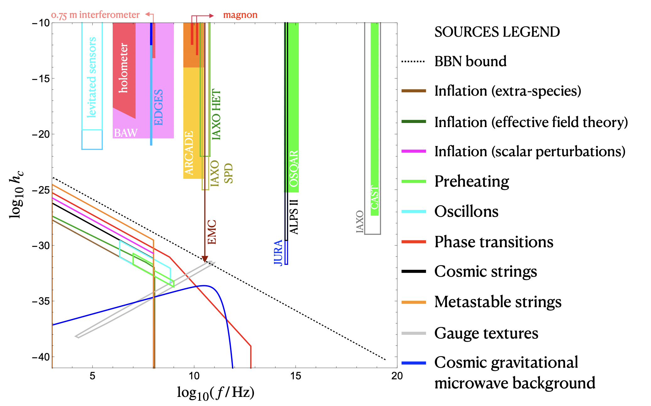
01
Overview of Ultrahigh Frequency Designs
· weak stochastic signal below the BBN bound
· Many parallel designs, but still quite distant from the signal level
Credit: arXiv.2011.12414 (Challenges and oppotunities of ultra-high frequency detection)
Notes:
And here is a brief review of the ultra-high frequency detection. For the science case part, there are many possible physical mechanisms in the early stage of uiverse that could generate stochastic signals at ultra-high frequencies, including preheating, GUT induced phase transition, cosmic strings, and so on. And there is an important bound, the BBN bound, which is a solid upper limit of the strength of these early-universe stochastic GW backgrounds. And, for detection proposals, there are also quite a lot. However, basically none of them has reach the sensitivity level of direct detection of such signals. Meanwhile, our understanding of ultra-high frequency detectors are quite case by case, there is not a unified insight for us to understand these various designs. In recent years, new proposals with different working principles and physical layouts continue to emerge, aiming to reach the sensitivity levels of BBN bound. Only analyze each design case-by-case would clearly be insufficient, and we want to develop a unified framework to put these various designs together.

Slide 6
Part Two
Unified Quantum Limit
Notes:
The way we united multiple designs is to derive a unified quantum limit that holds for a broad scenario. In this part, I'll introduce it briefly.

Slide 7




02
General Framework
$${\hat{a}}_{2}$$
$${\hat{a}}_{2}$$
$$G∙\sqrt{〈{(∆h)}^{2}〉}$$
Pre-operation
Preparing the input quantum state
$$G∙h$$
$${\hat{a}}_{1}$$
$${\hat{a}}_{1}$$
signal encoding
· Gain ：The system’s amplification to signal at the readout
· Metrology : Optimizing the input-output strategy to make signal more distinguishable from noise
Interaction with detection system, encoding the targeting signal physically to the quantum state
Post-processing
Optimal classical measurement
Notes:
Our starting point is the general framework of quantum measurement. Any quantum measurement can be decomposed into three components: (1) preparation of the input quantum state; (2) signal encoding, where the physical quantity being measured interacts with the measurement system, thereby encoding information into the quantum state; and (3) post-processing procedures to extract the information.
For gravitational wave detection, the sensitivity is primarily determined by two key quantities: First, the gain - which describes how much the output quantum state changes per unit strain signal. This quantity depends solely on the intrinsic properties of the physical system and is independent of the input quantum state or whether the signal is deterministic. Second, the metrology - which corresponds to how we design the input quantum state and readout scheme according to the signal characteristics to optimally extract information from the quantum state. I will elaborate on these two aspects separately later.

Slide 8
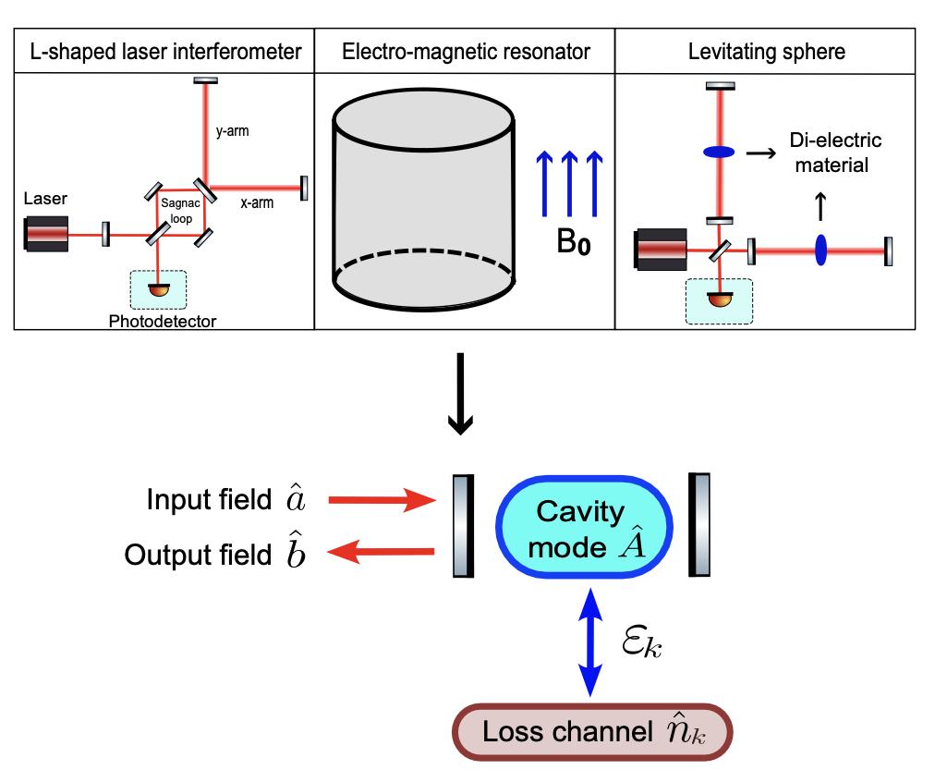
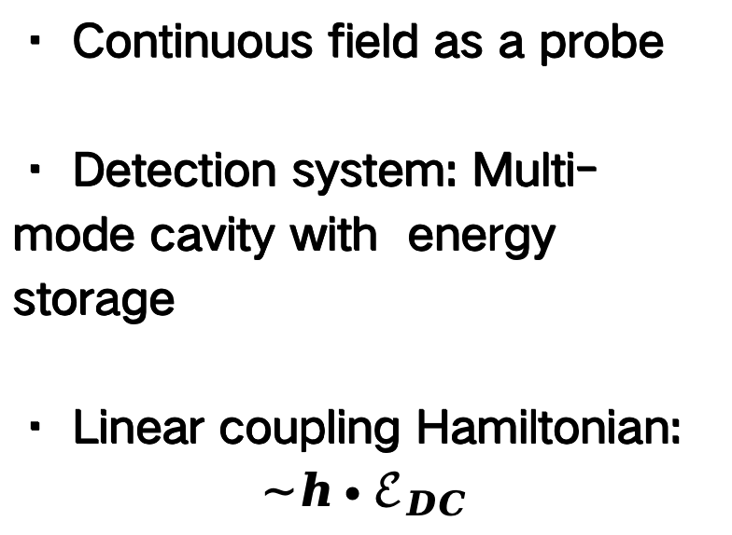
02
Similarities Among Various Designs
Similarities
· Continuous field as a probe
· Detection system: Multi-mode cavity with energy storage
· Linear coupling Hamiltonian:
$$\sim h∙ℰ_{DC}$$
Credit: [1] Phys. Rev. D 108, 124009 (2023) (EM cavity, based on Gertsenshtein effect)
[2] Phys. Rev. Lett. 128, 111101 (2022) (levitating object)
Notes:
For the discussion of gain, we starts from the layout of several typical designs, including traditional lab-scale laser interferometers; laser interferometers with levitating objects (which suspend dielectric material in the arm cavity and modify cavity dynamics ); and EM resonator designs that use resonant cavities with strong static magnetic fields to sense GW signals. They seems quite different, but they actually have commonalities. They all employ a resonant system with separate modes and large energy storage as the probe for gravitational wave detection. Meanwhile, they don't directly detect the resonant mode, but instead use a continuous field as the mediator. At last, the coupling between gravitational waves and the system follows the linear form shown below. Therefore, disregarding implementation details, all these proposals can be unified under this schematic diagram.

Slide 9


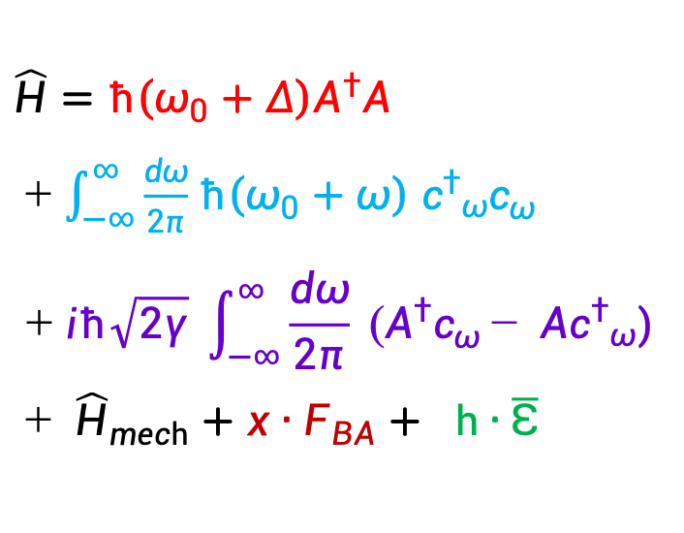

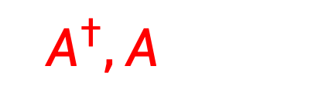
02
Single-mode Model
Scheme
Hamiltonian
Gain
$\hat{H}=ℏ\left(ω_{0}+Δ\right)A^{†}A$
+ $\int_{−∞}^{∞}{\frac{dω}{2π}}$ $ℏ\left(ω_{0}+ω\right)$ ${c^{†}}_{ω}c_{ω}$
$$+ iℏ\sqrt{2γ} \int_{−∞}^{∞}{\frac{dω}{2π}} (A^{†}c_{ω}− {{Ac}^{†}}_{ω})$$
+ ${\hat{H}}_{mech}+x∙F_{BA}+ h∙\overline{ℇ}$
Continuous
Mode
Bosonic
Mode
Mechanical
Part
$c^{†},c$
$A^{†},A$
$x,p$
GW coupling
$\overline{ℇ}$=$ℏ\left(ω_{0}+Δ\right)A^{†}A$
Credit: Yanbei Chen 2013 J. Phys. B: At. Mol. Opt. Phys. 46 104001 (single-mode formalism)
Notes:
The Hamiltonian of the generalized system can be directly written down. Since there is no coupling between different cavity modes, we can analyze each mode separately. The right-hand side shows the Hamiltonian for a single cavity mode, where:
The red and blue terms represent the self-interaction of the cavity mode and the continuous mode, respectively.
The purple term describes their cross-interaction.
The green term corresponds to the effect induced by gravitational waves (GWs).In principle, their should be an order-of-one factor alpha, which accounts for the configuration-dependent sky-averaged effect for GW signal. However, for order-of-magnitude analysis, we just drop it for simplicity.
The black and brown terms account for the influence of dynamical backaction.

Slide 10

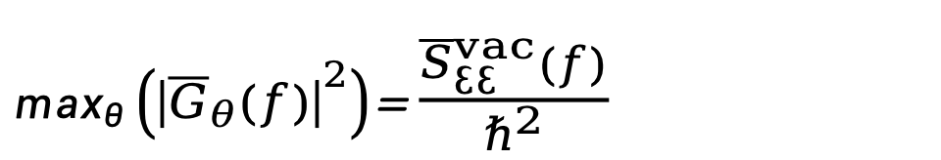
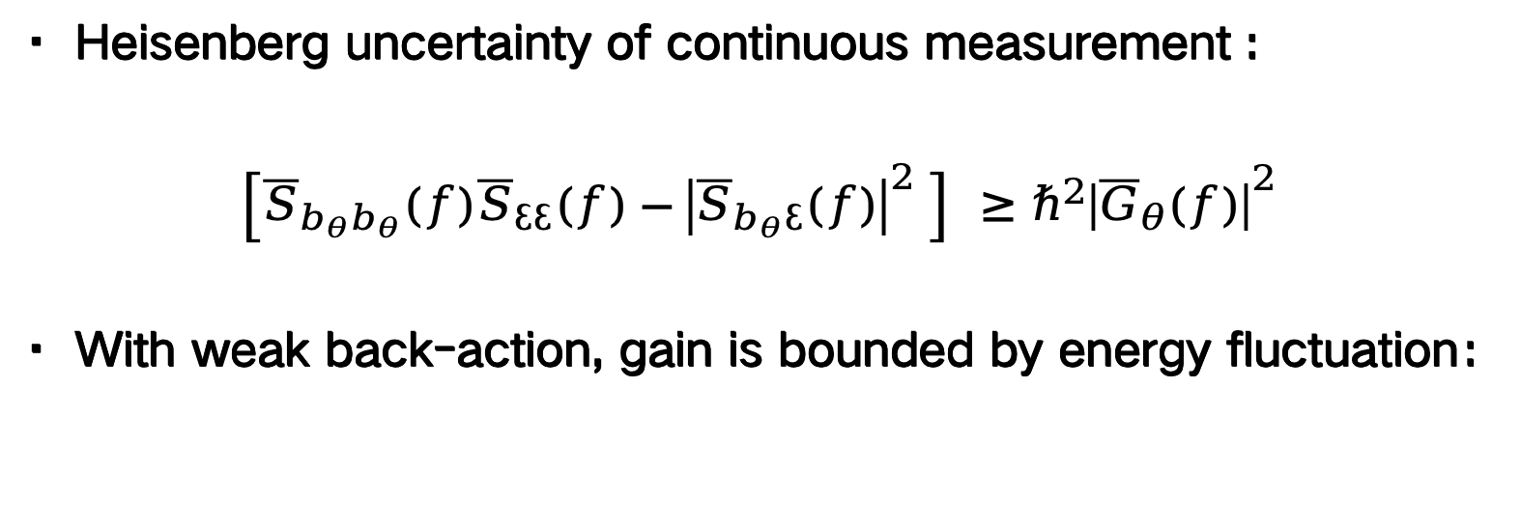
02
Quantum Limit of Gain
Key Result
· Heisenberg uncertainty of continuous measurement :
$$\left[{\overline{S}}_{b_{θ}b_{θ}}(f){\overline{S}}_{ℇℇ}(f)−{\left|{\overline{S}}_{b_{θ}ℇ}(f)\right|}^{2} \right] ≥ℏ^{2}{\left|{\overline{G}}_{θ}(f)\right|}^{2}$$
· With weak back-action, gain is bounded by energy fluctuation：
$\max_{θ}\left({\left|{\overline{G}}_{θ}(f)\right|}^{2}\right)$= $\frac{{\overline{S}}_{ℇℇ}^{vac}(f)}{ℏ^{2}}$
Credit: [1] Phys. Rev. Lett. 119, 050801 (2017) (Heisenberg bound for linear response theory)
Notes:
The key conclusion of this part is an quantum upper limit of the gain. The GW-induced displacement varies with the readout angle. According to linear response theory, the gain at each quadrature is linked to the correlation spectral density through the following relation—a direct consequence of the Heisenberg uncertainty principle.
The gain we defined earlier corresponds to the maximum displacement across all possible readout angles. When dynamical backaction is sufficiently weak, taking the maximization analytically, the gain is simply proportional to the energy fluctuatio within the cavity system with vacuum state injection.

Slide 11

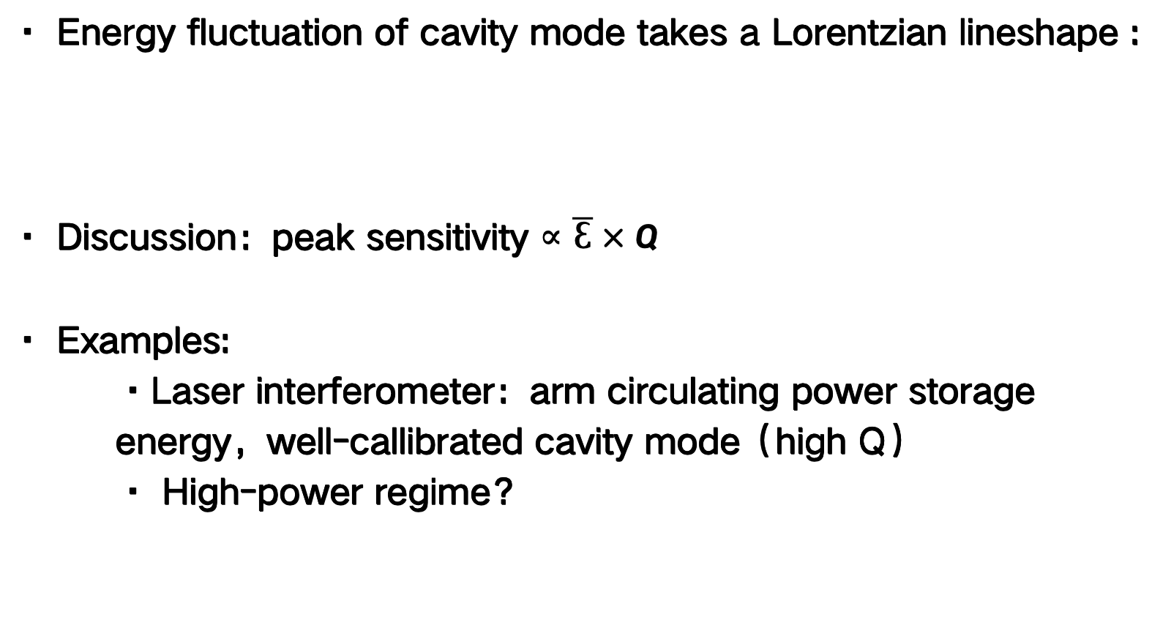
02
Energetic Quantum Limit
Key result
· Energy fluctuation of cavity mode takes a Lorentzian lineshape :
· Discussion：peak sensitivity $∝\overline{ℇ}×Q$
· Examples:
  ·Laser interferometer：arm circulating power storage energy，well-callibrated cavity mode（high Q）
  · High-power regime？
Notes:
special—it’s just a simple Lorentzian lineshape centered at the cavity resonance frequency. The gain therefore also follows this Lorentzian profile.
A direct corollary is that the gain at the sensitivity peak can be expressed in terms of fundamental system parameters as the total stored energy times the quality factor of the cavity mode. This offers valuable intuition for understanding detectors. From this perspective, we can easily assess whether a configuration suffers from quantum noise.
For example, in traditional interferometers, energy is stored as arm-circulating power, which are actually quite limited (only a few joules even in full-scale LIGO), but their well-calibrated cavity modes compensate for this limitation. Meanwhile, some high-energy regimes could possibly achieve excellent performance from the quantum perspective, such as resonant cavities with static magnetic fields.

Slide 12



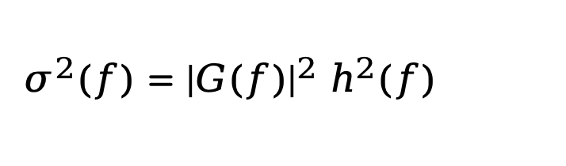
02
Metrology—Stochastic Signal Estimation
· No longer attainable linear signal ! Messages encoded in covariance matrix
· GW effect：excess variance:
${ σ}^{2}\left(f\right)={\left|G(f)\right|}^{2} h^{2}(f)$
State
Maximum SNR
Optimal measurement
$$\frac{σ^{2}}{ε}\sqrt{N}$$
· SMSV
· Vacuum
· TMSV(optimal)
Homodyne (linear measurement)
Photon counting (quadratic)
$$\sqrt{N/2}∙σ$$
$$\sqrt{N/2}∙\frac{σ}{\sqrt{ε}}$$
Credit: PRX Quantum 6, 030311 (2025) (stochastic waveform estimation)
Notes:
In this specific case, the mission of metrology is to select an optimal input quantum state and readout strategy under given loss conditions to maximize detection capability for stochastic signals.
This work was previously addressed by James Gardner (ANU) and Yanbei Chen/Tuvia Gefen (Caltech). Here, I will reference their key conclusions. In the scenario of stochastic signal estimation, the parameter to be estimated is the variance of the strain signal in the frequency domain, normalized by the optical gain. And，by integrating the signal for a period, we could effectively take N parallel samples, where N equals to the integration time times the frequency bin width. Here are their key results，which holds at weak back-action limit and with weak signal much below the noise level. For the highly squeezed single-mode vacuum state as input, the optimal SNR is essentially the normalized variance over a constant noise background, which could be saturated by regular homodyne detection. Meanwhile, interestingly, the optimal attainable SNR with vacuum state injection might perform better in the signal-limited regime, where the SNR scales as the square root of the variance—a characteristic feature of Poisson statistics, and could be saturated by photon counting, which is a kind of quadratic measurement. Lastly, with an ideal lossless ancilla serving as an entanglement source, the performance of photon counting can be further enhanced through squeezing, representing the ultimate limit among all possible quantum states,and it can be saturated by an ideal two-mode squeezed vacuum.

Slide 13
Part Three
Numerical benchmark
Notes:
Up to now, we have completed the full picture of sensitivity. The metrology discussion has addressed the mathematical framework for detection given a specific gain, while the gain itself is tied to the physical nature of the detection system through the energetic quantum limit. This now allows us to compare different designs

Slide 14
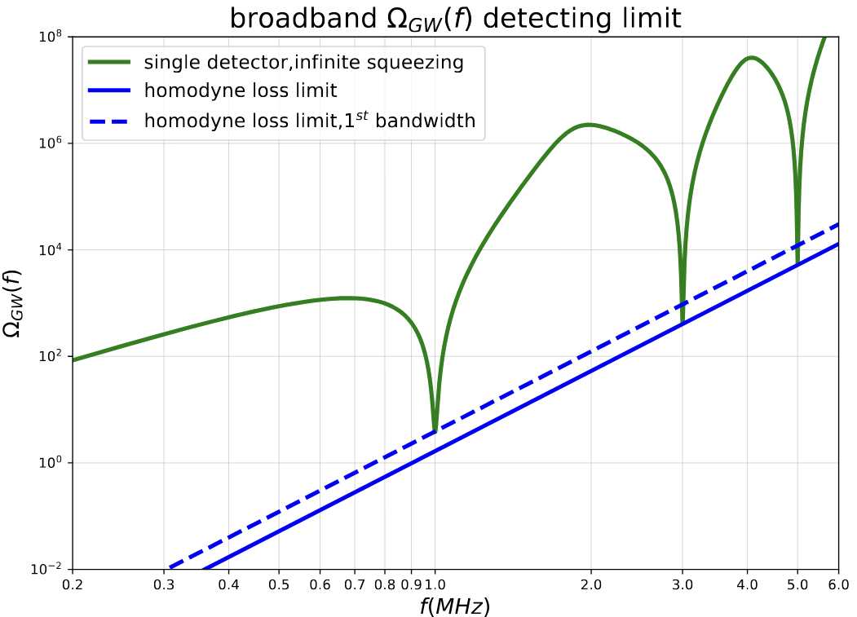
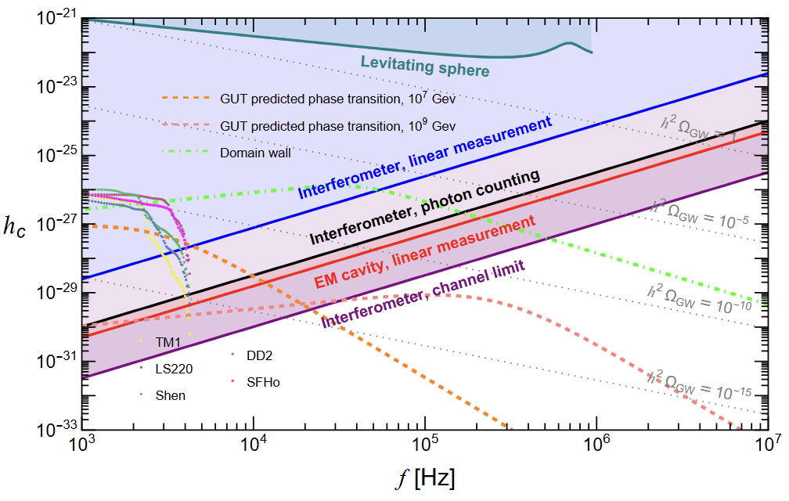
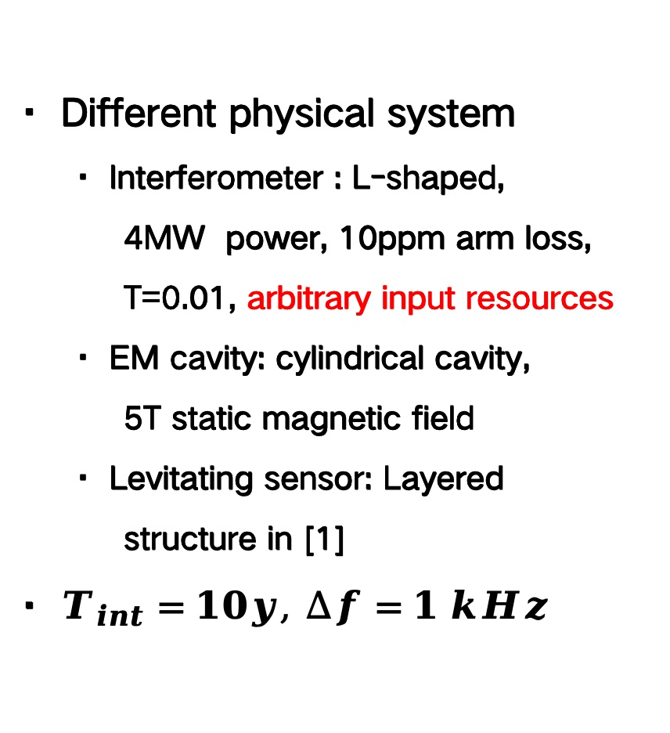
03
Numerical Performance
· Different physical system
· Interferometer : L-shaped,
  4MW power, 10ppm arm loss, T=0.01, arbitrary input resources
· EM cavity: cylindrical cavity,
  5T static magnetic field
· Levitating sensor: Layered structure in [1]
· $T_{int}=10y, ∆f=1 kHz$
Notes:
Here, we compared the quantum upper limit of both some parallel physical layouts with linear homodyne readout, and laser interferometer itself with different metrology. We quantitized the sensitivity limit of multiple designs by the minimum detectable strain with unity SNR. The integration time and frequency bin width are fixed as 10 years and 1 kHz. And, the straight lines in the figure are actually the combination of best performance of multiple individual detectors. Here, the blue line stands for a futuristic limit of laser interferometer with homodyne. As we can see, even in the highly optimistic arm loss limit with high power and low loss, the sensitivity remain insufficient to detect some GUT-motivated signal, while some advanced metrology or high energy regime might enable such direct detection

Slide 15
Part Four
Summary

Slide 16
04
Summary
· Two key factor of sensitivity: gain & metrology
· Energetic quantum limit : Large gain at the resonant peak corresponds to large energy storage and high Q factor
· Squeezed state and homodyne detection is not the most suitable for stochastic signal, advanced metrology might help
· Actually a loose upper limit for specific designs
· Application: quick preliminary assessment to rule out designs
Notes:
At last, I'll conclude with a few words. Quantum limit of ultra-high frequency GW detection are determined by two key factors: gain and metrology. For the gain part, the take-home message is the energetic quantum limit, that is, to reach high amplification for signal, the physical detection system should have both large energy storage and high Q factor, and designs with much higher energy compared to laser interferometer might be very promising. For the metrology part, queezed state and homodyne detection is not the most suitable for stochastic signal, advanced metrology might help. Due to the over simplification of model, such quantum limit could be very loose for specific design. However, it allows for quick preliminary assessment for the potential of various design, so that we could rule out design with poor quantum limit before dive into the complex details. This might be helpful for the future development of ultra-high frequency detection

Slide 17
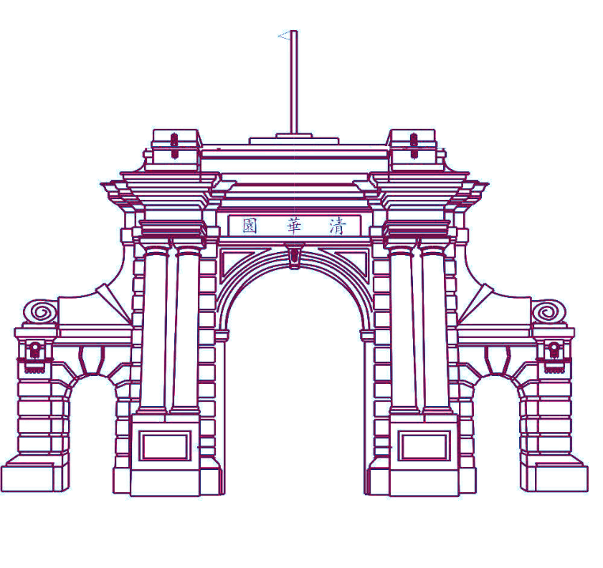
THANK YOU
guoxy24@mails.tsinghua.edu.cn

Slide 18
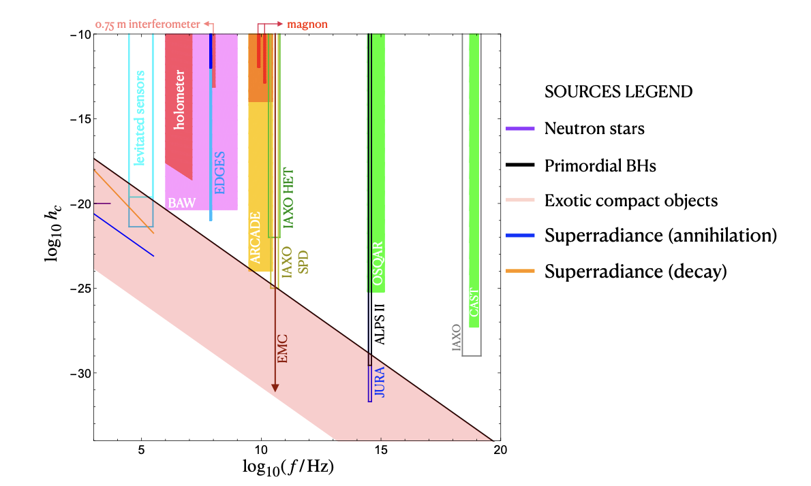
01
PBHs, superradiance
Notes:
In this specific case, the mission of metrology is to select an optimal input quantum state and readout strategy under given loss conditions to maximize detection capability for stochastic signals.
This work was previously addressed by James Gardner (ANU) and Yanbei Chen/Tuvia Gefen (Caltech). Here, I will reference their key conclusions. Their analysis employed two fundamental tools:
Quantum Fisher Information (QFI)
Quantum Cramér-Rao Bound (QCRB)
Basically, for a parameter theta encoded in a quantum state rho, the Quantum fisher information quantitized the maximum signal we could extract from the quantum state via all possible classical measurement, which depends solely on the quantum state itself and could be analytically calculated as follows. For unbiased parameter estimation, the QFI sets an upper limit to the corresponding "signal to noise ratio", name the quantum carmaer rao bound. Here, N is the total number of measurement, in the scenario of stochastic GW, it is the integration time times the width of each frequency bin.

Slide 19




01
Background——Possible Signal
Candidate sources
· Quantum gravity effect, i.e. , geontropic fluctuation^{[1]}
· GUT-motivated GW signals
$${\hat{a}}_{2}$$
$${\hat{a}}_{2}$$
Key feature
$$G∙\sqrt{〈{(∆h)}^{2}〉}$$
· Super weak
·No deterministic time-domain waveform, being purely stochastic in nature
$$G∙h$$
$${\hat{a}}_{1}$$
$${\hat{a}}_{1}$$
Determinstic Stochastic
Credit: [1] PHYSICAL REVIEW D 107, 024002 (2023) (geontropic fluctuation)
Notes:
The main signals in ultra-high frequency band are basically stochastic signal, including some quantum gravity effects like geontropic fluctuations, or GUT-motivated gravitational wave signals.
These signals are actually broadband, however, they are easily drowned out by the loud signals from astrophysical sources at typical astronomical frequencies.
As a result, the super-quiet ultra-high frequency window becomes the best opportunity to detect them.

Slide 20
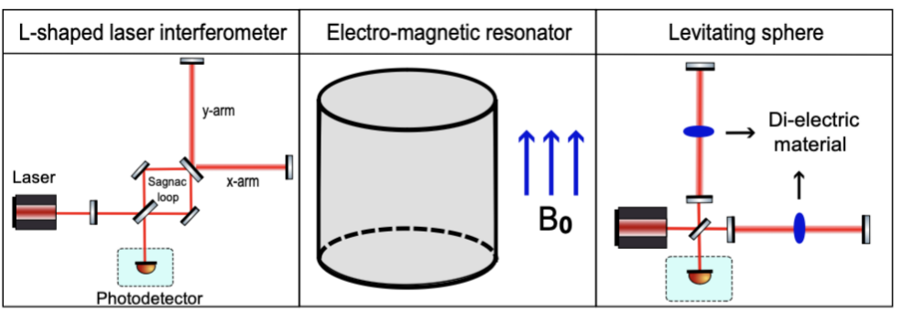
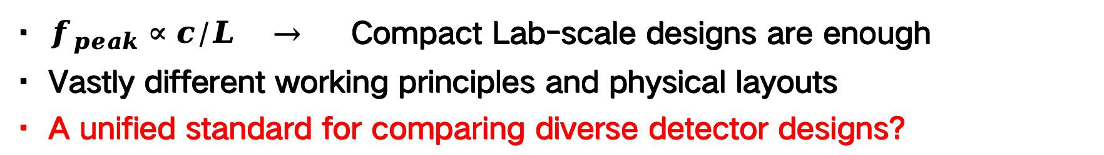
01
Background——Detection Proposals
· $f_{peak}∝c/L →$ Compact Lab-scale designs are enough
· Vastly different working principles and physical layouts
· A unified standard for comparing diverse detector designs?
Credit: [1] Phys. Rev. D 108, 124009 (2023) (EM cavity, based on Gertsenshtein effect)
[2] Phys. Rev. Lett. 128, 111101 (2022) (levitating object)
Notes:
Detection proposals for ultra-high frequency gravitational wave signals are remarkably diverse. Of course, we can infer the strain from some other observations, and for lab scales designs that directly search for ultra-high frequency GW signal, there're also a lot. Typical designs include: traditional lab-scale laser interferometers; laser interferometers with levitating objects (which suspend dielectric material in the arm cavity and modify cavity dynamics ); and EM resonator designs that use resonant cavities with strong static magnetic fields to sense GW signals. And all these stuff only requires lab-scale designs. In recent years, new proposals feature vastly different working principles and physical layouts continue to emerge. Only analyze each design case-by-case would clearly be insufficient. Therefore, developing a unified standard for comparing diverse detector designs has become our primary goal.

Slide 21
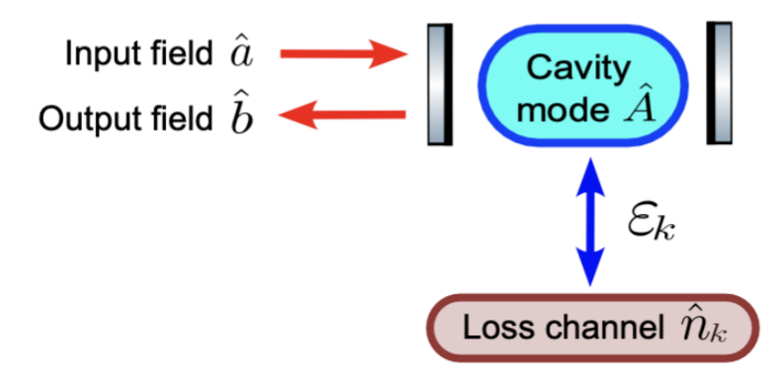



02
Metrology—Quantum Loss
· cold-quantum loss(some vacuum component mixed into the system)
Notes:
Another important issue is metrology. Fundamentally, the ultimate mission of detection is to distinguish the signal from noise—and here we consider only quantum noise.
The quantum noise primarily originates from two components:
The first is the intrinsic quantum fluctuation of the input quantum state propagating to the output;
The second is contribution from quantum loss.
In this work, we adopt the cold quantum loss model: the cavity mode couples to a local vacuum bath within the cavity, allowing vacuum components to leak into the system and ultimately reach the output. The amplitude of the noise field at the output are also closely related to Lorentzian lineshape.
For systems with weak back-action, the output noise component remains in the vacuum state. In contrast, systems with strong back-action exhibit noise fields that undergo significant internal squeezing.

Slide 22


02
Metrology—Method
Tool
·Quantum Fisher Information(QFI):
Information encoded in the quantum state
· Quantum Cramer-Rao Bound（QCRB）：
An upper bound of SNR of unbiased signal estimation
Credit: PRX Quantum 6, 030311 (2025) (stochastic waveform estimation)
Notes:
In this specific case, the mission of metrology is to select an optimal input quantum state and readout strategy under given loss conditions to maximize detection capability for stochastic signals.
This work was previously addressed by James Gardner (ANU) and Yanbei Chen/Tuvia Gefen (Caltech). Here, I will reference their key conclusions. Their analysis employed two fundamental tools:
Quantum Fisher Information (QFI)
Quantum Cramér-Rao Bound (QCRB)
Basically, for a parameter theta encoded in a quantum state rho, the Quantum fisher information quantitized the maximum signal we could extract from the quantum state via all possible classical measurement, which depends solely on the quantum state itself and could be analytically calculated as follows. For unbiased parameter estimation, the QFI sets an upper limit to the corresponding "signal to noise ratio", name the quantum carmaer rao bound. Here, N is the total number of measurement, in the scenario of stochastic GW, it is the integration time times the width of each frequency bin.

Slide 23
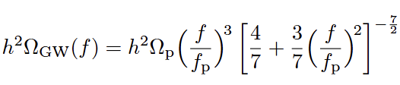
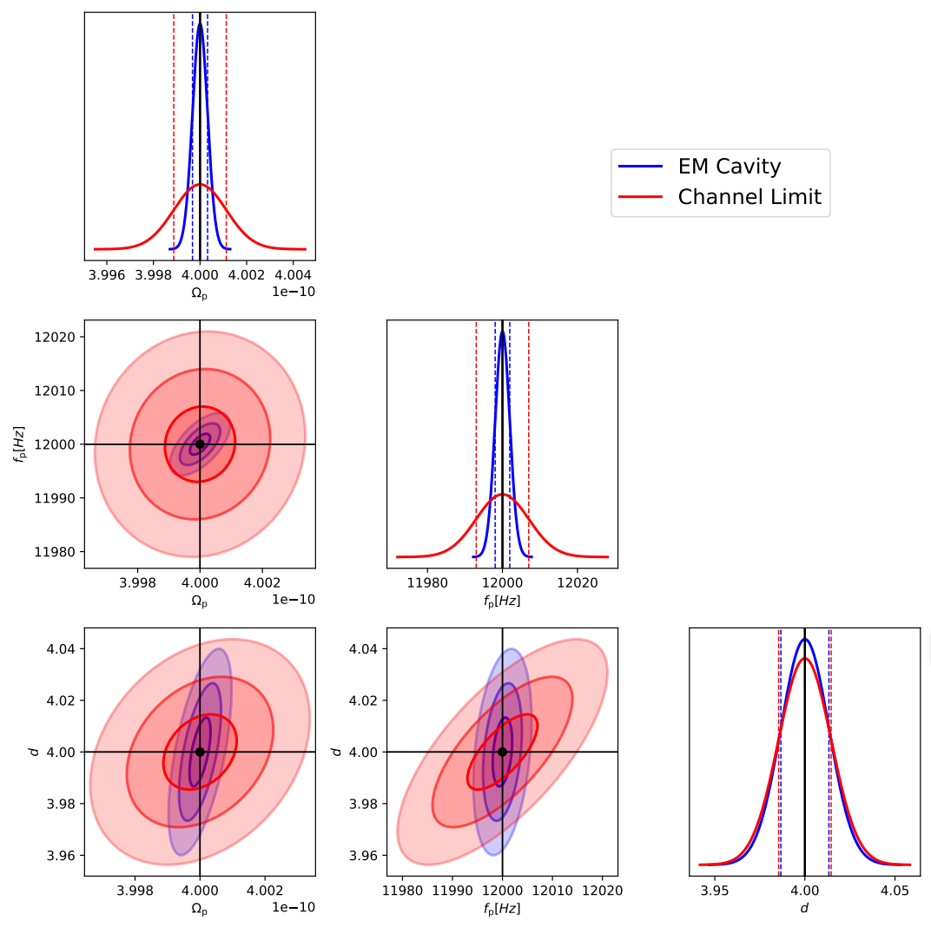
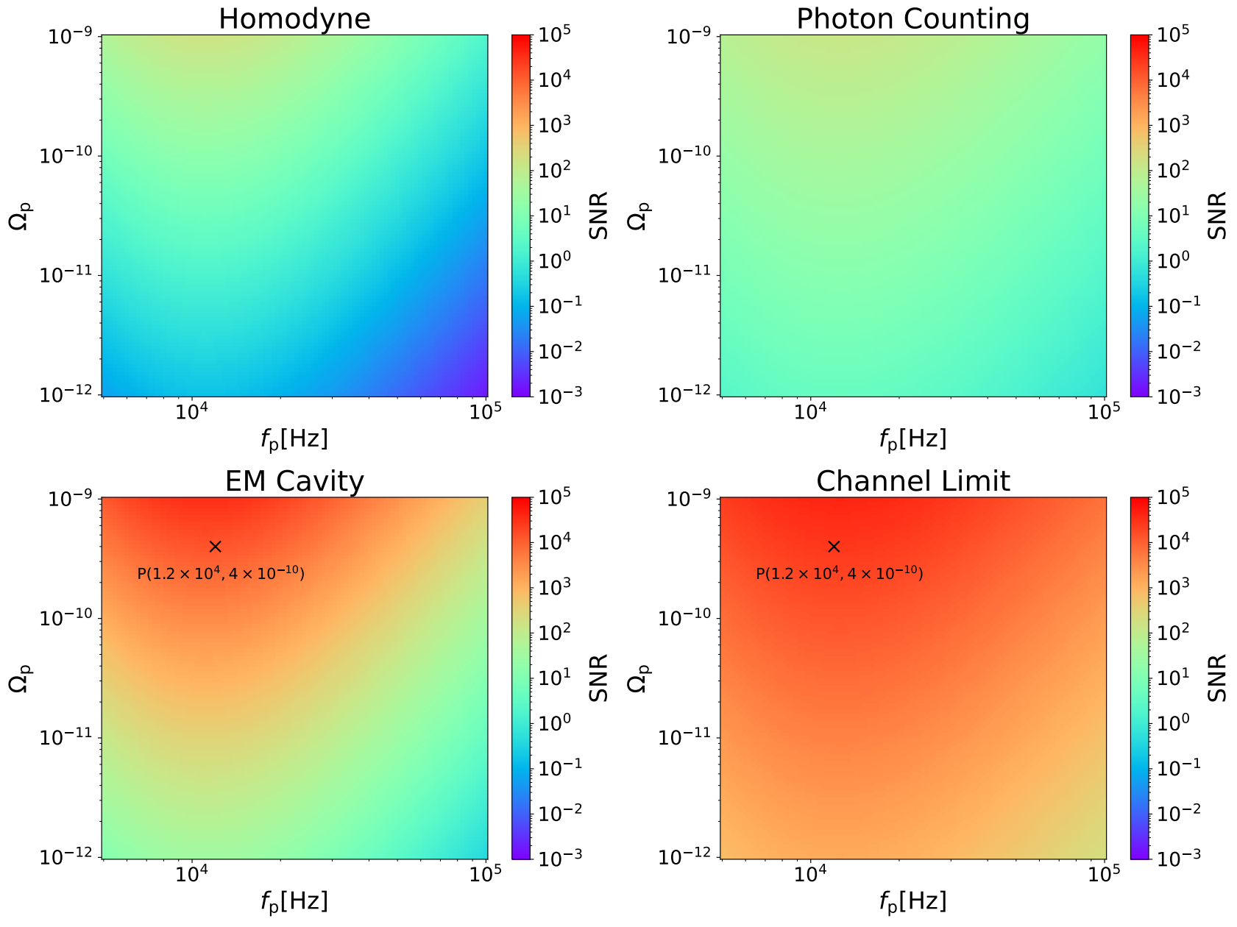
03
Phase Transition in GUT

