Slide 1
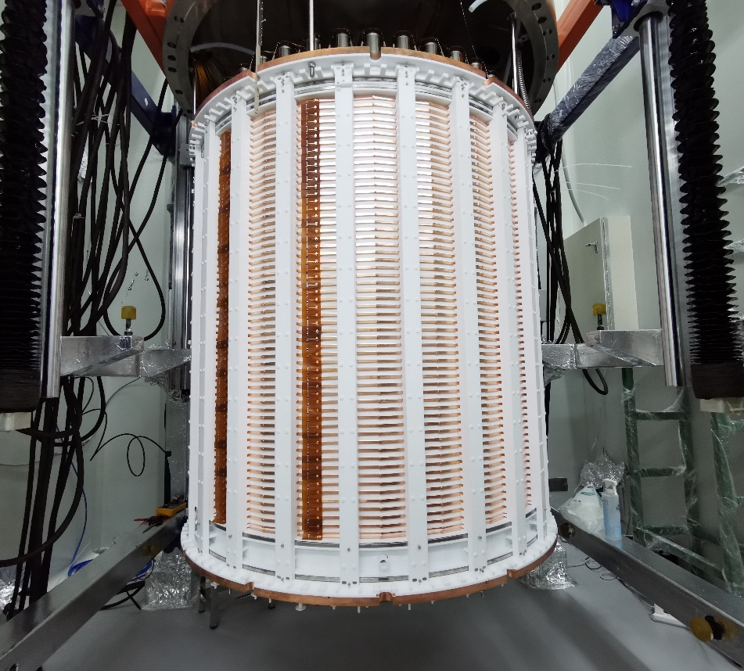

Search for Axions and Other New Physics
Signals with PandaX-4T
Xiaopeng Zhou, PandaX
the XIX International Conference on Topics in Astroparticle and Underground Physics (TAUP2025)
Notes:
Good afternoon, everyone!
This is Xiaopeng ZHOU from PandaX,
It is my great pleasure to present you the recent results from the PandaX-4T experiment, focusing on our searches for axions and other new physics signals.

Slide 2
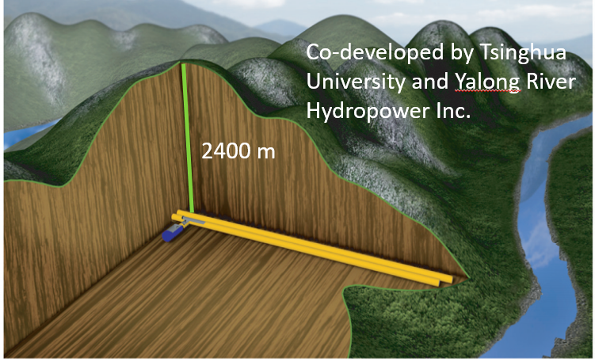
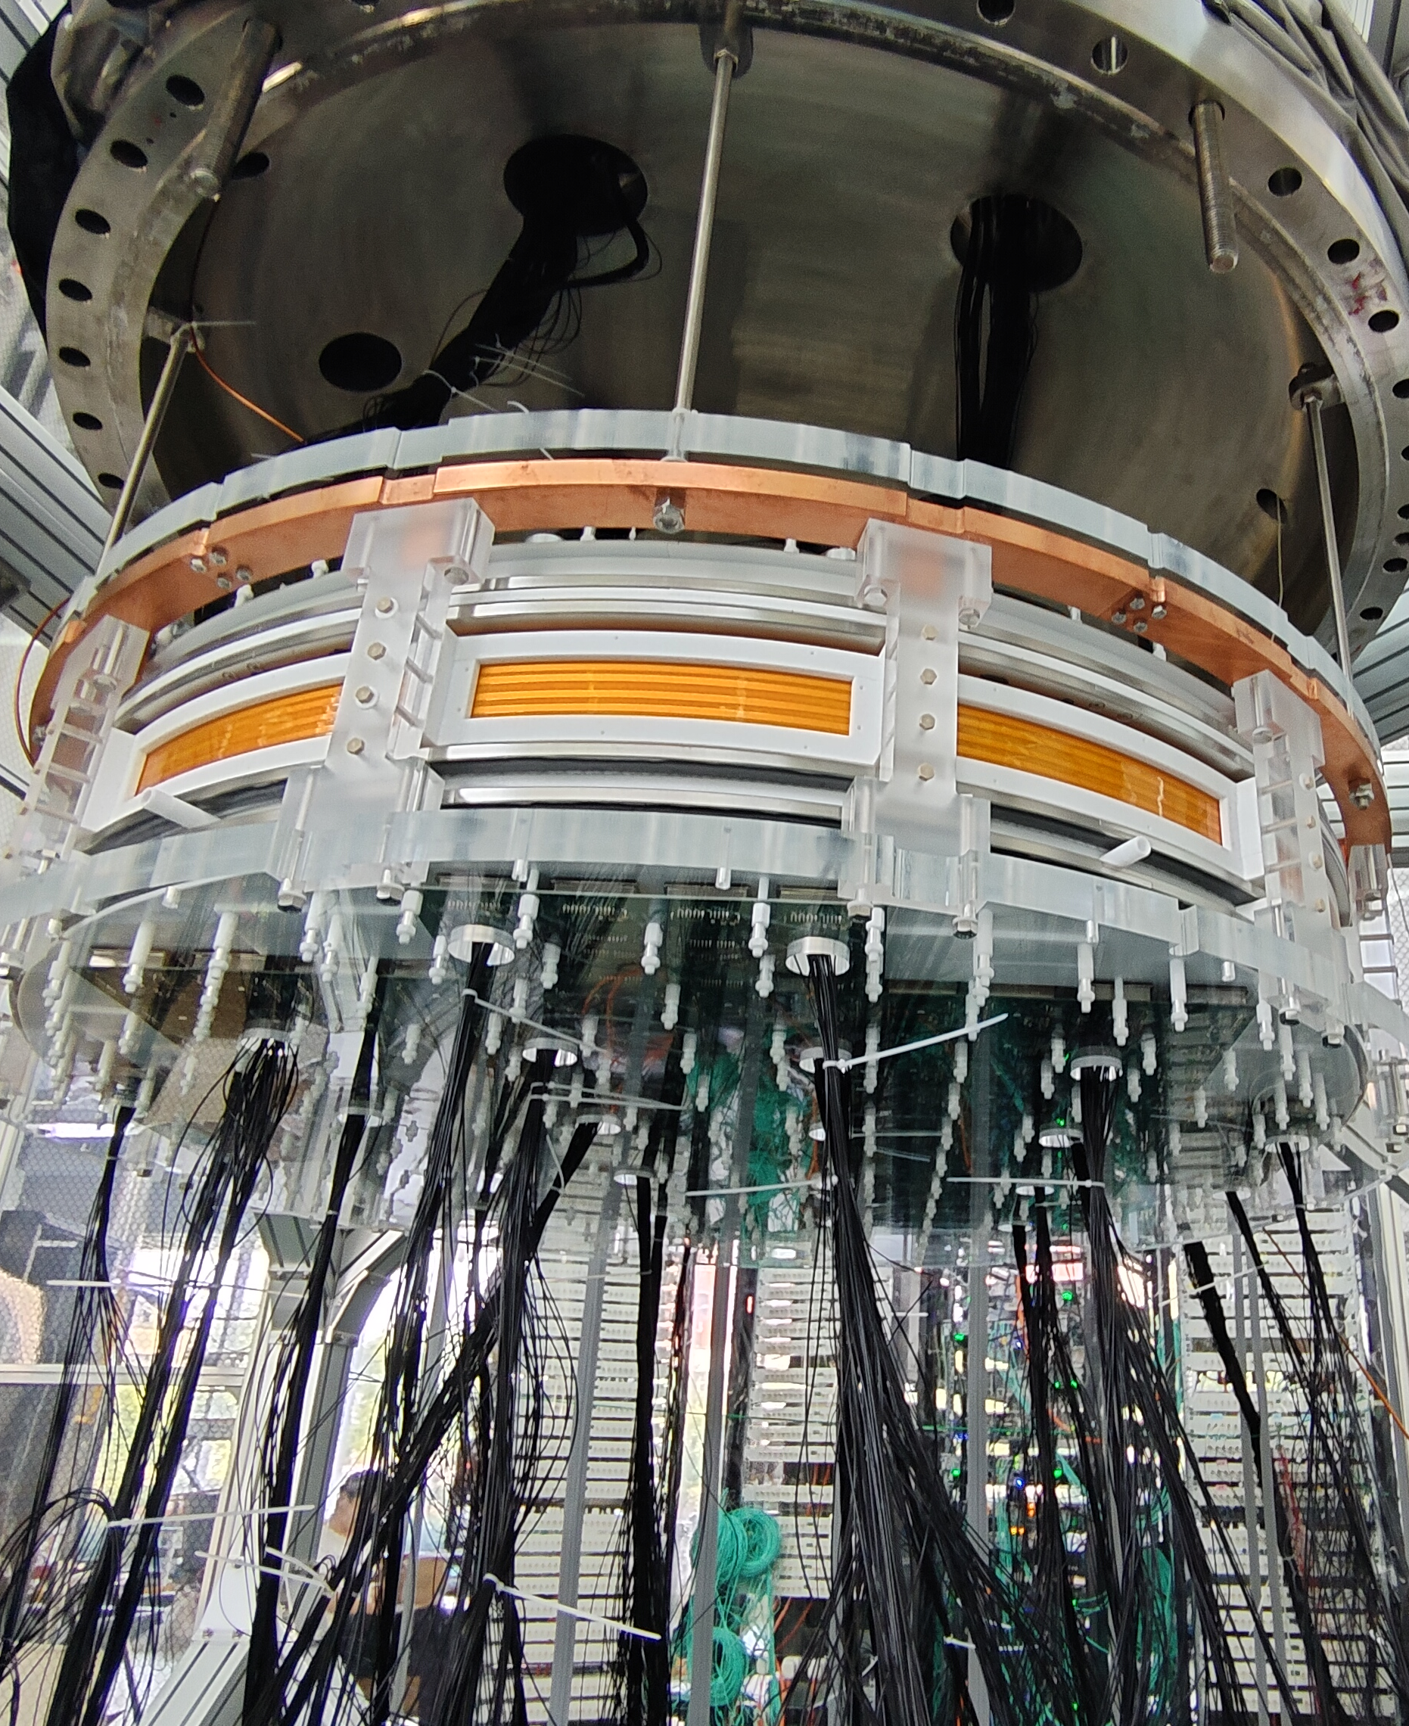
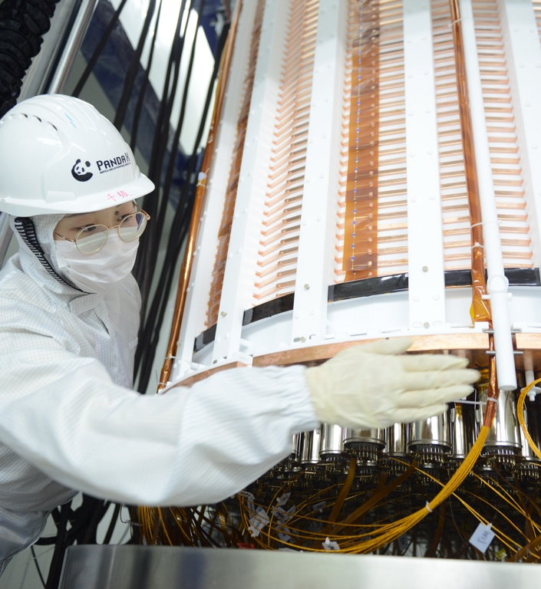
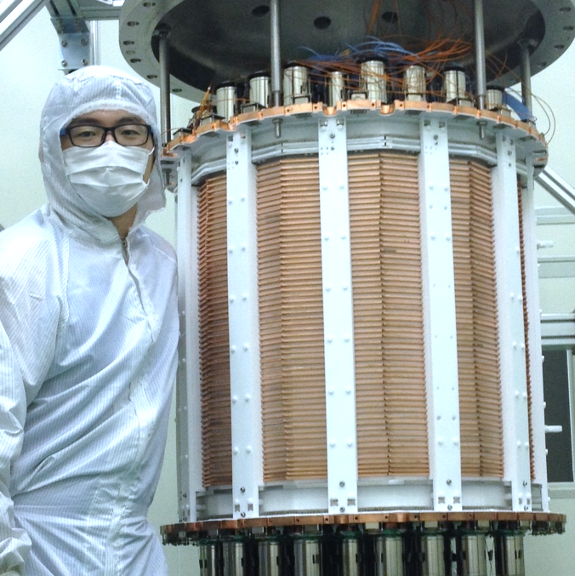
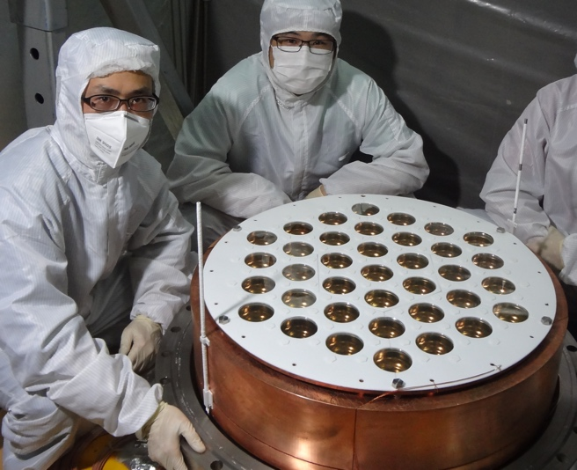

PandaX: Particle and Astrophysical Xenon Experiments
16 institutions, ∼100 collaborators
CJPL: Deepest (2400 m rock, 6800 m.w.e);
PandaX-4T data-taking is ongoing now.
PandaX-xT(20 ton)
PandaX-4T(3.7 ton)
China Jinping Underground
Laboratory (CJPL)
PandaX-II 580kg
PandaX-I 120kg
PandaX start
2009.3
2010 - 2014
2015 - 2019
2020 - Current
~ 2027
27/08/2025
2
Notes:
The is brief introduction about PandaX, we located in China Jinping Underground Labratory and the detector is taking data now.

Slide 3




Dual-Phase Xenon Time Projection Chamber
Liquid Xenon Properities
Large atomic number Z = 54; High mass number ⟨A⟩ = 131.3
High density @ 177K, ⟨𝞺⟩ = 2.86 g/cm³
No long-lived radioisotopes in WIMP ROI
Efficient UV scintillator (178 nm)
Gas Xe
E_{g}
Liquid Xe
S2
DM
Liquid Xenon As DM Detection Medium
Maximised interaction cross section for WIMP (∝ A²)
High stopping power and self-shielding
Ultra-low intrinsic background
Scintillation and Ionization Combined: Discrimination of nuclear recoil and electron recoil; 3D position reconstruction
Scalable – further sensitivity improvement
E_{d}
S1
PMT array
https://indico.bnl.gov/event/9858/
Notes:
and we use the dual phase xenon time projection chamber.
The principlesof Dual-Phase Xenon Time Projection Chamber has been introduced by many previous talks, so I will just skip this one.

Slide 4

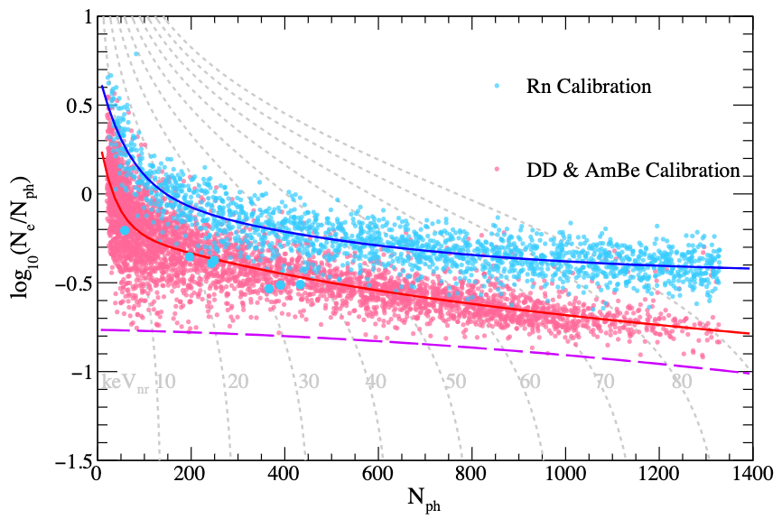

Nuclear Recoil V.S. Electron Recoil
S2
S1
ER
Time
Electron Recoil (ER)
S2
NR median
S1
NR
Time
Nuclear Recoil (NR)
The ratio: (S2/S1)_{ER} >> (S2/S1)_{NR} (NR has lower ionization rate but higher charge density);
Most of the backgrounds are ER events. exploring the ER region also holds promise for discovering new physics.
ER and NR response are calibrated separately: ²²⁰Rn (ER), DD + AmBe (NR);
Notes:
The Dual-Phase Xenon Time Projection Chamber is distinguished by its remakrable ability to discriminate between nuclear recoils and electron recoils.
Since most background signals are electron recoils,
However, exploring the electron recoil region also holds promise for discovering new physics.
In the PandaX experiment, we employed an internal calibration source, Rn-220, to calibrate the Low energ electron recoil response. For nuclear recoil , we used external sources such as Deuterium-Deuterium neutrons and AmBe.
This figure presents the separations of the electron recoil and nuclear recoil calibration data from PandaX-4T.

Slide 5




Rich Physics with Electron Recoil Data
 | sub keV | 1keV | 10 keV | 100 keV | 1MeV | 10 MeV
¹³⁶Xe(~9%)
¹³⁴Xe(~10%)
¹²⁴Xe(~0.1%)
Natural Xenon
ALPs, DPs, boosted dark matters...
Solar Axion
Muons ...
27/08/2025
5
Notes:
There are lots of valuable topics in electron recoil data, like thealso Solar axions, Axion-like particles and Dark photons.

Slide 6
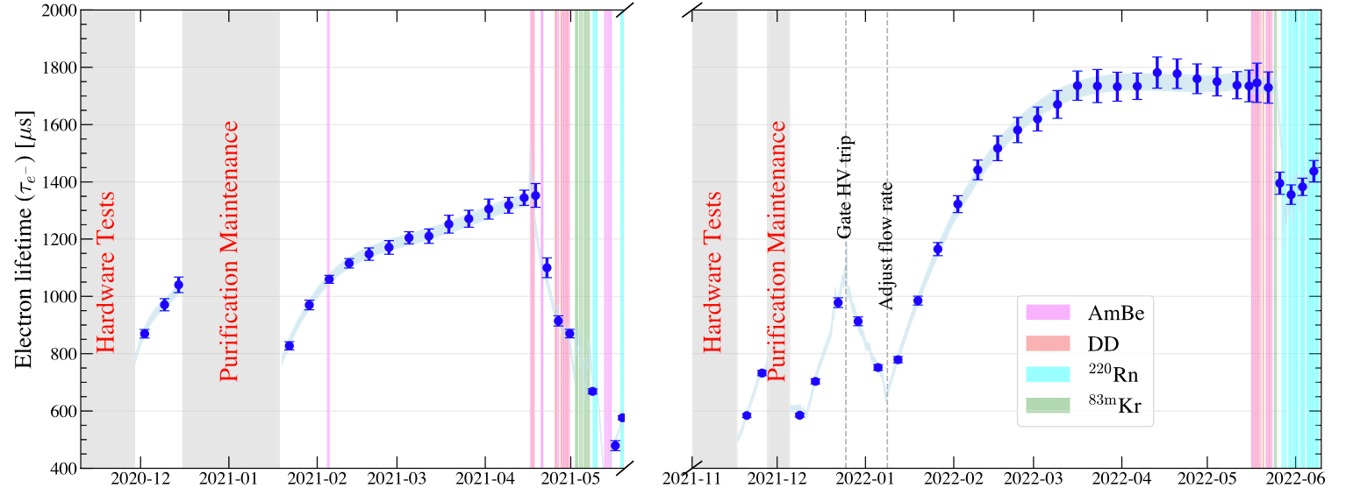
Data-taking of PandaX-4T
Run0
Run1
PandaX-4T has finished two phyiscs runs: Run0 and Run1, a total exposure of 1.54 ton⨉year after removed low-quality data;
Run0 results published @ 2021; Run0 + Run1 combined blind-analysis published @ 2025.
27/08/2025
6
Notes:
PandaX-4T has finished two phyiscs runs: the Run0 and Run1,
After dedicated reconstructions and selections, a total exposure of 1.54 ton-year electron recoil data was obtained.
We published the results of the run0-only analysis in 2021, and earlier this year, we released the resultss from the combined analysis of Run0 and Run1.

Slide 7
Background Model for keV region
Run0
Run1
Energy Region of Interest: S1 > 2 Photoelectrons (PE), E _{rec} < 30 keV, and ER 99.5% acceptance;
Background Composition: Tritium, ²¹⁴Pb, ⁸⁵Kr dominates the background level
  Run0: 0.20 events/day/ton/keV Run1: 0.14 events/day/ton/keV
27/08/2025
Xinning Zeng, PandaX (Shanghai Jiao Tong University)
7
27/08/2025
7
Notes:
These new physics process will deposit energy on the scale of keV in our detector;
for instance, through the so-called axio-electric effect.
To search for such signals, we restricted the energy range to 30 keV. This allows better control of backgrounds like Pb-214.
Here, shows the background compositions for Run0 and Run1.
As can be seen, the key contributions come from Tritium, Pb-214, and Kr-85.
especially for run 0 tritium contribute nearly 50% of the background.

Slide 8
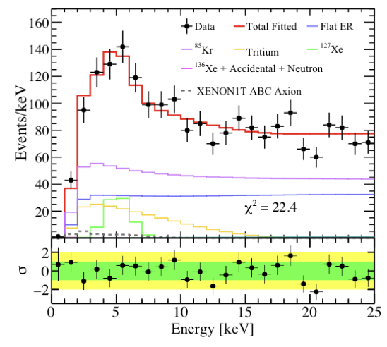
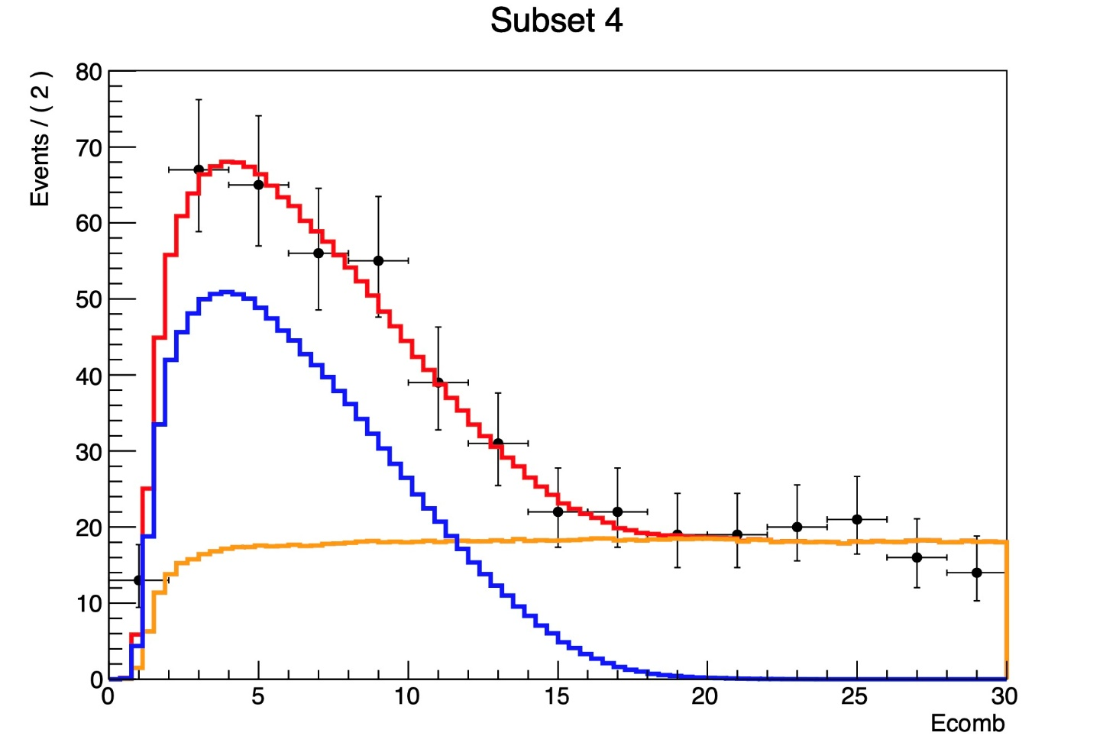
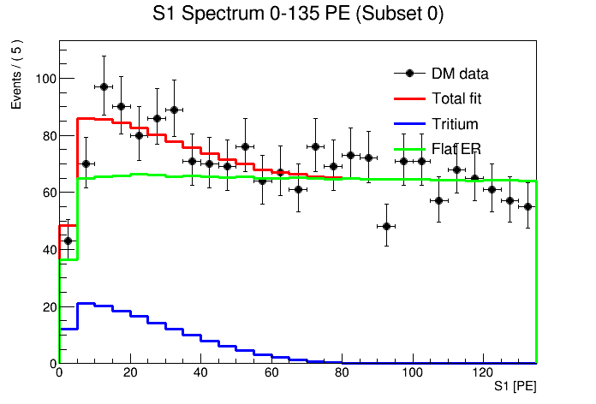
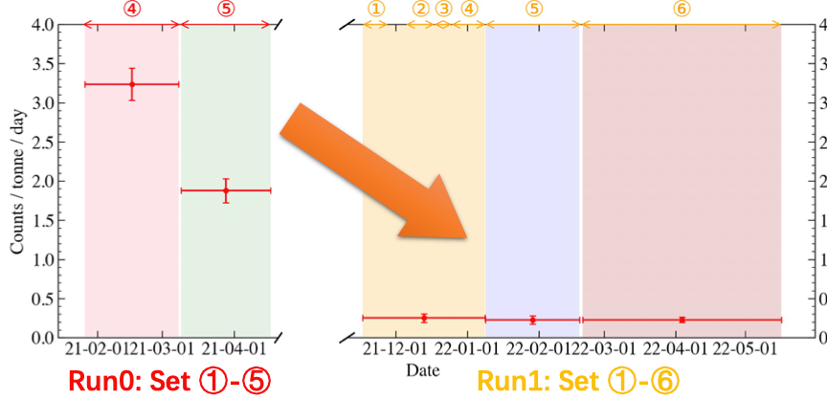
Tritium
Toy fit – only
Tritium + flat background
PandaX-II
PandaX-4T Run0
PandaX-4T Run1
E_{rec} (keV)
Tritium spectrum identified in the data;
Likely originated from the tritium calibration at the end of PandaX-II；
Estimation of tritium level in Run 1: fitting S1 spectrum, keeping S2 blinded (Set to free in fit );
Been suppressed by a factor of 5.
27/08/2025
27/08/2025
Xinning Zeng, PandaX (Shanghai Jiao Tong University)
8
27/08/2025
8
8
Notes:
The tritium in PandaX-4T, is likely leaving from the tritium calibration at the end of PandaX-II.
To estimate the tritium rate, we performed an S1 toy-fit with S2 blinded.
Rest assured, this estimation doesn't compromise the blind analysis, as tritium is set free in subsequent fitting.
The results show that tritium in Run1 has decreased by a facotr of five compared to Run0 Set5.

Slide 9
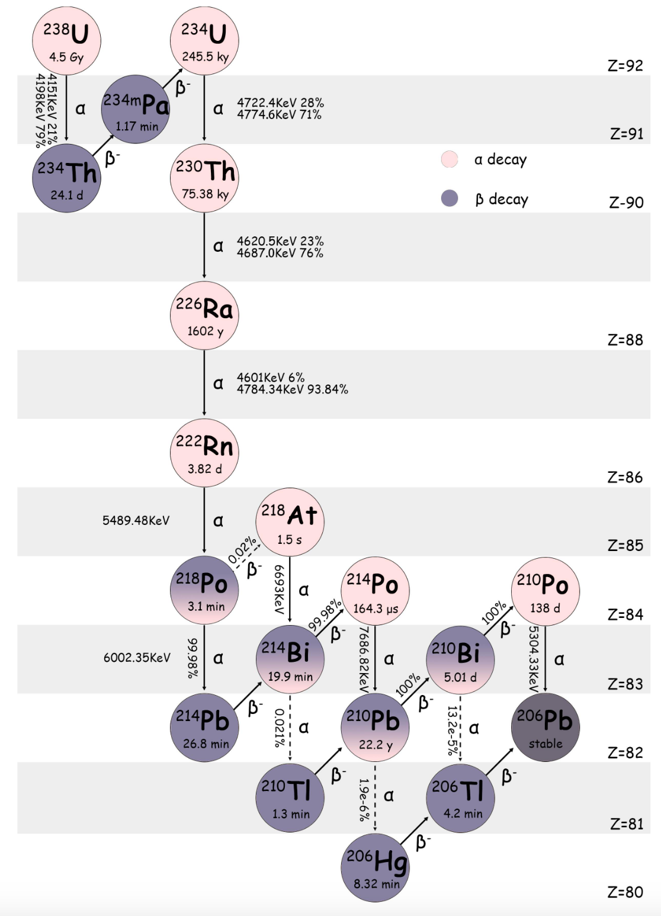
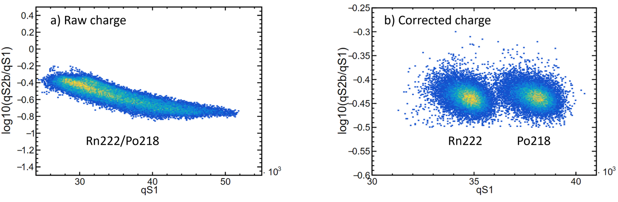
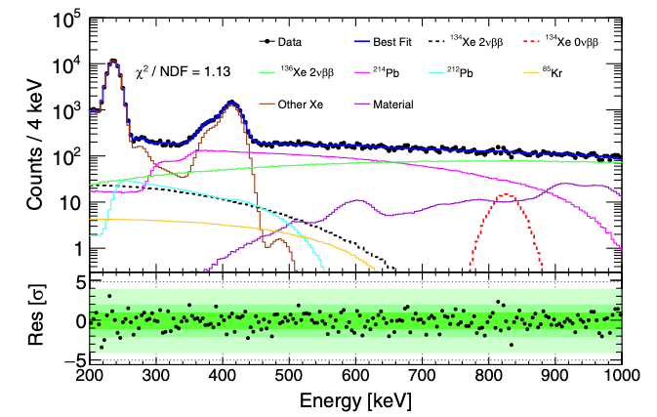
Radon
Raw Charge
Corrected Charge
Rn level | μBq/kg
Run 0 | 7.07 ± 0.02(stat.) ± 0.23(sys.)
Run 1 | 8.67 ± 0.01(stat.) ± 0.27(sys.)
Depletion effect: decreased concentration of longer-lived daughter nuclide compared to the parent;
Side band fit to determine exact contribution: from 200 keV to 1000 keV.
27/08/2025
27/08/2025
Xinning Zeng, PandaX (Shanghai Jiao Tong University)
9
27/08/2025
9
9
Notes:
Pb-214 originates from the Rn-222 decay chain,
After a series of corrections, the alphas from Rn-222 and Po-218 can be seprated, and the activity of Rn can be precisely estimated.
Run1 Rn level is slightly higher than run0, likely due to the replacement of the diaphragms of the circulation pump.
However, due to daughter nucleus depletion, Rn-222 activity cannot directly represent Pb-214 activity.
This depletion effect is associated with the movement of charged daughter ions.
Therefore, we use Rn-222 as input and fit the exact activity using the 200 keV - 1 MeV energy spectrum.

Slide 10
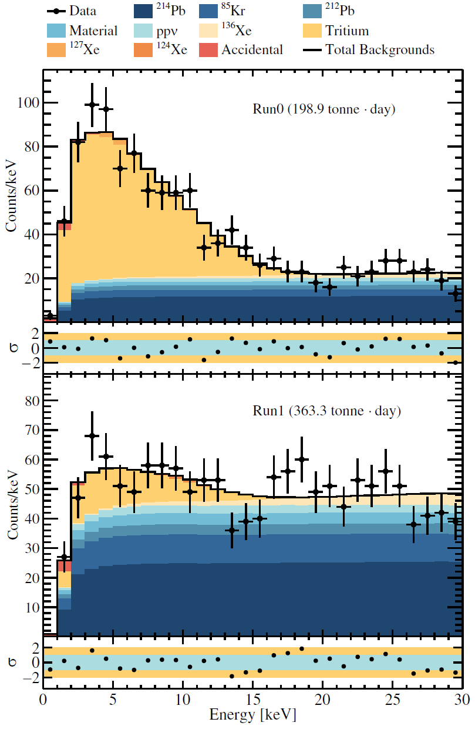
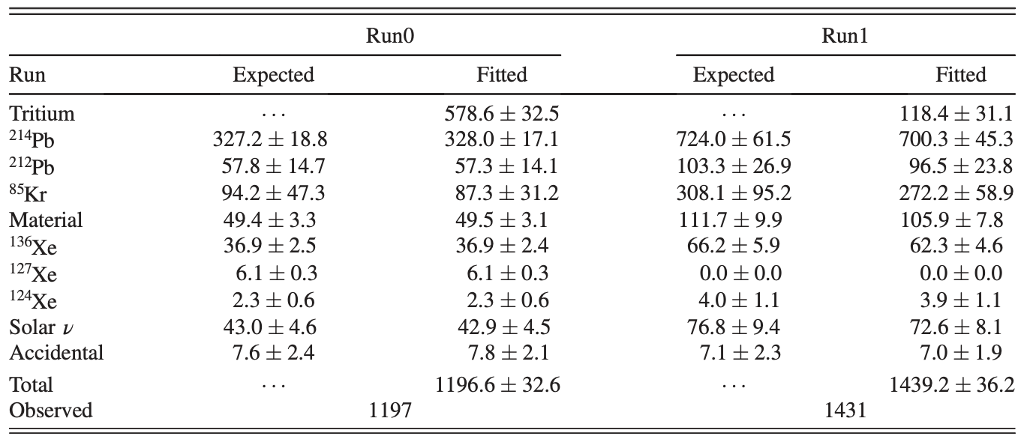
Best-fit of keV Background Model
A combined fit of Run0 and Run1 in 1D energy space;
Tritium is set to free in fit;
No excess found: consistent with background model (p-value = 0.16).
27/08/2025
Xinning Zeng, PandaX (Shanghai Jiao Tong University)
10
27/08/2025
10
Notes:
All other backgrounds were independently estimated, with results presented in the table.
We performed a combined fit for Run0 and Run1 in the 1D energy spectrum using the maximum likelihood method.
The fit results indicate no significant excess, aligning with our background model with a p-value of 0.16;

Slide 11
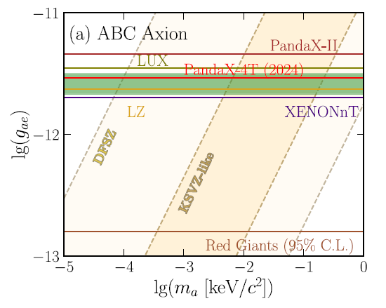
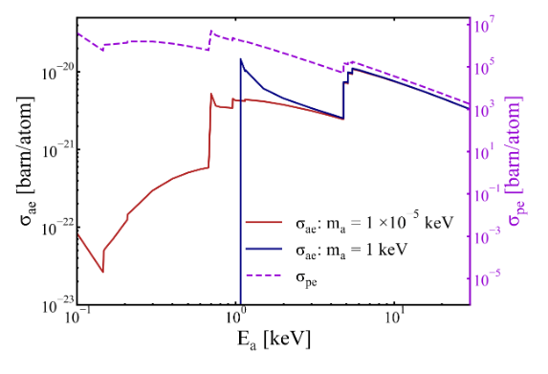
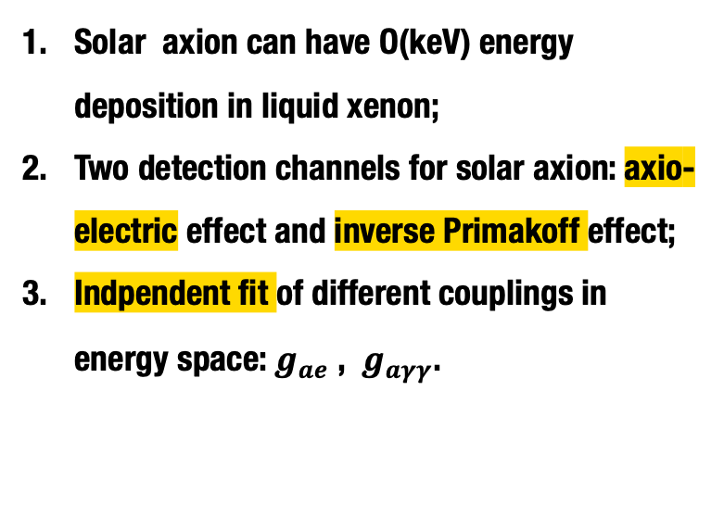
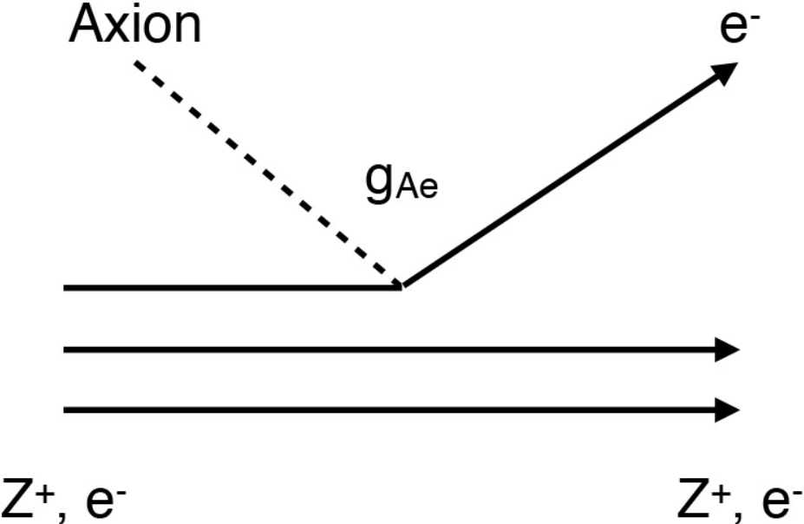
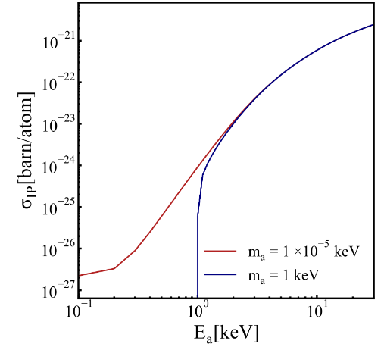
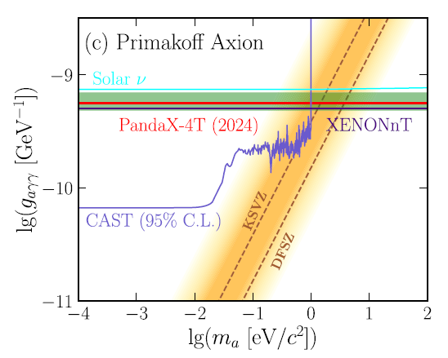
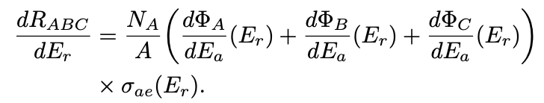
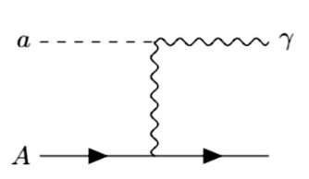

Solar Axions
axio-electric
inverse Primakoff
Phys. Rev. Lett. a134, 041001
27/08/2025
Xinning Zeng, PandaX (Shanghai Jiao Tong University)
11
27/08/2025
11
Notes:
In addition to the wellknown axio-electric effect, another detection channel, the inverse Primakoff effect via the g-a-gamma-gamma interaction, is also considered.
In this process, an axion interacts with an atom's entire electromagnetic field, converting into a gamma that deposits energy in the detector.
We utilize these two detection channels to independently test g-a-e and g-a-gamma-gamma.
The figure here presents the model-independent limits.

Slide 12
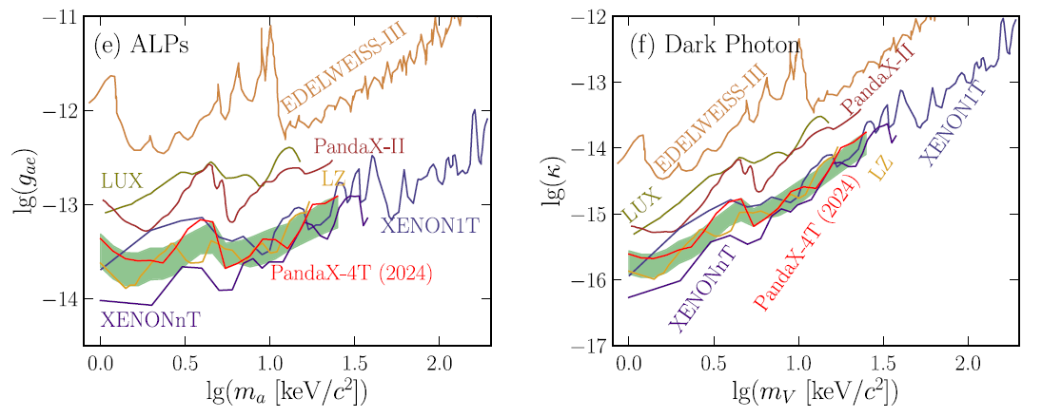
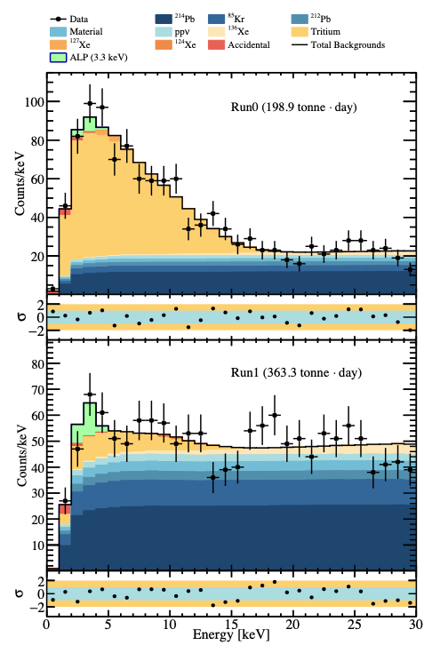
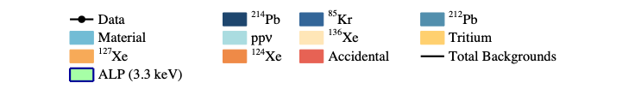
Light Dark Matters
Light Dark matter searching: Mono-energetic signals scan.
  Axionlike Particles (ALPs) and Dark Photons (DPs)
  Fermionic Dark Matter – v conversion
Data fluctuation yields a 1.9𝛔 (local) excess @ 3-5 keV;
Phys. Rev. Lett. 134, 041001
27/08/2025
Xinning Zeng, PandaX (Shanghai Jiao Tong University)
12
27/08/2025
12
Notes:
We've also explored light dark matter signals from axion-like particles (ALPs), dark photons, and Fermionic dark matter - neutrino conversions.
Given these signals' mono-energetic or quasi-mono-energetic signature, we conducted a mass scan.
The results show a 1.9-sigma local significance excess at 3 - 5 keV, Which is more likely to be the local fluctuations.

Slide 13
Rich Physics with Electron Recoil Data
 | sub keV | 1keV | 10 keV | 100 keV | 1MeV | 10 MeV
¹³⁶Xe(~9%)
¹³⁴Xe(~10%)
¹²⁴Xe(~0.1%)
Natural Xenon
ALPs, DPs, boosted dark matters...
Solar Axion
Muons ...
27/08/2025
13
Notes:
We also carried out some Low mass dark matter searches through the boosted methods

Slide 14

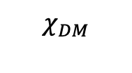
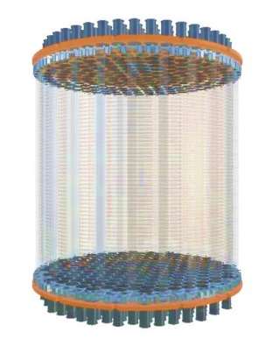

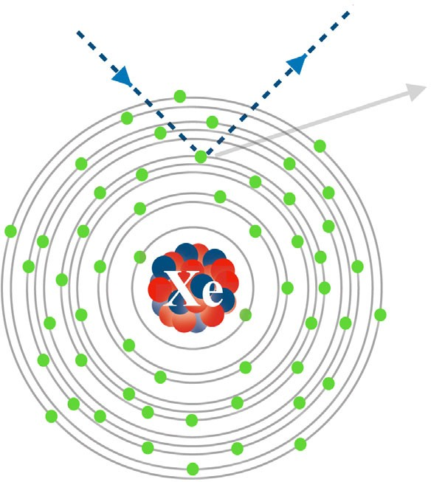



Solar Boosted Dark Matter
Light Dark Matter scattering off free electrons（heavy mediator）in the Sun generates a new (more energetic) component of the flux.
Dark Matter mass:
10keV-10MeV
Energy deposition:
10 to ~10³eV
Sun
keV range
Solar electrons
27/08/2025
Xinning Zeng, PandaX (Shanghai Jiao Tong University)
14
27/08/2025
14
Notes:
Here I would just introduce the solar boosted dark matter. When light dark matter at the mass region around the mass of electron, scatters off electrons in the Sun, it can produce a flux of higher-energy particles arriving at Earth.

Slide 15
Solar Boosted Dark Matter
  Target density of Xenon
  Reference cross section
Solar Reflected DM Flux
Solar Reflected DM Flux
Ionization Form Factor
  Depends on momentum transfer q and final state electron momentum.
  DarkART （used）same as CRBDM
Dark Matter Form Factor
  FDM = 1 heavy mediator(contact interaction)
  FDM ~ 1/q2 light mediator
27/08/2025
Xinning Zeng, PandaX (Shanghai Jiao Tong University)
15
27/08/2025
15

Slide 16
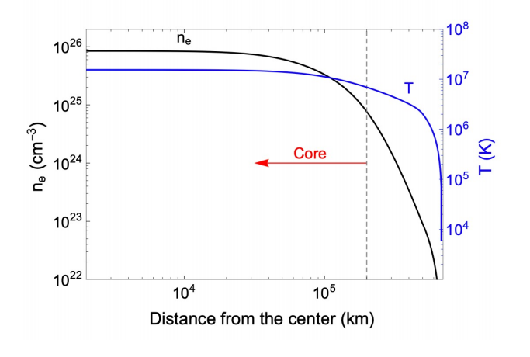
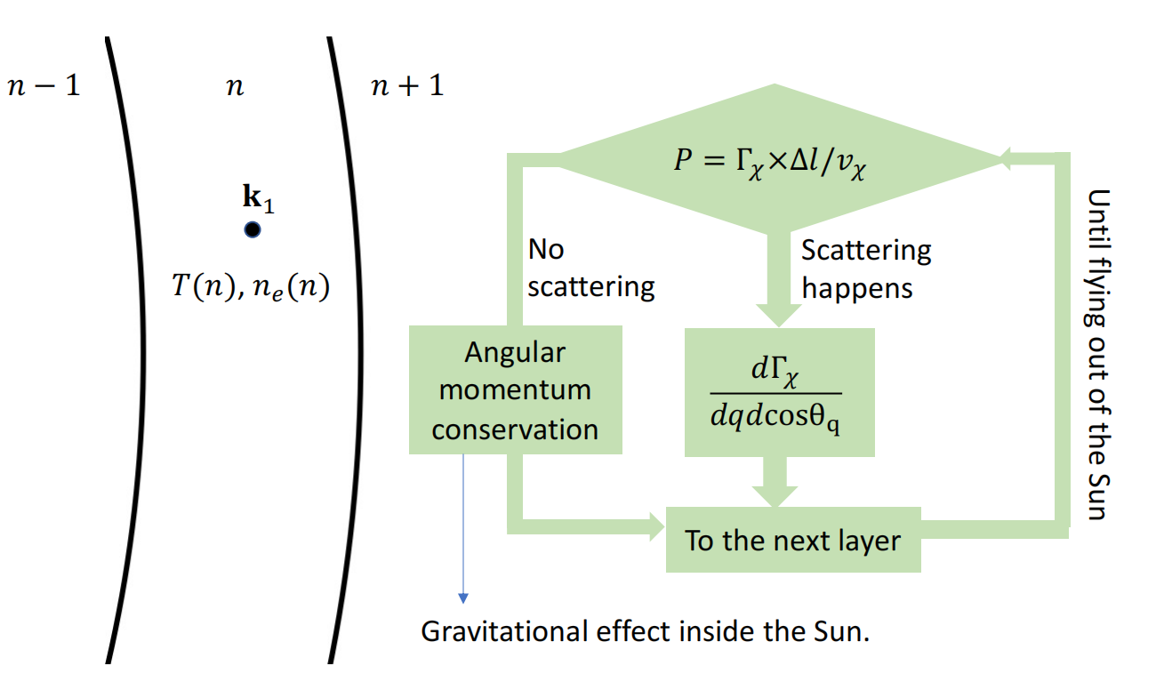

Solar Boosted Dark Matter
The details of the simulation
From Haipeng An’s team
temperature and electron density distributions are isotropic.
divide the Sun into slices.
Gravitational effect considered in an effective R = 4R_sun
27/08/2025
Xinning Zeng, PandaX (Shanghai Jiao Tong University)
16
27/08/2025
16

Slide 17
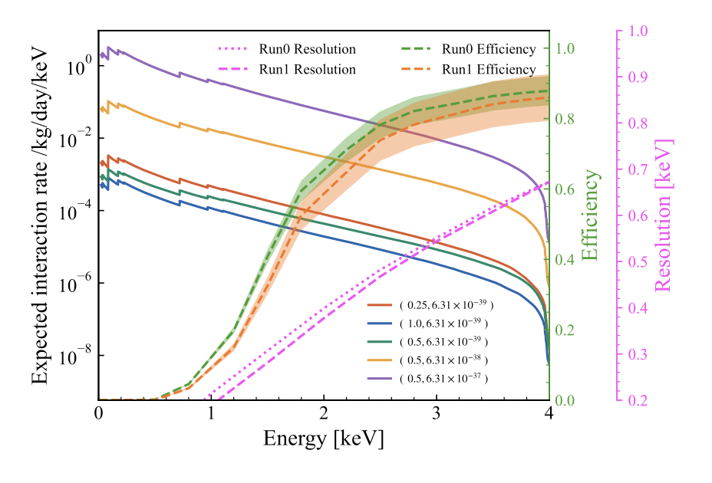
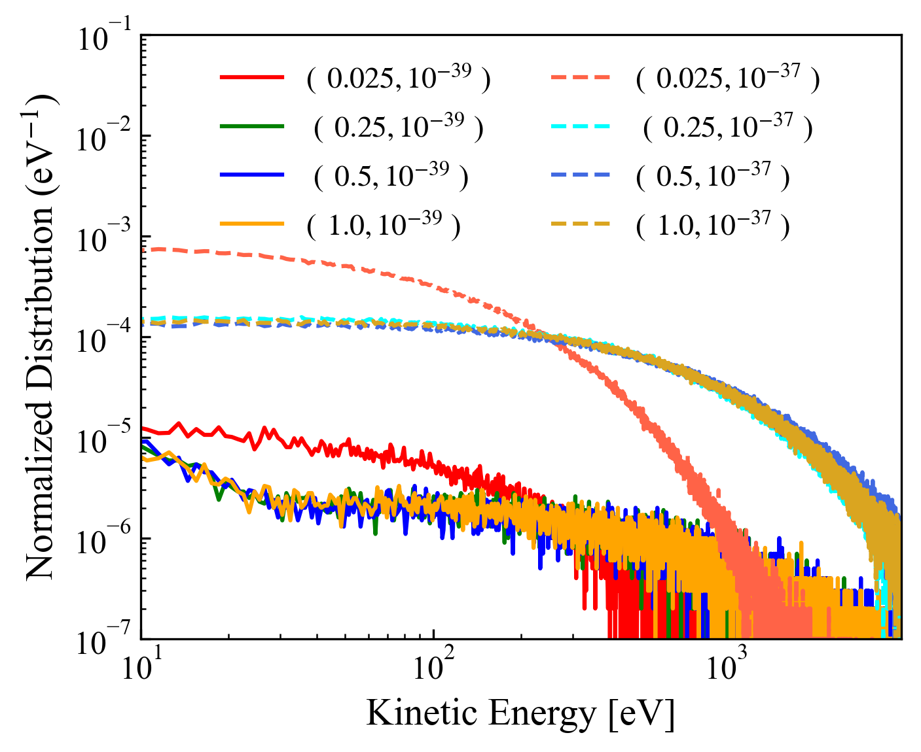
Solar Boosted Dark Matter
  Target density of Xenon
  Reference cross section
Solar Reflected DM Flux
Ionization Form Factor
  Depends on momentum transfer q and final state electron momentum.
  DarkART （used）same as CRBDM
Dark Matter Form Factor
  FDM = 1 heavy mediator(contact interaction)
  FDM ~ 1/q2 light mediator
27/08/2025
Xinning Zeng, PandaX (Shanghai Jiao Tong University)
17
27/08/2025
17
Notes:
for these light DM particle , it can be boosted by the cosmic ray 、the sun and other mechanism. For lighter DM like 10keV to 10MeV, for these DM , Dark matter scattering off free electrons in the Sun generates a new (more energetic) component of the flux impinging on the Earth and hit the Xenon target. The energy deposition can exceed PandaX-4T threshold.(1kV)

Slide 18
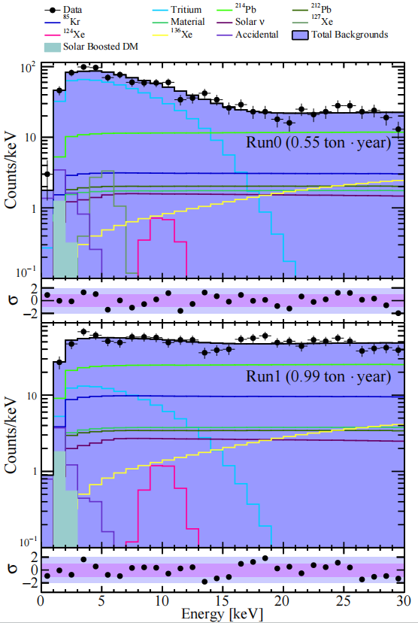
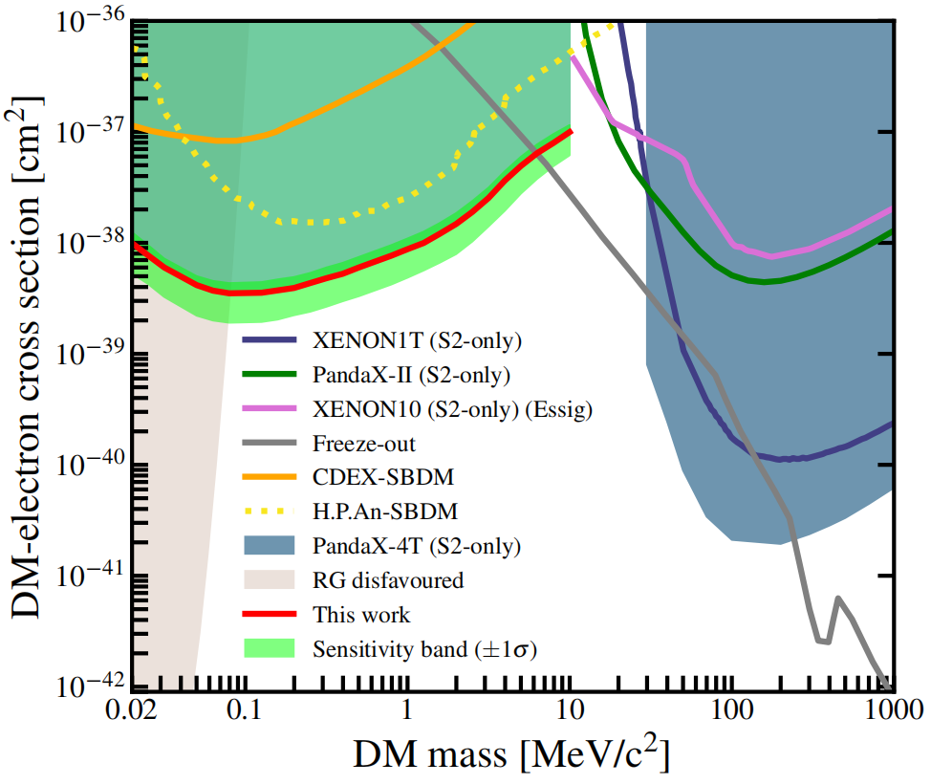
Solar Boosted Dark Matter
Phys. Rev. Lett. 134, 161003
DAMIC-M Phys. Rev. Lett. 135, 071002
The experimental search results using the xenon detector yield the most stringent cross-section for mass ranging from 0.02 to 10 MeV/c²
Combined with DAMIC-M new result, almost all the parameter space below 200 MeV for Freeze-out model was ruled out.
Thanks for
attentions
27/08/2025
Xinning Zeng, PandaX (Shanghai Jiao Tong University)
18
27/08/2025
18

Slide 19
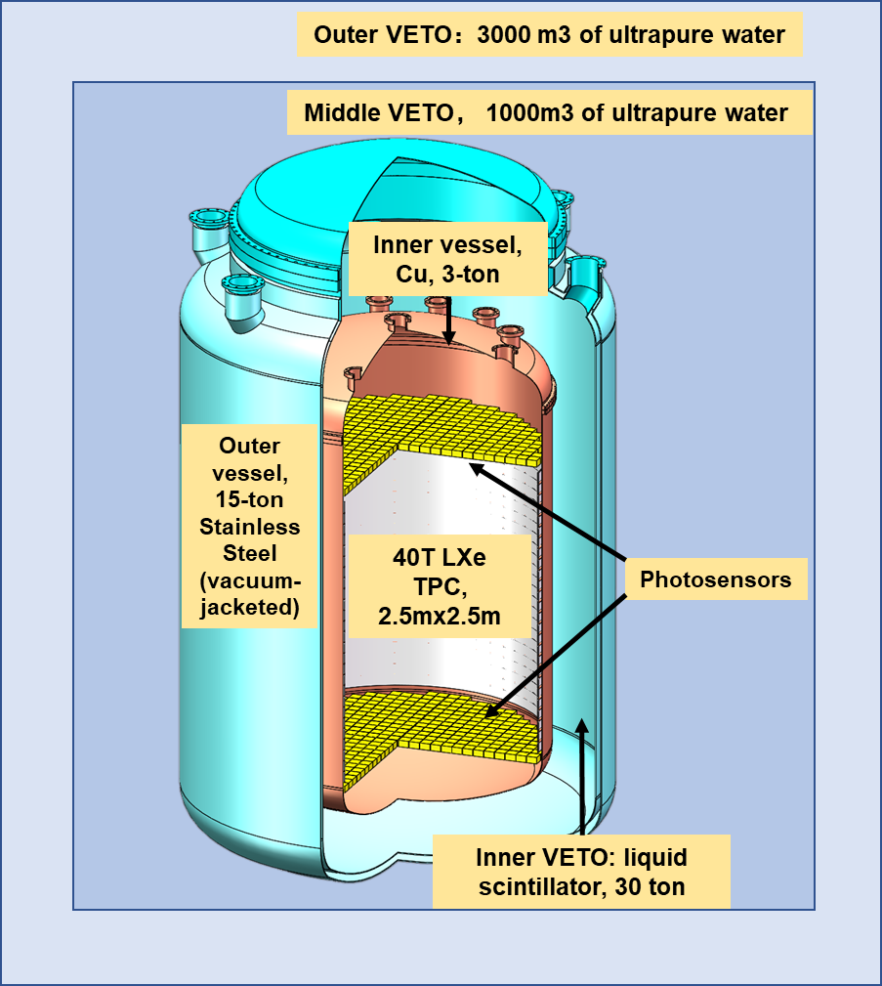
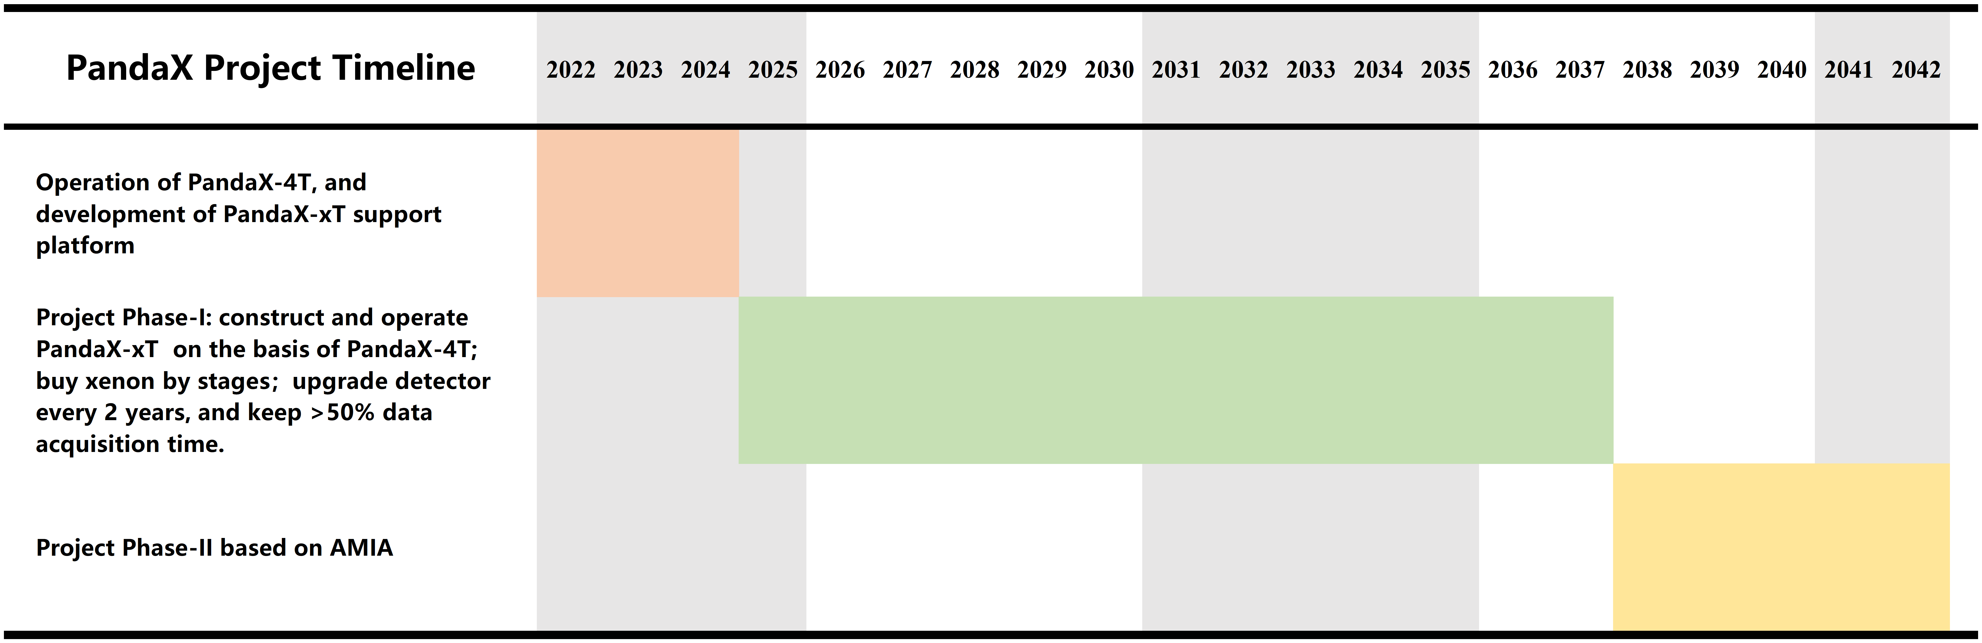
Solar Boosted Dark Matter
47-ton xenon, including 43-ton sensitive volume
  2.7 meters in diameter and height
  Cold LS veto right outside Cu cryostat
  Staged and upgradable
  Dual-phase or single-phase options
27/08/2025
Xinning Zeng, PandaX (Shanghai Jiao Tong University)
19
27/08/2025
19
Notes:
for these light DM particle , it can be boosted by the cosmic ray 、the sun and other mechanism. For lighter DM like 10keV to 10MeV, for these DM , Dark matter scattering off free electrons in the Sun generates a new (more energetic) component of the flux impinging on the Earth and hit the Xenon target. The energy deposition can exceed PandaX-4T threshold.(1kV)

Slide 20
Backup
27/08/2025
Xinning Zeng, PandaX (Shanghai Jiao Tong University)
20
27/08/2025
20
Notes:
for these light DM particle , it can be boosted by the cosmic ray 、the sun and other mechanism. For lighter DM like 10keV to 10MeV, for these DM , Dark matter scattering off free electrons in the Sun generates a new (more energetic) component of the flux impinging on the Earth and hit the Xenon target. The energy deposition can exceed PandaX-4T threshold.(1kV)

Slide 21
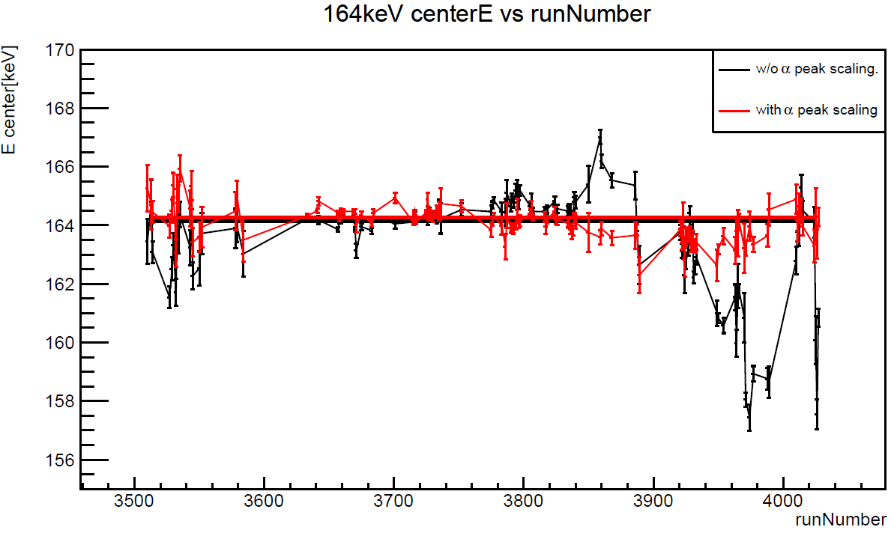
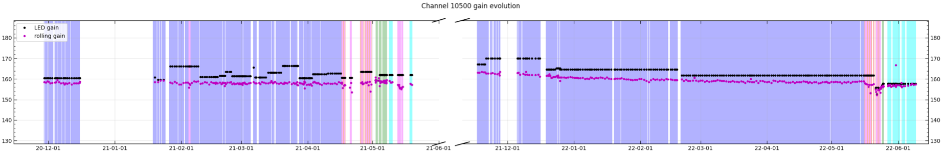
Updates in Data Reconstruction
Additional 10 top PMTs turn-off
Degrading of PMTs: LED-calibration to Self-calibration
Temporal variation of signal yield
Event builder: Fix-window and S1 quality in prior
others ......
after self-calibration
164 keV from ^{131m}Xe
Phys. Rev. D 110, 023029
LED calibration vs Self-calibration
27/08/2025
Xinning Zeng, PandaX (Shanghai Jiao Tong University)
21
27/08/2025
21
Notes:
Compared to the Run0-only analysis, numerous updates have been implemented in the combined analysis of Run0 and Run1.
For instance, in terms of low-level processes, the PMT-gain calibration has transitioned from LED calibration to self-calibration due to PMT degradation.
As evident from the results, the self-calibration method evolves smooothly, compared to the weekly LED calibration.
Additionally, we identified certain temporal instabilities in the signal yield and utilized mono-energetic peaks to correct these temporal variations.
Furthermore, improvements have been made to the event building and quality selection processes.

Slide 22
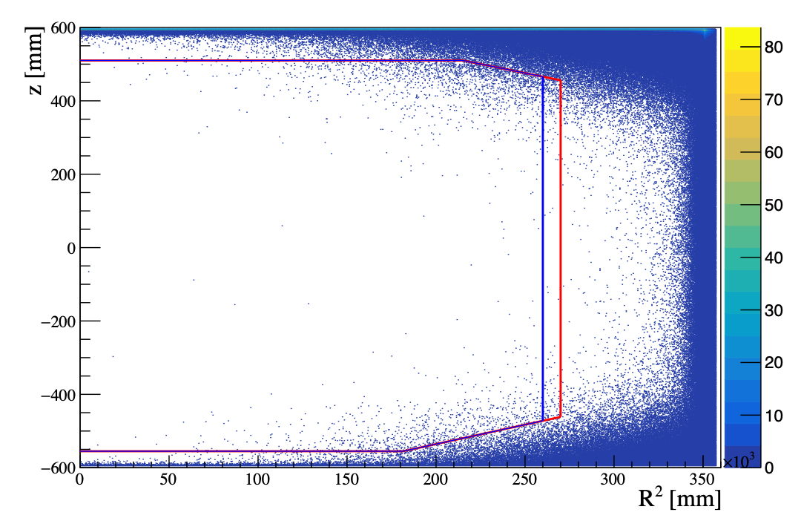
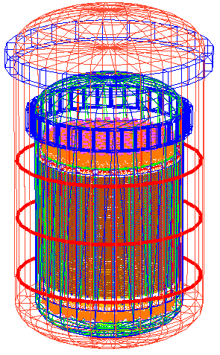
Building the Background Model
1. Material Screening and Geant4-based Simulation
HPGe, ICP-MS, etc
BambooMC
2. Fiducial Volume and Quality Selection
r - dependent material background
S1/S2 pulse shape and hit pattern
Run0
Run1
3. Side band analysis:
high energy alphas in decay chain
spectrum fitting in high energy: uncertainty reduction
27/08/2025
Xinning Zeng, PandaX (Shanghai Jiao Tong University)
22
27/08/2025
22
Notes:
uncertainties from HPGe is large, side band can help to reduce. [a figure to show???]

Slide 23
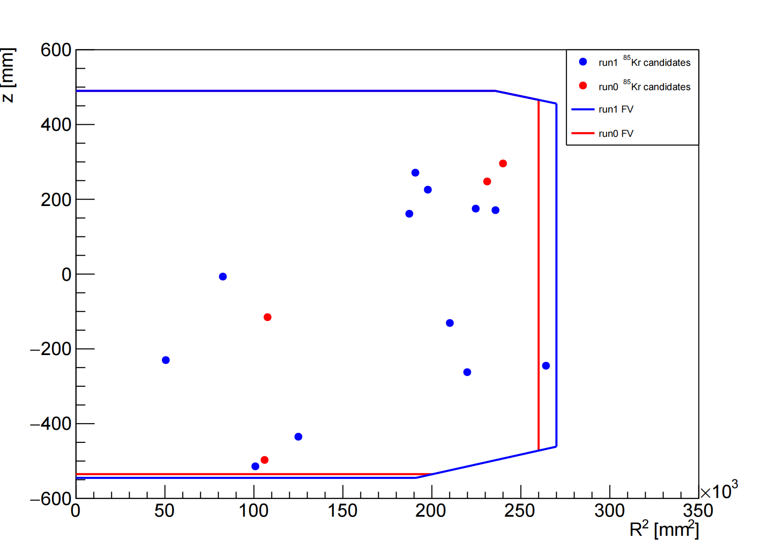
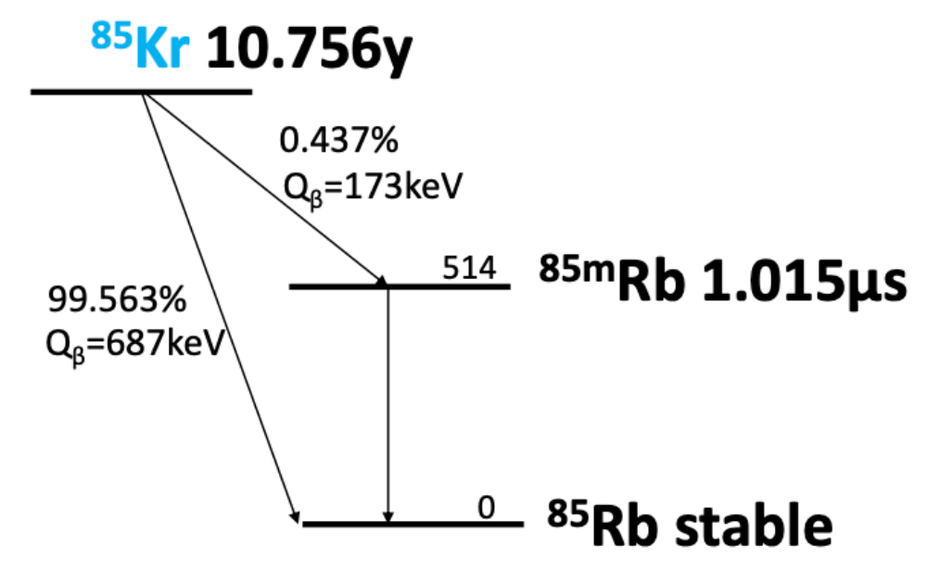
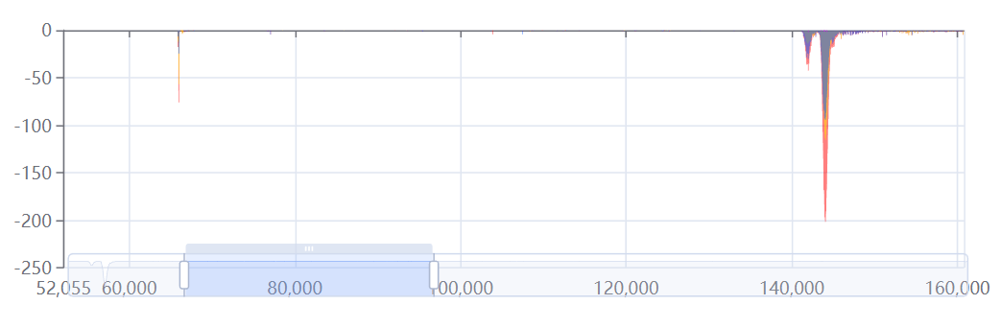
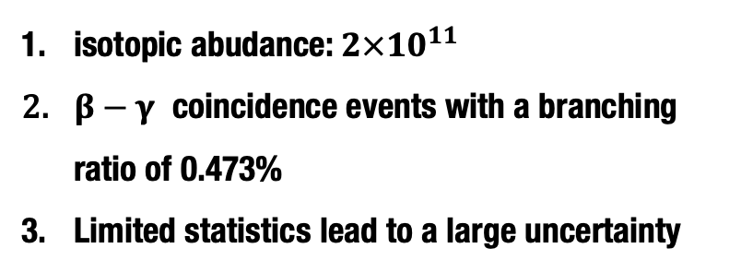
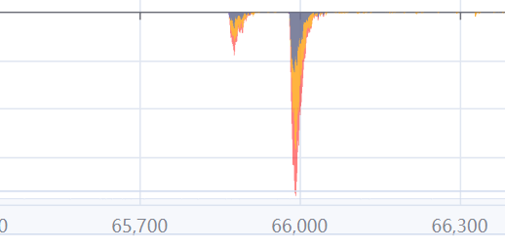
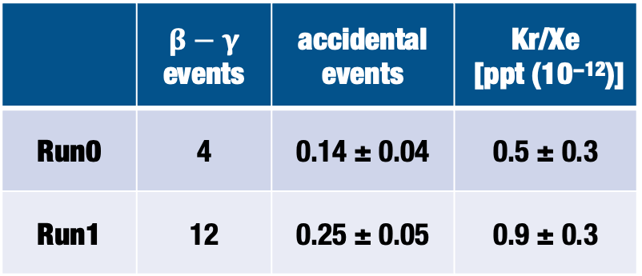
Krypton
⁸⁵Kr 10.75y
 |  | accidental events | Kr/Xe [ppt (10⁻¹²)]
Run0 | 4 | 0.14 ± 0.04 | 0.5 ± 0.3
Run1 | 12 | 0.25 ± 0.05 | 0.9 ± 0.3
Run0
Run1
^{85m}Rb 1.015μs
⁸⁵Rb stable
a typical waveform
β S2
β S1
γ S1
γ S2
27/08/2025
27/08/2025
Xinning Zeng, PandaX (Shanghai Jiao Tong University)
23
27/08/2025
23
23

Slide 24
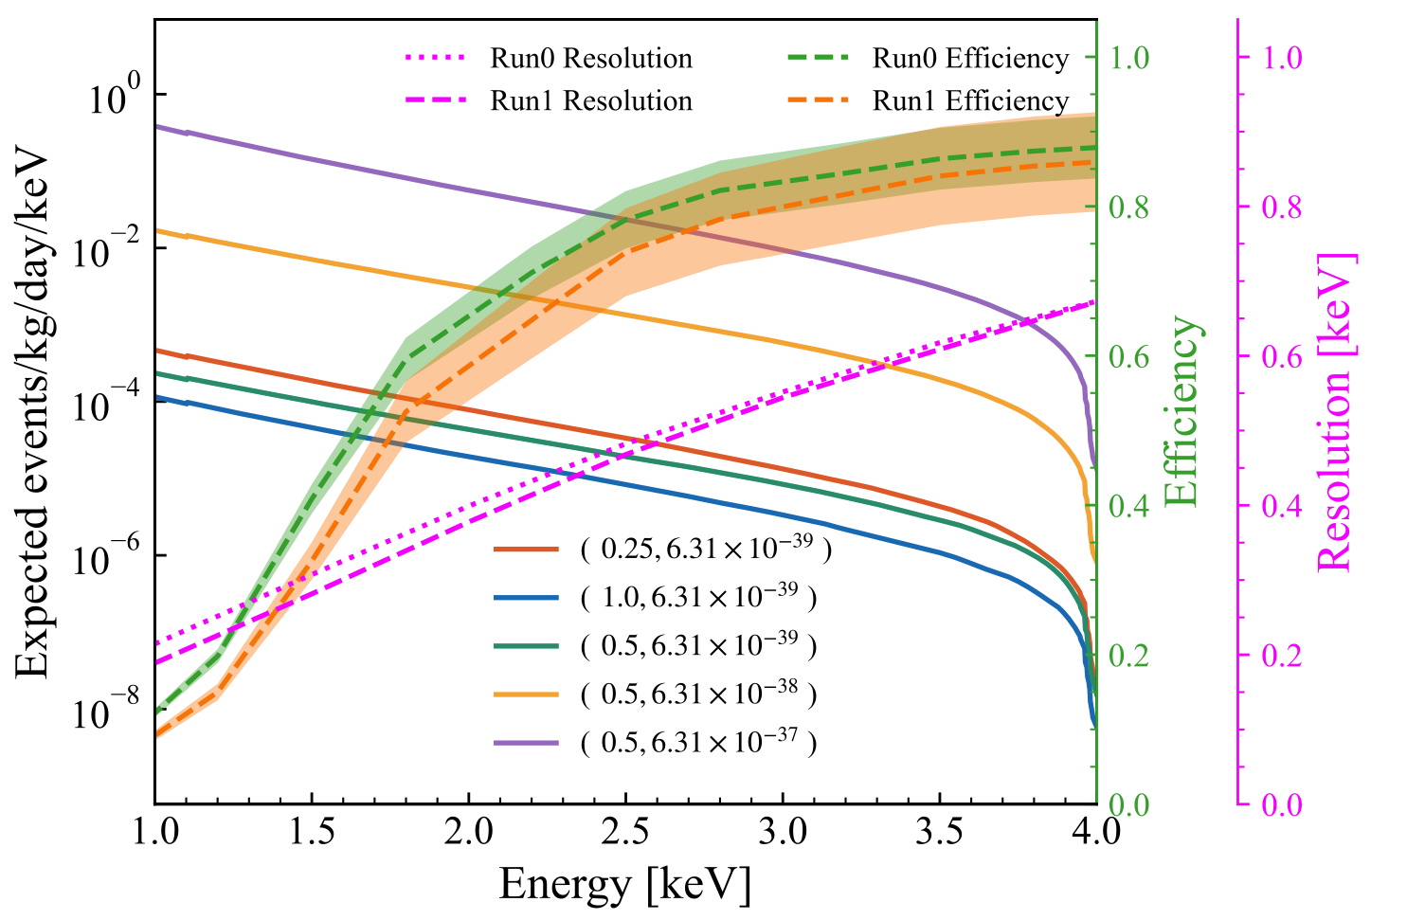

Solar Boosted Dark Matter
Assume the temperature and electron density distributions are isotropic;
The first experimental search results using the xenon detector yield the most stringent cross-section for mass ranging from 0.02 to 10 MeV/c², (23 fold improvement compared with earlier studies)
arXiv:2412.19970
27/08/2025
Xinning Zeng, PandaX (Shanghai Jiao Tong University)
24
27/08/2025
24
Notes:
Briefly introduction of the process of DM accelerated in the sun. The thermal plasma inside the Sun is composed of electrons and ions
Assume the temperature and electron density distributions are isotropic.
Now just consider the DM interacts with electrons. DM could be accelerated by the electrons inside the sun.
The energetic energy could reach to 5 keV, above the 1keV can meet pandaX-4T threshold and have large flux. For 0.025MeV when hits Xe, it can obtain a little kinetic energy,, but the number density is more. So in the low energy ,the flux is large then others.

Slide 25




Neutrinoless Double Beta Decay of Xe-136
Improvement to our previous PandaX-II results by an order of magnitude and to the XENON1T results by a factor of 1.8
Science Bulletin, 2025.03.009
27/08/2025
Xinning Zeng, PandaX (Shanghai Jiao Tong University)
25
27/08/2025
25

Slide 26



arXiv:2411.14355
27/08/2025
Xinning Zeng, PandaX (Shanghai Jiao Tong University)
26
27/08/2025
26
Notes:
In addition to the dark matter and dark matter related analysis, the PandaX-4T detector can actually do a lot of other physics. For example, double beta decays. Here, I'll use Xe-124 as an example, because this is my own work. I'll give you a brief introduction on measuring the half-life of the two-neutrino double electron capture(2𝝊DEC) of Xe-124 using pandax-4t.
This process is allowed by the Standard Model, and signal is featured by the two blue peaks in the spectrum, between 25 to 75 keV, which is our ROI.
The biggest challenge in this analysis is the Iodine-125 background, which are the purple peaks near here. The concentration of Iodine-125 in the detector can change over time. So, we developed a time-dependent background model and performed a two-dimensional likelihood fit in energy and time.
With the estimation of background in this region, the final fit results are shown here, with projection on energy and time axes. From here we can see how the time dependent backgrounds are modeled.
The measured half-life, represented here by the red band, is compared with both theoretical calculations the and recent results from XENON-nT and LZ. And it is consistent with others.
Getting this precise measurement of this process can act as a reference point for many nuclear matrix element (NME) calculation methods. Plus, it’s pretty much the foundation for detecting neutrino-less double electron capture of Xe-124.
Looking ahead, we’re planning to go further in this direction by studying other decay channels and search for the neutrino-less modes of Xe-124 in PandaX detector.
[13min]

Slide 27



Cosmic-Ray Boosted Dark Matter
Cosmic-Ray electron Boosted DM have the same interaction mechanism with DM- electron detection in the detector;
Self-developed MC simulation for the calculation of the DM Earth attenuation;
push the current mass range down by two orders of magnitude, achieve the minimum fermionic DM mass allowed by the Pauli principle;
Phys. Rev. Lett. 133, 101805
27/08/2025
27/08/2025
Xinning Zeng, PandaX (Shanghai Jiao Tong University)
Xinning Zeng, PandaX (Shanghai Jiao Tong University)
27
27/08/2025
27
27

