Slide 1
Probing MeV Dark Matter Via Solar Reflection
Haoming Nie, Tsinghua University
At TAUP2025
Notes:
Abstract: Solar reflected dark matter refers to dark matter particles reflected and accelerated by the high energy electrons in solar interior. This process can boost MeV dark matter energies, enhancing potential signals in direct detection experiments. we demonstrate that in detectors composed of single crystals, like in Bragg scattering, the collision rate and energy deposition are influenced by the angle between the momentum of the incoming DM and the orientations of the crystallographic axes. This results in a directional modulation of the signal. On the other hand, we also explore the scenario of inelastic dark matter, where scattering within the Sun promotes dark matter to an excited state. Subsequent de-excitation in terrestrial detectors releases additional energy, significantly enhancing the detection signature of dark matter with mass larger than electron mass.

Slide 2
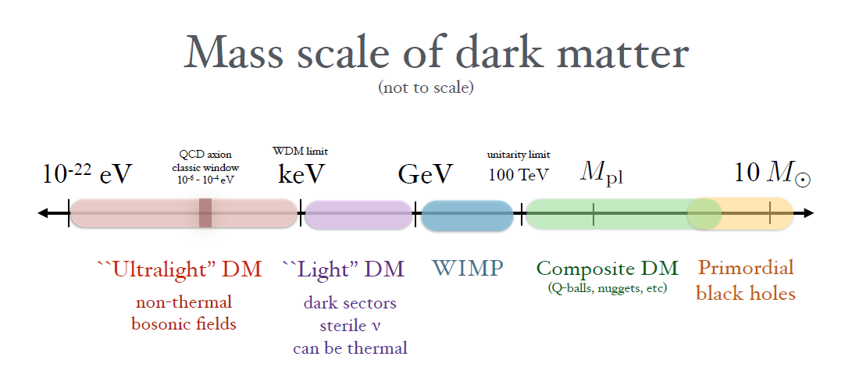
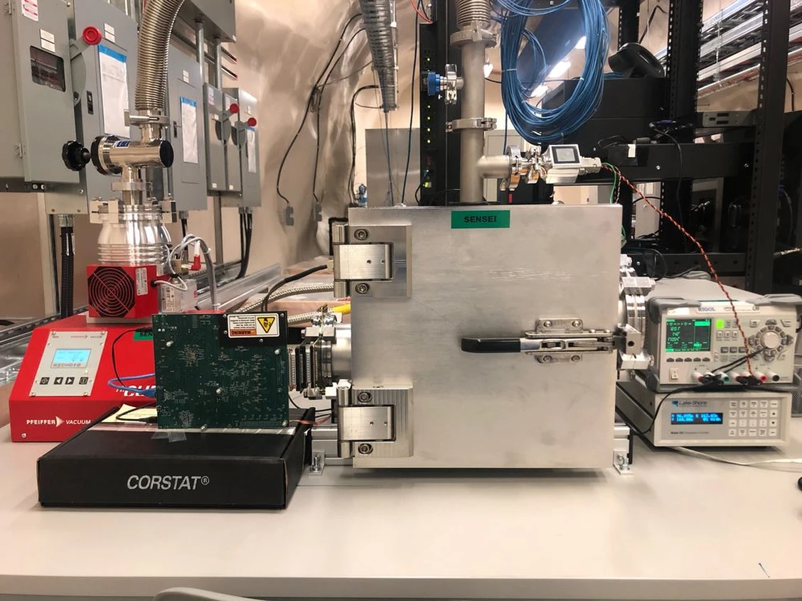
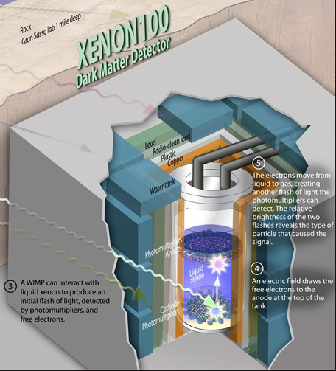
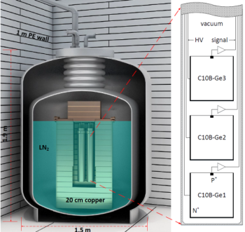
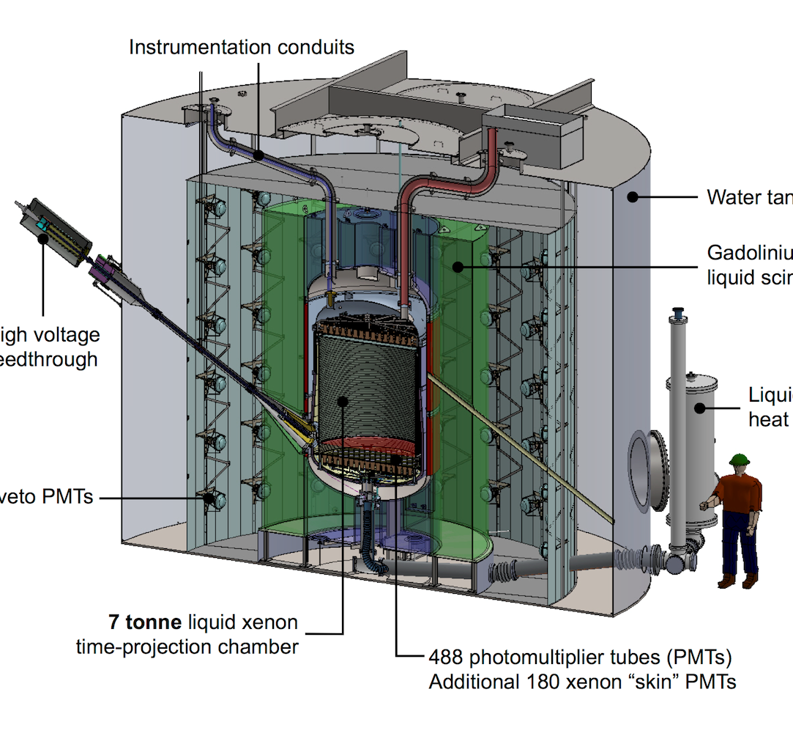
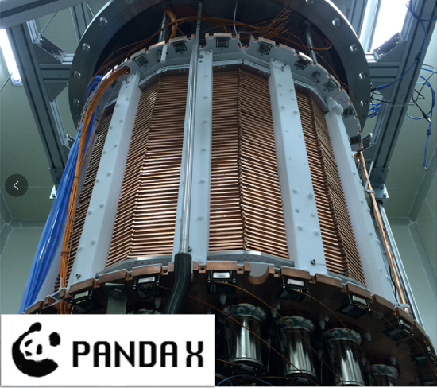
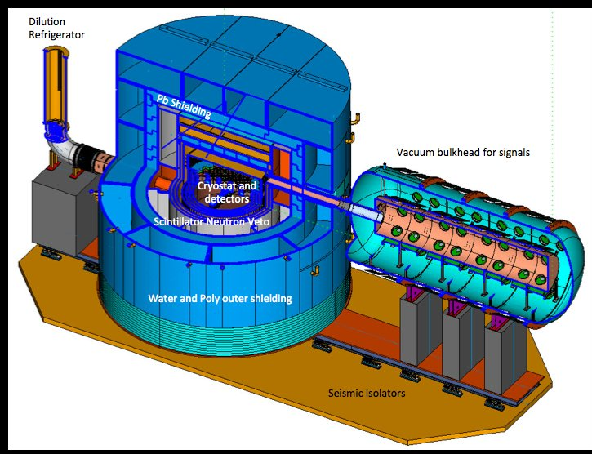
Motivation
Early Anisotropy/GW
Fifth force Exp.
Electron Recoil
Nuclear Recoil
SENSEI
XENON
CDEX
LZ
PANDAX
superCDMS
Notes:
DM important
Ultralight 5th force
PBH early anisotropy
Direct detection
Electron recoil hard

Slide 3
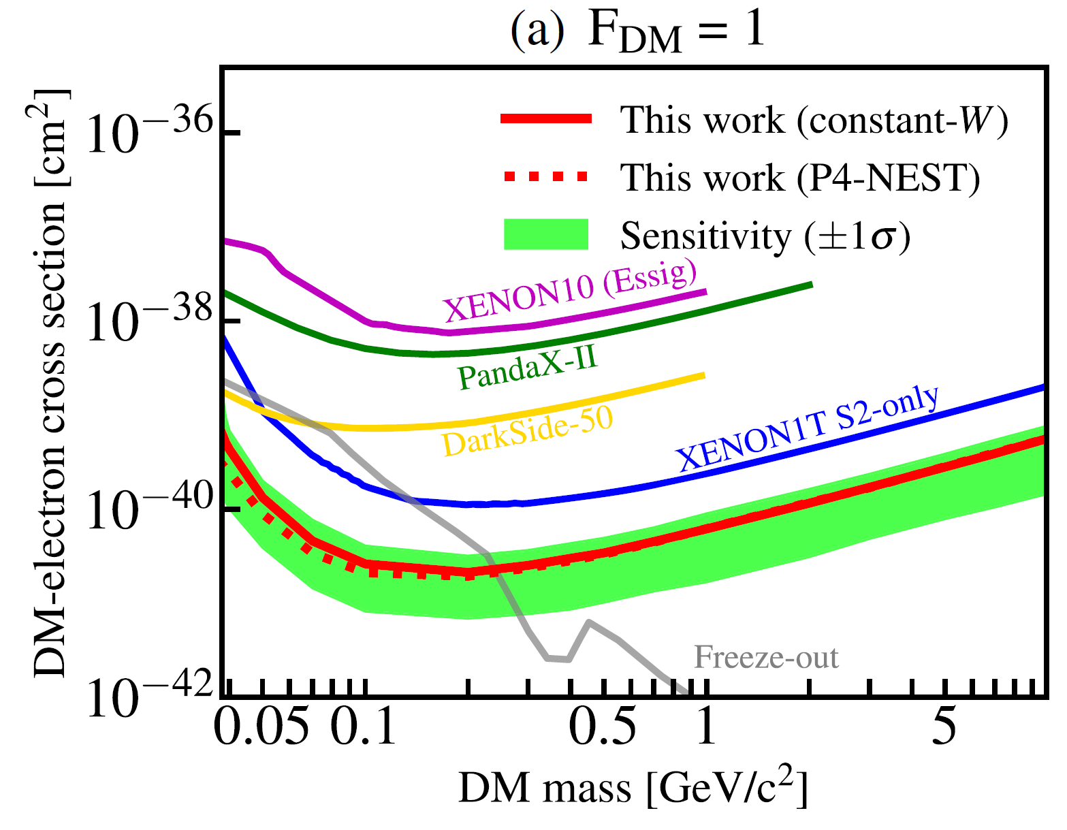
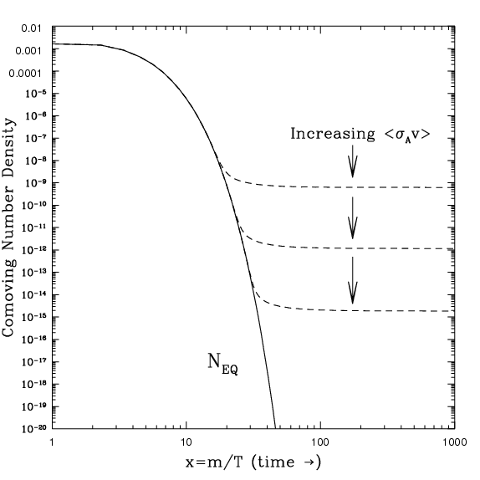
Freeze-out
DM
SM
Freeze-out
DM
Decay
SM
[1] S. Li et al. (PandaX), Search for Light Dark Matter with Ionization Signals in the PandaX-4T Experiment, Phys. Rev. Lett. 130, 261001 (2023), arXiv:2212.10067 [hepex].

Slide 4
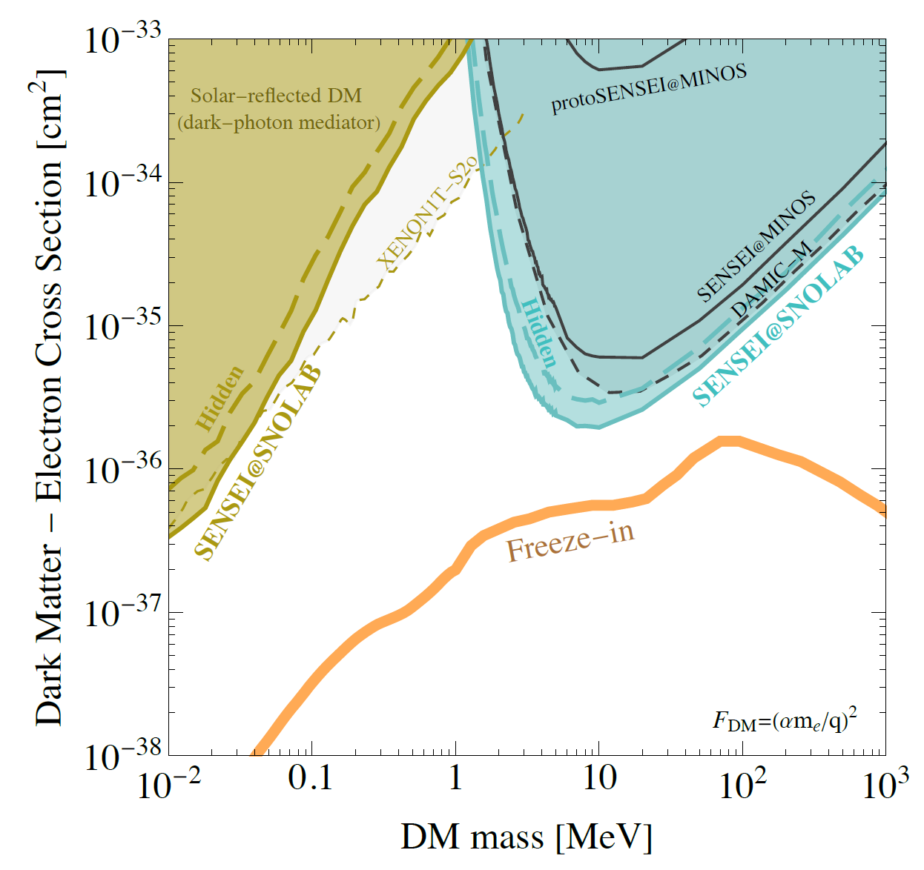
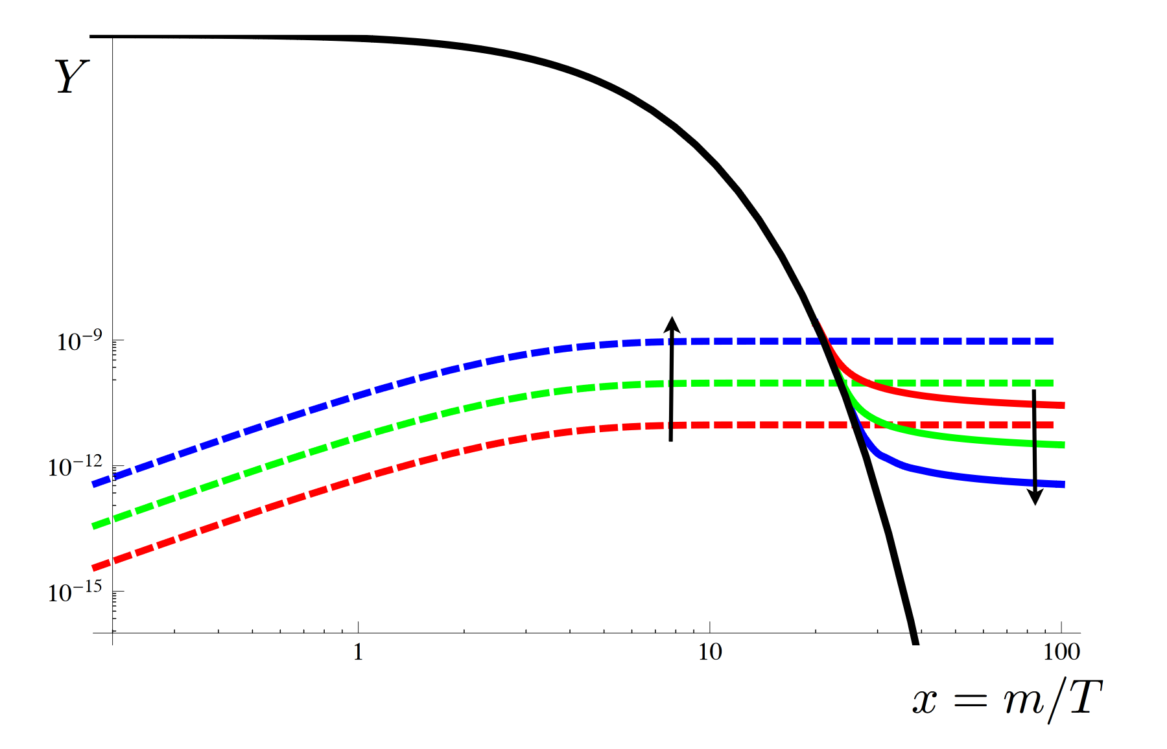
Freeze-in
SM
DM
Freeze-in
SM
Produce
DM
[2] SENSEI Collaboration, (2023), arXiv:2312.13342 [id=’astro-ph.CO’].

Slide 5
Motivation: MeV Dark Matter
Improve Sensitivity
Lowering Threshold
Better Data Analyzing
Increase DM Energy
New Experiment Design & New Electronic Tech.
Notes:
LDM: low electron recoil energy

Slide 6
Motivation: Solar Reflected DM
Improve Sensitivity
Lowering Threshold
Better Data Analyzing
Increase DM Energy
New Experiment Design & New Electronic Tech.
Boosted by Solar Reflection

Slide 7
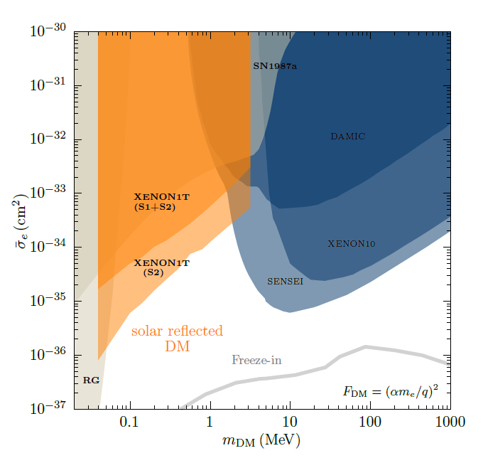
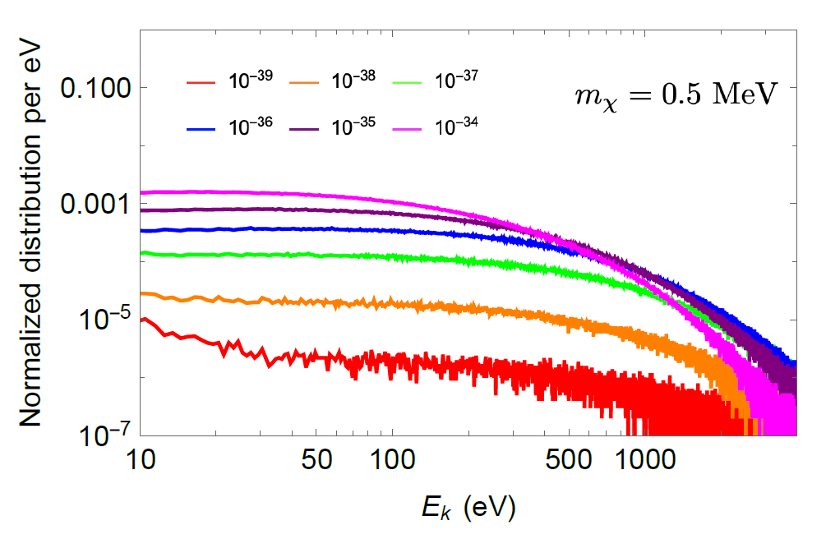
Solar Reflected Dark Matter
[3] Haipeng An, Haoming Nie, Maxim Pospelov, Josef Pradler, and Adam Ritz Phys. Rev. D 104, 103026, arXiv: 2108.10332
Notes:
LDM solar reflected
Simulated->bound

Slide 8
Motivation: Modulation
Improve Sensitivity
Lowering Threshold
Better Data Analyzing
Increase DM Energy
New Experiment Design & New Electronic Tech.
Boosted by Solar Reflection
New Variable: Modulations

Slide 9
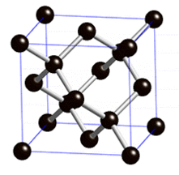
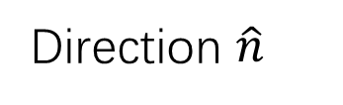

Motivation: Anisotropy of Reflected DM
$$e^{−}$$
DM
Direction dependent scattering
Direction $\hat{n}$
Notes:
Halo: isotropic
Reflected: directional
Single crystal anisotropic

Slide 10
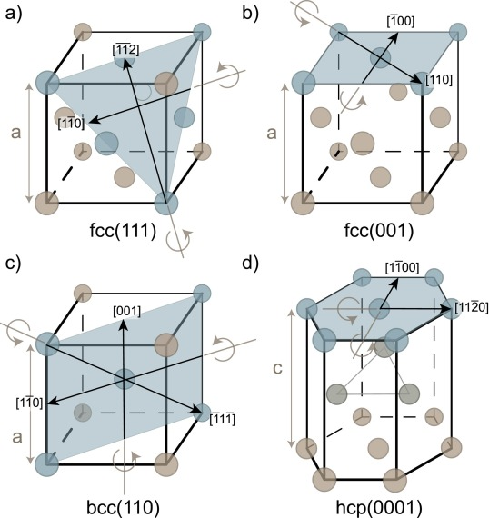
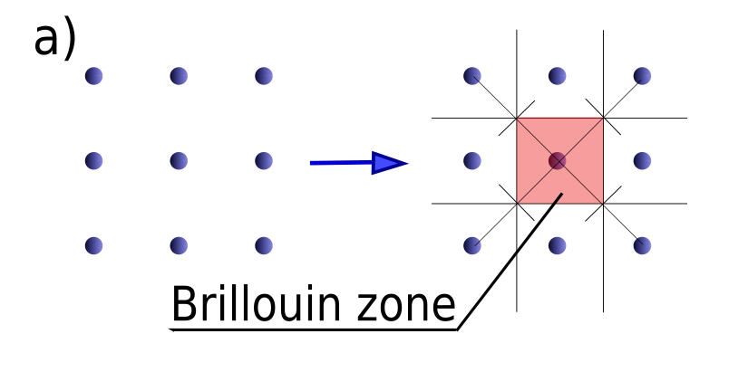

Crystal Structure
Reciprocal lattice vector
$$\vec{G}⋅\vec{R}=2πn$$
Bloch state in crystal
$$ψ_{i\vec{k}}\left(\vec{x}\right)=\frac{1}{\sqrt{V}}\sum_{\vec{G}}{{\tilde{u}}_{i}\left(\vec{k}+\vec{G}\right)e^{i\left(\vec{k}+\vec{G}\right)∙\vec{x}}}$$
G ~ crystal surface ~ Brillouin zone

Slide 11
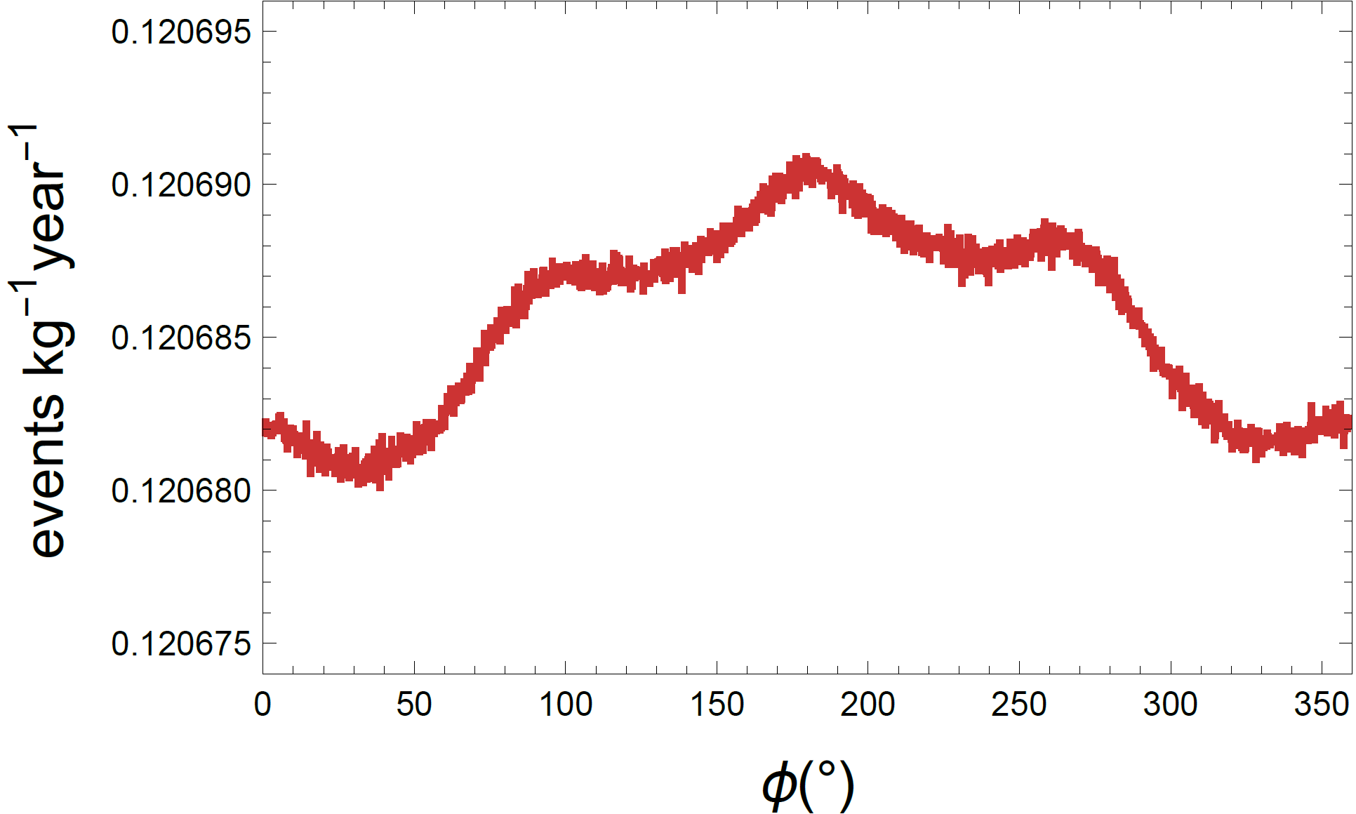
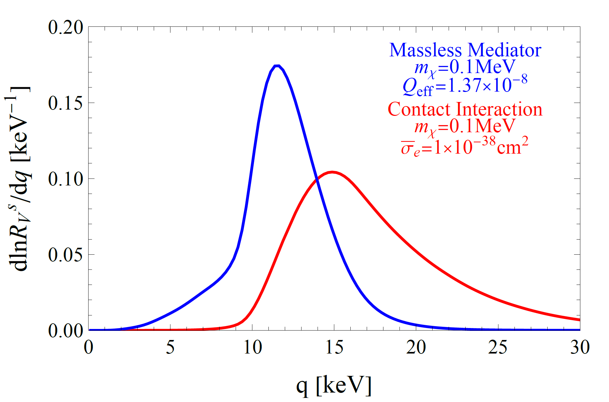
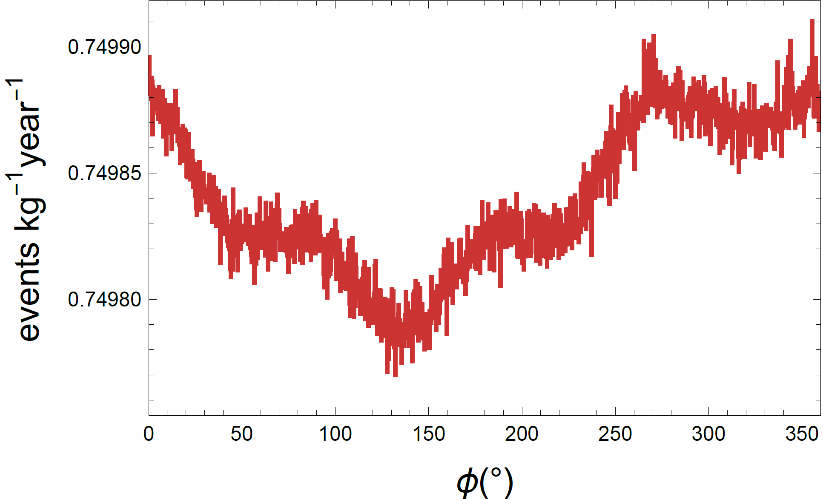
Valence Shell Scattering
Contact interaction
Massless mediator
Notes:
Small
q large
Expand in b/q, similar to free plane wave->small

Slide 12
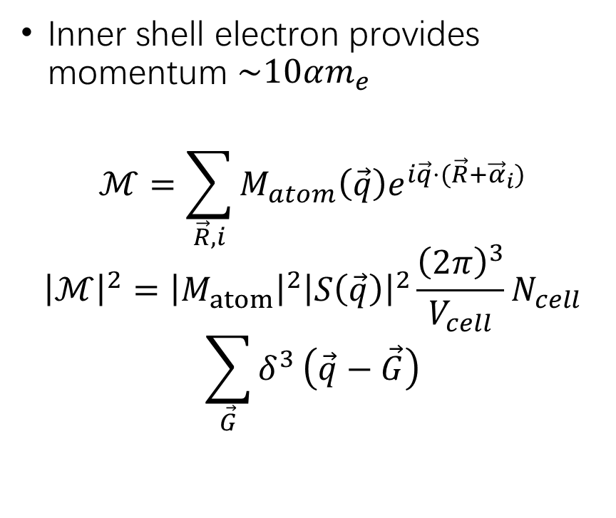
Bragg Scattering of Inner Shell Electrons
Inner shell electron provides momentum $\sim 10αm_{e}$
$$ℳ=\sum_{\vec{R},i}{M_{atom}\left(\vec{q}\right)e^{i\vec{q}⋅(\vec{R}+{\vec{α}}_{i})}}$$
$${\left|ℳ\right|}^{2}={\left|M_{atom}\right|}^{2}{\left|S\left(\vec{q}\right)\right|}^{2}\frac{{\left(2π\right)}^{3}}{V_{cell}}N_{cell}$$
$$\sum_{\vec{G}}{δ^{3}}\left(\vec{q}−\vec{G}\right)$$
Notes:
Bragg scattering
X-ray Bragg: q, out enhance
Matom e^(iqR) sum
Resum delta(q-G)

Slide 13


Bragg Scattering of Inner Shell Electrons
Equivalently $\int{d^{3}q}→\frac{{\left(2π\right)}^{3}}{V}\sum_{\vec{G}}{ }$
$\sqrt{3}\frac{2π}{a_{Ge}}$~3keV
Small q
Large q
Notes:
q continuous integral -> G discrete sum ~3keV

Slide 14
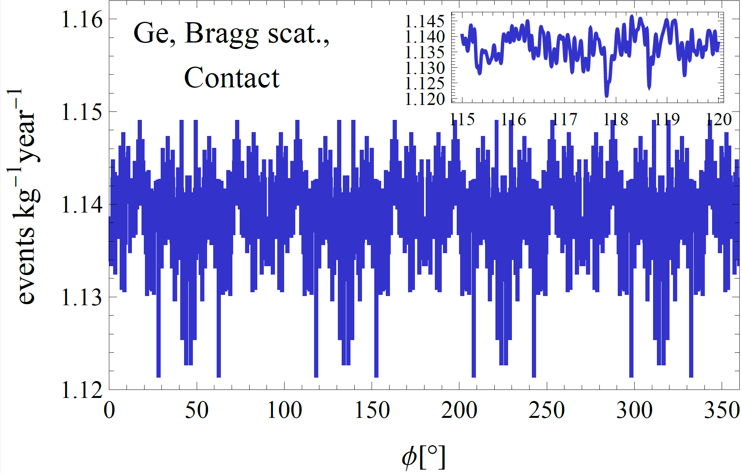
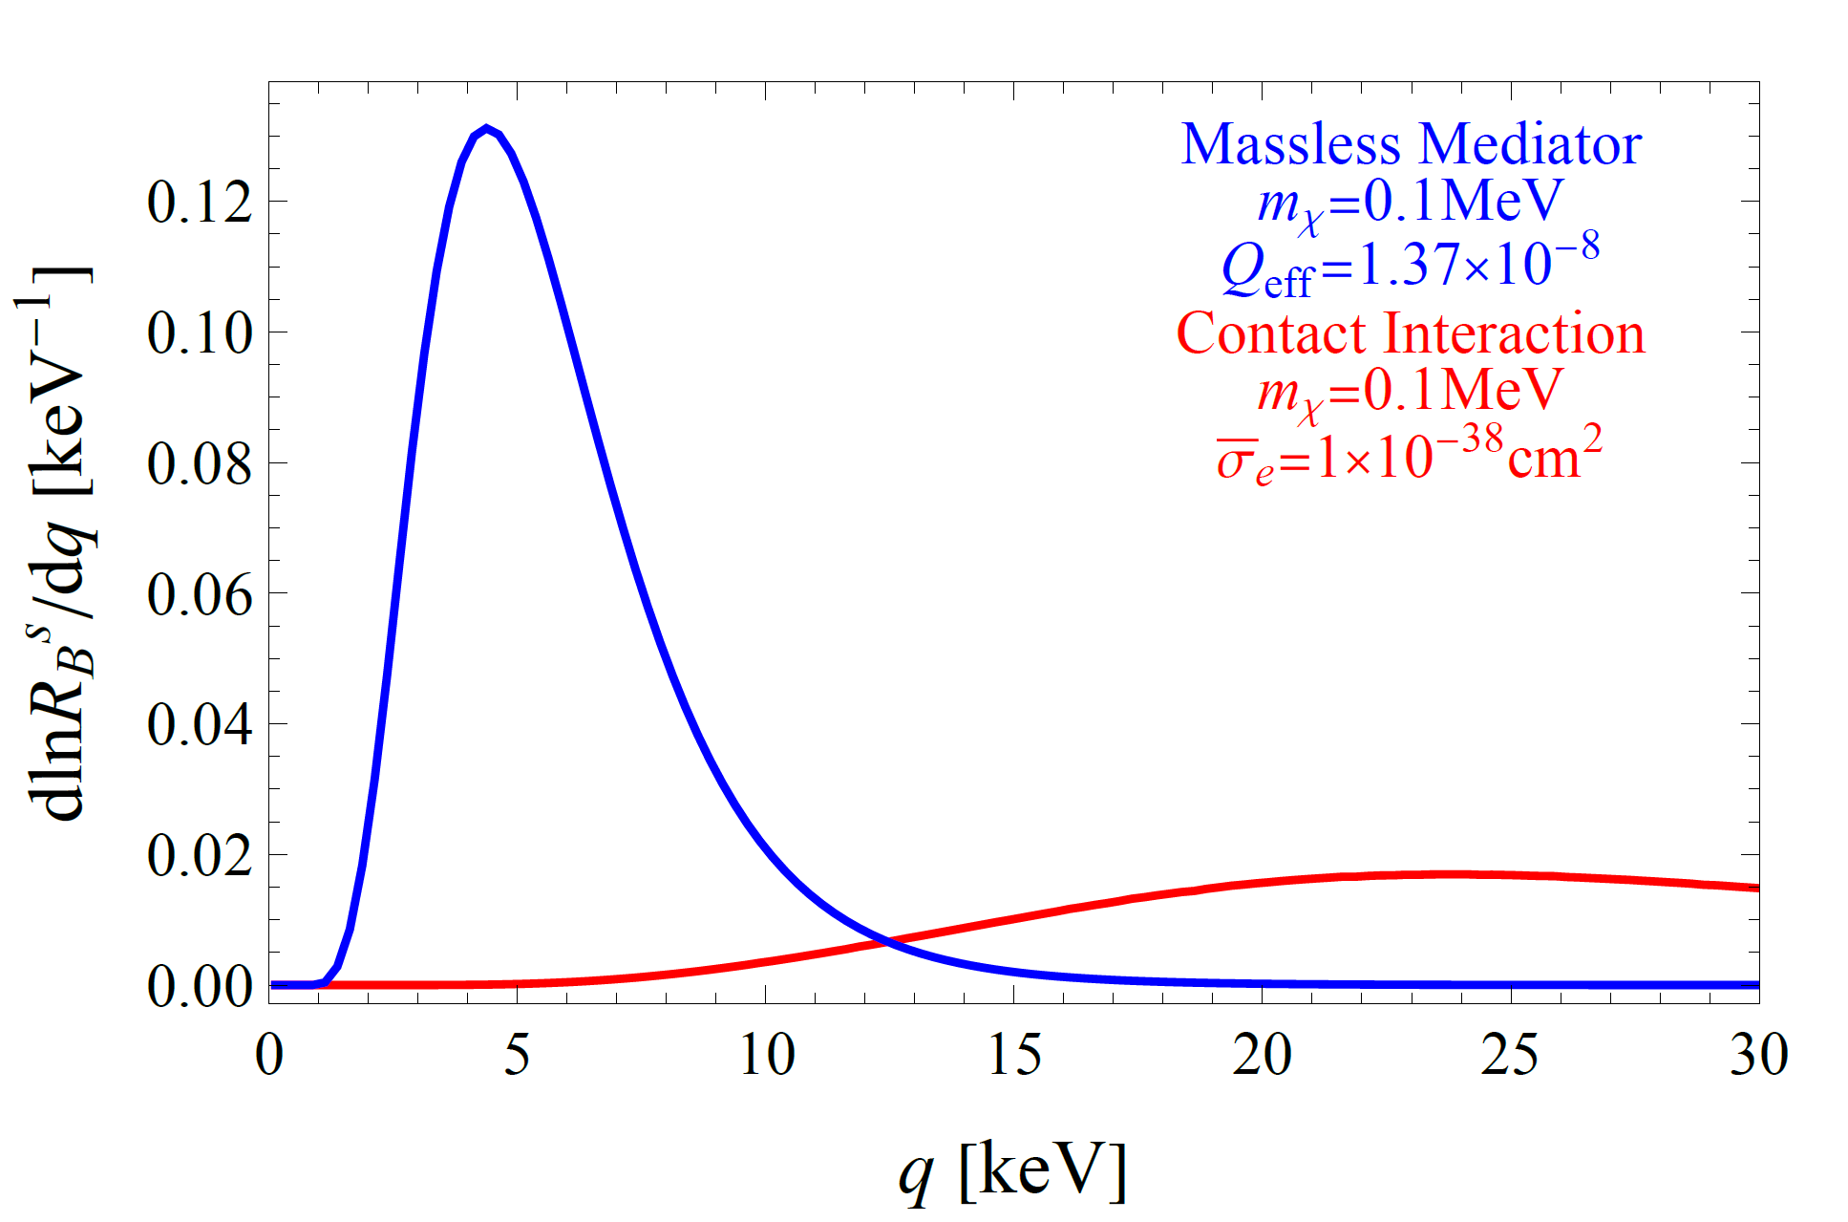
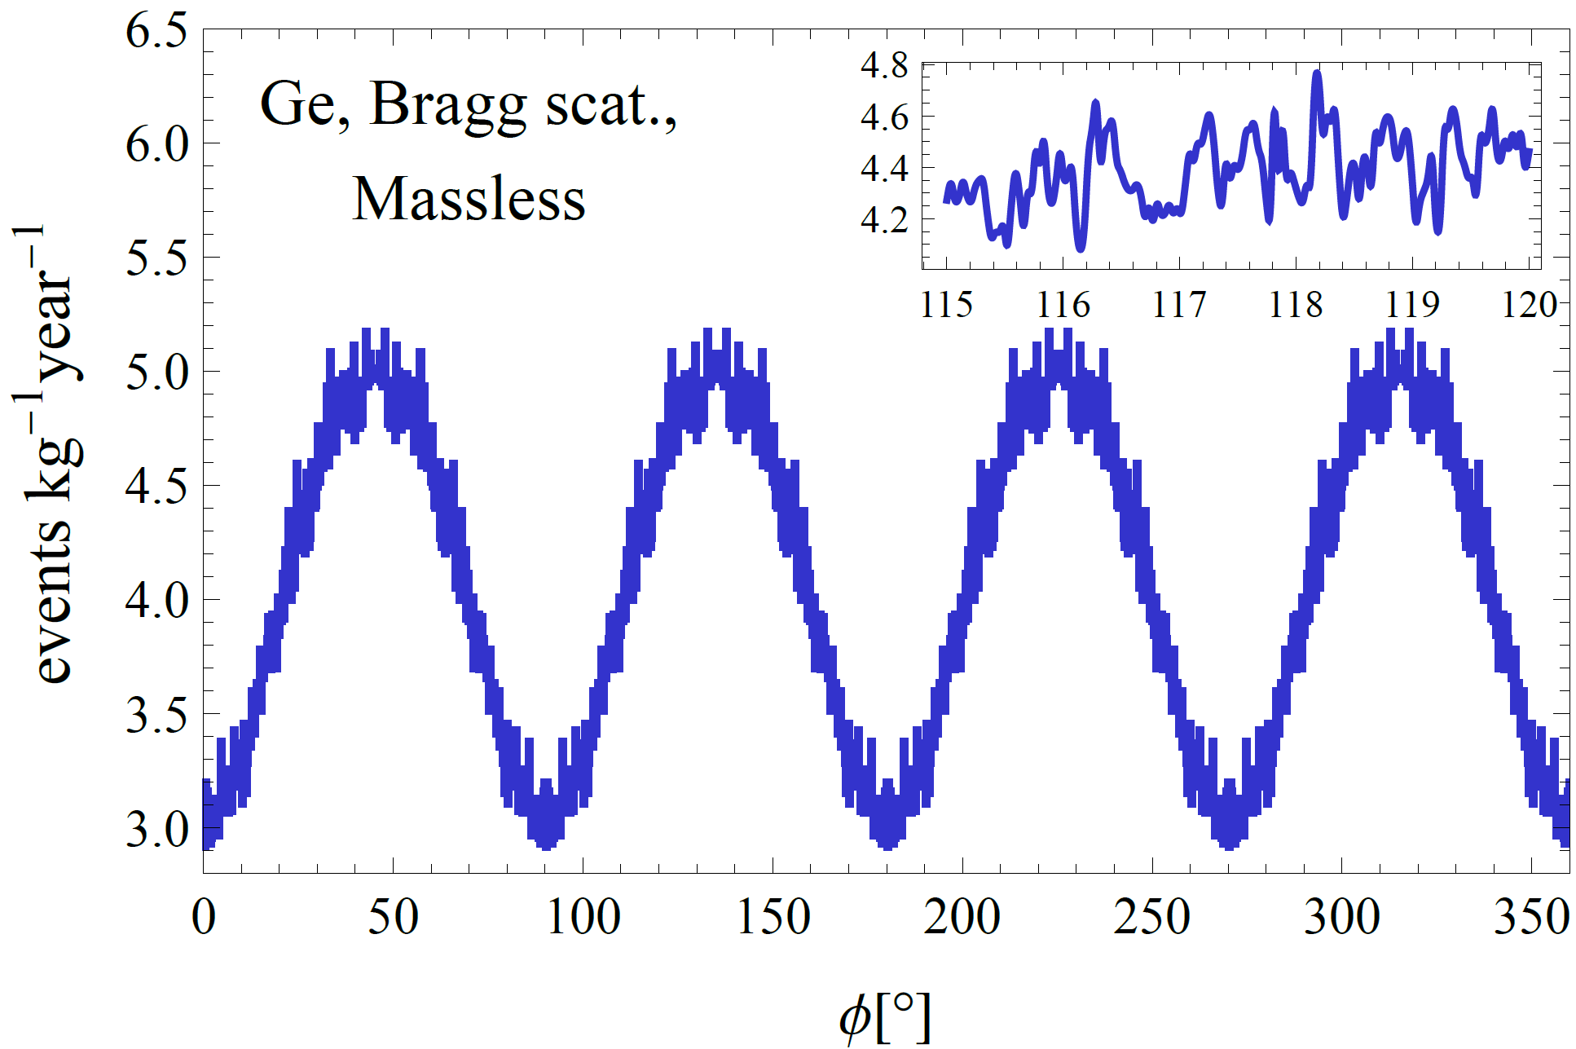
Bragg Scattering of Inner Shell Electrons
Notes:
Contact DMform~1 large-q >>3keV small anisotropy
Massless Dmform~1/q^2 small-q alpha me initial momentum ~3keV O(1) anisotropy

Slide 15
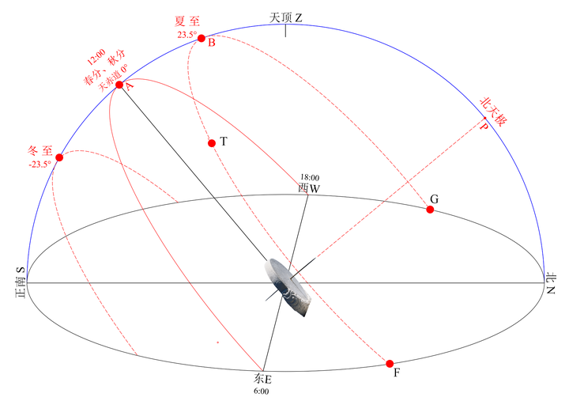
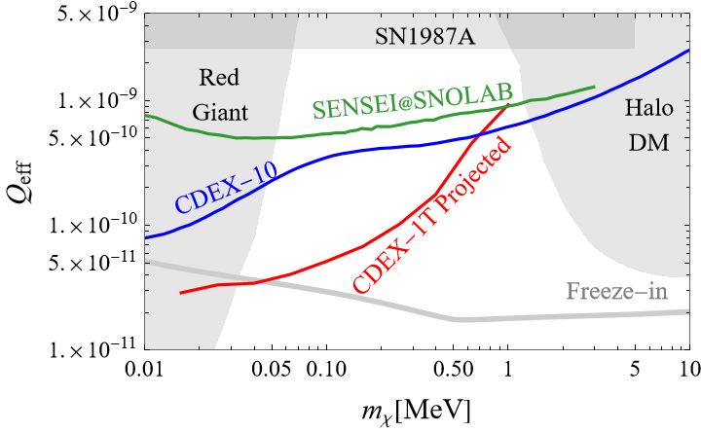
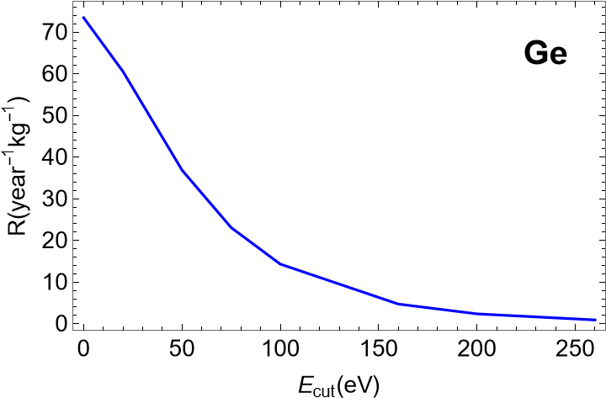
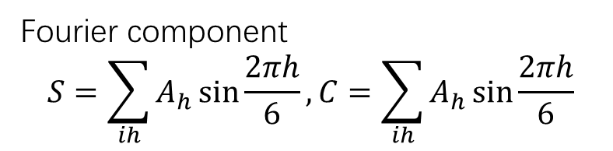

Analysis of Daily Modulation
4-fold symmetry axis, 6 hour period, 6 bins:
Fourier component
$$S=\sum_{ih}{A_{h}}\sin{\frac{2πh}{6}}, C=\sum_{ih}{A_{h}}\sin{\frac{2πh}{6}}$$
$$\hat{n}$$
inner
shell
[4] Haipeng An, Haoming Nie, arxiv: 2502.21140
Notes:
More statistic S
1.More info
2.Independent of BG model uncertainty
3.Identify SRDM
Likelihood ratio test -> preliminary

Slide 16
Motivation: Inelastic DM
Improve Sensitivity
Lowering Threshold
Better Data Analyzing
Increase DM Energy
New Experiment Design & New Electronic Tech.
Boosted by Solar Reflection
New Variable: Modulations
Inelastic DM Excited by Solar Reflection

Slide 17


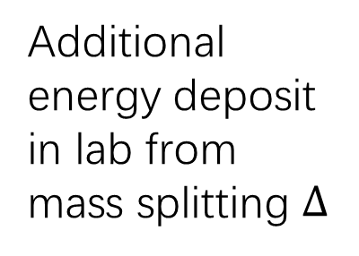



Inelastic DM
$$χ_{1}$$
$$m_{χ_{2}}=m_{χ_{1} }+Δ$$
$$e^{−}$$
Additional energy deposit in lab from mass splitting $Δ$
$$χ_{2}$$
$$χ_{1}$$

Slide 18
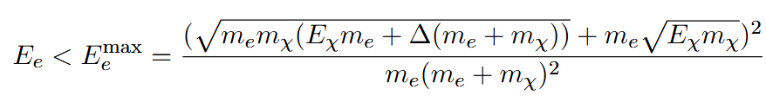
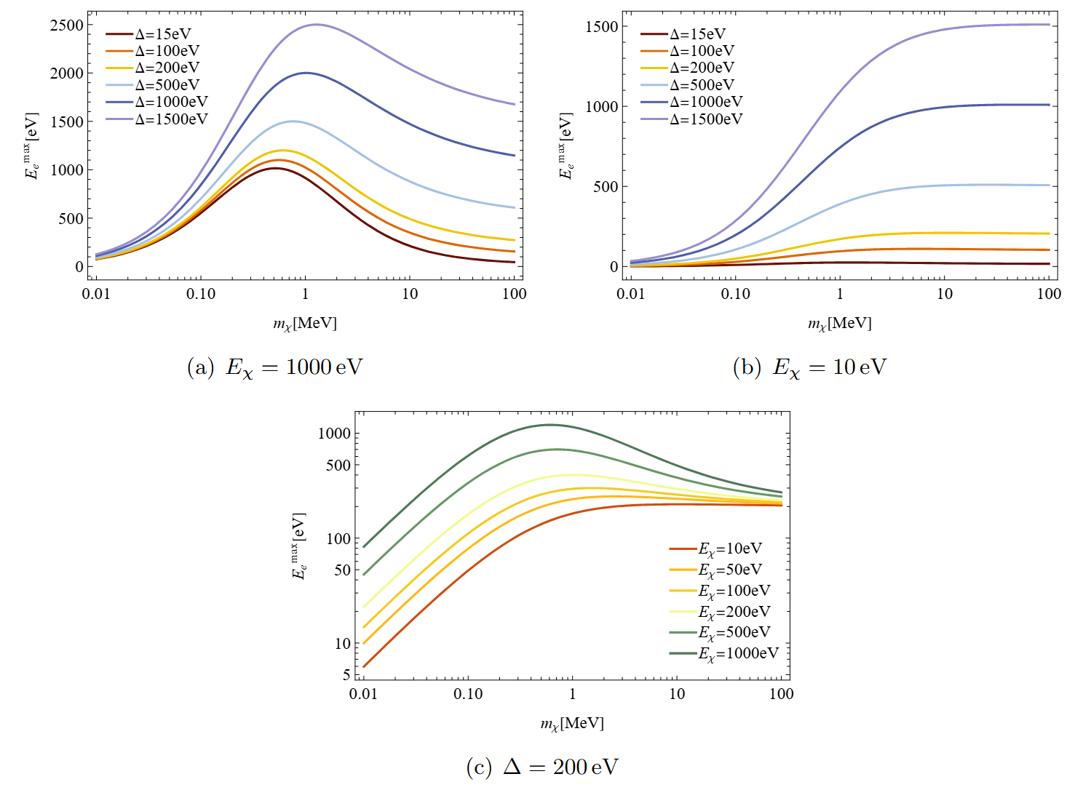
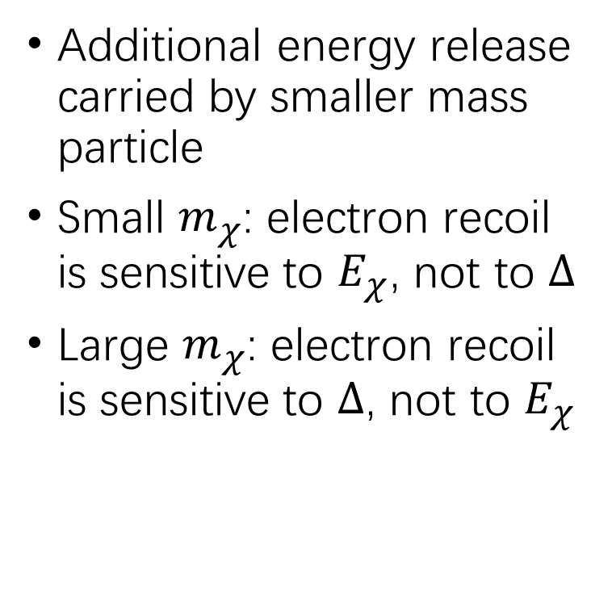
Inelastic Scattering
Additional energy release carried by smaller mass particle
Small $m_{χ}$: electron recoil is sensitive to $E_{χ}$, not to $Δ$
Large $m_{χ}$: electron recoil is sensitive to $Δ$, not to $E_{χ}$

Slide 19
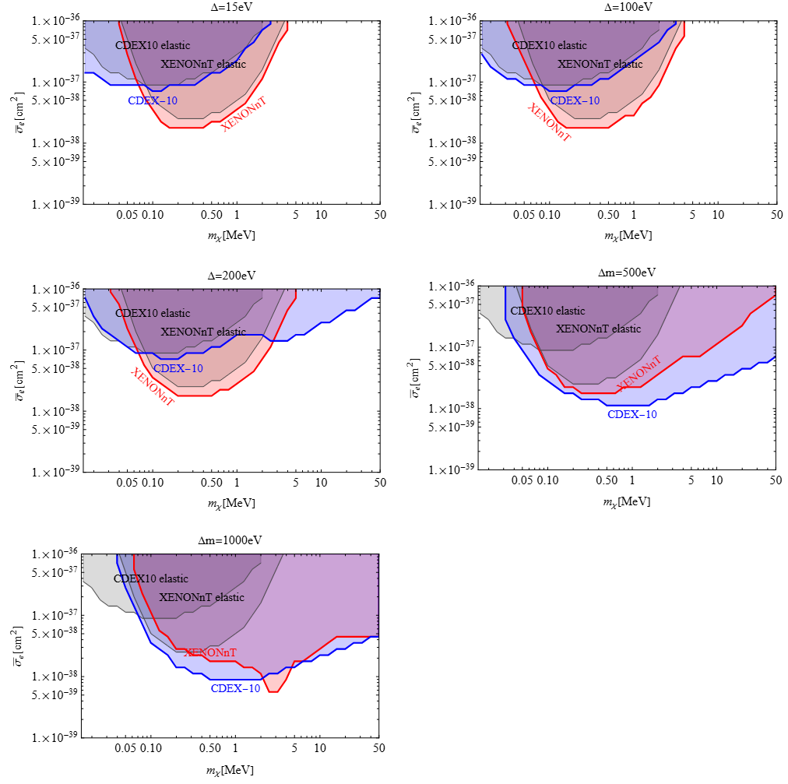
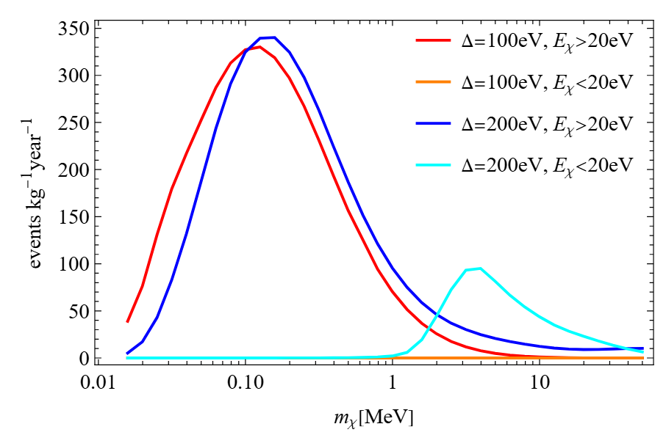
Limit of Solar Reflected Inelastic DM
CDEX-10
Preliminary
Dominated by high-kinetic-energy DM scattering
Dominated by excited state energy release

Slide 20
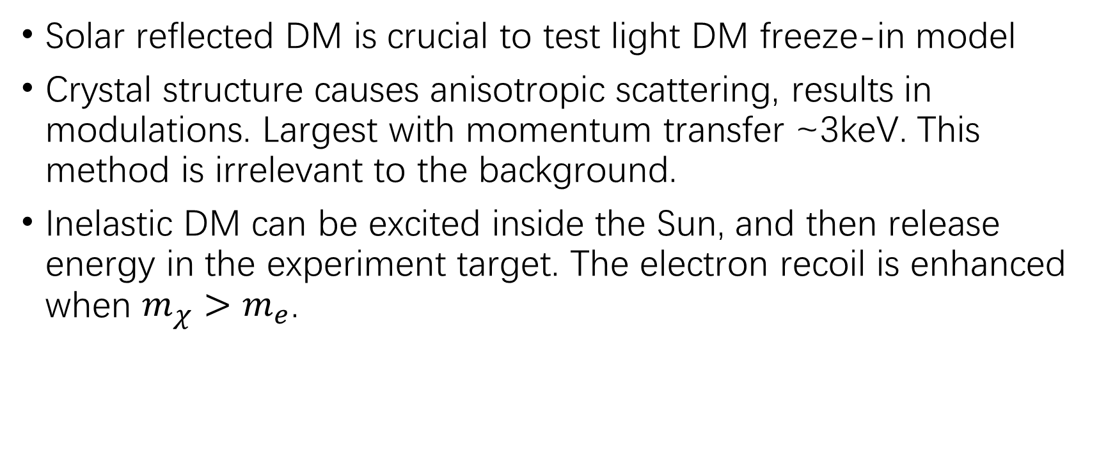
Summary
Solar reflected DM is crucial to test light DM freeze-in model
Crystal structure causes anisotropic scattering, results in modulations. Largest with momentum transfer ~3keV. This method is irrelevant to the background.
Inelastic DM can be excited inside the Sun, and then release energy in the experiment target. The electron recoil is enhanced when $m_{χ}>m_{e}$.

