Slide 1
Daily modulation of solar reflected dark matter signal
Haoming Nie (Tsinghua University)
CDEX Annual Meeting 2024
At Tsinghua University Cheng Yu-tung Hall
Notes:
太阳反射暗物质信号天调制

Slide 2
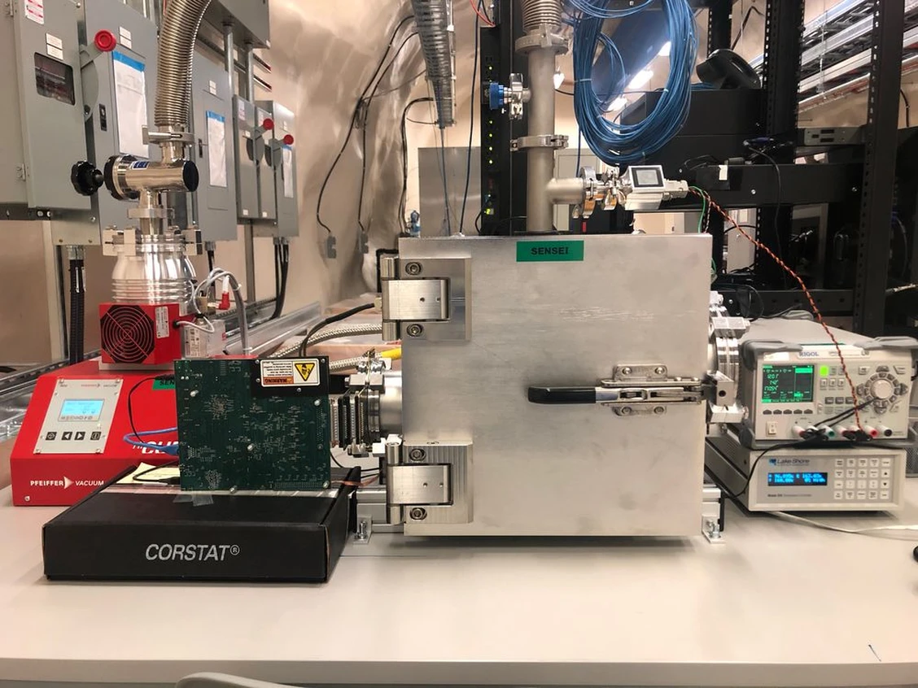
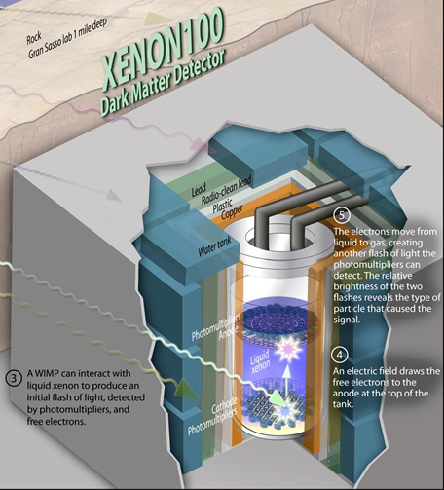
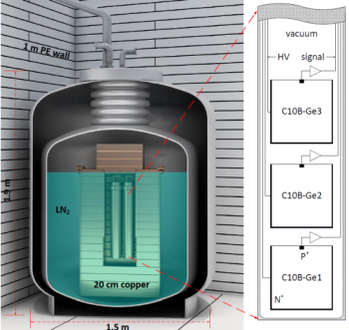
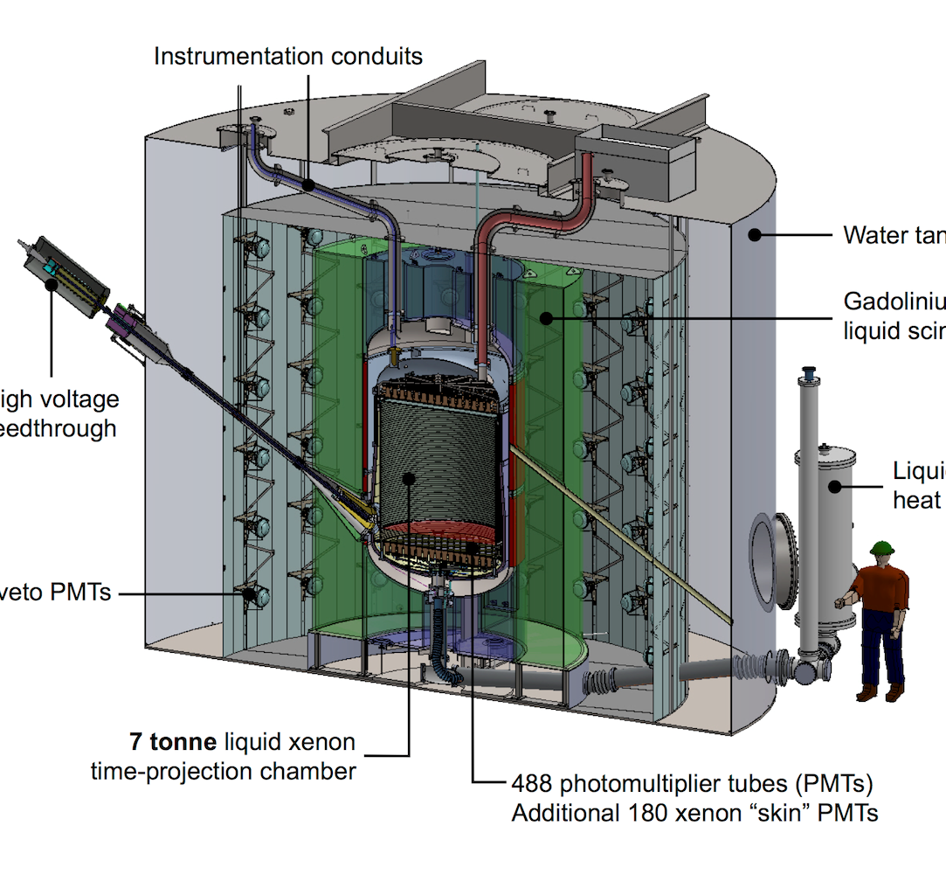
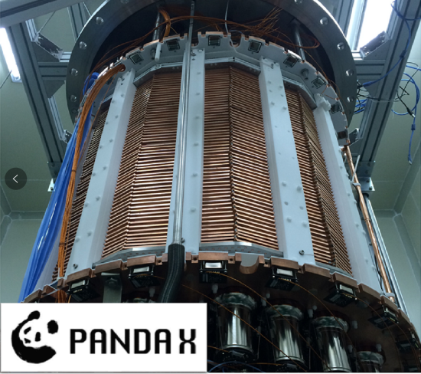
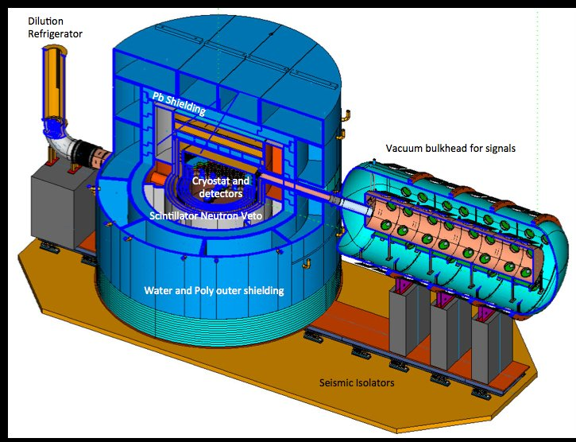
Motivation
Early Anisotropy/GW
Fifth force Exp.
Electron Recoil
Nuclear Recoil
SENSEI
XENON
CDEX
LZ
PANDAX
superCDMS
Notes:
DM important
Ultralight 5th force
PBH early anisotropy
Direct detection
Electron recoil hard

Slide 3
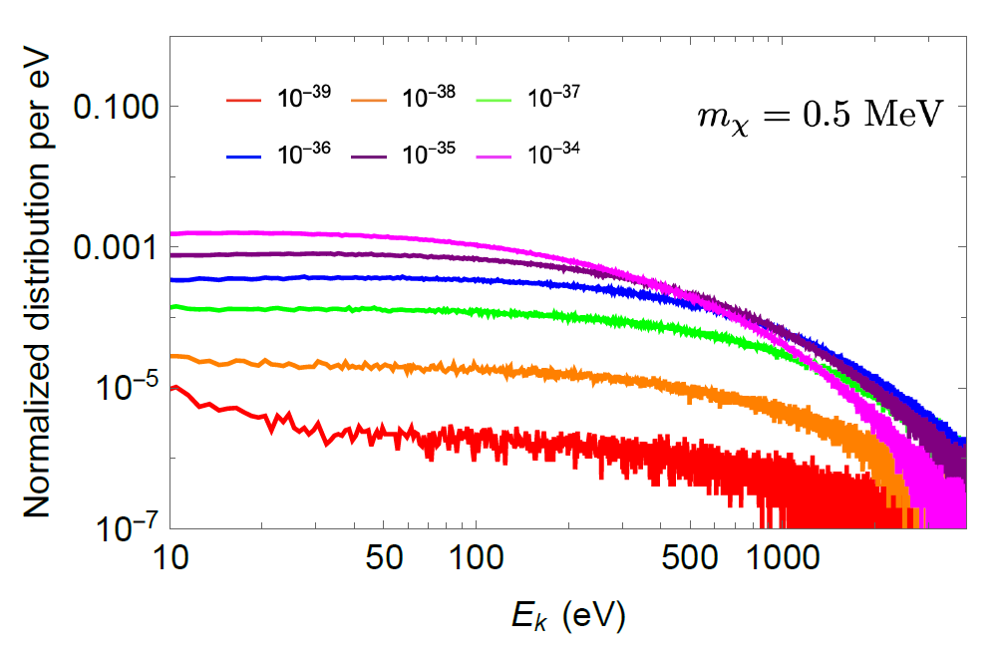
Solar Reflected Dark Matter
[1] Haipeng An, Haoming Nie, Maxim Pospelov, Josef Pradler, and Adam Ritz Phys. Rev. D 104, 103026, arXiv: 2108.10332
Notes:
LDM solar reflected
Simulated->bound

Slide 4
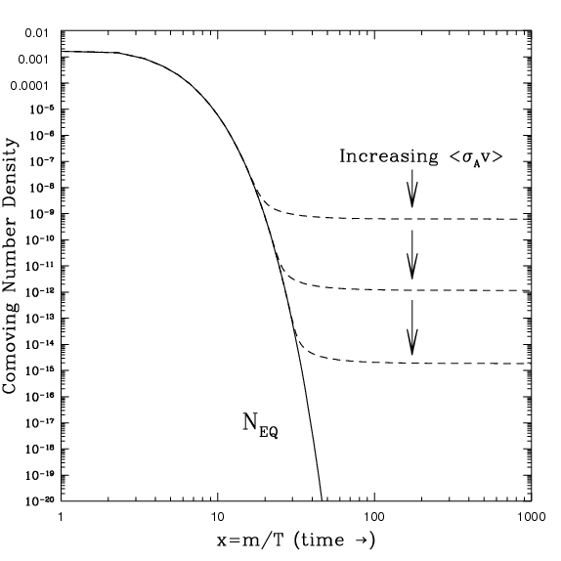
Freeze-out
DM
Freeze-out
SM
DM
Decay
SM
[1] S. Li et al. (PandaX), Search for Light Dark Matter with Ionization Signals in the PandaX-4T Experiment, Phys. Rev. Lett. 130, 261001 (2023), arXiv:2212.10067 [hepex].

Slide 5
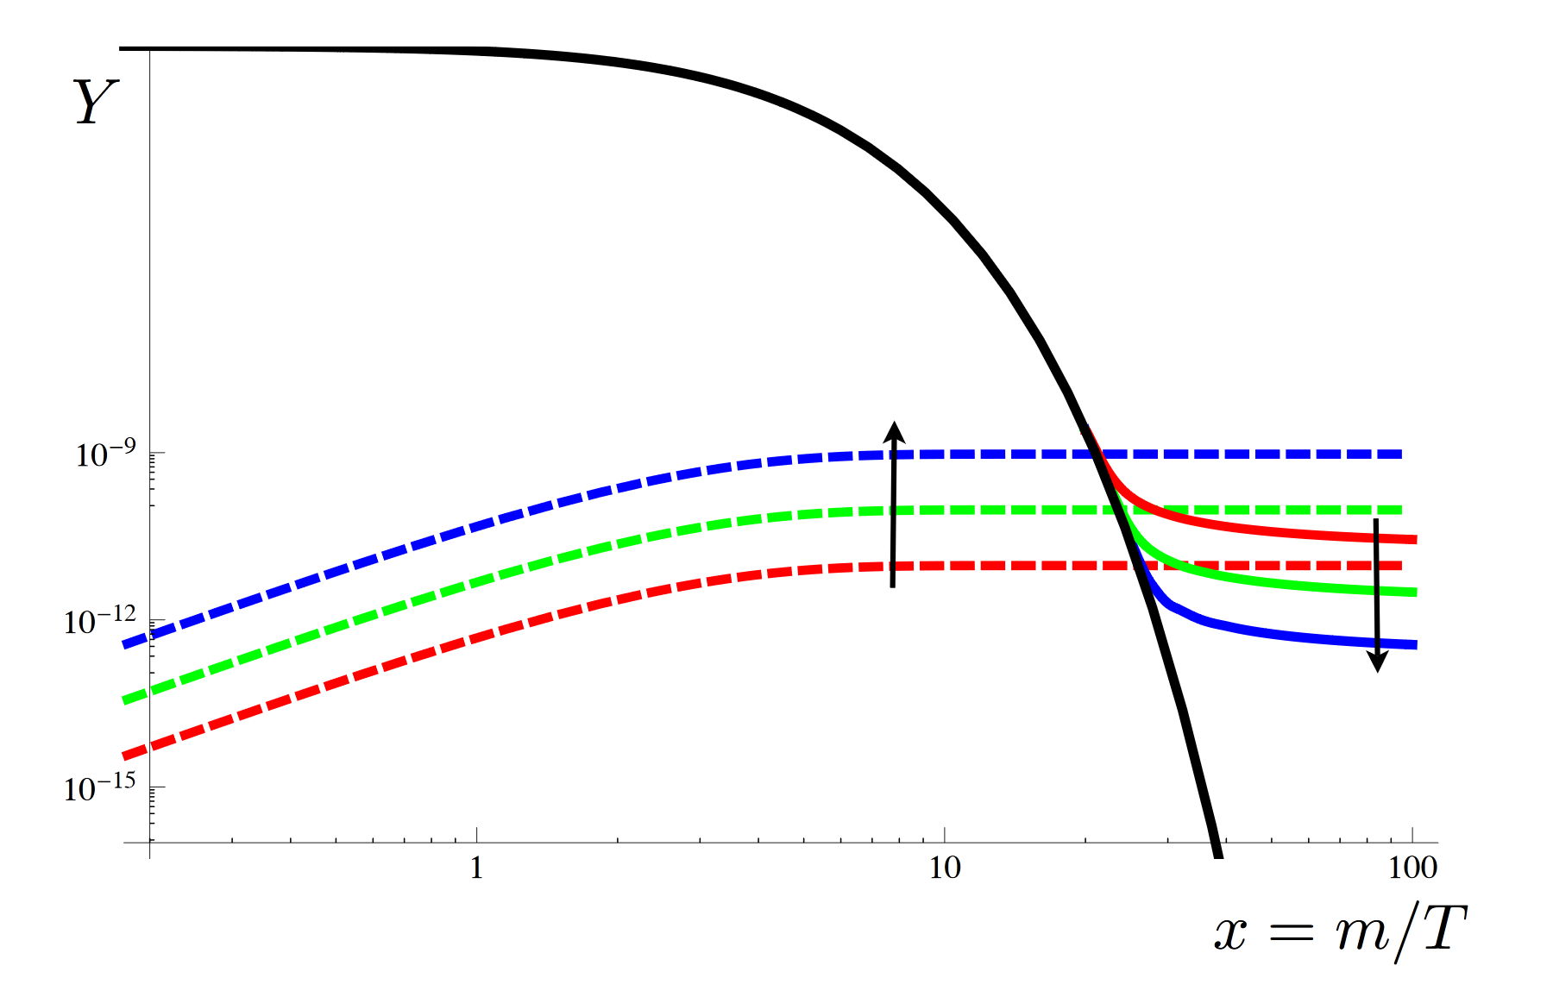
Freeze-in
SM
DM
Freeze-in
SM
Produce
DM
[2] SENSEI Collaboration, (2023), arXiv:2312.13342 [id=’astro-ph.CO’].

Slide 6
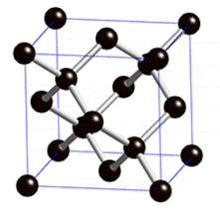
Motivation: Anisotropy of Reflected DM
$$e^{−}$$
DM
Direction dependent scattering
Direction $\hat{n}$
Notes:
Halo: isotropic
Reflected: directional
Single crystal anisotropic

Slide 7
Origins of angular dependence
Valence shell scattering
Energy band structure
Bloch wave function
Inner shell scattering
Bragg coherent scattering
$$e^{−}$$
DM

Slide 8
Crystal Structure
$$G=b_{1}+b_{2}+b_{3}$$
$$G=b_{3}$$
Reciprocal lattice vector
$$\vec{G}⋅\vec{R}=2πn$$
Electron Bloch state in crystal
G ~ crystal surface ~ Brillouin zone
$$\vec{G}$$
$$G=b_{1}+b_{2}$$

Slide 9
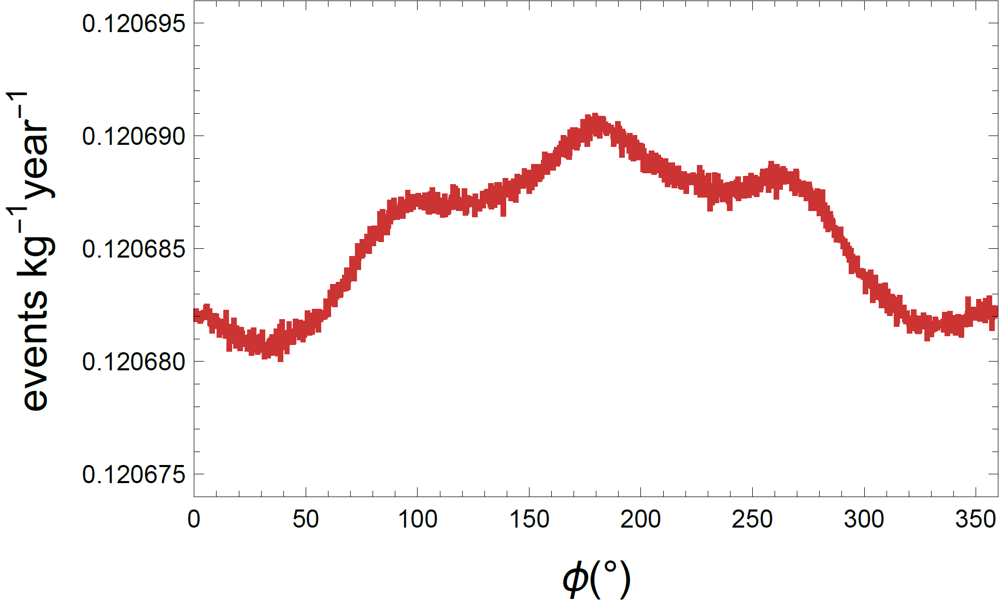
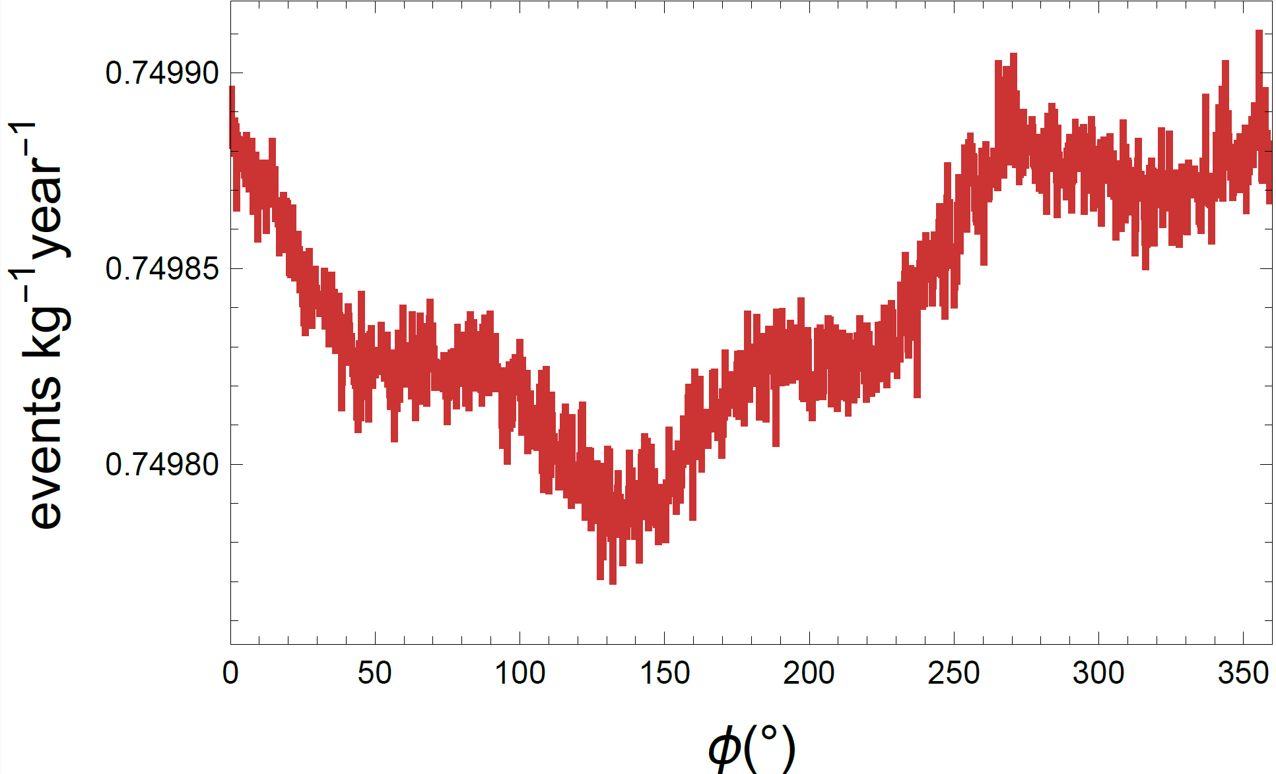
Valence Shell Scattering
Contact interaction
Massless mediator
Notes:
Small
q large
Expand in b/q, similar to free plane wave->small

Slide 10
Bragg Scattering of Inner Shell Electrons
Inner shell electron provides momentum $\sim 10αm_{e}$
$${\left|ℳ\right|}^{2}={\left|M_{atom}\right|}^{2}{\left|S\left(\vec{q}\right)\right|}^{2}\frac{{\left(2π\right)}^{3}}{V_{cell}}N_{cell}$$
$$\sum_{\vec{G}}{δ^{3}}\left(\vec{q}−\vec{G}\right)$$
Notes:
Bragg scattering
X-ray Bragg: q, out enhance
Matom e^(iqR) sum
Resum delta(q-G)

Slide 11
Bragg Scattering of Inner Shell Electrons
Equivalently $\int{d^{3}q}→\frac{{\left(2π\right)}^{3}}{V}\sum_{\vec{G}}{ }$
~3keV
Small q
Large q
Notes:
q continuous integral -> G discrete sum ~3keV

Slide 12
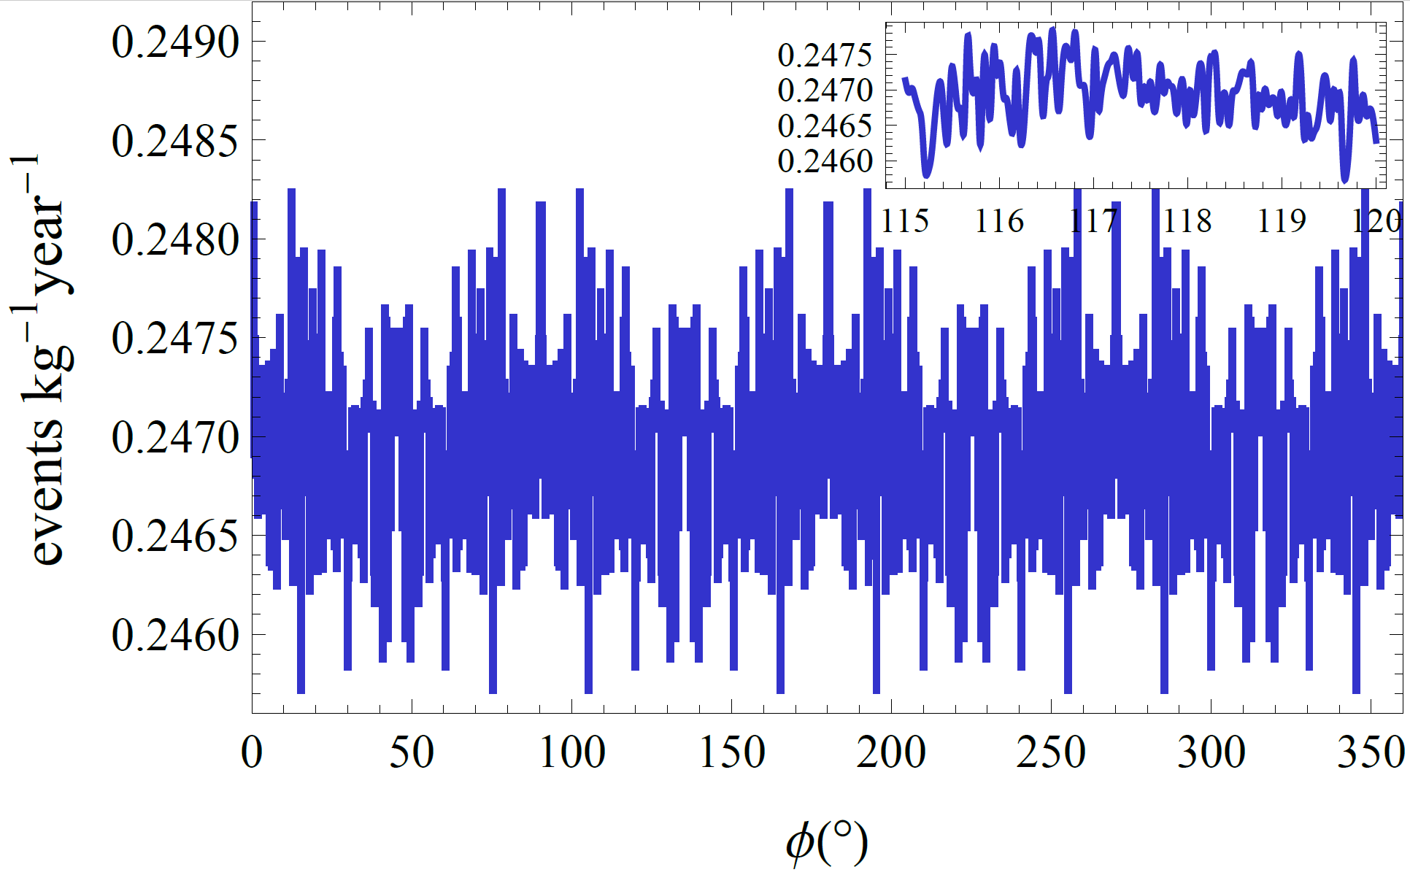
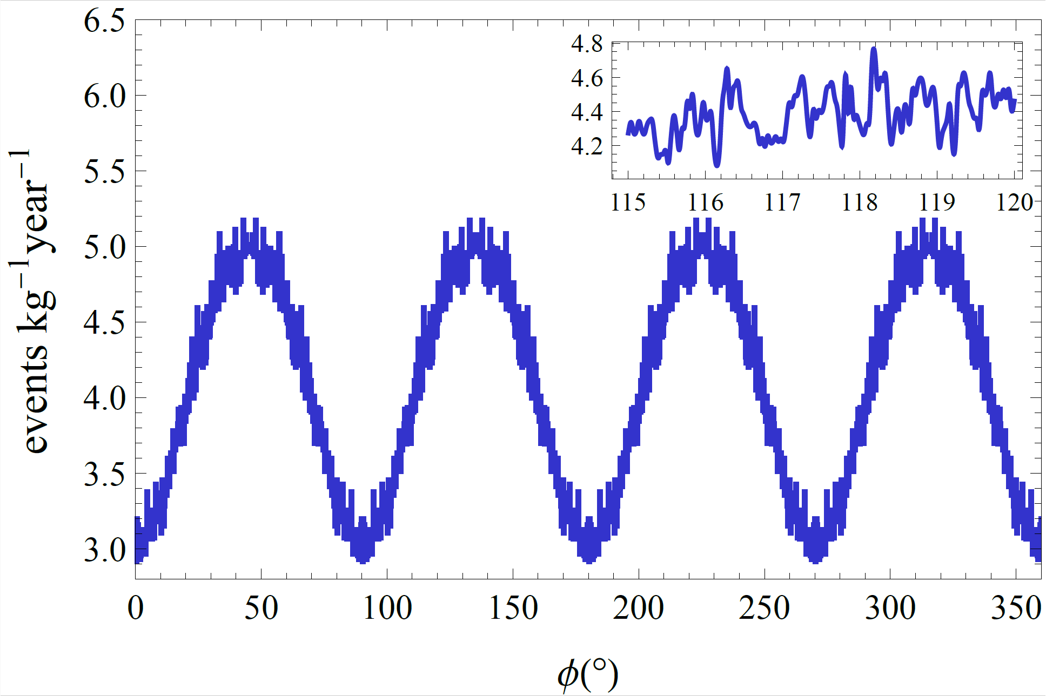
Bragg Scattering of Inner Shell Electrons
Contact
interaction
Massless
mediator
Notes:
Contact DMform~1 large-q >>3keV small anisotropy
Massless Dmform~1/q^2 small-q alpha me initial momentum ~3keV O(1) anisotropy

Slide 13
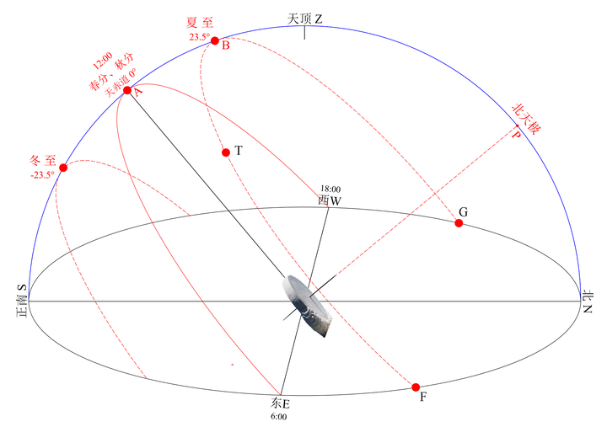
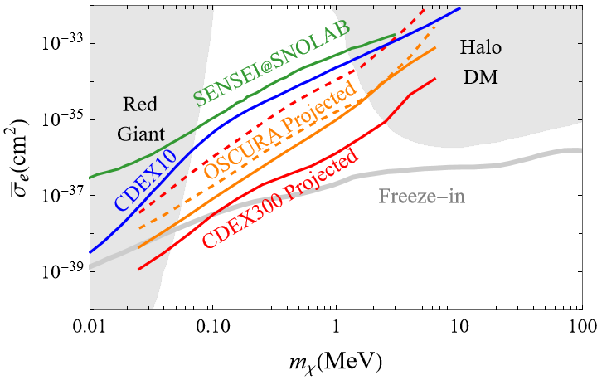
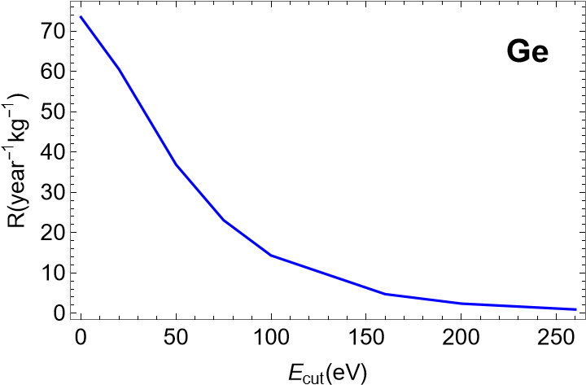
Analysis of Daily Modulation
4-fold symmetry axis, 6 hour period, 6 bins:
Fourier component
$$S=\sum_{ih}{A_{h}}\sin{\frac{2πh}{6}}, C=\sum_{ih}{A_{h}}\sin{\frac{2πh}{6}}$$
$$\hat{n}$$
inner
shell
Preliminary
Notes:
More statistic S
1.More info
2.Independent of BG model uncertainty
3.Identify SRDM
Likelihood ratio test -> preliminary

Slide 14
Summary
Solar reflected DM is crucial to test light DM freeze-in model
Crystal structure cases anisotropic scattering, results in modulations
Low momentum transfer ~3keV means large modulation
Modulation signal is irrelevant to background modeling error

Slide 15
The End

Slide 16
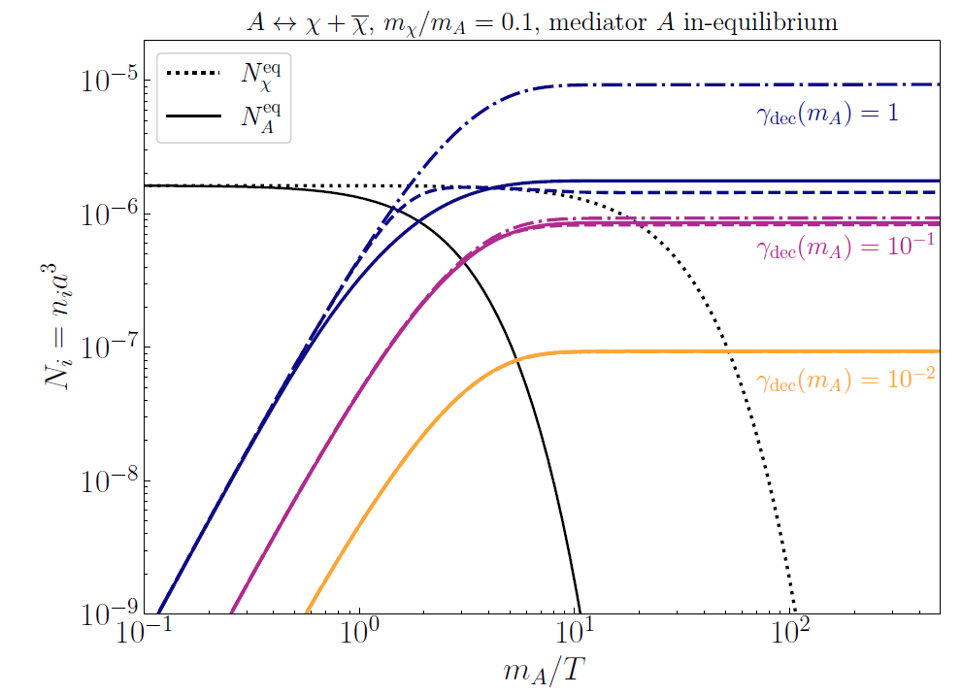
Light Dark Matter Freeze-in Model
Light dark matter-dark photon-kinetic mixing model
[1] C. Dvorkin, T. Lin, and K. Schutz, Phys. Rev. D99, 115009 (2019), [Erratum: Phys.Rev.D 105, 119901(2022)], 1902.08623.
[2] Y. Du, F. Huang, H.-L. Li, Y.-Z. Li, and J.-H. Yu, JCAP 04, 012 (2022), arXiv:2111.01267 [hep-ph].
Notes:
WIMP freeze-out almost ruled out
LDM freeze-in 0.1~10MeV

Slide 17
The rate
$$R=\frac{ρ_{χ}}{m_{χ}}v_{0}\int{d^{3}v g_{χ}\left(v\right)σ}=\frac{ρ_{χ}}{m_{χ}}v_{0}\frac{\overline{σ}}{8πμ_{χe}^{2}}\int{\frac{d^{3}q}{q} \int{\frac{d^{3}v}{v^{2}}g_{χ}\left(\vec{v}\right)Θ\left(v−v_{min}\right)}}{\left|F_{DM}\left(q\right)\right|}^{2}{\left|f_{ik→k^{′}}\left(\vec{q}\right)\right|}^{2}$$
Traditionally we integrate out $\int{d\cos{θ_{qv}}dφ_{qv}}$ of $\int{d^{3}q}$ and assume $g_{χ}\left(\vec{v}\right)$ to be isotropic
But now $g_{χ}\left(\vec{v}\right)=\frac{4R_{⨀}^{2}}{r_{⨁}^{2}} \tilde{f}\left(v\right)δ\left(\hat{n}\right)$
Notes:
Rate angle integral
Directional

Slide 18
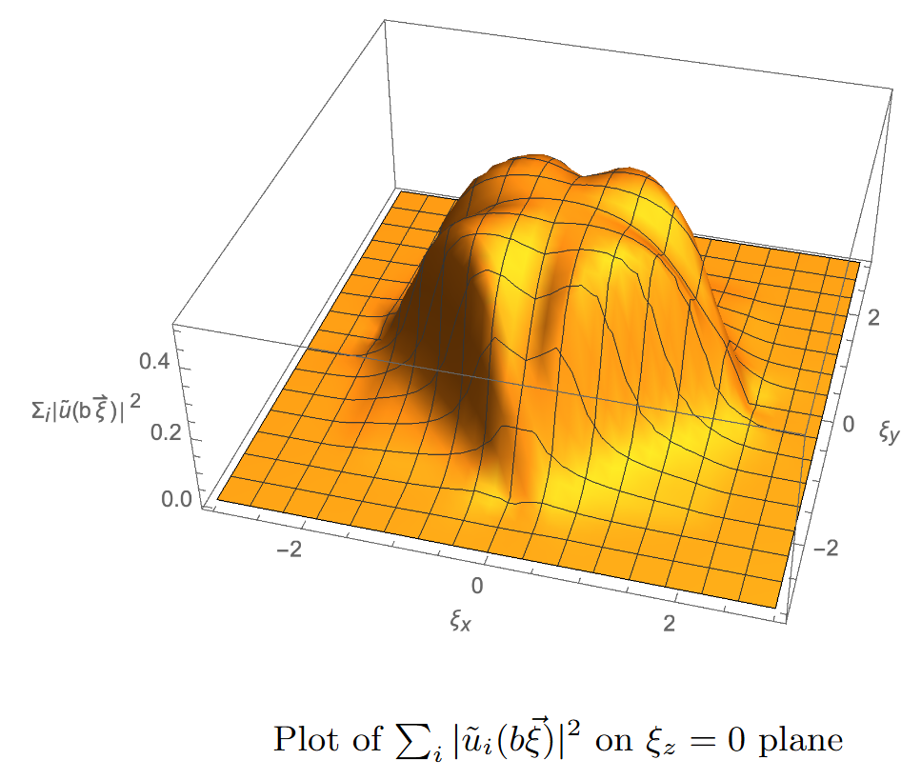
Valence Shell Scattering
Bloch state in crystal
$$ψ_{i\vec{k}}\left(\vec{x}\right)=\frac{1}{\sqrt{V}}\sum_{\vec{G}}{{\tilde{u}}_{i}\left(\vec{k}+\vec{G}\right)e^{i\left(\vec{k}+\vec{G}\right)∙\vec{x}}}$$
Form factor of Bloch $i\vec{k}$ to (almost) free state $\vec{k}′$
Band Structure of Germanium
[4]Niquet, Y. M. ; Rideau, D. ; Tavernier, C. ; Jaouen, H. ; Blase, X.; Onsite matrix elements of the tight-binding Hamiltonian of a strained crystal: Application to silicon, germanium, and their alloys; Physical Review B, vol. 79, Issue 24, id. 245201
Notes:
Bloch state->energy bands (anisotropic)
Form factor

