Slide 1
A Statistical Analysis of Early-stage Ni-Si Clusters in Ion-irradiated 316L Stainless Steel
Yifei GUO, Dongyue CHEN, Kenta MURAKAMI, Kenji NISHIDA, Guma YELI, Shasha LV, Naoto SEKIMURA, Zhengcao LI
May 2026
Guo, Y., et al. (2026). Journal of Nuclear Materials 626: 156561.
Notes:
Good morning. I’m Yifei Guo from the Department of Engineering Physics. The title of my presentation is “A Statistical Analysis of Early-stage Ni-Si Clusters in Ion-irradiated 316L Stainless Steel.”

Slide 2
Index
Index
Introduction
Experimental
The formation of solute clusters affected by Si
Clustering/Co-clustering analysis via LCB method
Conclusion
Notes:
My talk is organized into five parts: Introduction, Experimental, then two result sections about clusters and clustering, separately, and Conclusion.

Slide 3
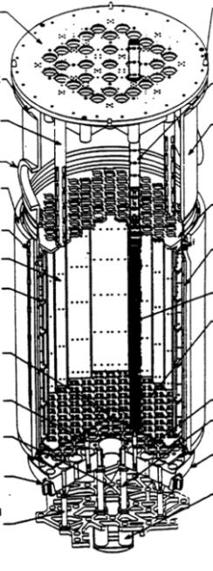
Stainless steel in Nuclear reactors
1.Introduction
304/316 series stainless steels (SS) are widely applied in light water reactor (LWR) core as structural materials.
Upper core plate
The degradation of some SS components may cause:
– Structural integrity failure.
– Control rod insertion failure.
– Loss of coolant in local area.
Core barrel
Core baffle & former
 | Temperature (ºC) | Dose | Component function
Upper core plate | ~325 | 0.3~0.45 | Ensure fuel assembly, control rod position.
Lower core plate | ~290 | 0.17~4.6 | Support the core; Control coolant flow.
Core barrel | 20~290 | 1~10 | Support the core.
Core baffle & former | 290~370 | 10~110 | Separate coolant flows.
Bolt | 300~370 | 58~110 | Connect and fix.
Typical PWR core (IAEA)
Notes:
Let’s start with the introduction.
304 and 316 stainless steels are widely used as structural materials in light water reactor cores. However, under reactor conditions — high temperature and intense neutron irradiation — these steels can degrade. This degradation may lead to structural integrity failure, control rod insertion failure, or local loss of coolant. All these situations could lead to serious consequences in the reactor.

Slide 4
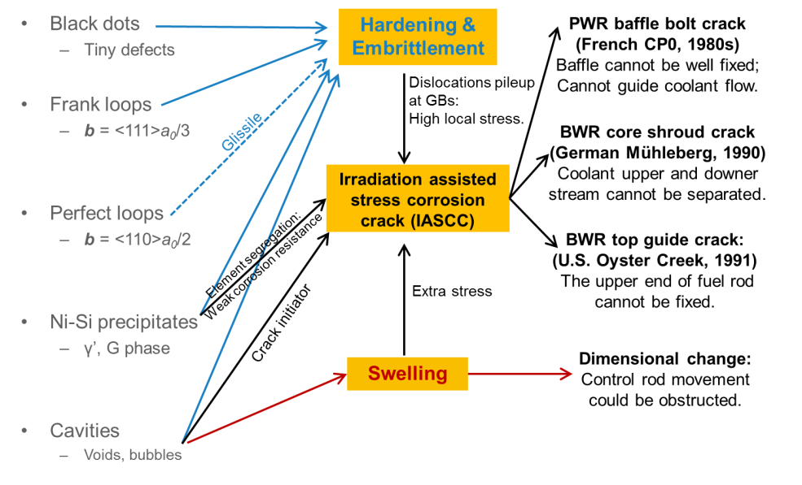

Defects in irradiated Stainless steel
1.Introduction
Defect formation will result in:
– Irradiation hardening & embrittlement.
– Irradiation assisted stress corrosion crack.
– Swelling.
Moving dislocation
Defects act as barrier
hardening & embrittlement
To prevent SS component failure, defect formation should be understood.
Notes:
And, these degradations are mainly caused by irradiation defects. Irradiation produces defects such as black dots, Frank loops, γ' precipitates, and cavities, which in turn cause irradiation hardening, embrittlement, stress corrosion cracking, and swelling. To prevent component failure, we need to understand how these defects form.

Slide 5
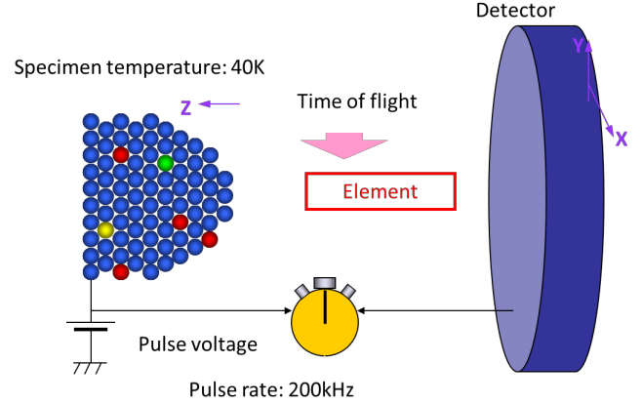
Limitations of Previous studies
1.Introduction
Limitations
Research Aims
1. The role of the Si element is unclear
Effect of Si addition
- Defect formation in SS is not only determined by irradiation temperature and dpa, but Si content as well.
- Control the Si content.
- Model alloys of high-purity 316L stainless steel.
2. TEM is not sensitive to γ’ precipitates
APT to analyze precipitate
as γ’ and γ matrix are similar in:
- Crystal structure;
- Lattice constant (0.35nm, 0.36nm);
- Usually coherent.
- Sensitive in distinguishing elements.
- Atom map of near-atomic resolution.
- Detects γ’ precipitates and its precursors.
Notes:
Previous studies had done lots of works on defects formation, but still there are two main limitations. First, the role of silicon is unclear which is one of the component of γ’ precipitates. Second, observation of defects is influenced by the detection technology. For example, TEM is not sensitive to γ' precipitates, because γ' and the γ matrix share a similar crystal structure.
Therefore, the objectives of this study are: (1) to study the effect of Si by controlling its content in model alloys; and (2) to use Atom Probe Tomography, which offers near-atomic resolution and excellent chemical sensitivity, to detect γ' precipitates and their precursors. And further explain the mechanism of irradiation segregation.

Slide 6
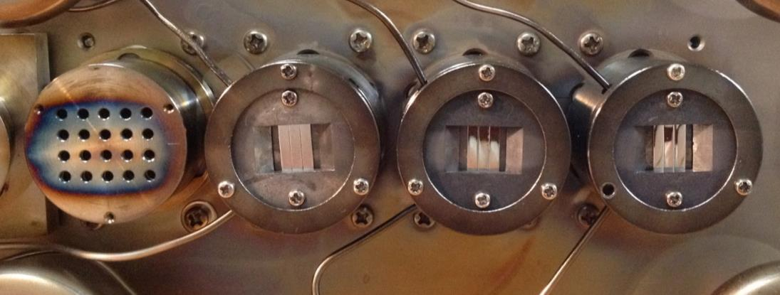
Materials and irradiation condition
2. Experimental
High purity 316L SS model alloys with two different Si content are chosen.
High purity
Solution annealed
Electron polishing before irradiation
 | Fe | Cr | Ni | Si | Mn | Mo
 | at.% | at.% | at.% | at.% | at.% | at.%
HS | Bal. | 18.1 | 12.8 | 1.88 | 1.00 | 1.31
NS | Bal. | 18.2 | 12.4 | <0.002 | 1.02 | 1.34
Irradiation is preformed in HIT facility in University of Tokyo:
– 3MeV Ni²⁺
– Dose rate: order of 1x10⁻⁴ dpa/s
Faraday cup array
Samples
Thermal couples
Notes:
So,
We prepared two model alloys with different Si contents; the compositions are shown in the table. I’ll refer to the high-Si alloy as HS and the Non-Si alloy as NS. Both were solution annealed, electropolished, and then irradiated with 3 MeV Divalent Ni ions at the HIT facility of the University of Tokyo. The dose is 0.8 dpa. The depth-dependent damage profile, calculated by SRIM, is shown here.

Slide 7
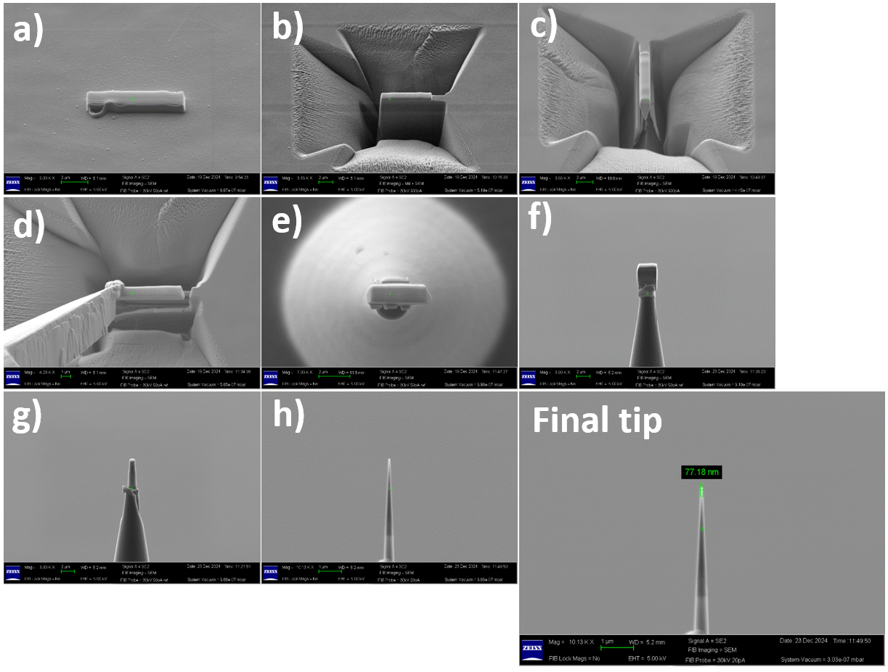
No visible clusters under APT
3. Solute clusters
- APT needle specimens were fabricated from the irradiated bulks using FIB.
- Surface milling using 30 kV, 10 kV, and finally 5 kV Ga ions.
We successfully obtained:
- 3 atom maps from the HS specimens
- 2 atom maps from the NS specimens
Leap 3000XHR
- Laser mode
- 250kHz pulse rate
- 15% pulse fraction
FIB procedure
Typical raw atom maps of a) HS, b) NS
Notes:
Then, the APT needle specimens were fabricated by FIB, followed by low-energy surface milling to remove FIB damage. We obtained three atom maps from the HS specimens and two from the NS specimens. As you can see from the typical raw maps, no visible clusters could be directly identified — so statistical analysis is necessary.

Slide 8
3. Solute clusters
The formation of solute clusters affected by Si

Slide 9
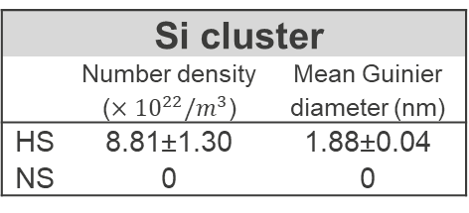
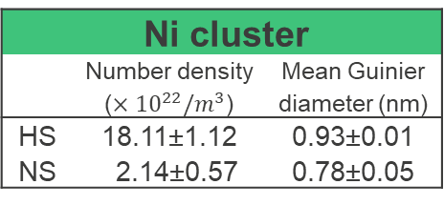
Ni clusters also formed in NS specimens
3. Solute clusters
Ni clusters
Si clusters
Iso-position method (IPM) parameters
- <Ni, 16 at. %, 0.47 nm, 15>
- <Si, 3 at. %, 0.67 nm, 15>
HS
In the HS specimen:
- The number density of Ni cluster was higher than that of the Si cluster.
- The diameter of the Si cluster was larger.
Si cluster
 | Number density (${×10}^{22}/m^{3}$) | Mean Guinier diameter (nm)
HS | 8.81±1.30 | 1.88±0.04
NS | 0 | 0
In the NS specimen:
- The Ni clusters in the NS specimen were smaller in size and about one order of magnitude lower in number density.
NS
Ni cluster
 | Number density (${×10}^{22}/m^{3}$) | Mean Guinier diameter (nm)
HS | 18.11±1.12 | 0.93±0.01
NS | 2.14±0.57 | 0.78±0.05
The addition of Si has enhanced the clustering of Ni.
Notes:
We first applied the Iso-Position Method — to search for Ni and Si clusters. In HS, both types of clusters were found. Ni clusters showed a higher number density, but a smaller diameter, than Si clusters.
Surprisingly, Ni clusters were also detected in NS. Compared to HS, Ni clusters were smaller in size and about an order of magnitude lower in number density in NS. It shows that Si addition strongly enhances Ni clustering.

Slide 10
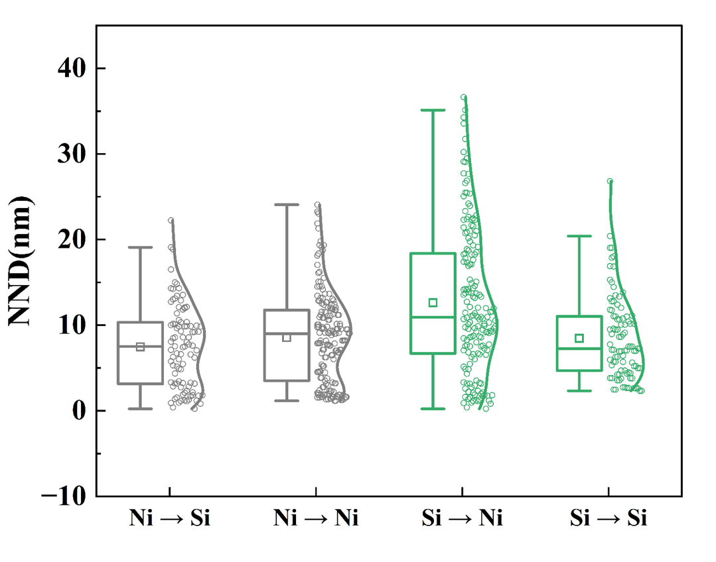
Nearest neighbor distribution of clusters in HS specimens
3. Solute clusters
②
①
The Ni clusters appear to be slightly more biased toward the Si clusters.
The Si clusters appear to not be biased toward the Ni clusters.
The Ni→Ni distribution shows a prominent secondary peak at very short distances.
→ The primary peak corresponds to Ni clusters associated with Si clusters, while the secondary short-distance peak corresponds to Ni clusters independent of Si clusters.
③
Homogenous and cross nearest neighbor distance of Ni clusters and Si clusters.
Some Ni and Si clusters may have formed together, potentially induced by Si. Other Ni clusters formed within the matrix, possibly generated by homogeneous nucleation.
Notes:
We then analyzed the nearest neighbor distances of clusters in HS. In the figure, “Ni point Si” means the distance from a Ni cluster to its nearest Si cluster. Three observations can be made:
The Ni point Si distance distribution is shifted to shorter values compared to Ni point Ni, indicating that Ni clusters are slightly biased toward Si clusters.
Similarly, Si clusters, show no such bias toward Ni.
The Ni point Ni distribution has a prominent secondary peak at very short distances, whereas Si point Si does not. We interpret the primary peak as Ni clusters associated with Si, and the secondary short-distance peak as Ni clusters that formed independently in the matrix.
Taken together, this suggests that some Ni and Si clusters formed together, likely induced by Si, while other Ni clusters nucleated homogeneously in the matrix.

Slide 11
4. Clustering/co-clustering
Clustering/Co-clustering analysis via LCB method
Notes:
However, IPM results are very sensitive to the chosen parameters. To obtain a more robust picture, we adopted an improved local-concentration-based method.

Slide 12
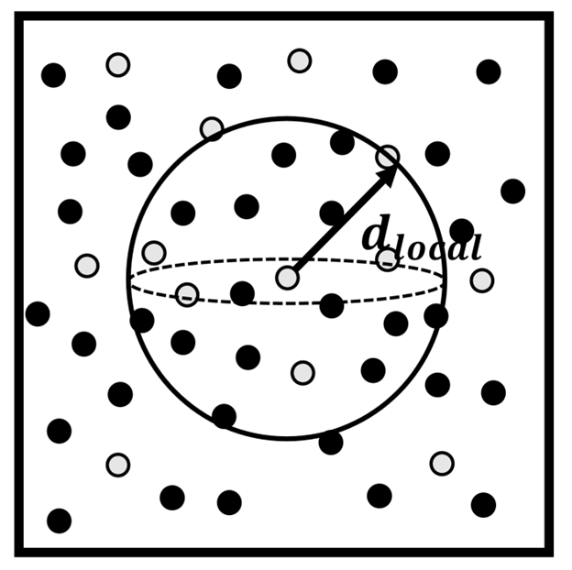

4. Clustering/co-clustering
A local-concentration-based method
Our work is modified from Ref. [1] and [2].
1) local-concentration-based method.
Less sensitive to local density variation (atom/nm³)
2) Local concentration (LC) of any atom in the atom map is defined by a sphere of d_{local} in its vicinity.
Simpler parameter selection.
3) d_{local} = 2.0 nm was selected,
As large as ~130 atoms in the sphere (ζ = 37%)
As small as the expected small-size of clusters.
Ref[1] used a=1.5 nm cubic (similar volume).
Solute atoms
Matrix atoms
$${LC}_{Si}\left(Ni\right)=\left\{{LC}_{Si} , \left({Ni}_{1}\right) , { LC}_{Si} , \left({Ni}_{2}\right) ...{ LC}_{Si}\left({Ni}_{N_{Ni}}\right)\right\}$$
$$f_{{LC}_{Si}\left(Ni\right)}\left(c\right)=\frac{1}{N_{Ni}}\sum_{k=1}^{N_{Ni}}{δ\left(c−{LC}_{Si}\left({Ni}_{k}\right)\right)}$$
Vicinity of a solute atom
Typical raw atom map
[1] Y.M. Chen, P.H. Chou, E.A. Marquis, Quantitative atom probe tomography characterization of microstructures in a proton irradiated 304 stainless steel, J Nucl Mater 451(1-3) (2014) 130-136.
[2] Y. Dong, A. Etienne, A. Frolov, S. Fedotova, K. Fujii, K. Fukuya, et al., Atom Probe Tomography Interlaboratory Study on Clustering Analysis in Experimental Data Using the Maximum Separation Distance Approach, Microsc Microanal 25(2) (2019) 356-366.
Notes:
In this method, the local concentration of an atom is defined by counting the number of atoms within a sphere of diameter *d*_local. We selected *d*_local = 2.0 nm, which contains about 130 atoms, which is small enough to resolve expected small clusters and less sensitive to local density variations.

Slide 13
4. Clustering/co-clustering
Si clustering and Ni clustering via LCB
Si
Cr
Ni
Fig. $f_{{LC}_{N}(N)}$ of experimental data and randomized data
- Si shows clear enrichment compared to the randomized data.
- The proportion of Ni atoms in both low-concentration and high-concentration regions increased, indicating that irradiation also caused the segregation of Ni atoms.
- The depletion effect of Cr is also noticeable.
Ni segregation is more pronounced in HS than in NS. The presence of Si may enhance Ni segregation.
Interestingly, the addition of Si seemed to lead to more pronounced Cr depletion.
Notes:
Using the LCB method, we first looked at Si and Ni clustering. In this plots, dark colors are experimental data; light colors are randomized data. For Si, it shows clear enrichment. For Ni, the proportion in both low- and high-concentration regions increases, indicating irradiation-induced segregation. And, Ni segregation is more pronounced in HS than in NS, also confirming that Si addition promotes the segregation. We also examined the segregation of Cr: interestingly, Si addition appears to cause more pronounced Cr depletion.

Slide 14

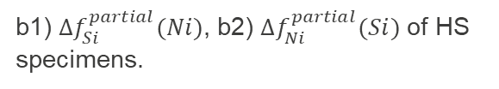
4. Clustering/co-clustering
Co-clustering of Ni and Si via LCB
$${∆f}_{N}\left(N\right)={f_{{LC}_{N}\left(N\right)}}_{experimental data} − {f_{{LC}_{N}\left(N\right)}}_{randomized data}$$
Clustering
Co-clustering
The lower peak:
implied the distribution of Si atoms in the vicinity of Ni atoms were closer to a random distribution as in the vicinity of Si.
- Strong Si segregation can occur independently of Ni.
The higher peak:
- Si might tend to be enriched in the Ni enrichment region.
a1) ${∆f}_{Si}(Si)$, a2) ${∆f}_{Ni}\left(Ni\right)$ of the HS specimens and NS specimens
b1) ${∆f}_{Si}^{partial}(Ni)$, b2) ${∆f}_{Ni}^{partial}(Si)$ of HS specimens.
Former analysis:
Si clusters may act as sinks for Ni atoms.
The existence of Si-rich clusters that are not necessarily paired with Ni-rich clusters.
Matrix Ni clusters
Homogeneous nucleation
2 types of Ni clusters
Si related Ni clusters
Heterogeneous nucleation
Notes:
We then analyzed the Ni-Si correlation. By subtracting the randomized data from the experimental data, we highlight the clustering and co-clustering tendencies.
The lower peak for Si around Ni implies that Si atoms around Ni are nearly randomly distributed compared to Si around Si — meaning strong Si segregation can occur independently of Ni.
The higher peak for Ni around Si indicates that Si tends to be enriched where Ni is already enriched.
Together, these results point to the existence of Si clusters that are not necessarily paired with Ni clusters, and that Si clusters may act as sinks for Ni atoms.
Consequently, we can identify two formation pathways for Ni clusters: matrix Ni clusters from homogeneous nucleation, and Si-related Ni clusters from heterogeneous nucleation.

Slide 15
5. Conclusion
Conclusion
Notes:
Finally, Let me now summarize the main conclusions

Slide 16
5. Conclusion
Conclusion
The LCB method was extended by using partially randomized data as a reference, enabling a quantitative assessment of the Ni-Si co-segregation tendency.
Under the irradiation condition of 290℃ and 0.8 dpa, Ni clusters and Si clusters were found in the HS samples. In contrast, in the NS alloy, Ni clusters were an order of magnitude lower in number density and significantly smaller in size compared to those in the HS alloy, demonstrating that Si addition enhances Ni clustering.
The clustering of Ni, Si, and Cr elements was studied using the LCB method. The clustering of Ni and Cr in the HS samples was more pronounced than that in the NS samples. The addition of Si promoted the segregation of Ni and Cr. The segregation of Si in the HS samples was more significant than that of Ni, suggesting that Si might have formed clusters earlier or more rapidly than Ni.
The relationship between Ni and Si clusters was studied using the NND method. A subset of Ni clusters shows a strong correlation with Si clusters, suggesting heterogeneous nucleation. The bimodal distribution of Ni-Ni distances and the existence of Ni clusters in the NS alloy may provide evidence for homogeneous nucleation within the matrix. The addition of Si promotes the overall nucleation of Ni clusters, likely by facilitating both ways.
Notes:
We extended the LCB method to quantitatively assess the Ni-Si co-segregation tendency.
We demonstrated that Si addition significantly enhances Ni clustering.
Si promotes the segregation of both Ni and Cr, and it likely forms clusters earlier or more rapidly than Ni.
Nearest neighbor analysis confirmed the coexistence of matrix and Si-related Ni clusters. And the Si effect is likely by facilitating both homogeneous and heterogeneous pathways.
That concludes my talk. Thank you for your attention, and I’m happy to take any questions.

Slide 17
Thank you for your attention!

Slide 18
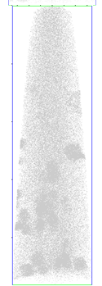
Method validation at late-clustering stage (HS, 5dpa, 450°C)
Si LC (local concentration) in the vicinity of Si atoms:
Si
Randomized atom map:
Si LC did not exceed 10 at.%
Real APT experiment:
A long tail at right side (Si-Si clustering)
Ni LC in the vicinity of Ni atoms:
Randomized atom map:
Ni LC peaked at 12~13 at.%.
(matched alloy composition)
Real APT experiment:
A long tail at right side (Ni-Ni clustering).
A rise at left side (Ni depletion).

Slide 19
IPM parameters selection

