Slide 1
Understanding flow behaviors of supercooled liquids by embodying solid-liquid duality at particle level
Dong-Xu Yu, and Zhe Wang
Tsinghua University
ydx22@mails.tsinghua.edu.cn
May 24, 2026

Slide 2
Supercooled liquids and rheology
Summary of previous studies
Contents
Solid-liquid duality in flowing supercooled liquids
Discussions and outlook

Slide 3
Supercooled liquids and rheology
Summary of previous studies
Contents
Solid-liquid duality in flowing supercooled liquids
Discussions and outlook

Slide 4
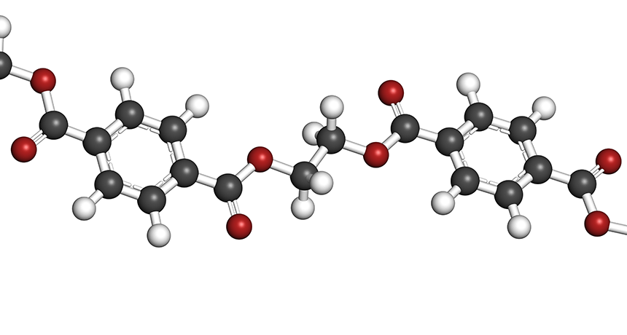
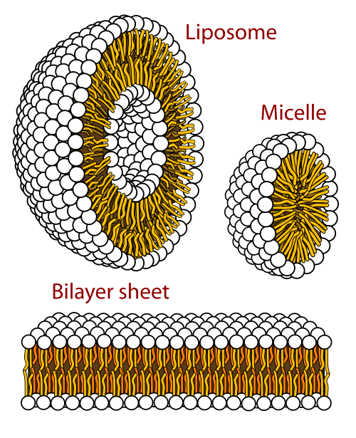
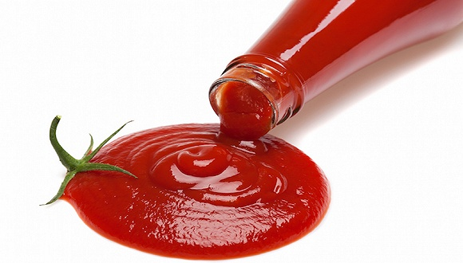
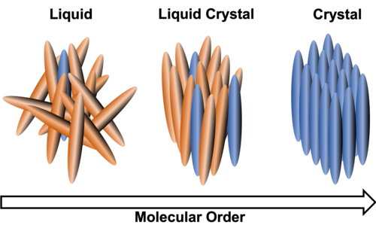
Soft matter
The Cornerstone of Modern Industry: Polymers
Soft matter is everywhere!
Nature of Life: Biological Soft Matter
Everyday Life: Colloids and Emulsions
Display Technology: Liquid Crystal
https://en.wikipedia.org/wiki/Soft_matter

Slide 5
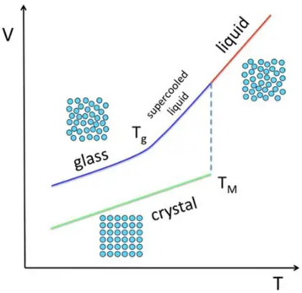
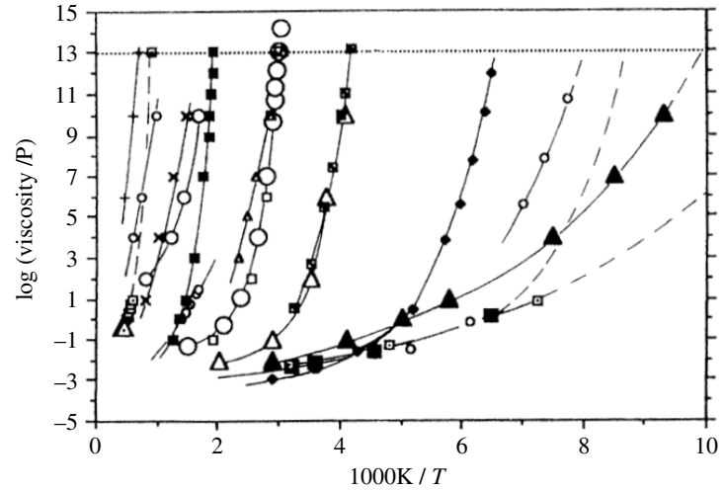
Supercooled liquids
Liquids that do not crystallize when cooled below its freezing point
Liquids with high viscosity
Liquids with strong dynamic heterogeneity
Viscosity vs. temperature
neighboring regions relax at very different rates
Nuovo Cimento D 16 (1994) 993
Nature Mater 9, 324 (2010)

Slide 6
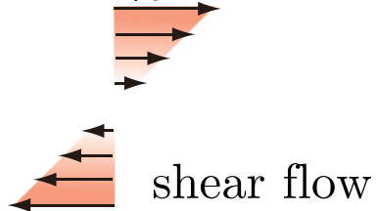
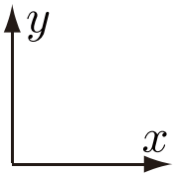









Flowing supercooled liquids
$$v_{x}=\dot{γ}y$$
Shear rate $\dot{γ}$: velocity gradient along y dimension
Shear stress $σ$
Viscosity: $η=σ/\dot{γ}$: decreases with $\dot{γ}$
Shear flow
Variation of $η$ with $\dot{γ}$
Newtonian regime
$$η∝{\dot{γ}}^{−0.7}$$
Crossover regime
$$\ln{η}$$
$$η$$
Shear-thinning regime
$$η∝{\dot{γ}}^{−λ}$$
$$\ln{\dot{γ}}$$
$$\dot{γ}$$
Phys. Rev. E 95, 012613 (2017)
Phys. Rev. Research 5, 023181 (2023).

Slide 7
Supercooled liquids and rheology
Summary of previous studies
Contents
Solid-liquid duality in flowing supercooled liquids
Discussions and outlook

Slide 8
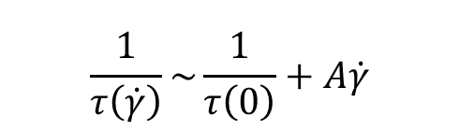

Conventional view
macroscopic
microscopic
viscosity decrease
Accelerated relaxation
Focus on relaxation time $τ\left(\dot{γ}\right)$ under shear.
The relaxation rate under shear arises from intrinsic relaxation and external shear.
$$\frac{1}{τ\left(\dot{γ}\right)}\sim \frac{1}{τ\left(0\right)}+A\dot{γ}$$
Relaxation rate under shear
Intrinsic relaxation rate
Shear acceleration
Representative references
[1] J. M. Brader, M. E. Cates, and M. Fuchs, Phys. Rev. Lett. 101, 138301 (2008).
[2] A. Furukawa, Phys. Rev. Research 5, 023181 (2023).
[3] V. Lubchenko, Proc. Natl. Acad. Sci. U.S.A. 106, 11506 (2009).
[4] R. Yamamoto and A. Onuki, Phys. Rev. E 58, 3515 (1998).

Slide 9
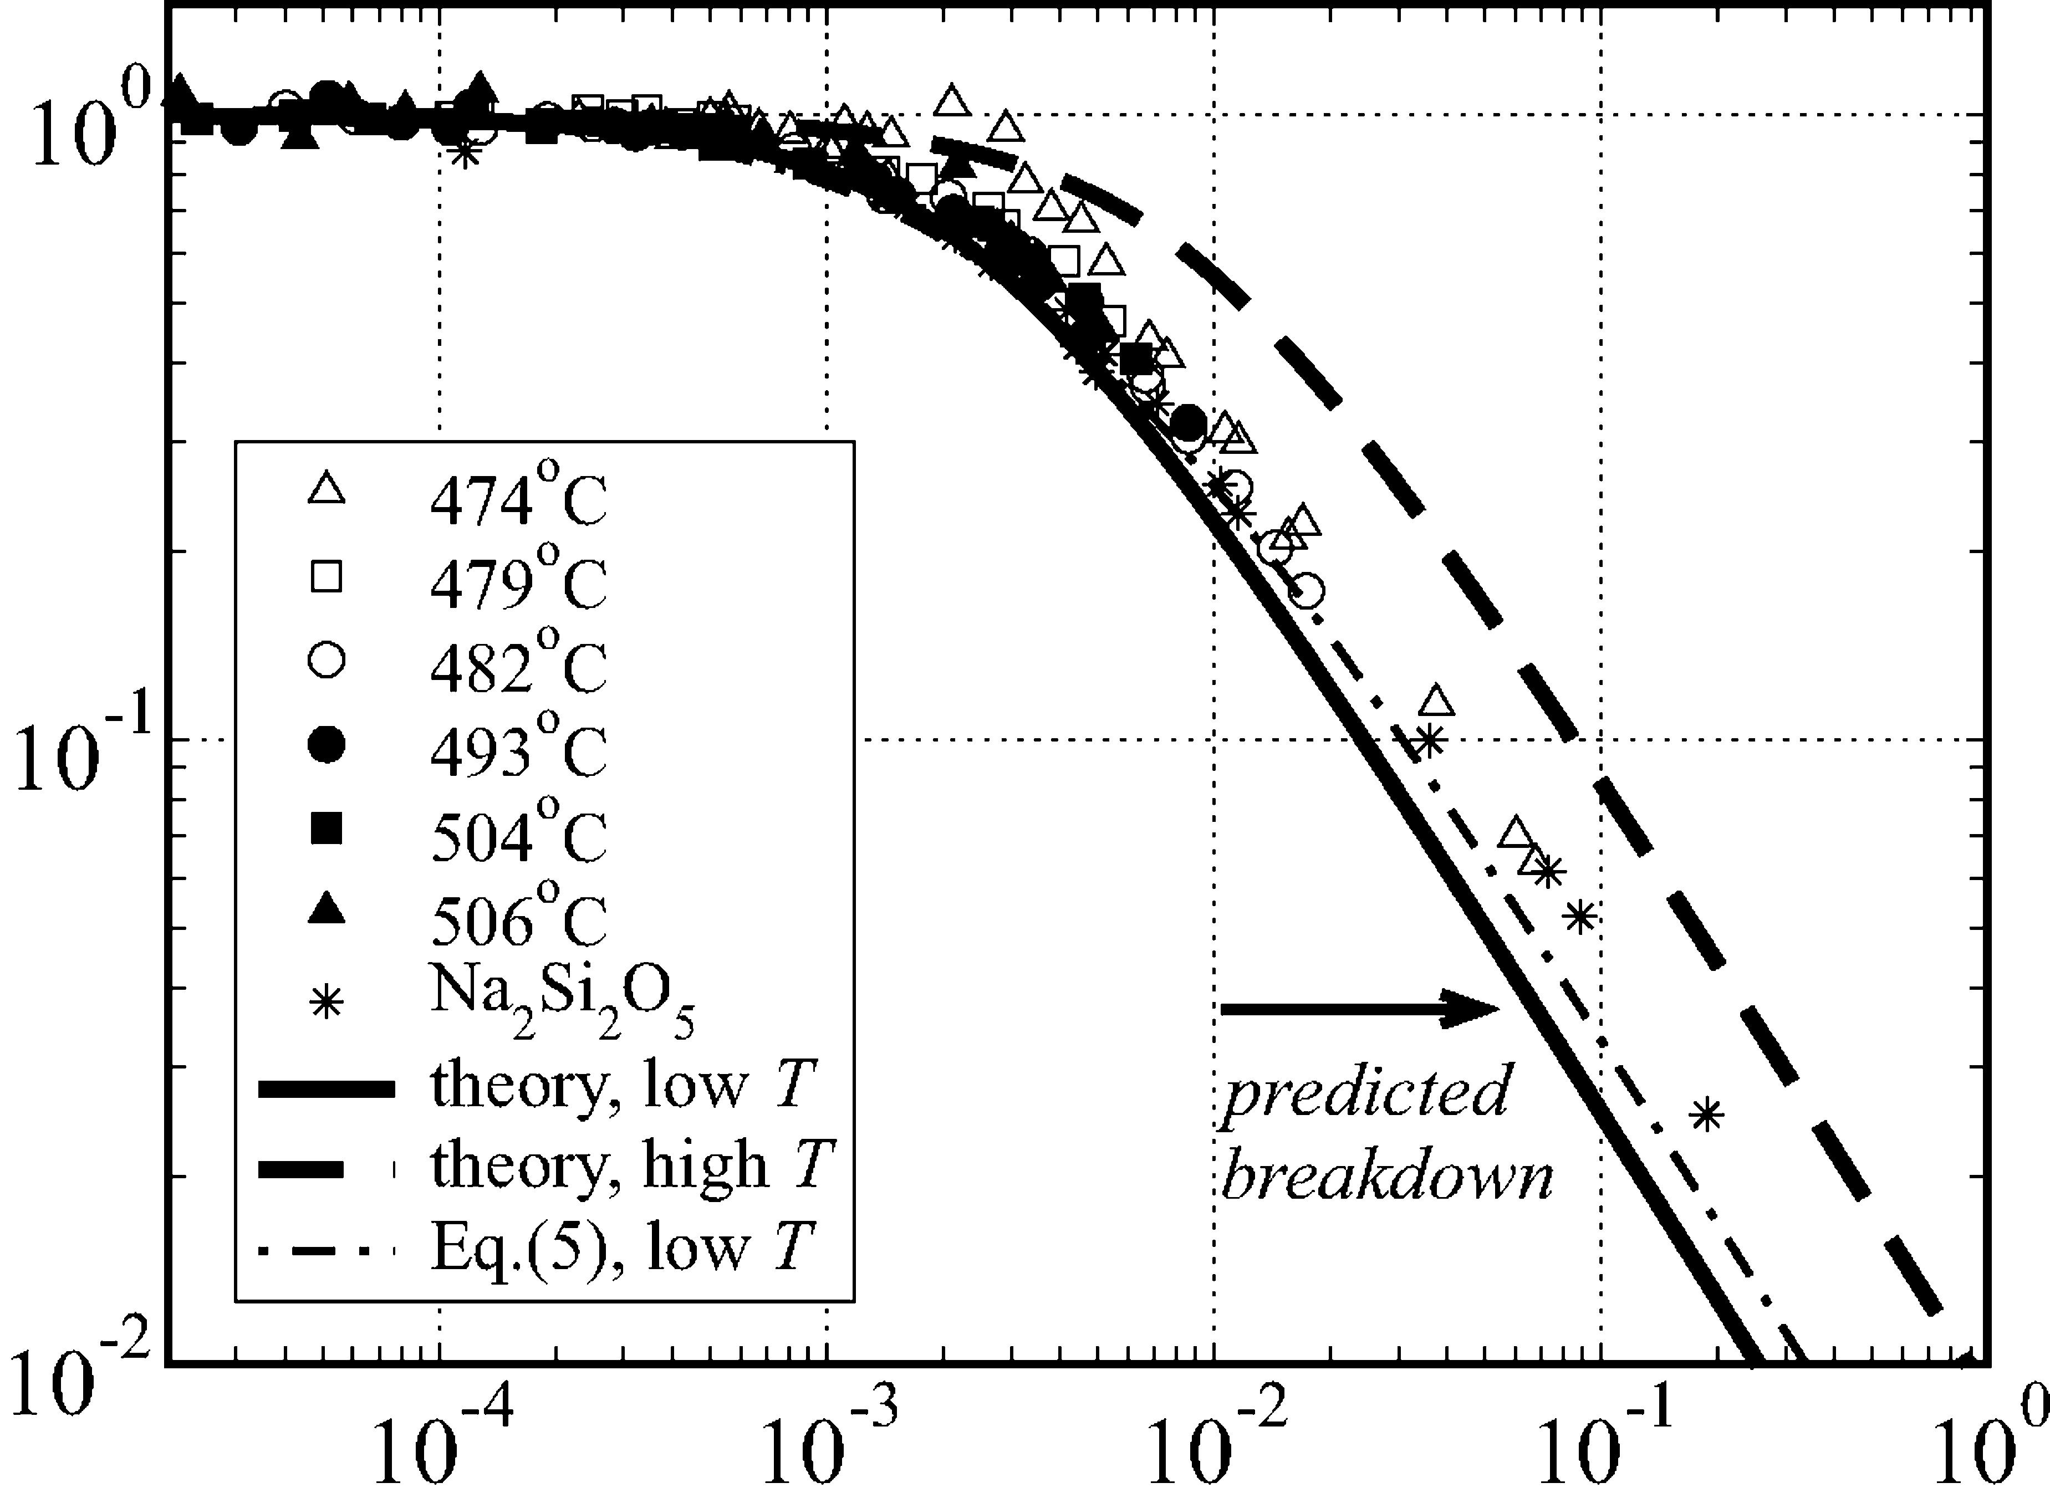

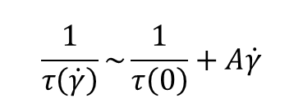


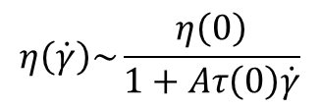
Where the conventional view breaks down
macroscopic
microscopic
viscosity decrease
Accelerated relaxation
Focus on relaxation time $τ\left(\dot{γ}\right)$ under shear.
$$\frac{1}{τ\left(\dot{γ}\right)}\sim \frac{1}{τ\left(0\right)}+A\dot{γ}$$
$$η∝τ$$
$$η\left(\dot{γ}\right)\sim \frac{η\left(0\right)}{1+Aτ\left(0\right)\dot{γ}}$$
Compare with experimental data
$$η\left(\dot{γ}\right)/η\left(0\right)$$
$$\dot{γ}\left\langle τ\right\rangle$$
Proc. Natl. Acad. Sci. U.S.A. 106, 11506 (2009).

Slide 10
Supercooled liquids and rheology
Summary of previous studies
Contents
Solid-liquid duality in flowing supercooled liquids
Discussions and outlook

Slide 11
Rethinking the analysis
shear
Traditional view: shear accelerates relaxation of all particles
Fast region
Slow region
Spatially varying mobility
Same relaxation rate under shear ?

Slide 12


Analysis of relaxation rate
If shear is much faster than the particle's own motion, it's being pushed; if comparable, it's moving on its own.
Intrinsic relaxation rate
Relaxation rate under shear
Shear drive
How to tell whether particle is accelerated by shear or not
Shear relaxation rate $≈$ intrinsic relaxation rate
Not accelerated
Compare shear relaxation rate and intrinsic relaxation rate
Shear relaxation rate $≫$ intrinsic relaxation rate
Accelerated

Slide 13

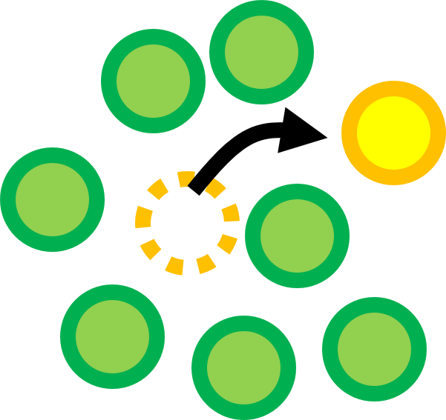





What is a relaxation event? — cage escape
Relaxation event for a particle: cage jump
Cage escape
Shear relaxation rate and intrinsic relaxation rate
Steady shear: define shear relaxation rate
$$\dot{γ}$$
Shear cessation: define intrinsic relaxation rate
$$0$$
$$t_{0}$$
$$t_{1}$$
$$t_{2}$$

Slide 14







Two timescales: $τ_{LC}$ and $τ_{sh}$
Two particle-level timescales
$τ_{LC}$: local configurational relaxation time
1. Stop the flow at time $t_{1}$
Measure $τ_{sh}$
2. Measure the waiting time for particle to jump the cage
$$\dot{γ}$$
$τ_{sh}$: relaxation time in shear
Measure $τ_{LC}$
$$0$$
1. Keep the flow
$$t_{0}$$
$$t_{1}$$
$$t_{2}$$
2. Measure the waiting time for particle to jump the cage

Slide 15
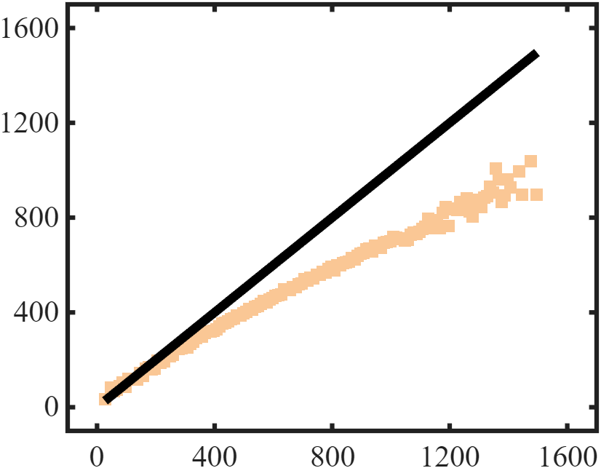







Where the conventional view breaks
Compare $τ_{LC}$ and $τ_{sh}$
Liquid-like
Solid-like
$τ_{sh}=τ_{LC}$ reference line
Shear facilitation
$τ_{sh}$
$τ_{LC}$
$τ_{sh}≈τ_{LC}$: flow does NOT facilitate relaxation
Solid-like particles
$τ_{LC}$ vs $τ_{sh}$
$τ_{sh}≪τ_{LC}$: flow facilitates relaxation
Liquid-like particles

Slide 16
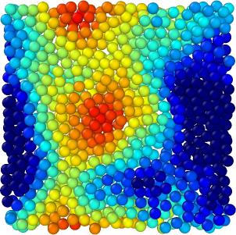
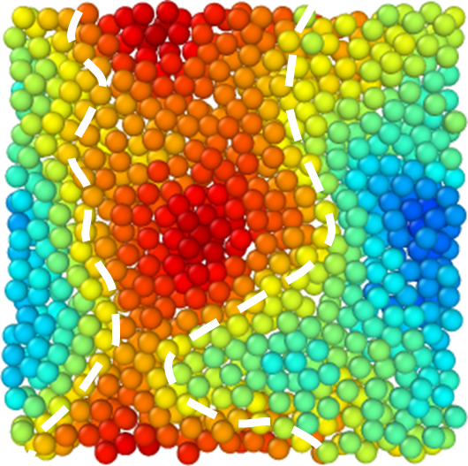




Solid-like and liquid-like particles
Spatial distribution of two particle groups
Clustering!
$τ_{LC}$
$τ_{sh}$
Liquid-like
Solid-like
$τ_{sh}=τ_{LC}$ reference line
Liquid-like
Shear facilitation
$τ_{sh}$
Solid-like
$τ_{LC}$
$$250$$
$$850$$

Slide 17
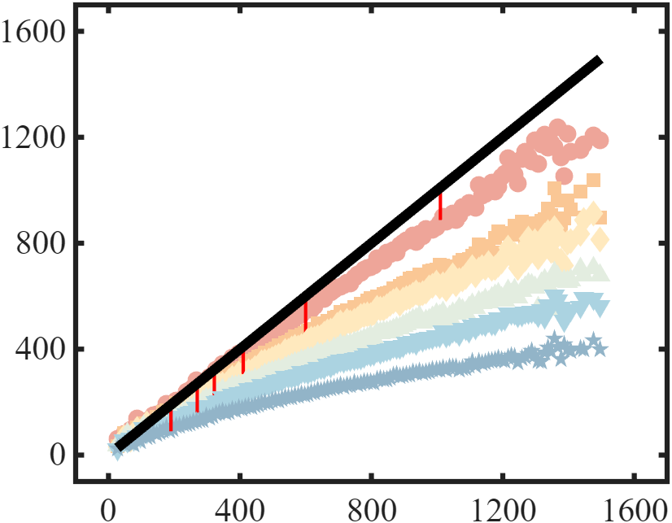
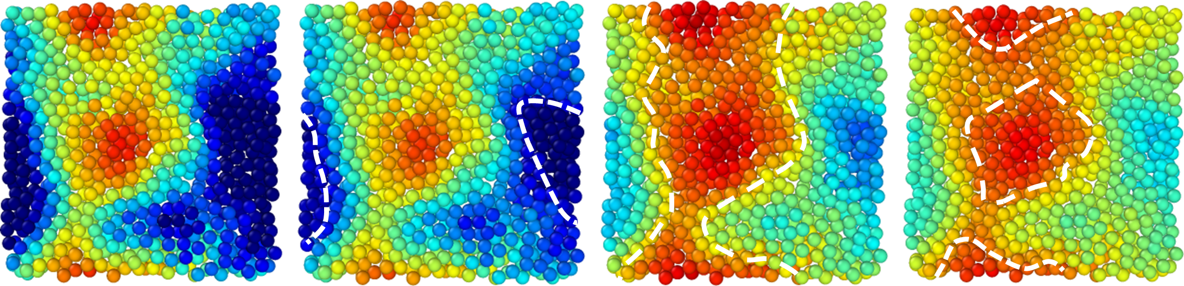







Solid-like and liquid-like particles
More particles behave solid-like as shear rate increases
$$\dot{γ} ↗$$
$τ_{sh}$
$$\dot{γ} ↗$$
$τ_{LC}$
$$250$$
$$850$$
$$τ_{LC},τ_{sh}$$

Slide 18
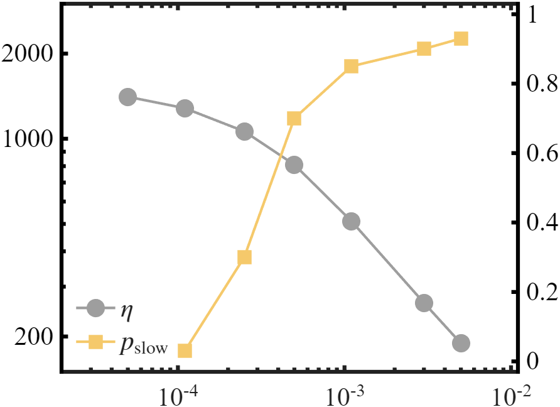






The proportion of solid-like particles
Compare the trends of $p_{solid}$and viscosity 𝜂 as a function of shear rate
Crossover: $p_{solid}$ increases rapidly
Newtonian: $p_{solid}$ negligible
$$p_{solid}$$
Shear thinning: $p_{solid}$ saturates
$$η$$
$$\dot{γ}$$

Slide 19
Intrinsic relaxation $⟷$ External shear: compete
Intrinsic relaxation
compete
External shear
Shear rate increase

Slide 20
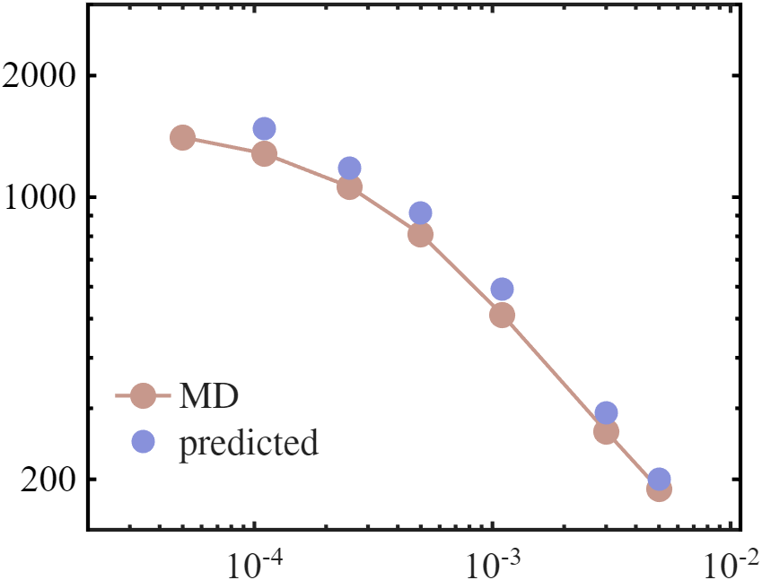
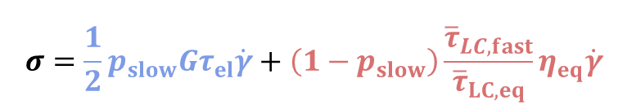


Estimate macroscopic stress
Macroscopic stress
Our two-state picture predicts macroscopic viscosity quantitatively.
$$σ=\frac{1}{2}p_{slow}Gτ_{el}\dot{γ}+\left(1−p_{slow}\right)\frac{{\overline{τ}}_{LC,fast}}{{\overline{τ}}_{LC,eq}}η_{eq}\dot{γ}$$
Contributed by solid-like particles
Contributed by liquid-like particles
$$η$$
$$\dot{γ}$$

Slide 21
Supercooled liquids and rheology
Summary of previous studies
Contents
Solid-liquid duality in flowing supercooled liquids
Discussions and outlook

Slide 22
Compare with literature: qualitative contrast
Traditional view
Our view
shear accelerates relaxation of all particles
only solid-like particles are accelerated, and their fraction grows with shear.
Shear rate increase

Slide 23




Compare with literature: quantitative contrast
Traditional studies
Our study
Qualitatively, emphasize varying trend
Quantitatively estimate
$$η\left(\dot{γ}\right)/η\left(0\right)$$
$$η$$
$$\dot{γ}\left\langle τ\right\rangle$$
$$\dot{γ}$$

Slide 24
Thank you
Dong-Xu Yu and Zhe Wang
Tsinghua University
*ydx22@mails.tsinghua.edu.cn

