Slide 1

Joint Self-Collimation Compton Imaging: A High-Resolution and High-SNR Solution for Wide-Energy SPECT
#72
Peize Li¹, Linxin Lei¹, Xingchun Zheng¹, Zhenlei Lyu¹, Zerui Yu¹, Linkang Liu¹, Rutao Yao², Tianyu Ma^{1*}
Department of Engineering Physics, Tsinghua University
Notes:
1、有一些页还在读页面上的文字，还没有完全熟练，尤其前面的introduction部分
2、有几个逻辑过渡还比较生硬

Slide 2

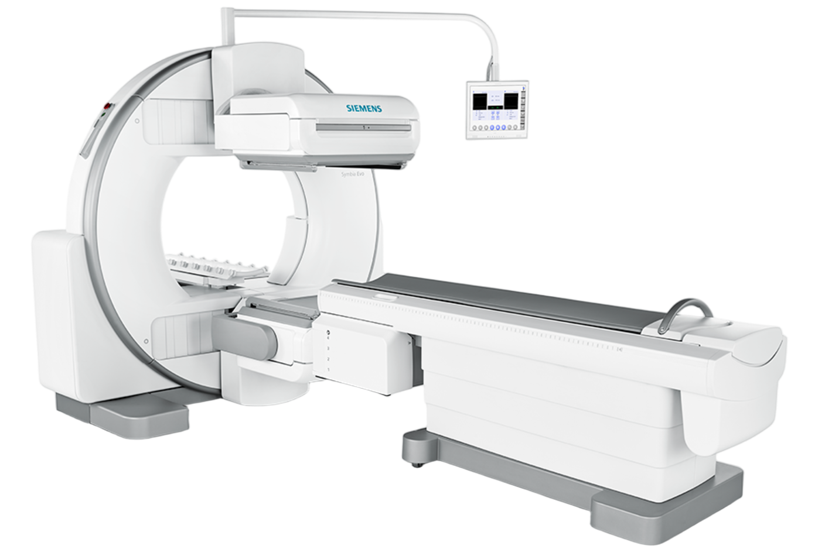
Introduction
High energy SPECT is of great importance
SPECT is a widely-used molecular imaging technology
^{99m}Tc-MIBI cardiac perfusion imaging
^{99m}Tc-MDP bone metastasis imaging
^{99m}Tc-ECD brain perfusion imaging
Spans a broad spectrum of diseases with diverse radiotracers
Conventional SPECT tracers emits low to medium energy photons
¹²³I - MIBG Sympathetic nerve imaging
^{99m}Tc
¹²³I
¹¹¹In
Energy/keV
100
200
300
400
500
600
Low Energy
Medium Energy
High Energy
Peize Li. Joint Self-Collimation Compton Imaging #72
Notes:
As is widely known, SPECT is able to be applied to many diseases with varies radiotracers.
Here we show some commonly used radiopharmaceuticals.

Slide 3
Introduction
High energy SPECT is of great importance
SPECT is a widely-used molecular imaging technology
^{99m}Tc-MIBI cardiac perfusion imaging
^{99m}Tc-MDP bone metastasis imaging
^{99m}Tc-ECD brain perfusion imaging
Spans a broad spectrum of diseases with diverse radiotracers
Conventional SPECT tracers emits low to medium energy photons
¹²³I - MIBG Sympathetic nerve imaging
SPECT is especially valuable in the era of theranostics
²²⁵Ac/¹⁷⁷Lu-PSMA/DOTATATE, ¹³¹I…
Radiotherapeutic isotopes emit medium to high-energy photons
For patient selection & response assessment
^{99m}Tc
¹²³I
¹¹¹In
Energy/keV
100
200
300
400
500
600
¹⁷⁷Lu
¹³¹I
²²⁵Ac
Low Energy
Medium Energy
High Energy
Peize Li. Joint Self-Collimation Compton Imaging #72

Slide 4
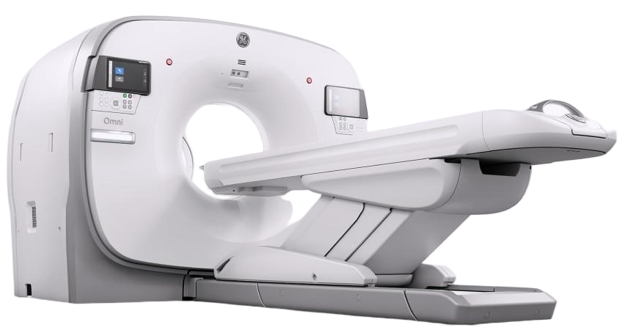
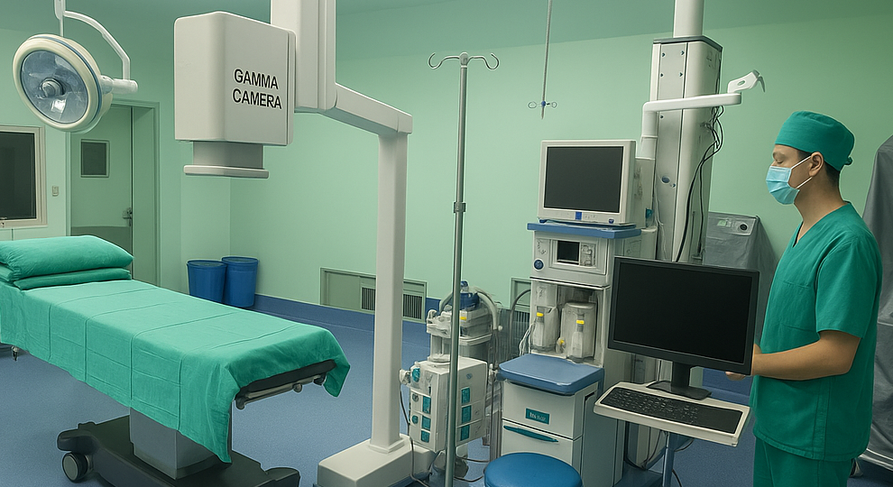
Introduction
High energy SPECT is of great importance
SPECT is a widely-used molecular imaging technology
^{99m}Tc-MIBI cardiac perfusion imaging
^{99m}Tc-MDP bone metastasis imaging
^{99m}Tc-ECD brain perfusion imaging
Spans a broad spectrum of diseases with diverse radiotracers
Conventional SPECT tracers emits low to medium energy photons
¹²³I - MIBG Sympathetic nerve imaging
SPECT is especially valuable in the era of theranostics
²²⁵Ac/¹⁷⁷Lu-PSMA/DOTATATE, ¹³¹I…
Radiotherapeutic isotopes emit medium to high-energy photons
For patient selection & response assessment
SPECT can be expanded to image positron-emission isotopes
Has promising potential for intraoperative imaging applications
^{99m}Tc
¹²³I
¹¹¹In
¹⁸F
Energy/keV
100
200
300
400
500
600
¹⁷⁷Lu
¹³¹I
²²⁵Ac
Low Energy
Medium Energy
High Energy
Peize Li. Joint Self-Collimation Compton Imaging #72
Notes:
讲的时候提一下核素名称。第一个标题要说出来。low~ to ~medium 着重说，放慢速度强调
flexible

Slide 5
Introduction
High energy SPECT is challenging
Challenge in performance balance
Parallel-hole collimator: Design of collimator introduces intrinsic resolution – sensitivity trade-off
Pin-hole collimator: Improves resolution by reducing distance to object. FOV - resolution – sensitivity trade-off
Parallel hole collimator
Pin-hole collimator
FOV
Collimator
Detector
Peize Li. Joint Self-Collimation Compton Imaging #72
Notes:
For conventional SPECT equiped with mechanical collimator, there is great challenge to balance performance

Slide 6
Introduction
High energy SPECT is challenging
Challenge in performance balance
Parallel-hole collimator: Design of collimator introduces intrinsic resolution – sensitivity trade-off
Pin-hole collimator: Improves resolution by reducing distance to object. FOV - resolution – sensitivity trade-off
Stronger collimator wall penetration
Higher photon energy leads to stronger penetration → degraded resolution
Parallel hole collimator
Pin-hole collimator
Energy / keV | Lead thickness needed for 90% photon attenuation | Scattering proportion in GAGG(Ce)
140 | 0.92 mm | 15.77%
208 | 2.38 mm | 33.87%
364 | 7.97 mm | 66.12%
440 | 11.10 mm | 74.76%
511 | 13.98mm | 80.21%
FOV
Collimator
Detector
Peize Li. Joint Self-Collimation Compton Imaging #72

Slide 7
Introduction
High energy SPECT is challenging
Challenge in performance balance
Parallel-hole collimator: Design of collimator introduces intrinsic resolution – sensitivity trade-off
Pin-hole collimator: Improves resolution by reducing distance to object. FOV - resolution – sensitivity trade-off
Stronger collimator wall penetration
Higher photon energy leads to stronger penetration → degraded resolution
Significantly increased scatter in detector/collimator
Reduced sensitivity and introduced noise → low SNR
Parallel hole collimator
Pin-hole collimator
Energy / keV | Lead thickness needed for 90% photon attenuation | Scattering proportion in GAGG(Ce)
140 | 0.92 mm | 15.77%
208 | 2.38 mm | 33.87%
364 | 7.97 mm | 66.12%
440 | 11.10 mm | 74.76%
511 | 13.98mm | 80.21%
FOV
Collimator
Detector
Peize Li. Joint Self-Collimation Compton Imaging #72

Slide 8
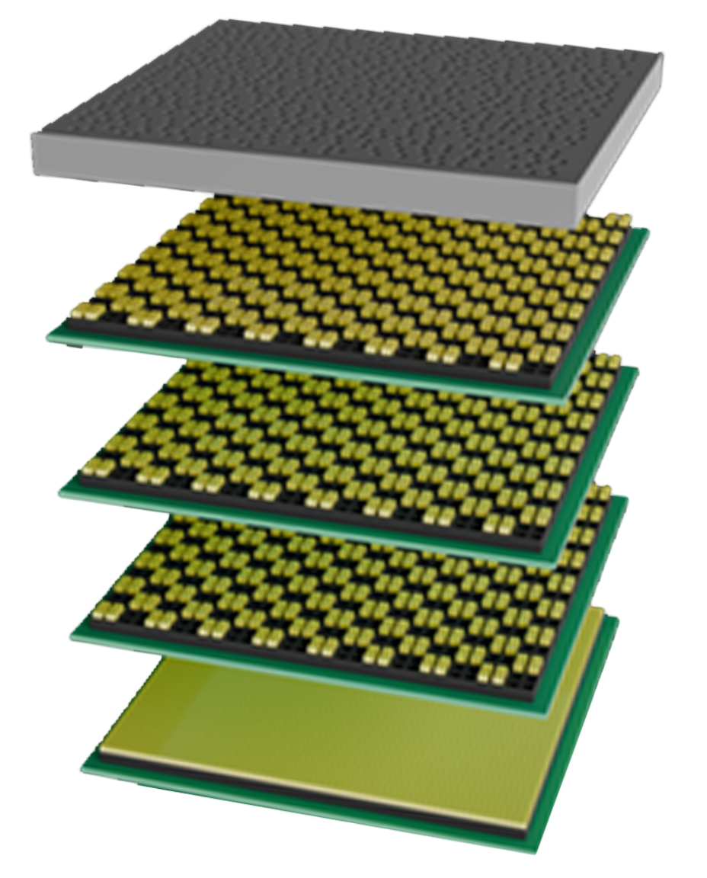
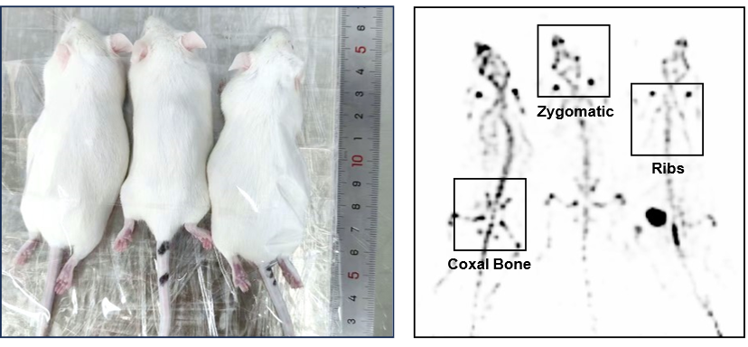
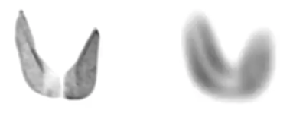
Introduction
Self-collimation (SC) SPECT
For low energy photons: significant performance improvement
Obtain collimation by the mutual shielding between detectors
Existing self-collimation gamma cameras can achieve super high resolution without losing sensitivity for ^{99m}Tc
FOV
3D thyroid ^{99m}Tc imaging
Mouse bone ^{99m}Tc-MDP scintigraphy
SC-SPECT
MIP, 30 Views
GE NM670 (LEHR)
MIP, 60 Views
Collimator
Multi-layer
Detectors
Peize Li. Joint Self-Collimation Compton Imaging #72

Slide 9
Introduction
Self-collimation (SC) SPECT
For low energy photons: significant performance improvement
Obtain collimation by the mutual shielding between detectors
Existing self-collimation gamma cameras can achieve super high resolution without losing sensitivity for ^{99m}Tc
FOV
3D thyroid ^{99m}Tc imaging
Mouse bone ^{99m}Tc-MDP scintigraphy
SC-SPECT
MIP, 30 Views
GE NM670 (LEHR)
MIP, 60 Views
Collimator
Multi-layer
Detectors
For high energy photons: degraded performance
Severe scintillator penetration → reduced collimatin effect
Increased Compton-scattering events → deteriorated image quality
Peize Li. Joint Self-Collimation Compton Imaging #72

Slide 10
Introduction
Self-collimation (SC) SPECT
For low energy photons: significant performance improvement
Obtain collimation by the mutual shielding between detectors.
Existing self-collimation gamma cameras can achieve super high resolution without losing sensitivity for ^{99m}Tc.
FOV
3D thyroid ^{99m}Tc imaging
Mouse bone ^{99m}Tc-MDP scintigraphy
SC-SPECT
MIP, 30 Views
GE NM670 (LEHR)
MIP, 60 Views
Collimator
Multi-layer
Detectors
For high energy photons: degraded performance
Severe scintillator penetration → reduced collimatin effect
Increased Compton-scattering events → deteriorated image quality
Joint Self-Collimation Compton Imaging (JSCC): combine self-collimation and Compton imaging
Peize Li. Joint Self-Collimation Compton Imaging #72

Slide 11
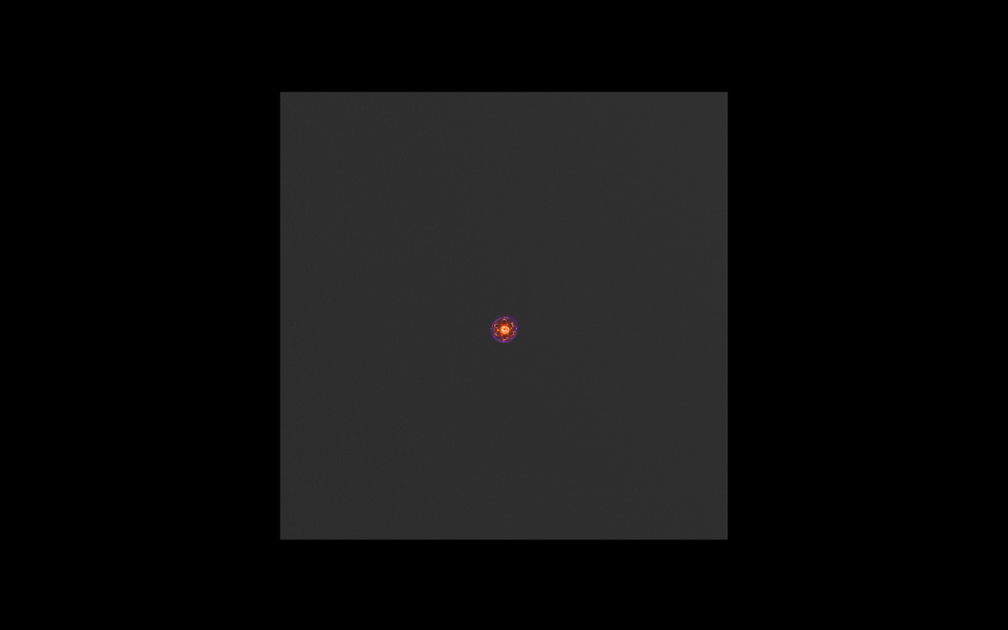
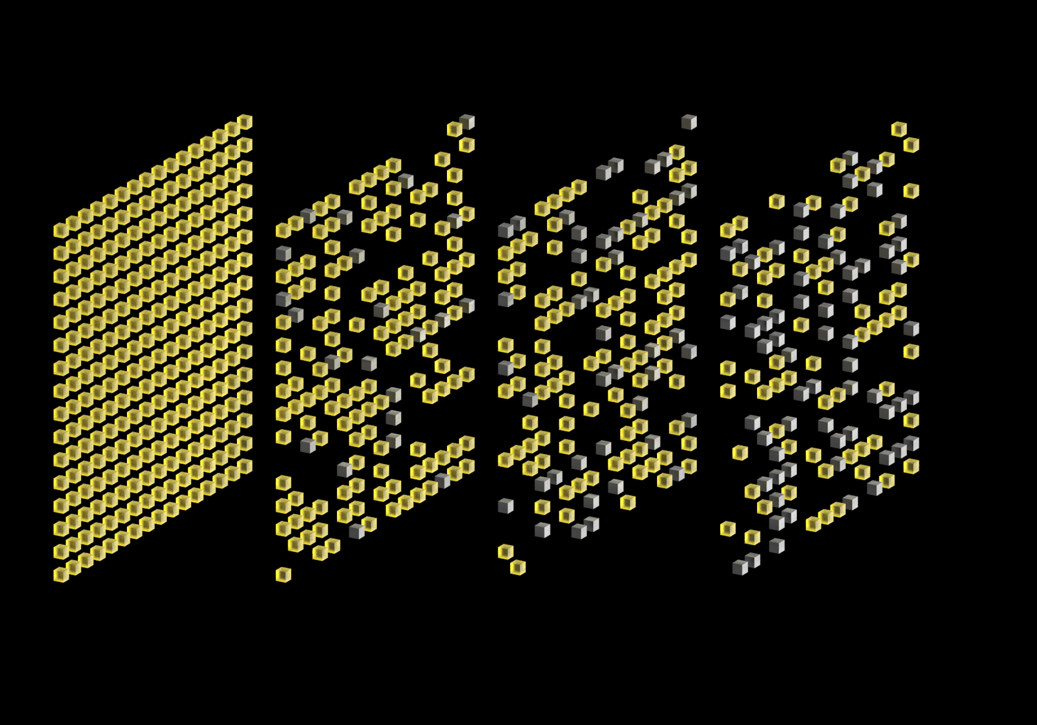


Introduction
Joint Self-Collimation Compton Imaging
Tsinghua University
JSCC gamma camera schematic diagram
Probability Distribution
Multi-layer Self-collimation Detectors with metel blocks
FOV
Scintillator Block
Metal Block
(Both as Collimator)
Peize Li. Joint Self-Collimation Compton Imaging #72
Notes:
Lets start with a self-collimation gamma camera desing with multi-layer detectors of mosaic-patterns 说明四层结构的自准直相机的构造

Slide 12
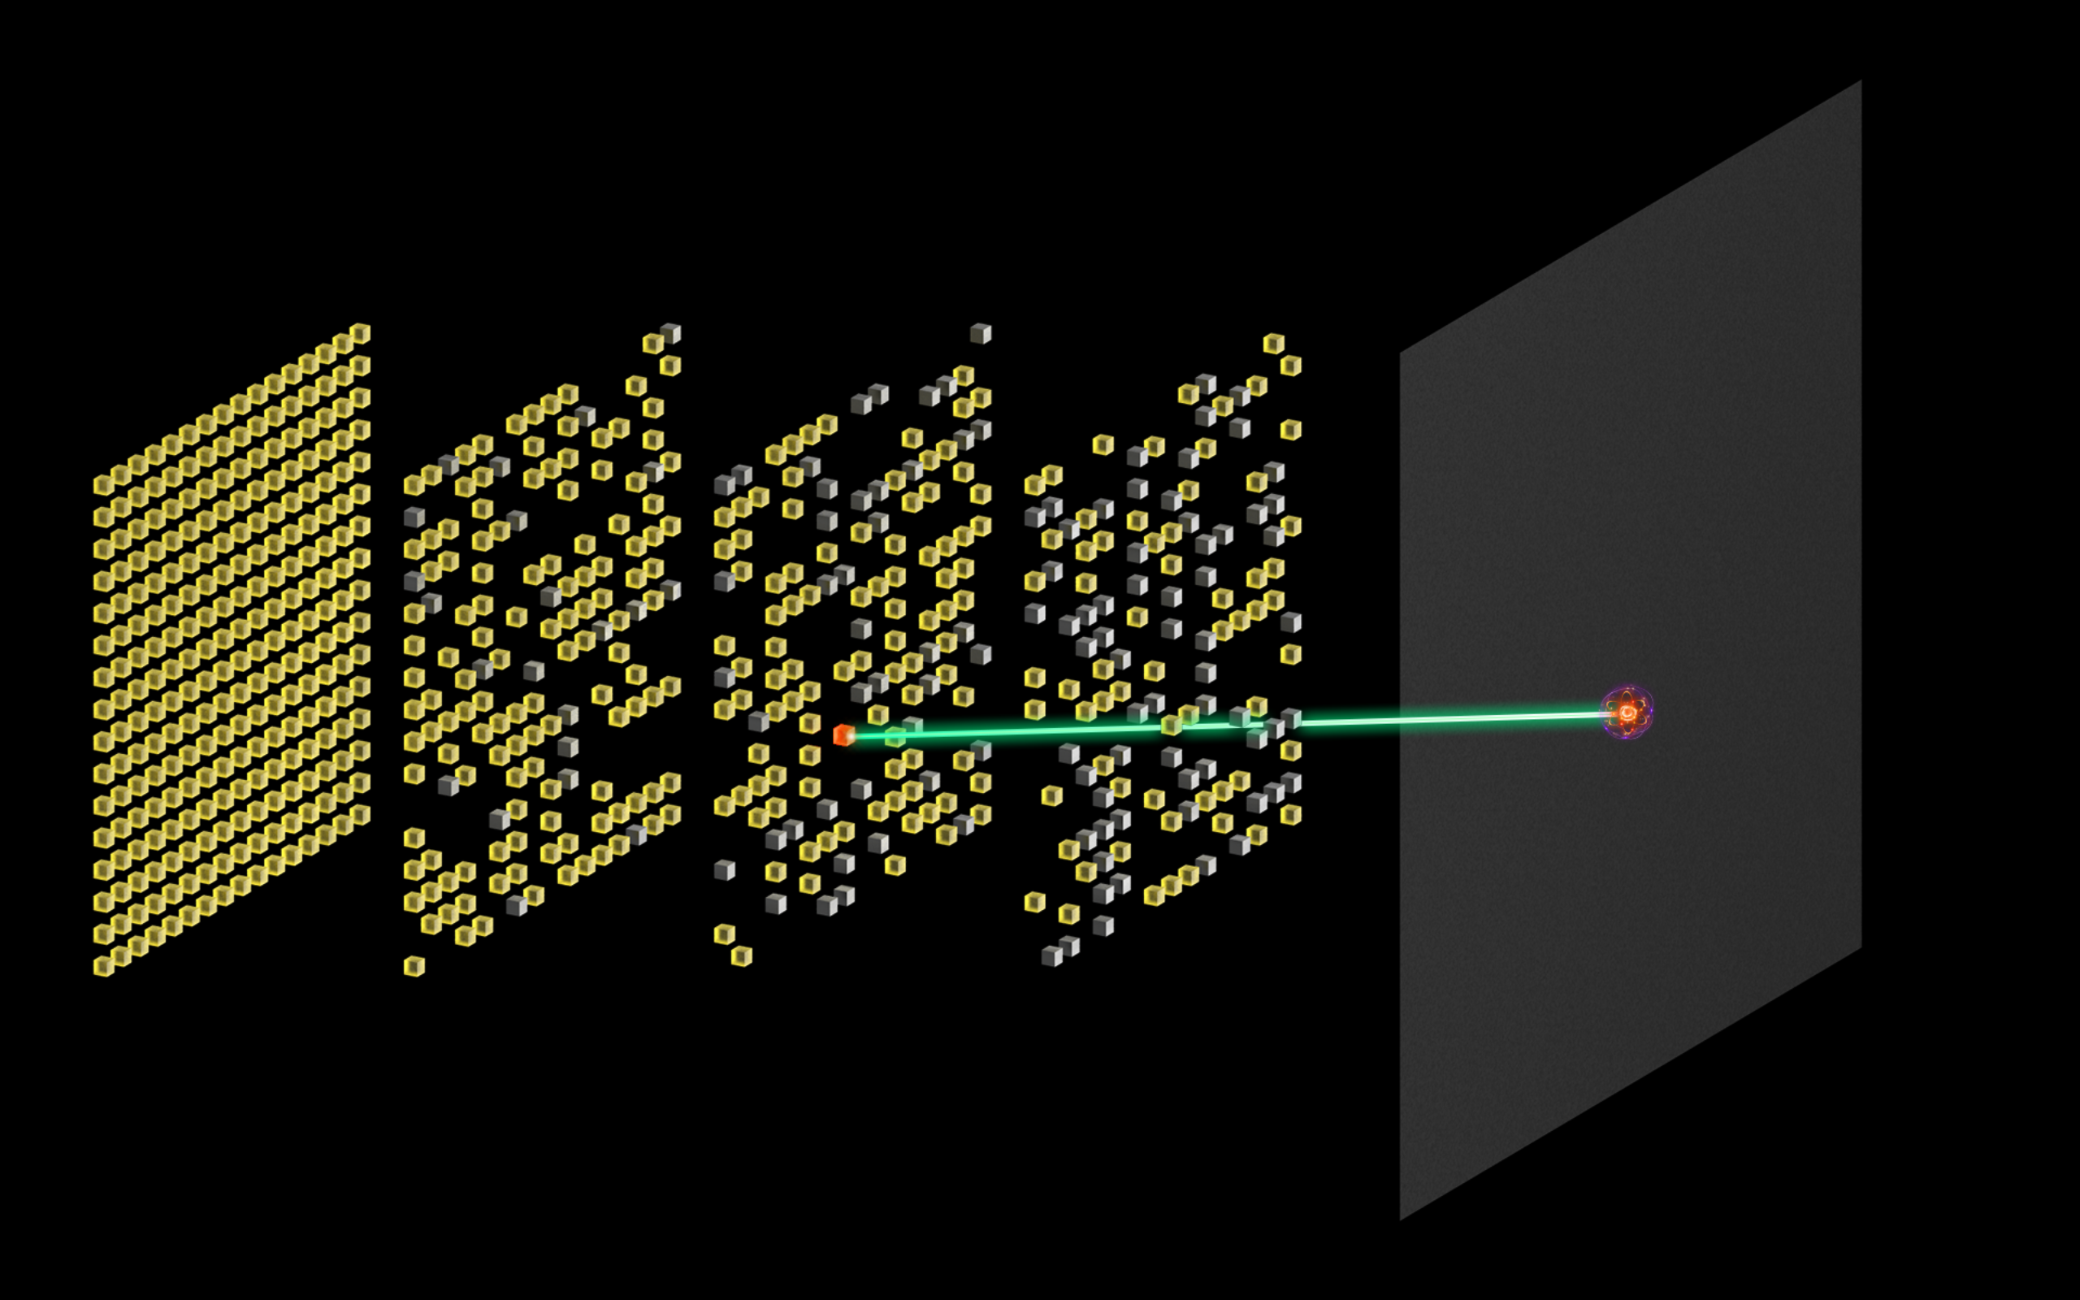
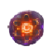
Introduction
Joint Self-Collimation Compton Imaging
Tsinghua University
An ideally collimated event
Probability Distribution
FOV
Scintillator Block
Metal Block
(Both as Collimator)
Source
Peize Li. Joint Self-Collimation Compton Imaging #72

Slide 13
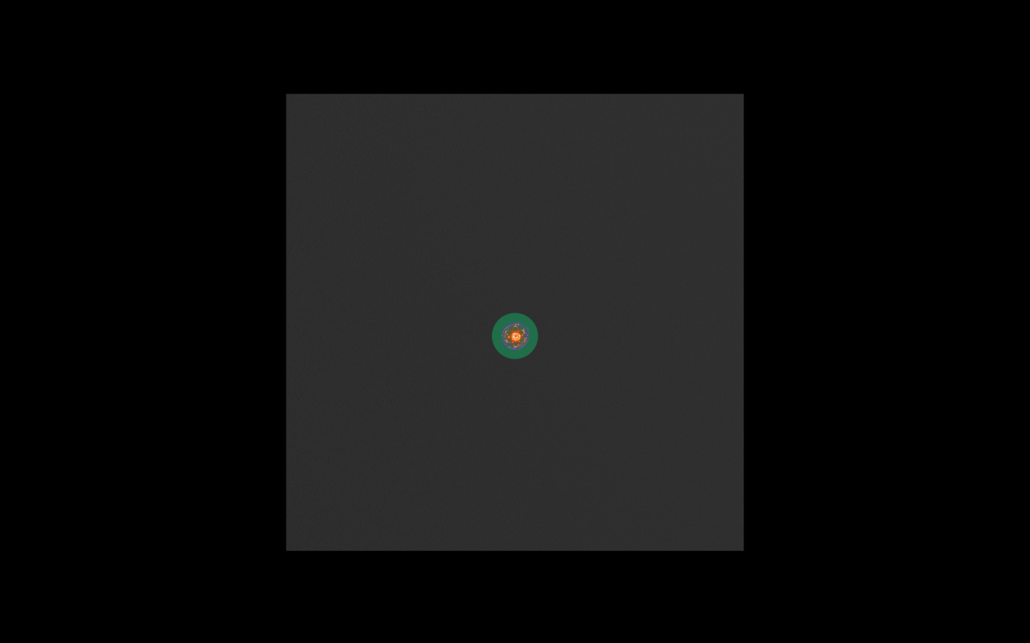
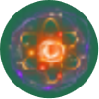
Introduction
Joint Self-Collimation Compton Imaging
Tsinghua University
Multiple possible photon paths induced multiplexing -> reduce SNR
Probability Distribution
Multiplexed Photon Path
True Photon Path
FOV
Multiplexed Photon Path
Scintillator Block
Metal Block
(Both as Collimator)
Source
Peize Li. Joint Self-Collimation Compton Imaging #72

Slide 14
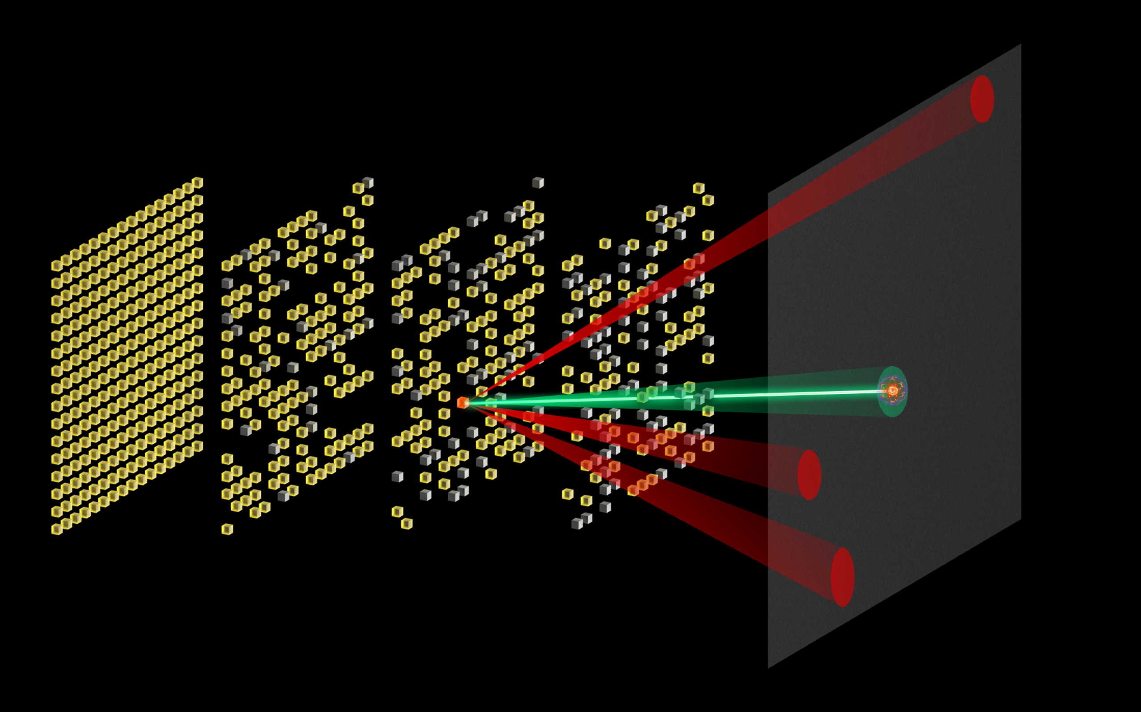
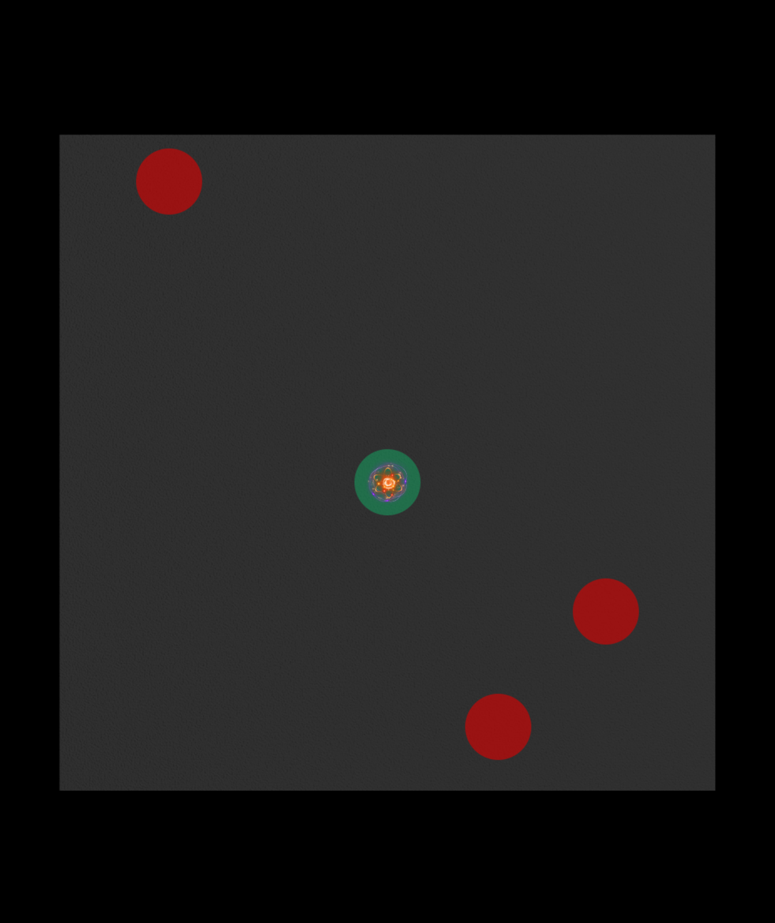
Introduction
Joint Self-Collimation Compton Imaging
Tsinghua University
High photon energy induced stronger penetration -> further deteriorate SNR
Probability Distribution
Multiplexed Photon Path
True Photon Path
FOV
Multiplexed Photon Path
Scintillator Block
Metal Block
(Both as Collimator)
Source
Peize Li. Joint Self-Collimation Compton Imaging #72

Slide 15
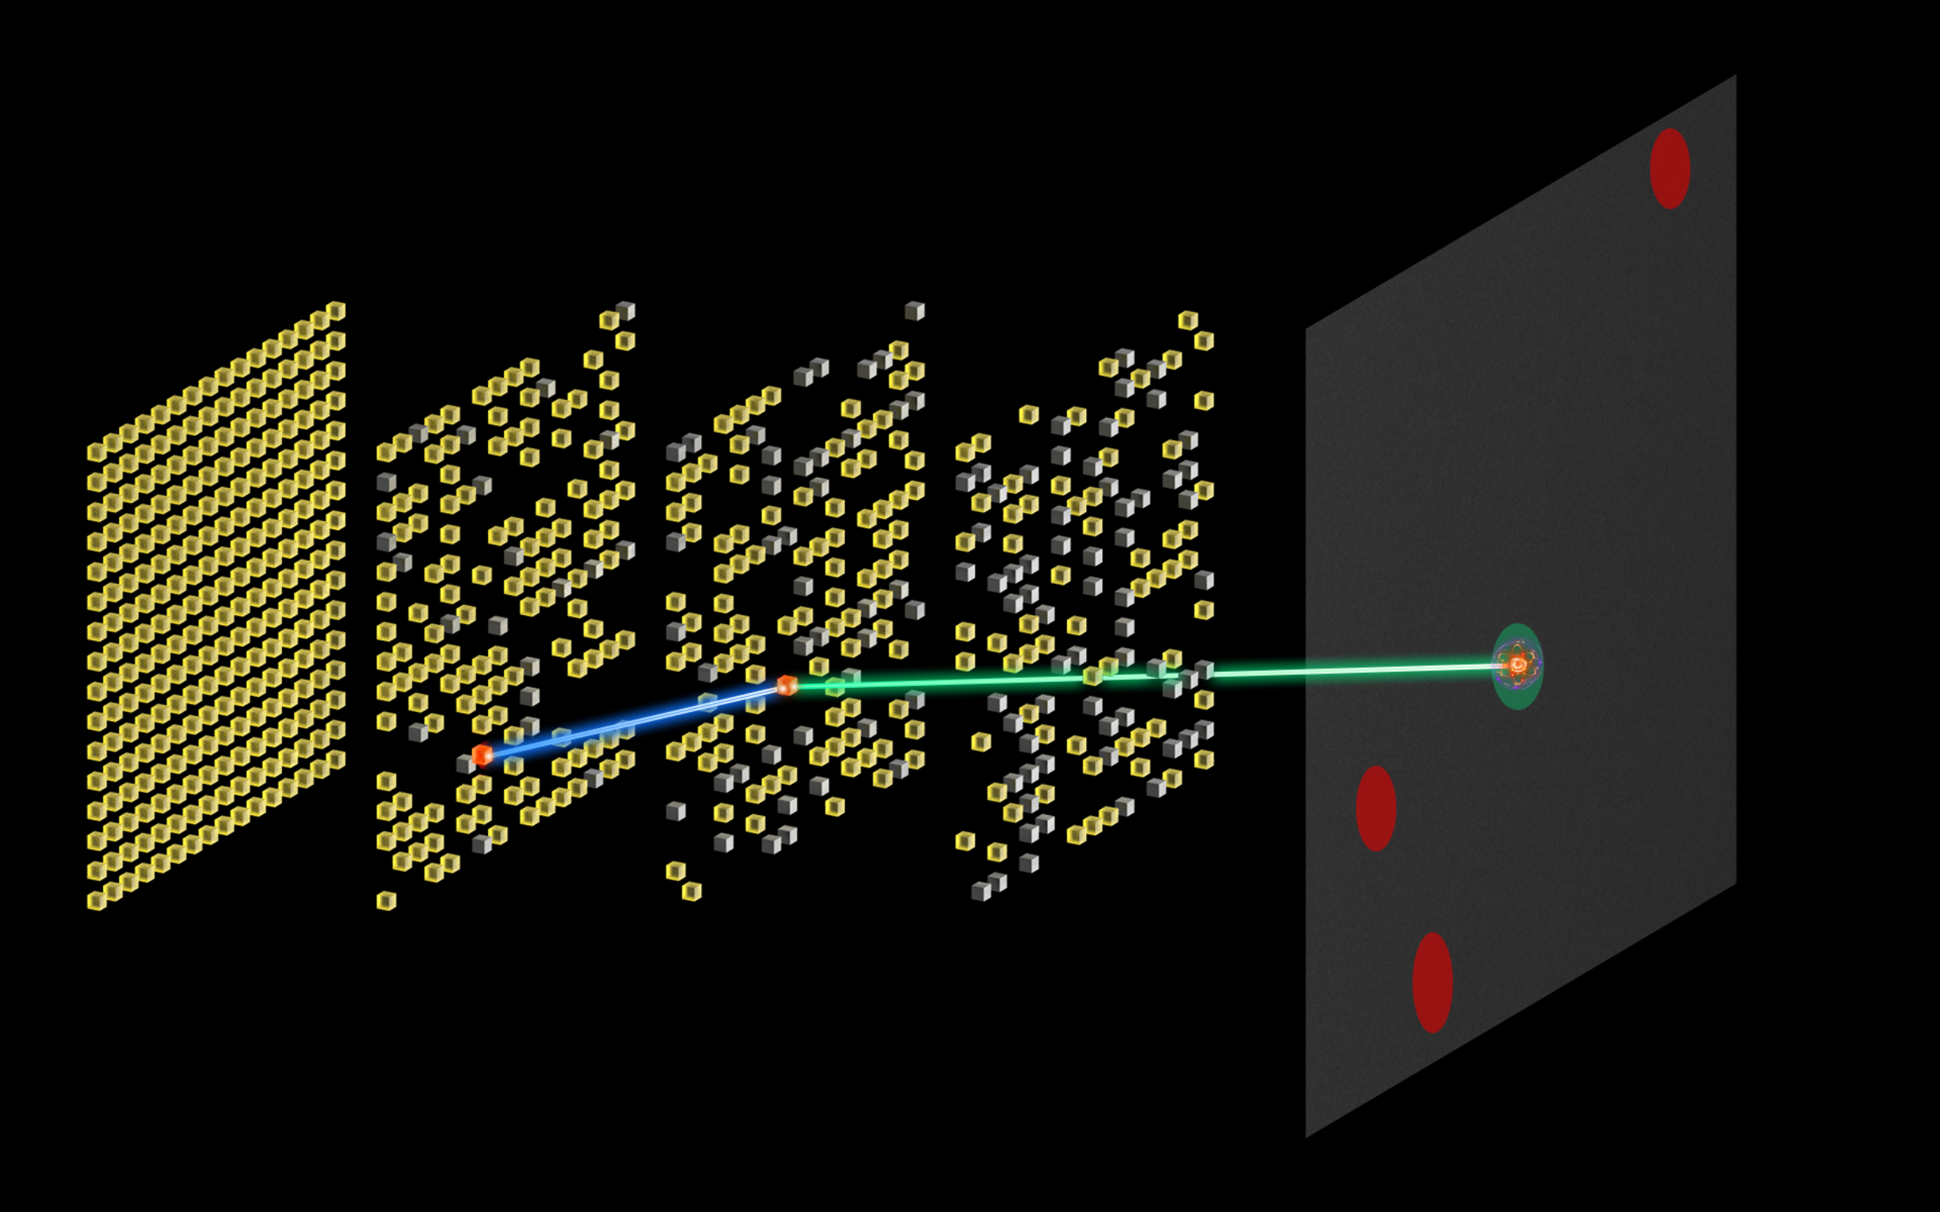
Introduction
Joint Self-Collimation Compton Imaging
Tsinghua University
A Compton scattering event
Probability Distribution
Multiplexed Photon Path
True Photon Path
FOV
Multiplexed Photon Path
Scintillator Block
Metal Block
(Both as Collimator)
Source
Scattered photon
Peize Li. Joint Self-Collimation Compton Imaging #72

Slide 16
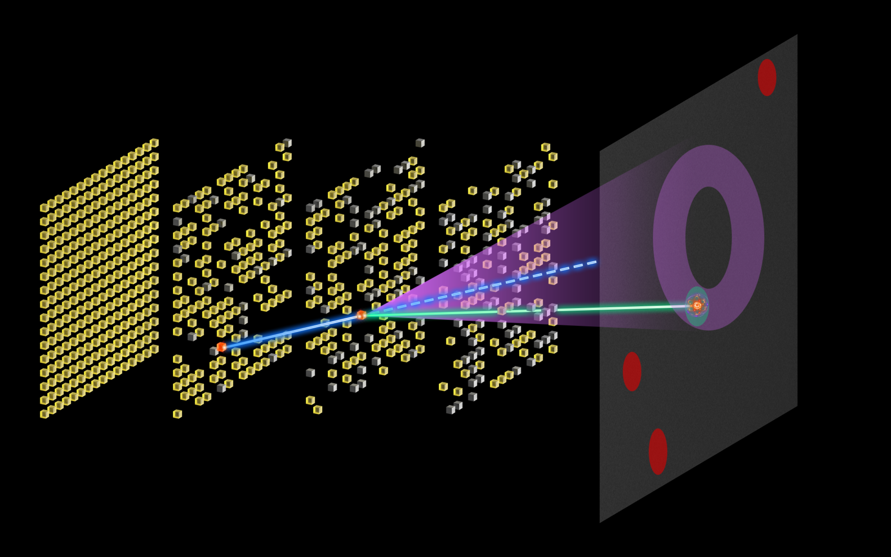
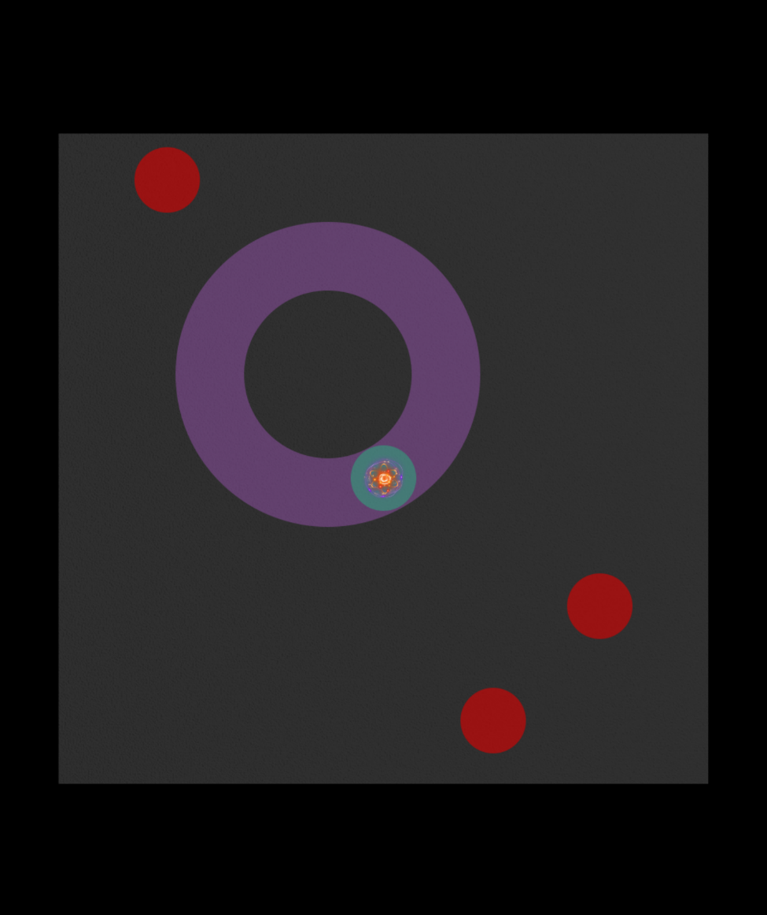
Introduction
Joint Self-Collimation Compton Imaging
Tsinghua University
Compton cone brings additional directional information
Probability Distribution
Multiplexed Photon Path
Compton Cone
True Photon Path
FOV
Multiplexed Photon Path
Scintillator Block
Metal Block
(Both as Collimator)
Source
Scattered photon
Peize Li. Joint Self-Collimation Compton Imaging #72
Notes:
说Compton Cone 同时展示出它

Slide 17
Introduction
Joint Self-Collimation Compton Imaging
Tsinghua University
Enhance imaging quality through joint imaging
Probability Distribution
Multiplexed Photon Path
Compton Cone
Intercepted zone
FOV
Multiplexed Photon Path
Scintillator Block
Metal Block
(Both as Collimator)
Source
Scattered photon
Peize Li. Joint Self-Collimation Compton Imaging #72

Slide 18
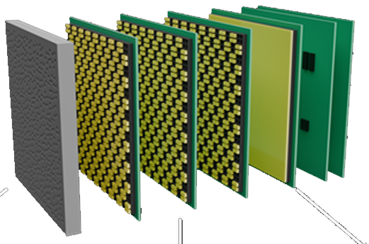
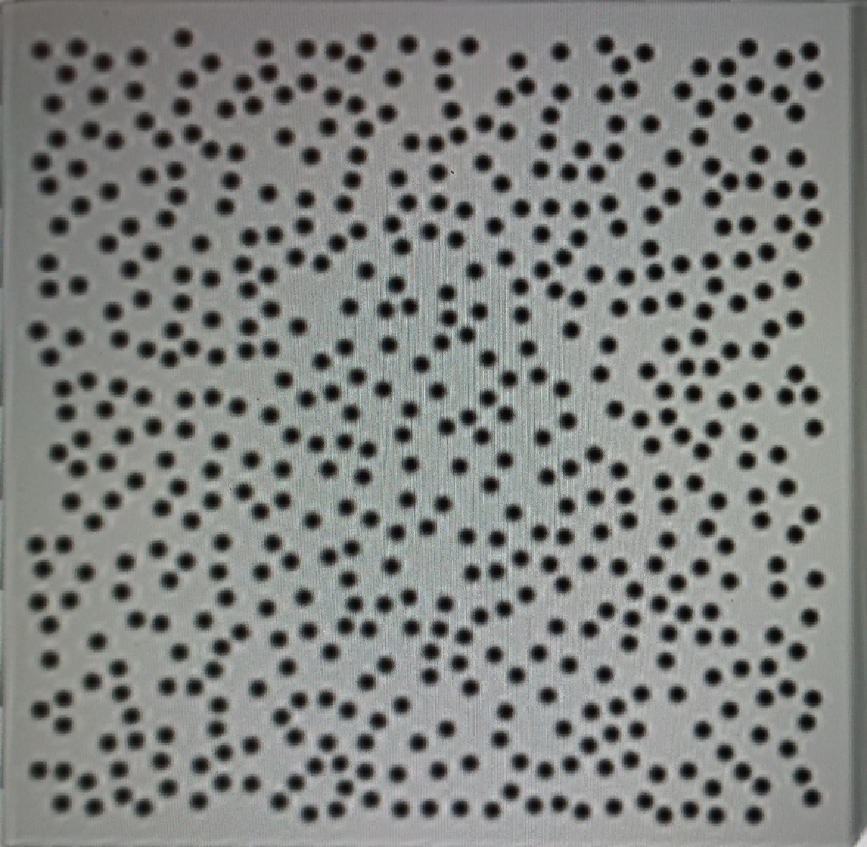
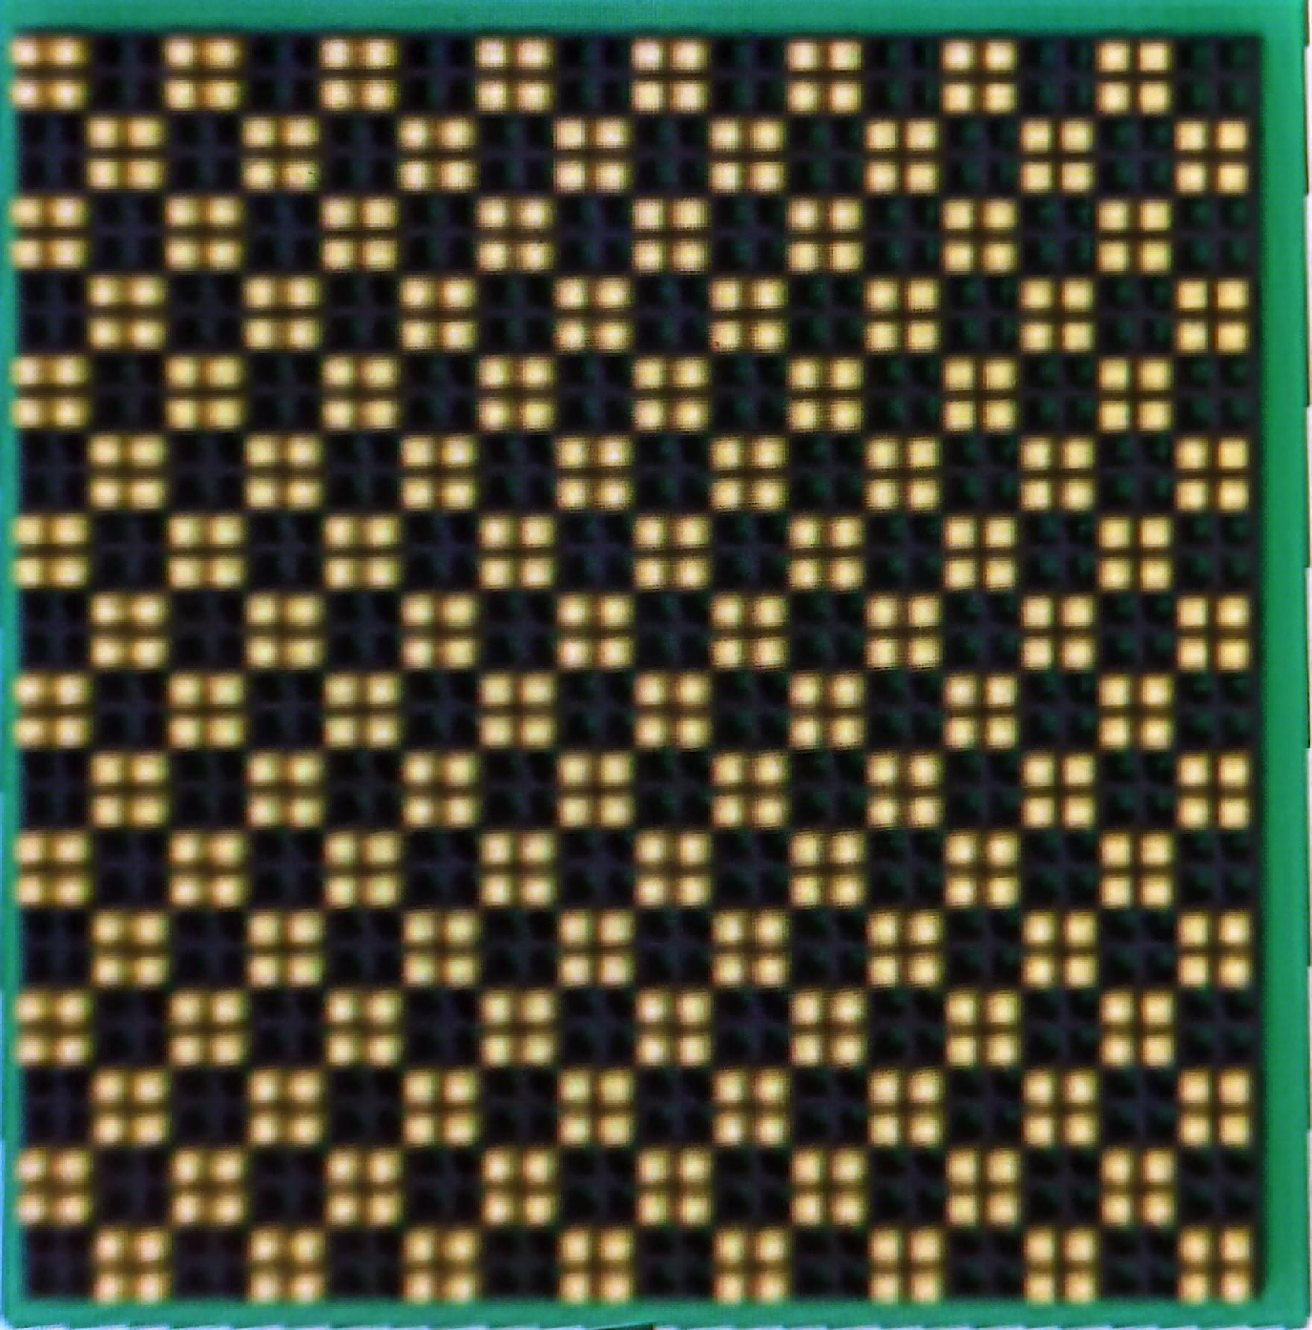
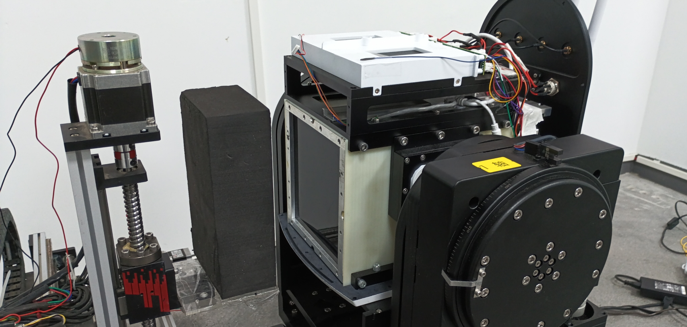
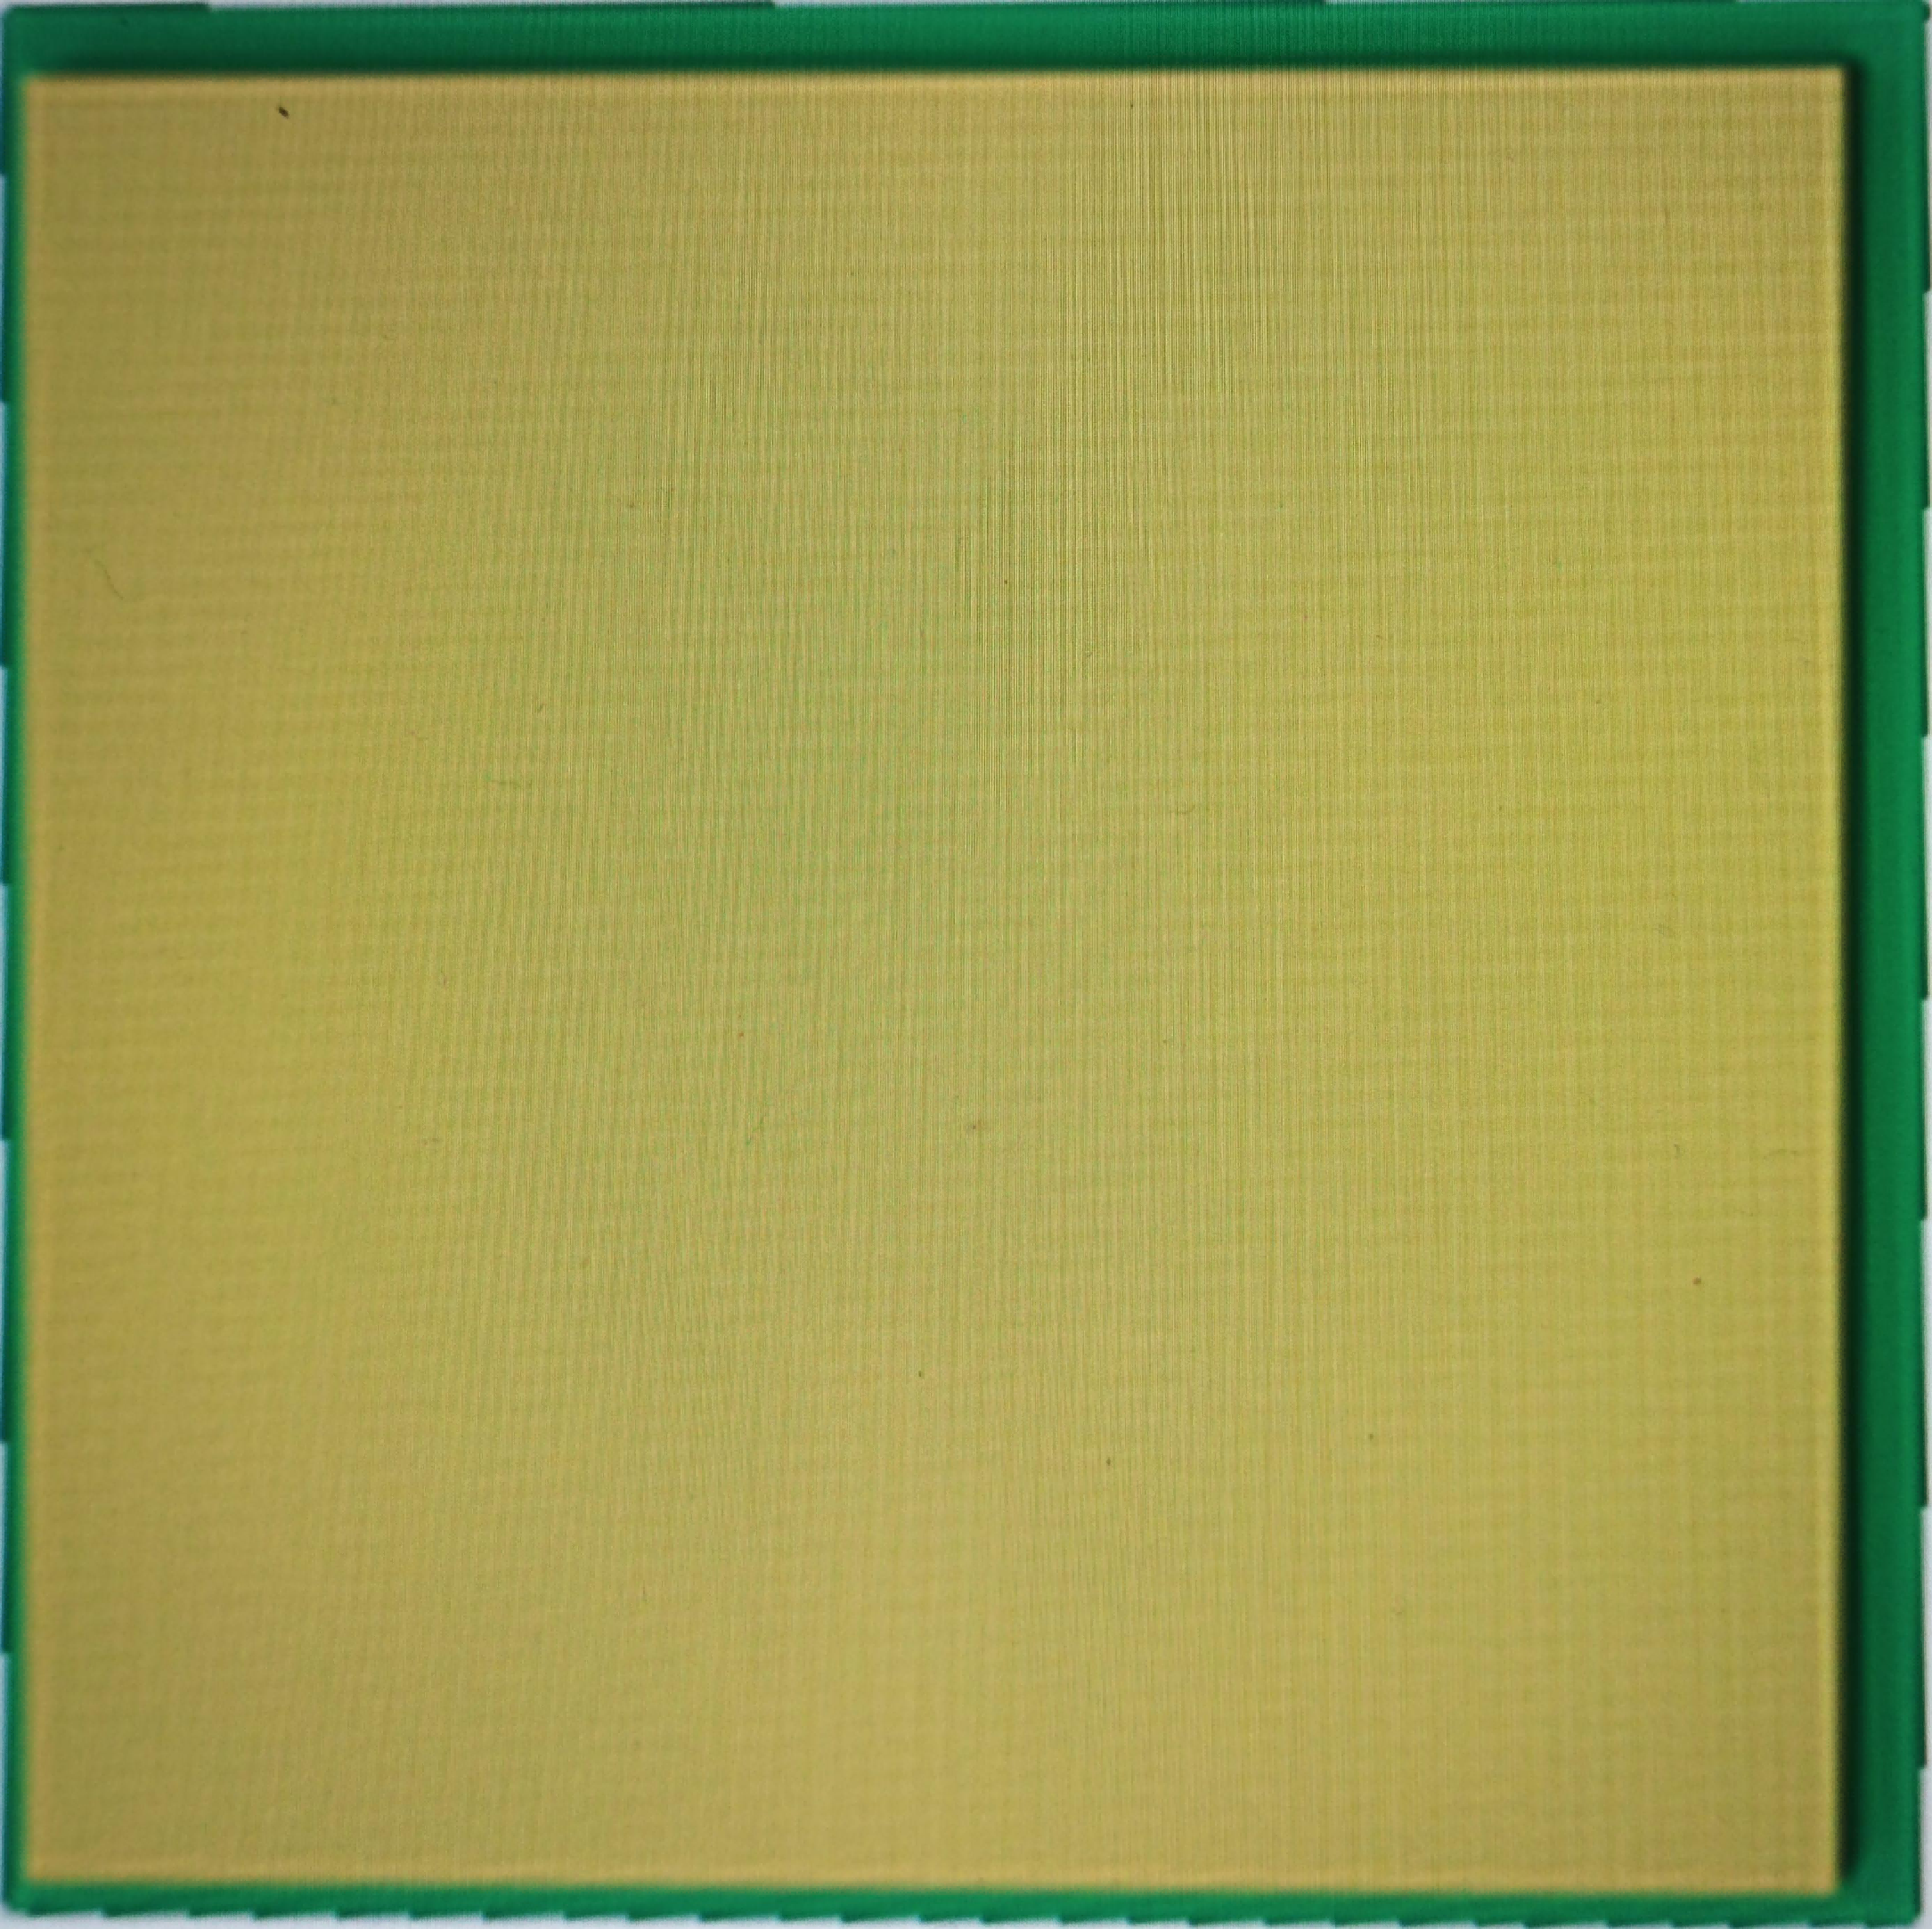
Methods
Proof-of-concept Experiment
Proof-of-concept on an existing self-collimation gamma camera design
Tungsten Coded aperture plate
588 holes with 3mm diameter
FOV
Layer1~Layer3
512 Mosaic-patterned GAGG(Ce) scintillator
Scintillator Size: 3mm×3mm×6mm
100mm
50mm
50mm
50mm
50mm
1
2
3
4
Self-collimation
Gamma Camera
Layer4
4096 Densely packed GAGG(Ce) scintillator
Scintillator Size: 2mm×2mm×6mm
Source/
Phantom
Peize Li. Joint Self-Collimation Compton Imaging #72
Notes:
To validate the JSCC method
Since this gamma camera was not specifically designed for JSCC, there are many aspects that still require optimization.

Slide 19
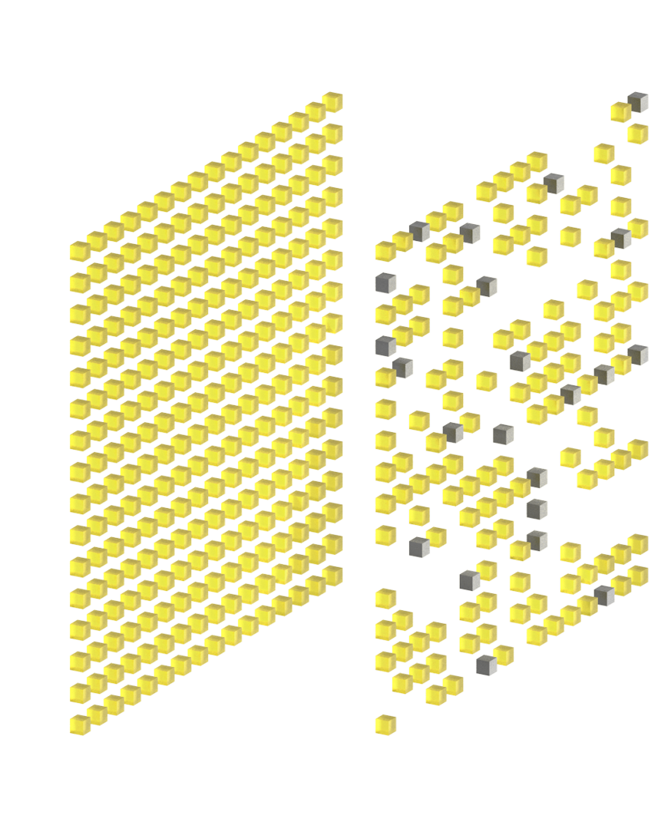
Methods
Experiment: Energy Calibration & Event Selection
Energy resolution: 13% FWHM at 511 keV
Select single-photon events from [460 560] keV window
Sort coincidence events with 50 ns window
Select Compton events from [460 600] keV window
E2
E1
^{Compton Events}
^{E1+E2 ≈ 511keV}
Peize Li. Joint Self-Collimation Compton Imaging #72
Notes:
We set a time window to acquire Compton coincidence events, and defined specific energy windows for the selection of two types of events.
加一个表示E1 & E2的图？

Slide 20
Results
Experimental Imaging Results
20 mm
SC
JSCC
SC
JSCC
24 mm
100 mm
1 s
2 s
511 keV
3.5 mCi
511 keV
10 mCi
0.5 s
0.2 s
0.25 s
0.1 s
Peize Li. Joint Self-Collimation Compton Imaging #72
Notes:
一页放所有实验结果，给出来single-photon和Compton events的比例，this is not an optimized porpotion

Slide 21
Results
Experimental Imaging Results
20 mm
SC
JSCC
SC
JSCC
24 mm
100 mm
1 s
2 s
Low Compton events proportion: 2.76%
Due to none-optimized system design
511 keV
3.5 mCi
511 keV
10 mCi
0.5 s
0.2 s
0.25 s
0.1 s
Peize Li. Joint Self-Collimation Compton Imaging #72
Notes:
一页放所有实验结果，给出来single-photon和Compton events的比例，this is not an optimized porpotion

Slide 22
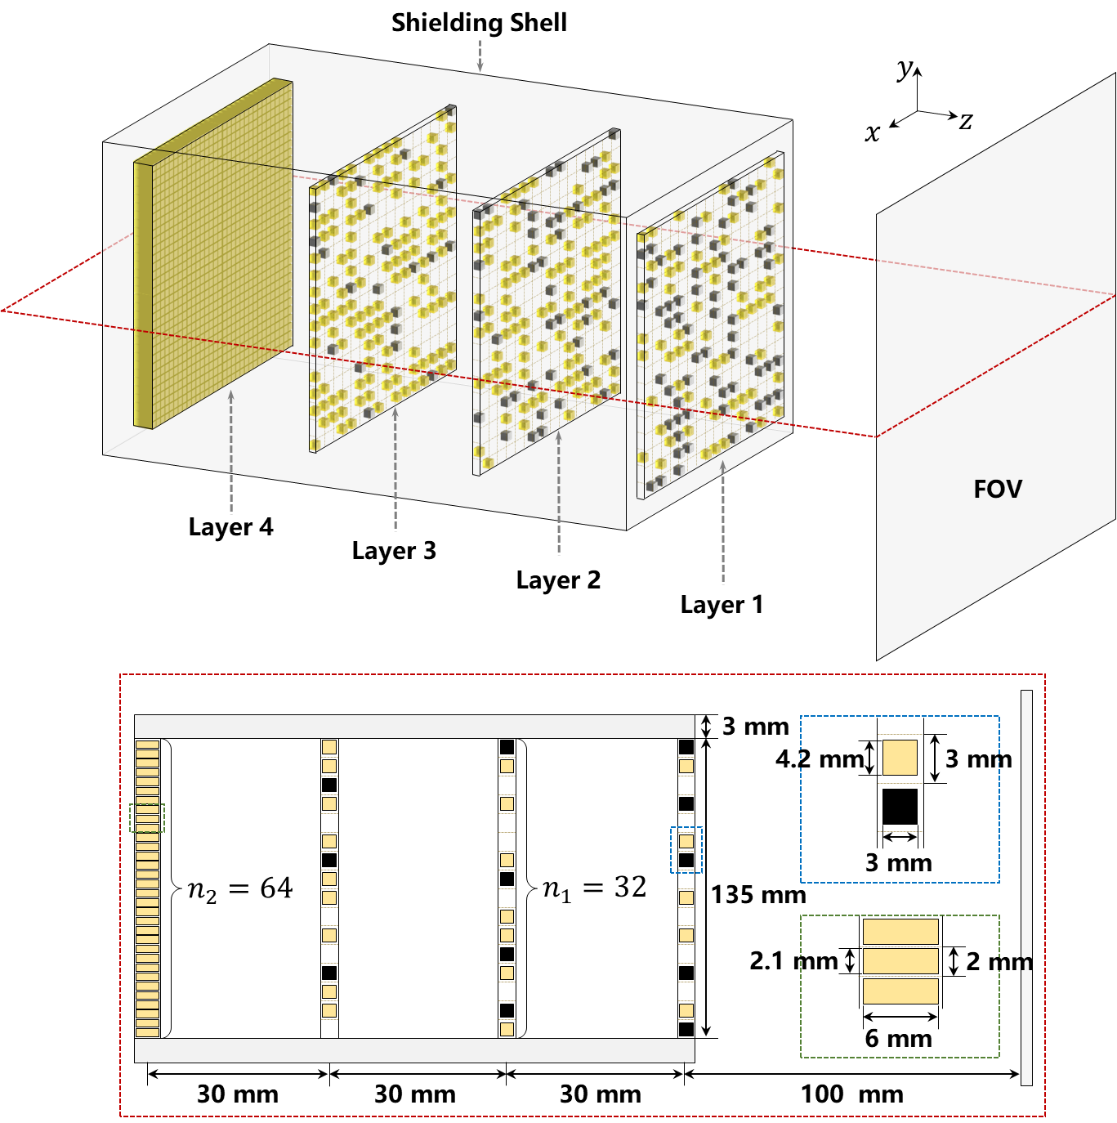
Methods
Monte-Carlo Simulation Configuration
Optimized JSCC gamma camera design
To improve sensitivity:
Remove the coded aperture plate
To balance sensitivity and resolution:
Place the metal blocks inside the detector layers
more metal on front layers, more scintillator on lateral layers
To reduce intra-scintillator Compton scattering:
Crystal size from 3mm×3mm×6mm to 3mm×3mm×3mm
Layer | Block Size | Number of GAGG(Ce) Blocks | Number of tungsten Blocks
1 | 3×3×3 mm³ | 256 | 256
2
 |  | 384 | 168
3
 |  | 512 | 88
4 | 2×2×6 mm³ | 4096 | 0
Peize Li. Joint Self-Collimation Compton Imaging #72
Notes:
三个点动画分别出来

Slide 23
Methods
Monte-Carlo Simulation Phantoms
Geant4 Monte Carlos simulation
Isotope | Energy | Energy Window (Single Events)
¹⁸F | 511 keV | [460 560]
Energy Resolution: 10% at 662keV
Hot-rod Phantom
NEMA Body Phantom
3.4 mm
Hot-rod: Background = 10:1
4.0 mm
2.8 mm
17 mm
13 mm
220 mm
22 mm
50 mm
10 mm
4.6 mm
5.8 mm
28 mm
37 mm
5.2 mm
290 mm
Evaluate spatial resolution
Evaluate SNR
Peize Li. Joint Self-Collimation Compton Imaging #72
Notes:
没必要提及225Ac和18F核素的应用

Slide 24
Results
Simulation: Hot-rod Phantom
511 keV
1 mCi
90 min
3.4 mm
4.0 mm
2.8 mm
SC
JSCC
Line Profile
SC
JSCC
4.6 mm
5.8 mm
5.2 mm
2.8 mm hot rods resolvable for both JSCC and SC in high-count condition
Relative Coordinates / mm
1.4 7.0 13.6 19.2
Peize Li. Joint Self-Collimation Compton Imaging #72
Notes:
significantly surpasses conventional SPECT, comparable to the level of PET

Slide 25

Results
Simulation: NEMA Body Phantom
511 keV
1 mCi
SC
JSCC
CNR(Contrast-to-Noise Ratio)
17 mm
13 mm
22 mm
50 mm
10 mm
9 min
28 mm
37 mm
$${CNR}_{i}=\frac{{C_{H,i}}/{C_{B}}−1}{{{std}_{B}}/{C_{B}}}$$
2 min
JSCC significantly improves SNR, especially in low-count conditions.
10 s
10 13 17 22 28 37
Diameter / mm
Peize Li. Joint Self-Collimation Compton Imaging #72
Notes:
this advantage becomes more prominent under

Slide 26
Results
Simulation: NEMA Body Phantom
511 keV
1 mCi
SC
JSCC
CNR(Contrast-to-Noise Ratio)
17 mm
13 mm
22 mm
50 mm
10 mm
9 min
28 mm
37 mm
$${CNR}_{i}=\frac{{C_{H,i}}/{C_{B}}−1}{{{std}_{B}}/{C_{B}}}$$
2 min
JSCC significantly improves SNR, especially in low-count conditions.
JSCC more clearly resolve cold-rods.
10 s
10 13 17 22 28 37
Diameter / mm
Peize Li. Joint Self-Collimation Compton Imaging #72
Notes:
this advantage becomes more prominent under

Slide 27
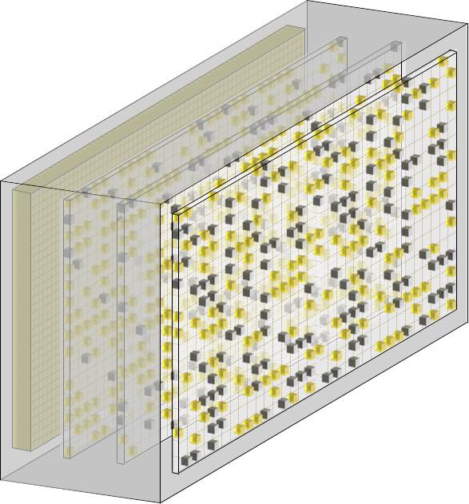
Methods
From 2D to 3D, High-energy to Wide-energy
Is the JSCC method effective for more complex conditions?
Planar, High-energy Imaging
Volumetric, Wide-energy Imaging
¹⁸F
^{99m}Tc
¹²³I
¹¹¹In
¹⁸F
500
600
100
200
¹⁷⁷Lu
300
¹³¹I
400
²²⁵Ac
500
600
High Energy
Low Energy
Medium Energy
High Energy
Peize Li. Joint Self-Collimation Compton Imaging #72
Notes:
this advantage becomes more prominent under

Slide 28
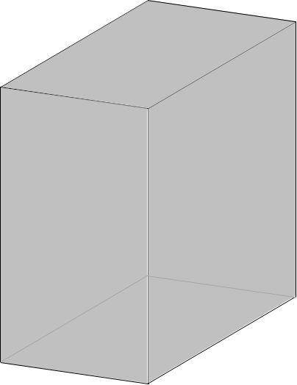
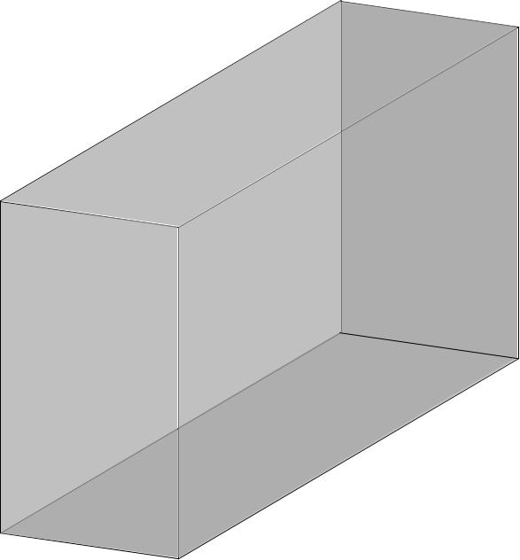
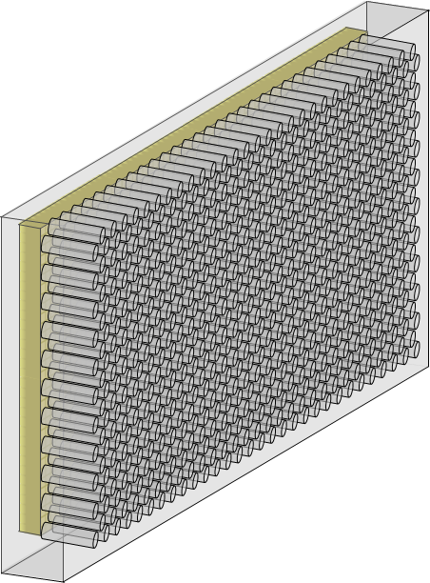
Methods
Monte-Carlo Simulation Configuration
JSCC SPECT Detector (Proposed)
Area: 270 mm × 135 mm
Lateral stitching of two planar imaging JSCC gamma cameras
200 mm
60 Rotations
Cylinder FOV
Parallel-hole SPECT (Comparison)
60 mm
Area: 270 mm × 135 mm
Scintillator: NaI, 10 mm Thickness
Collimator holes:
  Diameter: 2.5 mm,
  Septal thickness: 3.4 mm
  Hole length: 50.5 mm
300 mm
Peize Li. Joint Self-Collimation Compton Imaging #72
Notes:
this advantage becomes more prominent under

Slide 29
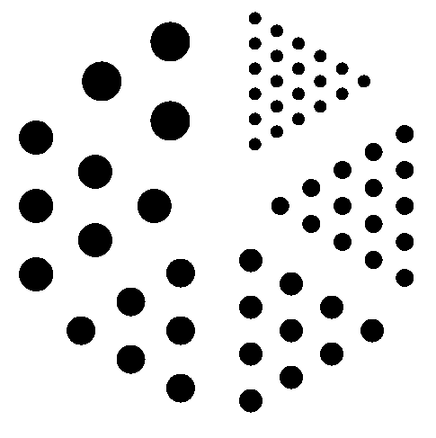
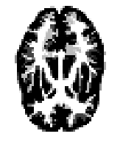
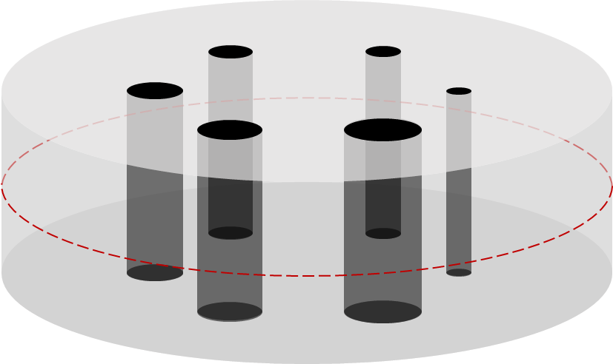
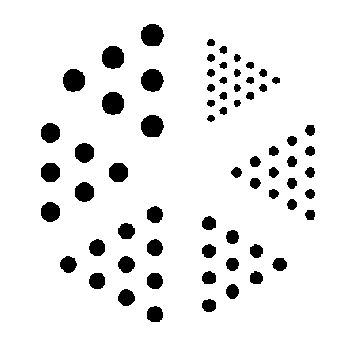
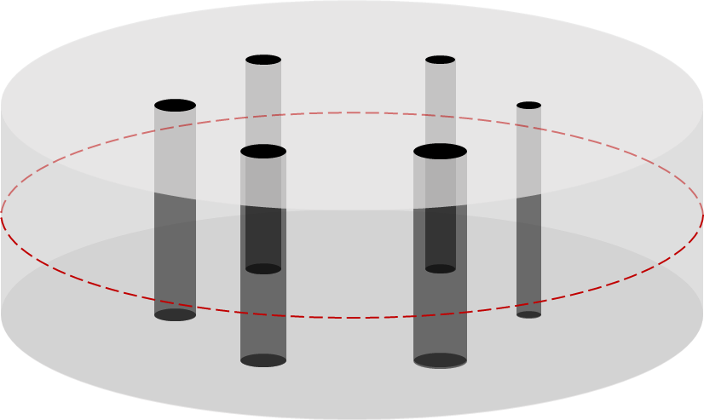
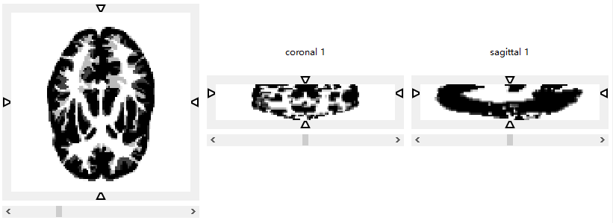
Methods
Monte-Carlo Simulation Phantoms
Phantoms for 511 keV
Hoffman Phantom
Contrast Phantom
Hot-rod Phantom
10 mm
Transverse
18 mm
14 mm
13 mm
7 mm
30 mm
22 mm
10 mm
250 mm
16 mm
22 mm
240 mm
26 mm
30 mm
Height: 30 mm
19 mm
Phantoms for 140 keV
180 mm
Contrast Phantom
Hot-rod Phantom
7 mm
Coronal
12 mm
10 mm
9 mm
5 mm
60 mm
30 mm
14 mm
8 mm
Sagittal
11 mm
15 mm
240 mm
16 mm
18 mm
Height: 30 mm
13 mm
Peize Li. Joint Self-Collimation Compton Imaging #72
Notes:
this advantage becomes more prominent under

Slide 30
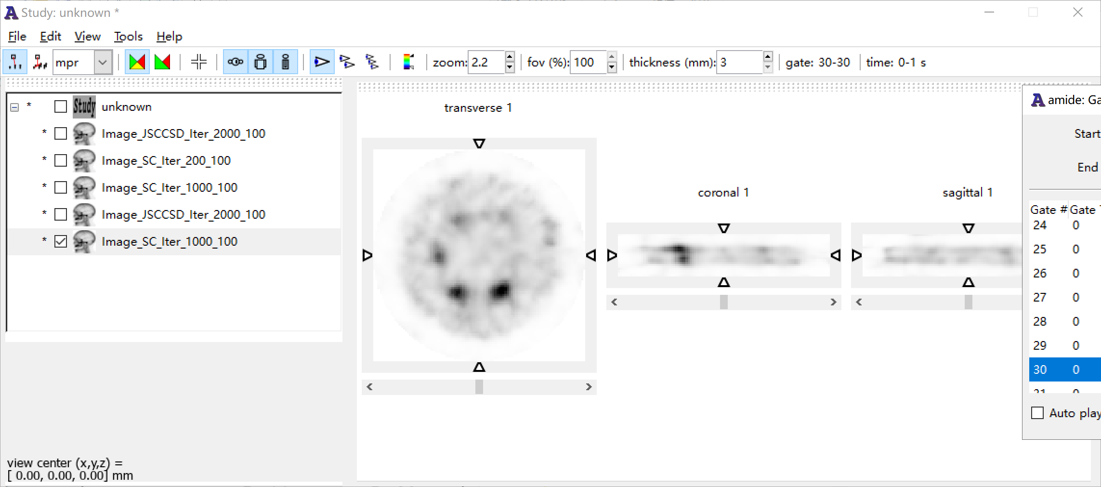
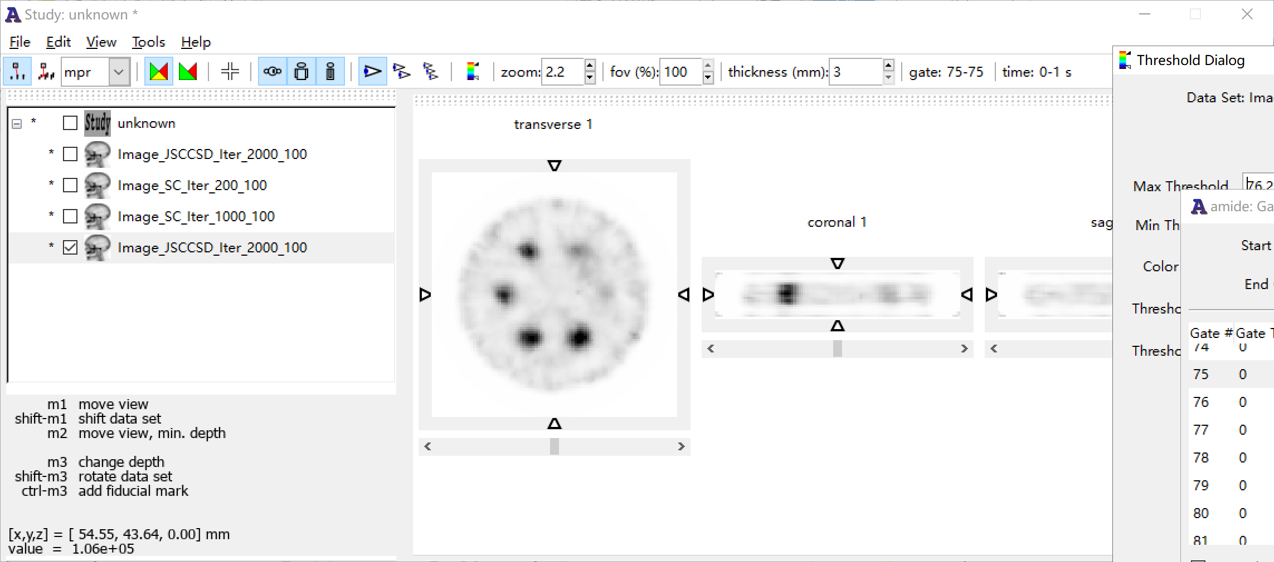
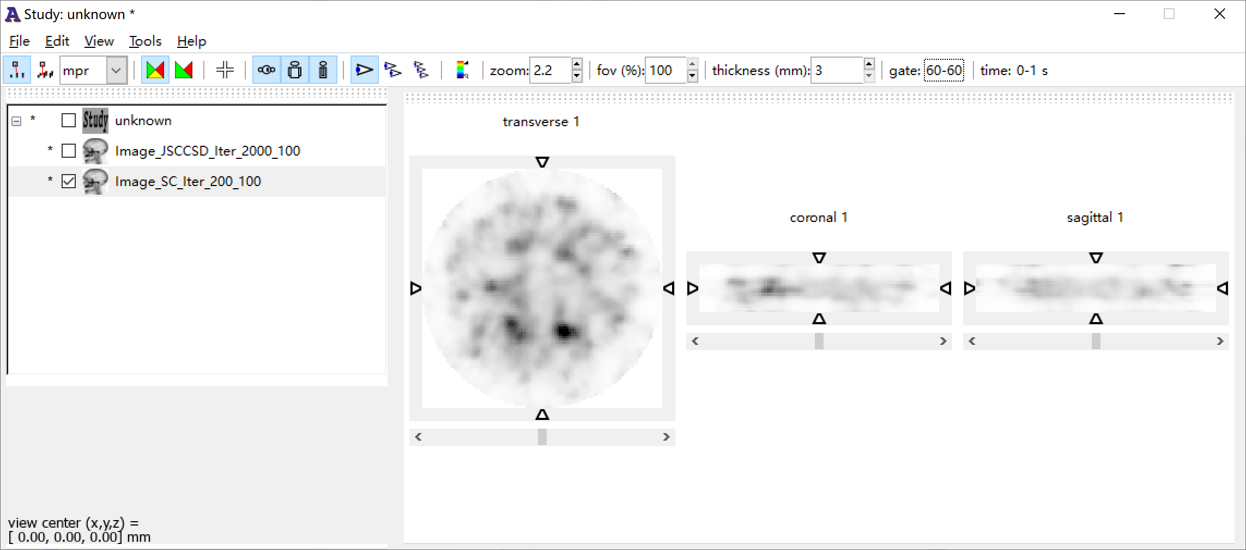
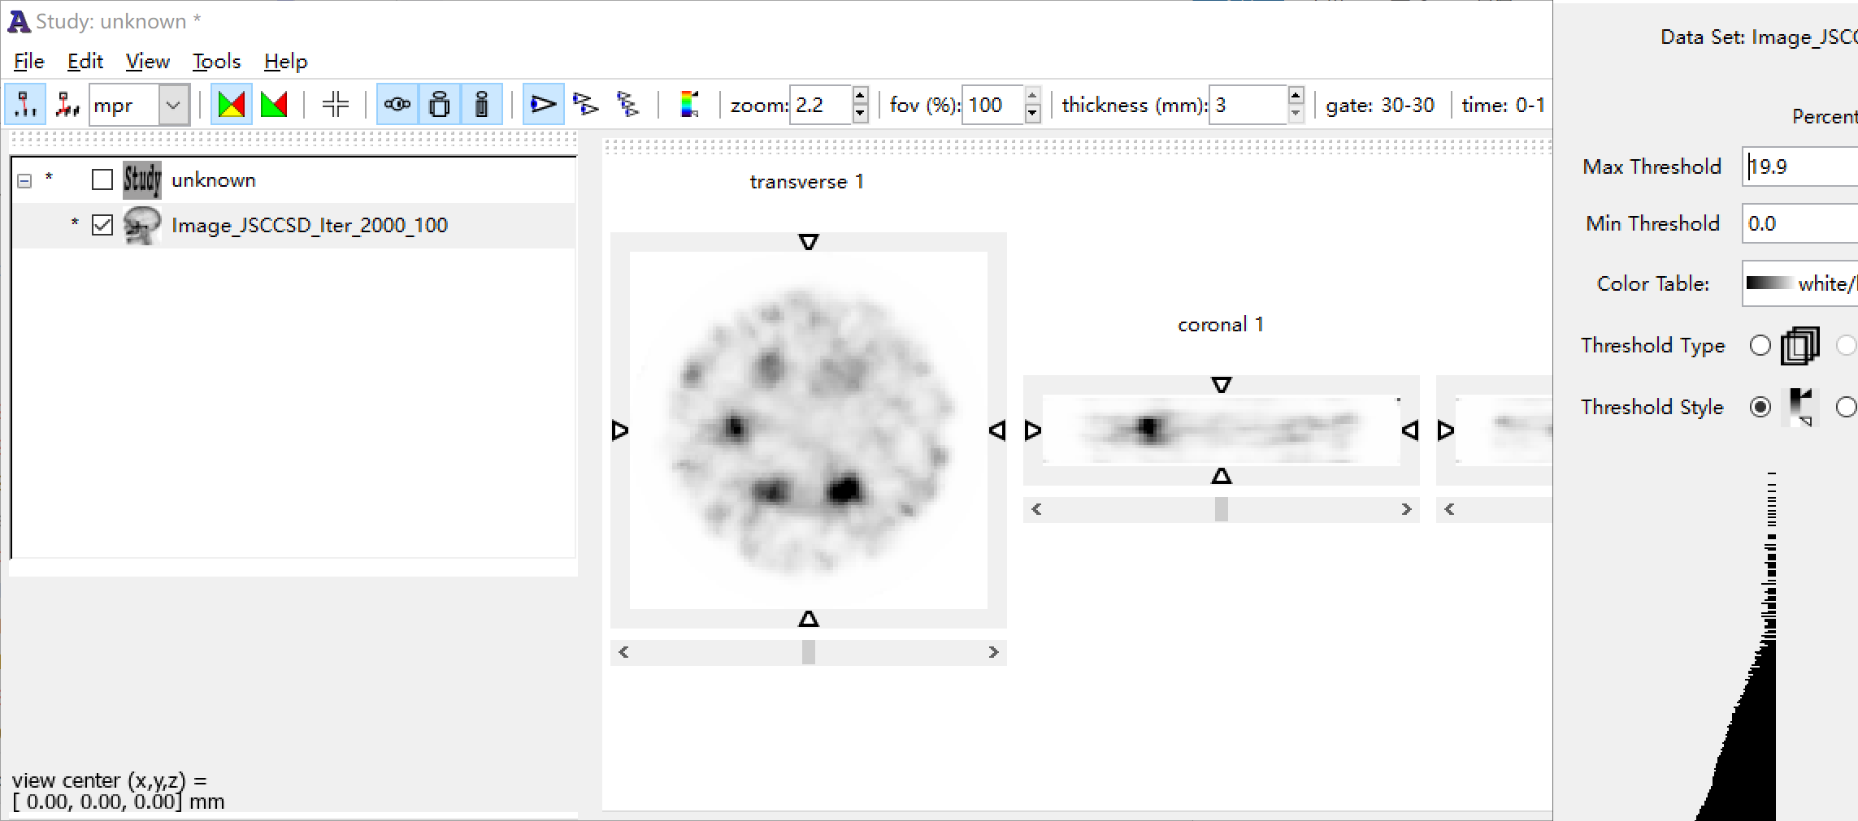
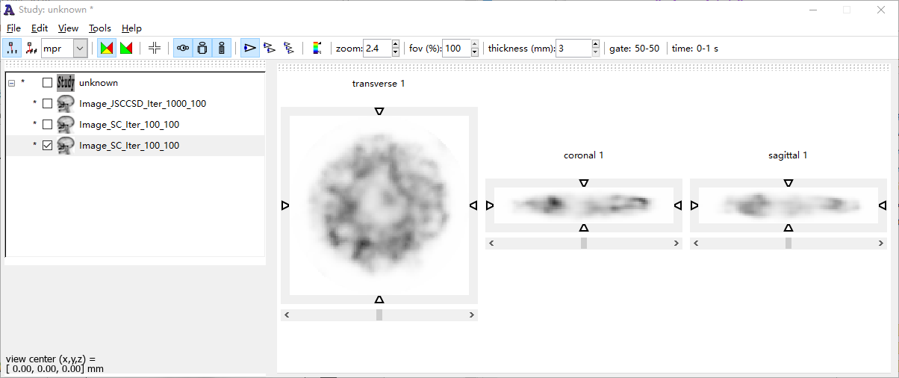
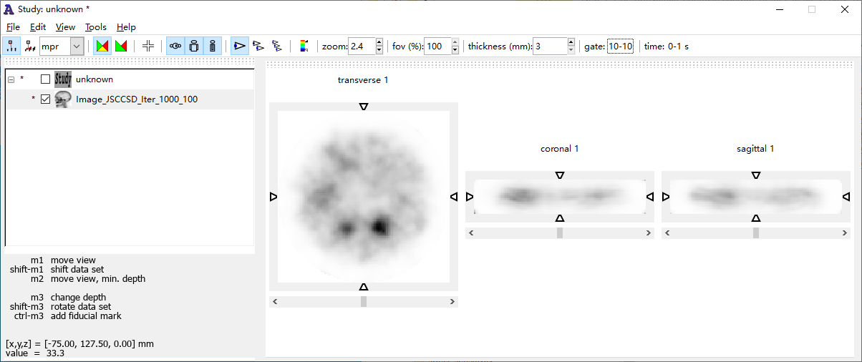
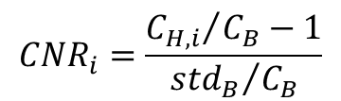
Results
Simulation – 511 keV
511 keV
1 mCi
Parallel-hole
JSCC
CNR(Contrast-to-Noise Ratio)
18 mm
14 mm
A
A'
B
B'
22 mm
10 mm
20 min
A – A'
B – B'
26 mm
30 mm
$${CNR}_{i}=\frac{{C_{H,i}}/{C_{B}}−1}{{{std}_{B}}/{C_{B}}}$$
A
A'
B
B'
2 min
A – A'
B – B'
JSCC significantly improves SNR, especially in low-count conditions.
A
A'
B
B'
30 s
A – A'
B – B'
10 14 18 22 26 30
Diameter / mm
Peize Li. Joint Self-Collimation Compton Imaging #72
Notes:
this advantage becomes more prominent under

Slide 31
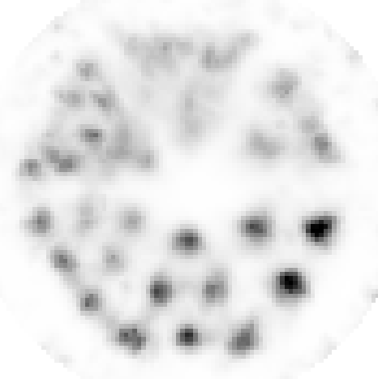
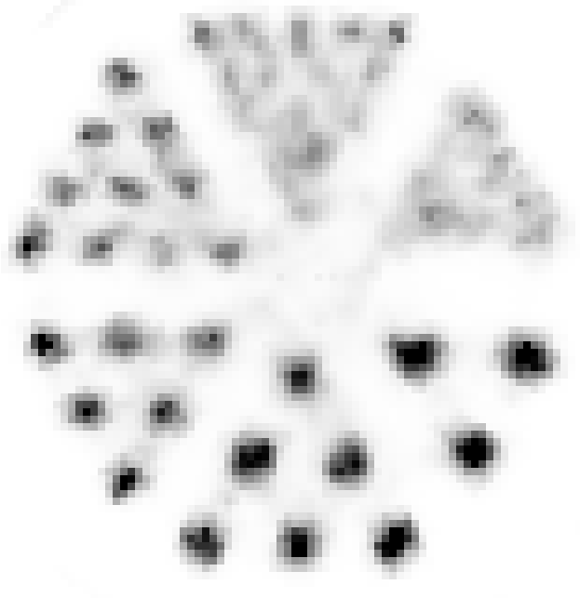
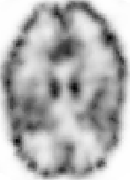

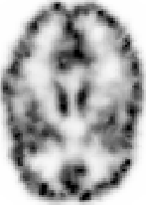



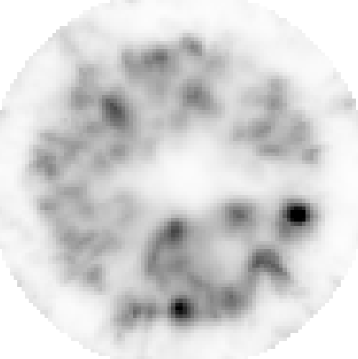
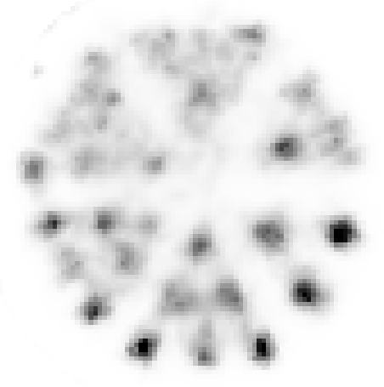
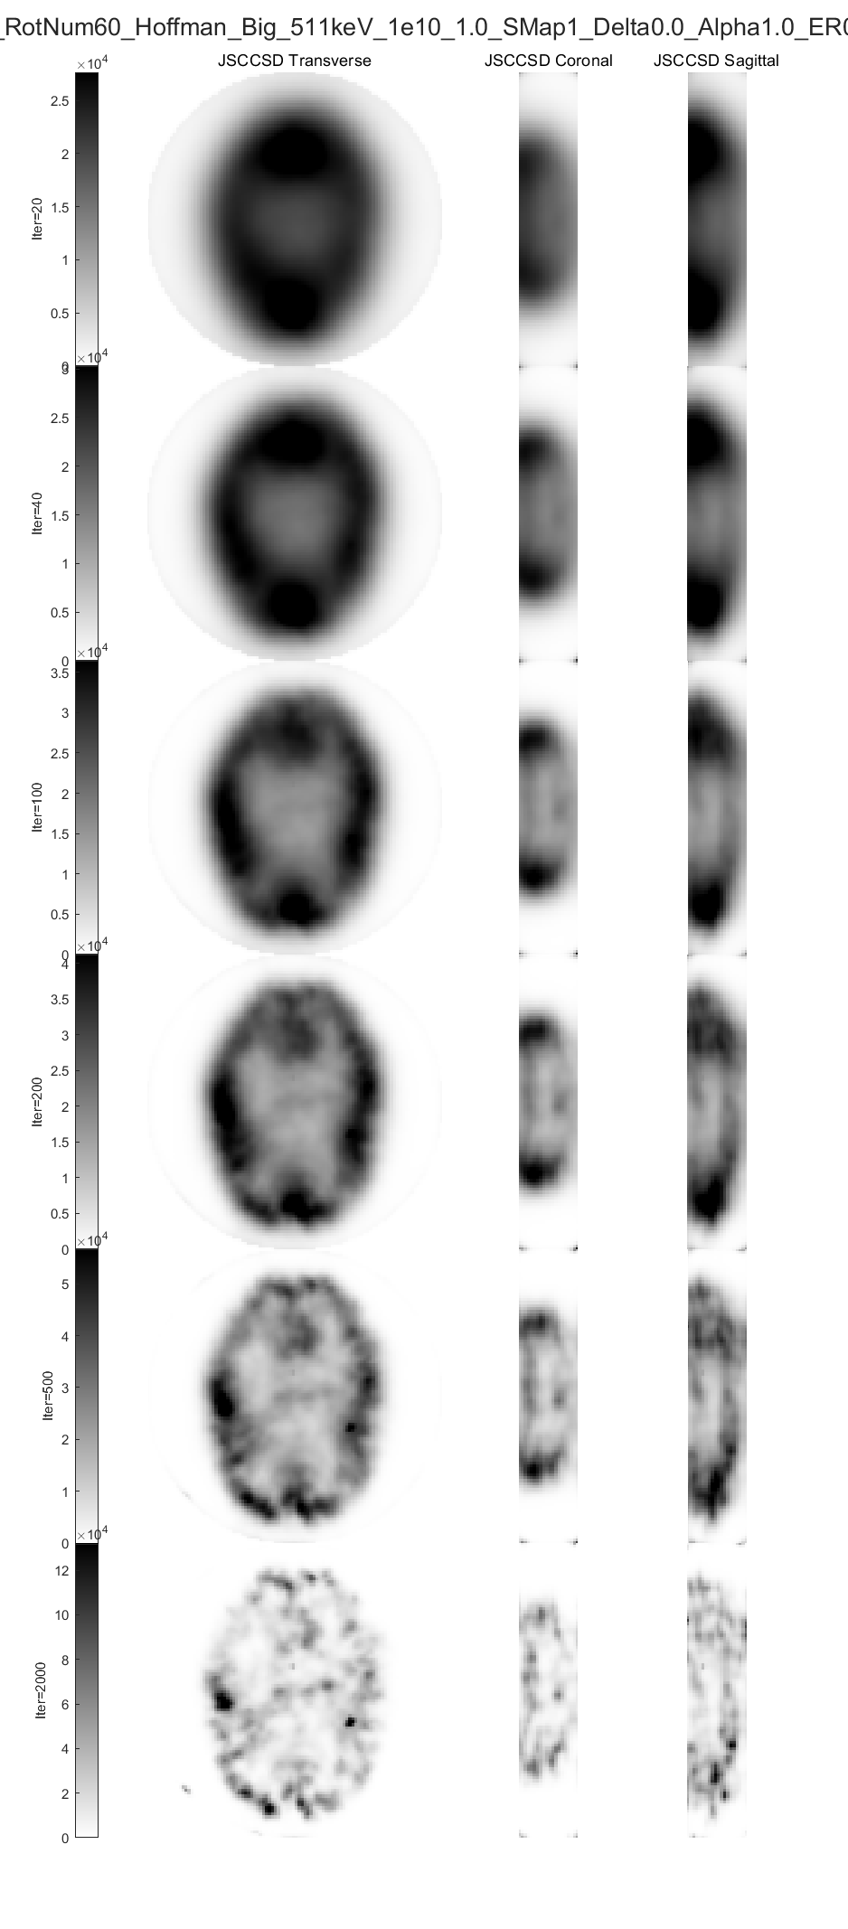
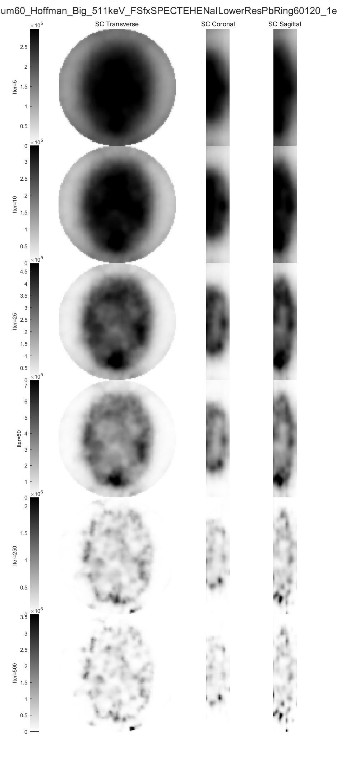
Results
Simulation – 511 keV
JSCC achieves better resolution and is better able to restore details of complex structures.
10 mm
Parallel-hole
JSCC
Parallel-hole
JSCC
13 mm
7 mm
Transverse
Coronal
Transverse
Coronal
16 mm
22 mm
19 mm
20 min
10 h
Sagittal
Sagittal
511 keV
1 mCi
511 keV
1 mCi
Transverse
Coronal
Transverse
Coronal
30 s
4 min
Sagittal
Sagittal
Peize Li. Joint Self-Collimation Compton Imaging #72
Notes:
this advantage becomes more prominent under

Slide 32
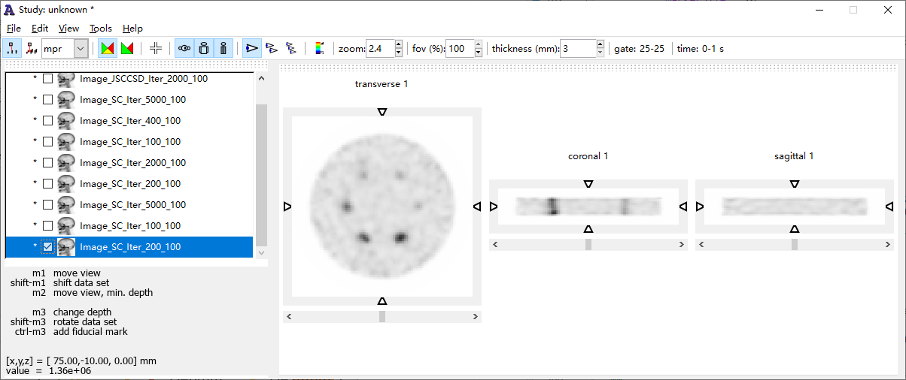





Results
Simulation – 140 keV
140 keV
1 mCi
Parallel-hole
JSCC
CNR(Contrast-to-Noise Ratio)
12 mm
10 mm
A
A'
B
B'
14 mm
8 mm
20 min
A – A'
B – B'
16 mm
18 mm
$${CNR}_{i}=\frac{{C_{H,i}}/{C_{B}}−1}{{{std}_{B}}/{C_{B}}}$$
A
A'
B
B'
2 min
A – A'
B – B'
JSCC significantly improves SNR, especially in low-count conditions.
A
A'
B
B'
30 s
A – A'
B – B'
8 10 12 14 16 18
Diameter / mm
Peize Li. Joint Self-Collimation Compton Imaging #72
Notes:
this advantage becomes more prominent under

Slide 33













Results
Simulation – 140 keV
JSCC also achieved significantly better image quality at low energy.
7 mm
Parallel-hole
JSCC
Parallel-hole
JSCC
9 mm
5 mm
Transverse
Coronal
Transverse
Coronal
11 mm
15 mm
13 mm
20 min
10 h
Sagittal
Sagittal
140 keV
1 mCi
140 keV
1 mCi
Transverse
Coronal
Transverse
Coronal
30 s
4 min
Sagittal
Sagittal
Peize Li. Joint Self-Collimation Compton Imaging #72
Notes:
this advantage becomes more prominent under

Slide 34
Conclusion
Proposed Joint Self-Collimation Compton Imaging concept:
Builds upon the high-resolution and high-sensitivity advantages of self-collimation
Incorporates Compton events to reduce multiplexing and improve SNR
Suitable for wide-energy SPECT
Proof-of-concept experiments:
Validate JSCC method on an existing self-collimation gamma camera
Proposed an optimized JSCC gamma camera design:
Through simulation, JSCC demonstrates both high resolution and high SNR
Shows strong potential for improving wide energy SPECT imaging performance
Future work
Continue building and refining the dedicated JSCC gamma camera
Further optimize image reconstruction algorithms
Peize Li. Joint Self-Collimation Compton Imaging #72

Slide 35



















Acknowledgment
Rutao Yao,
SUNY at Buffalo
Tsinghua Nuclear Imaging Physics Group
Engineering team
Peize Li. Joint Self-Collimation Compton Imaging #72

Slide 36
Thank you for listening！
Large animal SPECT/CT, SNMMI 2018 SS43 No. 362

