Slide 1

An S-Band Interlaced Side-Coupled Standing-Wave Linac with Continuous Energy Tunability from 1 to 10 MeV for Radiotherapy
Haipeng Zhi
Jiaru Shi, Hao Zha, Xiancai Lin, Jiaqi Qiu, Huaibi Chen
Department of Engineering Physics, Tsinghua University
Key Laboratory of Particle and Radiation Imaging, Ministry of Education With University of Electronic Science and Technology of China
OPAC2026

Slide 2
Medical motivation for 1–10 MeV tuning
Different medical applications motivate broad-range electron-energy flexibility.
Representative electron energies
Representative applications;
energy ranges are not strict boundaries.
This work: continuous 1–10 MeV source (design target)
Electron energy (MeV)
10 12
1
2.5
4 6
Incident 2.5 MeV electrons → Cu target
Dedicated 2.5 MV bremsstrahlung imaging beam
9
Portal X-ray imaging [1]
Electrons converted at a target
Electron radiotherapy [2]
Depth selection for superficial targets
Nominal clinical range: 4–22 MeV
continues beyond this axis
Electron IORT [3]
Direct irradiation during surgery
Mobetron IORT: 6, 9 and 12 MeV presets
Imaging needs
Electron energy and target design determine the X-ray spectrum and influence image contrast, penetration and dose.
Treatment needs
Electron energy governs therapeutic penetration and distal dose falloff, enabling
depth-matched treatment.
Complementary imaging and therapy applications motivate broad-range energy flexibility in compact electron linacs.
[1] Gräfe et al., JACMP 17(5):222–234 (2016). doi:10.1120/jacmp.v17i5.6323. [2] IAEA, Radiation Oncology Physics (2005), Ch. 8.
[3] IntraOp, Mobetron HDR Product Datasheet, Rev. D. Clinical presets are nominal energies; source and patient-surface energies can differ.
02

Slide 3
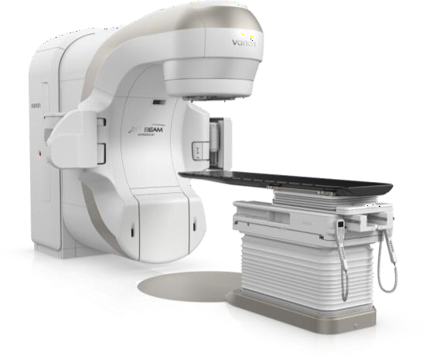
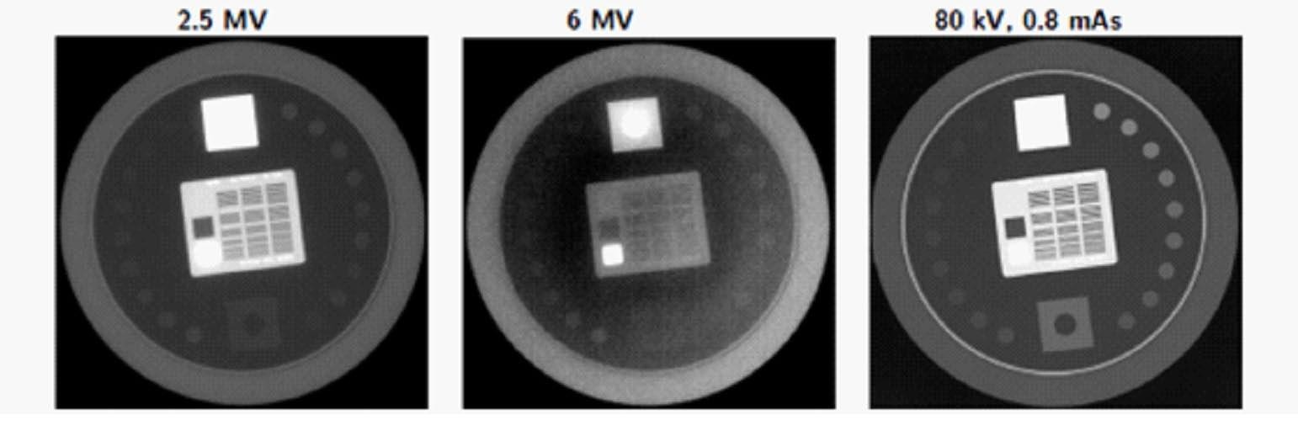
Low-MeV electrons for low-MV imaging
A clinical example: TrueBeam portal imaging uses 2.5 MeV electrons incident on a copper target [1].
Clinical platform Electron-to-photon conversion [1]
2.5 MeV electrons 2 mm Cu target 2.5 MV X rays
Bremsstrahlung has a broad photon spectrum. The MV label does not mean that every photon has an energy of 2.5 MeV.
Published image-quality comparison
TrueBeam — Varian
Manufacturer image [2] Representative platform illustration
Leeds TOR 18FG phantom, without overlying Solid Water. Low-contrast targets visible [1]
18/18 at 2.5 MV
10/18 at 6 MV
MV high-quality mode; DMI detector. Gräfe et al., Fig. 5 [1], CC BY 3.0.
The 2.5 MV imaging beam shows improved low-contrast visibility compared with the 6 MV beam
under the reported phantom conditions.
Gräfe et al., “Characterization of a 2.5 MV inline portal imaging beam,” JACMP 17(5):222–234 (2016). doi:10.1120/jacmp.v17i5.6323.
Varian / Siemens Healthineers, TrueBeam official product page. The phantom comparison establishes an advantage over 6 MV, not general superiority over kV.
03

Slide 4
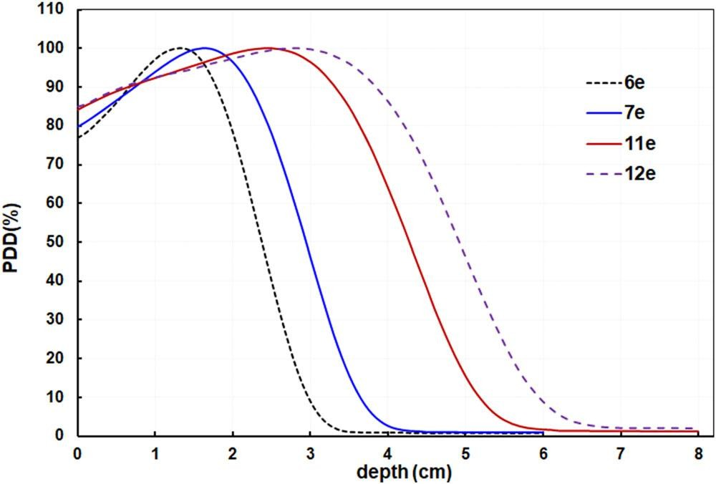
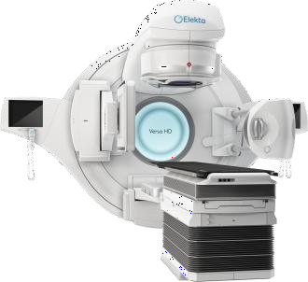
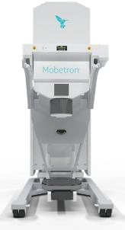
Electron radiotherapy and depth matching
Clinical energy presets control the distal dose falloff. Intermediate energies provide finer depth selection [1,2].
Direct electrons: rapid distal dose falloff [2] Clinical energy-selection platforms
Versa HD · Elekta
Photon/electron linac Clinical presets [3]
Mobetron · IntraOp
Electron IORT 6, 9, 12 MeV [4]
Custom 7 and 11 MeV settings [1]
Electron setting | Target I₅₀
7 MeV | 2.9 cm
11 MeV | 4.2 cm
Target I₅₀: 50% ionization depth.
15 × 15 cm² cone, SSD = 100 cm.
≈0.5 cm R₈₀ shift for 6→7 and 11→12 MeV
(10 × 10 cm² cone, SSD = 100 cm) [1].
Gao et al., Fig. 1 [1], CC BY 4.0. 10 × 10 cm² cone, SSD = 100 cm.
The 11/12 MeV beams provide clinical context beyond this design’s 10 MeV limit.
Clinical demand for finer depth matching motivates continuous 1–10 MeV source-energy control.
[1] Gao et al., JACMP 23:e13633 (2022). doi:10.1002/acm2.13633. [2] IAEA, Radiation Oncology Physics (2005), Ch. 8.
[3] Elekta, Versa HD official product and commissioning materials. [4] IntraOp, Mobetron HDR Product Datasheet, Rev. D. Device images: manufacturers.
04

Slide 5
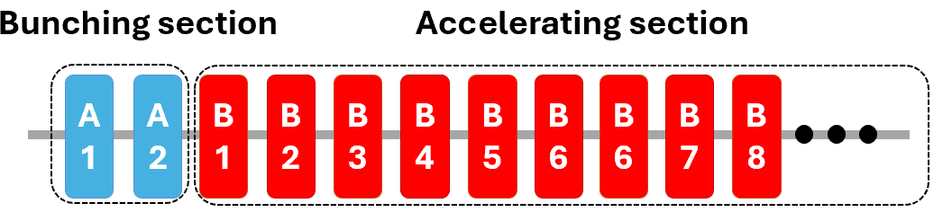
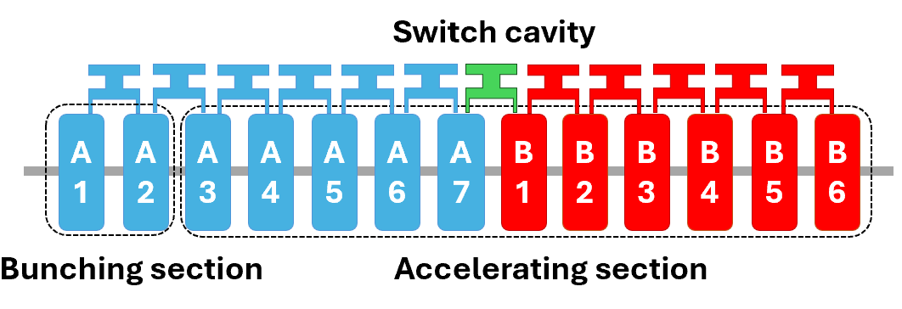
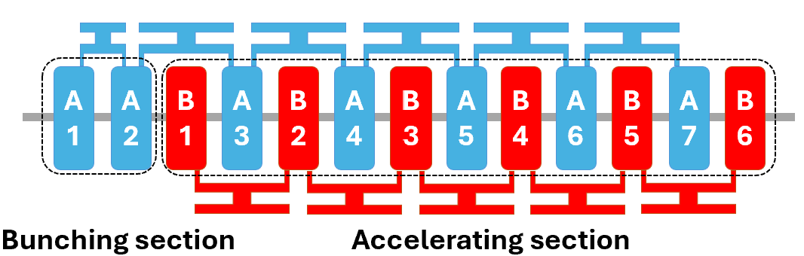
Conventional energy-tuning methods
Independently powered sections
Principles and Limitations
01 | RF Power Modulation
Side-cavity energy switching
Reduced bunching fields → lower capture efficiency and increased energy spread.
02 | Independently Powered Sections
Independent RF amplitude/phase control → increased system complexity.
03 | Side-Cavity Energy Switching
Proposed: Interlaced Dual-Chain Linac
Downstream field adjustment → discrete energy selection.
Key challenge: Reducing the net energy gain without weakening local RF focusing.
How can net energy gain be reduced without sacrificing strong RF focusing?
05

Slide 6
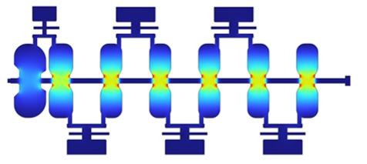
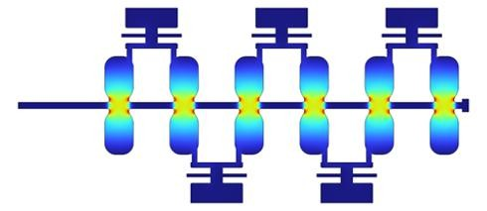
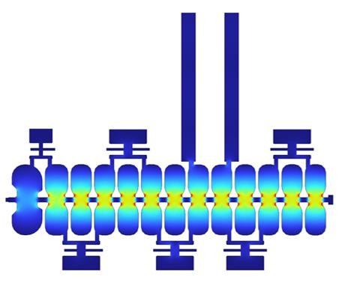
Interlaced dual-chain architecture
DUAL-CHAIN ARCHITECTURE
MICROWAVE ISOLATION
Adjacent A/B cells are connected only through the beam iris
CHAIN A
Fixed RF: bunching and capture
CHAIN B
Tunable RF: energy control
A
B
Electron
2 bunching+5 accelerating cells 6 accelerating cells
COMBINED INTERLACED STRUCTURE
Φ6 mm iris
RF operating freq.
2.998GHz
TE11 iris cutoff
~29GHz
350 mm × Φ150mm
13 on-axis cells I 2998MHz
Inter-chain coupling.
＜0.01%
Intra-chain coupling.
0.8%
Two independent RF feeds
Strong RF isolation enables independent amplitude and phase control.
Functional separation + electromagnetic independence enable voltage-superposition tuning.
06

Slide 7
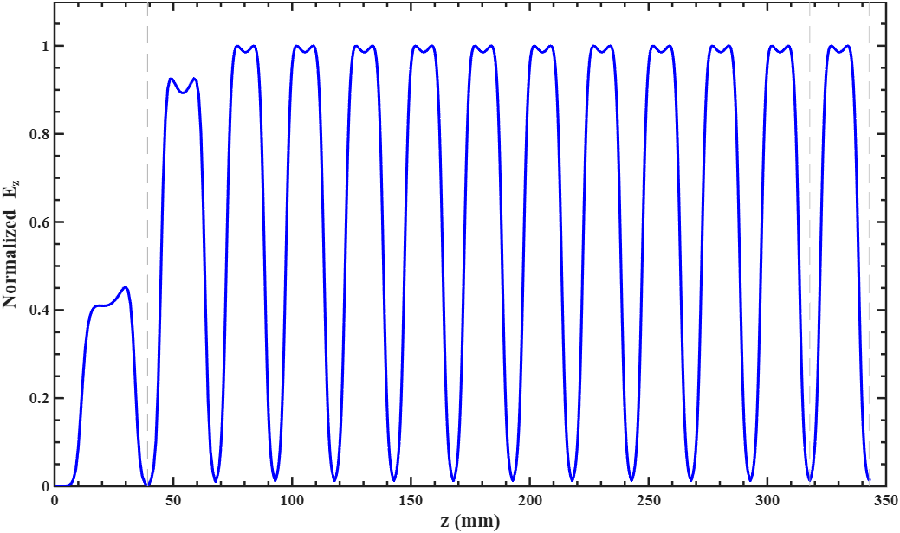
RF design and phase synchronization
2998 MHz · π/2 side-coupled mode
𝜆Τ4 single cell
A
B
A
90° flight 90° flight
180° transit between A cells compensates their 180° field reversal
Regular cell | Value
Length | 25.0 mm
Transit-time factor | 0.952
ZT² | 99.25 MΩ/m
Rising bunching field
Uniform accelerating field
Quarter-wavelength cells maintain synchronism within each interlaced chain.
07

Slide 8
Two tuning modes and the transition
High energy
5 < E ≤ 10 MeV
Transition
Nominal E = 5 MeV
Low energy
1 ≤ E < 5 MeV
B
A
B
A
B
A
B
B
A
B
A
B
A
B
B
A
B
A
B
A
B
+ + + + + + +
0 + 0 + 0 + 0
− + − + − + −
Definition: Δφ =φB- φA
A accelerates
B accelerates
Δφ = −90°
A accelerates
B is off
Chain B voltage: zero
A accelerates
B decelerates
Δφ = +90°
Reversing Chain B by 180° reduces net gain while preserving strong local fields.
08

Slide 9
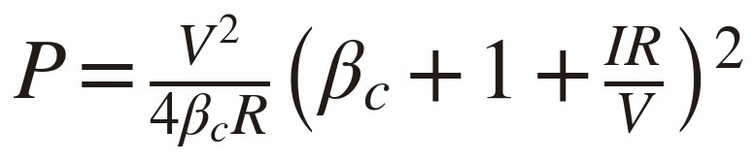
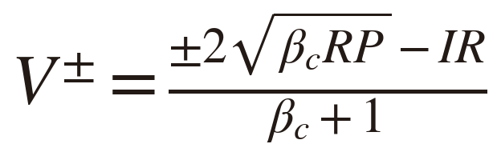
Circuit model and operating points
Resonant power balance with beam loading
I = 100 mA ; βc = 1.30 R_A / R_B = 19.1 / 14.9 MΩ
_{V} +
Accelerating solution
_{V} −
Decelerating solution
Energy transferred from RF field to beam.
Energy transferred from beam to RF field.
Circuit quantity | 10 MeV mode | 6 MeV mode | 1 MeV mode
Chain A power (MW) | 2.10 | 2.10 | 2.10
Chain B power (MW) | 2.10 | 0.15 | 1.00
Chain A voltage (MV) | 5.45 | 5.45 | 5.45
Chain B voltage (MV) | 4.90 | 0.84 | −4.48
Relative phase | −90° | −90° | +90°
Total voltage (MV) | 10.35 | 6.29 | 0.97
The RF power determines the voltage branches, while the relative phase selects acceleration or deceleration.
09

Slide 10
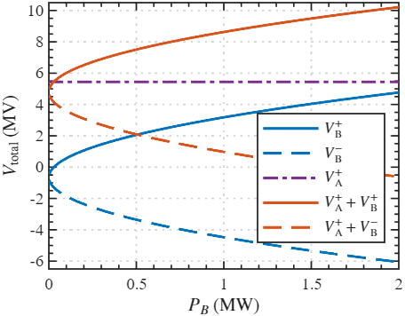
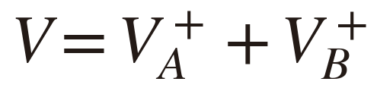
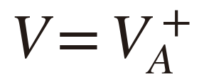
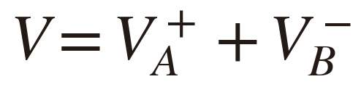
Continuous tuning by voltage superposition
High-energy mode
5 < E ≤ 10 MeV
Δφ = −90°
Transition
E ≈ 5 MeV
Chain B off
Low-energy mode
1 ≤ E < 5 MeV
Δφ = +90°
Amplitude controls voltage magnitude; phase reversal selects acceleration or deceleration.
10

Slide 11
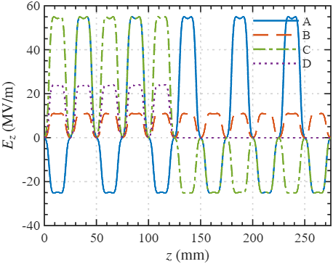
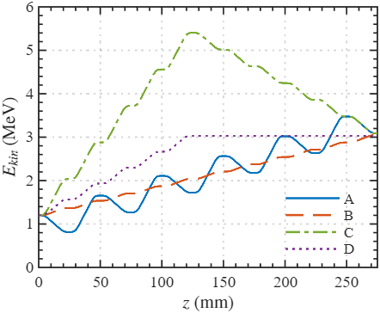
Comparison of Four Energy-Tuning Methods
Same 11-cell downstream section and identical post-buncher distribution
1.2 MeV average energy, 5.4% rms energy spread, σx = 1.1 mm.
A Alternating accel./decel. B Uniform RF reduction
Axial field (MV/m)
C Sectioned phase control
Particle energy (MeV)
D Energy switching
Equal 3 MeV exit energy provides a common basis for comparing transverse transport.
Sec. III.A, Fig. 5(a,b)
11

Slide 12
Single-Particle Transverse Dynamics Model
Linearized paraxial motion
Local mechanisms
𝛾′
γ′ > 0: adiabatic damping
γ′ < 0: antidamping
𝑥″ +
𝑥′ + 𝑘
2
RF
2
(4)
𝑧 − 𝑘_{sc}
𝑧 𝑥 = 0
2
𝛽 𝛾
RF restoring coefficient
RF focusing depends on the local
field and particle energy.
_{𝑘}2
𝑒
𝜕𝐸
𝑧 ₊
𝛽 𝜕𝐸
𝑧 =
𝑧
RF
(5)
2𝑚𝑐²𝛽²𝛾
𝜕𝑧
𝑐 𝜕𝑡
Lower beam energy strengthens space-charge defocusing.
Uniform cylindrical bunch
_{𝑘}2
𝐾
𝑒𝐼
𝑧 =
(6)
𝐾 =
(7)
Ez = Ea(z) sin(ωt + φ)
σx: rms size. K: generalized perveance.
sc
𝛽²𝛾³𝜎²
2𝜋𝜀 𝑚𝑐³
𝑥
0
Accelerating cell: entrance half focuses. Decelerating cell: exit half focuses.
Lower local energy gives these intervals greater weight, with |k²RF| ∝ 1/(β²γ).
Both accelerating and decelerating cells can provide net RF focusing
due to energy-dependent field weighting.
Sec. III.B.1, Eqs. (4–6); β = v/c, prime = d/dz, e > 0
12

Slide 13
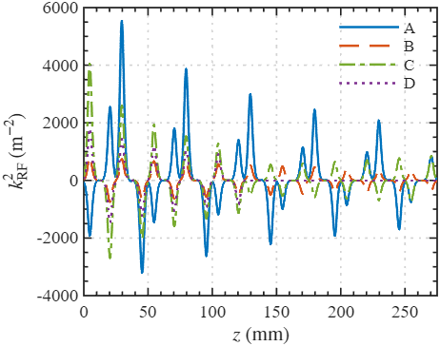
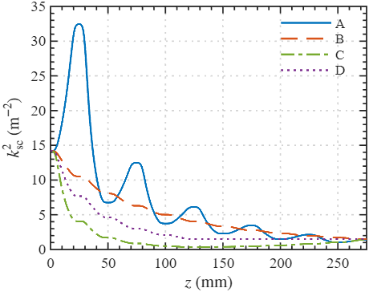
RF Focusing versus Space-Charge Defocusing
RF focusing coefficient Space-charge defocusing coefficient
A, C: strong local RF fields and focusing. B, D: substantially weaker RF focusing.
Typical |k²RF| is about 10² times k²sc at this operating point.
A: lower mean energy, stronger space charge. C: higher mean energy, weaker space charge.
Method A maintains stronger transverse focusing despite stronger space-charge defocusing.
Sec. III.B.1, Fig. 6(a,b); k²RF is a signed coefficient
13

Slide 14
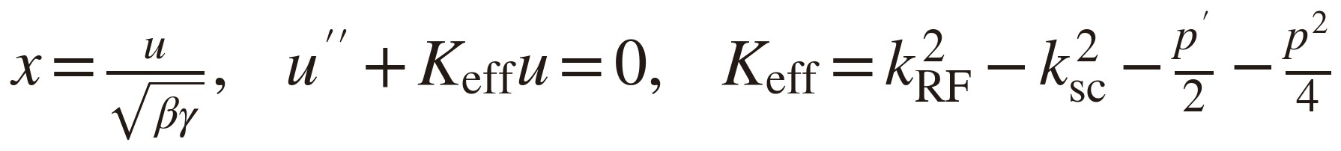
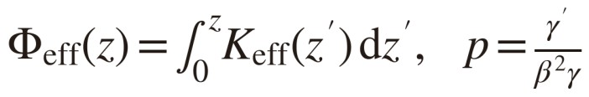
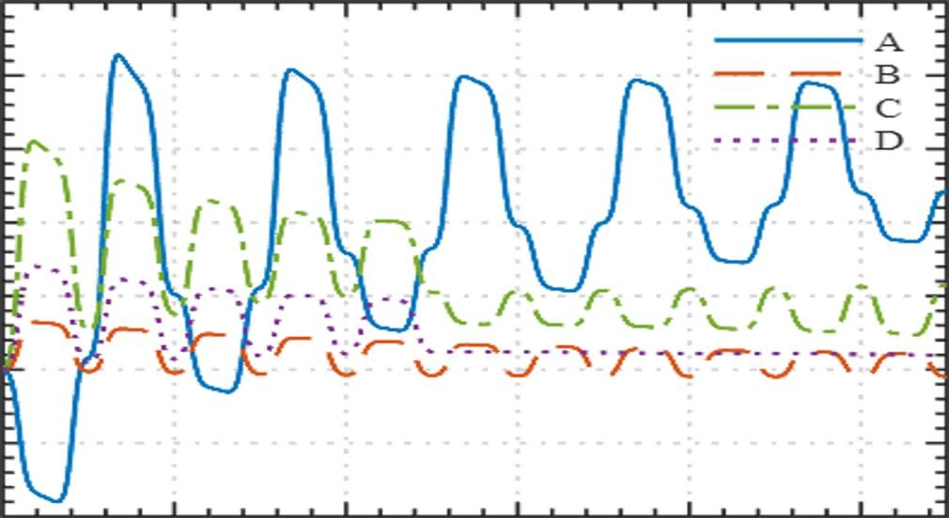
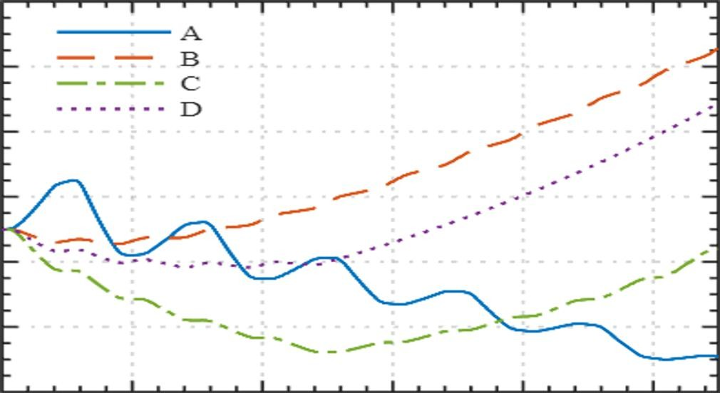
Cumulative Focusing and Particle Trajectories
I = 100 mA, σx,0 = 1.1 mm (fixed) x0 = σx,0, x′0 = 0
RF force dominates space charge in this reference
calculation.
Probe-particle displacement x (mm)
Cumulative focusing Φeff (m⁻¹)
A has the largest cumulative focusing.
C: sustained deceleration causes antidamping.
B, D: weaker RF fields and progressive divergence. Probe trajectories support the cumulative comparison.
The alternating method provides the strongest cumulative focusing
and superior confinement of the probe particle.
Sec. III.B.1, Eqs. (7–9), Fig. 6(c,d)
14

Slide 15

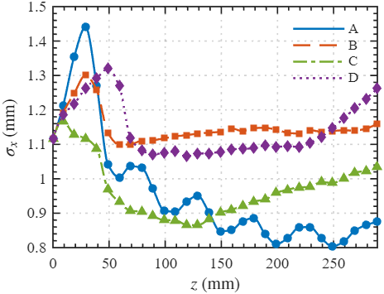
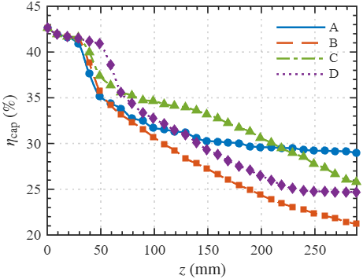
Multi-Particle Validation with ASTRA
ASTRA: 10⁵ macroparticles with self-consistent space charge. Reference current: 100 mA.
Same post-buncher distribution, same 11-cell section and identical final energy of 3.0 MeV.
A Alternating accel./decel. B Uniform RF reduction C Sectioned phase control D Energy switching
A: bounded after initial oscillations. B, D: growth. C: envelope growth in the consecutive decelerating cells.
A 29.1% B 21.2% C 25.8% D 24.7%
A versus B: +7.9 percentage points
Capture includes bunching losses. Nonlinear space charge and finite aperture affect the results.
Self-consistent multi-particle tracking confirms the transverse-focusing advantage
of the alternating acceleration–deceleration method.
Sec. III.A and III.B.2, Fig. 7(a,b)
15

Slide 16
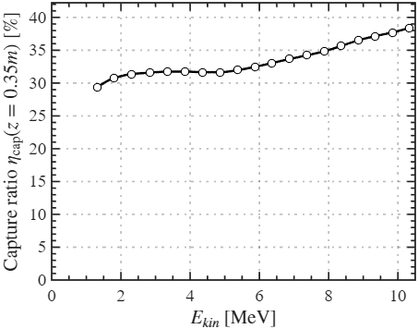
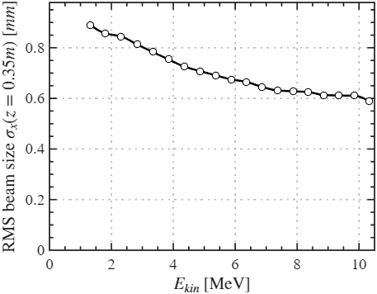
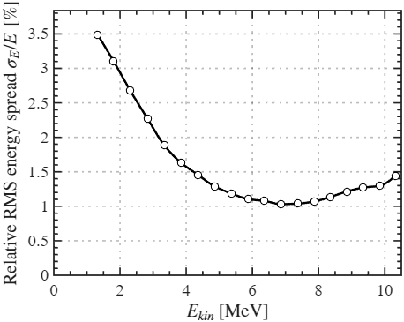
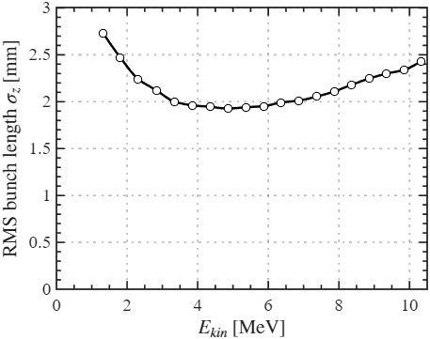
Beam Quality across the 1–10 MeV Tuning Range
(a)
(b)
Capture above 29% throughout
Overall capture increases
with output energy.
Smaller transverse rms size
0.89 mm at 1 MeV to 0.60 mm at 10 MeV. Consistent with weaker space-charge defocusing.
Lower energy spread near 6 MeV
Strong decrease from low energy,
followed by a slight rise at high energy.
(c)
(d)
Shallow U-shaped bunch length
Longitudinal phase focusing shifts the waist relative to the structure exit.
5 MeV: Chain B changes phase
Purple dashed lines mark the transition. No abrupt beam-quality degradation.
Beam quality varies smoothly across 1–10 MeV, with no abrupt deterioration at the 5 MeV mode transition.
Sec. III.C, Fig. 8 and Table IV; 0.5 MeV scan with synchronous-phase optimization
16

Slide 17

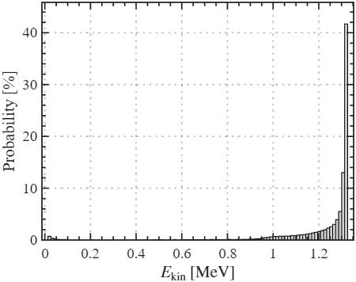
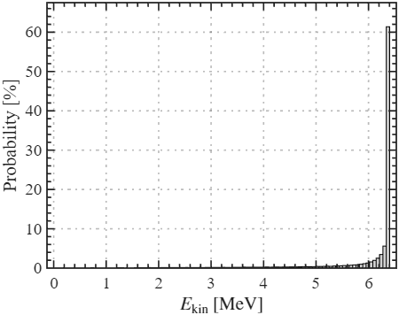
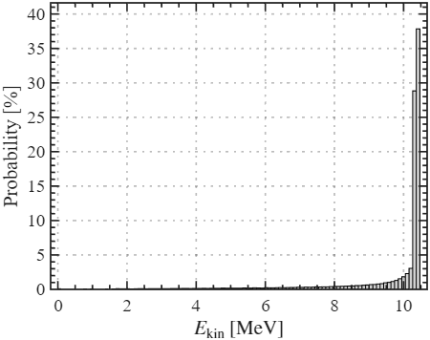
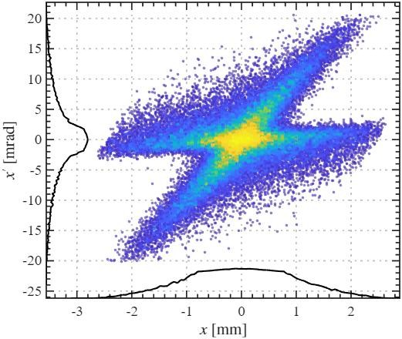
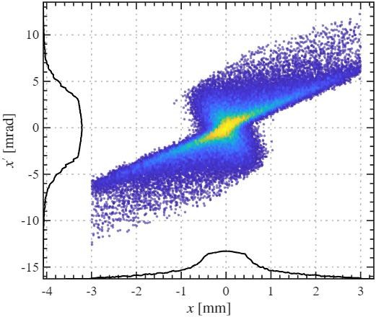
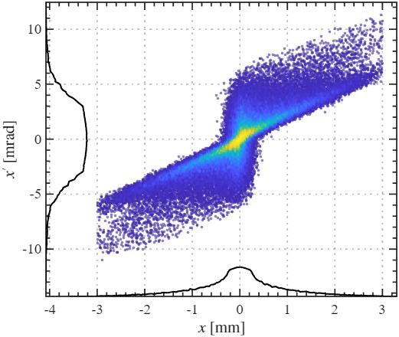
Representative Energy Spectra and Transverse Phase Space
1 MeV mode 6 MeV mode
10 MeV mode
Mean E: 1.06 MeV Rms x′: 2.01 mrad Nonlinear space charge and larger size increase nonlinear RF-field sampling.
Mean E: 6.05 MeV Rms x′: 1.29 mrad Less distortion, with the smallest divergence. Favorable energy spread and bunch length.
Mean E: 10.03 MeV Rms x′: 1.36 mrad Weaker space charge improves confinement. Waist proximity raises divergence above 6 MeV.
The 1 MeV mode shows stronger nonlinear distortion. The 6 and 10 MeV modes maintain improved transverse beam quality.
Sec. III.C, Fig. 9 and Table IV; 100 mA pulse current; nominal modes and mean energies distinguished
17

Slide 18
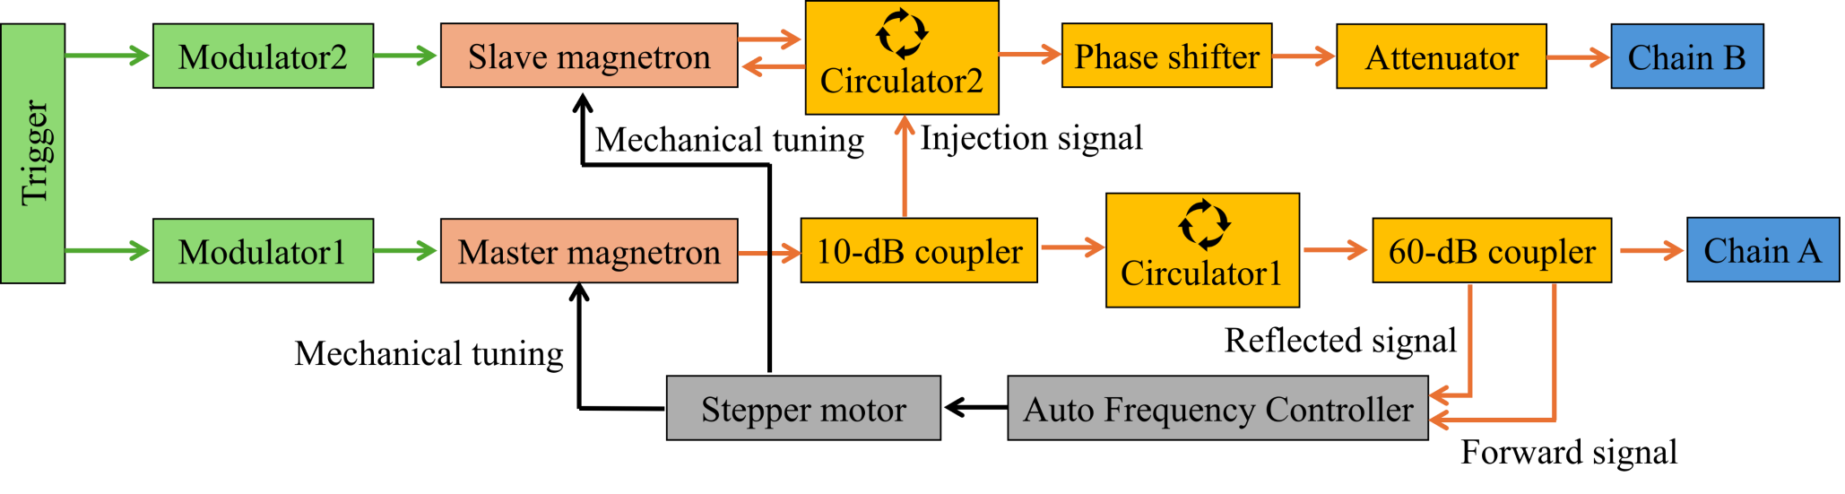
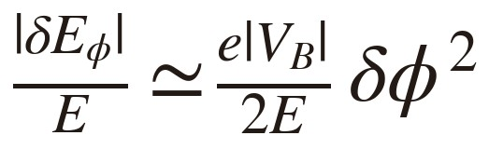
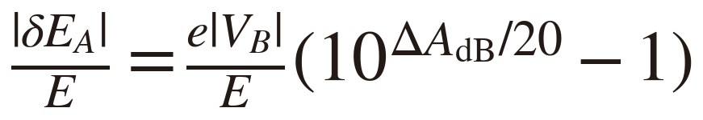
RF implementation and tuning accuracy
Two 2.5 MW magnetrons with master-slave injection locking
1° phase precision
<0.1% energy contribution
0.1 dB attenuation resolution
Up to 5.2% at 1 MeV before calibration
Near-cancellation makes low-energy accuracy most sensitive to Chain B amplitude control.
Manuscript Figs. 10–11, Eqs. (10–11); proposed system, supported by cited magnetron-locking experiments
18

Slide 19
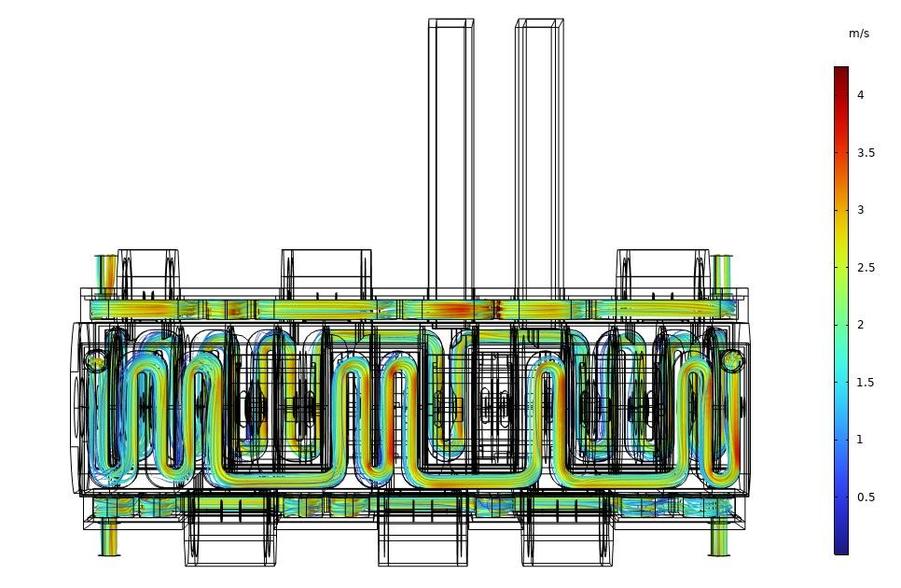
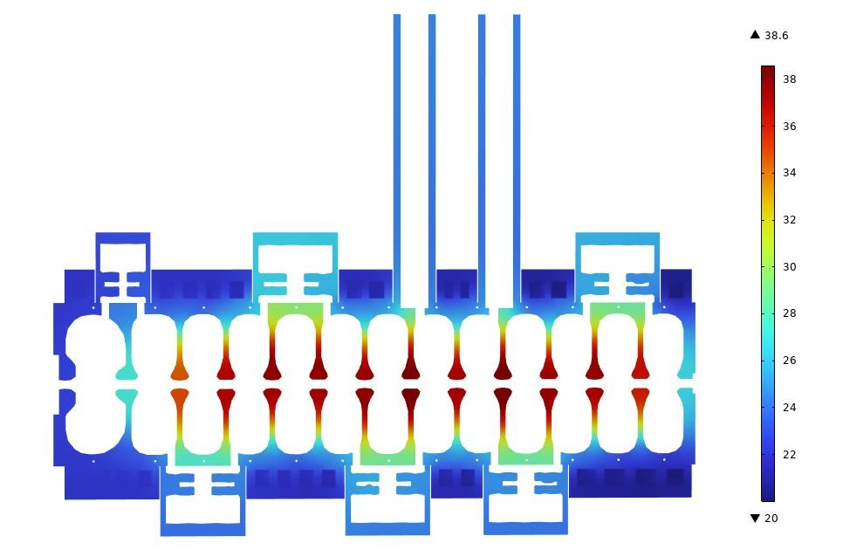
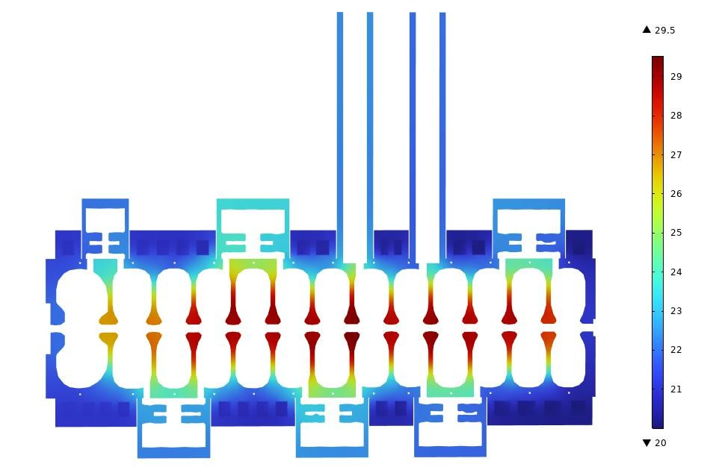
Cooling and differential thermal detuning
Inlet water: 20 °C ; Mean velocity: 2 m/s ; Flow rate: 38 L/min Symmetric operation Asymmetric operation Embedded serpentine channels Both chains at 2.1 MW Chain A on, Chain B off
 | Thermal result | Symmetric | Asymmetric
 | Peak temperature | 38.4 °C | 29.3 °C
 | Frequency shift A / B | −219 / −205 kHz | −84 / −76 kHz
 | Differential shift magnitude | 14 kHz | 8 kHz
Differential thermal detuning stays below 20 kHz in both simulated operating cases.
19

Slide 20
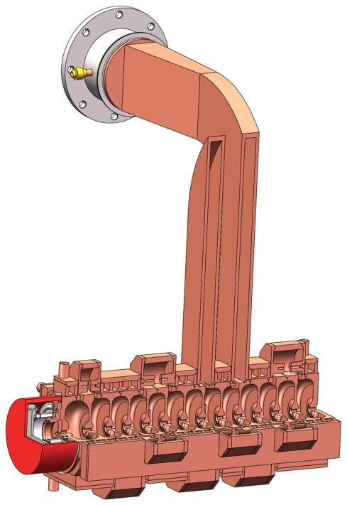
1–10 MeV
Conclusions and Outlook
29.1%
Capture Ratio at 3 MeV
Highest simulated capture of four methods
<20 kHz
Inter-Chain Frequency Difference
Thermal simulations, both operating cases
Continuous Energy Tuning
Independent chain amplitude and phase
01
Continuous Energy Tunability
Independent chain voltages tune the output energy while Chain A keeps the bunching conditions fixed.
Enhanced Low-Energy RF Focusing
Alternating acceleration and deceleration maintains
strong RF fields, improving confinement and simulated capture.
Engineering Feasibility
Phase-locked dual-magnetron RF and cooling designs support independent RF control and thermal stability.
02
03
Compact Interlaced Linac
Accelerating structure: 350 mm length × 150 mm diameter
→
→
Prototype Fabrication
RF Commissioning
Thank you for your attention.
Beam Measurements
Sec. V and Fig. 14; design and simulation results. Prototype validation is the next stage.
20

