Slide 1

The 8th OCPA Topical Accelerator School
and Workshop
Introduction to the Physical Model of Medical Cyclotron Penning Ion Sources
Zhaohui Liu
SPIC Nuclear Power Tongchuang(Beijing) Technology Co., Ltd
October.18, 2026 Guangyuan · China

Slide 2

目
Introduction
录
Physics Model of Penning Ion Source
CONTENTS
Lifetime of Penning Ion Source
Conclusions and Future Works

Slide 3
Introduction
PART 01

Slide 4
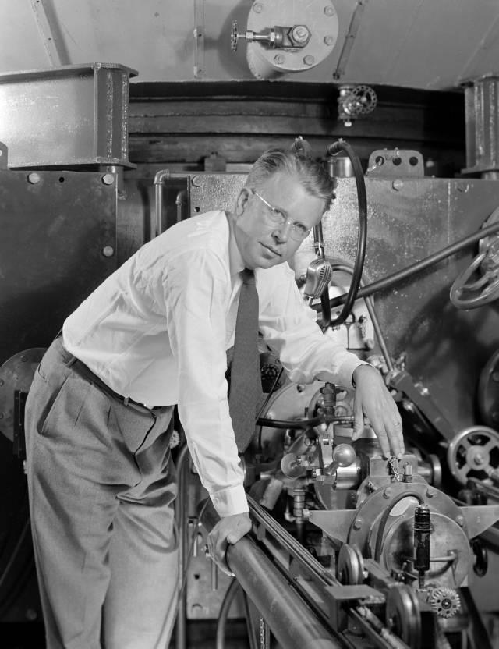
Introduction
E.O. Lawerence - Father of the Cyclotron
A positive or negative ion is released near the center of the cyclotron and moves gradually outward in a semicircular path due to the effect of a magnetic field.
A rapidly changing RF field can be used to increase the kinetic energy of the particle with each circulation
The cyclotron’s operation is based on the fact that the time per revolution is independent of the speed of the particles and of the radius of their path
When the energy of the ions in a cyclotron exceeds about 20 MeV, relativistic effects come into play

Slide 5
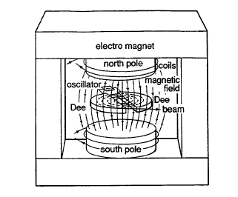
Introduction
Major Components
Magnet: The device that generates the magnetic field， with a north pole and a south pole.
Ion source: An ion source is a device to create a charged particle beam.
RF power: The Radio Frequency power supply that provides the high-frequency alternating current used to accelerate particles.
“Dee”structure: The two D-shaped hollow electrodes inside the accelerator
Working Principle
Magnetic Field: The magnetic field generated by the electromagnet is perpendicular to the direction of particle motion, causing the particles to move in a spiral path within the “Dee” structures.
Oscillator: Generates high-frequency alternating current, creating an electric field between the "Dee" structures to accelerate the particles.
Particle Beam: After multiple accelerations, the particles form a high-energy beam that is extracted from the accelerator.

Slide 6
Introduction
Why we have to create a charged particle beam?
Ordinary matter is neutral.
In an accelerator electric and magnetic fields are used to manipulate the beam (acceleration and transport).
What does it mean “to create a particle beam”?
The ion source • ionizes the particles • shapes a beam
The main beam properties are defined at the source
• charge state
• beam intensity
• beam energy
• beam shape and emittance
• time structure (continuous or pulsed)

Slide 7
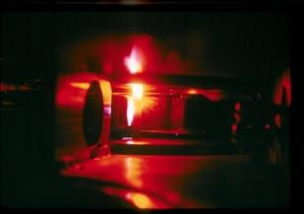
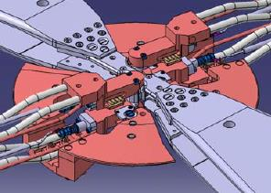
Introduction
Ion Sources in Cyclotrons
The purpose of the ion source is to create either positive or negative ions to be accelerated
The ions are usually generated in a plasma discharge
The ion source can be either external or internal
In most ion sources a gas of neutral atoms or molecules is“heated”into a plasma state were ions and electrons are dissociated and move independently as free particles.
The heating mechanism can be of various kinds. It can be thermal, electrical, or use laser light.
Once the ions are created in the source, they are then extracted from the plasma and accelerated

Slide 8
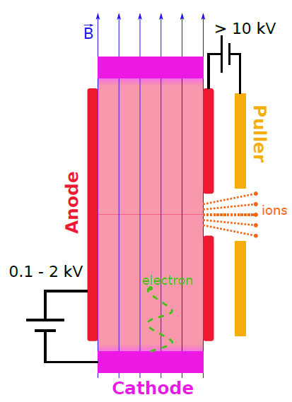
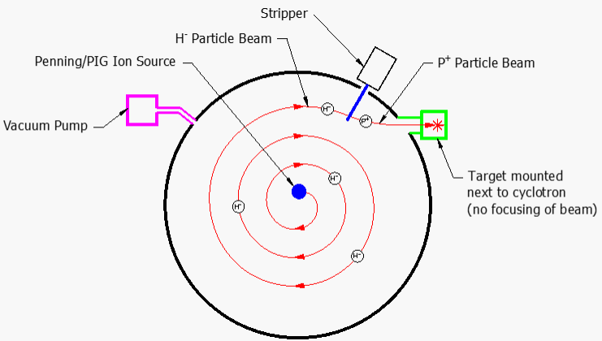
Introduction
Some ion source types
Metal vapor vacuum arc ion source (MEVVA)
Electron cyclotron resonance ion source (ECRIS)
Electron beam ion source (EBIS)
Laser ion source (LIS)
Duoplasmatron
Penning ion source
RF ion sources
Liquid metal ion sources

Slide 9
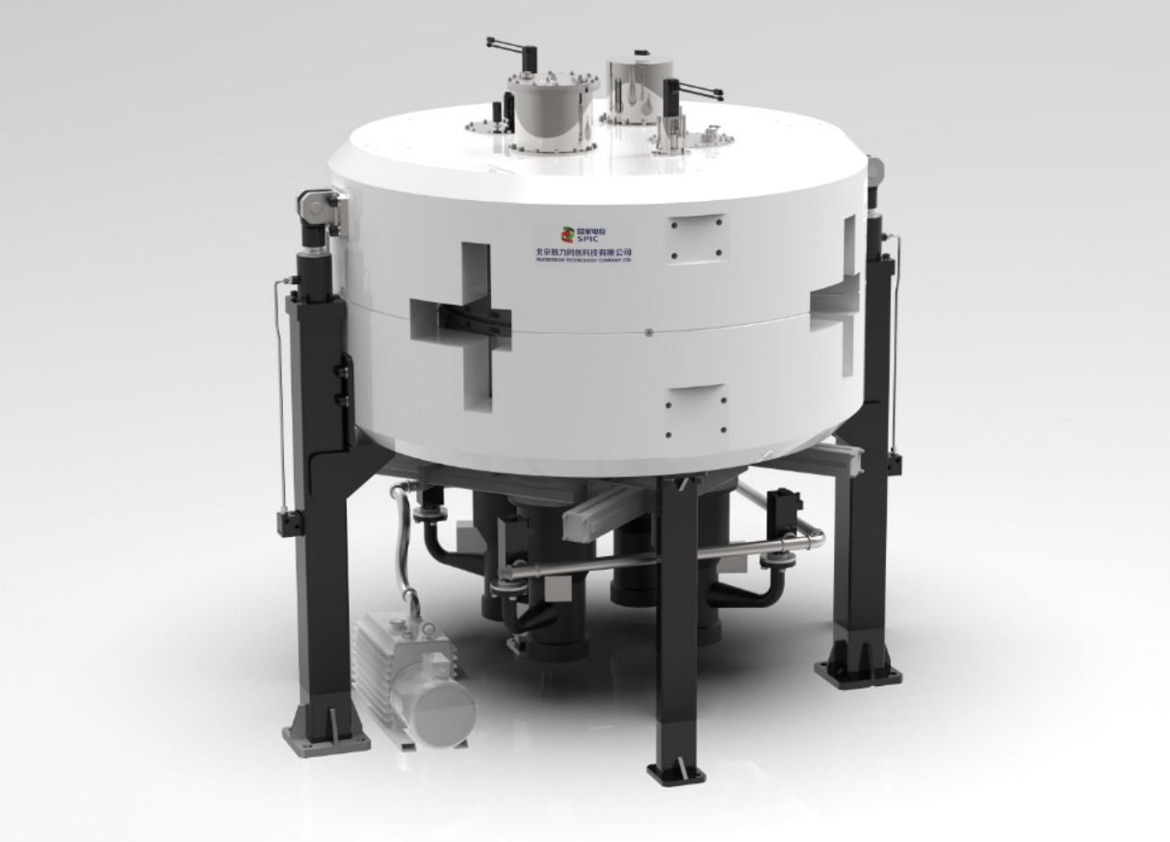
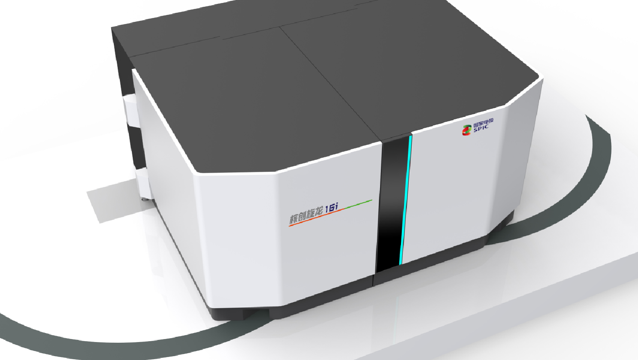
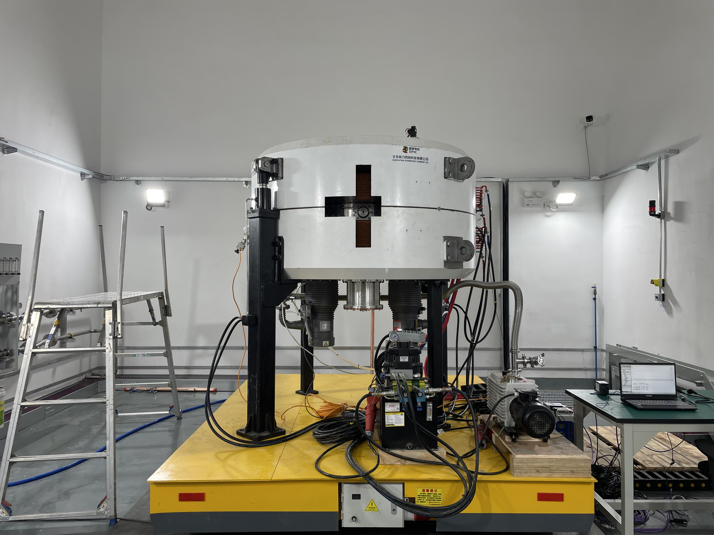
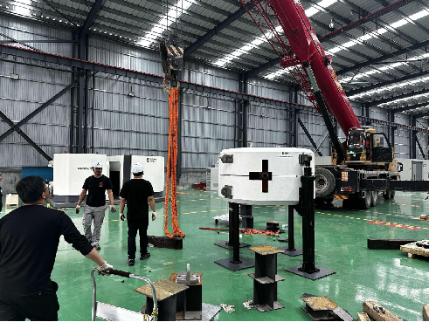
Introduction
16 MeV Medical Cyclotron
6Ci
222 GBq
60 μA
10Ci
370 GBq
100 μA
Applications:
Nuclear Medicine Departments | Nuclear Pharmacies | Research Institutes
Progress：
Successfully produced Zirconium-89 (Zr-89) isotope via target irradiation; after separation and purification, radiochemical purity >99.99%.
Achieved commercial sales of 2 units; supply contracts signed.
Notes:
应用领域：
核医学科 | 核药房 | 研究机构
进展：
✓ 成功通过靶材辐照生产锆-89（Zr-89）同位素；经分离纯化后，放射化学纯度 >99.99%。
✓ 已实现2台设备的商业销售；并签署供货合同。

Slide 10
Introduction
Why do we have to speak about ion sources?
The ion source is an essential part of an accelerator.
It is important to understand the limitations of the source (beam properties, reliability, life time).
Accelerator experts tend to forget these limitations and try to shift their problems towards the source.
A basic knowledge of the source can help during the operation and is essential for designing an accelerator (to find compromises between wishes and reality).
It is always good to know where the source is located and who the specialists are.

Slide 11
Physics Model of Penning Ion Source
PART 02

Slide 12
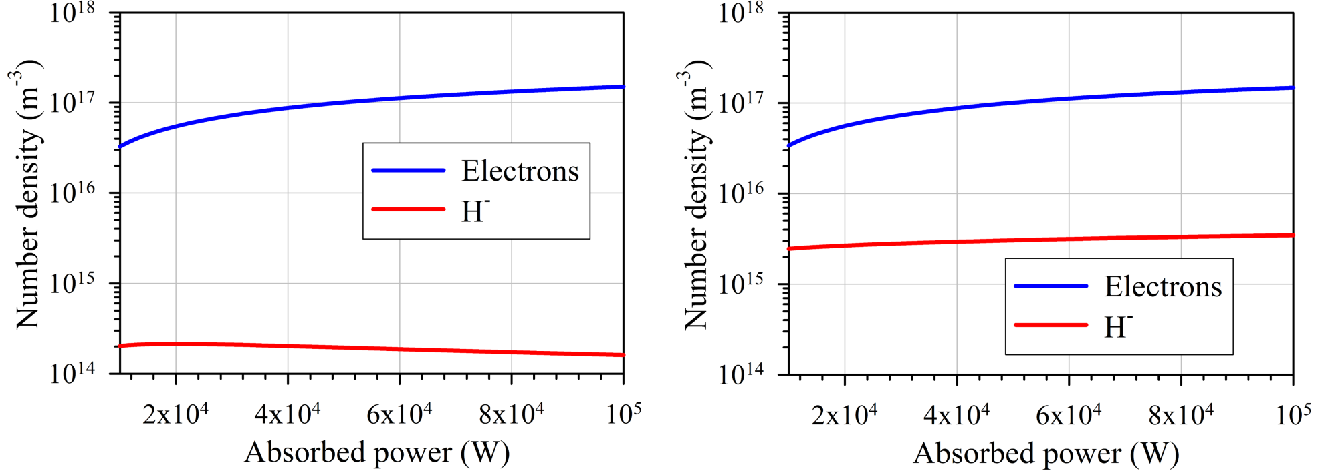
Global model (0D)
Set of coupled particle and power balance equations, neglects spatial
derivatives but simple implementation and efficient !
Difficulty: accurate cross sections / rates coefficients needed
Without Cs
With Cs
Accurate qualitative results (0D) to determine trends
[1] LXCat database: E. Carbone et al., Atoms 9, 16 (2021) [2] NIST database: V. K. Shen et al., NIST Standard Ref. Database 173
[3 ]S. H. Scarlett et al., Plasma Sources Sci. Technol. 28, 025004 (2019) [4] Averkin S. N. et al., AIP Conf. Proc. 2011 050026 (2018)
[5] Review Global Modelling: A. Hurlbatt et al., Plasma Process Polym. 14 1600138

Slide 13
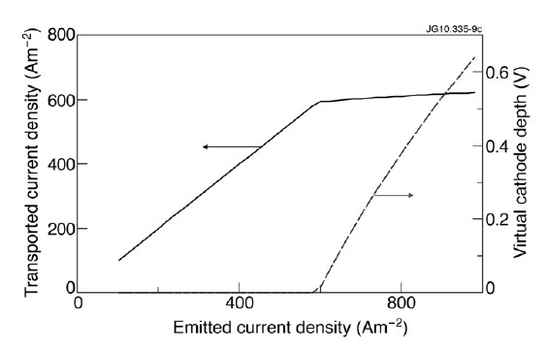
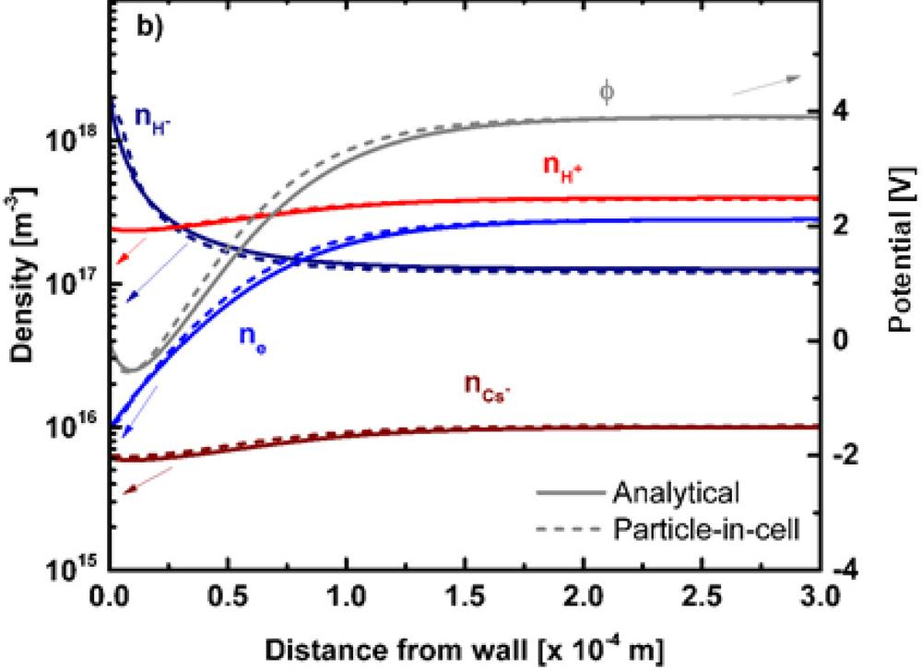
1D fluid and kinetic models
Fluid: moments of Boltzmann equation
Kinetic: truncated Maxwellian solutions of the Vlasov eq.
Plasma-wall interaction
For
Fluid
Kinetic
(Wall-)
(Wall-)
Transported negative ions: space-charge limitation (Child-Langmuir)
Very quick and accurate results, useful for parameters scans
[1] R. McAdams et al., Plasma Sources Sci. Technol. 20, 035023 (2011)
[2] L. Schiesko et al., J. Appl. Phys. 127 033302 (2020)

Slide 14
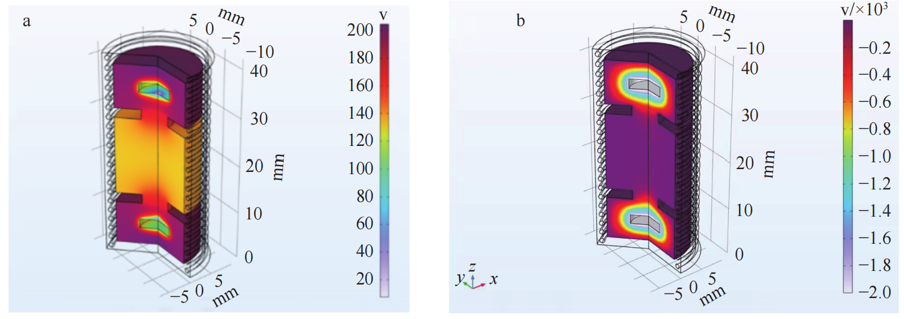
2D fluid for plasma transport
Fluid: moments of Boltzmann equations
Magnetic fields: drifts, at least 2D needed !
Electron temperature
Electron Potential
Very general models including neutrals and surface processes.
Reproduces non-trivial charged particles transport: ExB, diamagnetic drifts
[1] Development of a 10 MeV Ultra-Compact Cyclotron for Short-Lived Isotope Production, Journal of Isotopes, 39(3) 2026

Slide 15
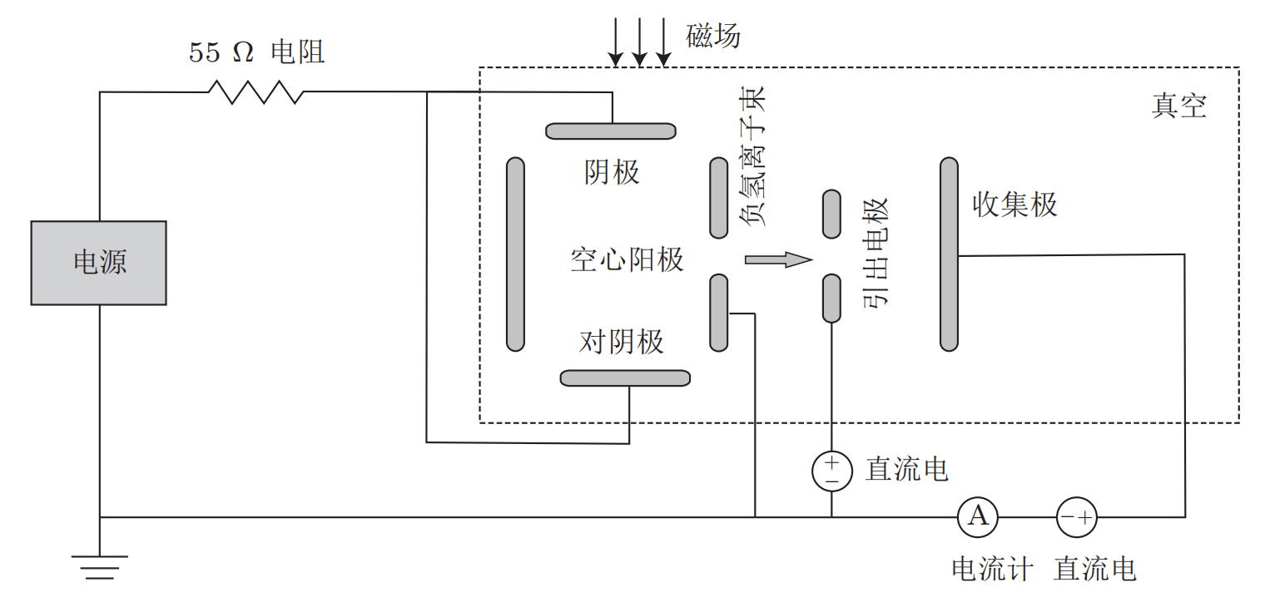
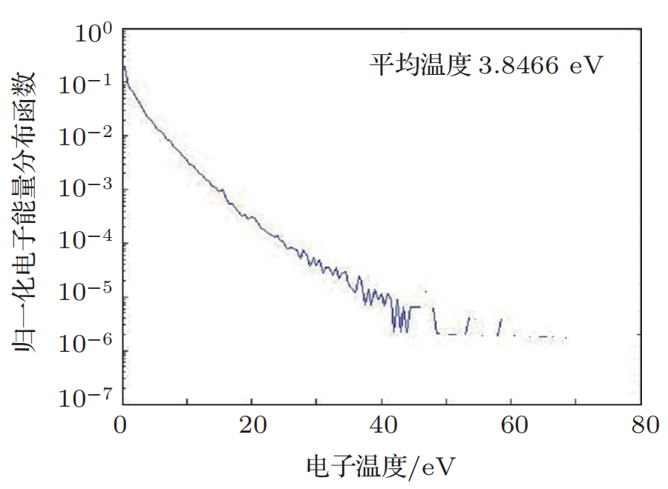
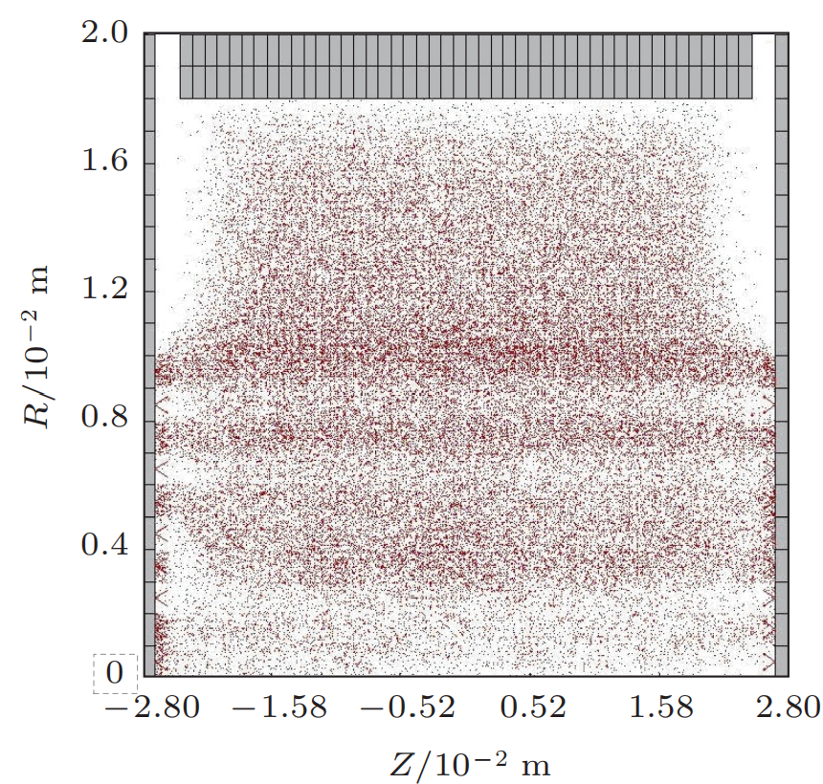
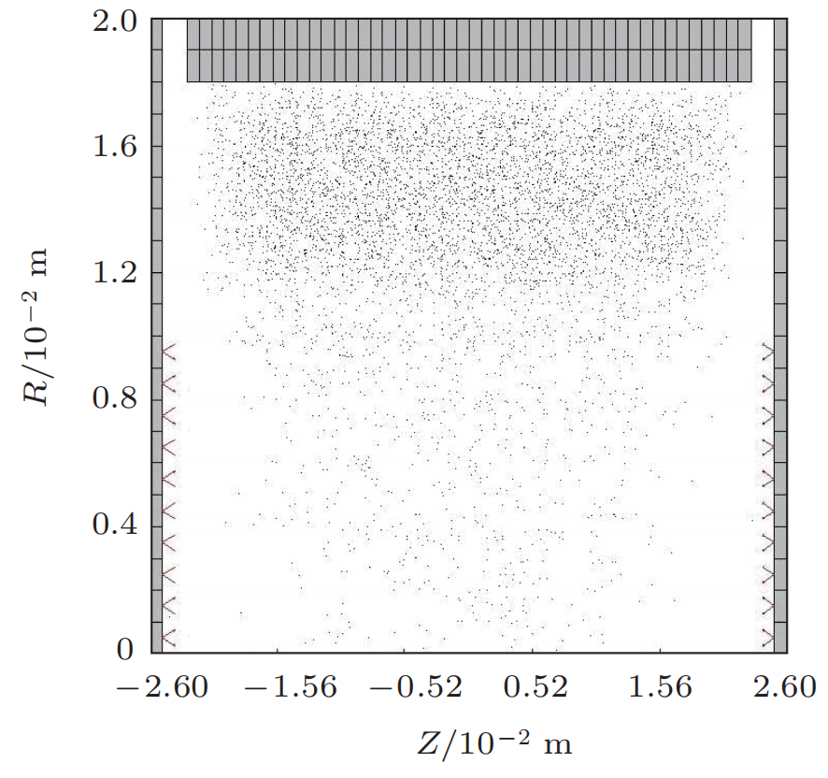
3D Particle-In-Cell(PIC): bulk plasma
PIC: self-consistent particle method
3D: realistic transport w/r magnetic field
Requires massive parallelisation (OpenMP,
OpenMPI, OpenAcc etc…)
Electron phase space
Electron energy
distribution
H₂⁺ ion phase space
[1] The full three-dimensional electromagnetic PIC/MCC numerical algorithm research of Penning ion source discharge, Acta Phys. Sin. Vol. 62, No. 20 (2013) 205207

Slide 16
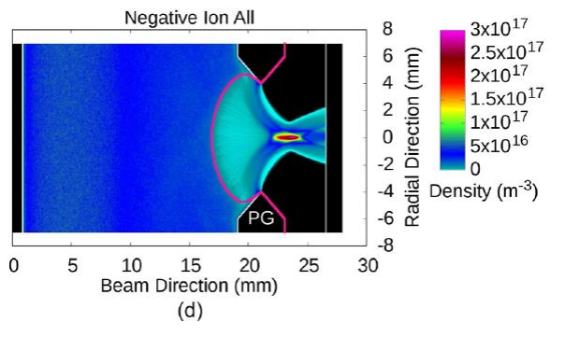
3D Particle-In-Cell(PIC): H⁻ extraction
Understanding the negative ion extraction is a key parameter
2D cannot fully unveil transport and extraction of H⁻ a plasma
Discrimination between direct and indirect extraction of surface generated H⁻
Beam formation and properties such as divergence, perveance …
[1] A. Revel et al., Journ. App. Phys. 122 103302 (2017)

Slide 17
Summary theory and modelling
Different possibilities for modelling
• qualitative, qantitative, predictive…
Global model / 0D
• volume averaged results, fast implementation,
• limitations on known rate coefficients is the major drawback
1D kinetic / fluid / PIC
• usually for plasma-wall interaction, quick and very accurate results
2D fluid or PIC
• transport of plasma species, presence of drifts
3D PIC
• simulations as close as possible to reality needed,
• negative ion generation, transport and extraction,
• time consuming, small volume simulated, cluster needed

Slide 18
Lifetime of Penning Ion Source
PART 03

Slide 19
Lifetime of Penning Ion Source
Company | GE | IBA | SAMYOUNG-UNITECH | Siemens
Extracted Current | H⁺ 160 μA @ 16.5 MeV | H⁺ 80 μA @ 18 MeV | H⁺ 120 μA @ 13 MeV | H⁺ 150 μA @ 11 MeV
Particle | H⁻ | H⁻ | H⁻ | H⁻
Source Bias | Grounded, RF Extraction from Dees | Grounded, RF Extraction from Dees | Grounded, RF Dee Extraction | -15 kV, Puller Grounded, then RF Acceleration
H- Current | Not Measured | N/A | Not Known | 1.5 mA DC (on Post Beam Stop)
Arc Power | ~100 W | 325W | Not Known | 244 W
Arc Current/Voltage | 300 mA/300V | 1.25A/260V | 2.8 A/2.5 kV* Ignition | 325 mA/750V
Gas Flow | 5 sccm | 2.5 -> 3.7 sccm | 6.5 sccm | 5 -> 9 sccm
Cathode Lifetime | >219 hrs | ~600 hrs | >83 hours | >246 hrs
弧后阴极形貌

Slide 20
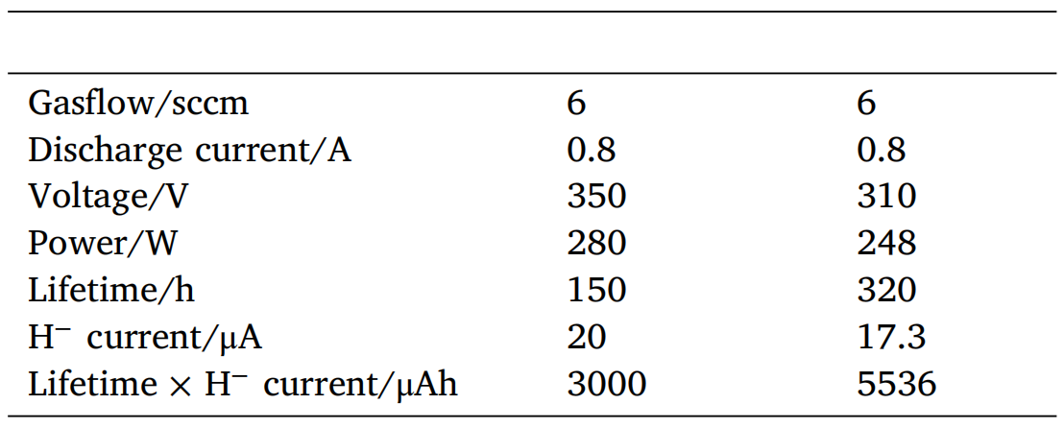
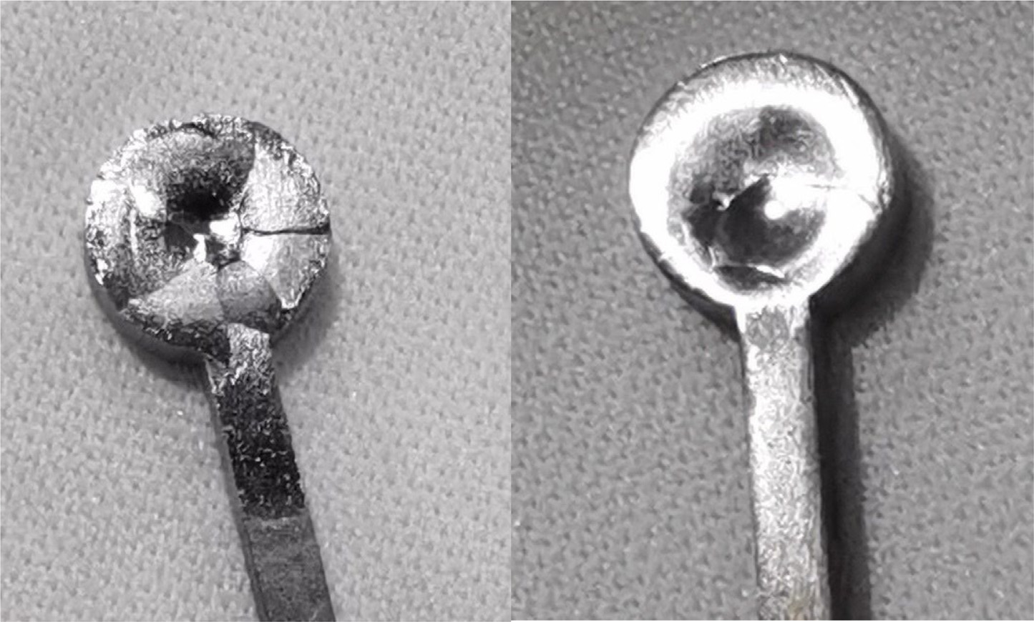
Lifetime of Penning Ion Source
Cathode sputtering causes wall deposits, leading to instability and short circuits, which drastically shorten the ion source's life.
Reducing cathode size lowers cooling capacity and ion impact power, theoretically extending the source's lifetime.
The small cathode achieved higher beam current stability and double the operational charge before failure.
弧后阴极形貌
Cathode diameter/mm
6
4.8
Ta cathode
[1] Y H Chen et al, Nuclear Inst. and Methods in Physics Research, A 1033 (2022) 166679

Slide 21
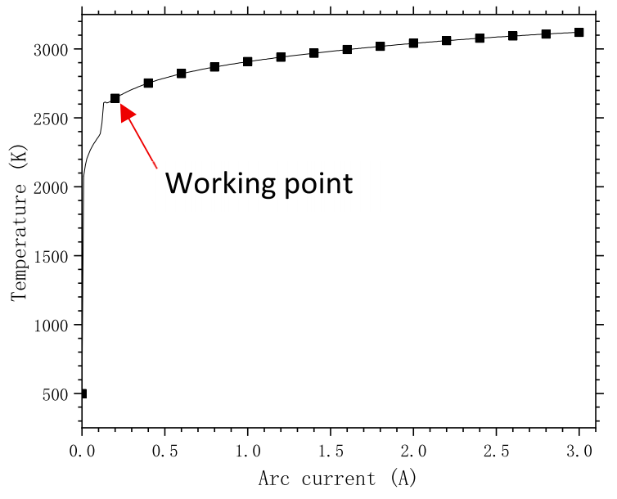
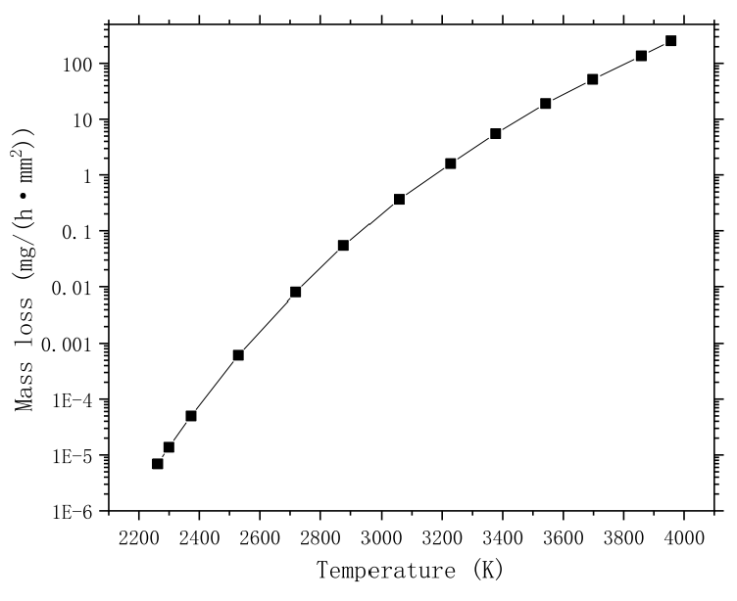
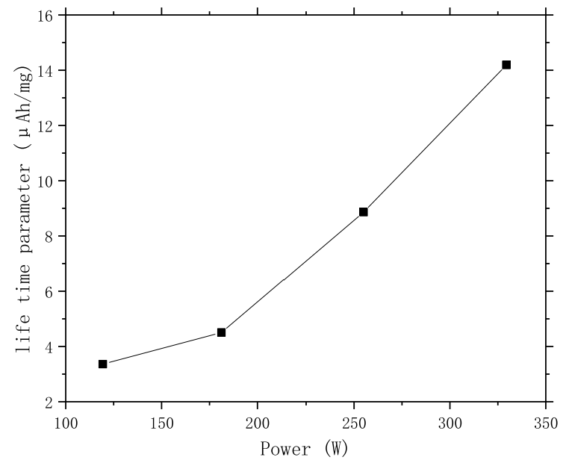
Lifetime of Penning Ion Source
The sputtering loss of cathode can be reduced by increasing the purity of gas
The sputtering loss of the cathode can be effectively reduced by enhancing the arc current in hydrogen (evaporation becomes the dominant mechanism)
The mass loss caused by sputtering and evaporation process can be reduced by reducing the size of cathode
弧后阴极形貌
Evaporation
dominant
[1] Y H Chen et al, Vacuum 247 (2026) 115116

Slide 22
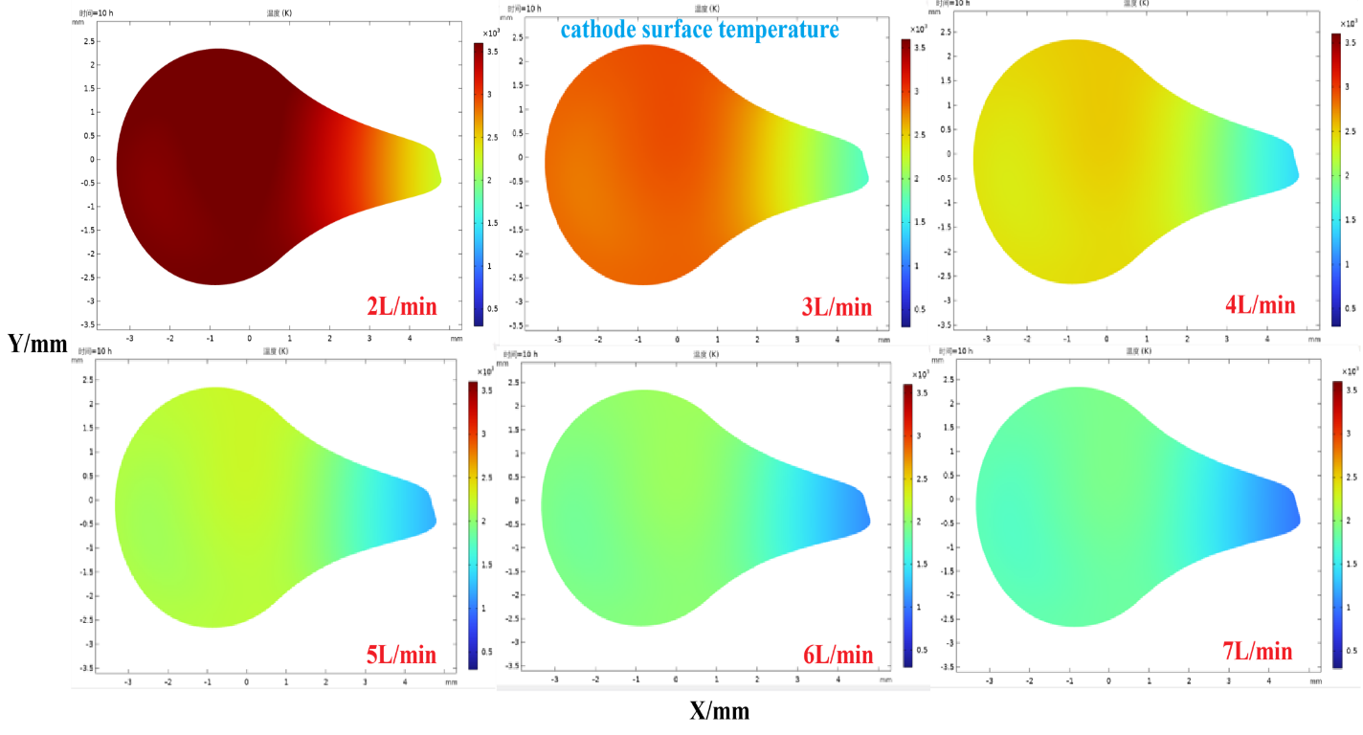
Lifetime of Penning Ion Source
Increasing water flow reduces cathode temperature and extends ion source lifetime.
Q (L/min) | u (m/s) | h (W/(m²·K))
2 | 1.698 | 8716
3 | 2.546 | 11885
4 | 3.395 | 14919
5 | 4.244 | 17869
6 | 5.093 | 20747
7 | 5.941 | 23549
弧后阴极形貌
Volume flow rate conversion、 Flow cross-sectional area、Average flow velocity、Reynolds number、Dittus–Boelter formula => Heat transfer coefficient

Slide 23
Conclusions and Future Works
PART 04

Slide 24
Conclusions and Future Works
The design and optimization of the internal ion source are pivotal for enhancing accelerator performance, making the understanding of its internal physical mechanisms essential.
Modelling and theory requires development: 0D, 1D, 2D and 3D models /particle-in-cell give hints on the underlying physics and can be predictive.
Extending the ion source lifetime is critical for the long-term stable operation of the accelerator.
Furthermore, plasma discharge modeling in Internal ion source of medical small cyclotron, also external ion source and metal vapor ion source are still the hot topic in the future study.

Slide 25
Thank you

