Slide 1


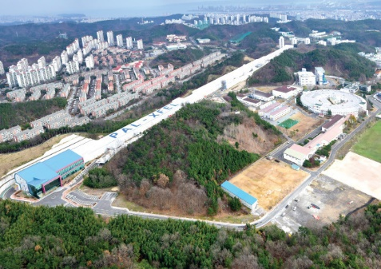

SSMB Workshop
Demonstration of a ring-FEL as an
EUV lithography tool
Jaeyu Lee, Seunghwan Shin
Pohang Accelerator Laboratory
Dec. 8, 2020

Slide 2
SSMB Workshop
Contents
Motivation
Target parameters for storage ring based FEL
Ring based FEL - Bypass design
Ring based FEL - Racetrack design
Overview
1

Slide 3
SSMB Workshop
Motivation
Pohang Accelerator Laboratory in Korea is running PLS-II (3 GeV, 282 m storage ring) and
PAL-XFEL (10 GeV, 60 Hz XFEL).
Also the project for a construction of low emittance ring about to starts in Korea.
How about storage ring based FEL ?
Motivation : With the advent of the low emittance ring (emittance ~ 100 pm),
normalized emittance become < 1 um.
Advantages : High repetition rate, Stable energy
Disadvantages : Low peak current, Large energy spread
PLS-II
PAL-XFEL
2

Slide 4
SSMB Workshop
Target parameters for ring-FEL
We started ring-FEL study for the X-ray regime, but it is more suitable for EUV and Water window regimes with a medium energy storage ring.
For a EUV lithography, target parameter is a 1 kW average radiation power at 13.5 nm.
3

Slide 5
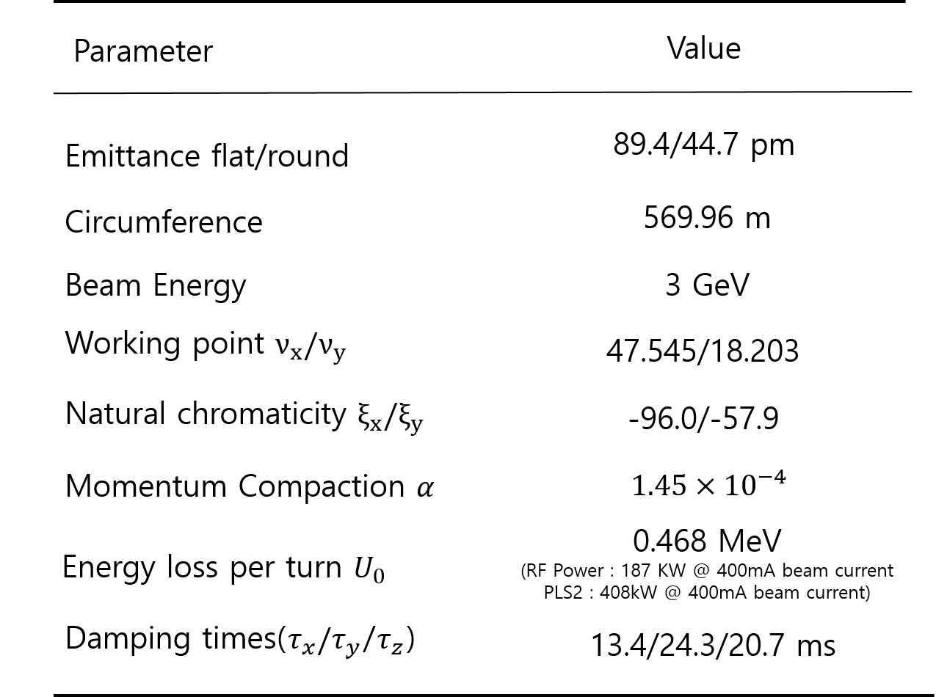
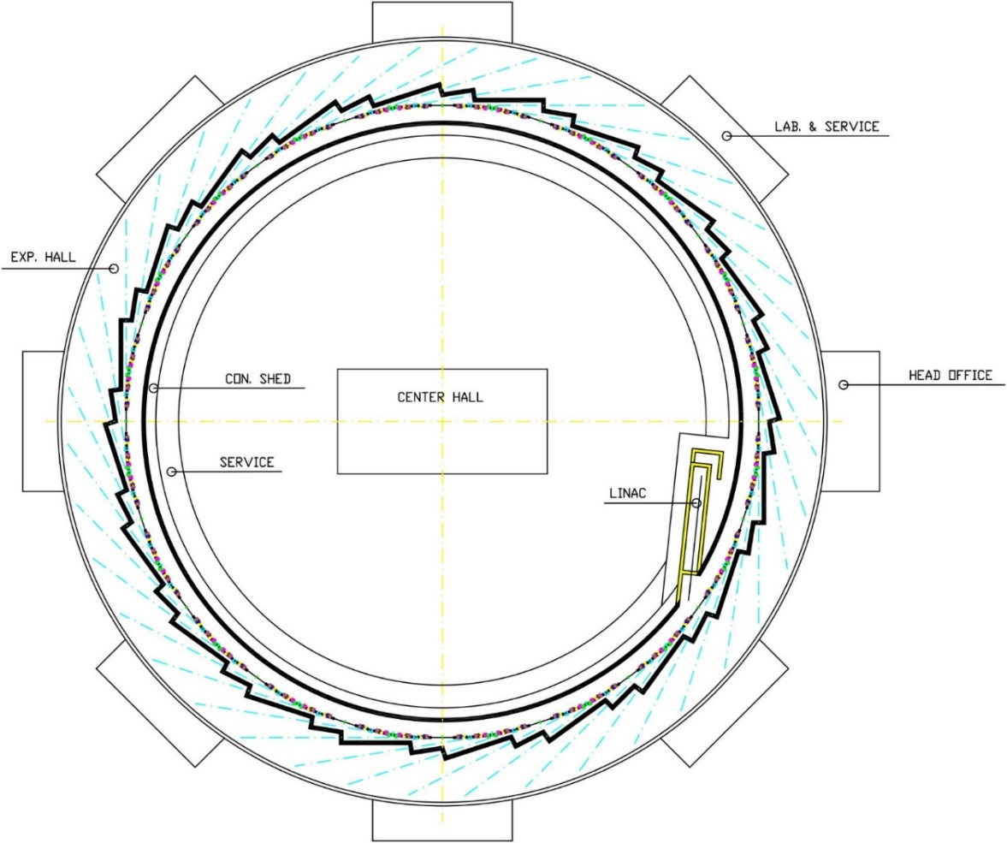
SSMB Workshop
Ring-FEL : bypass design
We started from a low emittance ring designed at 2018.
245 m
220 m
150 m
170 m
4

Slide 6
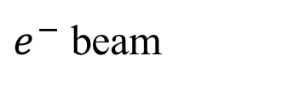

SSMB Workshop
Ring-FEL : bypass design
Ring-FEL configuration
Electron Beam Energy = 3 GeV
Circumference = 570 m
Transverse Emittance = 51 pm (round beam, after extraction)
Photon Beam Energy = 0.1 ~ 0.6 keV
(Water window & EUV)
Wait for damping after FEL lasing => repetition rate is order of 10 kHz
Bunch compression is a key point to achive 1 kW power.
100 m
50 m
N
S
N
S
N
S
N
S
Injection
Kicker
Bunch
compression
Extraction
Kicker
Beamline
S
N
S
N
S
N
S
N
5

Slide 7
SSMB Workshop
Ring-FEL : bypass design
Beam parameters
Beam | E (GeV) |  |  |  |  | 3.000 | 3.000
 | Rms bunch Length (ps) |  |  |  |  | 2.000 | 2.000
 | Charge /bunch Q (nC) |  |  |  |  | 5.0000 | 5.0000
 | Peak current I_{p} (kA) |  |  |  |  | 1.00 | 1.00
 | Normarized emittance (mm mrad) |  |  |  |  | 0.3000 | 0.3000
 | Emittance (nm rad) |  |  |  |  | 0.0511 | 0.0511
 | Diffraction-limited emit. (nm rad) |  |  |  |  | 1.0742 | 0.1591
 | β in undulator |  |  |  |  | 8.0 | 8.0
 | Beam size σ_{x} (μm) |  |  |  |  | 20.22 | 20.22
 | Relative rms energy spread |  |  |  |  | 0.001022 | 0.001022
 | Rms energy spread in terms of rest energy |  |  |  |  | 6.0 | 6.0
Undulator | Period (cm) |  |  |  |  | 4.4000 | 4.4000
 | Magnet full gap (mm) |  |  |  |  | 6.8100 | 18.6000
 | B_{u} (T) |  |  |  |  | 1.5447 | 0.5025
 | K_{u} |  |  |  |  | 6.3481 | 2.0652
 | Type |  |  |  |  | Planar | Planar
 | SASE-FEL Wavelength(nm) |  |  |  |  | 13.49926 | 1.99953
 | Photon Energy (keV) |  |  |  |  | 0.09 | 0.62
6

Slide 8
SSMB Workshop
Ring-FEL : bypass design
Operating using hybrid fill mode
Hybrid fill mode
Current
Use hybrid fill mode
Extract the beam using a 200-ns short pulse kicker.
The beam after FEL undulator is injected to SR and damped until next extraction.
Time
1 turn (~ 2 μs)
Short pulse kick + septum
7

Slide 9
SSMB Workshop
Ring-FEL : bypass design
Operating using FEL dedicated mode
150 camshaft mode
Current
Use high current 150 bunch mode
Extract the beam using a 2-μs short pulse kicker.
The beam after FEL undulator is injected to SR and damped until next extraction.
. . . . .
Time
~ 30 ns
1 turn
Short pulse kick + septum
8

Slide 10
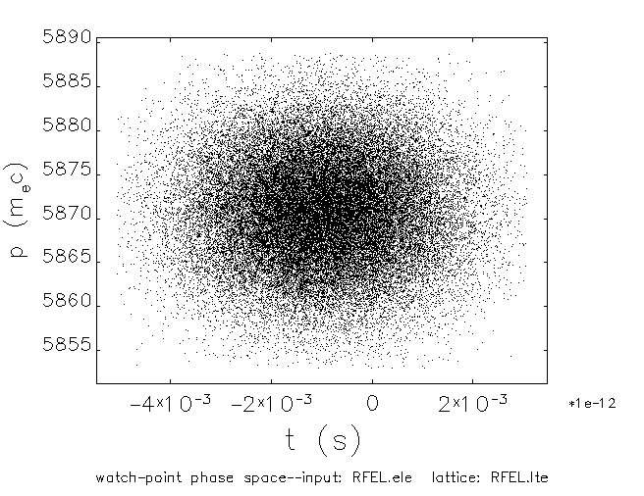
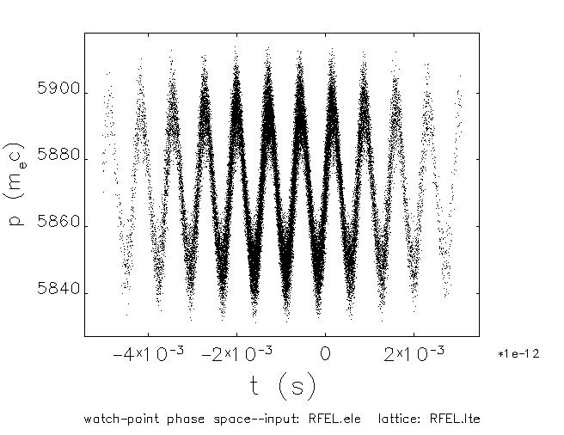
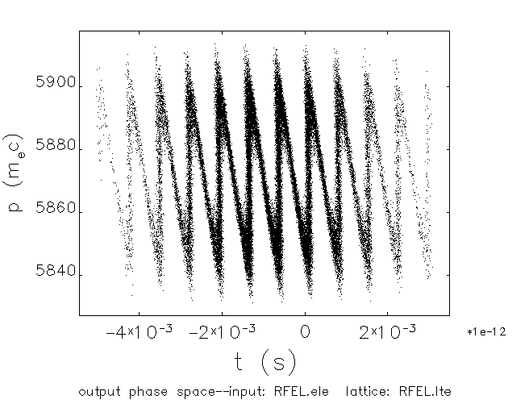

SSMB Workshop
Ring-FEL : bypass design
Bunch compression
Modulator
Dispersive section
Radiator
N
S
N
S
N
S
N
S
N
S
N
S
N
S
N
S
N
S
N
S
N
S
N
S
$e^{−} beam$
$$laser$$
S
N
S
N
S
N
S
N
S
N
S
N
S
N
S
N
S
N
S
N
S
N
S
N
Extracted bunch current is ~ 100 A. Compression factor should be > 10.
Nominal energy chirping & chicane scheme is hard to apply.
We apply High-Gain Harmonic-Generation (HGHG) scheme.
CSR & LSC ON
CSR & LSC OFF
9

Slide 11
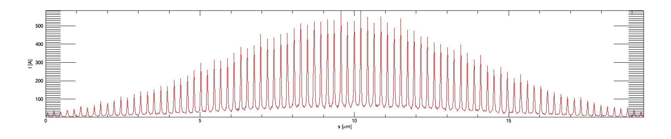
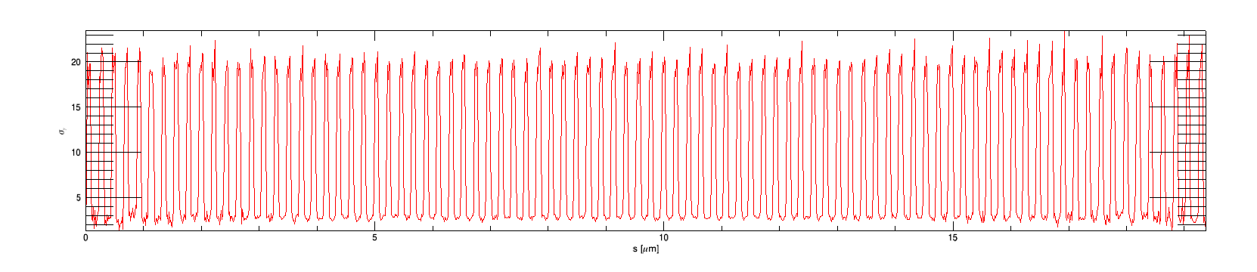
SSMB Workshop
Ring-FEL : bypass design
Limitation – large energy spread and low current
10

Slide 12
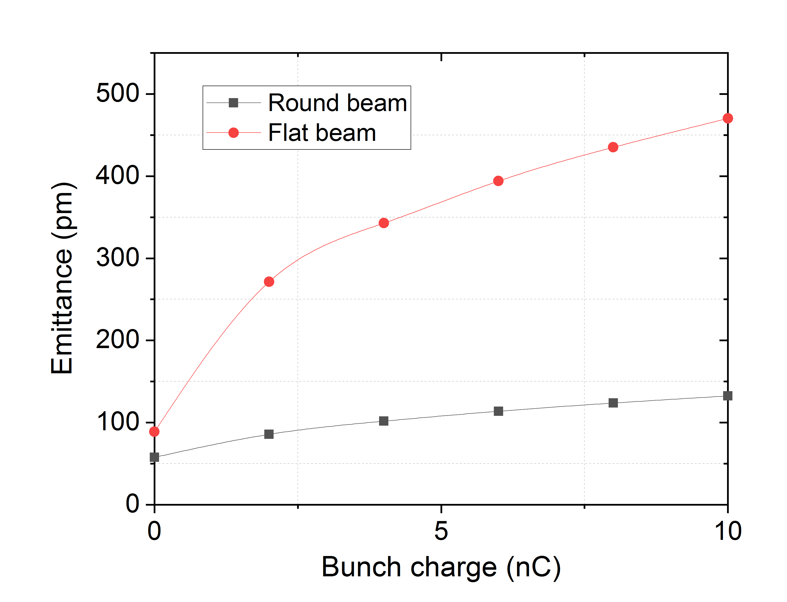
SSMB Workshop
Ring-FEL : racetrack design
No bypass
Electron Beam Energy = 3 GeV
Circumference = 870 m (including two 150 m SS)
Transverse Emittance = 200 pm (round beam)
Photon Beam Energy = 0.1 ~ 0.6 keV
(Water window & EUV)
Operates at equilibrium state => repetition rate is order of 10 MHz
100 m
N
S
N
S
N
S
N
S
Beamline
S
N
S
N
S
N
S
N
11

Slide 13
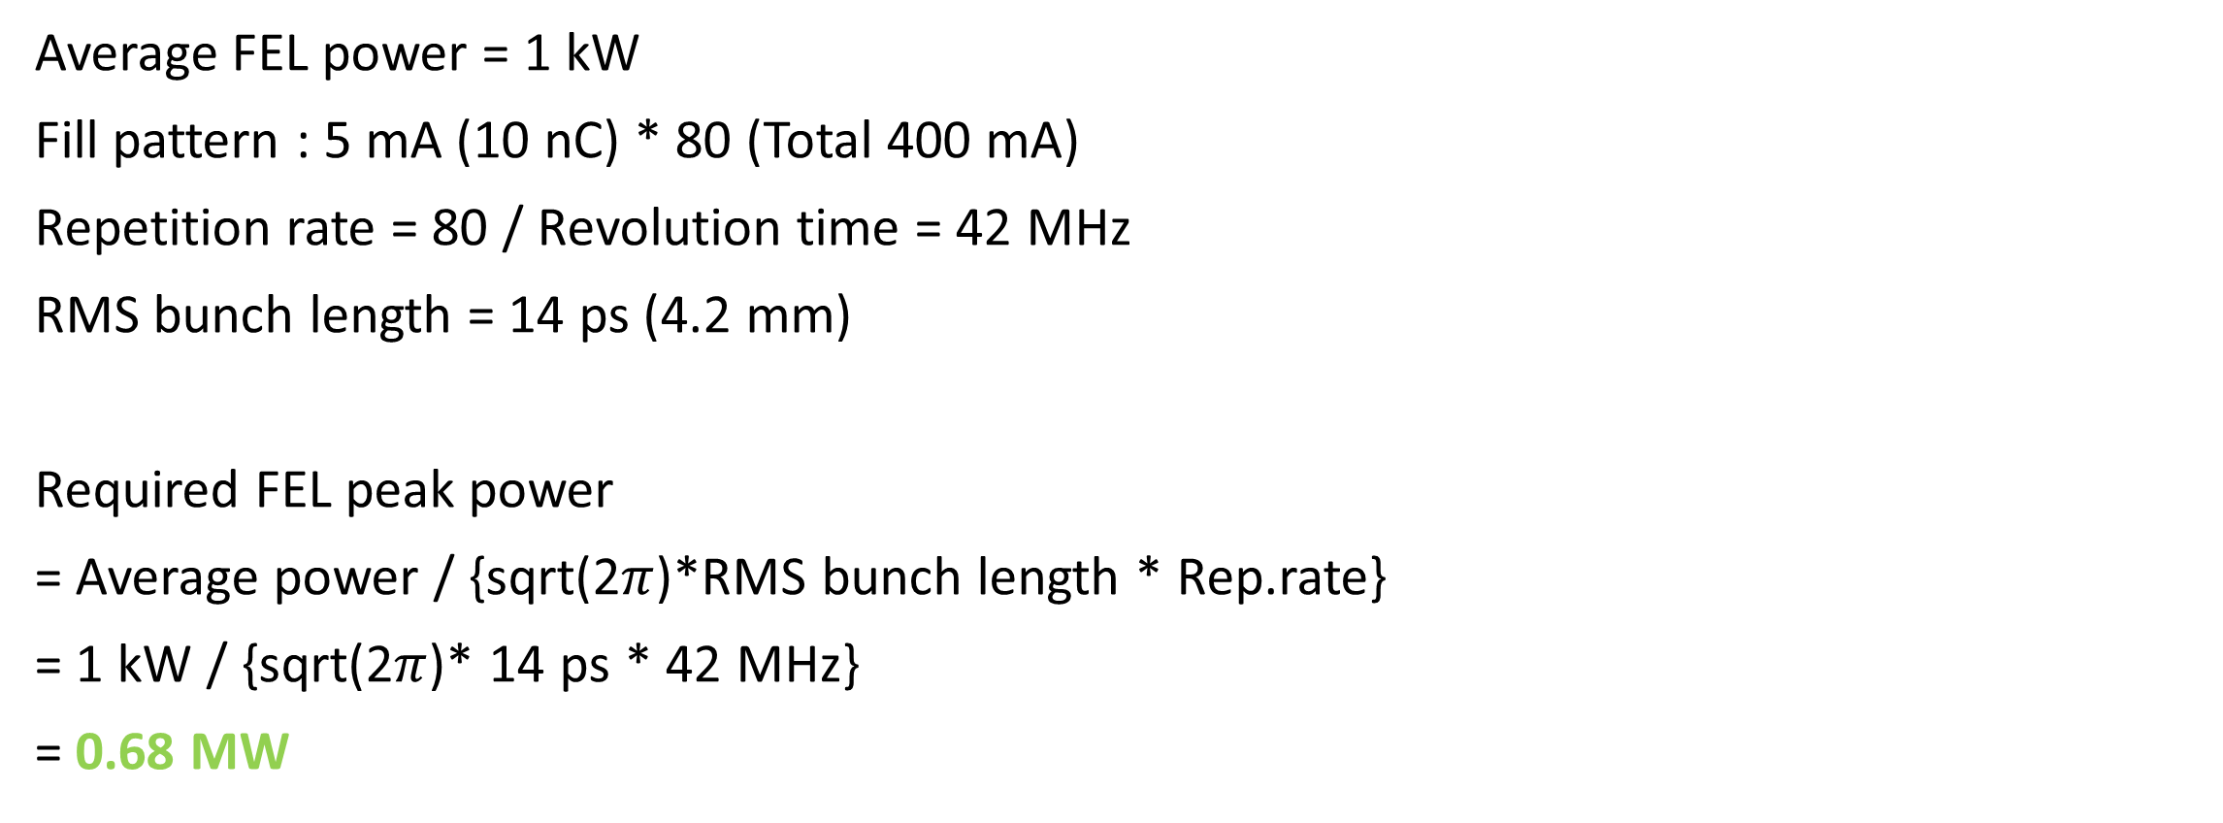
SSMB Workshop
Beam | E (GeV) |  |  |  |  | 3.000
 | Relativistic g |  |  |  |  | 5870.84
 | Magnet rigidity (T-m) |  |  |  |  | 10.00710
 | Rms bunch Length (ps) |  |  |  |  | 14.000
 | (Uniform bunch length ps) |  |  |  |  | 35.093
 | FWHM bunch length (ps) |  |  |  |  | 32.900
 | Rms bunch Length (μm) |  |  |  |  | 4197.200
 | Charge /bunch Q (nC) |  |  |  |  | 10.0000
 | Peak current I_{p} (kA) |  |  |  |  | 0.28
 | Normarized emittance (mm mrad) |  |  |  |  | 1.2000
 | Emittance (nm rad) |  |  |  |  | 0.2
 | Diffraction-limited emittance (nm rad) |  |  |  |  | 1.0742
 | β in undulator |  |  |  |  | 8.0
 | Beam size σ_{x} (μm) |  |  |  |  | 20.22
 | Relative rms energy spread |  |  |  |  | 0.001022
 | Rms energy spread in terms of rest energy |  |  |  |  | 6.0
 | Peak beam power (TW) |  |  |  |  | 0.85
Undulator | Period (cm) |  |  |  |  | 4.4000
 | Magnet full gap (mm) |  |  |  |  | 6.8100
 | B_{u} (T) |  |  |  |  | 1.5447
 | K_{u} |  |  |  |  | 6.3481
 | Type |  |  |  |  | Planar, in-vacuum
 | SASE-FEL Wavelength(nm) |  |  |  |  | 13.49926
 | Photon Energy (keV) |  |  |  |  | 0.09
Ring-FEL : racetrack design
Beam parameters
Average FEL power = 1 kW
Fill pattern : 5 mA (10 nC) * 80 (Total 400 mA)
Repetition rate = 80 / Revolution time = 42 MHz
RMS bunch length = 14 ps (4.2 mm)
Required FEL peak power
= Average power / {sqrt(2$π$)*RMS bunch length * Rep.rate}
= 1 kW / {sqrt(2$π$)* 14 ps * 42 MHz}
= 0.68 MW
 | P_{sat} (GW) |  |  |  |  | 0.23053
 | L_{sat} (m) |  |  |  |  | 56.08800
FEL | Peak Brilliance
 | Photons/sec/mm2/mrad2/0.1% bw |  |  |  |  | 9.185E+30
 | (Peak Brilliance for full transverse coherence)
 | Repetition rate |  |  |  |  | 4.00E+07
Average radiation power > 1 kW
12

Slide 14
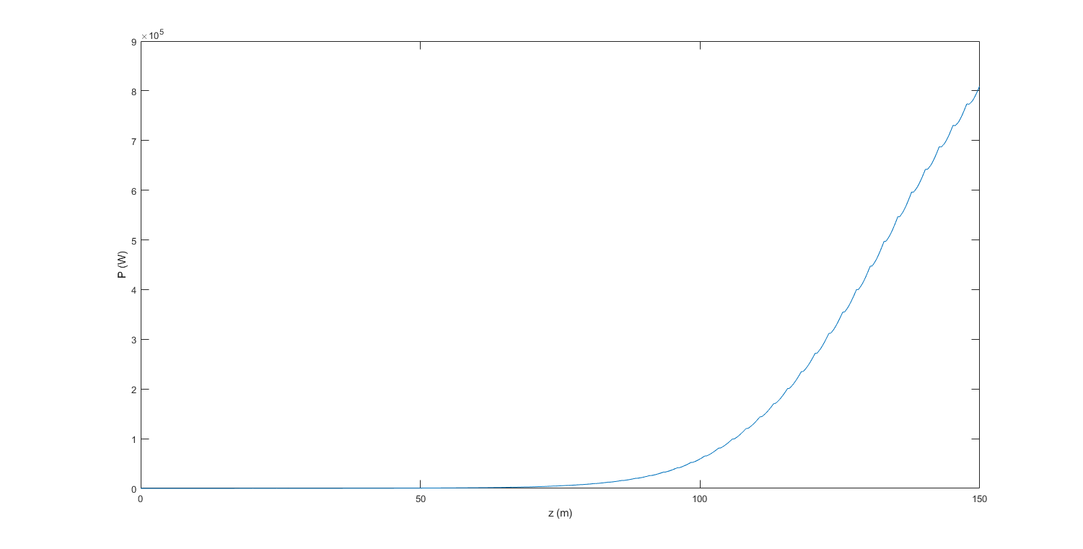
SSMB Workshop
Ring-FEL : racetrack design
FEL Lasing and target power
P(z) (Bunch averaged )
1 kW
13

Slide 15
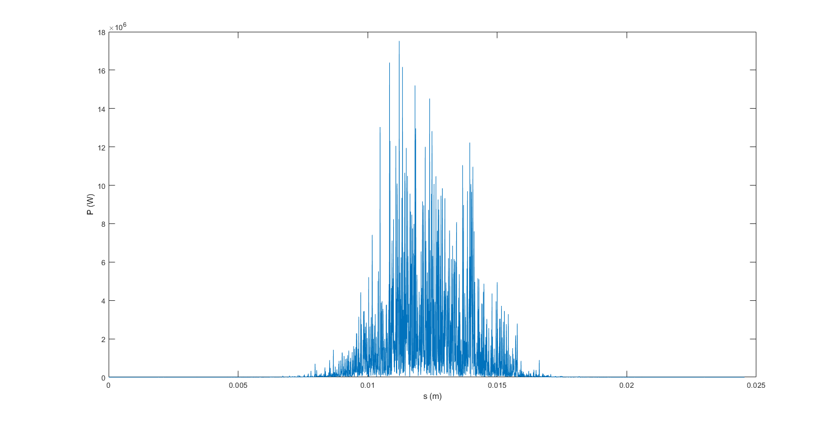
SSMB Workshop
Ring-FEL : racetrack design
P(s) at z = 135 m
10 MW
14

Slide 16
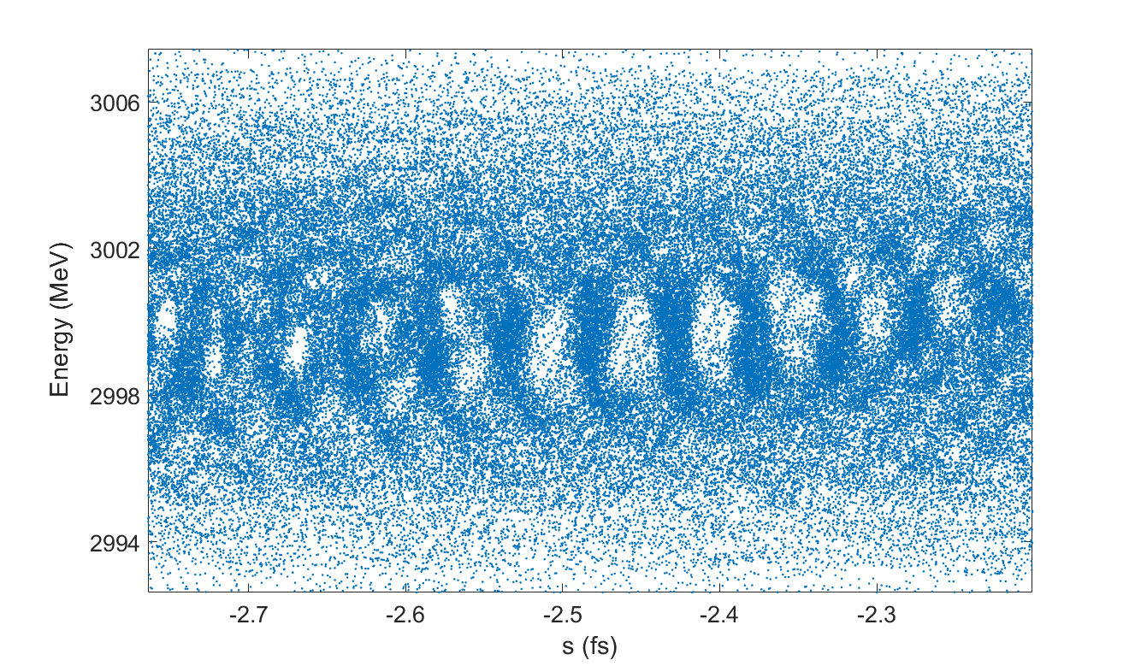
SSMB Workshop
Ring-FEL : racetrack design
Microbunching after 135 m undulator (avg. power = 1 kW)
15

Slide 17
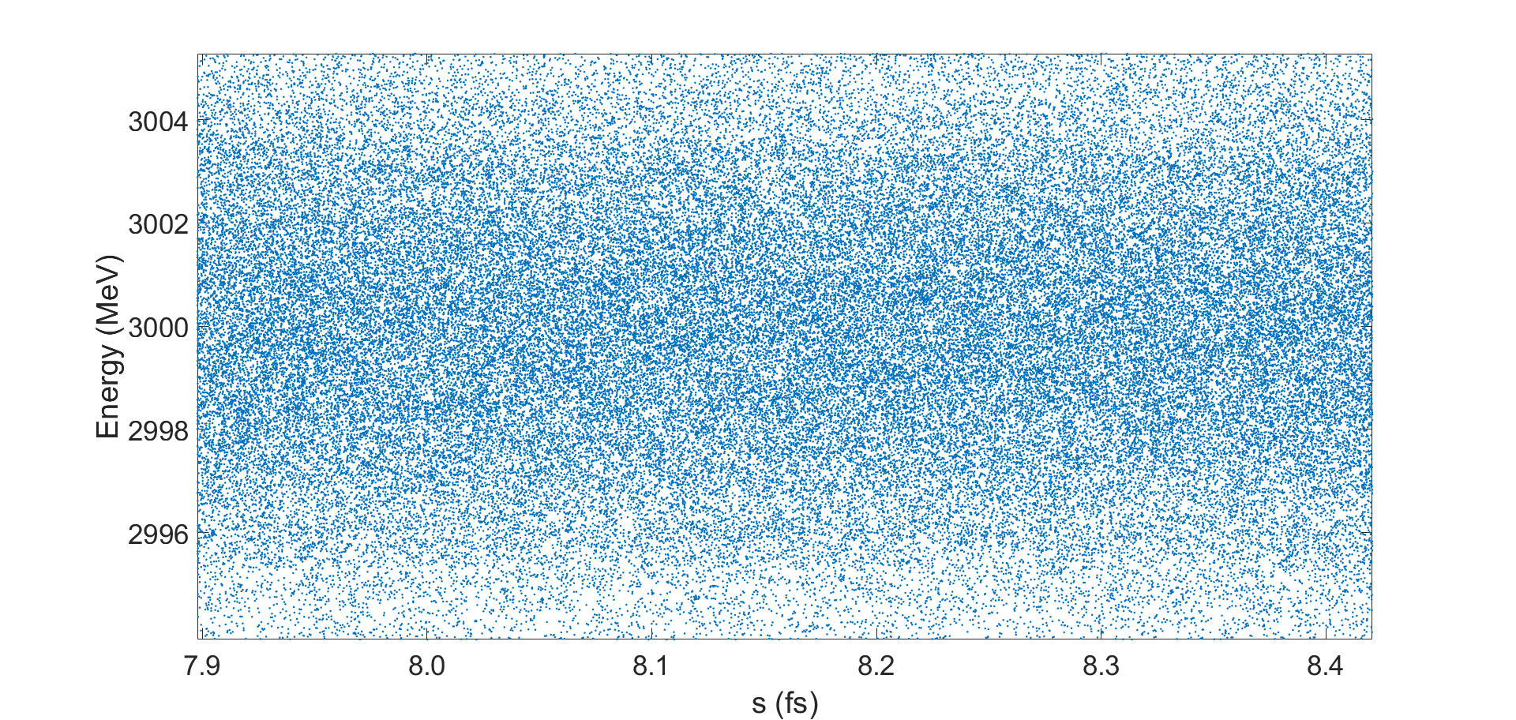
SSMB Workshop
Ring-FEL : racetrack design
De-bunched after passing 1 cell lattice
16

Slide 18
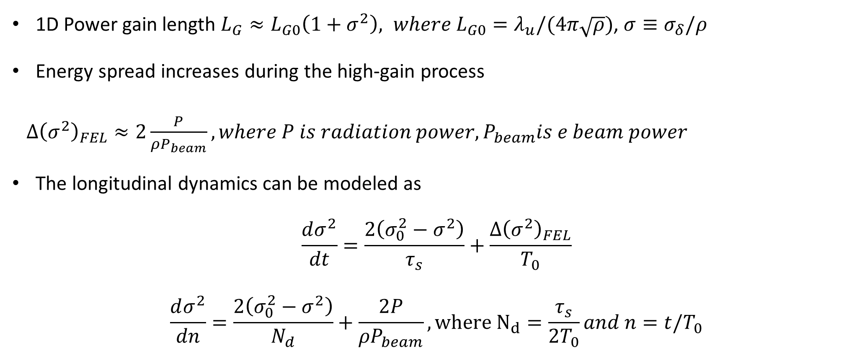
SSMB Workshop
Ring-FEL : racetrack design
Equilibrium parameters of storage ring with FEL lasing (From Z. Huang, NIMA (2008))
1D Power gain length $L_{G}≈L_{G0}\left(1+σ^{2}\right), where L_{G0}=λ_{u}/(4π\sqrt{ρ})$, $σ≡σ_{δ}/ρ$
Energy spread increases during the high-gain process
$Δ{\left(σ^{2}\right)}_{FEL}≈2\frac{P}{ρP_{beam}}, where P is radiation power, P_{beam}is e beam power$
The longitudinal dynamics can be modeled as
$$\frac{dσ^{2}}{dt}=\frac{2\left(σ_{0}^{2}−σ^{2}\right)}{τ_{s}}+\frac{Δ{\left(σ^{2}\right)}_{FEL}}{T_{0}}$$
$$\frac{dσ^{2}}{dn}=\frac{2\left(σ_{0}^{2}−σ^{2}\right)}{N_{d}}+\frac{2P}{ρP_{beam}}, where N_{d}=\frac{τ_{s}}{2T_{0}}and n=t/T_{0}$$
17

Slide 19
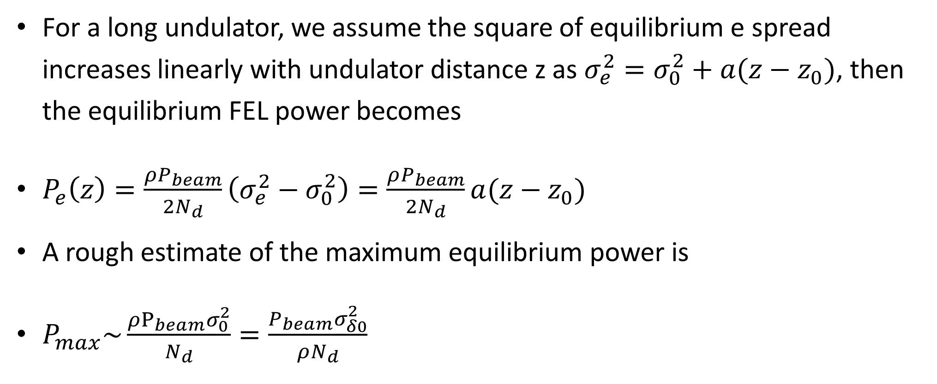
SSMB Workshop
Ring-FEL : racetrack design
Equilibrium parameters of storage ring with FEL lasing (From Z. Huang, NIMA (2008))
For a long undulator, we assume the square of equilibrium e spread increases linearly with undulator distance z as $σ_{e}^{2}=σ_{0}^{2}+a(z−z_{0})$, then the equilibrium FEL power becomes
$P_{e}\left(z\right)=\frac{ρP_{beam}}{2N_{d}}\left(σ_{e}^{2}−σ_{0}^{2}\right)=\frac{ρP_{beam}}{2N_{d}}a(z−z_{0})$
A rough estimate of the maximum equilibrium power is
$P_{max}\sim \frac{ρP_{beam}σ_{0}^{2}}{N_{d}}=\frac{P_{beam}σ_{δ0}^{2}}{ρN_{d}}$
18

Slide 20
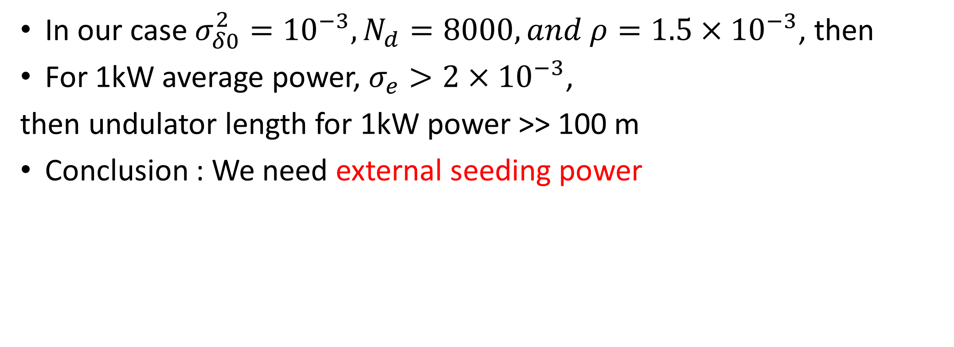
SSMB Workshop
Ring-FEL : racetrack design
Equilibrium parameters of storage ring with FEL lasing (From Z. Huang, NIMA (2008))
In our case $σ_{δ0}^{2}={10}^{−3}, N_{d}=8000, and ρ=1.5×{10}^{−3}$, then
For 1kW average power, $σ_{e}>2×{10}^{−3}$,
then undulator length for 1kW power >> 100 m
Conclusion : We need external seeding power
19

Slide 21
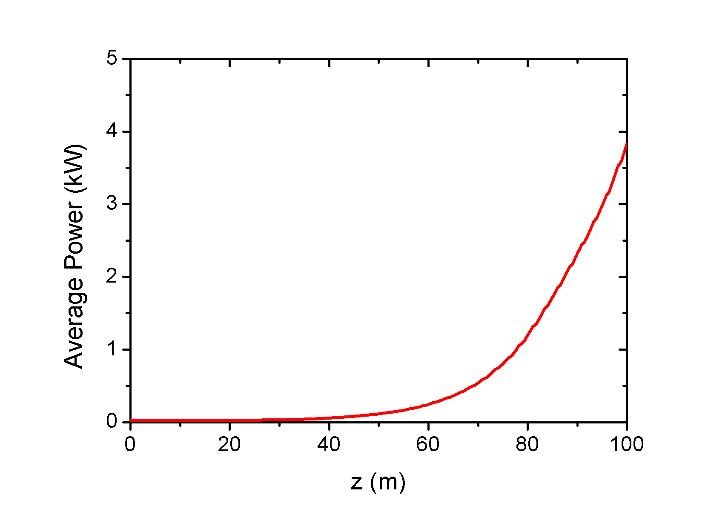
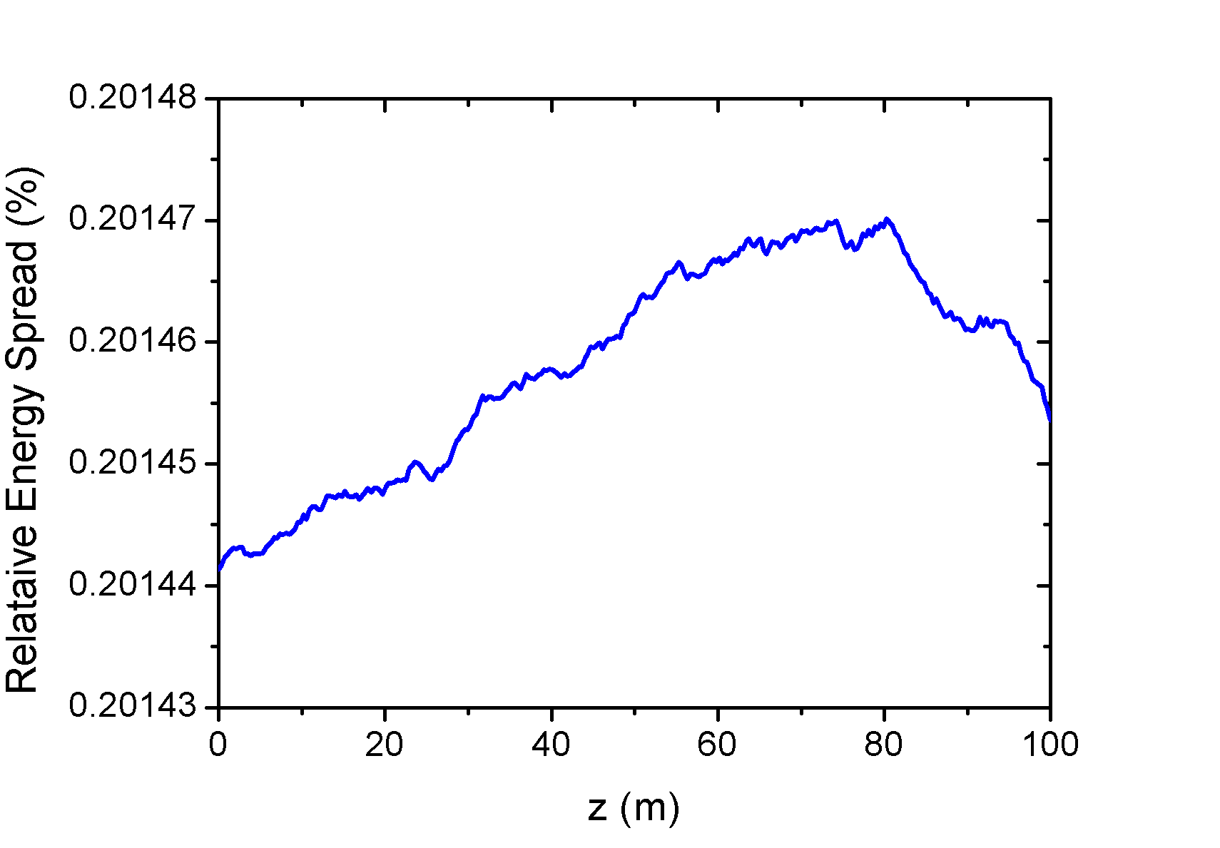
SSMB Workshop
Ring-FEL : racetrack design
With 10 kW (peak power) external seeding,
1 kW EUV is achieved and equilibrium energy spread is about 0.2 %
We need a seeding radiation with a power of 2% of FEL radiation power.
20

Slide 22
SSMB Workshop
Ring-FEL : racetrack design
Candidate for external seeding : Regenerative amplifier
H.P. Freund et al., PRAB 16, 010707 (2013)
21

Slide 23
SSMB Workshop
Overview
Medium-energy storage ring based FEL could provides 1 kW EUV radiation with low emittance ring and regenerative amplifier.
If the radiation wavelength for a lithography moves to soft X-ray, the XFEL in a high-energy storage ring can be a candidate for a lithography tool.
22

Slide 24
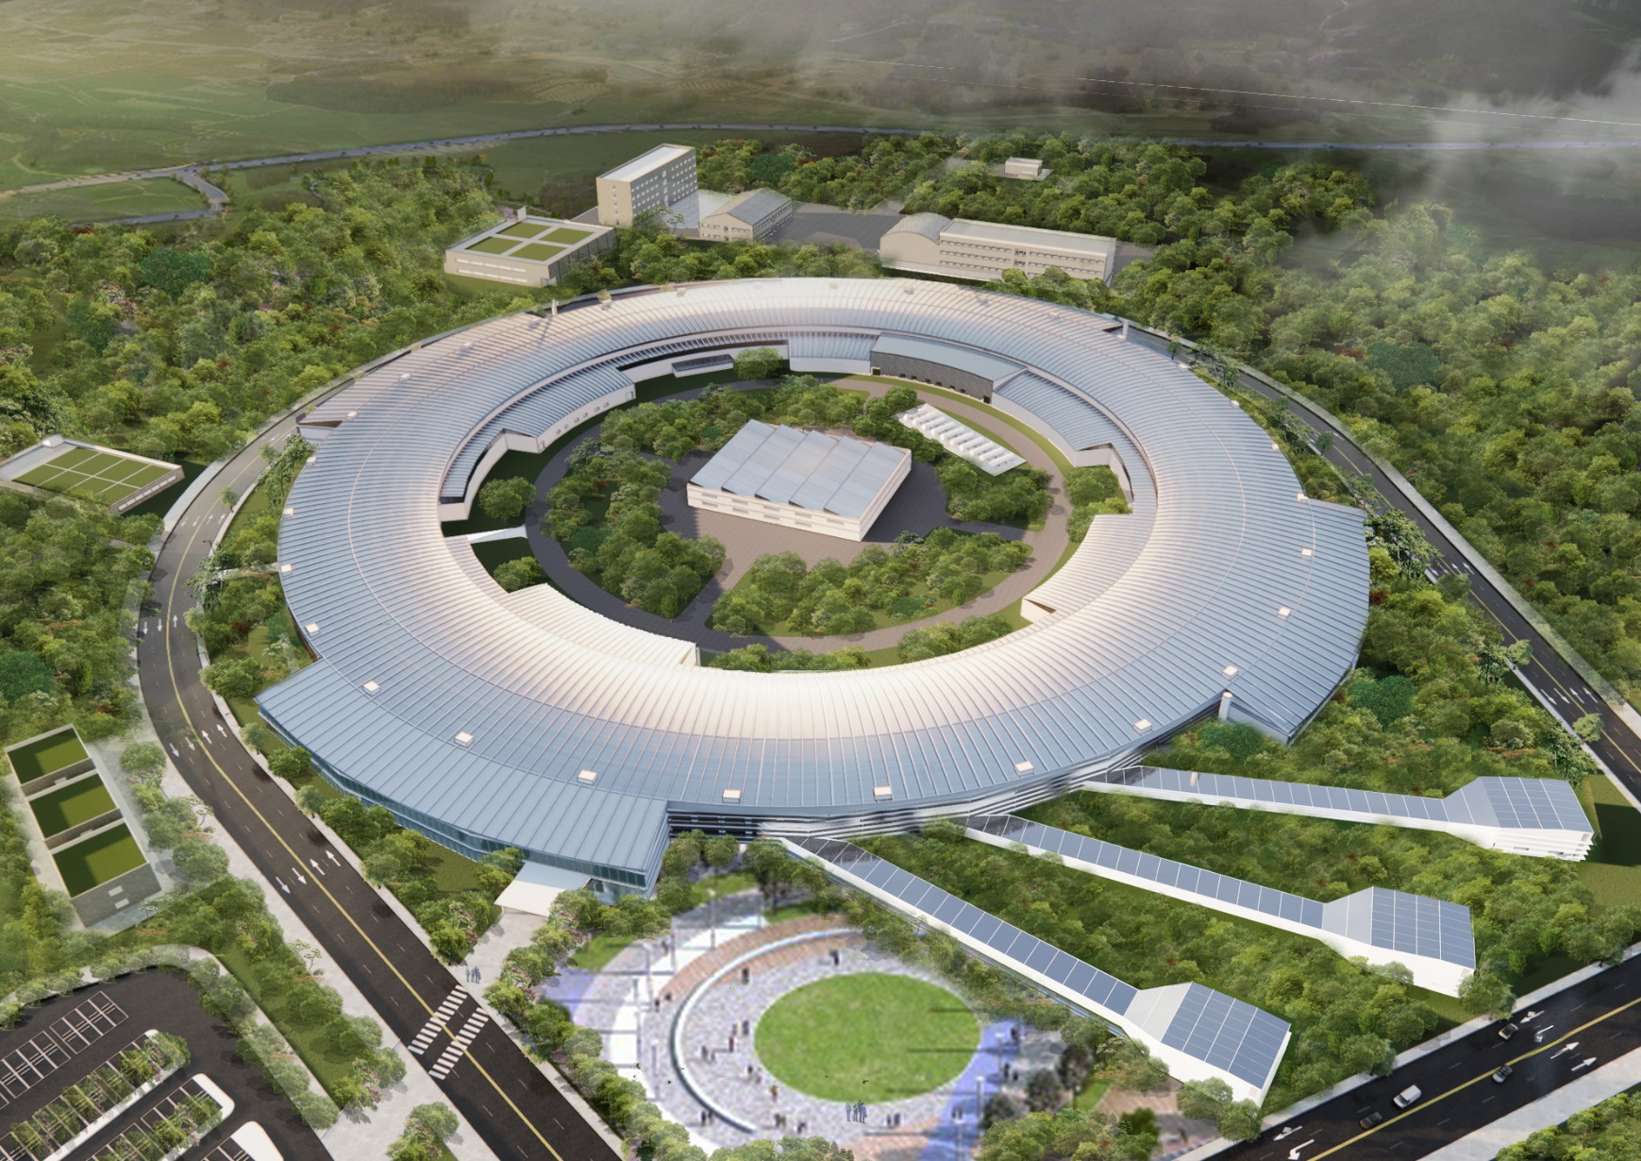
SSMB Workshop
Thank you

