Slide 1
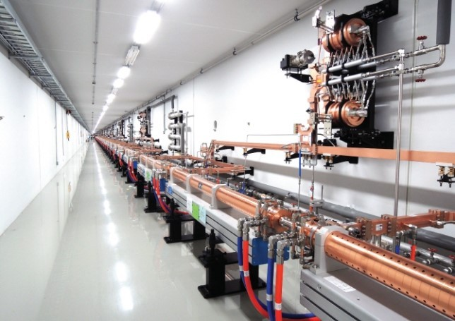
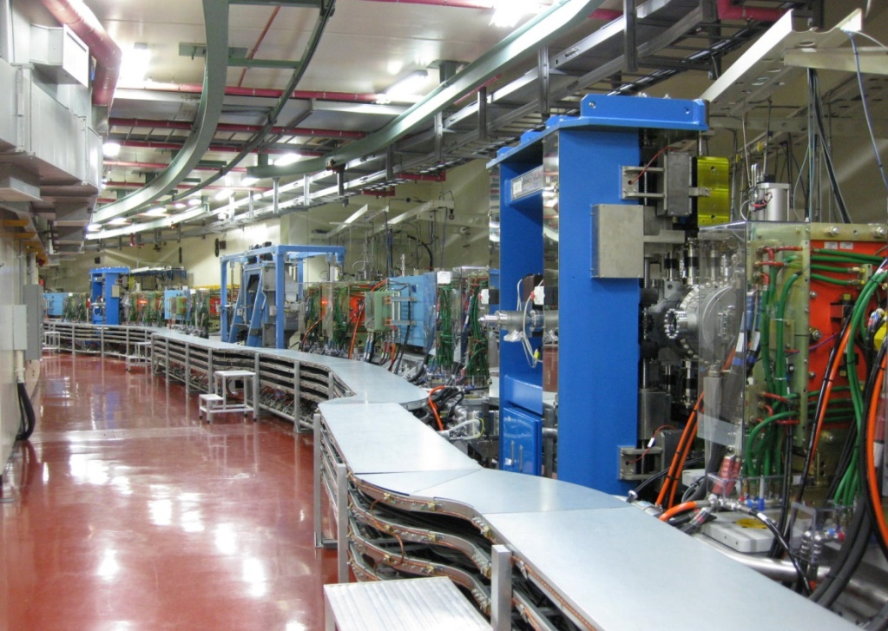
SSMB Workshop
Activities and future plan in BD group at PAL
Seunghwan Shin PLS-II Accelerator Division, PAL
Dec. 09, 2020

Slide 2
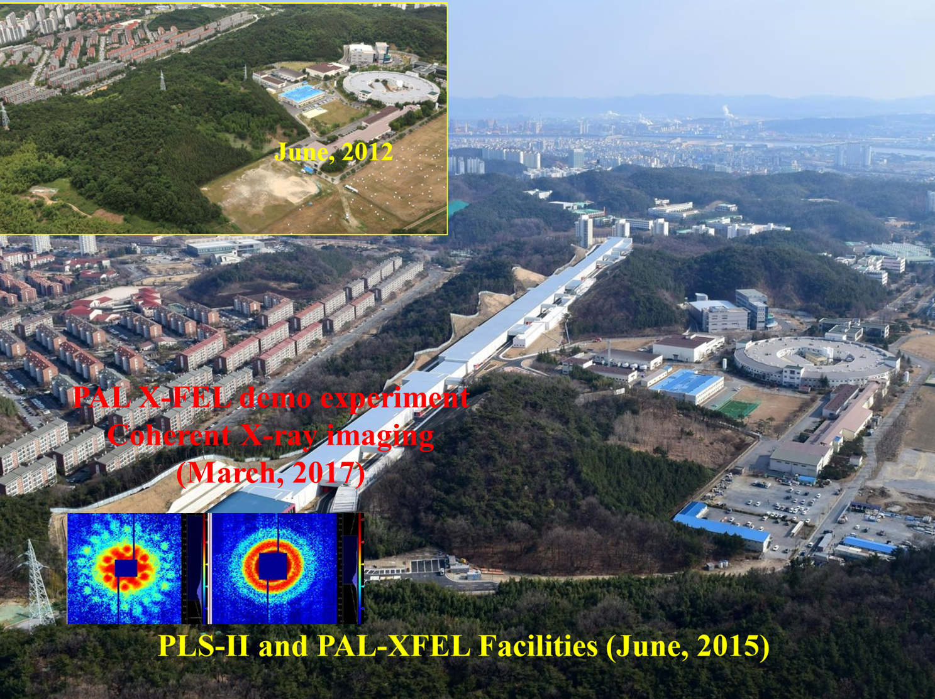
SSMB Workshop
PLS-II and PAL-XFEL in PAL
1

Slide 3
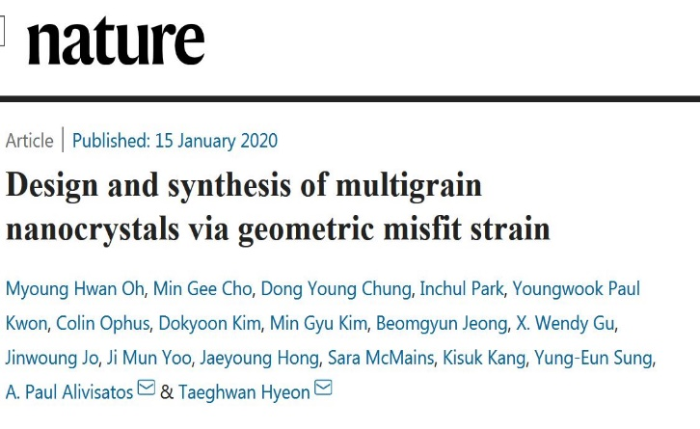
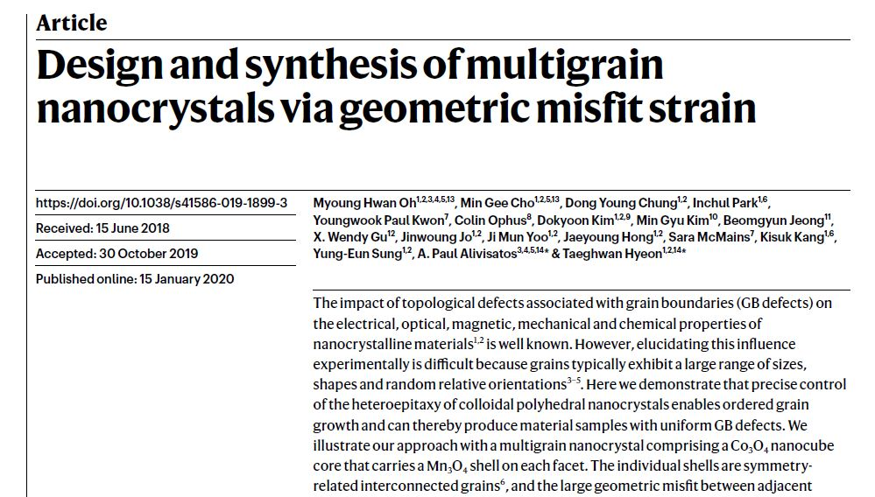
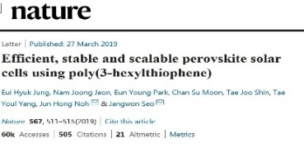
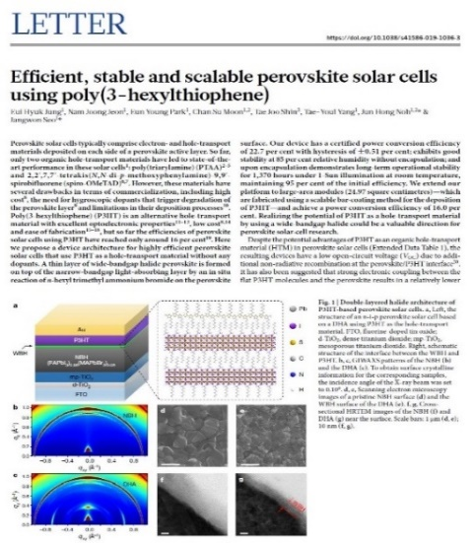
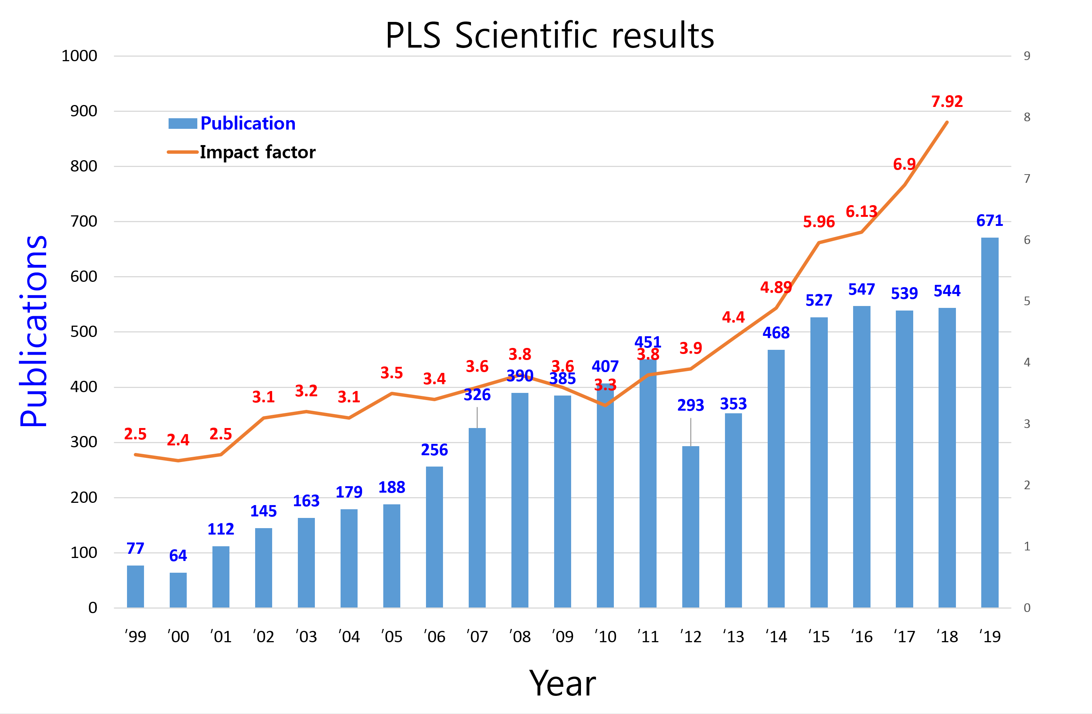
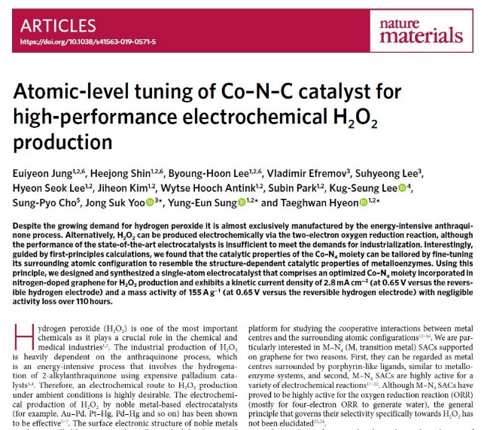
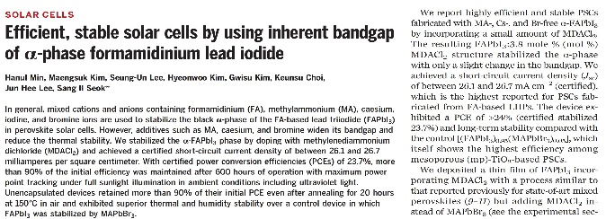
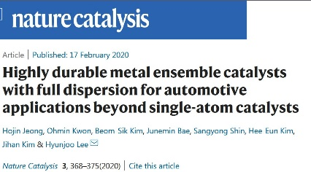
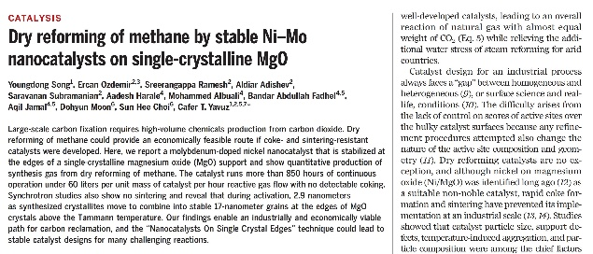
SSMB Workshop
PLS-II User Achievements (19 - 20)
NA
PLS-II
(3GeV, 300mA-400mA Top-up mode)
PLS
(2.5GeV, 150mA decay mode)
Impact factor
2

Slide 4
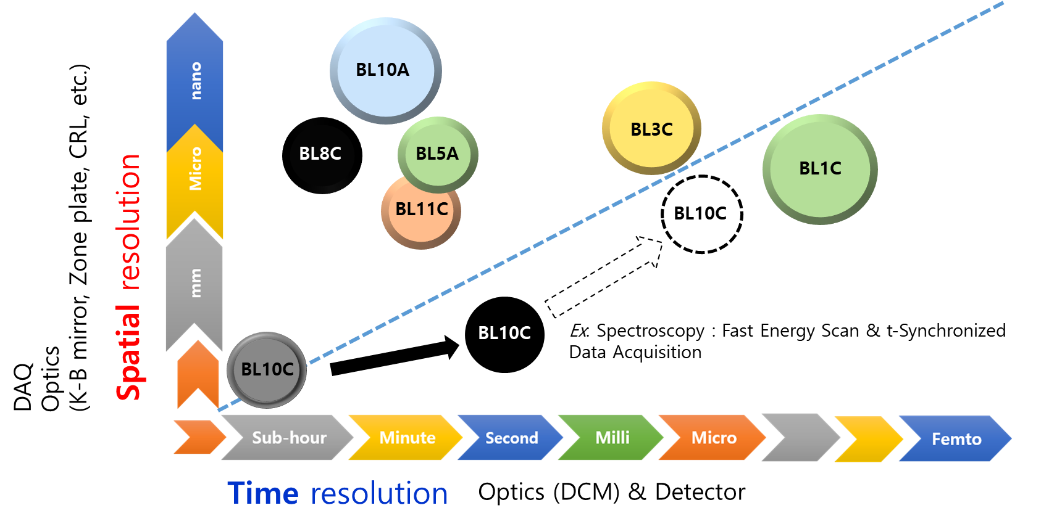
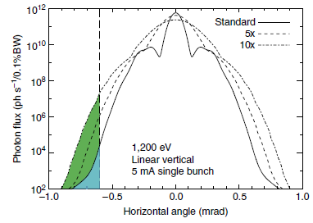
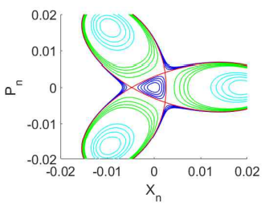
SSMB Workshop
PLS-II BLs in Spatial and time space
ALS
BESSY-II
3

Slide 5
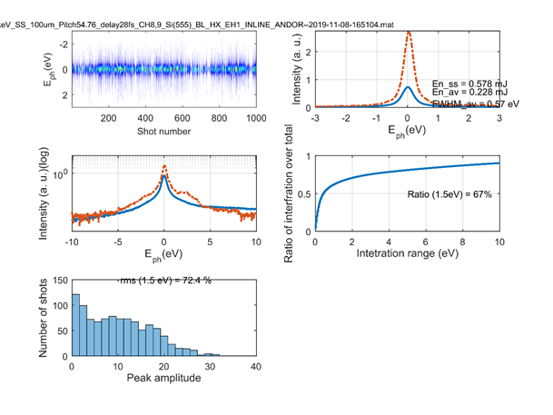
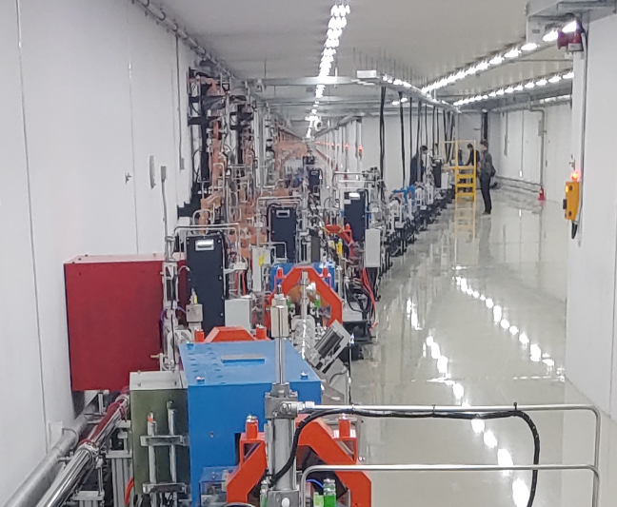
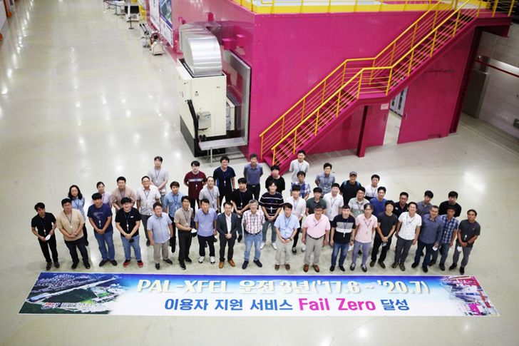
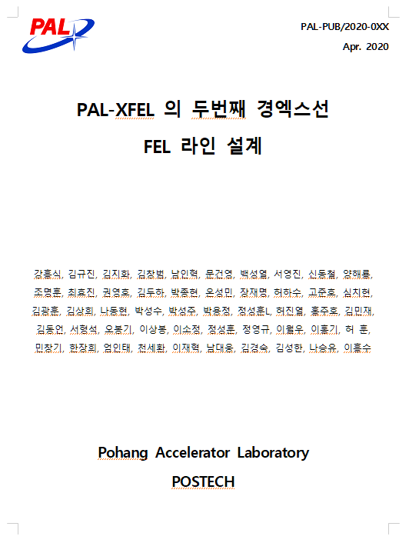
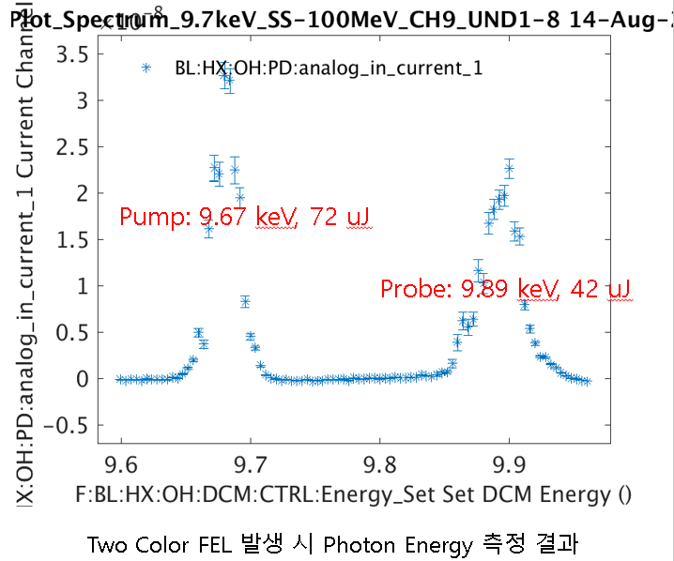
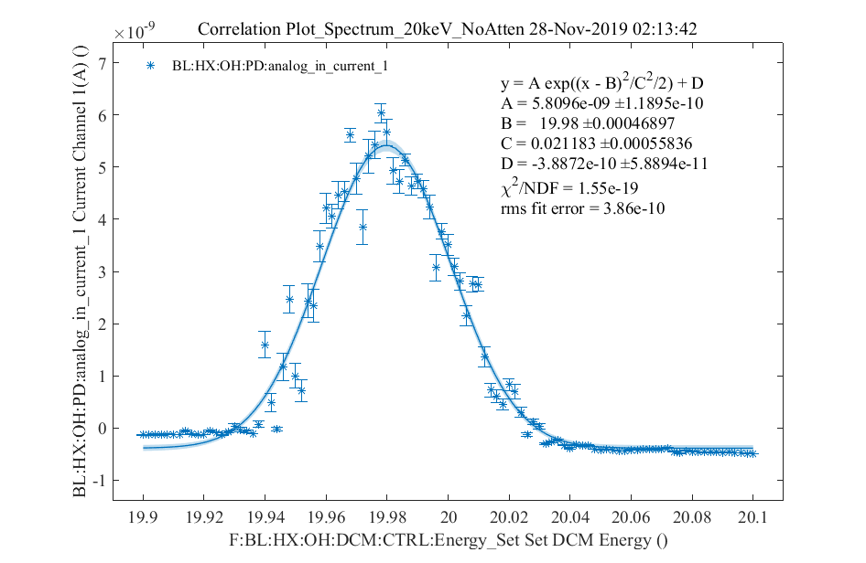
SSMB Workshop
Major Activities in PAL-XFEL
Achievement of 3-year fail-zero user service operation
Ready for self-seeded FEL service operation
Extending FEL range up to 20 keV
60 Hz operation is ready
Successful progress for sharing beam time between HX and SX
Demonstration of two-color FEL generation
Completing the CDR of HX2
4

Slide 6
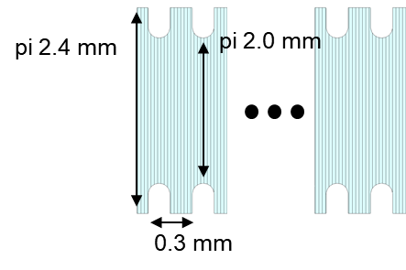
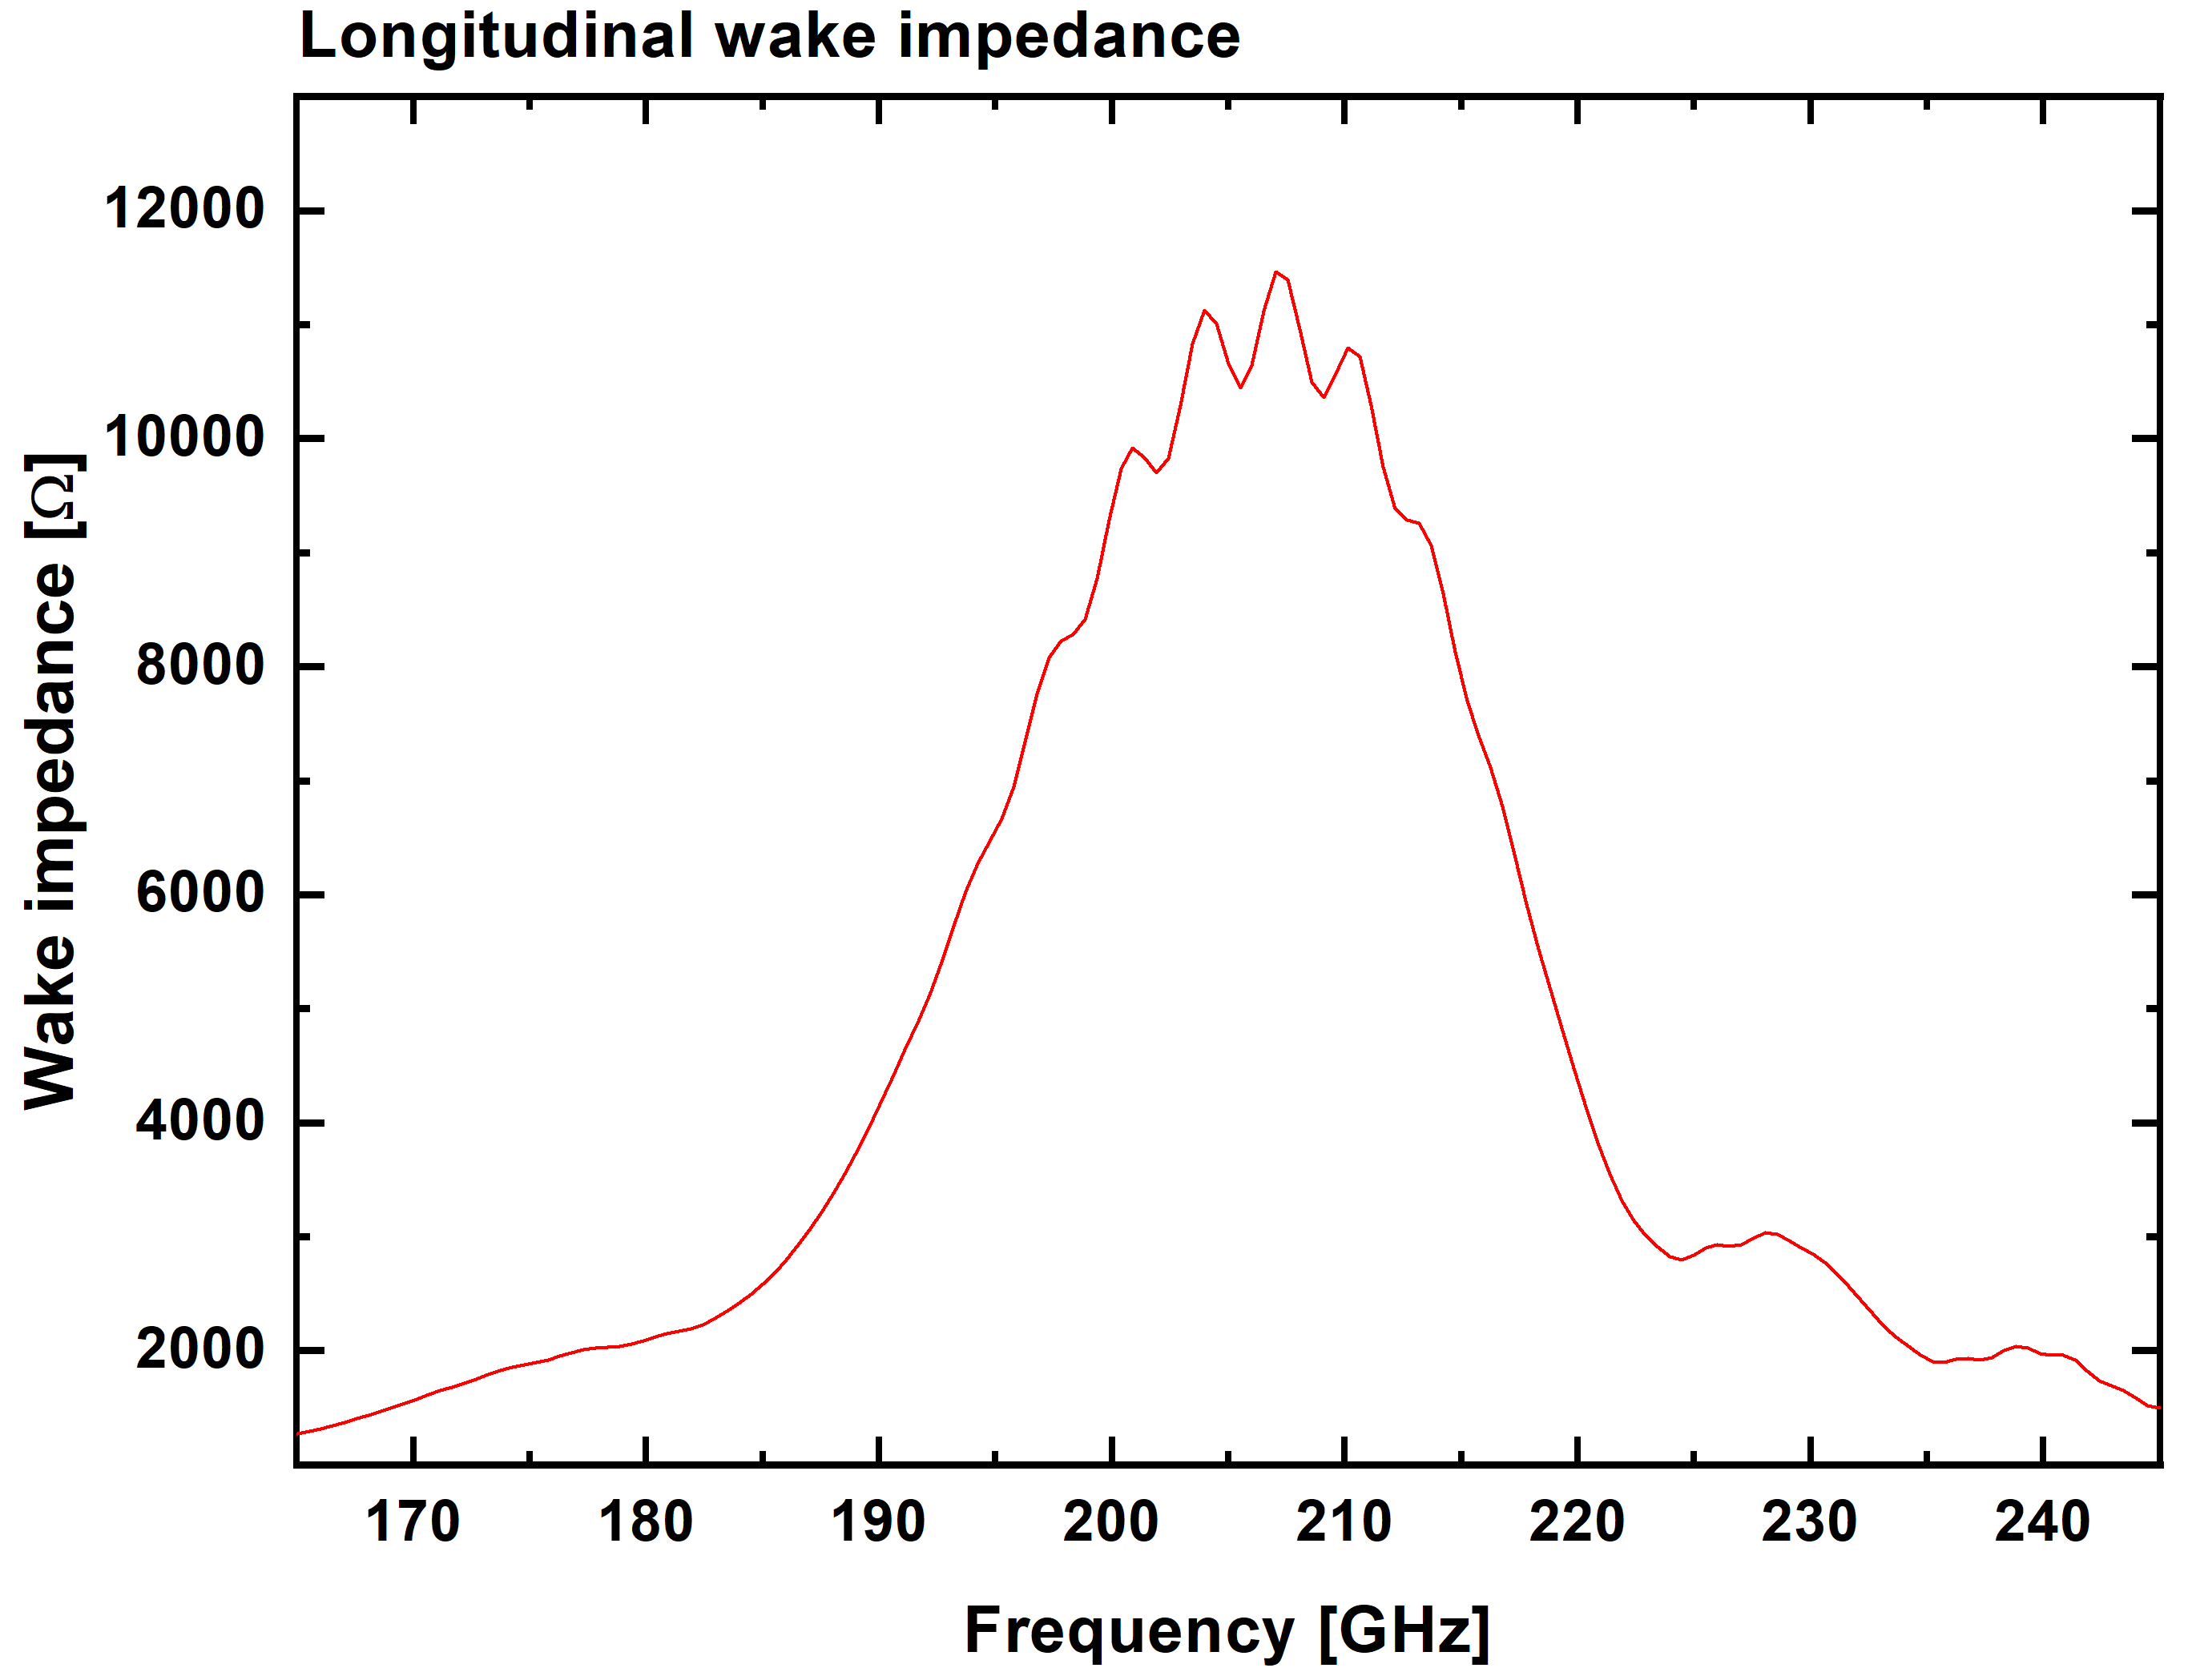
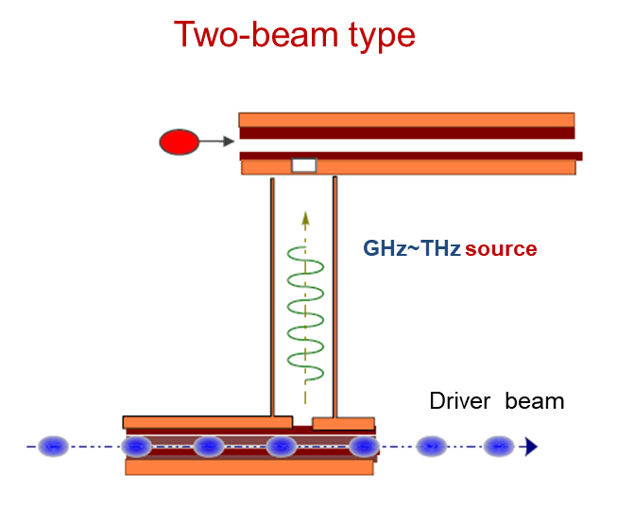
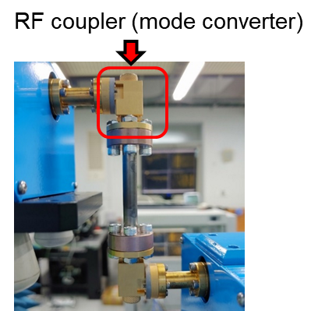
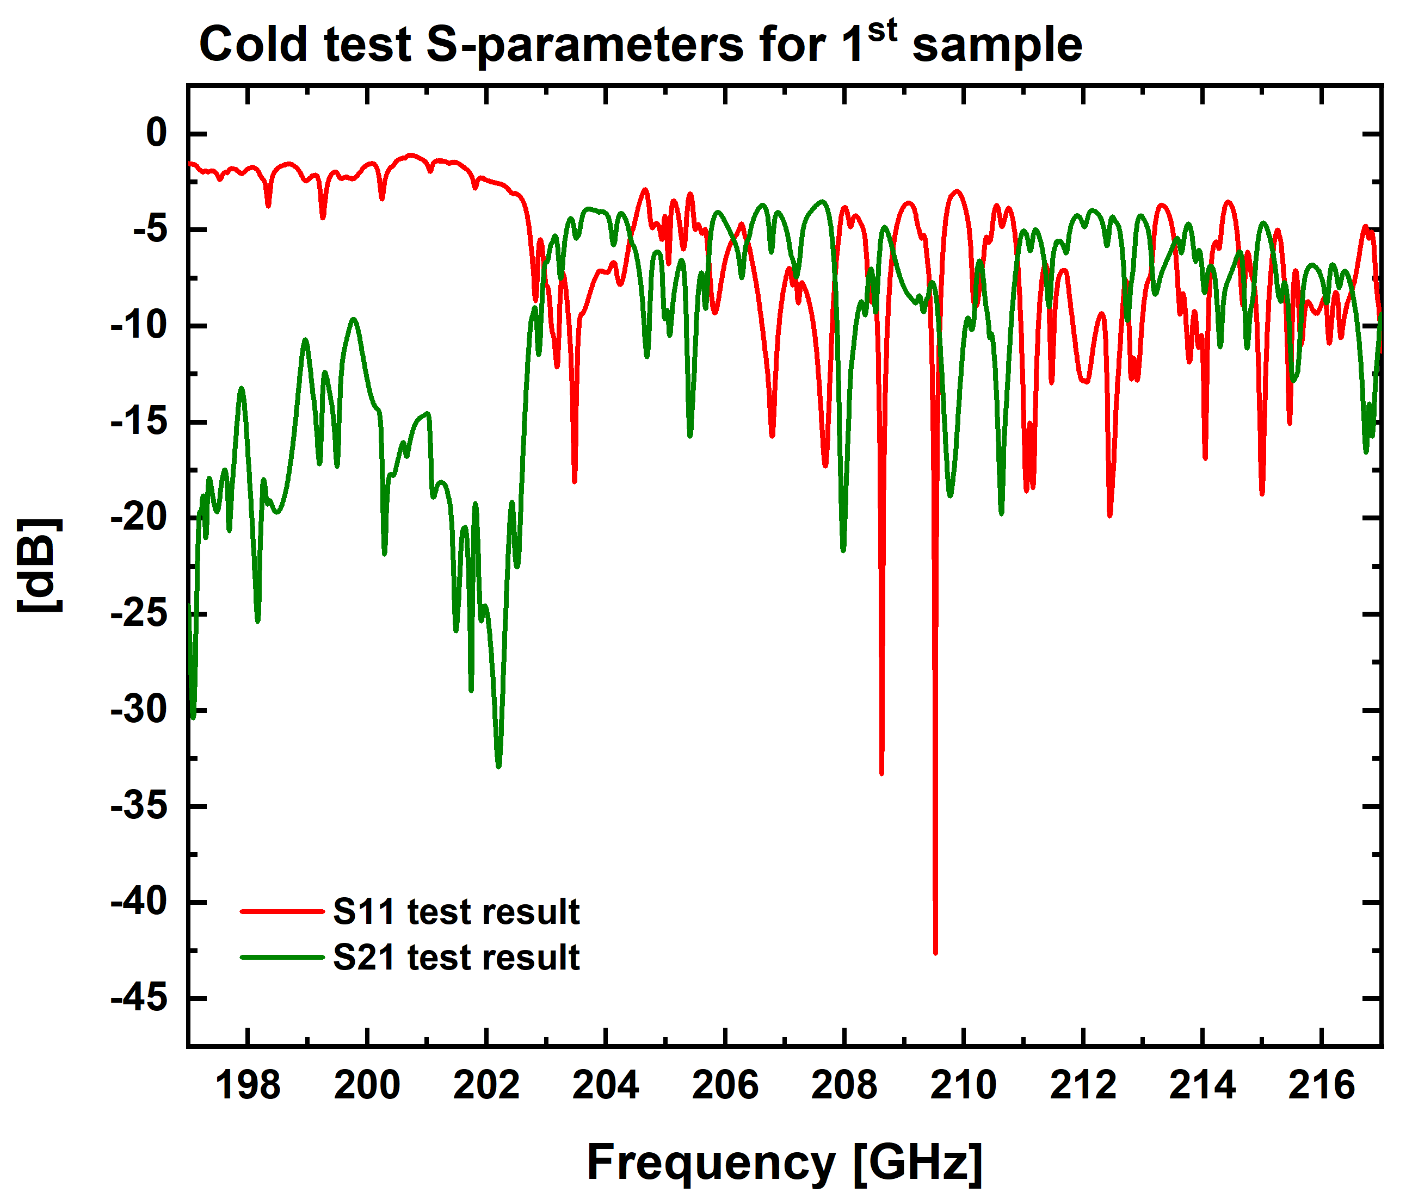
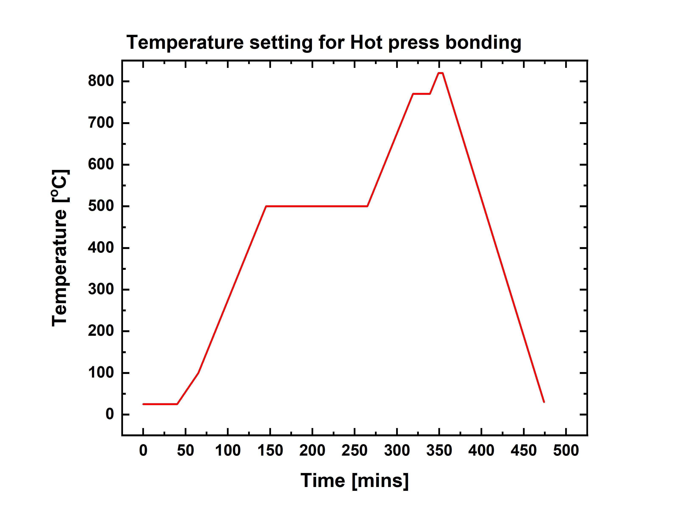
SSMB Workshop
Compact accelerator development
Structure wakefield accelerator.
5

Slide 7
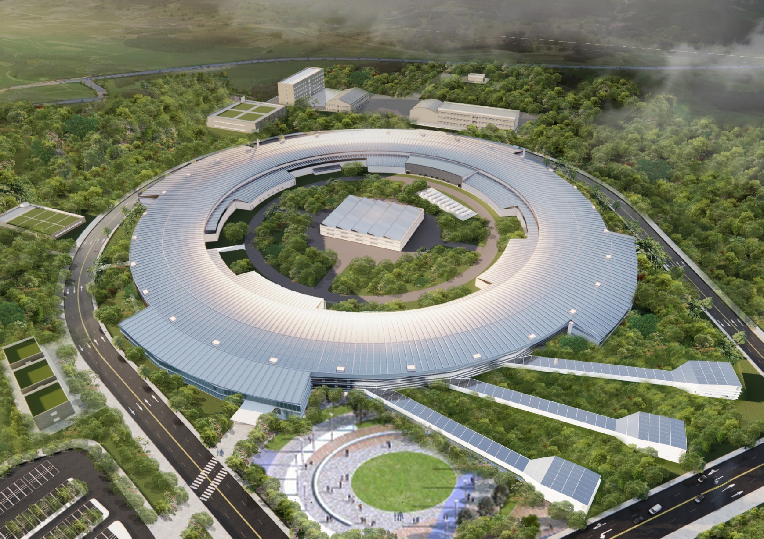
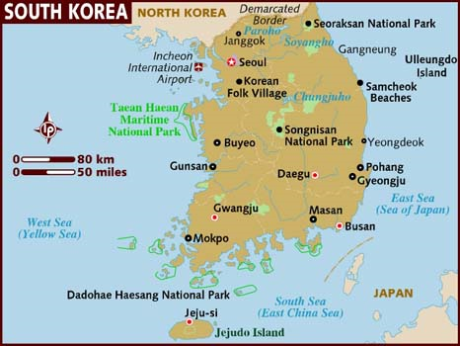
SSMB Workshop
Korean 4GSR project
Now CDR project is on going.
Project will be started from 2022.
Budget 10 M USD was already allocated in 2021.
Korean 4GSR
6

Slide 8
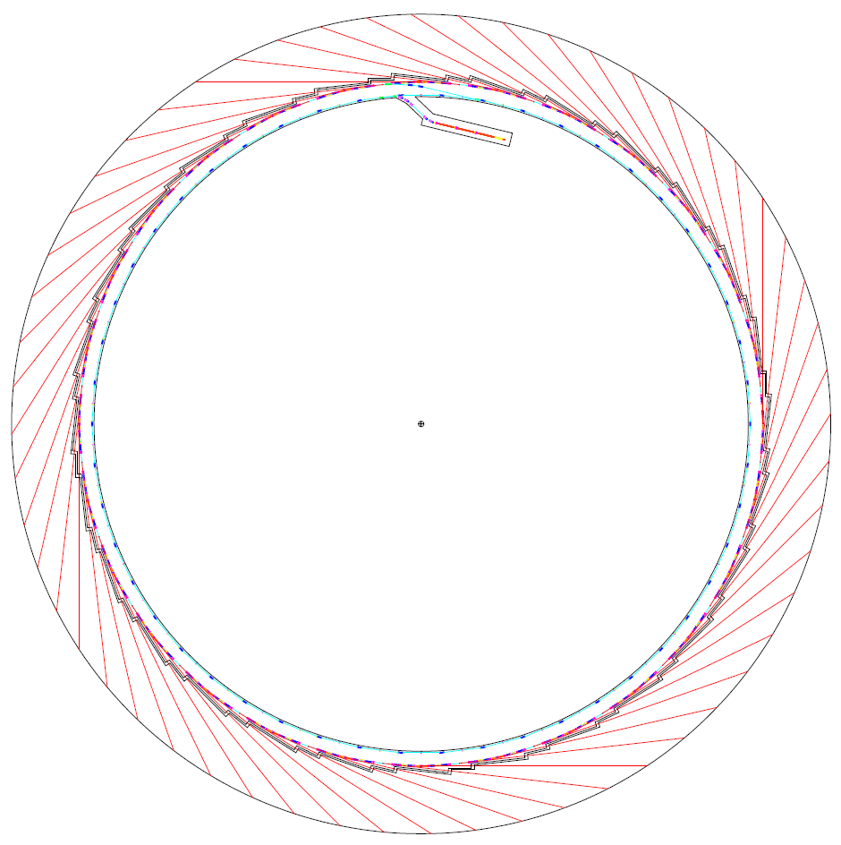
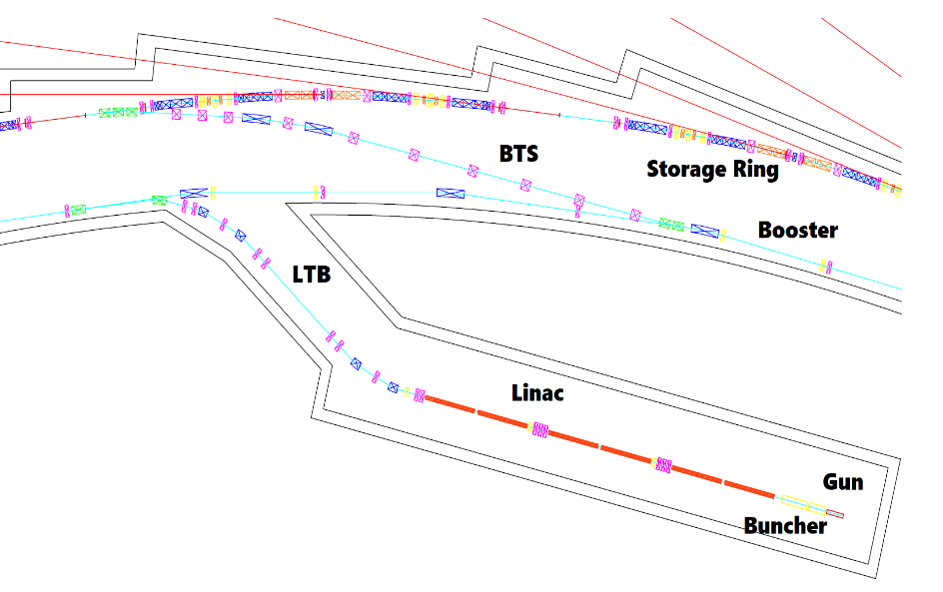
SSMB Workshop
Overview of Korean 4GSR
Parameter | Units | PLS-II | Korean 4GSR
Electron energy | GeV | 3 | 4
Horiz. Emittance | pm | 5800 | 58 (RB: 39 )
Vert. Emittance | pm | ~ 58 | ~ 5.8 (RB: 39 )
Bunch length (rms) | ps | 20 | 13 (50 with HC)
Circumference | m | 280 | 800
Harmonic # |  | 470 | 1332
RF frequency | MHz | 500 | 500
Beam stability @ ID (x/y) | $μm$ | < 4 / 2 | < 2.5 / 0.45
Injection mode |  | Top-up | Top-up
Injector: Booster
Total # of BL: 52 (60)
7

Slide 9
SSMB Workshop
Balanced design
정석민 교수님 강연 “황금비” @ 3세대 가속기부 / 시설팀 간담회
8

Slide 10
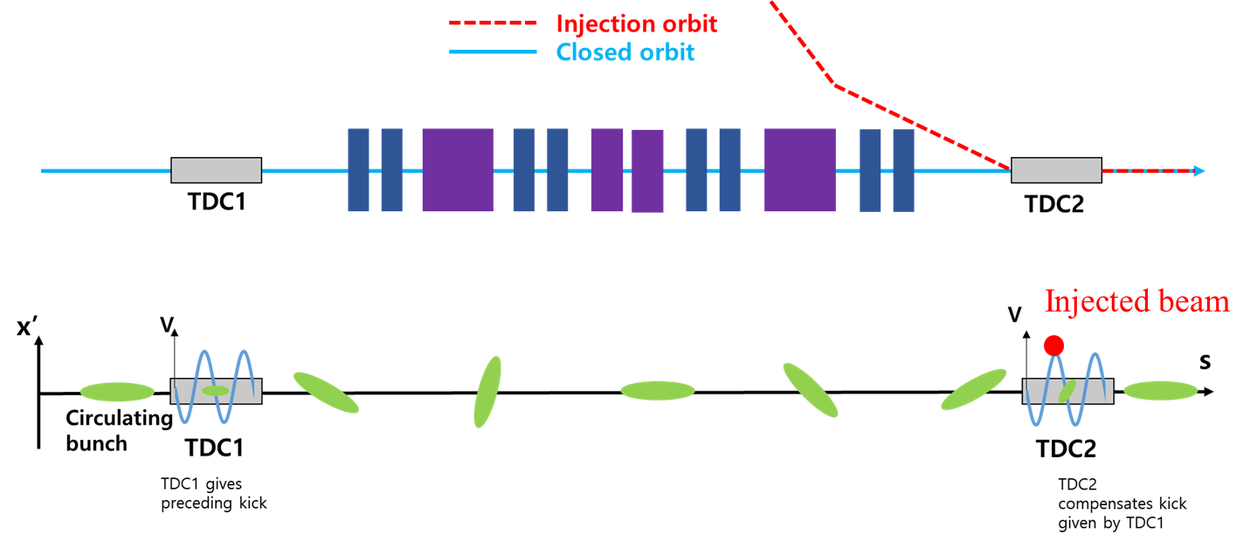
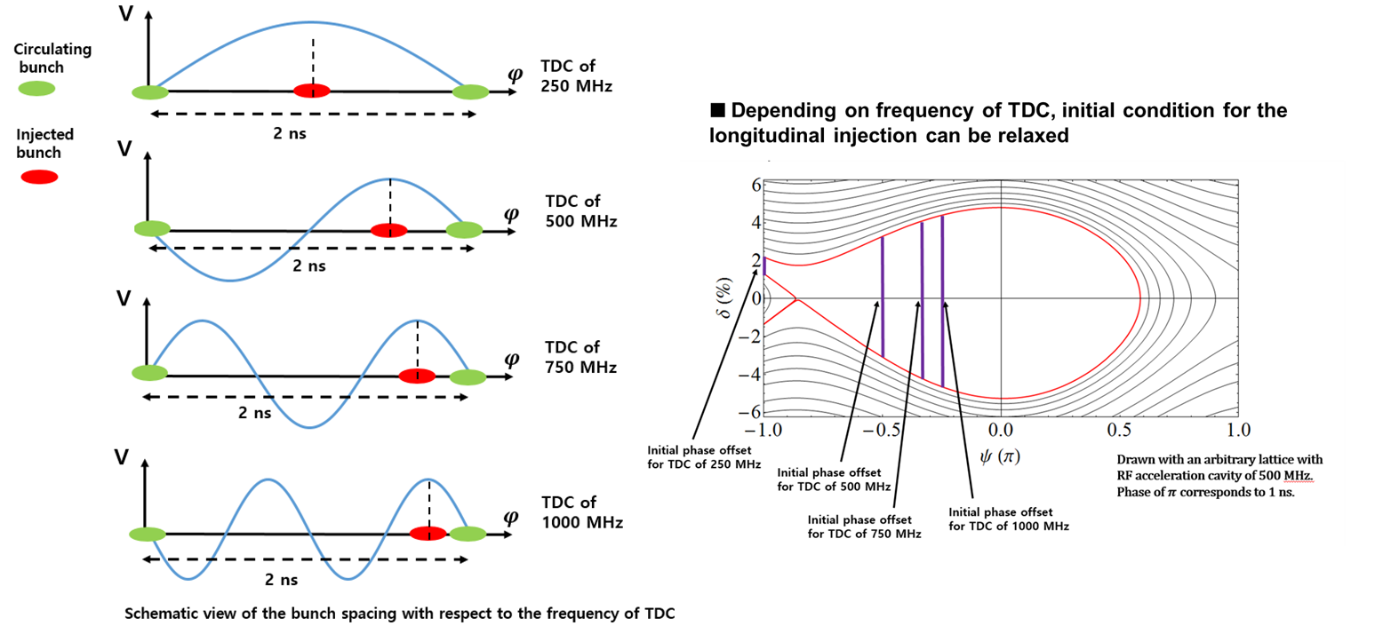
SSMB Workshop
New injection scheme
H phase difference between two TDCs is nπ.
Frequency of TDC should be n($f_{main}/2$).
Additional benefit - A short x-ray pulse can be generated from the bending magnet.
9

Slide 11
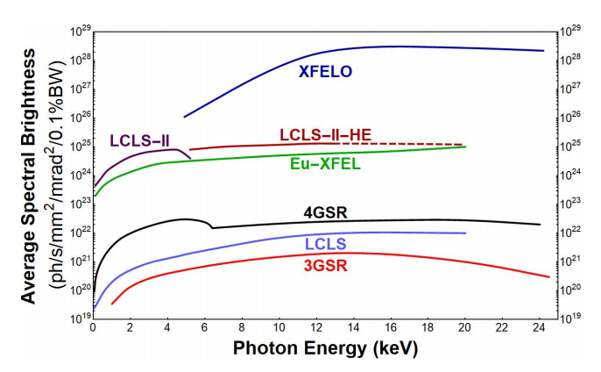
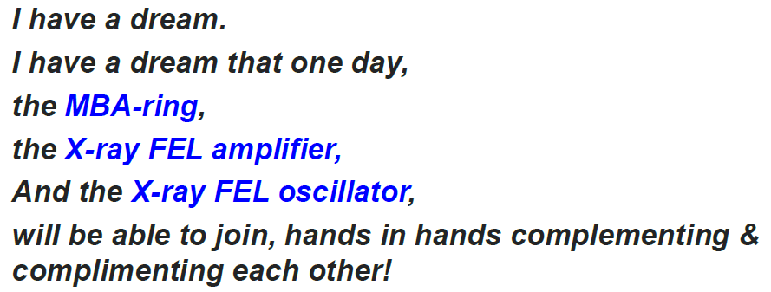
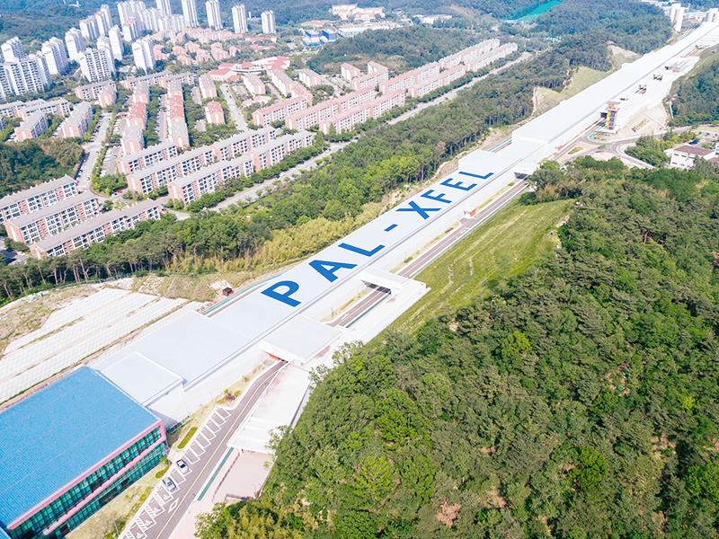
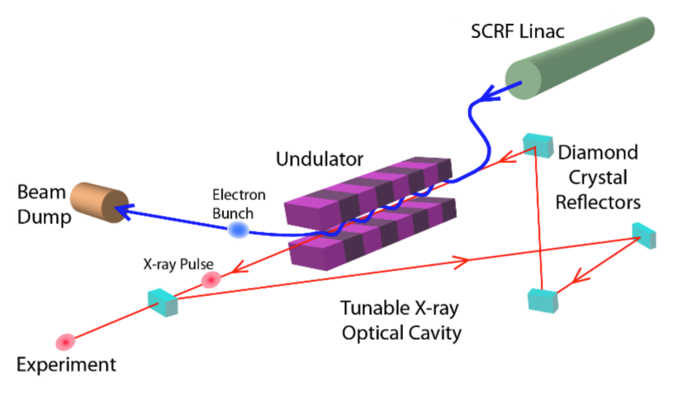
SSMB Workshop
Beyond 4GSR
Synergy among XFELO, PAL-XFEL and 4GSR.
Prof. KJK
10

Slide 12
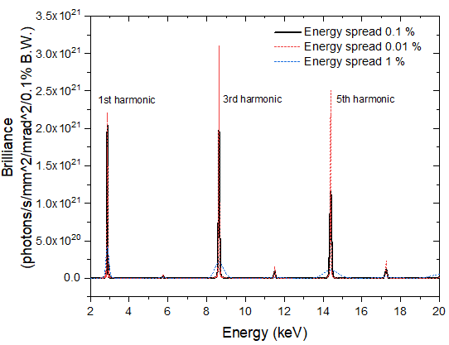
SSMB Workshop
Small energy spread ring
Ring option for XFELO
Emittance and energy spread:
Δγ/γ < 2×10-4/h, ~100 fs length, ~100 A peak current, < 1 um emittance, MHz repetition rate
$$ε_{0}=C_{q}γ^{2}\frac{I_{5}}{I_{2}−I_{4}}{=C}_{q}γ^{2}\frac{〈ℋ/{\left|ρ^{3}\right|}〉}{j_{x}〈1/{ρ^{2}}〉}$$
$$σ_{δ}^{2}=\frac{C_{q}γ^{2}I_{3}}{j_{z}I_{2}}≈\frac{C_{q}γ^{2}}{2ρ}$$
11

Slide 13
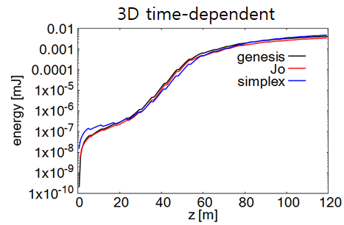
SSMB Workshop
PAL FEL code (version 1.0)
Algorithm - All slice particles are loaded initially. (Code does not scan slices.) - The basic algorithm follows GENESIS code.
Features: C language, MPI, HDF5, Gnu-Scientific Library (GSL)
Functions - 1D/3D, static/time-dependent, undulator taper, wakefield, Chicane, and external laser.
Next version (To do) - The self-seeding module will be continued.
Another type of FEL code: time-unaveraged algorithm will be developed; Fourier mode algorithm.
12

Slide 14
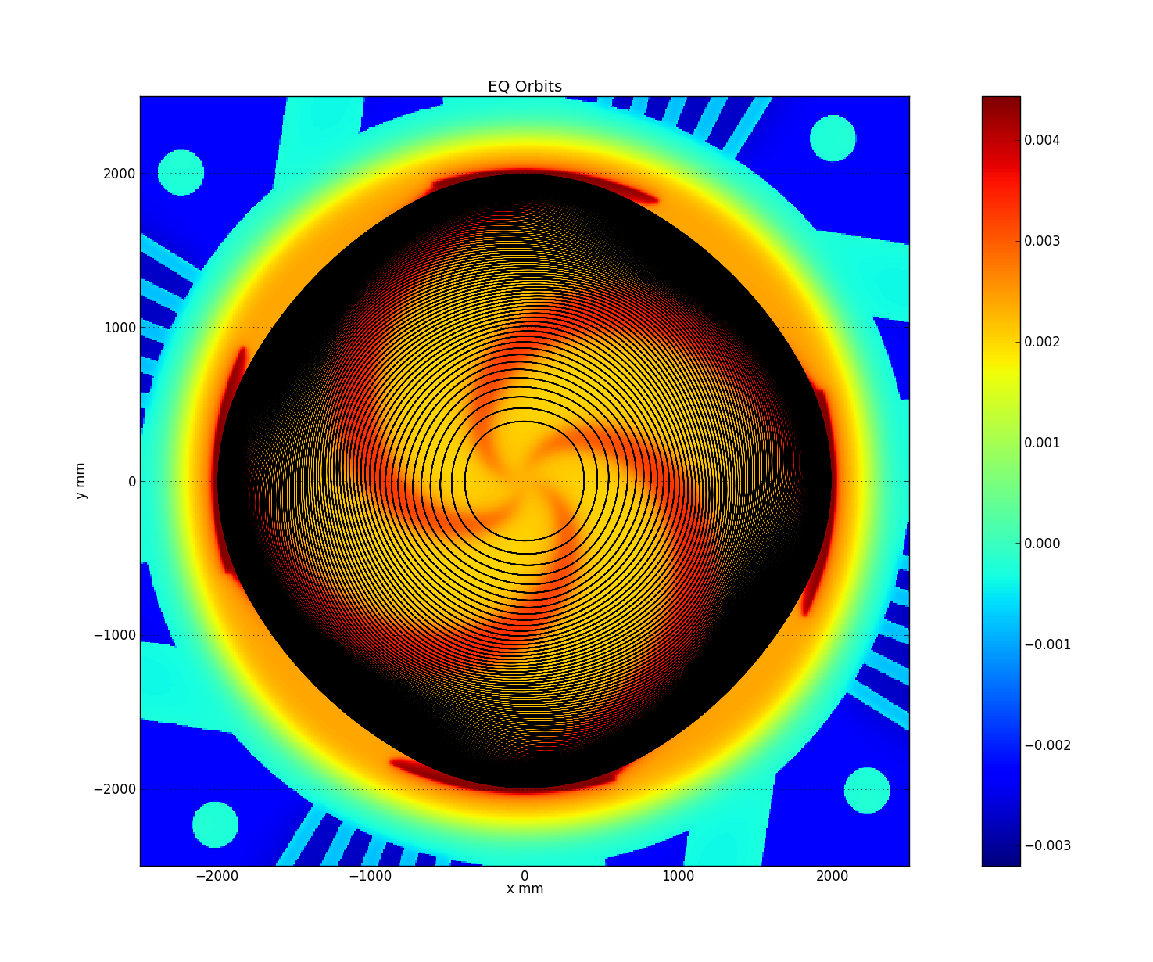
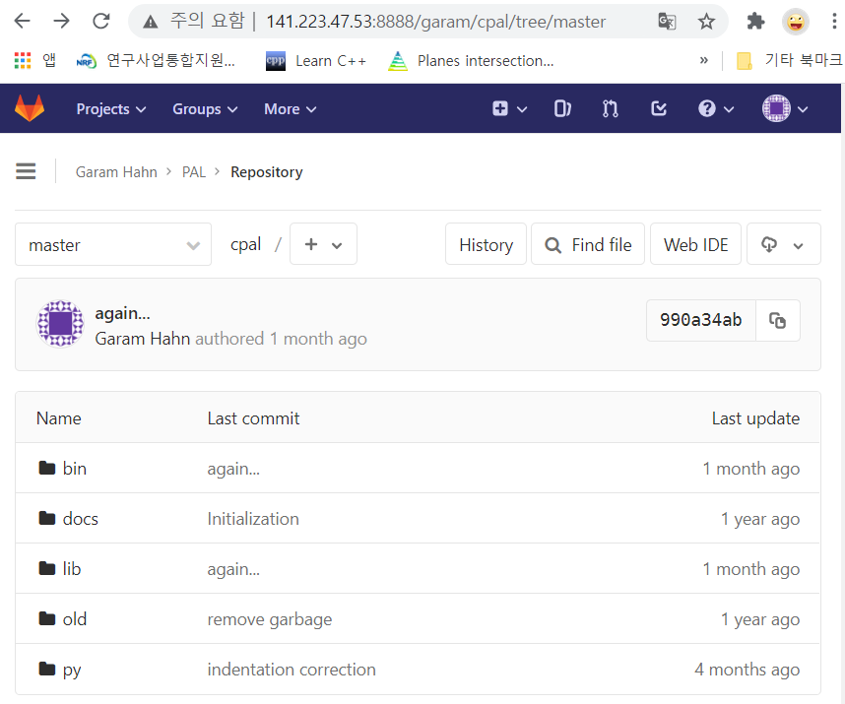
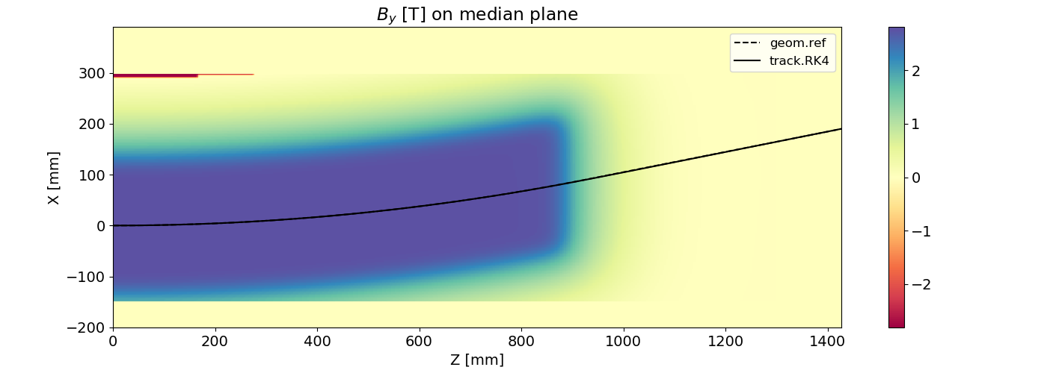
SSMB Workshop
PAL(Pal Accelerator Library, c++)
A Light-weight Multi-purpose Particle Tracking Library - Written in C++, Open-source (GPLv3), Object-oriented - User can develops a tracking SW for their own purpose.
Features : Vector/Geometry Analysis, 3D/4D Interpolation Integrators(RK4, PC3...), Bunch/Field Managers
Example Codes - Field-map analysis, EQ-orbit finder(cyclotron), Medical beamline
Dev. Interest - PIC Mesh, Symplectic RK4, Python wrapper, Volume Manager...
141.223.47.53:8888
GitLab code repository
13

Slide 15
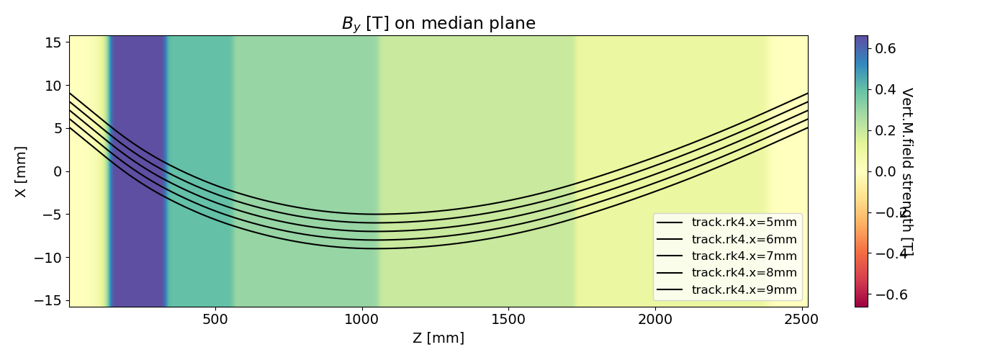
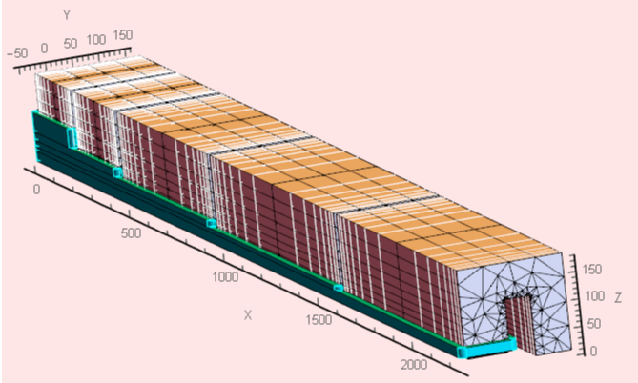
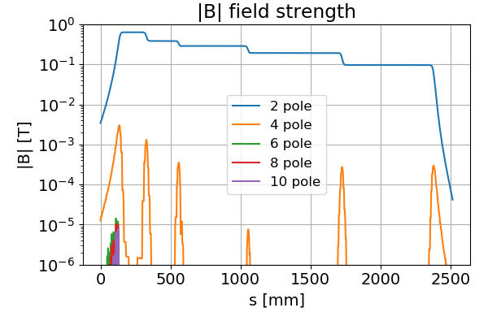
SSMB Workshop
PAL(Pal Accelerator Library, c++)
Important application of PAL: LGB for 4GSR
5 (mm)
9 (mm)
14

Slide 16
SSMB Workshop
Summary
Operation and improvement: PLS-II and PAL-XFEL.
Activities on development for 4GSR accelerator.
Fundamental beam physics on 4GSR: Nonlinear optimization, off injection beam in round beam mode, etc.
New scheme development: New injection scheme, Round beam and flat beam simultaneous operation, etc.
Code development: FEL code (Myung-hoon Cho), PAL (Garam Hahn), Multi-function tracking (Young-Dae Yoon).
Extending code to cover SSMB beam dynamics. (Our plan)
15

Slide 17
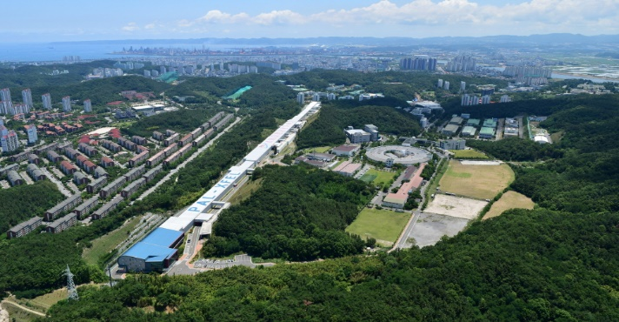
SSMB Workshop
Thanks so very much !!!
(We are enjoying SSMB workshop)

