Slide 1
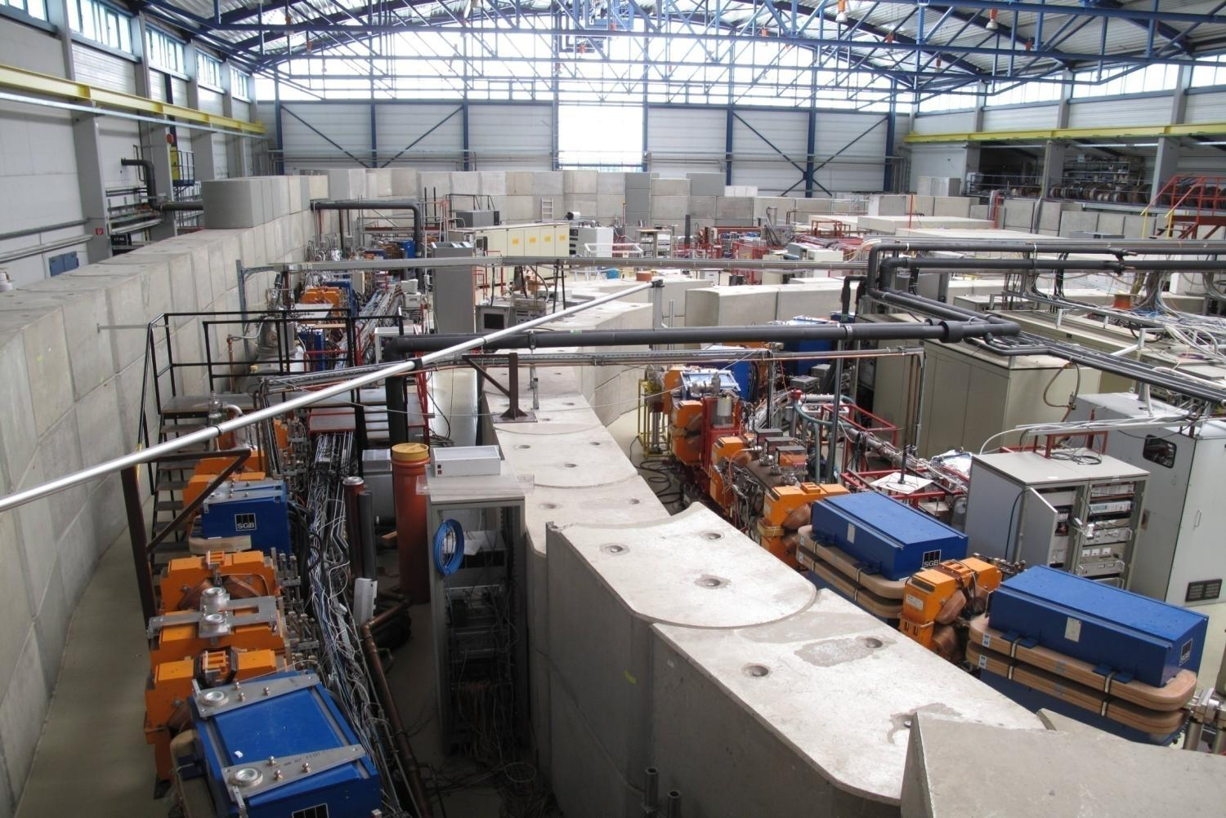
Laser-Induced Energy Modulation at DELTA
1
Shaukat Khan, Center for Synchrotron Radiation SSMB Workshop 2020

Slide 2
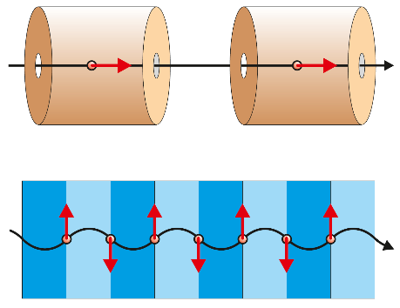
I have a dream ...*
... that storage rings could be driven by laser
instead of radiofrequency (RF) waves.
Typical wavelengths:
- RF: 60 cm (UHF) to 3 cm (X band)
- Infrared FEL: 100 μm
- Infrared laser: 10 μm
- Near-visible laser: 1500-200 nm
- Soft-X-ray FEL: sub-100 nm
RF resonators
* M. L. King jr., Washington D.C., 28.08.1963.
undulator

Slide 3
Laser-induced energy modulation yesterday and today
- Femtoslicing: ALS, BESSY, SLS, SOLEIL
- Coherent harmonic generation: ACO, UVSOR, ELETTRA, MAXlab, DELTA
- Coherent THz emission: ALS, BESSY, SLS, UVSOR, DELTA
- FEL seeding: FERMI, NLCTA, NSLS FEL, SINAP FEL, DCLS, FLASH, SXFEL
- Beam diagnostics: FLASH ...
R. Schoenlein et al., Science 287 (2000), 2237.
S. Khan et al., Phys. Rev. Lett. 97 (2006), 074801.
P. Beaud et al., Phys. Rev. Lett. 99 (2007), 174801.
M. Labat et al., J. Synch. Rad. 25 (2018), 385.
B. Girard et al., Phys. Rev. Lett. 53 (1984), 2405.
M. Labat et al., Eur. Phys. J. D44 (2007), 187.
G. De Ninno et al., Phys. Rev. Lett. 101 (2008), 053902.
N. Čutič et al., Phys. Rev. ST Beams 14 (2011), 030706.
S. Khan et al., Sync. Rad. News 26(3) (2013), 25.
J.M. Byrd et al., Phys. Rev. Lett. 96 (2006), 164801.
K. Holldack et al., Phys. Rev. Lett. 96 (2006), 054801.
V. Schlott et al., Proc. EPAC 2006, Edinburgh, Scotland, 1229.
M. Shimada et al., Jp. J. Appl. Phys. 46 (2007), 7939.
P. Ungelenk et al., Phys. Rev. Accel. Beams 20 (2017), 020706.
E. Allaria et al., Nat. Photon. 6 (2012), 699.
L.-H. Yu et al., Science 289 (2000), 932.
D. Xiang et al., Phys. Rev. Lett. 108 (2012), 024802.
Zh. Zhao et al., Nat. Photon. 6 (2012), 360.
G. Wang et al., Proc. IPAC 2017, Copenhagen, Denmark, 2907.
K. Hacker et al., Phys. Rev. ST Accel. Beams 18 (2015), 090704.
Zh. Zhao et al., Sync. Rad. News 30(6) (2017), 29.
G. Angelova et al., Phys. Rev. ST Accel. Beams 11 (2008), 070702.

Slide 4
Laser-induced energy modulation yesterday and today
- Femtoslicing: ALS, BESSY, SLS, SOLEIL
- Coherent harmonic generation: ACO, UVSOR, ELETTRA, MAXlab, DELTA
- Coherent THz emission: ALS, BESSY, SLS, UVSOR, DELTA
- FEL seeding: FERMI, NLCTA, NSLS FEL, SINAP FEL, DCLS, FLASH, SXFEL
- Beam diagnostics: FLASH ...
Laser-induced energy modulation tomorrow?
- Various seeding methods at FELs
- Echo-enabled harmonic generation at storage rings
- Steady-state microbunching at RF-driven storage rings
- Laser-driven storage rings
D. F. Ratner, A. W. Chao, Phys. Rev. Lett. 105 (2010), 154801.
A. Chao et al., Proc. IPAC 2016, Busan, Korea, 1048.
T. Rui et al., Proc. FLS 2018, Shanghai, China, 113.

Slide 5
Laser-induced energy modulation yesterday and today
- Femtoslicing: ALS, BESSY, SLS, SOLEIL
- Coherent harmonic generation: ACO, UVSOR, ELETTRA, MAXlab, DELTA
- Coherent THz emission: ALS, BESSY, SLS, SOLEIL, UVSOR, ELETTRA, DELTA
- FEL seeding: FERMI, NLCTA, NSLS FEL, SINAP FEL, DCLS, FLASH, SXFEL
- Beam diagnostics: FLASH ...
Laser-induced energy modulation tomorrow?
- Various seeding methods at FELs
- Echo-enabled harmonic generation at storage rings
- Steady-state microbunching at RF-driven storage rings
- Laser-driven storage rings
D. F. Ratner, A. W. Chao, Phys. Rev. Lett. 105 (2010), 154801.
A. Chao et al., Proc. IPAC 2016, Busan, Korea, 1048.
T. Rui et al., Proc. FLS 2018, Shanghai, China, 113.
Make storage rings
great again ...*
* D. J. Trump, New York, USA, 07.11.2012.

Slide 6
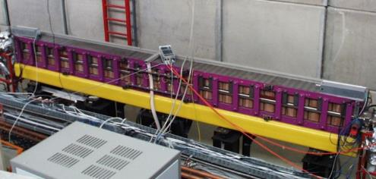
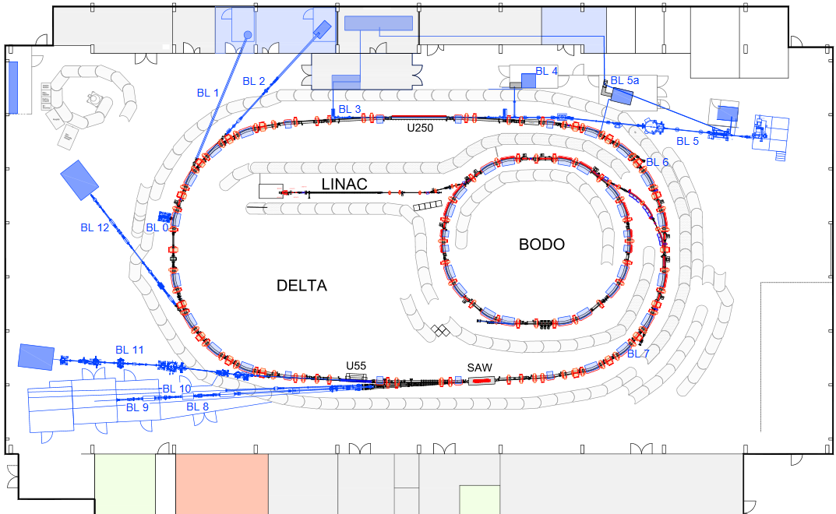
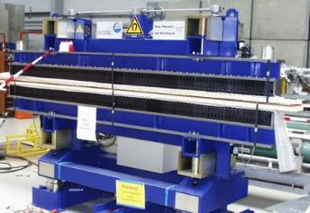
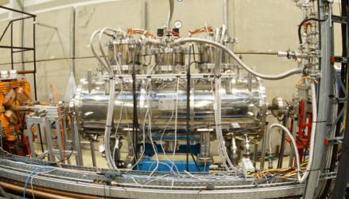
The synchrotron radiation source DELTA at TU Dortmund
beam energy 1.5 GeV
horizontal emittance 20 nm rad
beam current (multibunch) 130 mA
beam current (single bunch) < 20 mA
beam lifetime (100 mA) 15 hrs
bunch length (fwhm) 100 / 80 ps

Slide 7
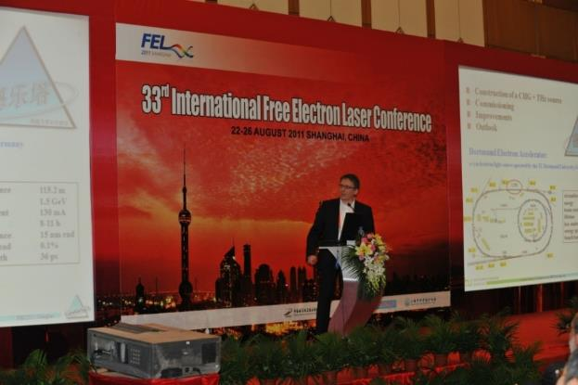
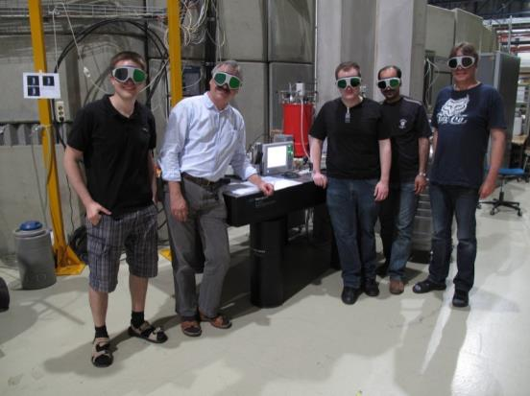
The synchrotron radiation source DELTA at TU Dortmund
Short-pulse facility since 2011
dé lè tă
H. Huck et al., Proc. FEL 2011, Shanghai, China, 5.
Annual schedule
德 user operation 20 weeks (2000 hours)
乐 machine studies 10 weeks (1000 hours)
> 500 hours / year
laser-electron interaction

Slide 8
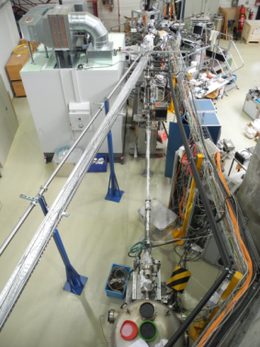
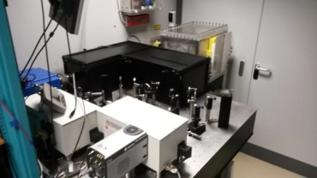
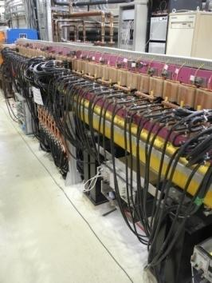
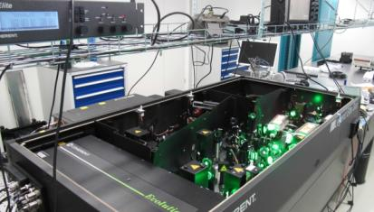
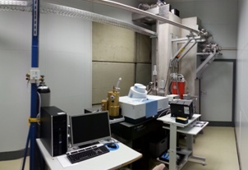
The synchrotron radiation source DELTA at TU Dortmund
Short-pulse facility since 2011
Diagnostics hutch at BL 4
photodiodes, streak camera
screens and cameras
spectrometers
gated iCCD camera
Ti:sapphire laser system + BL 3
wavelength 800 nm
pulse energy 8 mJ
repetition rate 1 kHz
SHG, THG, OPA
User beamline BL 5
ARPES
Undulator U250
period length 250 mm
number of periods 7+3+7
max. K value 10.3
Terahertz beamline BL 5a
bolometers, Schottky diodes
FT-IR spectrometers
Yb fiber laser

Slide 9
The synchrotron radiation source DELTA at TU Dortmund
Coherent harmonic generation (CHG)
- laser-induced energy modulation within a bunch "slice"
- density modulation in a magnetic chicane
- coherent emission at harmonics of the laser wavelength
Coherent terahertz (THz) radiation
- short "dip" due to energy-dependent path length
- coherent THz emission over several turns
- multiple dips from intensity-modulated laser pulses
energy modulation density modulation single dip multiple dips
→ vacuum-UV → broadband THz → narrowband THz radiation
100 ps (30 mm)
50 fs (15 μm)

Slide 10
The synchrotron radiation source DELTA at TU Dortmund
Results since 2011
Seeding with 800 nm and 400 nm, harmonics down to 80 nm
Longitudinal and transverse coherence studies
Spectrotemporal properties of CHG pulses
Seeding with RF phase modulation
Pump-probe study of photoelectron space charge
Broadband THz radiation over many turns
Narrowband tunable THz pulses
Seeding with double pulses
Off-axis harmonic seeding
Coherent edge radiation

Slide 11
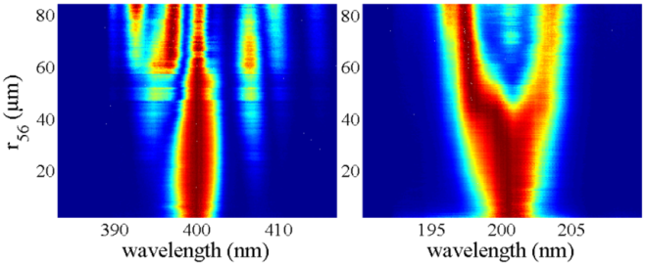
The synchrotron radiation source DELTA at TU Dortmund
Results since 2011
Seeding with 800 nm and 400 nm, harmonics down to 80 nm
Longitudinal and transverse coherence studies
Spectrotemporal properties of CHG pulses
Seeding with RF phase modulation
Pump-probe study of photoelectron space charge
Broadband THz radiation over many turns
Narrowband tunable THz pulses
Seeding with double pulses
Off-axis harmonic seeding
Coherent edge radiation
S. Khan et al.,
Proc. IPAC 2016, Busan, Korea 2851.

Slide 12
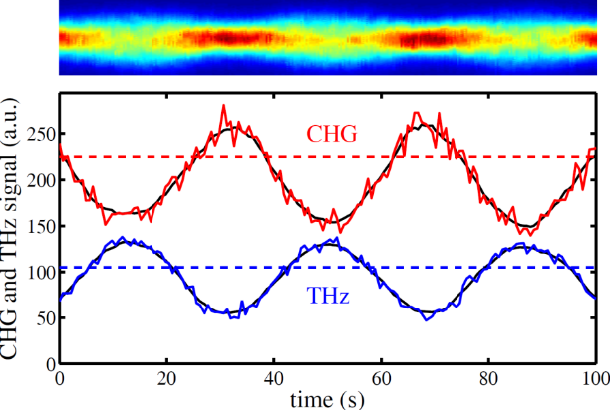
The synchrotron radiation source DELTA at TU Dortmund
Results since 2011
Seeding with 800 nm and 400 nm, harmonics down to 80 nm
Longitudinal and transverse coherence studies
Spectrotemporal properties of CHG pulses
Seeding with RF phase modulation
Pump-probe study of photoelectron space charge
Broadband THz radiation over many turns
Narrowband tunable THz pulses
Seeding with double pulses
Off-axis harmonic seeding
Coherent edge radiation
S. Khan et al., Proc. IBIC 2014, Monterey, USA, 202.

Slide 13
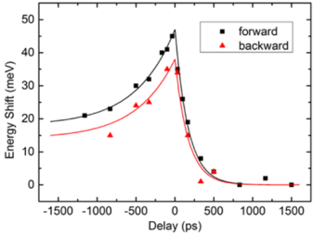
The synchrotron radiation source DELTA at TU Dortmund
Results since 2011
Seeding with 800 nm and 400 nm, harmonics down to 80 nm
Longitudinal and transverse coherence studies
Spectrotemporal properties of CHG pulses
Seeding with RF phase modulation
Pump-probe study of photoelectron space charge
Broadband THz radiation over many turns
Narrowband tunable THz pulses
Seeding with double pulses
Off-axis harmonic seeding
Coherent edge radiation
S. Khan et al., Proc. IPAC 2017, Kopenhagen, Denmark, 2578.

Slide 14
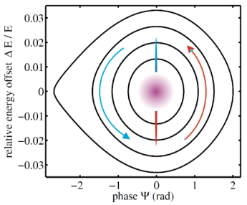
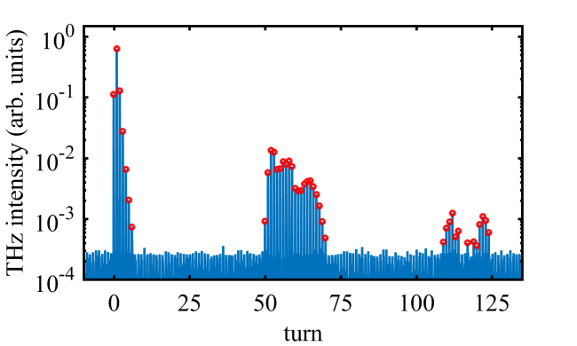
The synchrotron radiation source DELTA at TU Dortmund
Results since 2011
Seeding with 800 nm and 400 nm, harmonics down to 80 nm
Longitudinal and transverse coherence studies
Spectrotemporal properties of CHG pulses
Seeding with RF phase modulation
Pump-probe study of photoelectron space charge
Broadband THz radiation over many turns
Narrowband tunable THz pulses
Seeding with double pulses
Off-axis harmonic seeding
Coherent edge radiation
C. Mai et al., Proc. IPAC 2015, Richmond, USA, 823.
S. Khan et al. ESLS 2019, Cerdanyola, Spain.

Slide 15
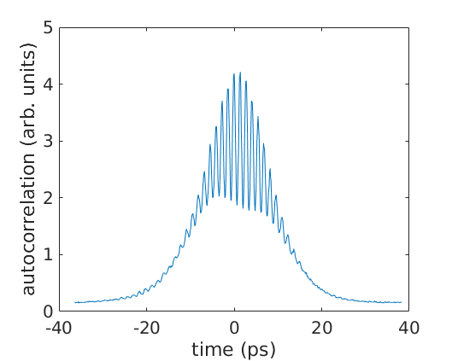
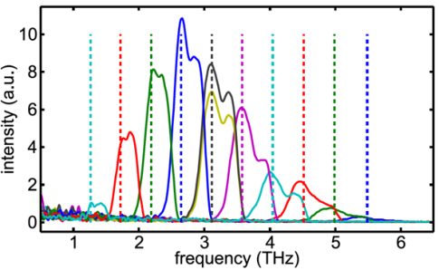
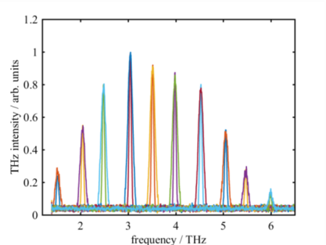
The synchrotron radiation source DELTA at TU Dortmund
Results since 2011
Seeding with 800 nm and 400 nm, harmonics down to 80 nm
Longitudinal and transverse coherence studies
Spectrotemporal properties of CHG pulses
Seeding with RF phase modulation
Pump-probe study of photoelectron space charge
Broadband THz radiation over many turns
Narrowband tunable THz pulses
Seeding with double pulses
Off-axis harmonic seeding
Coherent edge radiation
P. Ungelenk et al.,
PRAB 20 (2017), 020706,
C. Mai et al., Proc. IPAC 2019,
Melbourne, Australia, 1454

Slide 16
The synchrotron radiation source DELTA at TU Dortmund
Results since 2011
Seeding with 800 nm and 400 nm, harmonics down to 80 nm
Longitudinal and transverse coherence studies
Spectrotemporal properties of CHG pulses
Seeding with RF phase modulation
Pump-probe study of photoelectron space charge
Broadband THz radiation over many turns
Narrowband tunable THz pulses
Seeding with double pulses
Off-axis harmonic seeding
Coherent edge radiation
S. Khan et al.,
Proc. FEL 2017, Santa Fe, USA, 94.

Slide 17
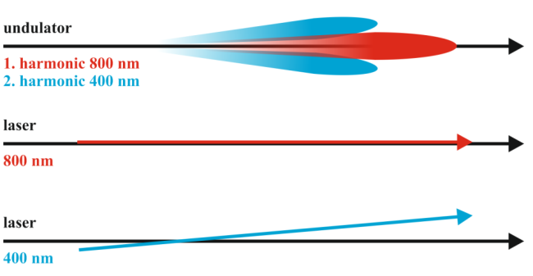
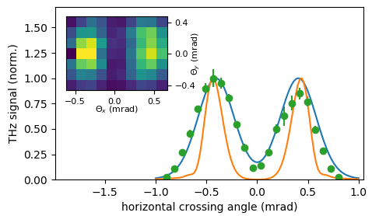
The synchrotron radiation source DELTA at TU Dortmund
Results since 2011
Seeding with 800 nm and 400 nm, harmonics down to 80 nm
Longitudinal and transverse coherence studies
Spectrotemporal properties of CHG pulses
Seeding with RF phase modulation
Pump-probe study of photoelectron space charge
Broadband THz radiation over many turns
Narrowband tunable THz pulses
Seeding with double pulses
Off-axis harmonic seeding
Coherent edge radiation
A. Meyer auf der Heide et al.,
Proc. IPAC 2019, Melbourne, Australia, 246.

Slide 18
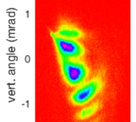
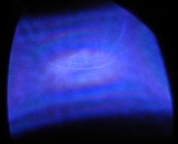
The synchrotron radiation source DELTA at TU Dortmund
Results since 2011
Seeding with 800 nm and 400 nm, harmonics down to 80 nm
Longitudinal and transverse coherence studies
Spectrotemporal properties of CHG pulses
Seeding with RF phase modulation
Pump-probe study of photoelectron space charge
Broadband THz radiation over many turns
Narrowband tunable THz pulses
Seeding with double pulses
Off-axis harmonic seeding
Coherent edge radiation
S. Khan et al., DELTA Annual Report 2020.
ChEER Coherently Emitted Edge Radiation

Slide 19
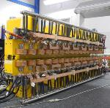
The synchrotron radiation source DELTA at TU Dortmund
Ongoing project: Echo-enabled harmonics generation (EEHG)
requires modification of 1/4 of the storage ring to create a 20.4 m straight section
S. Hilbrich et al., Proc. FEL 2015, Daejeon, Korea, 363.

Slide 20
Comments on laser-driven storage rings
User-relevant microbunching λ ~ 10 nm or less (like FEL) very difficult
Interesting prototype cases: λ = 60 cm → 3 cm (X band) → 10.6 μm (CO₂ laser)
100 m circumference ~ 10⁷ buckets
bunch rate: 2.8∙10¹³ Hz
bunch length: few fs
bunch charge: 3.5 fC (100 mA)
flexible bunch pattern if bunches
removed by 30-fs laser pulses
Isochronicity on the laser wavelength scale very demanding
- perfect control of high-order momentum compaction and matrix elements R₅₁ R₅₂ R₅₆
- control of partial momentum compaction due to random radiative energy loss ...
- microwave instability, coupled-bunch instabilities, Touschek lifetime seem to be ok
- but: unusual bunch aspect ratio
Y. Shoji, Phys. Rev. ST Beams 7 (2004), 080703.
Y. Shoji et al., Phys. Rev. E 54, R4556.
Fascinating ...*
* L. S. Nimroy, Los Angeles, USA,1965.

Slide 21
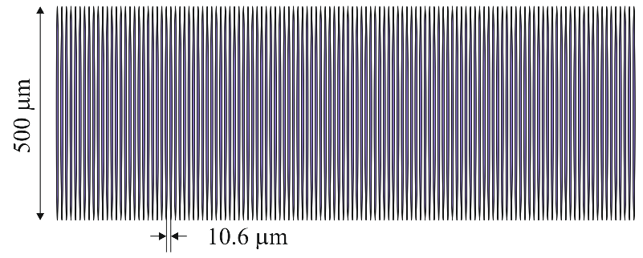
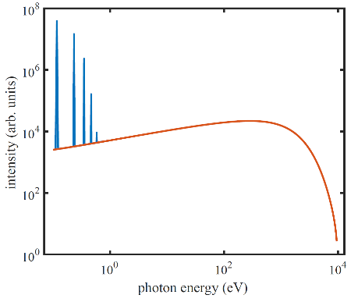
CO₂ laser-driven storage rings
Horizontal beam size ~ 500 μm (fwhm) for a 100-m storage ring
Longitudinal bunch size few μm
Radiation spectrum with coherent emission at bunch frequency and harmonics
Coherent power ~ 1% of total radiation power
S. Khan, J. Phys. Conf. Series 1596 (2020), 012025.

Slide 22
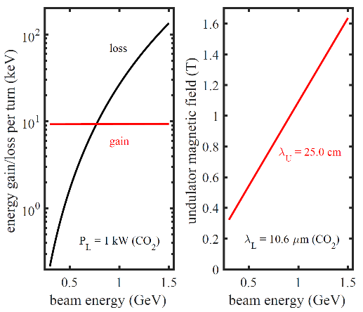
Sufficient energy modulation with cw CO₂ laser?
High-power lasers with mature technology
- invented 1964
- medical and industrial applications (cutting, welding)
- accelerator applications: Compton backscattering
Modulation amplitude with 1 kW cw laser
with realistic laser waist and 17 undulator periods
E_{m} = 10 keV overvoltage factor ~10 at 500 MeV
Undulator resonance condition
e.g., with period length λ_{U} = 25 cm
B = 0.45 T for 500 MeV beam energy
Yes, we can ...*
* B. H. Obama, New Hampshire, USA, 08.01.2008.
S. Khan, J. Phys. Conf. Series 1596 (2020), 012025.

Slide 23
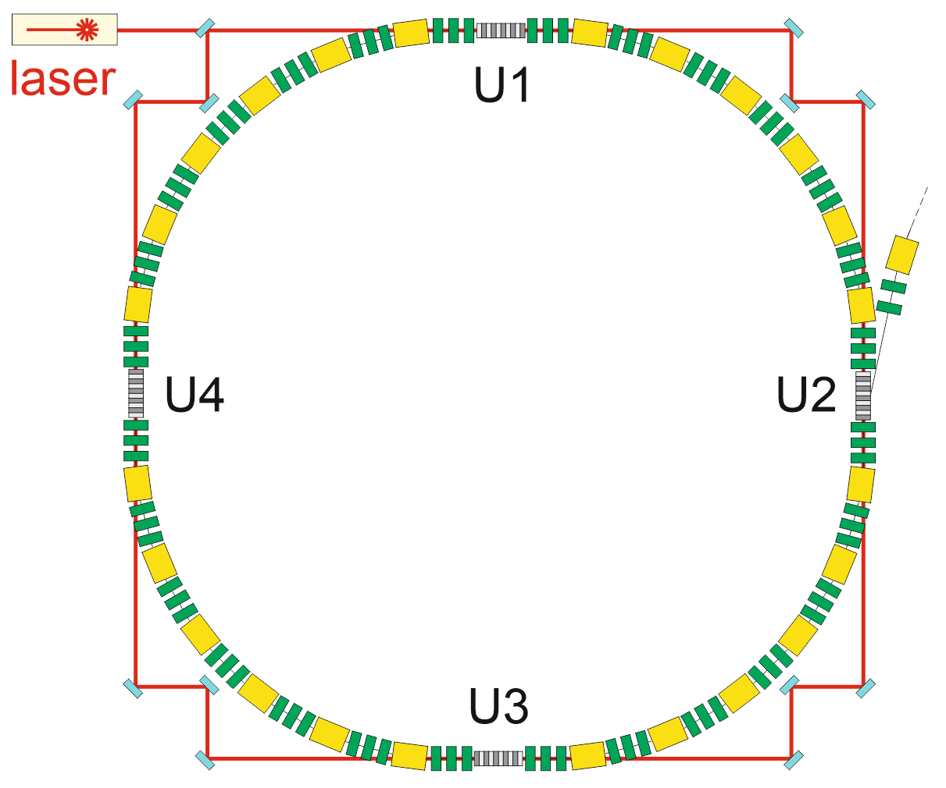
Storage ring configuration
- low emittance, very low momentum compaction
- several undulators: enhanches energy modulation,
reduces isochronicity demands
- laser beam in ring resonator (power enhancement)
A small step for mankind ...*
... but one giant leap for storage rings and
a novel type of "advanced accelerator"
* N. Armstrong, Mare Tranquilitatis, 20.07.1969.

Slide 24
Thank you for your attention 谢谢大家

